Slide 1


Achievements of WP 8
Frédéric Wrobel (Montpellier University)
RADNEXT 4th Annual Meeting – 12 and 13 May 2025
https://indico.cern.ch/e/radnext-2025

Slide 2
Outline
Structure of WP8
Status on deliverables and milestones
TID simulations
Feedback from previous review
Scientific publication and communication
Conclusions

Slide 3
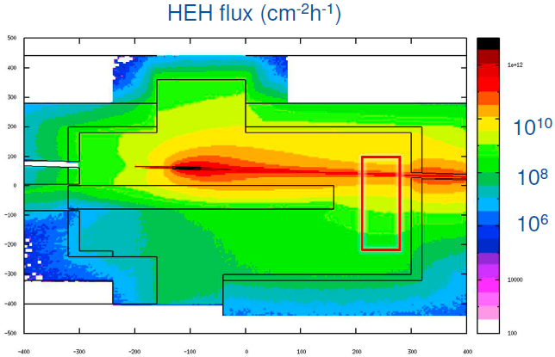
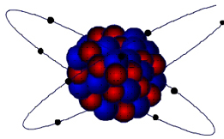
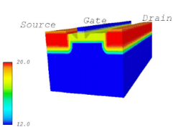
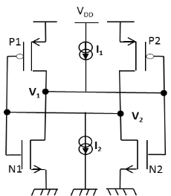
Multi-physics and multi-scale approach
Radiative environment
Natural environment, beam facilities (FLUKA)
Particle-matter interaction
FLUKA, GEANT4, DHORIN
Electrons and holes transport
trapping and detrapping
Ecorce, PredicSEE
Effect on the cell (SET, SEU …)
Spice
Effect on the system

Slide 4
WP8: Work Package Overview
• Task 8.1: Coordination (UM, CERN, GSI, ELI)
• Task 8.2: Impact of low energy particles on SEU rate prediction (UM)
• Task 8.3: Circuit level modelling (UM)
• Task 8.4: Facility modelling (CERN, GSI, ELI)
• Task 8.5: Dose Effect with ECORCE (UM)
• Task 8.6: Integration of SEE event-by-event scoring in FLUKA (CERN)

Slide 5
WP8: Main achievements in the fourth year
T0+18 | dec-22 | D8.1 |  | Frederic Wrobel |  |  | + Ygor Aguiar |  | + Cleiton Marques
 |  | M8.1 |  | Roberto Versaci |  |  | + All |  | + Postdocs
 |  | D8.2 |  | Roberto Versaci |  |  | + Jérôme Boch |  | + Postdocs
T0+24 | june-23 | D8.3 |  | Frederic Wrobel |  |  | + Ygor Aguiar |  | + Cleiton Marques
T0+30 | dec-23 | D8.4 |  | Frederic Wrobel |  |  | + Ygor Aguiar |  | + Cleiton Marques
 |  | M8.2 |  | Alain Michez |  |  | + Jérôme Boch
T0+36 | june-24 | M8.3 |  | David Lucsanyi |  |  | +Giuseppe Lerner |  | + Gabrielle Hugo
T0+42 | dec-24 | D8.5 |  | Alain Michez |  |  | + Jérôme Boch
D8.1 | Simulation results of the importance of 1-10MeV energy range on the SER for neutrons (T0+18months)
D8.2 | Modelling of the X-Ray generator and Co60 source (T0+18months)
D8.3 | Recommendation for simulating low energy protons (T0+24months)
D8.4 | Simulation results and report on circuit modelling (T0+30months)
D8.5 | Determination of the fitting parameters for the target device and comparison with the experimental results (T0+42months)
M8.1 | Facility modelling for RADNEXT experimental conditions (modelling released and simulations are running at T0+18months)
M8.2 | ECORCE evaluation (Modelling released and simulations are running at T0+30months)
M8.3 | Validation of Fluka SEE module (Report including benchmark results and instructions for users at T0+36months)

Slide 6
TID simulations (A. michez)
Well known TCAD tools: Sentaurus (from Synopsys), ATLAS (from Silvaco)
Focused on process and device modelling
Do not account for all phenomena induced by radiation
For TID effects, charges in the insulator are usually considered as immobile.
In this work we investigate refined modeling included in the Ecorce software:
  trapping-detrapping of charges in insulators
  carrier transport induced trap creation
    in the volume of insulators
    at the semiconductor/insulator interfaces

Slide 7
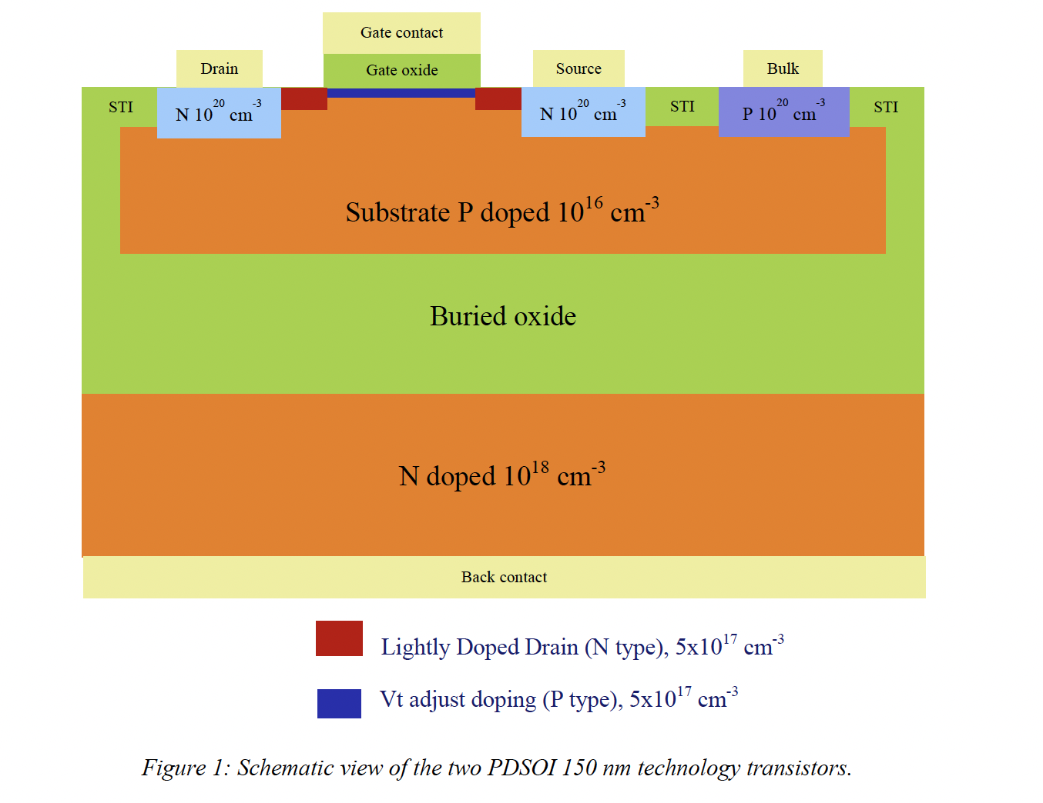
Target device
Microchip proposes a full set of transistors based on its AT77K PDSOI 150 nm process technology
These devices have been tested for Total Ionizing Dose (TID) up to 300 krad. This made this technology suitable to create ASICs (Application Specific Integrated Circuit) dedicated to space applications.
We focused on 2 NMOS:
  Logical NMOS (NMOSL): W/L = 10um/0.18um
  Power NMOS (NMOSP): W/L = 20um/1um

Slide 8
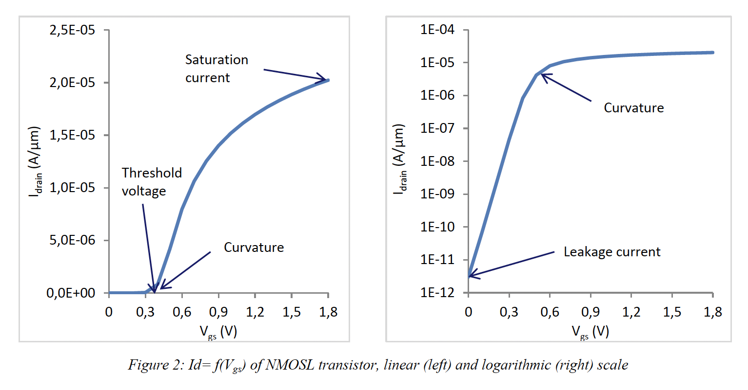
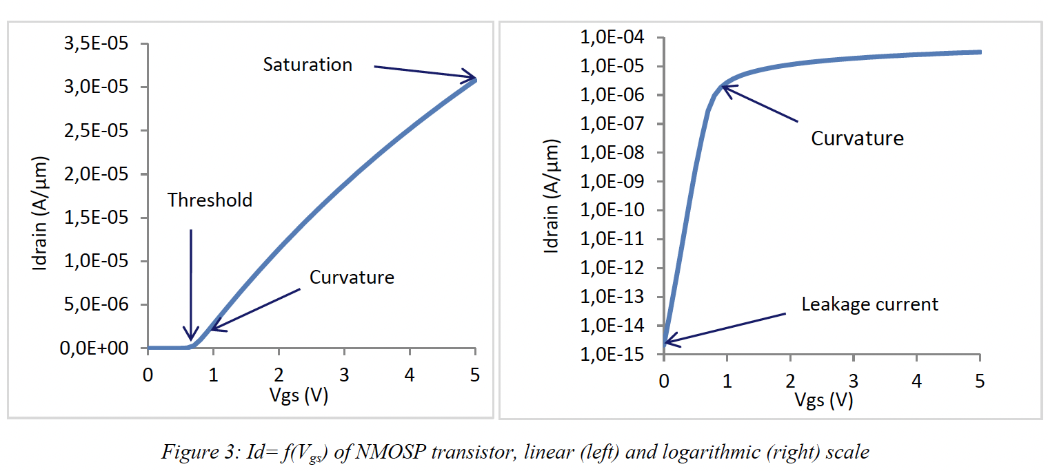
Static Characteristic
Before studying TID effects, simulations must be able to reproduce these characteristic!
Calibration is required!

Slide 9
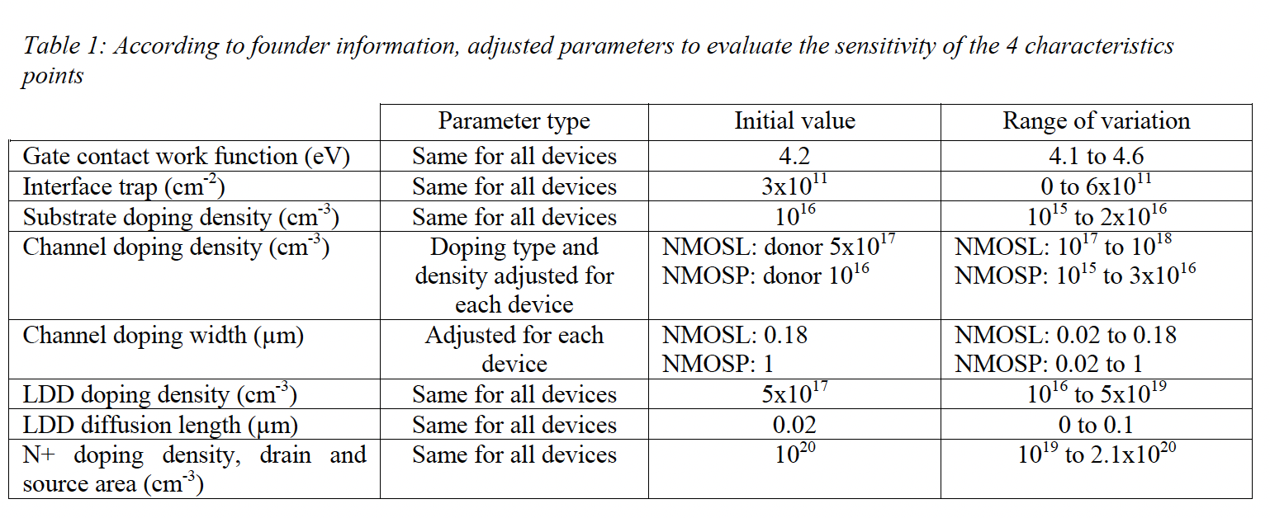
Adjusted parameters
The effect of the variation of all these parameters has been studied.

Slide 10
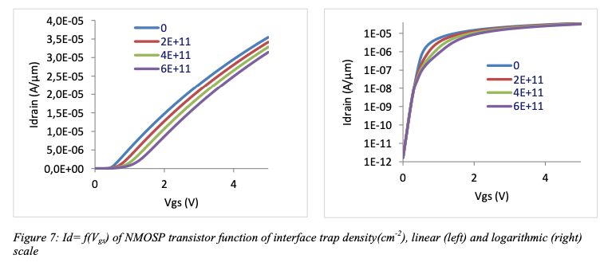
Example: Effect of interface trap

Slide 11
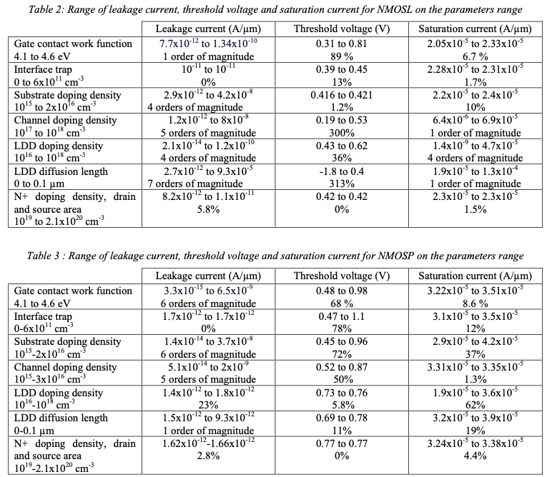
Parameters effects

Slide 12
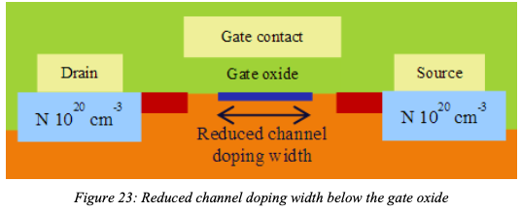
Additional mechanisms to account for
It appeared that we must account for 2 additional mechanisms:
  Reduction of the channel doping width
  Reduction of the mobility below the gate (need knowledge of the doping!)

Slide 13
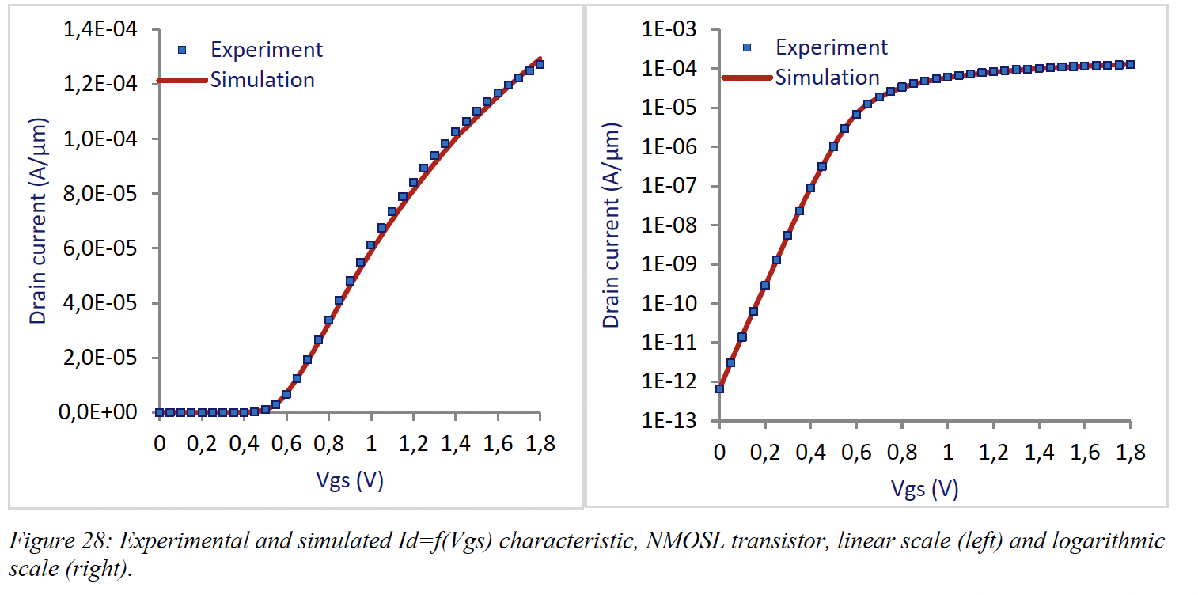
Calibration of the logical NMOS

Slide 14
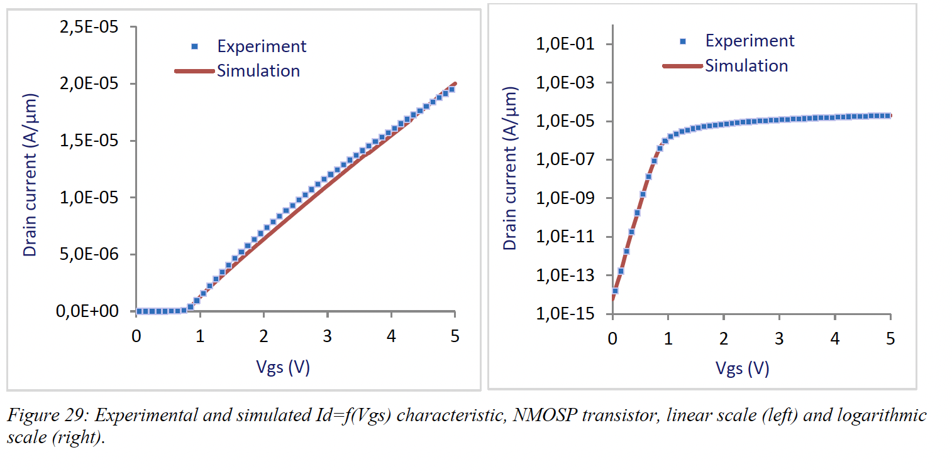
Calibration of the Power NMOS

Slide 15
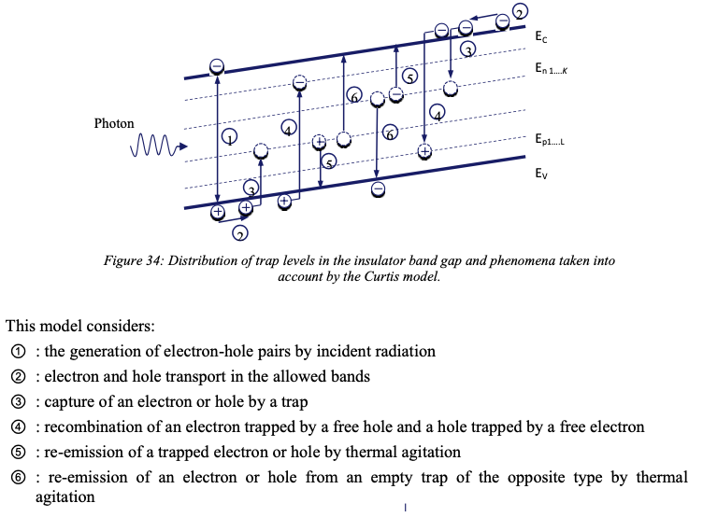
TID Modeling (1/2)
Usual Multiple trapping-detrapping model (fixed traps)

Slide 16
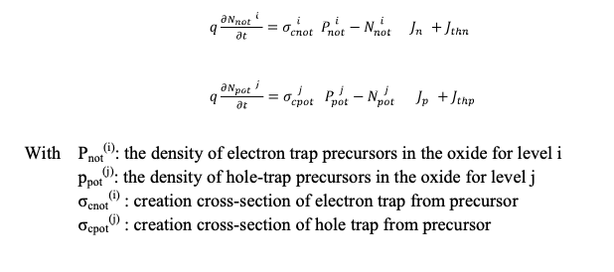
TID Modeling (2/2)
In addition to Curtis model, dynamics of trap creation are implemented in Ecorce through 2 additional equations.

Slide 17
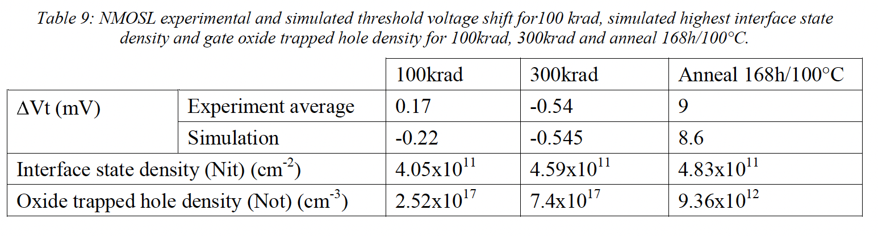
TID Modeling of the NMOSL
For NMOSL, the gate oxide is thin (2.8nm) and the TID effects are limited. The simulation of threshold voltage shift is challenging.
Simulations are consistent.

Slide 18
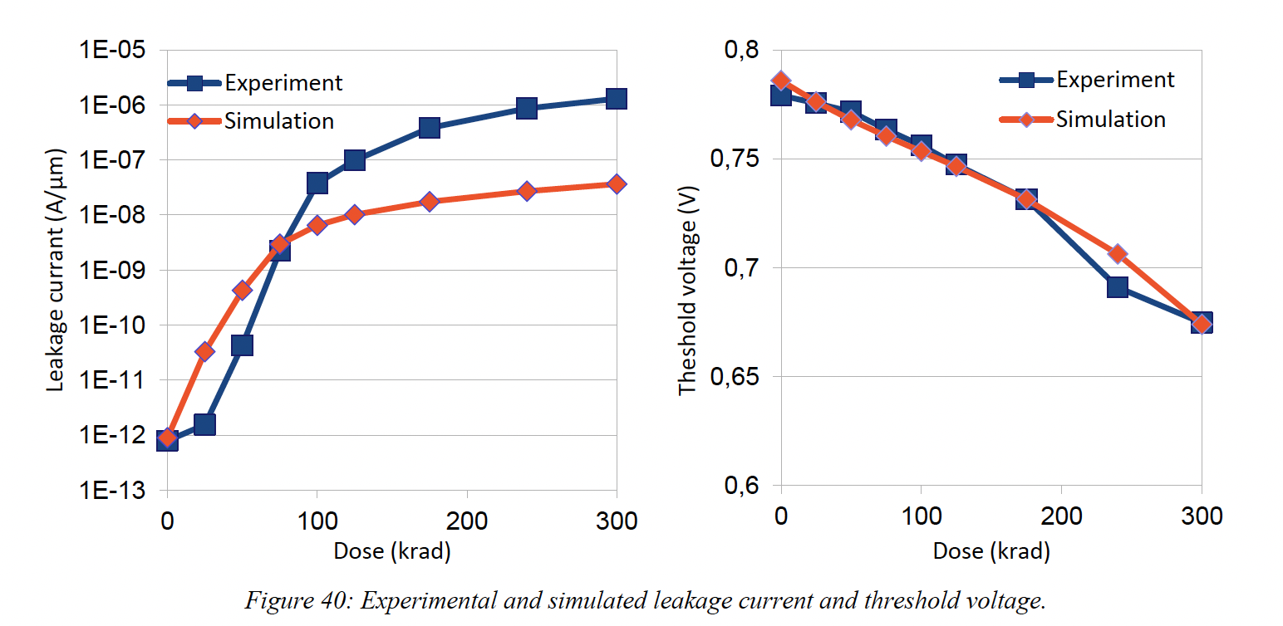
TID Modeling of the NMOSP
Leakage current simulation is not perfect but consistent with experiment.
Threshold voltage shift simulation is in very good agreement with experiment.

Slide 19
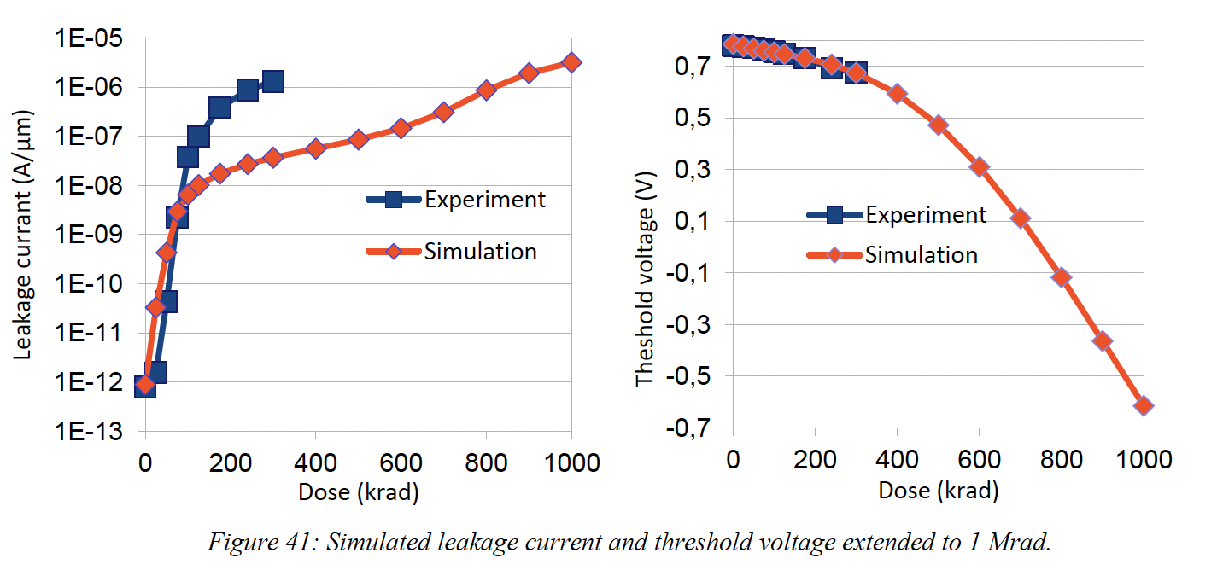
Above 300krad?

Slide 20
Conclusions on TCAD simulations
TCAD is a powerful tool
Ecorce has some excellent capabilities to simulate radiation effect in electronic devices.
A methodology for obtaining TCAD modeling results close to those of experiments has been proposed.
Simulations of TID in the 150nm SOI technology have been shown
Simulations results are in good agreement with experimental data
TCAD is also a very good tool to study a specific mechanism

Slide 21
Follow-up of recommendations and comments from previous review(s) (if applicable)
"WP8 reports activity as expected from the DoA, with clear progress with respect to P1. The results related to the simulation of low energy protons are carefully summarized in D8.3. The analysis of proton interactions made provides relevant simulation results for assessing device sensitivity. The strategy of using Montecarlo methods for simulating radiation effects at circuit and transistor level is effective and provides results in good agreement with experiments (D8.4). Results obtained using a TCAD software for device modelling (MS27) provide important information on the effect of radiation on the device behavior, including modelling of a specific microchip. MS28 presents also results of good quality concerning the validation of a single event effect simulation module. This module may contribute to reduce the use of radioactive sources, a long term objective of high interest."
No issue from report P2.
Deliverables have been accepted.
Milestones have been achieved.
All good!

Slide 22
Lessons learned from RADNEXT
Pros and cons.
  Nice and efficient exchanges between people
  Good equilibrium between experiment/simulations
What could be reused or rethought for the next proposal.
  Simulations tools can be still used to invetigate more mechanisms/methods
Any other item you would like to bring the attention to.

Slide 23
Scientific publication and communications
[1] Cleiton Marques, Frédéric Wrobel, Ygor Aguiar, Alain Michez, Jérôme Boch, et al..
A Methodology to Estimate Single–Event Effects Induced by Low–Energy Protons.
Eng, 2024, 5 (1), pp.319–332. ⟨10.3390/eng5010017⟩.
[2] Cleiton Marques, Leonardo Brendler, Frédéric Wrobel, Alexandra Zimpeck, Walter Bartra, et al..
A Detailed Electrical Analysis of SEE on 28 nm FDSOI SRAM Architectures.
IEEE, pp.1–6, 2023, ⟨10.1109/SBCCI60457.2023.10261665⟩.
[3] Frédéric Wrobel, Ygor Aguiar, Cleiton Marques, Giuseppe Lerner, Rubén García Alía, et al..
An Analytical Approach to Calculate Soft Error Rate Induced by Atmospheric Neutrons.
Electronics, 2023, 12 (1), pp.104. ⟨10.3390/electronics12010104⟩.
[4] Cleiton Marques, Frédéric Wrobel, Ygor Aguiar, Alain Michez, Frédéric Saigné, et al..
Evaluation of a Simplified Modeling Approach for SEE Cross–Section Prediction: A Case Study of SEU on 6T SRAM Cells.
Electronics, 2024, 13 (10), pp.1954. ⟨10.3390/electronics13101954⟩.
[5] Cleiton Marques, Alain Michez, Frédéric Wrobel, S. Kuboyama, Frédéric Saigné, et al..
Physical Explanation for the Higher Sensitivity to Ion–Induced Burnout in SiC Schottky Diodes Compared to Si Schottky Diodes.
RADiation Effects on Components and Systems (RADECS), Sep 2024, Maspalomas, Canary Islands, Spain.

Slide 24
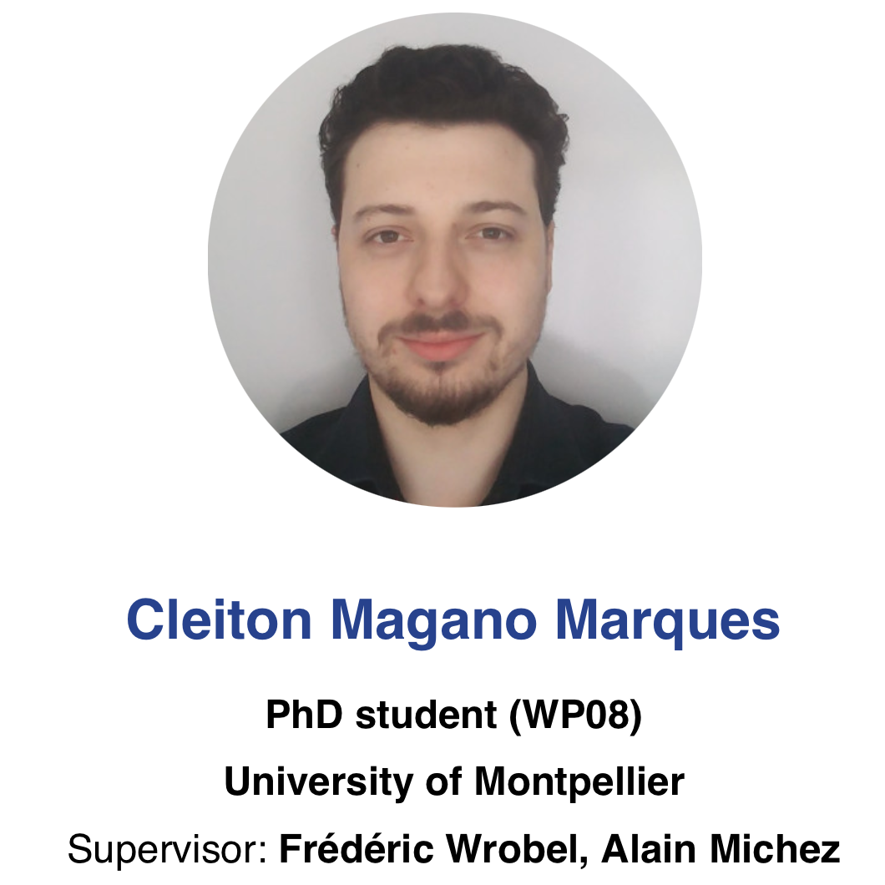
Cleiton Marques PhD
Cleiton has defended his PhD thesis on February 20th.
He has been involved in several topics of WP8:
  Proton simulation at low energy
  Neutron simulation at low energy
  Electronic devices modeling
  TCAD simulation (Ecorce)
  SEE simulation (PredicSEE)
Cleiton has been hired by Delphea (which develops Ecorce)

Slide 25
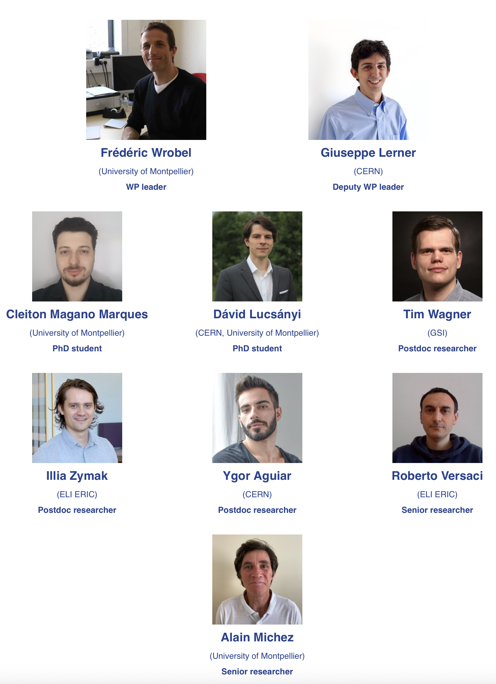
Conclusion
Last deliverable has been submitted on time.
Thank you to the great WP8 team!

Slide 26
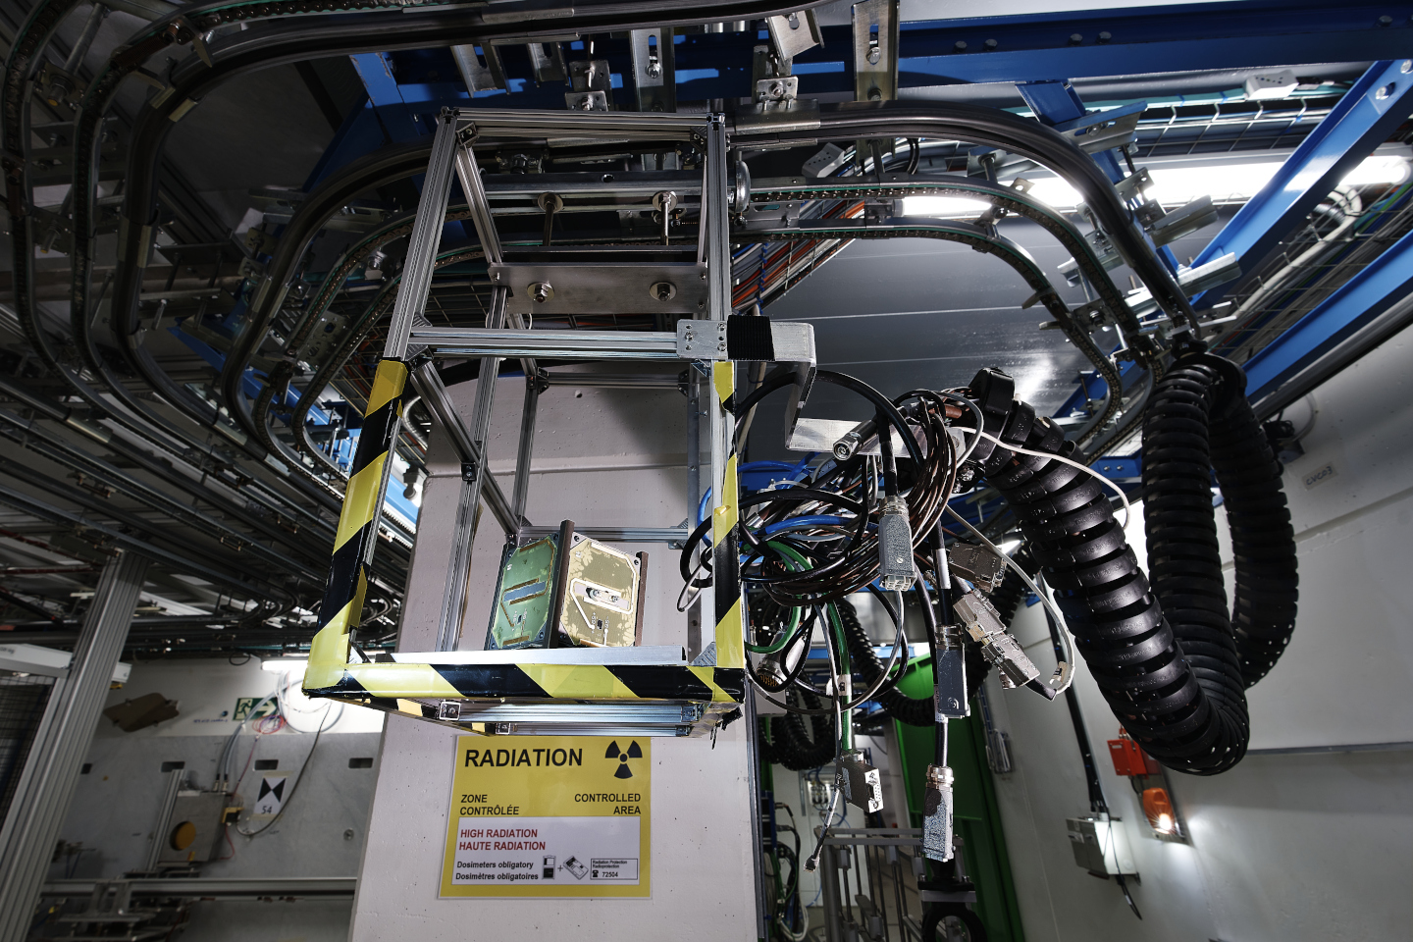
Thanks for your attention!
Image Source: CERN

