Slide 1


TA status and funds reallocation
Daniel Söderström (CERN)
RADNEXT 4th Annual Meeting – 12 and 13 May 2025
https://indico.cern.ch/e/radnext-2025
This project has received funding from the European Union’s Horizon 2020 research and innovation programme under grant agreement No 101008126

Slide 2
Outline
TA hours delivered and assigned
Remaining TA hours and TA redistribution
TA hours shown per particle type
  Protons
  Heavy ions
  Neutrons
  Other

Slide 3
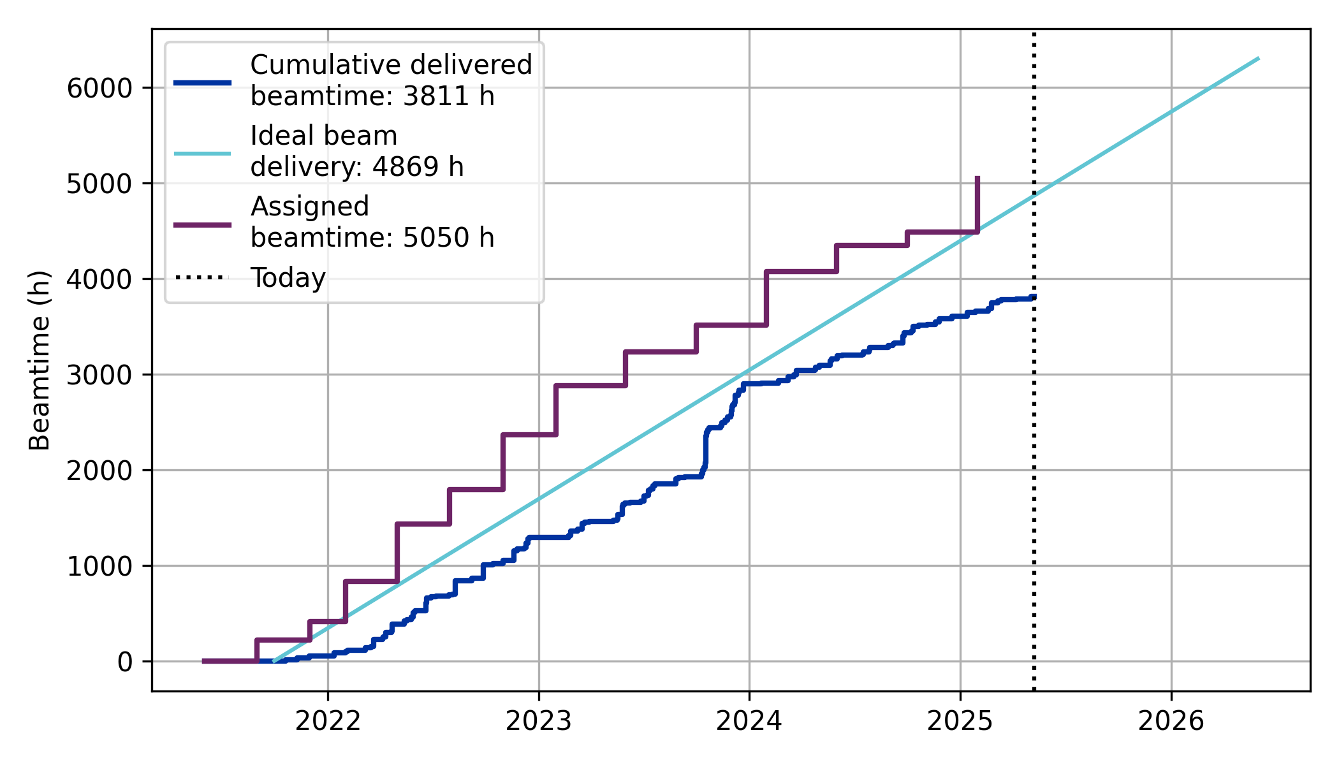
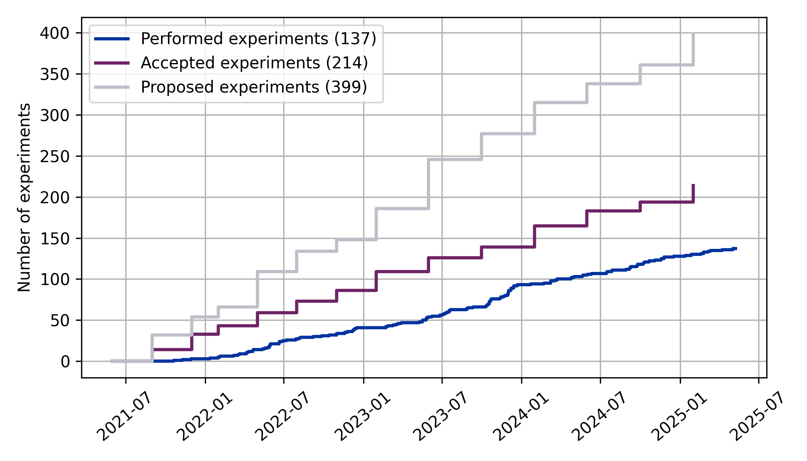
Delivered beamtime hours
Delivered beamtime hours:
3811 hours have been delivered so far, and 5050 hours assigned (after call 13)
  ~ 560 h assigned in TA13 (including one proposal to CHARM of 140 h)
137 experiments have been performed, and 399 proposed (until call 13)
(Ideal delivery line: 6300 h after May 2026)

Slide 4
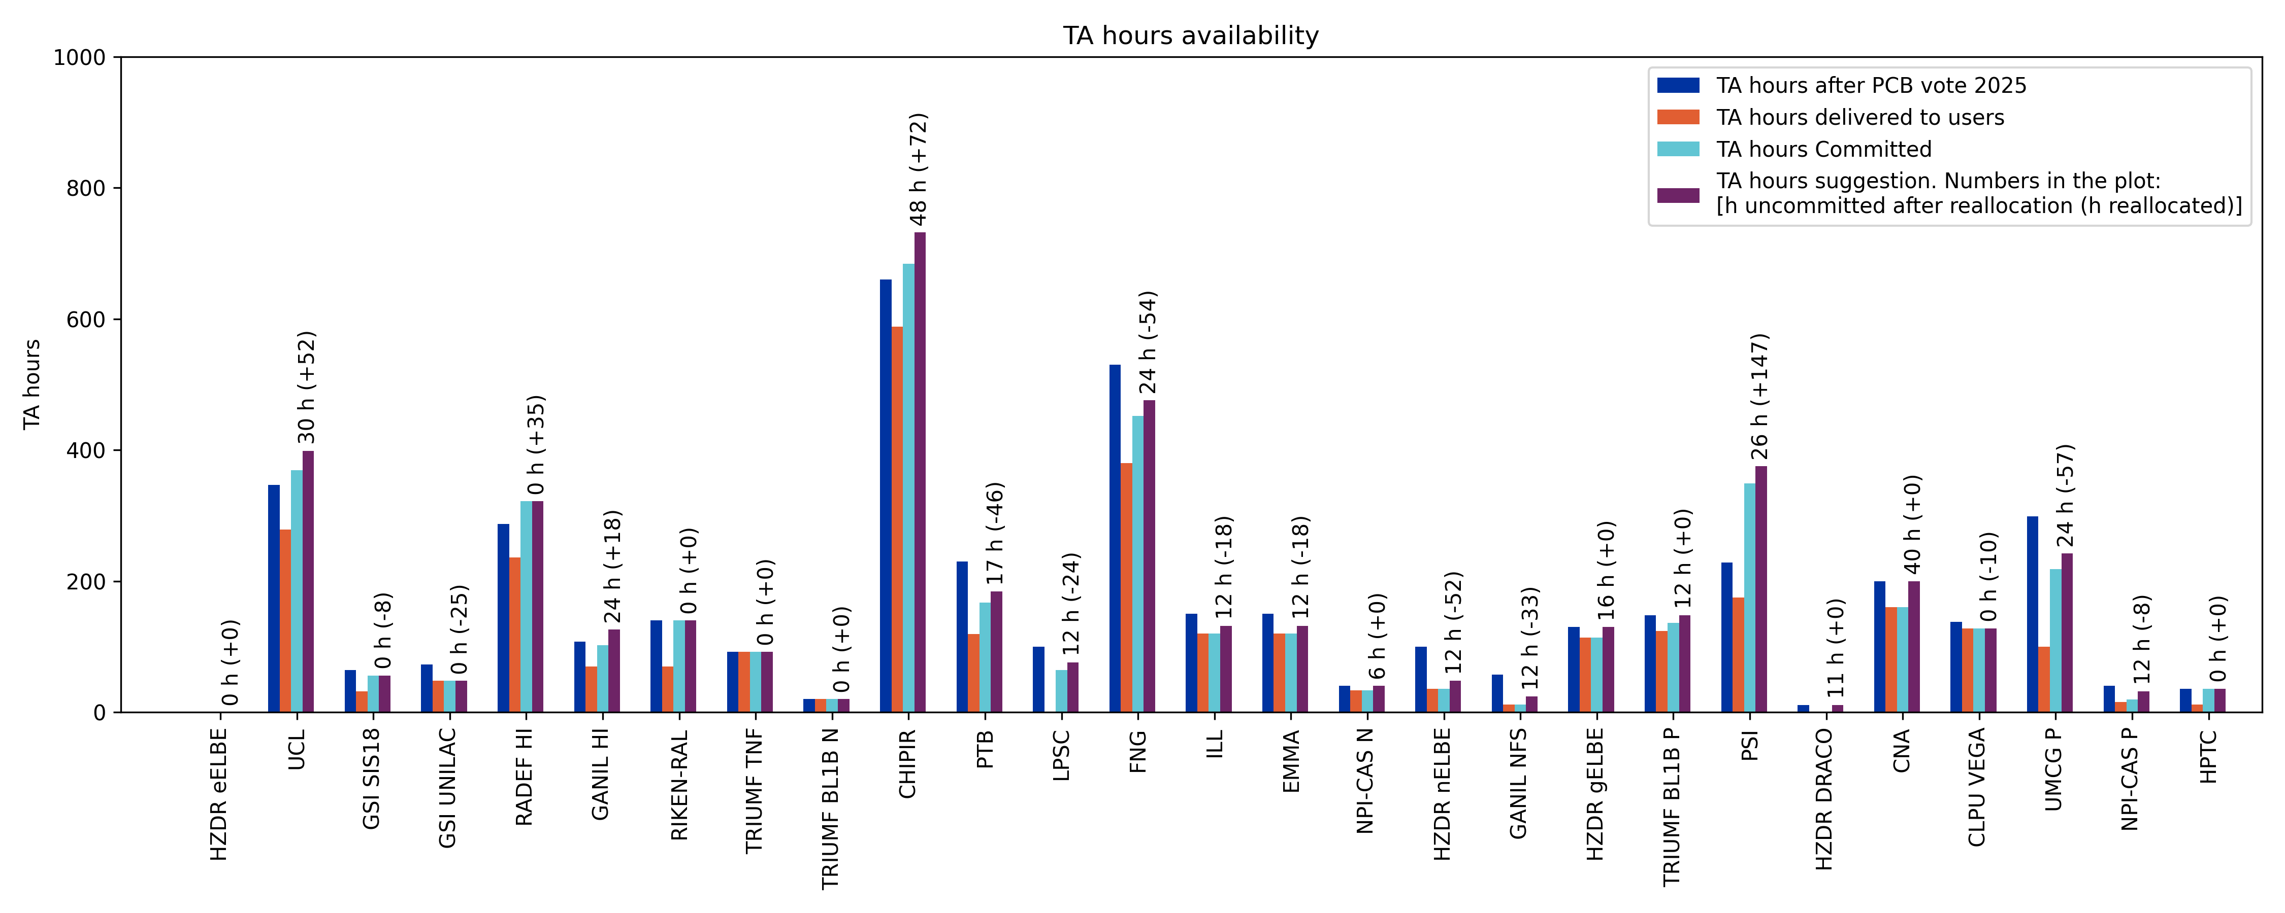
Remaining beamtime and reallocation overview
New re-allocation process ongoing, where further beamtime hours should be transferred to high-energy protons, heavy ions, and atmospheric neutrons
Final transfer of hours? Probably this would be best, since many of the facilities now would have only time for one experiment to be performed.
Draft of the redistribution, to be accepted by facilities and voted by the PCB.
Facilities with TA unit cost
No availability in the final calls

Slide 5
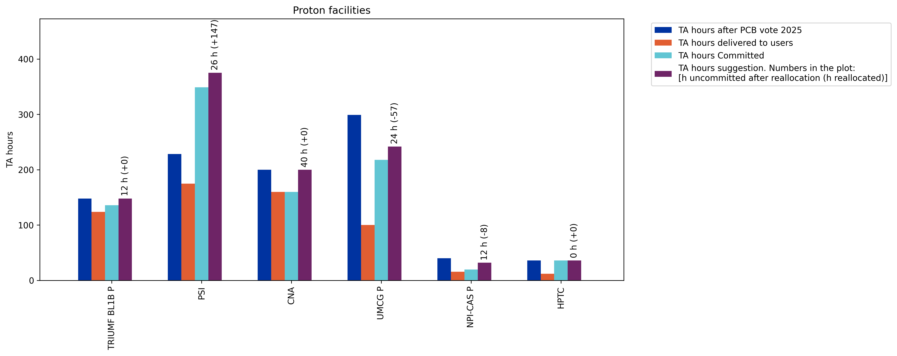
TA hours of proton facilities
PARTREC resumed operation with beam delivery, however with a large backlog, so some hours have been redistributed, and a few experiments moved to PSI
Adding hours to HPTC is cost intensive, and they currently have scheduled or executed all experiments assigned to them
CNA TA hours are cost efficient, and transferring hours from there is not beneficial
Suggestion | Number of hours
Change in beamtime | +82
Available beamtime | 114

Slide 6
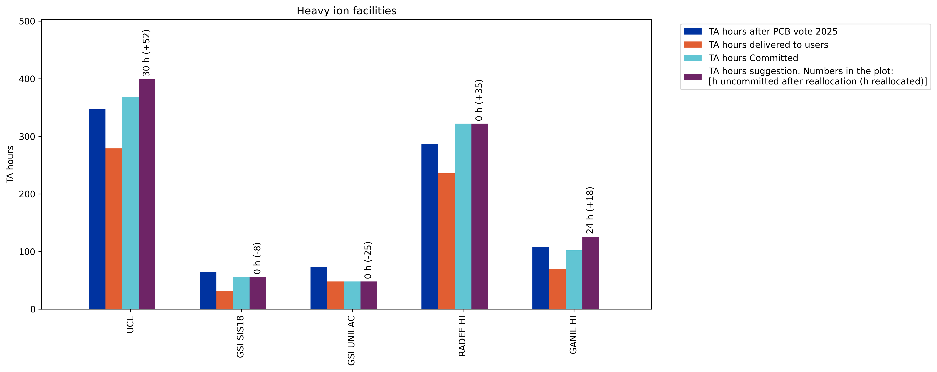
TA hours of heavy ion facilities
GSI facilities unavailable in the last calls
RADEF RADNEXT commitment and quota filled
UCL and GANIL with room for a few experiments each
Suggestion | Number of hours
Change in beamtime | +72
Available beamtime | 54

Slide 7
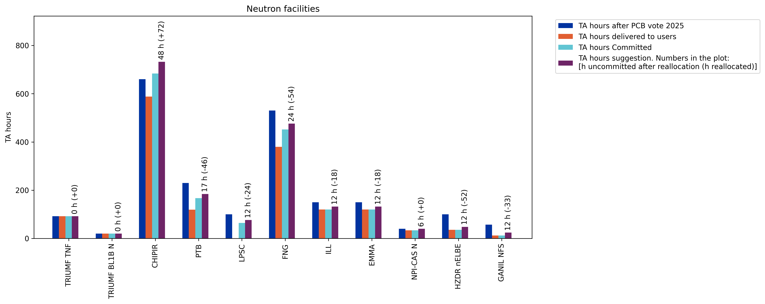
TA hours of neutron facilities
CHIPIR TA hours topped up, to have atmospheric neutrons present
Most other facilities have room for one or a few experiments
Suggestion | Number of hours
Change in beamtime | -173
Available beamtime | 155

Slide 8
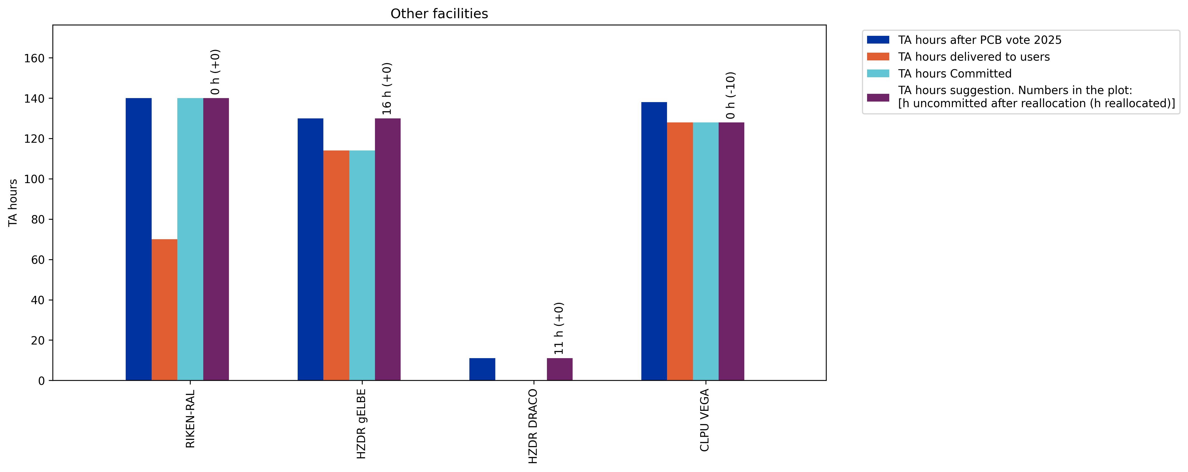
TA hours of other facilities
CLPU doesn’t have availability for the final calls
Potential for experiments still to be done at HZDR
The final part of the last experiment still to be completed at the RIKEN-RAL muon beam facility
Facilities without TA hour unit cost excluded from the figures
Suggestion | Number of hours
Change in beamtime | -10
Available beamtime | 27

Slide 9
Conclusion
As the final calls approach, the aim is to have all beam types and facilities represented. Most hours are concentrated to the most frequently utilized facilities, but these are expected to be used up during calls 14 and 15.
If some facilities still have beamtime left after call 15, a targeted call for these facilities can be opened during the winter 2025/2026, for experiments to be completed before/latest May 2026.
Some added funds potentially for increasing the remaining TA hours may be found in the unused TA user support, to be discussed separately

Slide 10
Thank you for your attention!

Slide 11
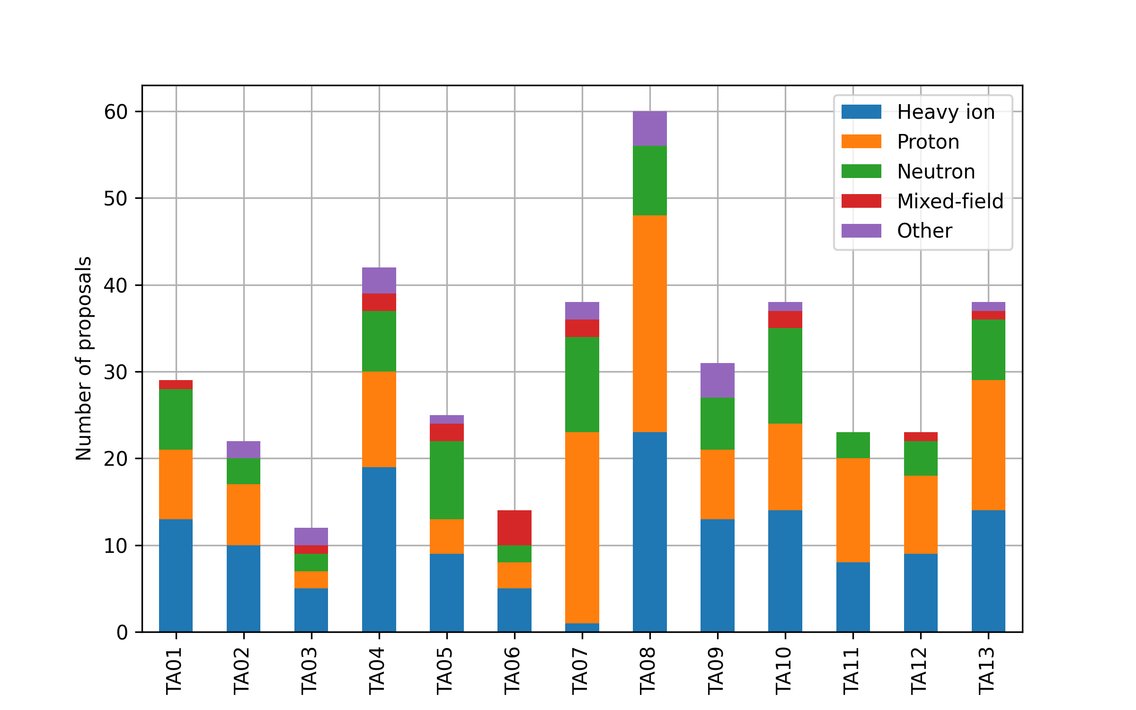
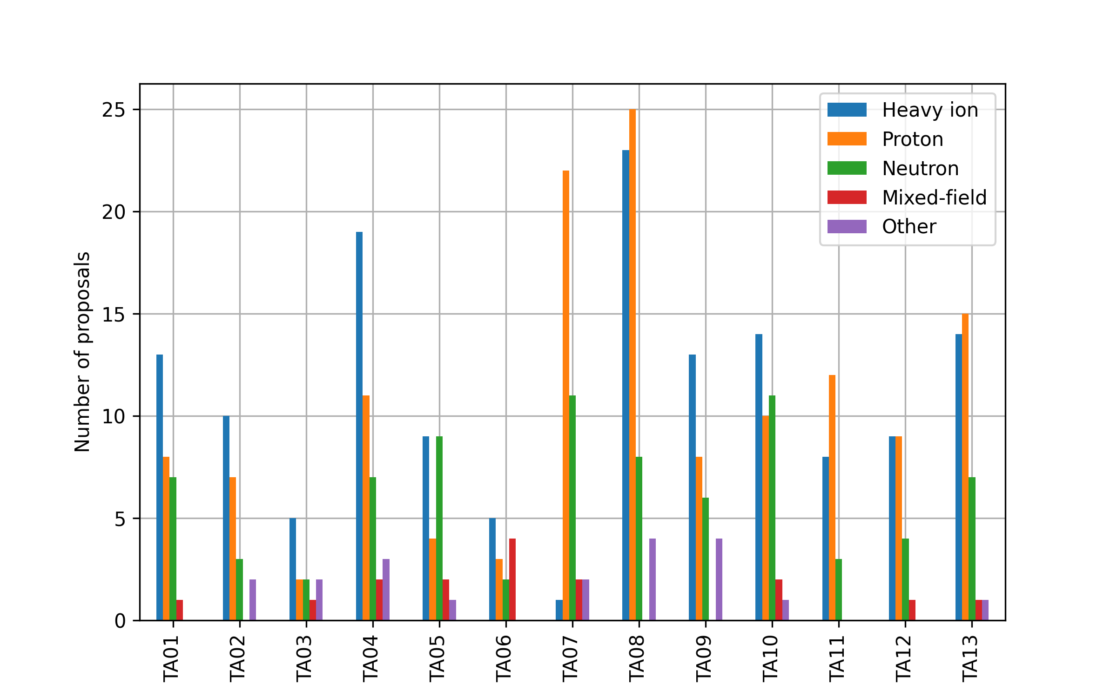
TA call 13 overview
Call 13:
38 proposals received
  9 for WP9
  29 for WP10
  13 RADNEXT internal (34 %)
  11 from industry (29 %)
20 proposal accepted (53 %)
  7 for WP9 (78 % of 9)
  13 for WP10 (45 % of 29)
  9 RADNEXT internal (69 % of 13)
  5 from industry (45 % of 11)

Slide 12
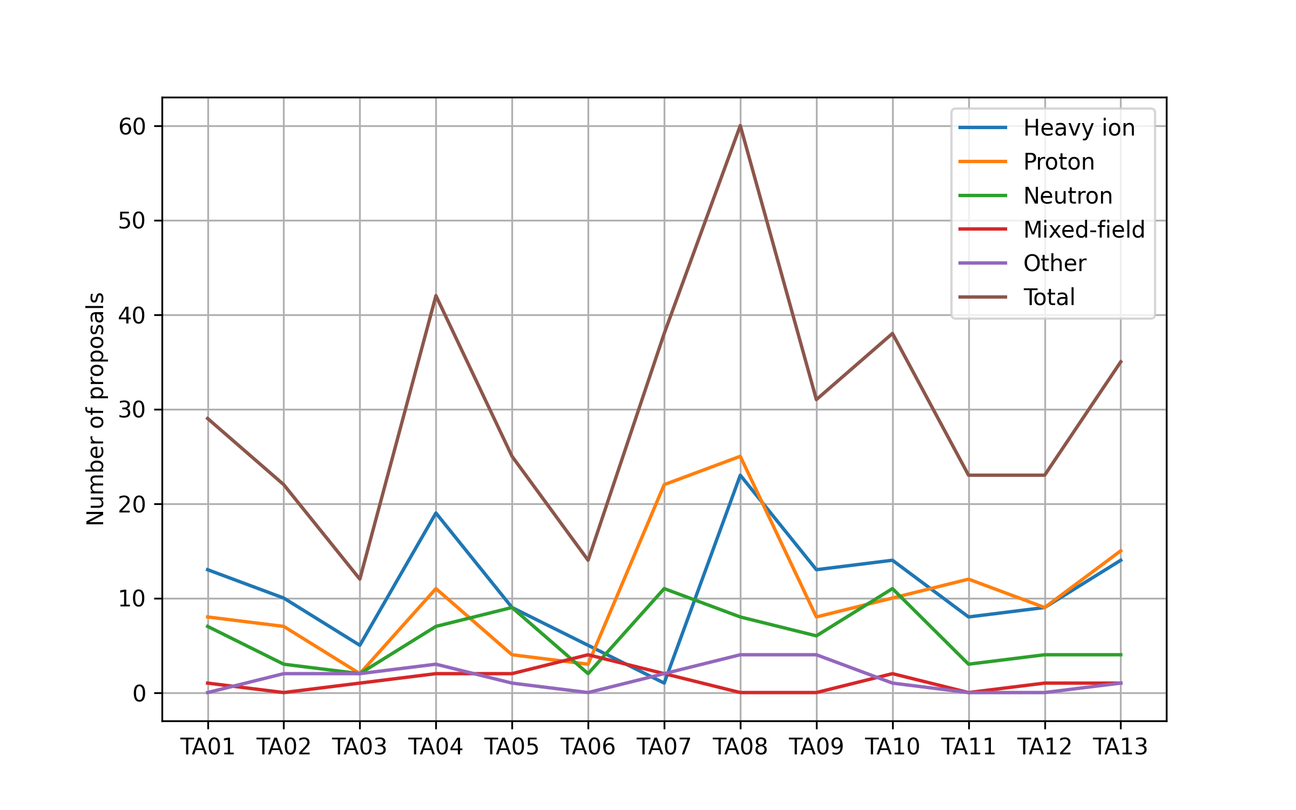
Beam types overview
Proposals of Heavy ion: 143 (36.2%)
Proposals of Proton: 136 (34.4%)
Proposals of Neutron: 80 (20.3%)
Proposals of Mixed-field: 16 (4.1%)
Proposals of Other: 20 (5.1%)
  Photon: 12
  Electron: 6
  Muon: 2
Same data in this figure as the ones on the previous slide

Slide 13
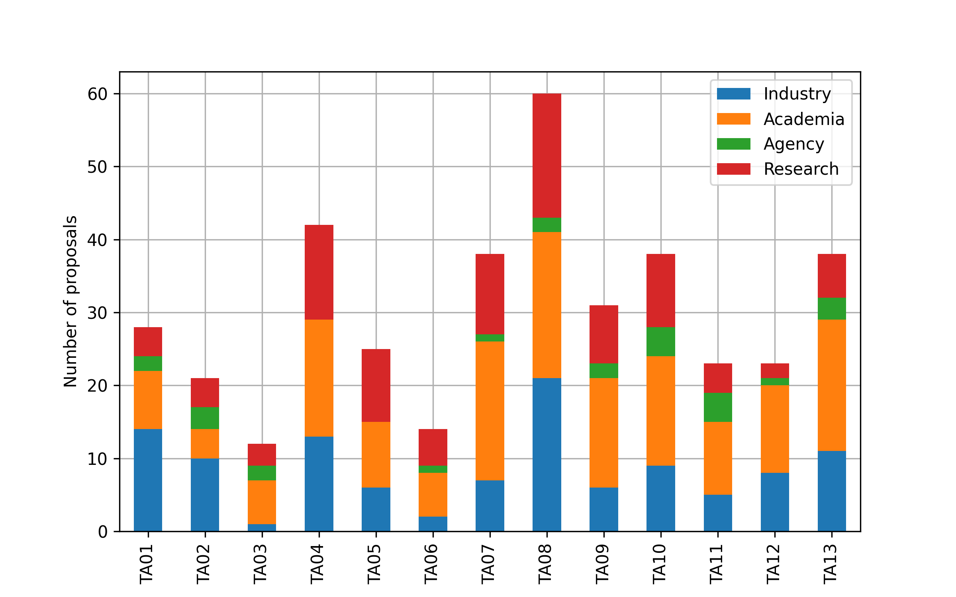
Overview of users and acceptance rates
Of 399 submitted proposals:
  214 proposals accepted (54 %)
  113 from industrial users (28 %)
  99 for WP9 (25 %)
  52 with a woman PI (13 %)
Of 214 accepted proposals:
  47 from industrial users (22 %)
  67 for WP9 (31 %)
  30 with a woman PI (14 %)
Of 47 accepted industrial users:
  32 companies represented from 14 countries
  24 tests executed, 8 cancelled, 5 scheduled, 10 pending
Institution type distributions over all submitted proposals

Slide 14
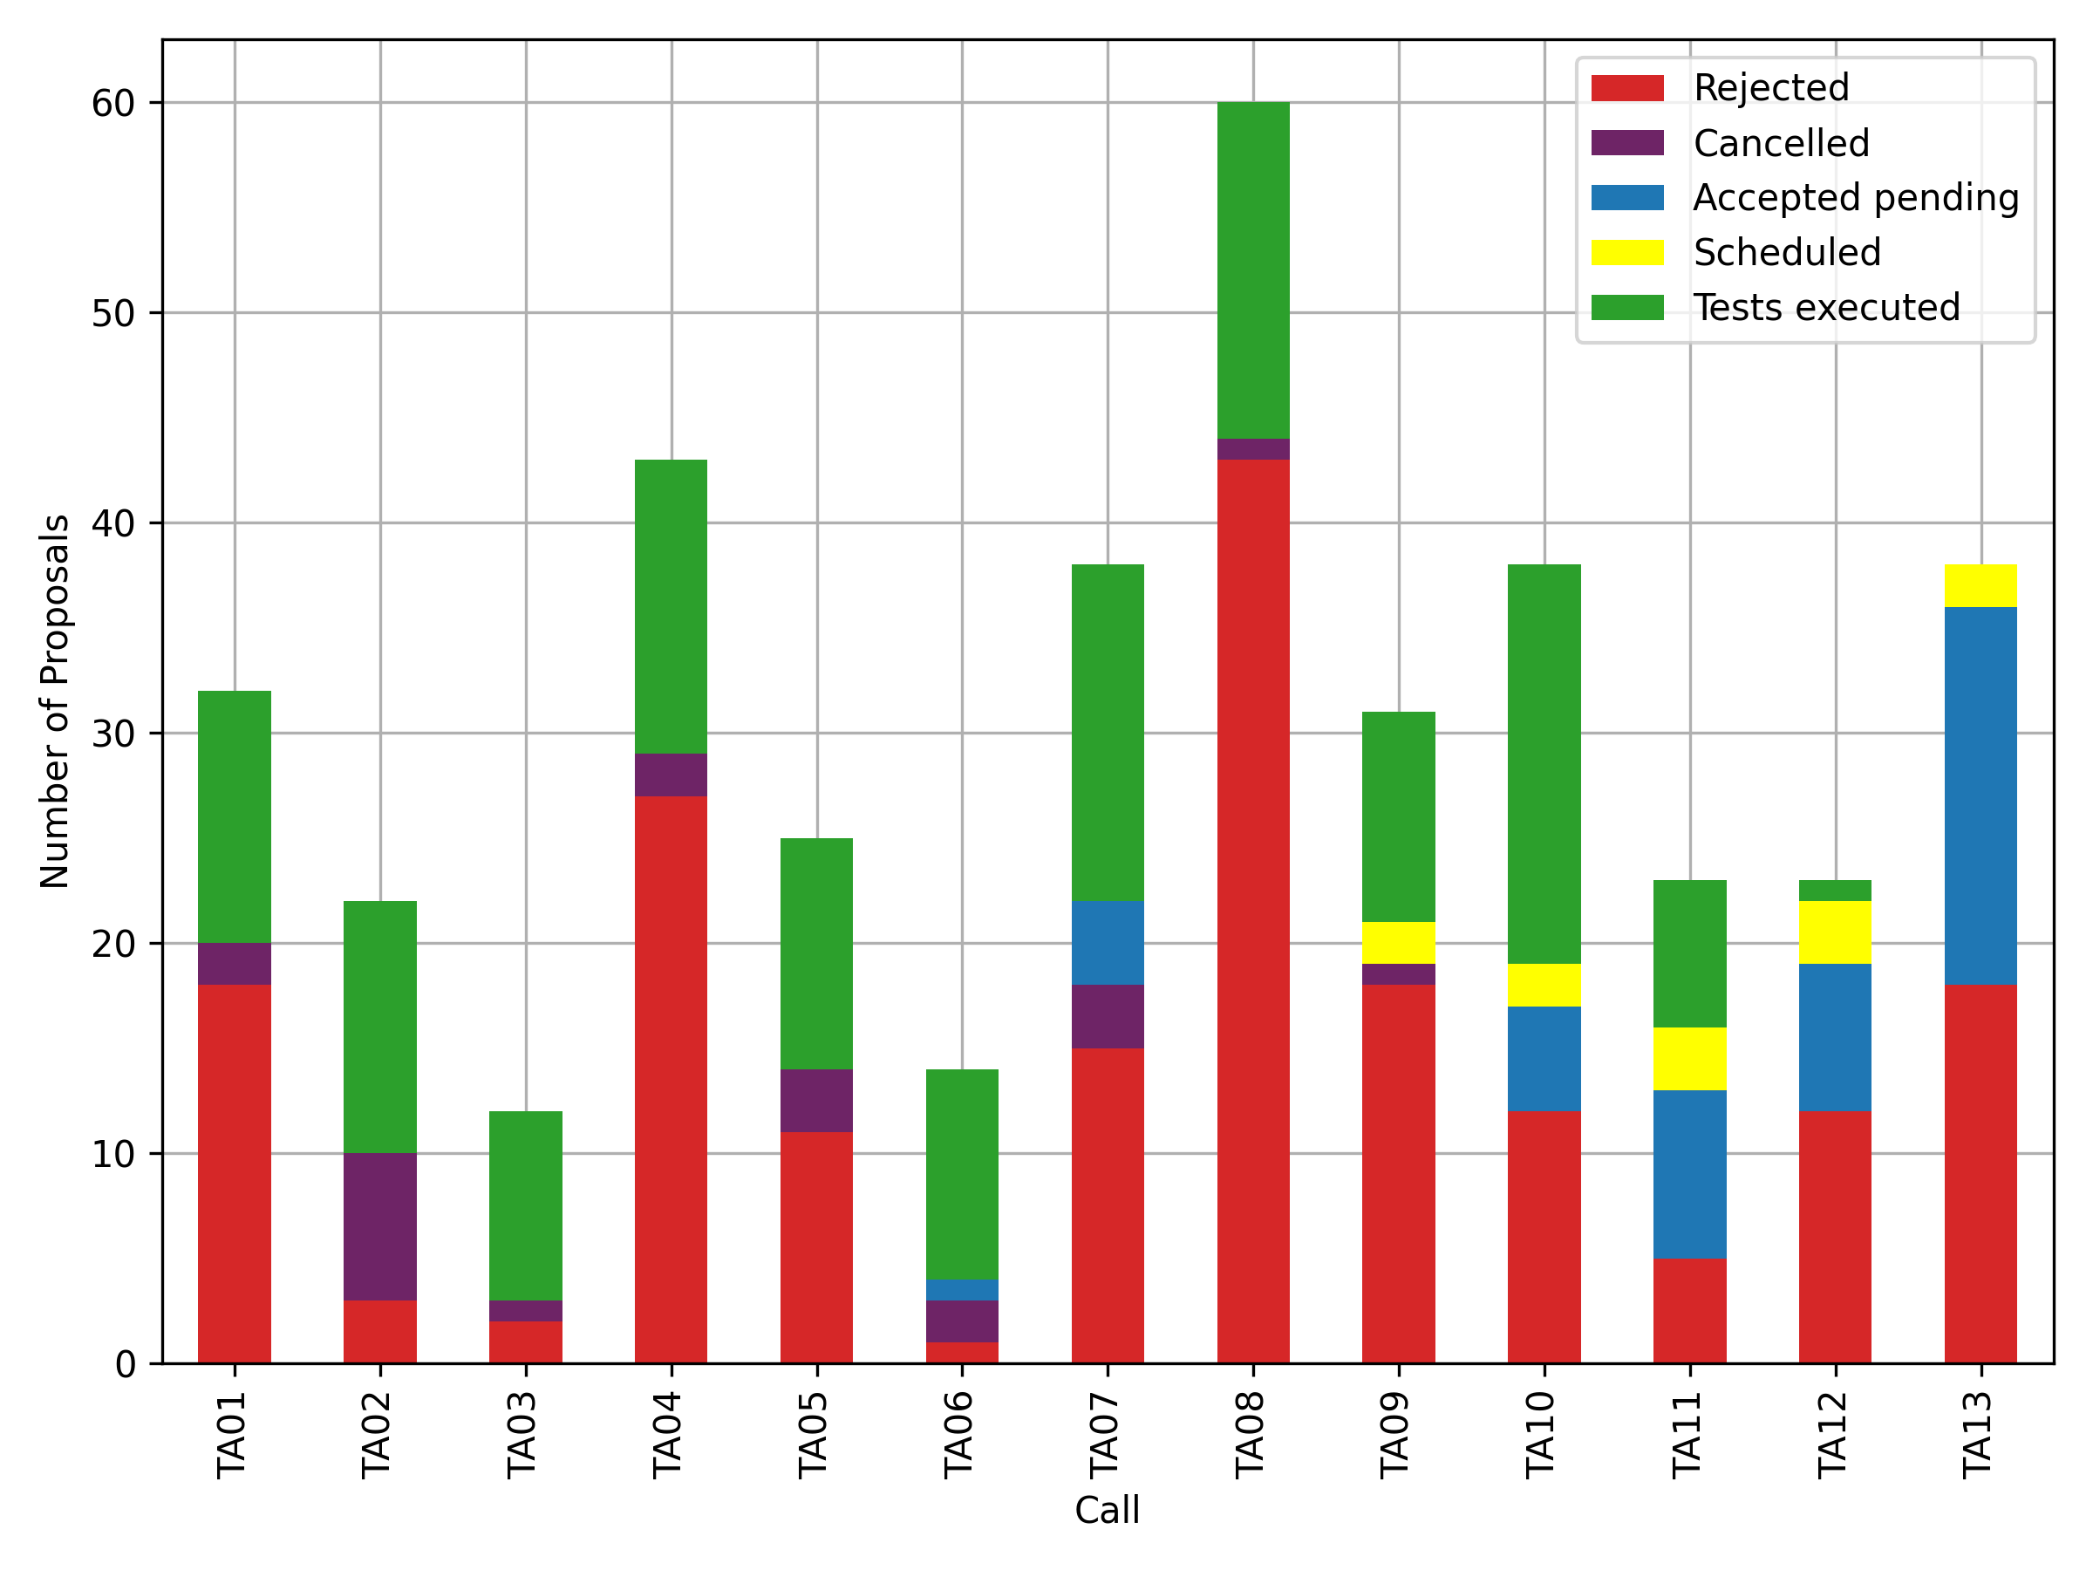
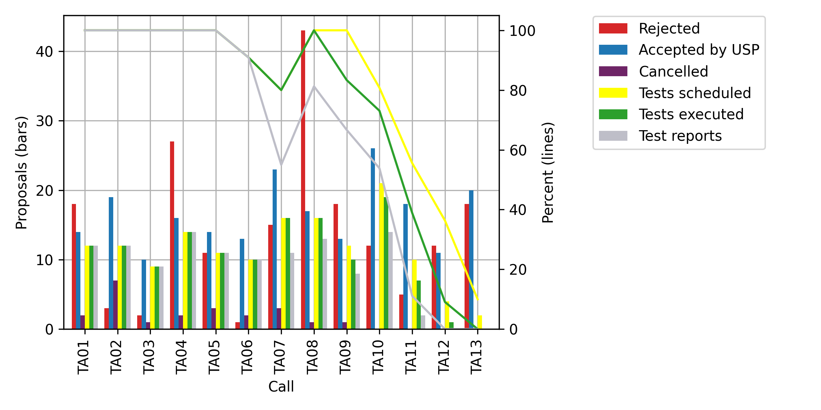
Proposal advancements
 | Total | TA01 | TA02 | TA03 | TA04 | TA05 | TA06 | TA07 | TA08 | TA09 | TA10 | TA11 | TA12 | TA13
Accepted by USP | 214 | 14 | 19 | 10 | 16 | 14 | 13 | 23 | 17 | 13 | 26 | 18 | 11 | 20
Cancelled | 22 | 2 | 7 | 1 | 2 | 3 | 2 | 3 | 1 | 1 | 0 | 0 | 0 | 0
Tests scheduled | 149 | 12 | 12 | 9 | 14 | 11 | 10 | 16 | 16 | 12 | 21 | 10 | 4 | 2
% Scheduled | 78% | 100% | 100% | 100% | 100% | 100% | 91% | 80% | 100% | 100% | 81% | 56% | 36% | 10%
Tests executed | 137 | 12 | 12 | 9 | 14 | 11 | 10 | 16 | 16 | 10 | 19 | 7 | 1 | 0
% Executed | 71% | 100% | 100% | 100% | 100% | 100% | 91% | 80% | 100% | 83% | 73% | 39% | 9% | 0%
Test reports | 116 | 12 | 12 | 9 | 14 | 11 | 10 | 11 | 13 | 8 | 14 | 2 | 0 | 0
% Reports | 60% | 100% | 100% | 100% | 100% | 100% | 91% | 55% | 81% | 67% | 54% | 11% | 0% | 0%

