Slide 1


WP05-JRA1 Radiation monitors, dosimeters and beam characterization
Sylvain GIRARD (WPL, UJM), Cornelia HOEHR (Deputy WPL, TRIUMF)
RADNEXT 4th Annual Meeting – 12 and 13 May 2025
https://indico.cern.ch/e/radnext-2025

Slide 2



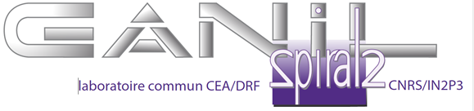








WP05-JRA1: Reminder
Main objective was to define and answer RADNEXT facilities and user needs in terms of radiation detectors, beam instrumentation and dosimetry.
  12 RADNEXT partners involved in WP05; 21 members in the CERN e-group during P2
  Regular interactions with WP7 and WP8 teams
  Part of the JRA is achieved benefiting from TA access, another part by direct collaborations
KUL
UU
GANIL
GSI
UJM
CERN
UniPD
UO
UM
TRIUMF
FINT
UKRI

Slide 3
WP05-JRA1: 3 main technical tasks
    Definition of the correlation matrix between the facility needs and the established or innovative monitoring solutions as well as the definition and standardization of the relevant beam parameters to be monitored across the facility network
    To investigate innovative instrumentation regarding their potential high impact on facility operation and optimization of radiation to electronics testing
    To develop, characterize and qualify low-cost detectors and dosimeters and have them accessible to RADNEXT users
Main objective: rendering the facility network more accessible, homogeneous and complementary

Slide 4
Outline
Organisation and main objectives, deliverables of WP5
Main achievements in Y-4
  Task 5.2 – Focus on Andreas Plaum (UO), PhD progress on beam shape characterization
  Task 5.3 – Focus on Luca Weninger (UJM, dedicated presentation by Luca)
  Task 5.3 – Brief overview from other research axis
    3D Nand Flash (UniPD)
    Neutron Detection (UU, GANIL dedicated presentation by Lucas de Arruda, UU)
  Task 5.4 – Brief overview of progress

Slide 5
Follow-up of recommendations and comments from previous review(s) (if applicable)
The results of the joint research activities are positively evaluated and further efforts should be made in this direction to conclude the work. In particular the activities related to the development of innovative approaches for detection, dosimetry.. (other JRA)... are of very good quality
The joint research activities are progressing well and the results already achieved are promising.
WP5 reports activity as expected from the DoA, with clear progress with respect to P1. In particular, the progress of tasks 5.2 and 5.3, related to the two PhD students of the WP is comprehensively described. It shows an effective collaboration with several RADNEXT partners- The work on detector arrays and the results related to beam size dependence on flux and energy are of very good quality. The work on optical fiber based solutions and the results related to 3D NandFlash SEU monitor and characterization of neutron fields are of very good quality and are progressing well, with minor problems.
➔ No particular follow-up was required by the evaluators, all good!

Slide 6
Main achievements in the fourth year
The 4 deliverables of the WP5 have been delivered during the period
Status | ID | Title | Deadline | Responsible (s)
Done | D5.1 | Book of Knowledge, M38 Definition and Standardization of Relevant Beam Parameters [Milestone 5.1] | 31/07/2024 | UO
Done | D5.2 | Report, M40 Potential of SEU monitor based on 3D NAND Flash memories for R2E | 30/09/2024 | UniPD
Done | D5.3 | Prototype, M44 Prototypes of Fiber-based dosimeter and Low cost RadMON detector [Milestone 5.2] | 31/01/2025 | UJM/CERN
Done | D5.4 | Report, M46 Characterization of neutron fields at the NFS facility | 31/03/2025 | UU
➔ All deliverables & Milestones have been done. All good!

Slide 7
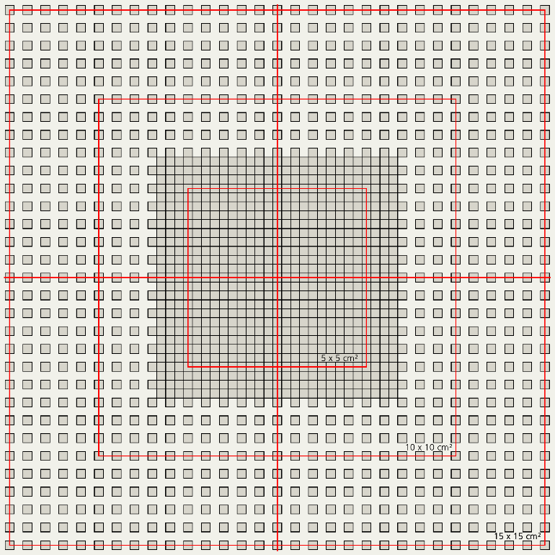
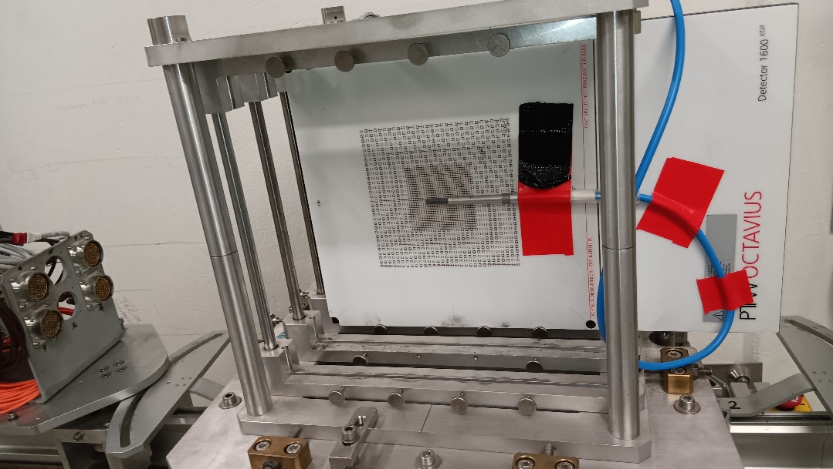
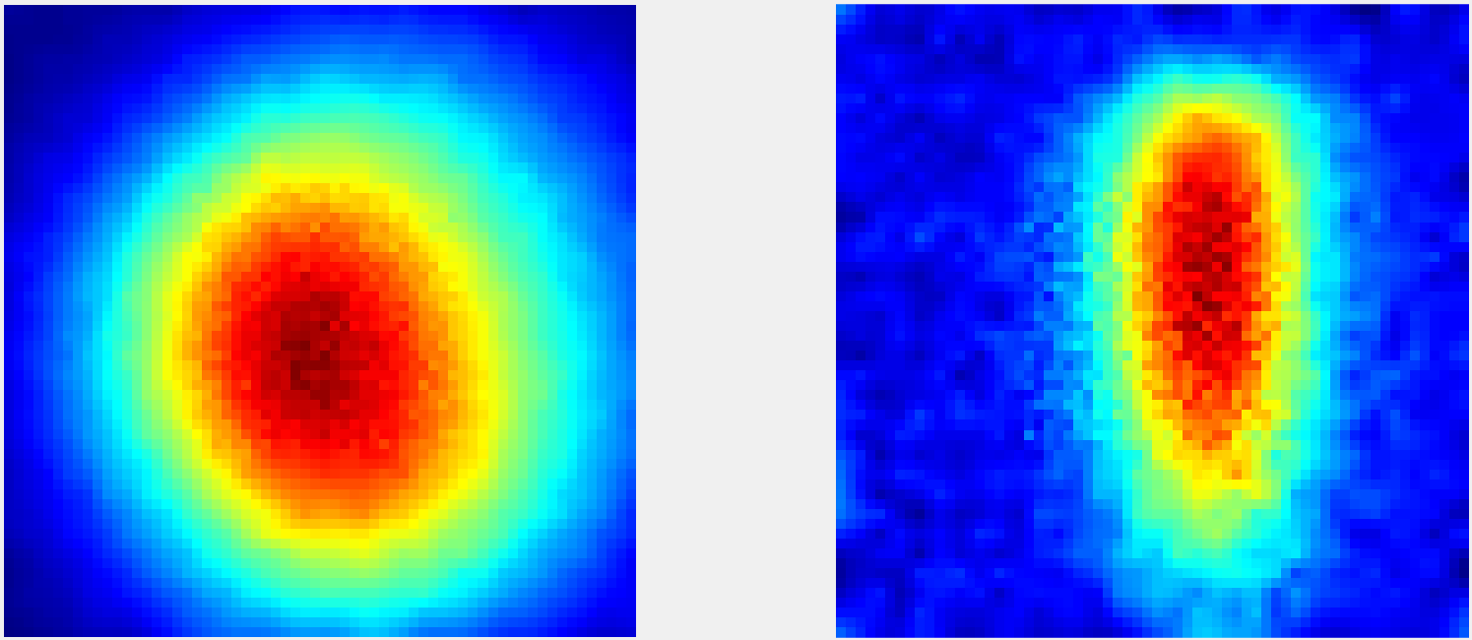
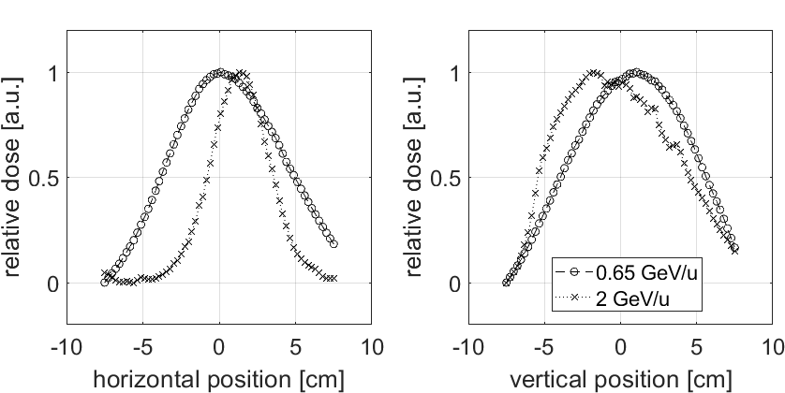

WP05-JRA1 Task 5.2 : Analysis of the results acquired at CHARM during P2
Left: Arrangement of detector chambers of the OD 1600 SRS and OD 1600 XDR. The grey squares indicate single detector chambers.
Right: Setup for measurements at CHARM with the detector array and a Farmer 30013 ionisation chamber.
Detectors:
  2D Arrays: OD 1600SRS and OD 1600XDR
  Farmer 30013 Chamber
2D intensity profiles
  Examination of changes depending on energy and flux
  comparison to CHARM monitoring (multi wire proportion chamber)
Andreas PFLAUM
Comparison of horizontal (left) and vertical (right) profiles at 0.65 GeV/u with 2 GeV/u. The beam shape differs significantly as the 2 GeV/u beam is narrower in the vertical direction.
Presented at RADECS 2024: “Spatial Profile of a Very High-Energy 208Pb Heavy Ion Beam at CHARM“, publication to be done
7

Slide 8
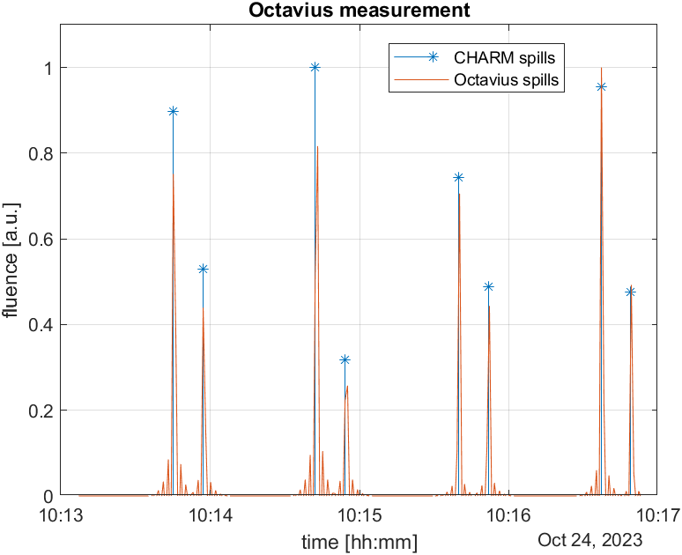
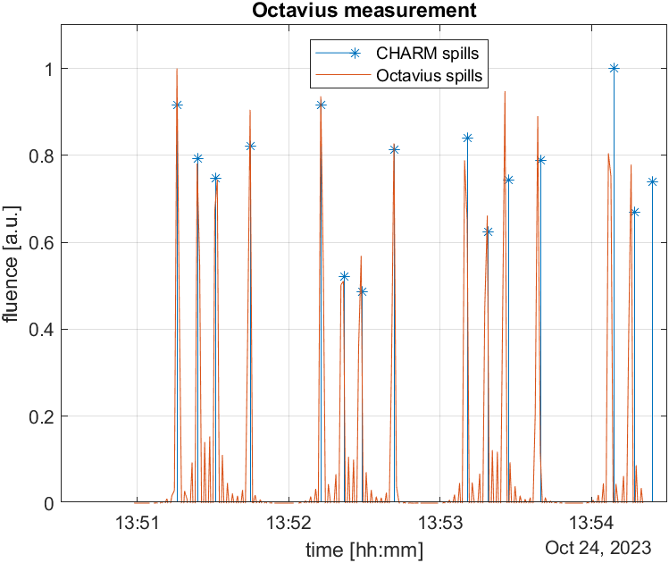
WP05-JRA1 Task 5.2 : Analysis of the results acquired at CHARM during P2
Fig. Example of the time structure of two measurements, left: 1 GeV with RFKO of 0.070 measured with OD 1600 SRS, right: same settings with OD 1600 XDR. It can be observed that the time structure of the beam changed in its pattern. The peaks of the array measurements match the peaks measured by the CHARM monitoring.
Andreas PFLAUM
Time structure of the beam
Comparison of array with CHARM monitoring (Radio frequency knockout technique)
Array measurements match CHARM monitoring
8

Slide 9
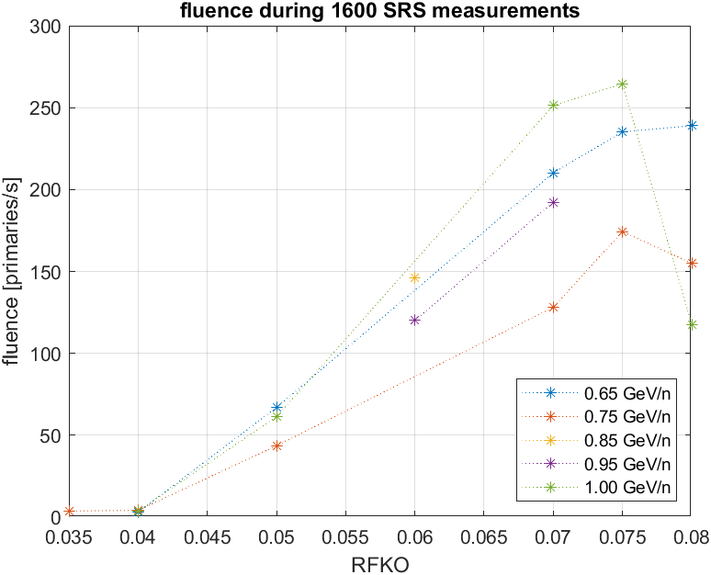
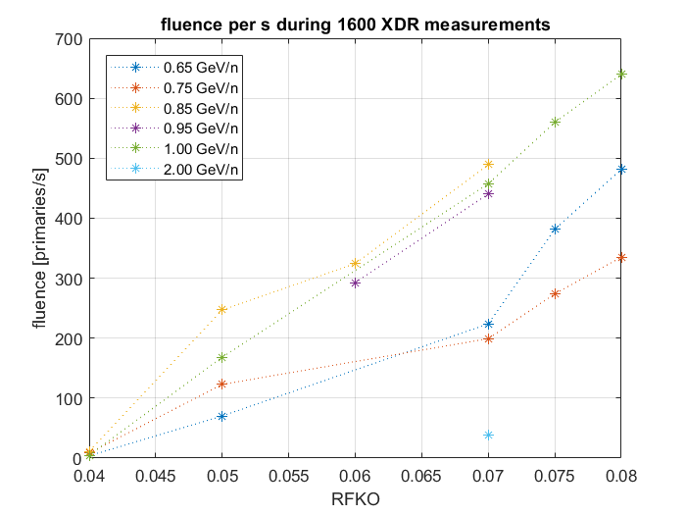
WP05-JRA1 Task 5.2 : Analysis of the results acquired at CHARM during P2
Andreas PFLAUM
Fig. Fluence over RFKO measured using 1600 XDR on day 1.
Fig. Fluence over RFKO measured with 1600 SRS on day 1.
Fluence has been correlated to Radio frequency knockout (RFKO) settings
Fluence data from CHARM monitoring
9

Slide 10
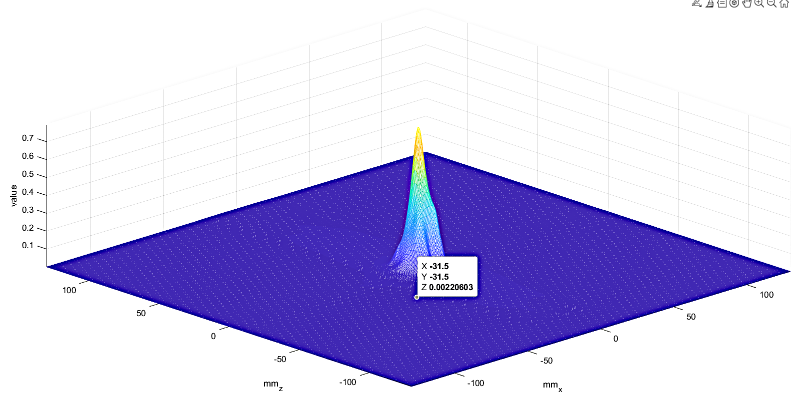
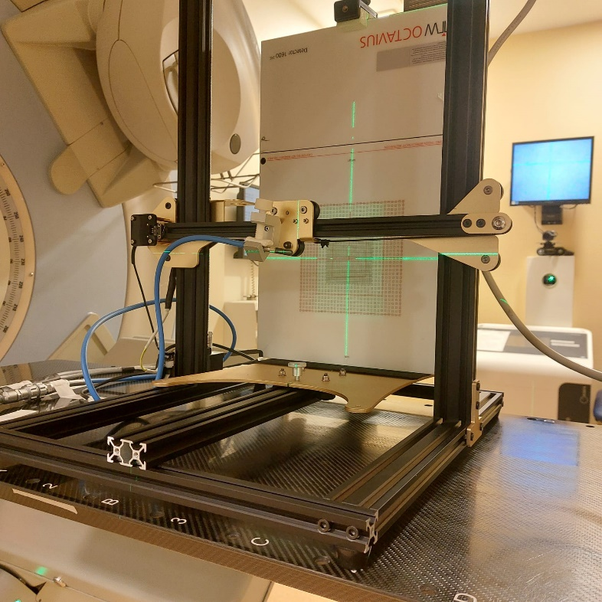
Online beam monitoring
WP05-JRA1 Task 5.2 : Definition of the RADNEXT facilities & users instrumentation needs, inter-laboratory comparison
Bachelor thesis by Jannis Wächter
Device enables the measurement of the beam with the opportunity to move a DUT into or out of the beam without the need to enter the room
Saves time, reduces necessary amount of RP measures
Locates beam center
Tested with a medical linear accelerator at Pius Hospital Oldenburg
Andreas PFLAUM
10

Slide 11
Plans for the last year (task#5.2)
Work in progress:
  Absolute dose to silicon conversion
  Beam quality correction factors
    Correction for difference in beam type of 208Pb beam at CHARM
    Array and Farmer chamber have been calibrated with gamma radiation from a ⁶⁰Co source
    Simulations of stopping power ratios and dose corrections in FLUKA
  Other ion species will be tested
    Measurements in May at GSI (in fact today!)
PhD Defense of Andreas will take place after the end of JRA activity
Andreas PFLAUM
11

Slide 12
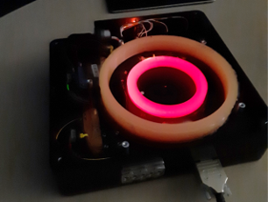
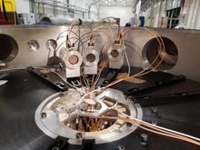
WP05-JRA1 Task 5.3 : Innovative instrumentation applied to RADNEXT facilities
Task Leader: UJM
Participants: TRIUMF, CERN, FINT, GSI, UniPD, UU, GANIL, UKRI-STFC, KUL
PhD student L. Weninger UJM
Optical Fiber-based solutions*
3D NAND Flash
SEU monitor **
Characterization of neutron fields **
SRAM Dosimetry
12

Slide 13




WP05-JRA1 Task 5.3 : Main progress on fiber-based solutions
Low-energy Proton testing @ CLPU (TA, dec 2023)
  Joint UJM-CERN-ELI-CLPU experiment & Analysis
Focus by Luca Weninger (UJM) / Article in progress
Low-energy Proton testing @ CNA (TA, end 2024)
  Joint UJM-CNA experiment & analysis
Neutron testing @ ENEA (TA, 2023, 2024)
RIL-based dosimetry @ FNG/ENEA atm. Neutrons (TA)
Official ENEA/UJM collaboration in progress
Neutron testing @ CHARM (to be done – 2025)
Fiber-based dosimetry in mixed fields
Luca WENINGER
➔ Luca defended his PhD thesis on March 21, 2025

Slide 14
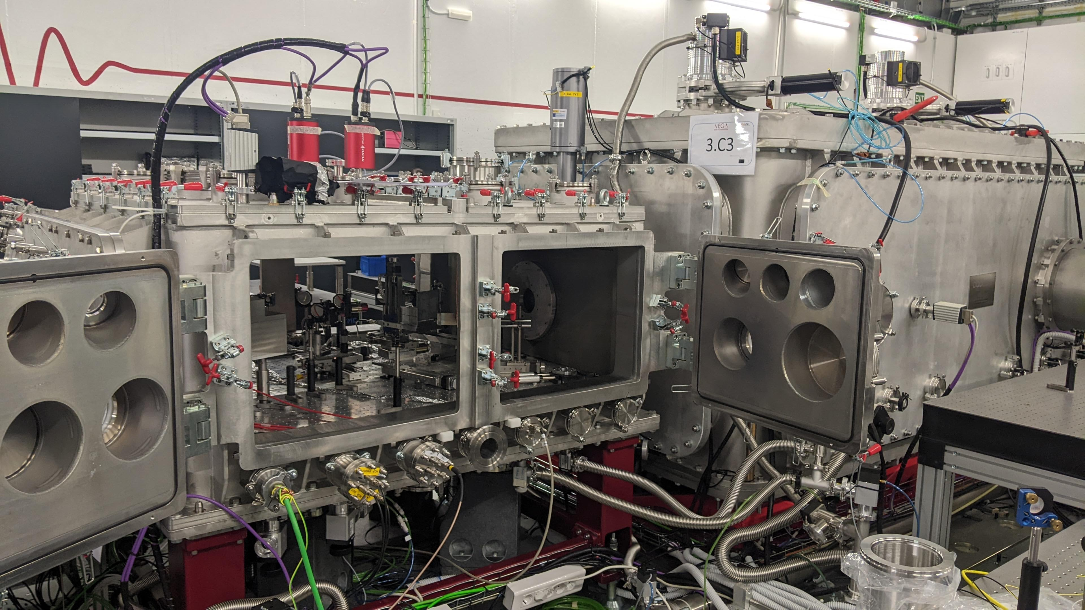
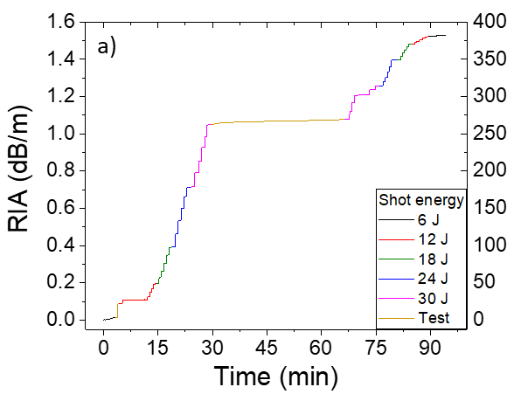
WP05-JRA1 Task 5.3: Potential of radioluminescent (RL) optical fibers for low-energy protons at CNA
Objective (focus by Luca)
Investigate the potential of the RIA & RIL fiber dosimetry to monitor the low energy proton fluence per shot / Benchmark with CERN solution
Facility interest: no monitoring system for now (TLD but integrated on several shots)
The beam time was obtained through the TA of RADNEXT
First collaboration between UJM & CLPU
Luca WENINGER

Slide 15
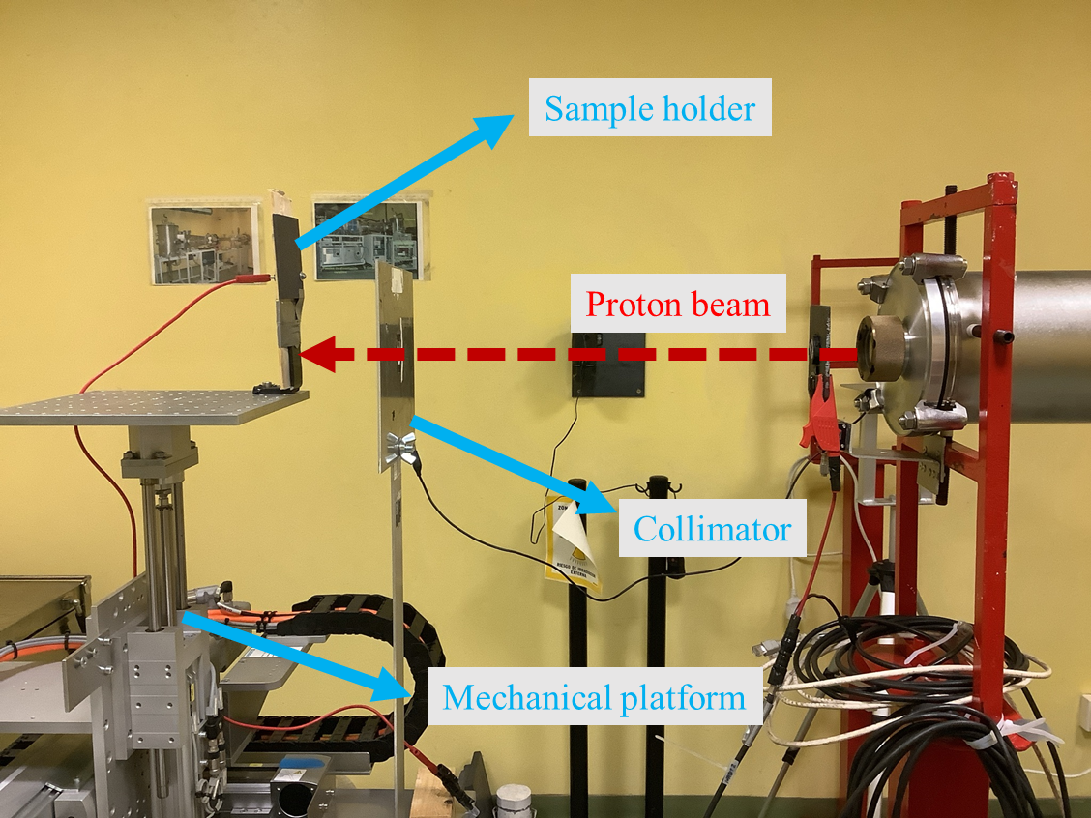

WP05-JRA1 Task 5.3: Potential of radioluminescent (RL) optical fibers for low-energy protons at CNA
Objective
Investigate the potential of the RIA & RIL fiber dosimetry to monitor the proton (3<E<15MeV) over large flux/fluence
Facility interest: monitoring of the low-flux ➔ optical fibers will be perfectly adapted for low energy proton flux monitoring at CNA in terms of sensitivity
The beam time was obtained through the TA of RADNEXT
First collaboration between UJM & CNA
Luca WENINGER

Slide 16
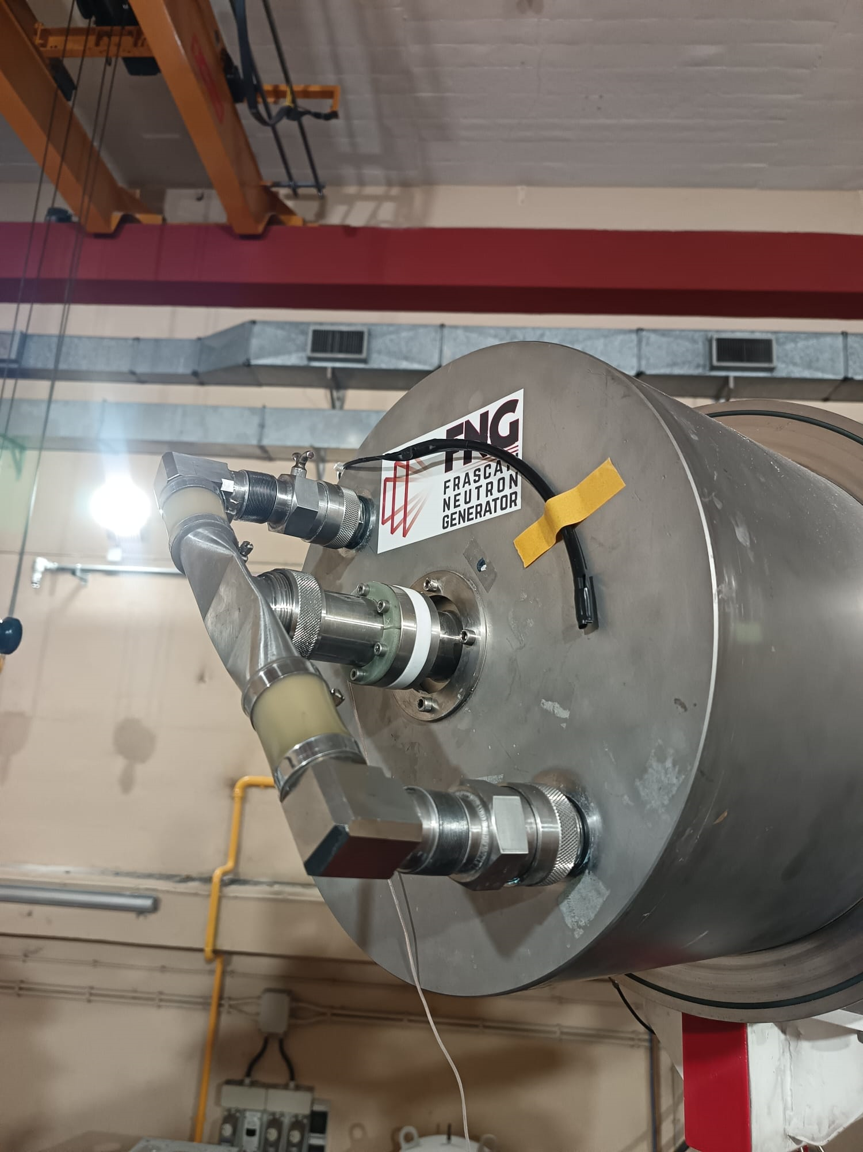
WP05-JRA1 Task 5.3: Potential of radioluminescent (RL) optical fibers for 14 MeV neutron beam monitoring
Luca’s P2 presentation: https://indico.cern.ch/event/1348465/contributions/5991275/)
Publication (UJM, ENEA): Results in Optics, vol19, 10087, 2025
The facility
During the 2024 TNA campaign, implementation of a full acquisition chain + ENEA training ➔ today the neutron yield is monitored by ENEA team in real time by the ENEA instruments: an alpha counter and a fission chamber and the RIL dosimeter
Luca WENINGER

Slide 17
WP05-JRA1 Task 5.3 : Innovative instrumentation applied to RADNEXT facilities
Task Leader: UJM
Participants: TRIUMF, CERN, FINT, GSI, UniPD, UU, GANIL, UKRI-STFC, KUL
Optical Fiber-based solutions*
3D NAND Flash
SEU monitor **
Characterization of neutron fields **
SRAM Dosimetry

Slide 18
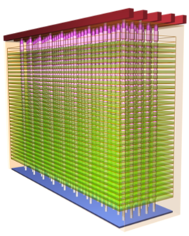
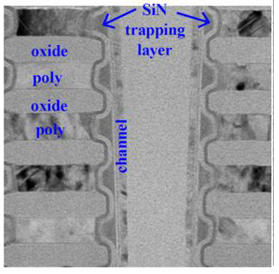
WP05-JRA1 Task 5.3 : 3D Nand Flash – Introduction & purpose
SEU monitor based on 3D NAND Flash
Ionizing radiation causes a threshold voltage shift (ΔV_{th}) in Flash cells. This shift can be exploited to realize a particle detector/ radiation dosimeter
3D NAND Flash devices offer many advantages as an ionizing particle detector, compared to other memories
  ΔV_{th} can be extracted, in addition to the number of errors
  Non-volatility: low power, no data loss with SEFIs, passive detectors, etc…
  Capability of tracking particles in three dimensions, higher precision in determining the beam features, discrimination of errors due to radiation from other errors
3D NAND Flash exploit either FG cells (conductive polysilicon Floating Gate cells) or RG technology using Charge Trap (CT) cells
The purpose is to explore the feasibility of a high-LET particle detector based on 3D NAND Flash CT memories

Slide 19
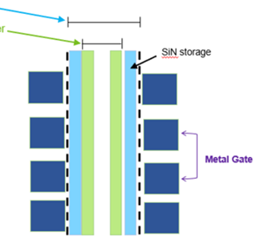
WP05-JRA1 Task 5.3 : 3D Nand Flash – Scaling
Etch Process Diameter
In order to increase the density of 3D Flash arrays, manufacturers increase the number of stacked layers and, at the same time, the distance between adjacent WLs (i.e., tier pitch) is reduced to avoid excessively tall pillars
Tier pitch scaling leads to higher electric fields between adjacent cells and therefore stronger disturbs
The impact of tier pitch scaling on cell array radiation sensitivity needs to be addressed, both in terms of single event effects and total ionizing dose
Channel Diameter
Silicon-nitride storage layer
Channel poly Si
Metal Gate (wordline)
Tier Pitch (TP)

Slide 20
WP05-JRA1 Task 5.3 : 3D Nand Flash – Impact of Tier Pitch on TID Sensitivity of 3D NAND Cells
Small Tier Pitch (STP) cells feature a larger threshold voltage shift (ΔV_{th}), up to 25% more than Large Tier Pitch (LTP) cells
The increase at smaller tier pitch is more evident for the highest program levels
M. Bagatin, S. Beltrami, A. Paccagnella, S. Gerardin, “Total-Dose Induced Threshold Voltage Shift Dependence on Tier Pitch in 3D NAND Flash Memories,” IEEE Trans. Nucl. Sci., 2024

Slide 21

WP05-JRA1 Task 5.3 : 3D Nand Flash – Impact of Tier Pitch on TID Sensitivity of 3D NAND Cells
To model this effect, an approximately constant height (Z₀) needs to be added to both STP and LTP cells, so that:
$$Q_{inj}=k (TP+Z_{0})$$
k depends on cell materials and geometry
Z₀ depends on geometry and electric field between cells
The weight of Z₀ increases with increasing pre-rad V_{th}, as it depends on the electric field
Therefore, charge loss normalized by the TP is comparatively larger in STP devices, and this is more apparent for L7 level, in agreement with data
LTP cells
STP cells
Future work
  Study of interaction between heavy ions and TID
  TCAD simulations
M. Bagatin, et al.,” IEEE Trans. Nucl. Sci., 2024

Slide 22
WP05-JRA1 Task 5.3 : Innovative instrumentation applied to RADNEXT facilities
Task Leader: UJM
Participants: TRIUMF, CERN, FINT, GSI, UniPD, UU, GANIL, UKRI-STFC, KUL
PhD student L. Weninger UJM
Optical Fiber-based solutions*
3D NAND Flash
SEU monitor **
Characterization of neutron fields **
SRAM Dosimetry

Slide 23
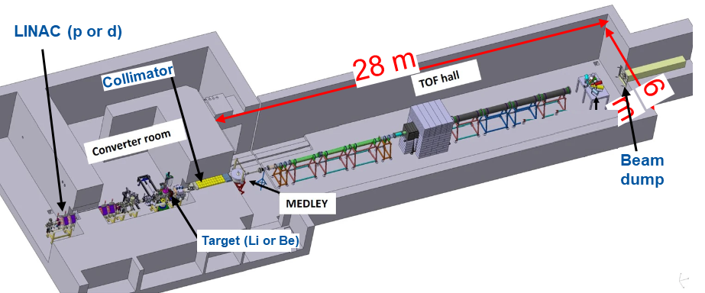
RADNEXT, WP5 - Task 5.3, D5.4 Characterization of neutron fields at the NFS facility
D. Tarrío and S. Pomp (Uppsala University, Sweden), L. de Arruda and X. Ledoux (GANIL, France)
WP05-JRA1 Task 5.3 : Characterization of neutron fields at NFS white neutron beam
Focus by Lucas de Arruda, UU(UU)
  Neutrons for Science (NFS) at GANIL (France) is a new neutron facility
  White spectrum neutron beam extends,from ~1 to ~ 40 MeV neutrons, and is produced by 40-MeV deuterons hitting on a 9-mm thick Beryllium target.
Experimental setup: The Medley setup, formerly used at Uppsala with quasi monoenergetic neutron beams.
Scheme of NFS facility, highlighting its main components.
23

Slide 24
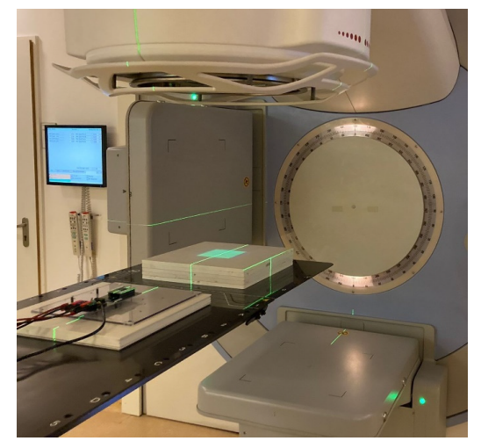
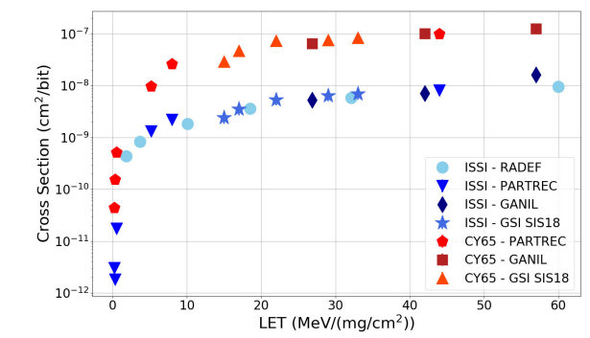
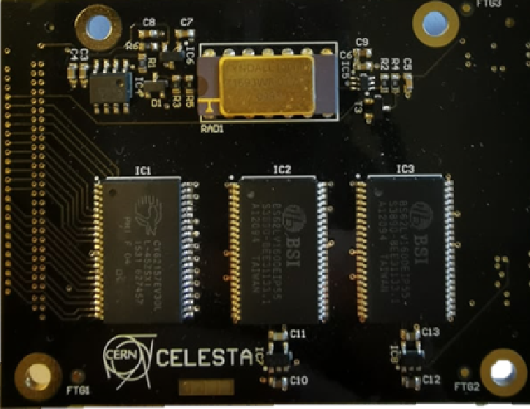
WP05-JRA1 Task 5.4 : develop, characterize and qualify low-cost detectors and dosimeters: SRAM
Static Random-Access Memories (SRAMs) are good candidates for radiation beams characterization thanks to the linear correlation between the number of SEU and the particle fluence they receive, combined with the readout ease and overall low cost of the solution.
[Collab CERN – UO – DLR] study of the secondary neutron field produced by a 15-MV radiotherapy facility / Benchmark between measurements and simulations
[Collab CERN – ENEA – Datzmann Interact and innovate - UJM] SRAM detector was used to compare results across a broad range of heavy-ion facilities
[Collab UM – CERN] Celesta cubesat exploiting its LET discrimination capabilities thanks to its correlation with the MCU distributions

Slide 25
Lessons learned from RADNEXT / Conclusions
The project was very efficient to create fruitful collaboration between end-users (facilities) and labs developping innovate solutions and speed up the increase of maturity level.
    New UJM collaborations with ENEA, CNA, CLPU as example
RADNEXT PhD students (and researchers) benefited from a very favorable environment to develop their research thanks to the TA access
As part of the WP5 research is driven by facility access (including TA), more results could have been generated by extending the JRA efforts as the TA actions.
Many thanks to all the members of WP5 and all the facilities involved in the joint research done during the RADNEXT project!

Slide 26
updated list of WP5 articles
L. Weninger, A. Morana, M. Ferrari, A. Boukenter, Y. Ouerdane, E. Marin, P. Paillet, M. Gaillardin, O. Duhamel, C. Hoehr, C. Bélanger-Champagne, M. Trinczek, S. Girard “External Quantum Efficiency Evolution of Light-Emitting Diodes under γ-rays, Electrons, Neutrons and Protons, “ in IEEE Transactions on Nuclear Science, under review.
F. Fricano, A. Morana, C. Hoehr, C. Campanella, C. Bélanger-Champagne, M. Trinczek, D. Lambert, P. Paillet, H. El Hamzaoui, B. Capoen, M. Bouazaoui, A. Boukenter, E. Marin, Y. Ouerdane, S. Girard, "Pre-irradiation Influence on Proton Radioluminescence Responses of Sol-gel Optical Fibers," in IEEE Transactions on Nuclear Science, accepted for publication, 2025, doi: 10.1109/TNS.2025.3553065.
L. Weninger, A. Morana, A. Colangeli, F. Fricano, Y. Ouerdane, E. Marin, A. Boukenter, S. Loreti, A. Pietropaolo, S. Girard, “Potential of radioluminescent silica-based optical fibers for 14 MeV neutron beam monitoring”, Results in Optics, Volume 19, 100807, 2025, https://doi.org/10.1016/j.rio.2025.100807.
M. Roche, D. Lambert, L. Weninger, A. Morana, N. Kerboub, C. Bélanger-Champagne, A. Colangeli, C. Hoehr, M. Trinczek, E. Marin, A. Boukenter, Y. Ouerdane, P. Paillet, J. Mekki, T. Robin, S. Girard, “14 MeV and Atmospheric Neutron Monitofring Through Optical Fiber Dosimeters”, IEEE Transactions on Nuclear Science (Dec. 2024) : DOI 10.1109/TNS.2024.3521506.
L. Weninger, A. Morana, Y. Ouerdane, E. Marin, A. Boukenter, S. Girard, “Distributed Optical Fiber-Based Radiation Detection Using an Ultra-Low-Loss Optical Fiber”, Radiation, vol. 4, pp. 167-182 (May 2024) : DOI 10.3390/radiation4020013.

Slide 27
updated list of WP5 articles
F. Fricano, A. Morana, D. Lambert, C. Hoehr, C. Campanella, C. Bélanger-Champagne, M. Trinczek, H. El Hamzaoui, B. Capoen, A. Cassez, M. Bouazaoui, G. Mélin, T. Robin, A. Boukenter, E. Marin, Y. Ouerdane, P. Paillet, S. Girard, "Very High Dose Rate Proton Dosimetry with Radioluminescent Silica-based Optical Fibers," in IEEE Transactions on Nuclear Science, vol. 71, n°8, pp. 1829-1836, doi: 10.1109/TNS.2024.3378803.
L. Weninger, A. Morana, C. Campanella, J. Vidalot, E. Marin, Y. Ouerdane, A. Boukenter, R. García Alía, S. Girard, "Radiation Monitoring with Radiosensitive Pure-Silica Core Ultra-Low Loss Optical Fiber," in IEEE Transactions on Nuclear Science, vol. 71, n°8, pp. 1813-1820, doi: 10.1109/TNS.2024.3380999.
L. Weninger, C. Campanella, A. Morana, F. Fricano, E. Marin, Y. Ouerdane, Aziz Boukenter, R. García Alía, S. Girard, “Calibration in the Visible and Infrared Domains of Multimode Phosphosilicate Optical Fibers for Dosimetry Applications " in IEEE Transactions on Nuclear Science, vol. 70, no. 8, pp. 1908-1916, Aug. 2023, doi: 10.1109/TNS.2023.3252941.
L. Weninger, R. Clerc, M. Ferrari, A. Morana, T. Allanche, R. Pecorella, A. Boukenter, Y. Ouerdane, E. Marin, O. Duhamel, M. Gaillardin, P. Paillet, S. Girard, “Gamma Ray Effects on Multi-Colored Commercial Light-Emitting Diodes at MGy Level”, Electronics, vol. 12(1), 81 (Dec. 2022): DOI 10.3390/electronics12010081
M. Bagatin, S. Beltrami, A. Paccagnella, S. Gerardin, “Total-Dose Induced Threshold Voltage Shift Dependence on Tier Pitch in 3D NAND Flash Memories,” IEEE Trans. Nucl. Sci., early access 10.1109/TNS.2024.3506787
L. de Arruda, D. Tarrío, X. Ledoux, S. Pomp, D. Ramos, A. V. Prokofiev, U. Tippawan, A. Al-Adili, M. Ansorge, D. Fernández, I. Ipatova, I. Kodeli, M. Lantz, J. Novák, E. Pirovano, H. Sengar, T. Tanaka and A. Cobo, EPJ Web Conf., 322 (2025) 08006, DOI: https://doi.org/10.1051/epjconf/202532208006

Slide 28
updated list of WP5 conferences
F. Fricano, L. Weninger, A. Morana, A. Colangeli, S. Loreti, Y. Ouerdane, E. Marin, A. Boukenter, D. Lambert, P. Paillet, B. Capoen, H. El Hamzaoui, M. Bouazaoui, A. Pietropaolo, S. Girard, “Toward Accurate Monitoring of 14 MeV Neutron Flux: Dual Calibration of a Lithium-Glass Scintillator”, Radiation and its Effects on Components and Systems (RADECS), Antwerp (Belgium), September 29 – October 3rd, 2025, submitted.
G. Ciachera, L. Weninger, D. Lambert, M. Darnon, A. Morana, V. Lalucaa, J-M. Belloir, C. Durnez, C. Virmontois, N. Kerboub, J. Mekki, Y. Morilla, P. Martin Holgado, A. Romero-Maestre, M. Gaillardin, P. Paillet, S. Girard, “Radiation Effects on Red, Green and Blue Light Emitting Diodes, ” Radiation and its Effects on Components and Systems (RADECS), Antwerp (Belgium), September 29 – October 3rd, 2025, submitted.
F. Fricano, A. Morana, C. Hoehr, C. Campanella, C. Bélanger-Champagne, M. Trinczek, G. Mélin, T. Robin, D. Lambert, A. Boukenter, E. Marin, Y. Ouerdane, P. Paillet, S. Girard, “Enhancing Performance of Optical Fiber-Based Sensor for Proton Dosimetry Through Pre-Irradiation Treatment, ” IEEE Nuclear & Space Radiation Effects Conference (NSREC), Nashville (USA), July 14–18, 2025, Oral Contribution.
L. Weninger, G. Ciachera, M. Darnon, A. Morana, F. Fricano, V. Lalucaa, J-M. Belloir, C. Durnez, C. Virmontois, N. Kerboub, J. Mekki, Y. Morilla, P. Martin-Holgado, A. Romero, M. Gaillardin, O. Duhamel, P. Paillet, S. Girard, “Radiation Reliability of the White LEDs of the MMX mission on Phobos, ” IEEE Nuclear & Space Radiation Effects Conference (NSREC), Nashville (USA), July 14–18, 2025, Poster Contribution.
L. Weninger, A. Morana, M. Ferrari, A. Boukenter, Y. Ouerdane, E. Marin, P. Paillet, M. Gaillardin, O. Duhamel, C. Hoehr, C. Bélanger-Champagne, M. Trinczek, S. Girard, “External Quantum Efficiency Evolution of Light-Emitting Diodes Under γ-rays, Electrons, Neutrons and Protons”, Radiation and its Effects on Components and Systems (RADECS), Maspalomas, Canary Islands, Spain, September 16–20, 2024, Poster Contribution.

Slide 29
updated list of WP5 conferences
F. Fricano, A. Morana, C. Hoehr, C. Campanella, C. Belanger-Champagne, M. Trinczek, D. Lambert, P. Paillet, H. El Hamzaoui, B. Capoen, M. Bouazaoui, A. Boukenter, E. Marin, Y. Ouerdane, S. Girard, “Pre-irradiation Influence on Proton Radioluminescence Responses of Sol-gel Doped Optical Fibers”, 17th International Conference on Scintillating Materials and their Applications (SCINT2024), July 8-12, 2024, Milano, Italy, Oral Contribution
M. Roche, D. Lambert, L. Weninger, A. Morana, N. Kerboub, C. Bélanger-Champagne, A. Colangeli, C. Hoehr, M. Trinczek, E. Marin, A. Boukenter, Y. Ouerdane, P. Paillet, J. Mekki, T. Robin, S. Girard, “14 MeV and Atmospheric Neutron Monitoring Through Optical Fiber Dosimeters”, IEEE Nuclear & Space Radiation Effects Conference (NSREC), Ottawa, Canada, July 22-26, 2024, Poster Contribution.
L. Weninger, A. Morana, Y. Ouerdane, E. Marin, A. Boukenter, S. Girard, “Distributed fiber dosimetry solution with ultra-low loss pure-silica core optical fiber, “ Radiation Effects on Optical Devices (RADOPT) 28-30 November 2023, Toulouse, Oral Contribution.
F. Fricano, A. Morana, D. Lambert, C. Hoehr, C. Campanella, C. Bélanger-Champagne, M. Trinczek, H. El Hamzaoui, B. Capoen, A. Cassez, M. Bouazaoui, G. Mélin, T. Robin, A. Boukenter, E. Marin, Y. Ouerdane, P. Paillet, S. Girard, “Very High Dose Rate Proton Dosimetry with Radioluminescent Silica-based Optical Fibers”, Radiation and its Effects on Components and Systems (RADECS), Toulouse, France, September 25-29, 2023, Poster Contribution.
L. Weninger, A. Morana, C. Campanella, J. Vidalot, E. Marin, Y. Ouerdane, A. Boukenter, R. Garcia Alia, S. Girard, “Radiation Detection with Radiosensitive Pure-Silica Core Ultra-Low Loss Optical Fiber”, Radiation and its Effects on Components and Systems (RADECS), Toulouse, France, September 25-29, 2023, Poster Contribution.
J. Vidalot, A. Morana, O. Duhamel, C. Belanger-Champagne, C. Hoehr, H. El Hamzaoui, B. Capoen, M. Trinczek, A. Boukenter, Y. Ouerdane, M. Bouazaoui, P. Paillet, S. Girard, “Beam Profile Monitoring based on Radioluminescent Ce3+-doped Silica-based Optical Fiber Material”, Advancements in Nuclear Instrumentation Measurement Methods and their Applications (ANIMMA), Lucca, Italy, June 12-16, 2023, Oral Contribution.

Slide 30
updated list of WP5 conferences
C. Bélanger-Champagne, F. Fricano, A. Morana, D. Lambert, C. Penner, P. Paillet, M. Trinczek, S. Usherovich, S. Girard, C. Hoehr, “Proton dosimetry using radiation-induced luminescence in micrometer-core germanosilicate optical fibers”, Radiation and its Effects on Components and Systems (RADECS), Venice, Italy, October 3-7, 2022, Poster Contribution.
L. Weninger, C. Campanella, A. Morana, F. Fricano, E. Marin, Y. Ouerdane, A. Boukenter, R. García Alía, S. Girard, “Calibration in the Visible and Infrared Domains of Multimode Phosphosilicate Optical Fibers for Dosimetry Applications”, Radiation and its Effects on Components and Systems (RADECS), Venice, Italy, October 3-7, 2022, Poster Contribution
M. Bagatin, S. Beltrami, A. Paccagnella, S. Gerardin, “Total-Dose Induced Threshold Voltage Shift Dependence on Tier Pitch in 3D NAND Flash Memories,” presented at NSREC 2024, Ottawa, Canada, July 2024
Andreas Pflaum, Markus Lapp, Björn Poppe, Andreas Waets, Natalia Emriskova, Eliott Philippe Johnson, Rubén García Alía, Hui Khee Looe, Vanessa Wyrwoll, “Spatial profile of a very high-energy 208Pb heavy-ion beam at CHARM ”, Radiation and its Effects on Components and Systems (RADECS), Maspalomas, Canary Islands, Spain, September 16–20, 2024, Poster Contribution.

Slide 31
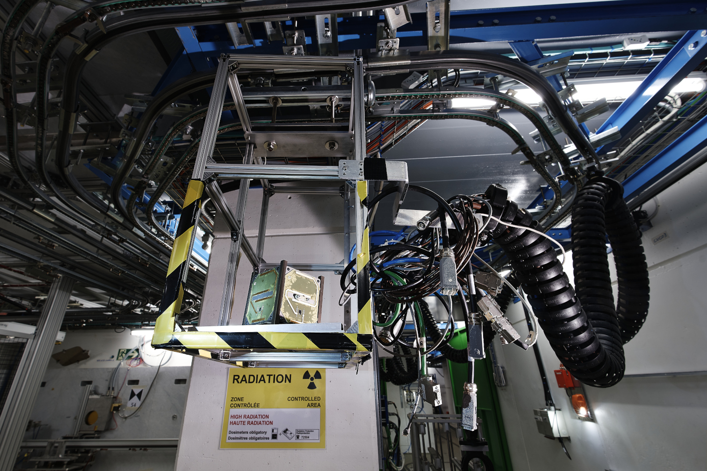
Thanks for your attention!
Image Source: CERN

