Slide 1
Brief introduction on
WP4.4 related study at USTC
Ming Shao

Slide 2
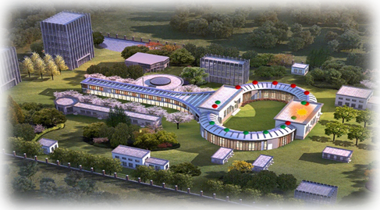
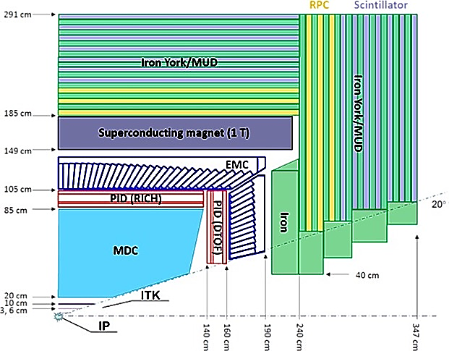
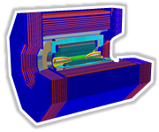

STCF PID system
Super Tau Charm Facility (STCF)
Damping Ring
150 m
Collier Rings
800-1000 m
A factory producing massive tau lepton and hadrons, to unravel the mystery of how quarks form matter and the symmetries of fundamental interactions
Linear Accelerator
400 m
E_{cm}= 2-7 GeV，$ℒ>$ 0.5×10³⁵ cm⁻² s⁻¹
Cherenkov technology for STCF PID detector
Polar angle coverage ~22°-36° (endcap), ~34°-90° (barrel)
π/K separation (4σ) for p<2GeV/c
400kHz physics event rate
Candidate technology: DTOF
Large area fused silica radiator
Multi-anode MCP-PMT
~15ps timing ASIC
Minimal material budget

Slide 3
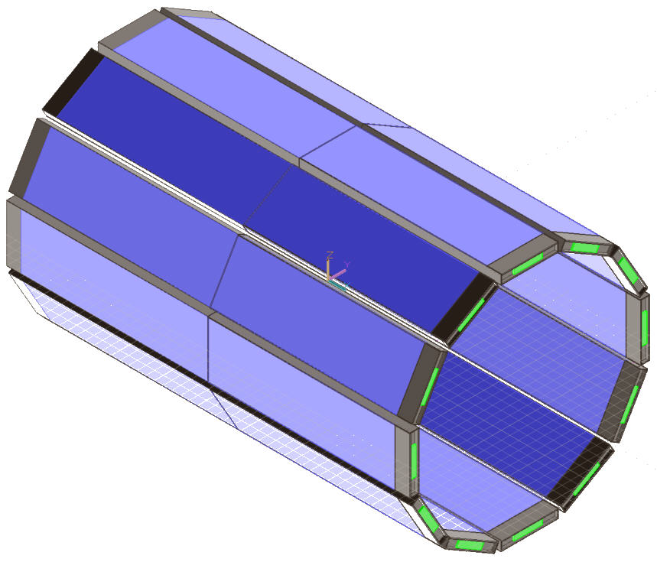
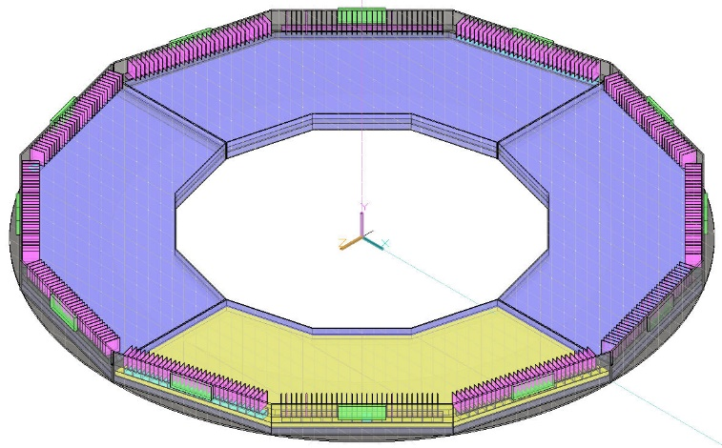
DTOF R&D related to WP4.4.3
Requirements:
  Overall material budget <0.3 X₀, as low as possible
  Fit in the limited space between tracker and ECAL
Plan:
  1st-version design (C fiber, Al honeycomb), 2024
  Prototyping & optimization, 2025
  Final design, 2026
Light-weight mechanical structure
Endcap PID
DIRC+TOF=DTOF
Barrel PID (DTOF option)
Plan to join LHCb-TORCH group (Technical Associateship)
→ Contribute to detector/electronics/mechanical etc.

Slide 4
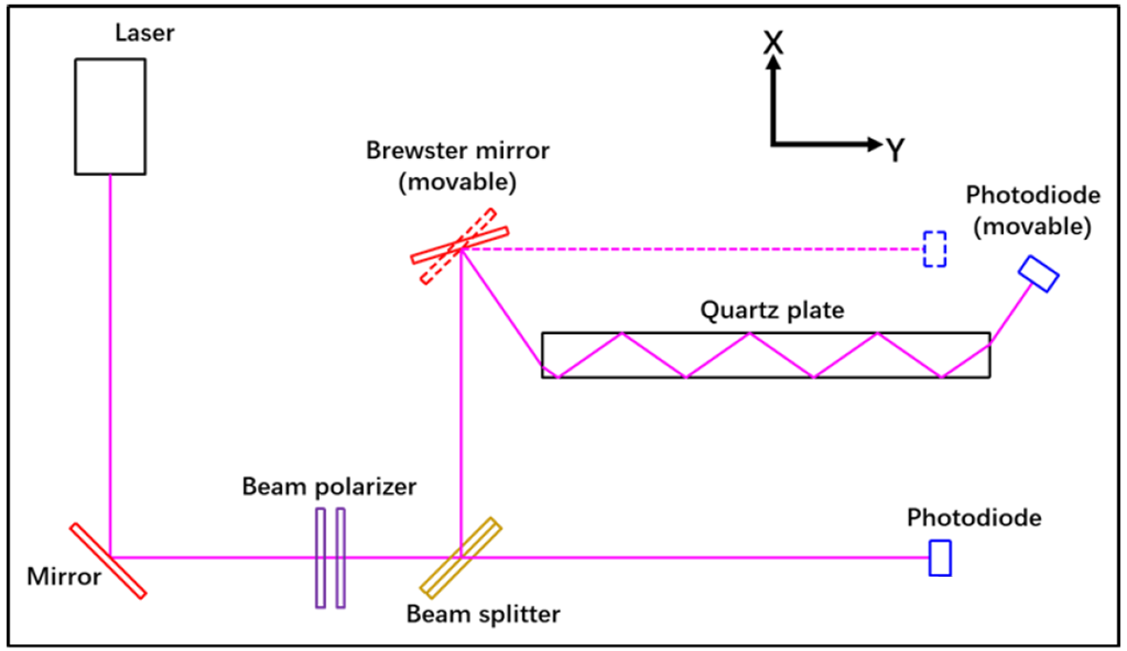
DTOF R&D related to WP4.4.4
Optical characterization of fused silica
Requirements
  Roughness <1nm (reflectivity, error <0.1%)
  Absorption length >100m, ±10% (λ>300nm)
Method
  Measuring laser intensity change after crossing fused silica
Plan
  Setup optical test stand in dark room, 2024~2025
  Test fused silica plates for endcap and barrel DTOF prototype, 2025-2026

Slide 5
Thank you!

