Slide 1





Muon Collider
D. Schulte
On behalf of the International Muon Collider Collaboration
Bonn, October 2024
This project has received funding from the European Union’s Research and Innovation programme under GAs No 101094300 and No 101004730.

Slide 2
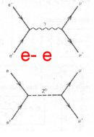
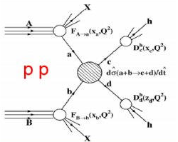
Physics Goals
Energy for discovery reach
10-14 TeV lepton collisions comparable to 100-200 TeV proton collisions
Leptons make the full energy available for particle production, protons only a fraction
Theorists defined goals:
Yields constant number of events in the s-channel
Luminosity must increase as E_{cm}² as production cross sections decrease
2

Slide 3
High-energy Colliders
accelerating cavities
Electron-positron rings are multi-pass colliders limited by synchrotron radiation: LEP, FCC-ee, CEPC
Hence proton rings are energy frontier: LHC, FCC-hh, SppC
N
N
S
S
Electron-positron linear colliders avoid synchrotron radiation, but single pass: SLC, ILC, CLIC
Typically cost proportional to energy and power proportional to luminosity,
Novel approach: muon collider (the first of its kind)
Large mass suppresses synchrotron radiation => multi-pass
Fundamental particle requires less energy than protons
But lifetime at rest only 2.2 μs
Proportional to energy

Slide 4
Muon Collider Overview
Would be easy if the muons did not decay
Lifetime is τ = γ x 2.2 μs
Short, intense proton bunch
Ionisation cooling of muon in matter
Acceleration to collision energy
Collision
Protons produce pions which decay into muons
muons are captured
4

Slide 5
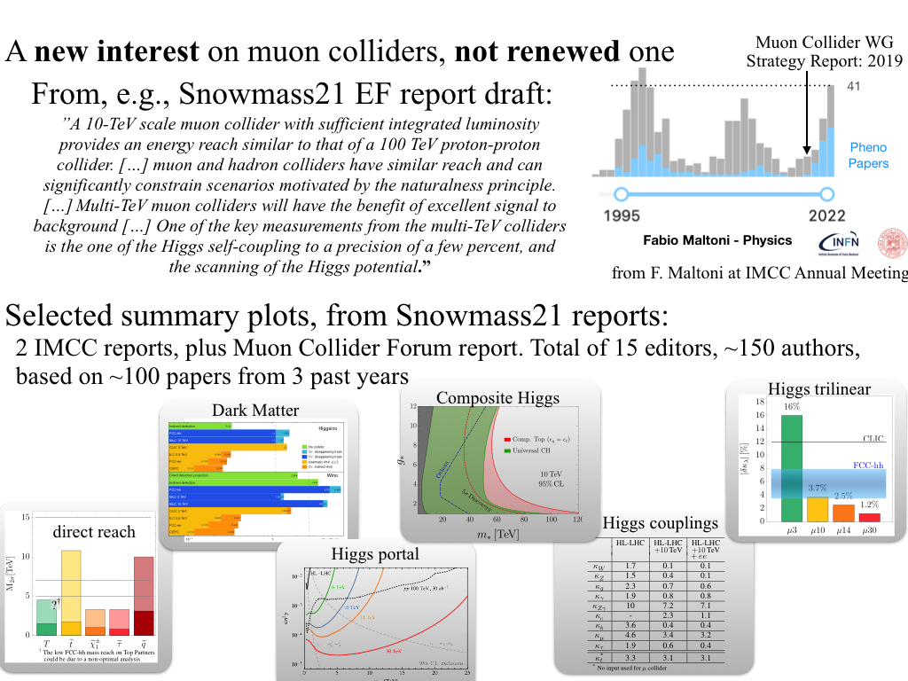
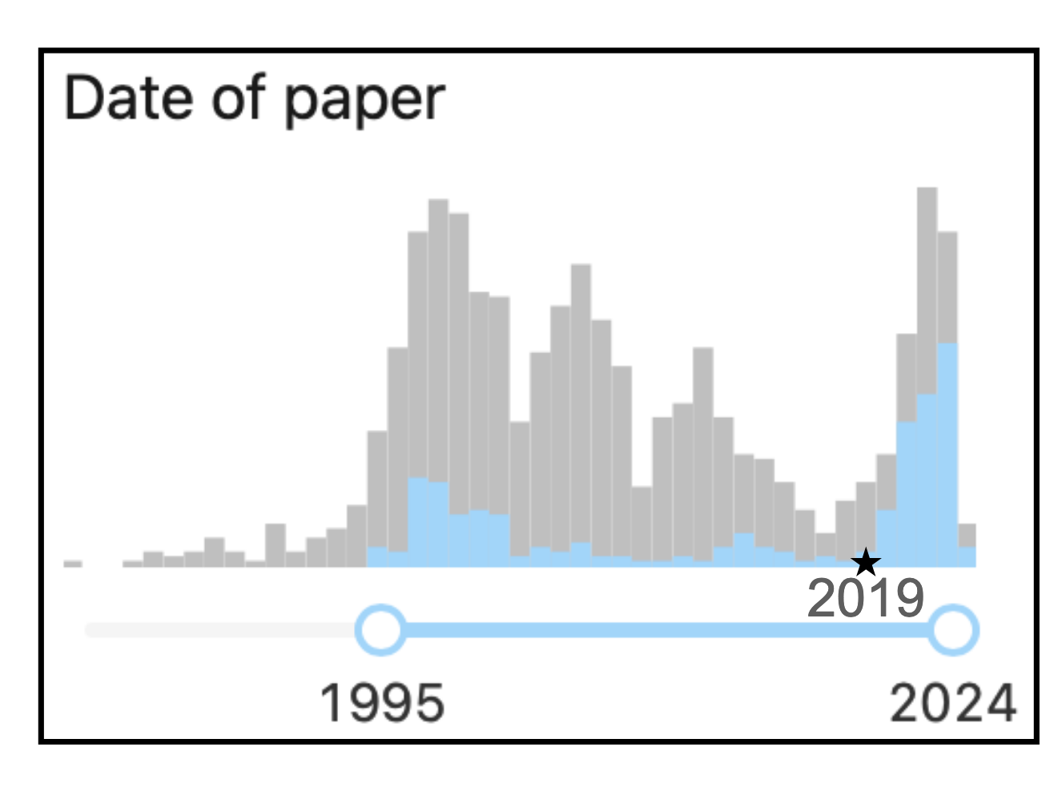
A new Interest in Muon Colliders
A. Wulzer, F. Maltoni, P. Meade et al.
O(150) authors, 15 editors, 100 papers
DELPHES card available

Slide 6
Muon Collider Promises
US Snowmass Implementation Task Force: Th. Roser, R. Brinkmann, S. Cousineau, D. Denisov, S. Gessner, S. Gourlay, Ph. Lebrun, M. Narain, K. Oide, T. Raubenheimer, J. Seeman, V. Shiltsev, J. Straight, M. Turner, L. Wang et al.
 | CME [TeV] | Lumi per IP [10³⁴cm⁻²s⁻¹] | Years to physics | Cost range [B$] | Power [MW]
FCC-ee | 0.24 | 8.5 | 13-18 | 12-18 | 290
ILC | 0.25 | 2.7 | <12 | 7-12 | 140
CLIC | 0.38 | 2.3 | 13-18 | 7-12 | 110
ILC | 3 | 6.1 | 19-24 | 18-30 | 400
CLIC | 3 | 5.9 | 19-24 | 18-30 | 550
MC | 3 | 1.8 | 19-24 | 7-12 | 230
MC | 10 | 20 | >25 | 12-18 | 300
FCC-hh | 100 | 30 | >25 | 30-50 | 560
Judgement by ITF, take it cum grano salis
6

Slide 7
IMCC Goals
Develop high-energy muon collider as option for particle physics:
Muon collider promises sustainable approach to the energy frontier
  limited power consumption, cost and land use
Technology and design advances in past years
Reviews in Europe and US found no unsurmountable obstacle
Accelerator R&D Roadmap identifies the required work
Has been developed with the global community
Goals are
Assess and develop the muon collider concept for a O(10 TeV) facility
Identify potential sites to implement the collider
Develop an initial muon collider stage that can start operation around 2050
Develop an R&D roadmap toward the collider
IMCC: International Muon Collider Collaboration
http://arxiv.org/abs/2201.07895
7

Slide 8
Muon Collider Community
CERN-hosted collaboration
EU Design Study helped to kick-start collaboration
(since March 2023, EU+Switzerland+UK and partners)
EU support also helps with funding in institutes
O(70) partners, 60+ already signed MoC
Increase resources of partners with other funding requests:
Submit to HORIZON-INFRA-2024-TECH
  Focus on magnet technologies
National funding agencies
Looking for new partners
In particular US
But also other regions

Slide 9
IMCC Partners
IT | INFN
 | INFN, Univ., Polit. Torino
 | INFN, Univ. Milano
 | INFN, Univ. Padova
 | INFN, Univ. Pavia
 | INFN, Univ. Bologna
 | INFN Trieste
 | INFN, Univ. Bari
 | INFN, Univ. Roma 1
 | ENEA
 | INFN Frascati
 | INFN, Univ. Ferrara
 | INFN, Univ. Roma 3
 | INFN Legnaro
 | INFN, Univ. Milano Bicocca
 | INFN Genova
 | INFN Laboratori del Sud
 | INFN Napoli
Mal | Univ. of Malta
EST | Tartu University
SE | ESS
 | University of Uppsala
PT | LIP
NL | University of Twente
FI | Tampere University
LAT | Riga Technical University
CH | PSI
 | University of Geneva
 | EPFL
BE | Univ. Louvain
AU | HEPHY
 | TU Wien
ES | I3M
 | CIEMAT
 | ICMAB
China | Sun Yat-sen University
 | IHEP
 | Peking University
KO | KEU
 | Yonsei University
IEIO | CERN
FR | CEA-IRFU
 | CNRS-LNCMI
DE | DESY
 | Technical University of Darmstadt
 | University of Rostock
 | KIT
UK | RAL
 | UK Research and Innovation
 | University of Lancaster
 | University of Southampton
 | University of Strathclyde
 | University of Sussex
 | Imperial College London
 | Royal Holloway
 | University of Huddersfield
 | University of Oxford
 | University of Warwick
 | University of Durham
US | Iowa State University
 | University of Iowa
 | Wisconsin-Madison
 | University of Pittsburgh
 | Old Dominion
 | Chicago University
 | Florida State University
 | RICE University
 | Tennessee University
 | MIT Plasma science center
 | Pittsburgh PAC
India | CHEP
US | FNAL
 | LBL
 | JLAB
 | BNL
9

Slide 10

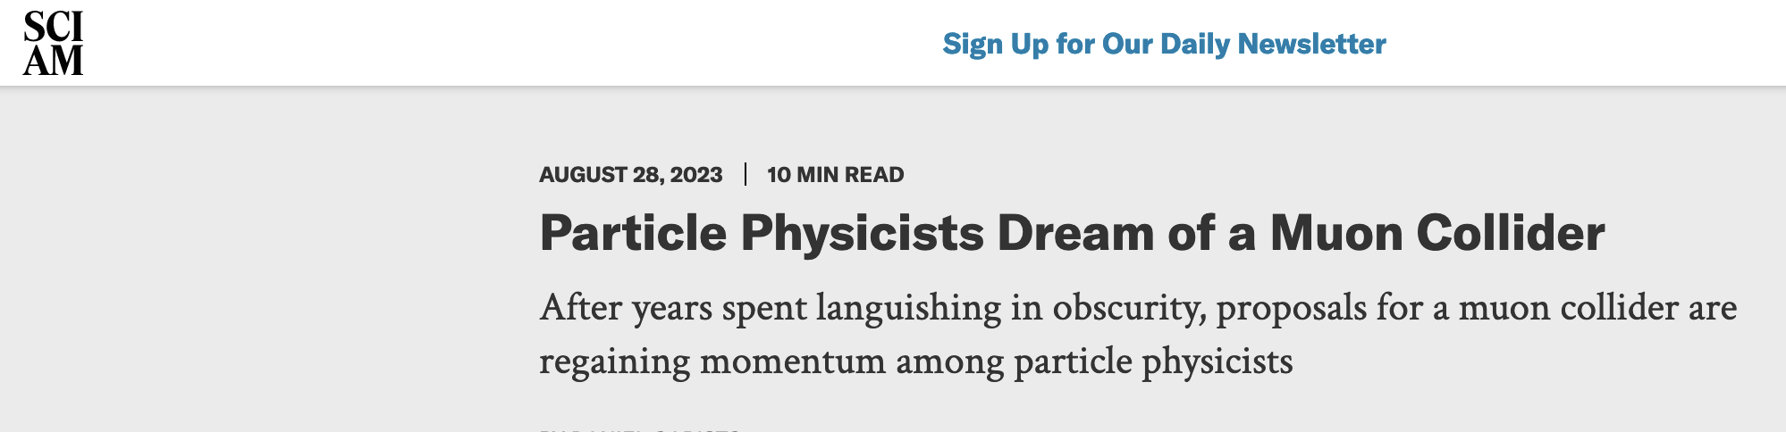
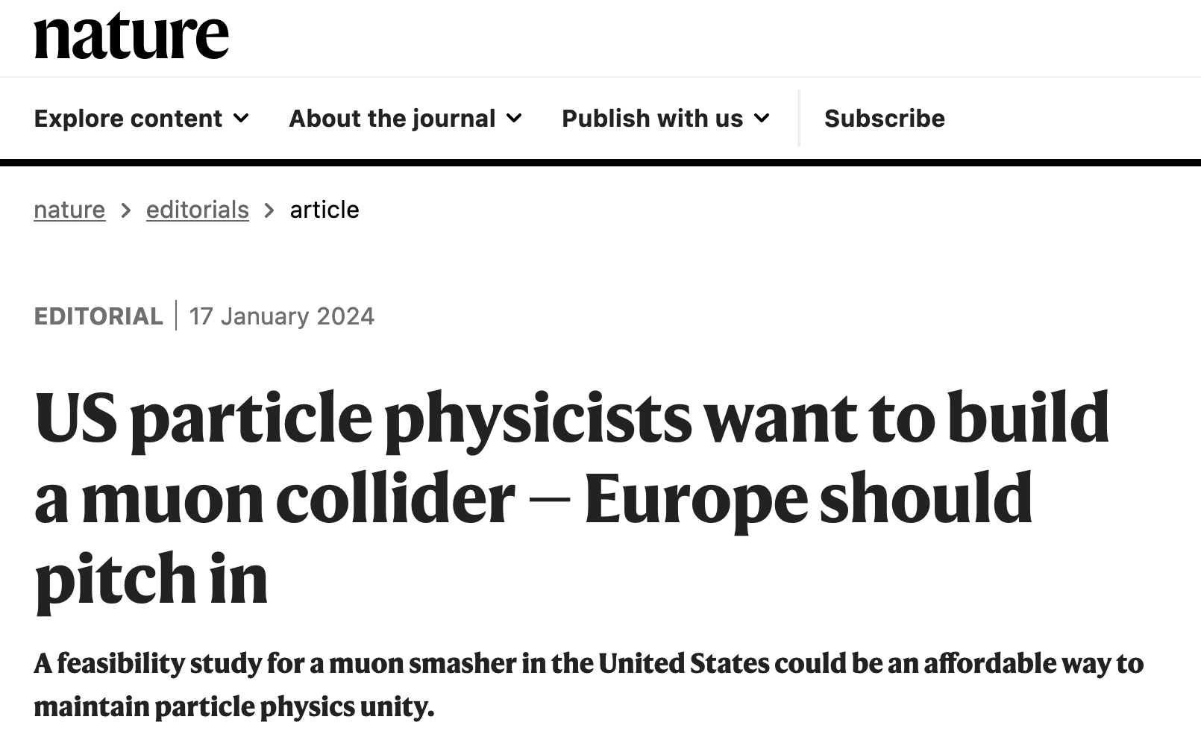
US P5: The Muon Shot
Particle Physics Project Prioritisation Panel (P5) endorses muon collider R&D: ”This is our muon shot”
Recommend joining the IMCC
Consider FNAL as a host candidate
US is already particpating to the collaboration
US ambition:
Want to reach a 10 TeV parton level collisions
Timeline around 2050
Fermilab option for demonstator and hosting
Reference design in a “few” years
Informal discussion with DoE (Regina Rameika, A. Patwa):
DoE wants to maintain IMCC as a global collaboration
Addendum to CERN-DoE-NSF agreement is in preparation
IMCC prepares options for Europe and for the US in parallel
10

Slide 11
Tentative Staged Target Parameters
Parameter | Unit | 3 TeV | 10 TeV | 10 TeV | 10 TeV
L | 10³⁴ cm⁻²s⁻¹ | 1.8 | 20 | tbd | 13
N | 10¹² | 2.2 | 1.8 | 1.8 | 1.8
f_{r} | Hz | 5 | 5 | 5 | 5
P_{beam} | MW | 5.3 | 14.4 | 14.4 | 14.4
C | km | 4.5 | 10 | 15 | 15
<B> | T | 7 | 10.5 | 7 | 7
ε_{L} | MeV m | 7.5 | 7.5 | 7.5 | 7.5
σ_{E} / E | % | 0.1 | 0.1 | tbd | 0.1
σ_{z} | mm | 5 | 1.5 | tbd | 1.5
β | mm | 5 | 1.5 | tbd | 1.5
ε | μm | 25 | 25 | 25 | 25
σ_{x,y} | μm | 3.0 | 0.9 | 1.3 | 0.9
Target integrated luminosities
Need to spell out scenarios
Need to integrate potential performance limitations for technical risk, cost, power, …
Example as discussion basis
numbers will change
11

Slide 12
Muon Collider Luminosity Scaling
Fundamental limitation
Requires emittance preservation and advanced lattice design
Applies to MAP scheme
High beam power
High energy
Large energy acceptance
Dense beam
High field in collider ring
Luminosity per power increases with energy
Provided technologies can be made available
Constant current for required luminosity scaling

Slide 13
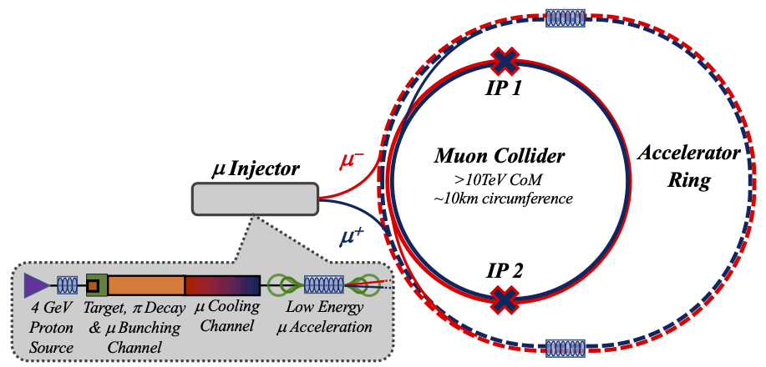
Key Challenges
0) Physics case
4) Drives the beam quality
MAP put much effort in design
optimise as much as possible
2) Beam-induced background
1) Dense neutrino flux
mitigated by mover system and site selection
3) Cost and power consumption limit energy reach
e.g. 35 km accelerator for 10 TeV, 10 km collider ring
Also impacts beam quality
13

Slide 14
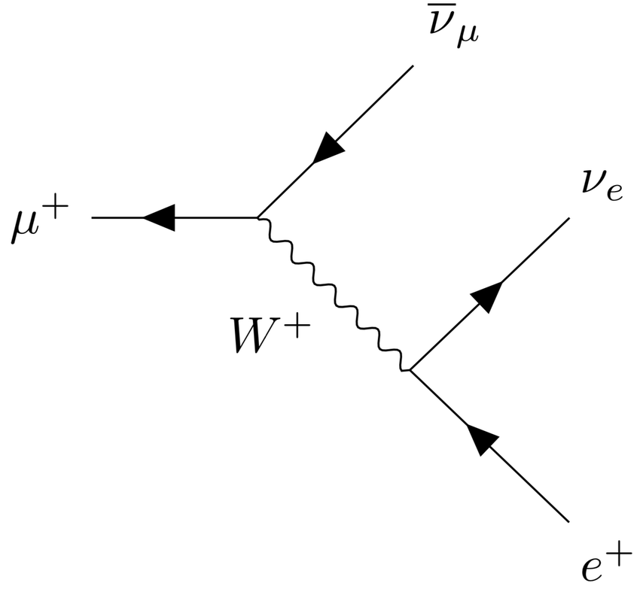
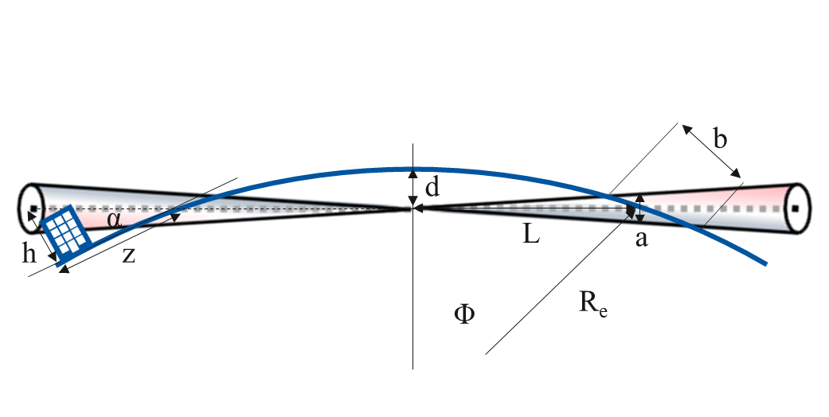
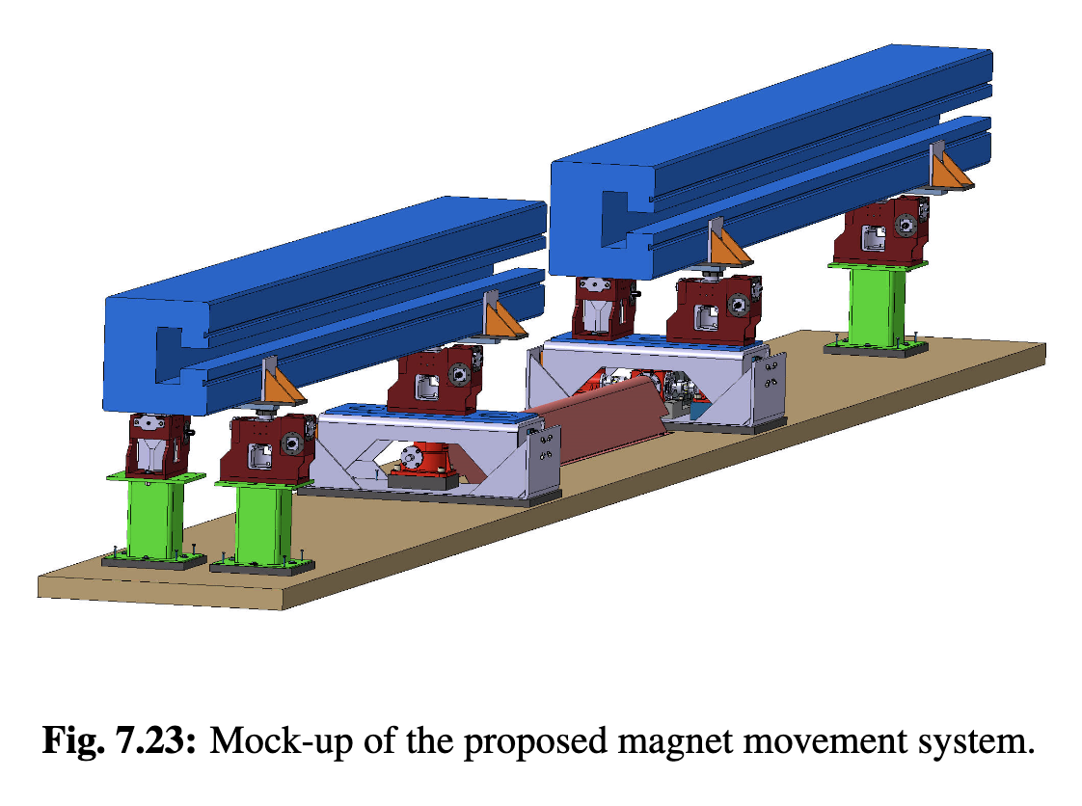
Muon Decay and Neutrino Flux
Muon decays in collider ring
Impact on detector, see Daniele
Have to avoid dense neutrino flux
Aim for negligible impact from arcs
Similar impact as LHC
At 3 TeV this is the case for 200 m depth
At 10 TeV go from acceptable to negligible with mover system
  Mockup of mover system planned
  Impact on beam to be checked
Impact of experimental insertions
3 TeV design acceptable with no further work
But better acquire land in direction of experiment, also for 10 TeV
t₁
t₂

Slide 15
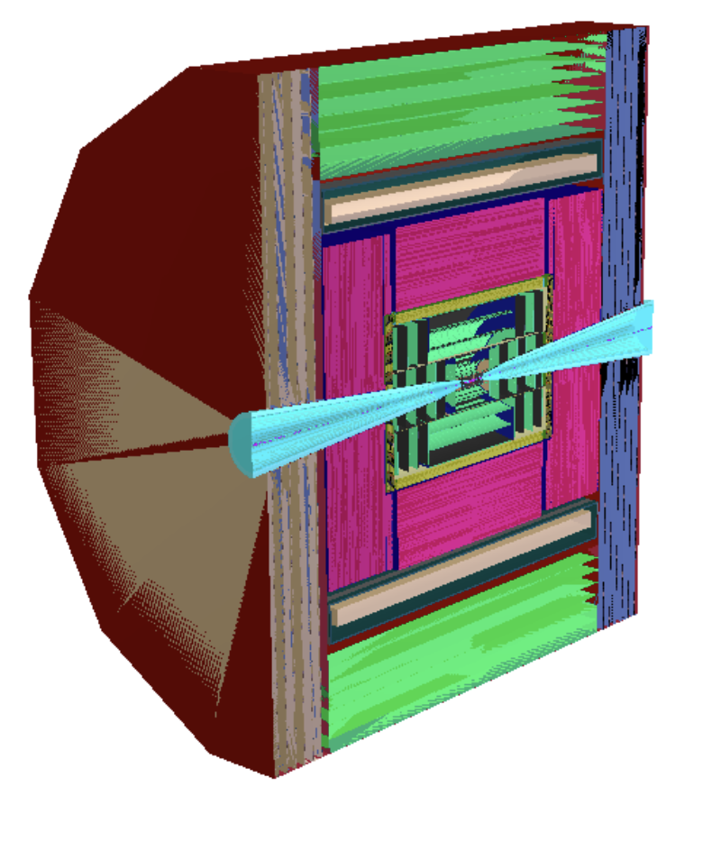
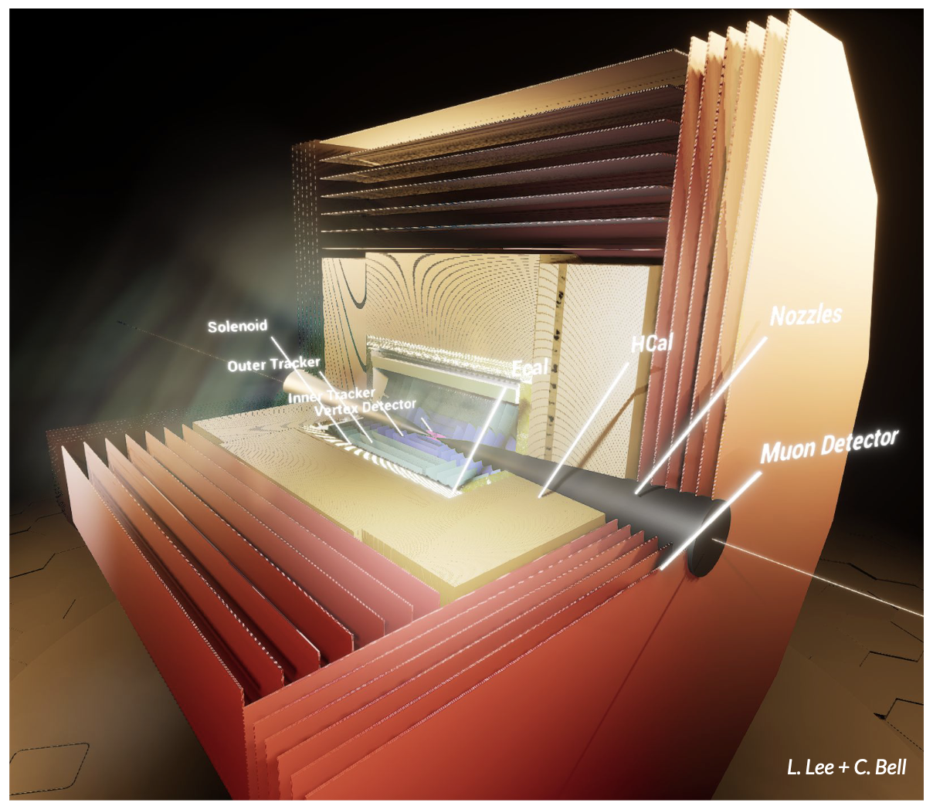
Physics and Detector Concepts
Two detector concepts are being developed
MUSIC
(MUon Smasher for Interesting Collisions)
MAIA
(Muon Accelerator Instrumented Aperatus)

Slide 16
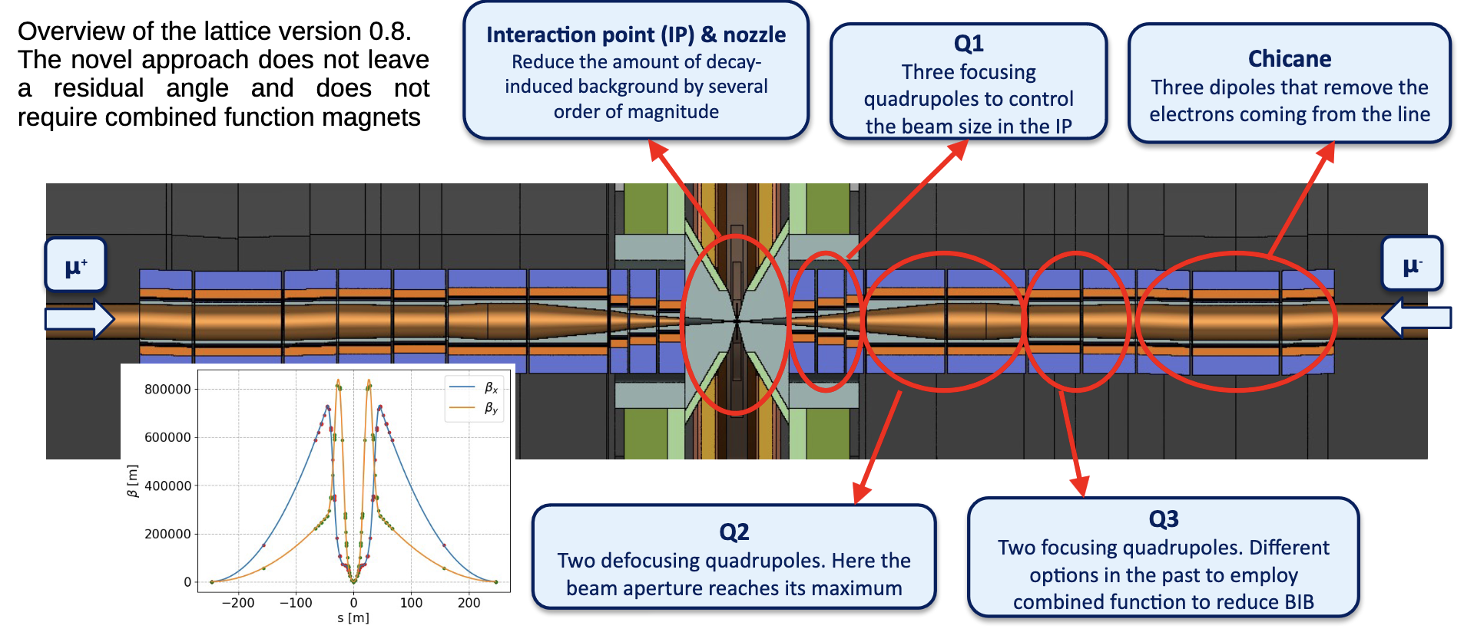
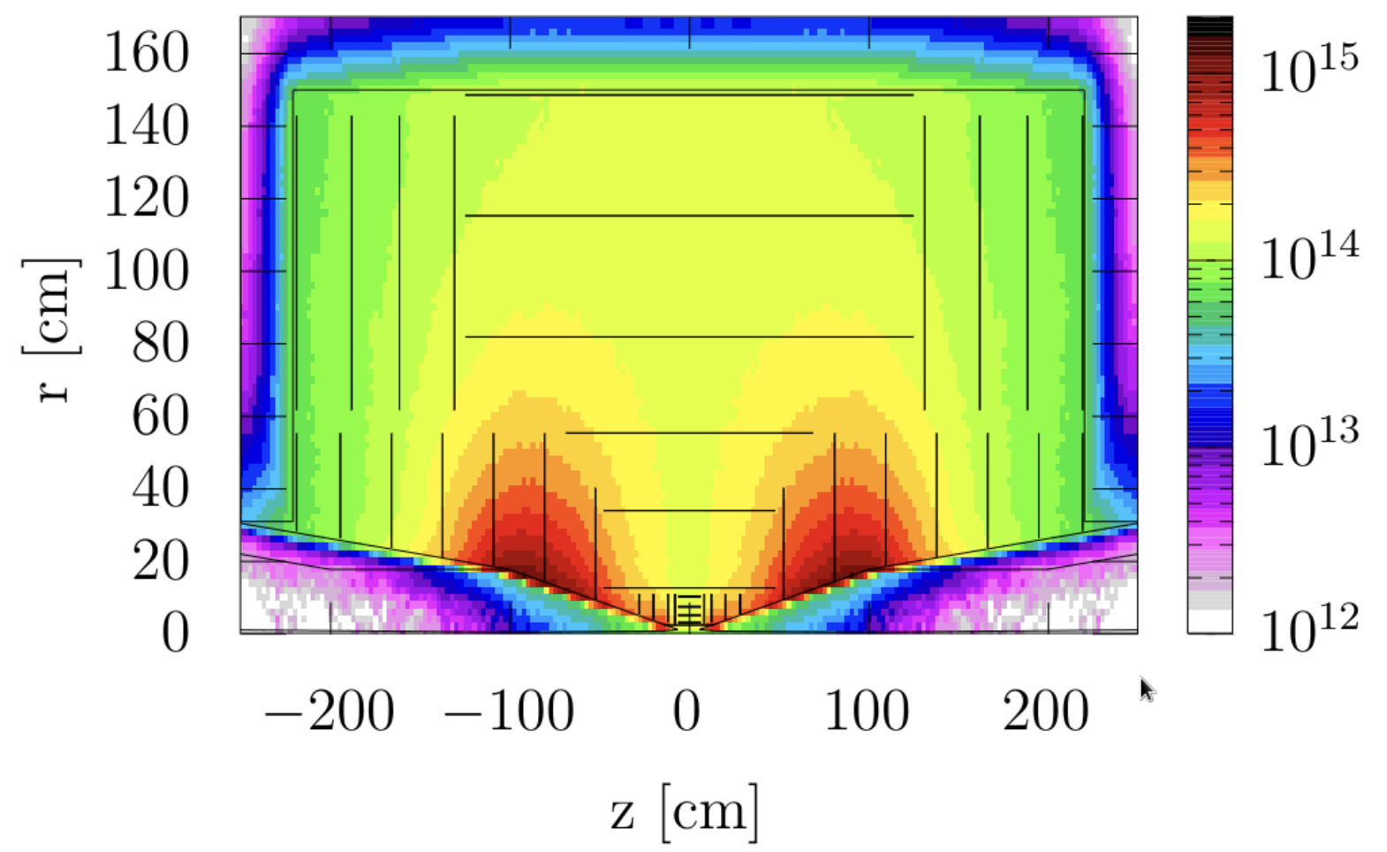
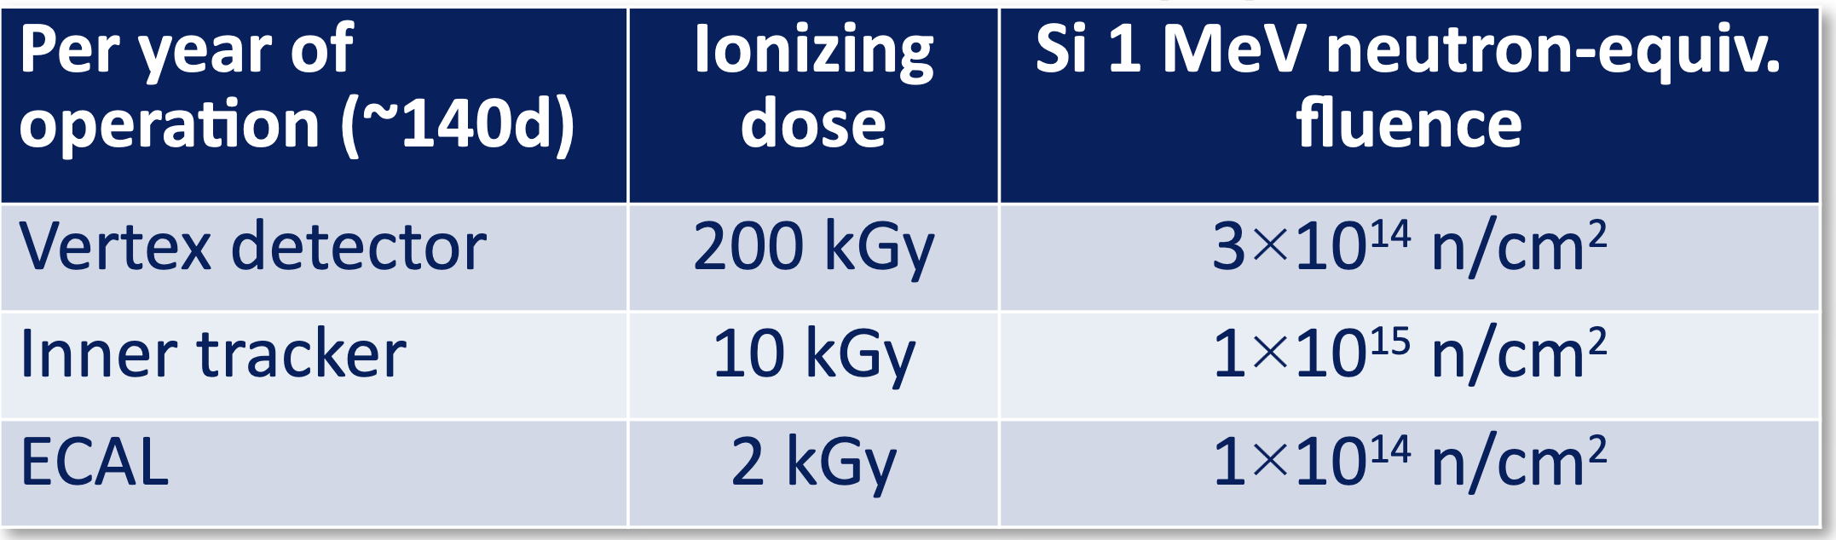
Beam-induced Background
Muon decay is dominant
Incoherent pairs is significant in inner layers
Synchrotron radiation does not matter much
Muon loss remains to be studied with source terms
Coherent and trident cascade pairs expected not important
Detailed studies with FLUKA

Slide 17
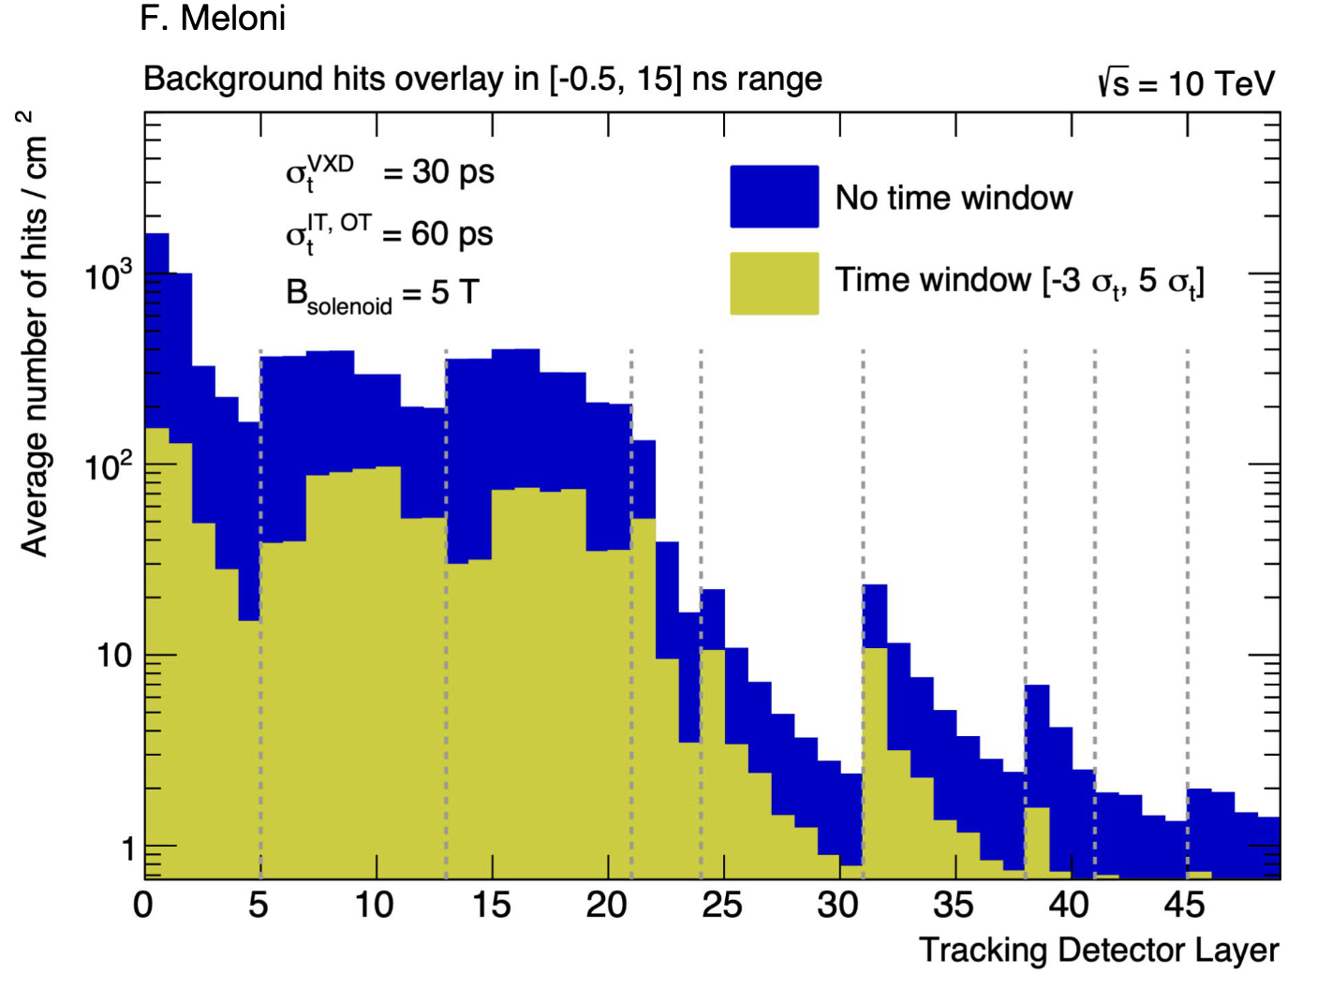
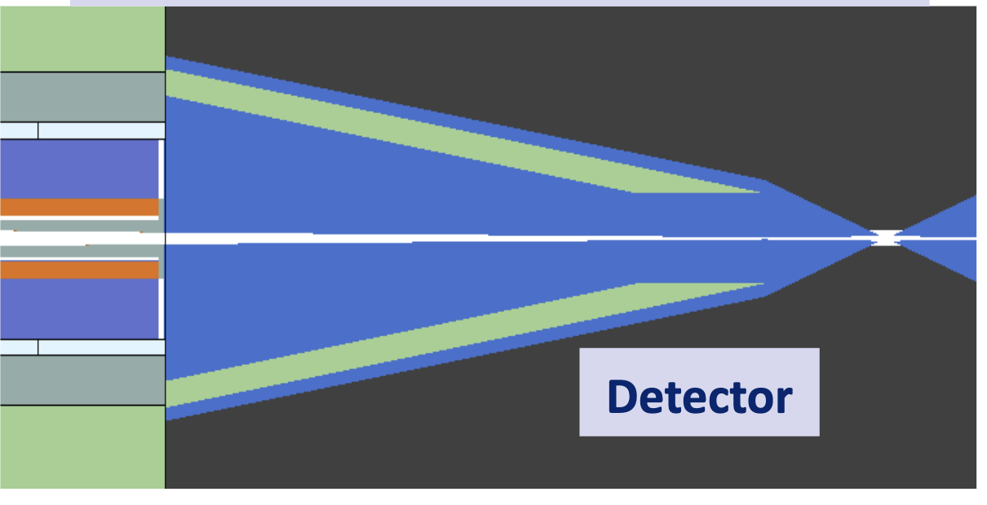
Beam-induced Background
Studies at 3 TeV showed that physics measurements can be done
But improvement potential exists
Studies at 10 TeV are starting
Background is reduced using timing and directional information
Optimisation of mask is ongoing
Background has impact on reconstruction efficiencies

Slide 18
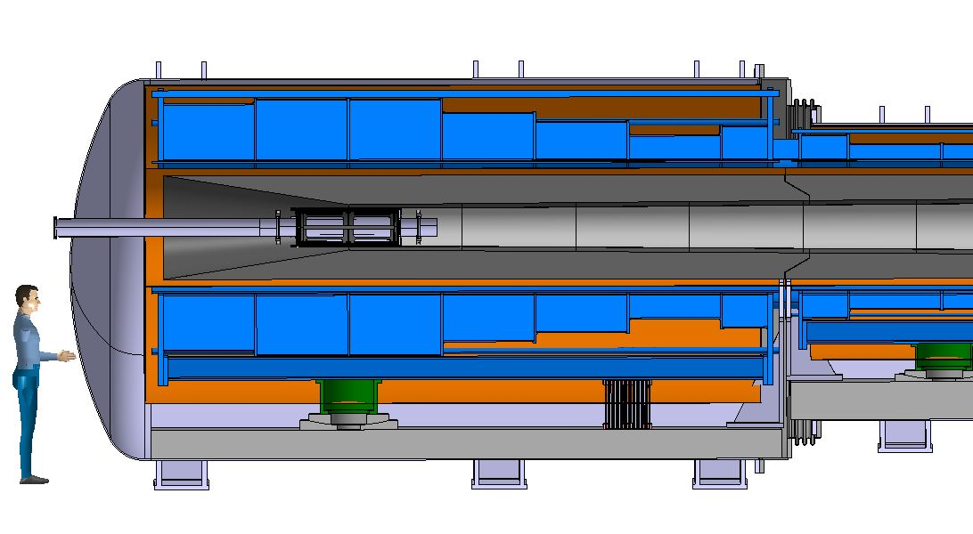
Proton Complex and Target
in target
decay
protons
pions
muons
400 kJ protons to produce 5 x 10¹³ captured muon pairs
5 GeV proton beam, 2 MW = 400 kJ x 5 Hz
Power is at hand
ESS and Uppsala will focus on merging beam into high-charge pulses
Optimisation of parameters planned
Graphite Target
20 T solenoid
to guide pions and muons
Tungsten shielding
To protect magnet

Slide 19
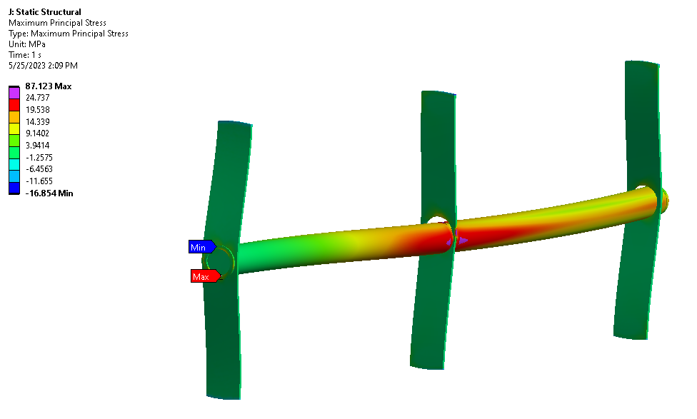
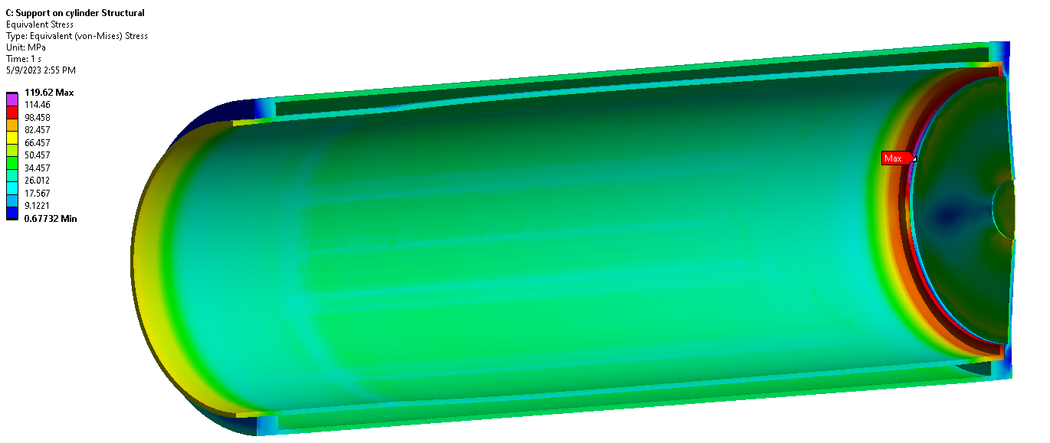
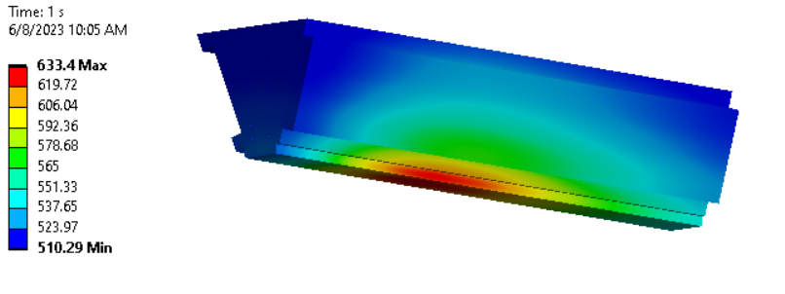
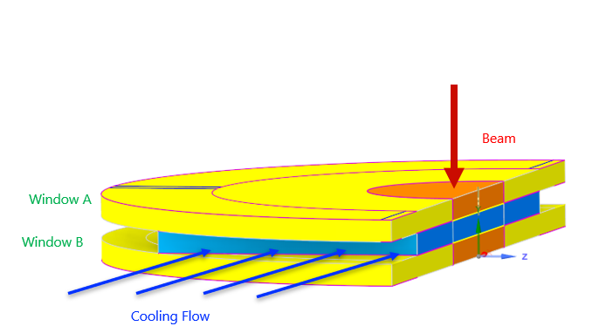
Target Design
2 MW, 5 x 10¹⁴ protons/pulse, 5 GeV (0.4 MJ), 5 Hz
graphite rod with 15 mm radius
Started studying alternative 4 MW target
Graphite
or liquid lead
or fluidised tungsten
CNGS
Target
Vessel
Tunsten shielding
Window
Liquid metal (and fluidised tungsten) as alternative
Collaboration w. ENEA
CNGS target
3.5 x 10¹³ protons/pulse, 400 GeV (2.2 MJ), 1/6 Hz
A. Lechner, D. et al.

Slide 20
Final Cooling Principle
High field solenoids minimise beta-function and impact of multiple scattering
Energy loss = cooling
Multiple scattering = heating

Slide 21
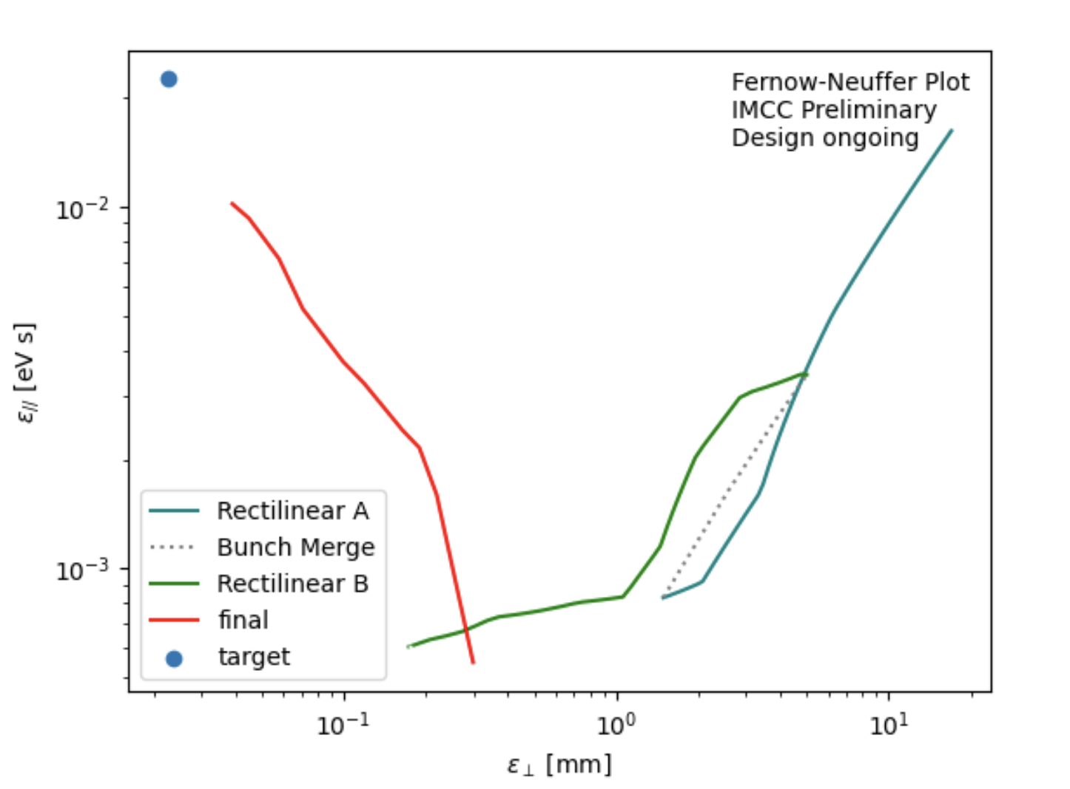
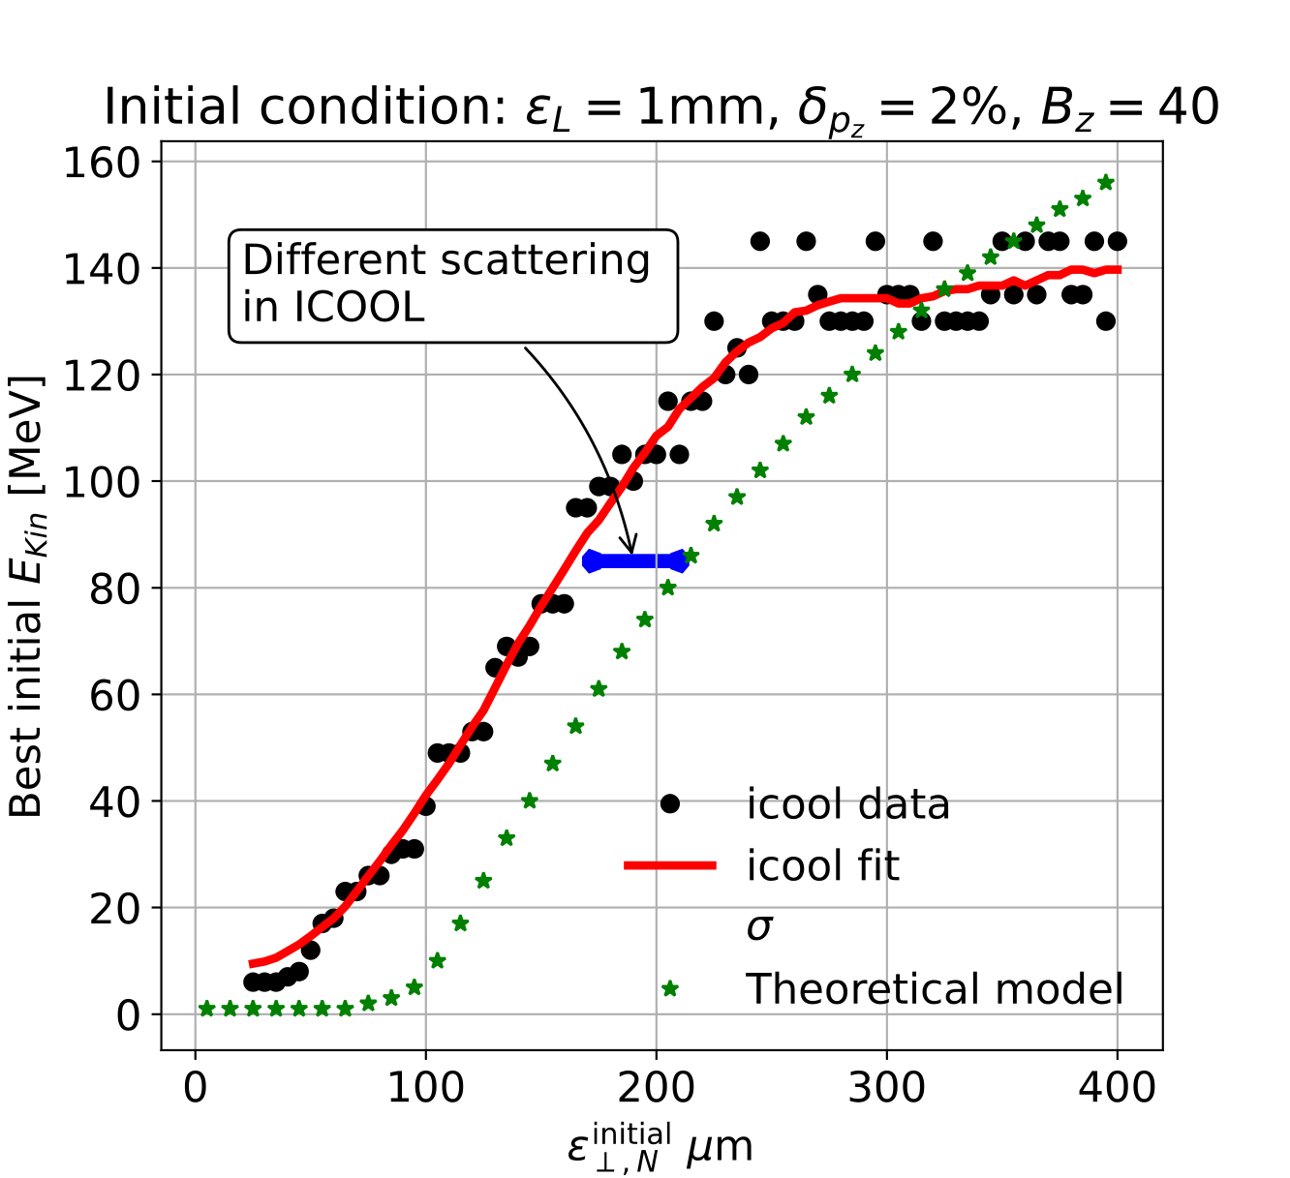
Muon Cooling Performance
MAP design achieved 55 um based on achieved fields (28 T)
Currently in 24-30 um range (goal 22.5 um)
In one design longitudinal emittance much better than target
  But field in one solenoid is 50 T
Need about 50% more muons
  Can improve transmission (most losses due to beam dynamics)
  or more initial muons (4 MW target yields 90% more muons, but have to deal with more beamloading)
Older design
B. Stechauner at al.
better
Identification of optimum energy for cooling as function of emittance
better
Ch. Rogers, Zhu Ruihu, R. Taylor, B. Stechauner, E. Vol, D.S. et al.

Slide 22
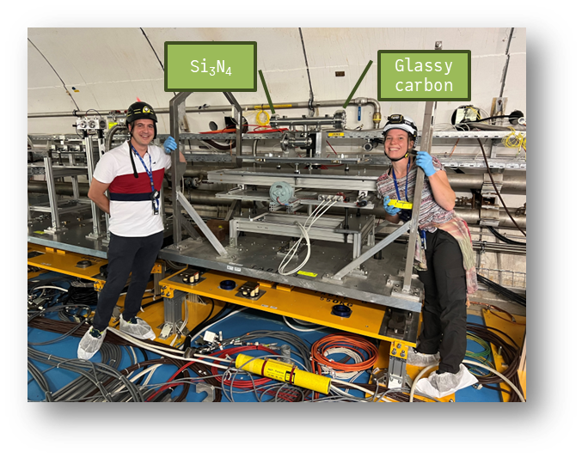
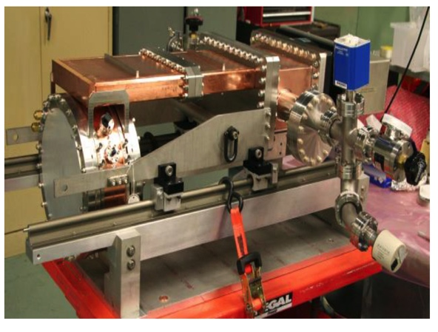
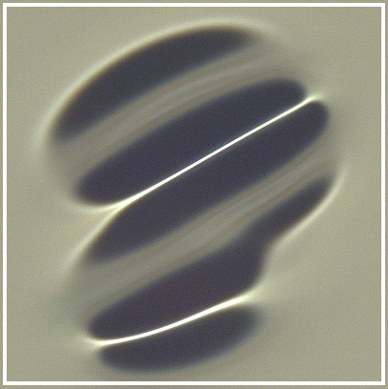
Cooling Cell Technology
Most complex example 12 T
Will develop example cooling cell with integration
tight constraints
additional technologies (absorbers, instrumentation,…)
early preparation of demonstrator facility
Windows and absorbers for high-density muon beam
Pressure rise mitigated by vacuum density
Tests in HiRadMat
L. Rossi et al. (INFN, Milano, STFC, CERN),
J. Ferreira Somoza et al.
RF cavities in magnetic field
MAP demonstrated higher than goal gradient
Improve design based on theoretical understanding
Preparation of new test stand, but needs funding
Test stand at CEA (700 MHz, need funding)
Test at other frequencies in the UK considered
Use of CLIC breakdown experiment considered
MuCool demonstrated >50 MV/m in 5 T
H2-filled copper
Be end caps
C. Marchand, Alexej Grudiev et al. (CEA, Milano, CERN, Tartu)
22

Slide 23

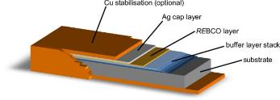
High-field Magnet Technology
Superconducting magnets reach highest fields, three main technologies for the cables
NbTi (niob-titanium, operating at 2-4 k)
is standard, used in LHC limited to O(8 T)
Nb₃Sn (niobium-tin, operating at 2-4 K)
Can reach O(16 T)
Difficult technology, needs to mature further
Expensive
Used in some points for HL-LHC
Foreseen for FCC-hh also in arcs
HTS (high-temperature superconductor, operating 20 K)
Different options exist, e.g. REBCO
In solenoids > 30 T demonstrated
Still expensive and technology challenges
Applications in other fields, e.g. medical, fusion reactors, power generators for wind energy, engines, …
Cut through a cable with superconductor embedded in copper, so some remains conductivity in case of a quench
REBCO Tape

Slide 24
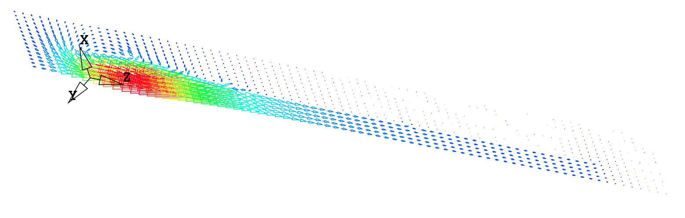
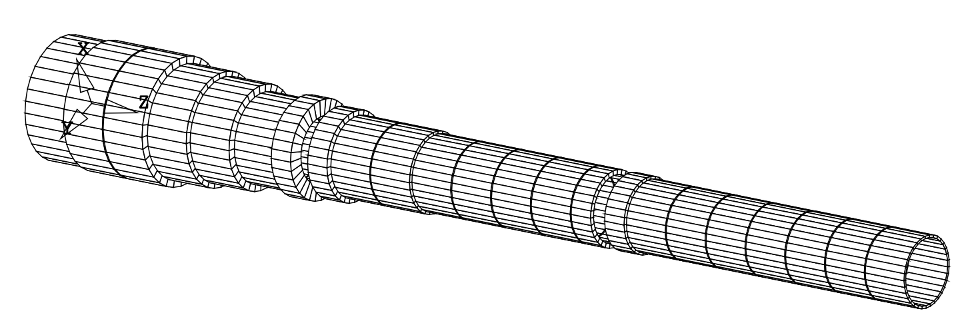
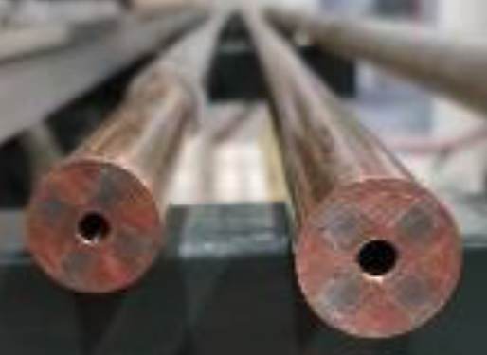
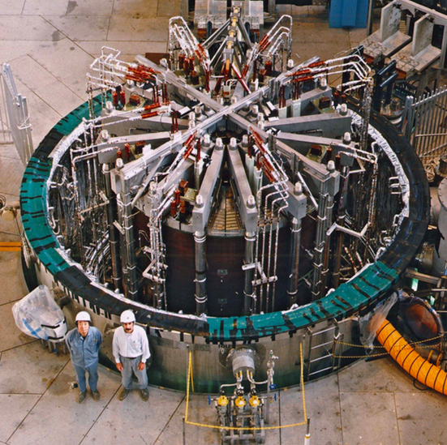

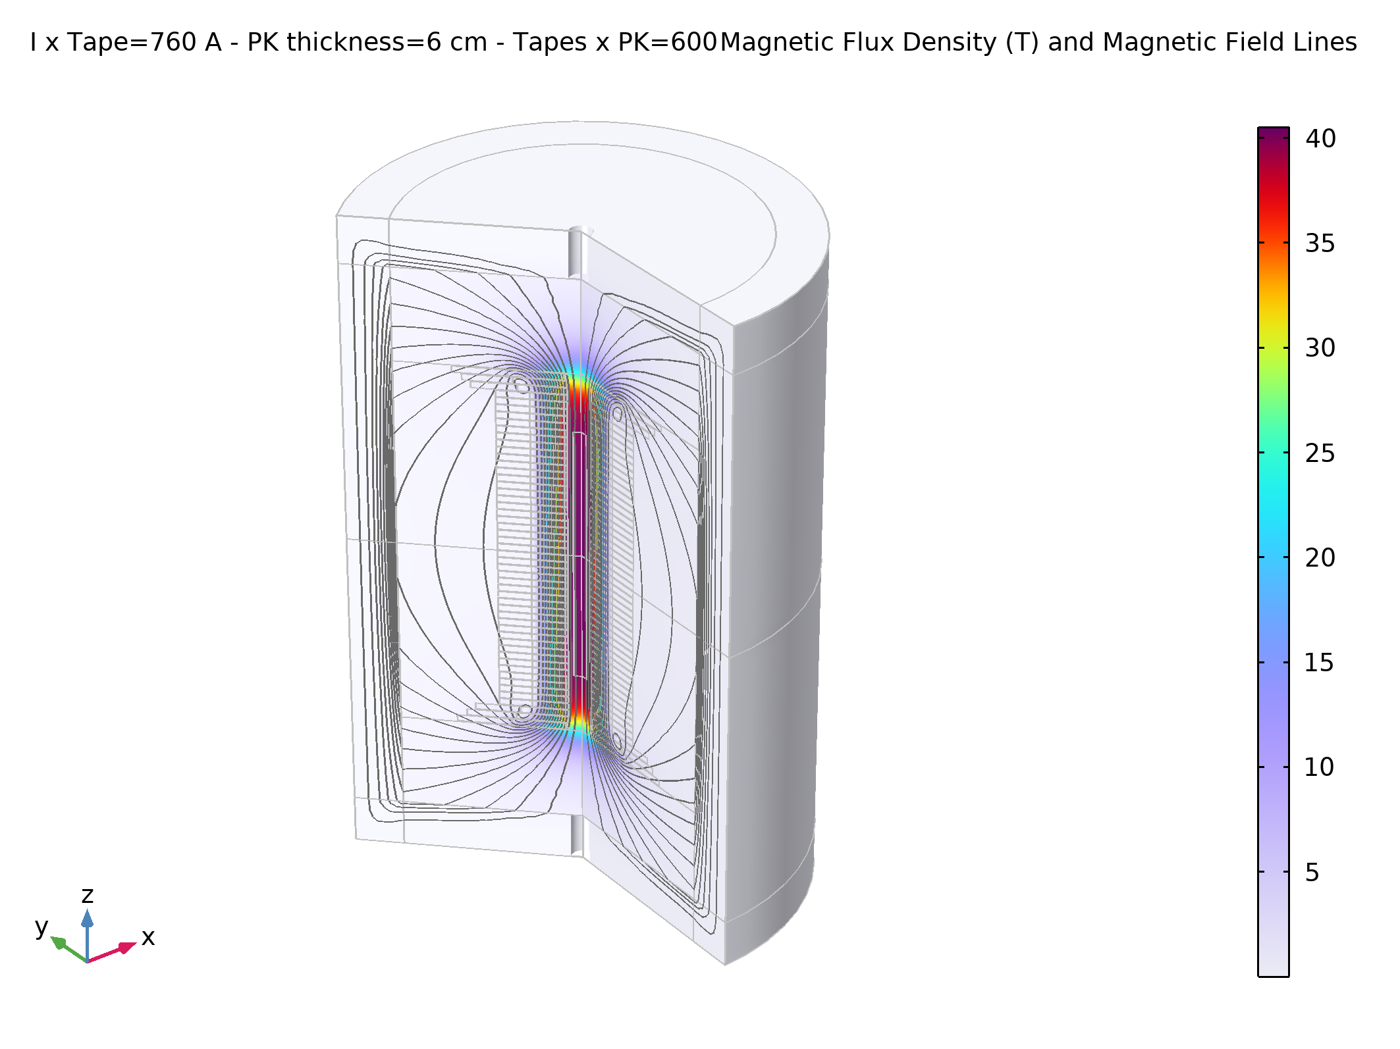
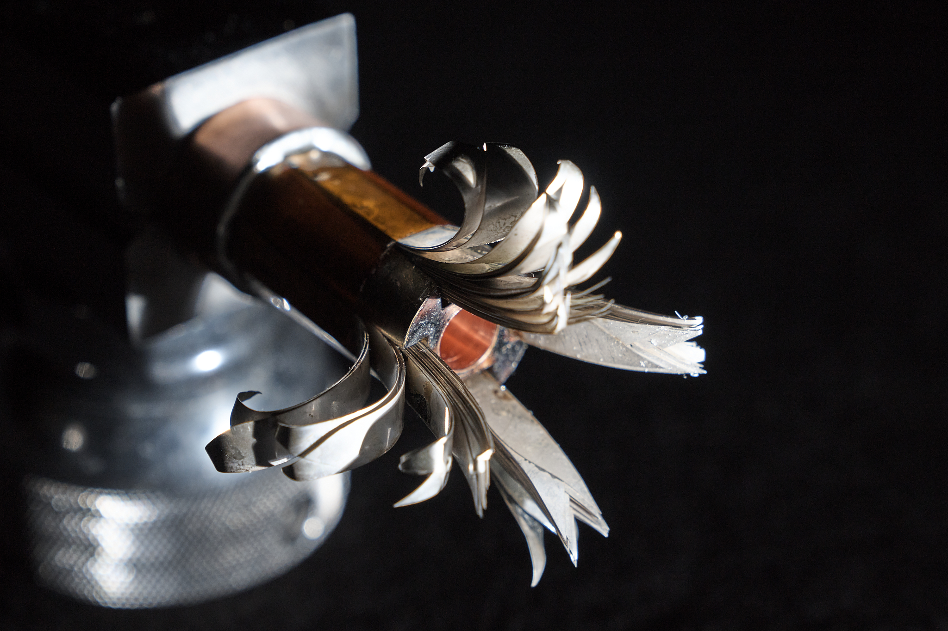
Solenoid R&D
Target solenoid, 20 T, 20 K
Started HTS solenoid development for high fields
Synergies with fusion reactors, NRI, power generators for windmills, …
15 T Nb₃Sn with 5 T resistive insert
Or 20 T HTS seems possible
Relevant for advanced fusion reactors
A Portone, P. Testoni, J. Lorenzo Gomez, F4E
Final Cooling solenoid
Goal 40 T
Estimation of limit
ITER Central Solenoid Model Coil
13 T in 1.7 m (LTS)
MIT “VIPER” conductor
NHFML
32 T solenoid with HTS
MuCol HTS conductor
Operating current: 61 kA

Slide 25
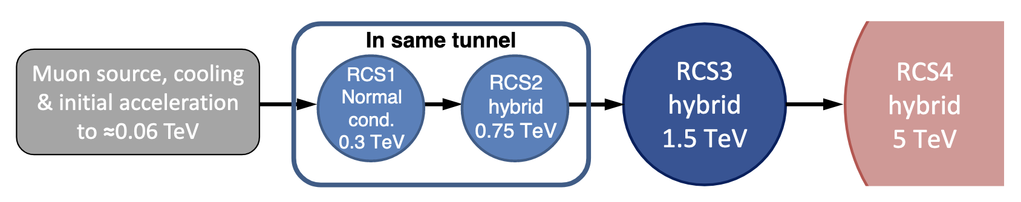
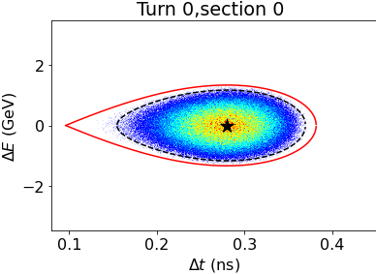
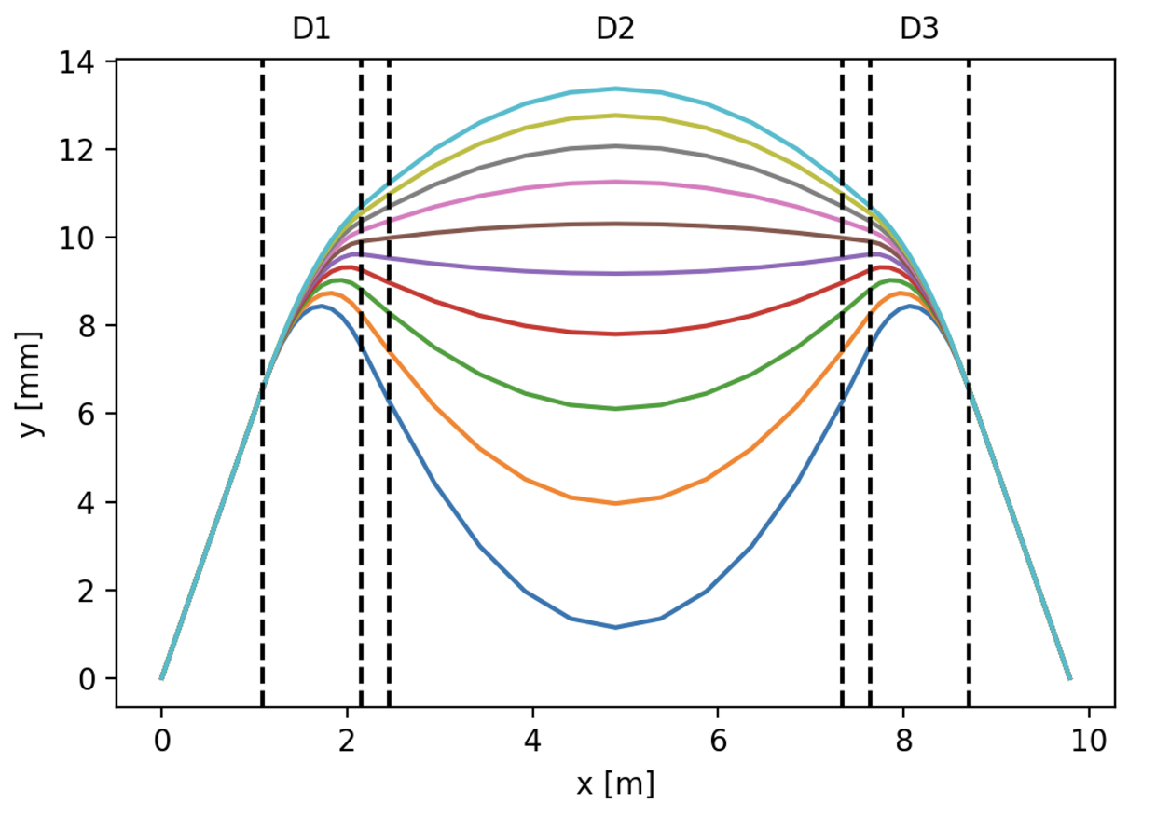
Acceleration Complex
Core is sequence of pulsed synchrotron (0.4-11 ms)
Alternative FFA
Long. Distribution assumed at injection in RCS1
Superconducting magnets
EMMA proof of FFA principle
Nature Physics 8, 243–247 (2012)
RF:
1.3 GHz cavities appear possible
in spite of high bunch charge
Lattice and integration: A. Chance et al. (CEA)
Long. dynamics and RF systems: H. Damerell, U. van Rienen, A. Grudiev et al. (Rostock, Milano, CERN)
Power converter: F. Boattini et al.
Magnets: L. Bottura et al. (LNCMI, Darmstadt, Bologna, Twente)
FFA: S. Machida et al. (RAL)
Lattice:
Hybrid design works
Can spread RF in the arcs
Fast-ramping magnets
25

Slide 26
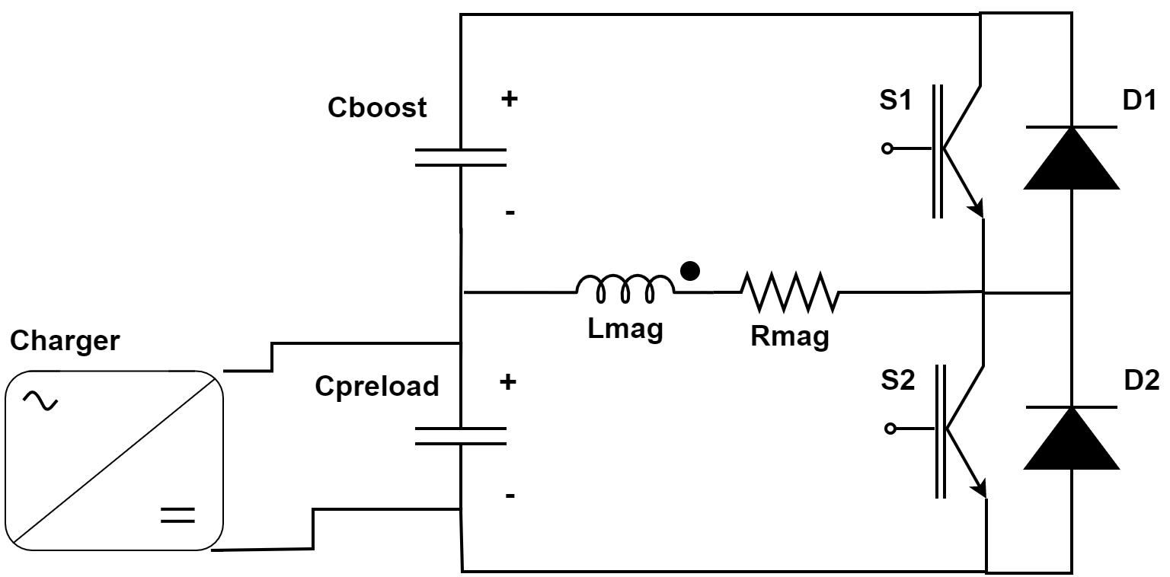
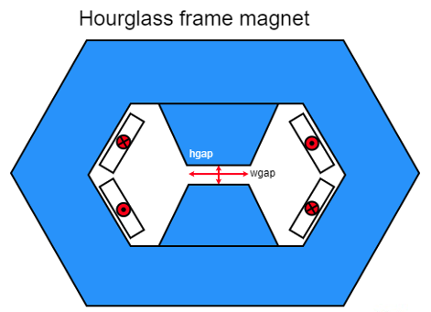
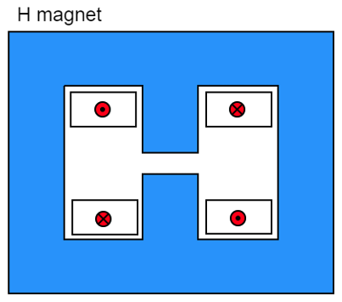
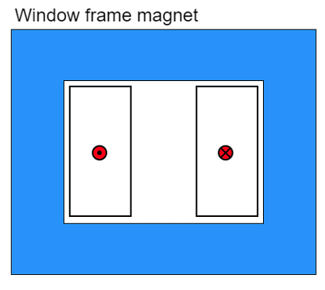
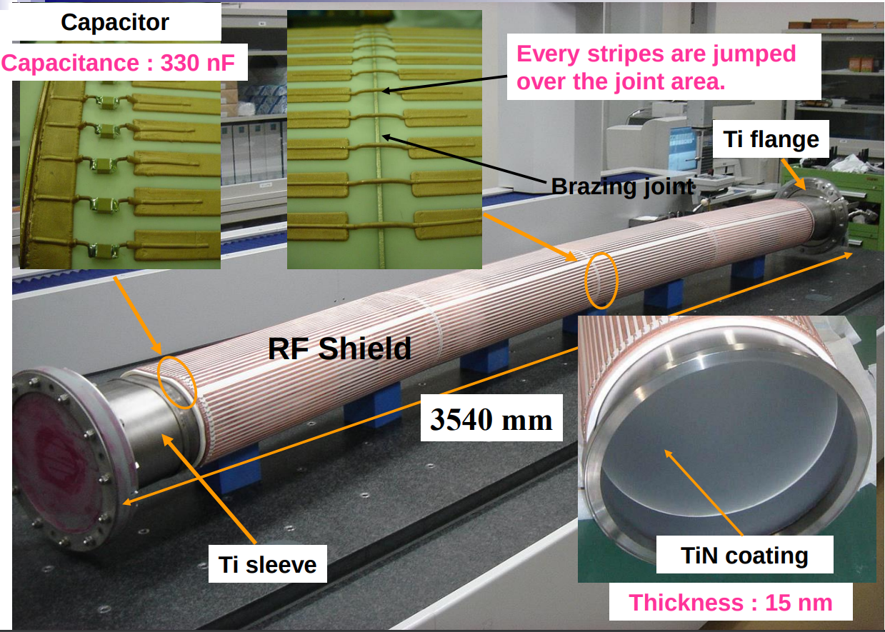
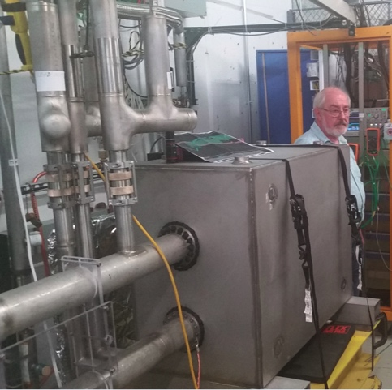
Fast-ramping Magnet System
Differerent power converter options investigated
Efficient energy recovery for resistive dipoles (O(100MJ))
Synchronisation of magnets and RF for power and cost
Commutated resonance
Attractive novel option
Better control
Much less capacitors
5.07 kJ/m
5.65…7.14 kJ/m
5.89 kJ/m
Beampipe study
Eddy currents vs impedance
Maybe ceramic chamber with stripes
Could consider using HTS dipoles for largest ring
Simple HTS racetrack dipole could match the beam requirements and aperture for static magnets
F. Boattini et al.
D. Amorim et al.
FNAL 300 T/s HTS magnet

Slide 27
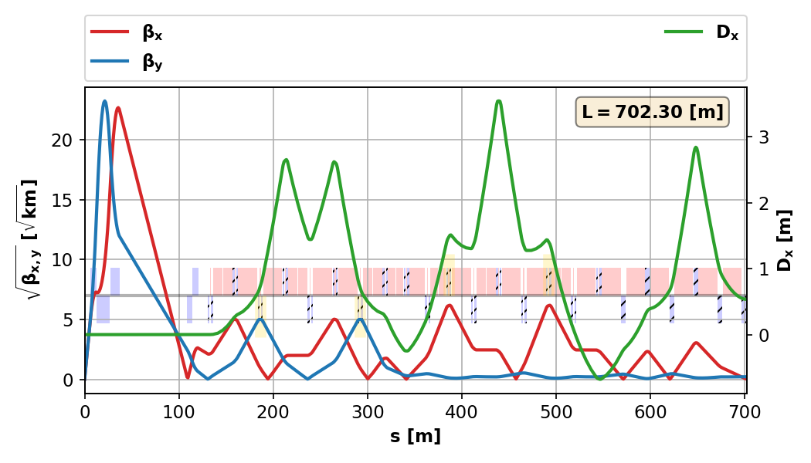
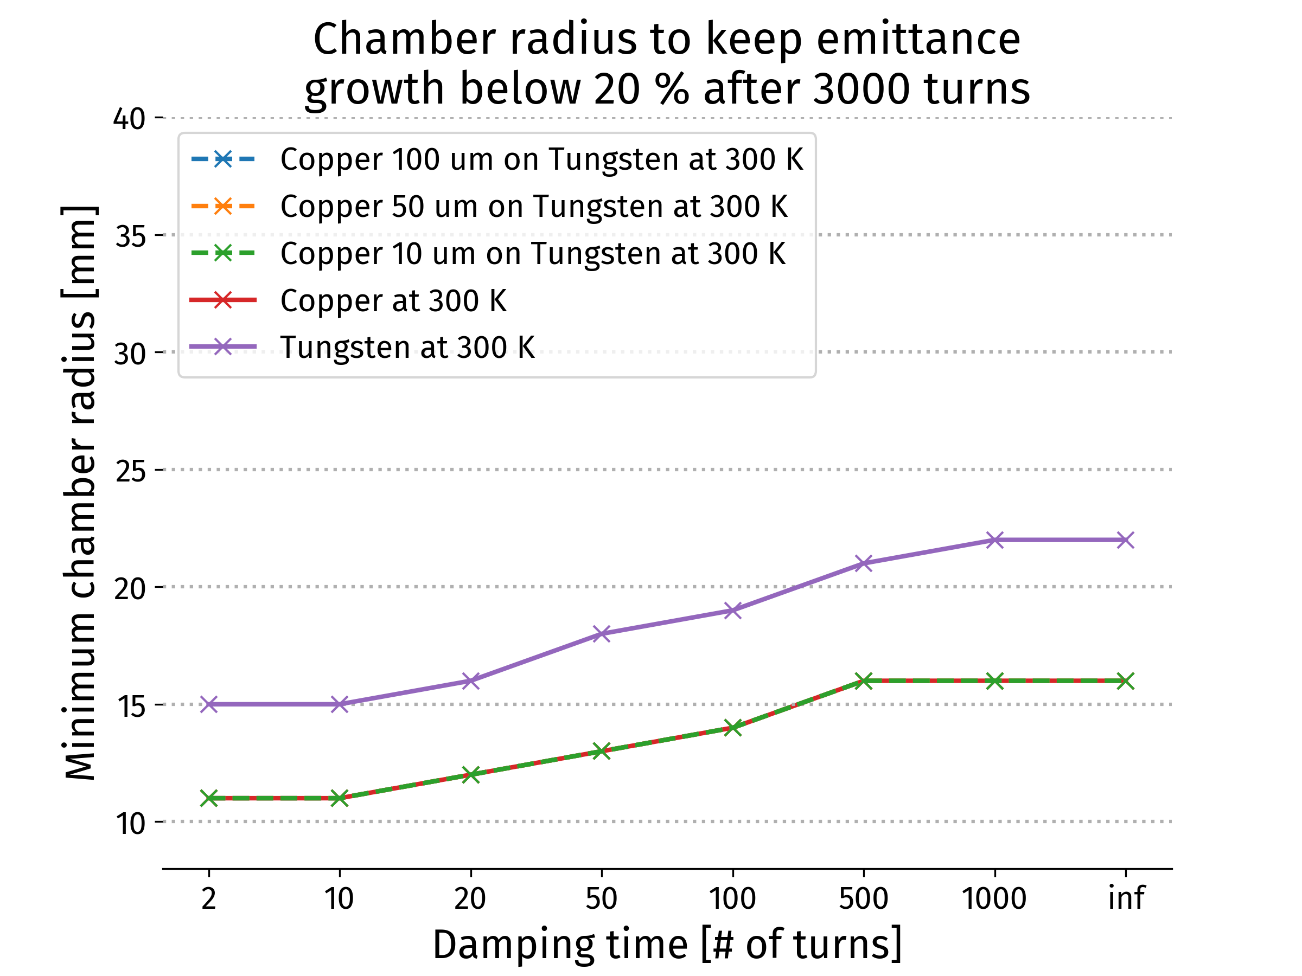
Collider Ring
High performance 10 TeV challenges:
Very small beta-function (1.5 mm)
Large energy spread (0.1%)
Maintain short bunches
3 TeV:
MAP developed 4.5 km ring with Nb₃Sn
magnet specifications in the HL-LHC range
5 mm beta-function
10 TeV collider ring in progress:
around 16 T HTS dipoles or lower Nb₃Sn
final focus based on HTS
Need to further improve the energy acceptance by small factor
E. Metral, D Amorim et al. (CERN)
Impedance studies
Single beam instability limits OK with
conservative feedback
K. Skoufaris, Ch. Carli, support from P. Raimondi, K. Oide, R. Tomas

Slide 28
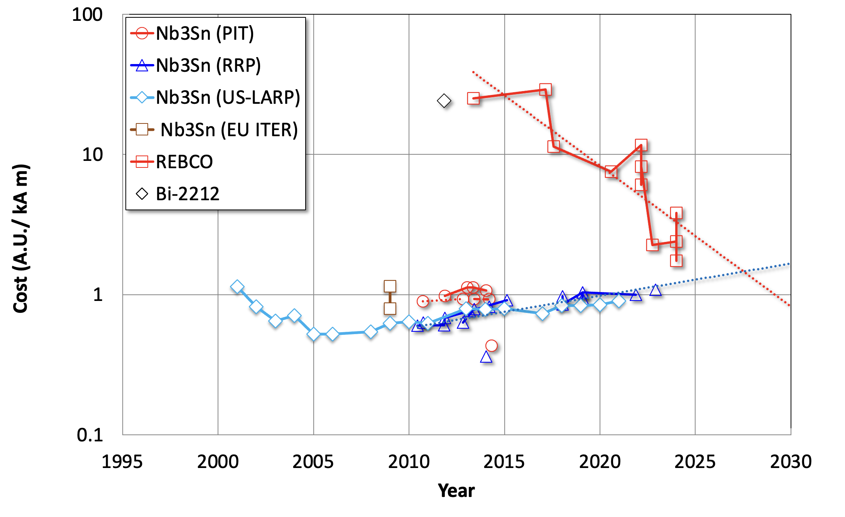
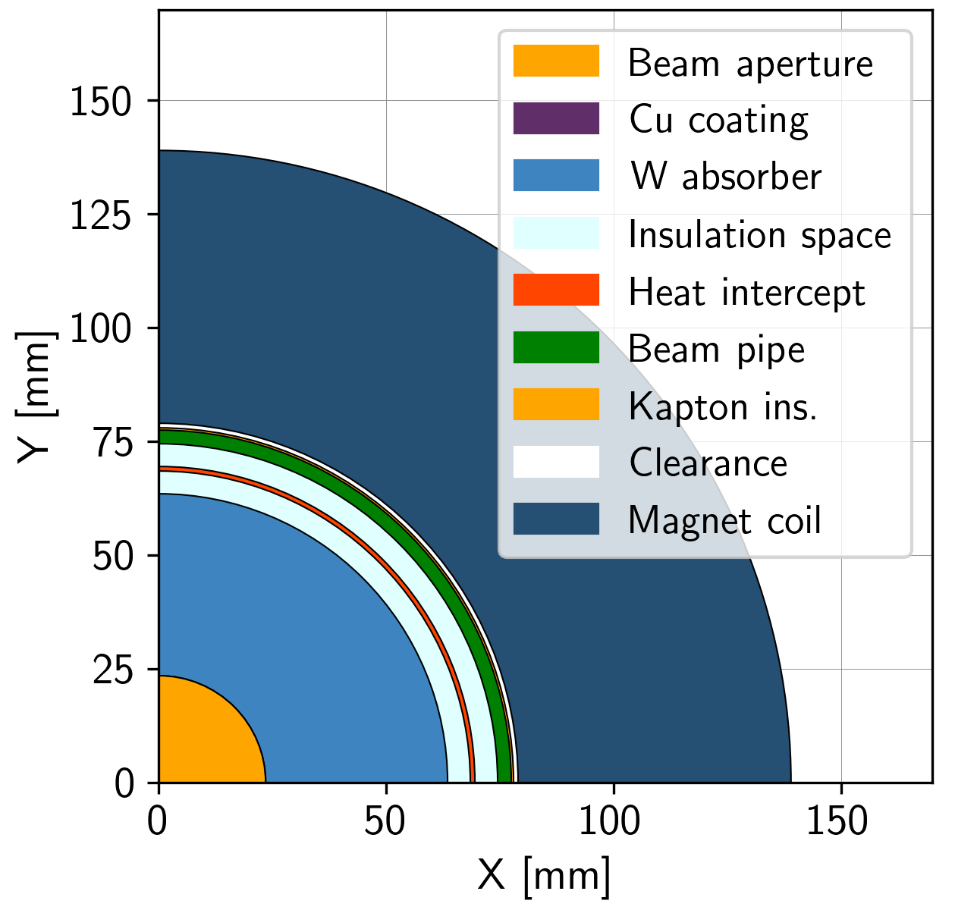
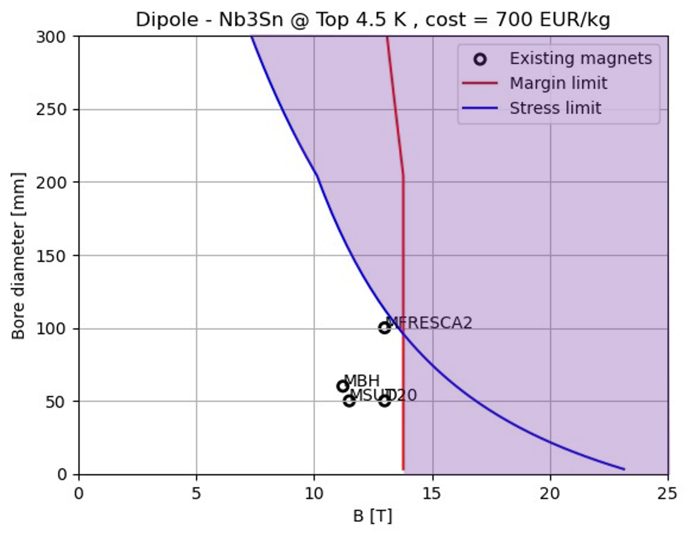
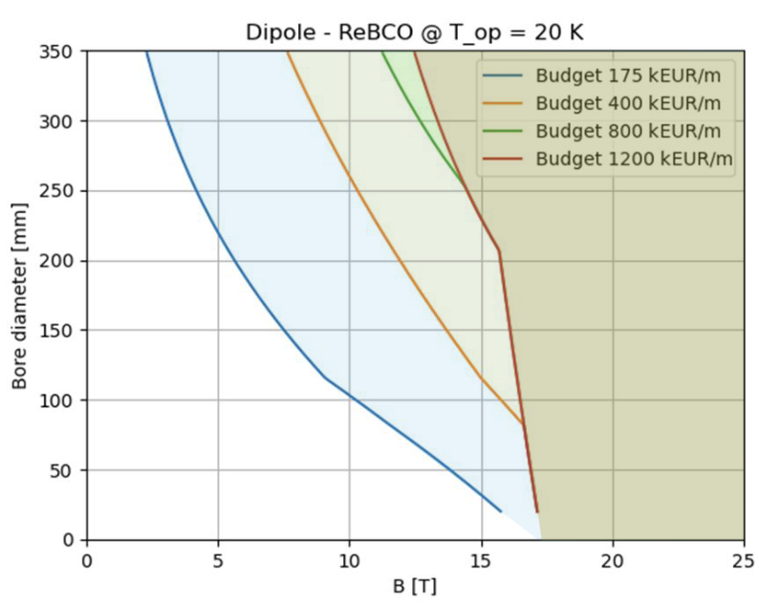
Collider Ring Technology
Large aperture to shield magnet
HTS cost is coming down
Used for other applications
Hard to predict the cost
Shielding of muon decay loss (500 W/m):
FLUKA: 20-40 mm tungesten (OK to safe)
Few W/m in magnets
No problem with radiation dose
Magnet coil radius 59-79 mm
Nb3SN good up to 11-12 T
HTS can go higher
Mainly a question of cost
Needs technical development
Coil
3 TeV Design
12 T
160 mm
Will be moved to reduce cost
Nb₃Sn
4.5 K
HTS
20 K
Shielding

Slide 29
IMCC Plans
For the ESPPU, will deliver
Evaluation report, including tentative cost and power consumption scale estimate
R&D plan, including some scenarios and timelines
Requires to push as hard as possible with existing resources
ESPPU submission
ESPPU result
After ESPPU submission:
Will fulfill EU contract
  Final deliverable is report on all R&D
Will have some US process after the ESPPU
  Likely requires Reference Design
LDG wants to maintain momentum
  EU Roadmap continues
Continue together to develop green field concept
Avoid becoming site specific before funding agencies put the resources on the table
Develop site specific versions as derived approaches
Note: IMCC will prepare all reports together as a global community

Slide 30
Implementation Considerations
Reviewing timeline (still evolving)
Uncertainties from physics case (e.g. HL-LHC), society development, budget profile etc.
Identify shortest possible timeline
  Technically limited, success-oriented schedule
Considered important for the timeline
Muon cooling technologies and integration
Magnet technology
Detector technologies
Civil engineering
Technology readiness appears possible by 2040
Provided funding is being made available
Main limitation from the magnet technology
Consensus of magnet experts (review panel):
Anticipate technology to be mature in O(15 years):
  HTS solenoids in muon production target, 6D cooling and final cooling
    HTS tape can be applied more easily in solenoids
    Strong synergy with society, e.g. fusion reactors
  Nb₃Sn 11 T magnets for collider ring (or HTS if available): 150mm aperture, 4K
This corresponds to 3 TeV design
Could build 10 TeV with reduced luminosity performance
  Can recover some but not all luminosity later

Slide 31
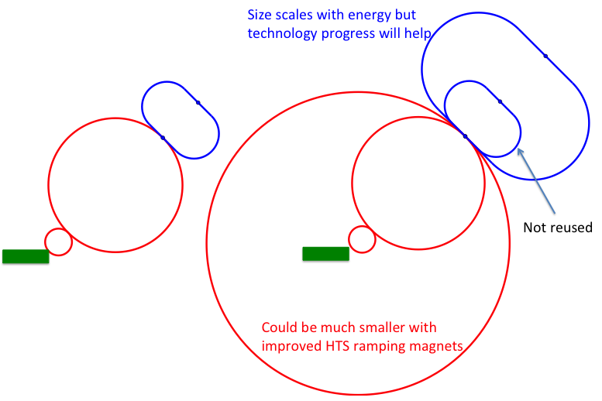
Staging Approaches
Assumptions:
In O(15 years):
  HTS technology available for solenoids
  Nb₃Sn available for collider ring
In O(25 years):
  HTS available for collider ring
Scenario 1: Energy staging
Start at lower energy (e.g. 3 TeV)
Build additional accelerator and collider ring later
Requires less budget for first stage
3 TeV design takes lower performance into account
Scenario 2: Luminosity staging
Start at with full energy, but less performant collider ring magnets
Main sources of luminosity loss are collider arcs and interaction region
  Can recover interaction region later (as in HL-LHC)
  But need full budget right away
  Some luminosity loss remains (O(1.5))
  More power for the collider ring required (lower magnet temperature)

Slide 32

R&D Programme
Broad R&D programme can be distributed world-wide
Muon cooling technology
RF test stand to test cavities in magnetic field
Muon cooling cell test infrastructure
Demonstrator
  At CERN, FNAL, ESS, JPARC, …
  Workshop in October at FNAL
Magnet technology
HTS solenoids
Collider ring magnets with Nb3Sn or HTS
Detector technology and design
Can do the important physics with near-term technology
But available time will allow to improve further and exploit AI, MI and new technologies
Many other technologies are equally important now to support that the muon collider can be done and perform
Training of young people
Strong synergy with HFM Roadmap and RF efforts

Slide 33

Test Facility
Target
+ horn (1st phase) /
+ superconducting solenoid (2nd phase)
Downstream diagnostics area, 5 m
Collimation and upstream diagnostics area, 10 m
Look for an existing proton beam with significant power
Different sites are being considered
CERN, FNAL, ESS are being discussed
J-PARC also interesting as option
Cooling area, 50 m
Momentum selection chicane, 10 m
Site choices at CERN, FNAL study in preparation

Slide 34


Site Studies
Candidate sites CERN, FNAL, potentially others (ESS, JPARC, … )
Study is mostly site independent
Main benefit is existing infrastructure
Want to avoid time consuming detailed studies and keep collaborative spirit
Will do more later
Some considerations are important
Neutrino flux mitigation at CERN
Accelerator ring fitting on FNAL site
Potential site next to CERN identified
Mitigates neutrino flux
  Points toward mediterranean and uninhabited area in Jura
Detailed studies required (280 m deep)

Slide 35

Example CERN Site
First look is promising:
Collider ring mitigates neutrino flux from experiments
  Some work required to ensure adjacent arcs are negligible
Good connection to LHC tunnel
Muon beam cooling complex on CERN land injecting into SPS
Example as discussion basis
numbers will change
Collider ring (10 TeV)
Both experiments on CERN land
Potential location of muon cooling complex
Transferline maximum slope 6%
Several studies remain to be done

Slide 36
Tentative Timeline (Fast-track 10 TeV)
Only a basis to start the discussion, will review this year
Need at least two years of demonstrator operation (better more)
Need RF test stand before
Decision starting in 2036
Estimated10 TeV construction/installation
Different initial estimates for detector
seem to be fast enough
Buit need to develop robust timeline

Slide 37
Cost Estimate
Led by Carlo Rossi, who also does it for CLIC
Cost estimate is based on Project Breakdown Structure
Fill in information at the level it is available to us
Identify uncertainties
Make trade-offs
But cannot optimize at this moment
Overall optimisation not yet done and probably needs time to fully conclude
Detailed studies ongoing of fast-ramping magnet and RF cost and trade-off
Proton complex similar to SPL
Mostly driven by magnet cost
Input data exists, but no optimisation for cost
Magnet cost estimates exist for different configurations

Slide 38
Synergies and Outreach
Training of young people
Novel concept is particularly challenging and motivating for them
Technologies
Muon collider needs HTS, in particular solenoids
Fusion reactors
Power generators
Nuclear Magnetic Resonance (NMR)
Magnetic Resonance Imaging (MRI)
Magnets for other uses (neutron spectroscopy, detector solenoids, hadron collider magnets)
Target is synergetic with neutron spallation sources, in particular liquid metal target (also FCC-ee)
High-efficiency RF power sources and power converter
RF in magnetic field can be relevant for some fusion reactors
High-power proton facility
Facilities such as NuStorm, mu2e, COMET, highly polarized low-energy muon beams
Detector technologies
AI and ML
Physics
38

Slide 39
Conclusion
R&D progress is increasing confidence that the collider is a unique, sustainable path to the future
Not as mature as some other projects
Need to do more R&D
Started exploring the implementation at CERN using existing infrastructure
Looks promising including neutrino flux mitigation
Cost estimate has started
We expect that a first collider stage can be operational by 2050
If the resources ramp up sufficiently
If decision-making processes are efficient
Need to continue ramping up the momentum
http://muoncollider.web.cern.ch To join contact muon.collider.secretariat@cern.ch

Slide 40
Reserve

Slide 41
Alternatives: The LEMMA Scheme
LEMMA scheme (INFN) P. Raimondi et al.
Note: New proposal by C. Curatolo and L. Serafini needs to be looked at
Uses Bethe-Heitler production with electrons
45 GeV positrons to produce muon pairs
Accumulate muons from several passages
Excellent idea, but nature is cruel
Detailed estimates of fundamental limits show that we require a very large positron bunch charge to reach the same luminosity as the proton-based scheme
Need same game changing invention

Slide 42
Organisation
Collaboration Board (ICB)
Elected chair: Nadia Pastrone
Steering Board (ISB)
Chair Steinar Stapnes
CERN members: Mike Lamont, Gianluigi Arduini
ICB members: Dave Newbold (STFC), Mats Lindroos (ESS), Pierre Vedrine (CEA), N. Pastrone (INFN)
Study members: SL and deputies
Will add US but wait for US decision on members
Advisory Committee
To be defined, discussion in SB
Coordination committee (CC)
Study Leader: Daniel Schulte
Deputies: Andrea Wulzer, Donatella Lucchesi, Chris Rogers

Slide 43

EU Design Study
Has been approved summer 2022
Very helpful to kick-start collaboration
Reapproved early 2023
It appears that there has been some issue with the refereeing of several projects, probably not directly with the muon collider
Brings 3 MEUR from the European Commission, the UK and Switzerland and about 4 MEUR from the partners
Basically nothing for CERN
Kick-off meeting in March 2023:
https://indico.cern.ch/event/1219912
Many thanks to all that contributed
https://mucol.web.cern.ch
Sat celeriter fieri quidquid fiat satis bene

Slide 44


US P5 Ask
S. Jindariani, D. Stratakis, Sridhara Dasu et al.
Goal is to contribute as much as Europe
Start of construction a bit later than in Roadmap
Will try to harmonise/define scenarios once US joins
Total resources would approach Roadmap
Some increase in Europe and Asia assumed
1-2 years delay
But profile is different
44

Slide 45
Muon Collider Luminosity Scaling
Fundamental limitation
Requires emittance preservation and advanced lattice design
Applies to MAP scheme
High beam power
High energy
Large energy acceptance
Dense beam
High field in collider ring
Luminosity per power increases with energy
Provided technologies can be made available
Constant current for required luminosity scaling

Slide 46
Staging
Ideally would like full energy right away, but
staging could lead to faster implementation
Substantially less cost for a first stage
Can make technical compromises
  e.g. 8 T NbTi magnets would increase collider ring from 4.5 to 6 km and reduce luminosity by 25%
Timeline might be more consistent with human lifespan
Upgrade adds one more accelerator and new collider ring
only first collider ring is not being reused

Slide 47
Alternatives: The LEMMA Scheme
LEMMA scheme (INFN) P. Raimondi et al.
Note: New proposal by C. Curatolo and L. Serafini needs to be looked at
Uses Bethe-Heitler production with electrons
45 GeV positrons to produce muon pairs
Accumulate muons from several passages
Excellent idea, but nature is cruel
Detailed estimates of fundamental limits show that we require a very large positron bunch charge to reach the same luminosity as the proton-based scheme
Need same game changing invention

Slide 48
Muon Decay
About 1/3 of energy in electrons and positrons:
Experiments needs to be protected from background by masks
simulations of 1.5, 3 and 10 TeV
optimisation of masks and lattice design started
first results look encouraging
will be discussed at ICHEP
Collider ring magnets need to be shielded from losses
Losses elsewhere will also need to be considered but are less severe
D. Lucchesi, A. Lechner, C Carli et al.
Neutrino flux to have negligible impact on environment
want to be negligible (same level as LHC)
opening cone decreases, cross section and shower energy increase with energy
Above about 3 TeV need to make beam point in different vertical directions
Mechanical system with 15cm stroke, 1% vertical bending
Length of pattern to be optimised for minimal impact on beam
~2 x 600 m
48

Slide 49
Key Challenges
Proton complex
- Compressing protons to few bunches
Target
- Target
- Solenoid
Cooling channel
- Channel design
- Solenoids
- RF in magnetic field
- Absorbers
- Integration
RCS
- Beam dynamics
- Ramping magnets
- Power converter
- RF system
Collider ring
- Optics
- Magnets
- Neutrino flux
- Detector background
49

Slide 50
Roadmap
In aspirational scenario can make informed decisions:
Three main deliverables are foreseen:
a Project Evaluation Report for the next ESPPU will contain an assessment of whether the 10 TeV muon collider is a promising option and identify the required compromises to realise a 3 TeV option by 2045. In particular the questions below would be addressed.
  What is a realistic luminosity target?
  What are the background conditions in the detector?
  Can one consider implementing such a collider at CERN or other sites, and can it have one or two detectors?
  What are the key performance specifications of the components and what is the maturity of the technologies?
  What are the cost drivers and what is the cost scale of such a collider?
  What are the power drivers and what is the power consumption scale of the collider?
  What are the key risks of the project?
an R&D Plan that describes an R&D path towards the collider;
an Interim Report by the end of 2023 that documents progress and allows the wider community to update their view of the concept and to give feedback to the collaboration.
50

Slide 51
R&D Plan
The R&D plan will describe the R&D path toward the collider, in particular during the CDR phase, and will comprise the elements below.
An integrated concept of a muon cooling cell that will allow construction and testing of this key novel component.
A concept of the facility to provide the muon beam to test the cells.
An evaluation of whether this facility can be installed at CERN or another site.
A description of other R&D efforts required during the CDR phase including other demonstrators.
This R&D plan will allow the community to understand the technically limited timeline for the muoncollider development after the next ESPPU.

Slide 52
Minimal Scenario
Will allow partially informed decisions
No conceptual design of neutrino flux and alignment system
No alternative superconducting fast-ramping magnet system
Several collider systems would (almost) not be covered, in particular
  the linacs
  the target complex
  the proton complex
  engineering considerations of the muon cooling cells
  alternative designs for the final cooling system, acceleration, collider ring
No RF test stand would be constructed for the muon cooling accelerating cavities
No conceptual design of a muon cooling cell for the test programme
No conceptual design of a muon cooling demonstrator facility
No concept of RF power sources
No tests/models to develop solenoid technology.

Slide 53
Key Technologies
Magnets
Superconducting solenoids for target and cooling profit from developments for society
  target solenoid comparable to ITER central solenoid fusion
  6D cooling solenoids similar and wind power generators, motors
  final cooling solenoids synergetic with high-field research, NMR
Collider ring magnets
  profit from developments for other colliders FCC-hh, stress-managed magnets
Fast-ramping normal-conducting magnet system
  HTS alternative, power converter
RF systems
superconducting RF, normal-conducting RF, efficient klystrons
Target, cooling absorbers, windows, shielding
Neutrino mitigation mover system, cooling cell integration, …
Detector

Slide 54
Key Technologies, cont.
RF systems
Normal-conducting cooling cavities in magnetic field
  profit from CLIC work
Superconducting accelerator RF
  profit from ILC, …
Efficient power sources
  profit from CLIC work
Beam-matter interaction
Proton target
Cooling absorbers
Shielding (accelerator and detector)
Mechanical system
Neutrino flux mitigation system
Muon cooling cell integration

Slide 55
Collaboration Vision
IMCC is an international collaboration and aims to
Enlarge the collaboration
  Physics interest in all regions, strong US contribution to the muon collider physics and detector, interest in Japan
  First US university have joined collaboration, try to see how to move forward, also with labs
Combine the R&D efforts for the design and its technologies
  Critical contributions in all relevant fields in the US
Consider several sites for the collider
  CERN would be one, FNAL and others should also be considered
  A proposal with alternative sites is stronger for a single site
Consider several sites for the demonstrators
  E.g. Muon production and cooling demonstrator at CERN, FNAL, ESS, JPARC
  e.g. RCS at ESRF or elsewhere
  Target tests
  …

Slide 56
Initial Target Parameters
Target integrated luminosities
Note: currently focus on 10 TeV, also explore 3 TeV
Tentative parameters based on MAP study, might add margins
Achieve goal in 5 years
FCC-hh to operate for 25 years
Aim to have two detectors
Parameter | Unit | 3 TeV | 10 TeV | 14 TeV
L | 10³⁴ cm⁻²s⁻¹ | 1.8 | 20 | 40
N | 10¹² | 2.2 | 1.8 | 1.8
f_{r} | Hz | 5 | 5 | 5
P_{beam} | MW | 5.3 | 14.4 | 20
C | km | 4.5 | 10 | 14
<B> | T | 7 | 10.5 | 10.5
ε_{L} | MeV m | 7.5 | 7.5 | 7.5
σ_{E} / E | % | 0.1 | 0.1 | 0.1
σ_{z} | mm | 5 | 1.5 | 1.07
β | mm | 5 | 1.5 | 1.07
ε | μm | 25 | 25 | 25
σ_{x,y} | μm | 3.0 | 0.9 | 0.63
CLIC at 3 TeV
2 (6)
28
56

Slide 57

US Snowmass
Strong interest in the US community in muon collider
seen as an energy frontier machine
decoupled from LC
US community wants funding for R&D
Goal: match European effort
Community interested in the US to host a muon collider
Meenakshi Narain: Energy Frontier / Large Experiments, Snowmass Community Summer Study July 17-26, 2022
57

Slide 58



Muon Collider magnets
HTS !
NC ±1.8 T, 400 Hz 100 mm x 30 mm
SC < 10T
100 mm x 30 mm
20 T, 200 mm
Radiation heat load ≈ 5…10 kW
Radiation dose: 80 MGy
HTS ?
SC dipole
NC dipole
NC dipole
SC dipole
RCS
> 40 T, 60 mm
16 T peak, 150 mm
Radiation heat load ≈ 5 W/m
Radiation dose ≈ 20…40 MGy
HTS ?
HTS !

Slide 59
US Snowmass
Strong interest in the US community in muon collider
seen as an energy frontier machine
decoupled from LC
US community wants funding for R&D
Goal: match European effort
Community interested in the US to host a muon collider
Meenakshi Narain: Energy Frontier / Large Experiments, Snowmass Community Summer Study July 17-26, 2022
59

Slide 60
Coordination Committee Members
Physics | Andrea Wulzer
Detector and MDI | Donatella Lucchesi
US (detector) | Sergo Jindariani
US (accelerator) | Mark Palmer
Asia (China) | Jingyu Tang
Asia (Japan) | tbd
Protons | Natalia Milas
Muon production and cooling | Chris Rogers
Muon acceleration | Antoine Chance
Collider | Christian Carli
Magnets | Luca Bottura
RF | Alexej Grudiev, Dario GIove
Beam-matter int. target systems | Anton Lechner
Collective effects | Elias Metral
A strengthening on the physics and detector side is planned
Cooling cell design | Lucio Rossi
Demonstrator | Roberto Losito

Slide 61
Physics Goals
Full lepton energy available for production of new particles, in protons only a fraction
Need more luminosity at higher energies as production cross section decreases
Discovery reach
10-14 TeV lepton collisions are comparable to 100-200 TeV proton collisions for production of heavy particle pairs
Luminosity goal
(Similar to L(E_{CM} > 0.99 E_{CM,0}) CLIC at 3 TeV)
4x10³⁵ cm⁻²s⁻¹ at 14 TeV
Yields constant number of events in the s-channel
61

Slide 62
Physics Studies
Details on physics case, detector and accelerator can be found in
Snowmass white papers https://indico.cern.ch/event/1130036/
EPJC report in preparation
Used tentative detector performance specifications in form of DELPHES card
based on FCC-hh and CLIC performances, including masks against beam induced background (BIB)
Please find the card here: https://muoncollider.web.cern.ch/node/14
M. Selvaggi, W. Riegler, U. Schnoor, A. Sailer, D. Lucchesi, N. Pastrone, M. Pierini, F. Maltoni, A. Wulzer et al.
Initial detector simulation studies at 1.5 and 3 TeV indicate that this is a good model
Now moving to 10 TeV
If you are interested to contribute please contact me or the responsible deputies:
Andrea Wulzer (Physics) and Donatella Lucchesi (Detector and MDI)
D. Lucchesi, F. Meloni et al.
62

Slide 63

Possible CERN Locations
Consider nTOF-like beam from PS for cooling experiment:
1 pulse of 10¹³ p at 20 GeV per 1.2 s, i.e. 27 kW
maybe O(100kW) possible
If SPL were, installed could use its beam, e.g. 5 GeV, 4 MW
M. Calviani, R. Losito, J Osborn et al.

Slide 64
Collider Site Studies
Study is mostly site independent
However, some considerations are being made
Candidate sites are CERN, FNAL, potentially others (ESS, JPARC, … )
  FNAL takes test facility into account in their ACE plans
But need some site considerations
Main site concern:
Neutrino flux mitigation
Neutrinos in direction of experimental insertions need to be mitigated by site choices
Main site benefit:
Potentially significant cost saving from reusing exiting infrastructure
Will study this later
Potential site next to CERN identified
Mitigates neutrino flux
  Points toward mediterranean and uninhabited area in Jura
Detailed studies required (280 m deep)

Slide 65
Muon Collider Timeline (Roadmap)
Technically limited timeline
To be reviewed considering progress, funding and decisions
Muon collider important in the long term
Even after potential FCC-hh
But also plan B as next project in Europe and maybe plan A in US and elsewhere
Fast track option if require next as project after HL-LHC:
Lower energy initial option, e.g. 3 TeV
Upgrade to 10 TeV later
  Little extra cost
Subject to funding
Evaluation+decision
Evaluation+decision
65

Slide 66


MICE: Cooling Demonstration
Principle of ionisation cooling has been demonstrated
Use of data for benchmarking is still ongoing
Nature vol. 578, p. 53-59 (2020)
More complete experiment with higher statistics, more than one stage required
Integration of magnets, RF, absorbers, vacuum is engineering challenge
More particles at smaller amplitude after absorber is put in place
66

Slide 67


RF Test Stand
Module work focuses on RF test stand at this moment
Important ensure timely R&D plan
Try to identify infrastructure for this
  CEA, INFN, Cockroft, CERN, …
  Will not be cheap so need to find resources
Bare coils and RF cavity
SC HTS coils
RF Wave guide
Pillbox test cavity
Two stage cryocooler
With cryostat
Thermal shield
Coil support structure
Vacuum vessel
Tie rods for repulsion and compression forces
L. Rossi, C. Marchand, D. Giove, A. Gurdiev, G. Ferrand, M. Castoldi, S. Sorti et al.
SC HTS coils

Slide 68
Use of SPS and LHC Tunnels
Superconducting magnets
Filling factor of green field studies for the arcs
Consider hybrid and non-hybrid designs
Use robust assumptions for the magnets (10 T static and 1.8 T ramping magnets)
Fast-ramping magnets
 |  | Scenario 1 | Scenario 2a | Scenario 2b
SPS | RCS 1 | 380* | 380* | 380*
 | RCS 2 | --- | 860 | 860
LHC | RCS 3 | 1250* | 2700 | 2700
 | RCS 4 | --- | --- | 4000
Stronger magnets or better filling factors would allow 10 TeV
Need to confirm whether LHC cross section can house two RCSs

Slide 69

Neutrino Flux
Goal: similar to LHC: limit neutrino flux to have negligible impact, “fully optimised” (10% of MAP goal)
Verify performance of concept to be good for 14 TeV
Mover and support system
FLUKA dose studies
Conformity Verification Scheme
F. Bertinelli et al. (CERN, Riga)
G. Lerner, D. Calzolari, A. Lechner, C. Ahdida
G. Lacerda, Y. Robert, N. Guilhaudin (CERN)
C. Ahdida, P. Vojtyla, M. Widorski, H. Vincke
Flux direction map / lattice design / mover impact on beam
Mitigation:
Site choice tool
C. Carli, K. Skoufaris (CERN)
69

Slide 70
Magnet Roadmap
Consensus of experts (review panel):
Anticipate technology to be mature in O(15 years):
  HTS solenoids in muon production target, 6D cooling and final cooling
    HTS tape can be applied more easily in solenoids
    Strong synergy with society, e.g. fusion reactors
  Nb₃Sn 11 T magnets for collider ring (or HTS if available): 150mm aperture, 4K
This corresponds to 3 TeV design
Could build 10 TeV with reduced luminosity performance
  Can recover some but not all luminosity later
Still under discussion:
Timescale for HTS/hybrid collider ring magnets
For second stage can use HTS or hybrid collider ring magnets
Strategy:
HTS solenoids
Nb₃Sn accelerator magnets
HTS accelerator magnets
Seems technically good for any future project

Slide 71


Collider Ring
Challenges:
Very small beta-function (1.5 mm)
Large energy spread (0.1%)
Maintain short bunches
K. Skoufaris, Ch. Carli, support from P. Raimondi, K. Oide, R. Tomas
MAP developed 4.5 km ring for 3 TeV with Nb₃Sn
magnet specifications in the HL-LHC range
Work progressing on 10 TeV collider ring
around 16 T HTS dipoles or lower Nb₃Sn
final focus based on HTS
Important progress: V0.6 good dynamic aperture at almost 0.1% off-energy, approaching the target
pT [%] | DAmin [σ]
0.07 | 5
0.08 | 4
0.09 | 3
0.1 | <1

Slide 72
Muon Cooling Performance
MAP design achieved 55 um based on achieved fields
Integrating physics into RFTRACK, a CERN simulation code with single-particle tracking, collective effects, …
A. Latina, E. Fol, B. Stechauner at al.
Simple 50 T design achieves 24 um and better longitudinal emittance
Need to improve transmission by factor 1.6 (large part of losses due to beam dynamics not muon decay)
Higher power target would increase charge by factor 1.9
  But need to work on beamloading in accelerator chain
Are working on more detailed design
40 T solenoid
Including windows
Final absorbers are H2 vapor
30 um transverse emittance
Ch. Rogers, Zhu Ruihu, R. Taylor, B. Stechauner, E. Vol et al.

Slide 73


Collider Ring Technology
L. Bottura et al.
Power loss due to muon decay 500 W/m FLUKA simulation of shielding:
Require 30-40 mm tungesten
Few W/m in magnets
No problem with radiation dose
Initial estimate of magnet field limits:
11 T for Nb₃Sn, more for HTS/hybrid
Need stress management
Shielding
A. Lechner
D. Calzolari (CERN)
K. Skoufaris, Ch. Carli, D. Amorim, A. Lechner, R. Van Weelderen, P. De Sousa, L. Bottura et al.
Coil
Different cooling scenarios studied
< 25 MW power for cooling possible
Shield with CO₂ at 250 K (preferred) or water
Support of shield is important for heat transfer
Discussion on options for magnet cooling
R. Van Weelderen, P. De Sousa

