Slide 1



Design of the Detector Systems in HPES Test Beam Terminals
Presentation on the BTTB-13 workshop.
19-23, May, 2025. Valencia, Spain.
Author： Yuhang Guo, Hantao Jing
On behalf of the HPES Development Group
Date： 2025/05/20

Slide 2
Introduction to HPES
Detector System of HPES
  2.1 Proton Beam Telescope
  2.2 Proton Energy Measure Device
  2.3 Trigger System
  2.4 Beam State Monitors
Summary

Slide 3
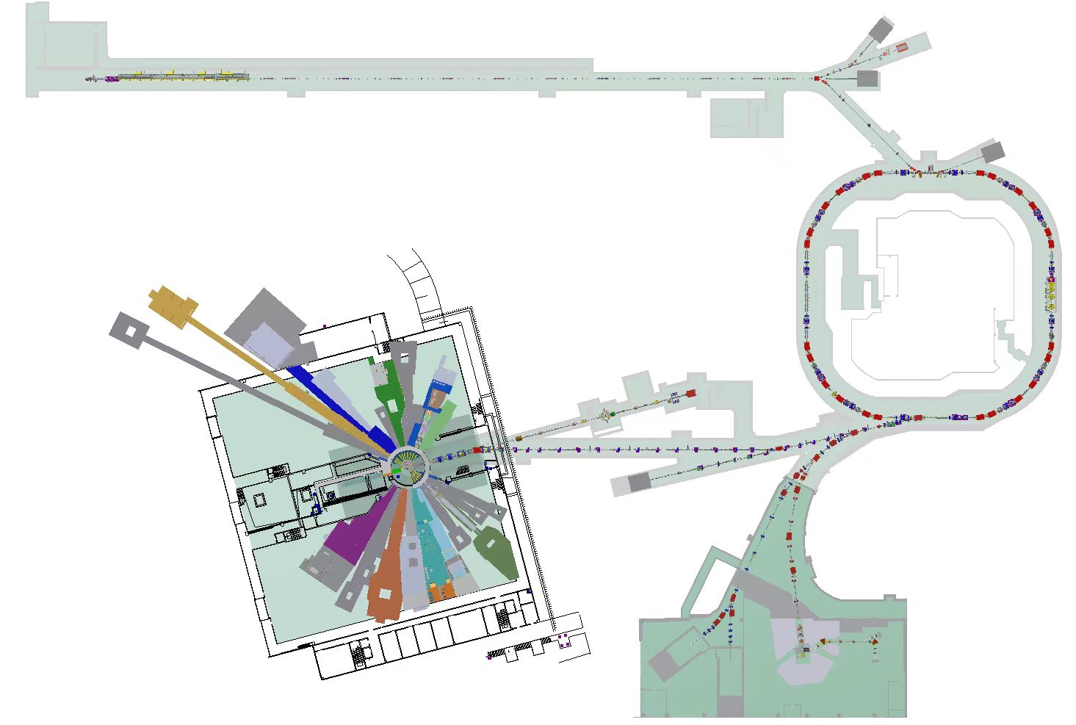
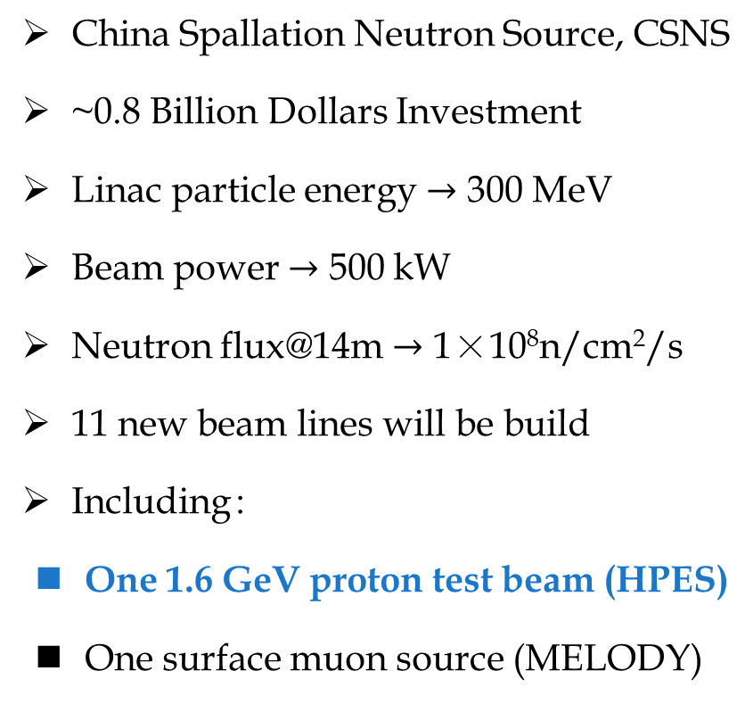
1.1 CSNS-II project
China Spallation Neutron Source, CSNS
~0.8 Billion Dollars Investment
Linac particle energy $→$ 300 MeV
Beam power $→$ 500 kW
Neutron flux@14m $→$ 1×10⁸n/cm²/s
11 new beam lines will be build
Including：
  One 1.6 GeV proton test beam (HPES)
  One surface muon source (MELODY)
Linac-300 MeV
RCS-500 kW
Neutron spectrometers and terminals-11 to be build

Slide 4
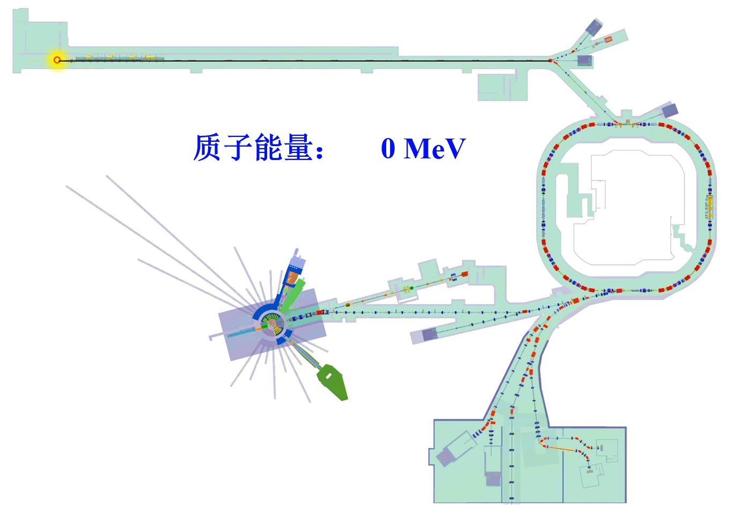
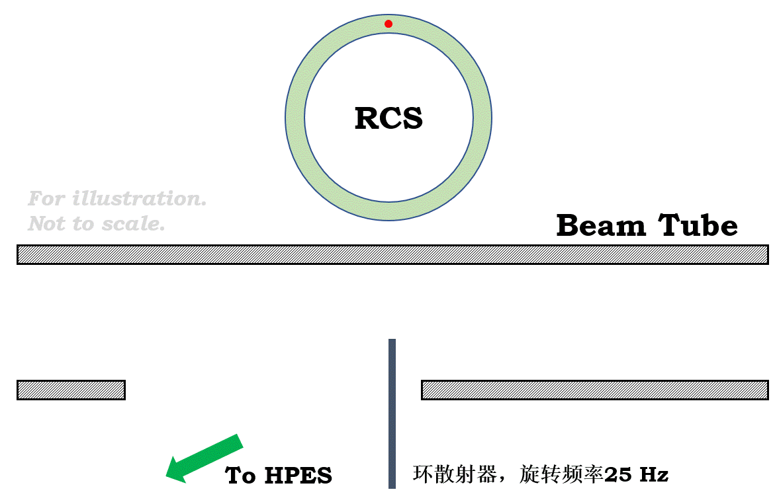
1.2 Introduction to HPES
High-energy Proton Experiment Station（HPES）
First GeV proton test beam in China.
Under civil. First beam @ 2029.
Proton extracted by a diamond proton scatter.
Weak and Strong beam can be provided according to the requirement.
Item | Parameters
Energy | 0.8-1.6 GeV
Frequency | 24 Hz
Strong Flux | 10⁶-10⁹ p/s
Weak Flux | 10³-10⁴ p/s
Diagram of the Proton scatter

Slide 5
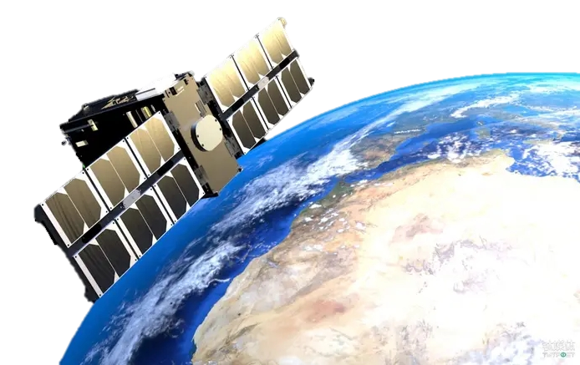
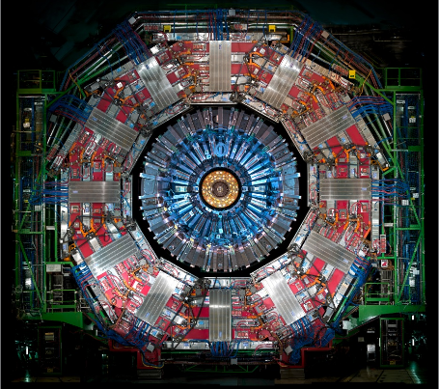
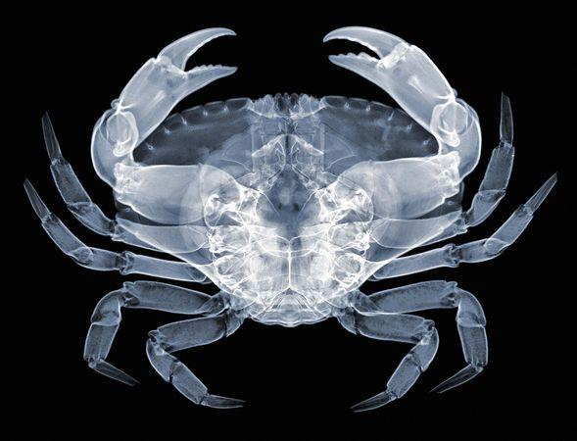
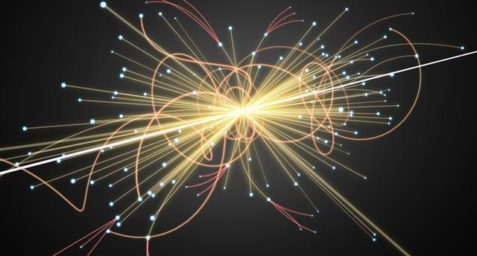
1.3 Applications of 1.6 GeV proton beam
Aerospace related Study
Calib. to Calorimeter
Calib. to Pixel Detector
800~1600 MeV proton
Hadron Collider Calorimeter calibration.
1.6 GeV proton in MIP state
Positioning Performance calibration in 10 μm
1.6 GeV proton, close to Cosmic ray.
Performance test to the aerospace devices.
Proton Imaging
Particle Physics
Provide a test platform for proton imaging technique development.
Important properties of mesons in detector.

Slide 6
2. Detector System of HPES
Primary purpose of HPES: provide a detector test platform for CEPC.
HPES is equipped with 6 detector systems：
  Proton Event Detectors：Measure the local information of proton particle.
  Beam State Monitors：Measure the general information of the proton beam.
Devices |  | Quantity | Techniques | Key paramters
Proton Event Detector | LEMS | Energy | LGAD | Energy res. < 1%
 | Telescope | Track | Pixel Detector | Position res. < 10 μm
 | FLASH | Time | Scintillator Fiber | Timing res. <1 ns
Beam State Monitor | PROUD | Beam Intensity | Plastic Scintillator | Dynamic Range 1~10⁸ p/s
 | BMOS | Beam Stability | SiC | Intensity < 1E5 p/s
 | PALET | Beam Profile | Micromegas | Position res. < 150 μm

Slide 7
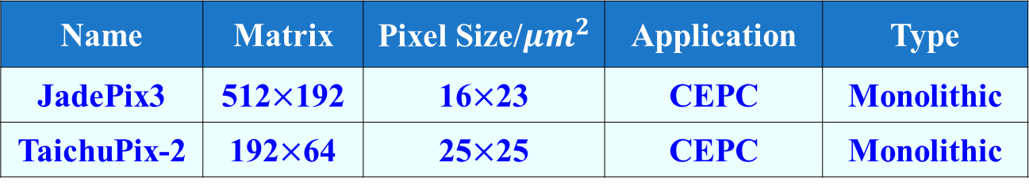
2.1.1 Calibration to Pixel Detector
Pixel Detector TaichuPix and JadePix are potential options for CEPC trackers.
Pos. Res. of CEPC ITK is required < 10 μm.
Tens of thousands of pixel detectors in CEPC. Need plenty of beam resources to test.
1.6 GeV proton beam will contribute to the performance test of the CEPC tracking detectors.
Jadepix 3
Name | Matrix | Pixel Size/$μm^{2}$ | Application | Type
JadePix3 | 512$×$192 | 16$×$23 | CEPC | Monolithic
TaichuPix-2 | 192$×$64 | 25$×$25 | CEPC | Monolithic
Silicon tracker of CEPC

Slide 8
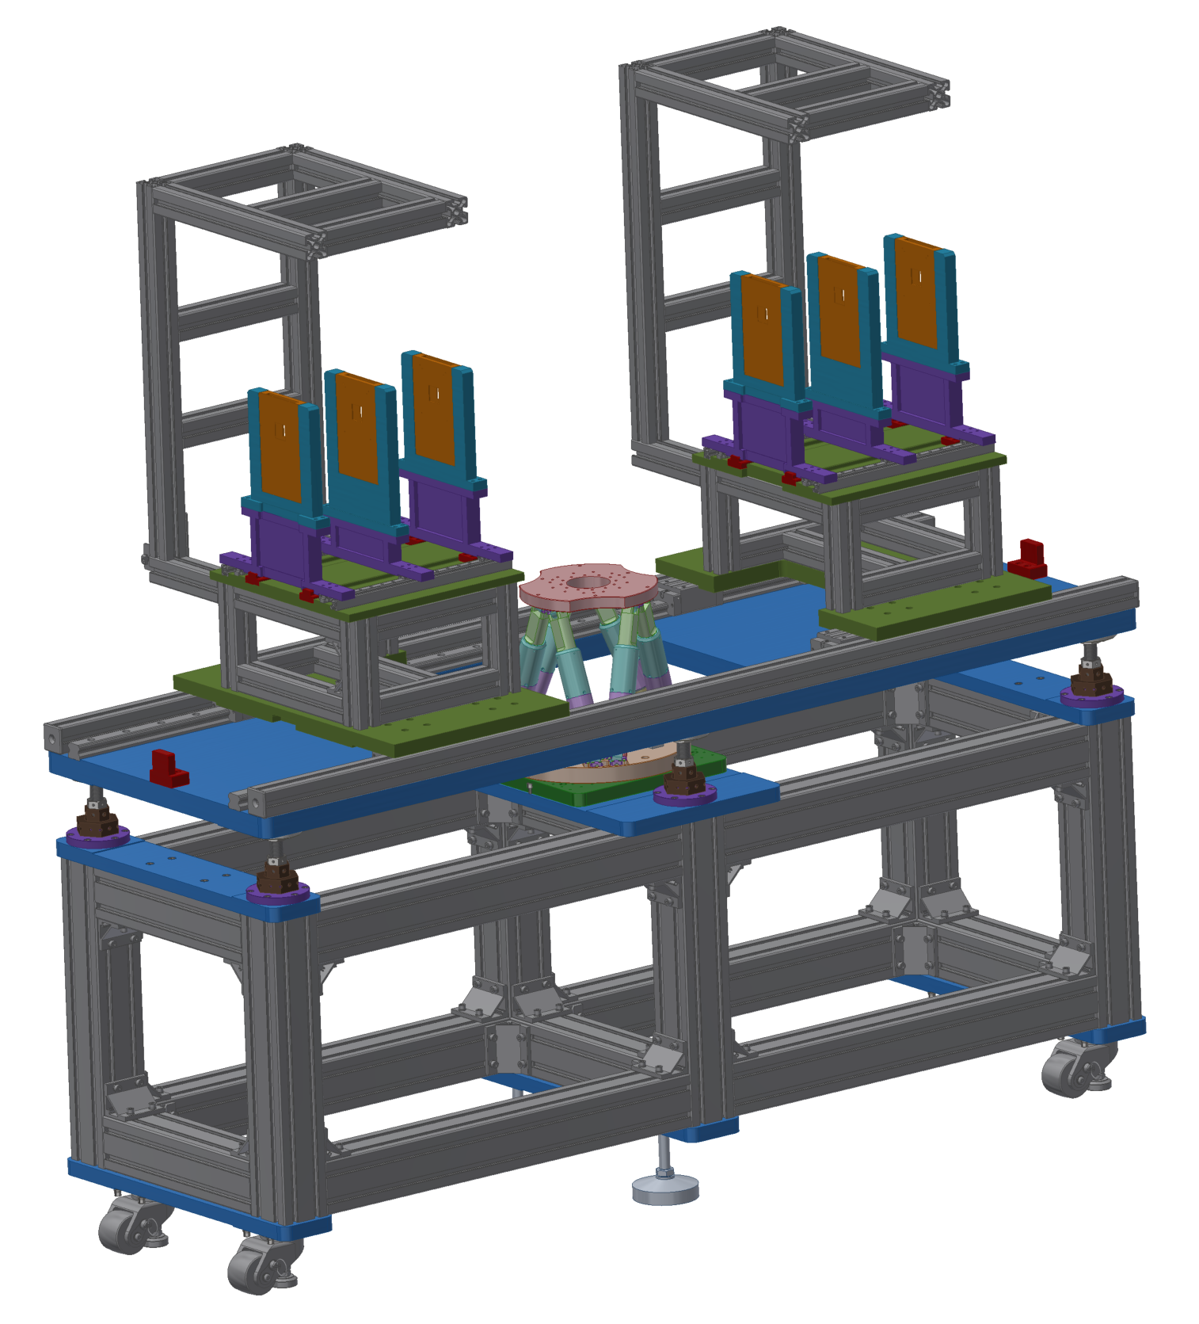
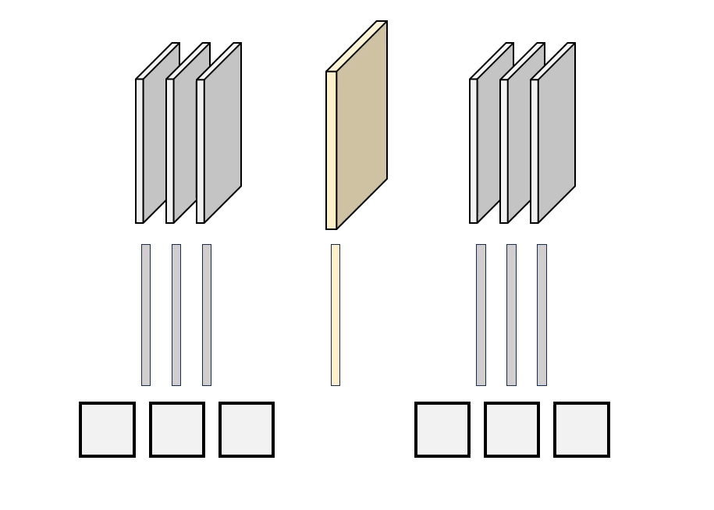
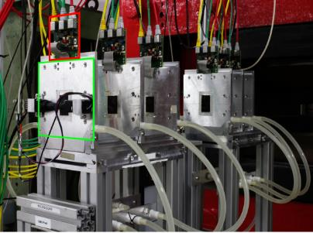
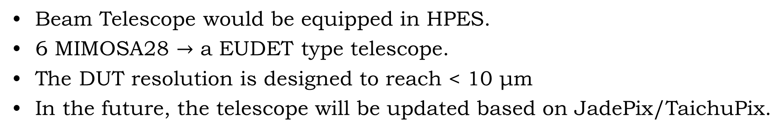
2.1.2 Proton Beam Telescope
Beam Telescope would be equipped in HPES.
6 MIMOSA28 $→$ a EUDET type telescope.
The DUT resolution is designed to reach < 10 μm
In the future, the telescope will be updated based on JadePix/TaichuPix.
EUDET telescope @ DESY

Slide 9
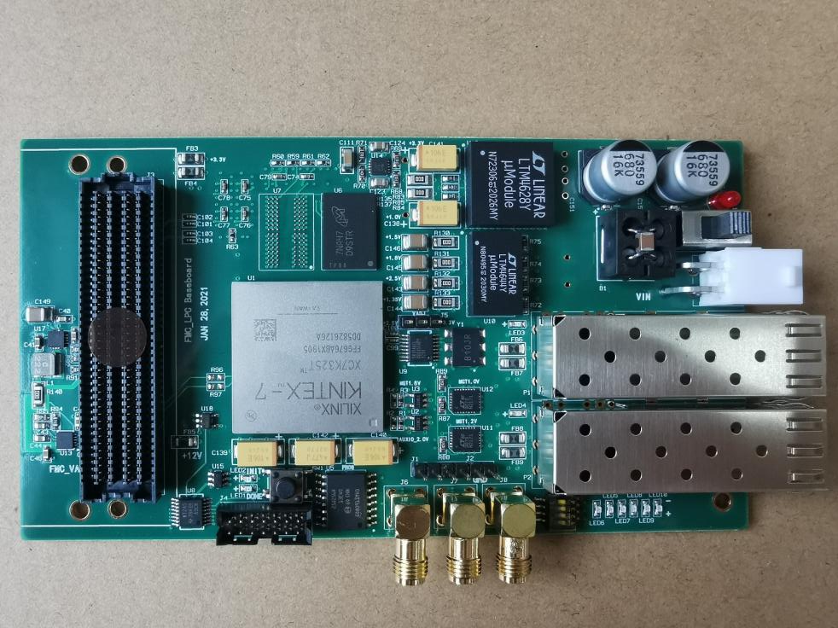
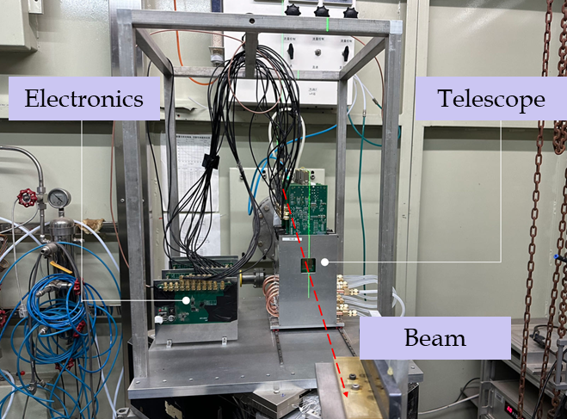
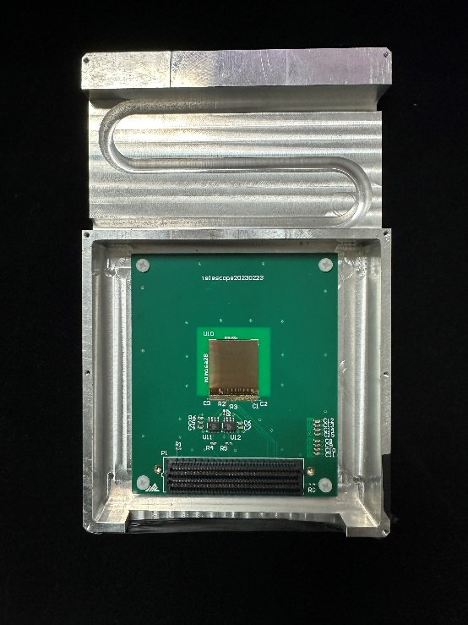
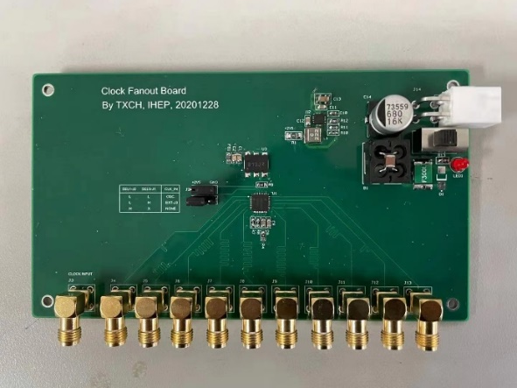
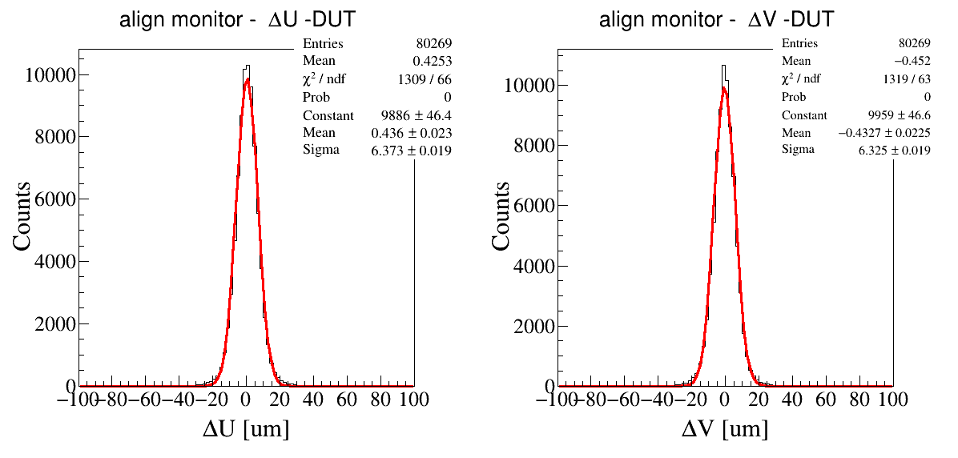
2.1.2 Proton Beam Telescope
Recent test on 1.3 GeV electron beam shows the DUT resolution is ~6.37 μm.
Efficiency is > 99%.

Slide 10
2.2.1 Calibration to Calorimeter
ECAL/HCAL, two types of Calorimeter in CEPC.
Energy Res. of the CEPC calorimeter is required < 3%.
BGO/Glass + SiPM, under prototype test.
Recent test work are carried out on CERN and DESY.
Protons in HEPS can be degraded to 0.8~1.6 GeV, and are good option for the test for CEPC calorimeter.
ECAL of CEPC
1.6 GeV proton beam
Degraded proton beam
Calorimeter Prototype
Degrader
Collimator
E_{proton}

Slide 11
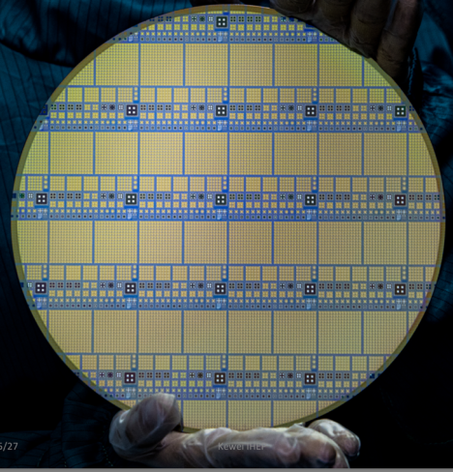
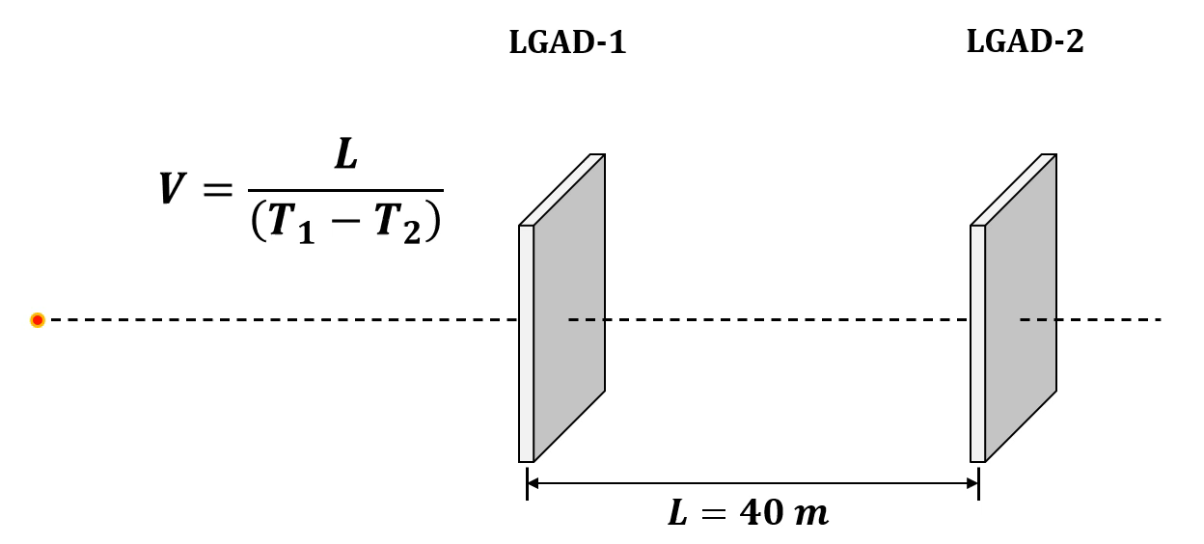
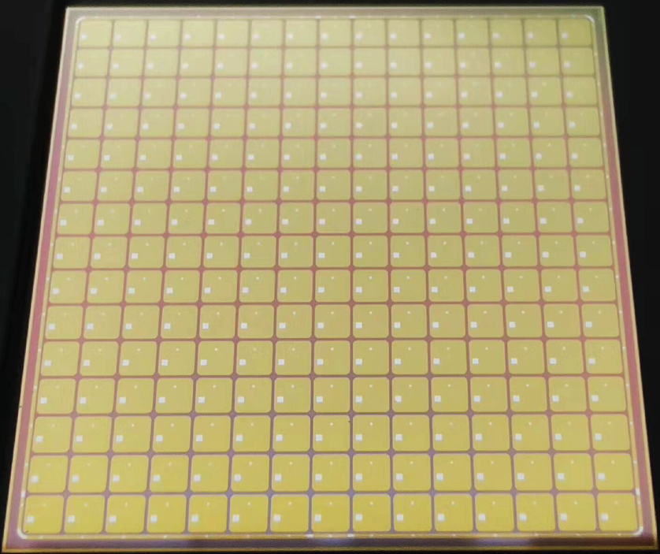
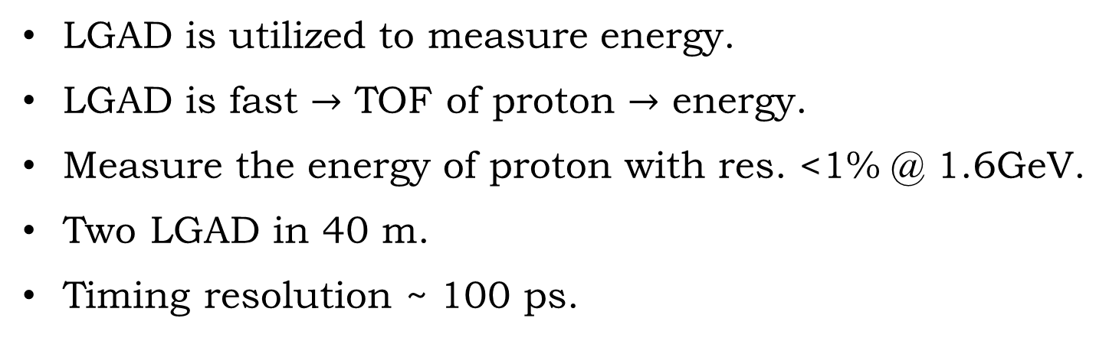
2.2.2 Proton Energy Measurement Device
LGAD is utilized to measure energy.
LGAD is fast $→$ TOF of proton $→$ energy.
Measure the energy of proton with res. <1% @ 1.6GeV.
Two LGAD in 40 m.
Timing resolution ~ 100 ps.
LGAD produced by IHEP, CAS
Parameters | Requirements
Energy Res. | 1% @ 1.6 GeV
TOF Res. | 140 ps @ 40 m
Timing Res. of LGAD | 100 ps

Slide 12
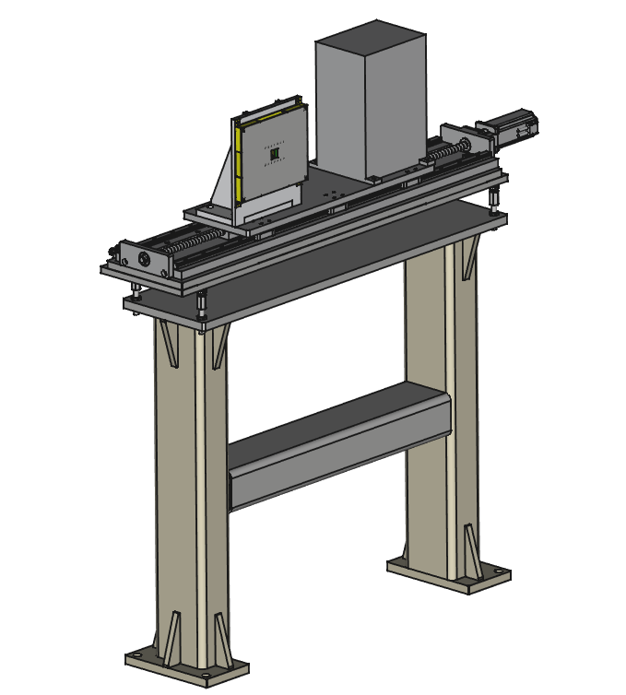
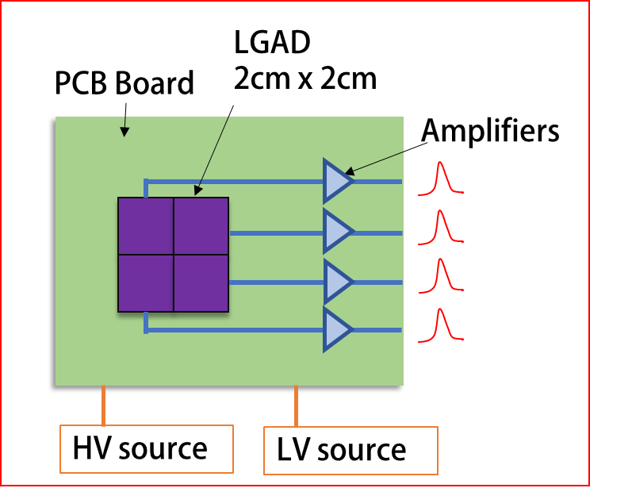
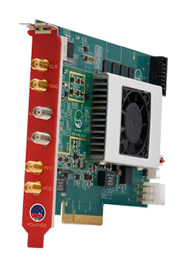
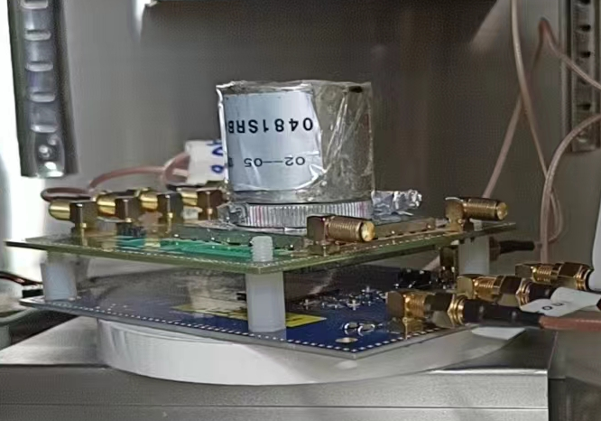
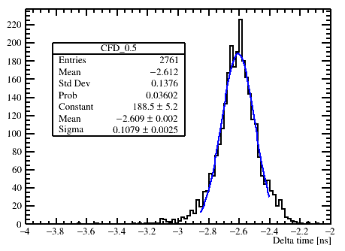
2.2.2 Proton Energy Measurement Device
One 15x15 LGAD matrix is divided into 4 portions.
LGAD pixels in one portions are connected in parallel.
Waveforms acquisition with 6.4 Gsps developed by the EVERACQ Tech. company.
Recent test shows the timing res. is ~ 108 ps.

Slide 13
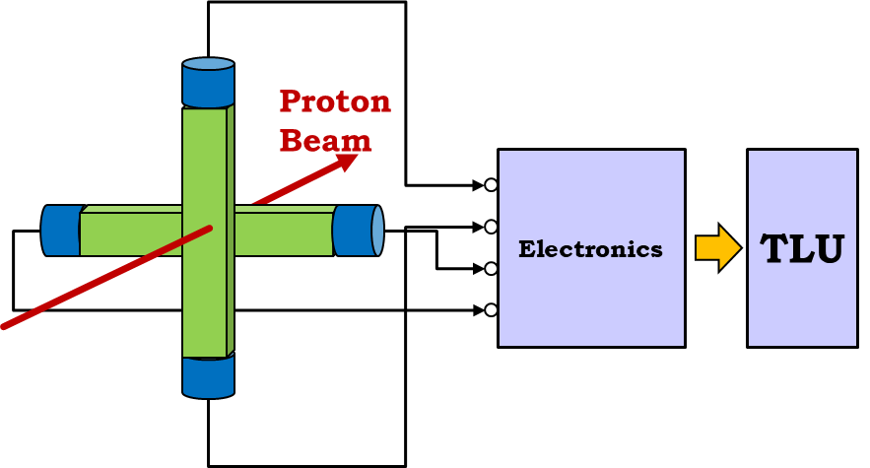
2.3 Trigger System
Data alignment in proton level is required in telescope and energy measurement.
A trigger system is equipped to fan out trigger ID to each detectors.
The trigger ID will be the handle to achieve the data alignment in proton level.
LEMS
Trigger
System
Trigger ID
Telescope
DAQ
system
PALET
PROUD
DUT
Type
Time Stamp
Trigger ID
Trigger ID
Data
Event Alignment

Slide 14
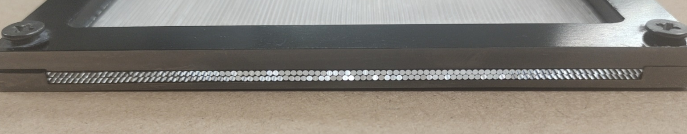
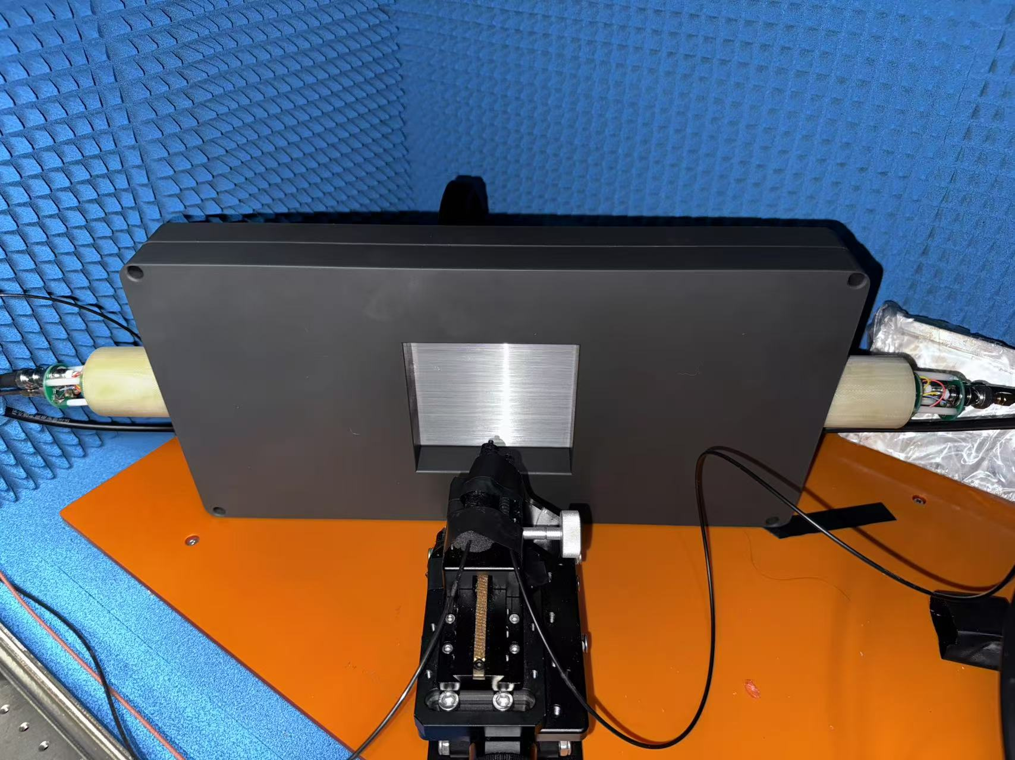
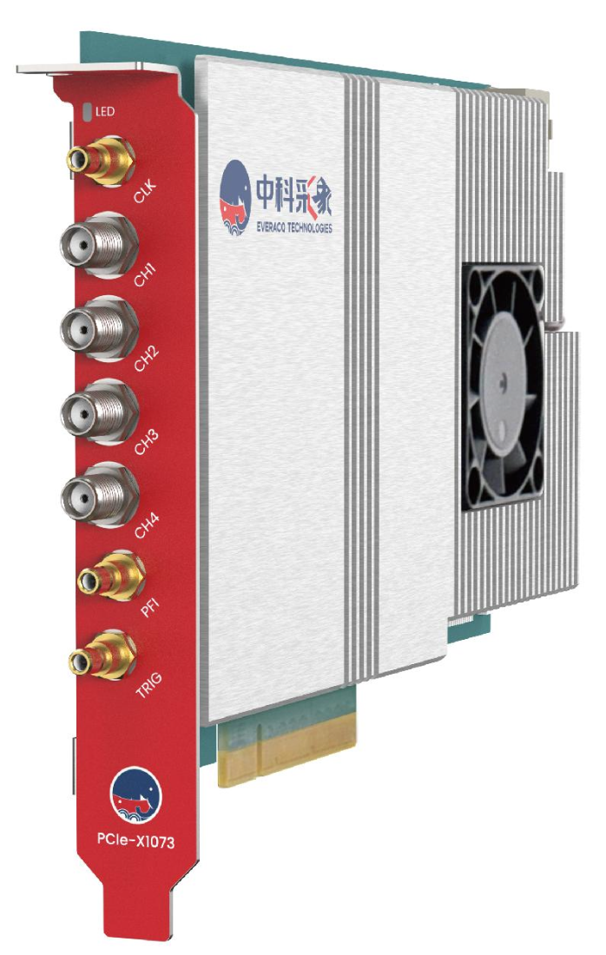
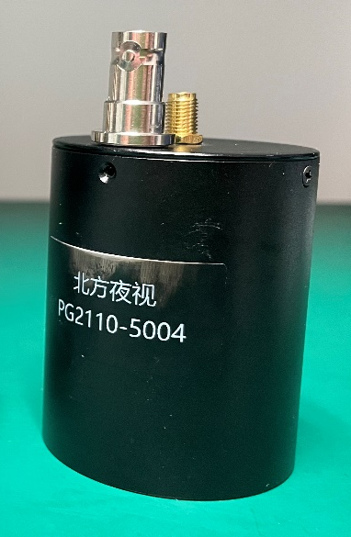
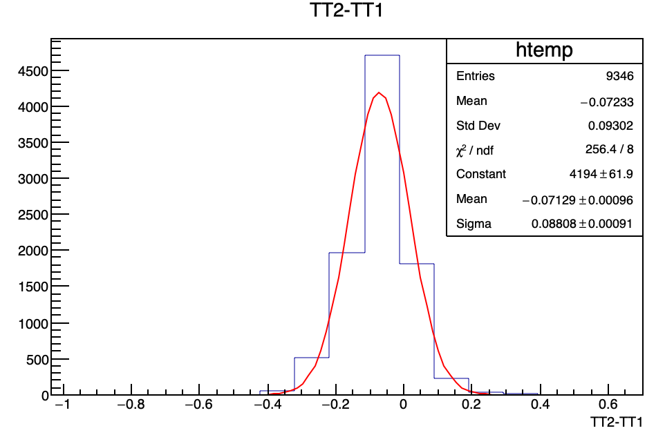
2.3.1 Trigger Detection System
The scintillation fibers + NNVT FPMT
EVERACQ used to produce basic triggers.
Recent test shows a 88 ps trigger time jitter.
Fibers

Slide 15
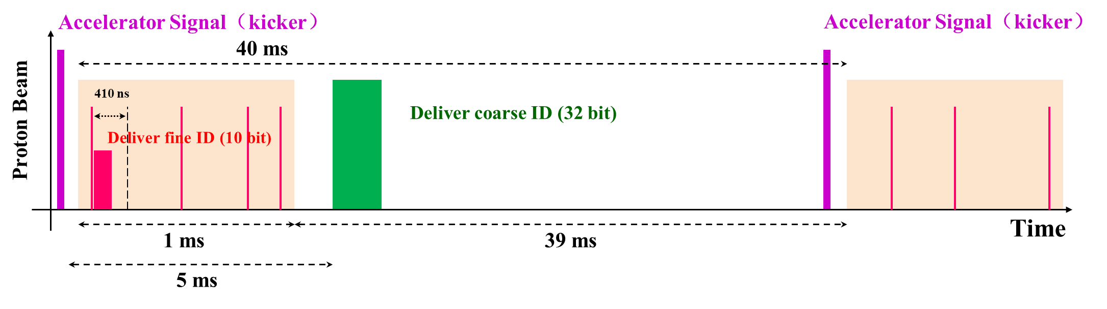
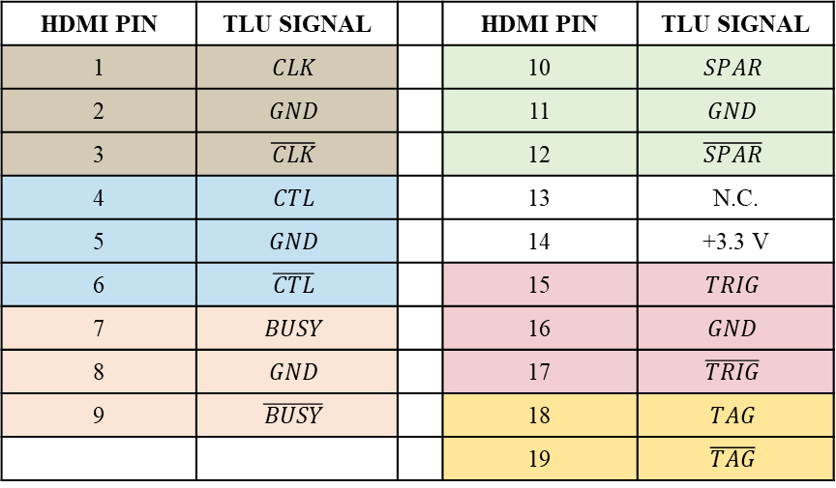
2.3.2 Trigger Logic Unit
Trigger Logic Unit (TLU) is developed based on the design of AIDA-2020.
Trigger ID is split to fine ID and coarse ID, to reduce the signal transition time.
The HPES-TLU is compatible with devices following AIDA trigger standard.
Parameters | AIDA-2020 | HPES-TLU
Delivered Digit of ID | 15 | 10 fineID + 32 coarseID
Time of signal trans. | ~450 ns | 375 ns
Supported TLU mode | eudet/aida | eudet/aida/hpes

Slide 16
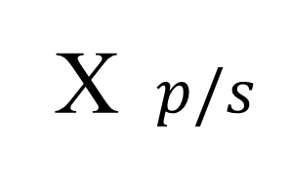
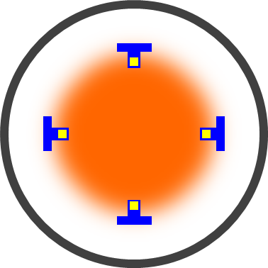
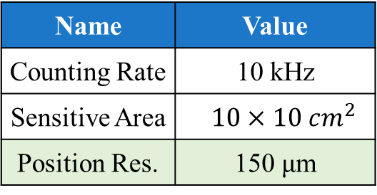
2.4 Beam State Monitors of HPES
Beam State Monitor：Measure the general information of proton beam
Profile Measurement
Flux Measurement
Online Flux Monitor
Micromegas
Scintillator
SiC
Proton Beam
Profile Distribution
Measure Absolute Flux
  Beam Tuning.
  Calibrate the flux every month and year.
Measure Relative flux
Online the beam.
Name | Value
Counting Rate | 10 kHz
Sensitive Area | $$10×10 cm^{2}$$
Position Res. | 150 μm
Requirement：Large Dynamic range.
（10⁴~10⁹ p/s or 0.2~20000 MIP）

Slide 17

3. Summary
A 1.6 GeV proton test beam is under construction in China. Beam supply will start from 2029.
Based on the running plan of CSNS, more than 5000h beam plan will be provided every year.
HPES can provide single particle proton beam to test the performance of detectors.
Several devices will be equipped to HPES:
  Proton beam telescope
  Proton energy measurement device
  Trigger system
  Beam State Monitors
Any creative ideas and cooperation are welcomed.
Contact：Guo Yuhang
Phone：+86 18392181025
Email：guoyh@ihep.ac.cn
Scan to contact with me on WeChat!

Slide 18


致谢
承蒙厚爱
感谢倾听
Thanks!
中国散裂中子源
China Spallation Neutron Source
Development Group of HPES
Director： Jing Hantao
Detector System Expert：
Fan Ruirui（Dongguan）、Dong Mingyi（Beijing）
Proton Beam Design： Han Yanliang
Conceptual Design and Physical Test：Guo Yuhang
Control and DAQ system：
Zhang Hongyu
Trigger System：
Qian Sen, Ma Lishuang
Energy Measurement Device：
Liang Zhijun, Li Mengzhao
Beam Telescope：
Dong Mingyi, Li Lankun
Profile Monitor： Yi Han
Intensity Monitors：
Lv You, Li Qiang, Shi Xin, Xiao Suyu
We are appreciate to their effort and Contributions!

