Slide 1


CERN Beamlines and facilities
P. Alexaki, D. Banerjee, E. Barber, J. Bernhard, M. Brugger, N. Charitonidis, G. Dal Maso, M. van Dijk, S. Fiore, A. Goillot, M. Jaekel, P. Martinengo, F. Metzger, L. Nevay, G. Pezzullo, B. Rae, F. Ravotti, S. Schuh, F. Stummer
19.05.2025

Slide 2
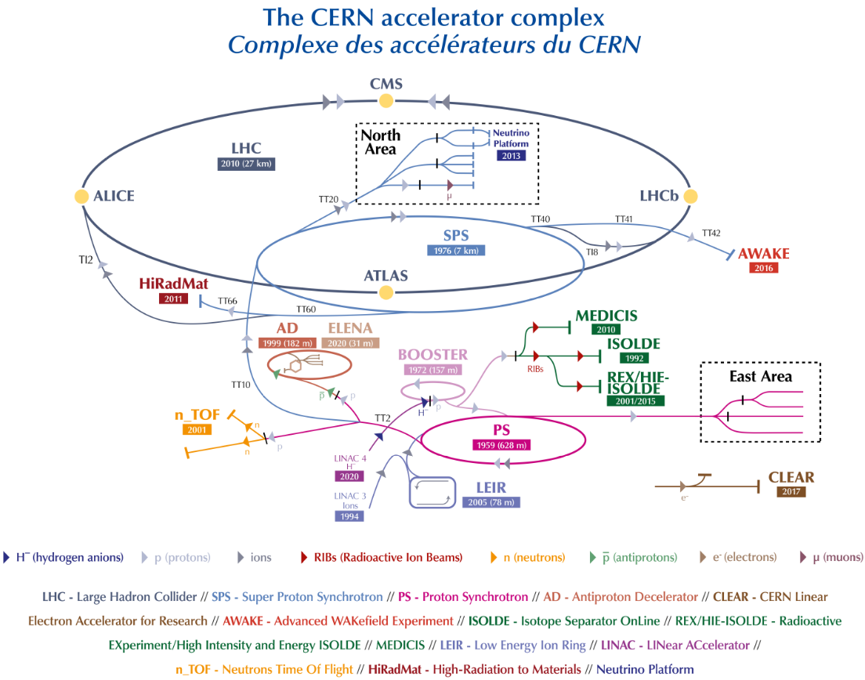
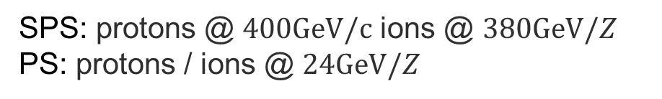
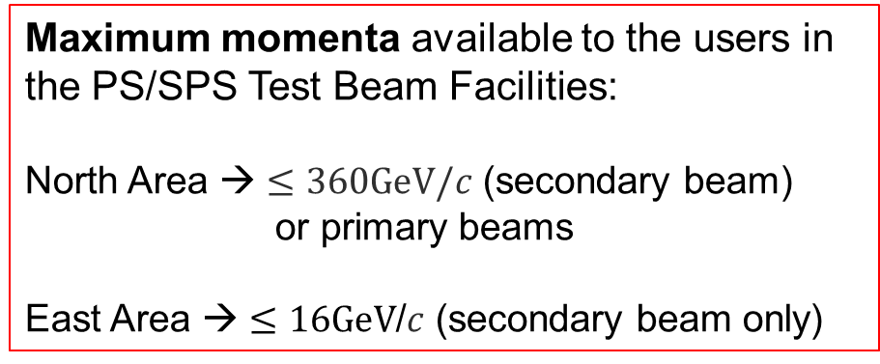
CERN Accelerator Complex
SPS: protons @ $400GeV/c$ ions @ $380GeV/Z$
PS: protons / ions @ $24GeV/Z$
Maximum momenta available to the users in the PS/SPS Test Beam Facilities:
North Area → $≤360GeV/c$ (secondary beam)
or primary beams
East Area → $≤16GeV$/$c$ (secondary beam only)

Slide 3
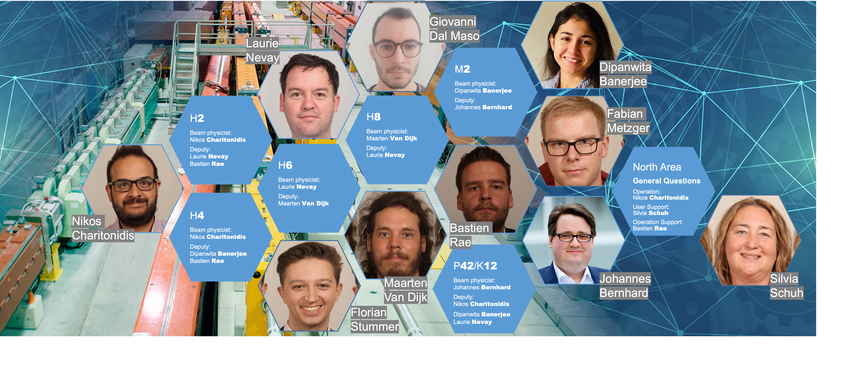
North Area Secondary Beamlines

Slide 4
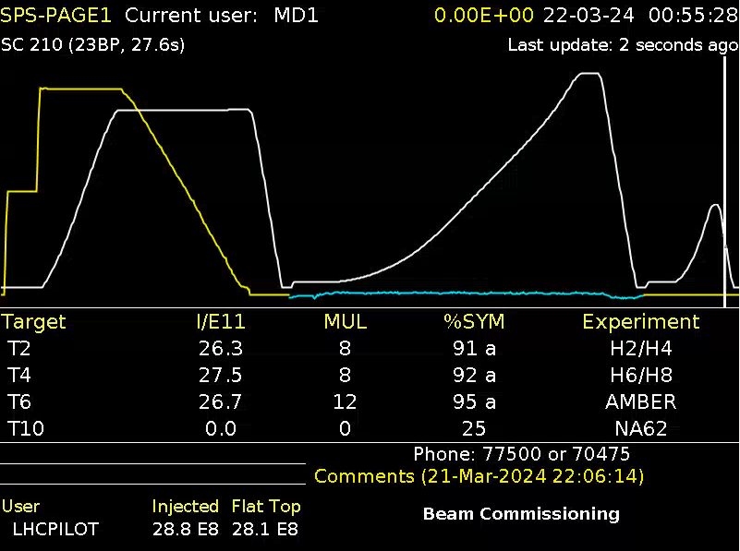
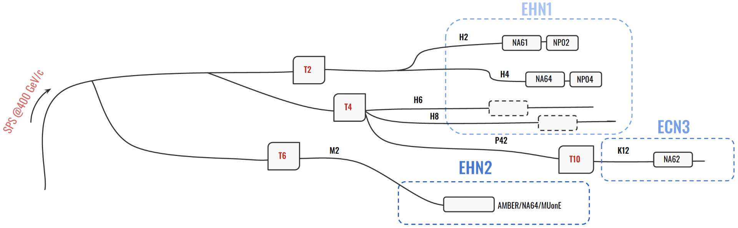
North Area Secondary Beamlines
Current in
main bends
Time
line
Spill of 4.8s flat top (14.4s for full North cycle)
  The 400 GeV/c primary beam is slowly extracted to three primary targets → T2, T4, T6
  Typically 3 cycles / SPS supercycle for North Area
  for a total of ~3000 spills / day
  Supercycle structure depends on
  SPS physics program (LHC, AWAKE,
  HiRadMat, Machine Development)
North Area will be renovated in
upcoming long shutdowns
  Dedicated talk by L. Nevay next!
Proton
intensity
(also intensity)
Intensity at North Area targets
Quality
of the steering on the target

Slide 5
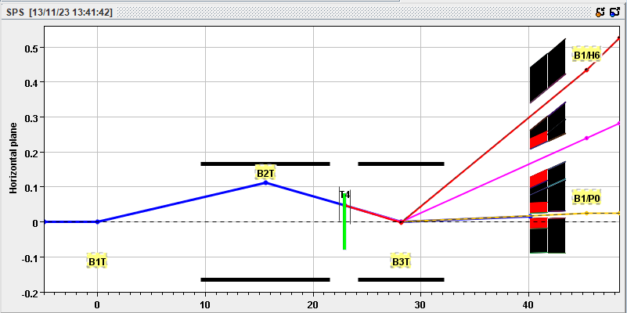
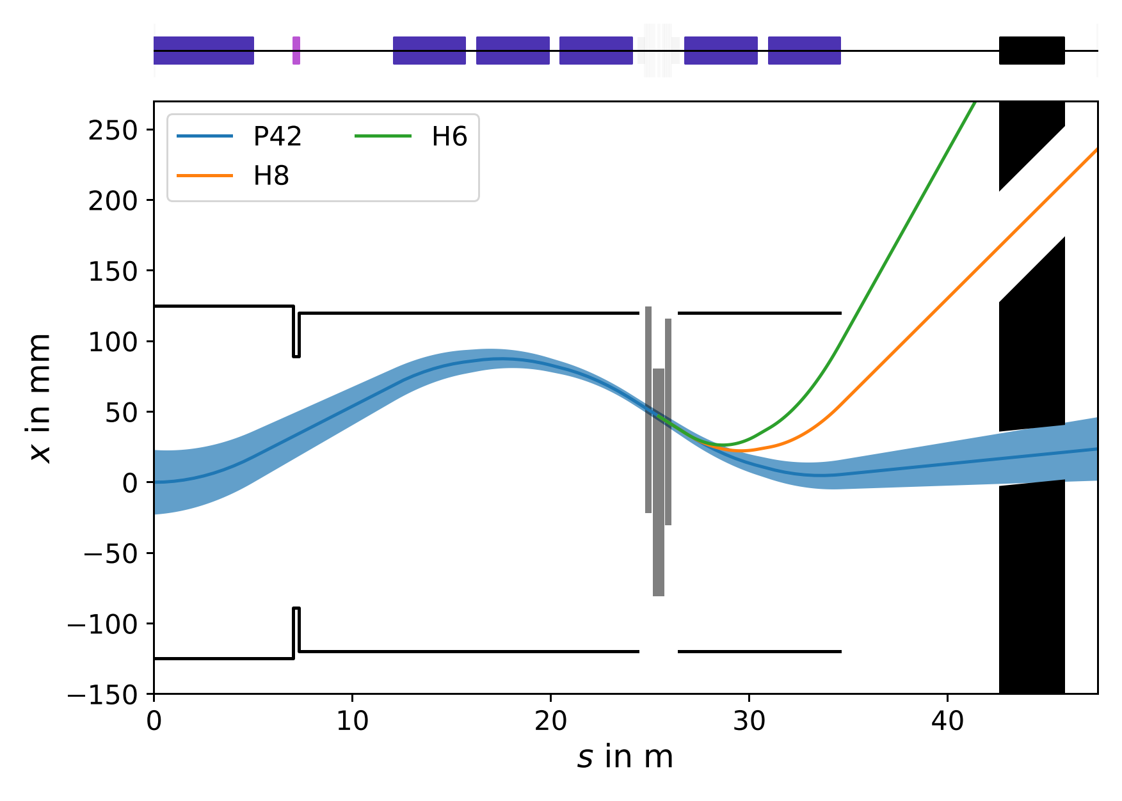
North Area target wobbling
+120
T4 standard wobbling
Beam on target produces all momenta below
primary momentum (400 GeV/c)
  Magnet behind target bends secondaries to angle
  depending on momentum
  Three beamlines can be served simultaneously
  Changing position and angle target (B1+B2) and final
  magnet (B3) allows to send a variety of beams
  Momenta sent to three beamlines (H6/H8/P42)
  selected simultaneously (and with limited choices)
Wobbling of the T4 target shown
  T2 wobbling similar (goes to H2/H4)
  T6 has no wobbling (only for muon/hadron beamline M2)
+180
+400
TAX
(these are the same picture)
+120 GeV
+180 GeV
+400 GeV
TAX

Slide 6
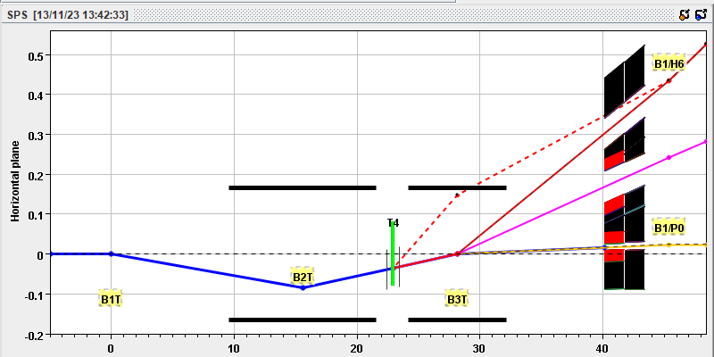
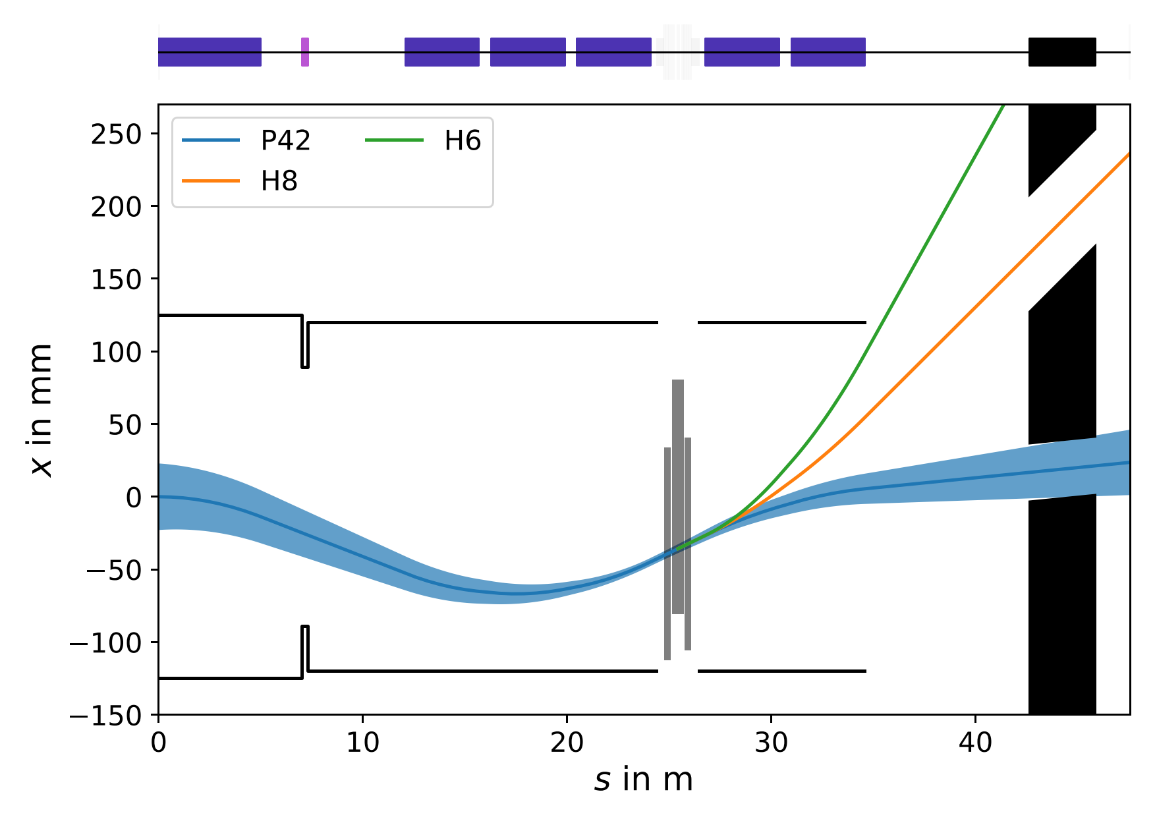
North Area target wobbling
-120
T4 alternate wobbling
Beam on target produces all momenta below
primary momentum (400 GeV/c)
  Magnet behind target bends secondaries to angle
  depending on momentum
  Three beamlines can be served simultaneously
  Changing position and angle target (B1+B2) and final
  magnet (B3) allows to send a variety of beams
  Momenta sent to three beamlines (H6/H8/P42)
  selected simultaneously (and with limited choices)
Wobbling of the T4 target shown
  T2 wobbling similar (goes to H2/H4)
  T6 has no wobbling (only for muon/hadron beamline M2)
-300
+400
TAX
(these are the same picture)
-120 GeV
-300 GeV
+400 GeV
TAX

Slide 7
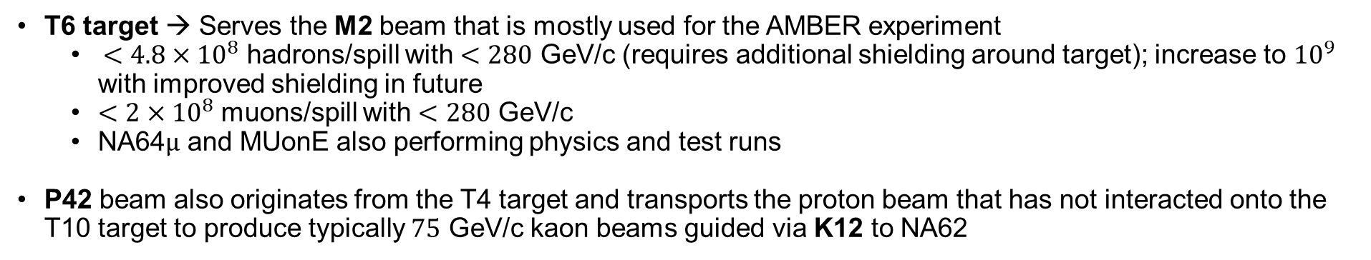
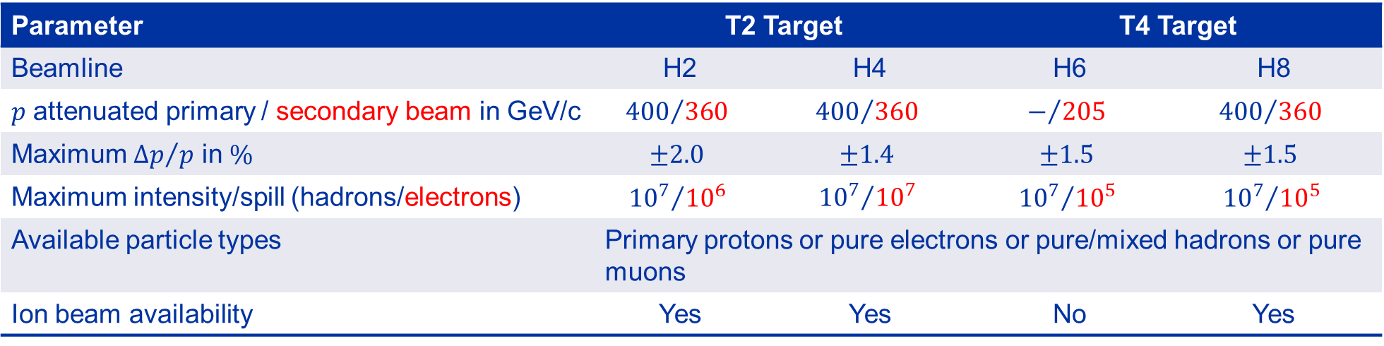
Characteristics of the beams
Parameter | T2 Target |  | T4 Target
Beamline | H2 | H4 | H6 | H8
$p$ attenuated primary / secondary beam in GeV/c | $${400}/{360}$$ | $${400}/{360}$$ | $$−/{205}$$ | $${400}/{360}$$
Maximum ${∆p}/p$ in $\%$ | $$±2.0$$ | $$±1.4$$ | $$±1.5$$ | $$±1.5$$
Maximum intensity/spill (hadrons/electrons) | $${{10}^{7}}/{{10}^{6}}$$ | $${{10}^{7}}/{{10}^{7}}$$ | $${{10}^{7}}/{{10}^{5}}$$ | $${{10}^{7}}/{{10}^{5}}$$
Available particle types | Primary protons or pure electrons or pure/mixed hadrons or pure muons
Ion beam availability | Yes | Yes | No | Yes
T6 target → Serves the M2 beam that is mostly used for the AMBER experiment
  $<{4.8×10}^{8}$ hadrons/spill with $<280$ GeV/c (requires additional shielding around target); increase to ${10}^{9}$ with improved shielding in future
  $<2×{10}^{8}$ muons/spill with $<280$ GeV/c
  NA64$μ$ and MUonE also performing physics and test runs
P42 beam also originates from the T4 target and transports the proton beam that has not interacted onto the T10 target to produce typically $75$ GeV/c kaon beams guided via K12 to NA62

Slide 8
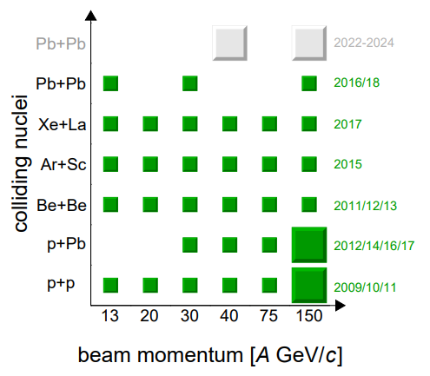
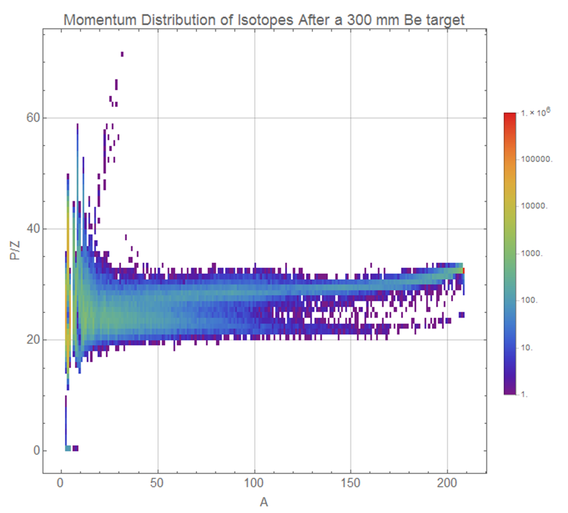
Ion beams
Courtesy: NA61
Ion beams are available in the North Area
  Typically 2-4 weeks at the end of the year (typically with lead ions)
  Argon and xenon beams have also been used in the last decade
  2025 also has an oxygen run in July (1 week)
Primary and fragmented ion beams are available
  Primary beam set by general program, usually driven by NA61 in H2
  2024: 3 weeks @ 150 AGeV/c Pb ions and 1 week @ 13.5 AGeV/c
  Fluence highly adjustable, between 10³ – 10⁵ primary or fragments / spill
  Fluence is limited by RP considerations, with special measures 10⁷ primary
Test beam users like Medipix, Nucleon, HERD, PAN request ions
HEARTS/CHIMERA requested low energy ions in T08

Slide 9
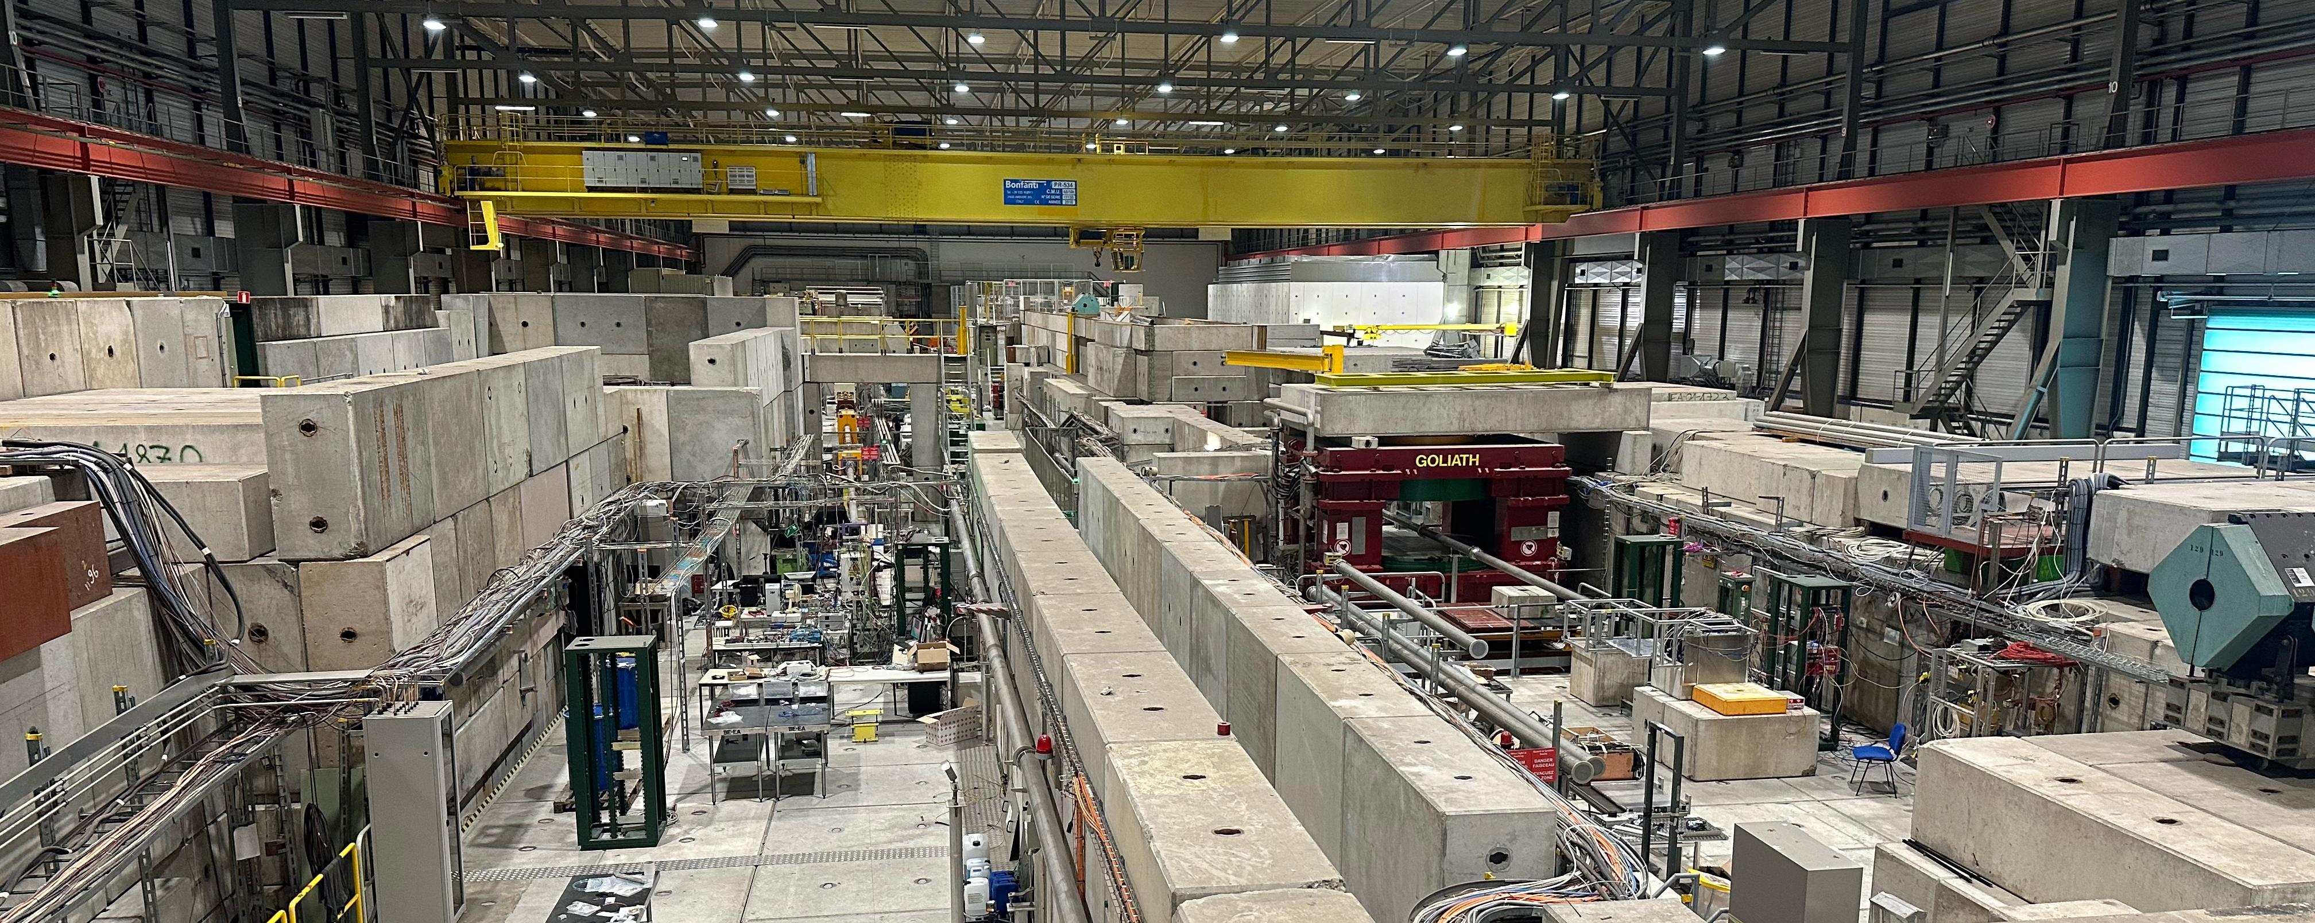
EHN1 (B-887, Prevessin Site)
H8
H2
H4
H6

Slide 10
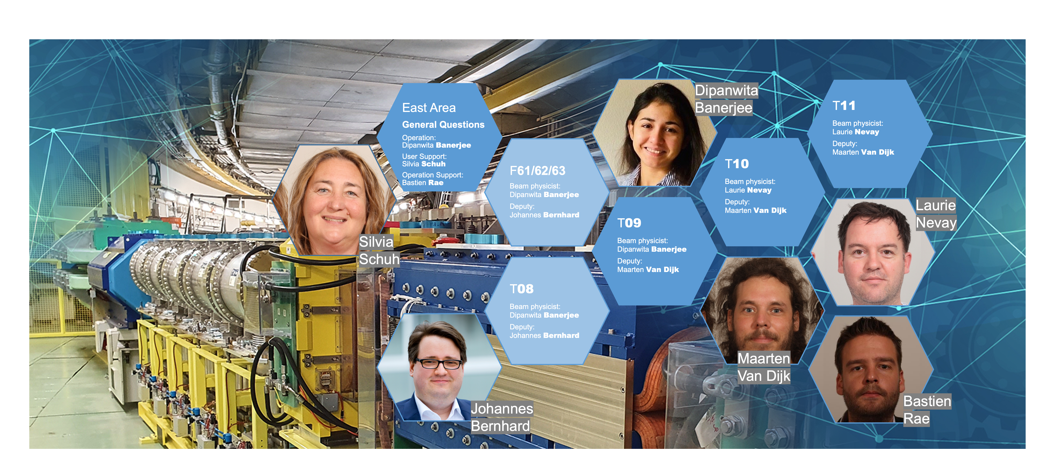
East Area – Secondary Beamlines

Slide 11
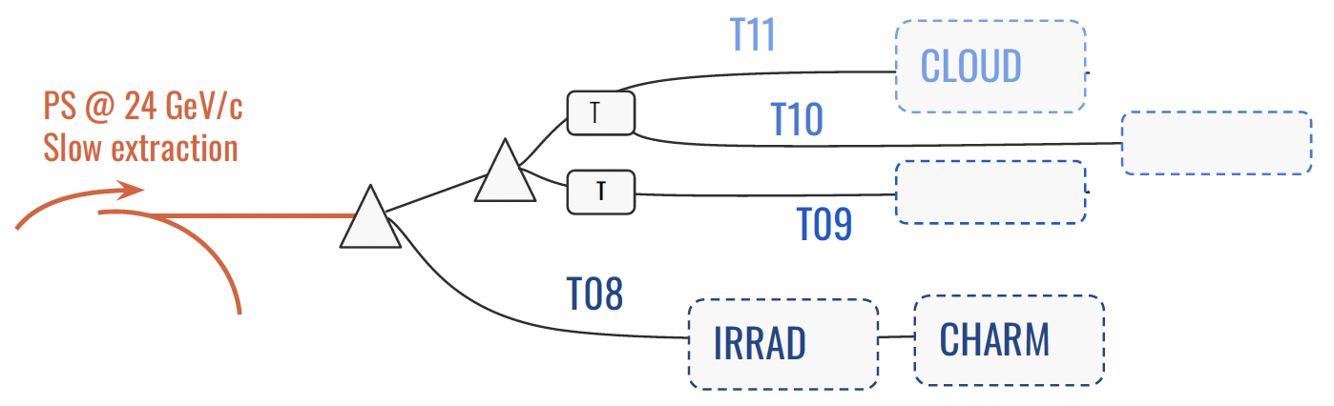
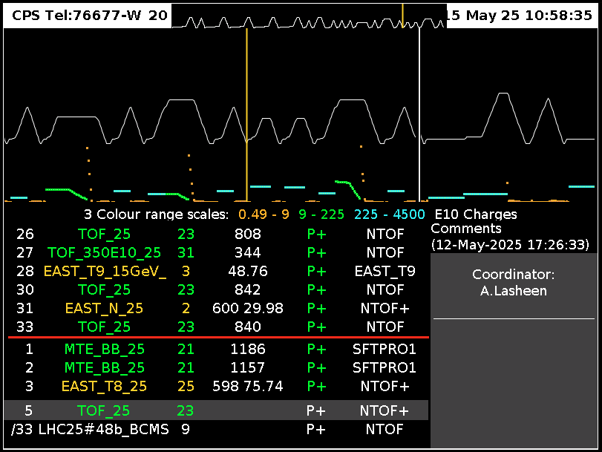
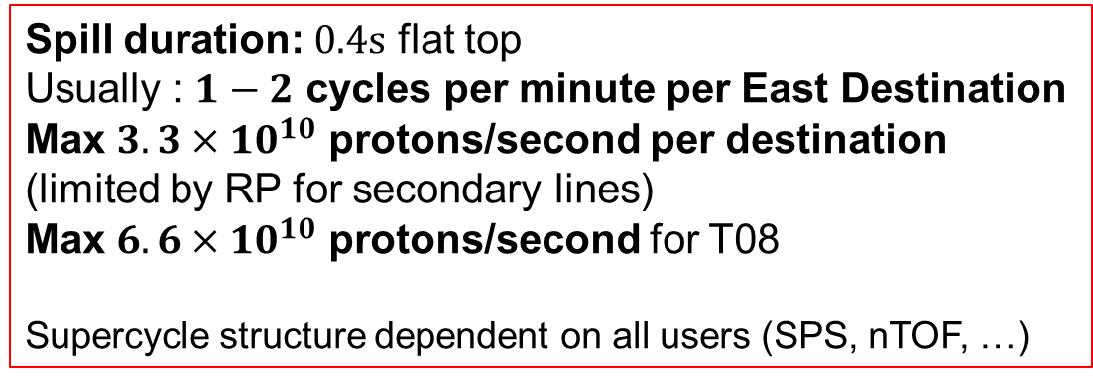
East Area Secondary Beamlines
Spill duration: $0.4s$ flat top
Usually : $1−2$ cycles per minute per East Destination
Max $3.3×{10}^{10}$ protons/second per destination (limited by RP for secondary lines)
Max $6.6×{10}^{10}$ protons/second for T08
Supercycle structure dependent on all users (SPS, nTOF, …)
The East Area was extensively renovated in LS2

Slide 12
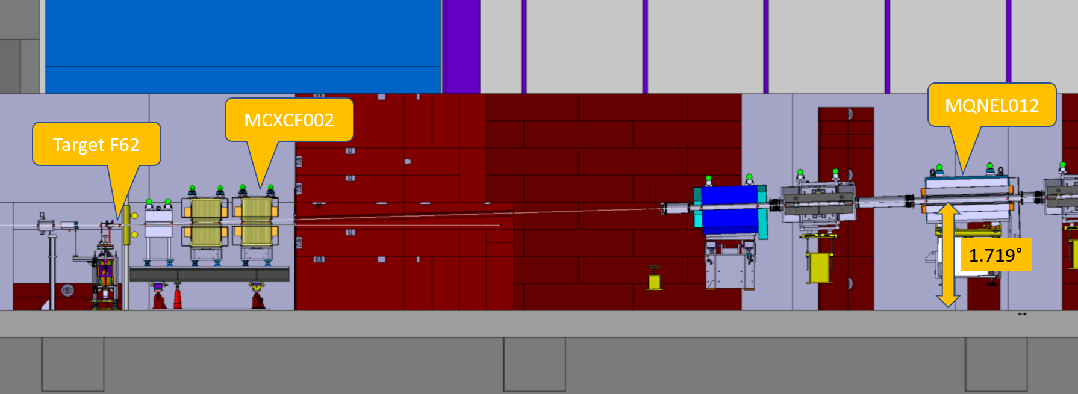
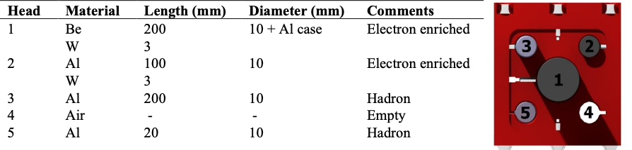
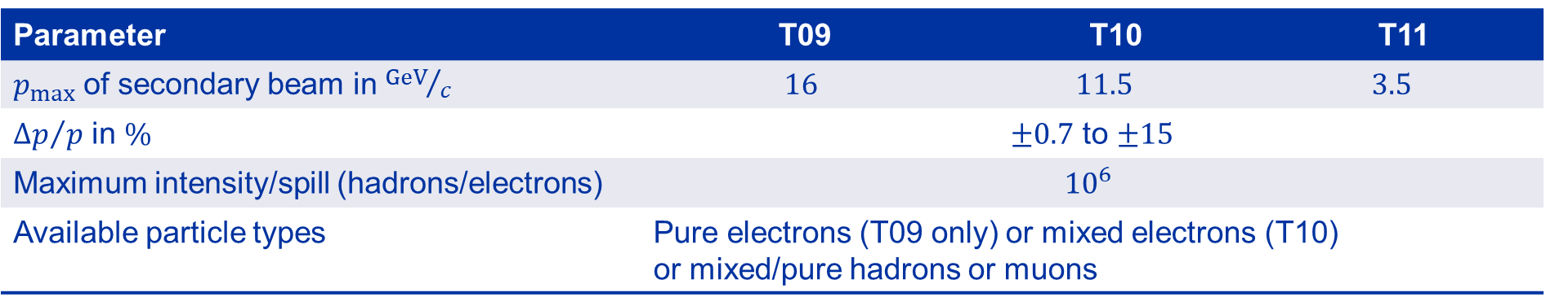

Characteristics of the beams
Parameter | T09 | T10 |  | T11
$p_{max}$ of secondary beam in ${GeV}/c$ | $$16$$ | $$11.5$$ | $$3.5$$
${∆p}/p$ in $\%$ | $±0.7$ to $±15$
Maximum intensity/spill (hadrons/electrons) | $${10}^{6}$$
Available particle types | Pure electrons (T09 only) or mixed electrons (T10) or mixed/pure hadrons or muons
T11 serves the CLOUD experiment which is a permanent installation
$30−35mrad$ vertical production angle
Multi-target configuration

Slide 13
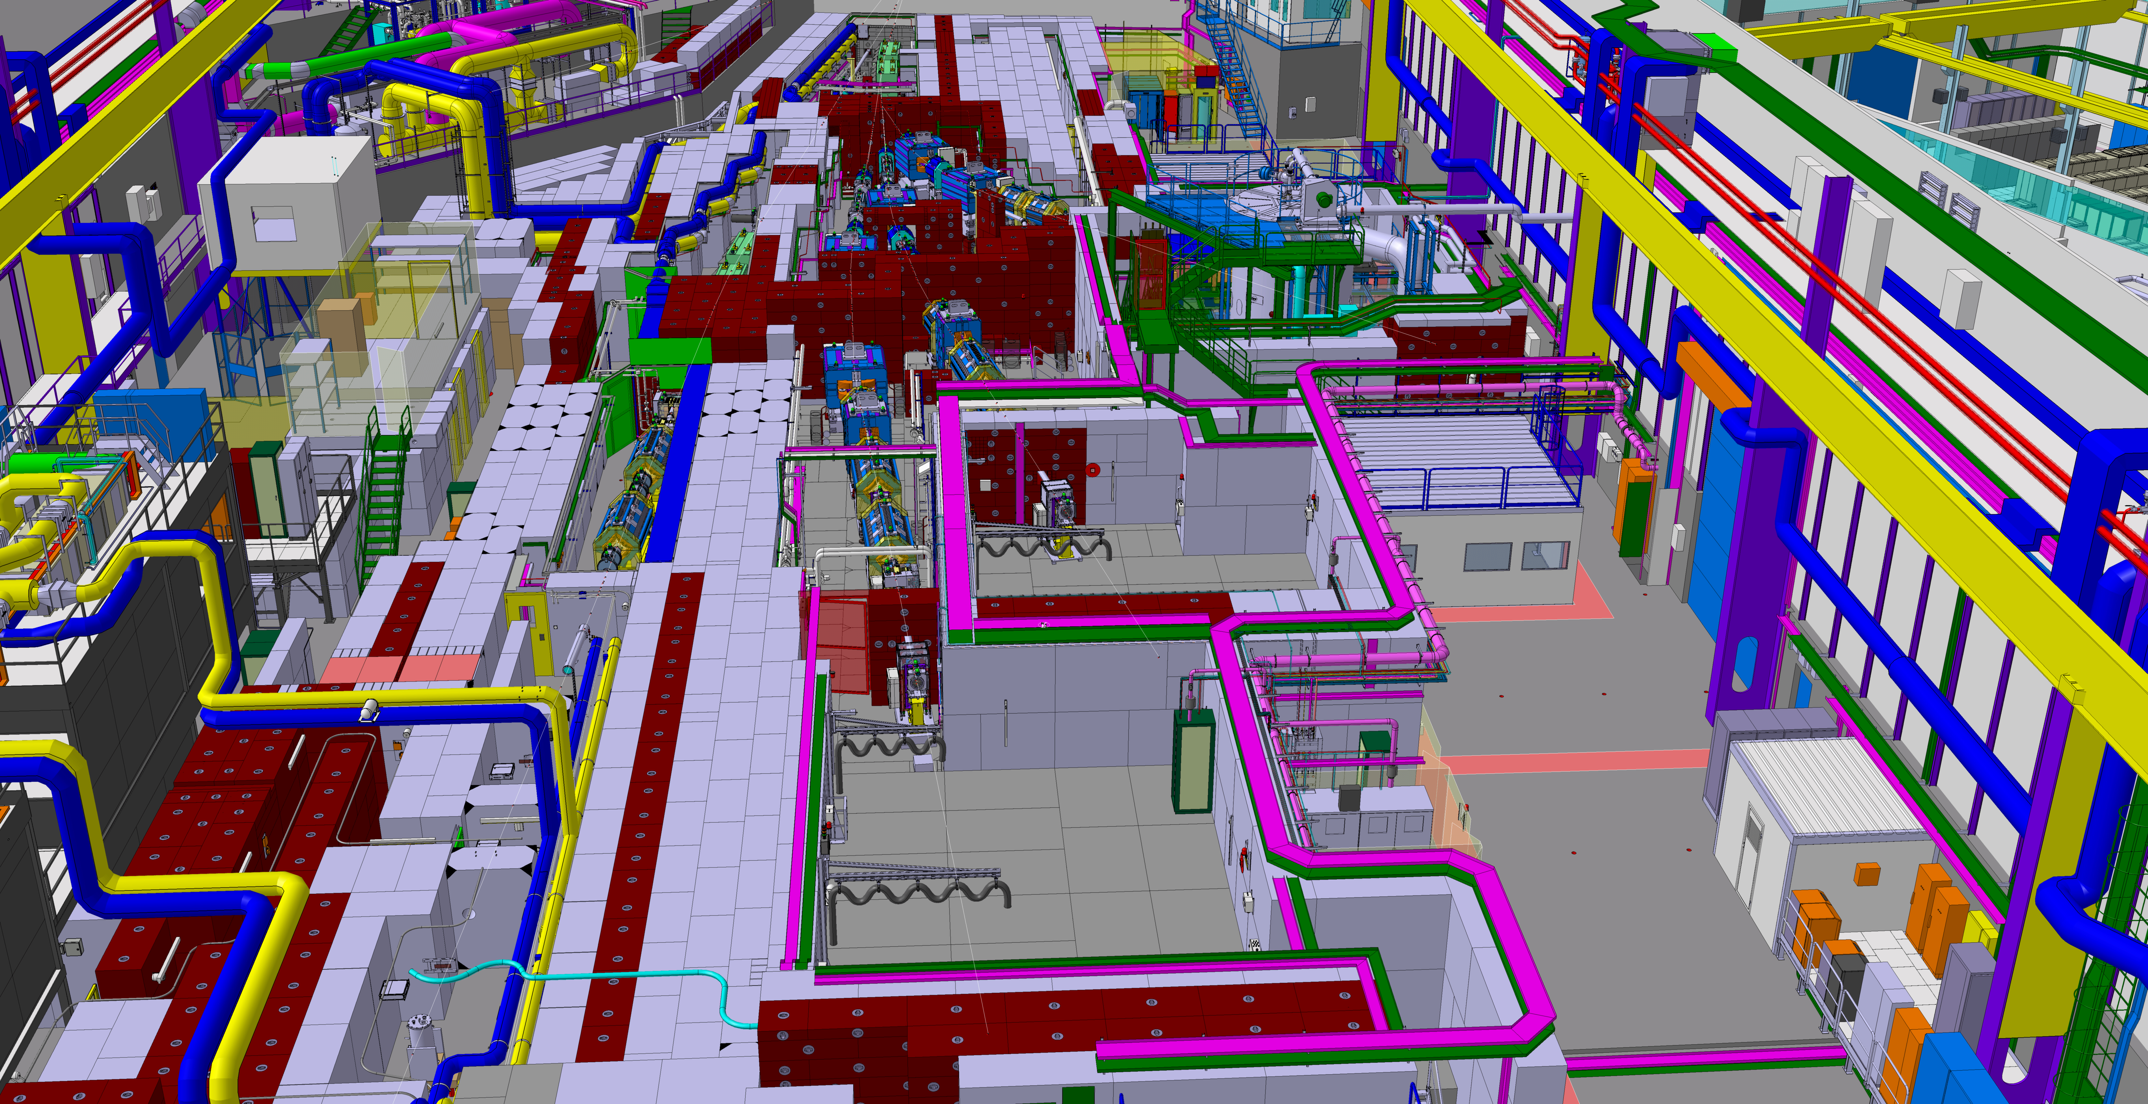
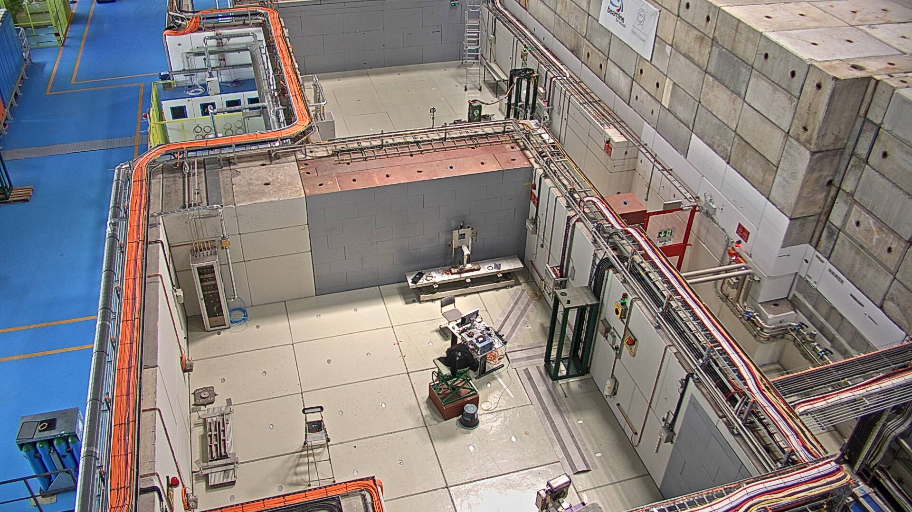
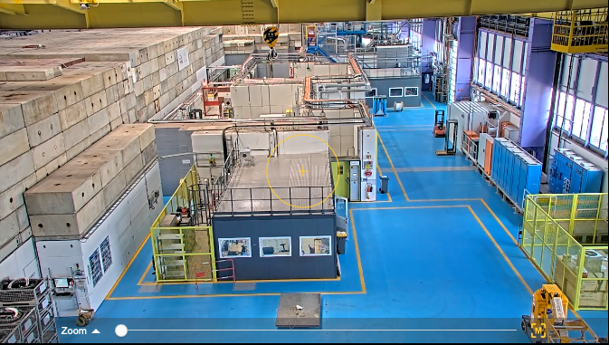
East Area (B-157)
Beam
Beam
T09
T11
T11
T10
T10
T09
T10
T08
T08
T09
Beam

Slide 14
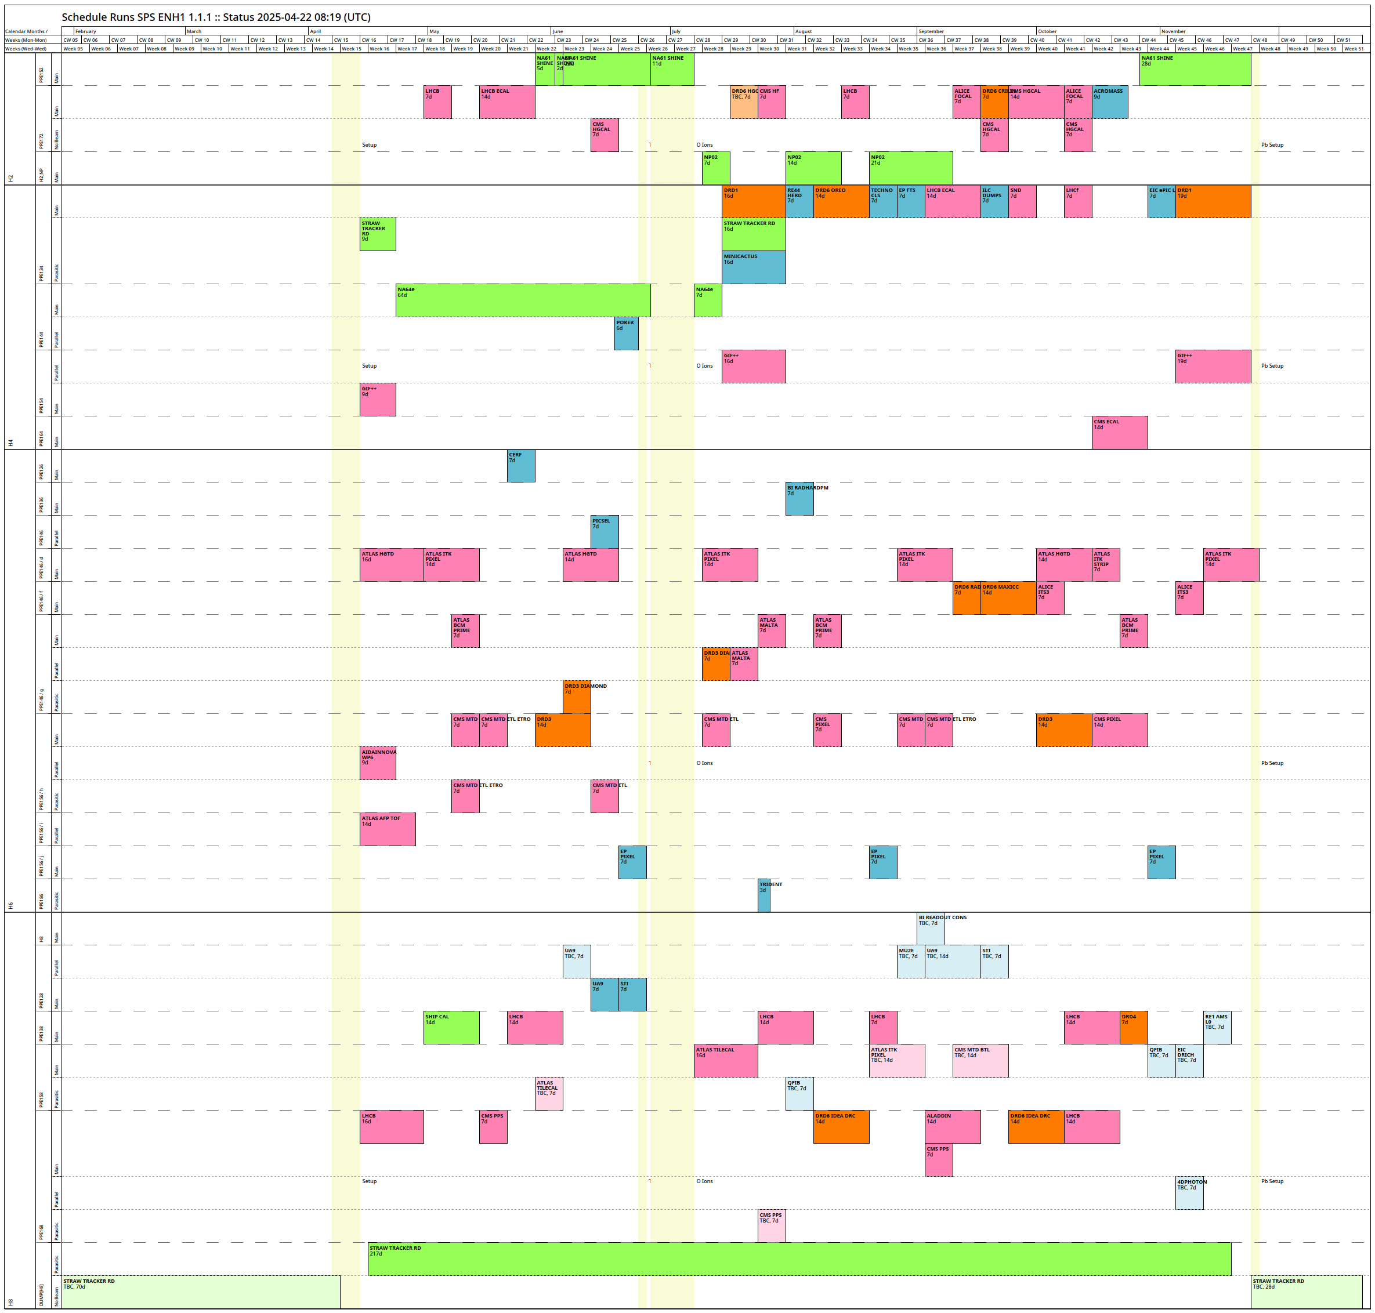
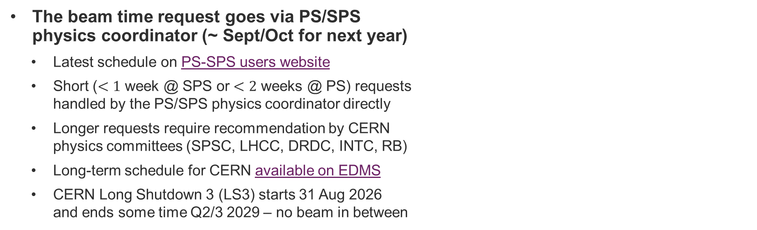
Schedule and planning
(North and East Area)
Current North Area schedule (v1.1.1)
Scheduling is based on priorities of different experiments and is defined by the SPS coordinator & scientific committees and approved by the CERN research board
Dedicated talk by PS/SPS coordinator
(M. Jaekel)
today at 15:30!
The beam time request goes via PS/SPS
physics coordinator (~ Sept/Oct for next year)
  Latest schedule on PS-SPS users website
  Short ($<1$ week @ SPS or $<2$ weeks @ PS) requests
  handled by the PS/SPS physics coordinator directly
  Longer requests require recommendation by CERN
  physics committees (SPSC, LHCC, DRDC, INTC, RB)
  Long-term schedule for CERN available on EDMS
  CERN Long Shutdown 3 (LS3) starts 31 Aug 2026
  and ends some time Q2/3 2029 – no beam in between

Slide 15




Irradiation facilities
Coordinator: F. Ravotti
Coordinator: S. Fiore
Coordinator: P. Martinengo
Coordinator: R. Garcia Alia

Slide 16
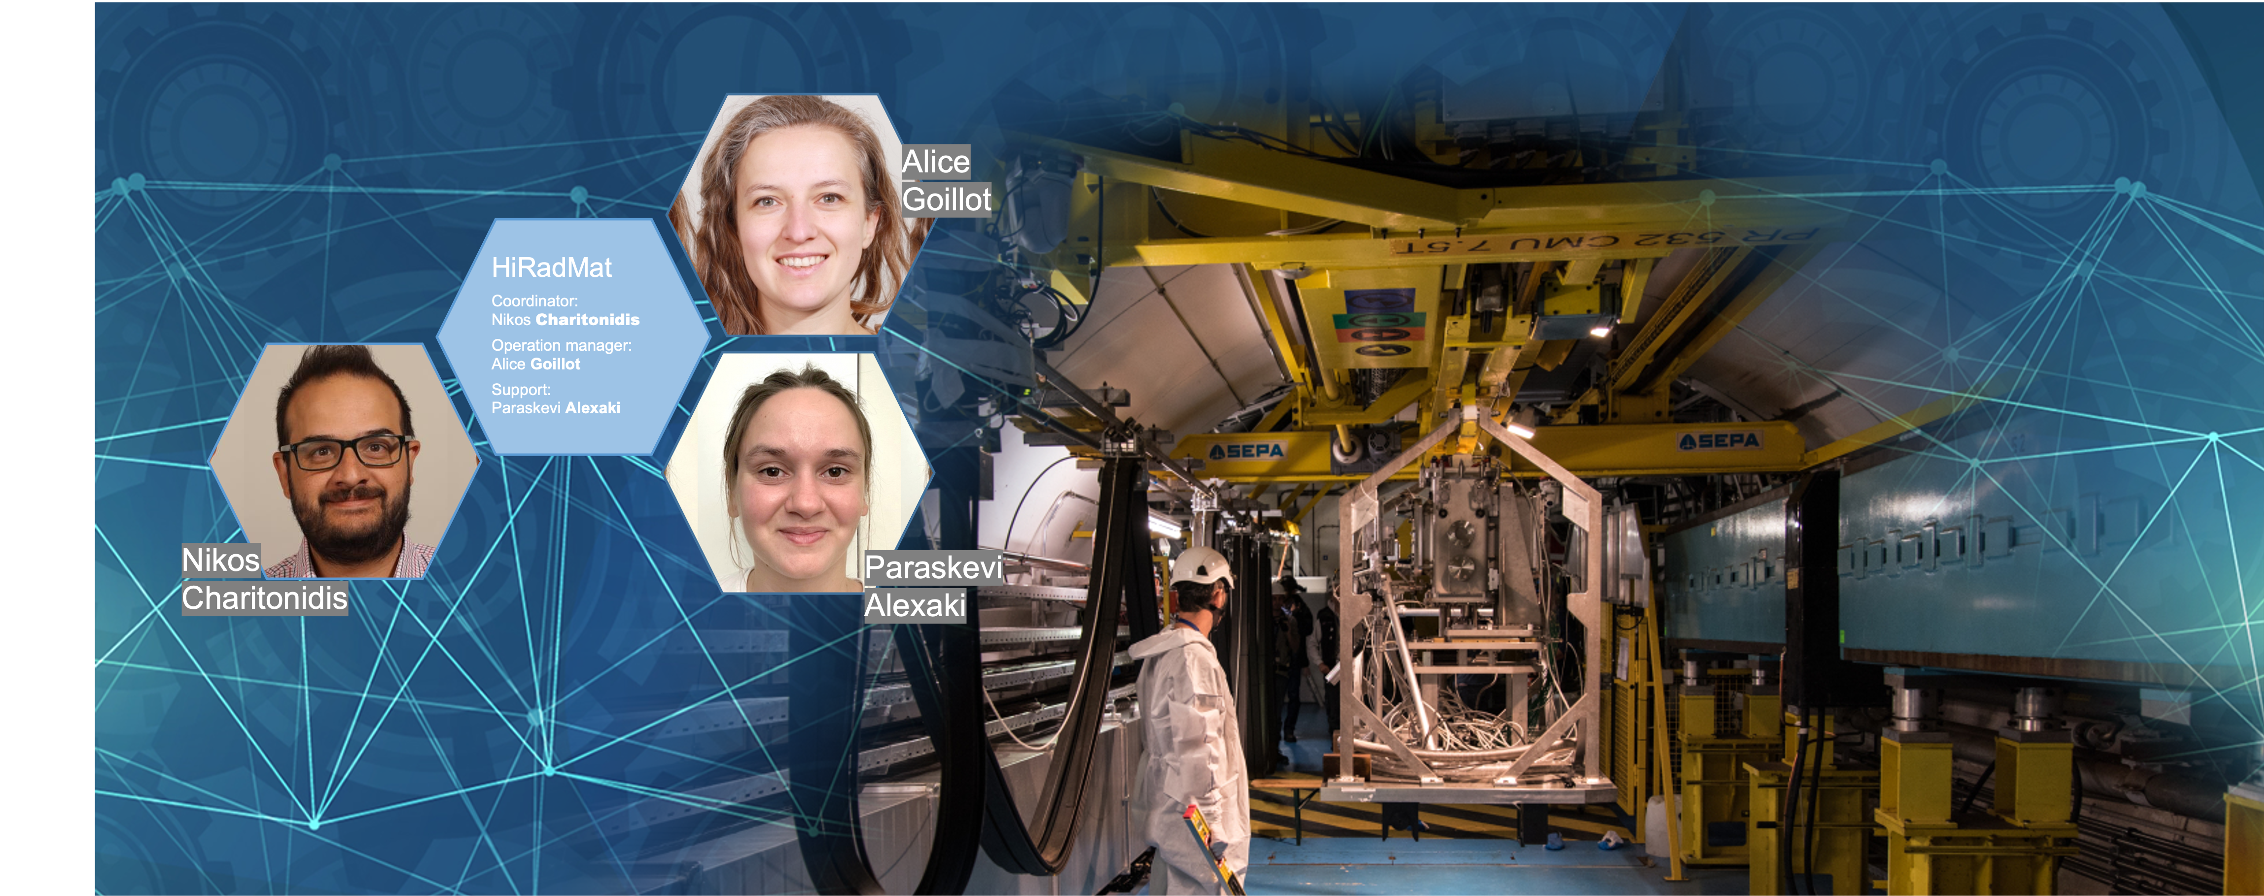
HiRadMat

Slide 17
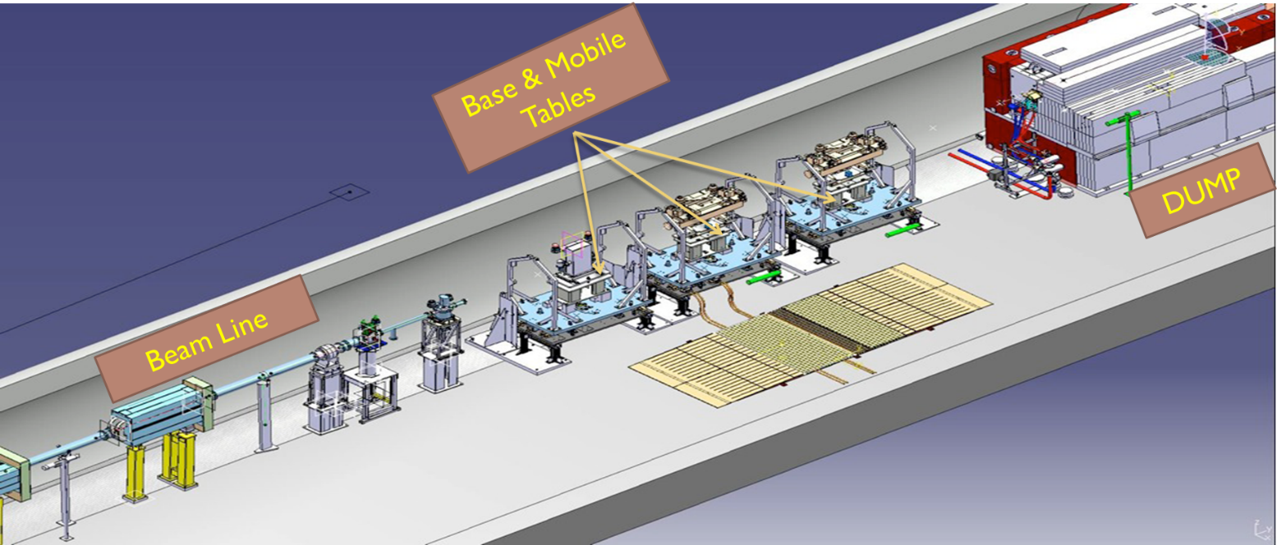
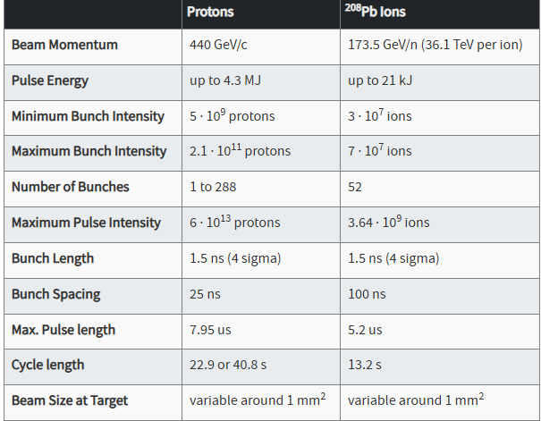
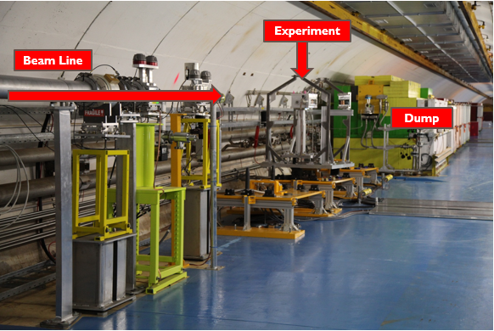
HiRadMat: High Radiation to Materials
3 stands for experiments underground
Supporting remote installation and transport to a dedicated cool—down zone
Automatic connections for signals, electricity (low and high voltage) and water
Preparation lab at surface
Safe commissioning / installation and pre-flight check of the experiment
Availability of various experimental instruments:
High Speed Camera, Laser-Doppler Vibrometer, Microphones,
Beam Loss Monitors...
Beam from SPS
440 GeV/c
Experiment @ HiRadMat
Application for beam time
2. Initial discussion with facility’s management
3. Review by Scientific Board
4. Review by Technical Board
For more information :
http://www.cern.ch/hiradmat
hiradmat.sps@cern.ch

Slide 18
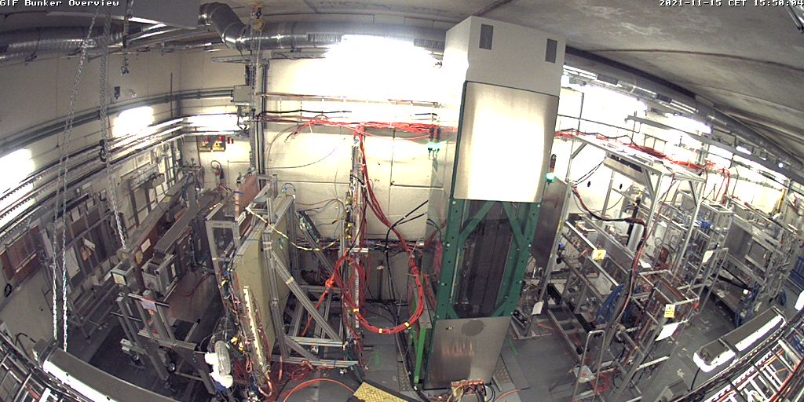

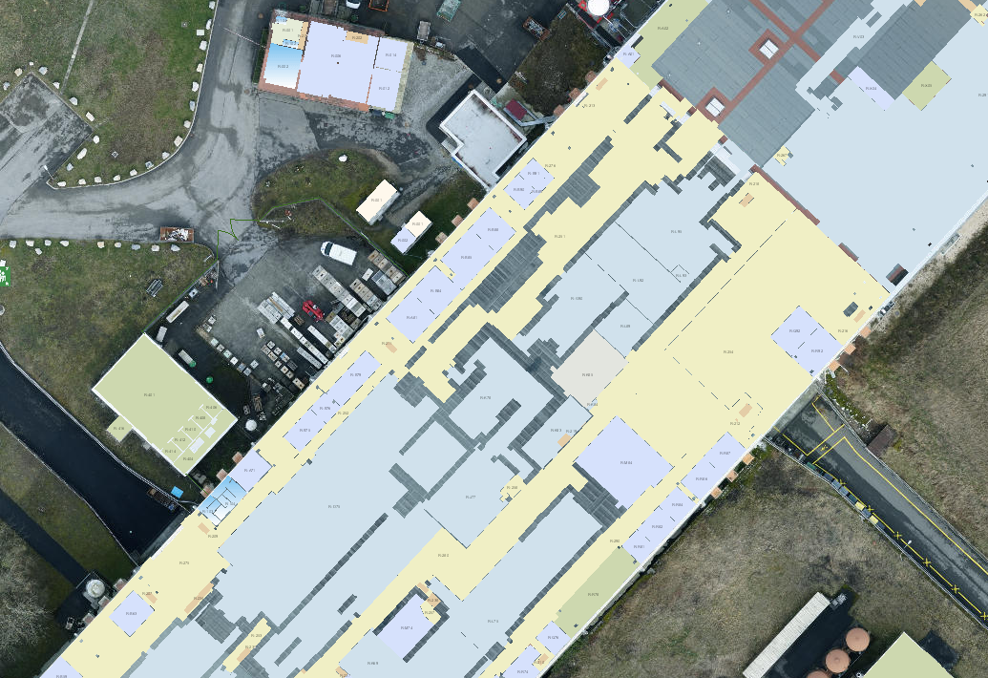
GIF++ irradiation facility @ North Area (H4)
Irradiator operation
throughout
the whole
year
Irradiation Bunker
GIF++ combines high energy muon beam with
12 TBq* ¹³⁷Cs gamma source
  Joint EP & BE facility, operated by EP-DT
  Designed for testing real size detectors
  ≈100 m² irradiation fields, 2 irradiation zones with independent attenuation systems
  Central Control System, wide range of available gases
  (+ custom gases), common DCS…
Detector validation tests under realistic conditions: high radiation background & muon beam
  Ageing studies under HL-LHC radiation conditions
  Search for eco-friendly gas mixtures
  Mass-production test of muon chambers
  Radiation tests of electronics and optical components
*) 14TBq as of 2014
Cs 137
muon beam
downstream field
upstream field
SALEVE
Neutrino
Platform
CMS ECAL
Service Area
(electronics, gas)
Preparation Area
H4 beam line
Control Room

Slide 19
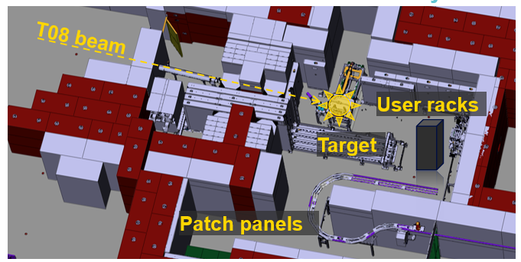
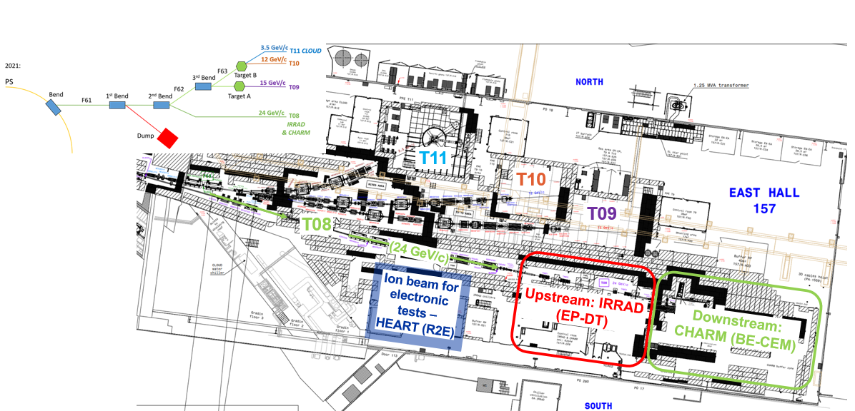


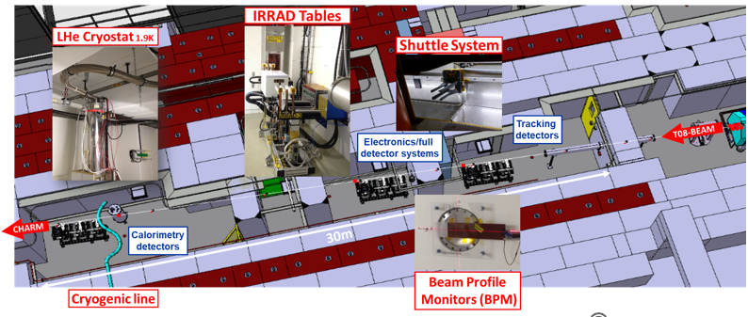
IRRAD / CHARM Irradiation Facilities (T08)
Testing of electronics components with heavy ion (Pb) beams (typically ~2w per year) on the T8 beam line.

Slide 20
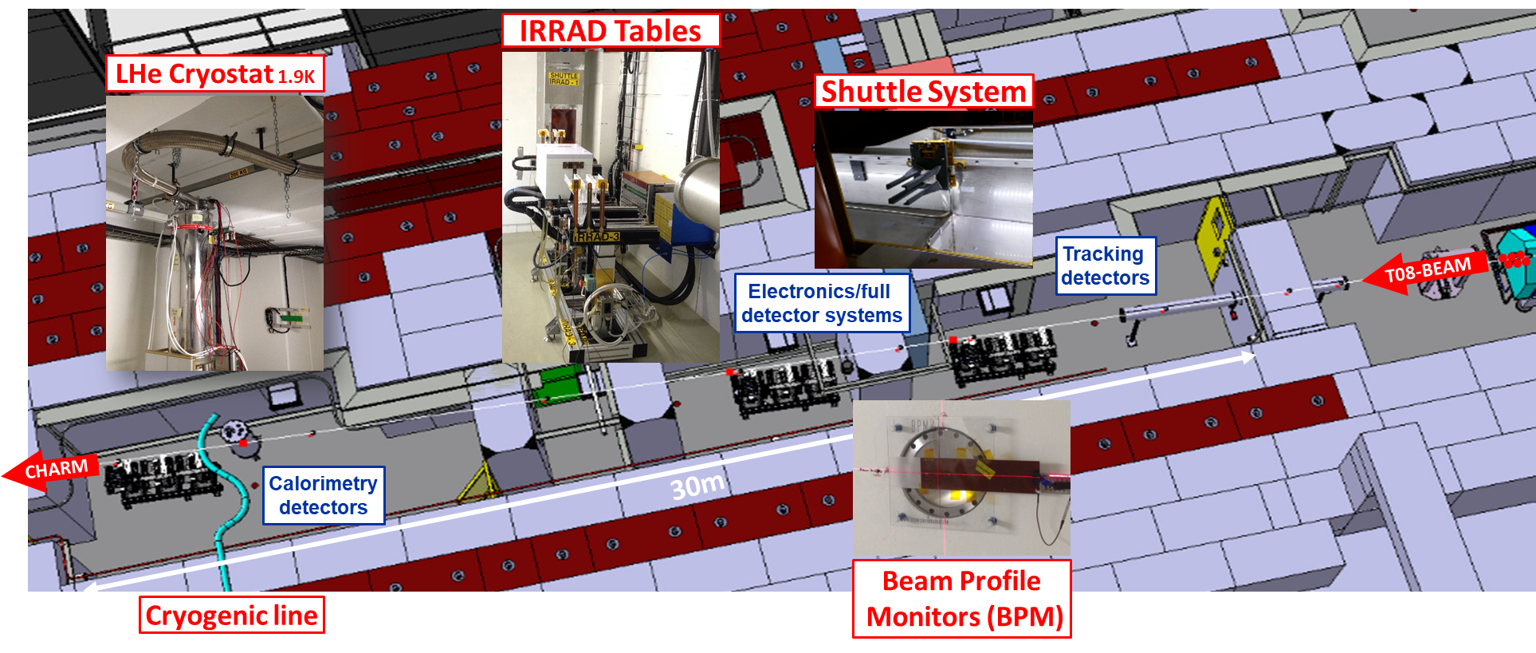
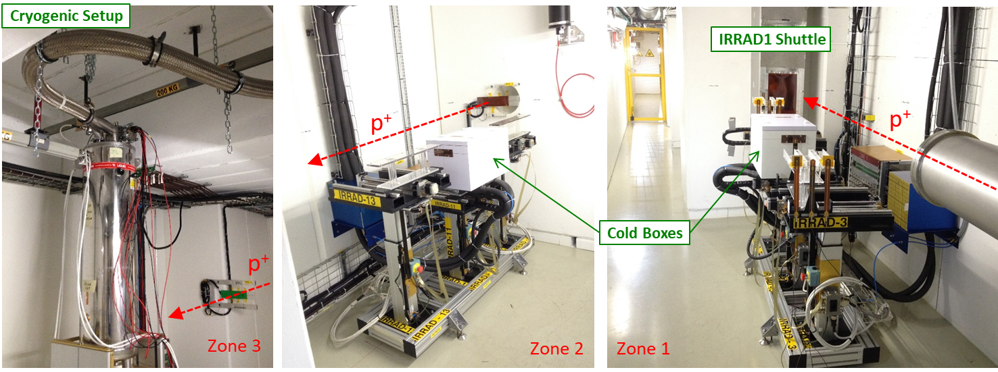
Proton Facility IRRAD (CERN EP)
24 GeV/c protons
  400ms spills
  ~8×10¹¹ protons per spill
~1×10¹⁶ n_{(1 MeV Si eq,)} / cm² / w
  beam spot 12x12mm2 FWHM
1 shuttle system (small samples)
9 irradiation tables
  6x room temperature
  2x cold boxes (-25°C)
  1x cryogenic setup (1.9K)
local user infrastructure

Slide 21
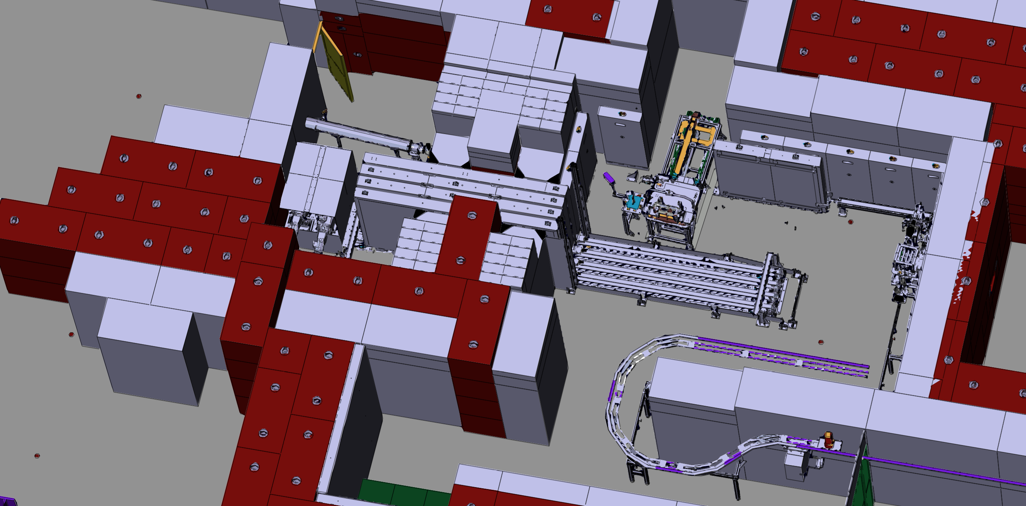
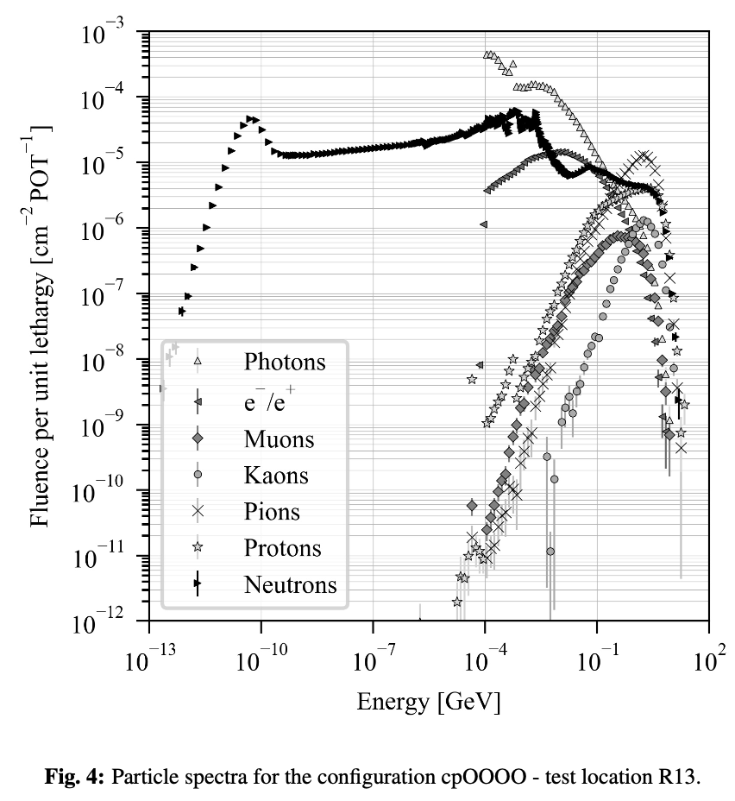
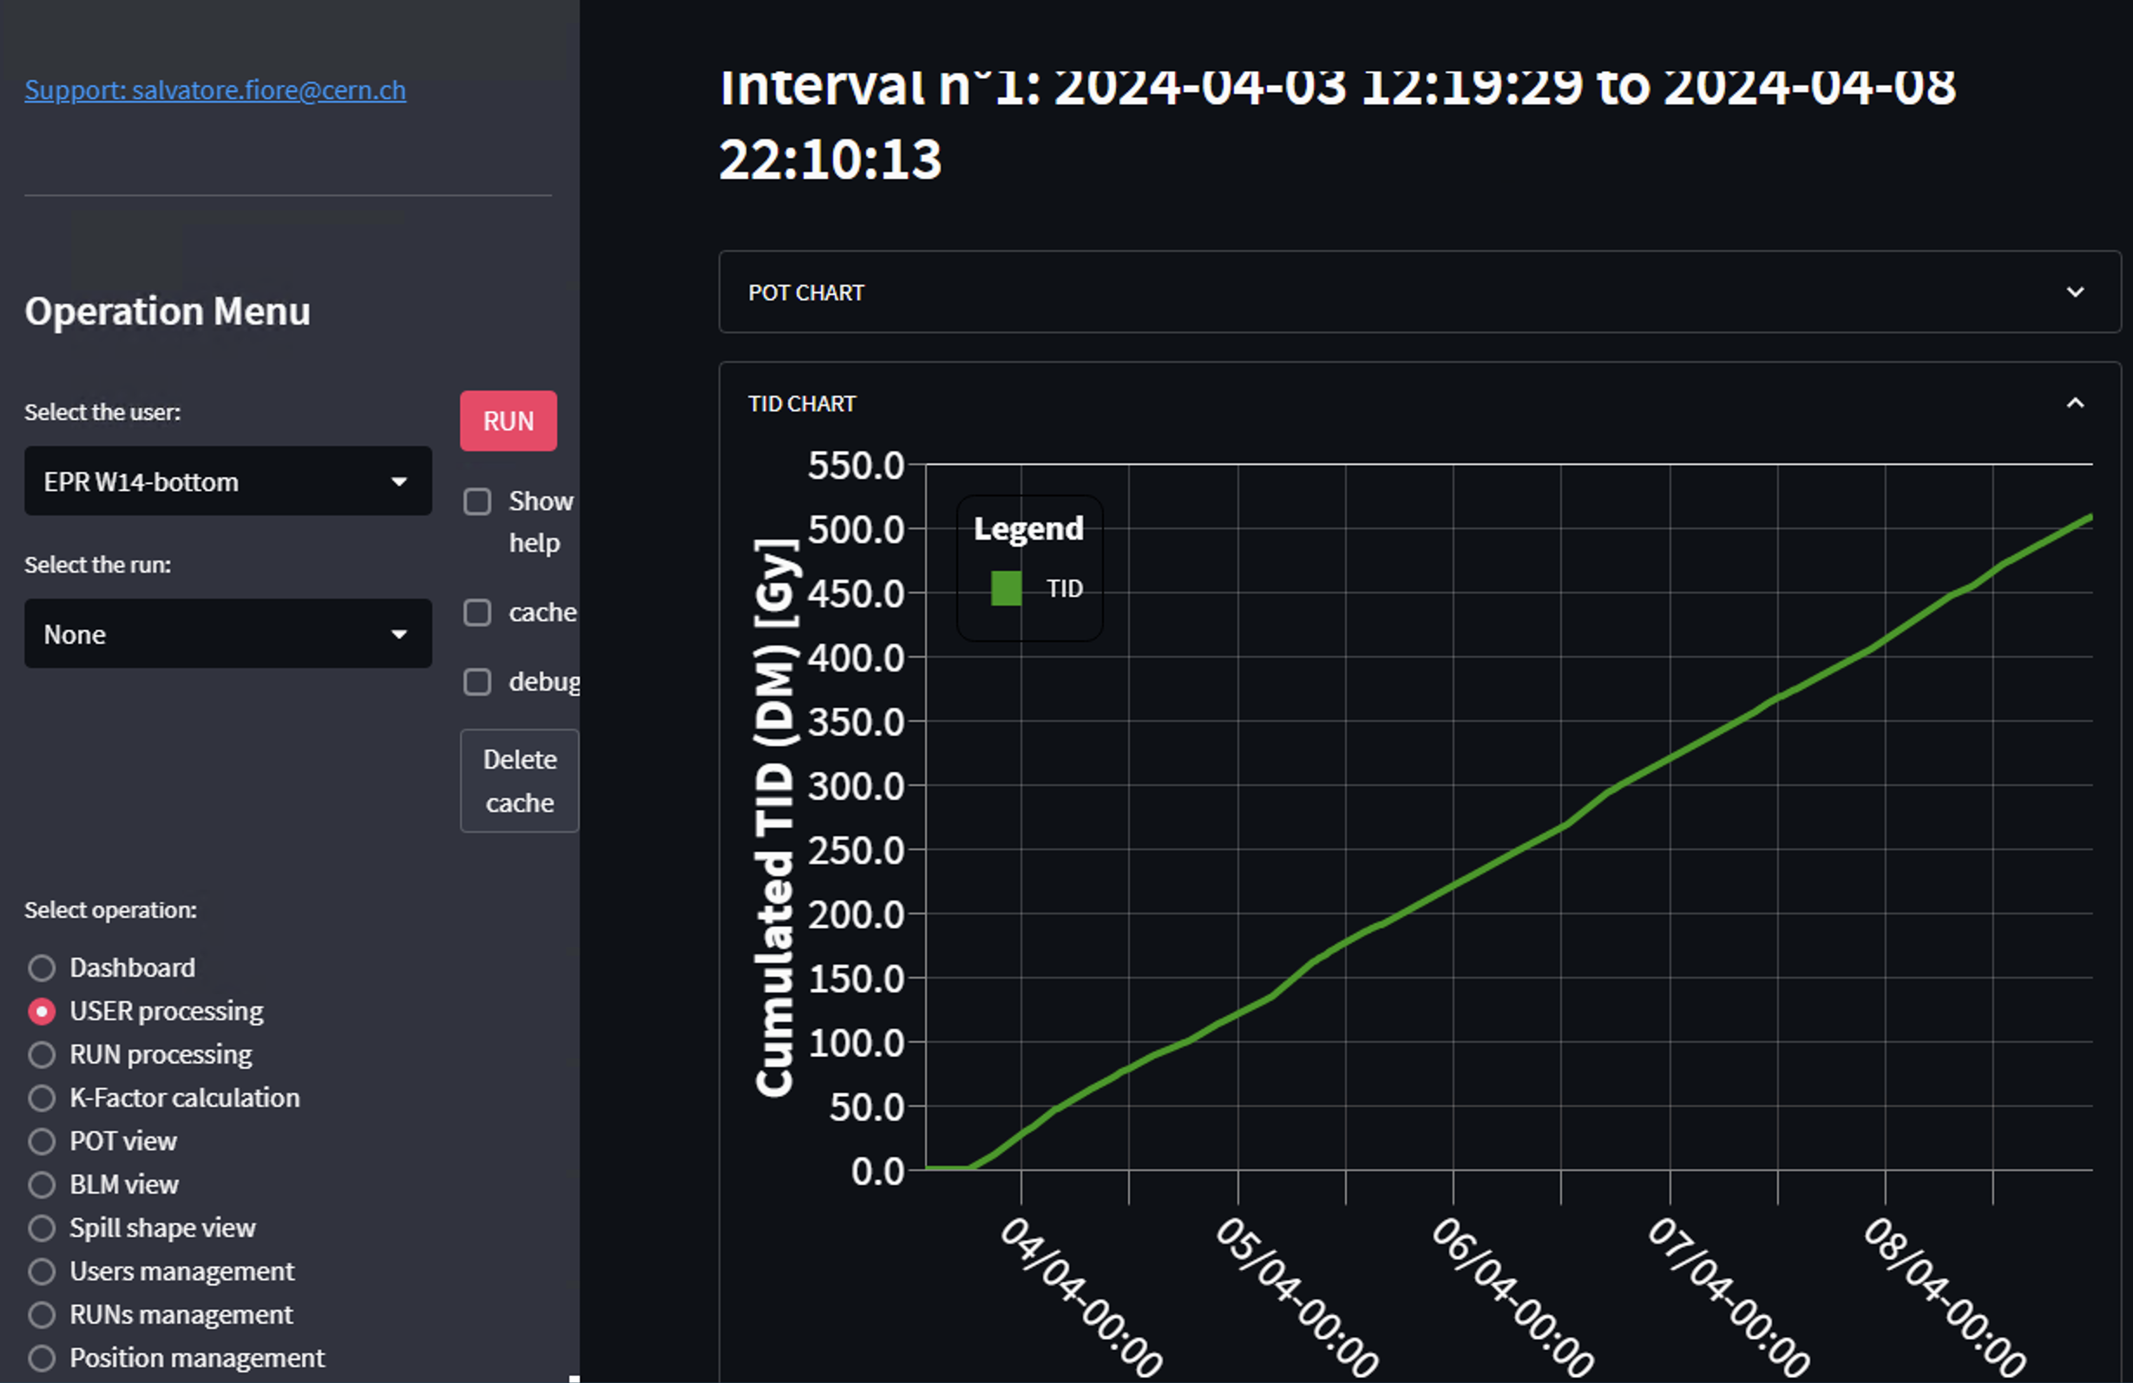
Mixed-Field Facility CHARM (CERN BE)
Mixed-field radiation field
  24 GeV/c p+ on target
  various testing positions and radiation mixes available
TID ~500 Gy / w (typical)
  individual dosimetry provided to each user
User equipment
  setups hosted in standard 21” rack, moved in irradiation position by robotic conveyor
  additional lower radiation intensity positions
  mock-up for dry run available in the preparation room
T08 beam
User Rack
Target

Slide 22
Summary
CERN offers a great variety of test beam options and irradiation facilities
  Primary + secondary beams available in North area (≤ 400 GeV/c) and secondary in East Area (≤ 16 GeV/c)
  Variety of irradiation facilities: SPS primary beam @ HiRadMat (440 GeV/c), mixed field μ/γ @ GIF++,
  PS primary beam @ IRRAD (28 GeV/c), mixed field @ CHARM (24 GeV/c beam on thick target)
For North and East Area beams: Please contact in advance Sps.Coordinator@cern.ch and sba-operation@cern.ch to optimally use your beam time and the facilities
  Visit https://ps-sps-coordination.web.cern.ch/ps-sps-coordination/ for the updated version of the schedule and other useful information
  Subscribe to ps-sps-users e-group
  Visit https://be-dep-ea.web.cern.ch/experimental-areas/beamline-responsibles for further information
  In case of questions – don‘t hesitate to reach out!!
Looking forward to seeing you at CERN!

Slide 24
Backup slides

Slide 25

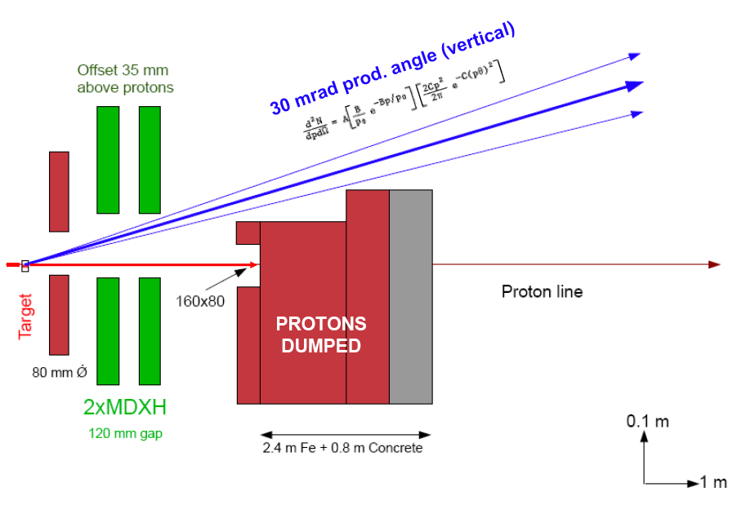
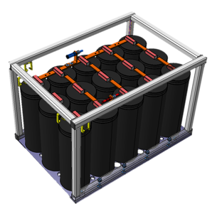
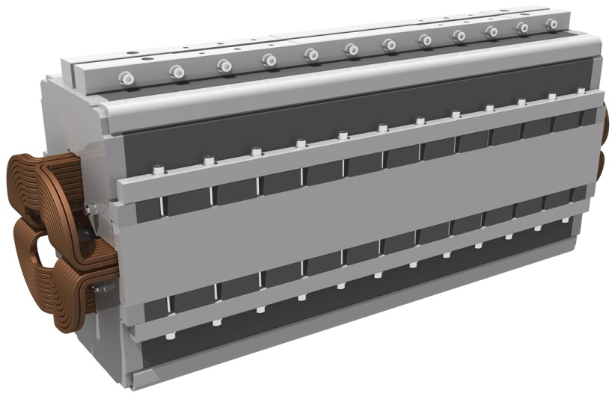
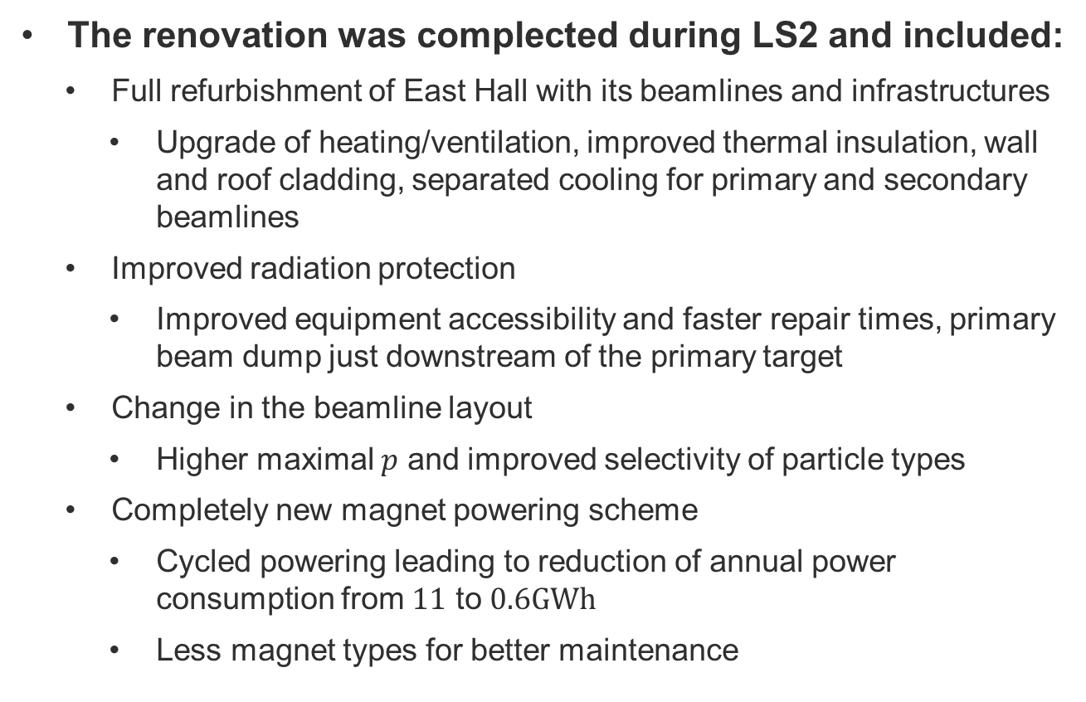
East Area Renovation
The renovation was complected during LS2 and included:
  Full refurbishment of East Hall with its beamlines and infrastructures
    Upgrade of heating/ventilation, improved thermal insulation, wall and roof cladding, separated cooling for primary and secondary beamlines
  Improved radiation protection
    Improved equipment accessibility and faster repair times, primary beam dump just downstream of the primary target
  Change in the beamline layout
    Higher maximal $p$ and improved selectivity of particle types
  Completely new magnet powering scheme
    Cycled powering leading to reduction of annual power consumption from $11$ to $0.6GWh$
    Less magnet types for better maintenance
Energy storage unit
New laminated Q74 magnet

Slide 26
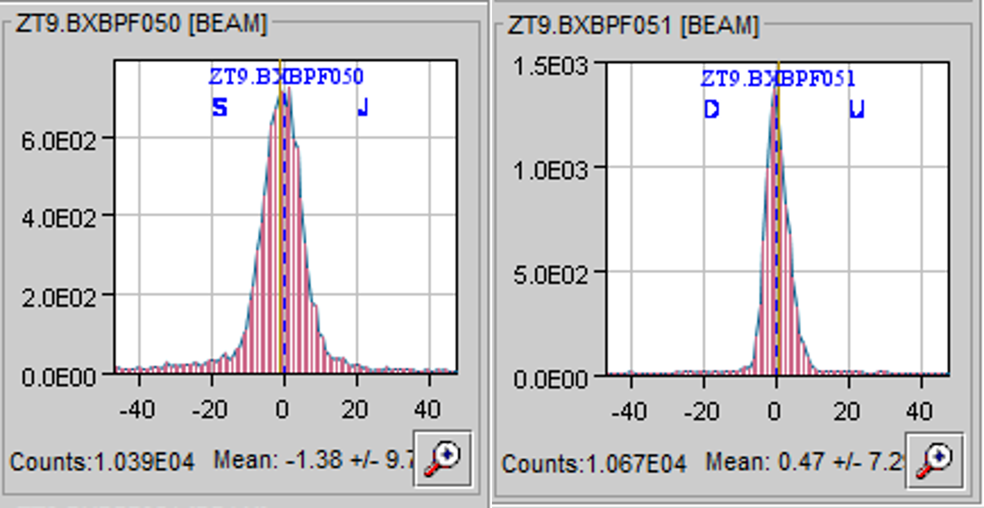
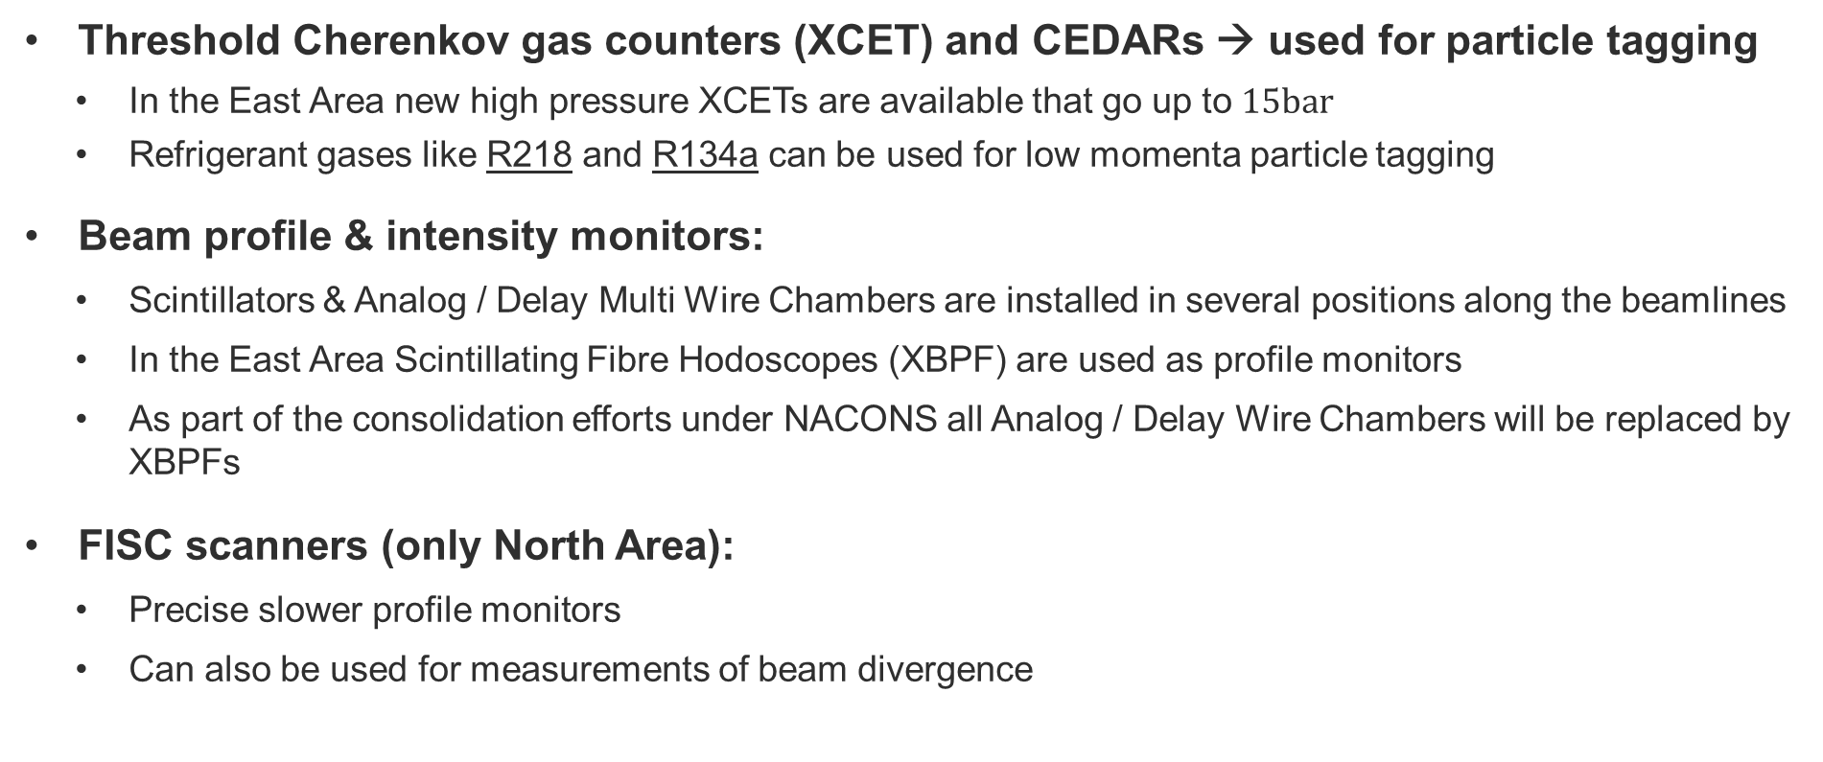
Beam Instrumentation in the North and East Area
Threshold Cherenkov gas counters (XCET) and CEDARs → used for particle tagging
  In the East Area new high pressure XCETs are available that go up to $15bar$
  Refrigerant gases like R218 and R134a can be used for low momenta particle tagging
Beam profile & intensity monitors:
  Scintillators & Analog / Delay Multi Wire Chambers are installed in several positions along the beamlines
  In the East Area Scintillating Fibre Hodoscopes (XBPF) are used as profile monitors
  As part of the consolidation efforts under NACONS all Analog / Delay Wire Chambers will be replaced by XBPFs
FISC scanners (only North Area):
  Precise slower profile monitors
  Can also be used for measurements of beam divergence

Slide 27
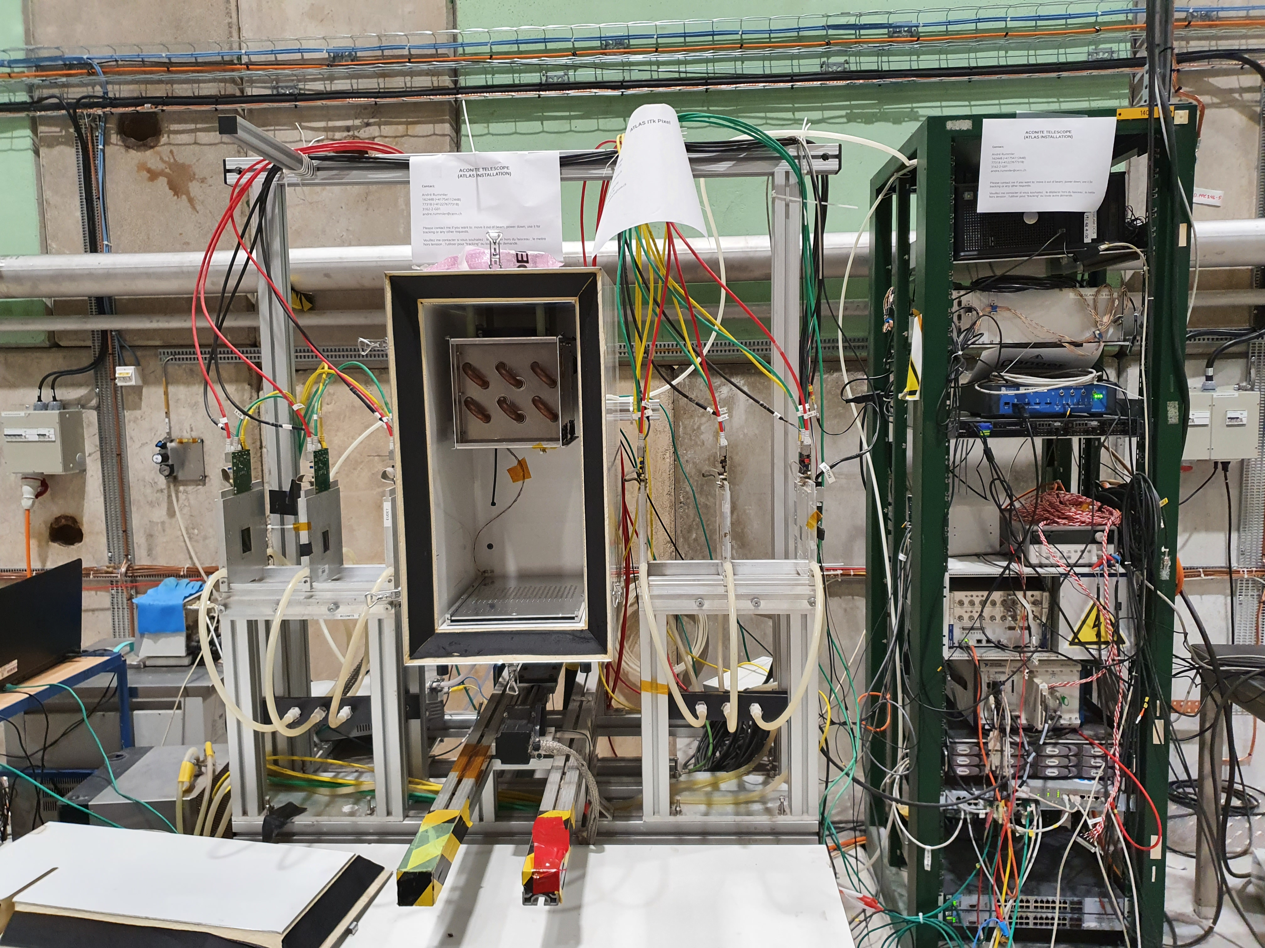
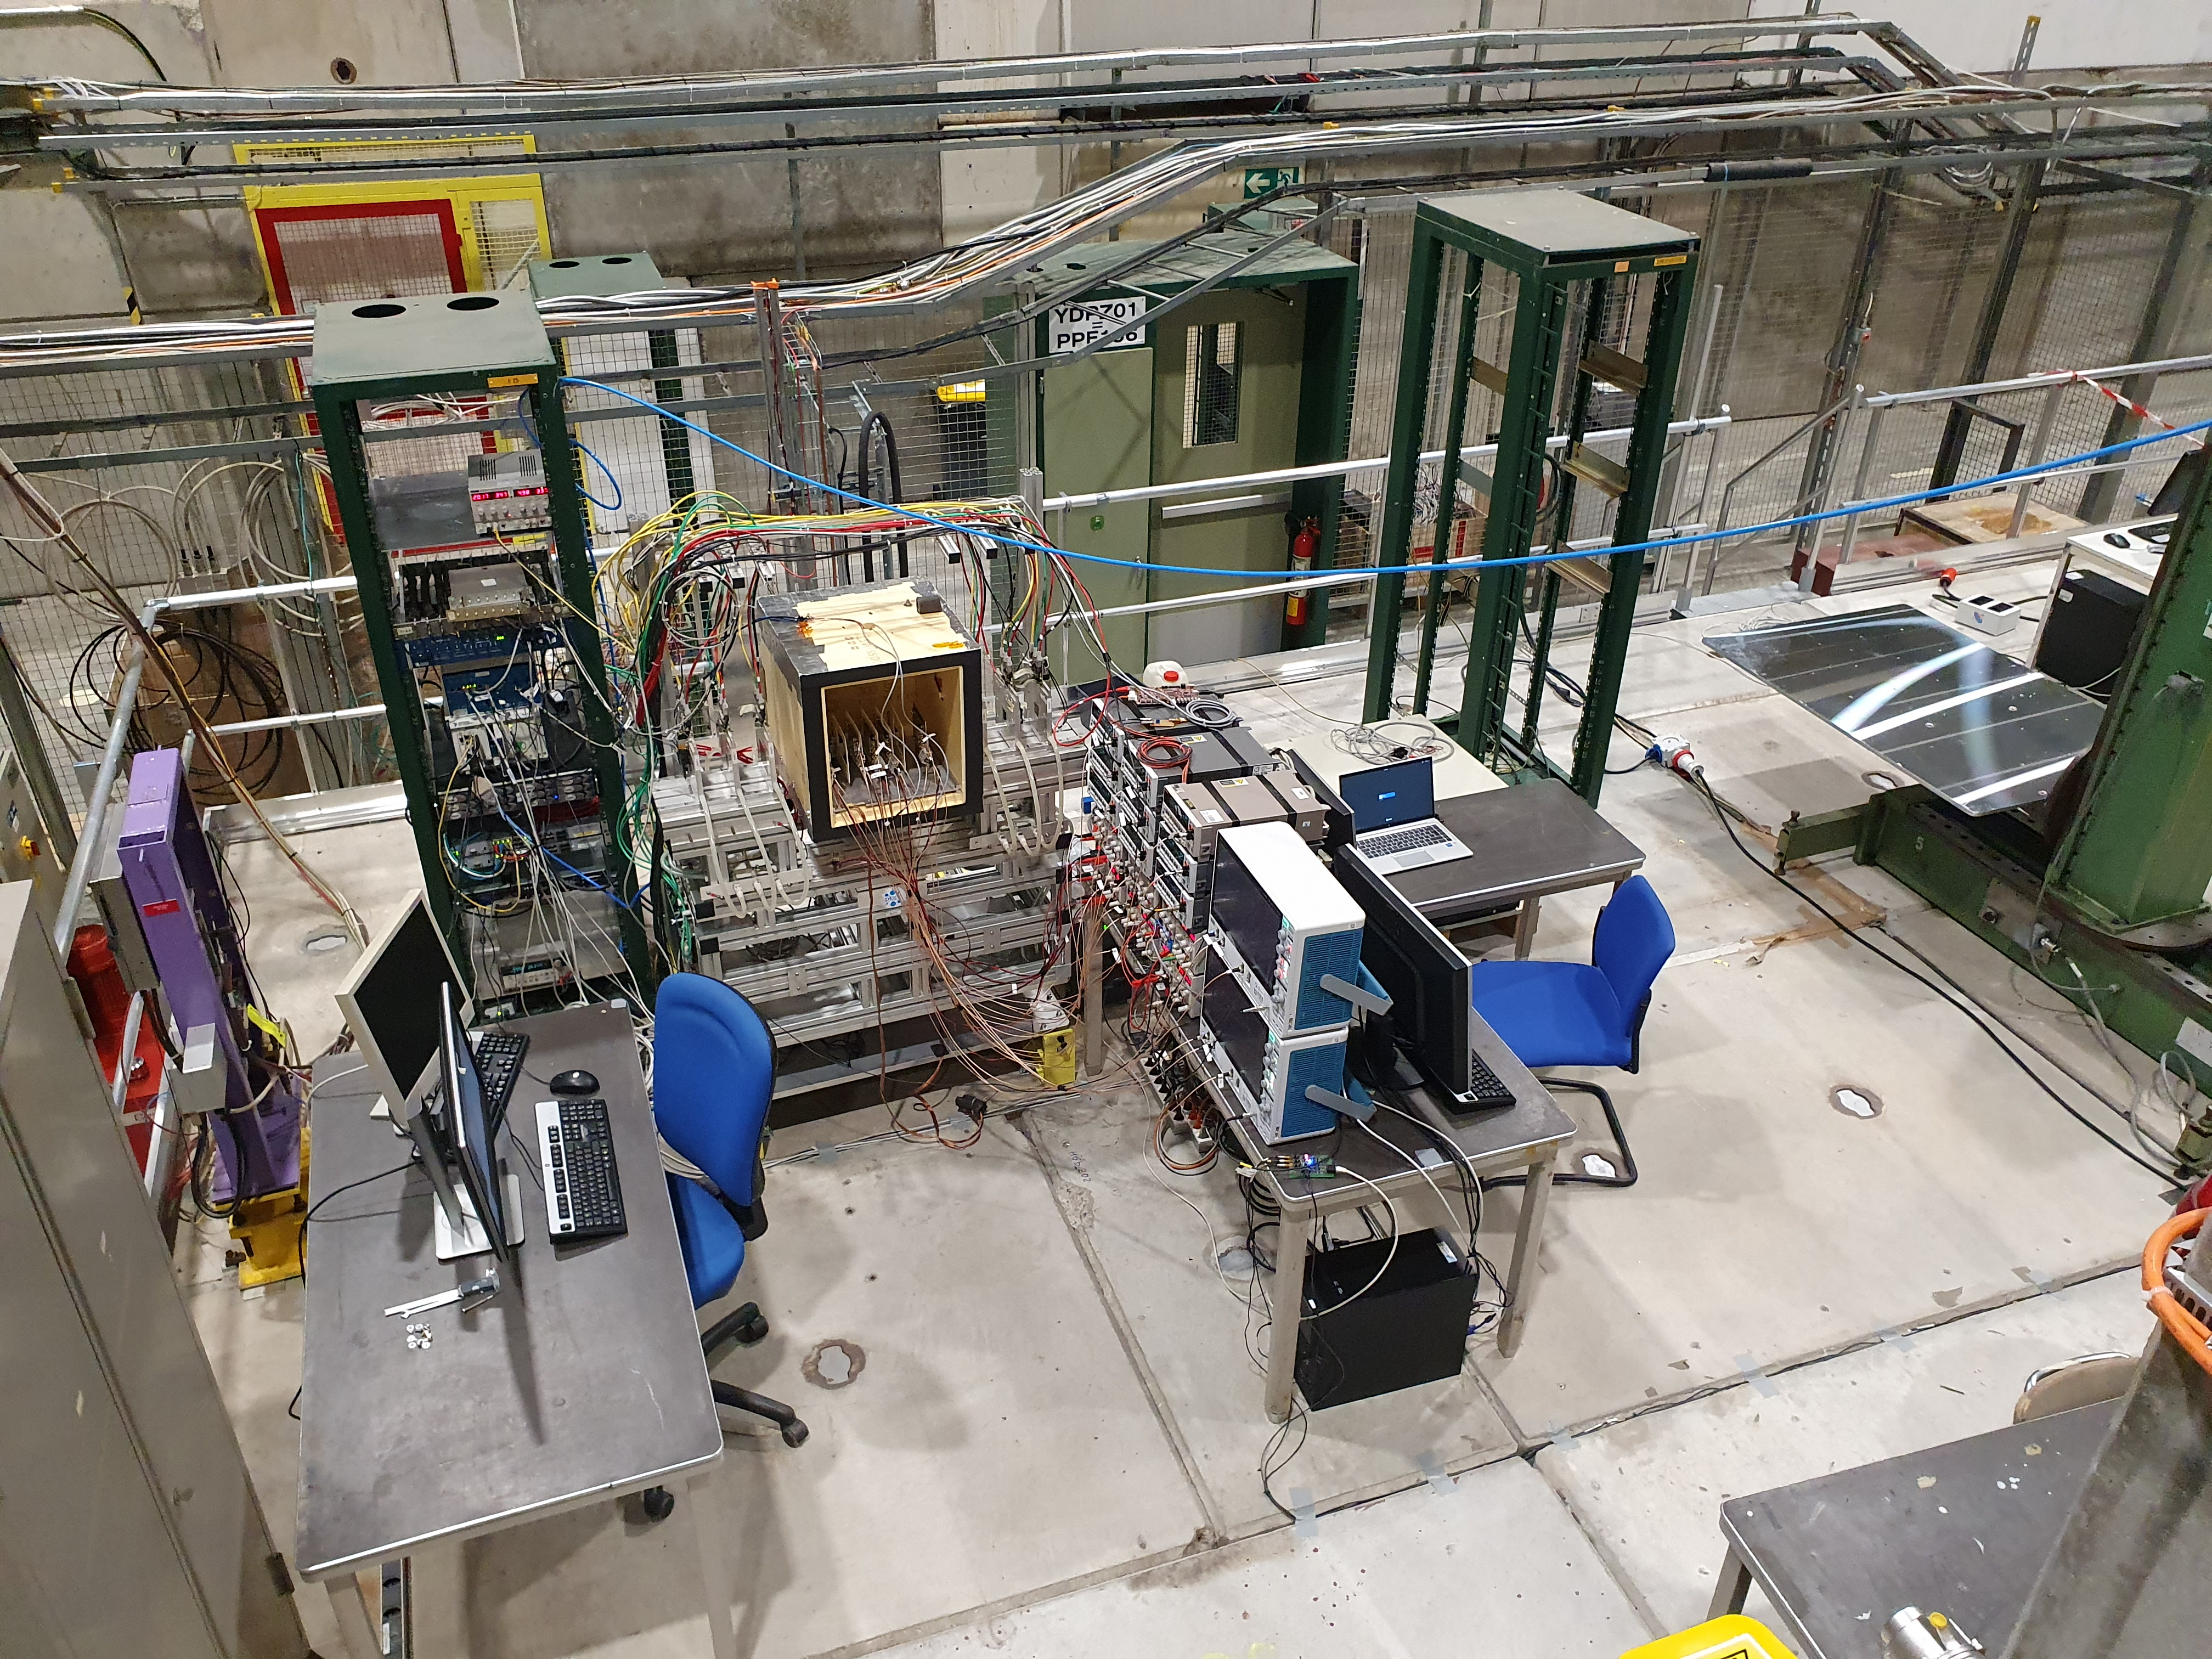
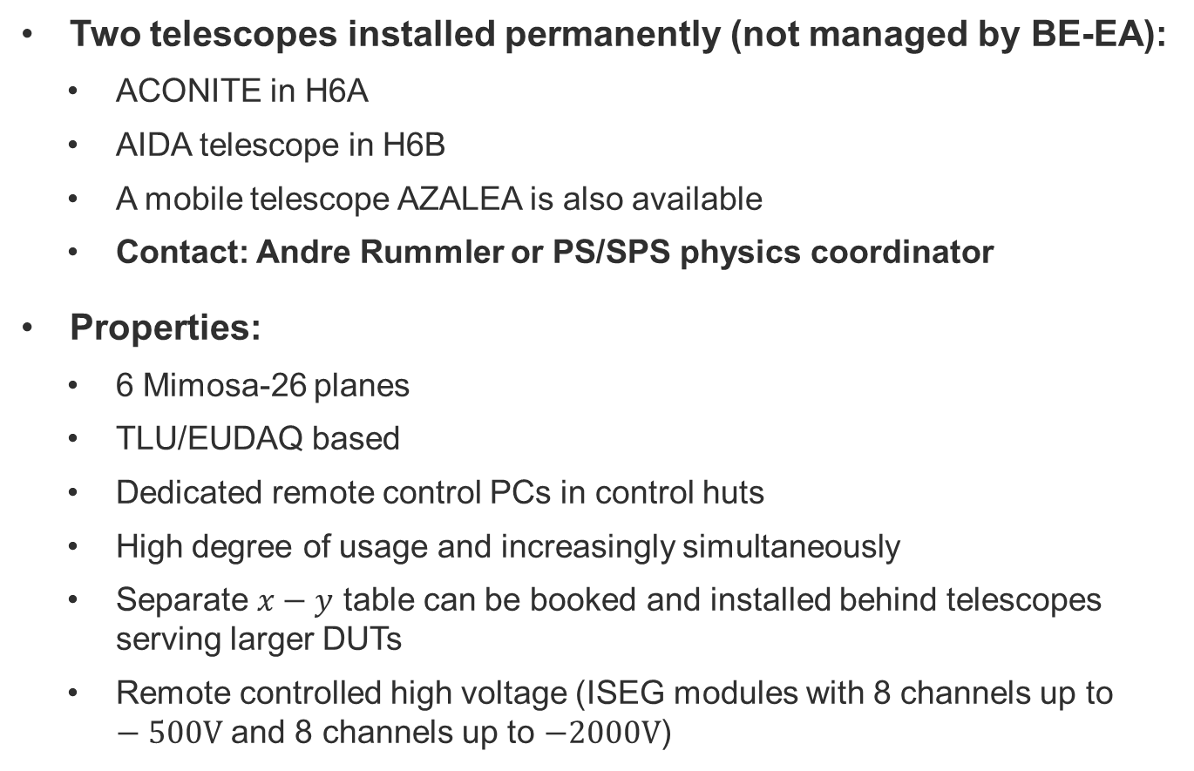
Telescopes in CERN North Area (SPS)
Two telescopes installed permanently (not managed by BE-EA):
  ACONITE in H6A
  AIDA telescope in H6B
  A mobile telescope AZALEA is also available
  Contact: Andre Rummler or PS/SPS physics coordinator
Properties:
  6 Mimosa-26 planes
  TLU/EUDAQ based
  Dedicated remote control PCs in control huts
  High degree of usage and increasingly simultaneously
  Separate $x−y$ table can be booked and installed behind telescopes serving larger DUTs
  Remote controlled high voltage (ISEG modules with 8 channels up to $−500V$ and 8 channels up to $−2000V$)
H6A
H6B

Slide 28





Large aperture magnets for tests with beam
GOLIATH
EHN1, H4 beamline
Large classical dipole
$160×240×360{cm}^{3}$
$1.5T$ field
Morpurgo
EHN1, H8 beamline
Superconducting dipole
$1.6m$ diameter, $4m$ length
$1.5T$ field
CMS M1 magnet
EHN1, H2 beamline
Superconducting dipole
$82cm$ gap, $1.4m$ diameter
$3.0T$ field

Slide 29


T2 (left) and T4 (right) wobbling solutions
H2
H4
H2
H4
H4
H2
H4
H2
H4
H2
H4
H2

Slide 30

Access and Beam Control Software
The beam can be controlled using the CESAR interface (will be replaced after LS3)
  Magnet currents can be changed, collimators can be controlled, Threshold Cherenkov pressure can be set, beam files can be loaded, beam profiles and trigger information can be accessed etc.,
The zone can be accessed with a dosimeter and safety equipment
  Helmet, safety shoes
  No special access request is needed
2-3 members from each user group are given the patrol rights
  Required only to turn on the beam
  Needs on-site training

