Slide 1
MD on injection quality – longitudinal and transverse parameters
Wolfgang Bartmann, Thomas Bohl, Karel Cornelis , Heiko Damerau, Lene Drosdal, Chiara Bracco, Brennan Goddard, Verena Kain

Slide 2
MD plan
Effect of beam quality in longitudinal plane on injection losses
Effect of scraping on injection losses
  Operational emittances: 2.5 μm
  Nominal emittances: 3.5 μm
  Larger than nominal emittances: >7 μm
All injections using beam 1 in TI2 as we are more sensitive for injection losses there
In parallel: UFO MD on beam 2
12 bunch injections + a few 36 bunch injections
Transfer line collimators @ 4.5 s throughout MD

Slide 3
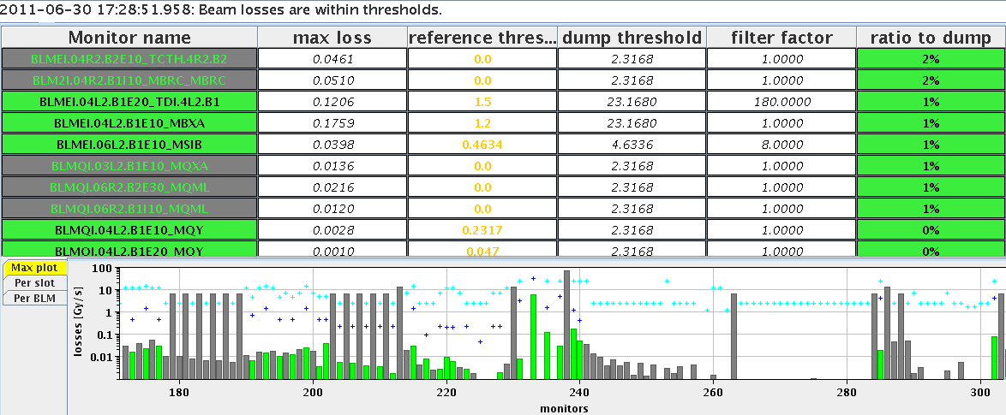
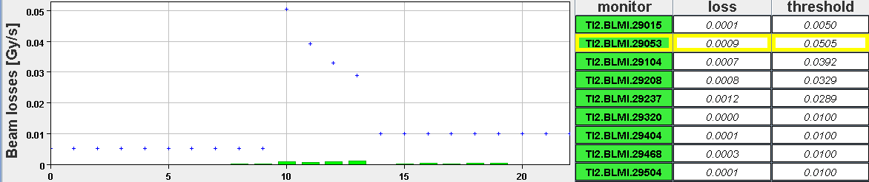
Reference: 12 bunch injection
Clean reference: scraper settings (H = -8.1 mm, V = 2.2 mm)
Emittance: H = 2.5 um, V 1.9 um
Losses: 1 % of dump threshold

Slide 4
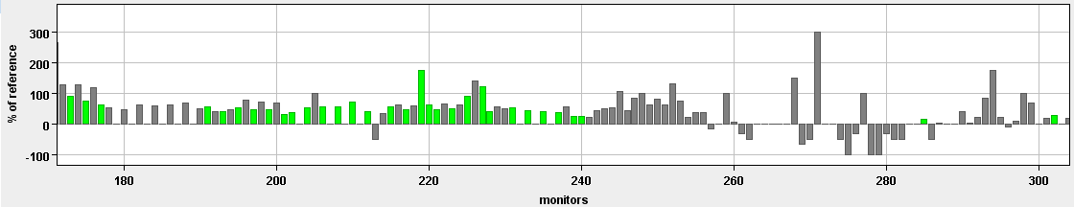
Effect of longitudinal parameters
Most cases gave low/same losses as reference:
Bad radial steering
Satellites from PS
RF on for all booster rings
SPS 800 MHz on wrong harmonic
Radial steering affected the scraping efficiency – but: radial steering can move the beam at the scraper → increase losses
Longitudinal parameter changes similar increase in losses as sudden oscillations down the line from MSE ripple.
Losses from sudden oscillation down the line
% of reference losses
Losses on TCDIs
Losses on TDI, triplet,…ALICE,…up to Q6R2

Slide 5
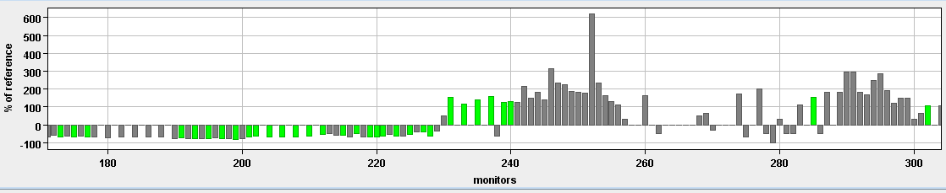
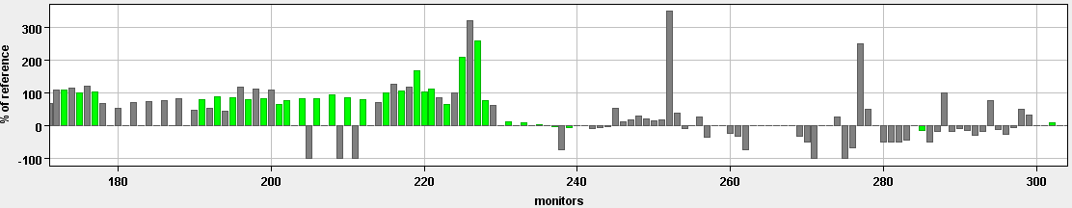
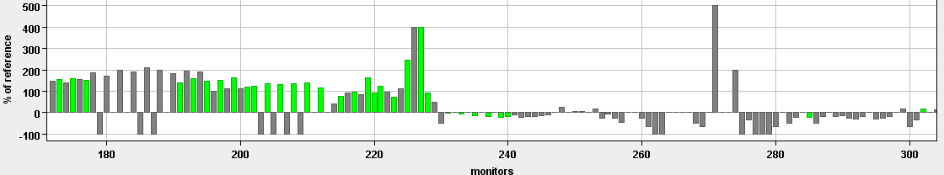
Increased injected bunch length into the SPS: 4.1 → 4.9ns (SPS BQM warning, but no interlock)
→ Observed losses on the TDI/MQX
Increased dp/p at extraction: bunch length at extraction: 1.5 → 2.2 ns
→ Losses on the TCDIs
Turned off the 800 MHz in SPS
→ Losses on the TCDIs
TDI
% of reference losses
MQX
MSI
% of reference losses
MKIs and Q5
MSI
% of reference losses
Notes:
Special plot from IQC without thresholds and logscale

Slide 6
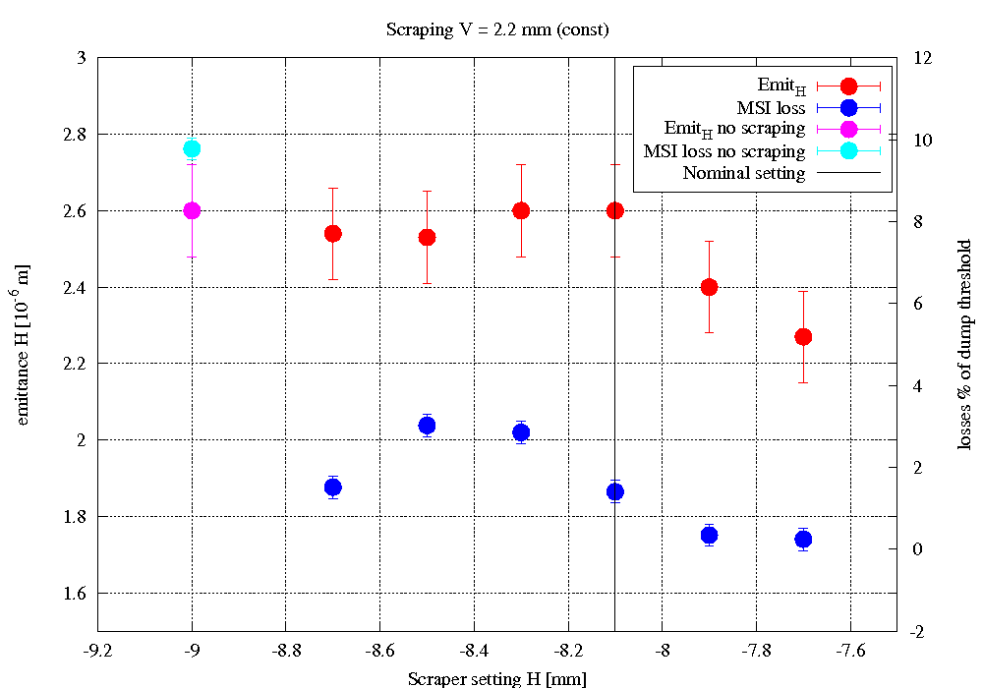
Effect of scraping – no blowup
Effect of H scraper, V scraper constant
Nominal scraper setting: emittance not affected, losses affected → scraping tails
Scraper out
Virtual scraper setting

Slide 7
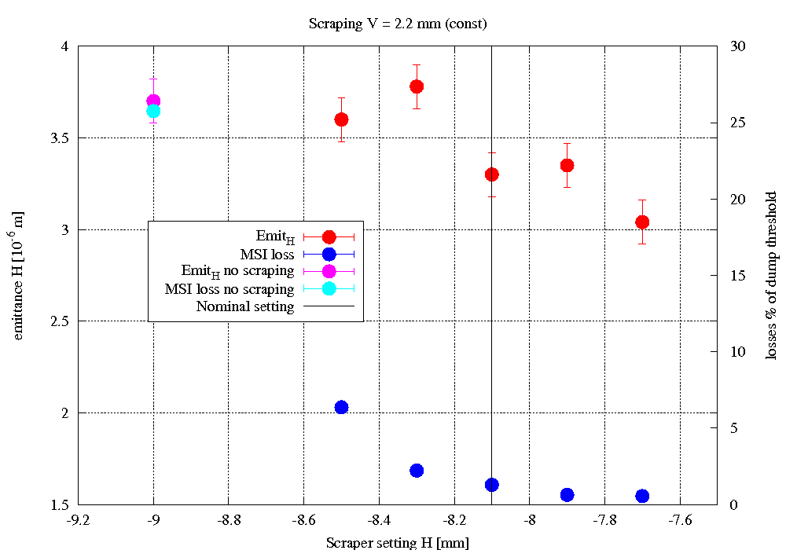
Nominal emittances - H
Blow up with screen in TT10
1 % losses ~ 3.4 mm emittance in H for correct scraping

Slide 8
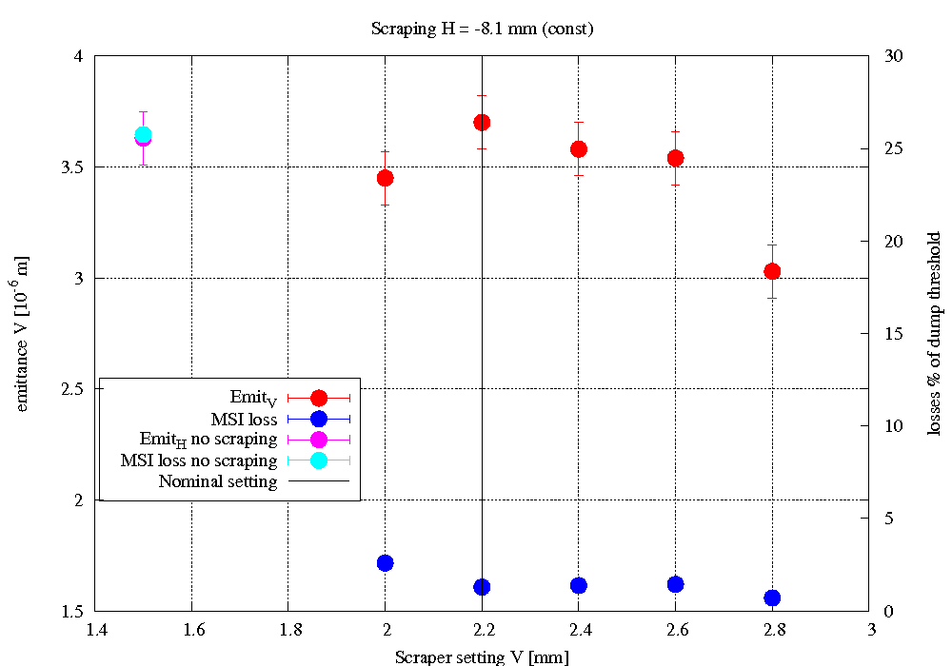
Nominal emittances - V
Blow up with screen in TT10
With 3.5 mm still only scraping tails

Slide 9
Very blown-up beams - emittance scan
Used two screens in TT10 → emittance > 7 mm
Cutting into beam core at all times
Scanned H scraping, V scraping constant
Remaining intensity: function of scraper position:
  Remove all particles with amplitudes larger than scraper pos – remaining intensity N(scraper pos):
  → can get beam position @ scraper (+ initial emittance)

Slide 10
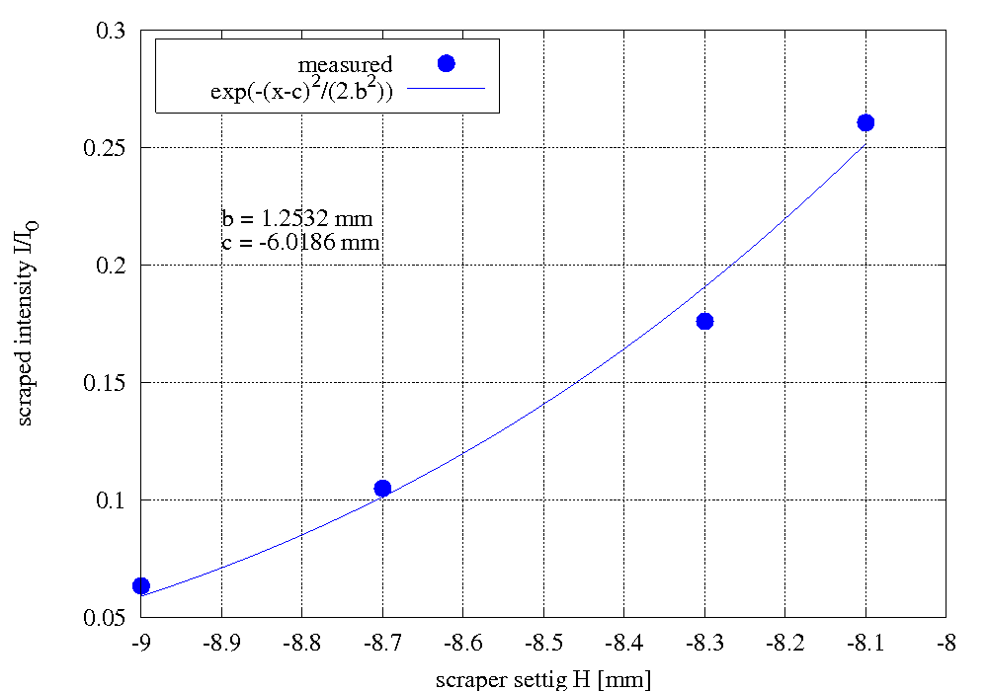
Result of scraper scan H with large emittance
B = initial beam size
C = beam position wrt scraper

Slide 11
Conclusion
We are very sensitive to scraping in the SPS – scraper settings and beam position at scrapers
→ We need to further investigate the evolution of the beam position at the scraper – SPS MD time
Not so sensitive to the longitudinal parameters – and the SPS BQM also blocks in most cases
If scraping is set up properly and the beams are Gaussian,
3.5 um emittances give similar loss levels as our operational beams – with TCDIs at 4.5 s
Not done yet:
  Check of sensitivity to transfer line steering

