Slide 1

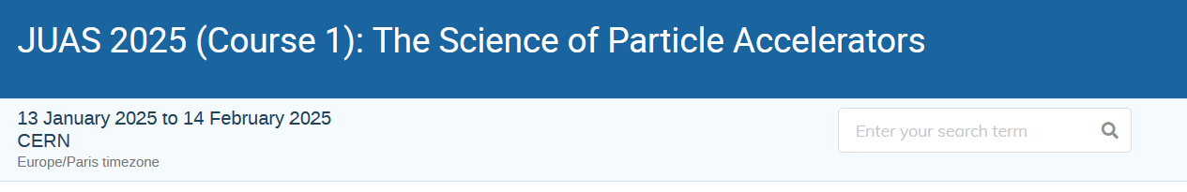
Welcome
Practical information
D. Baizhanova

Slide 2

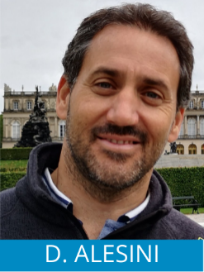
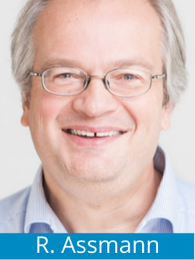
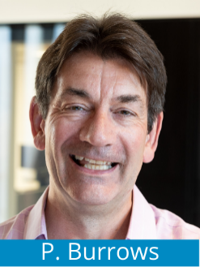
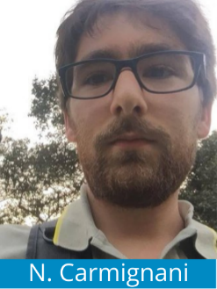
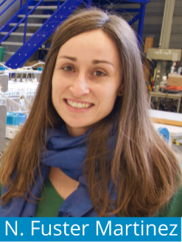
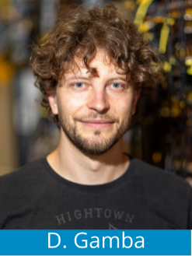
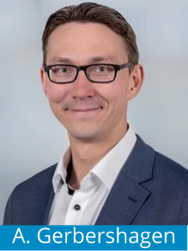
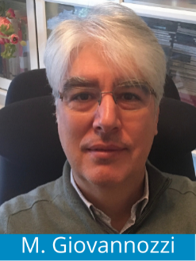
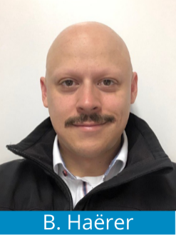
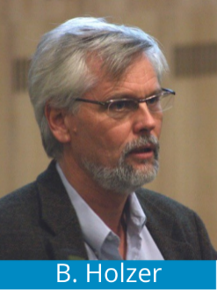
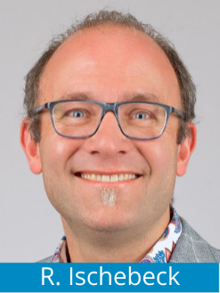
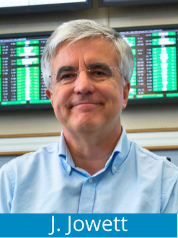
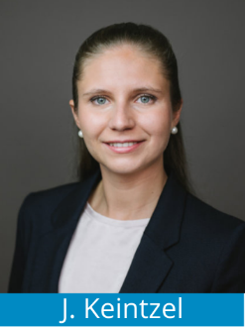
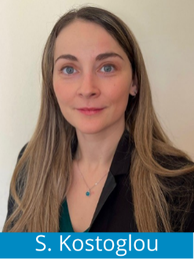
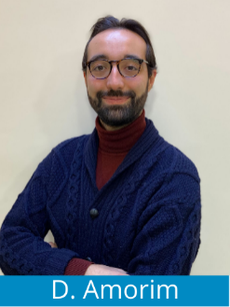
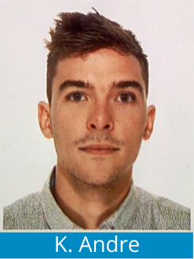
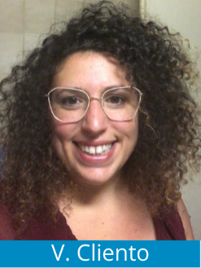
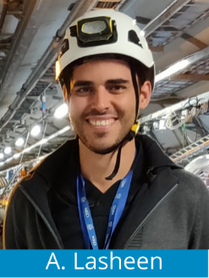
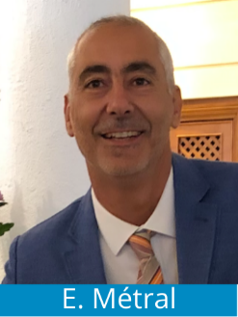
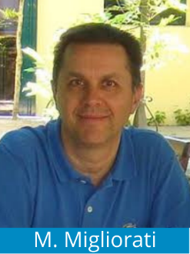
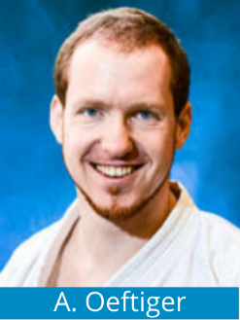
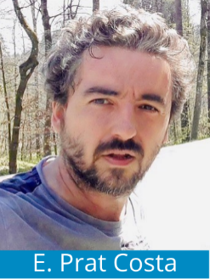
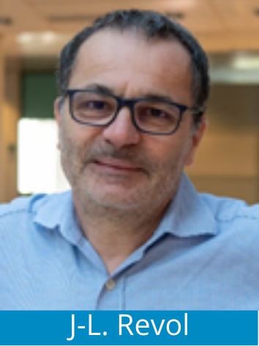
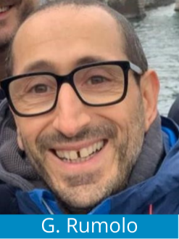
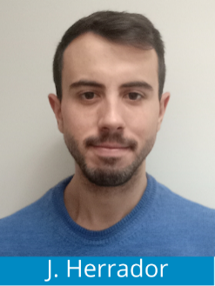
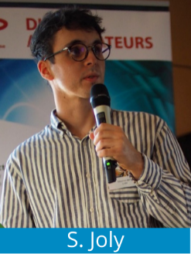
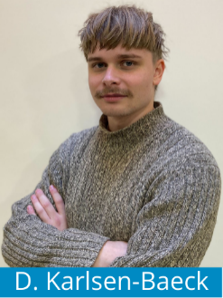
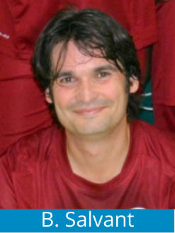
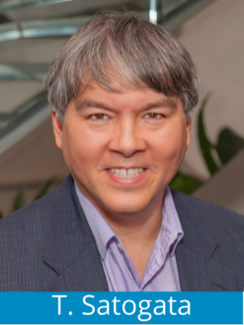
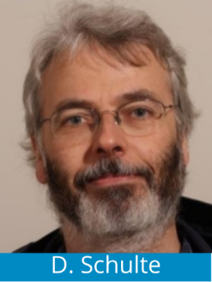
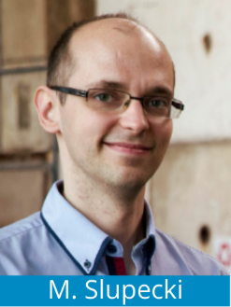
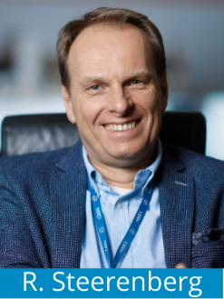
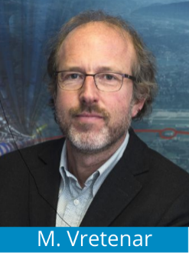
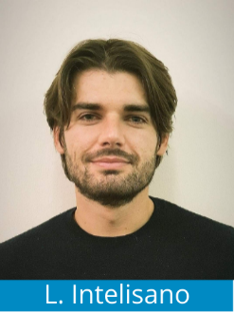

Your Faculty during these 5 intensive weeks
27 lecturers in 2025
And 8 assistants in 2024!

Slide 3












Institutions Faculty

Slide 4
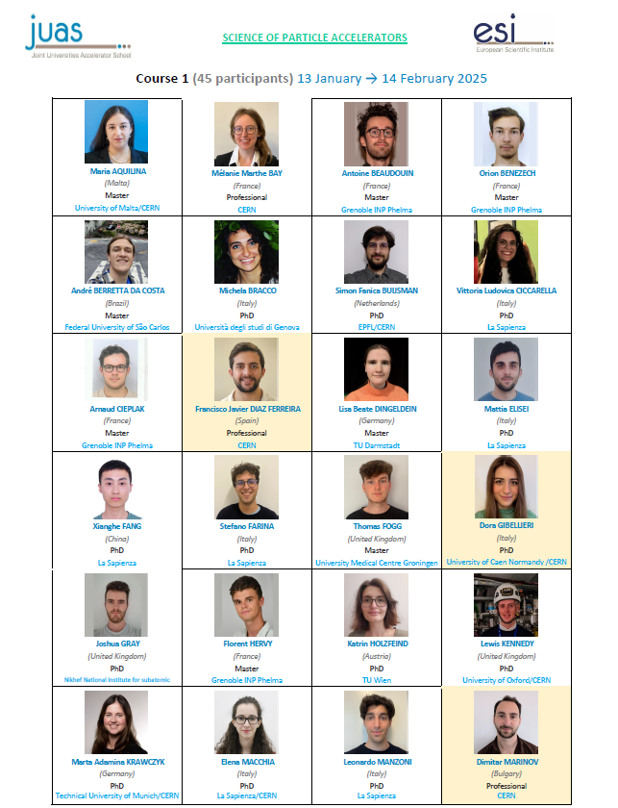
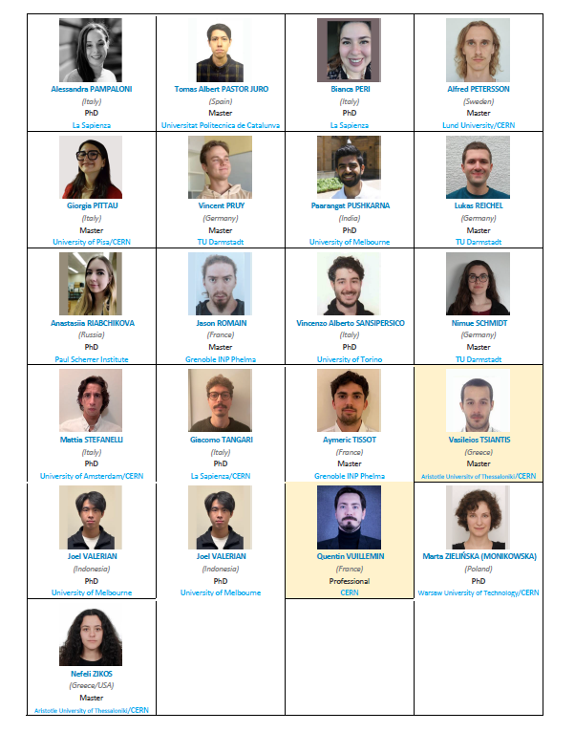

You…
45 Participants
21 Nationalities
19 Master students
22 PhD students
4 Professionals
Affiliated to 24 Universities and research establishments

Slide 5
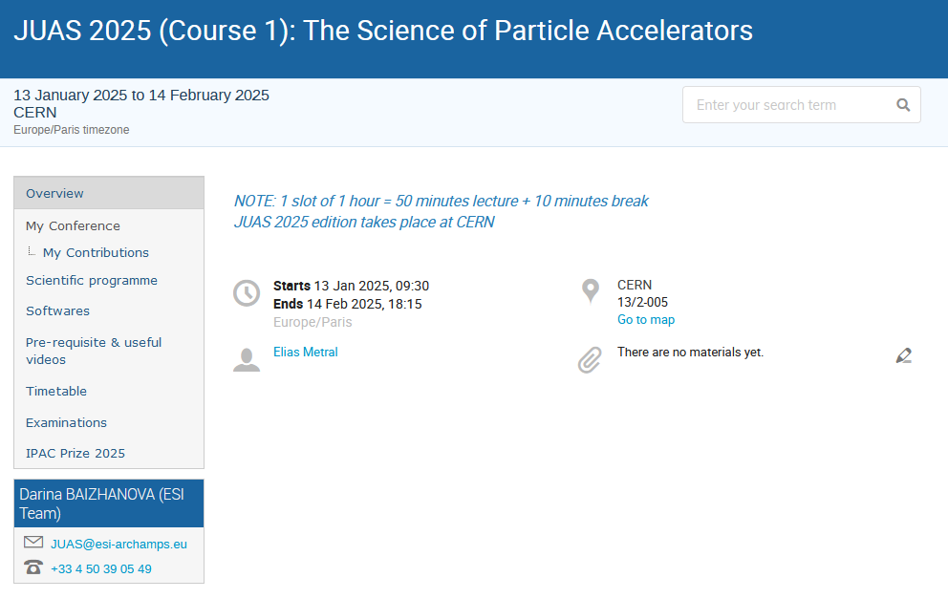
The program (INDICO)

Slide 6
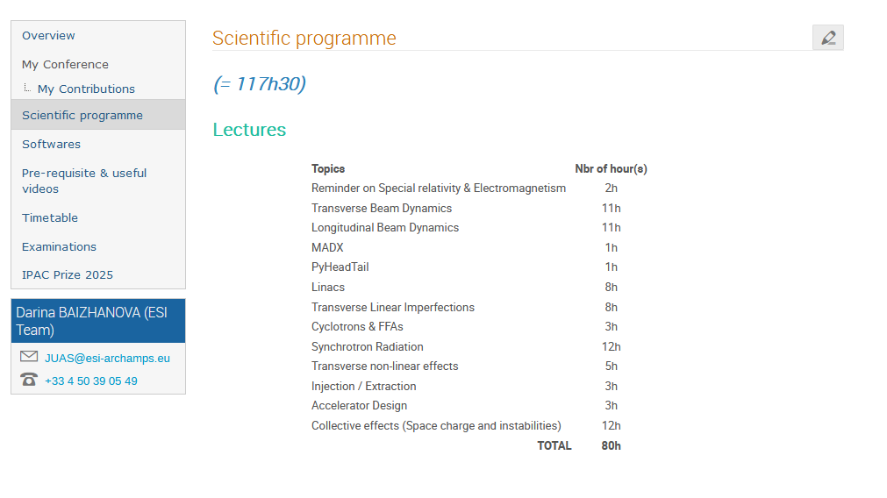
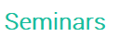
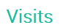
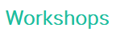
The program (INDICO)

Slide 7
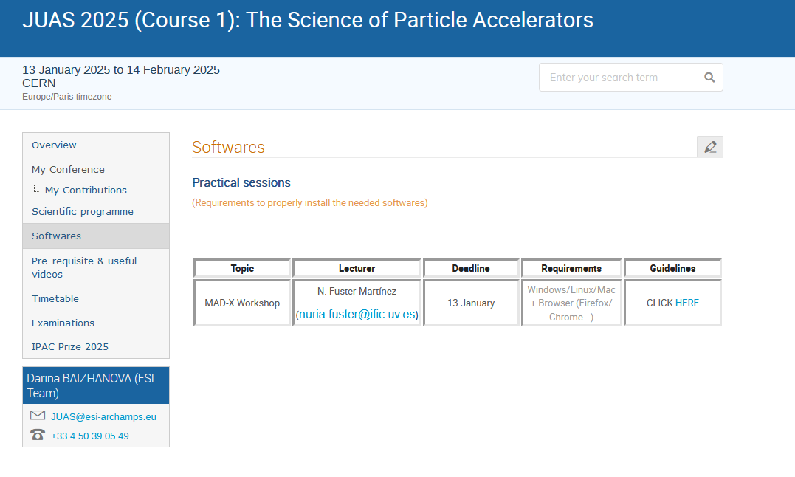
The program (INDICO)

Slide 8
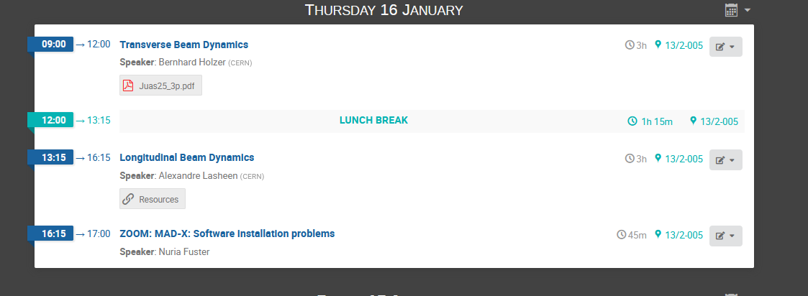
The program (INDICO)

Slide 9
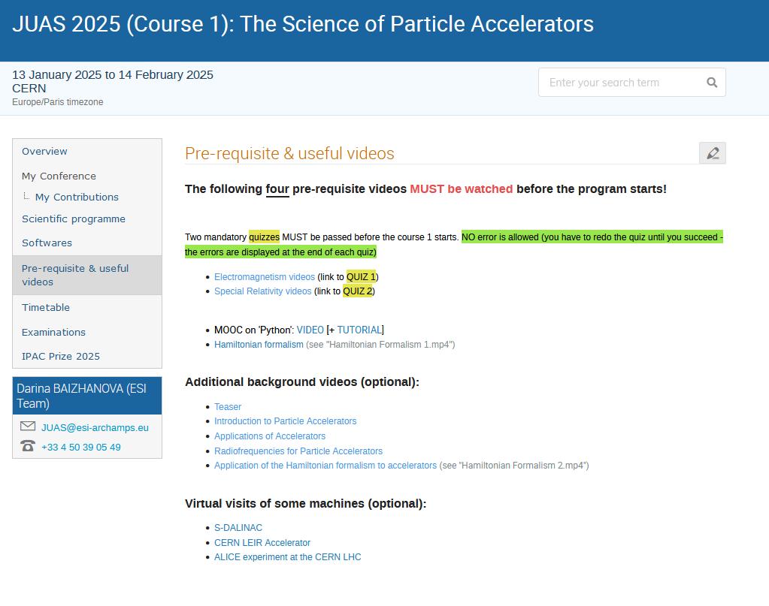
The program (INDICO)

Slide 10
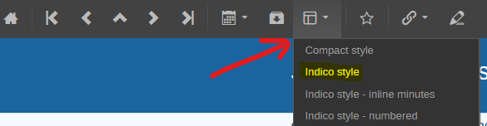
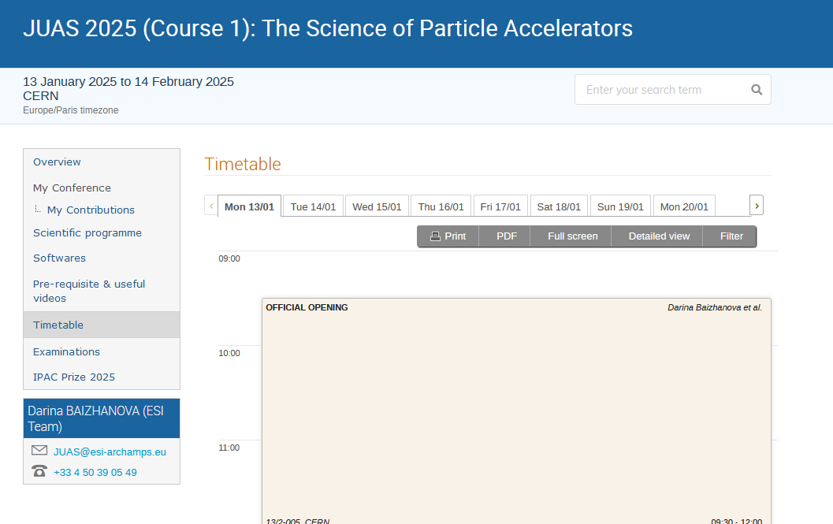
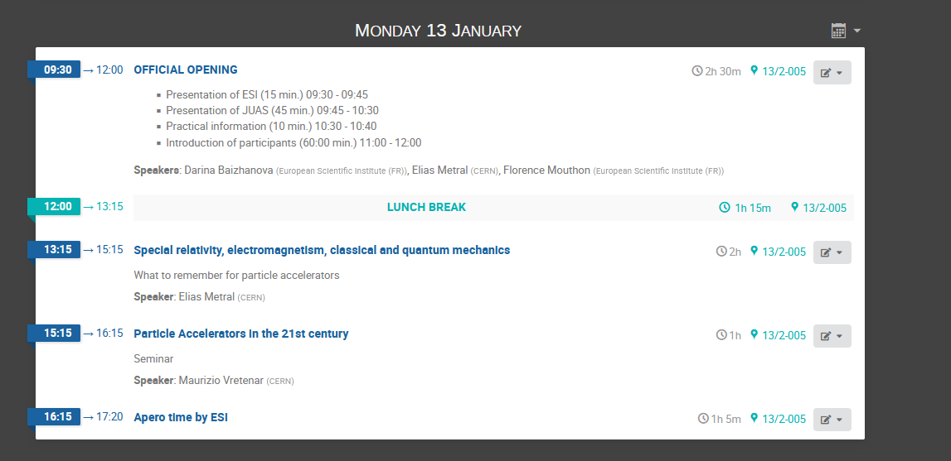
The program (INDICO)

Slide 11
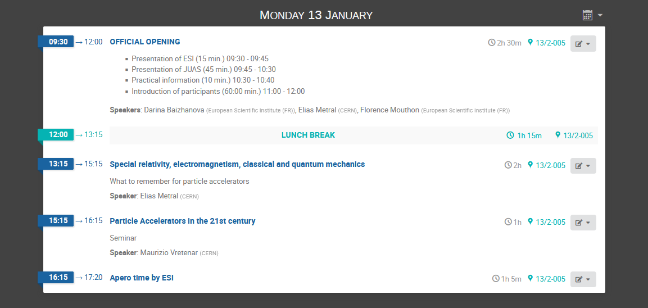
The program (INDICO)

Slide 12
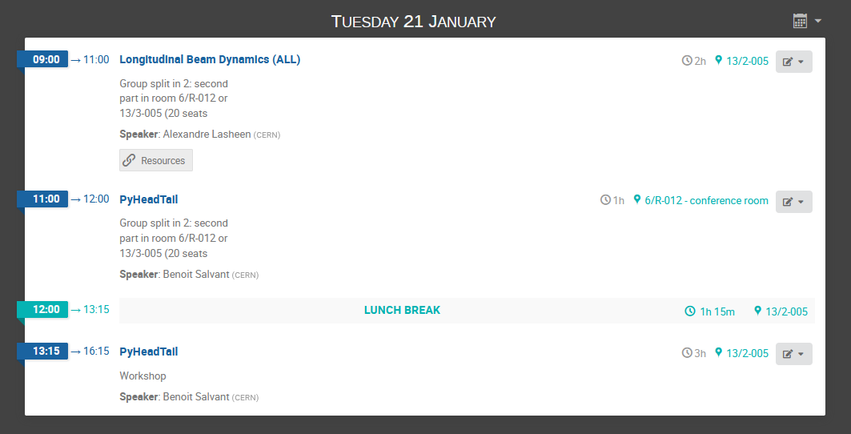
The program (INDICO)

Slide 13

The program (INDICO)

Slide 14

The program (INDICO)

Slide 15



Visits
Tuesday 28 January
Program:
  ALICE introduction, exhibition & experiment in underground cavern
  CERN Control Center
  CERN LEIR Accelerator
  Dinner
Thursday 13 February
Departure from Globe at 8:15 // Return from ESRF (bus departure at 16:00)
Detailed program not finalized yet
It will be MANDATORY to bring your ID Card / Passport (and visa when applicable) and insurance paper for all the visits scheduled in the programme. This is due to the very strict security protocols in place in the institutions you will visit!

Slide 16

Practical Information (CERN)
For those staying at the hostel, respect the rules of the hostel;
Take the badge today or tomorrow evening;
You are in charge of your own daily meals;
Lunch/dinner might be provided during the visit, we will let you know in advance;
Lunch break is 1h15min;
Table tennis are at your disposal;
List of clubs and events

Slide 17



Evaluation forms (topics / speakers)
Purpose: To improve JUAS program in the future !
A global evaluation form will be shared to you at the end of the course.
Specific to organizational & logistical questions.
Your feedback will bring added value for next editions !

Slide 18


Certificate of participation / Attendance list
At the end of the course, we will generate your individual certificate of attendance
(including your marks - for those who will take the exams). You will receive it in March.

Slide 19


Last information
Please sign the agreement regarding reproduction of photographic images
as from tomorrow
Attendance list MUST be signed upon your arrival every day
- Thank you -

Slide 20
Ice-breaking activity
Please check the number you took and find other people with the same number
Form the group
Answer the questions below to get to know each other. You have 30 min.
Introduce yourself (name, where are you from, where you study).
Why did you decide to join JUAS and why did you decide to study and work in the particle accelerators area?
What is your best quality?
If you could have one superpower today, what would it be, and what would you use it for?
What’s your culture’s most underrated food?
What’s an unusual national tradition you have (or from your region/hometown)?
Who was the last person you felt inspired by?
Some more questions if you have time:
8. What’s one country you would love to visit and why?
9. What’s a word or phrase in another language (or your own) that you really like?
10. What’s something you couldn’t live without?
11. Have you ever experienced a culture shock? Where was it, and what happened?

Slide 21
Ice-breaking activity
We now ask each group to come to the center and present yourselves (one by one, from the group 1)
Please tell: Your name, which country you are from and your best quality

