Slide 1

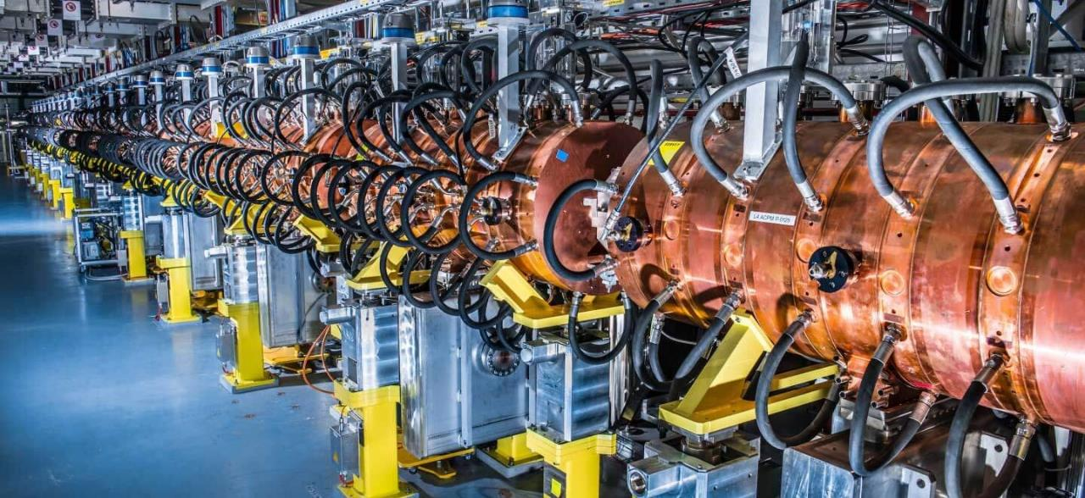
Particle Accelerators in the XXI Century
Maurizio Vretenar CERN JUAS 2025

Slide 2


This Seminar
This Seminar is intended as an “appetizer” to introduce you to the Science and Technology of Particle Accelerators
Goals:
Give a general overview of status and challenges of particle accelerator technologies and applications, with no maths;
Give some hints to guide your study and your future choices.
Outline:
Accelerators as instruments
Accelerator and innovation
Key accelerator challenges
Accelerators for society
The future…

Slide 3

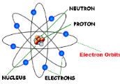
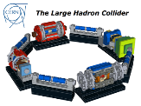
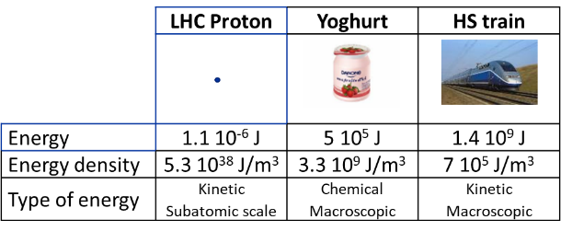
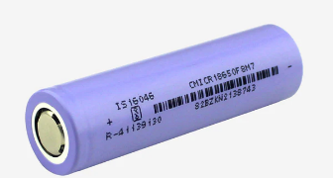

Accelerators: our door to the subatomic world
Extracting charged particles from an atom (protons, electrons, nuclei) and accelerating them we concentrate enormous amounts of energy in very small volumes
proton
LHC proton: 7 TeV
Yoghurt: 150 g, 120 cal.
TGV train: 400 tons, 200 m, 300 km/h
Full LHC bunch (1.15 10¹¹ protons) at interaction point (30 cm, 16x16 mm²): energy 1.3 10⁵ J, energy density ≈ 0.5 10¹² J/m³
For comparison: Li-ion battery 6 10⁹ J/m³, Diesel fuel 4 10¹⁰ J/m³
Particle accelerators are our door to access the subatomic dimension… to study and exploit the atom and its components
1 Joule is really tiny:
=1 W*s, cost ≈ 10⁻⁷ €

Slide 4
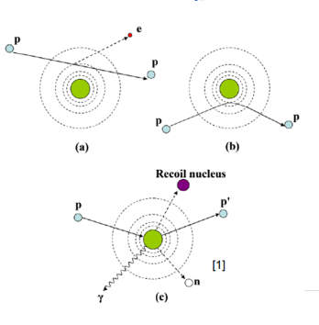
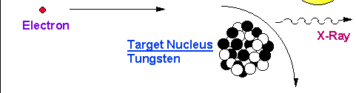
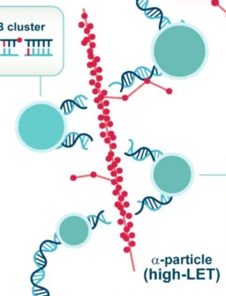
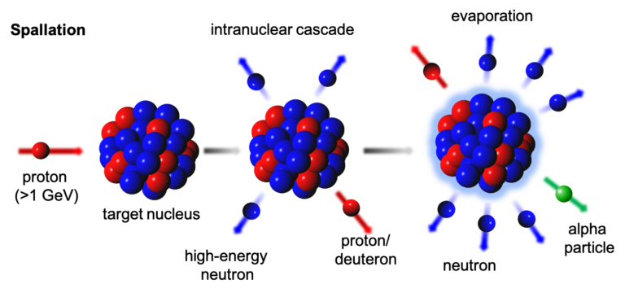
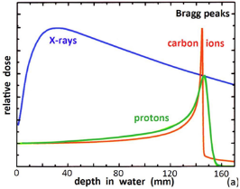
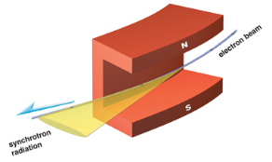
Where does the energy go?
The accelerated particle can:
kick an electron out of the atom (ionization) – breaking of molecular bonds, generation of free chemical radicals acting at chemical and molecular level.
Excite the electron to a higher energy level, that comes back generating an X-ray (photon).
be deflected by the nucleus giving energy to the atom - increase of temperature, etc.
Interact with the nucleus, generating secondary particles (radiation) or breaking/modifying the nucleus.
Interact with other subatomic particles, generating new particles.
Secondary beams, e.g. X-rays or neutrons, are used in applied science and medicine.
Particle-driven chemical processes are used for medicine and environment.
X-rays:
bremsstrahlung or synchrotron light
Neutrons:
spallation or other reactions
Penetration depth dependent on beam energy (Bragg peak)
Break molecules or DNA
Limited to microscopic quantities by the small total energy.

Slide 5

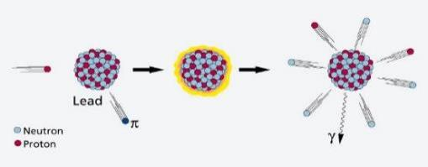
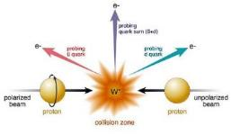
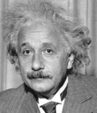

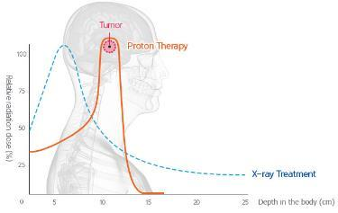
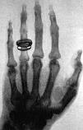

Accelerators can fulfil old human dreams
1. The dream of NUCLEAR PHYSICS
Particles can break and modify the nucleus, generating new atomic elements and transforming matter
Transforming matter, the dream of ancient alchemists
2. The dream of PARTICLE PHYSICS
E = m c²
In high-energy collisions, energy can generate new particles
The magic of creating matter
3. The dream of MEDICINE
Treatment and imaging using accelerators
Particles deposit energy at a well-defined depth without damaging surrounding tissues.
The dream of observing and curing the body without blood

Slide 6
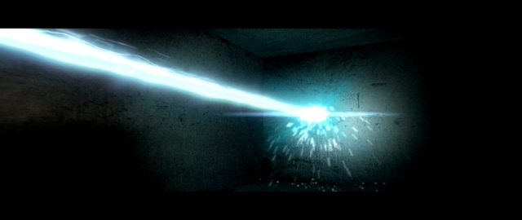
Accelerators can precisely deliver energy
A «beam» of accelerated particles is like a small “knife” penetrating into the matter
A particle beam can deliver energy to a very precisely defined area, interacting with the electrons and with the nucleus.
Particles can penetrate in depth
(different from lasers!).
Particle beams are used in medical and industrial applications,
e.g. to cure cancer, delivering their energy at a well-defined depth inside the body (Bragg peak)
Lasers and accelerators have comparable peak energy densities, but different interactions and penetration

Slide 7
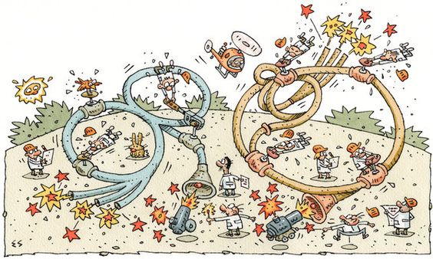
Innovation in Particle Accelerators
How old are particle accelerators?
How does their technology evolve?
Elwood Smith, NYT

Slide 8
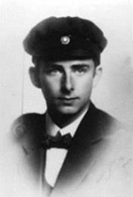
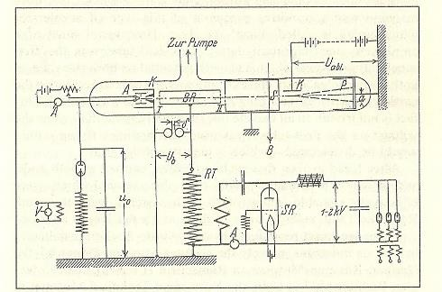
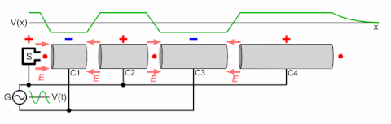
Modern particle accelerators are 97 years old
In 1928 a PhD Thesis introduced the basic concept of modern particle accelerators, using periodic acceleration provided by electric fields at Radio-Frequency (RF).
A major step from the previous DC (constant voltage) acceleration, limited to few MeV
Rolf Widerøe’s PhD thesis, 1928, University of Aachen – he was 26 years old!
Acceleration of potassium ions 1+ with 25kV of RF at 1 MHz → 50 keV acceleration in an 88 cm long glass tube) “at a cost of four to five hundred marks”, less than 2’000 € today!
(from R. Wideroe’s thesis)
use of Radio-Frequency technology (at the time limited to 1-2 MHz) → marrying radio technology and accelerators.
Acceleration in a sequence of gaps separated by tubes → invention of periodic acceleration.
complete accelerator: ion source, RF accelerator, detector, in vacuum.
Ion source
Accelerating tube at
V=V₀sinωt
RF generator
Detector
(image credit: Wikimedia commons)

Slide 9

At the roots of innovation
What were the ingredients of Rolf Wideröe’s innovation?
He was young and curious (PhD student, fresh ideas and time available)
He was under pressure to complete his thesis («necessity is the mother of invention»)
He was merging information and experience from different fields (cross-fertilisation)
He was going all the way down to practical realisation (to «innovate»).
The Oslo Manual (OECD/Eurostat, 2005), defines innovation as “the implementation of a new or significantly improved product or process …”

Slide 10
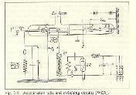
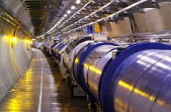
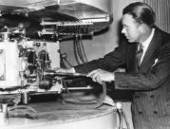
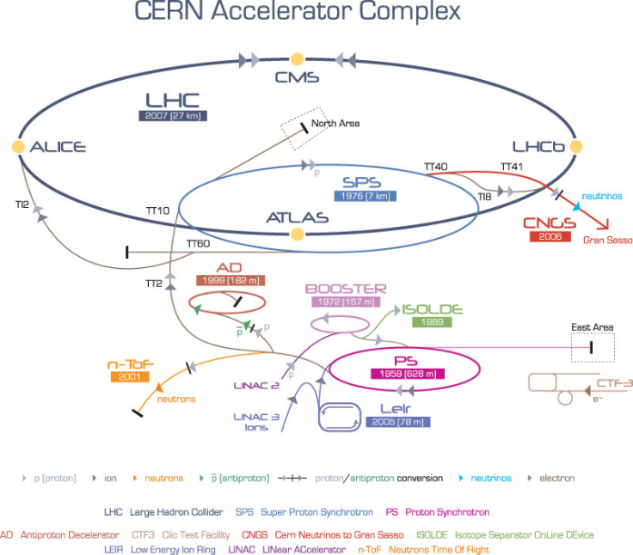
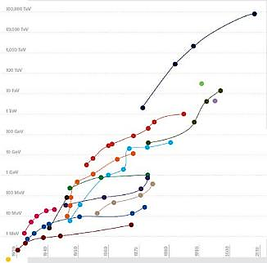
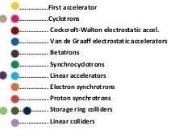
Innovation in the particle accelerator field
1931………….1945/48….1952…………..1965/90’s….…
XXI century
?
Cyclotron: cyclic acceleration with magnets (Lawrence)
Strong focusing
Superconducting magnets and acc. cavities
2008: the Large Hadron Collider
Colliders
Application of WW2 radar technology to accelerators
Succession of enabling technologies (technology leaps)
Energy
S. Livingston, 1959:
Accelerator energy increases by a factor of 10 every 6 years
(Moore’s law of accelerators)
2009 Livingston plot, Symmetry magazine
(for colliders, energy to reach same c.o.m. energy in collision with proton at rest)

Slide 11
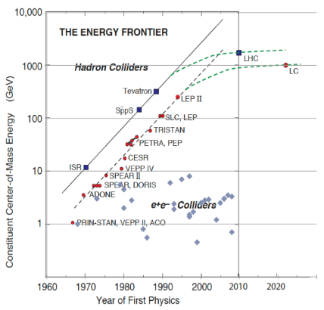
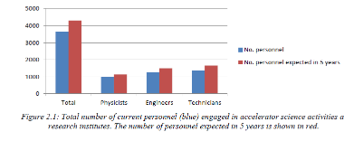
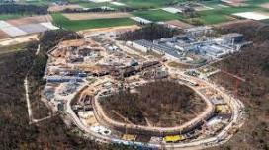
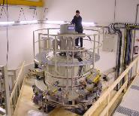
Particle Accelerators in 2025
We have reached the end of exponential growth…
but the field has never been so flourishing!
TIARA Need for Accelerator Scientists report, 2013: 3’700 people engaged in accelerator science in Europe, growing to 5’000 by 2020.
?
As many as 50 ongoing accelerator construction or upgrade projects listed in the 2017 IPAC Conference (13 America, 11 Asia, 26 Europe).
Annual market for medical and industrial accelerators estimated (2018) at US$5.0 Billion/year, growing at 5%/year.
Updated Livingstone-type chart (Wikipedia 2014, uploaded by J.Nash, Imperial College)
How many particle accelerators there are in the world, and where are they?

Slide 12
Multiple challenges for accelerator science
There are more than 35’000 particle accelerators in operation around the world:
For all XXth century, fundamental science has been the driving force for the development of new accelerators, with its continuous quest for high energies required to discover new particles.
In this early XXI century, we are moving to a new paradigm where together with particle physics applied science (photon and neutron science) and healthcare appear as driving forces for innovation.
Advanced medicine and new materials are key technology drivers of the XXIst century.
Research |  | 6%
 | Particle Physics | 0,5%
 | Nuclear Physics, solid state, materials | 0,5%
 | Biology | 5%
Medical Applications |  | 35%
 | Diagnostics/treatment with X-ray or electrons | 33%
 | Radio-isotope production | 2%
 | Proton or ion treatment | 0,1%
Industrial Applications |  | 60%
 | Ion implantation | 34%
 | Cutting and welding with electron beams | 16%
 | Polymerization | 7%
 | Neutron testing | 3.5%
 | Non destructive testing | 2,3%
What is the role of accelerators in this transition?
12

Slide 13

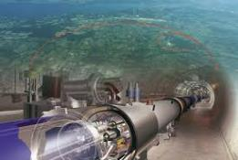
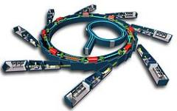
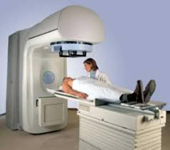
Accelerators in transition – for science and for society
Transition to new more sustainable technologies: lower use of natural, financial, and human resources.
Transition from basic science as main technology driver to a multiple system where basic and applied science, medicine and industry will together drive accelerator development.
Transition from a centralised configuration based on large laboratories to a distributed scheme (project clusters of small and large laboratories and industry)
innovation
Limitations related to size, cost, energy.
New ideas and technologies
Fundamental science
Societal applications (medicine, industry, environment, etc.)
Applied science (photon and neutron sources)
The electron linac for cancer radiotherapy, the most widespread accelerator in the world (> 12000 units)

Slide 14

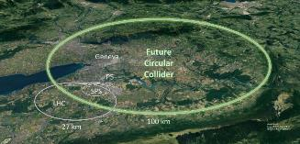
The big challenges for accelerator science
Making accelerator-based particle physics research sustainable over the long-term, increasing at the same time the benefits of particle accelerators for society are the main challenges to the accelerator community in this XXI century.
We need new ideas (innovation!) and a collaborative and creative environment for these ideas to grow
From the LHC (27 km) to the Future Circular Collider (90 km)
Sustainability translates into considering from an early design phase that resources are finite and use them conservatively and wisely with a view to long-term priorities, for the entire life cycle. New accelerator projects require Life Cycle Assessments (resources and emissions for construction / operation / decommissioning).
The goal is to reduce the overall environmental footprint of particle accelerators, minimising their impact as large consumers of energetical, environmental, financial, and human resources.

Slide 15
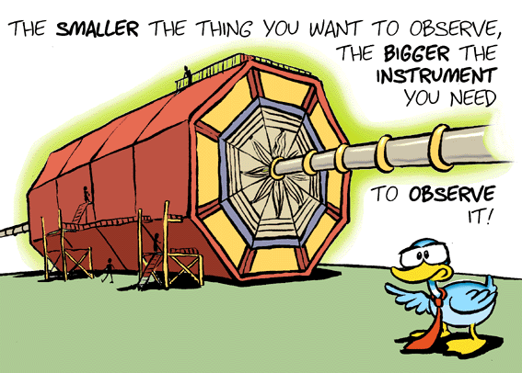
Multiples challenges for accelerator R&D

Slide 16
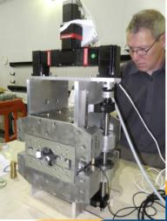
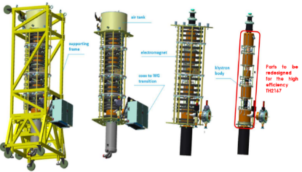
Increasing energy efficiency
Accelerators requires large amounts of energy to operate.
Low overall efficiency, between <1% (scientific accelerators) and 20-50% for high-intensity applications.
Due to high quality of the concentrated energy of a particle beam: from the electric grid the energy goes to several transformation (AC/DC, high voltage, radio-frequency, cryogenics, magnetic fields), each with a (low) characteristic efficiency, often from thermodynamics.
Large effort ongoing to develop components with better efficiency (e.g. superconductivity, permanent magnets, high-efficiency RF sources).
Electrical power consumption (MW) for LHC and future projects (estimated)
 | normal | Stand-by
LHC | 122 | 89
HL-LHC | 141 | 101
ILC | 230
CLIC 500 GeV | 235 | 167
CLIC 1.5 TeV | 364 | 190
FCC hh | 580 | 300?
Power flow in the PSI cyclotron facility: 13% of power to production target, 87%% dissipated into heat.
Only a tiny fraction of power on target converted into beams (n, μ) for physics.
High-efficiency upgrade of LHC klystrons : from 60% to 70% efficiency
Permanent magnet quadrupoles

Slide 17
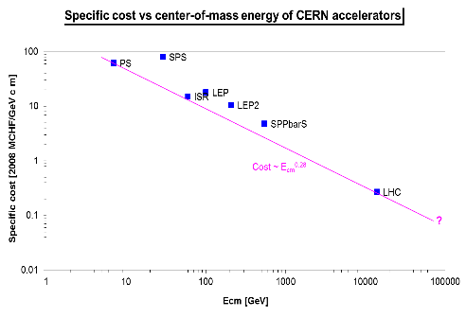
Economic sustainability and innovation
Moving along this line was made possible by new technologies
(colliders – antiproton production and storage – superconductivity)
FCC-ee
collider
p-pbar
collider
superconducting
collider
scaling of present technology
reduction in cost with new technologies
Plot courtesy of P. Lebrun
The economic environment and the priorities of a society define the budget to be invested in large scientific infrastructure (“Big Science”).

Slide 18
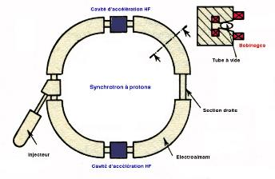
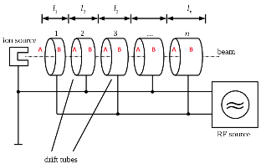
Reducing environmental footprint: smaller accelerators
Synchrotrons: p/q=Bρ
Need to maximise magnetic field
Superconductivity is mandatory, the limitations is the critical current density Jc for SC magnets
Linear accelerators: W=El
Need to maximise electric field
Limitations: arcing between electrodes, field emission, etc.
(and RF power, proportional to V² !)

Slide 19
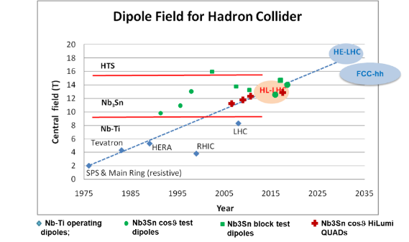
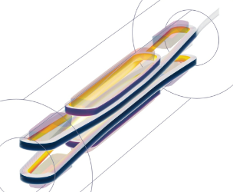
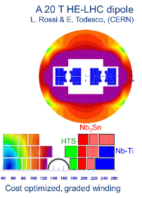
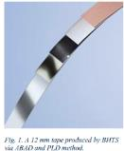
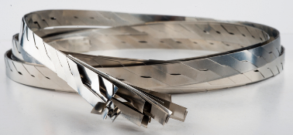
The magnetic field frontier in superconducting magnets
Three technologies under consideration
1. NbTi (Niobium Titanium as in the LHC): mature but limited to about 9T field.
2. Nb₃Sn (Niobium Tin) technology has seen a great boost in the past decade (factor 3 in J_{C} w/r to ITER) but is not yet used in an accelerator – The HL-LHC upgrade will be the first one.
3. HTS (High-Temperature Superconductor) technology still in the experimental phase (Production quantities, homogeneity and cost need to evolve!) but can be a disruptive technology for future high-field magnets.
Courtesy L. Rossi, CERN
R&D towards a 20 T HTS dipole magnet, develop 10 kA cable.
REBCO (rare earth barium copper oxyde) deposition on stainless substrate, tape arranged in Roebel cables.
values of 900-1200 A/mm2 at 4.2 K , 18-20 T have been obtained
Right: layered structures with sections of different conductors
Left: new magnet designs are required for HTS

Slide 20
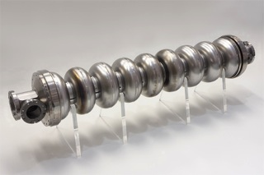
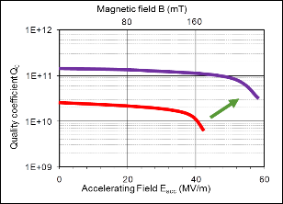
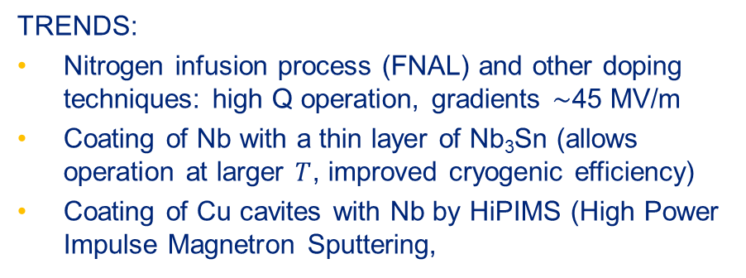
The electric field frontier – superconducting cavities
TRENDS:
Nitrogen infusion process (FNAL) and other doping techniques: high Q operation, gradients ∼45 MV/m
Coating of Nb with a thin layer of Nb₃Sn (allows operation at larger $T$, improved cryogenic efficiency)
Coating of Cu cavites with Nb by HiPIMS (High Power Impulse Magnetron Sputtering,
Multi-layer
SRF Thin Film
Bulk Nb
Long-term goal: 60 → 90 MV/m

Slide 21
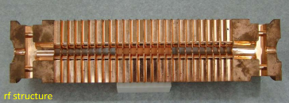

The electric field frontier – normal conducting cavities
Most advanced results by the Compact Linear Collider (CLIC) study based at CERN (X-band, 12 GHz)
Large international collaboration to understand the physics of breakdown phenomena.
Pulsed systems, characterised by a BreakDown Rate (BDR), pulses lost because of vacuum arcing in the structure
100 MV/m gradient can be achieved (and exceeded)
… but power scales as the square of gradient! High gradient means smaller dimensions but higher power consumption.

Slide 22



New acceleration techniques using lasers and plasmas
Accelerating field of today’s RF cavities or microwave technology is limited to <100 MV/m
  Several tens of kilometers for future linear colliders
Plasma can sustain up to three orders of magnitude much higher gradient
  SLAC (2007): electron energy doubled from 42GeV to 85 GeV over 0.8 m → 52GV/m gradient
Lasers can produce huge transverse electric fields (TV/m !)
Can we convert the transverse fields into longitudinal and use them for acceleration?
(1) Micro/Nano-Accelerators
(2) Plasma Accelerators
Use a plasma to convert the transverse electrical field of the laser (or the space charge force of a beam driver) into a longitudinal electrical field, by creating plasma waves.
Send THz Laser into Dielectric Waveguide (Micro-Accelerator)
The «accelerator on a chip»

Slide 23




A plasma-based linear collider?
Main challenges
W.P. Leemans & E. Esarey, Physics Today, March 2009
HALHF:

Slide 24




Other options for high energy: muon collider
Colliding muons:
Muons are leptons, similar to electrons but heavier (207 times),
produced by pion decay or electron/positron annihilation, have a lifetime of only 2.2 μs.
Muon production complex
Muon acceleration complex
Neutrino radiation
Good in term of power/luminosity, potential for cost savings
Many critical technical challenges requiring R&D

Slide 25

Accelerators for society
The Economist, October 2013

Slide 26





Accelerators for medicine and industry
>35000 accelerators in use world-wide:
  44% for radiotherapy
  41% for ion implantation
  9% for industrial applications
  4% low energy research
  1% medical isotope production
  <1% research
Treating cancer
Making better semi-conductors
“Curing” materials:
sterilisation; carbon dating; treating flue gases or water; etc
Microanalysis of materials, mass spectroscopy, PIXE, etc
PET and SPECT medical imaging
Radiotherapy electron linac
26
A tandem accelerator for material and artwork analysis
A commercial system for ion implantation
The IBA Rhodotron for production of intense electron beams
Proton cyclotron for radioisotope production

Slide 27

Particle accelerators: a formidable tool for medicine
Particles beams can activate nuclei generating radiation that can destroy cancerous cells or be detected from outside.
The energy deposited by a proton or ion beam has a well-defined peak (Bragg peak) inside the body: destroys the cancer cells with minimum damage to other tissues.
Accelerators realise the old dream of a bloodless surgery and imaging: penetrate into the human body to treat diseases and to observe internal organs without using surgical tools.
≈ 16’000 particle accelerators operating for medicine worldwide, in cancer therapy and imaging
M. Vretenar | NIMMS
Notes:
One step back

Slide 28




Treating cancer with particle beams
Electron Linac (linear accelerator) for X-ray radiation therapy of cancer
Proton Cyclotrons and Ion (Carbon) synchrotrons for particle therapy of cancer
Different from X-rays, protons and ions deposit their energy at a given depth inside the tissues, minimising the dose to the organs close to the tumour. (“Bragg peak”)
5 – 25 MeV e-beam
Tungsten target
>14,000 in operation worldwide!
>150 centres for protons, 12 for carbon

Slide 29



Environmental applications of accelerators
Low-energy electrons can break molecular bonds and be used for:
Flue gas treatment (cleaning of SOx from smokes of fossil fuel power plants)
Wastewater and sewage treatment
Treatment of marine diesel exhaust gases (removal of SOx and NOx).
Hybrid Exhaust Gas Cleaning Retrofit Technology for International Shipping (HERTIS)
A project based on a patent from INCT Warsaw promoted by a collaboration of research institutions (including CERN), accelerator industry, shipyards, maritime companies, maritime associations (Germany, UK, Switzerland, Poland, Latvia, Italy).
150 kV electron accelerator to break the high order molecules that are then cleaned by a water jet (scrubber)
To air
Testing on a tugboat at Riga shipyard, 5.07.2019
From engine

Slide 30






Accelerators for art
Ion Beam Analysis (e.g. PIXE, Proton Induced X-ray Emission)
A beam of particles (protons) from an accelerator is sent on a sample (e.g. a painting)
The atoms are excited and emit different types of radiation (X-rays, gammas, etc.)
Different atomic elements emit X-rays at different energies – Spectral analysis from one or more detectors allows determination of the chemical composition (e.g. of the pigments).
Radiation detection and spectral analysis
Emission of radiation of characteristic energies (X-rays, γ, particles…)
Ritratto Trivulzio by Antonello da Messina, 1476 – analysis at INFN-LABEC (Florence)
particle beam
particle accelerator
Portable PIXE system based on an RFQ linac built by CERN and LABEC
2 m

Slide 31

Some conclusions - at the roots of innovation
Particle accelerators are facing a critical moment in their evolution.
The expectations on accelerators from basic science, applied science, medicine and industry are increasing but some of our technologies are still the same as Widerøöe’s invention almost 100 years ago.
There is today a lot of space and encouragement for innovative ideas!
But what are the ingredients of innovation? Remember the first slide on Widerøe’s invention:
  Merge inputs from different science and technology fields (look around you!)
  Challenge the established traditions (but respect experience!)
  Take risks (but foresee mitigations!)
The 4 industrial revolutions (4th still ongoing!)
Particle accelerators can become crucial actors of the
4th industrial revolution
allowing industry and medicine to exploit technologies based on subatomic particles
Image credit: B. Horvath, S. Mundi, 2018
Dimensions: chemistry/molecule physics/electrons physics/atoms physics/subatomic level

Slide 32

Some final words…
Particle accelerators are a vibrant and growing field, in full transition from basic science to applied science and to wider societal applications.
But to drive this transition and to push further the frontiers of accelerators we need fresh ideas, technology jumps, and (why not!), some change in paradigm.
The secret for the success are novel ideas by young people developed in a collaborative environment, jumping across borders between different scientific fields.
To achieve these goals, we need multinational research programmes with wide support from governments and scientific communities, but above all…
Thank you for your attention! maurizio.vretenar@cern.ch

