Slide 1
EXERCISE 1: TRANSIT TIME FACTOR
Derive the general expression of the transit time factor of an accelerating gap of length L, with constant accelerating field, in which the field is oscillating at f_{RF} and that accelerate particles with relativistic factor β.
Remembering that the light wavelength in free space is given by λ_{RF}=c/f_{RF}, for which value of the accelerating gap length L, T is equal to zero?
Calculate the numerical value of T for L=10 cm, f_{RF}=1 GHz and ultra-relativistic electrons (β=1).
Calculate the accelerating voltage as a function of the gap length L assuming an injection phase on crest (φ_{inj}=0)

Slide 2
RF ACCELERATION: ENERGY GAIN
We consider now the acceleration between two electrodes fed by an RF generator
gap
E_{z}
source
z
-L/2
+L/2
z
Hyp. of symmetric accelerating field
t=z/v
Injection phase
Peak gap voltage
T<1
Transit time factor
Average accelerating field in the gap
Average accelerating field seen by the particle

Slide 3
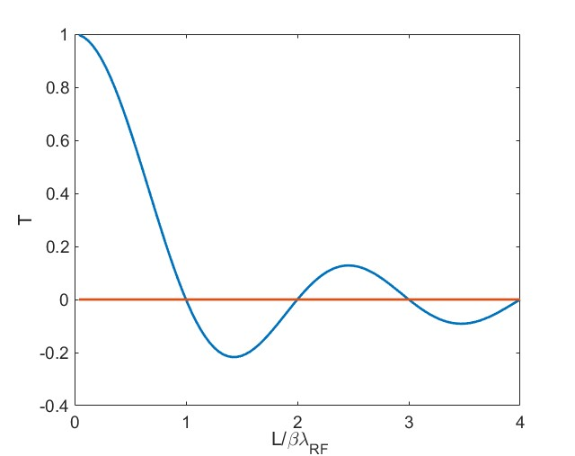
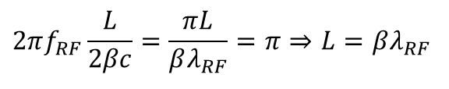
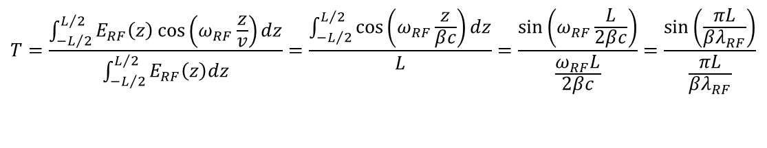

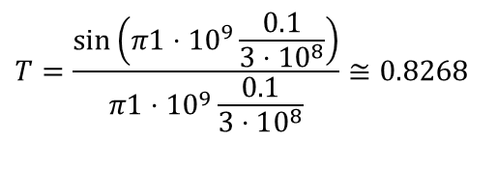
EXERCISE 1: SOLUTION
$${\hat{E}}_{RF}$$
$$T=\frac{\int_{−L/2}^{L/2}{E_{RF}\left(z\right)\cos\left(ω_{RF}\frac{z}{v}\right)dz}}{\int_{−L/2}^{L/2}{E_{RF}\left(z\right)dz}}=\frac{\int_{−L/2}^{L/2}{\cos\left(ω_{RF}\frac{z}{βc}\right)dz}}{L}=\frac{\sin\left(ω_{RF}\frac{L}{2βc}\right)}{\frac{ω_{RF}L}{2βc}}=\frac{\sin\left(\frac{πL}{βλ_{RF}}\right)}{\frac{πL}{βλ_{RF}}}$$
-L/2
+L/2
z
It is equal to zero when
$$2πf_{RF}\frac{L}{2βc}=\frac{πL}{βλ_{RF}}=π⇒L=βλ_{RF}$$
Numerical calculation
$$T=\frac{\sin\left(π1⋅10^{9}\frac{0.1}{3⋅10^{8}}\right)}{π1⋅10^{9}\frac{0.1}{3⋅10^{8}}}≅0.8268$$

Slide 4
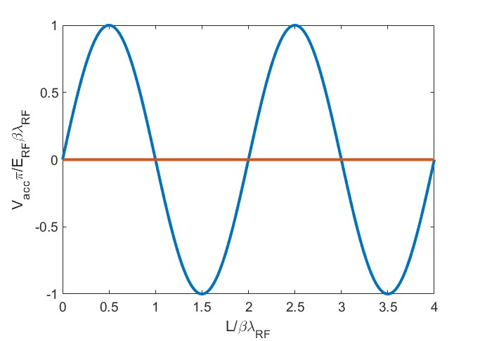
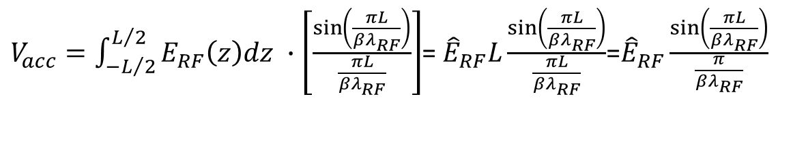
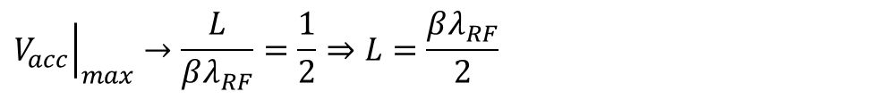
Total accelerating voltage
$V_{acc}=\int_{−L/2}^{L/2}{E_{RF}\left(z\right)dz} ∙\left[\frac{\sin\left(\frac{πL}{βλ_{RF}}\right)}{\frac{πL}{βλ_{RF}}}\right]$= ${\hat{E}}_{RF}L\frac{\sin\left(\frac{πL}{βλ_{RF}}\right)}{\frac{πL}{βλ_{RF}}}$=${\hat{E}}_{RF}\frac{\sin\left(\frac{πL}{βλ_{RF}}\right)}{\frac{π}{βλ_{RF}}}$
$${\left.V_{acc}\right|}_{max}→\frac{L}{βλ_{RF}}=\frac{1}{2}⇒L=\frac{βλ_{RF}}{2}$$
Very small accelerating gaps for low beta particles

Slide 5
EXERCISE 2: ALVAREZ STRUCTURES
A proton beam is injected into a DTL (Alvarez structure) working at f_{RF}=300 MHz, with a kinetic energy W_{in}=4 MeV. Calculate:
the distance between the first two centers of the accelerating gaps (L_{gaps}) assuming a constant velocity of the proton beam between the first two gaps and a negligible increase of the velocity due to the accelerating field;
if the structure is composed by 40 accelerating gaps (N_{gaps}) and the average accelerating voltage per gap is V_{acc}=0.5 MV, calculate final proton beam kinetic energy.
REMEMBER
proton rest energy m_{0_p}c²=E_{0_p}=938 MeV
velocity of light c=2.998e8

Slide 6
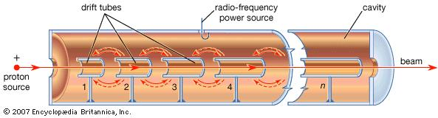
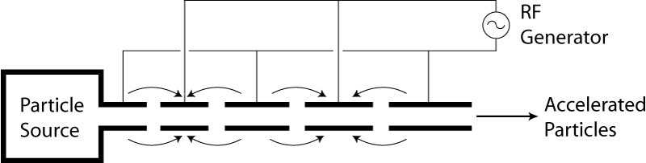
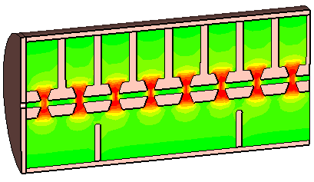
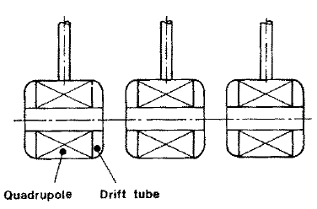
ALVAREZ STRUCTURES
Alvarez's structure can be described as a special DTL in which the electrodes are part of a resonant macrostructure.
(protons and ions)
© Encyclopaedia Britannica, inc
⇒The DTL operates in 0 mode for protons and ions in the range β=0.05-0.5 (f_{RF}=50-400 MHz, λ_{RF}=6-0.7 m) 1-100 MeV;
⇒The beam is inside the “drift tubes” when the electric field is decelerating. The electric field is concentrated between gaps;
⇒The drift tubes are suspended by stems;
⇒Quadrupole (for transverse focusing) can fit inside the drift tubes.
⇒In order to be synchronous with the accelerating field at each gap the length of the n-th drift tube L_{n} has to be:
E_{z}
z

Slide 7
EXERCISE 2: SOLUTIONS
L_{gaps}=β_{in}λ_{RF}=92 mm
λ_{RF}=c/f_{RF}=0.9993m
γ_{in}=(W_{in}+E_{0_p})/E_{0_p}=1.0043
β_{in}=sqrt(1-1/γ_{in}^2)= 0.0921
W_{fin} = W_{in} +qN_{gaps}*V_{acc}=24 MeV

Slide 8
EXERCISE 3: ALVAREZ STRUCTURES AND TRANSIT TIME FACTOR
Particles at β=0.5 are accelerated through an ideal DTL operating at f_{RF}=400 MHz. Assuming a uniform accelerating RF field (E_{RF}) along the gap, calculate the accelerating gap length (L) that maximize the energy gain of the accelerated particles.

Slide 9
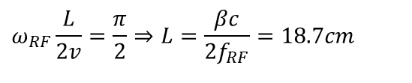
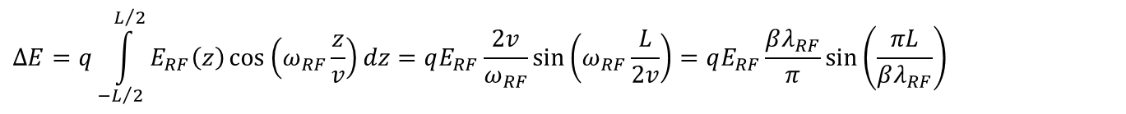
EXERCISE 3: SOLUTIONS
$$ΔE=q\int_{−L/2}^{L/2}{E_{RF}\left(z\right)\cos\left(ω_{RF}\frac{z}{v}\right)dz}=qE_{RF}\frac{2v}{ω_{RF}}\sin\left(ω_{RF}\frac{L}{2v}\right)=qE_{RF}\frac{βλ_{RF}}{π}\sin\left(\frac{πL}{βλ_{RF}}\right)$$
The energy gain as a function of L oscillates
Maximum energy gain when:
$$ω_{RF}\frac{L}{2v}=\frac{π}{2}⇒L=\frac{βc}{2f_{RF}}=18.7cm$$
$$ω_{RF}\frac{L}{2v}=\frac{π}{2}+2nπ⇒L=\frac{βc}{f_{RF}}\left(\frac{1}{2}+2n\right)=βλ_{RF}\left(\frac{1}{2}+2n\right)=18.7cm+n⋅75cm$$

Slide 10
EXERCISE 4: FILLING TIME
A SW cavity is feed by an RF generator with constant power, calculate after how much time the field in the cavity is 90% the field at full regime supposing that the cavity operate at f_{RF}=1.3 GHz and has an equivalent Q factor of 10000.

Slide 11
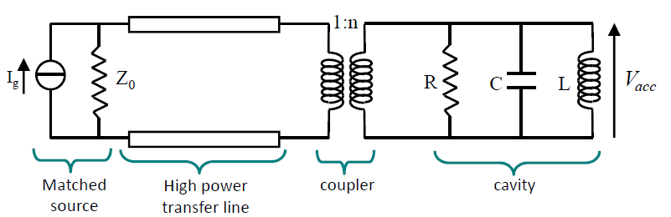
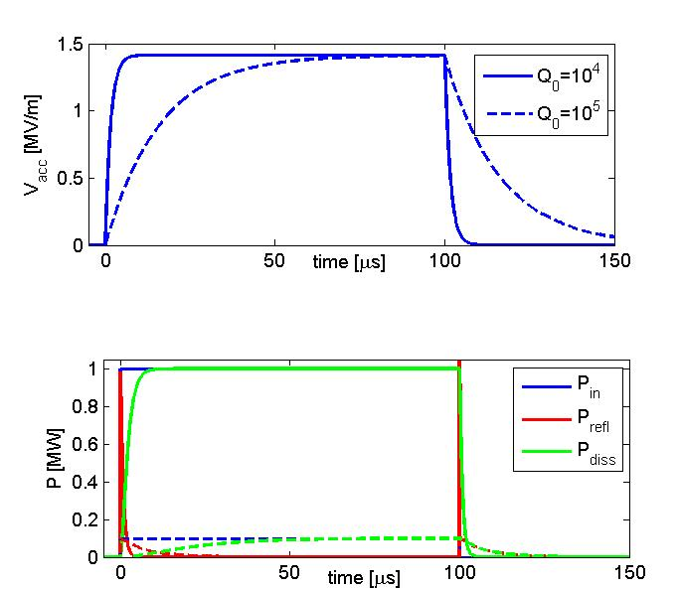
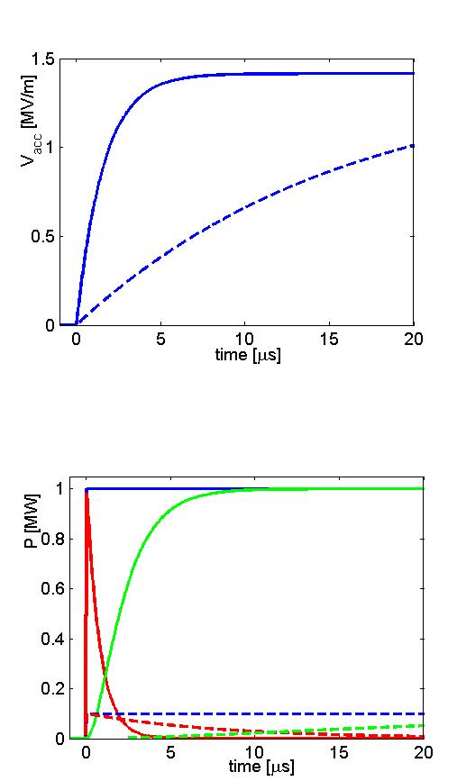
SW CAVITIES : FILLING TIME AND DISSIPATED POWER
Let us now consider the case of a cavity powered by a source (klystron) in pulsed mode at a frequency f_{RF}=f_{res}. The accelerating voltage has an exponential behavior and reach the steady state regime asymptotically with a certain filling time (τ_{F}) that is proportional to the quality factor of the resonator.
Time domain
[MV]
One needs several filling times to completely fill the cavity
FILLING TIME
P_{diss} ∝1/Q
To reach a given voltage the required power is inversely proportional to the Q-factor
The reachable V_{acc} for a given power is proportional to √Q but, on the other hand, the filling time is ∝Q
Example:
  Q∼10000
f_{RF}=1 GHz
τ_{F}=3.1 μs
P_{refl} to the generator (it that has to be protected!)

Slide 12

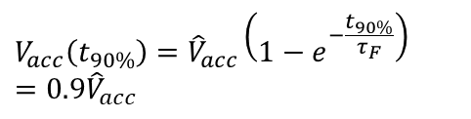
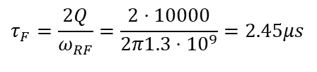
EXERCISE 4: SOLUTION
$$V_{acc}\left(t_{90\%}\right)={\hat{V}}_{acc}\left(1−e^{−\frac{t_{90\%}}{τ_{F}}}\right)=0.9{\hat{V}}_{acc}$$
$$t_{90\%}=−τ_{F}\ln\left(1−0.9\right)=5.64μs$$
$$τ_{F}=\frac{2Q}{ω_{RF}}=\frac{2⋅10000}{2π1.3⋅10^{9}}=2.45μs$$

Slide 13
EXERCISE 5: π MODE STRUCTURES
A π-mode structure, operating at f_{RF}=400 MHz, is made up of N=8 cells and is used to accelerate protons. Each single cell has a shunt impedance R=3 MΩ and a length L_{cell}=15 cm. Calculate:
the total shunt impedance of the π-mode structure;
the accelerating voltage if the total dissipated power into the cavity is P_{diss}=1 MW;
the average accelerating field;
the average β of the proton beam accelerated by this structure.

Slide 14
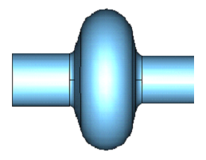
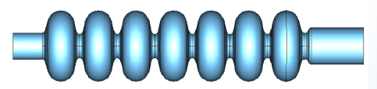
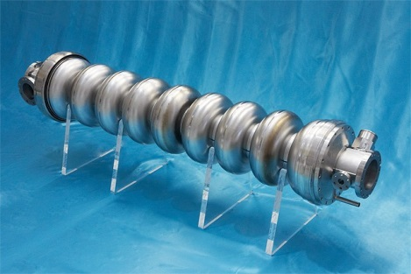
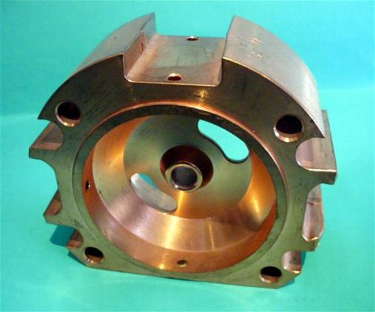
MULTI-CELL SW CAVITIES
P_{in}
(electrons or protons and ions at high energy)
P_{in}
R
.
nR
In a multi-cell structure there is one RF input coupler. As a consequence the total number of RF sources is reduced, with a simplification of the layout and reduction of the costs;
The shunt impedance is n time the impedance of a single cavity
They are more complicated to fabricate than single cell cavities;
The fields of adjacent cells couple through the cell irises and/or through properly designed coupling slots.

Slide 15
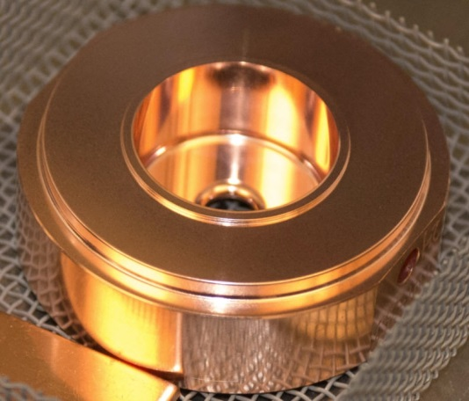
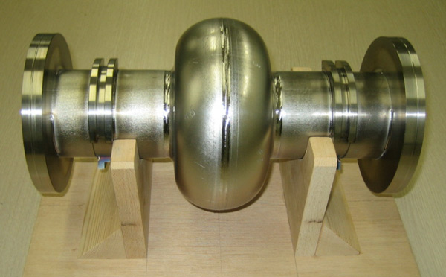
SW CAVITIES PARAMETERS: R, Q, R/Q
ACCELERATING VOLTAGE (V_{acc})
DISSIPATED POWER (P_{diss})
STORED ENERGY (W)
SHUNT IMPEDANCE
QUALITY FACTOR
The shunt impedance is the parameter that qualifies the efficiency of an accelerating mode. The highest is its value, the larger is the obtainable accelerating voltage for a given power. Traditionally, it is the quantity to optimize in order to maximize the accelerating field for a given dissipated power:
  NC cavity Q∼10⁴
  SC cavity Q∼10¹⁰
SHUNT IMPEDANCE PER UNIT LENGTH
The R/Q is a pure geometric qualification factor. It does not depend on the cavity wall conductivity. R/Q of a single cell is of the order of 100.
  NC cavity R∼1MΩ
  SC cavity R∼1TΩ
Example:
  R∼1MΩ
P_{diss}=1 MW
V_{acc}=1MV
For a cavity working at 1 GHz with a structure length of 10 cm we have an average accelerating field of 10 MV/m

Slide 16
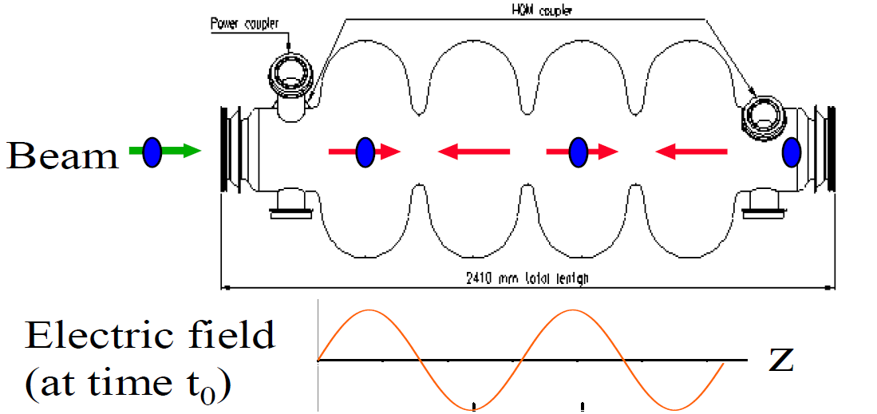
MULTI-CELL SW CAVITIES: π MODE STRUCTURES
(electrons or protons and ions at high energy)
0 mode
The N-cell structure behaves like a system composed by N coupled oscillators with N coupled multi-cell resonant modes.
The modes are characterized by a cell-to-cell phase advance given by:
.
E_{z}
The multi cell mode generally used for acceleration is the π, π/2 and 0 mode (DTL as example operate in the 0 mode).
The cell lengths have to be chosen in order to synchronize the accelerating field with the particle traveling into the structure at a certain velocity
z
π mode
EXAMPLE: 4 cell cavity operating on the π-mode
E_{z}
⇒For ions and protons the cell lengths have to be increased along the linac that will be a sequence of different accelerating structures matched to the ion/proton velocity.
⇒For electron, β=1, d=λ_{RF}/2 and the linac will be made of an injector followed by a series of identical accelerating structures, with cells all the same length.
z

Slide 17
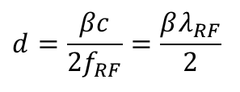
EXERCISE 5: SOLUTION
1) R_{TOT}=N*R_{cell}=24 MΩ
2) V_{acc}=sqrt(R_{TOT}*P_{diss})=4.9 MV
3) E_{acc}=V_{acc}/(L_{cell}*N)=4.08 MV/m
4) β_{in} =2*L_{cell} /λ_{RF}=0.4
being
λ_{RF}=c/f_{RF}=0.7495 m
$$d=\frac{βc}{2f_{RF}}=\frac{βλ_{RF}}{2}$$

Slide 18
Exercise 6: TW STRUCTURES
A) Demonstrate that if we define the attenuation constant as:
the power flow along the structure scales as:
B) Demonstrate that if we define the shunt impedance per unit length as:
the accelerating field “seen” by an ultrarelativistic particle (z=ct) along the structure can be expressed as:
C) Demonstrate that the total accelerating voltage is given by:

Slide 19
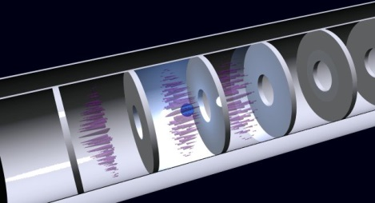
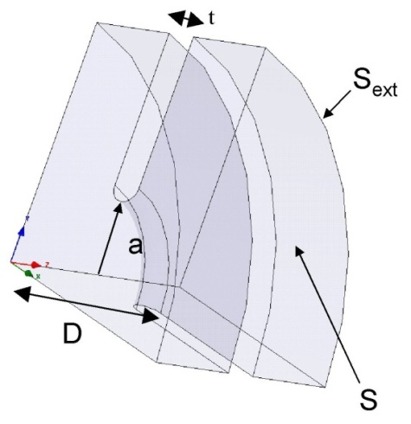
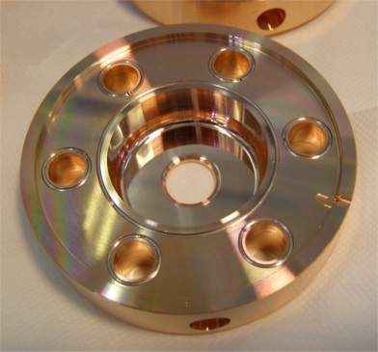
TW CAVITIES PARAMETERS: r, α, v_{g}
Similarly to the SW cavities it is possible to define some figure of merit for the TW structures
Shunt impedance per unit length [Ω/m]. Similarly to SW structures the higher is r, the higher the available accelerating field for a given RF power.
Field attenuation constant [1/m]: because of the wall dissipation, the RF power flux and the accelerating field decrease along the structure.
Group velocity [m/s]: the velocity of the energy flow in the structure (∼1-2% of c).
Working mode [rad]: defined as the phase advance over a period D. For several reasons the most common mode is the 2π/3

Slide 20
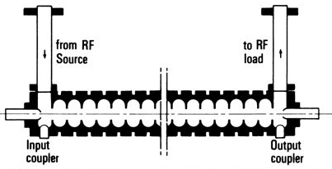
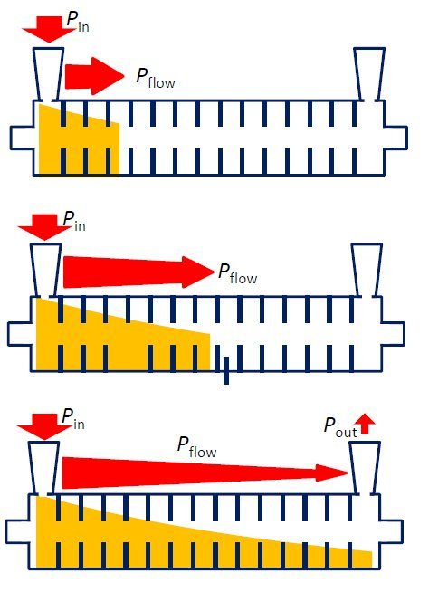
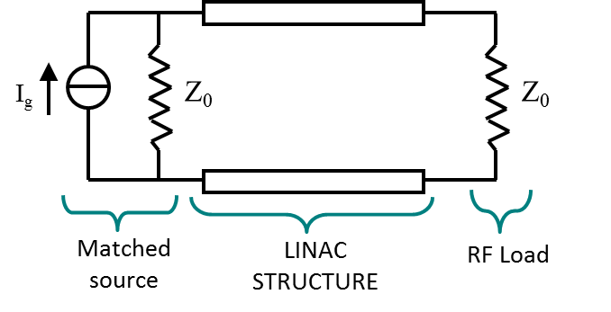
TW CAVITIES: EQUIVALENT CIRCUIT AND FILLING TIME
In a TW structure, the RF power enters into the cavity through an input coupler, flows (travels) through the cavity in the same direction as the beam and an output coupler at the end of the structure is connected to a matched power load.
If there is no beam, the input power, reduced by the cavity losses, goes to the power load where it is dissipated.
In the presence of a large beam current, however, a fraction of the TW power is transferred to the beam.
In a purely periodic structure, made by a sequence of identical cells (also called “constant impedance structure”), α does not depend on z and both the RF power flux and the intensity of the accelerating field decay exponentially along the structure :
The filling time is the time necessary to propagate the RF wave-front from the input to the end of the section of length L is:
Differently from SW cavities after one filling time the cavity is completely full of energy
L

Slide 21
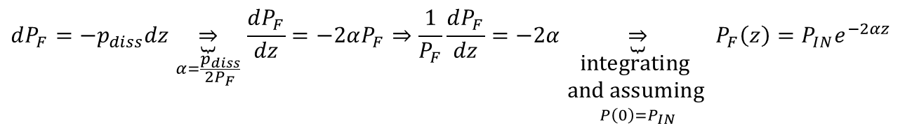
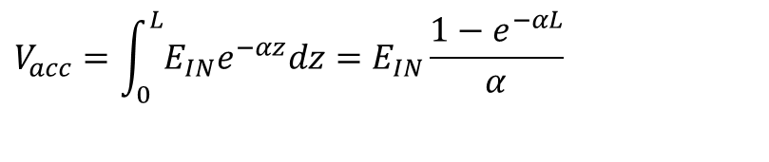
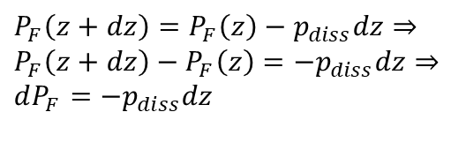
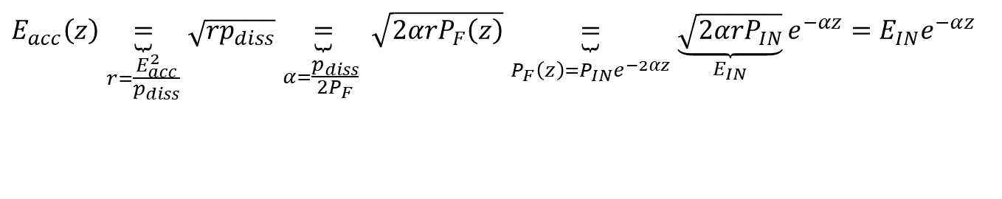
Exercise 6: SOLUTION
p_{diss}dz
A)
$$dP_{F}=−p_{diss}dz\underset{α=\frac{p_{diss}}{2P_{F}}}{\underbrace{⇒}}\frac{dP_{F}}{dz}=−2αP_{F}⇒\frac{1}{P_{F}}\frac{dP_{F}}{dz}=−2α\underset{\begin{aligned}\text{integrating} \\ \text{and} \text{assuming} \\ P\left(0\right)=P_{IN}\end{aligned}}{\underbrace{⇒}}P_{F}\left(z\right)=P_{IN}e^{−2αz}$$
P_{F}(z)
P_{F}(z+dz)
z
z+dz
B)
$$E_{acc}\left(z\right)\underset{\begin{aligned}&r=\frac{E_{acc}^{2}}{p_{diss}} \\ & \end{aligned}}{\underbrace{=}}\sqrt{rp_{diss}}\underset{\begin{aligned}& \\ &α=\frac{p_{diss}}{2P_{F}} \end{aligned}}{\underbrace{=}}\sqrt{2αrP_{F}\left(z\right)}\underset{\begin{aligned}& \\ &P_{F}\left(z\right)=P_{IN}e^{−2αz}\end{aligned}}{\underbrace{=}}\underset{E_{IN}}{\underbrace{\sqrt{2αrP_{IN}}}}e^{−αz}=E_{IN}e^{−αz}$$
$$P_{F}\left(z+dz\right)=P_{F}\left(z\right)−p_{diss}dz⇒ \\ P_{F}\left(z+dz\right)−P_{F}\left(z\right)=−p_{diss}dz⇒ \\ dP_{F}=−p_{diss}dz$$
C)
$$V_{acc}=\int_{0}^{L}{E_{IN}e^{−αz}dz=E_{IN}}\frac{1−e^{−αL}}{α}$$

Slide 22
Exercise 7: TW STRUCTURES
A SLAC-type TW structure accelerate ultra-relativistic electrons. The structure length is L=3m and it can be simplified as a structure with a group velocity is v_{g}=1.1% the velocity of light. Calculate:
the filling time;
if we suppose that the structure has a field attenuation constant α=0.2 m⁻¹, calculate the total accelerating voltage if the accelerating field at the beginning of the structure is E_{INPUT}=20 MV/m;
Calculate the average accelerating field
if the average dissipated power per unit length in the structure, corresponding to the previous value of the accelerating field, is p_{diss}= 4 MW/m calculate the shunt impedance per unit length.

Slide 23
TW CAVITIES PARAMETERS: r, α, v_{g}
Similarly to the SW cavities it is possible to define some figure of merit for the TW structures
Shunt impedance per unit length [Ω/m]. Similarly to SW structures the higher is r, the higher the available accelerating field for a given RF power.
Field attenuation constant [1/m]: because of the wall dissipation, the RF power flux and the accelerating field decrease along the structure.
Group velocity [m/s]: the velocity of the energy flow in the structure (∼1-2% of c).
Working mode [rad]: defined as the phase advance over a period D. For several reasons the most common mode is the 2π/3

Slide 24
TW CAVITIES: EQUIVALENT CIRCUIT AND FILLING TIME
In a TW structure, the RF power enters into the cavity through an input coupler, flows (travels) through the cavity in the same direction as the beam and an output coupler at the end of the structure is connected to a matched power load.
If there is no beam, the input power, reduced by the cavity losses, goes to the power load where it is dissipated.
In the presence of a large beam current, however, a fraction of the TW power is transferred to the beam.
In a purely periodic structure, made by a sequence of identical cells (also called “constant impedance structure”), α does not depend on z and both the RF power flux and the intensity of the accelerating field decay exponentially along the structure :
The filling time is the time necessary to propagate the RF wave-front from the input to the end of the section of length L is:
Differently from SW cavities after one filling time the cavity is completely full of energy
L

Slide 25
Exercise 7: SOLUTION
1) L=3; ⇒ t_{F}=L/v_{g}=909.7 ns
2)
3) E_{acc}=V_{acc}/L=15 MV/m
4) r=E_{acc}^2/p_{diss}=56.5 MΩ/m

Slide 26
Exercise 8: TW STRUCTURES
A constant impedance TW structure, accelerates ultra-relativistic electrons (β=1). The cavity has the following parameters: α=0.25 m⁻¹ ; shunt impedance r=65 MOhm/m and a total length of 2 m. Calculate:
the input power to have an energy gain of the particles of 60 MeV
if the group velocity v_{g} is 1% the speed of light, which is the filling time of the structure?

Slide 27
Exercise 8: SOLUTION
1)
2) t_{F}=L/v_{g}=667 ns

Slide 28
EXERCISE 9: π MODE STRUCTURES AND DUTY CYCLE
A multi cell SW cavity, operating on the π-mode at 1 GHz, accelerates protons at β=0.5. The cavity is a 9 cell structure. Assuming a negligible variation of the particle velocity through the cavity itself calculate:
the distance between the centers of the accelerating cells;
assuming a shunt impedance of the single cell (R) of 1 MΩ, calculate the dissipated power to have a peak accelerating voltage on the overall structure of V_{acc}=10 MV;
Calculate the maximum average accelerating field;
If the cavity is fed by 4 μs rf pulses with a repetition rate of 100 Hz, calculate the Duty Cycle.

Slide 29
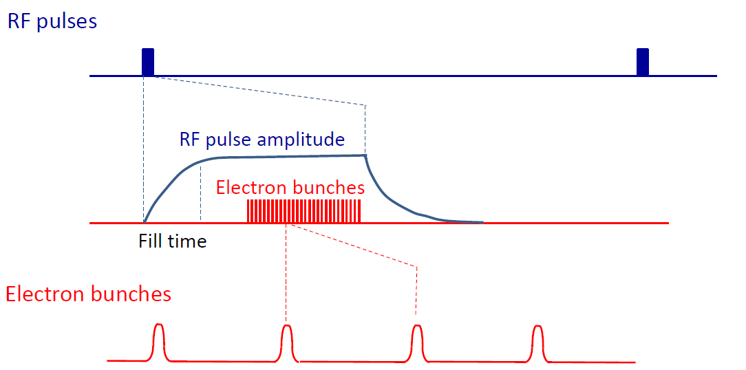
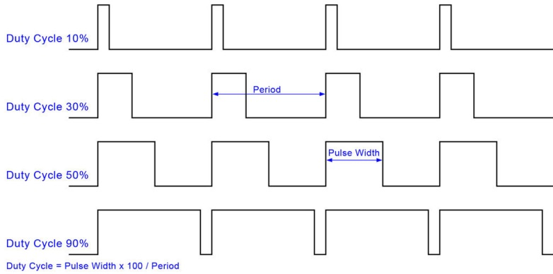
RF STRUCTURE AND BEAM STRUCTURE: NC vs SC
The “beam structure” in a LINAC is directly related to the “RF structure”. There are two possible type of operations:
CW (Continuous Wave) operation ⇒ allow, in principle, to operate with a continuous (bunched) beam
PULSED operation ⇒ there are RF pulses at a certain repetition rate (Duty Cycle (DC)=pulsed width/period)
RF power
RF pulses
time
Bunch spacing
⇒SC structures allow operation at very high Duty Cycle (>1%) up to a CW operation (DC=100%) (because of the extremely low dissipated power) with relatively high gradient (>20 MV/m). This means that a continuous (bunched) beam can be accelerated.
⇒NC structures can operate in pulsed mode at very low DC (10⁻²-10⁻¹ %) (because of the higher dissipated power) with, in principle, larger peak accelerating gradient(>30 MV/m). This means that one or few tens of bunches can be, in general, accelerated. NB: NC structures can also operate in CW but at very low gradient because of the dissipated power.
Amplitude
10³-10⁸ RF periods
t

Slide 30
EXERCISE 9: SOLUTION
1)
2)
R_{TOT}=N*R=9 MΩ
P_{diss}=V_{acc}^2/R_{TOT}=11.1 MW
3)
L_{TOT}=d*N=67.4 cm
E_{acc}=V_{acc}/L_{TOT}=14.8 MV/m
4)
DC=T_{imp}/T_{period}=4e-6/0.01=4e-4 (0.04%)

Slide 31
EXERCISE 10: energy acceptance
A RF accelerating structure operating at f_{RF}=400 MHz, is used to accelerate protons at an input nominal kinetic energy W_{in}=10 MeV. Assuming that the nominal synchronous phase φ_{s}=-π/6 and that the average accelerating field is E_{acc}=2 MV/m, calculate the maximum kinetic energy of the protons that is possible to capture in the RF bucket (assuming that it is injected at a phase corresponding to the synchronous one).

Slide 32
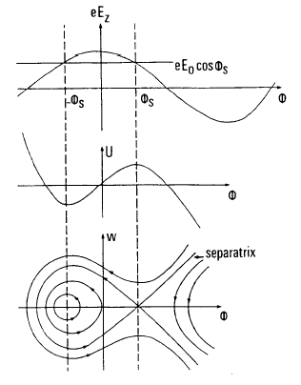
APPENDIX: LARGE OSCILLATIONS AND SEPARATRIX
To study the longitudinal dynamics at large oscillations, we have to consider the non linear system of differential equations without approximations. In the adiabatic acceleration case it is possible to easily obtain the following relation between w and ϕ that is the Hamiltonian of the system related to the total particle energy:
⇒For each H we have different trajectories in the longitudinal phase space
⇒the oscillations are stable within a region bounded by a special curve called separatrix: its equation is:
⇒the region inside the separatrix is called RF bucket. The dimensions of the bucket shrinks to zero if φ_{s}=0.
⇒trajectories outside the RF buckets are unstable.
⇒we can define the RF acceptance as the maximum extension in phase and energy that we can accept in an accelerator:
φ_{s}
-φ_{s}
ϕ
ϕ
Small amplitude oscillations
ϕ
RF bucket

Slide 33
EXERCISE 10: SOLUTION
γ_{in}=(W_{in}+E_{0_P})/E_{0_P}=1.0107
β_{in}=sqrt(1-1/γ_{in}^2)= 0.1449
W_{MAX=}W_{in}+Δw=10.362 MeV

Slide 34
Exercise 11: low energy electrons
An electron beam generated by a DC gun at 40 keV is directly accelerated by a TW structure. Calculate the minimum accelerating field needed to capture the beam, assuming an operating frequency of 6 GHz and a final β_{fin} equal to 1.
If the accelerating field is twice the minimum accelerating field, what is the final phase (φ_{fin}) with respect to the accelerating field of a particle injected at φ_{in}=-π/2?

Slide 35
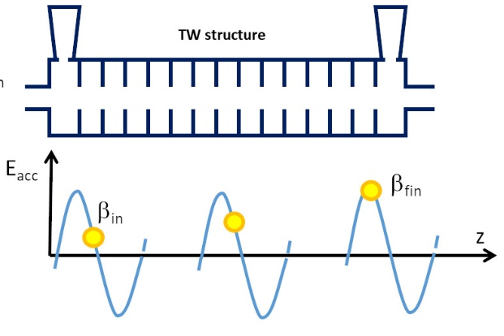
LONGITUDINAL DYNAMICS OF LOW ENERGY ELECTRONS: PHASE SPLIPPAGE
The accelerating field of a TW structure can be expressed by
The equation of motion of a particle with a position z at time t accelerated by the TW is then
It is useful to find which is the relation between β and φ from an initial condition (in) to a final one (fin)
Should be in the interval [-1,1] to have a solution for φ_{fin}
Suppose that the particle reach asymptotically the value β_{fin}=1 we have:
This limits the possible injection phases (i.e. the phase of the electrons that is possible to capture)
This quantity is >0
We always have that
E_{acc}
E_{acc}
z
φ_{in}
β_{in}
φ_{fin}
β_{fin}=1
φ

Slide 36
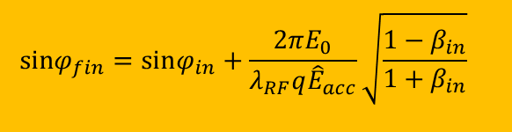
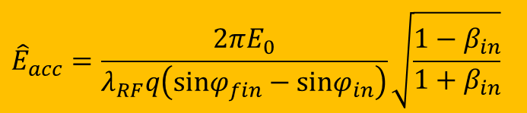
EXERCISE 11: SOLUTION
$$\text{sin}φ_{fin}=\text{sin}φ_{in}+\frac{2πE_{0}}{λ_{RF}q{\hat{E}}_{acc}}\sqrt{\frac{1−β_{in}}{1+β_{in}}}$$
$${\hat{E}}_{acc}=\frac{2πE_{0}}{λ_{RF}q\left(\text{sin}φ_{fin}−\text{sin}φ_{in}\right)}\sqrt{\frac{1−β_{in}}{1+β_{in}}}$$
Where λ_{RF}=c/f_{RF}=0.05 m, E₀=0.51 MeV and βin can be calculated as follows:
γ_{in}=(W_{in}+E_{0_e})/E_{0_e}=1.078
β_{in}=sqrt(1-1/γ_{in}^2)= 0.374
substituting we obtain
E_{acc}
φ_{in}
β_{in}
φ
φ_{fin}
β_{fin}=1
The final phase is given by:
E_{acc}
φ_{fin}
β_{fin}=1
φ_{in}
β_{in}
φ

Slide 37
Exercise 12: transverse beam dynamics
A DTL (Alvarez structure) working at f_{RF}=300 MHz accelerate protons with an injection energy W_{in}=4 MeV, permanent magnet quadrupoles are inside the drift tubes and the focusing system is equivalent to a FODO lattice, as sketched below. The quadrupoles inside the drift tubes have a length L_{Q}=5 cm.
If the average accelerating field per cell is E_{acc}=2 MV/m and the nominal synchronous phase φ_{S}=-π/6, calculate, using the “smooth approximation” approach, the quadrupole gradient (G) that is necessary to have, in the first cells, of the structure in order to achieve a transverse phase advance per period (σ) equal to π/3, supposing that the period of the FODO (L_{P}) is exactly twice the distance between two accelerating gaps.
proton rest energy m₀c²=E₀=938 MeV
velocity of light c=2.998e8

Slide 38
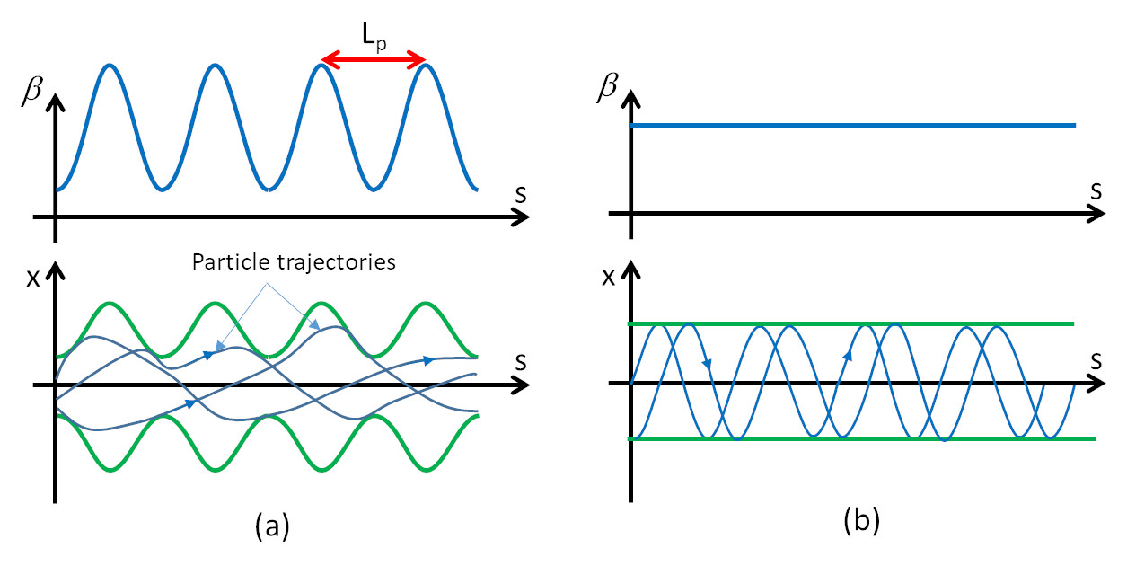
SMOOTH APPROXIMATION OF TRANSVERSE OSCILLATIONS
⇒In case of “smooth approximation” of the LINAC (we consider an average effect of the quadrupoles and RF) we obtain a simple harmonic motion along s of the type (β is constant):
L_{p}
l
G=quadrupole gradient [T/m]
l=quadrupole length
Phase advance per unit length (σ/L_{p})
Magnetic focusing elements (for a FODO)
RF defocusing term
NB: the RF defocusing term ∝f sets a higher limit to the working frequency
If we consider also the Space Charge contribution in the simple case of an ellipsoidal beam (linear space charges) we obtain:
I= average beam current (Q/T_{RF})
r_{x,y,z}=ellipsoid semi-axis
f= form factor (0<f<1)
Z₀=free space impedance (377 Ω)
Space charge term
For ultrarelativistic electrons RF defocusing and space charge disappear and the external focusing is required to control the emittance and to stabilize the beam against instabilities.

Slide 39
Exercise 11: transverse beam dynamics
λ_{RF}=c/f_{RF}=0.9993m
γ_{in}=(W_{in}+E_{0_P})/E_{0_P}=1.0043
β_{in}=sqrt(1-1/γ_{in}^2)= 0.0921
L_{_gaps}=β_{in}λ_{RF}=92 mm
L_{P}=2*L_{gaps}=184 mm
K₀=(π/3)/L_{P}=5.69 m⁻¹

