Slide 1
SPD cooling TEST BENCH
Test section design and construction

Slide 2
Design guidelines
We want:
to have a layout as similar as possible to the real system;
to have the same sansor in the same place;
to have more sensor than the real system;
to have the possibility to simply adjust the operating point.

Slide 3
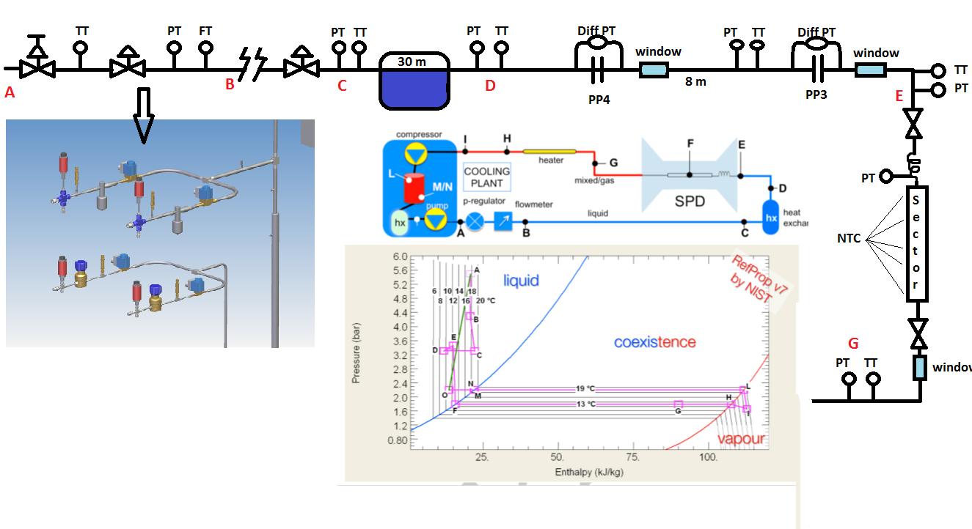

Slide 4
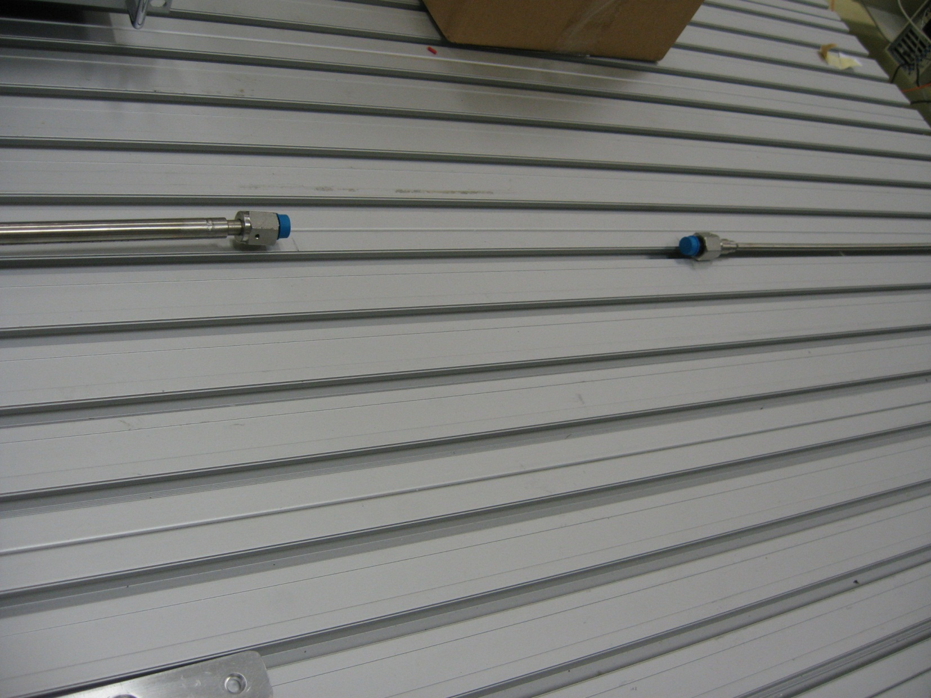
Test section connections

Slide 5
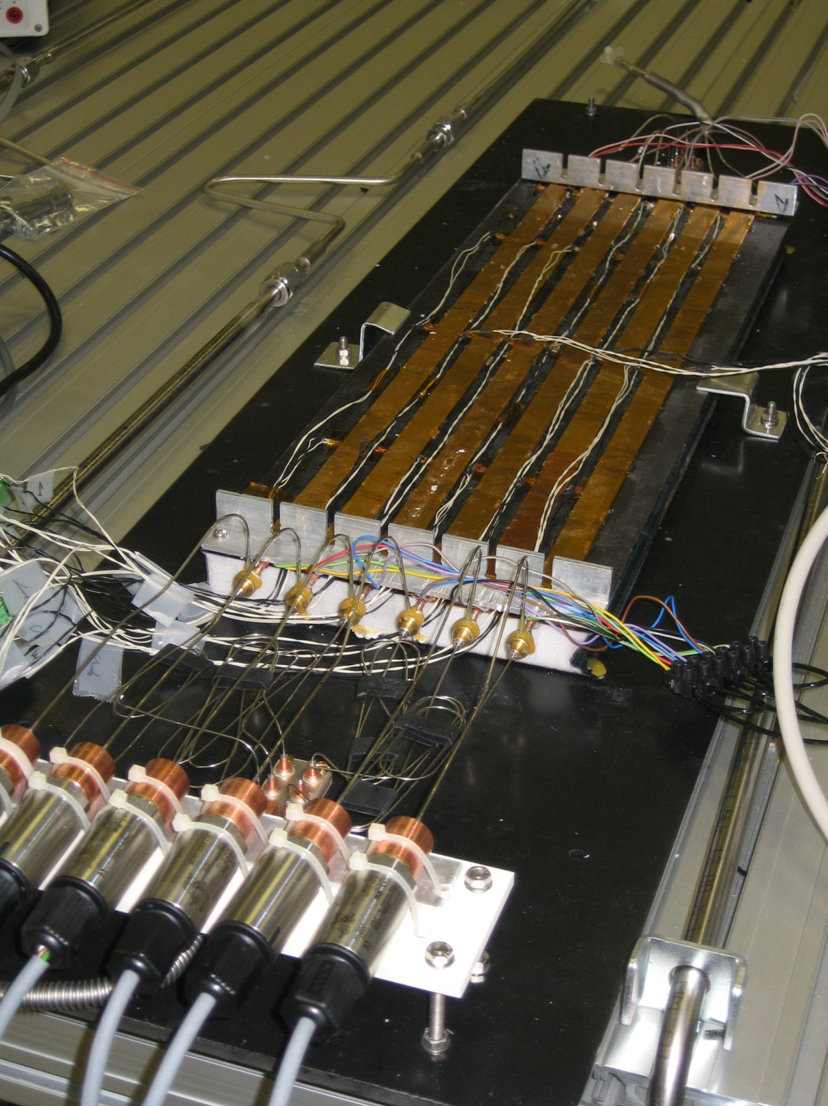
The dummy sector

Slide 6
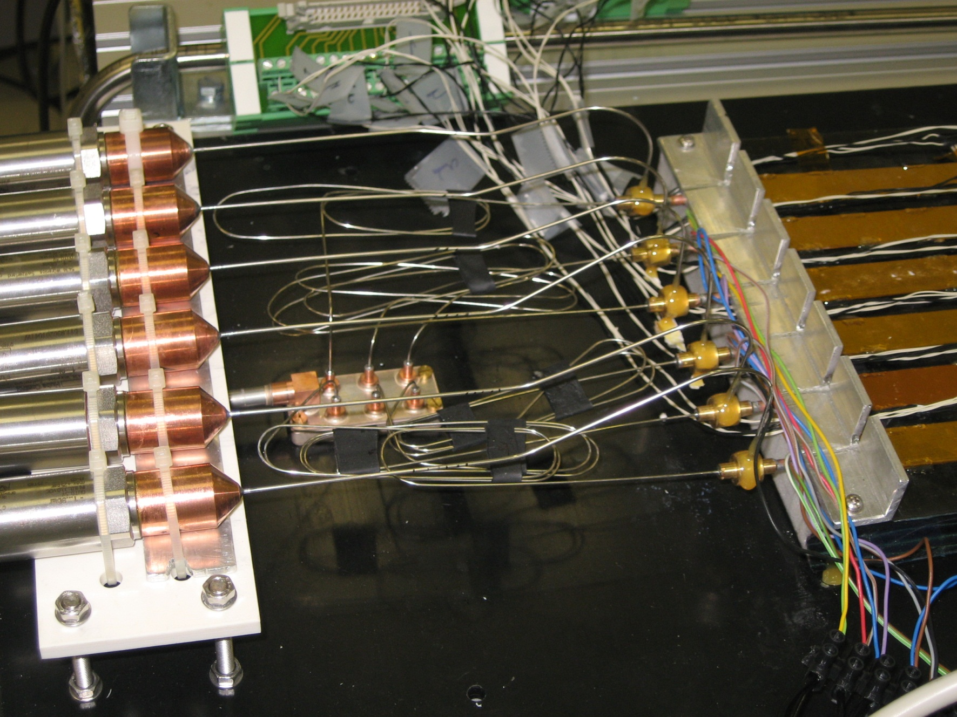
Capillaries PT

Slide 7
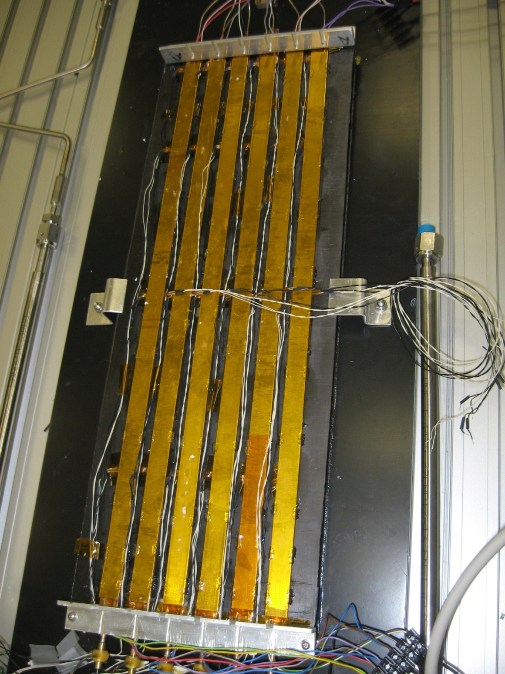
Temperature sensors (NTC)
Al+Kp
Resistor
Cooling tube

Slide 8
Coming soon…
Assembly of the test section
Connection of all the sensors to the ELMB
Calibration of the ELMB
Software integration between data from the plant (via PLC) and data from the test section.

