Slide 1
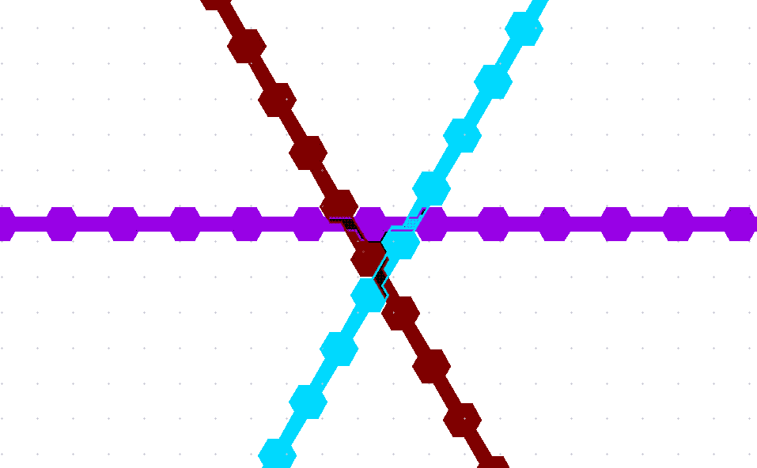
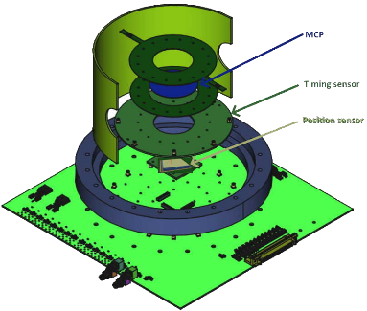






PICMIC-1 evolution of PICMIC-0
https://indico.cern.ch/event/1469522/
CERN DRD WP4.2
21/10/2024

Slide 2
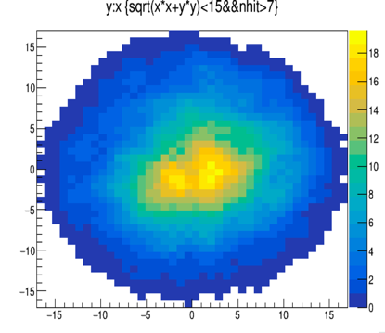
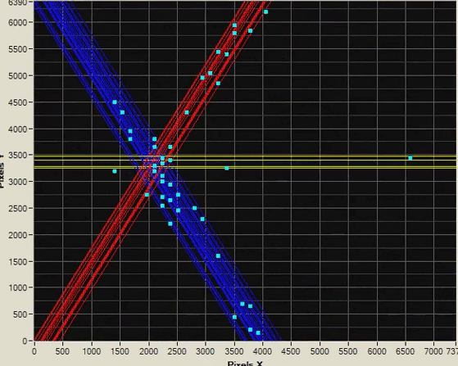

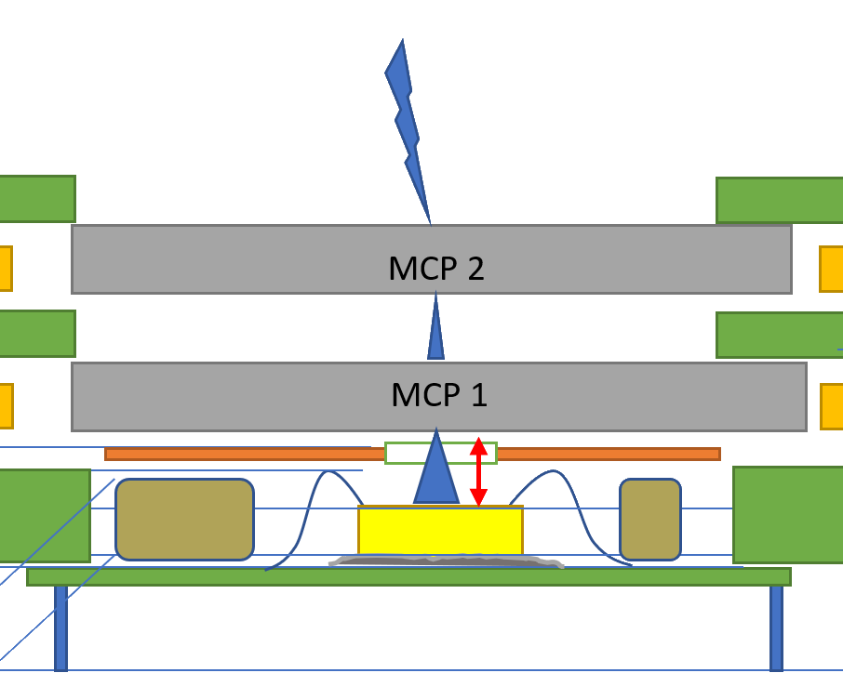



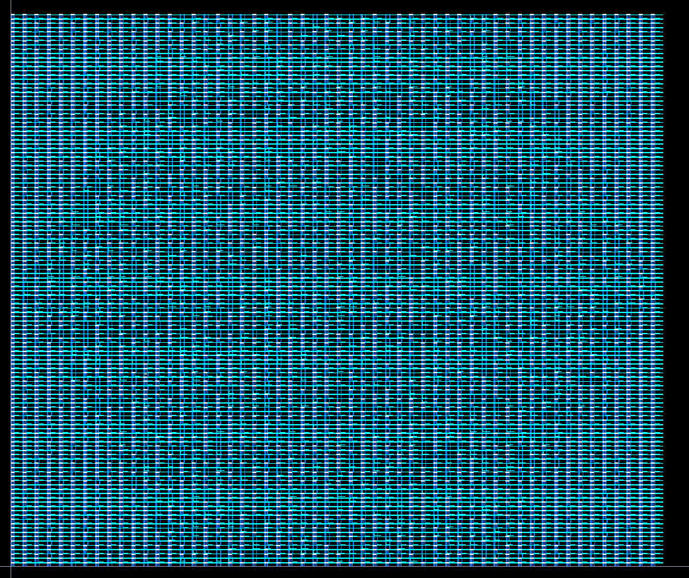
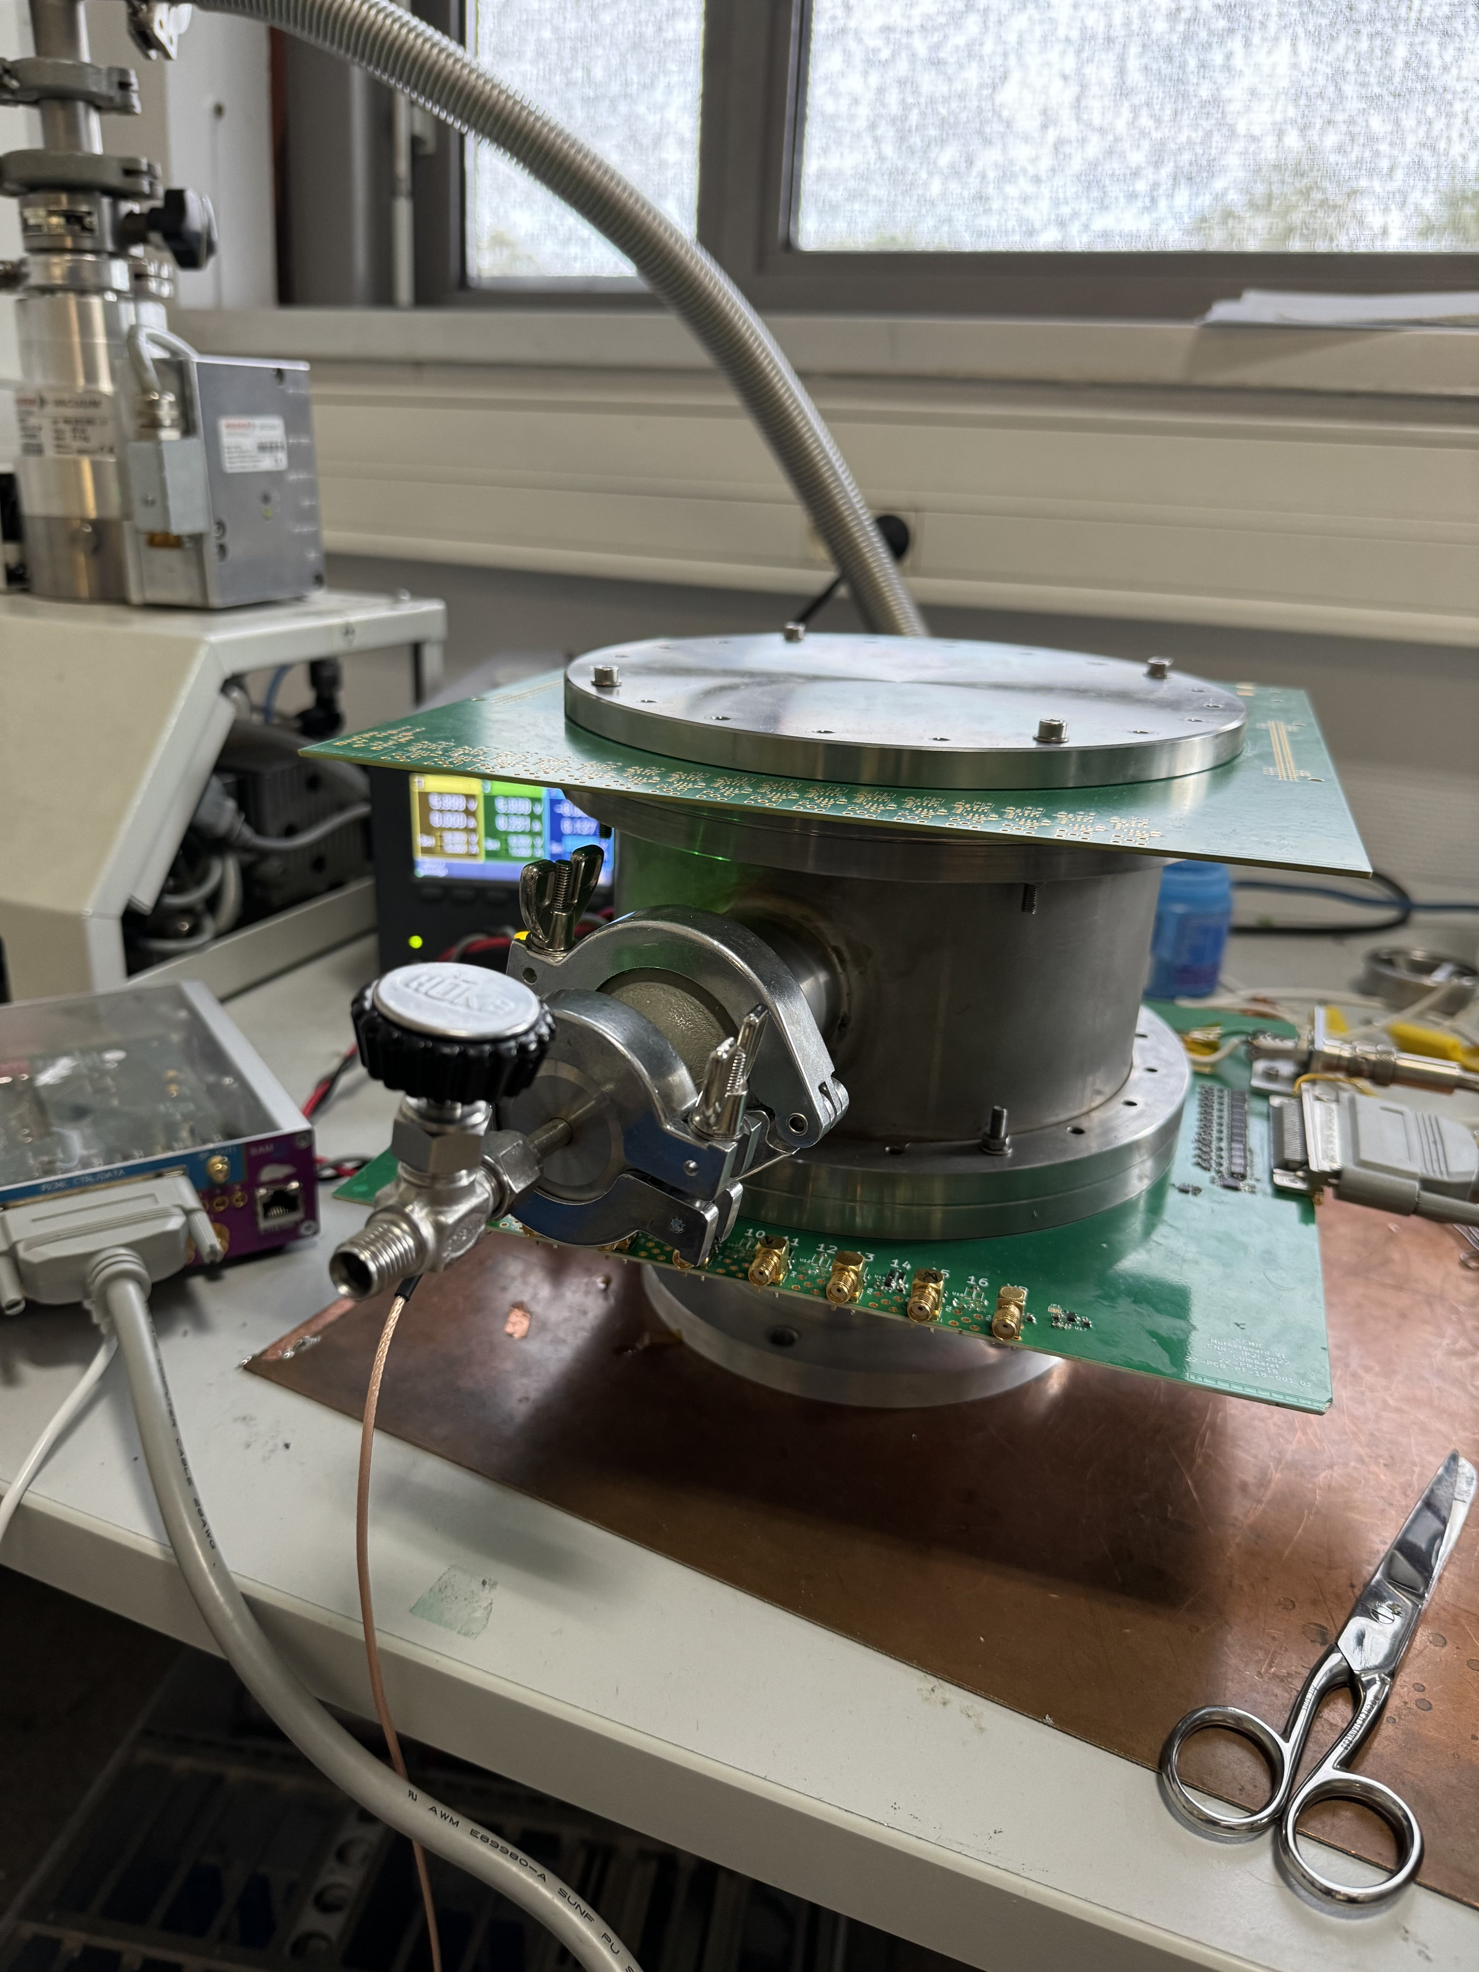
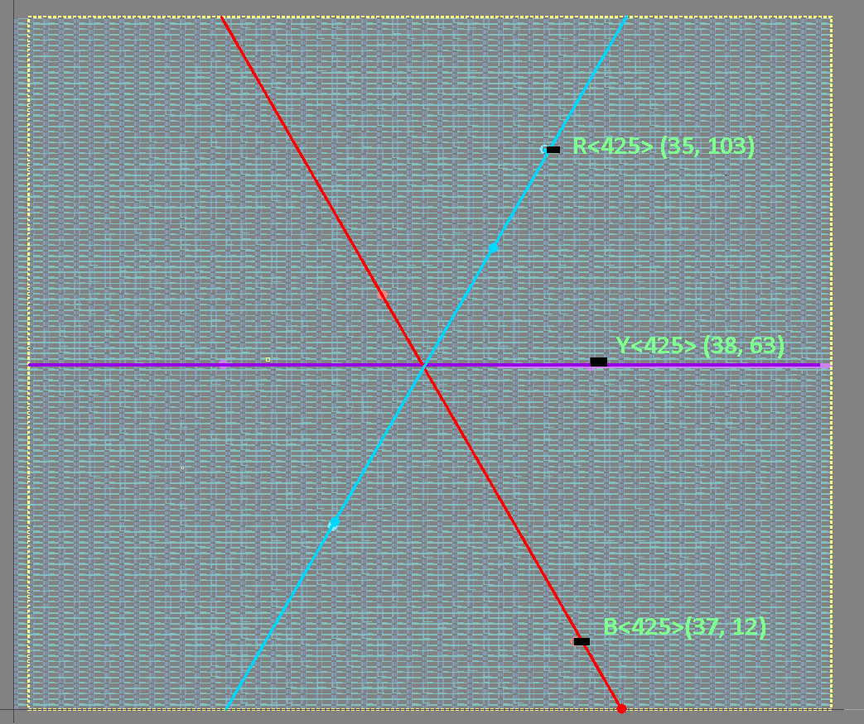

Proof-of-concept Demonstrator
3ps Time precision + 1mm position estimation
t_{i}-t_{j}
=>
(tracker-like)
SAMPIC
HW
(electron absorber)
(Row,Col)(35,103)(38,63)(37,12)
SAMPIC
FirmWare
TWEPP2023 paper
5µm position, in 400ns frame resolution
https://doi.org/10.1088/1748-0221/19/05/C05015

Slide 3
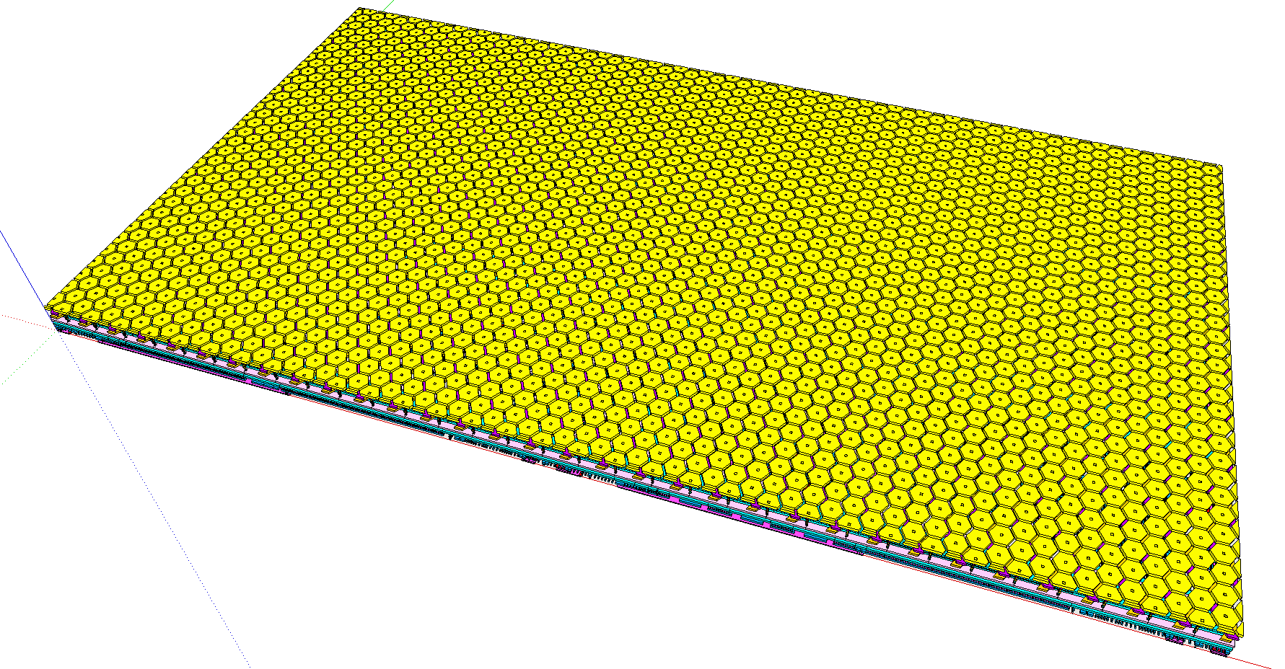
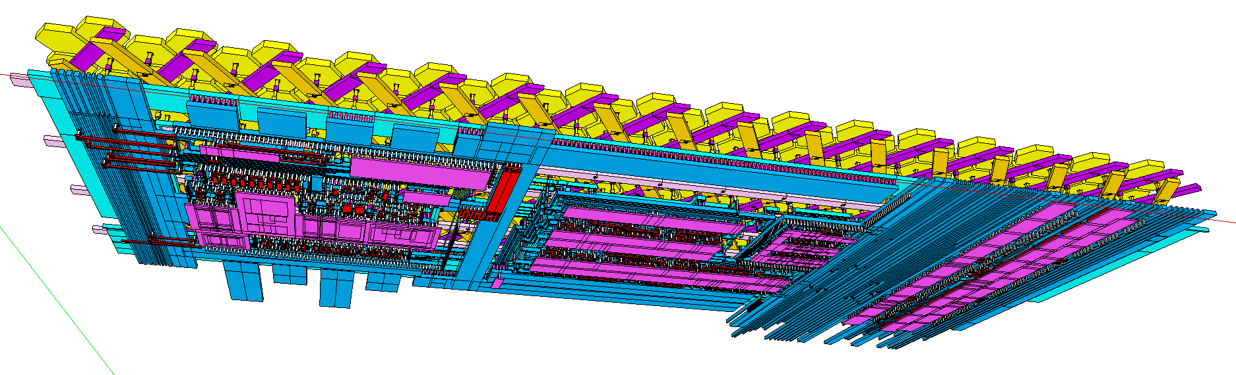
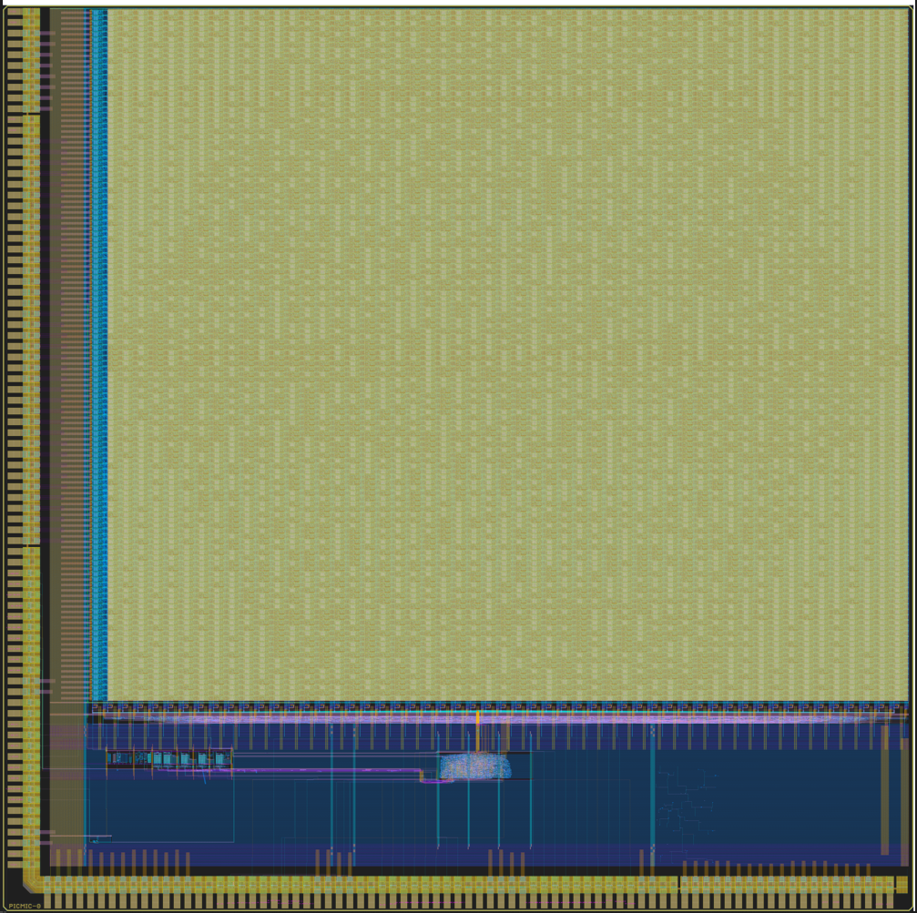
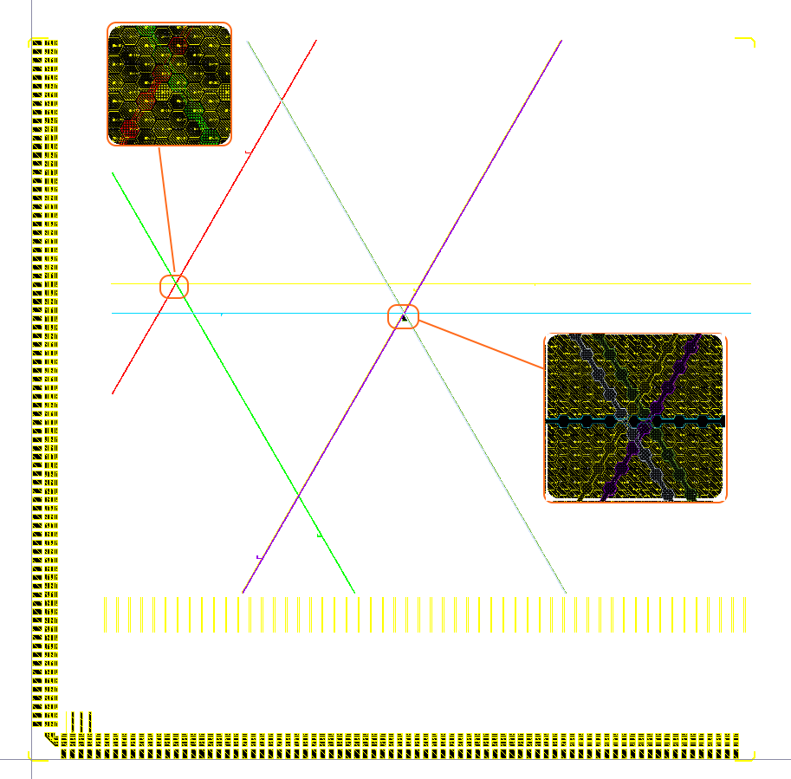
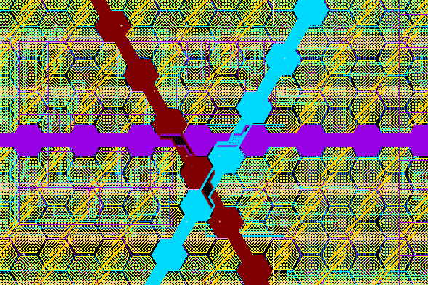
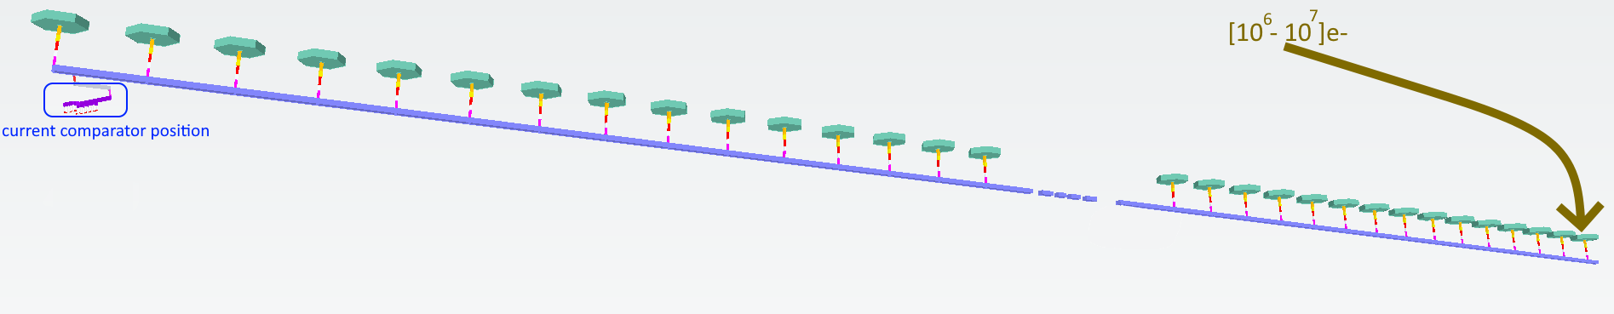
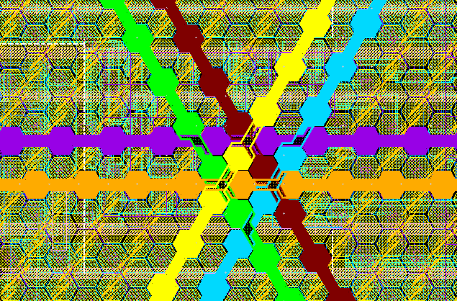
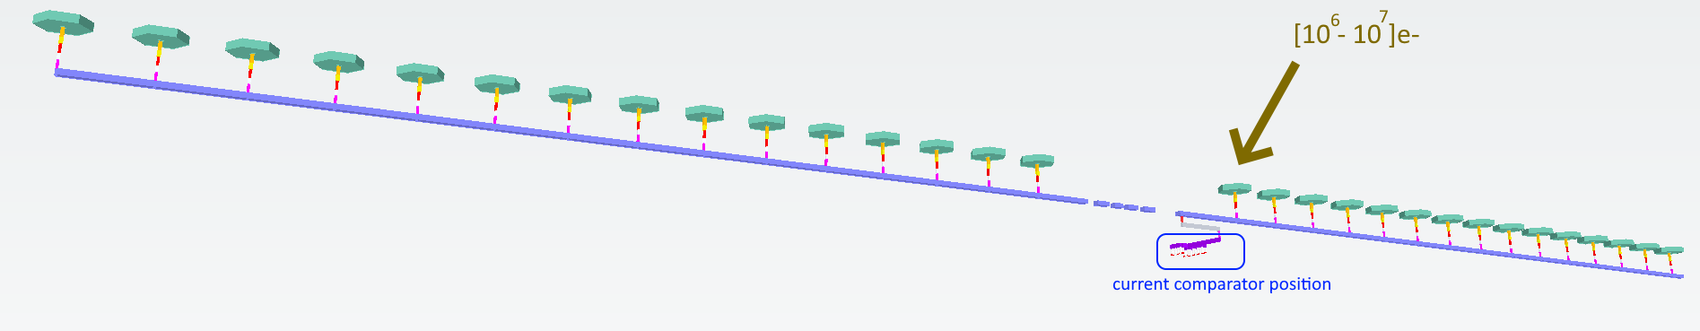
PICMIC-0 : 2556 strip-lines comparator in a 8x8mm² die of a 6 metal 180nm technology

Slide 4
 | PICMIC-0 | PICMIC-1 (reasonable) | PICMIC-1 (optimal)
chip size | 8.4 mm * 8.4 mm | 16.4 x 14.76 mm² | 16.4 x 14.76 mm²
pixel matrix size ROW number * Column number Active readout cell size active readout channels | 7.4 mm * 6.4 mm 128*53 140µm x 50µm 3*852=2556 canaux | 14.8 mm x 12.8 mm 184 x 74 199.92 um x 70 um 3*1704=5112 canaux | 14.8 mm x 12.8 mm 318 x 256 280 um x 100 um 5112 canaux
Power consumption | 256mA*1.8V | 2*256mA*1.8V | -
incomming Charges [current x time] | [13uA x 2ns] and [1.8mA x 0.4ns] | - | -
maximum Hit rate | 16 cells hit in 400ns => 2.5MHz RATE | 10MHz | 100MHz: 1 event / 10ns
multiplicity | 8 strips touched by impact 2 possible impacts => 16 cells | 2 strip/direction => 6 strips 1 impact => 8 (+2 for noise margin)
touched address data size | 7-bit pour ROW + 6-bit pour COL | 8-bit pour ROW + 7-bit pour COL (+ 2-bit increase due to size x4)
internal readout clock | 40MHz par encodeur de priorité | 40MHz /colonne | 40MHz / colonne
data size | 13-bit + Valid + Marker | 15-bit + Timestamp ? subFrame=1,28G/40M=32 =>5bit
External readout clock | 14-bit @40MHz parallel bus | 1.28Gbits/s SLVS ? ou 2 lien 640MHz ou 4 liens 320MHz ou 8 liens 160MHz (double edges) | 20 Gbit/s or 10 links @ 1.28Gbit/s
Pitch (position quantification pitch) | 5µm (height of an hexagon) | 5µm | -
total number of hexagon | 2 077 200 (~2 Million) | 8 million
=>Aire *4
=> *2 (only)

Slide 5
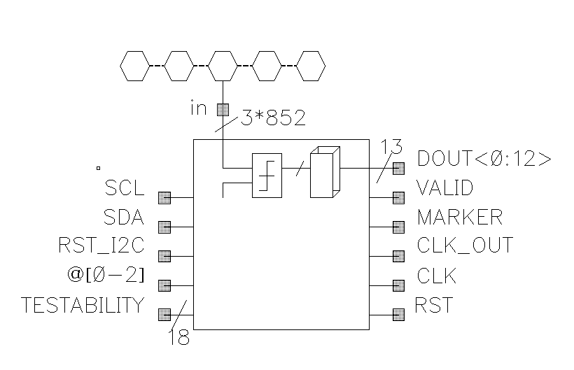
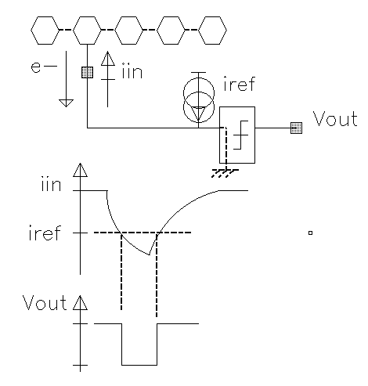
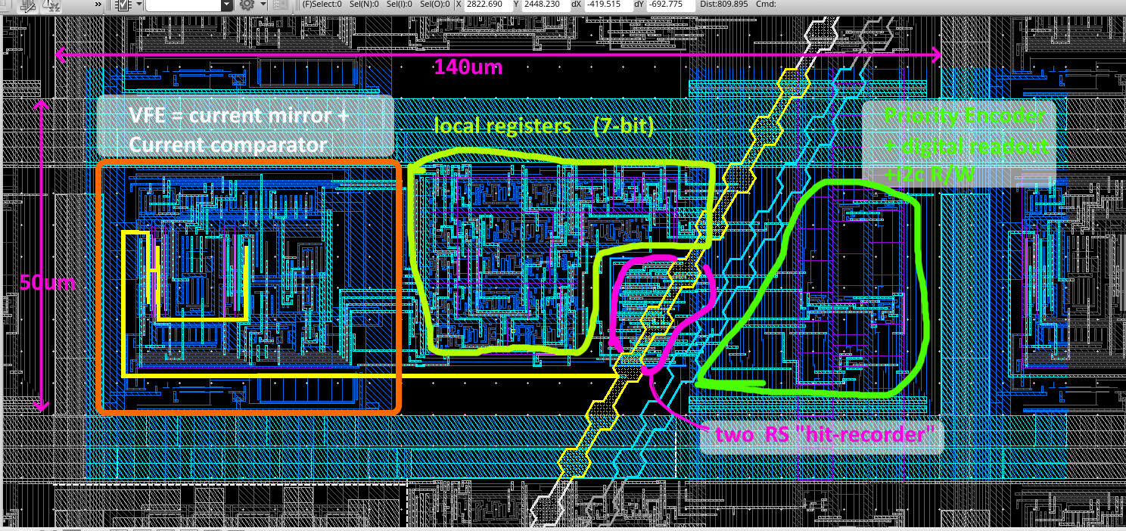
Picmic0 reminder :
An hexagon strip line connect a front-end, generate a falling edge which trigger the digital readout part.

Slide 6
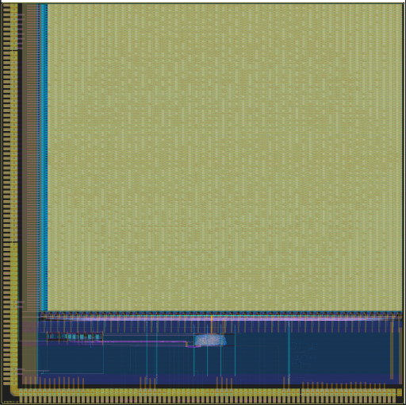

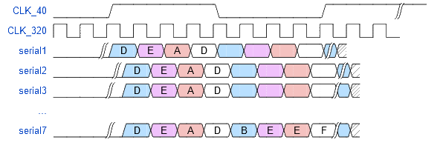
spatial ASIC mesurement version 2 : PIMCIC-1
PIMCIC-0
PICMIC-1
The sensitiv area si increased by a factor 4
The data throughput is increased a factor 4
An additionnal Charge Sensitive Amplifier is added
Additionnal registers into each channel for local tuning
Integration of a PLL
8 channel @ 160MHz Double Data Rate

Slide 7
PIMCIC-1 synoptic
* nb ROW : 184
CSA
inpixel logic
+ 16-bit register
PE
VFE
* nb ROW : 184
Config ROW
calib.
* nb COL : 74
Ext_clock (160 MHz)
Pulse_tic
Pixel_RO : ReadOut cell
Clock
Syn_rst
40 MHz tick period
Ext_reset
Flush (overflow)
gated_clock(160MHz)
EOC_LOGIC
data emulation
Load (all pxls)
* nb COL : 74
From FPGA
SDA
Slow ctrl (I2C)
SDL
sequencer
Mux with buffer
160 MHz tick period
Tx_frame
160 MHz
SPI TX
clk mux
Driver
PLL
320 MHz
double edge
Flush
load
Data(8)
clock
40 MHz
valid
For monitoring
To FPGA

Slide 8
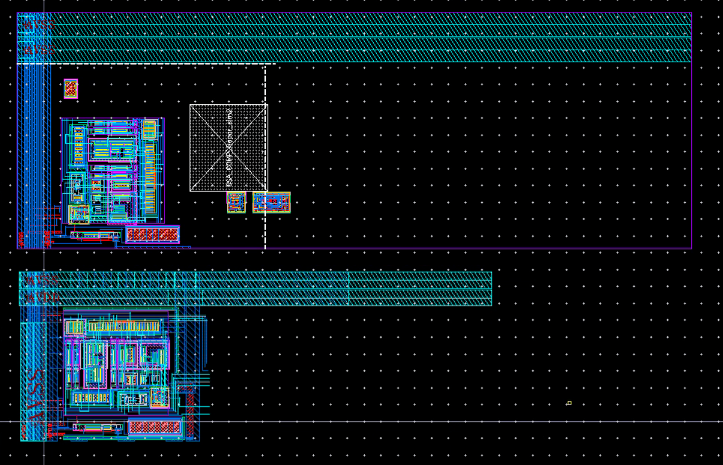
v1 versus v0
ReadoutCell
area of PICMIC-1
and
PICMIC-0
at the same scale

Slide 9
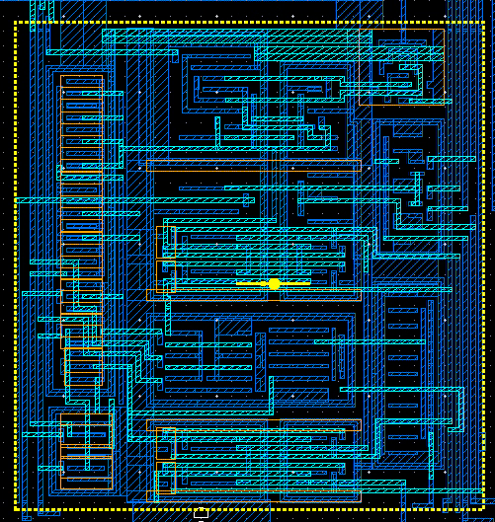
M2 blocage zone for digital => only vertical M1
M1/ M2 routing layers only
10um
199.92um
zone M1 to M2 bias connection
instead of poly in picmic0
Analog AVSS/AVDD (M2)
15um
M2
VFE
32 x 30
CSA
15x28
16-bit regs
+ inpixel logic
Priority Encoder zone
Ana power,bias 10u
70um
M2
M3 to M2
MOSCAP 16x5
M3
Digital power 5u (M1/M2)
79.92um
120 um=70u+ 50u
picmic-1 layout constraints

Slide 10
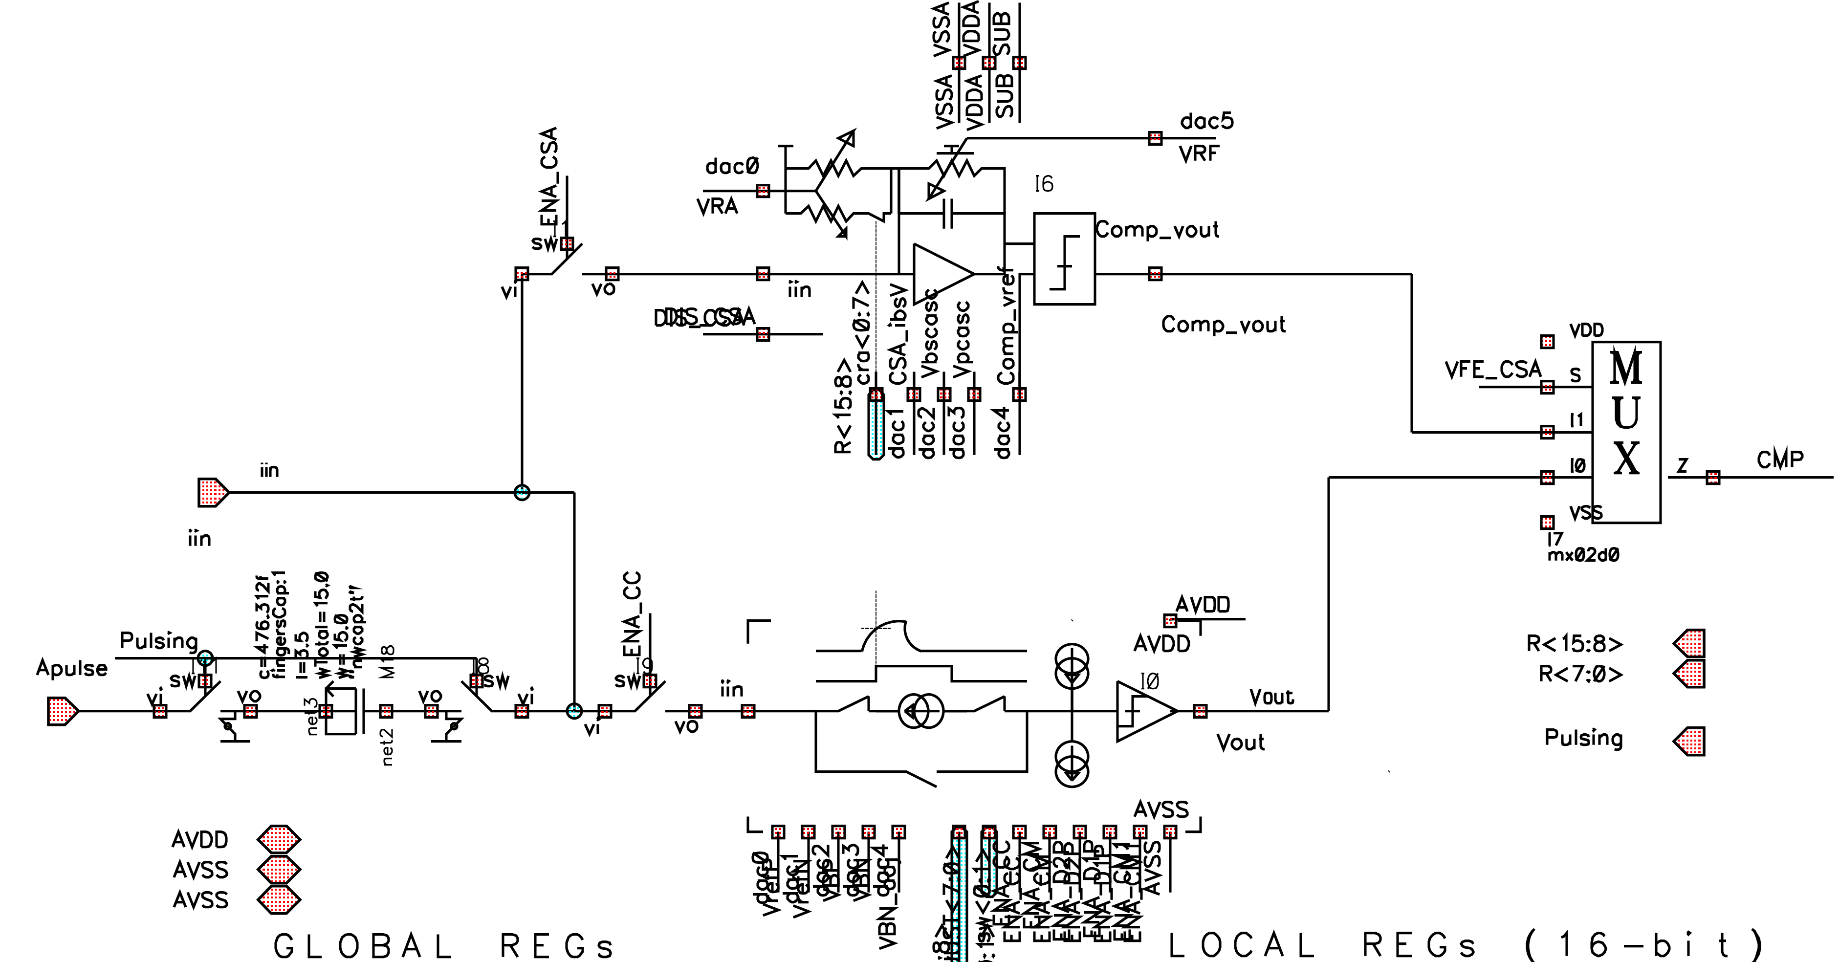
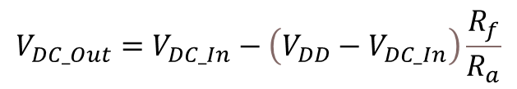
Charge Sensitive Amplifier
V _{DD}
R_{A}
R_{f}
C _{f}
-A
Vout
Idet
C_{d}
GND
$$V_{DC_Out}=V_{DC_In}−\left(V_{DD}−V_{DC_In}\right)\frac{R_{f}}{R_{a}}$$
Requirements for Picmic1
Input current : 2 µA to 20 µA
Charge collection time : 2 ns
Input charge : 4 fC to 40 fC (25 ke⁻ to 250 ke⁻)
Counting rate : 1 Mevt/s reasonable, 100Mevt ultimate target
Detector capacitance
  CSA simulations with 5 pF for (extract RC-couped)
ENC < 0,4 fC (2500 e-)
8-bit tuning of the CSA baseline

Slide 11
Thank you!
For the PICMIC collaboration

Slide 12
BACKUP

Slide 13
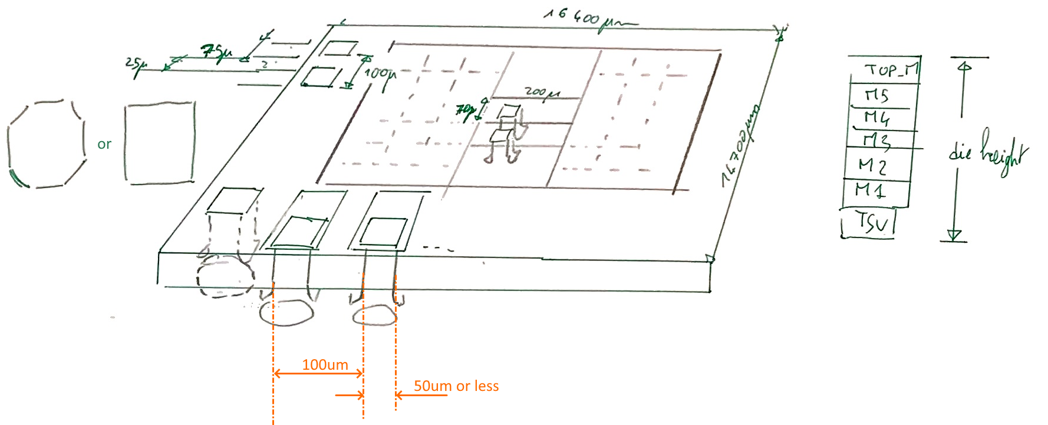
expected TSV not available for this Run :-(

