Slide 1

MuCol
5th Governing Board (21.11.2024)
1st Financial report
Laura Gina DALLA PALMA
CERN

Slide 2
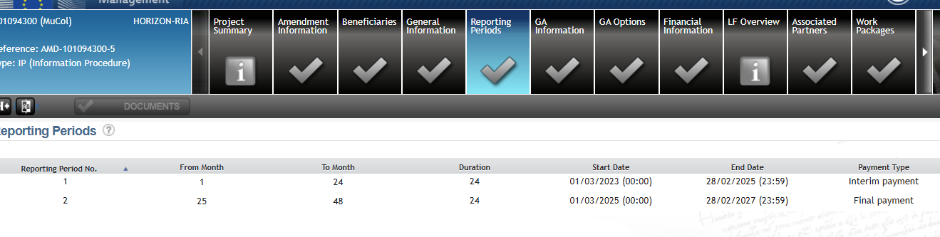
Reporting periods

Slide 3
Reporting to the EU
When ?
  Within 60 days after the end of each reporting period as stated in the GA
  (RP1 01.03.2023 – 28.02.2025 + 60 days and RP2 01.03.2025 – 28.02.2027 + 60 days)
What ?
  Financial Statement
  Technical Period report
  Certificate on Financial Statement (only at the end of the project if requested EU contribution> € 430.000)
Who ?
  Finance officers, persons working on the project and Scientists in charge
  External Grants Section (for CERN)
  External Auditor if thresholds reached (CFS)

Slide 4
Reporting to the EU
When:
1st reporting period ends the 28.02.2025 + 60 days to prepare the report, (official submission by the 30.04.2025 to the EC)
  Easter holidays from 18.04.2025 (plus public holidays, 25.04.2025 and 01.05.2025)
  Proposed timetable:
    08.04.2025 : submission of the first draft of the financial report by all beneficiaries (on the EC portal)
    15.04.2025 : analysis of the reports and deviations (requests for clarification, if necessary) to complete the technical report (Use of resources – deviations)
  Submission of the financial report to the EC the 24.04.2025.

Slide 5
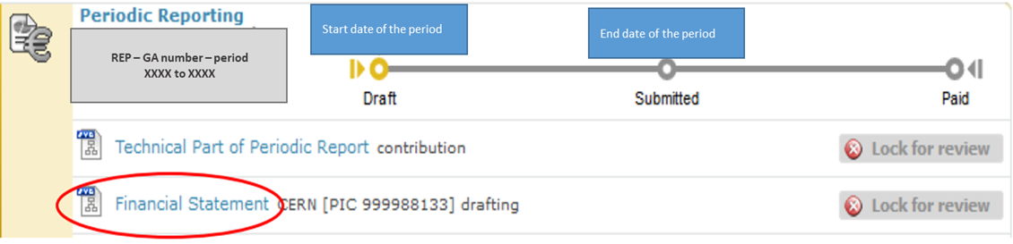
Reporting to the EU
What:
Important: data must be consistent with the grant agreement

Slide 6
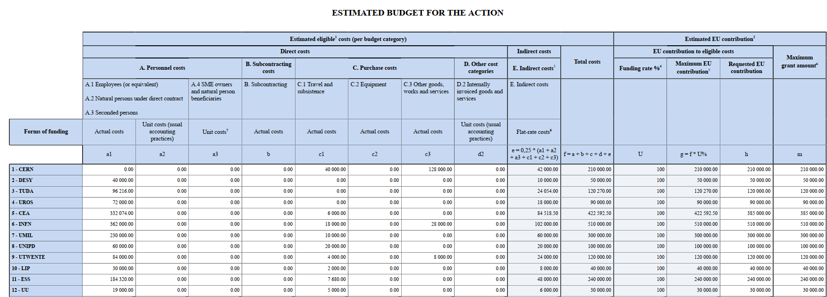
Budget approved (annex 2)

Slide 7
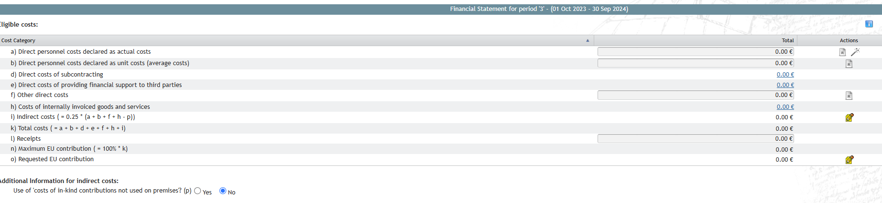
Financial statement
Once filled in the financial data, the financial statement need to be saved, signed and submitted to CERN

Slide 8
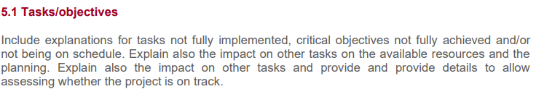
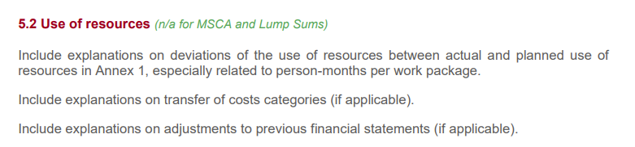
Technical report, Part B
SECTION 5 : DEVIATIONS FROM ANNEX 1 AND ANNEX 2 (IF APPLICABLE)

Slide 9
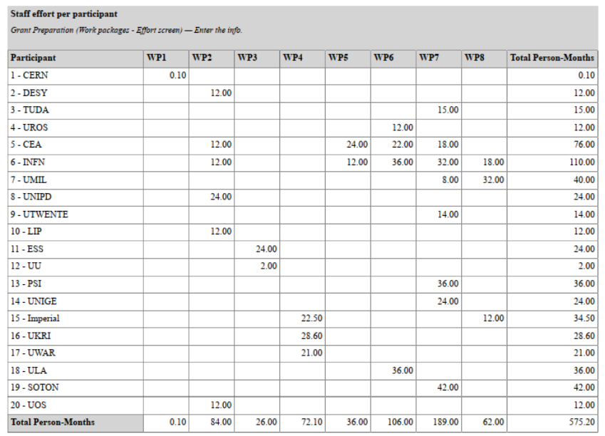
Staff effort

Slide 10
How to report to EC
KEEP RECORDS:
Supporting documents for personnel costs
  Employment contract
  Beneficiary internal guidelines for time recording + timesheets
  Collective labour and job descriptions
  Payroll / salary slips for all personnel involved in the action
  Proof of payment ….
Supporting documents for travel costs
  List and dates of events/trips/conference + link to the action
  Agenda, participant list
  Authorised travel request forms
  Underlying documentation (original invoices(bus, taxi, hotel…) , minutes of the meeting, facilities reservations, boarding cards if printed, link to presentation
Material: invoices and, if needed, tender procedure
GUIDELINES will be sent to help beneficiaries

Slide 12
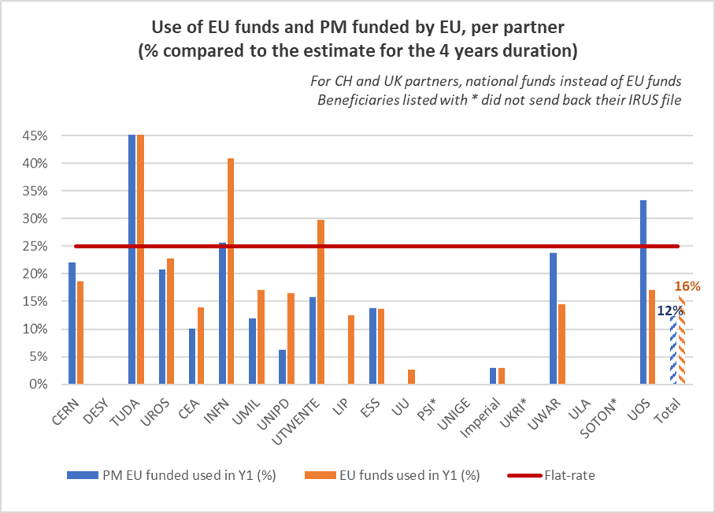
Use of funds

Slide 13
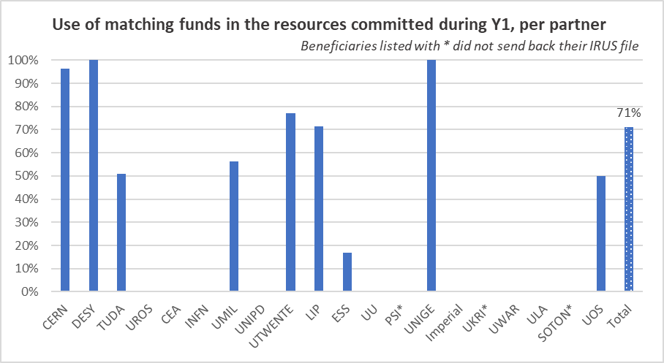
Use of funds

