Slide 1
Preparation for MuCol
P1 reporting to the EU
Roberto Losito (MuCol Technical Leader), Michela Lancellotti (Muon Collider Secretariat)
Cloe Levointurier-Vajda (CERN EU Office)
21 November 2024
Notes:
Sabrina

Slide 2
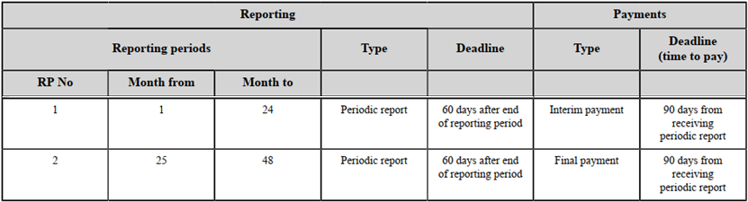
Background information
MuCol is 48 months duration: from M1 (March 2023) to M48 (February 2027)
MuCol is divided into 2 reporting periods
P1 (M1-M24) from the start date to the end of February 2025
P2 (M25-M48) from March 2025 to the end date
Grant Agreement inputs about periodic reporting
See the GA Data Sheet,
and article 21 (& Art. 22
for payments)
2 months after end of the
period to submit the report
For P1 report, the
deadline is end of
M26 = April 2025

Slide 3
P1 reporting timeline
P1 report accepted & interim payment from EC to Coord
~~M30?
End of P1
P1 report submission
P1 review meeting
~ during M27
End date
M48
Start date
M24
M26
M1
M2
RP1
RP2
P1 reporting preparation
= 2 months
End of P1
= M24 = 28/02/2025
P1 report EU review & consortium revision/answers
= from ~2 months to …
P1 report submission deadline
= M26 = 30/04/2025

Slide 4
Composition of a periodic report
Periodic report = Technical Part A + Technical Part B + Financial Part
Technical Parts
The Technical Report consists of 2 parts:
Technical Part A contains structured tables with project information
  Part A is generated by the IT system. It is based on the information which are entered (mostly by the Coordinator) into the EC Portal, through the Continuous Reporting module, and the Periodic Reporting module.
Technical Part B is a narrative description of the work carried out during the reporting period
  Part B needs to be uploaded as PDF on the EC Portal.
  No page limit for this narrative description, but it should be concise and readable.
  Any duplication should be avoided (e.g.: no copy-paste from deliverable report in the Part B, since Deliverables are in Part A).
Financial Part
The Financial Report is generated by the IT system on the basis of the financial information entered into the Periodic Reporting module (mostly the individual Financial Statements (Annex 4 to the GA) for each Beneficiary).

Slide 5
Technical reporting
Part A & B

Slide 6
General template for Part A (1/2)
The template & instructions are accessible on the EC Portal, in the “Reference Documents”: Periodic report (HE)
Pages 6 to 28 are focused on Part A and relevant for MuCol. Pages 27 to 32 are not applicable for MuCol.
The following items are part of Part A:
Project summary → Coordinator
  Will be published through CORDIS and possibly other communication channels: do not include confidential information
Researchers involved in the project → Institute representatives
  Beneficiaries should update the corresponding tab in the EC portal (Continuous reporting)
  Associated partners should provide updated info to the Muon Collider Secretariat (see Excel file on Indico)
List of critical risks (foreseen and unforeseen) → WP Leaders
Results → Coordinator, WP Leaders
  e.g: Scientific discovery, model, theory // Method, material, technology, design (new or improved) // Event (conference, seminar, workshop) // Learning and training (learning modules, curricula) // New or improved infrastructures or facilities // …
Results ownership list (optional at P1 reporting, mandatory for the final reporting)

Slide 7
General template for Part A (2/2)
Publications (more efficient if Zenodo is up-to-date) → MuCol Communication Officer, WP Leaders
Datasets → Coordinator, WP Leaders
Intellectual Property Rights (e.g : Patent / Trademark / Registered design / Utility model / Other) → not applicable atm
Standards → not applicable atm
Other results (e.g: Software / Workflow / Protocol / Prototype / Other) → Coordinator, WP Leaders
Dissemination and communication activities → MuCol Communication Officer, WP Leaders
Impact → Coordinator, WP Leaders
Specific and targeted instructions/templates will be sent in November 2024

Slide 8
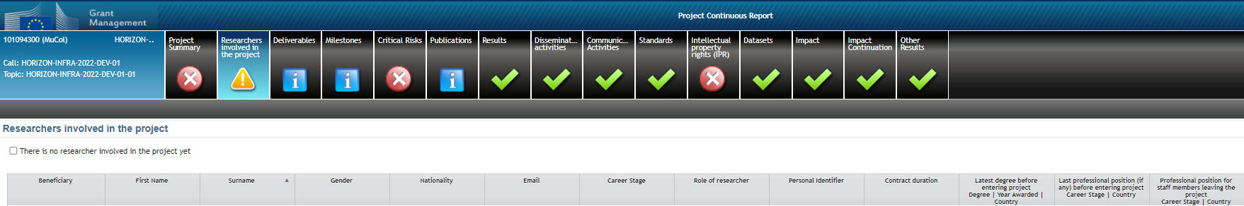
The Continuous Reporting as preparation for Part A
The module is accessible during the whole project duration
CERN (as Coordinator) is responsible to enter the data in the IT system for all tabs
CERN will collect inputs from relevant WPs, Task leaders & consortium bodies.
Exceptions:
  the “Researchers involved in the project” tab can be filled by each Beneficiary
  The Publications can be uploaded on Zenodo (the EC Portal IT system is synchronised with Zenodo) → keep in mind acknowledge the EU funding on each publication!

Slide 9
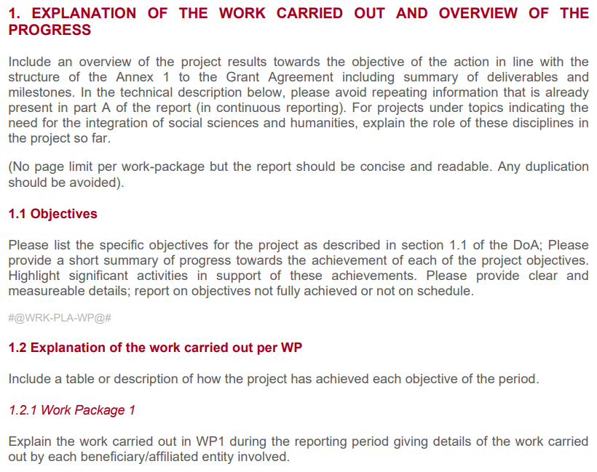
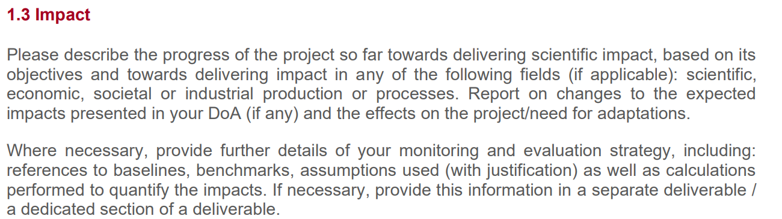
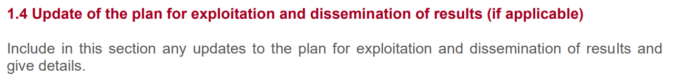
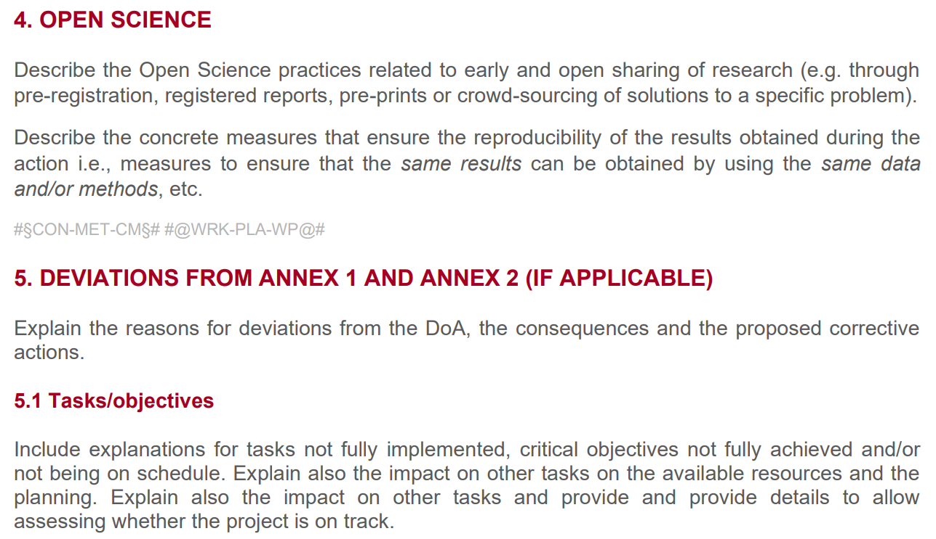
General instructions for Part B
All instructions are included in the template, accessible on the EC Portal, in the “Reference Documents”: Periodic report (HE)

Slide 10
General template for Part B
For the Technical report - Part B we will ask WP Leaders to provide input → Max. 5 pages per WP in total
Based on the general template for Technical Part B, it is recommended to follow this structure for MuCol P1 Technical Part B:
Explanation of the work carried out and overview of the progress
  Overview of the project results
  Objectives
  Explanation of the work carried out per WP/ Task (Max. ½ pages per Task)
    WP1
    WP2
    …
  Impact
  Update of the plan for exploitation and dissemination of results (if applicable)
Open science
Deviations from Annex 1 and Annex 2
  Tasks/objectives
  Use of resources

Slide 11
Distribution of work, Customised templates
Institutes representatives should provide info on Researchers (EC Portal) & Financial matters
WP Leaders should provide info on Technical Report Part A & B according to costumised templates
The Coordinator (CERN) will compile all info to generate the final report.
Structure of customised templates for WP Leaders:
1. Explanation of the work carried out and overview of the progress
  Objectives
  Explanation of the work carried out per WP
  Impact
  Update of the plan for exploitation and dissemination of results (if applicable)
2. Open science
3. Deviations from Annex 1 and Annex 2
  Tasks/objectives
  Use of resources
4. INPUT FOR TECHNICAL REPORT PART A (CONTINUOUS REPORTING)
A. List of critical risks
  Foreseen risks
  Unforeseen risks if applicable
  State of play (for each old/new risk)
B. Project Pathway to impact
  Results if applicable
  Publications
  Dataset if applicable
  Other results if applicable
C. Communication & Dissemination activities if applicable

Slide 12
Tentative timeline for Technical reporting Part A/B
The March 2025 month will be busy with EUSPP strategy document submission, leading to limited availabilities of Management team and WP & Task leaders for the drafting of the Technical report
The Technical report should be approved by MuCol Governing Board before submission
The Technical report submission deadline is end of April 2025 (so is the Easter… ~20th of April)
Consequently, MuCol consortium should anticipate as much as possible the preparation of mandatory documents.
The table in the next slides includes the following acronyms:
GB: Governing Board
MC: Management Committee (includes a CERN representative, the SL, the Deputy SL, the TL, all the WP leaders)
SL: Study Leader → Daniel Schulte
TL: Technical Leader → Roberto Losito
WP: Work Package
AC: Advisory Committee
FO: CERN Financial Officer
MCS: Muon Collider Secretariat

Slide 13
Tentative timeline for Technical reporting Part A/B
When | Who | What
~Nov. 2024 | TL, MCS | Customised template distribution to MC
Nov. 2024 – Jan. 2025 | WP Leaders, MC, Task leaders, … | Filling the template and sending it back to TL and MCS Note that all activities & achievements until 28/02/2025 should be also included → see #6 below
Early Feb. | TL and SL | Distribution of the assembled document for review to MC and AC
February | MC, AC | Reviewing and commenting of the document, raising questions or asking for clarifications, advising on improvements… and send the annotated document to TL and MCS
Late Feb. | TL | Distribution of the annotated assembled document for review to MC
March | WP/Task leaders, … | Revision according to the comments, and inclusion of the latest activities performed until 28/02/2025 and sending back the document to TL and MCS
Early April | MCS, TL and SL | Restricted distribution of the document for final editing
Until ~Apr. 24th | SL, DSL, TL, FO | Final review and edits, and inclusion of the justifications for financial deviations
~Apr. 25th | TL or SL or MCS | Distribution of the final Technical Report Part A/B for GB approval
Until Apr. 29th | GB | Approval of the final Technical Report Part A/B by the GB
April the 30th | TL, MCS | Submission of the approved final Technical Report Part B
#1
#2
#3
#4
#5
#6
#7
#8
#9
#10
#11

Slide 14
Remarks
Anticipate
Identify key players in the technical report preparation – Part A and Part B may require inputs from different persons!
The Financial part is specific and managed by Financial Officers / EU Offices in each institute (Beneficiaries only) however it is a long process as well.
Technical & Financial colleagues should study the templates beforehand and ask questions if something is not clear – Less experienced partners are encouraged to identify themselves to the Coordinator for benefiting from a specific support or guidance if needed.
Be on time & play your part
The preparation of such periodic reporting includes a lot of persons
Minor delay by 1 person / entity may create major delay in the whole process
The deadline will come quicker than what you think
Think of the bright side
Once the P1 reporting process will be over, you will receive a very instructive Review report … and for Beneficiaries you will also receive interim payment for eligible EU costs incurred during P1!
Notes:
Concluding remarks

Slide 15
Lists of contacts

Slide 16
Scientific Contacts – Beneficiaries
Beneficiary | Contact(s) | Specific role, if any
1. CERN | Daniel.Schulte@cern.ch | SL
2. DESY | Federico.Meloni@cern.ch
3. TUDA | herbert.degersem@tu-darmstadt.de
4. UROS | ursula.van-rienen@uni-rostock.de
5. CEA | antoine.chance@cea.fr | WP5 Leader
6. INFN | nadia.pastrone@to.infn.it
7. UMIL | lucio.rossi@unimi.it ; fortunato.laface@unimi.it ; samuele.mariotto@unimi.it | WP8 Leader
8. UNIPD | donatella.lucchesi@unipd.it | WP2 Leader
9. UTWENTE | a.u.kario@utwente.nl
10. LIP | Michele.Gallinaro@cern.ch
11. ESS | natalia.milas@ess.eu | WP3 Leader
12. UU | vitaliy.goryashko@physics.uu.se
Scientific contacts from Beneficiaries & Associated partners will be asked to provide data to the WP Leaders for filling up the Technical Report.

Slide 17
Scientific Contacts – Associated partners
Associated Partner | Contact | Specific role, if any
13. PSI | bernhard.auchmann@psi.ch
14. UNIGE | carmine.senatore@unige.ch
15. Imperial | j.pasternak@imperial.ac.uk
16. UKRI | k.long@imperial.ac.uk
17. UWAR | s.b.boyd@warwick.ac.uk
18. ULA | graeme.burt@cockcroft.ac.uk
19. SOTON | y.yang@soton.ac.uk
20. UOS | a.cerri@sussex.ac.uk
21. SYSU | tangjian5@mail.sysu.edu.cn
22. KIT | tabea.arndt@kit.edu
23. CNRS | xavier.chaud@lncmi.cnrs.fr
24. ENEA | carlo.carrelli@enea.it
25. UNIPV | cristina.riccardi@unipv.it
26. STRATHCLYDE | k.ronald@strath.ac.uk
27. HUD | rob.edgecock@cern.ch
28. RHUL | stephen.gibson@rhul.ac.uk
29. UOXF | philip.burrows@physics.ox.ac.uk
30. ISU | hauptman@iastate.edu
Scientific contacts from Beneficiaries & Associated partners will be asked to provide data to the WP Leaders for filling up the Technical Report.

Slide 18
Admin Contacts
Beneficiary | Contact
1. CERN | muon.collider.secretariat@cern.ch
2. DESY | susanne.hummel@desy.de jana.goerner@desy.de
3. TUDA | euforyou@tu-darmstadt.de
4. UROS | tim.joppke@uni-rostock.de
5. CEA | florence.ragon@cea.fr ; nathalie.judas@cea.fr marie.weyland@cea.fr
6. INFN | rosaria.porcu@to.infn.it ; paola.mauro@to.infn.it
7. UMIL | fortunato.laface@unimi.it
8. UNIPD | nicoletta.ariani@unipd.it
9. UTWENTE | contract-office-tnw@utwente.nl
10. LIP | natalia@lip.pt
11. ESS | adrameh.gaye@ess.eu martha.dadson@ess.eu
12. UU | eu-support@uadm.uu.se
Administrative contacts from Beneficiaries will be asked to provide data for the «Researchers» tab (see Technical Reporting Part A)

Slide 19
Financial Contacts
Beneficiary | Contact
1. CERN | laura.gina.dalla.palma@cern.ch
2. DESY | donatella.rosetti@desy.de ; susanne.hummel@desy.de ; annika.thies@desy.de
3. TUDA | euforyou@tu-darmstadt.de ; vanessa.werkmeister@tu-darmstadt.de
4. UROS | kristin.arnold@uni-rostock.de
5. CEA | florence.ragon@cea.fr; marie.weyland@cea.fr ; nathalie.judas@cea.fr ; yvon.bali@cea.fr
6. INFN | rosaria.porcu@to.infn.it ; paola.mauro@to.infn.it
7. UMIL | fortunato.laface@unimi.it ; audit.ricerca@unimi.it
8. UNIPD | costantina.magnifico@unipd.it ; flavio.seno@unipd.it ; nicoletta.ariani@unipd.it
9. UTWENTE | contract-office-tnw@utwente.nl ; e.j.a.borggreve@utwente.nl ; h.vanunen@utwente.nl
10. LIP | pimenta@lip.pt
11. ESS | adrameh.gaye@ess.eu ; martha.dadson@ess.eu
12. UU | margareta.uvhagen@uadm.uu.se ; patrik.armuand@uadm.uu.se ; ulrika.soderlind@physics.uu.se
Financial contacts from Beneficiaries will be asked:
To report on the eligible EU costs for P1 (i.e. fill Financial Statements)
To justify deviations in the use of EU resources, if any
Financial contacts from Beneficiaries & Associated Partners will be asked:
To report on use of resources per WP (i.e. fill IRUS)
Associated Partner | Contact
13. PSI | No specific contact
14. UNIGE | No specific contact
15. Imperial | No specific contact
16. UKRI | No specific contact
17. UWAR | No specific contact
18. ULA | No specific contact
19. SOTON | No specific contact
20. UOS | No specific contact

Slide 20
Thank you for your attention
Any questions?

