Slide 1

Edge AI on a satellite for near real-time marine plastic detection and monitoring
Nick Ziogas – CERN Knowledge Transfer, Konstantinos Karantzalos – National Technical University of Athens,
François de Vieilleville – Agenium Space, Sioni Summers – CERN EP CMS, Joseph Thuilier – EnduroSat
29.11.2024

Slide 2


The Partners
Project Coordinator, French SME based in Toulouse. Created in 2018 part of the Agenium Group.
Expertise: AI solutions for space

Slide 3
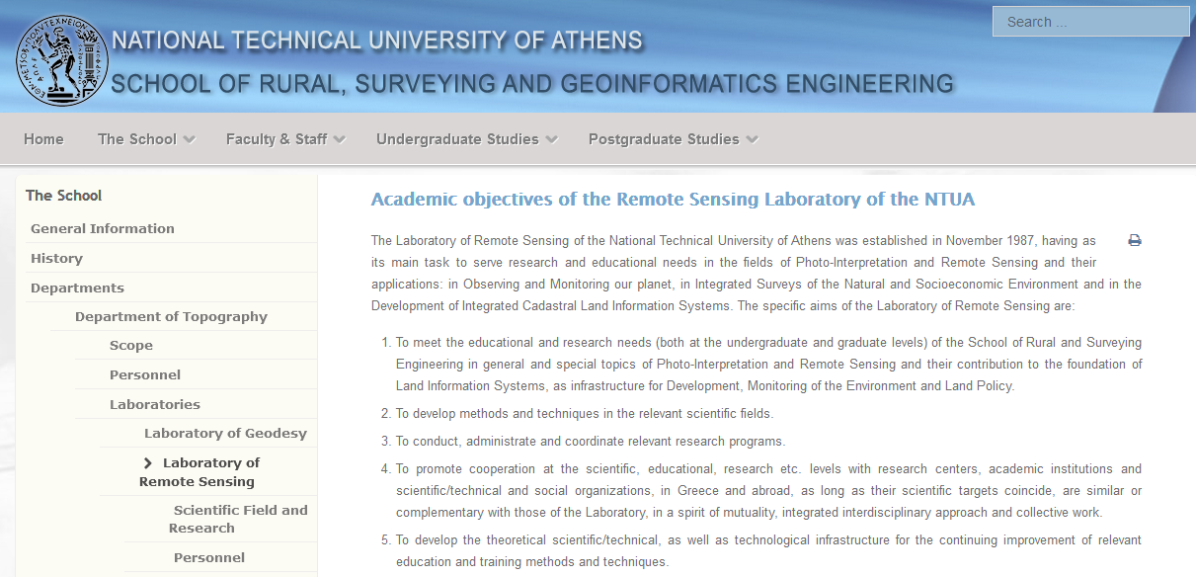
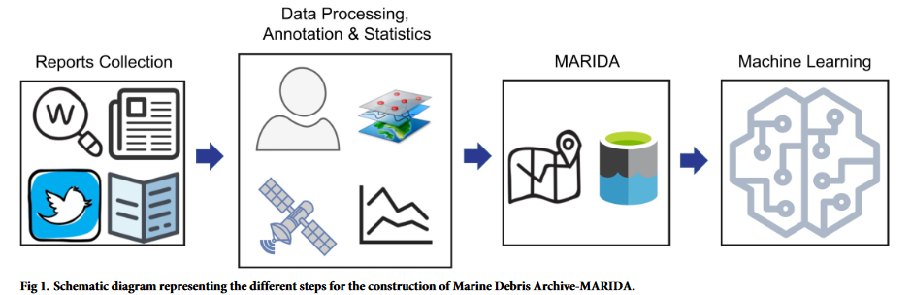

The Partners
Remote Sensing Lab of NTU Athens
Expertise: ML techniques associated in remote sensing.
EU-funded project, Marine Debris Archive (MARIDA). Benchmark dataset for developing & evaluating ML algorithms for Marine Debris.
SME based in Sofia, Bulgaria.
Expertise: Plan, Build & Operate Satellite Services
Software-driven satellite architecture
Project Coordinator, French SME based in Toulouse. Created in 2018 part of the Agenium Group.
Expertise: AI solutions for space

Slide 4
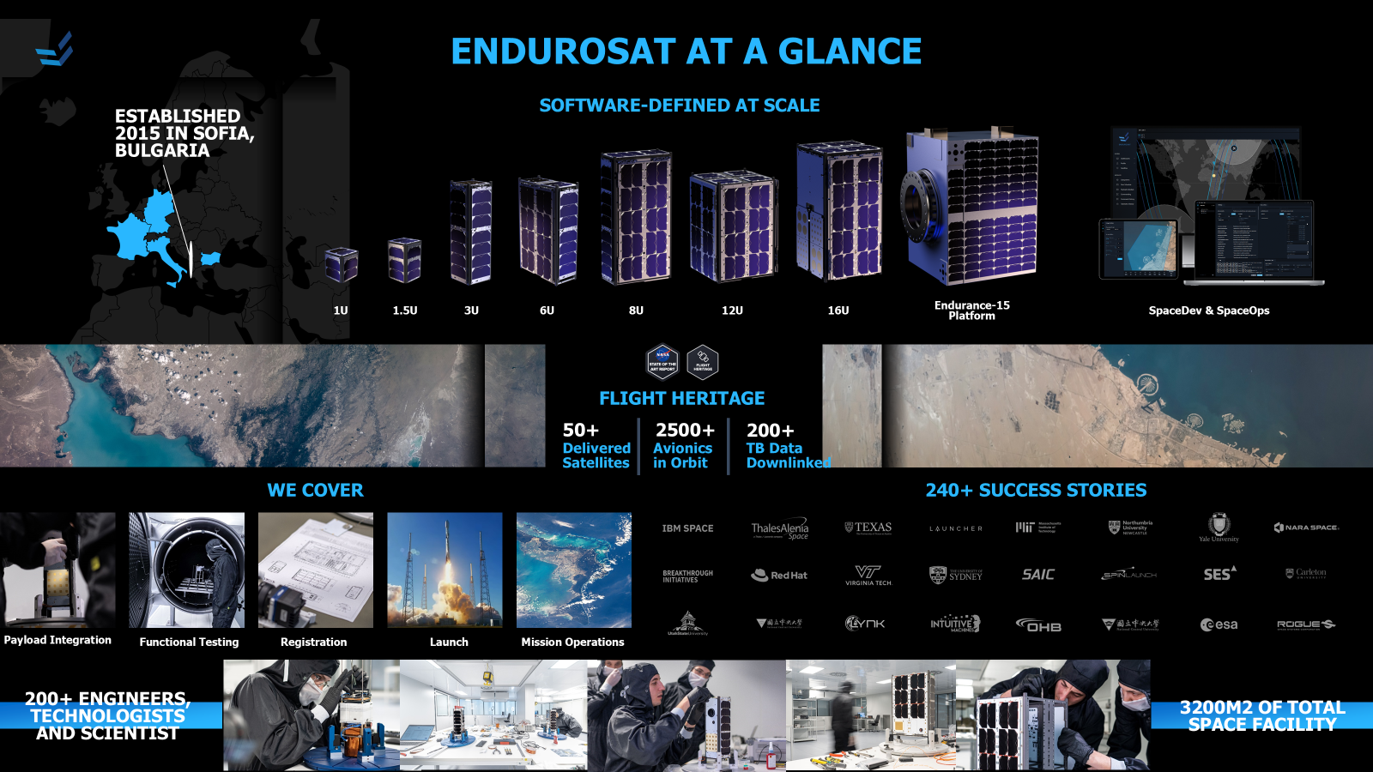
The Partners
SME based in Sofia, Bulgaria.
Expertise: Plan, Build & Operate Satellite Services
Software-driven satellite architecture
EnduroSat
Project Coordinator, French SME based in Toulouse. Created in 2018 part of the Agenium Group.
Expertise: AI solutions for space

Slide 5
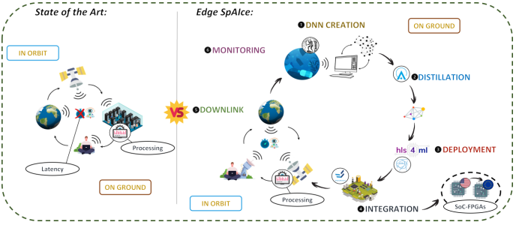
The Project
A novel Edge-AI system for accurate and near real-time plastic detection and monitoring in marine environment
- Latency due to downlink data volumes
- Bottlenecks at the data center
- Massive reduction of downlink data volumes. Bandwidth allows for (almost) RT monitoring
- Reduced cost & environmental impact - no heavy earth-based processing needed.

Slide 6
The Project
EU HORIZON-CL4-2023-SPACE-01 EU Call –RIA, lump sum grant.
Fully funded, 2.5m €, 3 yr project, started in January 2024.
TRL sought 6. Allow for commercial development of services.
CERN Tech & expertise: hls4ml OS sw & DNN optimization. From CMS trigger to EO services.
Why FPGAs ? Latency and power consumption (~ 10W available on board)
Development of backend implementation to target NanoXPlore European Space Grade FPGA

Slide 7
The Project
The wider picture: Novel Earth Observation (EO) services
Application areas: Government, public and emergency services, Agriculture, Electricity & utilities, Supply chain monitoring, insurance & sustainable finance etc
Our approach: Autonomous, re-configurable on demand (in-orbit updates) service, depending on application.
400% increase in # of EO satellites 2014 – 2021. Number expected to almost triple in the coming decade.
WEF Study: the potential value-added from Earth data is estimated to reach $700 billion in 2030. Cumulative $3.8 trillion contribution to global GDP between 2023-2030.

Slide 9
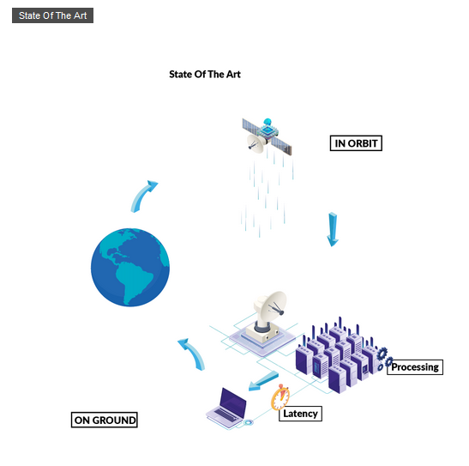
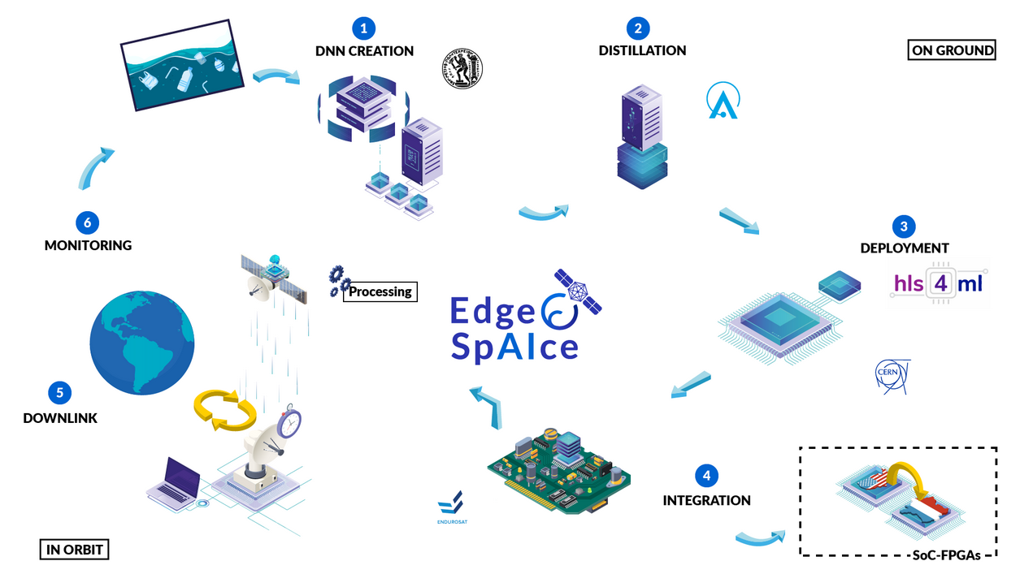
The Project
A novel Edge-AI system for accurate and near real-time plastic detection and monitoring in marine environment
- Latency due to downlink data volumes
- Bottlenecks at the data center
- Massive reduction of downlink data volumes. Bandwidth allows for (almost) RT monitoring
- Reduced cost & environmental impact - no heavy earth-based processing needed.

Slide 10

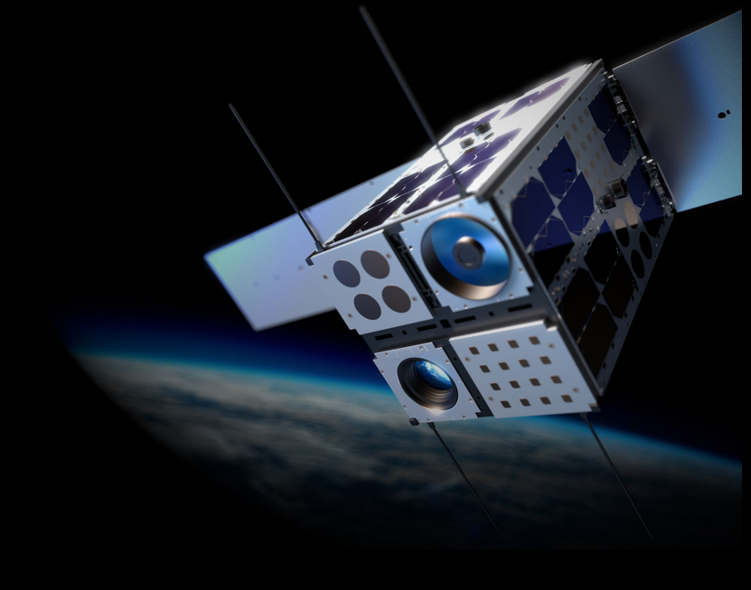

The Partners
EnduroSat
SME based in Sofia, Bulgaria.
Expertise: Plan, Build & Operate Satellite Services
Software-driven satellite architecture
Project Coordinator, French SME based in Toulouse. Created in 2018 part of the Agenium Group.
Expertise: AI solutions for space

