Slide 1


Econophysics Restart
Chapter 1-8 of Mantegna and Stanley’s book
T. Csörgő^{1,2}
¹ Wigner RCP, Budapest, Hungary
² MATE KRC, Gyöngyös, Hungary
R. N. Mantegna and H. E. Stanley:
An introduction to econophysics
Correlations and complexity in finance
Authors
Chapter 1-8
New data
New references

Slide 2
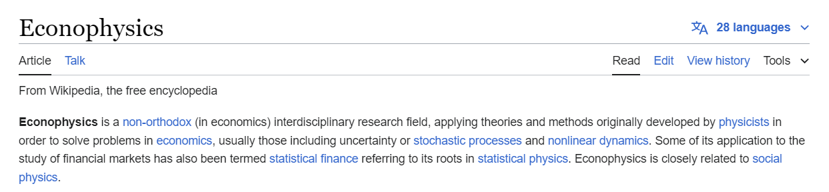
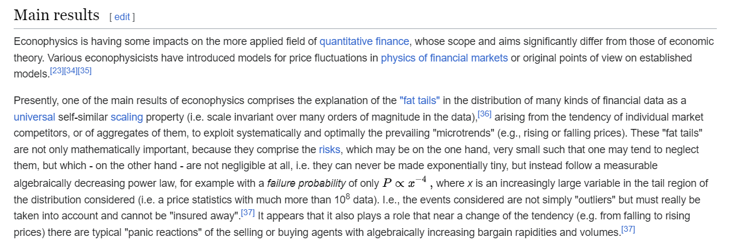
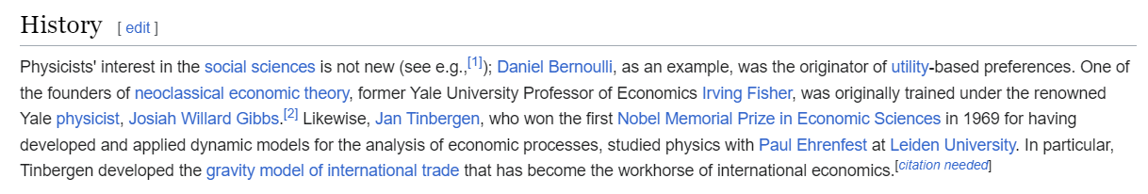
Motivation: Wiki on Econophysics
2
Basic problem: small amount of data usually Gaussian or exponential.
Data improve, Gaussians become unsatisfactory, due to heavy tails.
https://en.wikipedia.org/wiki/Econophysics

Slide 3
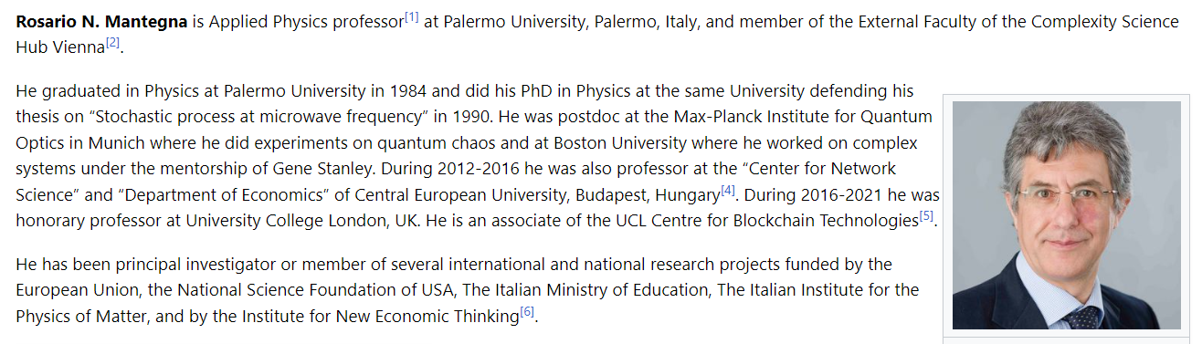
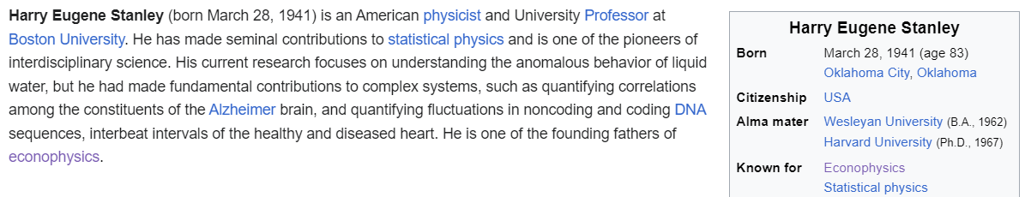

Authors
3
Top class authors, establishing a new field,
But by now the field has grown up (25+).

Slide 4
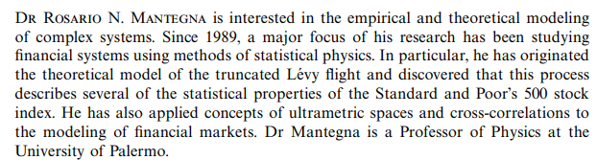
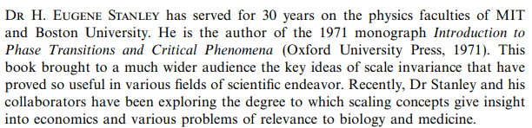
Authors
4
Both focusses on topics interesting for us:
Corrections to Levy flights and scaling.

Slide 5
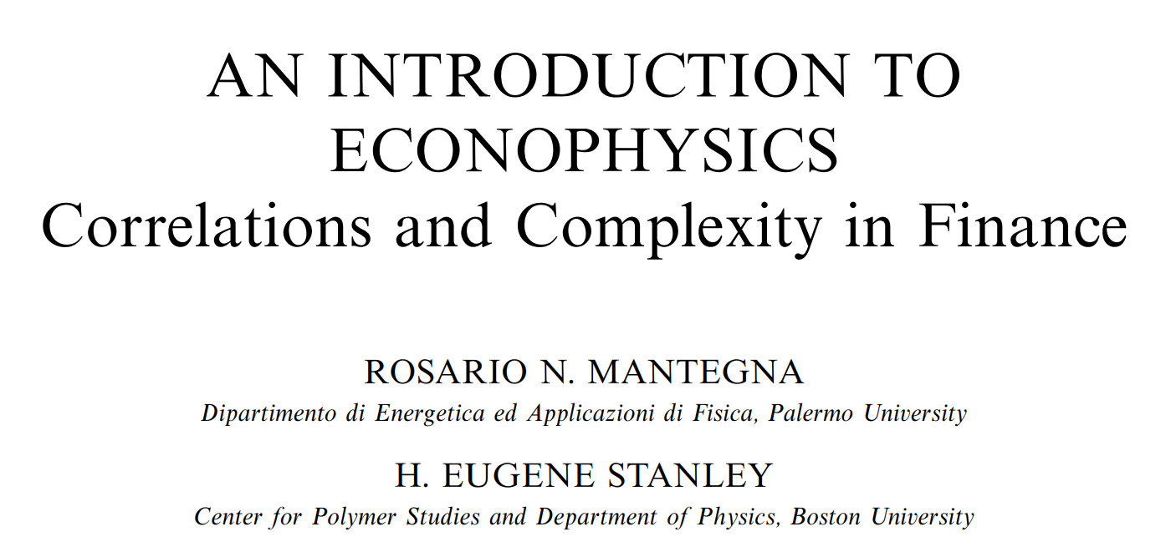
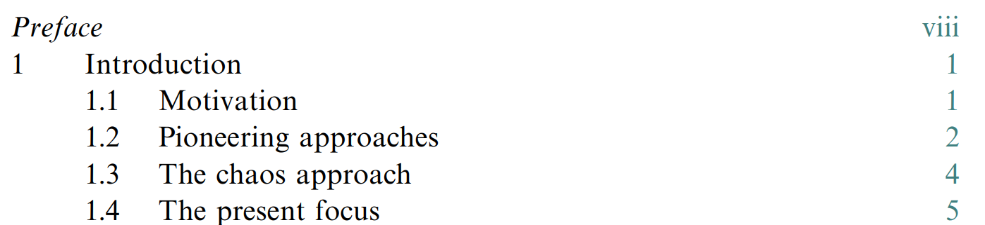
Chapter 1
5
Levy flights: stochastic processes
Chaos: non-linear dynamics
Focus: power-law tails

Slide 6
Feldolgozott fejezetek
Chapter 2: Efficient market hypothesis
Brigi
Chapter 3: Random walk
István
Chapter 4: Lévy stochastic processes
N. Tamás
Chapter 5: Scales and scaling in financial data
Gábor
Chapter 6: Korrelációk 1
Sanyi
Chapter 7: Korrelációk 2
Chapter 8: Stat. models of price dynamics
Cs. Tamás
Plan for this semester: Chapters 9-13
6

Slide 7
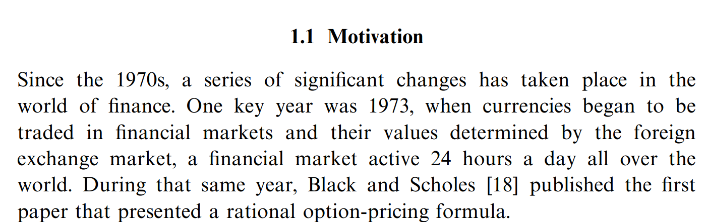
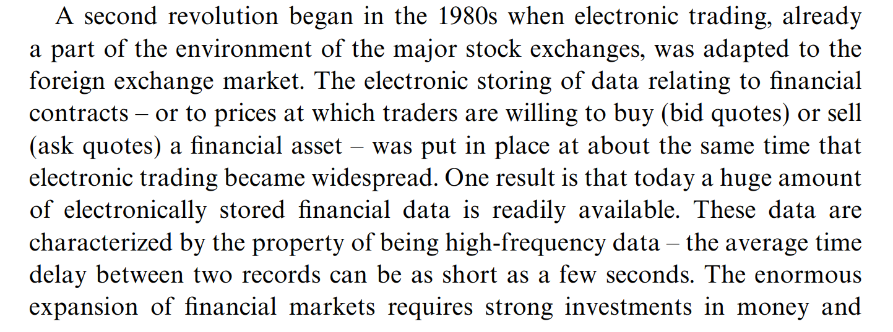
Chapter 1
7
Black and Scholes formula: Gauss eloszlást feltételez. Hivatkozás!

Slide 8
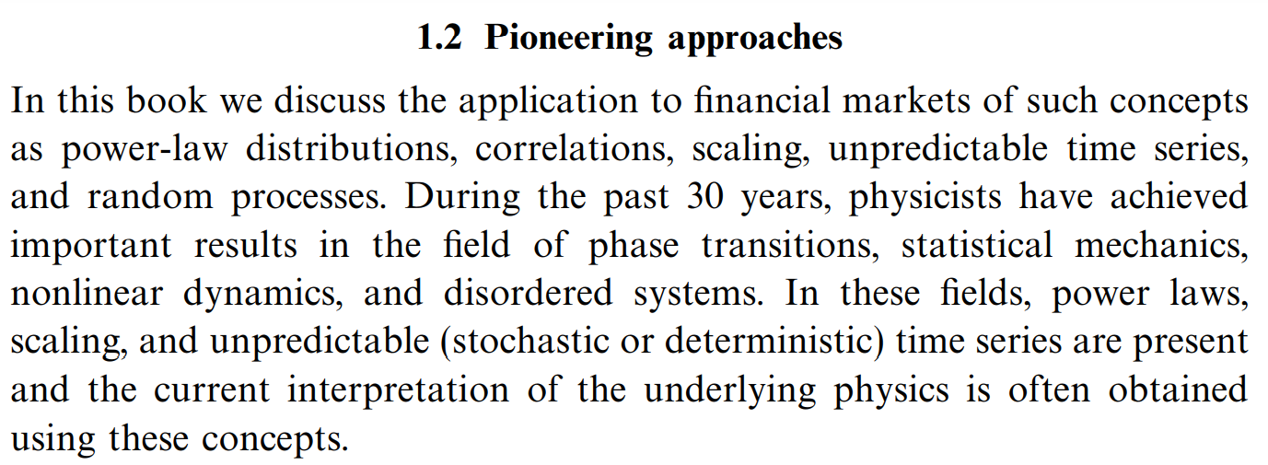
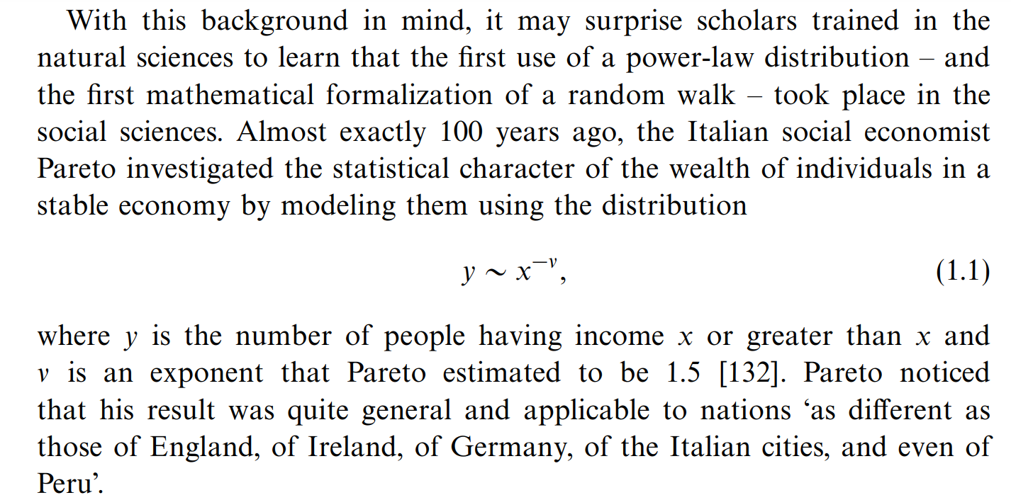
Chapter 1
8
Pareto törvénye: 1897

Slide 9
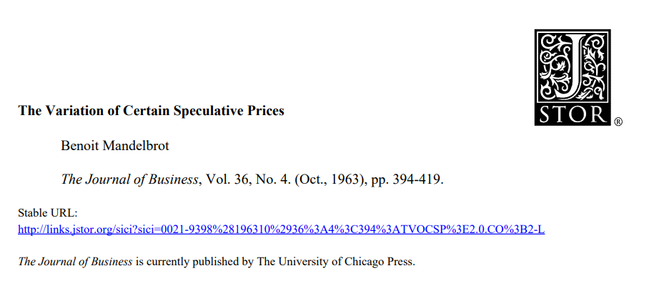
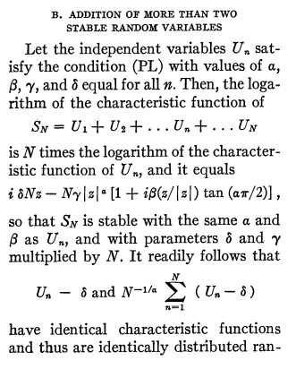
Section 8.1: Levy stable model
Proposed by B. Mandelbrot in 1963 for modeling cotton ln Y(t).
Seconded by Fama (1965)
Stable for convolution
Generalized central limit theorems
Infinite second moment for α < 2.
Infinite first moment for α < 1.
Gaussian is recovered for α = 2.
Top cited, paradigm shifting paper.
9

Slide 10
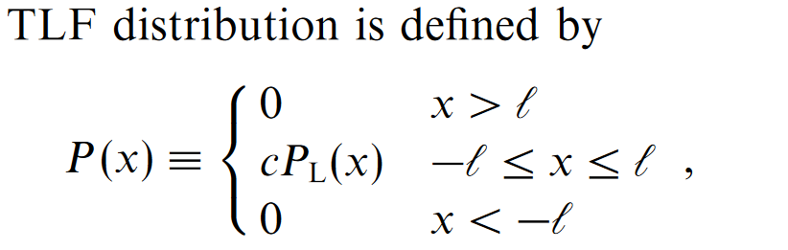
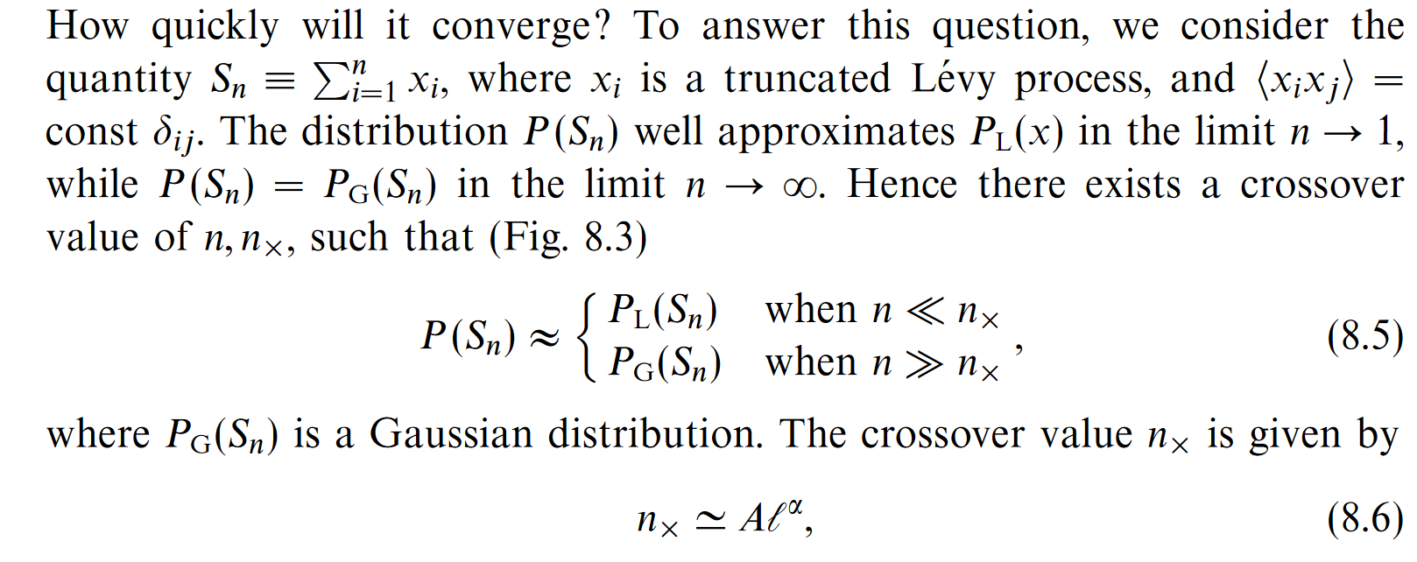
Section 8.4: Truncated Levy Flights (TLF)
Not stable for convolution.
It has finite means and variances: asymptotically Gaussian.
But how quickly?
10
Very interesting.

Slide 11
Section 8.4: Truncated Levy Flights (TLF)
Not stable for convolution.
It has finite means and variances: asymptotically Gaussian.
But how quickly?
11
Very interesting.

Slide 12
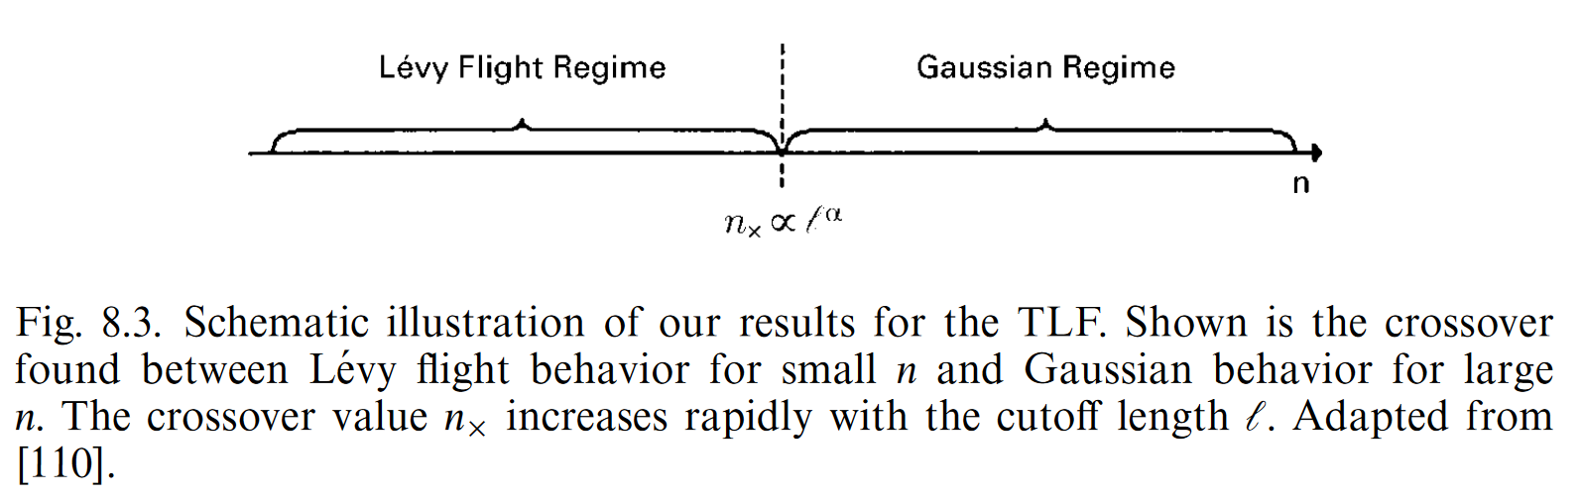
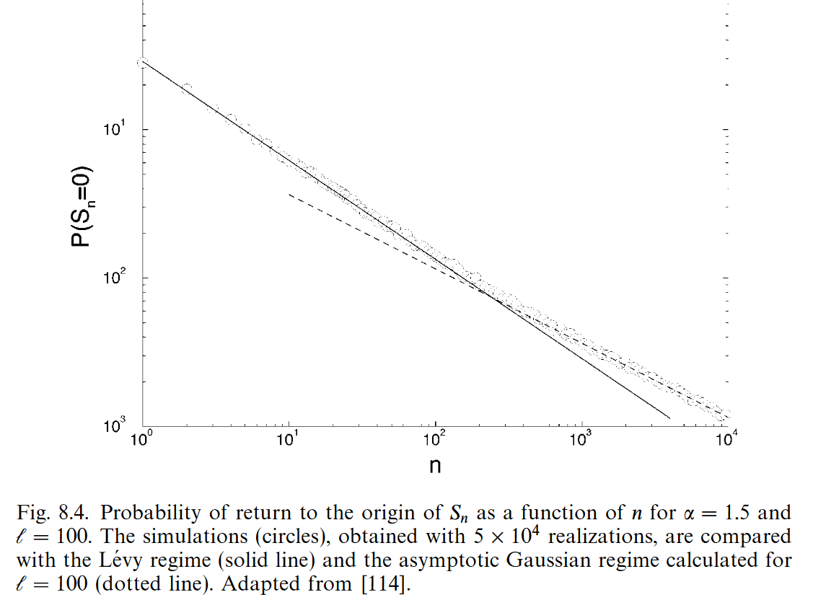
Section 8.4: Truncated Levy Flights (TLF)
[110] R. N. Mantegna and H. N. Stanley, Phys. Rev. Lett. 73 (1994) 2946
Two regimes, can be tested on data.
12
[114] R. N. Mantegna and H. N. Stanley, Physics Investigation of Financial Markets In: The physics of complex systems. Book issued by IOS Press, (1997) pp. 473-489.

Slide 13
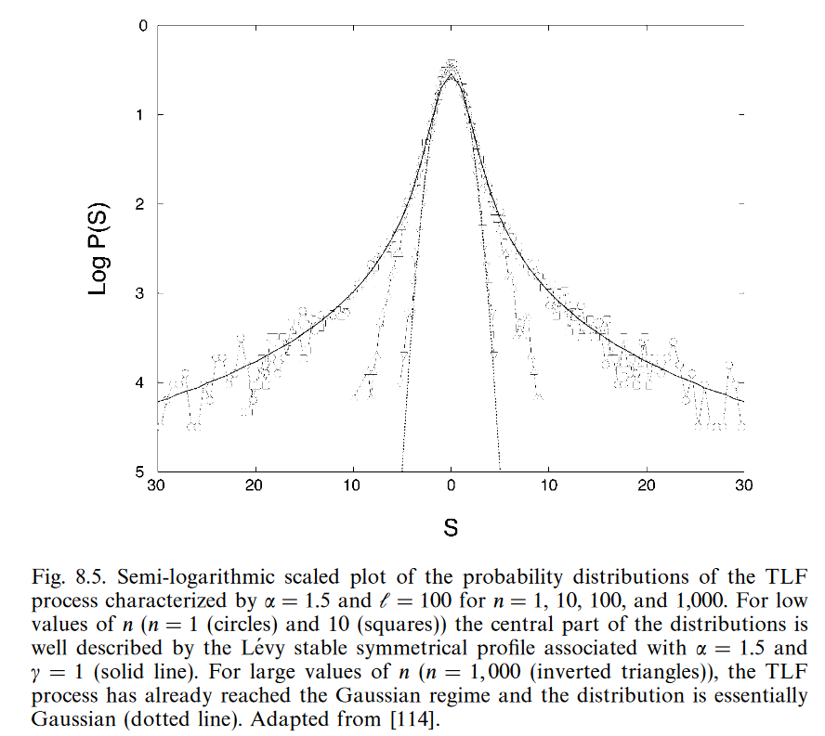
Section 8.4: Truncated Levy Flights (TLF)
Transition from Levy to Gaussian regime. From [114].
Very interesting: effect of truncation dominant for long term.
Similar effects for St. Peterburg
Paradox.
13
[114] R. N. Mantegna and H. N. Stanley, Physics Investigation of Financial Markets In: The physics of complex systems. Book issued by IOS Press, (1997) pp. 473-489.

Slide 14
New references
Deribit.com
Investopedia
New books recommended by
T. Novák and by Z. Lakner
Let us restart the study
seminar series
14

