Slide 1


Horizontal Test Results of LQXFA/B02
Guram Chlachidze
Fermilab, Nov. 1, 2024

Slide 2
LQXFA/B02 Test Summary
LQXFA/B02 test goals are achieved
  Electrical insulation tests passed at RT, at NOC, and at 100 K
  Splice resistance requirements are met
  Magnets survived a maximum temperature gradient of 50 K during a controlled warm-up and cool-down
  After a quench at acceptance current, the magnets reached again steady operation at acceptance current
  Quench performance requirements are met
    Only one spontaneous quench in two test cycles
    Nominal and acceptance currents were reached at 1.9 K
    Nominal current was reached at 4.0 K
  Ramp rate requirements are met
    Ramping up at 30 A/s and down at 150 A/s successfully validated
  Nominal current was held for 5 hours

Slide 3
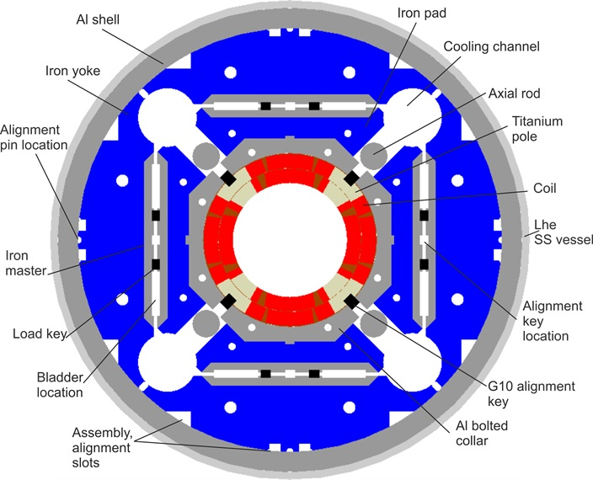
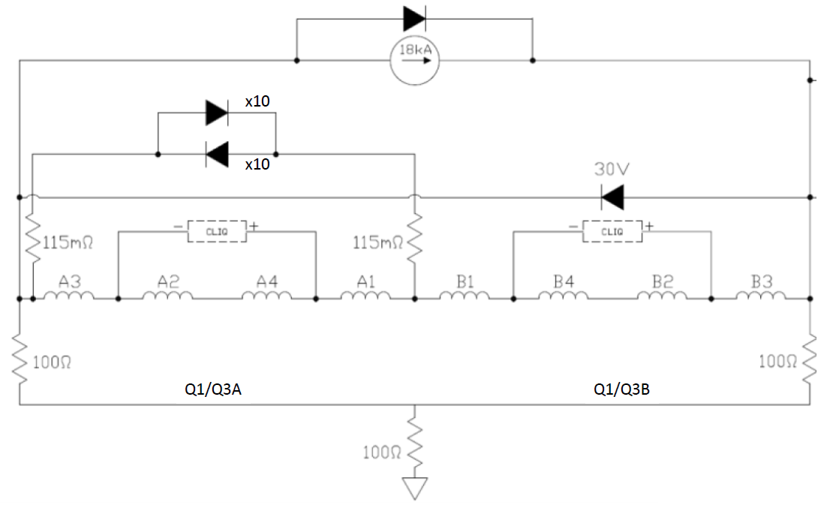
LQXFA/B02
MQXFA05 and MQXFA06 magnets of LQXFA/B02 have been trained at BNL
Quench protection includes CLIQ
& Strip heaters on the outer coil
No external EE (Dump delay 1s)
COIL 116
COIL 207
COIL 119
COIL 122
COIL 209
COIL 115
COIL 211
COIL 123
MQXFA05 (MQXFA.A)
MQXFA06 (MQXFA.B)
Notes:
COIL ARE fabricated

Slide 4
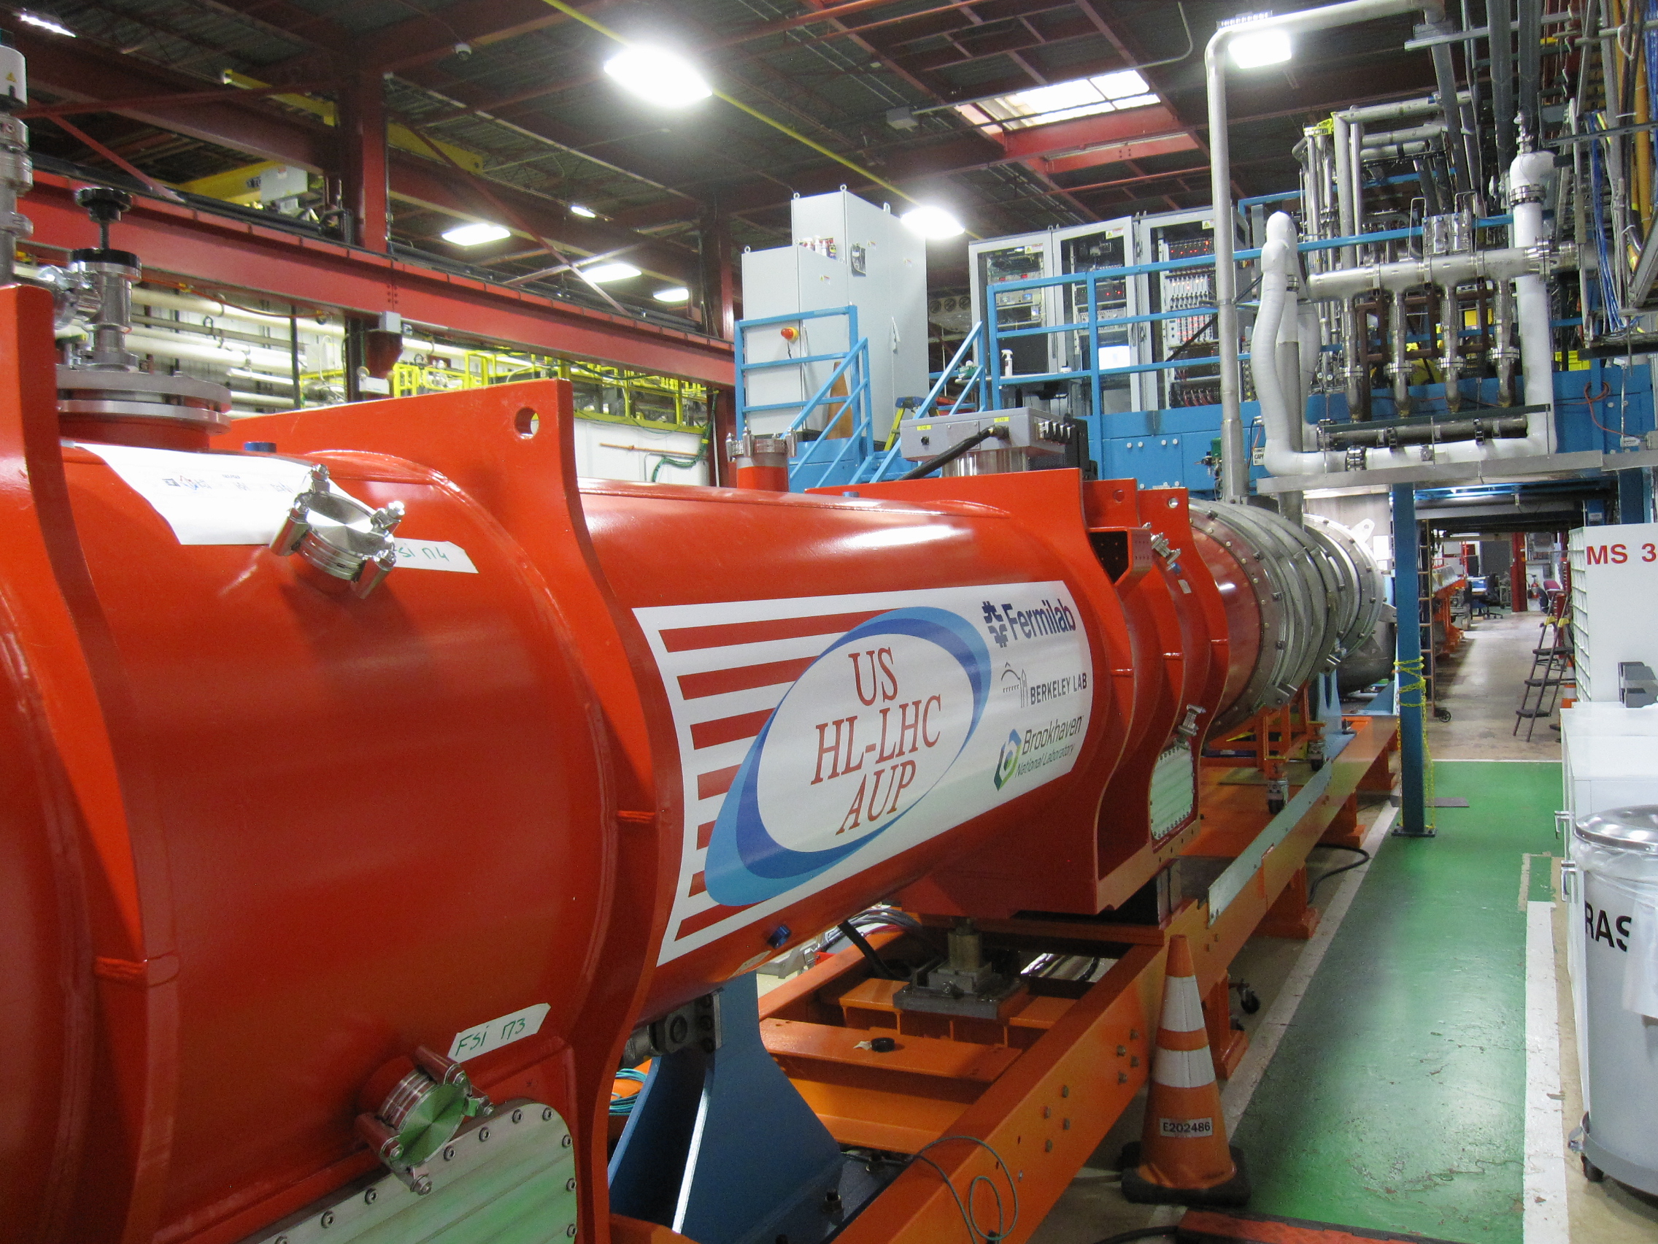
LQXFA/B02 at Fermilab’s horizontal test stand
Lead End
MQXFA05 (A)
MQXFA06 (B)

Slide 5
Electrical Checkouts
All V-taps, temperature sensors and protection heaters functional
Successfully passed room temperature insulation (Hipot) tests
  Lead-to-ground at 2.5 kV, Top plate w/o magnets
  Coil-to-ground (heaters grounded) at 368 V
  Quench heater-to-coil (coil grounded) at 460 V
Successfully passed cold insulation tests performed at 1.9 K
  Coil-to-ground (heaters grounded) at 1840 V
  Quench heater-to-coil (coil grounded) at 2300 V
Successfully passed cold insulation tests at gaseous helium conditions (100 K)
  Coil-to-ground (heaters grounded) at 425 V
  Coil and Quench heaters-to-ground at 425 V

Slide 6
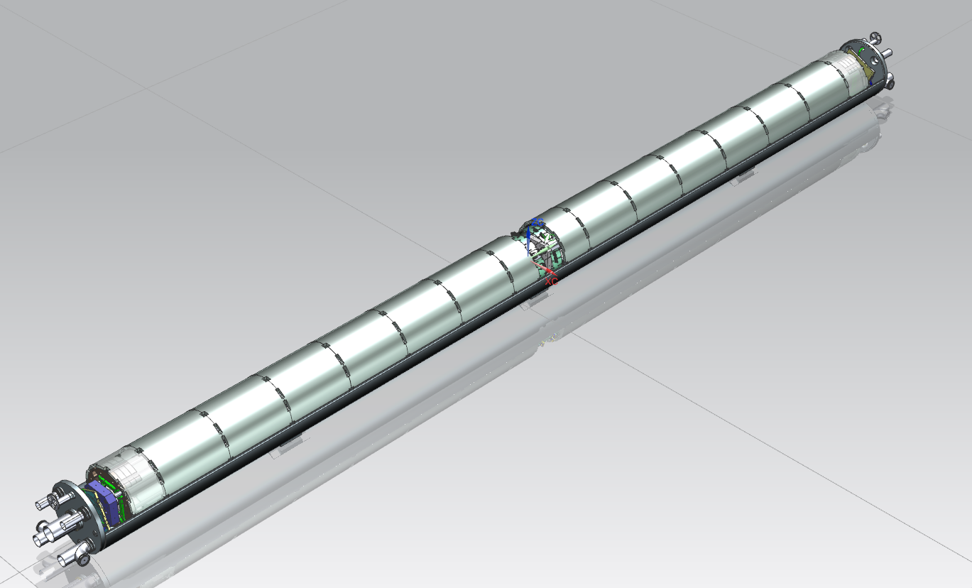
LQXFA/B02 controlled cooldown
Fermilab RTDs are used for monitoring temperature gradient in each magnet
Magnet A LE
Magnet B LE
Magnet B RE
Magnet A RE

Slide 7
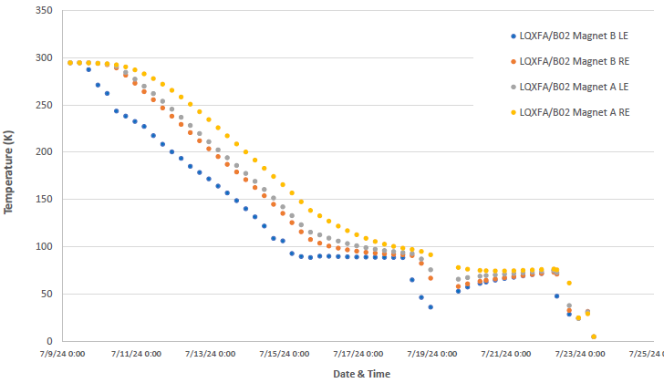
LQXFA/B02 controlled cooldown
14 days of controlled cooldown (compare to 19 days in LQXFA/B01)
  50 K requirement between the ends in each magnet
  Two days of downtime due to cybersecurity issues
Two days of downtime

Slide 8
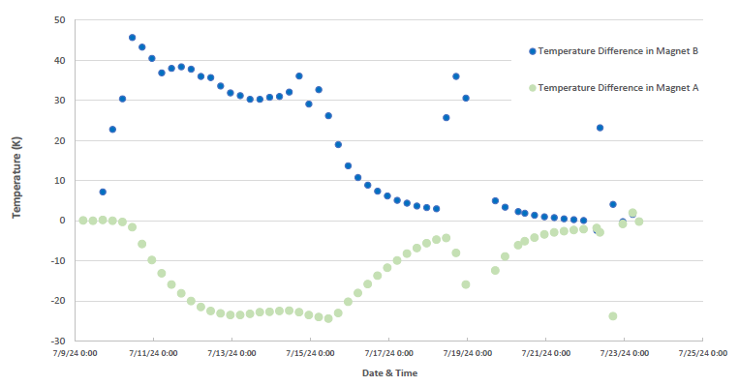
LQXFA/B02 Controlled cooldown (2)
Better temperature control with temperature sensors installed on both ends of each magnet in LQXFA/B02

Slide 9
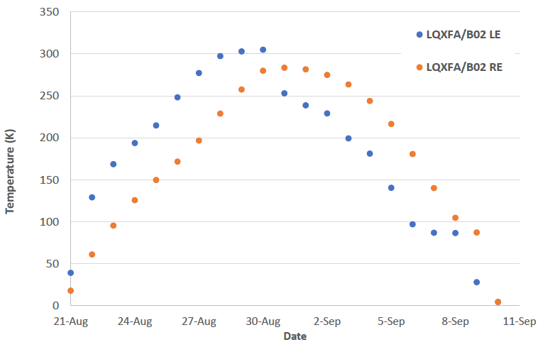
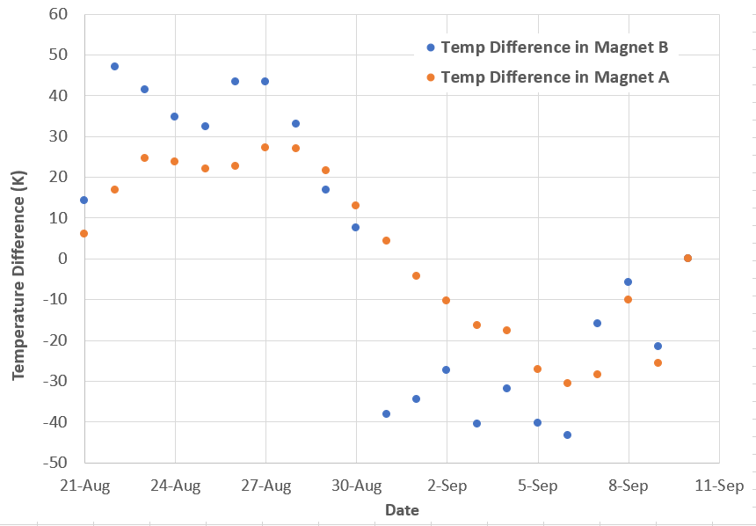
Thermal Cycle
Controlled warmup and cooldown from Aug. 21 to Sep. 10
  Total of 20 days

Slide 10
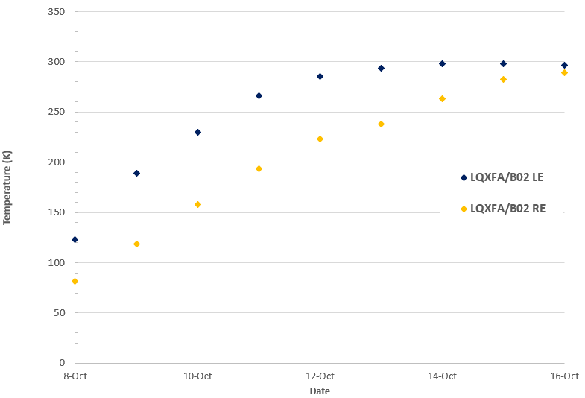
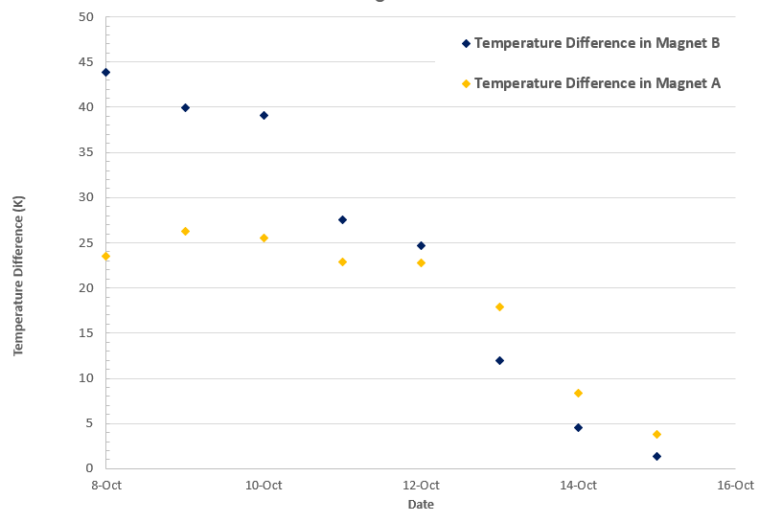
Final warm-up
8 days after 100 K Hipot from Oct. 8 to Oct. 16

Slide 11
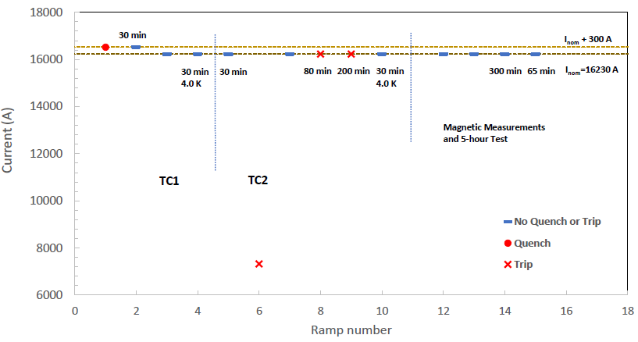
LQXFA/B02 Quench Performance
Reached the acceptance current in one quench
  Only one quench in two test cycles
Power supply induced trips at 7323 A and during the holding current test at 16230 A

Slide 12
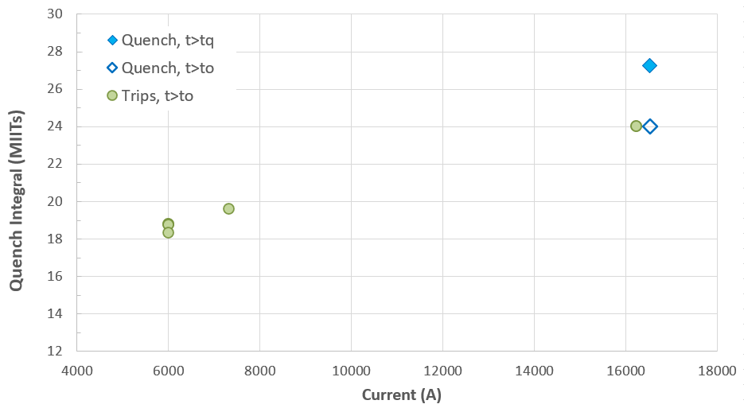
LQXFA/B02 Test Summary
4 provoked trips at 6000 A
2 ramps to 16530 A and 12 ramps to 16230 A
  1 natural quench at 16524 A
  Holding current tests at 16230 A: 80 min, 200 min and 300 min
  3 trips due to power supply issues at 7323 and twice at 16230 A

Slide 13
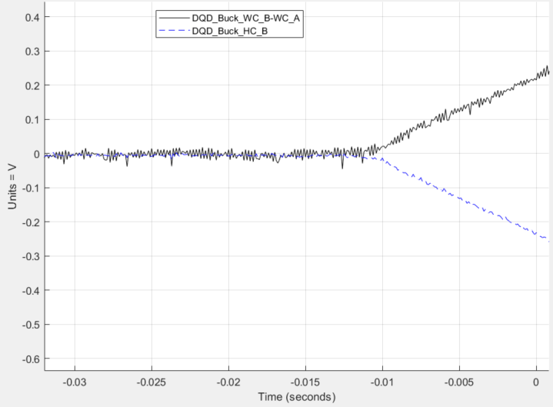
Quench in TC1
Only one spontaneous quench in MQXFA06 (B), coil 122 (pole 1)
  Quench current 16524 A
  Quench Integral 27.2 MIITs

Slide 14
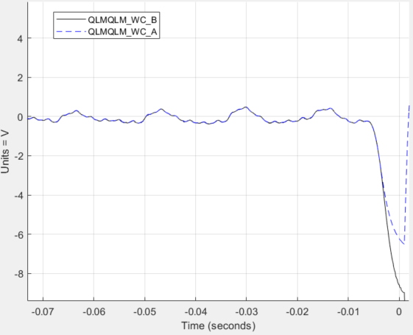
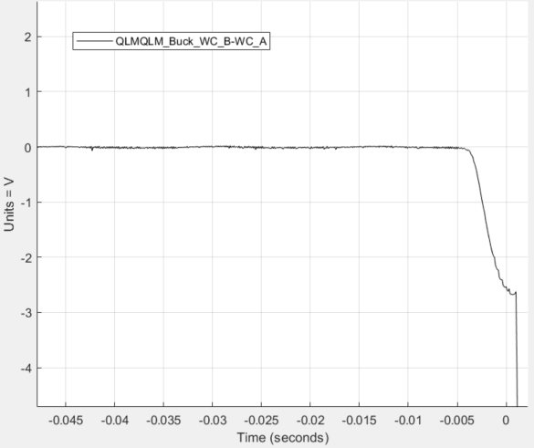
Trips at the nominal current
Two trips at I_{nom} with very similar pattern
  No resistive signals in coils or leads, only inductive signals in all coils
  Quench detection has been triggered due to difference between the inductive signals in magnets B and A

Slide 15
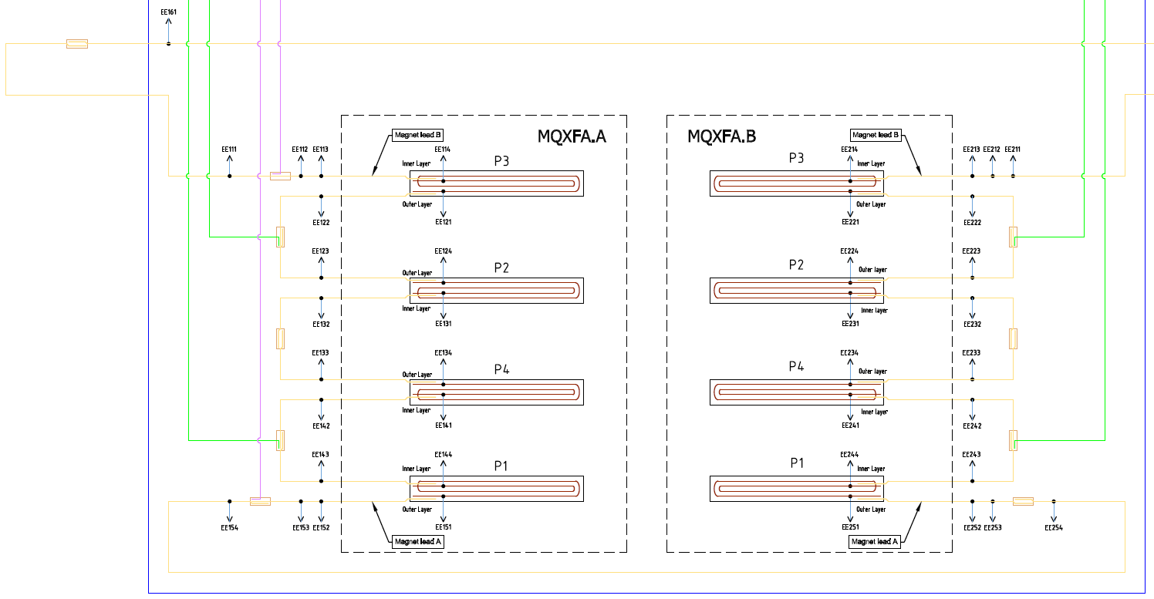
Splice measurements
All splices, made at Fermilab, have been measured
  Includes two splices required for connected magnets to the test facility
0.35 nOhm
0.77 +/- 0.1 nOhm
0.38 nOhm
0.1 nOhm
0.43 nOhm

