Slide 1
LQXFA/B02 Documentation
Jamie Blowers (AUP), Hector Garcia Gavela (CERN),
Gorana Prica (CERN)
01.11.2024 – AUP-CERN Meeting

Slide 2
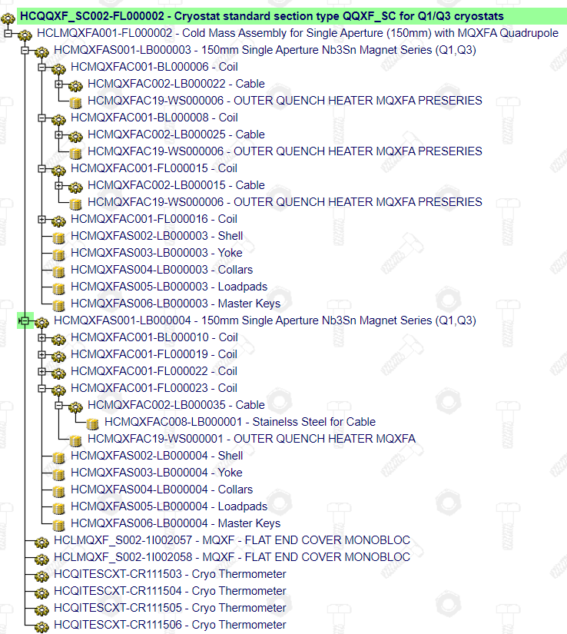
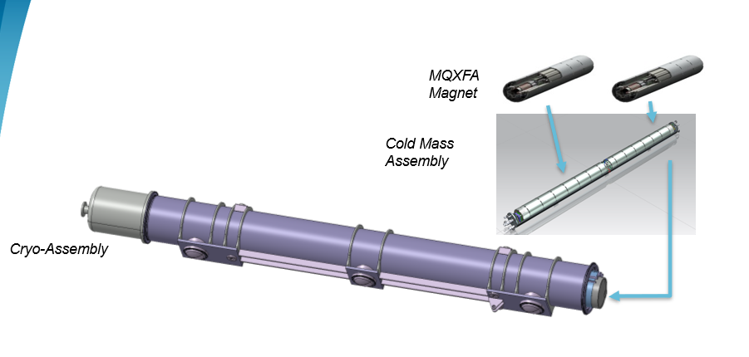
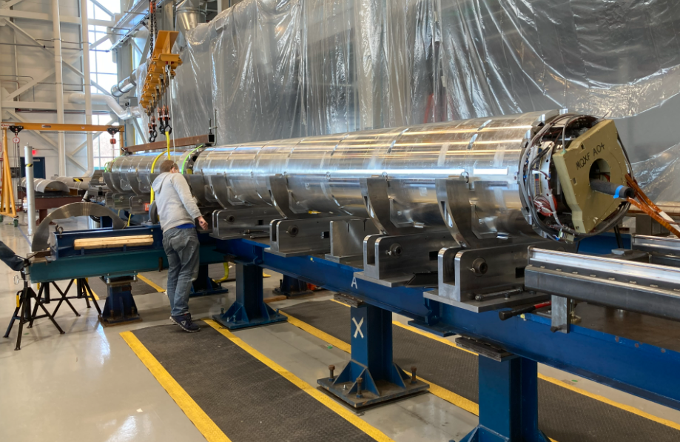
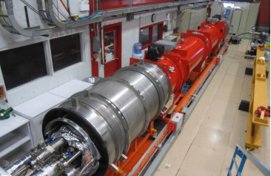
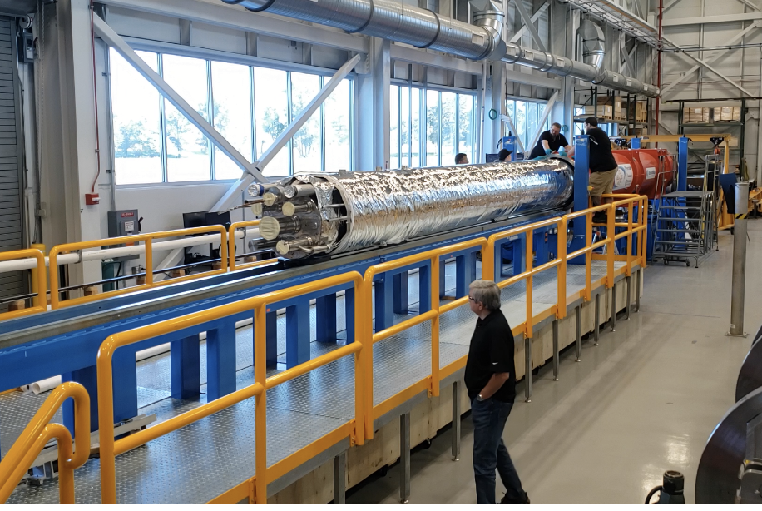
2nd Cryoassembly built by AUP (LQXFA/B02)
Cold Mass LMQXFA02 / CM02 (HCLMQXFA002-FL000002)
Magnet MQXFA05 (HCMQXFA001-LB000003)
Magnet MQXFA06 (HCMQXFA001-LB000004)

Slide 3
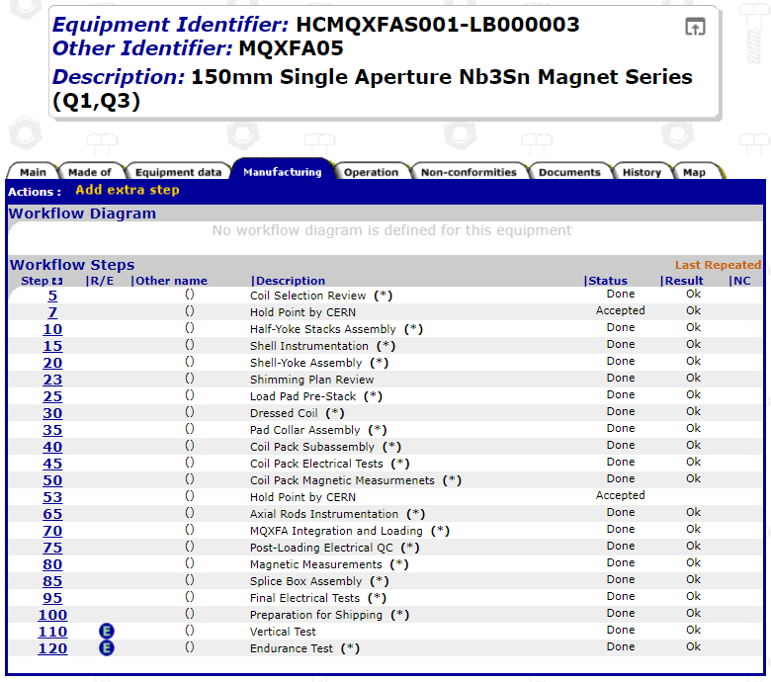
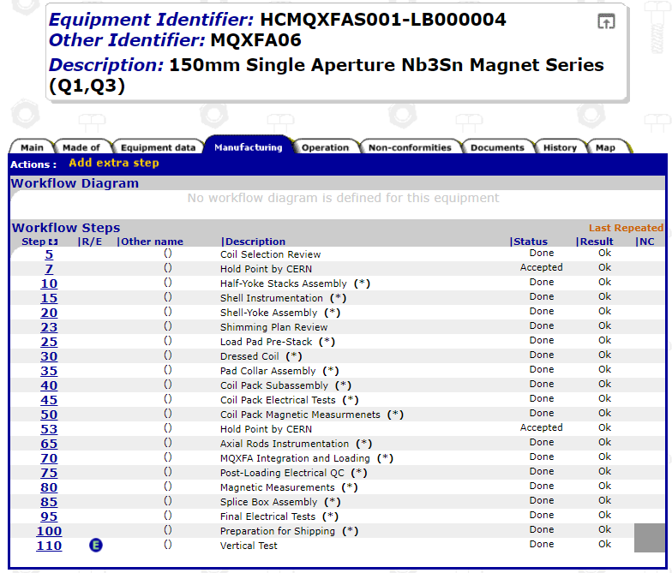
Magnets – MQXFA05 and MQXFA06
Documentation related to MQXFA05 and MQXF06 (including cables and coils) is complete and released
During the Coil Selection Review (1st step of the workflow), the data of the coils is assessed and validated prior to starting the magnet manufacturing
(Hold Point by CERN): EDMS 2444265 (Coil Selection Review MQXFA06) and EDMS 2350172 (Coil Selection Review MQXFA05)

Slide 4
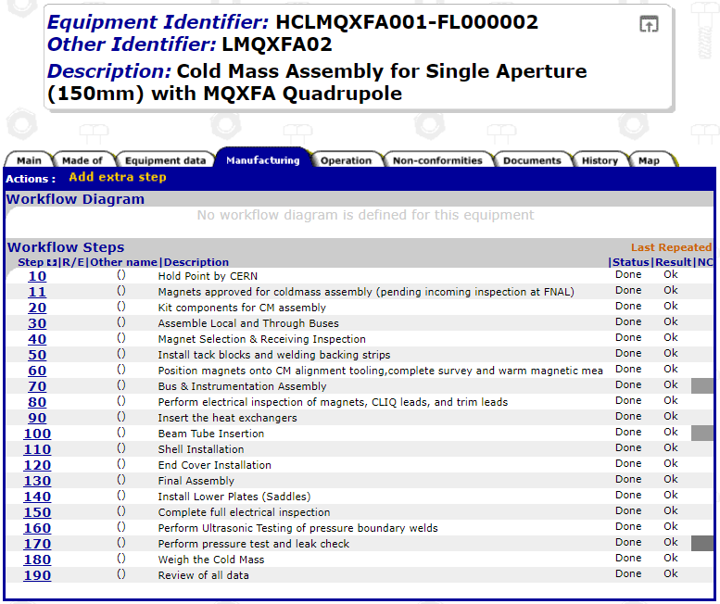
Cold mass – LMQXFA02
Documentation related to CM02 is complete and mostly released with a few exceptions:
  Position magnets onto CM alignment tooling,complete survey and warm magnetic mea - HCLMQXFA001-FL000002 – EDMS 3126405
  Alignment report after End Cover Installation – EDMS 3126445
  Final Assembly Alignment – EDMS 3126433
  Alignment data & reports have been discussed by both teams. They are under final check by CERN colleagues.
As requested and agreed in CA01 review, held in Oct’23, most of the cold mass manufacturing data has been provided prior to starting the horizontal test (Thanks)

Slide 5
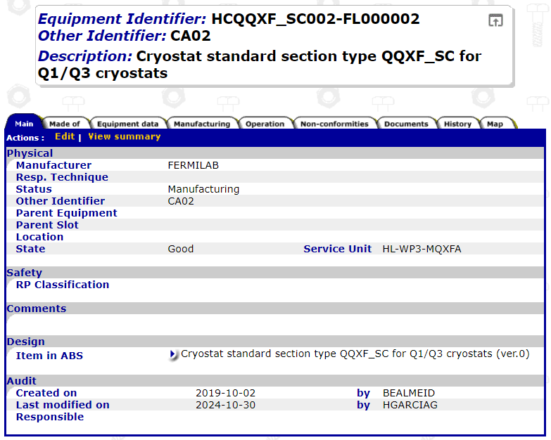
Cryo-assembly Standard Section – LQXFA02
Documentation related to CA02 is still being uploaded (alignment report is there, RT report,
What’s missing:
Assembly documentation for AUP Q1/Q3 cryoassembly 02 - HCQQXF_SC002-FL000002, including the traveller, parts used, assembly procedure filled in, dimensional inspection report, etc.)
Weld map/Welding book
Combined Pressure & Leak Test report
Horizontal Cold Test Report
DRs
This is to be provided asap – We still have time to look through and provide feedback prior to shipment.

Slide 6
Main Nonconformities
Total of ~150 AUP-internal Discrepancy/Nonconformance reports issued (associated to cables, coils, magnets, cold mass and cryostat for CA02); most were minor and handled within AUP (level 1 or 2)
Only 1 critical Nonconformity related to this Cryo-assembly.
  EDMS 3024619 : CM02 Instrumentation Wire Damage and Repair ; Repair performed by AUP and NCR was closed
  However, recently, another NC became critical due to schedule constraints for shipment EDMS 3153512 - LQXFA/B-02 IFS Warm Head Misalignment – Pressure weld for which CERN HSE clearance is required. Following the distribution of the NCR, CERN provided feedback (HSE and WP3), and 2 dedicated meetings were organized. A FEA was performed by AUP, which shows a safety margin of almost a factor of 2 wrt Pressure at Operation (20 bar).
  The take away message is that these type of NCs are to be communicated timely as HSE (Notified Body for WP3 pressure equipment) needs to be in the loop – Lesson learned for the future

Slide 7
Deviation Request
No Deviation Requests have been issued in the framework of CA02

Slide 8
Miscellaneous
In-track documentation file prepared by Gorana Prica, which is timely shared with WP3 and AUP, is proven to be very helpful to keep track of MTF status (documentation and steps) and easily spot what’s missing
Regular QA meetings between both teams and dedicated technical meetings with tehcnial experts (i.e. alignment) are very much helpful to discuss an agree on actions.

Slide 9
Conclusions (and lessons learned)
Intermediate steps for revision of documentation is proven to be effective (coils, magnets, cold mass) and avoid unnecessary overload to everyone at the end of the production
Improvement for Cold Mass documentation – Shared prior to cold test (We already look forward to CM03)
Timely issuing of critical NCRs to trigger the discussions and the formal approval process. We sometimes need external colleagues to WP3 (or even the Project) to give feedback and grant concessions
Documentation is in good shape for CA02 and main subassemblies but still not completed
All critical NCRs are closed or about to be (misalignment of the IFS head)

Slide 10
Looking forward to receiving CA02 at CERN

Slide 11
Main Nonconformities
Total of ~150 AUP-internal Discrepancy/Nonconformance reports issued (integrated for cables, coils, magnets, cold mass and cryo-assembly CA02); most were minor and handled within AUP (level 1 or 2)
Only 1 critical Nonconformity related to this Cryo-assembly.
  EDMS 2515070: "nodal" distance between two magnets out of spec; NCR accepted and closed with warnings – Decision to wait for the results of CM02 before changing the acceptance criteria
  EDMS 2905753: leak check of CM in the CA was not able to achieve necessary background to verify spec; NCR has been accepted by WP3 and CERN TE-VSC – Waiting for final approval from TE DH and HL PL (already given offline), will be closed with warnings – Results of the Leak Test to be done at CERN after phase II cryostating shall be added to this NCR. Leak Test procedure to be shared with CERN/TE-VSC before the next test and results to be immediately share with CERN/TE-VSC for validation. OK for installation in the IT String
  EDMS 2937955: VT EE152 is open; NCR under review. Suggestion from TE-MPE to disconnect VT EE152 completely at the IFS, and use VT EE151 instead (bridge at IFS). To be closed with warning adding this remark and also adding preventive actions
  EDMS 2769128 and 2883868: two QH failures; NCR under review – OK for installation in the IT String. The NC shall be repaired via a disassembly of the cold mass and (if needed) a magnet replacement prior to installing the machine (or to be considered as spare)

