Slide 1
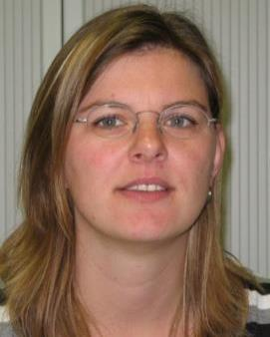
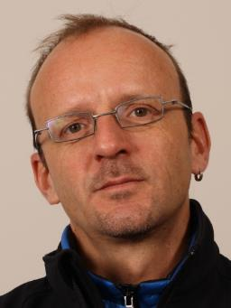
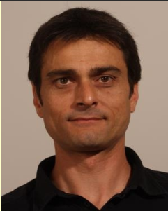
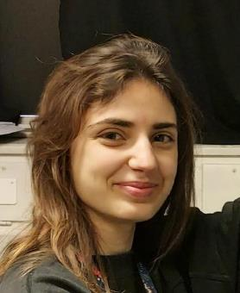
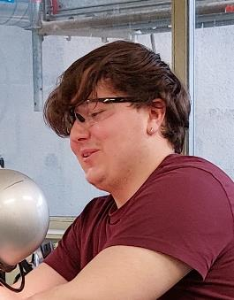
EP-DT Thin Film and Glass Lab (TFG)
Miranda van Stenis
Thomas Schneider
Jerome Noel
Apprentices & Graduates
Thin film coating
Glass & ceramic machining
Optics Quality Control lab
Apprentice's training
General support to DT detector projects
See link=> https://ep-dep-dt.web.cern.ch/thin-film-glass-service
More than 50 years growing experience
Standard service
Production
R&D

Slide 2
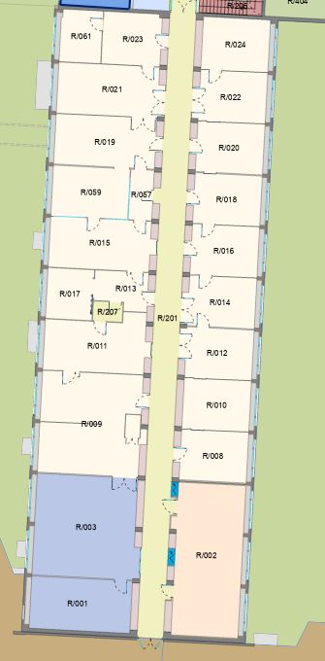
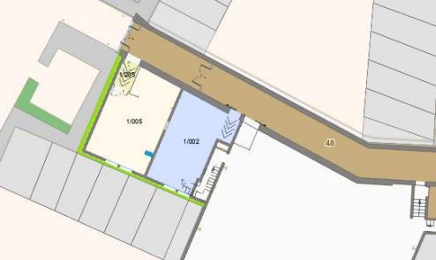
EP-DT-TFG Location
Optical QC lab
(Microscopes)
Optical QC lab
(optical spectrometer)
Clean room with 7 coating devices
Offices
Entrance area with ovens
and gluing facility
Entry
Glass and Ceramic workshop
Building 108
Building 3 R

Slide 3
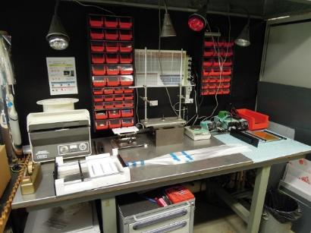
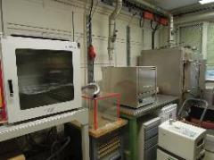
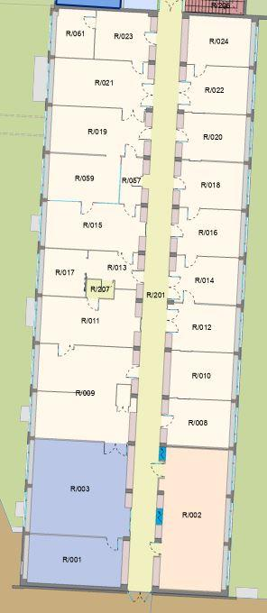
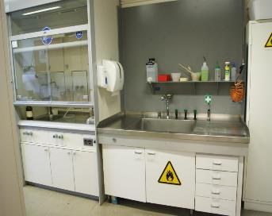
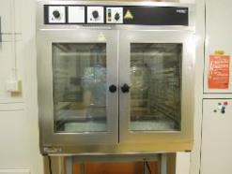
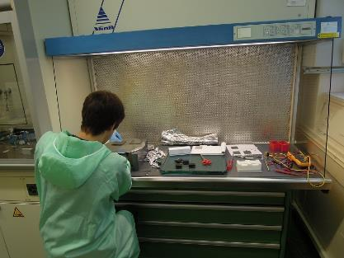
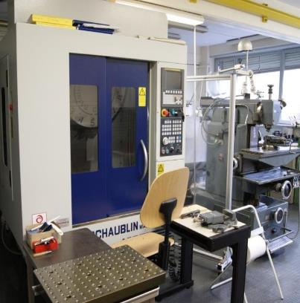
EP-DT-TFG Infrastructure
Ovens
Gluing area ( Fibre beam monitor)
Chemistry and cleaning
Entry
laminar flow cabinets for assembly activities (ISO class 5)
Glass & Ceramics Workshop
Building 3 R

Slide 4
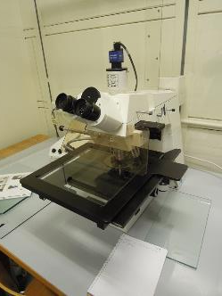
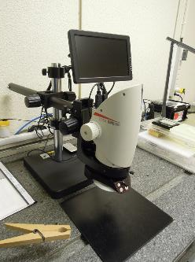
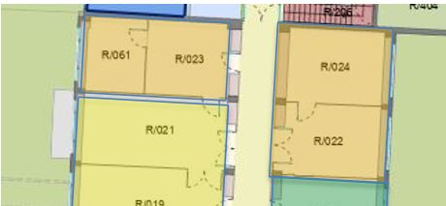
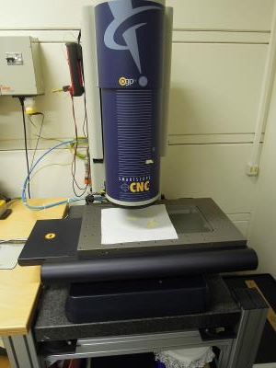
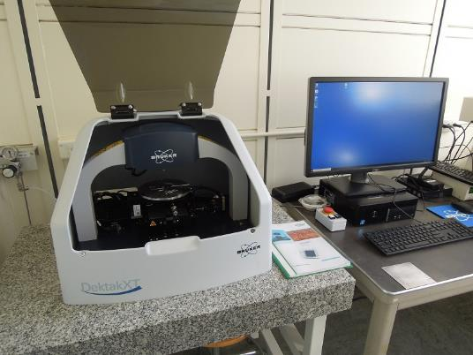
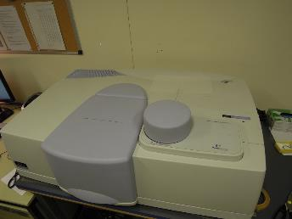
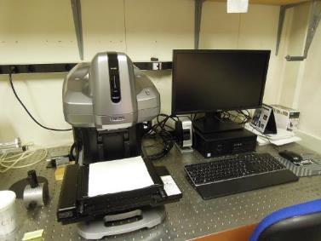
EP-DT-TFG Infrastructure
Optical Quality Control equipment
Different microscopes
OGP 3D metrology
Perkin Elmer spectrometer for spectral/diffuse reflection and transmission (200-900nm)
BRUKER Profile-meter
DEKTAK for measurement in nm scale
Keyence VR3000 3D
measurement system (μm)

Slide 5
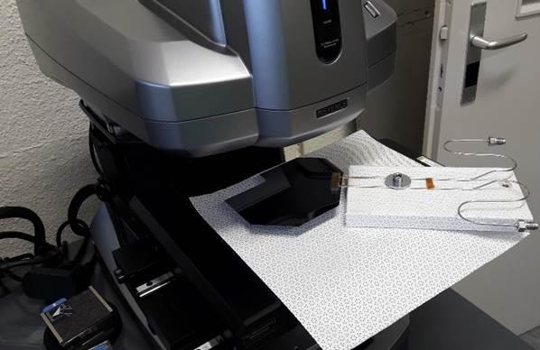
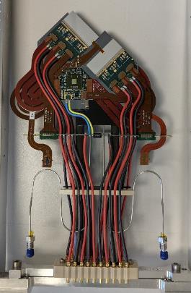
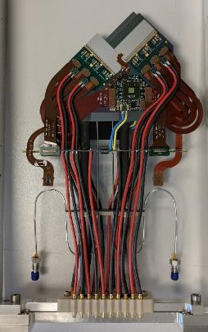
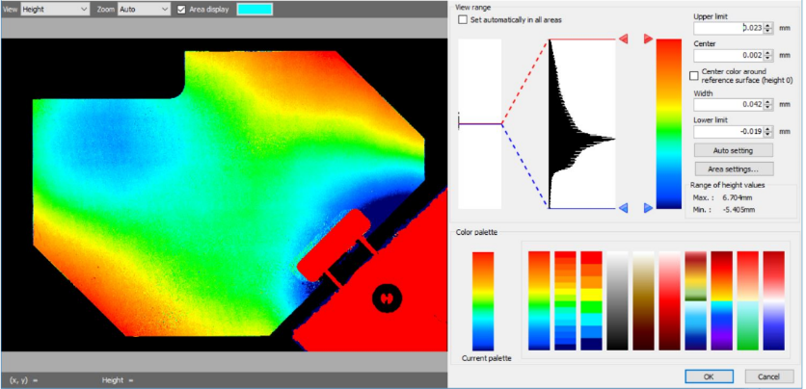
Metrology
VELO Substrate metrology
(Keyence VR3200)
Microchannel planarity measurement after soldering and before place front end components.

Slide 6
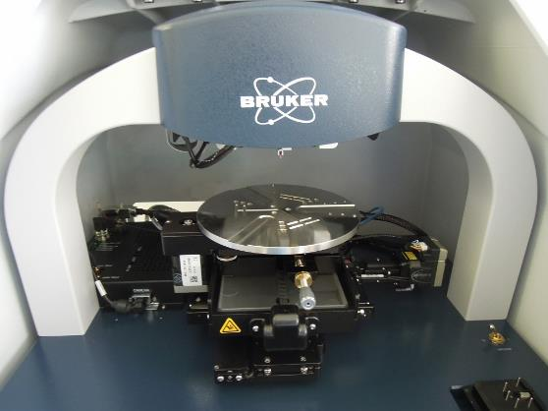
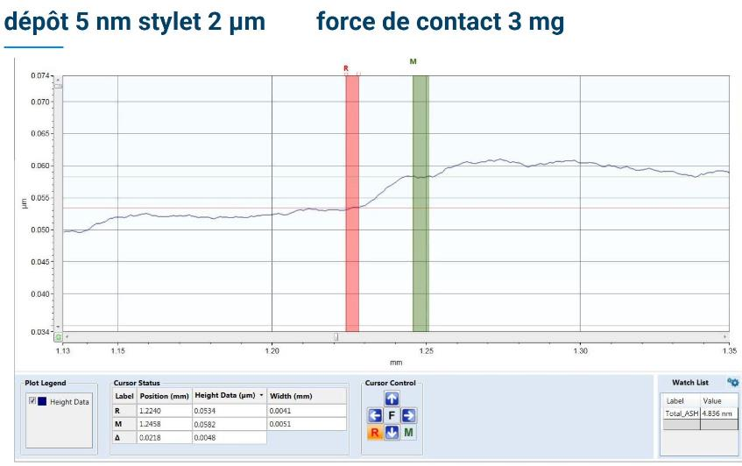
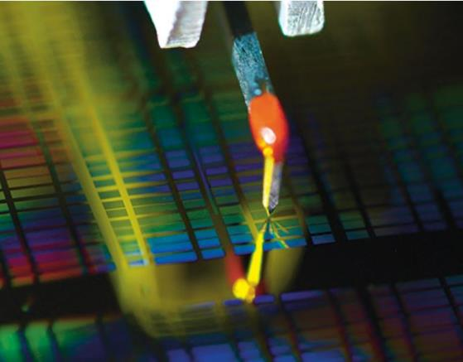
Thin Film characterization
DEKTAK XT Stylo-meter
(Bruker )
Thin Film Thickness measurement >10nm
Roughness measurement down to few nm

Slide 7
EP-DT-TFG general support
List of detector groups or users profiting of our infrastructure (~last 5 years):
NA62 Giga Tracker (assembly, cleaning and metrology in cleanroom)
LHCb SciFi (close collaboration, QC tools)
LHCb SciFi/RICH (Carbon filter regeneration)
LHCb SPACAL R&D (fibre machining/prototype assembly)
LHCb Velo (component cleaning/surface metrology)
LHCb Muon (microscopic chamber inspection)
CMS HGCal (large silicon sensor cleaning)
TE-VSC (ceramic machining/spectroscopy)
CAST –CAPP (repair of turning mechanism for cavity)
Student workshop (Optics lab of TFG)
Neutrino platform (PM QE measurements)
BE-BI (Fibre detector production)
ATLAS ITk (cleaning/surface metrology)
DT µ-channel cooling (cleaning/surface metrology)
DT µ-fabrication facilities (cleaning/surface metrology)
Picosec project with RD51 (machining/handling of photocathodes)
The Perkin Elmer spectrometer (UV-VIS) is used by various CERN users
Open lab?!

Slide 8
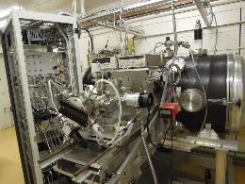
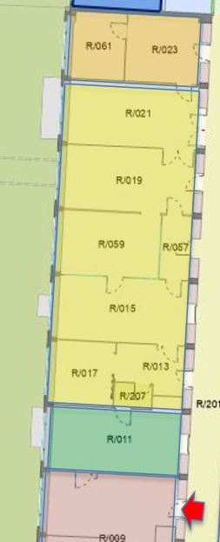
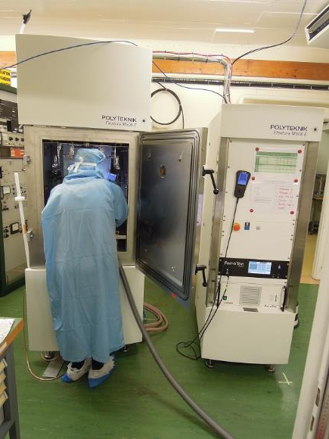
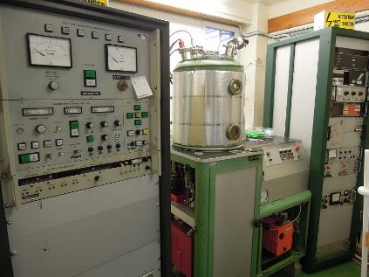
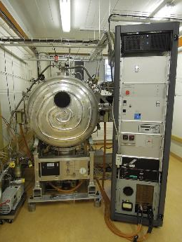
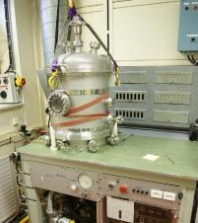
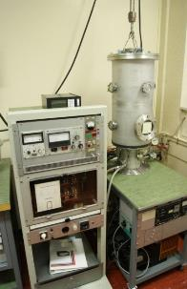
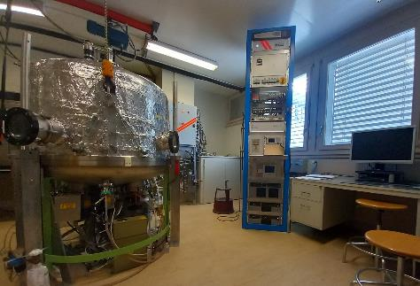
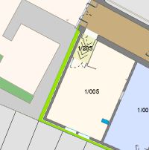
EP-DT-TFG coating facilities
PVD thin film coating devices
Big CsI coating unit
Generic coating unit (Balzers 1957!)
New state of the art coating unit
WLS/Zinc coater
Small CSI coater
Upgrade big production coater (1m diameter)

Slide 9
EP-DT-TFG PVD coating technology
Motivation for vacuum thin film coating:
High purity thin layers <=vacuum environment
Low cost of material <=thin layers with same performance as bulk material
Good reproducibility <=precise control of process parameters
Different kind of technologies available:
Physical Vapour Deposition (PVD):
Resistive
Thermal Evaporation (30th)
(EP-DT) E-beam
Cathodic
Sputtering (70th)
(TE-VSC) Magnetron
Chemical Vapour Deposition (CVD)
Thermal vs sputtering
“Thermal evaporation is the more mature technology...it allows coating almost all materials needed for “standard” coating applications”
+high flexibility in substrate material and
geometry
+Also exotic material can be coated (low
temp)
=>Best candidate for R&D device in TFG lab
-need high vacuum level ( ~10⁻⁷mbar)
-lower energy coating (packing
density/adherence)

Slide 10
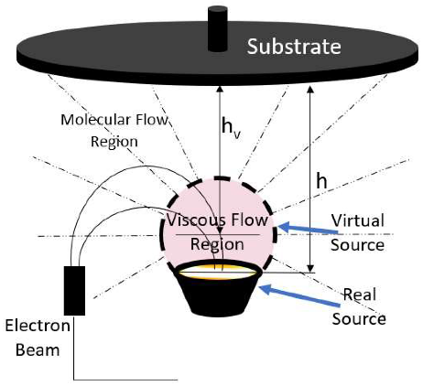
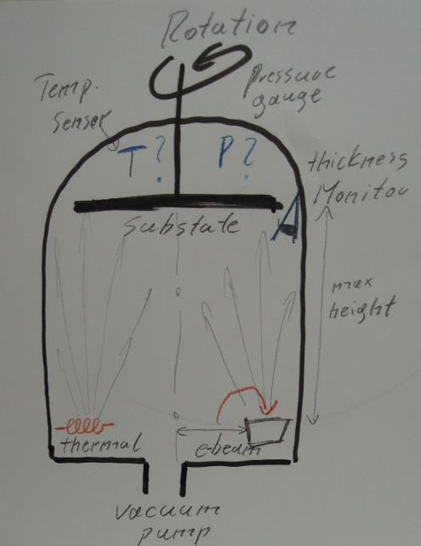
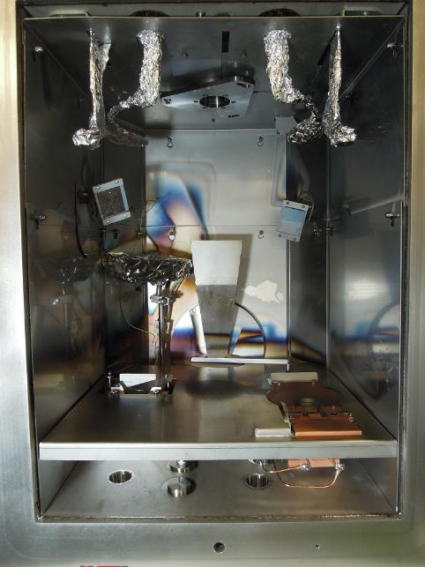
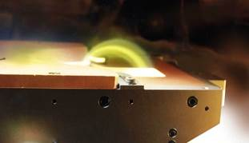
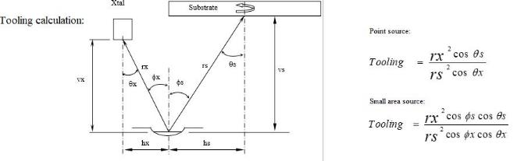
EP-DT-TFG PVD schematics
Uniformity of layer thickness is key issue
concept for uniform large area coating:
Increase distance source –substrate
Rotate substrate
Position source most excentric

Slide 11
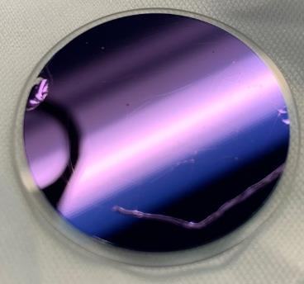
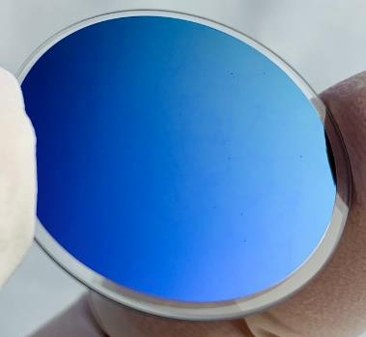
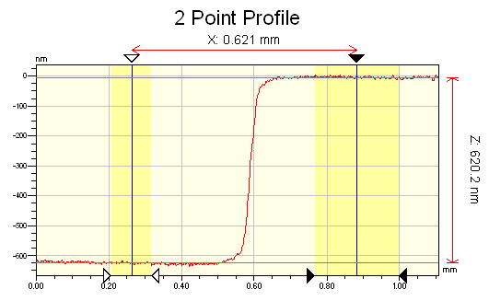
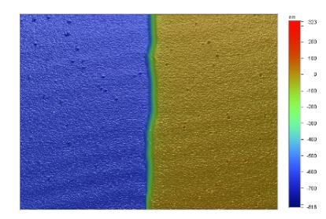
EP-DT-TFG R&D LHCb RICH Photonic crystal
Two multi-layer samples successfully manufactured.
61 layers 57 layers
SiO₂ substrate
Chrome
SiO₂
TiO₂
SiO₂
TiO₂
Coater calibrated with single layer couples of SiO2 and TiO2.
SiO₂
TiO₂
Dissertation Michele Blago 2021

Slide 12
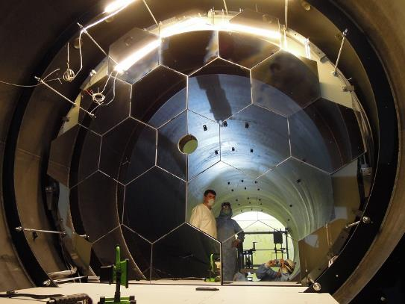
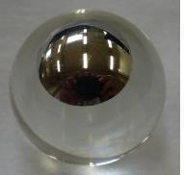
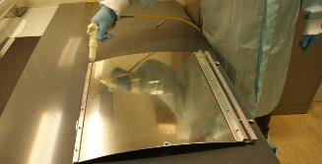
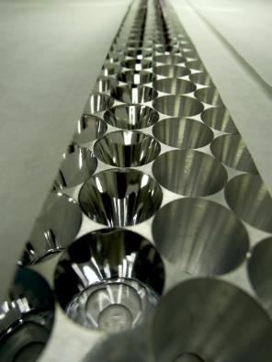


EP-DT-TFG PVD optical coatings
Optical coatings
Enhanced reflective coatings
Anti reflective coatings
Geometer target
NA62 RICH UV mirror system
Mylar foil coating for NA62 RICH optical feed trough
AR quartz window for LHCb RICH1

Slide 13






EP-DT-TFG LHCb RICH1 enhanced mirror coating
The LHCb RICH1 upgrade is certainly the Flagship project of our coating service. Enhanced Reflective coating (Cr/Al/SiO2/HfO2) has been applied to spherical composite substrates (1m diameter)
COATING

Slide 14



EP-DT-TFG PVD coating application
Other light related coatings
Wavelength shifter coatings (WLS)
Photocathode layers (PC)
Compass Thick-gem PC coating (CsI)
PM wavelength shifter coating (TPB)

Slide 15



EP-DT-TFG PVD coating application
Pico-sec R&D (close collaboration with GDD)
Very reactive coating service along the different test beam Periods. Developed base line recipe:
3.8nm Cr (transparent + conductive)
100nm Cr (outer border region)
18nm CSI (Photocathode layer)
=>
Scale up
=>

Slide 16




EP-DT-TFG optical Fiber activities
Construction and installation of ATLAS ALFA detector (initially started with lateral fibre coating)
Demonstrator construction for AX-PET
Strongly involved in LHCb SciFi development
Development and construction of 15 Fibre beam monitors for Neutino Platform (collaboration with BE-BI)
Contribution to prototype of E-cal LHCb
Individual fibre polishing for various detector groups (fibre–fin)
Competencies:
Individual fibre polishing
Fibre gluing
Fibre detector construction
Reflective (Al) lateral fibre coating
Fibre end coating

Slide 17





EP-DT-TFG Participation to LHCb E-cal upgrade
TFG support to SPACAL project
Mechanics workshop
QC Spectroscopy
Fiber gluing and polishing
Light guide conception
Cleanroom assembly

Slide 18








EP-DT-TFG PVD coating application
Functional layers
Pre-coating of conductive layers
Transparent conductive layers
De-moulding layers
Zinc layer for isotropic radicals
Micro buses de-molding layer (Au)
Titanium (conductive) spirals on CLOUD UV sabre
Conductive layer (Cu) on ceramics
Zinc layer on gold plates for MEDICIS (Medical Isotopes Collection ISOLDE)

Slide 19

























End ?questions? End

