Slide 1
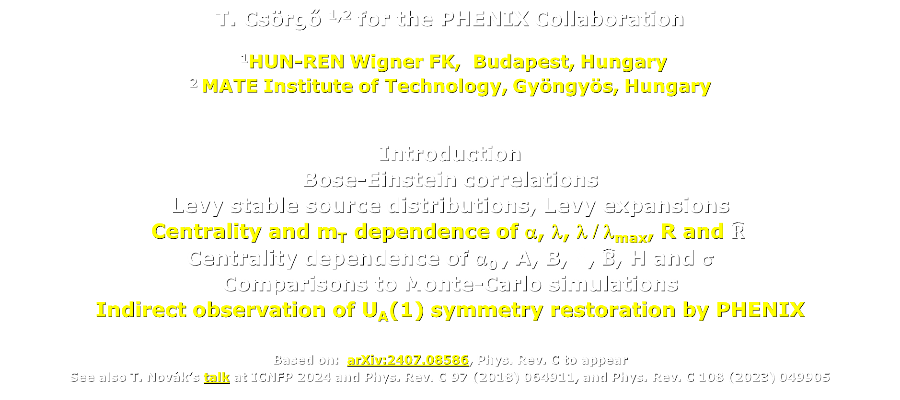
U_{A}(1) symmetry restoration from PHENIX measurements
in √s_{NN} = 200 GeV Au+Au collisions
T. Csörgő ^{1,2} for the PHENIX Collaboration
¹HUN-REN Wigner FK, Budapest, Hungary
² MATE Institute of Technology, Gyöngyös, Hungary
Introduction
Bose-Einstein correlations
Levy stable source distributions, Levy expansions
Centrality and m_{T} dependence of α, λ, λ / λ_{max}, R and $\hat{R}$
Centrality dependence of α₀ , A, B, $\hat{A}$, $\hat{B}$, H and σ
Comparisons to Monte-Carlo simulations
Indirect observation of U_{A}(1) symmetry restoration by PHENIX
Based on: arXiv:2407.08586, Phys. Rev. C to appear
See also T. Novák’s talk at ICNFP 2024 and Phys. Rev. C 97 (2018) 064911, and Phys. Rev. C 108 (2023) 049905

Slide 2
PHENIX Detector @ RHIC – RUN HISTORY
Completed 16 years of operation with versatility.
9 collision species and 9 collision energies.
Both geometry and beam energy scan.
Species | Run Year
Au+Au | 2001, 2002, 2004, 2007, 2008, 2010, 2011, 2014, 2016
d+Au | 2003, 2008, 2016
Cu+Cu | 2005
U+U | 2012
Cu+Au | 2012
³He+Au | 2014
p+Au | 2015
p+Al | 2015
PHENIX has completed its datataking and has been replaced by sPHENIX. But PHENIX data analysis continues, exploiting the discovery potential of PHENIX.
In this talk: centrality dependence of Bose-Einstein correlations in a special 2010 run
for Au+Au at √s_{NN} = 200 GeV, that allows for charged pions identification at low m_{T} .
2

Slide 3
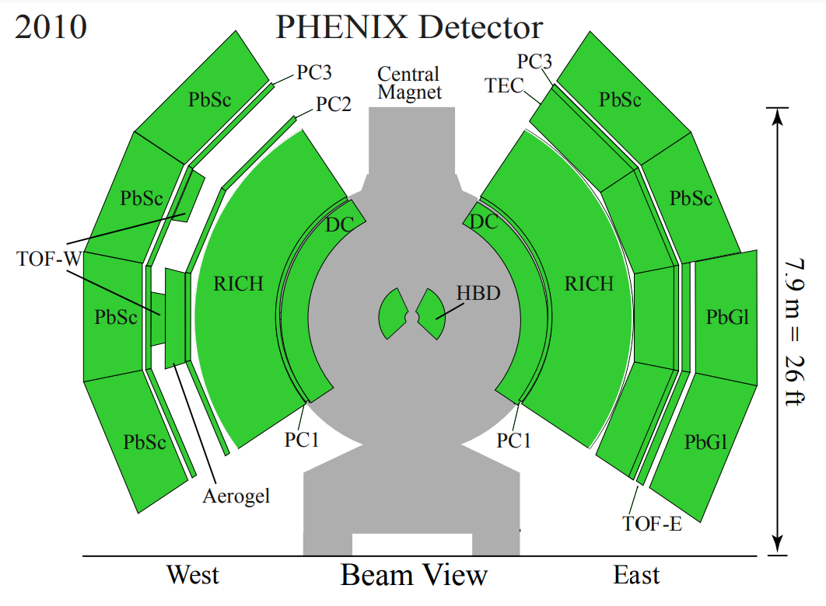
THE PHENIX Detector - 2010
For PHENIX Heavy Ion overview,
T. Novák’s talk at ICNFP’24
Central Arm detectors
DC: Drift Chamber
PC1 – PC3: PAD Chamber
PbSc: EM Cal
PbGl: EM Cal
HBD: Hadron Blind Det
(half magnetic field in CM)
Not shown:
BBC, ZDC: centrality
3

Slide 4
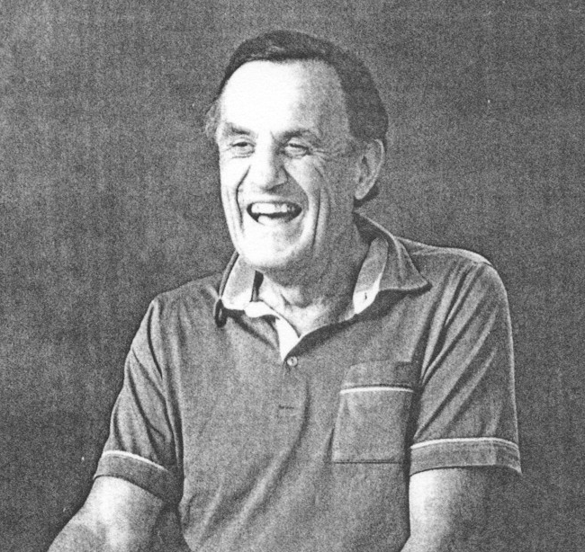
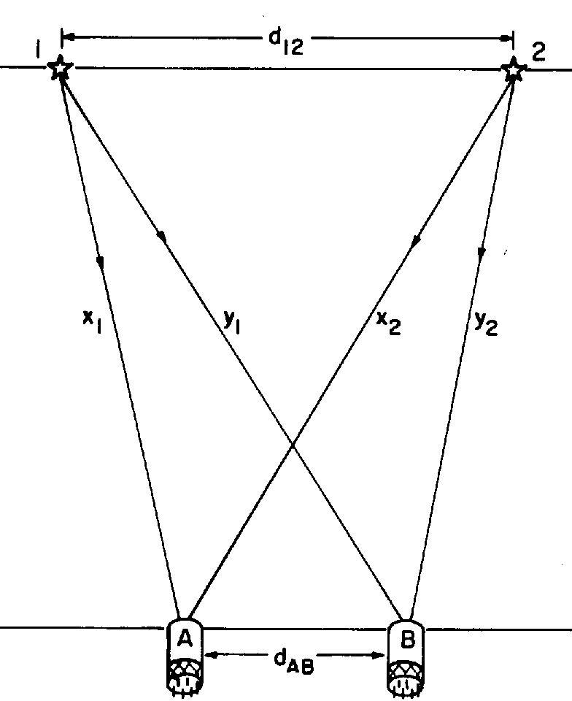
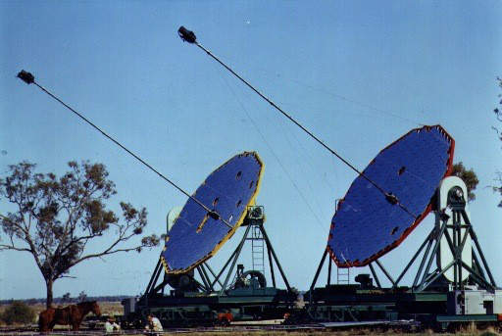
HBT: Robert HANBURY BROWN – Richard Quentin TWISS
Two people: Robert Hanbury Brown and Richard Quentin Twiss
– Robert, Hanbury as well as Richard and Quentin: can be given names, but…
– Sir Robert Hanbury Brown had a compound family name…
R. Hanbury Brown and R. Q. Twiss: Engineers, who worked in radio and optical astronomy
„Interference between two different photons can never occur.”
P. A. M. Dirac, The Principles of Quantum Mechanics, Oxford, 1930
„As an engineer my education in physics had stopped far short of the quantum theory.
Perhaps just as well … ignorance is sometimes a bliss in science.”
R. H. Brown: Boffin: A Personal Story … ISBN 0-7503-0130-9
In particle physics: GGLP effect (Goldhaber, Goldhaber, Lee, Pais) discovered independently,
Explanation: Bose-Einstein statistics of pions
Two particle Bose-Einstein/HBT:
C₂(q) = 1 + positive-definite term
1+ |Fourier–transform of the source|²,
Usually evaluated in
Gaussian approximation
Dubna school: use it as a tool
Kopylov, Podgoretskii, Lednicky:
x <-> k
C₂ = 1 + |Fourier–transform source|²
4

Slide 5
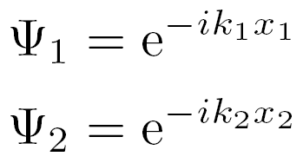
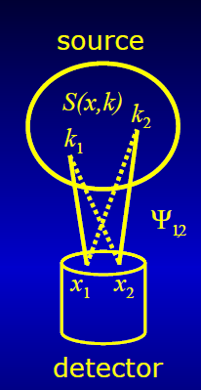




Introduction to Bose-Einstein or HBT correlations
Two plane waves
Symmetrized, + for bosons, - for fermions
Expansion dynamics, final state interactions, multiparticle symmetrization effects: negligible
Two particle HBT correlations, typically, but needs cross-checks:
C(q) = 1 + positive-definite term
C(q) = 1+ |Fourier–transform of the source|²,
Earlier: evaluated in Gaussian approximation
Dependence on mean momentum:
expansion dynamics ρ(x) → S(x,k)
Dubna school: use it as a tool
Kopylov, Podgoretskii, Lednicky: x <-> k
1+ |Fourier–transform of the source|²
5

Slide 6
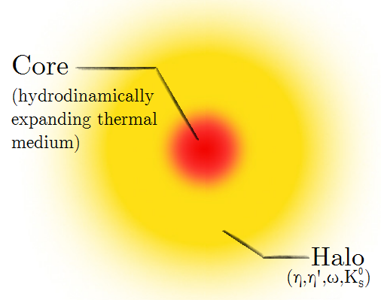
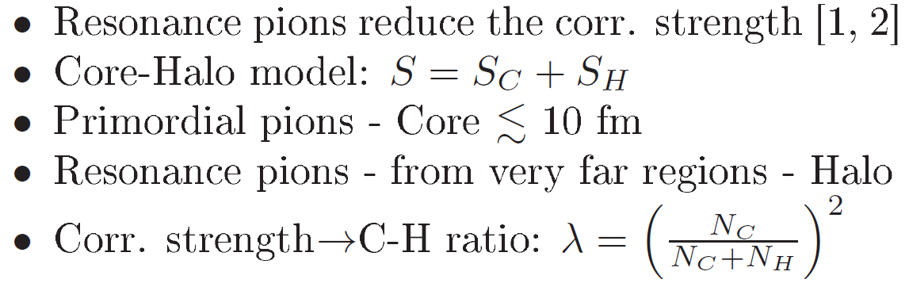

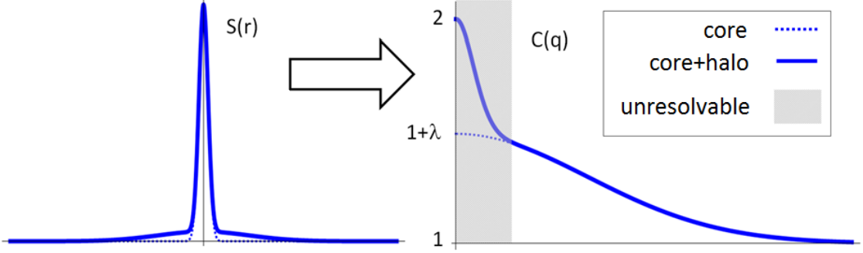
Core/halo model, long-lived resonances
Variance: halo dominated!
Precise measurement of λ important !
Precise measurement of λ is
based on extrapolation to Q = 0,
needs precise measurement
of the shape of C(q):
→ Levy expansion
[1] J. Bolz et al: Phys.Rev. D47 (1993) 3860-3870
[2] T. Cs, B. Lörstad, J. Zimányi: hep-ph/9411307, Z.Phys. C71 (1996) 491-497
6

Slide 7

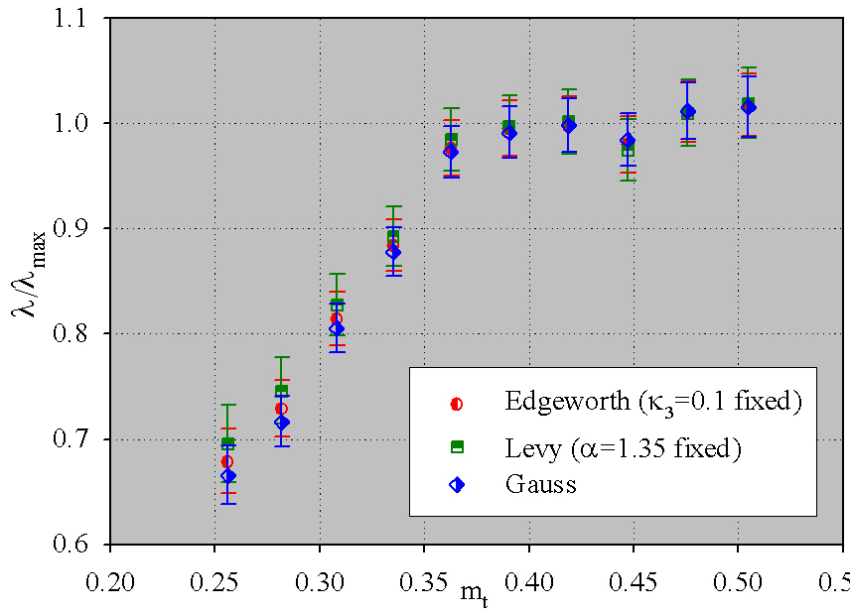
M. Csanád for PHENIX Collaboration,
arXiv:nucl-ex/0509042:
/ λ_{max} is independent of
the method of extrapolation
of C₂(q) to q = 0
7

Slide 8
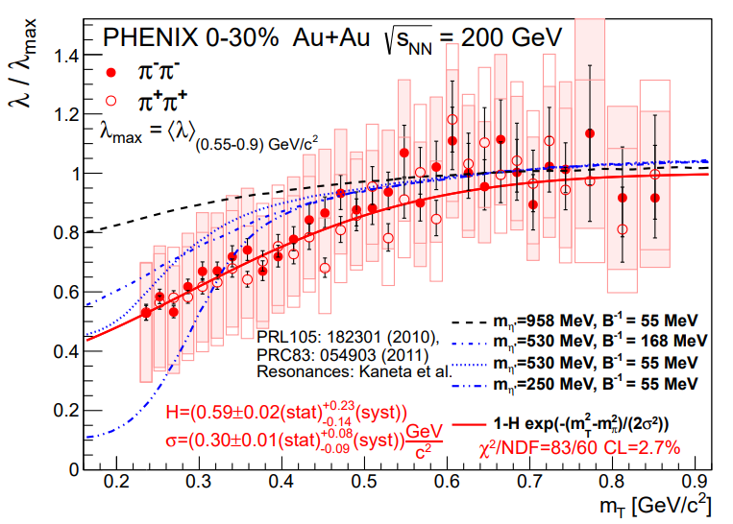
U_{A}(1) symmetry restoration: Can We turn it ON/off?
Is it centrality dependent?
PHENIX data + Monte Carlo simulations, PHENIX Phys. Rev. C 97 (2018) 064911:
0-30 % Au+Au @ 200 GeV Levy Bose-Einstein is sensitive to in-medium mass modification of η’
8

Slide 9
DATA SAMPLE
√s_{NN} = 200 GeV Au+Au collisions, half field in PHENIX central magnet
allows pion id down to transverse momentum p_{T} > 0.16 GeV.
Min. bias data sample ~ 7.3 billion events.
0 – 60 % centrality selection ~ 4.4 billion events.
Centrality vs N_{part} determination with PHENIX Glauber calculations.
Similar single track selections as in earlier 0 – 30 % central results,
published in Phys. Rev. C 97 (2018) 064911.
Six centrality classes:
0-10%, 10-20%, 20-30%, 30-40%, 40-50% and 50-60%
In each centrality class:
23 bins in m_{T} = √(m² + p_{T}²), from 0.248 GeV to 0.876 GeV
Due to broader central range, more stringent pair cuts,
as compared to our 0-30 % results
published in Phys. Rev. C 97 (2018) 064911. Other details similar.
9

Slide 10
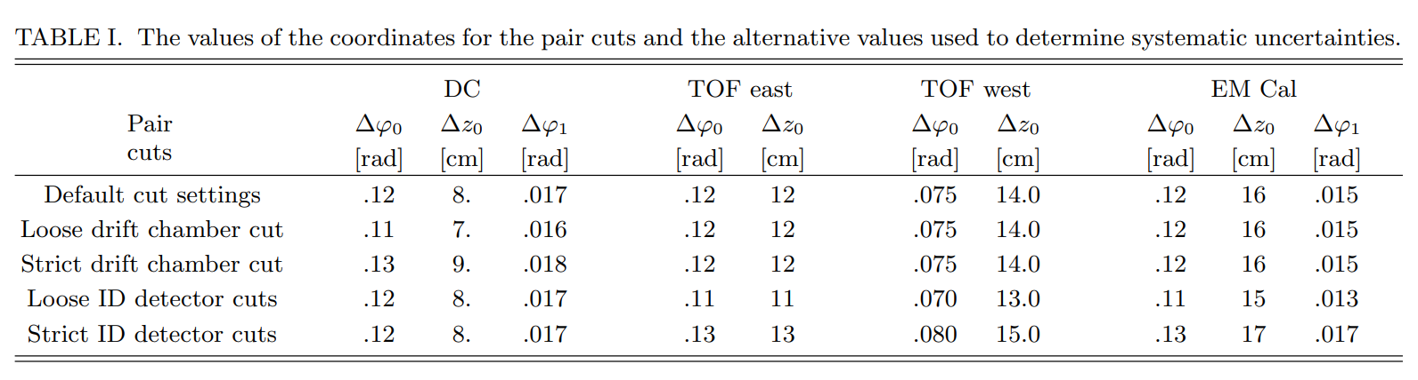
NEW PAIR CUTS and systematic errors
Systematic errors fully propagated to the very end
of this analysis chain:
Cross-checks with three alternative syst error calculation methods.
Most conservative estimate of the systematic errors is shown.
Correlated error propagation is taken into account.
Improvements in Coulomb corrections not detailed in this talk due to time limitations.
10

Slide 11

FITTING FUNCTION: LEVY SHape
Cs. T., S. Hegyi, W. A. Zajc, nucl-th/0310042
Approach: we do not know the shape a priori.
Precise measurement of the intercept λ needed:
λ has important physical meaning.
Is it Gaussian? Maybe, test if α = 2, or not.
Check also with Edgeworth and Gauss expansion.
Is it exponential? Maybe, test if α = 1, or not.
Check also with Laguerre expansion.
Is it Levy? Maybe, test the fit quality.
We used Levy expansion. First order corrections are consistent with 0.
In every step of this analysis:
Fits represent data, p-value or confidence level (CL) > 0.1% required.
11

Slide 12
m_{T} and centrality dependent results
12

Slide 13
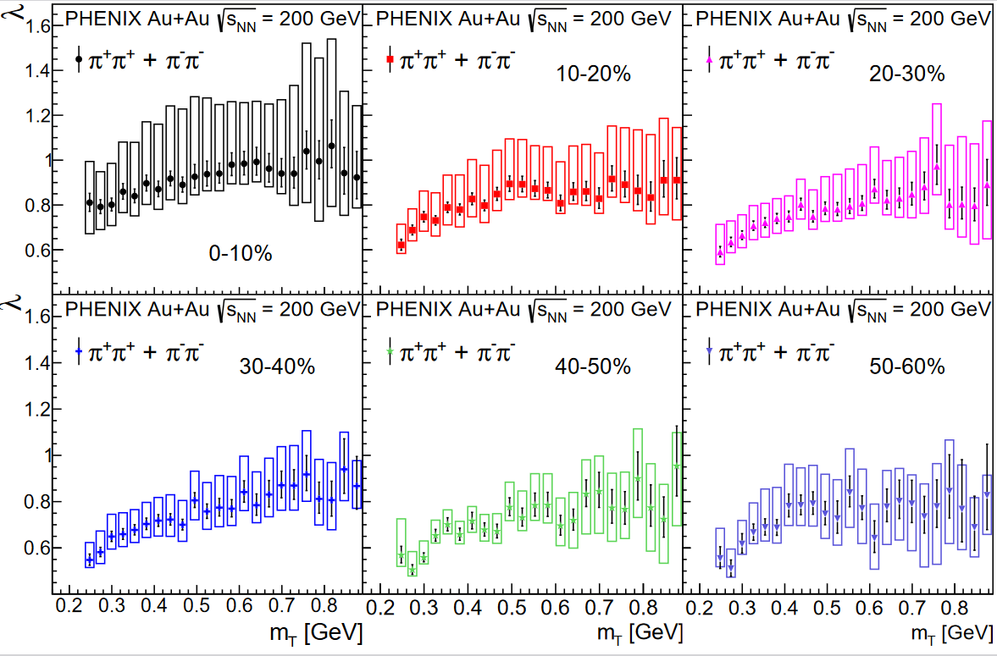
m_{T} and centrality dependence of LéVY λ
Results for Levy λ
saturation at large m_{T}
and
suppression at low m_{T}
In each
centrality CLASS
Saturated region:
0.45 ≤ m_{T} ≤ 0.9 GeV
average value: λ_{max}
13

Slide 14
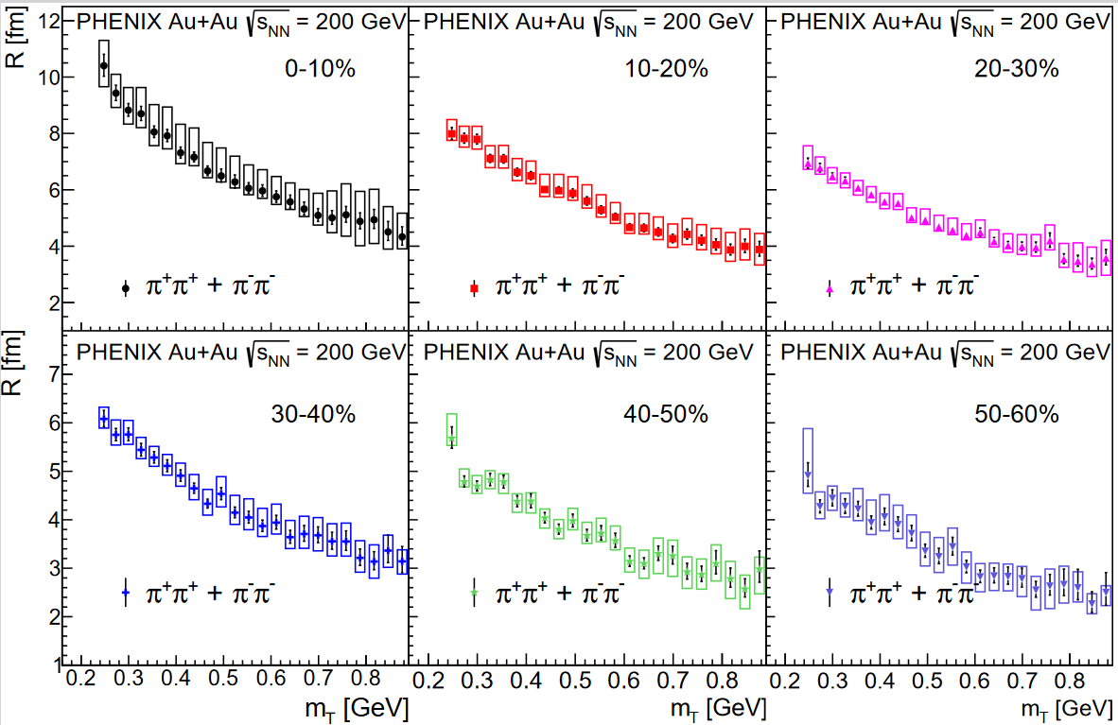
m_{T} and centrality dependence of LEVY R
Results for Levy R
monotonic decrease
with increasing m_{T}
In each
centrality CLASS
14

Slide 15
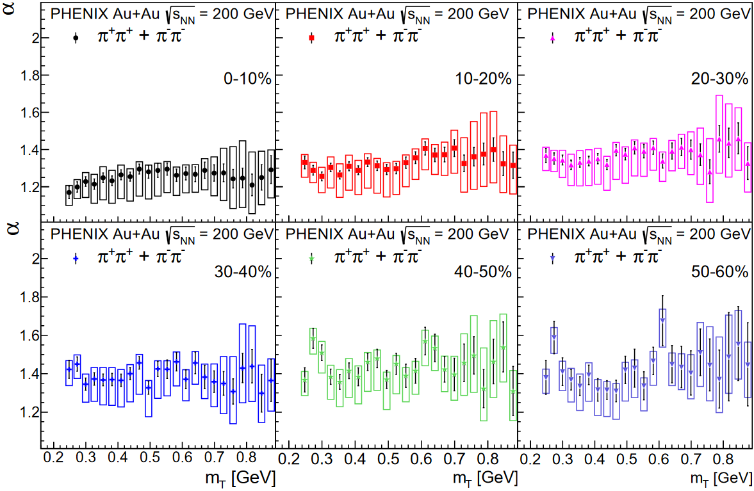
m_{T} and centrality dependence of LéVY α
Results for Levy α
m_{T} independent
constant α₀ value
In each
centrality CLASS
15

Slide 16
PARAMETERIZATION OF m_{T} dependenCE
16

Slide 17
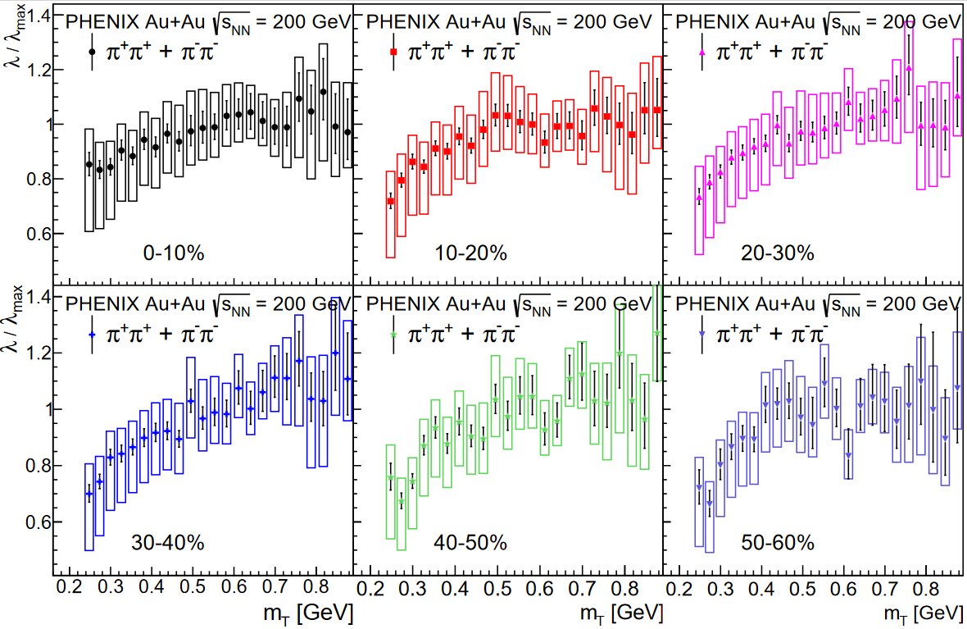
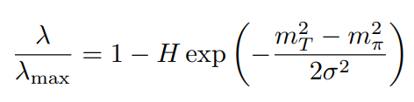
m_{T} dependence of LéVY λ/ λ_{max}
0.45 ≤ m_{T} ≤ 0.9 GeV
saturated value: λ_{max}
Scale it out!
Results for λ / λ_{max}
Unexpected, centrality independent scaling
In each
centrality CLASS
Values of
and H are expected to be independent of centrality
17

Slide 18
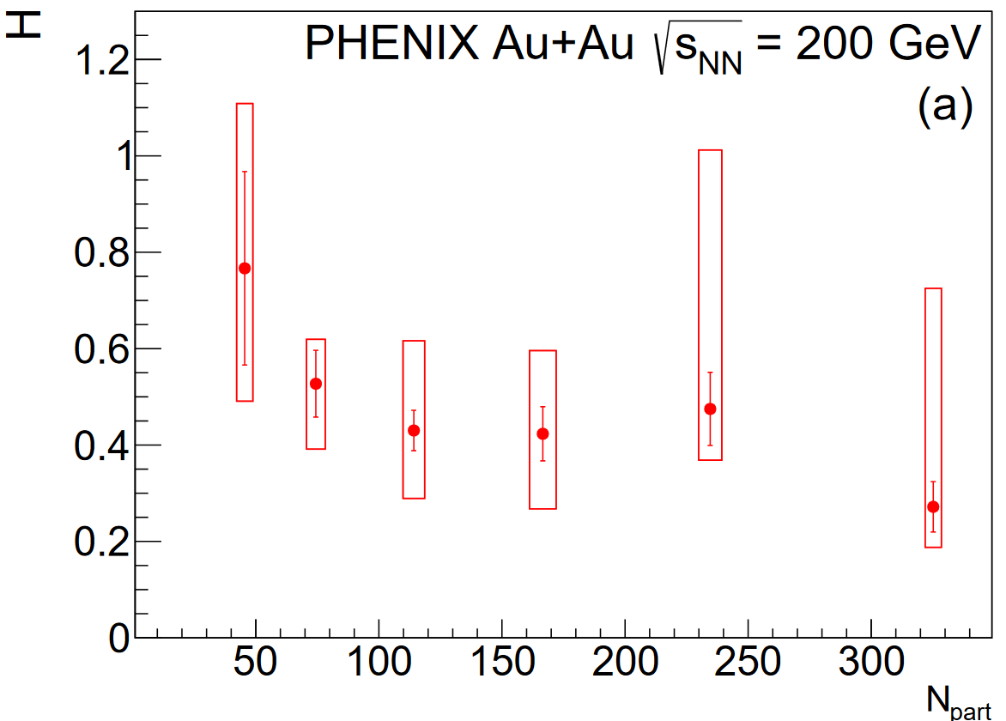
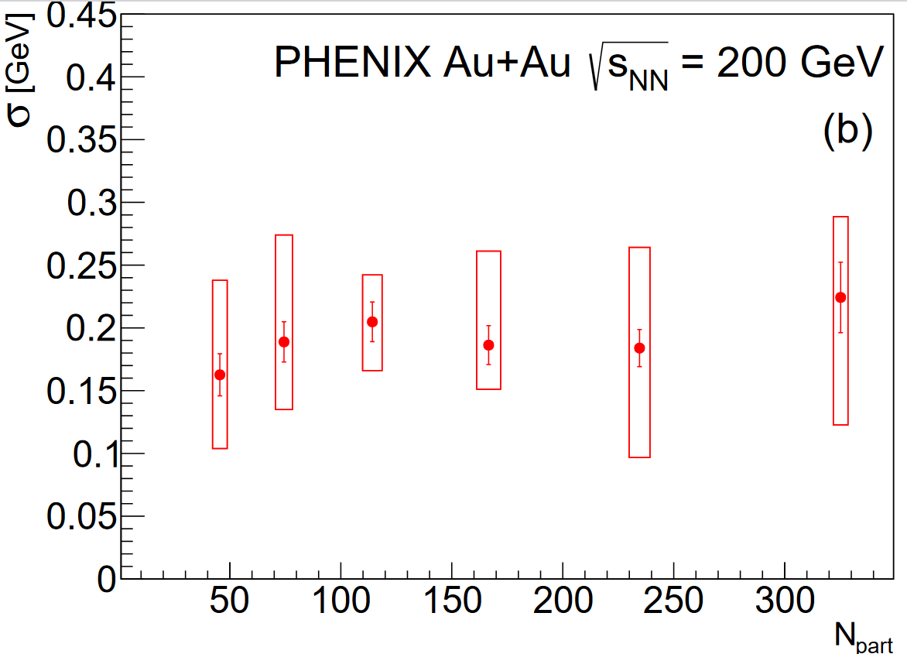
CENTRALITY dependence of σ and H
Values of σ and H are (within errors) independent of centrality, with a CL > 0.1 %
18

Slide 19
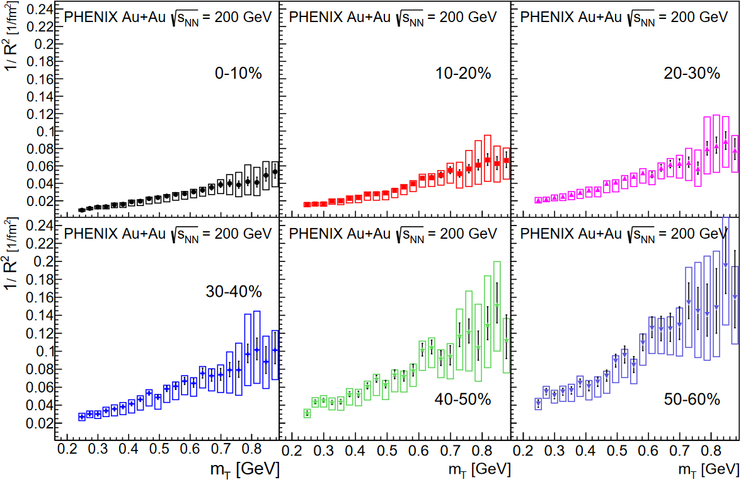
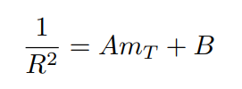
m_{T} dependence of LéVY 1/R²
Analytic hydro predicts for α = 2 :
1/R² = A m_{T} + B
UnexpectedLY,
1/R² scaling
Holds also for
α < 2
In each
centrality CLASS
Values of A and B are expected to be centrality dependent
19

Slide 20
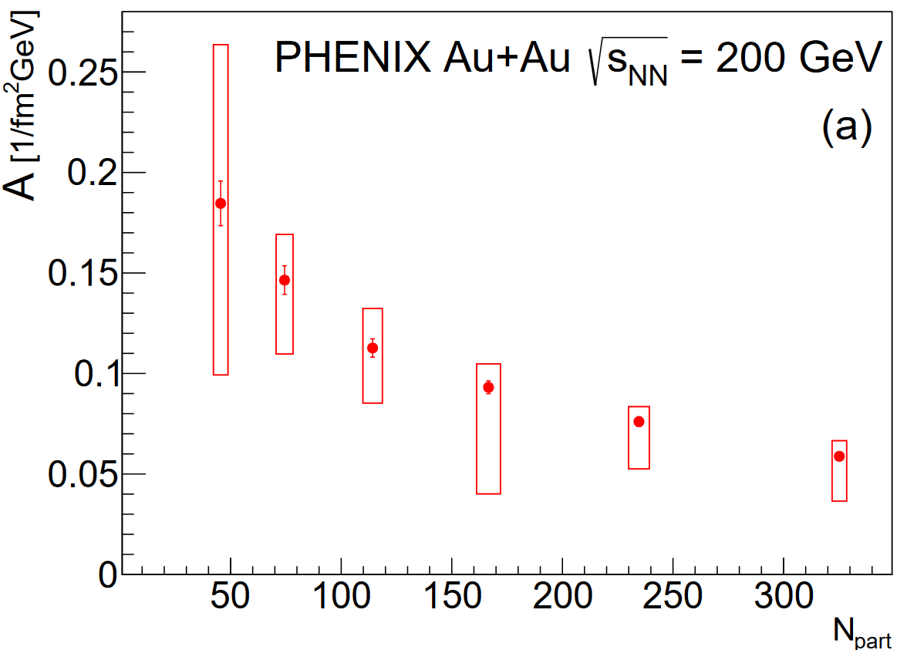
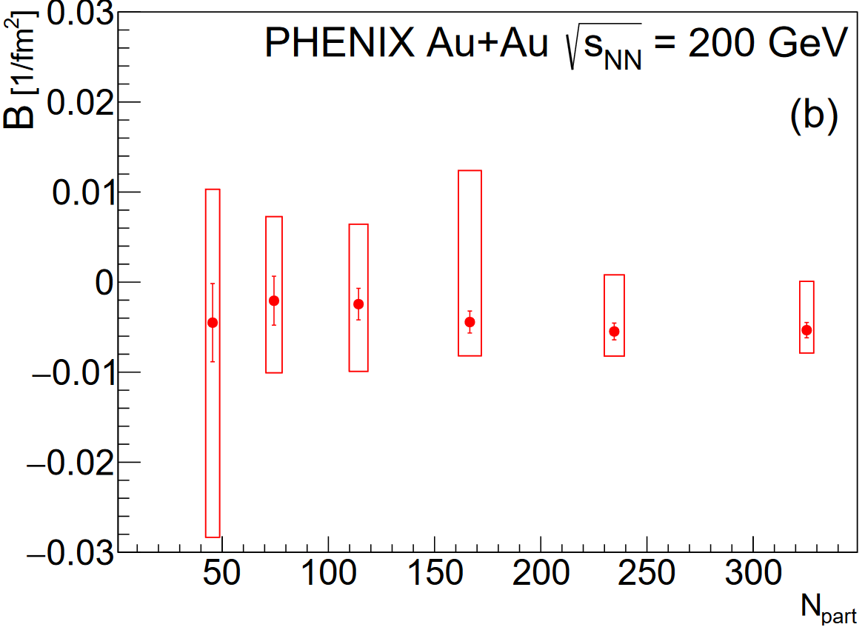
CENTRALITY dependence of a And B
Values of A decrease for more central collisions: R increases with centrality
B are (within errors) nearly vanishing, suggesting large geometrical size
and a possible Cooper-Frye effect
20

Slide 21
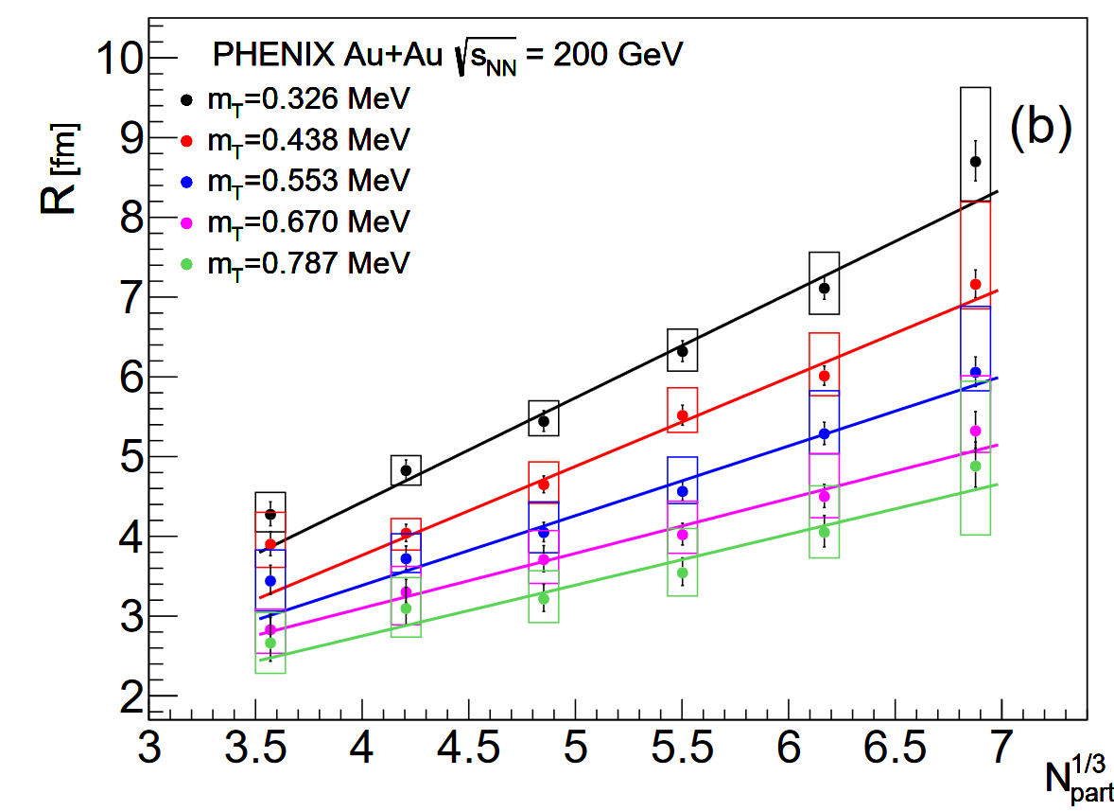

N_{part} dependence of LeVY R
Levy scale R
in selected m_{T} bins
Affine linear in N_{part}^{1/3}
Volume of the Levy source
V ~ R³ ~ N_{part}
Similarly, volume of a Gaussian source
V ~ R³_{G} ~ N_{part}
in each centrality class
PHENIX,
Phys.Rev.Lett. 93 (2004), 152302
21

Slide 22
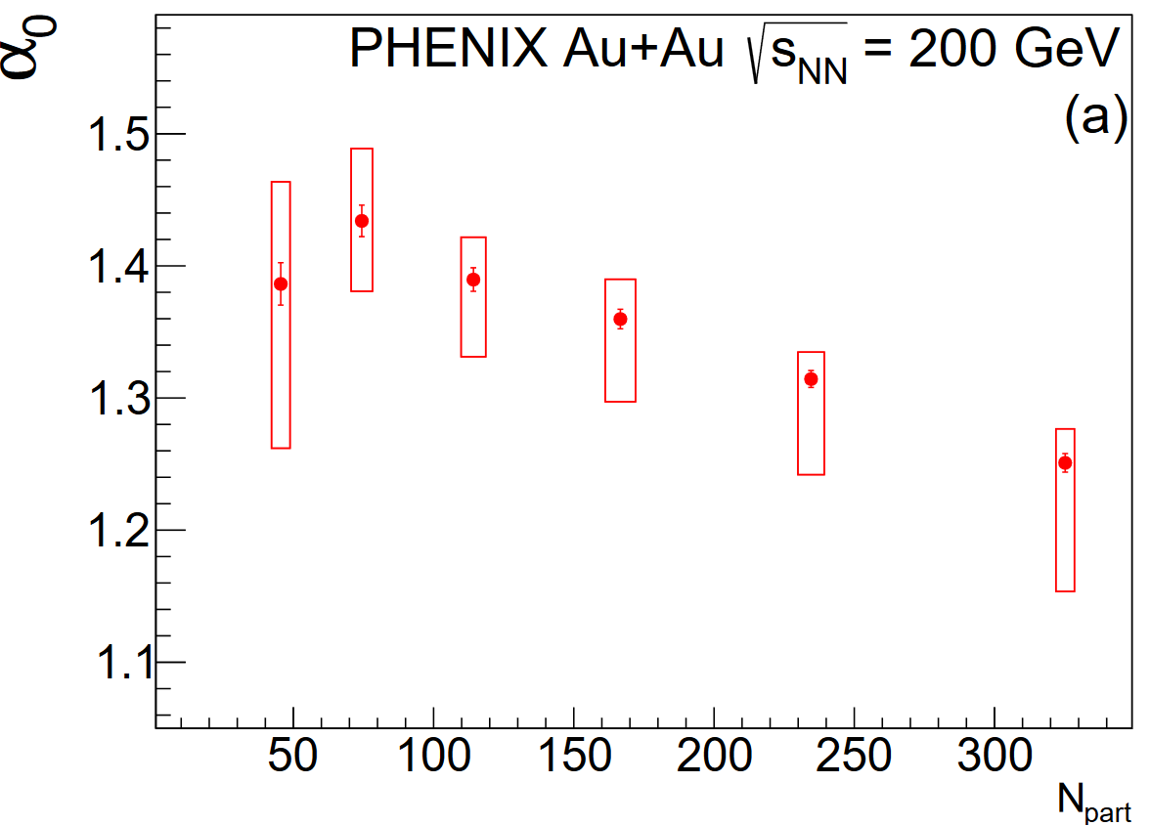
N_{part} dependence of LEVY α₀
Levy fits
1 < α₀ < 2
Far from 1: not exponential
Far from 2: not Gaussian
in any centrality class
α₀ decreases with increasing N_{part}
Comparison with kaons and protons needed
22

Slide 23
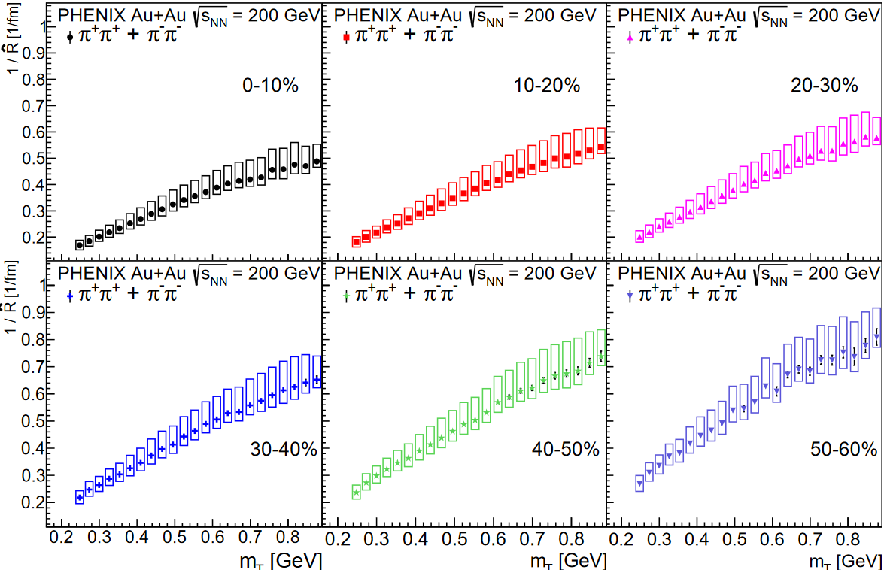
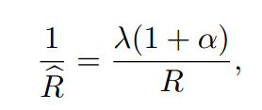
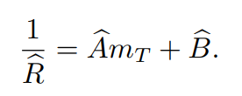
m_{T} and centrality dependence of $\hat{R}$
An unexpected scaling law was found by PHENIX in
Phys. Rev. C 97 (2018) 064911,
√s_{NN} = 200 GeV Au+Au, in
0-30 % centrality class:
NOW it is seen
IN EACH
centrality CLASS
- challenge for theory
Part of systematics cancel,
less correlated as λ, R and α
23

Slide 24
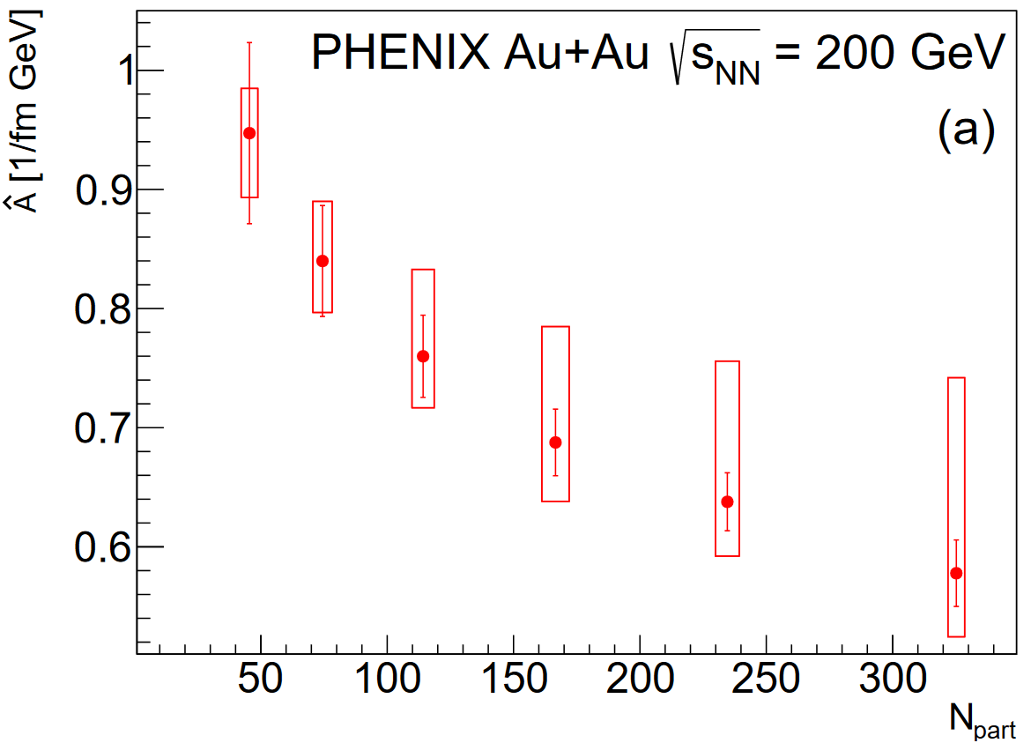
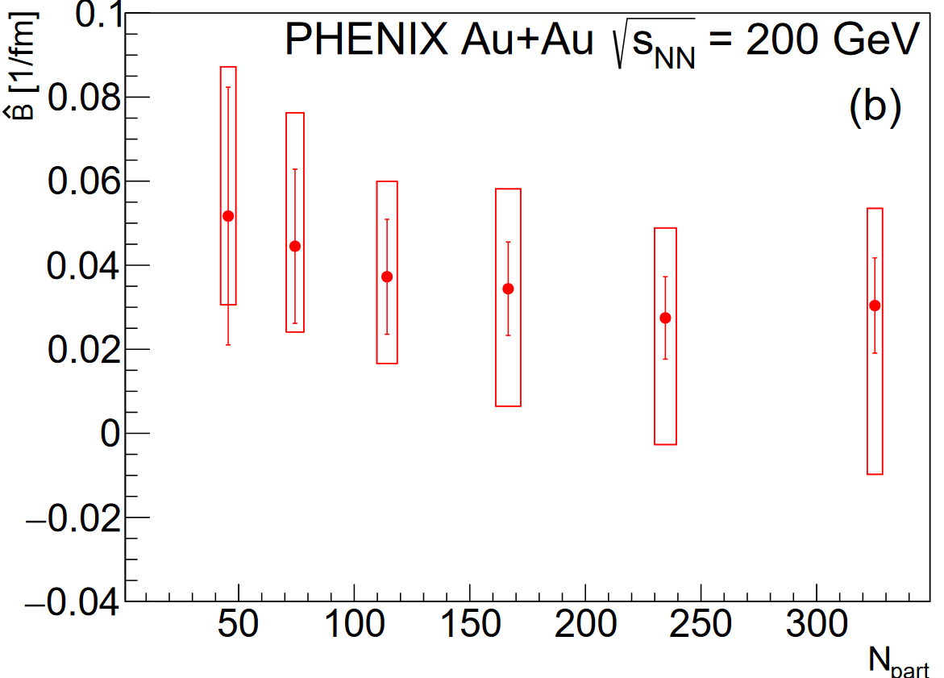
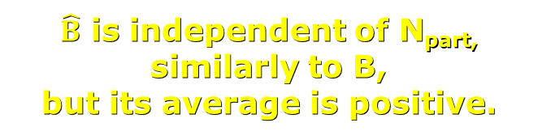
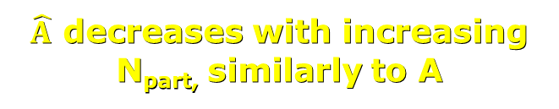
N_{part} dependence of $\hat{A}$ AND $\hat{B}$
$\hat{A}$ decreases with increasing N_{part,} similarly to A
$\hat{B}$ is independent of N_{part,} similarly to B,
but its average is positive.
24

Slide 25
COMPARISON WITH MONTE-CARLO SIMULATIONS:
Search for U_{A}(1) symmetry restoration
25

Slide 26
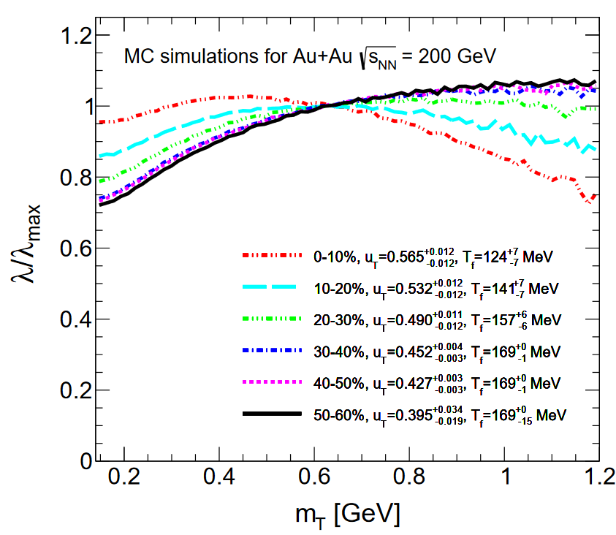
MONTE-CARLO SIMULATIONS FOR LéVY λ/ λ_{max}
Simulations
without
in-medium η’ mass modification
MC results indicate
Expected
and monotonic
centrality dependence
An interplay of radial flow and
resonance chain decay effects.
η’ →
η + π⁺ + π⁻ →
(π⁺ + π⁻ + π⁰ ) + π⁺ + π⁻
26

Slide 27
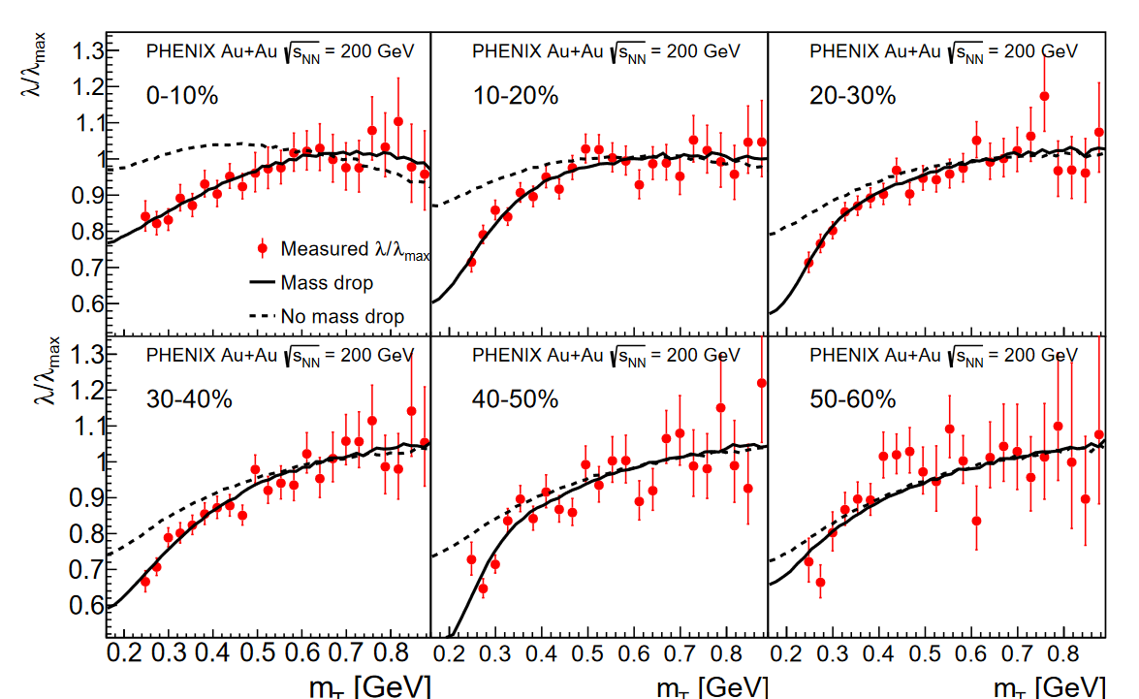
MONTE-CARLO SIMULATIONS FOR LéVY λ/ λ_{max}
Scale out saturated value of λ at large m_{T}
Results for λ / λ_{max}
Simulations with and without
In-mEDIUM η’ mass modification
in each
centrality CLASS
THERMAL model (SHARE) for resonance production, T_{chem} and μ_{B} values from STAR. K⁺, K⁻, p and anti-p spectra fitted.
Resonance chain decays included.
27

Slide 28
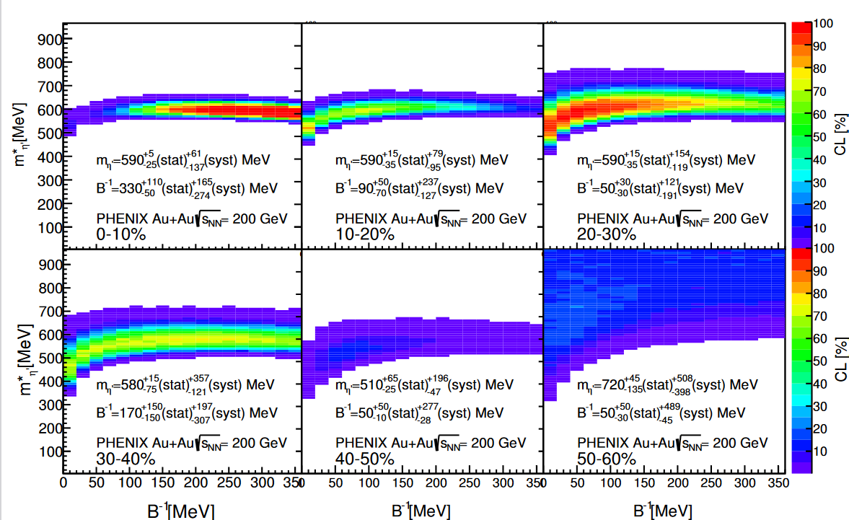
χ²/NDF and CL (or p-value) maps FOR LéVY λ/ λ_{max}
Maps out allowed regions and best values of
In-mEDIUM η’ mass modification
in each
centrality CLASS
Colored region:
allowed with
CL > 0.1 %
Selective, except
in 50-60 %
centrality class
28

Slide 29
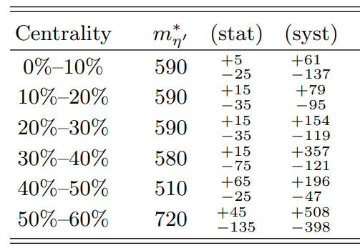
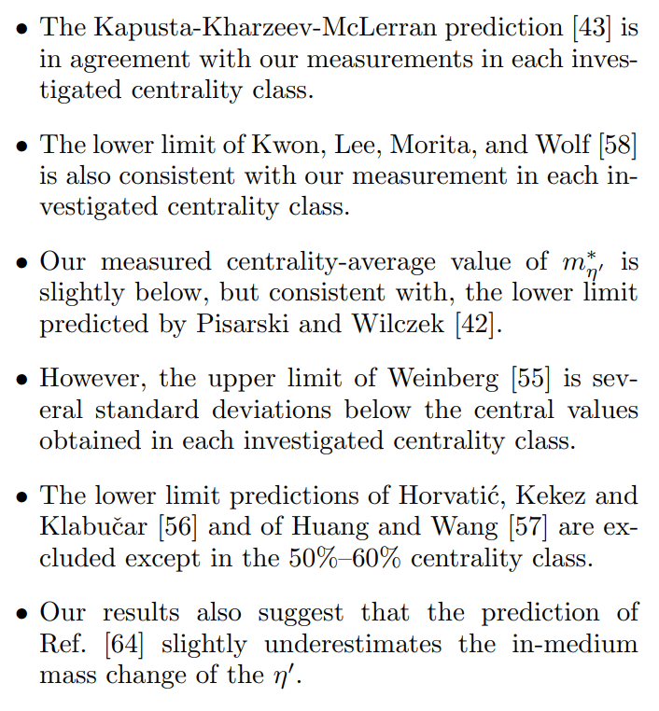
CENTRALITY dependence of in-MEDIUM MASS OF η’
In-medium mass of η’ determined indirectly
from Levy Bose-Einstein correlations.
Similar to the vacuum mass of η (548 MeV)
in each centrality class!
Lower, than the vacuum mass of η’ (958 MeV)
except the 50-60% centrality class!
29

Slide 30
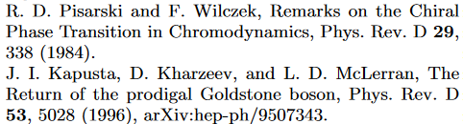
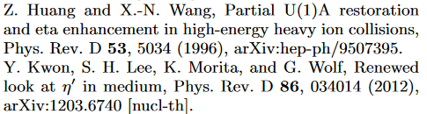
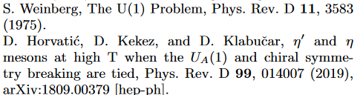

CENTRALITY dependence of in-MEDIUM MASS OF η’
In-medium mass of η’ determined indirectly
from Levy Bose-Einstein correlations.
Similar to the vacuum mass of η (548 MeV)
in each centrality class!
Lower, than the vacuum mass of η’ (958 MeV)
except the 50-60% centrality class!
30

Slide 31
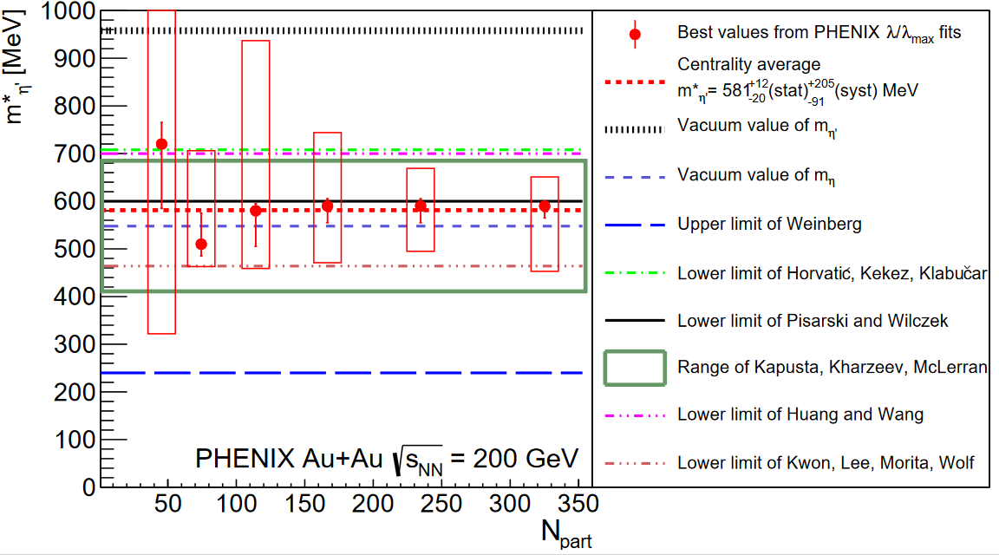
N_{part} dependence of in-MEDIUM MASS OF η’
In-medium mass of η’ is determined with the help of Levy Bose-Einstein correlation measurements and Monte-Carlo simulations to be similar to the vacuum mass of η
in each centrality class: indirectly, return of the prodigal Goldstone boson η’
Centrality dependent selection power, successful: KHM, KLMW, PW: m*(η’) ~ m(η)
31

Slide 32
SUMMARY AND CONCLUSIONS
Centrality dependent Levy stable Bose-Einstein correlations
in √s_{NN} = 200 GeV Au+Au collisions by PHENIX
1 < α < 2 singificantly,
decreasing with increasing N_{part}
Unexpected scaling laws found
Data not inconsistent with U_{A}(1) symmetry restoration:
In-medium mass modification of η’ with indirect method
Direct observation e.g. η’ → γ + γ
is particularly challenging
but also particularly rewarding:
Challenge for sPHENIX?
32
32

Slide 33
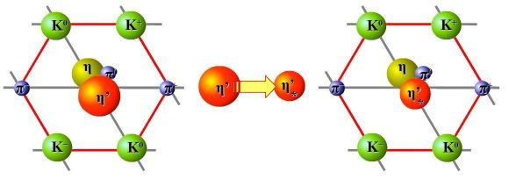
Thank you for your attention!
Questions?
Partially supported by NKFIH and MATE KKP FRG, Hungary
and by the PHENIX funding agencies and organizations listed at https://www.bnl.gov/rhic/phenix.php
33
33

Slide 34
BACKUP SLIDES
34

Slide 35
THE PHENIX Detector @ RHIC – side view
Muon Magnets followed by
Muon Arm Detectors
MuTr: Muon Tracker
MuID: Muon Identification
For centrality in Au+Au:
BBC: Beam to Beam Counter
ZDC: Zero Degree Calorimeter
35

Slide 36
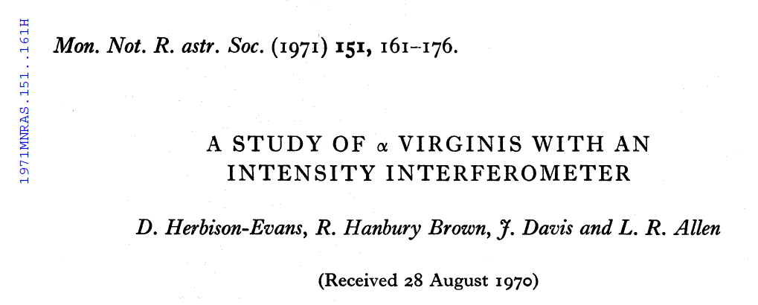
Hanbury Brown: a family name
Grandfather: Sir Robert Hanbury Brown, K.C.M.G., a notable irrigation engineer (Wiki link)
Father: Basil Hanbury Brown
Twin sons:
Robert Hanbury Brown
Jordan Hanbury Brown
Daughter:
Marion Hanbury Brown
„It is not all that unusual that an English last name is a compound one, with or without a hyphen.”
Wes Metzger
Thank you Wes!
For private communications on the family tree of Sir Robert Hanbury Brown
36

Slide 37
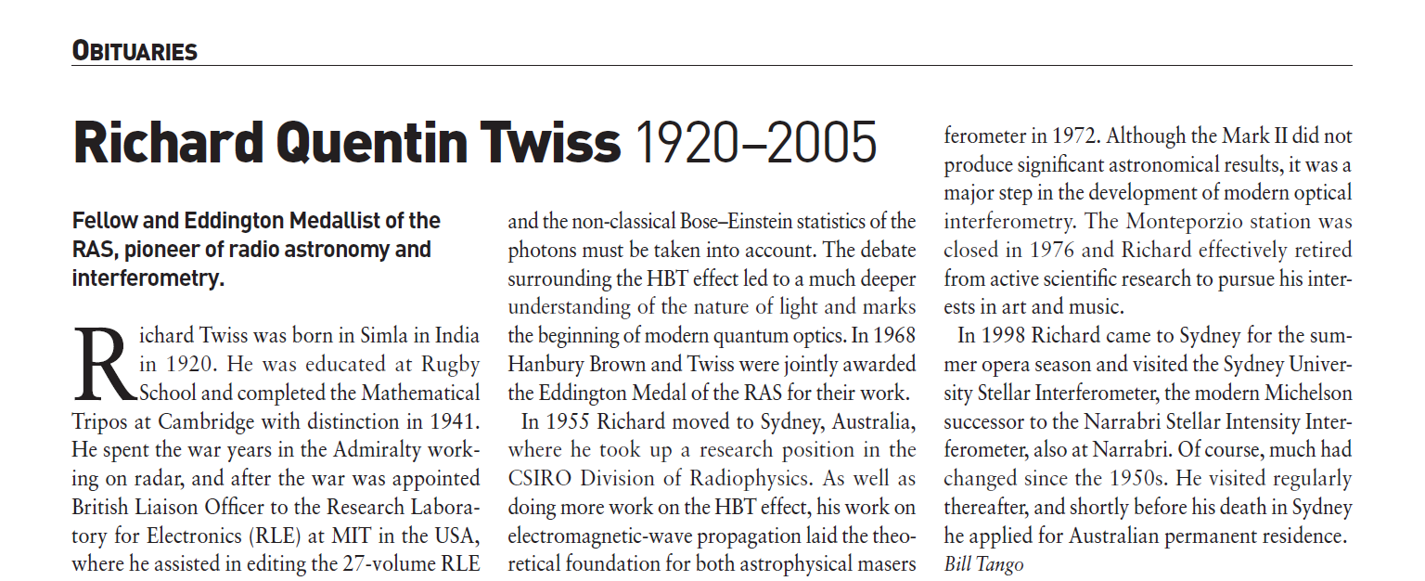
R. Q. Twiss: Richard Quentin TWISS
Reference:
Bill Tango: Richard Quentin Twiss (1920-2005), A&G vol 47, p. 4.38 (2006)
Apologies:
For my earlier mistaken communications on resolving „Q.” in Richard Quentin Twiss
37

Slide 38







HBT: „Has to be a Gaussian”, IF …
Model-independent but Gaussian IF we assume:
1 + positive definite forms
Plane wave approximation
Two-particle symmetrization (only)
IF f(q) is analytic at q = 0 and
IF means and variances are finite
Follows an approximate Gaussian(α = 2)
Model-independent but non-Gaussian IF we assume:
1 + positive definite form (same as above)
Plane wave approximation (same)
Two-particle symmetrization only (same)
IF f(q) is NOT analytic at q = 0 and
IF means and variances are NOT finite
IF Generalized Central Limit theorems are valid
Follows a Levy shape( 0 < α ≤ 2)
Earlier Gaussian recovered for α = 2
Cs. T, S. Hegyi, W. A. Zajc, nucl-th/0310042
38

Slide 39
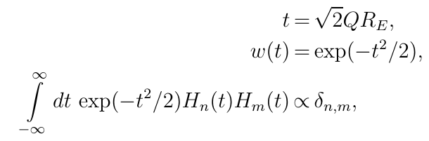
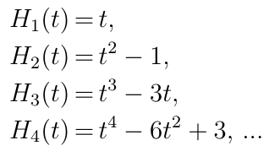
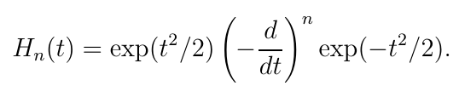
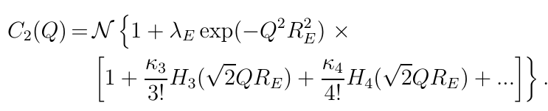
Edgeworth expansion method
Gaussian w(t), -∞ < t < ∞
3d generalization straightforward
Applied by NA22, L3, STAR, PHENIX, ALICE, CMS
39

Slide 40
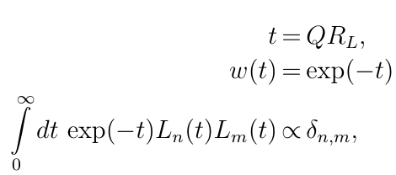




Laguerre expansion method
Model-independent but experimentally tested:
  w(t): Exponential
  0 < t < ∞
  Laguerre polynomials
First successful tests
  on NA22, UA1 data , convergence criteria satisfied
  Intercept: λ* ~ 1
40

Slide 41
Gauss expansion method
Gaussian w(t), 0 ≤ t < ∞
Provides a new expansion around a Gaussian shape
that is defined for the non-negative values of t only.
Edgeworth expansion is different from this:
Edgeworth is around two-sided Gaussian,
includes negative values of t also.
arXiv:1604.05513 [physics.data-an]
41

Slide 42





Levy expansions for 1+ positive definite forms
Model-independent but:
Generalizes exponential (α =1) and Gaussian(α = 2)
In this case, for 1+ positive definite forms
ubiquoutous in nature
How far from a Levy?
Works also for in elastic pp scattering
In 200 GeV Au+Au, 1st order corrections vanish
T. Novák, T. Cs., H. C. Eggers, M. de Kock: arXiv:1604.05513
T. Cs., R. Pasechnik, A. Ster: arXiv:1807.02897 [hep-ph]
42

Slide 43


Interpretation of λ
PHENIX preliminary data from arXiv:1610.05025
Method: S. Vance, T. Cs., D. Kharzeev: PRL 81 (1998) 2205-2208 , nucl-th/9802074
Predictions: Cs. T., R. Vértesi, J. Sziklai, arXiv:0912.5526 [nucl-ex] arXiv:0912.0258 [nucl-ex]
43

Slide 44


Interpretation of α
Prediction: at QCD CEP, α = η_{c} ≤ 0.5 (critical exponent of the correlation function)
T. Cs, S.Hegyi, T. Novák, W.A. Zajc, nucl-th/0512060 T. Cs, arXiv.org:0903.0669
Search for the QCD critical point with α (m_{T}, √s, %, …)
44

Slide 45


HBT: Interpretation of R
Possibility: hydro scaling behaviour of R at low m_{T}
Hubble ratio of Big Bang and Little Bangs ~ 10⁴⁰ (α = 2, centrality dependence, …)
M. Csanád, T. Cs, B. Lörstad, A. Ster, nucl-th/0403074
NEEDS generalization for α < 2 !
45

Slide 46



Variables and Coulomb corrections for Levy C₂(Q)
From PHENIX, Phys.Rev.C 97 (2018) 6, 064911 and 2407.08586 [nucl-ex]
For recent results on Coulomb corrections for a Levy source, see:
M. Nagy, A. Purzsa et al, Eur.Phys.J.C 83 (2023) 11, 1015, arXiv:2308.10745 [nucl-th]
For a recent review on Levy Bose-Einstein correlations in heavy ions:
M. Csanád and D. Kincses, Universe 10 (2024) 2, 54, arXiv:2401.01249 [hep-ph]
46

Slide 47




Quality plot for Levy fits of C₂(Q)
$$λ$$
$$α$$
$$R$$
√s_{NN} = 200 GeV 0-30 % Au+Au collisions, from Phys.Rev.C 97 (2018) 6, 064911
Note the good fit quality, p-value or CL > 0.1 %
47

Slide 48

CENTRALITY DEPENDENCE OF B_{η’}⁻¹
Cold source in 10-60 % centrality: very low B_{η’}⁻¹ or effective temperature of in-medium modified η’ mesons,
from the shape of suppression λ(m_{T})/λ_{max} .
48

Slide 49






Levy C(Q) for kaons: no U_{A}(1), but new m_{T} scalings
PHENIX preliminary, charged KK correlations, √s_{NN} = 200 GeV min bias Au+Au:
λ(KK) ~ λ_{max}(ππ), no λ(KK)/λ_{max} signal for U_{A}(1), as expected.
α(KK) ~ α(ππ): no anomalous diffusion??
L. Kovács for the PHENIX Collaboration, Universe 2023, 9(7), 336 , arXiv:2307.09573 [nucl-ex]
49

Slide 50








HBT: Two-particle symmetrization, chaotic source
- or not ? Partial coherence: 3 vs 2 particle correlations
arXiv:0604021: R. J. Glauber noted that partial coherence may be present, but swamped in a large background. Check it with three-particle vs two-particle Bose-Einstein correlations!
Three-body Coulomb correction in Riverside approximation,
domain of validity checked.
PHENIX preliminary data on three-pion Bose-Einstein: A.Bagoly, poster at QM17 Partial coherence measurement possible!
B. Kurgyis for the PHENIX Collaboration, Phys.Part.Nucl. 51 (2020) 3, 263-266, arXiv:1910.05019 [nucl-ex]]
50

Slide 51



HBT: Two-particle symmetrization, chaotic source
- or not ? Partial coherence: 3 vs 2 particle correlations
PHENIX preliminary data on three-pion Bose-Einstein: A.Bagoly, poster at QM17 Partial coherence measurement possible!
B. Kurgyis for the PHENIX Collaboration, Phys.Part.Nucl. 51 (2020) 3, 263-266, arXiv:1910.05019 [nucl-ex]]
51

Slide 52

HBT: Two-particle symmetrization, chaotic source
- or not ? Partial coherence: 3 vs 2 particle correlations
κ₃ ~ 1
within errors
→
No signal for
partial coherence
(p_{c} > 0), so
→
p_{c} cannot mask U_{A}(1)
B. Kurgyis for the PHENIX Collaboration, Phys.Part.Nucl. 51 (2020) 3, 263-266, arXiv:1910.05019 [nucl-ex]]
52

Slide 53

Can λ/λ_{max} U_{A}(1) restoration signal be switched off?
Yes, as known from the first papers!
NA44 data on charged pion Bose-Einstein correlation indicate a null effect in S+Pb at √s_{NN} = 19.4 GeV !
Contrasted to STAR data on charged pion B-E correlation in √s_{NN} = 62 and 200 GeV Au+Au collisions:
suppression signal of U_{A}(1) restoration. R. Vértesi, T.Cs., J. Sziklai , arXiv:2307.09573 [nucl-ex]
53

Slide 54


Can λ/λ_{max} U_{A}(1) restoration signal be switched off?
Yes, as known from the first papers, but confirmed by NA61!
NA61 data: no signal of decrease of λ/λ_{max} for m_{T} < 0.5 GeV, no signal of U_{A}(1) symmetry restoration
Small systems (Be+Be) and relatively low energy, √s < 20 GeV.
NA61 data on charged ππ correlation in 150 AGeV Be+Be collisions
Eur.Phys.J.C 83 (2023) 10, 919, e-Print: 2302.04593 [nucl-ex]
54

Slide 55

Can λ/λ_{max} U_{A}(1) restoration signal be switched off?
NA61:
YES!
NA61 data: no signal of decrease of λ/λ_{max} for m_{T} < 0.5 GeV, no signal of U_{A}(1) symmetry restoration
Small AND intermediate systems (Be+Be and Ar+Sc) and relatively low energy, √s < 20 GeV.
NA61 data on charged ππ correlation in 150 AGeV Be+Be and E_{lab} ≤ 150 GeV Ar+Sc collisions
B. Pórffy for the NA61 Collaboration, e-Print: 2406.022423 [nucl-ex]
55

Slide 56

Is λ(m_{T})/λ_{max} confirmed in √s_{NN} = 200 GeV Au+Au?
STAR
preliminary:
YES!
STAR preliminary, charged ππ correlation in 0-10%, 10-20%, 20-30% and 30-40% Au+Au @ 200 GeV
D. KIncses for the STAR Collaboration, Universe 10 (2024) 3, 102, e-Print: 2401.11169 [nucl-ex]
56

Slide 57

Can λ/λ_{max} U_{A}(1) restoration signal be switched off?
PHENIX preliminary data: qualitatively a of decrease of λ/λ_{max} for m_{T} < 0.5 GeV, but limited statistics!
both at √s_{NN} = 39 and 62 GeV: greater magnetic field, less momentum resolution at low m_{T}
as compared to Run-10 Au+Au data.
57
D. Kincses for the PHENIX Collaboration, Universe 4 (2018) 1, 11, e-Print: 1711.06891 [nucl-ex]

Slide 58

Excitation function of λ(m_{T})/λ_{max} in Au+Au@RHIC BES?
STAR
preliminary:
in 0-10% Au+Au,
λ_{min}/λ_{max}
decreases
with decreasing √s_{NN}
STAR preliminary, charged ππ correlation in 0-10% Au+Au @ 200, 54.4, 27, 19.6, 14.5 and 7.7 GeV
D. KIncses for the STAR Collaboration, Universe 10 (2024) 3, 102, e-Print: 2401.11169 [nucl-ex]
58

Slide 59




HBT: Signals of 3d hydro flow, ONLY for α = 2
Theory challenge for Levy α < 2
Indication of hydro scaling behaviour of Gaussian R(side,out,long) at low m_{T}
R_{long} m_{t}-scaling: Yu. Sinyukov and A. Makhlin: Z.Phys. C39 (1988) 69
R_{side} , R_{out} , R_{long} m_{t}-scaling: T. Cs, B. Lörstad, hep-ph/9509213 (shells of fire vs fireballs)
S. Chapman, P. Scotto, U. W. Heinz, hep-ph/9408207
59

