Slide 1
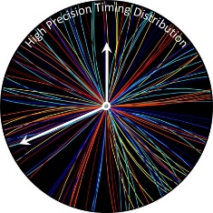

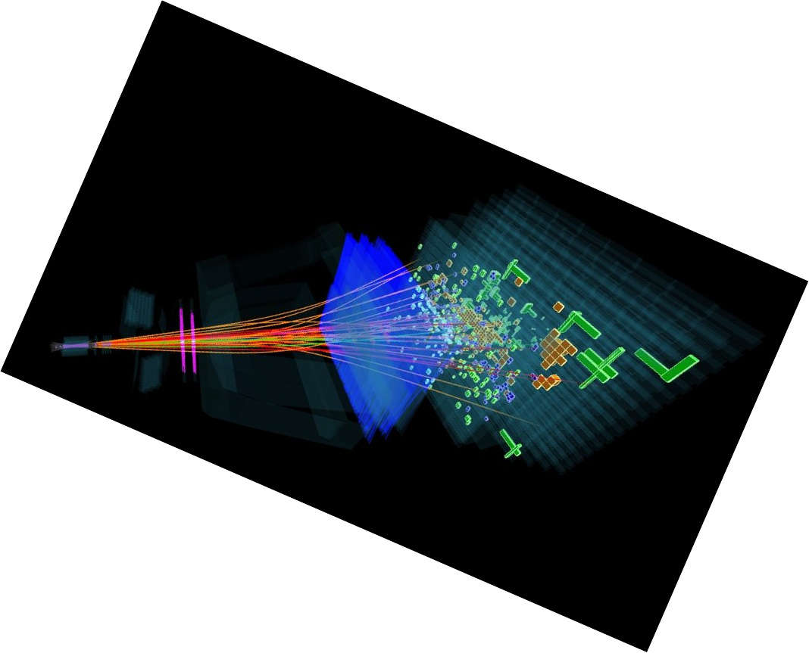


Achieving the Best Timing Performance with a PCIe40
High Precision Timing Distribution
Meeting #17
Mauricio Féo – LHCb Online

Slide 2
Current Clock Distribution at LHCb
Generates Timing and Fast Commands
Provides clock with fixed and deterministic latency
Distributes them to all the detector electronics
  BackEnd cards via TTC-PON (Project link)
  FrontEnd modules via GBT (Project link)
All cards are PCIe40s with different firmwares
LHC clock
Supervisor = SODIN
Control = SOL40
DAQ = TELL40
TFC links
GBT ctrl links
GBT data links
PON
Splitter
Controlled via TFC
42 Control cards
480 DAQ cards
2000 FEE ctrl links
DAQ
PON
Splitter
Control
GBT data links
Readout
Supervisor
LHC clock
VME
clock
crate
clock
GBT ctrl links
FrontEnd
LHC orbit
FrontEnd
orbit
FrontEnd
TFC links
FrontEnds

Slide 3
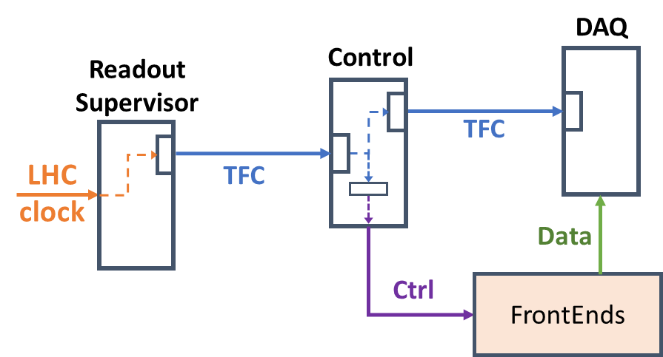
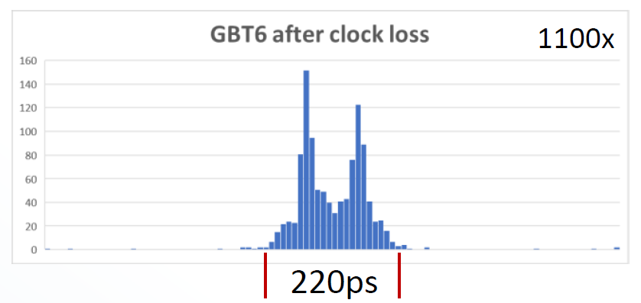
Current Clock Distribution at LHCb
Phase Shift Control
Control card
PCIe40
FPGA
TFC from
Supervisor
SI5345
Jitter Cleaner
PON
Rx
(ONU)
SI5345
Jitter Cleaner
PLL
SYS
clock
Phase shift resolution
Internal PLL | 104ps
Si5345 | 72ps
240
40
240
240
DDMTD
Phase
Monitor
SYS
clock
TFC to
DAQ Cards
40
PON
Tx
(OLT)
40
GBT banks
TFC to FEE
Recovered clock phase at the FEE after a clock loss

Slide 4
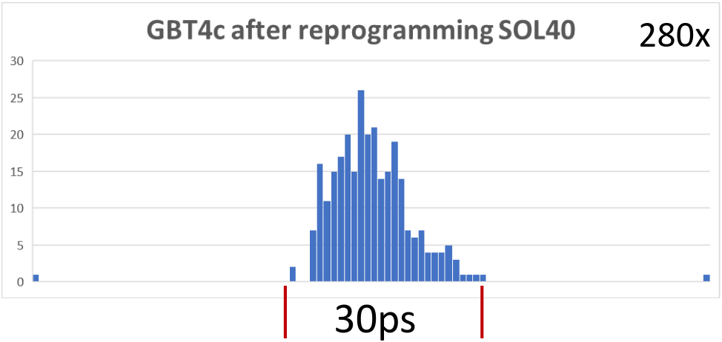
Best Alternative Studied Before (but not in use)
Control card
PCIe40
FPGA
TFC from
Supervisor
ZDM clk
feedback
SI5345
Jitter Cleaner
PON
Rx
(ONU)
SI5345
Jitter Cleaner
40
This alternative is intended to be fixed-latency
No phase correction mechanism
40
SYS
clock
TFC to
DAQ Cards
240
40
PON
Tx
(OLT)
40
PLL
240
GBT banks
TFC to FEE
Recovered clock phase at the FEE after reprogramming the FPGA

Slide 5
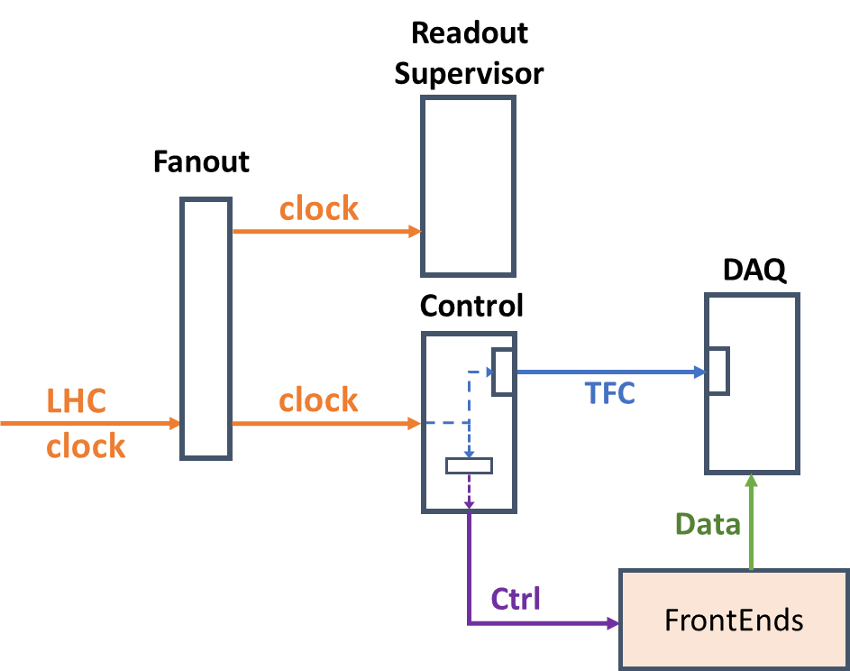
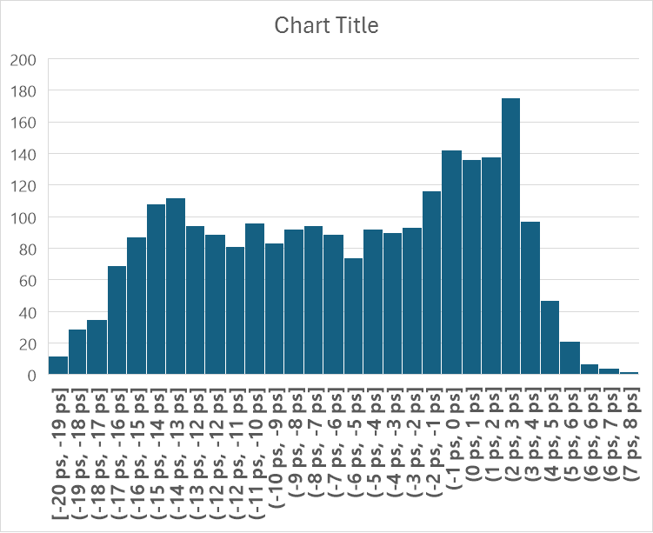
New Clock Distribution Architecture
Control card
PCIe40
FPGA
TFC from
Supervisor
SI5345
Jitter Cleaner
ZDM clk
feedback
PON clock
not used
PON
Rx
(ONU)
SI5345
Jitter Cleaner
40 MHz
LHC clk
The LHC clock goes straight to the Control cards instead of being recovered by the FPGA XCVR
40
SYS
clock
TFC to
DAQ Cards
240
40
PON
Tx
(OLT)
40
PLL
240
GBT banks
to FE (VLDB)
25ps
Looks similar to previous alternative, HOWEVER…

Slide 6
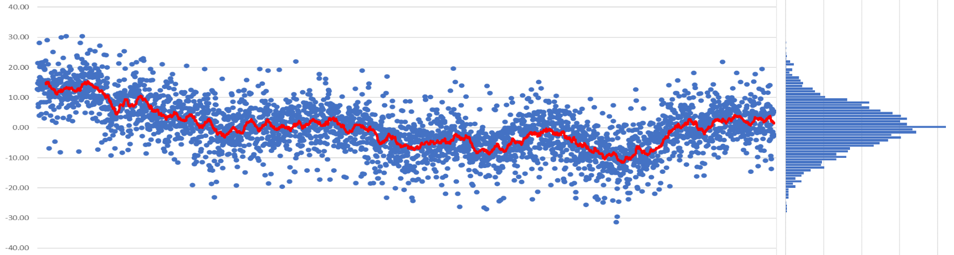
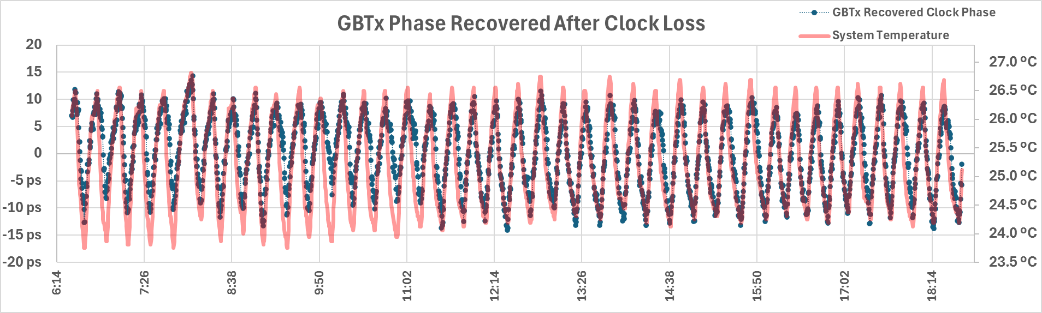
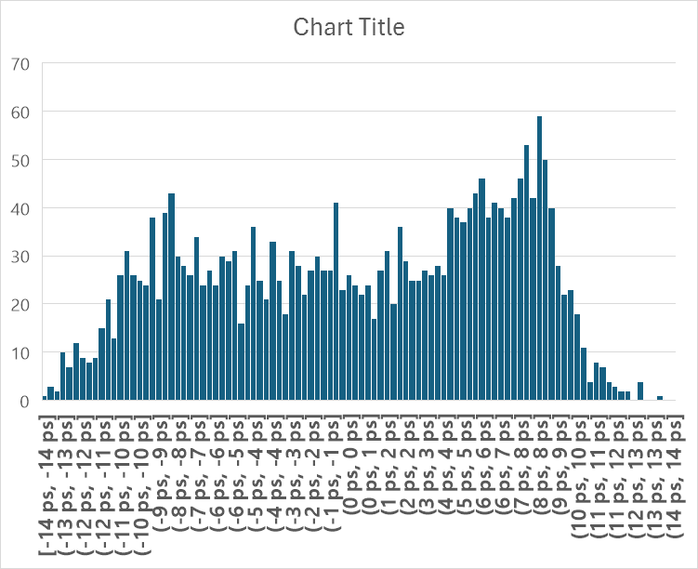
Comparison: Old vs New Architecture
They are not exactly the same!
30ps
30ps

Slide 7
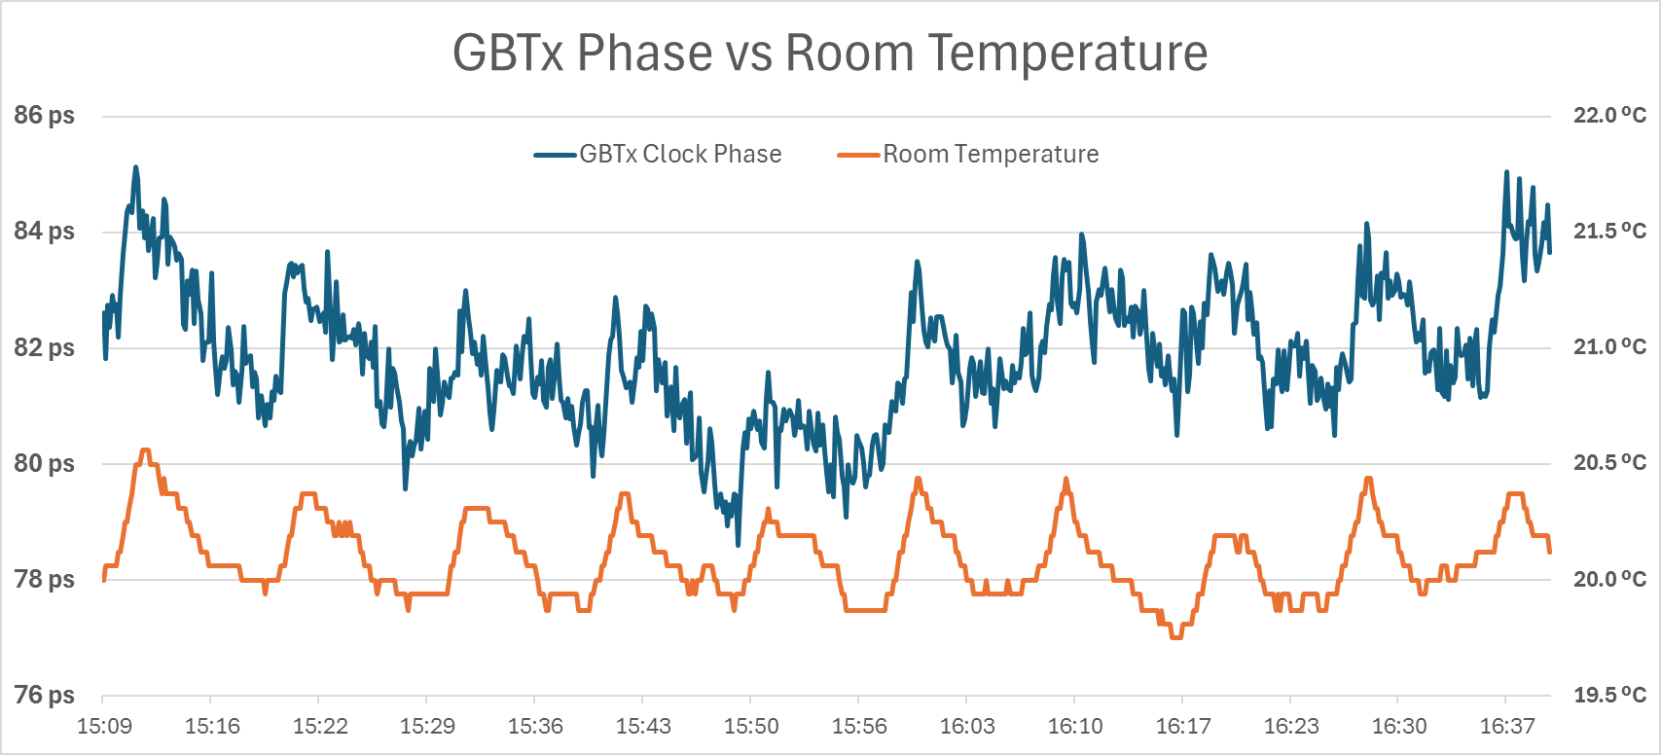
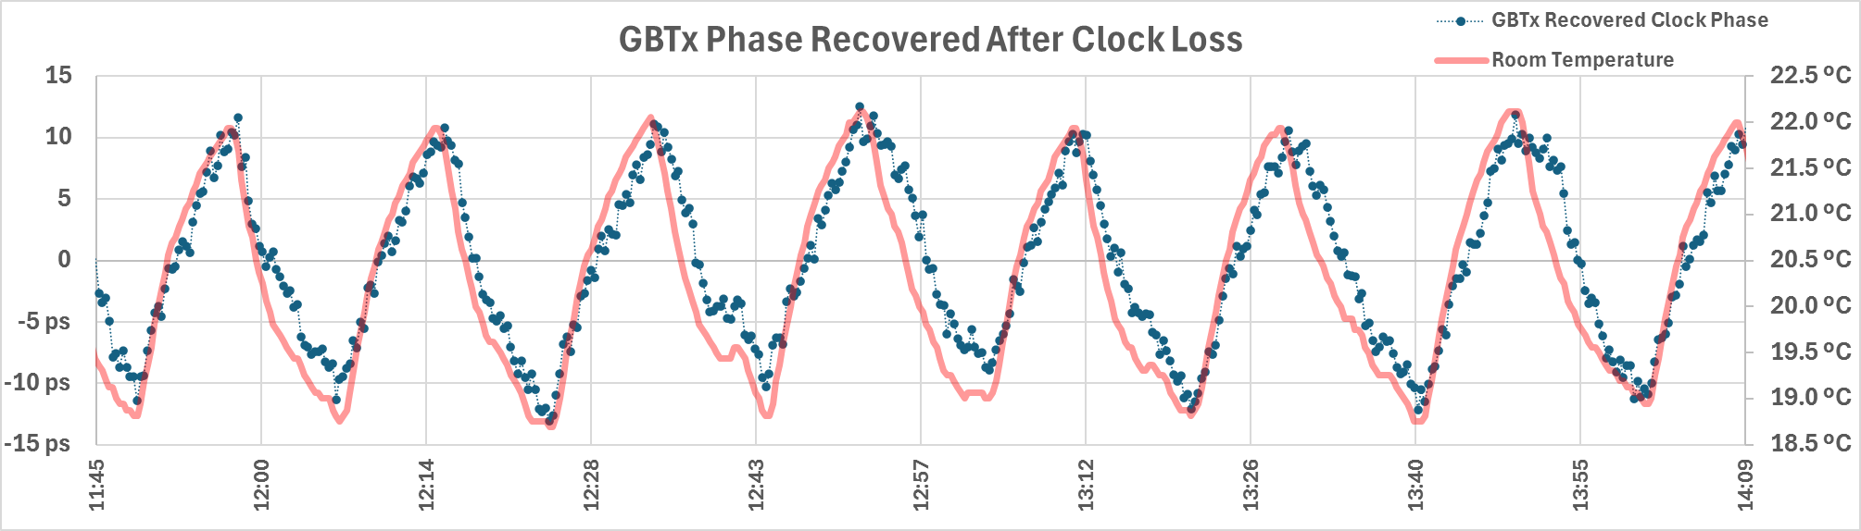
How would it behave in realistic conditions?
In lab conditions…
(numbers are approximate)
Temperature (pk-pk) | Phase (pk-pk)
3.0 C | 25ps
0.5 C | 4ps

Slide 8
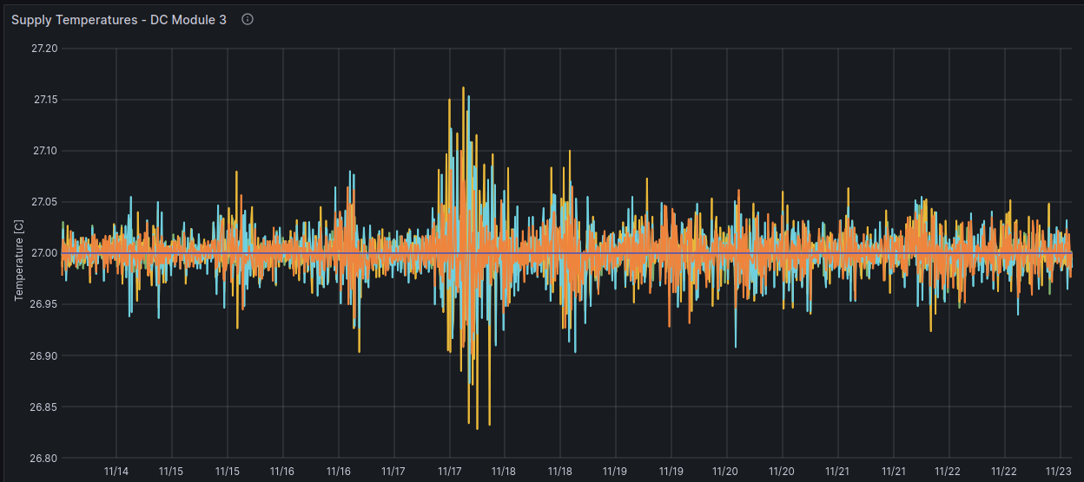
How would it behave in realistic conditions?
In lab conditions…
Temperature (pk-pk) | Phase (pk-pk)
3.0 C | 25ps
0.5 C | 4ps
Temperature oscillations at the datacenter are incredibly low and experts believe it could be consistently kept under 1C or less.
At LHCb’s datacenter where the PCIe40s are installed…
(Last 10 days of the LHC run)
However, the FEE and the ~200m long fibers are not inside the datacenter.
But the goal of this exercise is to evaluate the PCIe40, not the whole system.
Additionally, I have not yet tested how the phase of multiple PCIe40 channels will vary w.r.t. each other.

Slide 9
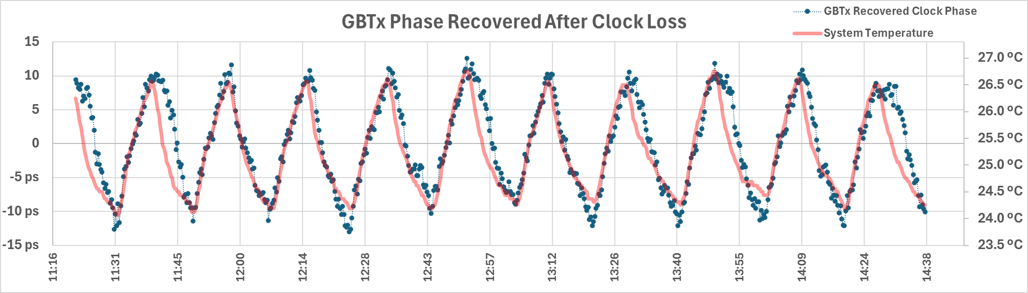
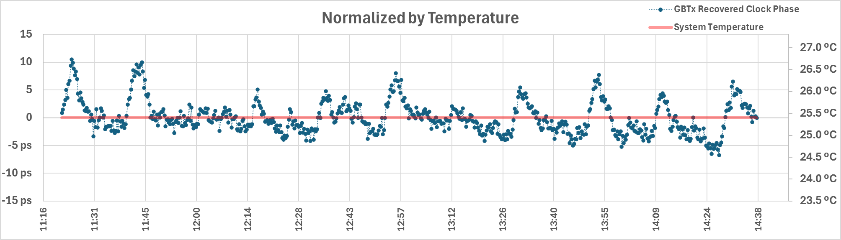
Clock Recovery Uncertainty Normalized by Temperature

Slide 10
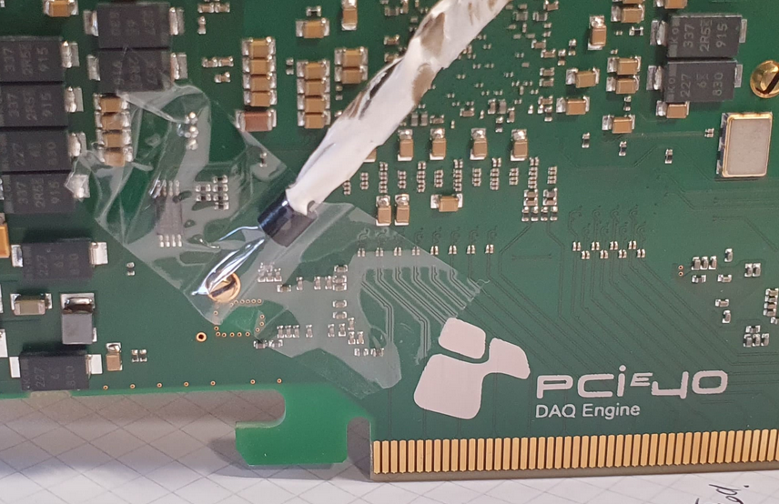
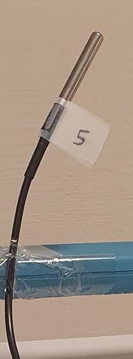
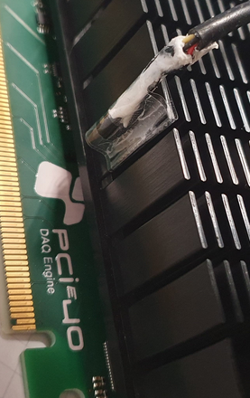
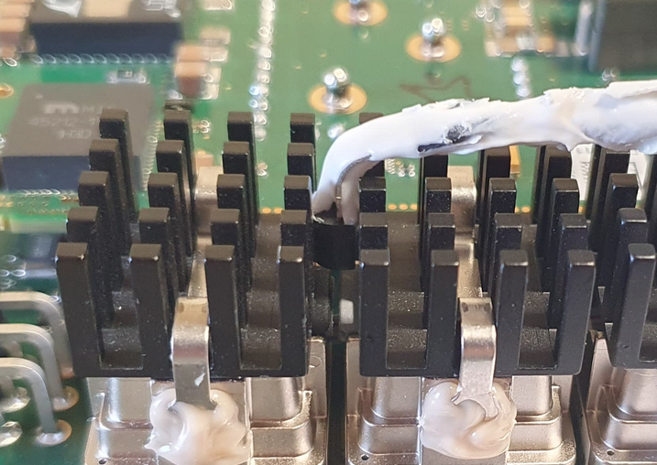
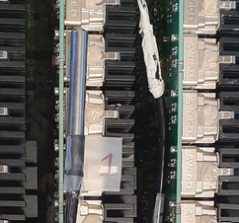
Clock Recovery Uncertainty Normalized by Temperature
But this is not a fair result…
Phase variations will be caused by different temperatures across the whole system.
I just picked the sensor that seemed to be the closest representation.
Please don’t judge me for taping sensors to a PCIe board :D

Slide 11
What if we could correct for temperature?
As an exercise to see the best we could achieve with a PCIe40, I went after solutions to shift the clock phase to compensate for temperature drift.
It turns out shifting clocks electronically at a picosecond level is a huge challenge. ☹
So I decided to make a Python-based PID controller script to control the fans of the server and use the FPGA temperature itself as a phase shifter.
  (If you can't beat them, join them)

Slide 12
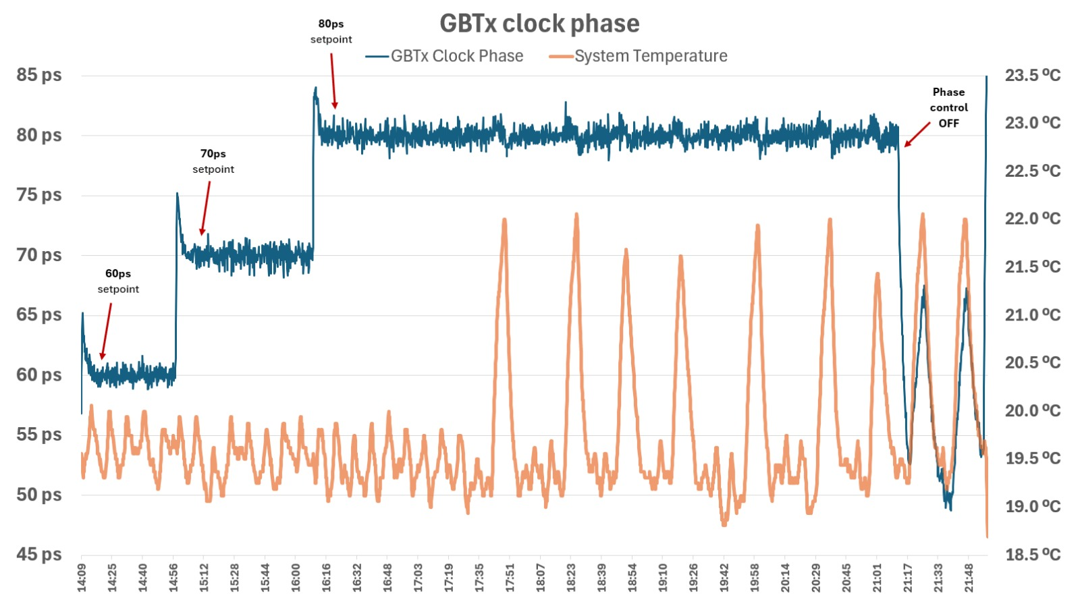
What if we could correct for temperature?

Slide 13
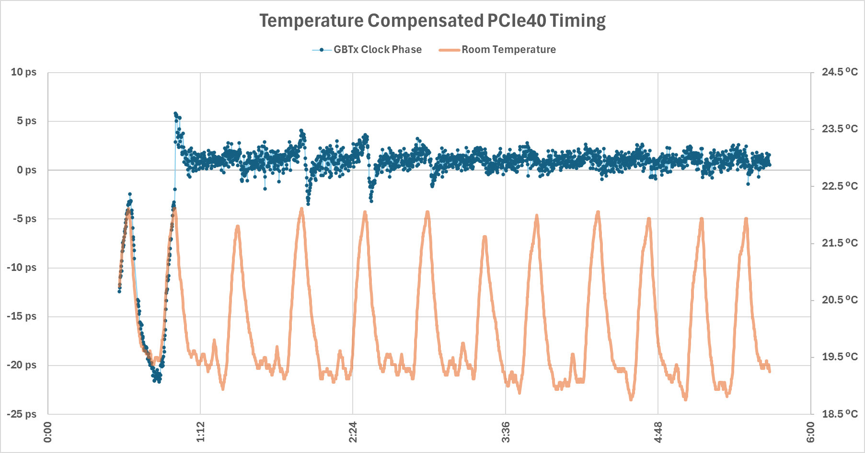
What if we could correct for temperature?
Std.Dev. = ~1ps

Slide 14
Thank you
all for listening!
And Sophie Baron,
Daniel Montesinos,
Edgar Lemos,
for their time and support. :)

Slide 15
Measured clock path
Si5395J
Eval. Board
PCIe40
~1m
VLDB
~1m
Scope
~1m
2x SMA cable (diff) +Diff pair Ethernet
Optical fiber
SMA cable
(single ended)
Ref clock path
Test setup at B2
~1m
2x SMA cable (diff)
Si5395
Clk gen + Fanout
SODIN
Scope
PON (just for TFC, not clock)
SOL40
VLDB
SCOPE

Slide 16
Readout
Supervisor
Fanout
clock
DAQ
Control
LHC
clock
clock
TFC
Data
Ctrl
FrontEnds

