Slide 2

Vacuum Systems
Slot 2
V. Baglin
CERN TE-VSC, Geneva

Slide 3
Outline
Measure of vacuum
Production of vacuum
Summary

Slide 4
1. Measure of vacuum

Slide 5
1.1 Vacuum gauges

Slide 6
Vacuum gauges pressure range
16 orders of magnitude !
Pa
10⁻¹²
10⁻¹⁰
10⁻⁸
10⁻⁶
10⁻⁴
10⁻²
10
10²
10⁴
Capacitance
Spinning rotor
Piezo
Pirani
Penning
Bayard-Alpert
Helmer, extractor
mbar
10⁻¹⁴
10⁻¹²
10⁻¹⁰
10⁻⁸
10⁻⁶
10⁻⁴
10⁻²
10
10²

Slide 7
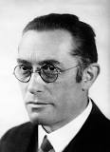
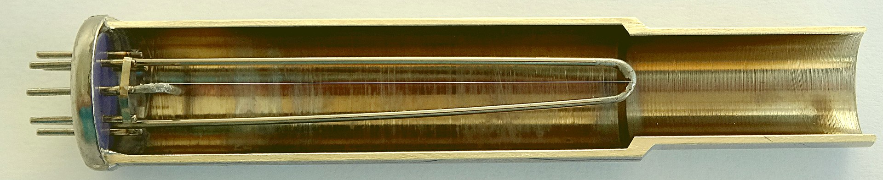
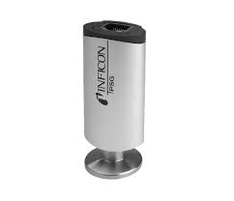
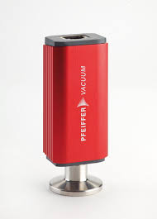
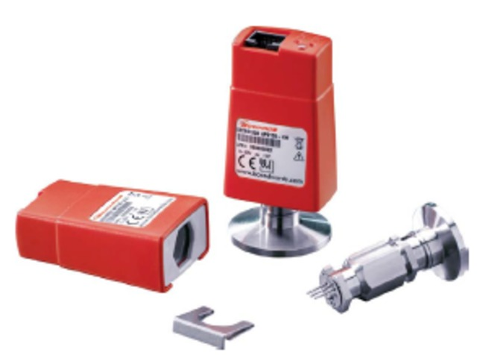
Pirani Gauge
Pirani gauges are used in the range 1 atm -10⁻⁴ mbar to monitor the roughing of a vacuum system
Robust, gas dependent, accuracy 10-100 %
Operating principle based on the variation of the heat conductivity through a gas: balancing a Wheatstone bridge to keep power through filament constant
  ➔ pressure reading above 1 mbar are wrong
Tungsten wire
wikipedia
M. Pirani 1906
Inficon Pirani gauge
Pfeiffer Pirani gauge
Edwards Pirani gauge

Slide 8
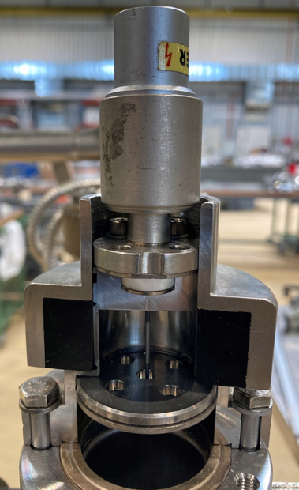
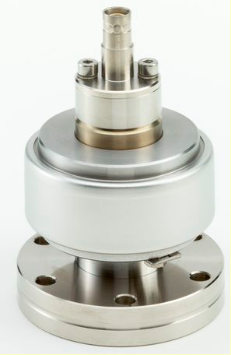

Penning gauge
Penning gauges are commonly used in the range 10⁻⁵ -10⁻¹⁰ mbar. They are use for interlocking purposes
Robust, gas dependent, accuracy ~ 20-50 %
It is a cold cathode ionisation gauge i.e. there are no hot filament: electron are produced by field emission
The operating principle is based on the measurement of a discharge current in a Penning cell which is a function of pressure : I⁺ = P^{n}, n is close to 1
B
F. Penning 1937
Pfeiffer Penning gauge

Slide 9
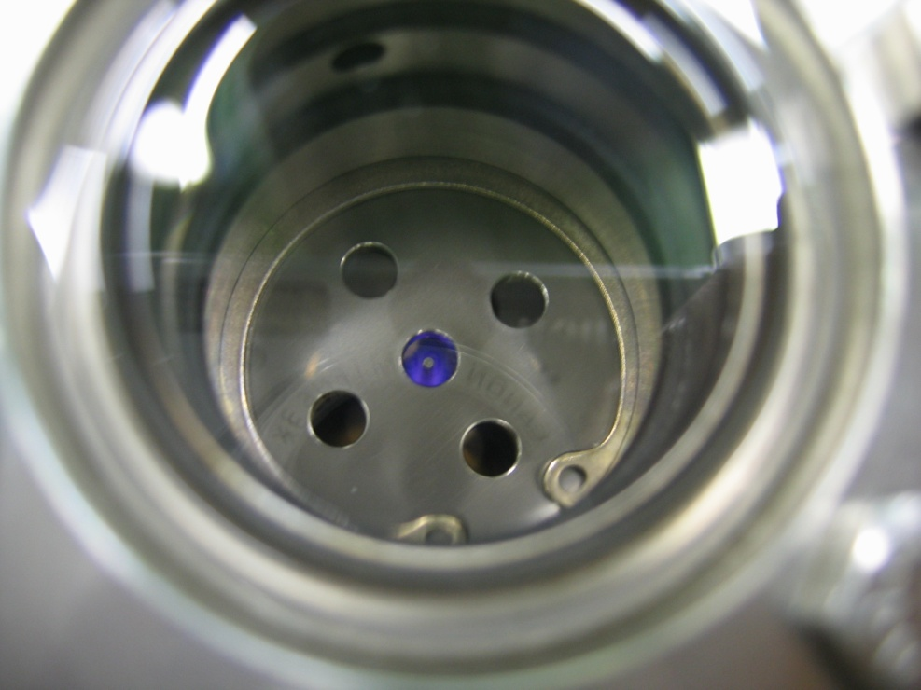
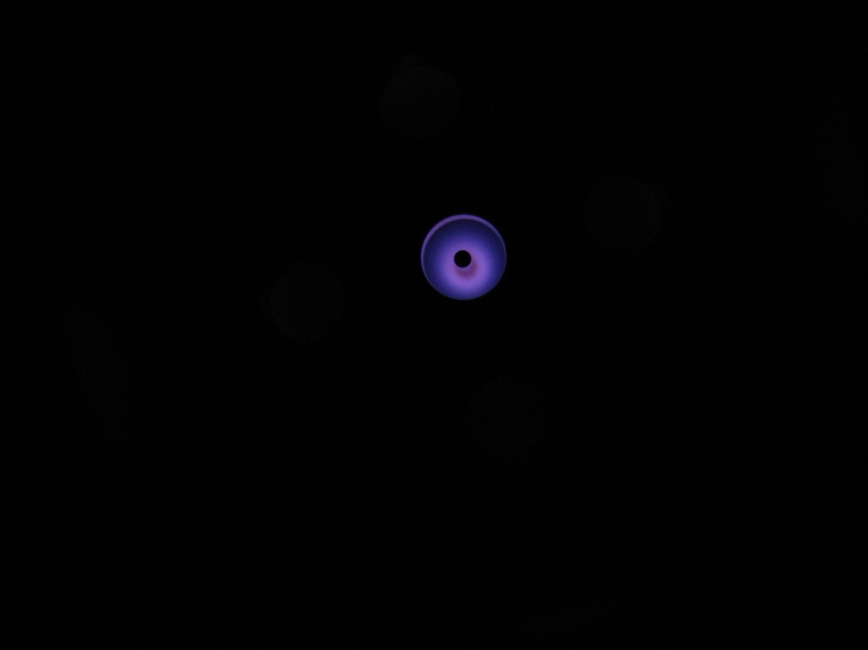
A discharge in a Penning gauge
Penning gauge: a cloud of electrons is kept in place by a solenoidal magnetic field created by a permanent magnet ring
In the dark, the discharge is seen: a plasma is created
Penning gauge ON behind a glass window
Anode rod
Pictures courtesy B. Henrist, TE-VSC

Slide 10
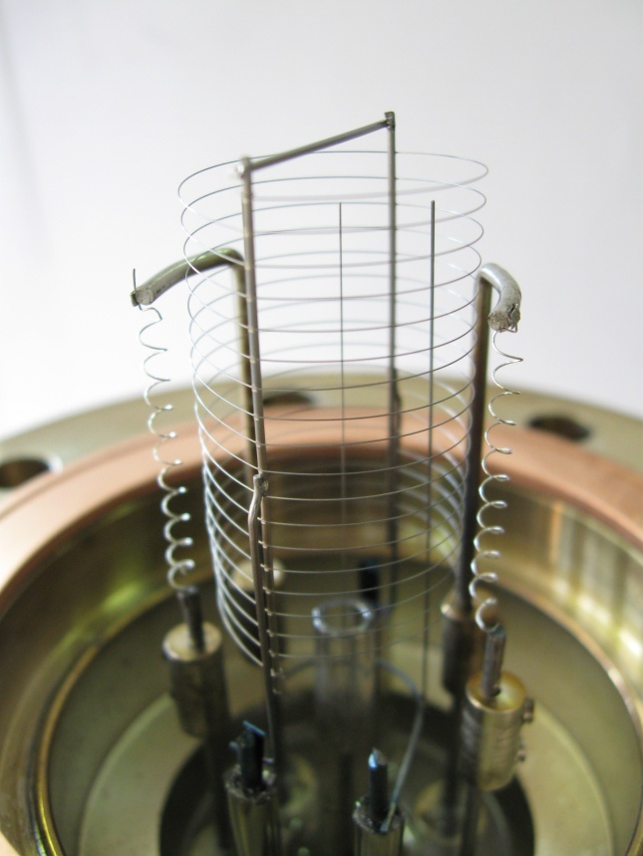
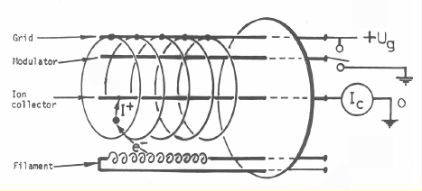
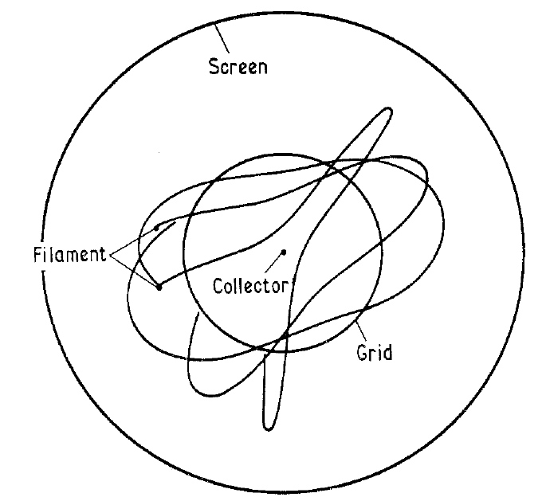
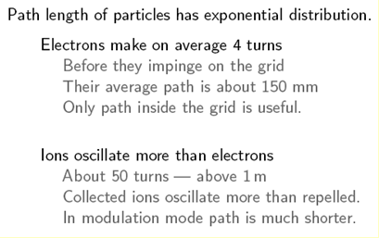
Bayard-Alpert Gauge
Bayard-Alpert gauges are used for vacuum measurement purposes in the range 10⁻⁶ -10⁻¹² mbar.
It is a hot filament ionization gauge. Electrons emitted by the filament perform a few oscillations inside the grid and ionise the molecules of the residual gas. Ions are then collected by an electrode.
Ion collector = 0 V
Filament = + 50 V
Grid = + 150 V
Modulator = + 150 V
Electron trajectories for three different angles of incidence at the grid boundary, in a cross section of a Bayard-Alpert gauge
Courtesy B. Jenninger, TE-VSC
L.G. Pittaway. J. of Phys. D: Appl. Phys. 3, 1113-1121, 1970

Slide 11
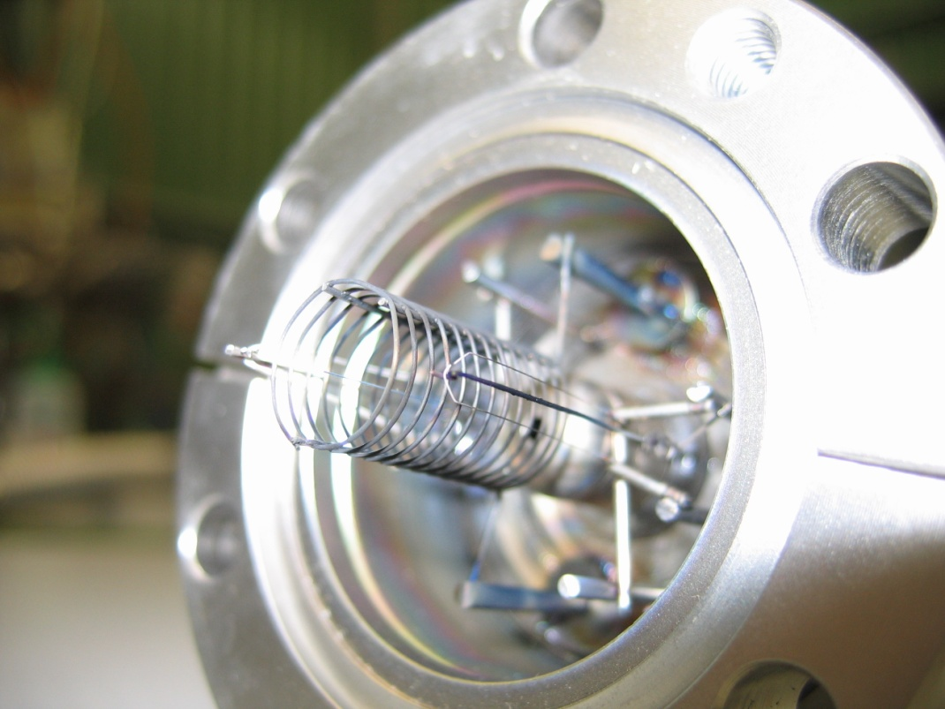
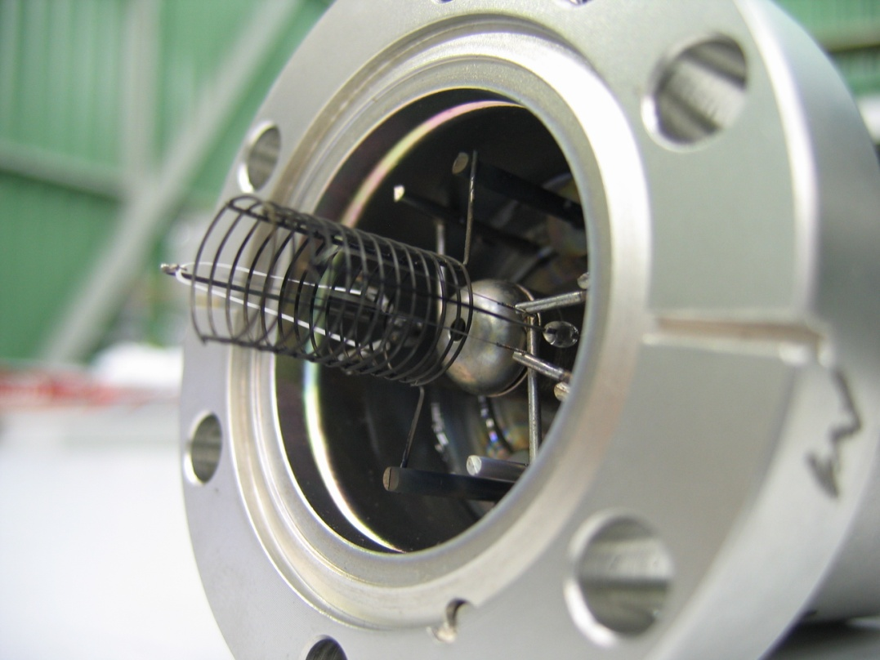
A burned filament
Obviously, even if there are 2 filaments, the gauge is polluted therefore the pressure measurement will not be correct !
It is wise to exchange the vacuum gauge
Pictures courtesy B. Henrist, TE-VSC

Slide 12
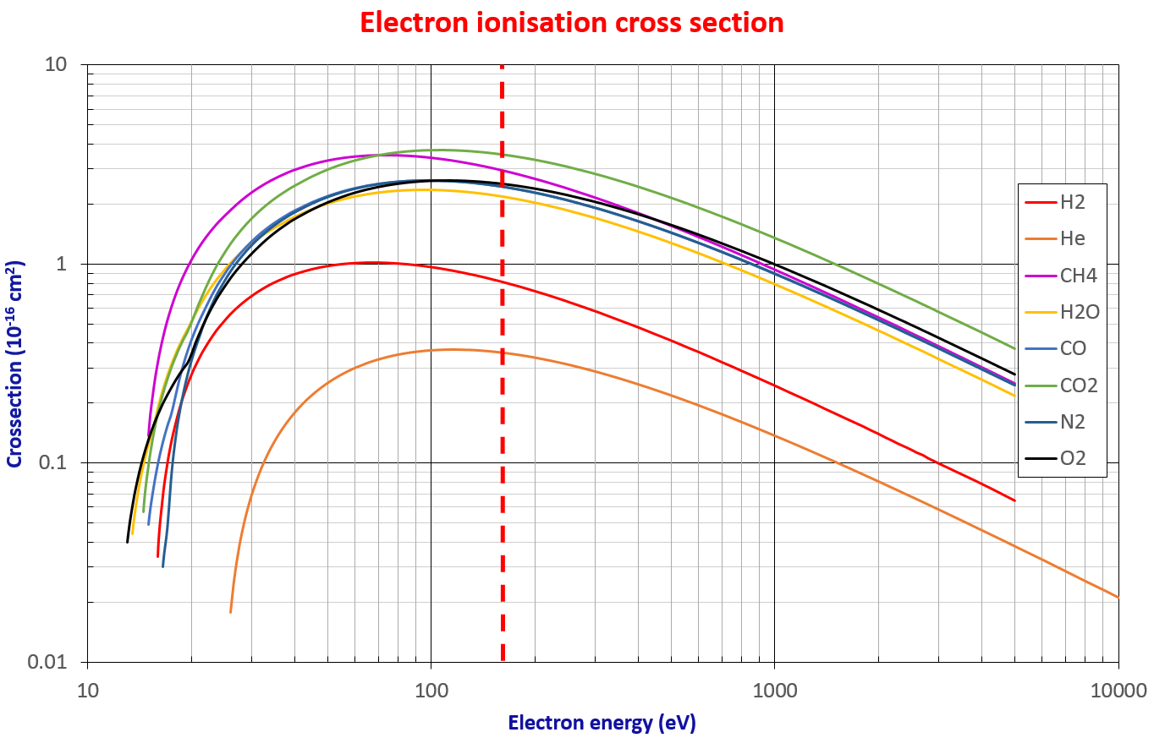

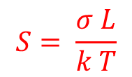

Bayard-Alpert Gauge: Sensitivity
The ion current collection can be described by:
$$I^{+}=I_{e}σ n L$$
Where :
I⁺ is the ion current
I⁻ is the filament current
σ is the ionization cross section
n the gas density
L the electron path length
The vacuum gauge sensitivity, S in mbar ⁻¹, is defined by:
$$S= \frac{σ L}{k T}$$
$$I^{+}=I_{e} S P$$
I_{e} (mA) | P (mbar) | I⁺ (pA)
4 | 10⁻¹⁰ | 16
4 | 10⁻¹² | 0.16
0.1 | 10⁻¹⁰ | 0.4
0.1 | 10⁻¹² | 0.004
The gauge needs to be calibrated for several gases
S_{N2} ~ 40 mbar ⁻¹
The pressure reading is expressed in nitrogen equivalent
In UHV, typical collected currents are in the pA range

Slide 13
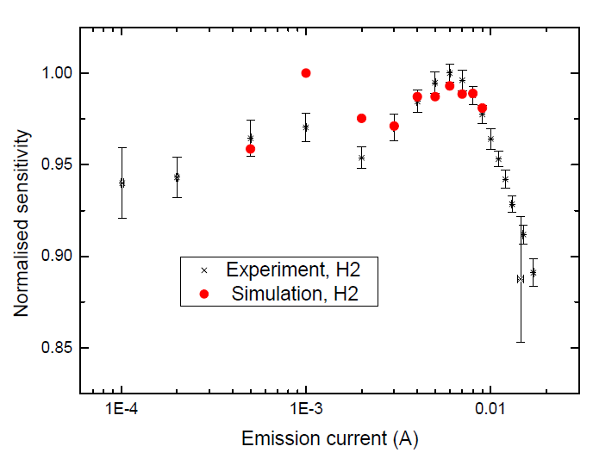
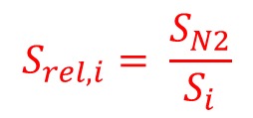
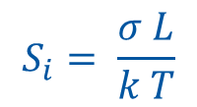

Bayard-Alpert Gauge: Sensitivity
The sensitivity can be measured and also computed from simulations
$$S_{i}= \frac{σ L}{k T}$$
Space charge
effect
Relative sensitivity:
$$S_{rel,i}= \frac{S_{N2}}{S_{i}}$$
4 mA
$$P_{i}= S_{rel,i} P_{N2}$$
B. Jenninger et al. Vacuum 138 (2017) 173-177
 | H₂ | He | CH₄ | Ne | N₂ | CO | C₂H₆ | Ar | CO₂ | Xe
S_{i} (mbar⁻¹) | 19.06 | 7.46 | 60.62 | 10.48 | 41.84 | 42.30 | 114.71 | 53.19 | 54.48 | 7.50
S_{rel,i} (mbar,i/mbar,N₂) | 2.20 | 5.61 | 0.69 | 3.41 | 1.0 | 0.99 | 0.36 | 0.79 | 0.77 | 4.83
The sensitivity relative error equals ~ 10 %
A pressure reading in N₂ equivalent is: P_{read} =2 10⁻¹⁰ mbar, in the case the main molecular species is H₂, the real pressure is: P = S_{rel,H2} x P_{read} = 4.4 10⁻¹⁰ mbar

Slide 14
1.2 Gas analysis

Slide 15
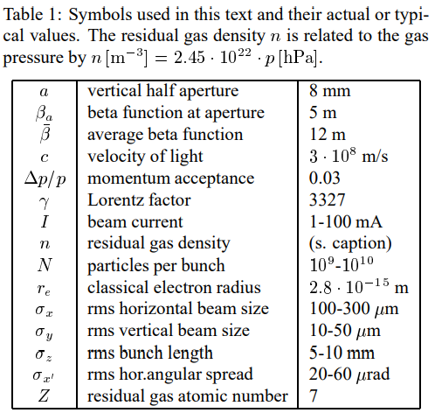
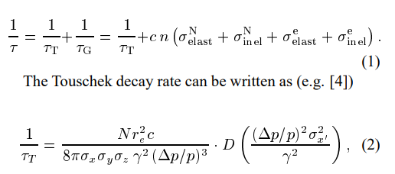
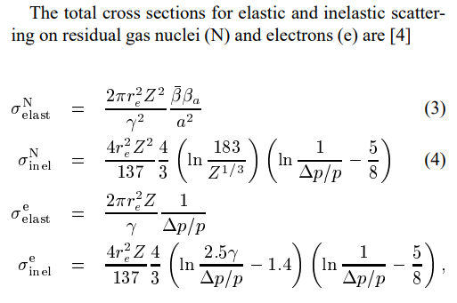
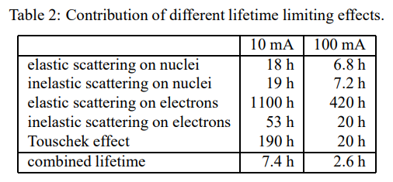
Residual gas composition
Q: “Why do we need to know the gas composition in an accelerator?”
As already mentioned, the beam circulating in the accelerator has a probability to collide with the residual gas.
The beam can interact via elastic and inelastic processes (energy conserved or not), through many physical mechanisms.
Here an example for the BESSY-II light source in Berlin (1.7 GeV, e- accelerator).
Ref. https://accelconf.web.cern.ch/p99/PAPERS/THA104.PDF

Slide 16
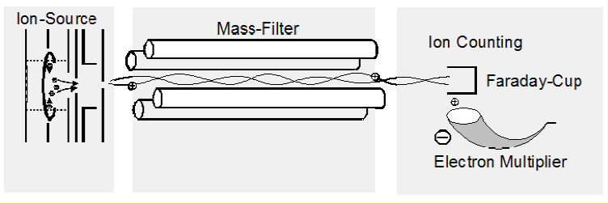
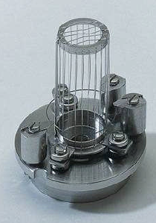
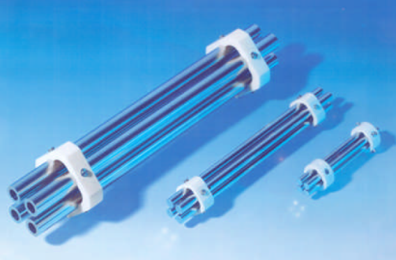
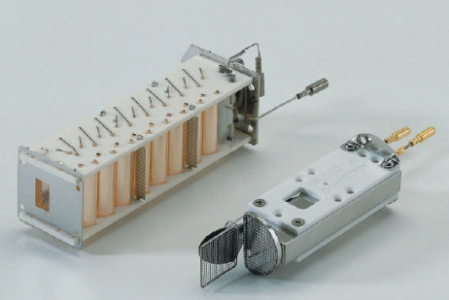
Residual Gas Analysers
Residual Gas Analysers are used in the range 10⁻⁴ -10⁻¹³ mbar. Their purpose is to do gas analysis to define the gas composition.
A filament produces electrons which ionise the residual gas inside a grid.
A mass filter is introduced between the grid and the ion collector.
The ion current can be measured in Faraday mode or in secondary electron multiplier mode.
G.J. Peter, N. Müller. CAS Vacuum in accelerators CERN 2007-003
Picture Pfeiffer
1 mA
Q ~ 2 10⁻⁹ mbar.l/s
ΔM at FHWM = 0.5 AMU
Range: 10⁻¹⁴ till 10⁻⁵ A
Gain ~ 10³ -10⁴ electrons/ion

Slide 17
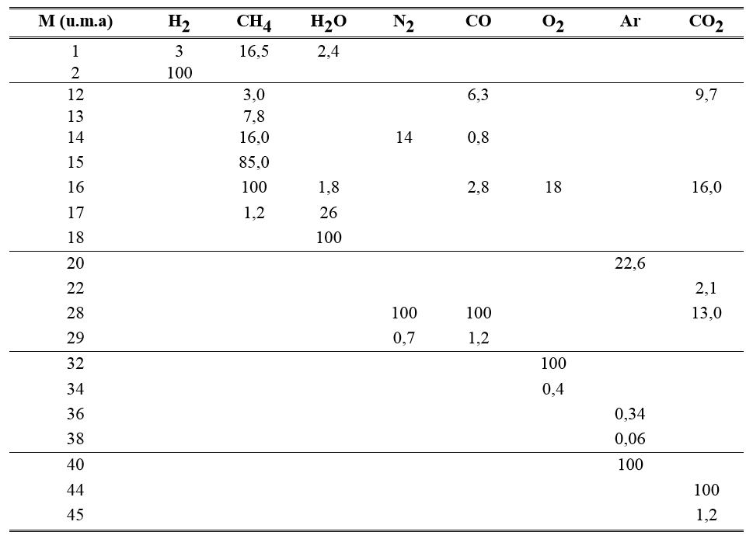
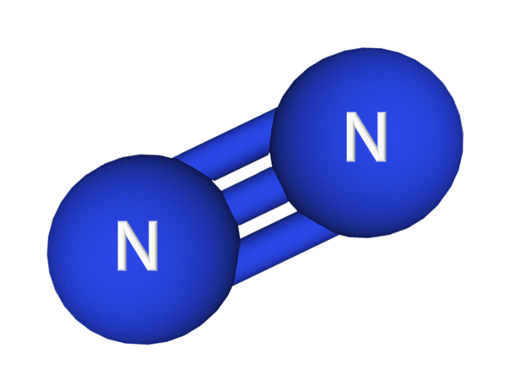
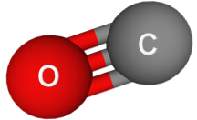
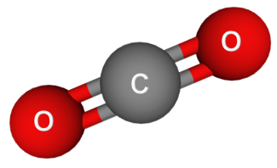
RGA: Cracking pattern
Ions produced inside the grid can be fragmented into sub-species by the collisions with electrons
The table gives the percentage of the fragments with respect to the main peak
Example Mass 28
Nitrogen is traced by mass:
  28 (N₂⁺)
  14 (N⁺): I₁₄ = 0.14 I₂₈
Carbon monoxide is traced by mass:
  28 (CO⁺)
  12 (C⁺): I₁₂ = 0.06 I₂₈
Carbon dioxide is traced by mass:
  44 (CO₂⁺)
  28 (CO⁺): I₂₈ = 0.13 I₄₄
  16 (O⁺): I₁₆ = 0.16 I₄₄
  12 (C⁺): I₁₂ = 0.10 I₄₄

Slide 18
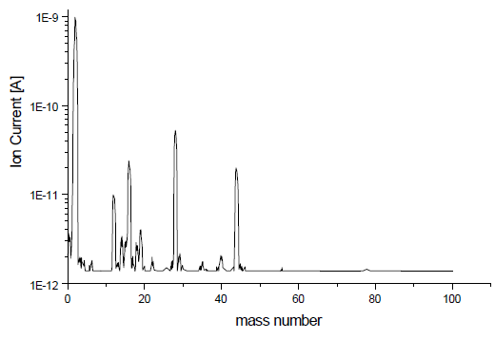
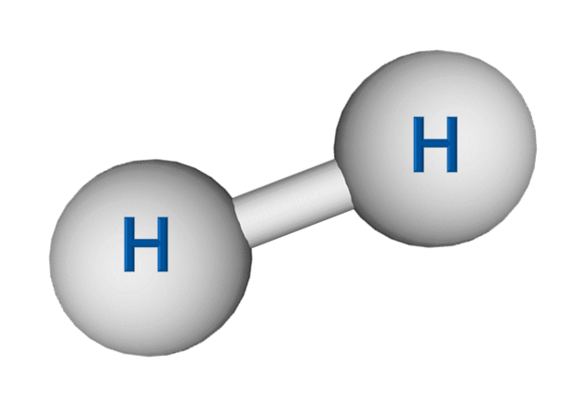
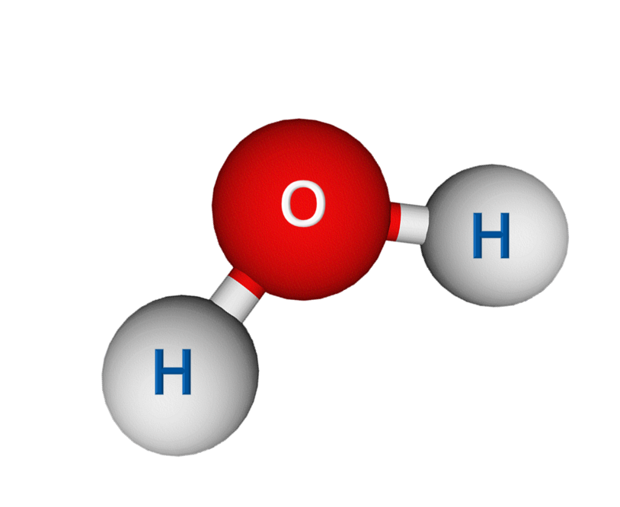
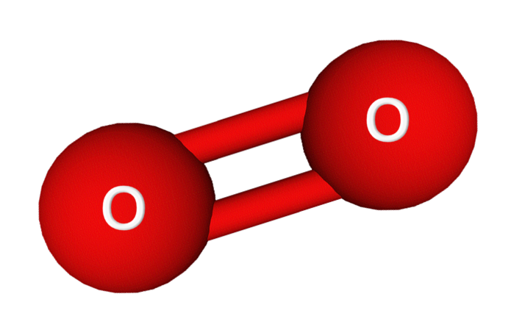
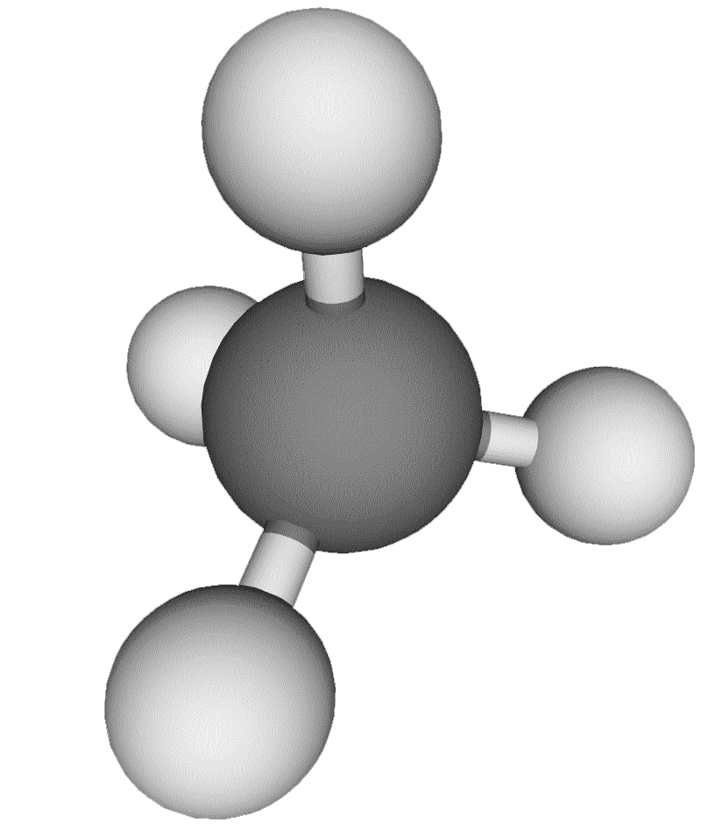
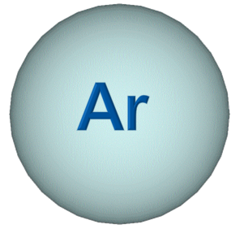
RGA: Spectrum
* Baked vacuum system:
System which has received a thermal cycle above ~150 °C in order to remove H₂O vapor
A typical spectrum of a baked* vacuum system: P = 10⁻¹⁰ mbar
M/e | Ion | Molecule
2 | H₂⁺ | H₂
15 | CH₃⁺ | CH₄
28 | CO⁺ | CO
40 | Ar⁺ | Ar
44 | CO₂⁺ | CO₂
12 | C⁺ | CO+CO₂
16 | O⁺ | Filament artefacts
19 | F⁺
2
28
16
44
12
19
15
40
H₂
Di-Hydrogen
M/e=2;1
CH₄
Methane
M/e=15;(16)
H₂O
Water
M/e=18;17;16
CO
Carbon monoxide
M/e=28;12
Ar
Argon
M/e=40;20
CO₂
Carbon dioxide
M/e=44;16;28;12
N₂
Nitrogen
M/e=28;14
O₂
Oxygen
M/e=32;16

Slide 19
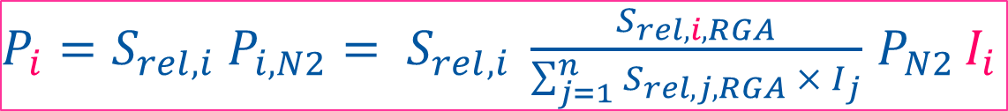
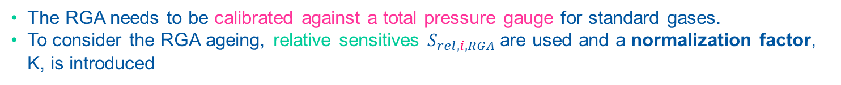
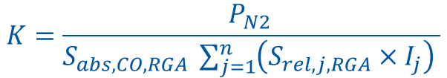
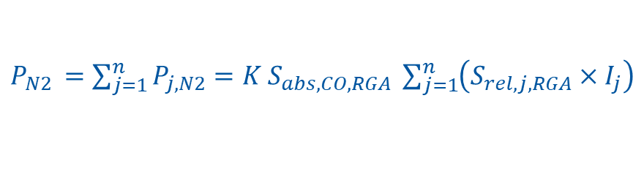
RGA: Partial Pressure
The RGA needs to be calibrated against a total pressure gauge for standard gases.
To consider the RGA ageing, relative sensitives $S_{rel,i,RGA}$are used and a normalization factor, K, is introduced
$$P_{i, N2}=K S_{abs,CO,RGA}{×S}_{rel,i,RGA} ×I_{i}$$
According to Dalton’s law, the reading given by the total pressure gauge should be equal to the sum of the partial pressures, expressed in nitrogen equivalent:
$P_{N2 }=$ $\sum_{j=1}^{n}{P_{j, N2}=K S_{abs,CO,RGA} \sum_{j=1}^{n}{\left(S_{rel,j,RGA}×I_{j}\right) }}$
Therefore:
$$K=\frac{P_{N2 }}{S_{abs,CO,RGA} \sum_{j=1}^{n}{\left(S_{rel,j,RGA}×I_{j}\right) }}$$
So:
$P_{i}=S_{rel,i} {P_{i, N2}= S}_{rel,i} \frac{S_{rel,i,RGA}}{\sum_{j=1}^{n}{S_{rel,j,RGA} × I_{j}}}$ $P_{N2 }I_{i}$
 | H₂ | CH₄ | N₂ | CO | Ar | CO₂
S_{rel,i,RGA} (Torr N₂/Torr_{i}) | 1.09 | 0.93 | 0.99 | 1 | 1.18 | 1.96

Slide 20
Typical spectrum of a baked vacuum system
Baked system with P= 10⁻¹⁰ mbar N₂₋eq
“Baking” means heating under vacuum above 150 ºC for >24h, to remove water vapor; It is a pre-requisite to getting pressures below 10⁻⁸ mbar quickly)
2
28
44
 | H₂ | CH₄ | CO | Ar | CO₂
I (A) | 1·10⁻⁹ | 2 ·10⁻¹² | 7·10⁻¹¹ | 5·10⁻¹³ | 2·10⁻¹¹
P (mbar) | 2·10⁻¹⁰ | 1·10⁻¹³ | 6·10⁻¹² | 4·10⁻¹⁴ | 3·10⁻¹²
% Pi | 96 | 0 | 3 | 0 | 1
Note: a simple estimation from the total pressure measurement would give P = 2.2·10⁻¹⁰ mbar!

Slide 21
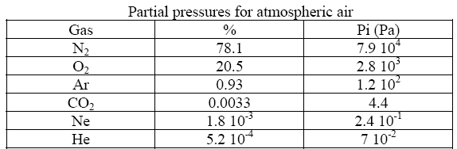
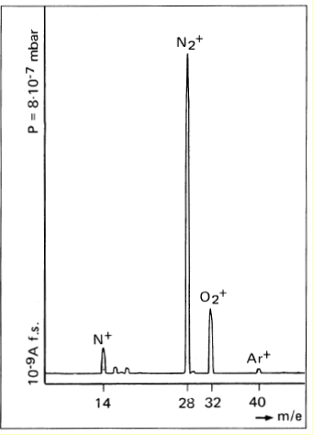
Typical spectrum in the presence of an air leak
RGA are also useful to identify, trace and estimate air leaks
Air leak
M/e | Ion | Molecule
14 | N⁺ | N₂
28 | N₂⁺ | N₂
32 | O₂⁺ | O₂
40 | Ar⁺ | Ar
Assume an 8 cm diam. tube with specific conductance ~ 60 ℓ·m/s:
  a leak detected 10 m away from the gauge (at P= 8·10⁻⁷ mbar)
  Hence, a pumping speed of 6 ℓ/s at the level of the leak gives a leak rate of:
    6 x 8·10⁻⁷ = 4.8·10⁻⁶ mbar·ℓ/s
Beware, oxygen being highly chemically reactive, its mass is not always present in the spectrum!

Slide 22
2. Production of vacuum

Slide 23
Vacuum pumps pressure range
16 orders of magnitude !
Pa
10⁻¹²
10⁻¹⁰
10⁻⁸
10⁻⁶
10⁻⁴
10⁻²
10
10²
10⁴
Oil sealed mech. pump
Turbo molecular pump
Sputter ion pump
Cryopumps
Ti sublimation pump
NEG & cryogenic pumps
mbar
10⁻¹⁴
10⁻¹²
10⁻¹⁰
10⁻⁸
10⁻⁶
10⁻⁴
10⁻²
10
10²

Slide 24
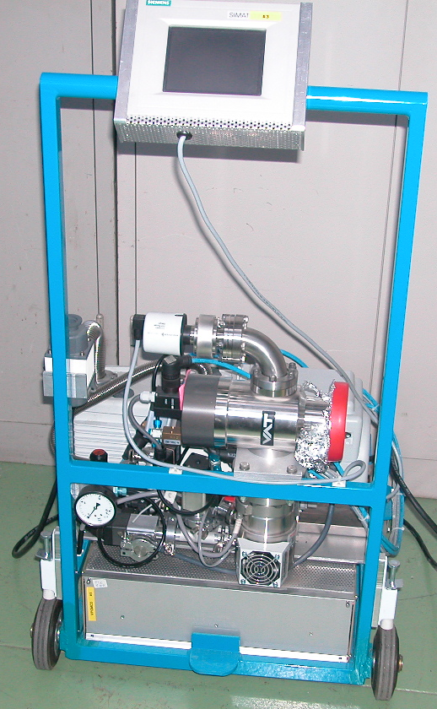
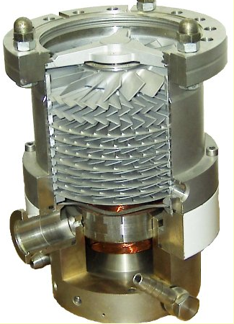
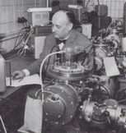
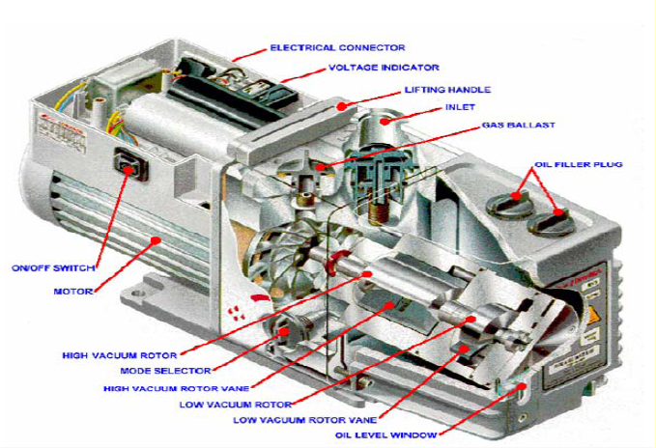
Turbomolecular pumping group
Used to pump down from atmosphere and commission vacuum sectors down to 10⁻¹¹ mbar
Mobile system based on rotary vane primary pump and turbomolecular pump
Turbomolecular pump
Primary pump
Valve
W. Becker, 1956
A. Pfeiffer GmbH
Primary pump
Turbomolecular pump
Primary pump

Slide 25
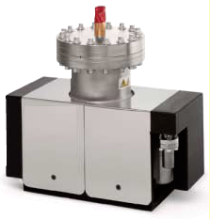
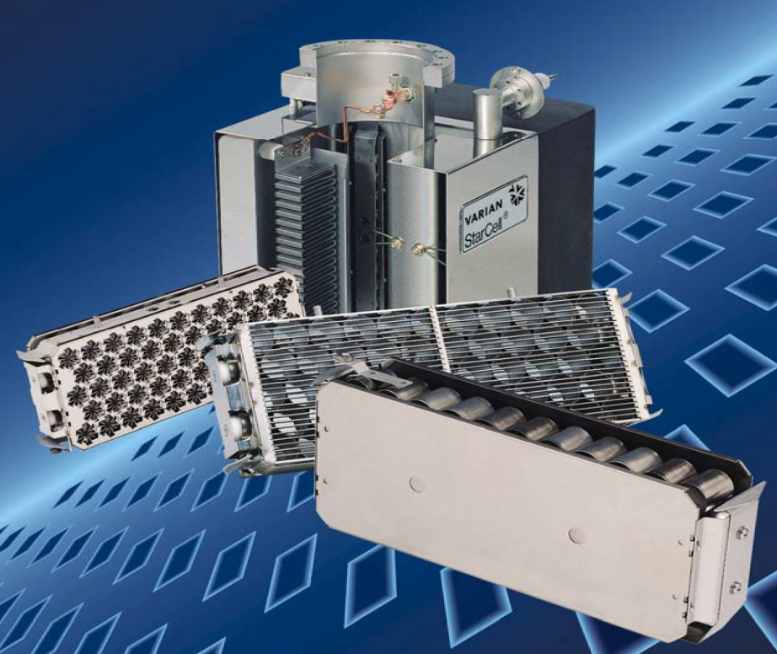
Sputter Ion Pump
This pump operates in the range 10⁻⁵ -10⁻¹¹ mbar. It is used to maintain the pressure in the vacuum chamber of an accelerator. It has NO exhaust, it traps the gas species.
Typical pumping speed range from 1 to 500 l/s (but 1000-2000 l/s custom models exist)
Titanium sputtered from the cathode bombarded by accelerated ions provides pumping.
The ion current is proportional to pressure, hence these pumps are often used for interlocks, in place of gauges
Hi-Voltage feed-thru
3-7 kV
Pictures Agilent (Varian)

Slide 26



NEG cartridge
This pumps operates in the UHV regime in a range < 10⁻⁸ mbar
It is used as a complementary pumping system to e.g. ion pumps.
Zr based getter materials are sintered and form porous disks.
After activation at ~ 500ºC for 1h, the pumping speed can be large: 100 – 2 000 l/s
Large sorption capacity: >0.1 – 10 mbar.l for N₂, CO and > 10 mbar.l for H₂!
  Reminder: 1 mbar.l = 4.3 10¹⁹ molecules, ~ 1 monolayers of a 10m long,Ø10 tube
H₂ diffuse into the bulk, CO is adsorbed in 1 active site whereas N₂ requires 6.
Gas mixture: CO adsorption inhibit H₂ and N₂ pumping
Courtesy G. Bregliozzi, J. Callagher, 2012

Slide 27



Non-Evaporable Getter (NEG)
Getters (eg Ti) are materials capable of chemically adsorbing gas molecules. To do so their surface must be clean.
For Non-Evaporable Getters (eg TiZrV films) a clean surface is obtained by heating to a temperature high enough to dissolve the native oxide layer into the bulk.
NEGs pump most of the gas except rare gases and methane at room temperature
1 µm thick film coated at 300˚C
Very large pumping speed : ~ 250 l/s/m for H₂,
20 000 l/s/m for CO ➔ distributed pumping
Very low outgassing rate (~200 CH₄/s/cm²)
But : limited capacity and fragile coating, sensitive to pollutant (hydrocarbons, Fluor …)
C. Benvenuti, 1996
P. Chiggiato and P. Costa Pinto, Thin Solid Films, 515 (2006) 382-388

Slide 28
Summary
In order to measure the total pressure one has to use a combination of vacuum gauges, adopting different technologies (although new “integrated” gauges are on the market, where one instrument does it all, from ambient pressure down to UHV)
Typical gauges are: Capacitance, Spinning Rotor, Piezoelectric, Pirani, Penning, Bayard-Alpert, Helmer, extractor;
In addition to the total pressure one needs to know also the residual gas composition, since the stored particle beams interact in different ways and intensities in presence of different gas species: the elastic and inelastic cross-sections of interaction (residual gas nuclei and electrons) have a strong dependence on the atomic number of the residual gas molecules/atoms.
Residual Gas Analyzers (RGAs) are typically used for the purpose of determining the gas composition; typically they are of the four-rod type, spanning 100-200 a.m.u.’s.
For a well-baked vacuum system with no leaks, the typical gas composition is H₂, CH₄, CO, CO₂, with H₂ being the biggest component (good, as it has lowest Z)
As for pumps, not a single pump can work in the full pressure range, from atmosphere (pumpdown phase) to UHV.
Typical pumps used on particle accelerators are: turbopumps, ion-sputtering pump, NEG, cryogenic; NEG-coating is also very much used on modern accelerators (0.2~2 μm-thick layer of NEG material, deposited via physical vapor deposition techniques, sputtering; NEG: ternary alloy of Ti, Zr, V.)

Slide 29
Some References
Cern Accelerator School, Vacuum technology, CERN 99-05
Cern Accelerator School, Vacuum in accelerators, CERN 2007-03
Cern Accelerator School, Vacuum for particle accelerators, CERN-ACC-2020-0009
The physical basis of ultra-high vacuum, P.A. Redhead, J.P. Hobson, E.V. Kornelsen,
American Vacuum Soc.
Scientific foundations of vacuum technique, S. Dushman, J.M Lafferty. J. Wiley & sons.
Handbook of Vacuum Technology, K. Jousten (ed.), Wiley VCH
Vacuum Technology, A. Roth. Elsevier Science
Foundations of vacuum science and technology, Ed by J.M. Lafferty. J. Wiley & sons.
Some Journals Related to Vacuum Technology for Particle Accelerators
Journal of vacuum science and technology A and B
Vacuum
Nuclear Instruments and Technology (A and B)
Review Modern Instruments
Applied Physics
Fusion Engineering and Design

Slide 30
Thank you for your attention !!!

