Slide 2

Vacuum Systems
Slot 3
V. Baglin
CERN TE-VSC, Geneva
https://indico.cern.ch/event/1470062/timetable/?view=standard#day-2025-02-17

Slide 3
Outline
Elements of adsorption/desorption
Outgassing
Bake-out

Slide 4
1. Elements of adsorption/desorption

Slide 5
Reminder: Pressure in a system
The Pressure, is the ratio of the flux of molecules in the vacuum vessel to the pumping speed
S ranges from 10 to 20 000 l/s
Q ranges from 10⁻¹⁴ mbar.l/s for metalic tubes to 10⁻⁵ – 10⁻⁴ mbar.l/s for plastics
mbar.l/s
mbar
l/s
3 orders of magnitude for pumping
vs
10 orders of magnitude for outgassing
Outgassing MUST be optimised to achieve UHV

Slide 6
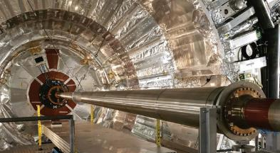



Reminder: Mass flow & quantities
The mass flow can be derived from the ideal gas law
$Q=p \frac{dV}{dt}=\frac{1}{𝒩}\frac{dn}{dt} RT$
$$R=𝒩 k=8.31 J {mol}^{−1}K^{−1}$$
It has the unit of [Pa.m³/s] which is equivalent to a number of molecules/s (or Watt)
PV | G
1 mbar.ℓ | 2.46 10¹⁹ molecules
1 Torr.ℓ | 3.27 10¹⁹ molecules
at 300 K
Langmuir: 1 L = 10⁻⁶ Torr for 1 s.
1 monolayer ~ 10¹⁵ molecules/cm²
1 Torr.ℓ injected inside a 10m long, 10 cm diameter chamber corresponds to 1 monolayer adsorbed on the surface!
=> the LHC experimental NEG beam pipe would be saturated and unusable

Slide 7
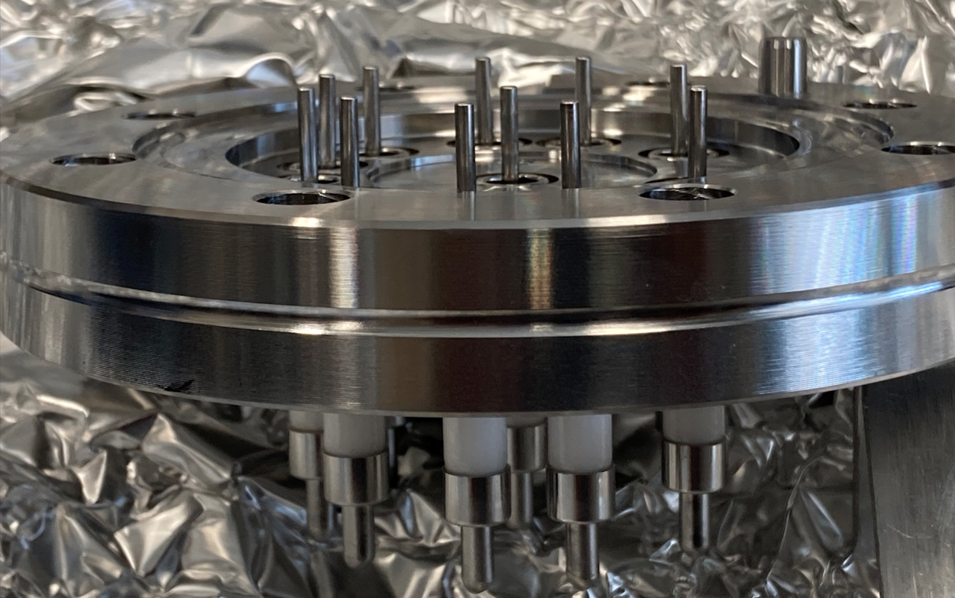
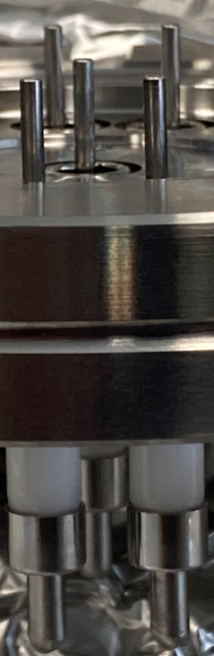
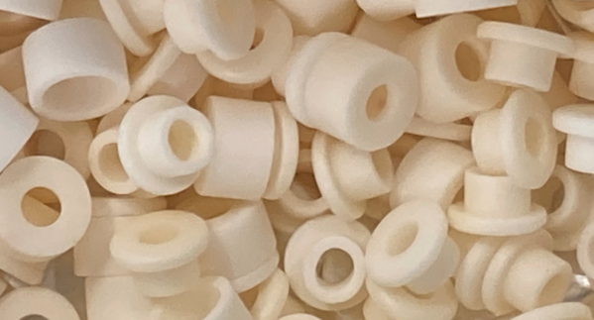
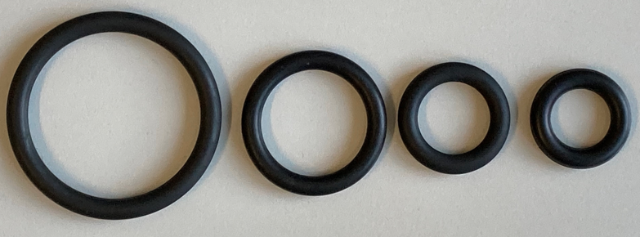
Material for Vacuum Technology
Metals are used for vacuum chambers building parts:
  Stainless steels, coppers, aluminums, beryllium
Insulating material are used for instrumentation or assembly:
  Minerals:
    Ceramics, Macor, glass
  Polymers (plastics):
    Kapton, PEEK, Teflon
    Glues
    Elastomers eg Viton, Neoprene, EPDM
During the manufacturing process of these materials, atoms and molecules are sorbed i.e. adsorbed or absorbed on the material surface or the bulk
The surface can be very rough and the material highly porous
Quantities of gas adsorbed / absorbed in materials can be very large:
  1 cm³ of stainless steel can contain 0.05 – 0.5 mbar.ℓ of hydrogen
  Under vacuum, Nylon can lose 4% of its weight i.e. 5 mbar.ℓ per cm³
Alumina feedthrough
Alumina balls
Viton o’rings

Slide 8
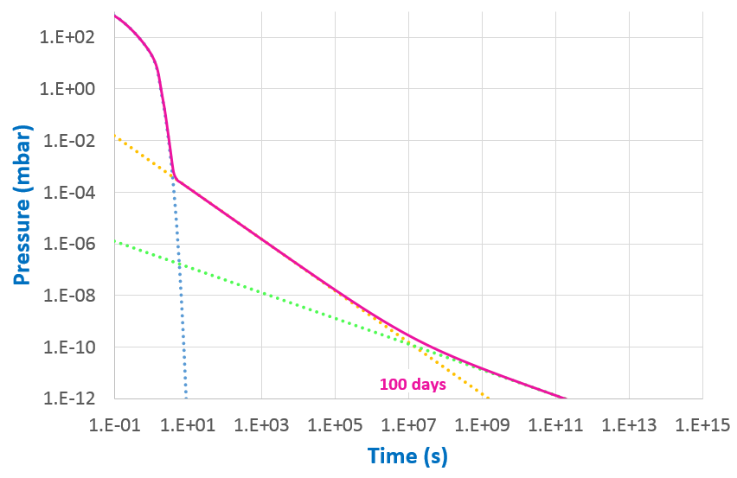
Long term pump down of a vessel
Consider 1 m long, Ø10 cm stainless steel tube pumped by 30 l/s
4 regimes
Volume ~ e^{-a t}
1) Volume pumping
2) Surface desorption
3) Diffusion from the bulk
4) Permeation through the wall (solubility+diffusion)
Surface ~ 1/t
Bulk ~ 1/√t

Slide 9
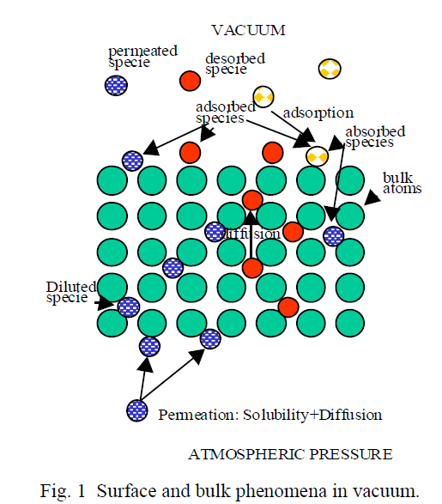


A schematic description
The release of these molecules into the vacuum is named OUTGASSING
Desorbed molecules originates from:
  Adsorption
  Absorption
  Diffusion
  Permeation
J De Segovia, Physics of Outgassing, CAS, CERN-99-05

Slide 10
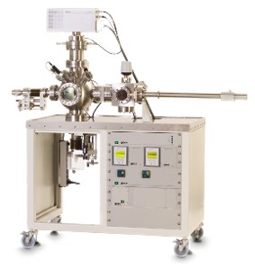
Adsorption-Desorption
The process is driven by the interaction energy between the molecule or atom with the surface
Weakly bounded molecules are physisorbed (~ 0,1 eV), strongly bounded are chemisorbed (~1 eV)
Several monolayers of gas can be physisorbed on a surface
Chemisorption can be dissociative (H₂) and non dissociative (C=O), a monolayer can be adsorbed
The order of desorption and the desorption energy can be evaluated from Temperature Programmed Desorption or Thermal Desorption Spectroscopy
Hiden TPD/TDS station

Slide 11
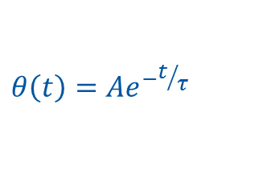


1st order desorption
Applicable for physisorbed molecules and non-dissociated chemisorbed molecules
The rate of molecular desorption from a surface is given by:
$$− \frac{dθ}{dt}=ν_{1}θ e^{−{E_{D}}/{kT}}$$
θ, surface coverage, ν₁ frequency of vibration of an adsorbed molecule (10¹³ Hz), E_{D}, activation energy for desorption
The solution describes the surface coverage evolution with time:
$$θ\left(t\right)=Ae^{−t/τ}$$
$$τ={\frac{1}{ν_{1}}e}^{{E_{D}}/{kT}}=τ_{0} e^{{E_{D}}/{kT}}$$
➔ time constant:
Sojourn time – residence time

Slide 12
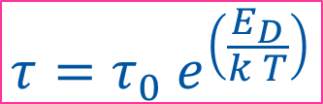
Sojourn time
This is the characteristic time for a first order desorption process
The sojourn time (residence time) of a molecule on a surface is a function of the desorption energy, E_{D}, and the surface temperature, T:
$$τ=τ_{0} e^{\left(\frac{E_{D}}{k T}\right)}$$
With τ₀ the oscillation period of the molecules on the surface ~ 10⁻¹³ s.
The inverse of the sojourn time is the desorption probability of a molecule
For some binding energies the residence time of a molecules is of the order of a week
Increasing the temperature decrease the residence time
Decreasing the temperature, increase the residence time
Strongly bound molecules have long residence time

Slide 13
2. Outgassing

Slide 14
Units of outgassing rate
The (intrinsic) outgassing rate is the quantity of gas leaving the surface per unit time per unit of exposed geometric surface: Pa m³ s⁻¹ m⁻² (or Pa m s⁻¹ or W m⁻² )
 | Pa m s⁻¹ | Torr l s⁻¹ cm⁻² | mbar l s⁻¹ cm⁻² | molecules s⁻¹ cm⁻²
1 Pa m s⁻¹ | 1 | 7.5×10⁻⁴ | 10⁻³ | 2.46×10¹⁶
1 Torr l s⁻¹ cm⁻² | 1.33×10³ | 1 | 1.33 | 3.27×10¹⁹
1 mbar l s⁻¹ cm⁻² | 10³ | 0.75 | 1 | 2.46×10¹⁹
Examples:
  3 10⁻¹⁰ Torr l/(s cm²) is converted to 1.33 10³ x 3 10⁻¹⁰ = 4 10⁻⁷ Pa m s⁻¹
  5 10⁻¹³ Torr l s⁻¹ cm⁻² is converted to 1.33 x 5 10⁻¹³ = 6.7 10⁻¹³ mbar l s⁻¹ cm⁻²
  5 10⁻¹⁵ mbar l s⁻¹ cm⁻² is converted to 10³ x 5 10⁻¹⁵ = 5 10⁻¹² Pa m s⁻¹
  5 10⁻¹⁵ mbar l s⁻¹ cm⁻² is converted to 123 000 molecules / (s cm²)
P. Redhead, Recommended practices for measuring and reporting outgassing data, J. Vac. Sci. Technol. A 20(5), Sep/Oct 2002, 1667-1675

Slide 15
H₂O - Sojourn time
At room temperature (i.e. for unbaked vacuum systems), the sojourn time of water on the surface is very large ~ 1 week
  The surface coverage of water is therefore reduced by 1/e in a week
Water desorption is dominating the pumping process and several months are needed to fully evacuated the water adsorbed on the surface
Water originates from previously adsorbed molecules and from reaction with oxides:
FexOy+2H➔ Fe+H2O
Sojourn time of a molecule as a function of temperature
1 week

Slide 16
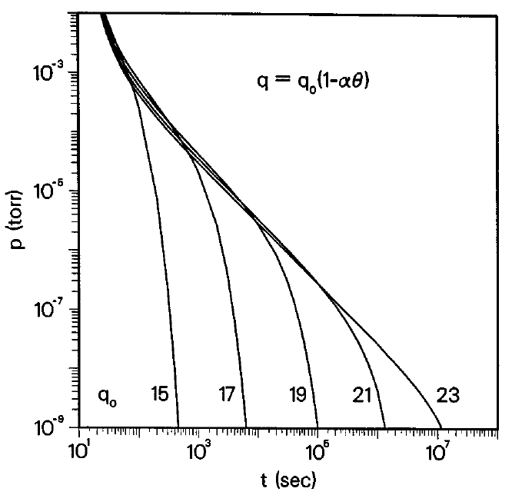


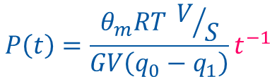
Unbaked system: water outgassing
It is observed that the desorption of water follows an inverse power law form, with a ~ 1 for metals and metal oxides:
$$q\left(t\right)=q_{0} t^{−a}$$
In practical units
$$q\left(t\right)=\frac{{3 10}^{−9}}{t [h]}mbar.l.s^{−1}.{cm}^{−2}$$
Model of Redhead:
  Desorption/adsorption is assumed to be reversible
  The surface coverage can be expressed as a function of pressure by a suitable isotherm
  A Temkin like isotherm with several possible adsorption energies, q_{i}, due to the complexity of the technical surface (15-23 kcal/mole i.e. 0.6 - 1 eV)
$$P\left(t\right)=\frac{θ_{m}RT V/S}{GV\left(q_{0}−q_{1}\right)}t^{−1}$$
P.A. Redhead, J. Vac. Sci. Technol. A 13(2), Mar/Apr 1995
100 days

Slide 17
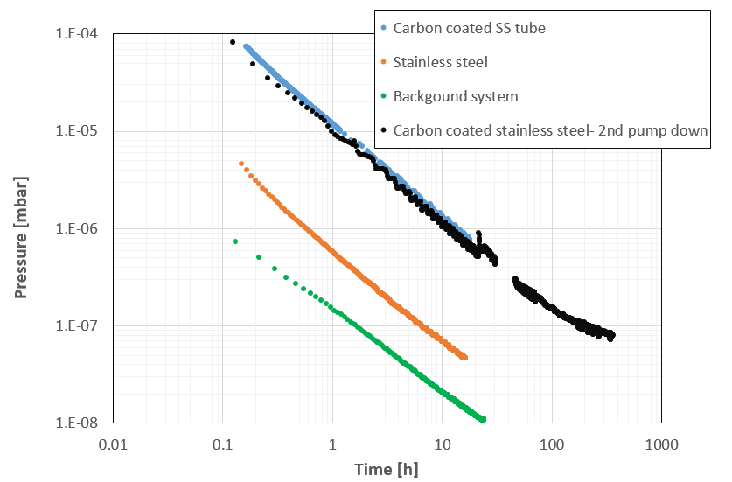
Impact of roughness
Case of unbaked a-C coated stainless steel tube, 450-500 nm thick:
  Mass spectrum is water dominated
  ~ x 30 unbaked stainless steel
  2nd pump down very similar to 1st one
  After 10h pumping:
  Stainless steel = 2 10⁻¹⁰ mbar.l/s/cm²
  a-C coating = 6 10⁻⁹ mbar.l/s/cm²
x 30
Courtesy I. Wevers
The amount of water chemisorbed on the surface increases when increasing the surface roughness
Mechanical polishing or electropolishing are used to reduce the outgassing rate of materials

Slide 18
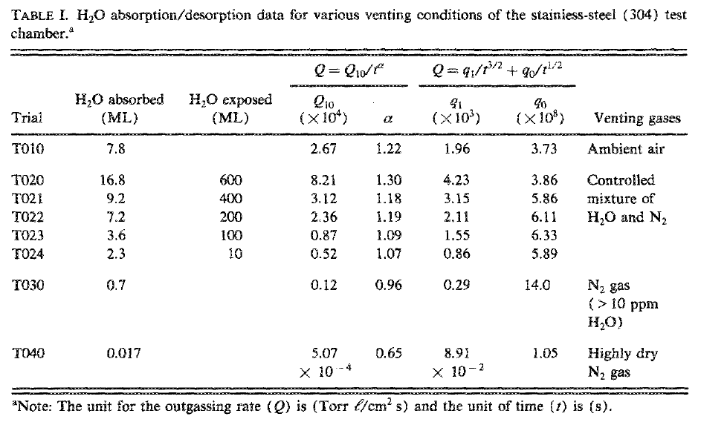
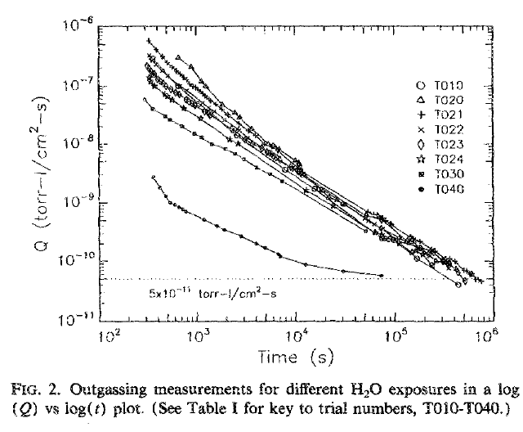
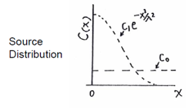
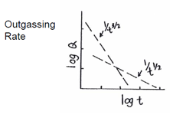

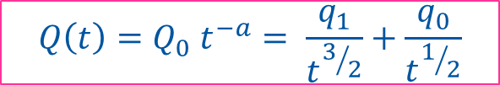
Water outgassing & venting
$$Q\left(t\right)=Q_{0} t^{−a}= \frac{q_{1}}{t^{3/2}}+\frac{q_{0}}{t^{1/2}}$$
The exponent, a, varies with the quantity of water absorbed:
  ambient air (8 ML): 1.2
  large water exposure (17 ML): 1.3
  low water exposure (0.02 ML): 0.65
The observation can be modeled by the superposition of:
  a water surface concentration => a ~ 3/2
  a water bulk concentration => a ~ 1/2
-1.3 to -0.96
N₂
F. Dylla, CAS 2006 & J. Vac. Sci. Technol. A 11(4), Jul/Aug 1993
Venting with dry N2 reduces pump down times

Slide 19
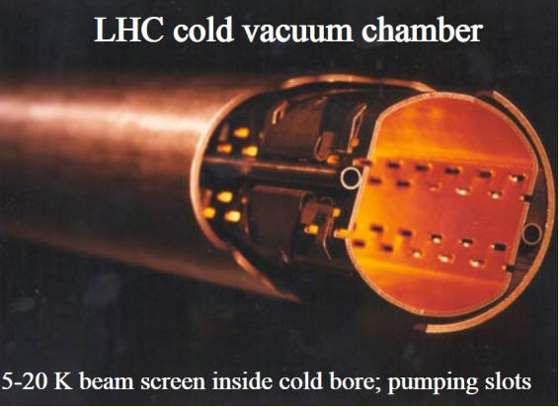
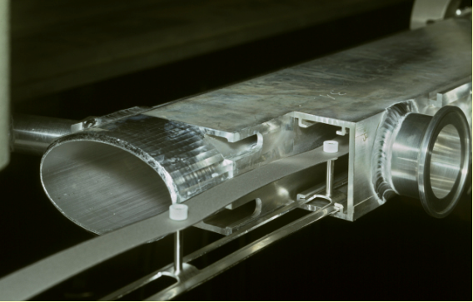
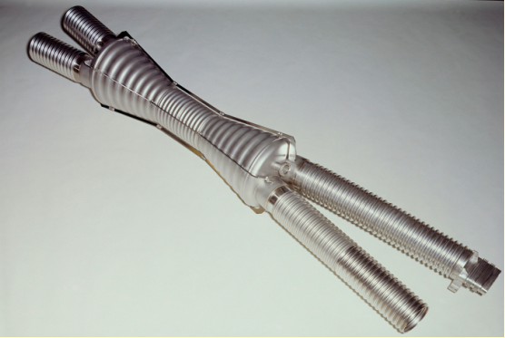

Typical design value of outgassing rates
The outgassing rate of unbaked surfaces is dominated by H₂0.
For metallic surfaces, unbaked after 10h of pumping (Torr.l.s⁻¹.cm⁻²)
Gas | Al | Cu | St. Steel | Be
H₂ | 7 10⁻¹² | 1.4 10⁻¹¹ | 7 10⁻¹² | 1.4 10⁻¹¹
CH₄ | 5 10⁻¹³ | 5 10⁻¹³ | 5 10⁻¹³ | 1 10⁻¹²
H₂O | 3 10⁻¹⁰ | 3 10⁻¹⁰ | 3 10⁻¹⁰ | 6 10⁻¹⁰
CO | 5 10⁻¹² | 1 10⁻¹² | 5 10⁻¹² | 1 10⁻¹¹
CO₂ | 5 10⁻¹³ | 2.5 10⁻¹³ | 5 10⁻¹³ | 1 10⁻¹²
A.G. Mathewson et al. in Handbook of Accelerator Physics and Engineering, World Scientific, 1998
LEP dipole chamber
ISR intersection “bicone” chamber

Slide 20
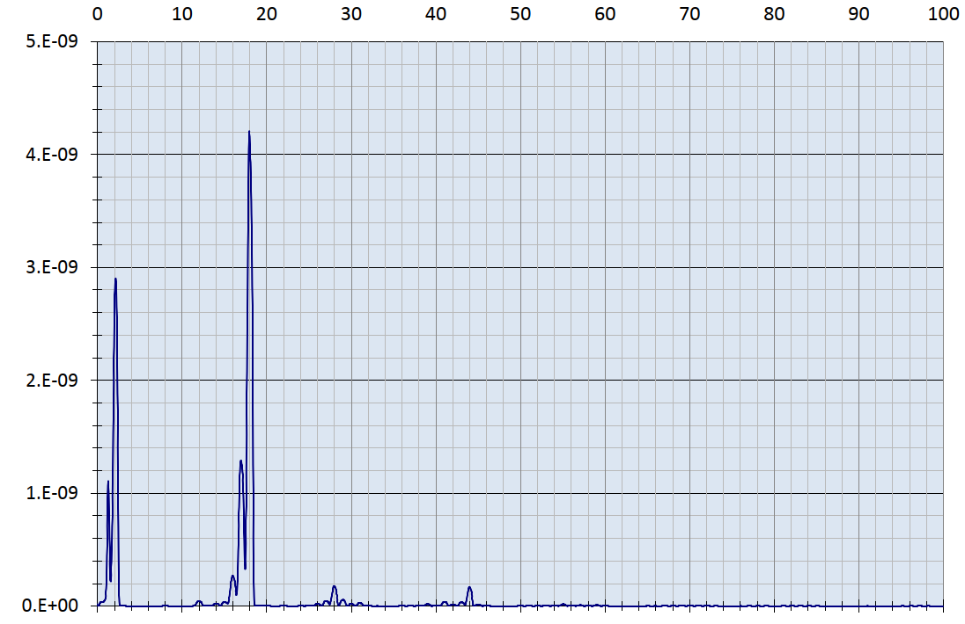
Gas composition of un-baked system
P = 4 10⁻⁹ mbar after 30h turbomolecular pumping of a1 m long, 10 cm diameter tube
Dominated by Water, then hydrogen ,carbon monoxide, carbon dioxide
H₂O
H₂
CO
CO₂
Data courtesy B. Jenninger

Slide 21
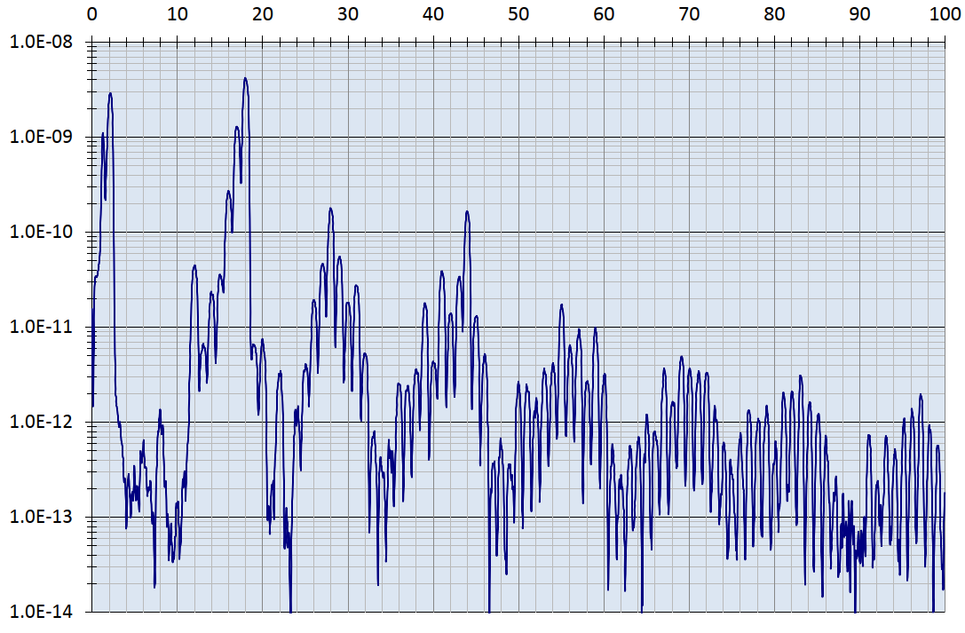
Gas composition of un-baked system
P = 4 10⁻⁹ mbar after 30h turbomolecular pumping of a 1 m long, 10 cm diameter tube
Dominated by Water, then hydrogen ,carbon monoxide, carbon dioxide
Presence of alkanes up to high masses (C_{n}H_{2n+2}) from cutting fluids and/or lubricants
Traces of ethanol from cleaning: C₂H₅OH
H₂
H₂O
CO
CO₂
Data courtesy B. Jenninger

Slide 22
3. Bake-out
Next: Chapter 3

Slide 23
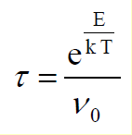
Sojourn time at high temperature
The sojourn time decrease strongly with increasing temperature
Heating the material allows a degassing of the molecules having binding energies < 2 eV
E(eV) | 120°C | 200°C | 300°C | 400°C
0.9 | 4 10⁻² s | 4 10⁻⁴ s | 8 10⁻⁵ s | 6 10⁻⁷ s
1.1 | 13 s | 5 10⁻² s | 5 10⁻⁴ s | 2 10⁻⁵ s
1.7 | 20 years | 1.5 days | 88 s | 0.5 s
2.0 | 1 10⁵ years | 6 years | 10h | 95 s
2.8 | 3 10¹⁵ years | 2 10⁹ years | 1 10⁴ years | 3 years
Molecules with larger binding energies than 1.7-2 eV will not be depleted by a bake-out
  ➔ However, those molecules will be available for subsequent desorption by e.g. ion bombardment !!

Slide 24
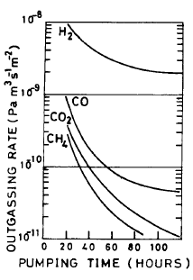
In Situ Bake Out
A bake-out above 150°C increase the desorption rate of H₂O and reduce the H₂O sojourn time in such a way that H₂ becomes the dominant gas for baked vacuum systems
Sojourn time of a molecule as a function of temperature
Baked Al
A.G. Mathewson et al.
J.Vac.Sci. 7(1), Jan/Fev 1989, 77-82

Slide 25
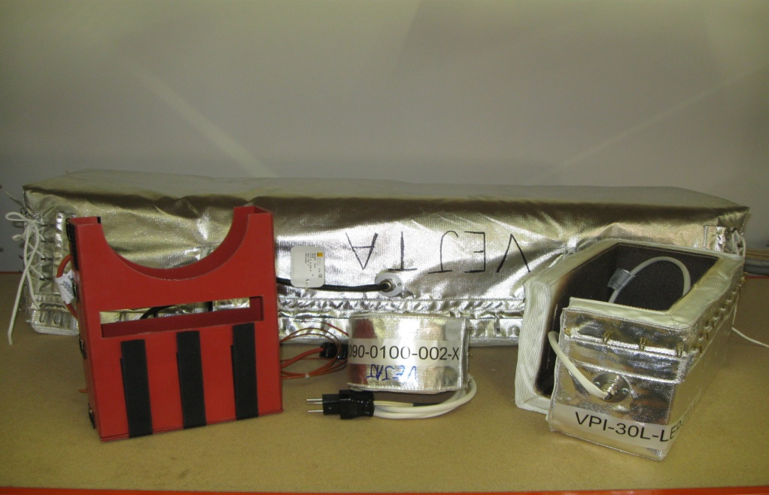
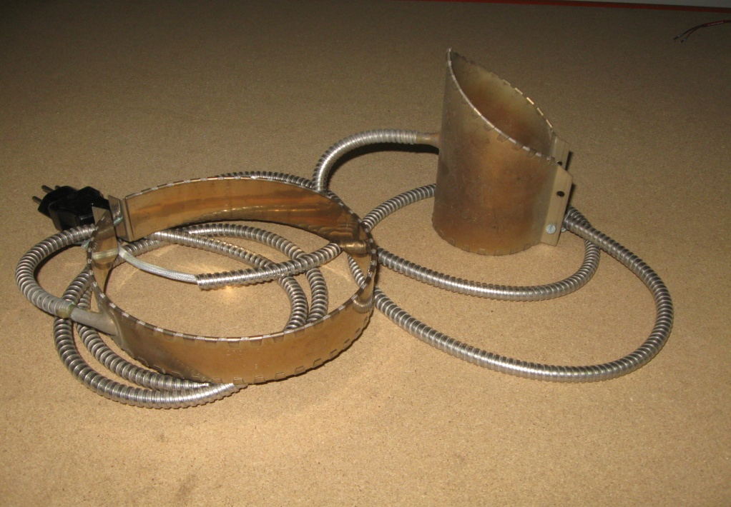
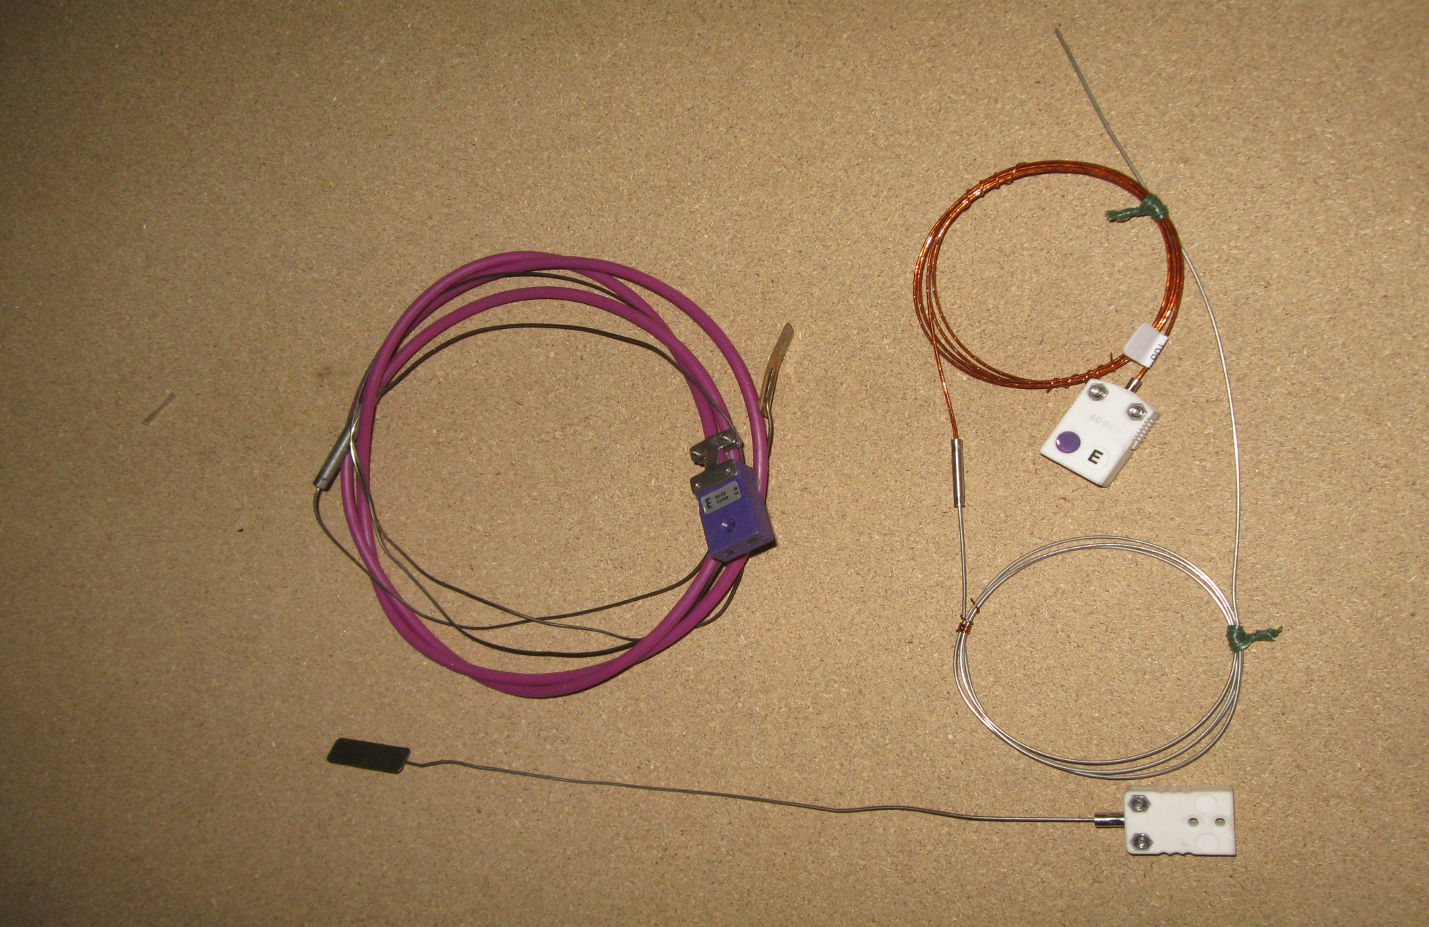
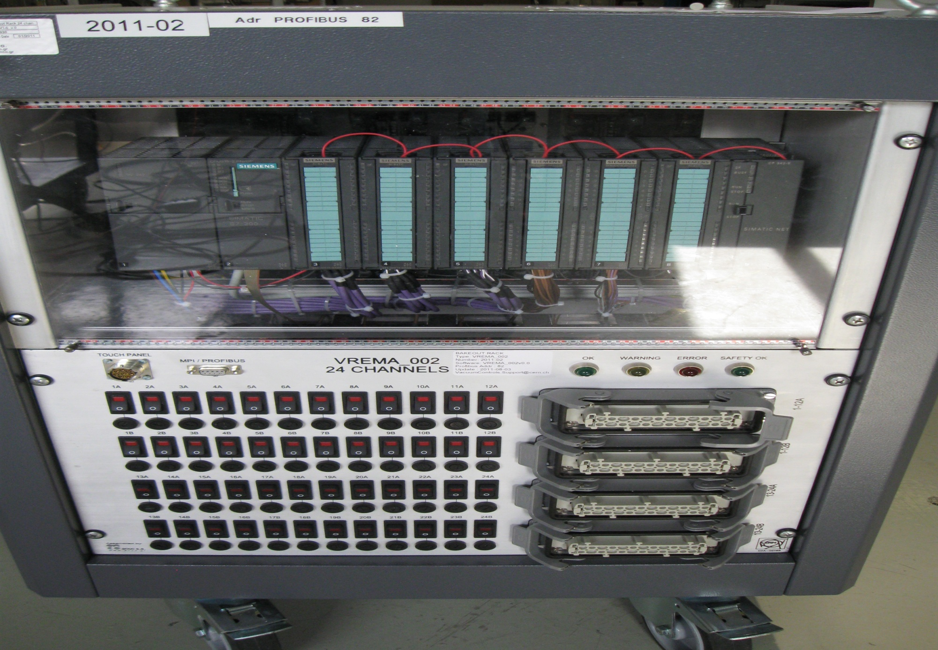
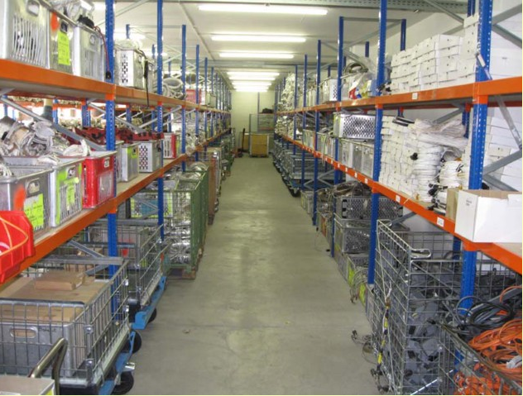
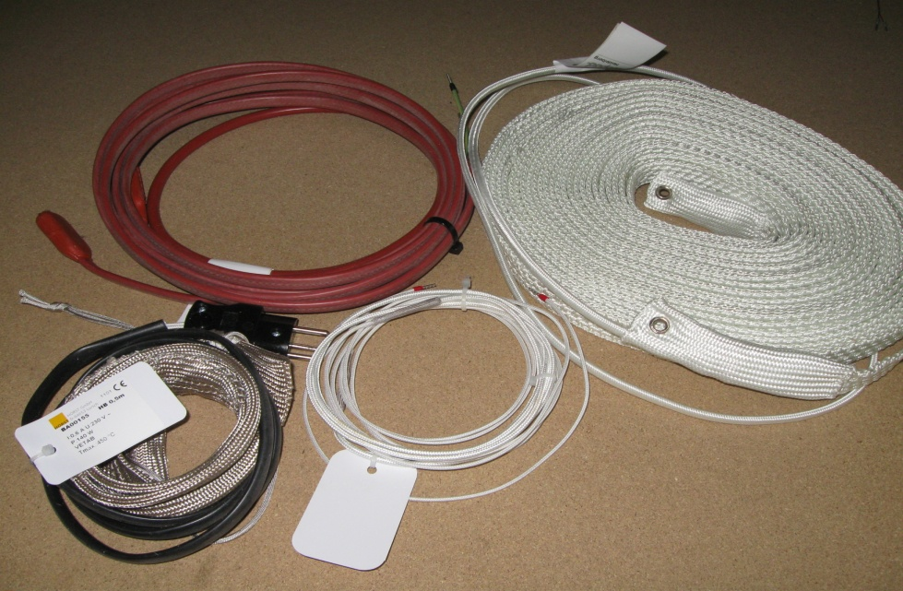
Material for bakeout
thermocouples
Collars
bakeout jackets
heating tape
racks
All parts shall be baked (including in vacuum assemblies) : cold spots are forbidden !
Storage area

Slide 26
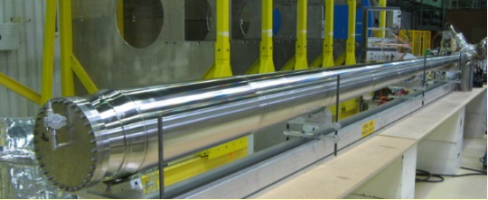
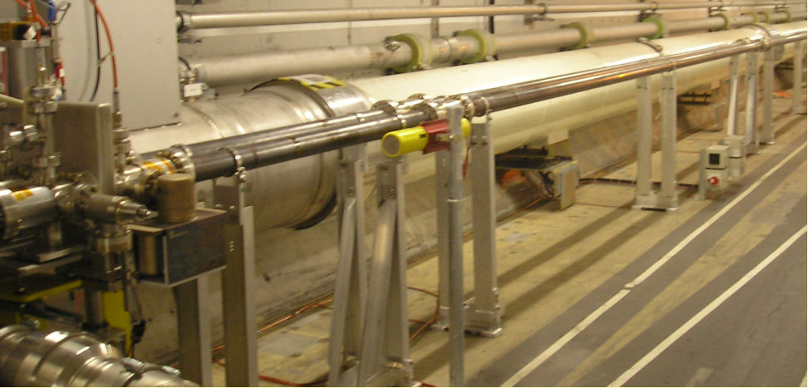




Typical design values of outgassing rates
The outgassing rate of baked surfaces is dominated by H₂
Metal, baked (24 h at 150ºC for Cu and Al, 300ºC for SS) after 50h of pumping (Torr.l.s⁻¹.cm⁻²)
Gas | Al | Cu | St. Steel | Be
H₂ | 5 10⁻¹³ | 1 10⁻¹² | 5 10⁻¹³ | 1 10⁻¹²
CH₄ | 5 10⁻¹⁵ | 5 10⁻¹⁵ | 5 10⁻¹⁵ | 1 10⁻¹⁴
H₂O | 1 10⁻¹⁴ | <1 10⁻¹⁵ | 1 10⁻¹⁴ | 2 10⁻¹⁴
CO | 1 10⁻¹⁴ | 1 10⁻¹⁴ | 1 10⁻¹⁴ | 2 10⁻¹⁴
CO₂ | 1 10⁻¹⁴ | 5 10⁻¹⁵ | 1 10⁻¹⁴ | 2 10⁻¹⁴
A.G. Mathewson et al. in Handbook of Accelerator Physics and Engineering, World Scientific, 1998
Outgassing rate of baked materials are 2-3 order of magnitude less than unbaked materials
CMS End cap chamber
Copper tubes

Slide 27
Amount of gas removed after a bake-out
After a laboratory bake-out of a stainless-steel chamber at 200ºC for 20 h
Gas species | H₂ | CH₄ | H₂O | CO | CO₂ | Total
Molecule.cm⁻² x 10¹⁵ | 11 | 0.7 | 7 | 4.4 | 5.7 | 28.8
C. Herbeaux et al., J. Vac. Sci. Technol. A 17(2), Mar/Apr 1999, 635
Several monolayers of gas are removed from the vacuum system during a bake out

Slide 28
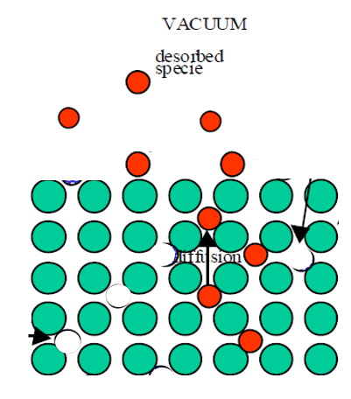



Model of diffusion
The diffusion coefficient is a strong function of the diffusion energy and temperature:
$$D(T)=D_{o}e^{−{E_{diff}}/{kT}}$$
The hydrogen diffusion in materials is governed by Fick Laws:
1st Law: The gaseous flux, q, is equal to the product of the diffusion coefficient, D, by the gradient of hydrogen concentration
$$q(x,t)=−D \frac{∂c(x,t)}{∂x}$$
2nd Law: The time variation of the hydrogen concentration is equal to the product of the diffusion coefficient by the second derivative of the hydrogen concentration in the solid
$$\frac{∂c(x,t)}{∂t}=D \frac{∂^{2}c(x,t)}{∂x^{2}}$$
➔ These simple laws explain the hydrogen outgassing of materials

Slide 29

Hydrogen outgassing versus time
During a pump down, the hydrogen concentration on the surface and in the material is reduced with time
The time variation of the hydrogen concentration can be computed using the 2nd Law which allows to compute the hydrogen outgassing rate from the first law.
The hydrogen outgassing rate, q, after a pumping time, t is (Co being the initial hydrogen concentration assumed to be uniform):
$q\left(t\right)=D{\left(\frac{∂c(x,t)}{∂x}\right)}_{x=0}=c_{o}\sqrt{\frac{D}{π}}\frac{ 1}{\sqrt{t}} ∝ {\sqrt{D} t}^{−1/2}$
The H₂ outgassing rate varies inversely with the square root of the pumping time
During the pump down, the hydrogen naturally embedded in the material is depleted from it => re-exposure to air do not recharge the bulk
R.J. Elsey, Vacuum 25, 7 (1975), 299

Slide 30
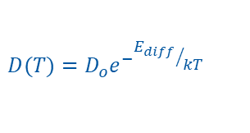

Bake-out
During an in-situ bake-out, the temperature of the material is increased to several 100ºC (T_{BO})
for several hours (t_{BO}) in such a way the hydrogen diffusion is increased to stimulate its depletion from the material of thickness L.
As a result, the outgassing rate at room temperature is greatly reduced and almost constant vs time
$$q_{RT}\left(t\right)≈\frac{{4 c}_{o }D(T_{RT}) }{L}e^{−{\left(\frac{π}{L}\right)}^{2}{D\left(T_{BO}\right)t}_{BO}}$$
In practice, increasing the bake out temperature is more efficient than increasing the bake out duration time:
$$D(T)=D_{o}e^{−{E_{diff}}/{kT}}$$
200ºC | 250ºC | 300ºC
1 day | 7h | 2h
4 days | 1 day | 8h
10 days | 2 days | 1 day
Table of equivalences between
bake out temperature
R.J. Elsey, Vacuum 25, 7 (1975), 299
R. Calder, G. Lewin, Br J Appl. Phys, 18, 1967, 1459

Slide 31
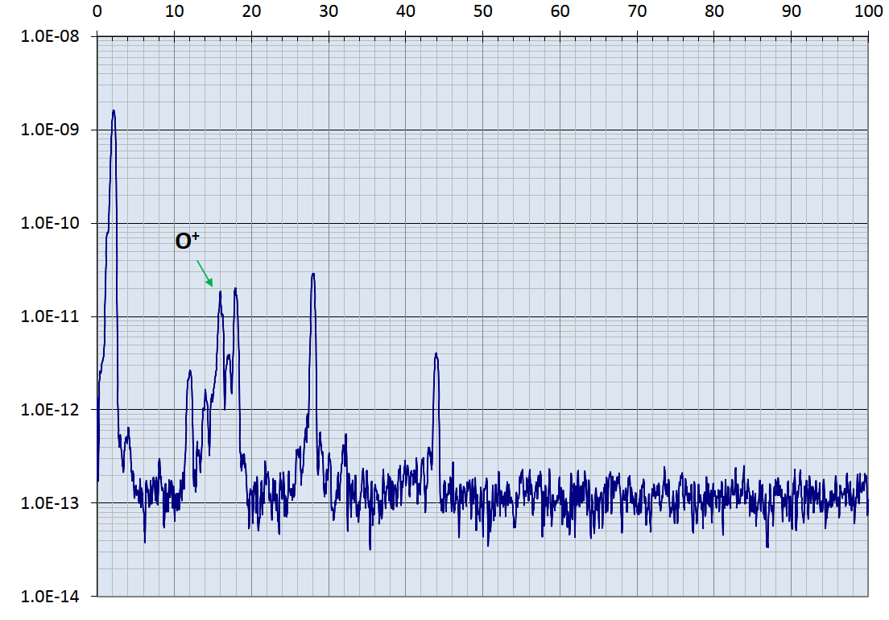
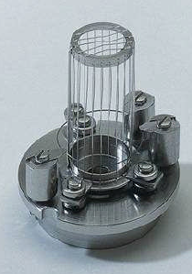
Gas composition after bakeout
Baked system P = 4 10⁻¹¹ mbar
Clean spectrum
  Hydrogen dominated, traces of H₂O, CO, CO
  No contamination (no masses above 50 i.e. no hydrocarbons)
  Spurious peaks following the grid bombardments by electrons (16: O⁺,19:F⁺)
H₂
F⁺
1 mA
Q ~ 2·10⁻⁹ mbar·l/s
Data courtesy B. Jenninger

Slide 32
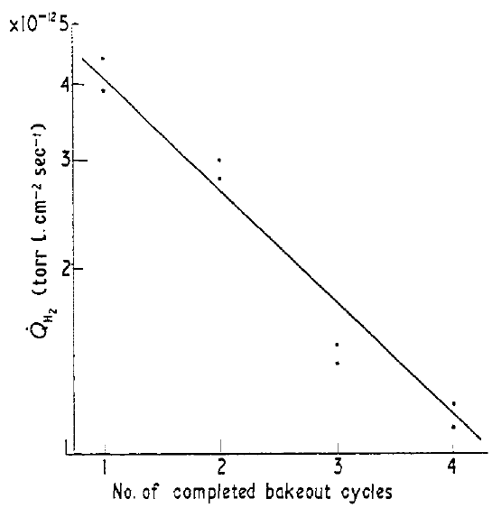


Successive bake-outs
n successive bakeouts at T_{BO} give the following outgassing rate at room temperature:
$$q_{n}\left(t\right)=\frac{{4 c}_{o }D(T_{RT}) }{L}e^{−n {\left(\frac{π}{L}\right)}^{2} {D\left(T_{BO}\right)t}_{BO}}$$
R. Calder, G. Lewin, Br J Appl. Phys, 18, 1967, 1459
A plot ln(q) vs number of bakeout cycles,n, is linear
with a slope proportional to the diffusion coef.
$$\frac{q_{n+1}\left(t\right)}{q_{n}\left(t\right)}=e^{{\left(\frac{π}{L}\right)}^{2} {D\left(T_{BO}\right)t}_{BO}}$$
➔ each bakeout cycle reduce the outgassing at room temperature by a constant value
Stainless steel sample: a reduction of x1.3-1.5 after each cycle
LHC collimator: a reduction of x1.3 after each cycle
R. Calder, G. Lewin, Br J Appl. Phys, 18, 1967, 1459
J. Kamiya et al., Vacuum 85 (2011) 1178-1181

Slide 33
Slot 3 summary
The pressure in a vacuum vessel is determined by the outgassing of its surface
The sojourn time of a molecule on a surface is a strong function of its binding energy and the temperature of the surface
Unbaked materials are dominated by water outgassing. The desorption rate is 1/t
Baked material are dominated by hydrogen outgassing. The desorption rate is 1/√t limited by diffusion

Slide 34
Thank you for your attention !!!

Slide 35
Some References
J.L de Segovia, Physics of outgassing, CAS, CERN 99-05
K. Jousten, Thermal outgassing, CAS, CERN 99-05
H.F. Dylla, Water outgassing, CAS Vacuum in Accelerators, May 2006
P. Chiggiato, Thermal outgassing, CAS Vacuum in Accelerators, May 2006 & Material & properties: Outgassing, CERN ACC-2020-009
R. Calder, G. Lewin, Reduction of stainless-steel outgassing in ultra-high vacuum, Br J Appl. Phys, 18, 1967, 1459
R.J. Elsey, Outgassing of vacuum materials, Vacuum 25, 7 (1975), 299
A. G. Mathewson, Making it Work, CAS, CERN 92-03
R. J. Reid, Cleaning for vacuum services, CAS, CERN 99-05
M. Taborelli, Cleaning and surface properties, CAS, CERN 2007-003 & CERN ACC-2020-009
The physical basis of ultra-high vacuum, P.A. Redhead, J.P. Hobson, E.V. Kornelsen. AVS.
Scientific foundations of vacuum technique, S. Dushman, J.M Lafferty. J. Wiley & sons. Elsevier Science.
Les calculs de la technique du vide, J. Delafosse, G. Mongodin, G.A. Boutry. Le vide.
Vacuum Technology, A. Roth. Elsevier Science

