Slide 2

Vacuum Systems
Slot 4
V. Baglin
CERN TE-VSC, Geneva
https://indico.cern.ch/event/1470062/timetable/?view=standard#day-2025-02-17

Slide 3
Outline
Hydrogen reduction
Other materials
Qualification of materials

Slide 4
1. Hydrogen reduction

Slide 5
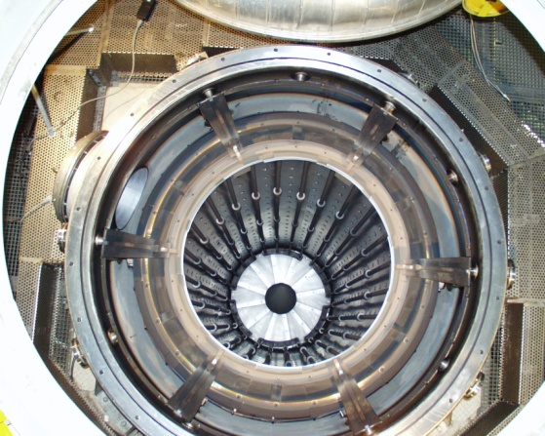
Vacuum firing
A method to reduce hydrogen content in stainless steel (316 series)
Degassing of the material is performed in an oven at 950°C under vacuum (<10⁻⁵ mbar) for 2 h
The high temperature allows to enhance hydrogen diffusion
CERN large furnace
Length: 6 m
Diameter: 1 m
Maximum charge weight: 1000 Kg
Ultimate pressure: 10⁻⁹ mbar
P at the end of the treatment:
high 10⁻⁶ mbar range
Courtesy P. Chiggiato, TE-VSC

Slide 6
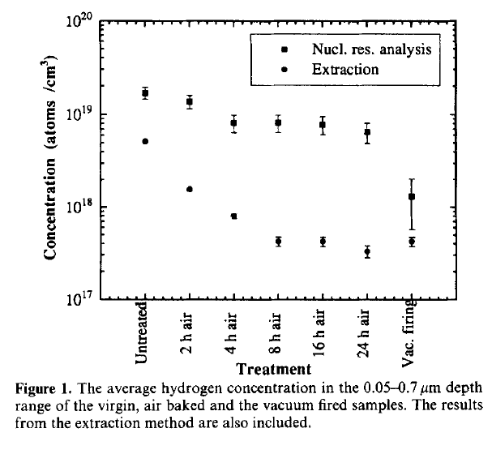
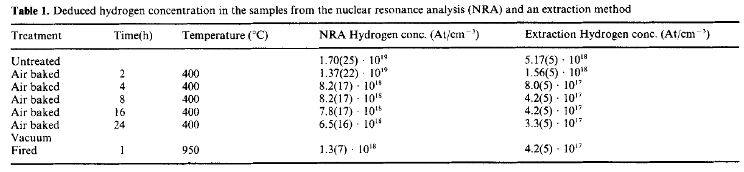



Impact on structural properties
Under the heat surface treatment 304 series stainless steel are recrystallized due to carbide precipitation at the grain boundaries
➔ cannot be used as material for flanges (leak at the level of the knife)!
➔ low carbon and low carbon nitrogen alloys stainless steel are used (316LN)
The hardness of the material is not modified
The surface is enriched in Fe due to the Cr evaporation during the heat treatment
When the material is brought back to atmospheric pressure, it keeps the memory of the treatment since the hydrogen diffusion at room temperature is small
    ➔ A single treatment is needed for the full life of the material
c ~ 2 10¹⁹ H/cm³ reduced to 10¹⁸ H/cm³
L. Westerberg et al., Vacuum 48 (1997) 771-773

Slide 7
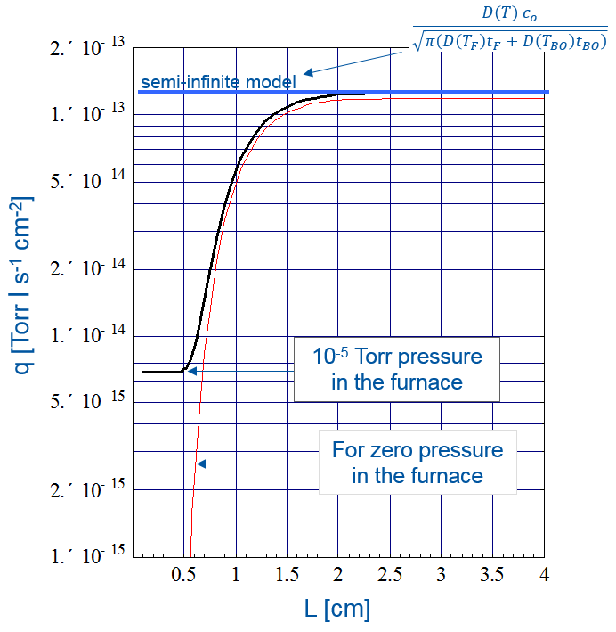


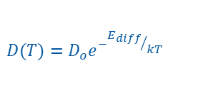

Subsequent bakeouts following vacuum firing
As in previous lecture (slide 32), considering the achieved hydrogen surface concentration following the vacuum firing, the hydrogen outgassing rate after n successive bakeout at temperature T_{BO} and duration t_{BO} is obtained from the 1st Fick Law:
$$q\left(t\right)=D{\left(\frac{∂c(x,t)}{∂x}\right)}_{x=0}$$
$$q_{n,F}\left(t\right)=\left[c_{F}+\left(c_{o}−c_{F}\right) e^{−{\left(\frac{π}{L}\right)}^{2}D\left(T_{F}\right)t_{F}}\right]\frac{4 D(T_{RT}) }{L}e^{−n {\left(\frac{π}{L}\right)}^{2} {D\left(T_{BO}\right)t}_{BO}}$$
R. Calder, G. Lewin, Br J Appl. Phys, 18, 1967, 1459
The diffusion terms dominates:
For thin sheets (tubes), the initial content of the hydrogen is fully removed. The final outgassing is defined by the H₂ pressure in the furnace:
  q ~ 5 10⁻¹⁵ mbar.ℓ/(s.cm²)
For thick slab (flanges), the pressure in the furnace as limited influence:
  q ~ 10⁻¹³ mbar.ℓ/(s.cm²)
$$D(T)=D_{o}e^{−{E_{diff}}/{kT}}$$
Courtesy P. Chiggiato, TE-VSC

Slide 8
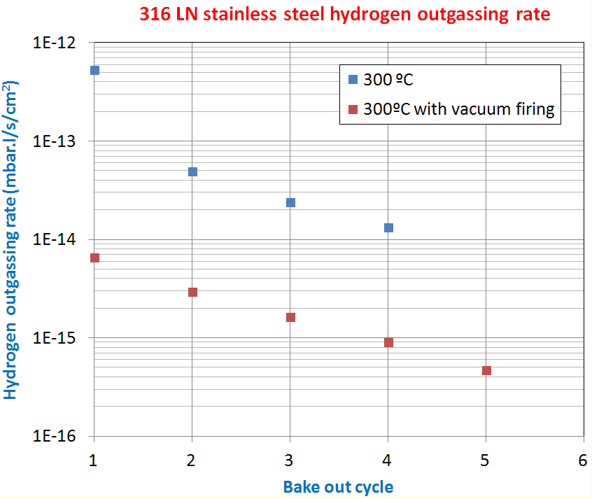
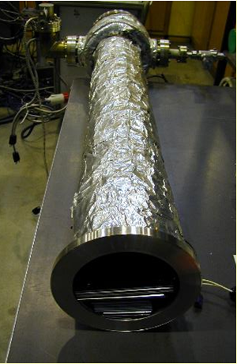
Stainless steel 316 LN
1.5 mm thick sheet held at 300°C for 24 h, rate measured 120 h after the end of bake-out
As expected from diffusion theory:
  - H₂ outgassing rate of 6 10⁻¹⁵ mbar.ℓ/(s.cm²) and a reduction of ~ 1.8 between each cycle
B. Versolatto, N. Hilleret, CERN Vacuum Technical Note 2002

Slide 9
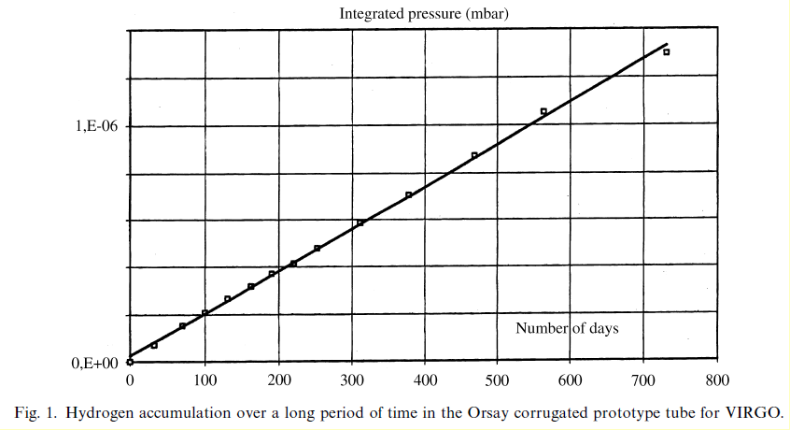
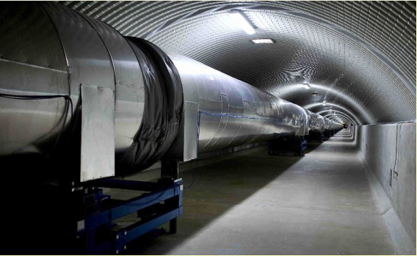
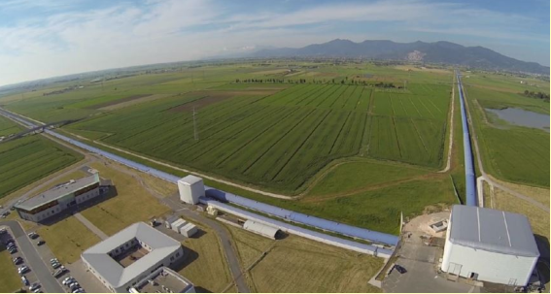
Diffusion barrier: air baking
The hydrogen diffusion is reduced by a diffusion barrier created during the air bake-out
Stainless steel tube:
  8 m length, 1.2 m diameter, 2mm thick
Air fired at 400 deg for 38h
Then baked at 150 deg for 7 days
Oxide thickness x 10
q = 10⁻¹⁵ mbar.ℓ/s/cm²
Diffusion energy increased from 0.5 to 0.6 eV
Low cost!
Outgassing performance of an industrial prototype tube for the Virgo antenna, P. Marin et al. , Vacuum 49 (1998) 309
2x3 km arms
VIRGO Gravitational Waves detector at Pisa, Italy

Slide 10
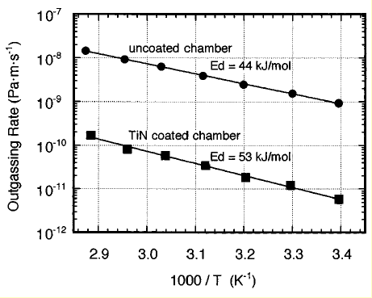
Diffusion barrier: TiN coating
The hydrogen diffusion is reduced by a diffusion barrier created by a coating e.g. TiN
At least 1 μm film thickness
The film reduce the hydrogen permeation
Extrapolation from coupons measurements predicts 10⁻¹⁴ Pa.m s⁻¹ (10⁻¹⁷ mbar.l/s/cm²)
3D objects: difficulties to realise a uniform coating without pinholes which compromised the observed performance on a tube or vacuum chamber
Reduction of 2 orders of magnitude of the hydrogen outgassing rate:
  Uncoated chamber: 10⁻¹² mbar.l/s/cm²
  TiN coated chamber: 7 10⁻¹⁵ mbar.l/s/cm²
N₂ equivalent
75˚C
RT
TiN thin film on stainless steel for extremely high vacuum material, K. Saito et al. , J. Vac. Sci. Technol. A 13(3) May/Jun 1995, 556
Today: no application in accelerator yet (some attempts for SNS ring, P. He et al., PAC 2003)

Slide 11
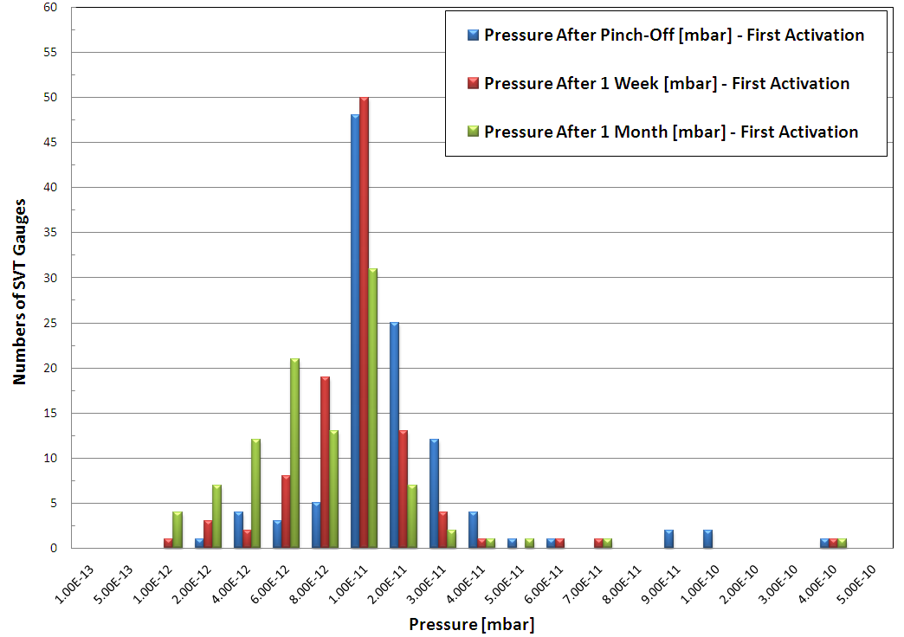
Dissolving hydrogen: NEG (TiZrV) coating
Ti-Zr-V is coated by magnetron sputtering using Kr gas
~ 1 μm thick
Owing to the high solubility and diffusivity of hydrogen once activated to 180-200˚C, the coating provides at room temperature extremely:
  Low outgassing rate: <10⁻¹⁷ Torr.ℓ/cm² that means < 300 CH₄/cm²
  Large pumping speed: 0.3-2.2 ℓ/s/cm² for H2 and 5-9 ℓ/s/cm² for CO
    ➔ ~ 2 000 & 15 000 ℓ /s per m of LHC vacuum chamber for H₂ and CO resp. !
Pressure distribution in the LHC RT vacuum sectors
  <P> ~ 10⁻¹¹ mbar
  Pressure reading limited by outgassing of the gauge port and by the gauge sensitivity
C. Benvenuti et al. Vacuum 60 (2001) 57-65
P. Costa Pinto, P. Chiggiato / Thin Solid Films 515 (2006) 382-388
G. Bregliozzi et al. EPAC’08, Genoa 2008

Slide 12
2. Other materials

Slide 13
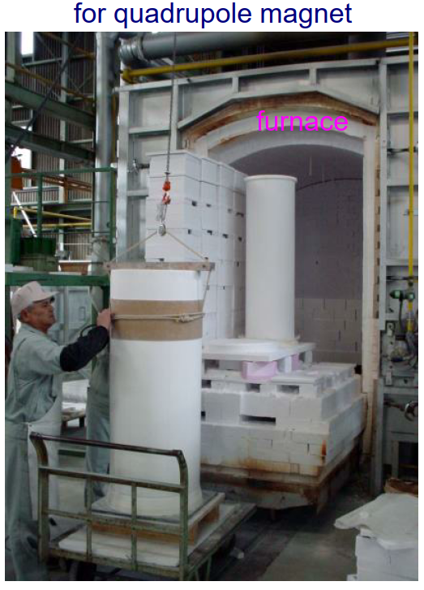
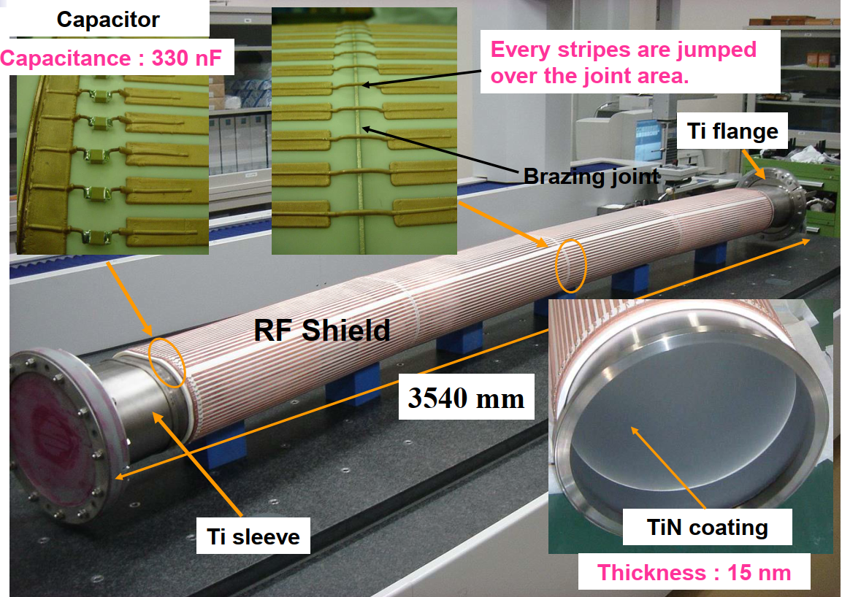

Outgassing of ceramics
Ceramics are used as insulators for feedthrough, as RF windows for their transparency to EM fields or to minimise Foucault’s currents induced in the vacuum chambers of fast ramping magnets (kickers) or fast cycling accelerators.
Outgassing rates are function of the porosity
J-Parc Vacuum chambers, M. Kinsho, Nov. 2005
Alumina (Al₂O₃) is sintered at high temperature (1600˚C) and chemically stable
TiN coated alumina chamber has q = 1 10⁻¹¹ mbar.ℓ/s/cm² after 50 h pumping
Macor and nitrides ceramics requires in-situ bakeout at 200˚C to reach ~ 10⁻¹¹ mbar.ℓ/s/cm² at RT
Y. Saito et al. Vacuum 86 (2012) 817-821
K. Battes et al. J. Vac. Sci. Technol. B39, 034202 (2021)

Slide 14
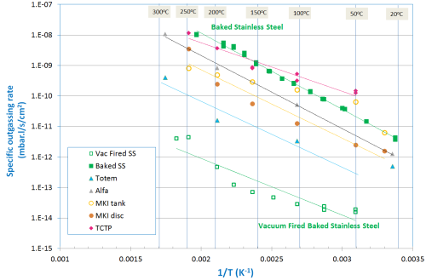
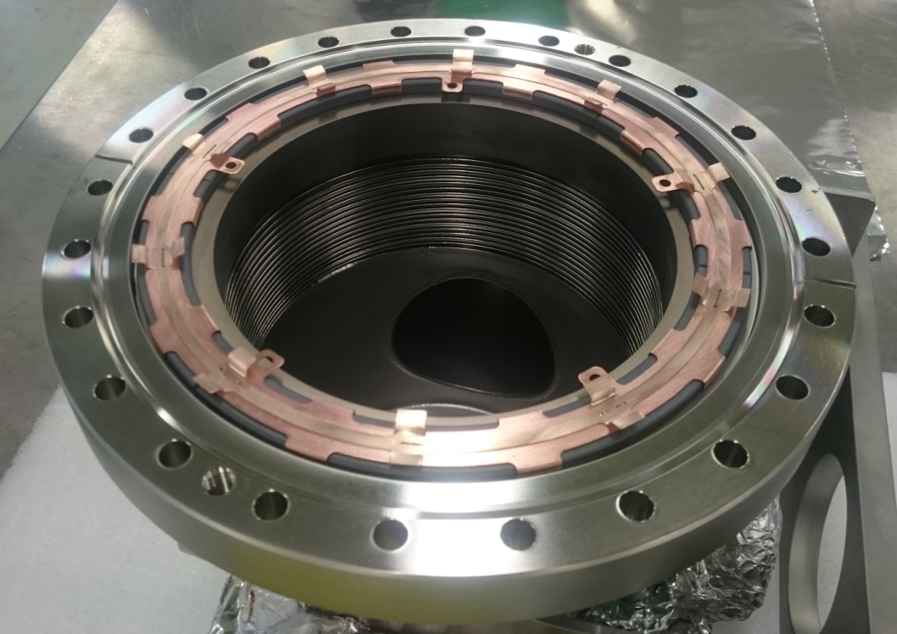
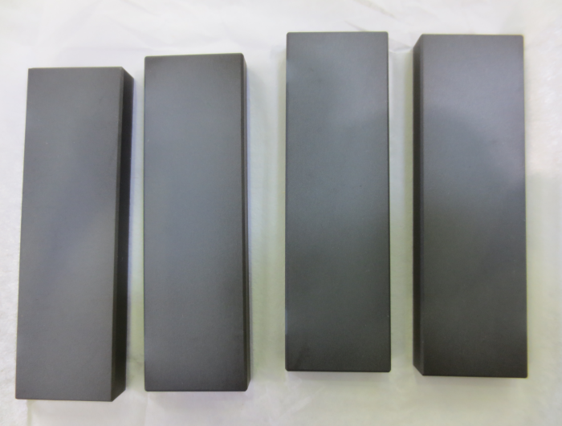
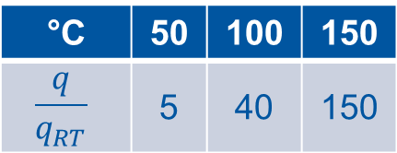
Outgassing of ferrites
Ferrites inserted in devices (XRP, TCSP, TCTP, MKI, TDI …) have low outgassing rate 10⁻¹¹ mbar.ℓ/s/cm² (after bakeout)
TT2-111R, CMD5005 and CMD10
Treated at 400°C – 1000°C
Arrhenius plot
But can heat up during operation => increase of outgassing rate
°C | 50 | 100 | 150 | 200
 | 5 | 40 | 150 | 600
LHC Roman Pots ferrite

Slide 15
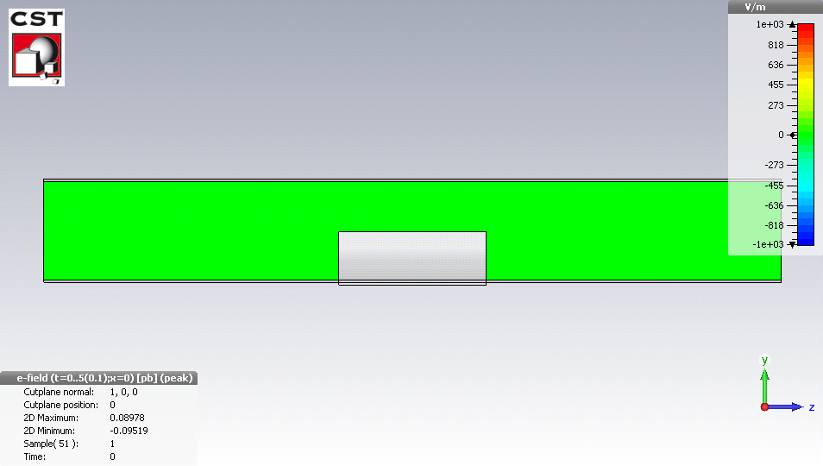
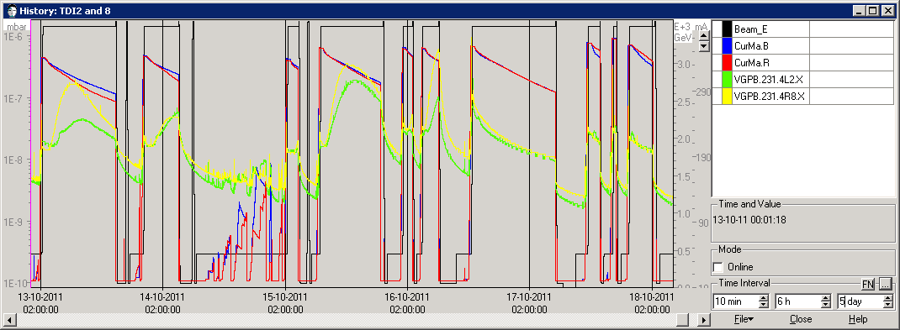

Example TDI during RUN1 and 2
A Target Dump for Injection device to protect downstream elements
Circulating beams increase the temperature of the BN jaws by impedance effects
Any beampipe component generates EM wakefields and may behave like a resonator or a damper
$$Q=Q_{o}e^{−\frac{E}{k T}}$$
Beam induced heating
X. Buffat, CAS, 2022
B. Salvant et al. EM simulations of the impedance of the LHC TDI. Proc. of IPAC 2012, New Orleans, USA
B. Salvant et al. Update on beam induced RF heating in the LHC. Proc. of IPAC 2013, Shangai, China

Slide 16
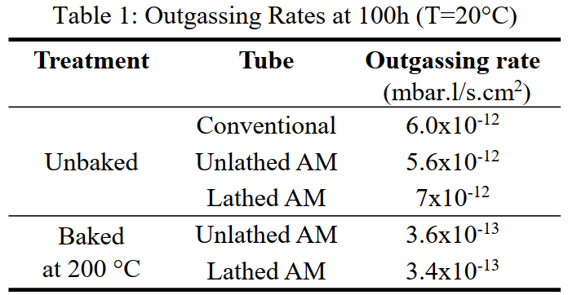
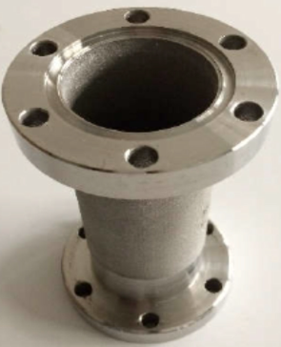
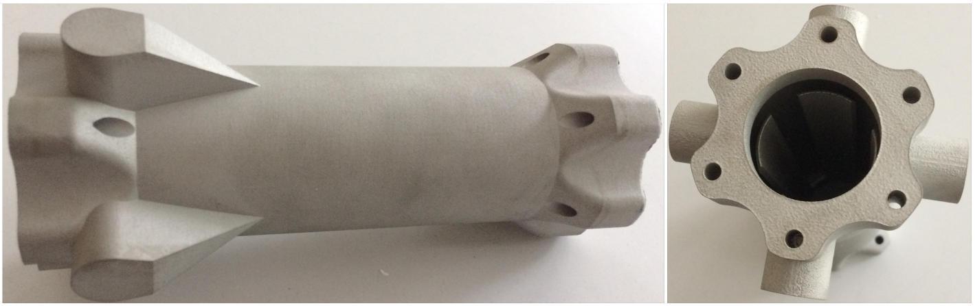
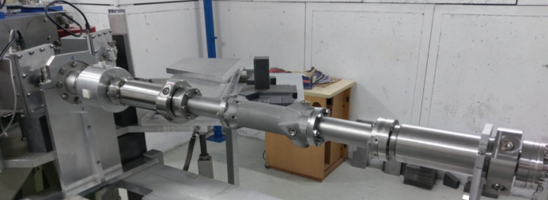
Outgassing of additive manufactured materials
Recent technique, only few applications yet
Additive manufactured stainless steel tube outgassing are as low as conventional ones.
G. Sattonnay et al. Proc. of IPAC 2019, Melbourne, Australia
Construction of an AM BPM
Test on a photo-injector show results as good as conventional BPMs
  ➔ AM BPM became THOM-X baseline
N. Delerue et al. Proc. of IPAC 2019, Melbourne, Australia

Slide 17
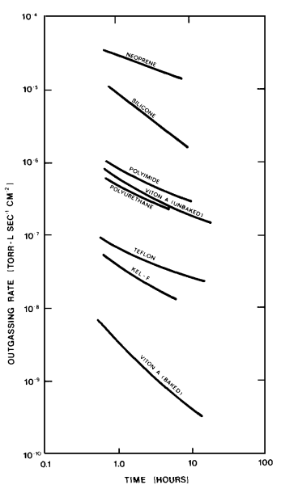
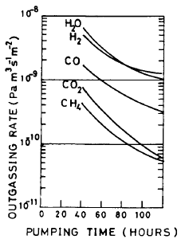


Outgassing of polymers & elastomers
Plastic materials are highly porous and contains much more water than metallic surfaces
Their outgassing rate is limited by a diffusion process with a = 1/2
$$q\left(t\right)=q_{0} t^{−a}$$
Plastic surfaces q ~ q₀/√t
Metallic surfaces q ~ q₀/t
x 10² - 10⁵
R.N. Peacock
J.Vac.Sci. 17(1), Jan/Fev 1980, 330-336
Unbaked Al
A.G. Mathewson et al.
J.Vac.Sci. 7(1), Jan/Fev 1989, 77-82
Good Vacuum Design :
Use ONLY metallic surfaces and reduce to ZERO the amount of plastics

Slide 18
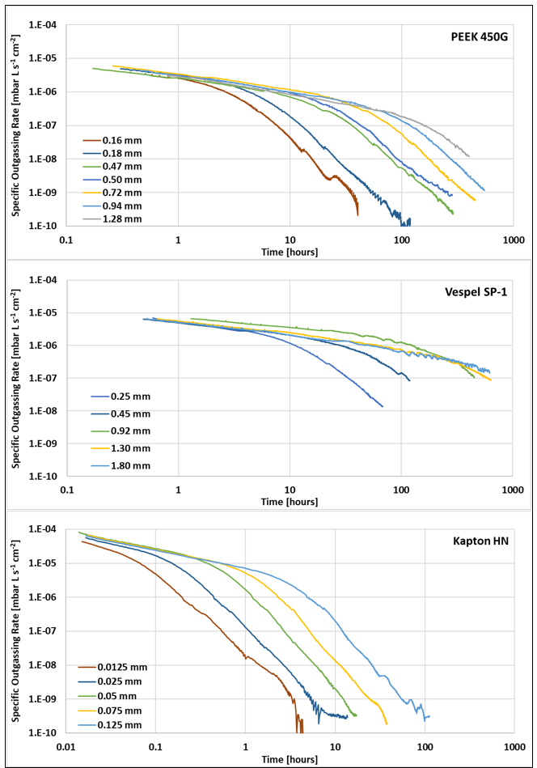
Outgassing of thin polymers
The thicker the material, the more moisture is embedded
q decreases from 10⁻⁵ after 1h to 10⁻¹⁰-10⁻⁷ after 100h
Compared to Vespel® & Kapton®, PEEK has:
  larger diffusion coefficient hence faster q reduction
  lower moisture content hence lower q
Diffusion process in 1/√t then 1/t³ after extended time (>100 h)
Polymers thicker than ~ 1 mm requires more than 2 weeks of pumping to reduce q significantly
A bake-out to 200˚C strongly reduce outgassing in the
10⁻¹¹ – 10⁻¹⁰ mbar.ℓ/s/cm² range
Venting with N₂ or dry air preserve the bake-out benefit
Increasing thickness
-0.5
-3
S. Sammartano et al. CERN-ACC-Note-2020-0039

Slide 19
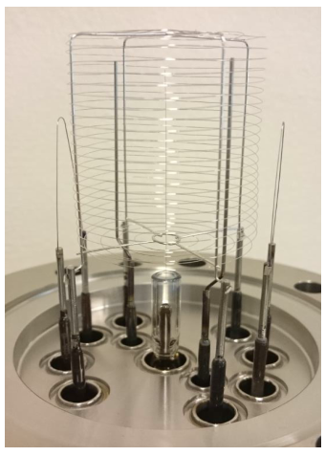
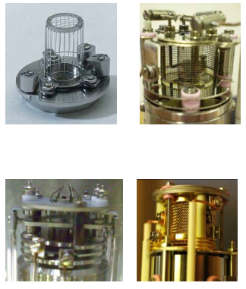
Outgassing of gauges filaments
During operation, filaments are heated to ~ 2 000˚C consequently desorbing gas and provoke also Electron Stimulated Desorption (ESD)
Q = 2 10⁻⁹ mbar.ℓ/s for W filament
= 1 10⁻¹⁰ mbar.ℓ/s for thoriated W filament
RGA | Ion source | Filament | Q (mbar.ℓ/s)
Faraday/SEM | Vac. fired grid | W | 2 10⁻⁹
Faraday/Channeltron | Vac. fired grid | W | 4 10⁻⁹
 | grid | W | 4 10⁻⁸
 | Vac. fired open source | Y | 8 10⁻⁹
 | Open source | Y/W | 2 10⁻⁸ 5 10⁻⁷
S. Meunier, CERN, 2019

Slide 20
3. Qualification of materials

Slide 21
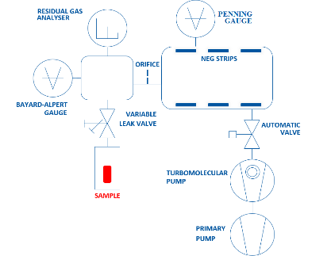

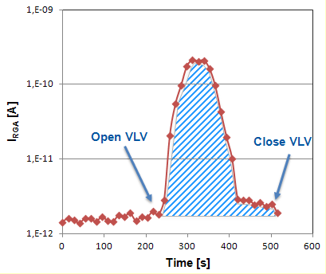
Outgassing measurement by Accumulation
A sample is placed in an evacuated vessel and the leak valve closed
Desorbed gas accumulates into the sample chamber
After some accumulation time t_{acc}, the leak valve is opened and the mass spectra recorded
The leak valve is closed again and the procedure repeated every 1 to 72 h
With:
  S_{i} the pumping speed for gas, i
  α the RGA calibration factor for gas, i
  I_{RGA} the current recorded during the leak valve opening
  Δt the RGA recording duration
  Δt_{ac} the accumulation time
Sensitive measurement but gas re-adsorption may matters
Courtesy I. Wevers, TE-VSC

Slide 22
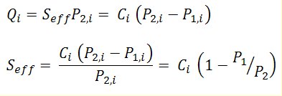


Outgassing measurement: throughput method
P₁
C
P₂
P₂base ~ 3∙10⁻¹⁰ mbar
J. Kamiya et al., Vacuum 85 (2011) 1178-1181
The component is connected to a pumping system via a conductance, C
Background is determined by a dry run
The outgassing rate is
➔
α the RGA calibration factor for gas, i
I_{i} the RGA current for gas I
c_{i} the conductance for gas i
In N₂ equivalent no RGA is needed!

Slide 23
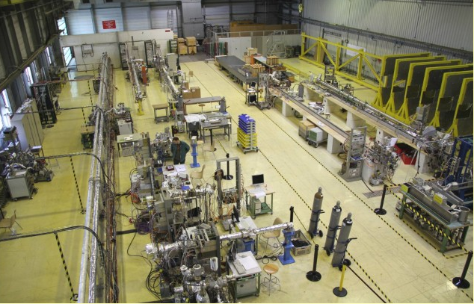
Vacuum Acceptance Test Laboratory
LHC vacuum laboratory during LS1 (2013-2014)

Slide 24
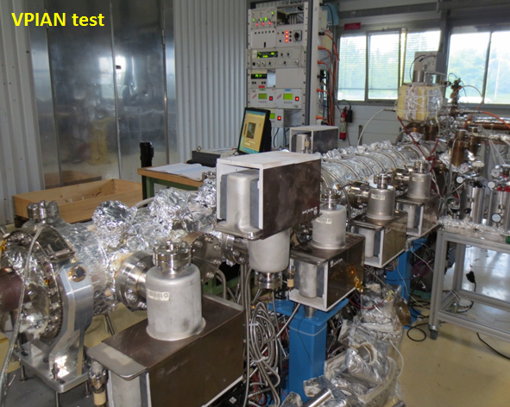
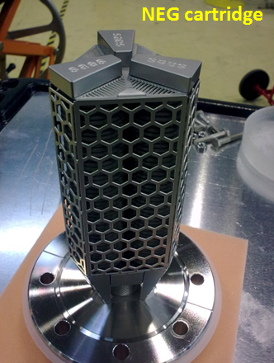
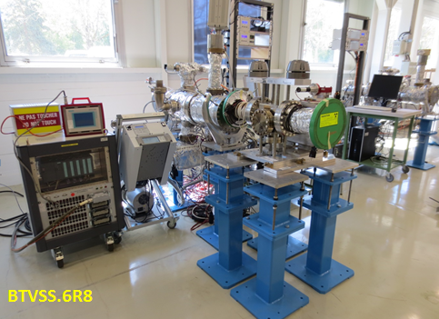
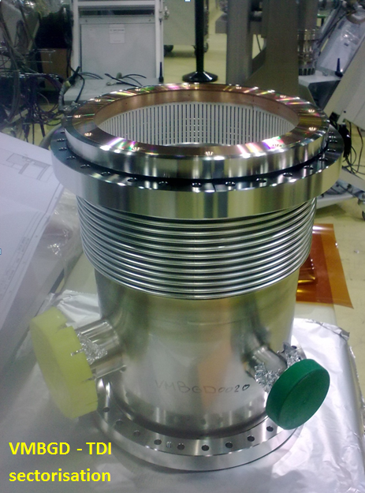
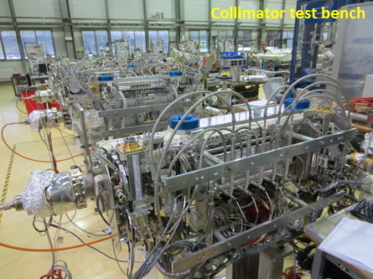
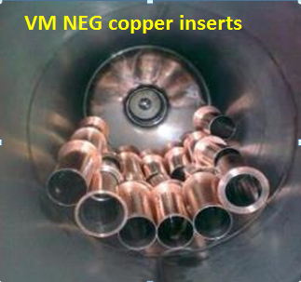
Example of tested parts

Slide 25
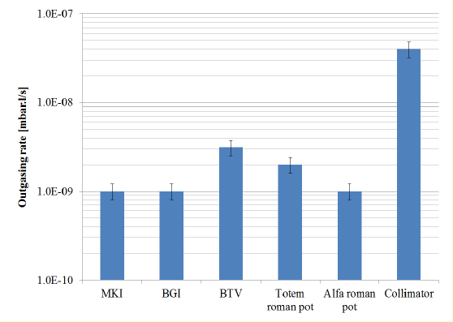
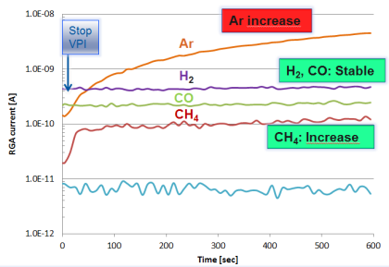
LSS Vacuum Sectors
Vacuum Acceptance Tests
Prior to LS1 installation ~1200 LSS’s equipments have been baked and validated at the surface :
  functional test
  pump down
  leak detection
  residual gas composition
  total outgassing rate
Identification of virtual leaks by accumulation test
whilst pumping with NEG system
Outgassing rate of some LHC components
G. Cattenoz et al. , Proceeding of IPAC’14, Dresden, Germany

Slide 26
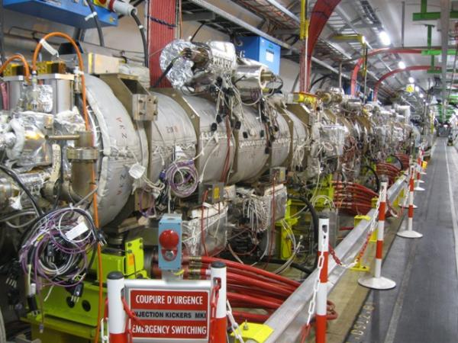
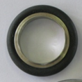
LSS Vacuum Sectors
Magnet Kicker for Injection (MKI)
Total outgassing rate of this chain of 4 MKIs is ~ 5 10⁻⁹ mbar.ℓ/s
  ➔ that corresponds to the outgassing of 2 VITON seals after 1 year of pumping
=
+
LHC Kickers

Slide 27
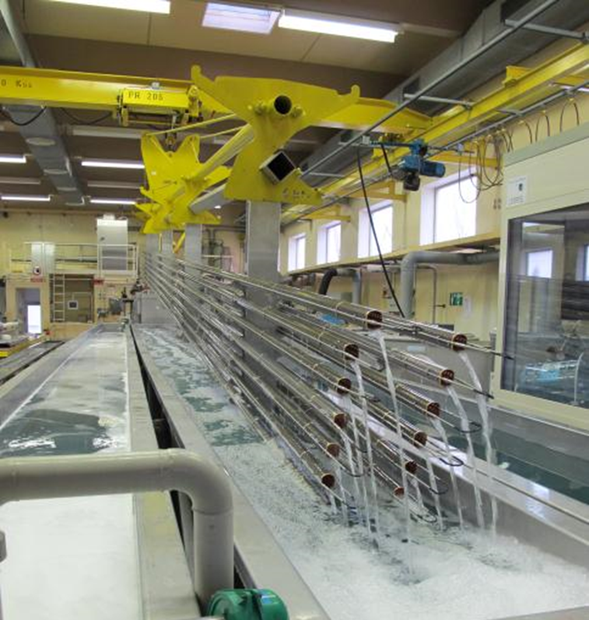
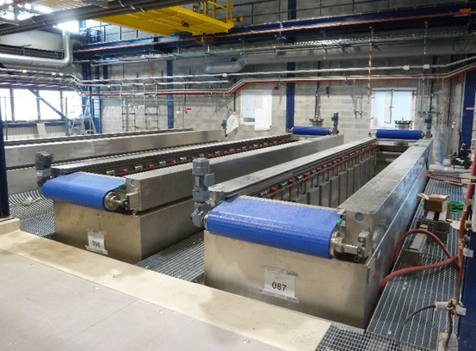
Cleaning Methods
Chemical cleaning is used to remove gross contamination such as grease, oil, fingerprints.
It can be needed to attack the surface with acids to etch the oxide layer
Passivation can be helpful to produce a “stable” oxide layer on the surface
Example of CERN LHC beam screens :
  Degreasing with an alkaline detergent at 50°C in an ultrasonic bath
  Running tap water rinse
  Cold demineralised water rinse by immersion
  Rinse with alcohol
  Dry with ambient air
L. Ferreira, CERN TE-VSC

Slide 28
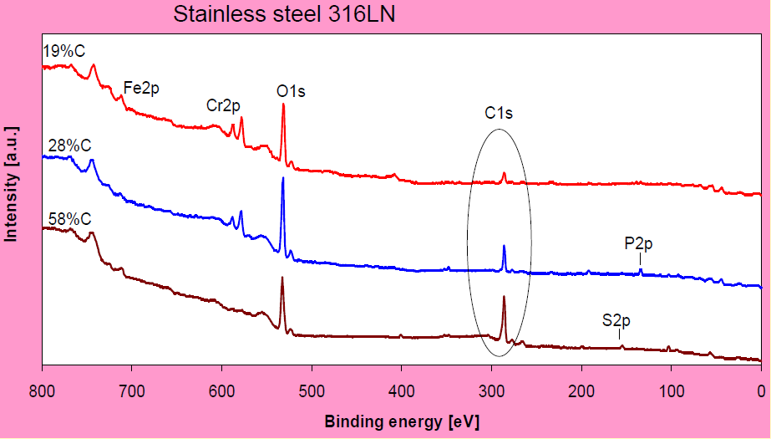
Surface analysis methods
Surface analysis is used to evaluate the cleanliness of a material, identify species, monitor a process etc.
Auger electron Spectroscopy
X-ray Photoelectron Spectroscopy
The assessment of metal surface cleanliness by XPS, C. Scheuerlein and M. Taborelli, Appl. Surf. Sci 252 (2006) 4279

Slide 29
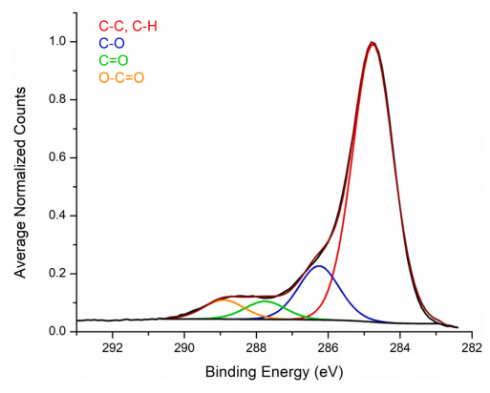
Example of adventitious carbon
Adventitious carbon = a thin layer of carbonaceous material that deposits on air-exposed surfaces
XPS analysis of adventitious carbon around C1s at 284.8 eV
Adventitious carbon layer is aliphatic (hydrocarbons C, H, having an open chain structure) in nature and not graphitic, with functional groups of C, O
Presence of CO and CO₂ molecules bounded on the very near surface (nm)
LH Grey et al., Appl. Surf. Sci 635 (2024) 159319

Slide 30
Slot 4 summary
Vacuum firing is used to reduce by 2 orders of magnitude the hydrogen outgassing of baked material.
Other material than metals have their outgassing rate spread over several orders or magnitude with plastics at the high extreme (x 10⁵ metallic surface)
Vacuum instruments outgas!
Components must be characterised in the laboratory with appropriate tools to guarantee a good performance in an accelerator

Slide 31
Thank you for your attention !!!

Slide 32
Some References
J.L de Segovia, Physics of outgassing, CAS, CERN 99-05
K. Jousten, Thermal outgassing, CAS, CERN 99-05
H.F. Dylla, Water outgassing, CAS Vacuum in Accelerators, May 2006
P. Chiggiato, Thermal outgassing, CAS Vacuum in Accelerators, May 2006 & Material & properties: Outgassing, CERN ACC-2020-009
R. Calder, G. Lewin, Reduction of stainless-steel outgassing in ultra-high vacuum, Br J Appl. Phys, 18, 1967, 1459
R.J. Elsey, Outgassing of vacuum materials, Vacuum 25, 7 (1975), 299
A. G. Mathewson, Making it Work, CAS, CERN 92-03
R. J. Reid, Cleaning for vacuum services, CAS, CERN 99-05
M. Taborelli, Cleaning and surface properties, CAS, CERN 2007-003 & CERN ACC-2020-009
The physical basis of ultra-high vacuum, P.A. Redhead, J.P. Hobson, E.V. Kornelsen. AVS.
Scientific foundations of vacuum technique, S. Dushman, J.M Lafferty. J. Wiley & sons. Elsevier Science.
Les calculs de la technique du vide, J. Delafosse, G. Mongodin, G.A. Boutry. Le vide.
Vacuum Technology, A. Roth. Elsevier Science

