Slide 1
RF Engineering
Introduction
Christine Völlinger (CERN) & Manfred Wendt (BNL)

Slide 2
Introduction
Basic concepts of RF engineering, with some focus on particle accelerators
This course material was presented several times at previous JUAS’s, still evolving…
  Topics, scope and presentation style is based on personal preferences
    and on some feedback from the JUAS 2023 and 2024
  Not meant to be complete or comprehensive, focus on the basics of ‘classic’ analog RF techniques
    Not covered: particle beam dynamics, LLRF, digital RF.
    Additional material, examples and exercises can be found in chapter II.2 – RF engineering of the JUAS Book:
    https://e-publishing.cern.ch/index.php/CYRSP/article/view/1618
      Highly recommended!!!
Let’s try to learn interactive
  For most sessions we tried to include some little quiz, please don’t be shy and answer!
  Try to work in teams with your colleagues, also for the exam preparation, but NOT during the exam!!!
  Make use of additional material / demo-software with links for download provided on indico
    Also, please exercise on previous exams, and actively follow the tutorials
Active student participation
  Quiz, Q&A, PC software examples (using CST Studio, Dellsperger Smith, Qucs, etc.)
Please install and test the software
  https://cernbox.cern.ch/s/mmvRrQhj0LdqAJG
  The CST Studio Suite 2025 needs to be installed BEFORE the lecture!
    Please attend the RF engineering software installation session Wednesday, 19th Feb. 2025, 16:15, room 13/2-005

Slide 3
RF Engineering Lecture
Basic concepts
  Introduction in RF engineering for particle accelerators
  Transmission-lines (TEM and waveguides), cylindrical (“pill-box”) resonator
  Standing waves, Smith-chart, scattering parameters
Some RF engineering details and examples
  Accelerating structures (standing / travelling wave)
  RF measurement techniques
    diode detector, oscilloscope, spectrum analyzer, vector network analyzer
  RF components
    Transmission-line components, couplers, filters, amplifiers, power RF
Preparation for the RF exam
  Tutorials, Q&A

Slide 4
RF Engineering Schedule
Wednesday, 19th Feb., AM | Thursday, 20th Feb., AM | Friday, 21^{rst} Feb., AM | Monday, 24th Feb., AM | Tuesday, 25th Feb., AM
 | 9:00 RF Engineering Manfred: Introduction to the Smith Chart | 9:00 RF Engineering Christine: Pillbox Resonator I | 9:00 RF Engineering Christine: Accelerating Structures | 9:00 RF Engineering Manfred: RF measurement techniques
15 minutes break
10:00 RF Engineering Christine & Manfred: Some practical notes Christine: RF Introduction | 10:00 RF Engineering Christine: Transmission-lines II | 10:00 RF Engineering Michela: 3D Numerical Analysis of Pillbox Eigenmodes | 10:00 RF Engineering Manfred: RF components – a selection | 10:00 RF Engineering Michele, Manfred: Tutorials (exam prep on S-parameters, Smith chart and pill-box resonator)
15 minutes break
11:00 RF Engineering Christine: Transmission-lines I | 11:00 RF Engineering Manfred: S-Parameters | 11:00 RF Engineering Manfred: PC exercise with Qucs Christine: Pillbox Resonator II

Slide 5
RF Engineering Schedule
Monday, 3rd March, AM | Tuesday, 11th March, all day | Wednesday, 12th March, all day
9:00 Morning until 10:30 Written Examination RF Engineering | 9:30 All day (CERN Prevessin) Practical Days RF Measurements Michele | 9:30 All day (CERN Prevessin) Practical Days RF Measurements Michele

Slide 6
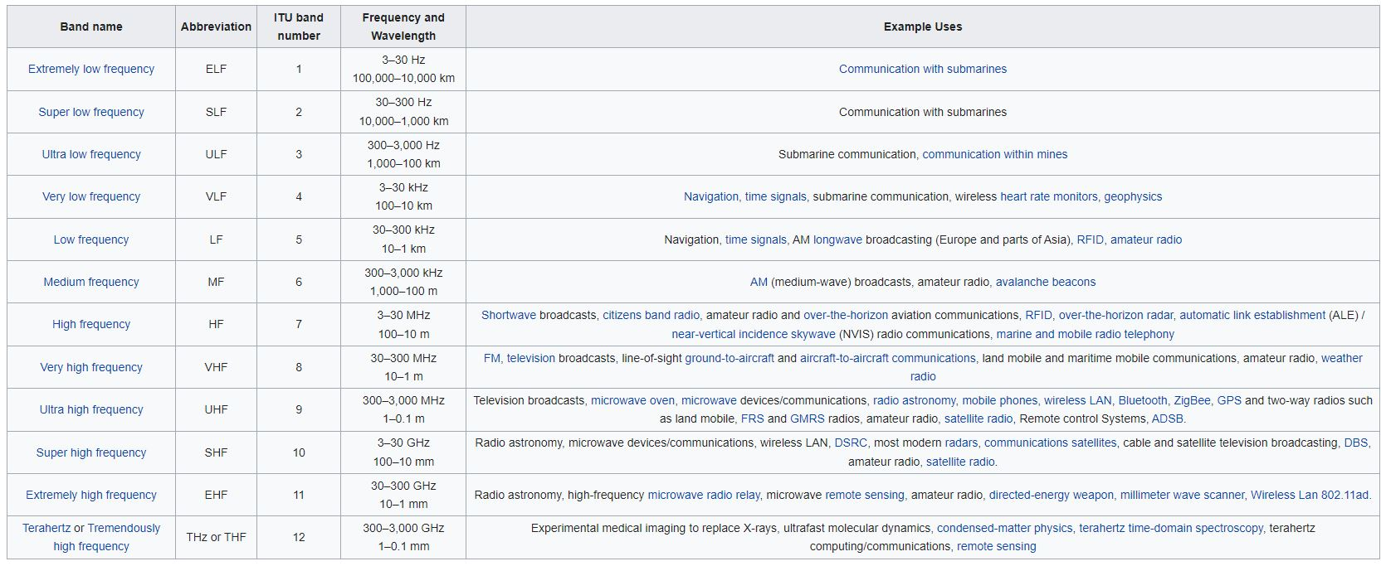
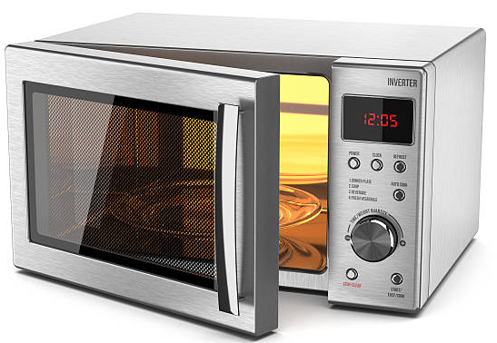

What is RF (Radio Frequency)?
Source: en.wikipedia.org/wiki/Radio_spectrum

Slide 7
What is RF (Radio Frequency)?
Source: en.wikipedia.org/wiki/Radio_spectrum
“RF frequencies”
Frequency
Wavelength
“Microwave range”
“millimeter waves (wavelengths in mm)”
What you should know by heart:
Hz “Hertz” is the unit of frequency: sec⁻¹
1 MHz = 10⁶ Hz (Megahertz)
1 GHz = 10⁹ Hz (Gigahertz)
Frequency f and wavelength λ are inversely proportional:
Large frequency means small wavelength.

Slide 8
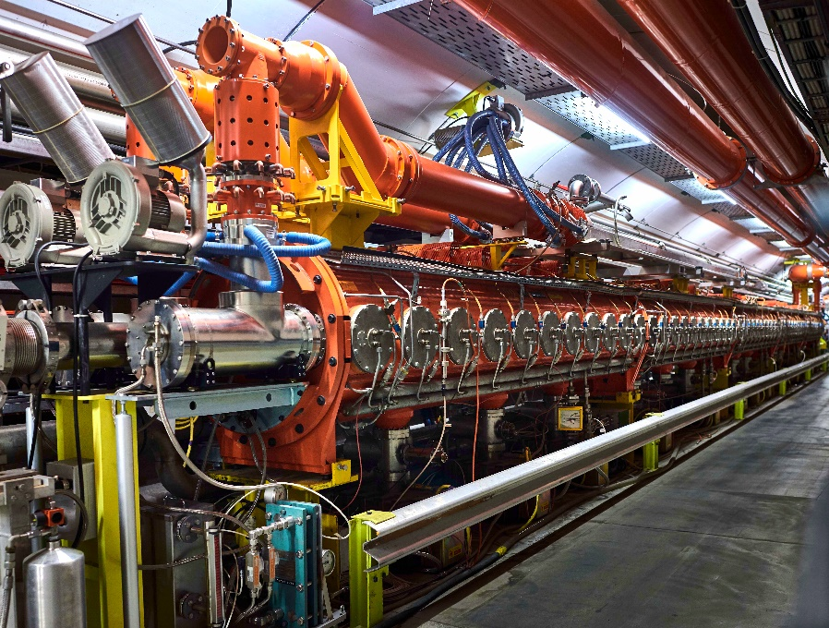
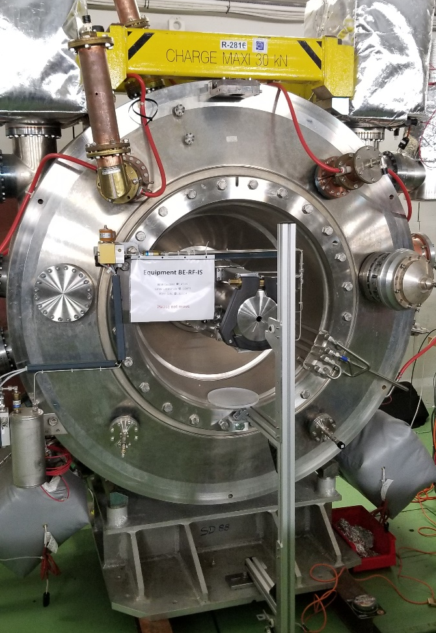
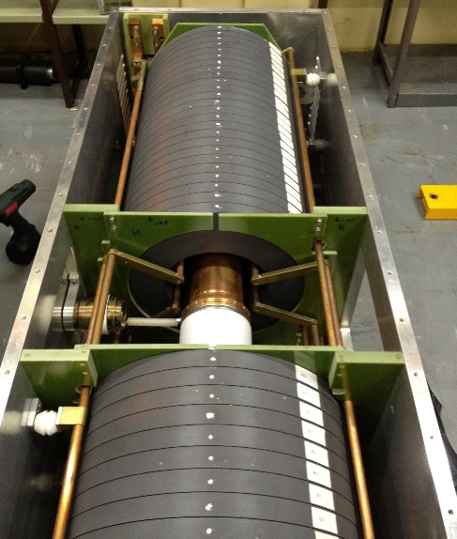
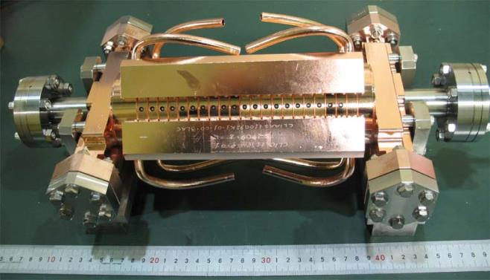
What is Radio Frequency (for accelerators)?
Source: en.wikipedia.org/wiki/Radio_spectrum
approx. 2 m
Travelling wave cavity, freq = 200 MHz
Total length: 16 m. (CERN SPS)
Accelerating Cavity, freq = 80 MHz
(CERN PS)
Ferrite Loaded Cavity,
freq = 3 – 8 MHz
(CERN PS Booster)
All pictures © CERN
CLIC structure, freq = 12 GHz

Slide 9
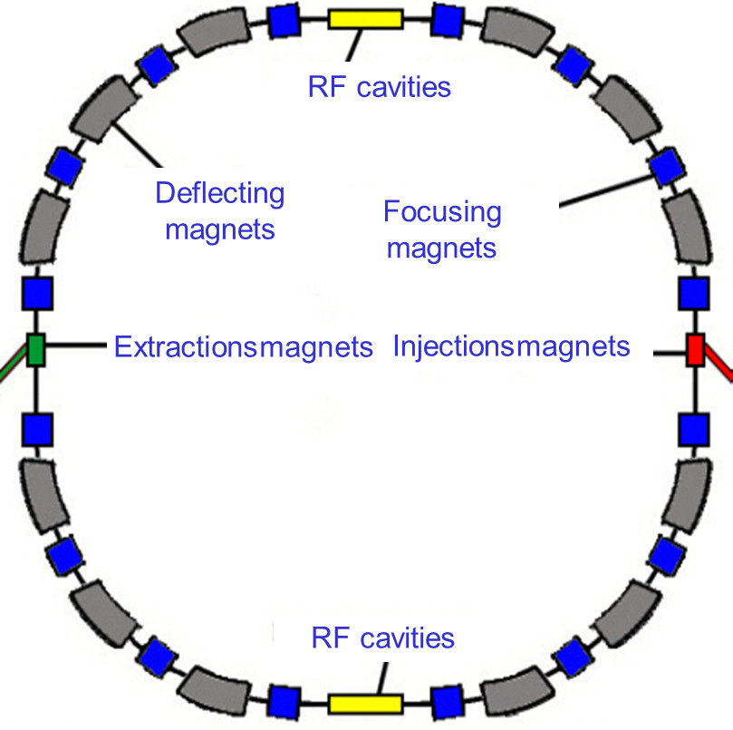
What is Radio Frequency (for accelerators)?
RF domain is huge!
The radiofrequency (RF) system does the actual acceleration - it transforms a string of magnets into an accelerator.
Cavity is the most visible part of an RF system
  On top of the RF system food chain
  Interacts directly with beam
  Provides acceleration and RF manipulations, but
  also some unwanted effects (e.g. beam coupling
  impedance contribution)
  Cavity is no “stand-alone” element…
  … requires RF signals generated (LLRF system) to be operated successfully and power input to transfer energy to the beam.

Slide 10
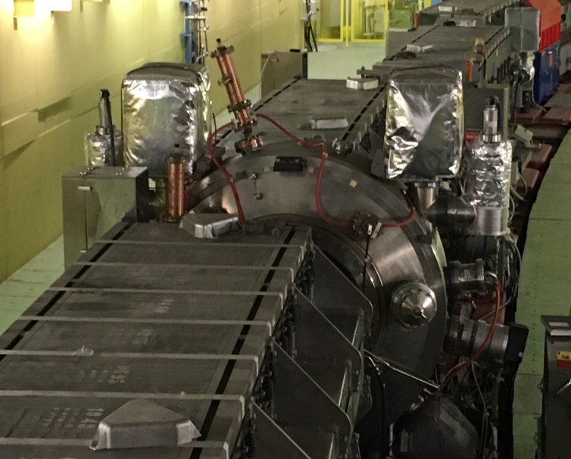
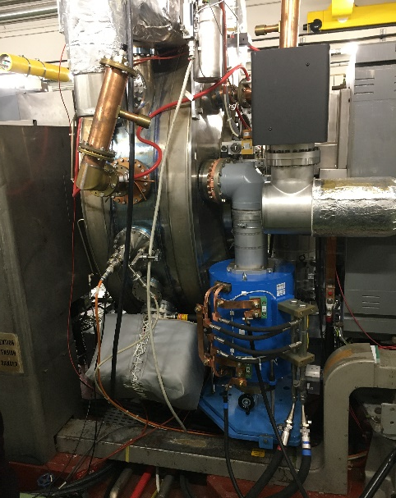
A simplified RF System
Low-level
RF system
High power
RF system
RF source
High power RF
waveguide or coaxial
distribution system
LLRF
High power
RF input coupler
RF field probe
signal
RF cavity resonator (“pillbox cavity”)
PS single cell cavity (“pillbox”)
q
v
beam
E
metallic beam pipe
Illustration stolen from M. Wendt

Slide 11
Purpose of this lecture
From the introduction of Maxwell’s equation (lecture of Andrea Mostacci), you know already:
What are the sources of electro-magnetic fields.
Differential form of Maxwell’s equations.
Now, we will look into:
Lorentz’ force (direct application of M.E. to particle accelerators).
Time-varying fields and the wave equation.
Plane waves as simplest solution of the wave equation, and corresponding terms like:
  Frequency f, radian frequency ω and wavelength λ
  Propagation constant k (real and complex), attenuation constant α and phase constant β
  Phase velocity v_{p} and wave impedance
  Skin depth (penetration depth) δ

Slide 12


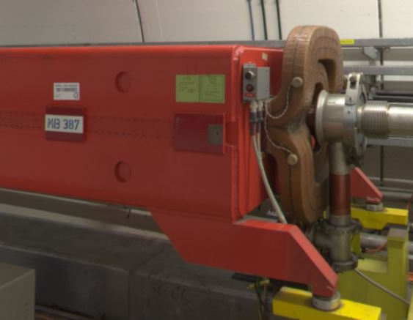
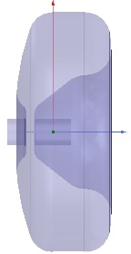




Purpose of this lecture
From M.E. in differential form to Helmholtz’ equation… these give the basis of our field description.
or
q
Accelerating force and bending force in a circular accelerator.

Slide 13
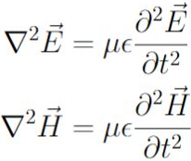
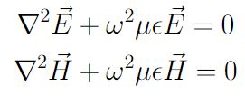


Basic Wave Equation & Figures of Merit
… can’t spare you some maths, but at least it is not new…
From Maxwell’s curl equations
(“differential form”)
Wave equation or Helmholtz’ equation
(see talk of Andrea Mostacci for details)
What you should know:
Equally, we can write Helmholtz’ equation in phasor notation (source-free, linear media, harmonic time dependence):
Propagation constant k
(or: phase constant, or wave number, or separation constant),
with unit 1/m
define
is the radian frequency

Slide 14
Basic Wave Equation & Figures of Merit
This is the equation to solve…
Simplest solution is: Plane wave (no variation in x and y). We assume propagation in z-direction:
Quiz!
Test your knowledge.
Exponential function in frequency domain
Real part of e-function in time domain
E⁺ and E⁻ denote the wave amplitudes for travelling in positive and negative z-direction.
We will now consider 3 different cases to introduce the yet unknown figures of merit.
Plane wave in a lossless medium,
Plane wave in lossy medium,
Plane wave in a good conductor.

Slide 15
Quiz no. 1
What is the unit of frequency?
- m
- 1/sec
- mm/sec
- Ohm
With increasing frequency, does the wavelength of a microwave reduce or increase?
  - wavelength reduces with increasing frequency
  - wavelength increases with increasing frequency
  - wavelength is a constant and does not change
What is the phase velocity of a wave travelling in vacuum?
  - v_{p}= λ· f
  - c₀ (speed-of-light)
  - ω

Slide 16
Quiz no. 1
What is the unit of frequency?
- m
- 1/sec (correct answer)​
- mm/sec
- Ohm
With increasing frequency, does the wavelength of a microwave reduce or increase?
  - wavelength reduces with increasing frequency (correct answer)​
  - wavelength increases with increasing frequency
  - wavelength is a constant and does not change
What is the phase velocity of a wave travelling in vacuum?
  - v_{p}= λ· f (correct answer)​
  - c₀ (speed-of-light) (correct answer)​
  - ω

Slide 17
Basic Wave Equation & Figures of Merit
1. Solution for plane wave in a lossless medium
wave travelling in positive z-direction
wave travelling in negative z-direction
How can we “see” that?
Keep the cosine argument constant to maintain a fixed point of the wave: for increasing time, z has to increase as well → this describes a propagation in positive z-direction.  ☺

Slide 18


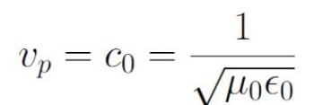
Basic Wave Equation & Figures of Merit
1. Solution for plane wave in a lossless medium
wave travelling in positive z-direction
wave travelling in negative z-direction
What you should know
We define
Phase velocity v_{p} as the velocity at which a fixed phase point travels:
In free-space, this would be the speed of light:

Slide 19
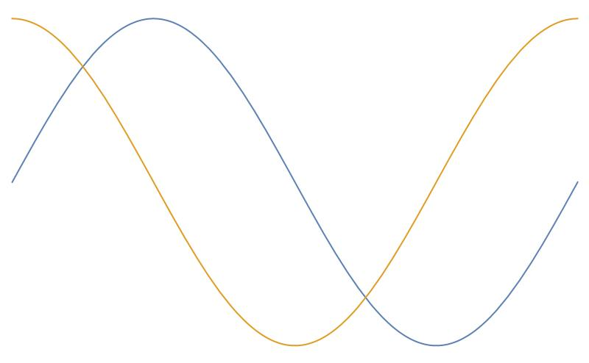



Basic Wave Equation & Figures of Merit
1. Solution for plane wave in a lossless medium
We define
λ
Wavelength λ as the distance between two successive
reference points on the wave at a fixed instant in time:
λ
Hence:
Position ‘z’
Position ‘z+ λ’
What you should know by heart:
We define
Wave impedance for plane waves = intrinsic impedance of a medium
in vacuum,
also called vacuum impedance

Slide 20





Basic Wave Equation & Figures of Merit
2. Solution for plane wave in a conductive (lossy) medium
Take the plane wave description for harmonic time dependence (slide 9), and the propagation constant k.
In the case of conductive medium, we observe losses and k becomes complex.
Remember? From:
If we now take conductive (lossy) medium, conductivity σ remains in the equations.
Complex propagation constant
phase constant
define
attenuation constant

Slide 21

Basic Wave Equation & Figures of Merit
2. Solution for plane wave in a conductive medium (lossy)
What you should know
Complex propagation constant
phase constant
define
attenuation constant
Important remarks:
The same equation for the complex propagation constant was derived in the lecture of Andrea Mostacci by using a complex permittivity.
If the conductivity is zero, we obtain:
In textbooks, formulae for attenuation constant differs, depending on the used definition.
Be careful and check the naming convention used in the different books before you start calculating!

Slide 22



Basic Wave Equation & Figures of Merit
3. Solution for plane wave in a good conductor (good, but not perfect!)
Good conductor means that displacement current is considerably smaller than conduction current:
What you should know
Side remark:
define
skin depth (= penetration depth):
Depth over which amplitude of the EM-field will decrease by a factor of 1/e.

Slide 23
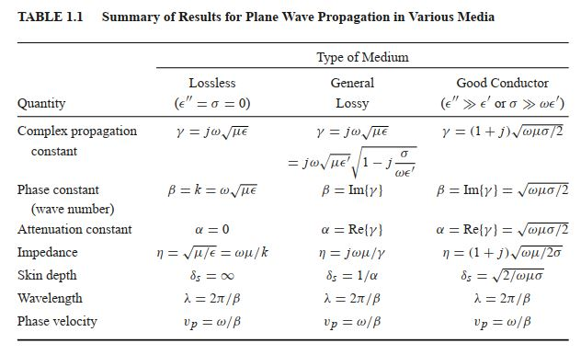
Plane wave propagation at a glance…
2nd quiz!
Test your knowledge.
Source: Pozar, Microwave engineering, 4th ed., Wiley

Slide 24
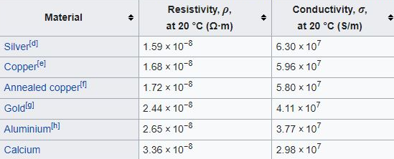
Quiz no. 2
The table shows the different electrical conductivities of copper, gold and aluminum:
Source: https://en.wikipedia.org/wiki/Electrical_resistivity_and_conductivity
Which metal has the lowest field penetration depth?
- Silver
- Calcium
- Gold
Does the skin depth increase or reduce with increasing frequency?
- skin depth increases with increasing frequency
- skin depth reduces with increasing frequency

Slide 25
Quiz no. 2
The table shows the different electrical conductivities of copper, gold and aluminum:
Source: https://en.wikipedia.org/wiki/Electrical_resistivity_and_conductivity
Which metal has the lowest field penetration depth?
- Silver (correct answer)
- Calcium
- Gold
Does the skin depth increase or reduce with increasing frequency?
- skin depth increases with increasing frequency
- skin depth reduces with increasing frequency (correct answer)

Slide 26




RF Engineering terms…decibels: dB
Decibels are used to express large number ranges by using the base 10 logarithm of numbers.
Decibels are very handy to cover several orders of magnitude, for example power from mW to MW…
Although the ratio gives a dimensionless expression, we call the result “Bel” - after Alexander Bell.
The factor of “10” then just compensates for deci-Bel (dB). (yes, with only one ‘l’, must have been a physicist typing…)
Let’s develop this:
Trivial. Just like 1 deci-meter = 0.1 meter.

Slide 27



RF Engineering terms…decibels: dB and dBm
Backwards conversion is also possible, of course:
Very often, the power of 1 mW is taken as reference quantity. In this case, we speak of “dBm”:

Slide 28
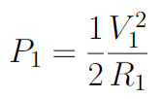
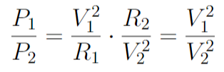
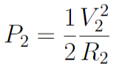


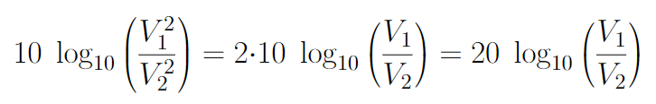
RF Engineering terms…decibels: dB
Finally, let’s speak about voltage decibels and power decibels
(that’s just nonsense!).
There is only one type of decibels as it is a ratio. A value given in dB is always the same.
However, if we express our power values in voltages…. we could create voltage decibels… 
Remember?
If (!):
Let’s use the identity:

“voltage decibels”

Slide 29

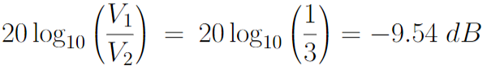



RF Engineering terms…decibels: dB
This can be confusing, if you are not used to it.
Remember what we said before:
There is only one type of decibels as it is a ratio. A value given in dB is always the same.
(Power value as input)
(Voltage value as input)
Example:

Slide 30
RF Engineering terms…decibels: dB
S-parameters, the standard measurement value used in RF (more details later) are often expressed in dB.
Per definition, S-parameters are already ratios thus no explicit reference is needed.
Power ratio = voltage ratio squared.
Some common values expressed in dB:
 | power ratio | V, I, E or H ratio, S-parameter
-20 dB | 0.01 | 0.1
-10 dB | 0.1 | 0.32
-3 dB | 0.50 (-50%) | 0.71
-1 dB | 0.794 (about -20%) | 0.891 (about-11%)
0 dB | 1 | 1
1 dB | 1.258 (about+26%) | 1.122 (about+12%)
3 dB | 2.00 (+100%) | 1.41
10 dB | 10 | 3.16
20 dB | 100 | 10
n * 10 dB | 10^{n} | 10^{n/2}

Slide 31
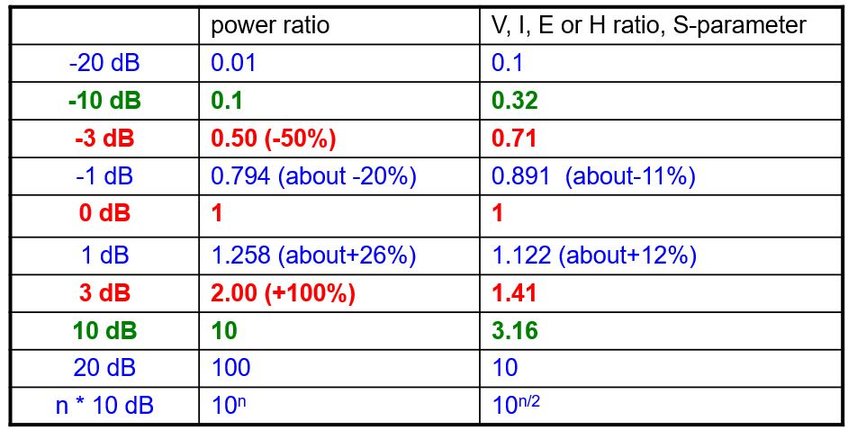



RF Engineering terms…decibels: dB
Let’s have a closer look and let’s talk RF-engineering:
“I measure 3dB less” →
The measured power is only half of the reference power.
Last quiz!
Test your knowledge.
“ We see a 3dB increase…” →
The measured power is twice the reference power.
But: the measured voltage is higher by a factor ~1.5.
“ I hardly see any signal anymore” → (Yup, I put in a 20 dB attenuator)
… so our signal went down by a factor of….?
“Upps, 33 dB more power, is that enough?” → 33dB = 20dB + 10dB + 3dB (so your power increases by: 100*10*2 = 2000)

Slide 32
Quiz no. 3
If I have -5dB on a signal, is this amplifying or reducing the signal?
- amplifying the signal
- reducing the signal
- both
If my amplifier gives an amplification of 0dB, can I be happy with this?
- yes, this is a good amplification value
- no, this is a poor amplification value
- this is not amplifying
If we see a 3dB increase, the measured power is:
- half the reference power
- twice the reference power
- power does not change, only the voltage changes

Slide 33
Quiz no. 3
If I have -5dB on a signal, is this amplifying or reducing the signal?
- amplifying the signal
- reducing the signal (correct answer)
- both
If my amplifier gives an amplification of 0dB, can I be happy with this?
- yes, this is a good amplification value
- no, this is a poor amplification value
- this is not amplifying (correct answer)
If we see a 3dB increase, the measured power is:
- half the reference power
- twice the reference power (correct answer)
- power does not change, only the voltage changes

Slide 34
Thank you for your attention!

Slide 35
Let’s have a break!

Slide 36
Further reading…
POZAR, David M., “Microwave Engineering”, 4th edition, Wiley and sons.
ZHANG, Keqian, “Electromagnetic Theory for Microwaves and Optoelectronics”, 2nd edition, Springer

