Slide 1
RF Engineering
Transmission Lines I
Christine Völlinger (CERN) & Manfred Wendt (BNL)

Slide 2
Transmission Lines and Waveguides
Waves in unbounded media
(see last session & lecture of A. Mostacci).
Two categories of electromagnetic waves
Waves confined by material boundaries, so-called guided waves.
We will learn about:
General transmission line theory.
Coaxial lines and operating conditions (damping, power transmission, cut-off frequency).
Metallic Waveguides (round and rectangular) and their defining parameters
- cut-off frequencies
- group and phase velocity
- attenuation
- higher order modes
Other transmission lines: striplines & micro-striplines

Slide 3
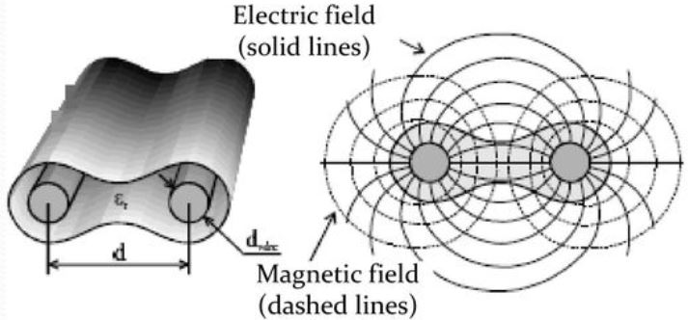
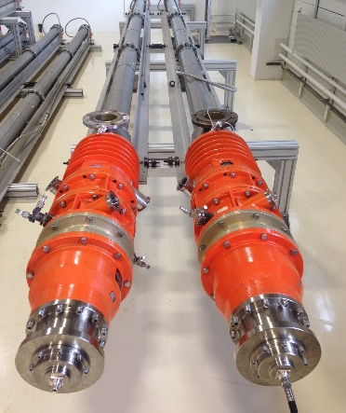
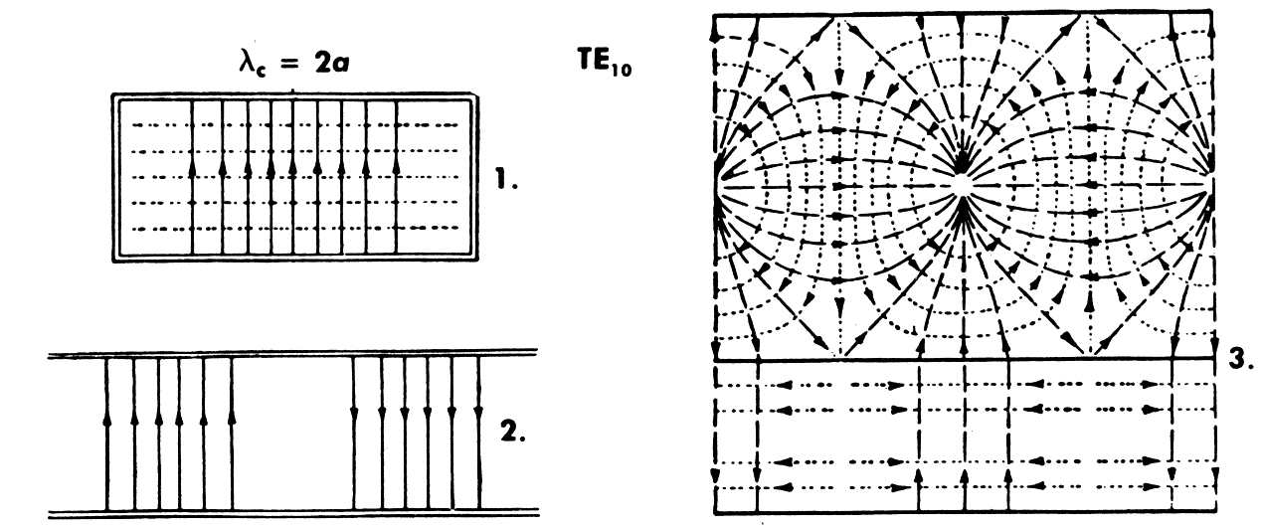
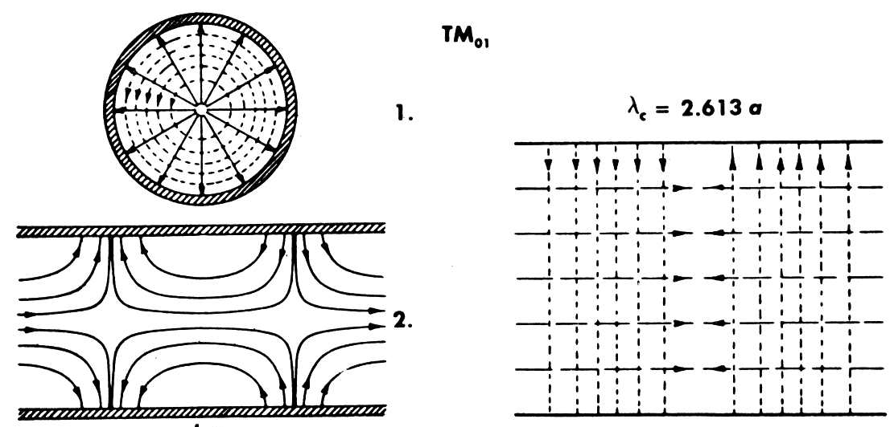
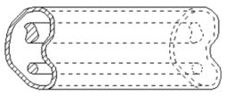
Transmission Lines and Waveguides
Wave patterns in guided wave systems depend on the number of conductors used.
“Open” two-wire system (TEM)
Coaxial line (TEM)
TEM-propagation = 2 conductor system
E-field ---H-field
Source: Ma, Electromagnetic Waves and Applications Part III, univ. lecture
Picture: Coaxial loads for the SPS 200 MHz cavity © CERN
Uniform waveguides rectangular, round, random cross-section (all non-TEM)
E-field
---H-field
Source: Saad, Microwave Engineers Handbook, vol. 1, Artech House
Source: Zhang, Electromagnetic Theory for Microwaves and Optoelectronics, 2nd ed., Springer

Slide 4
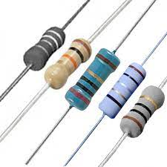
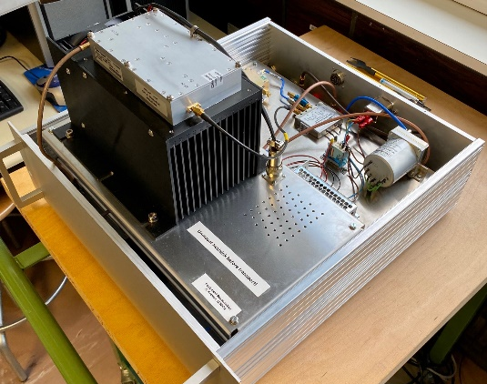

Basic Transmission Line Theory
Transmission line theory bridges the gap between field analysis (Maxwell’s theory) and basic circuit theory (lumped element theory).
Circuit theory assumes that the dimensions of the elements (like resistors) are much smaller than the wavelength of the signal. This means voltage or current do not change along the lumped element dimension.
Transmission lines cover a fraction of the wavelength, voltages and currents vary in magnitude and phase along the element. They are expressed by distributed circuits which allow wave description along geometrical lengths.
Transmission lines are then modelled piecewise by a lumped-element circuit.

Slide 5
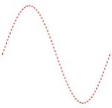
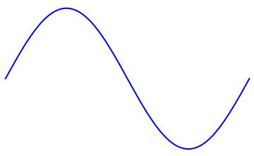

Basic Transmission Line Theory
i(z)
z
v(z)
Consider a transmission line of a certain length aligned in z-direction.
Voltage and current along the line depend on z.
Their variation along the line depends on their wavelength.
Remember? High frequency comes with short wavelength.
We split the line in infinitesimal increments of length dz.
We model the length dz with lumped elements.
dz
series resistor
series inductance
dz
parallel capacitance
parallel conductance

Slide 6




Basic Transmission Line Theory
i(z)
dz
v(z)
dz
R’ dz
L’ dz
i(z)
i(z+dz)
Consider a transmission line of length dz.
Voltage and current along the line depend on z.
We model the line length dz with lumped elements.
We express all lumped elements per unit length dz :
v_{R}(z)
v_{L}(z)
v(z)
v(z+dz)
G’ dz
C’ dz
resistance in [Ω/m]
inductance in [H/m]
conductance in [S/m]
capacitance in [F/m]

Slide 7







Basic Transmission Line Theory
dz
R’ dz
L’ dz
i(z)
i(z+dz)
v(z)
v_{R}
v_{L}
v(z+dz)
mesh rule
G’ dz
C’ dz

Slide 8
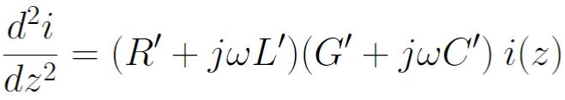





Basic Transmission Line Theory
Transmission line equations
2nd derivative
& combine…
This equation, we know already!
Mathematically, it is the same type as the one-dimensional, scalar Helmholtz’ equation for EM-fields.
phase constant
attenuation constant
Complex propagation constant

Slide 9
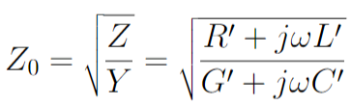


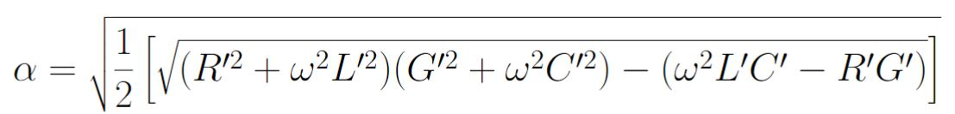
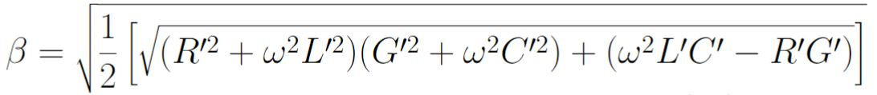
Basic Transmission Line Theory
define
Characteristic line impedance
This is the general case for all two-conductor lines in TEM mode.
Propagation constant
which leads to:
Attenuation and phase constant

Slide 10



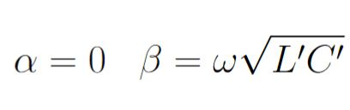
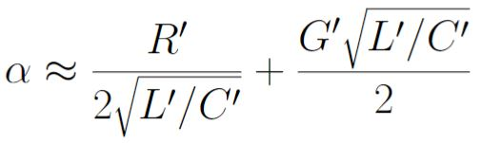

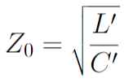


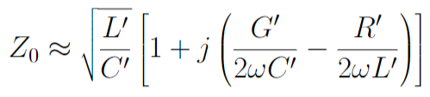
Basic Transmission Line Theory
This is the general case for all two-conductor lines in TEM mode.
Propagation constant
Characteristic line impedance
Lossless line
Small loss case (high frequency)
High loss case (low frequency)
No wave propagation
on the line!
Forward and backward
travelling wave
Source: Zhang, Electromagnetic Theory for Microwaves and Optoelectronics, 2nd ed., Springer

Slide 11
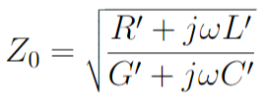
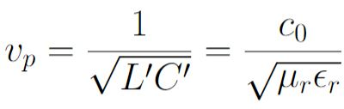
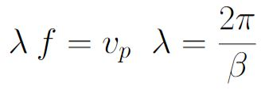
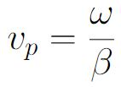
Basic Transmission Line Theory
This is the general case for all two-conductor lines in TEM mode.
Propagation constant
Quiz!
Test your knowledge.
Characteristic line impedance
Very often, you can find in textbooks expressions for R’, G’ , L’ and C’ of a two-conductor system.
Also, the phase velocity in this system is often given by:
(Remember: Phase velocity is the speed at which a constant phase point travels.)
Making use of the formulae from last session for wave propagation:

Slide 12
Quiz no. 4
What is the purpose of transmission line theory?
- it replaces Maxwell’s equations which are not suited to the problem.
- it replaces Maxwell’s equations because they don’t work here.
- it replaces Maxwell’s equations and bridges the gap between field theory and circuit theory.
- it replaces Maxwell’s equations to that RF engineers can understand it.
In transmission line theory, we use gamma for the propagation constant. What happens in the lossless case?
- gamma is zero, no wave propagation is possible.
- alpha is zero, and the transmission line starts to radiate.
- alpha is zero, and there is no attenuation on the transmission line.

Slide 13
Quiz no. 4
What is the purpose of transmission line theory?
- it replaces Maxwell’s equations which are not suited to the problem.
- it replaces Maxwell’s equations because they don’t work here.
- it replaces Maxwell’s equations and bridges the gap between field theory and circuit theory.
(correct answer)
- it replaces Maxwell’s equations to that RF engineers can understand it.
In transmission line theory, we use gamma for the propagation constant. What happens in the lossless case?
- gamma is zero, no wave propagation is possible.
- alpha is zero, and the transmission line starts to radiate.
- alpha is zero, and there is no attenuation on the transmission line. (correct answer)

Slide 14
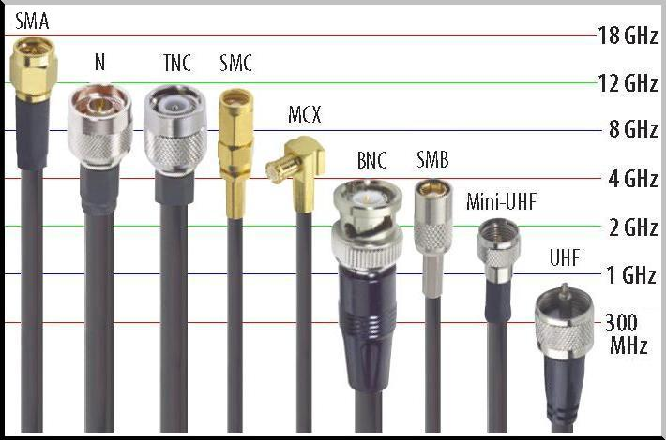
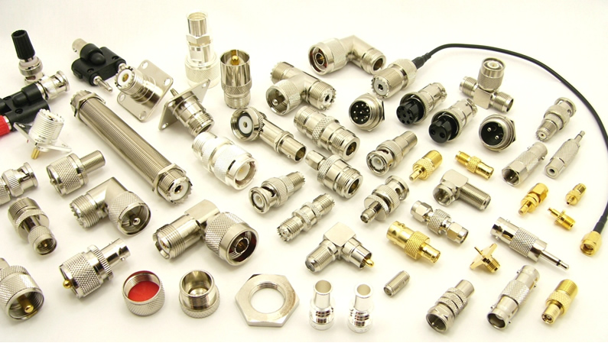
Coaxial Line
Coaxial line is largely used in laboratories, as a two-conductor system, the line carries TEM-signals.
Most common are the SMA and the N-connector. Depending on the application, you can also use BNC.
The choice of your cable and your connector depends on the frequency range of your work.
Coaxial cables are limited towards higher frequencies, as then higher order (non-TEM) modes start propagating.
Source: www.winpoint.com.tw

Slide 15
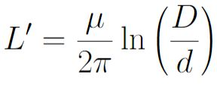
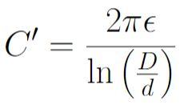
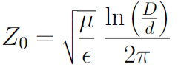


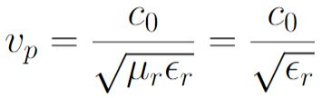


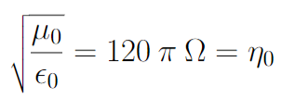
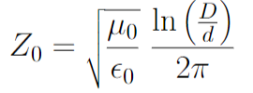
Coaxial Line in TEM-mode
E-field ---H-field
Characteristic impedance for a lossless line:
From textbook, we look up (calculated from electrostatic equations…):
d
D
Usually, there is low-loss dielectric between inner and outer conductor.
Coax characteristic impedance
with low-loss dielectric
If the signal propagation speed is critical, we use so-called “airlines” without dielectric, so that there is no signal delay.
Coax characteristic impedance
without dielectric (“airline”)

Slide 16
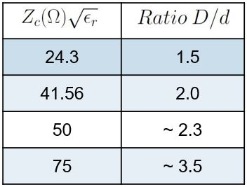

Coaxial Line in TEM-mode
E-field ---H-field
Coaxial line impedances and ratios outer/inner conductor:
Coax characteristic impedance
with low-loss dielectric
d
D
RF measurement technique
Antenna technique
For measurements, a “50 Ohm-cable” is used in most cases. The ratio of diameters outer/inner is then ~ 2.3.
The ratio between inner and outer conductor is not only important to have a certain Z₀.
→ Optimum ratio D/d to minimize losses exist (minimum damping), equally for maximum voltage carriage to avoid RF cable breakdown or maximum power transmission.

Slide 17
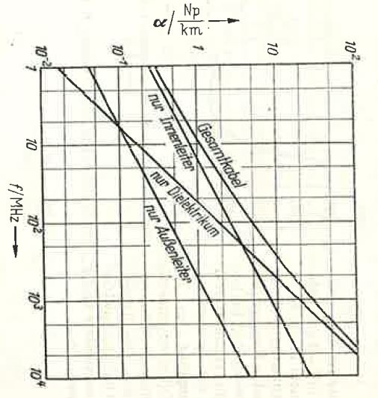
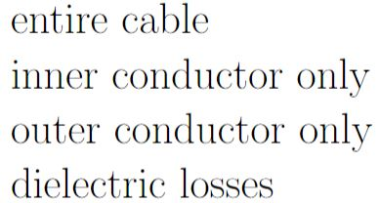
Coaxial Line in TEM-mode - losses
Losses in coaxial cables are usually small for frequencies below 3 GHz, but they can quickly rise with frequency.
The main loss at low frequency is due to the skin effect in the inner conductor.
At higher frequency, dielectric losses of the insulating medium between outer and inner conductor can become dominant.
1 Np [Neper] ≈ 8.686 dB
Losses are not the only concern in coaxial cable optimization. A power line, for example, is optimized for efficient power transport and to avoid voltage breakdown, whereas a measurement cable needs phase-stability.
Source: Meinke/Gundlach, Taschenbuch der Hochfrequenztechnik, 1968

Slide 18



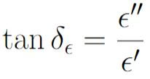

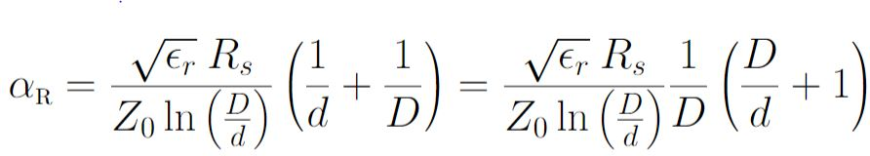
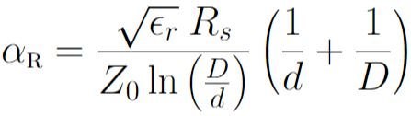
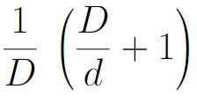
Coaxial Line with Minimum Damping
How to get the optimal ratio D/d for a coaxial cable to obtain minimum loss?
Attenuation constant:
surface resistance
resistive losses
dielectric losses
surface resistance
dielectric loss tangent (see lecture A. Mostacci)
(only the 1st term depends on the ratio D/d )
→ Find the ratio D/d at which the 1st term is at minimum:
The equation depends also on 1/D.
vacuum impedance
This term says: “damping goes down if the line is very large….” - bit obvious…
and does not answer the diameter-ratio-question.

Slide 19

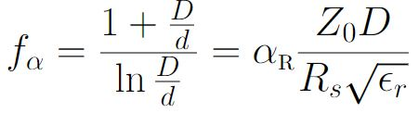
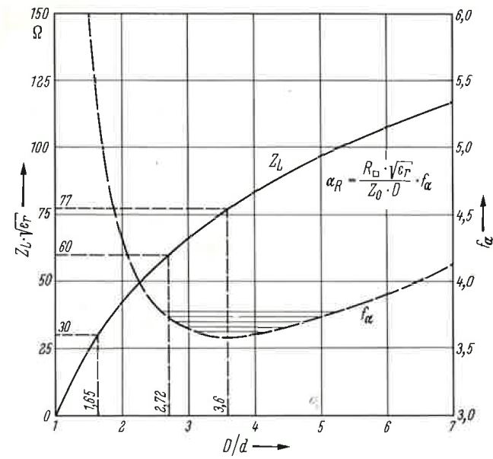


Coaxial Line with Minimum Damping
How to get the optimal ratio D/d for a coaxial cable to obtain minimum loss?
Take all terms that depend on the ratio D/d, and
Separate this from .
We get a form factor
Quiz!
Test your knowledge.
that only depends on the ratio D/d and is of the type: x+1 / ln(x).
The form factor has a minimum if the ratio D/d = 3.6 which corresponds to a characteristic impedance: = 77Ω.
Select PTFE with = 2.1, we get ~ 53 Ω.
Note that this value is valid only if inner and outer conductor are of the same material. Same principle, but more complex otherwise.
Source: strategy and picture taken from: Zinke & Brunswig, Hochfrequenztechnik 1, Springer

Slide 20
Quiz no.5
The coaxial line is a transmission line…
  - which is always lossless
  - which is not radiating
  - which is radiating a lot, that is why it is used as antenna cable
The ratio of inner to outer conductor in a coaxial line can be optimized…
  - to reduce losses in the line
  - to increase losses in the line
  - to improve power transmission capabilities
  - to reduce signal delay time

Slide 21
Quiz no.5
The coaxial line is a transmission line…
  - which is always lossless
  - which is not radiating (correct answer)
  - which is radiating a lot, that is why it is used as antenna cable
The ratio of inner to outer conductor in a coaxial line can be optimized…
  - to reduce losses in the line (correct answer)
  - to increase losses in the line
  - to improve power transmission capabilities (correct answer)
  - to reduce signal delay time

Slide 22
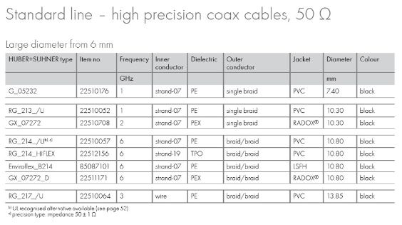
Coaxial Line Selection
What to do in practice?
Usually, you don’t optimize cables for minimum attenuation if you only want to buy a measurement cable.
For installation in an underground area (your accelerator), you will probably need halogen-free cables and/or you will have some other constraints in addition.
Let’s assume this is what is offered by our supplier (I just randomly chose one from the web).
Some cables rule out because of the LSFH-demand
(= LowSmokeFreeofHalogen).
Source: literature.hubersuhner.com/Technologies/Radiofrequency

Slide 23
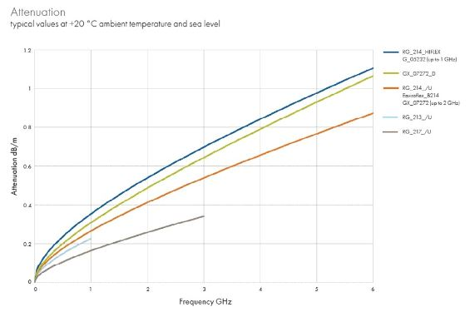
Coaxial Line Selection
What to do in practice?
For operating at 1.5 GHz, we would expect an attenuation of ~0.33 dB/m.
If we want to take a signal from an accelerator like LHC, which is installed underground, we need to bridge at least 200 m, so we would get a total damping of the cable alone (no connectors, etc!) of ~ 66 dB.
Hm.…. We might want to add a small signal amplifier in this case…
How to do this:
See details in the RF engineering session of Manfred!
0.33 dB/m
1.5 GHz
Source: literature.hubersuhner.com/Technologies/Radiofrequency

Slide 24
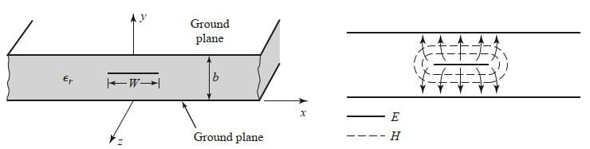
Planar transmission lines – Stripline (1/5)
Source: Pozar, Microwave engineering, 4th ed., Wiley
Stripline is a flat conductor between two ground plates, also called planar transmission line type.
Note that you have a top and bottom ground plate with a dielectric substrate in between.
It is often used for integrated circuit design as it allows to be produced with photolithographic methods.
The line is produced by etching a conductor strip on a substrate and then covering the set with a second substrate layer.
The second ground plate is then added in a metallization process.

Slide 25
Planar transmission lines – Stripline (2/5)
Source: Pozar, Microwave engineering, 4th ed. p. 141
Conducting strip is usually centered between the two ground plates, but also asymmetric striplines exist.
Stripline is usually operated in TEM-mode, which can be “guaranteed” if the distance b is kept below λ/2.
For TEM-mode operation, electrostatic field calculation is sufficient, otherwise, conformal mapping is used.
Exact EM-calculation is heavy, but closed-form expressions exist in most textbooks.
Note that the thickness of the flat center conductor is usually neglected to simplify the expressions.

Slide 26
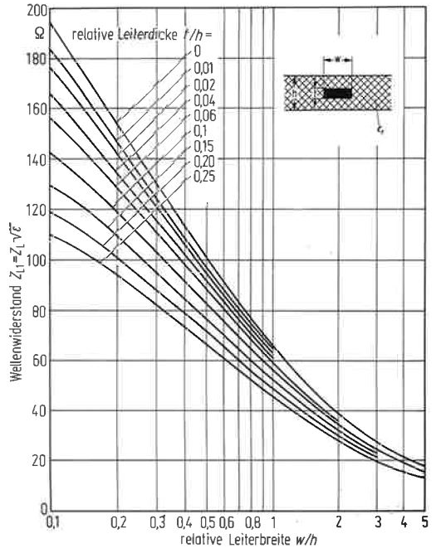

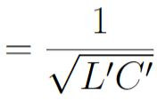

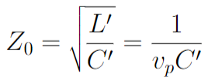
Planar transmission lines – Stripline (3/5)
relative thickness t/b
Source: Pozar, Microwave engineering, 4th ed. p. 141
Most important parameters (for TEM) are:
Phase velocity:
Phase constant:
Characteristic impedance:
Note that on the plot on the right, t is the height of the conductor which is considered as well as thickness relative to the ground plate separation b.
w/b
Source: Zinke, Brunswig, Hochfrequenztechnik I, Springer

Slide 27
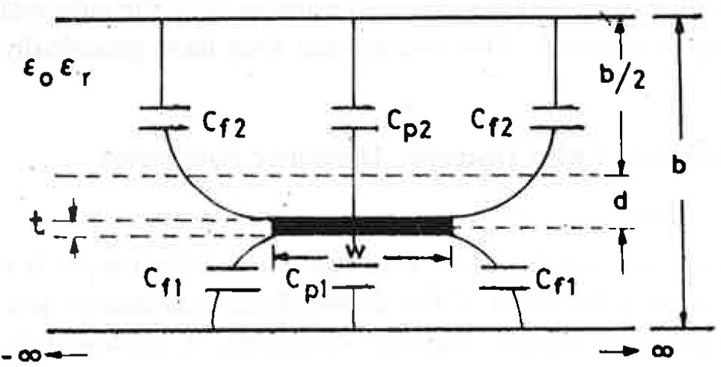
Planar transmission lines – Stripline (4/5)
principal capacitance
parasitic (fringe) capacitance
Source: Bhat Shiban, Stripline-like transmission Lines for Microwave Integrated Circuits,
New Age International Publishers
Mathematical treatment can become heavy as soon as the stripline is off-centered, or if the separation of the two ground-plates is large compared to the conductor width.
For large separations of ground plane, parasitic capacitances build-up which need to be considered. We speak of fringe-field effects.
Total capacitance: C_{tot} = C_{p1} + C_{p2} + 2 C_{f1}+2 C_{f2} .
Remember that the capacitance impacts on the characteristic impedance and the propagation velocity.

Slide 28
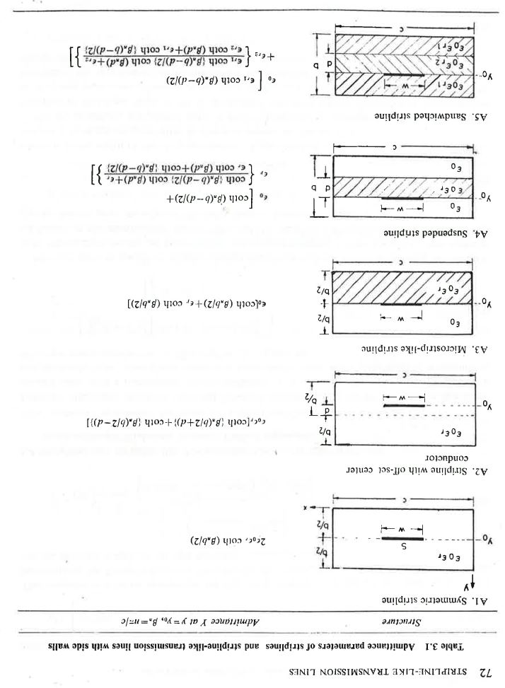
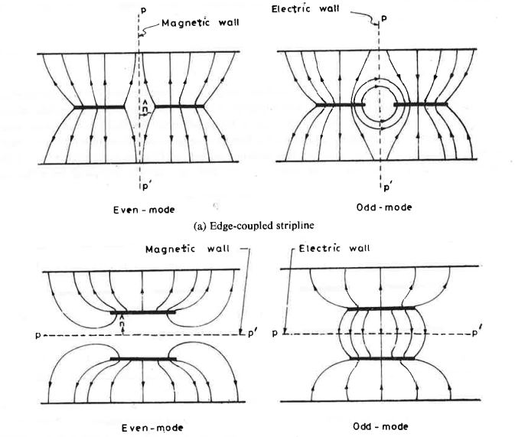
Planar transmission lines – Stripline (5/5)
Striplines exist in all varieties, we then speak of stripline-like transmission lines.
The calculation of even simple parameters can become very quickly very demanding.
Pictures taken from a book about striplines just to give you an idea.
Coupled striplines are another option, in this case, also the operating mode (even or odd) has to be taken into account.
Source: Bhat Shiban, Stripline-like transmission Lines for Microwave Integrated Circuits,
New Age International Publishers

Slide 29
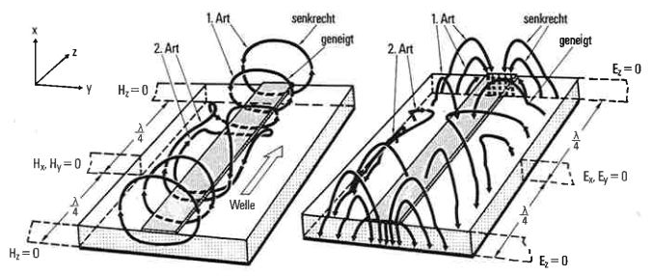
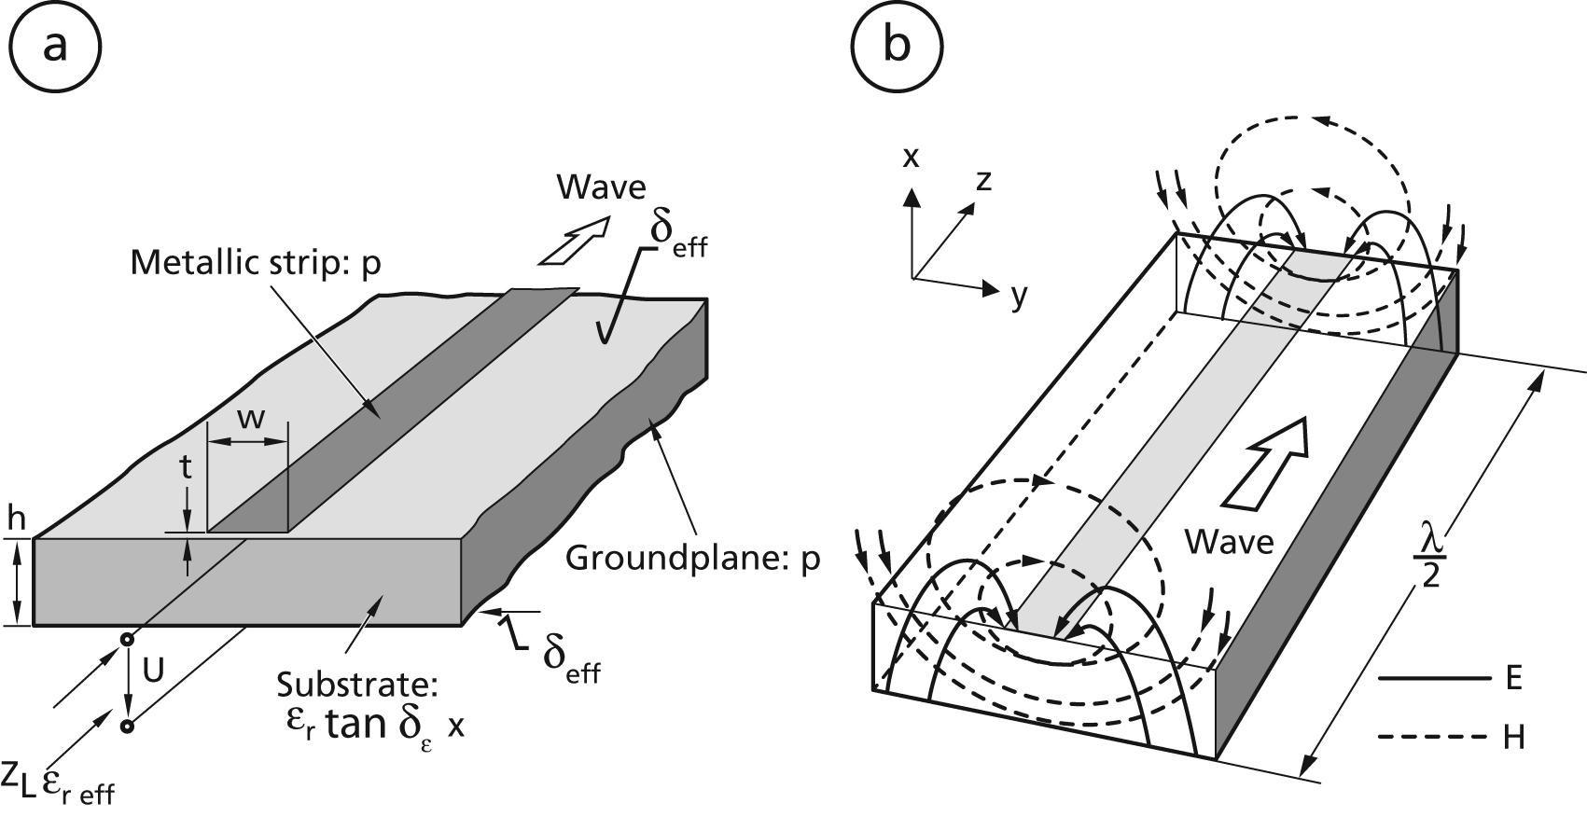
Planar transmission lines – Microstripline (1/2)
Microstripline is in principle a stripline where you leave the top dielectric layer away, creating an asymmetry in the cross-section.
The propagating wave is thus only quasi-TEM – with plenty of longitudinal field components (so-called hybrid waves)
This leads to a frequency-dependent characteristic impedance (so-called dispersive behaviour).
The wave in the upper half will travel faster than the one in the substrate due to the different material properties.
Electric and magnetic field lines
of a microstripline (“quasi-TEM”)
Source: Hoffmann, Integrierte Mikrowellenschaltungen, Springer

Slide 30
Thank you for your attention.

Slide 31
Let’s have a break!

Slide 32
Further reading…
POZAR, David M., “Microwave Engineering”, 4th edition, Wiley and sons.
ZHANG, Keqian, “Electromagnetic Theory for Microwaves and Optoelectronics”, 2nd edition, Springer
BHAT, Shiban, “Stripline-like transmission Lines for Microwave Integrated Circuits”,
New Age International Publishers
HOFFMANN, Integrierte Mikrowellenschaltungen, Springer

