Slide 1

CERN Practical days
11 – 12 March 2025

Slide 2
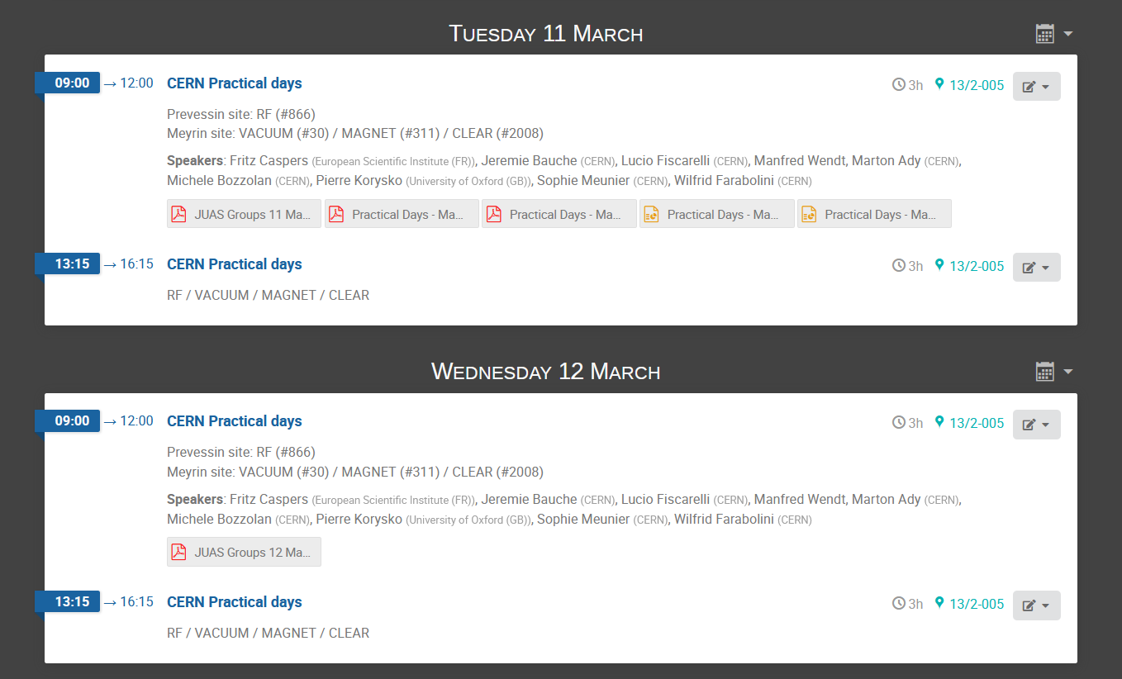

Slide 3
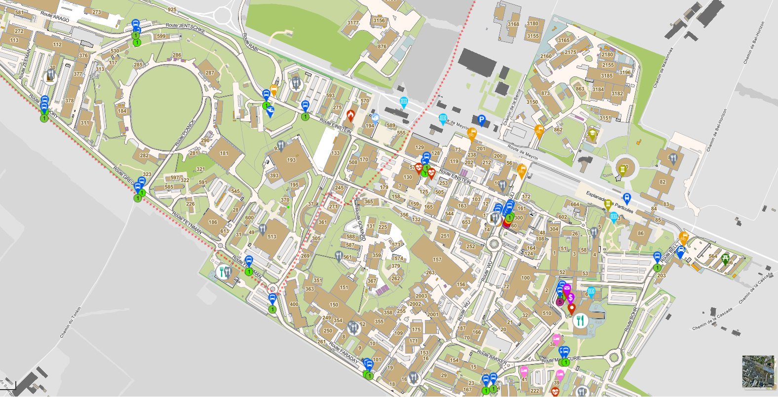
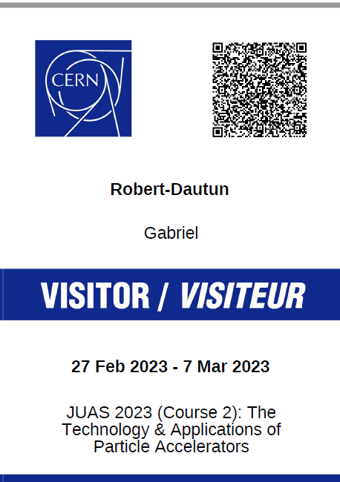
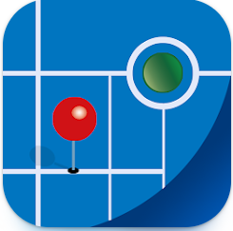
30
311
VACUUM
MAGNET
Restaurant #2
2008
CLEAR
https://sce-dep.web.cern.ch/mobile-applications

Slide 4
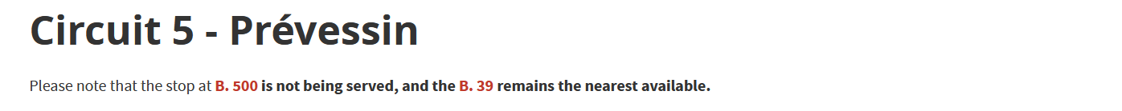
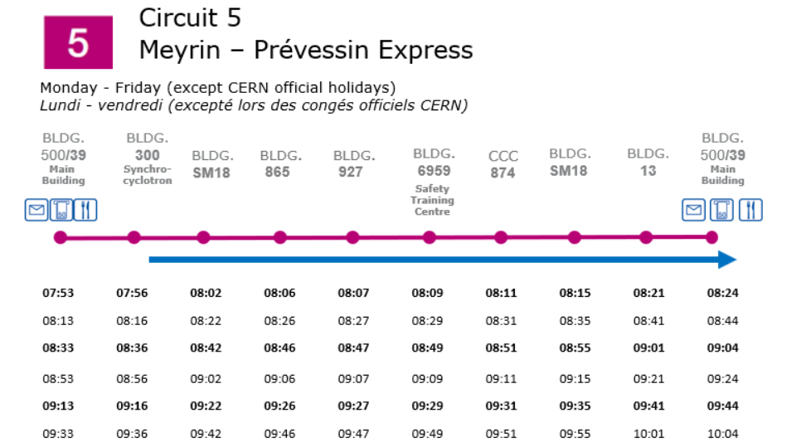

Slide 5
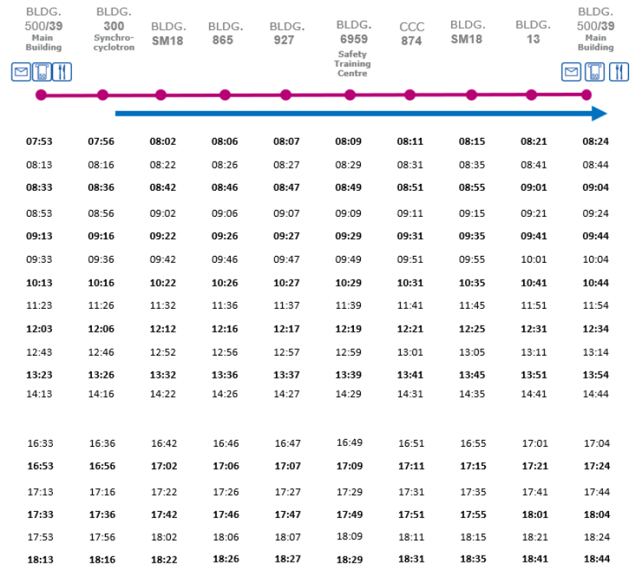

Slide 6
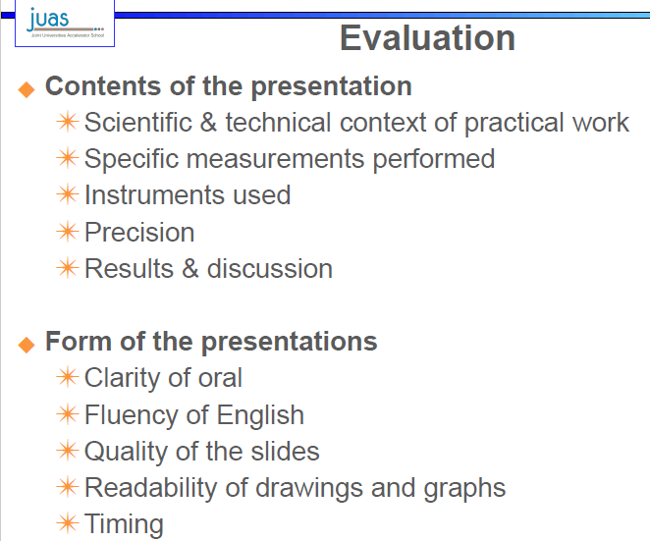
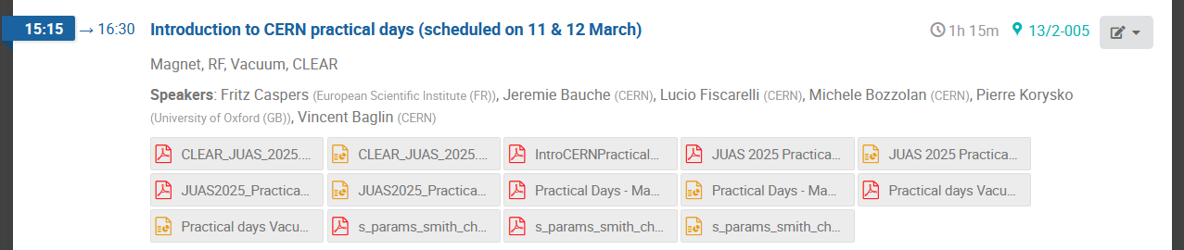
REMINDER
1 subject per student (among the 2 subjects you’ll work on during the practical days)
– deadline 13 March at noon! WhatsApp in main group “Your Name = Vacuum”
We will do the groups allocation (4 people max / group)
Prepare an oral presentation (all students should speak to get their marks)
Oral presentation on Monday 17 March (morning)
– 2 minutes talk + 2 minutes Q&A per speaker (evaluate by a Jury)
You will be evaluated on the CONTENT and on the FORM of the presentation
(refer to the slide 7&8 of Elias for the details )

