Slide 1


Practical Days @ CERN
Normal Conducting Magnets
Part 1: Magnet Technology, Production and Testing
Tuesday 11th & Wednesday 12th March 2025, 9:00 – 16:15
jeremie.bauche@cern.ch

Slide 2


Outline
Normal Conducting Magnets at CERN
  Magnet group
  Magnet patrimony
  NCM mission and opportunities
Program and Organization of Magnet Practical Works
  Magnet Technology, Production and Testing
  Magnetic Measurements (see next talk from L. Fiscarelli)

Slide 3
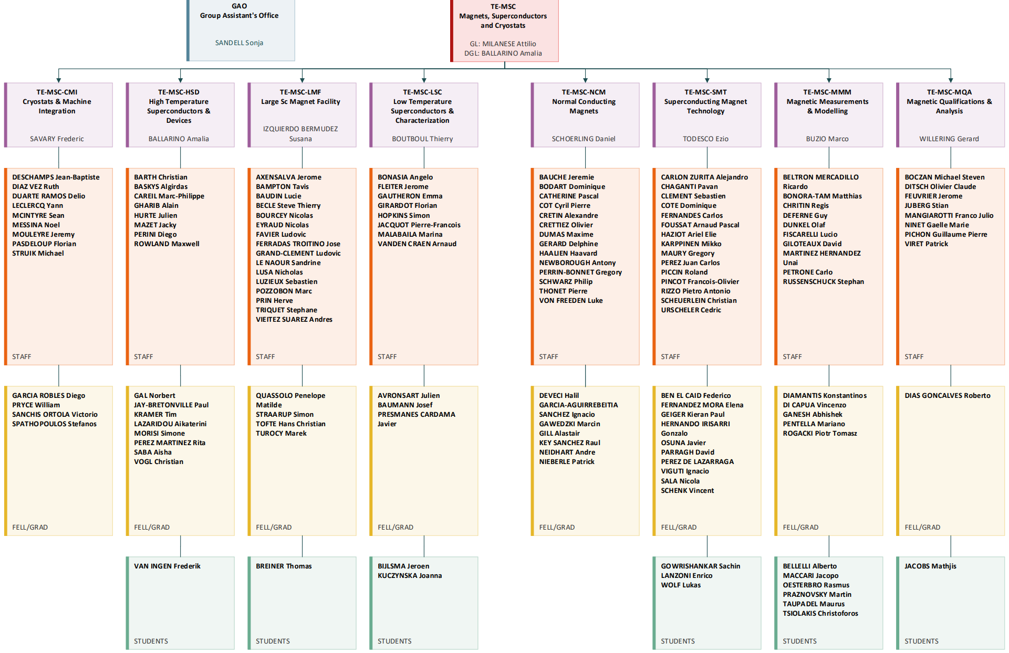
~150 persons (staff, fellows, students)
Superconducting Magnets
Normal Conducting Magnets

Slide 4
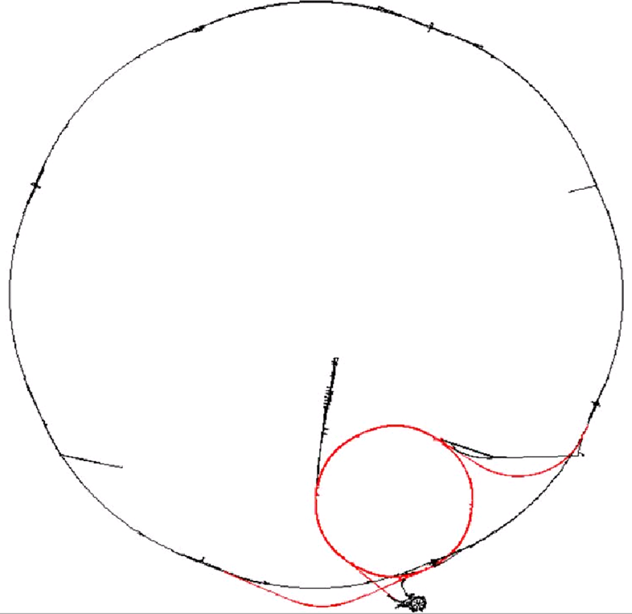


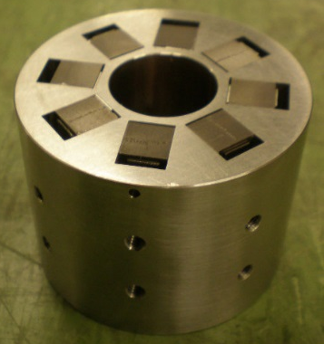
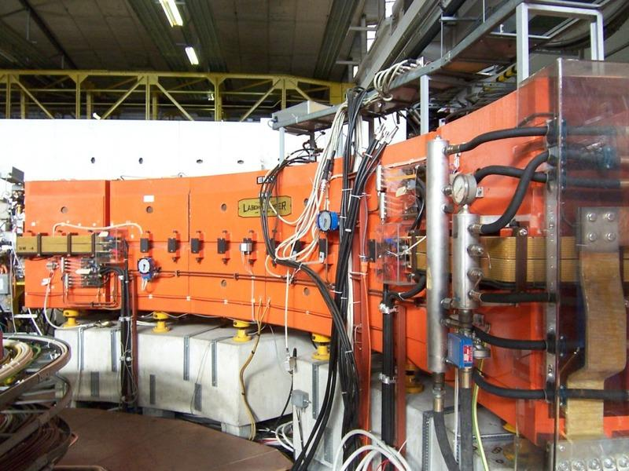
CERN Normal Conducting Magnets
About 20 km of beam lines in >20 different machines, all interconnected
~ 4500 installed magnets + ~ 2000 stored magnets → 50 000 tons
1 km
Large variety: ~ 500 different types
LINAC4 DTL PMQ, < 1 kg
LEIR main dipole, 60 tons

Slide 5
The MNC Section
Design, procurement/manufacture, maintenance, consolidation, upgrade, disposal of the normal conducting magnets in the accelerators, transfer lines and experimental areas
Operation: maintenance and consolidation of existing machines
2 dedicated radioactive workshops treating about 100 magnets/year
→ maintenance of installed magnets in the accelerators
→ interventions during physics run to minimize beam downtime
Projects: upgrades and new beam lines
2 dedicated workshops for magnet and component production (prototyping)
→ upgrade of existing magnet systems (e.g. ISOLDE 2GeV, HL-LHC)
→ construction of new magnets (existing and future accelerators, like FCC-ee)
https://te-msc-ncm.web.cern.ch/

Slide 6
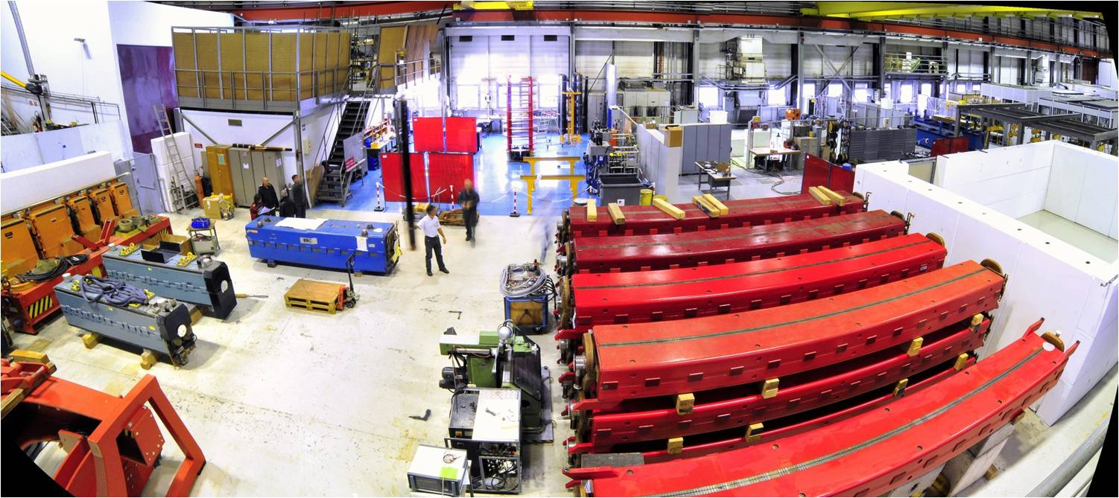
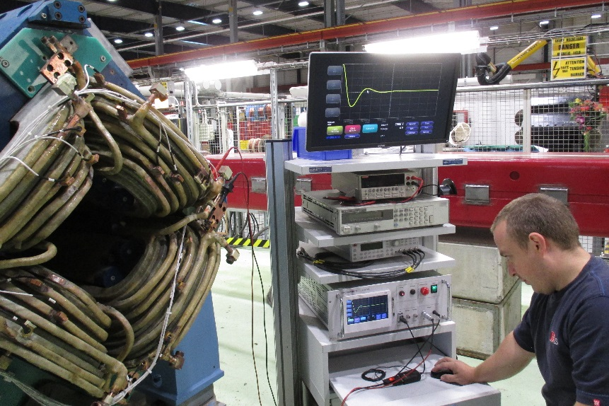
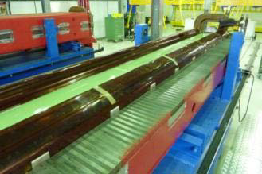
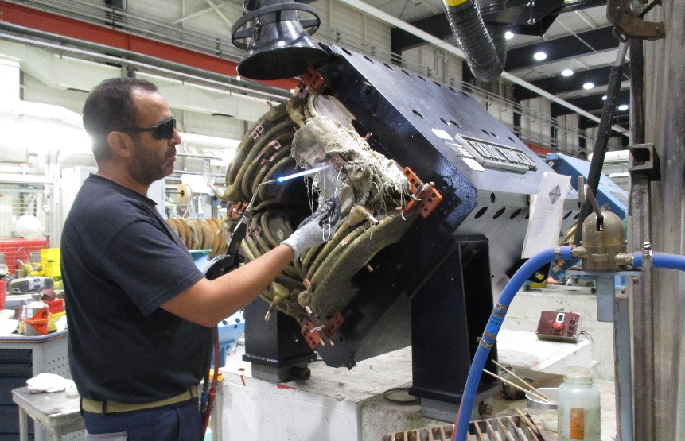
Operation and Maintenance
  CERTIFICATION
  MAGNET ASSEMBLY
  REFURBISHMENT

Slide 7
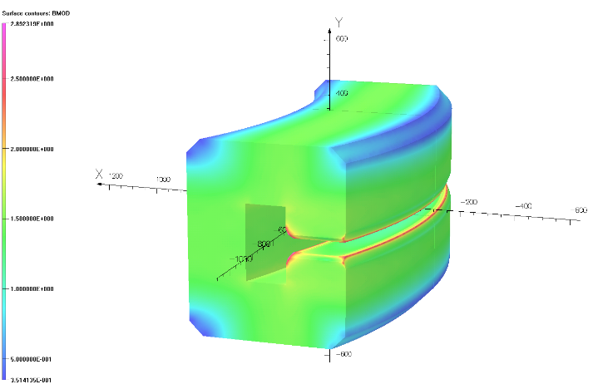
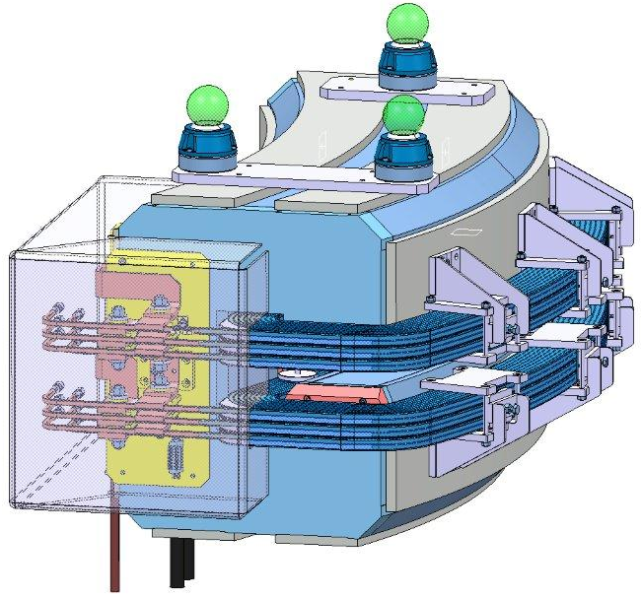
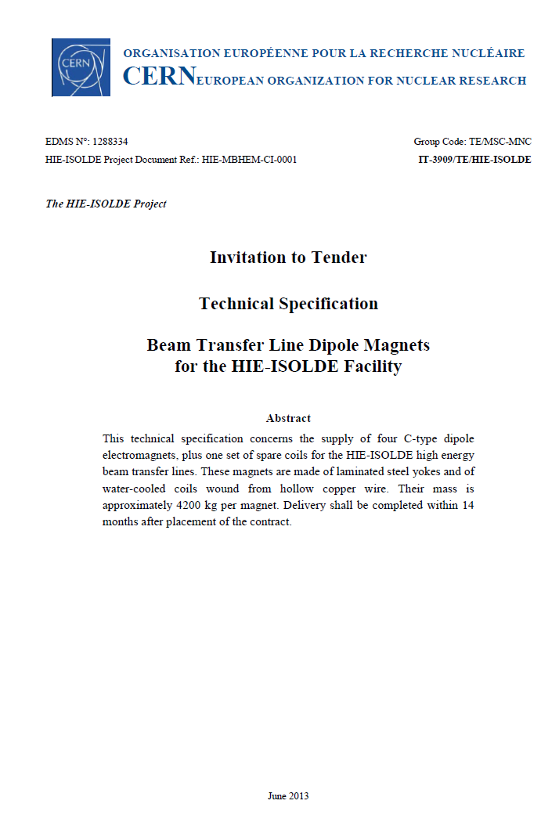
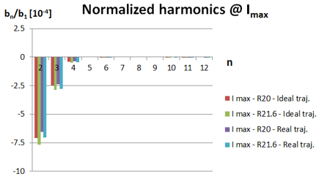
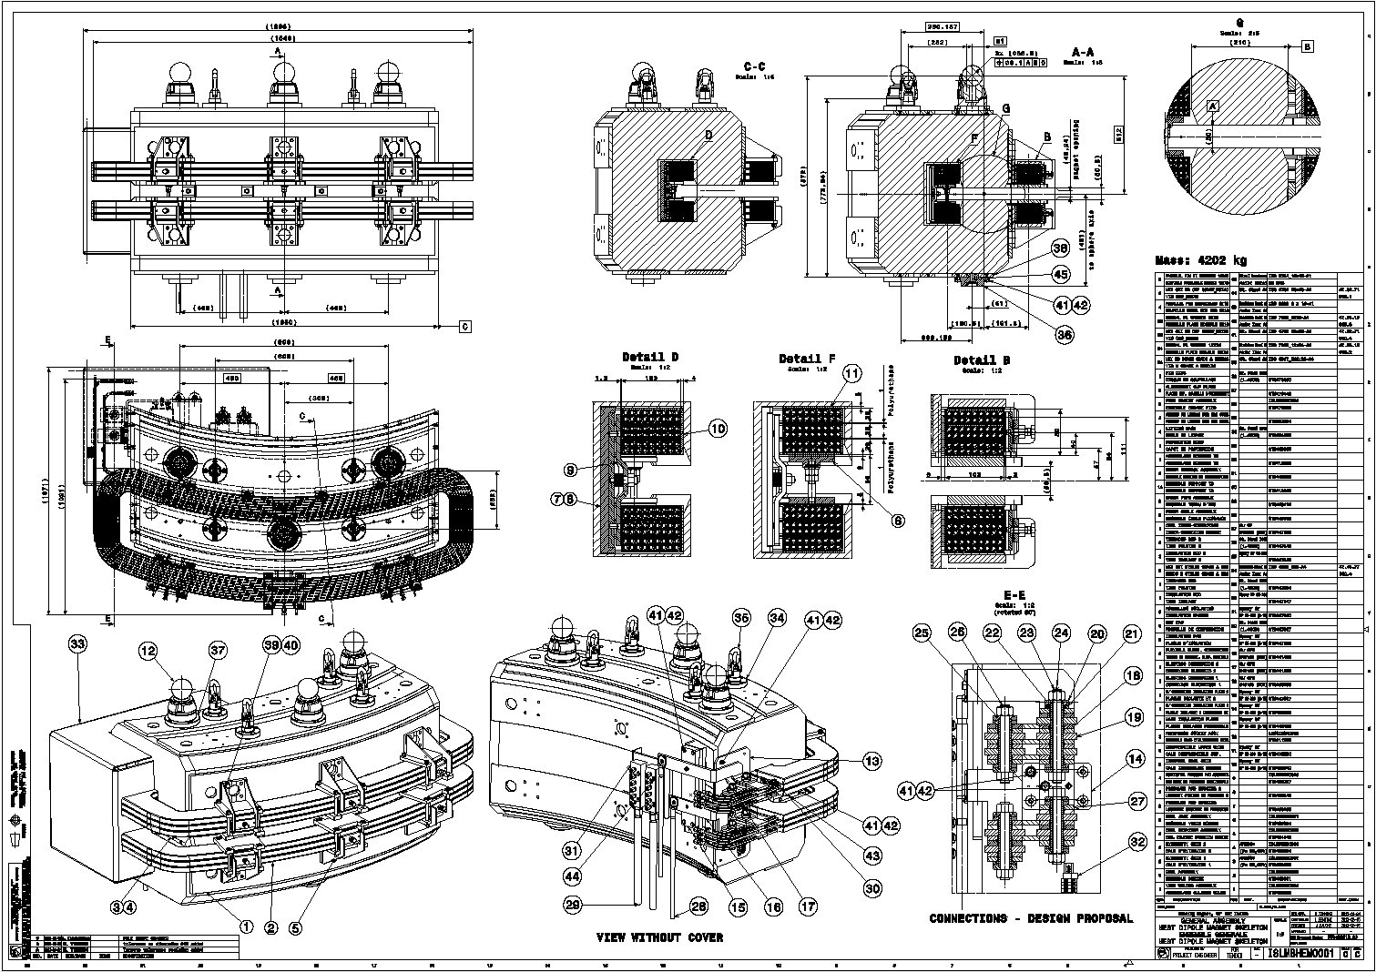
Design and Procurement
Magnetic design
Mechanical design
Specifications for manufacture;
Production
in house / in industry

Slide 8
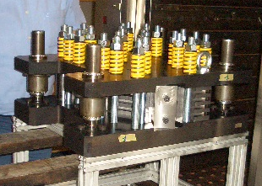
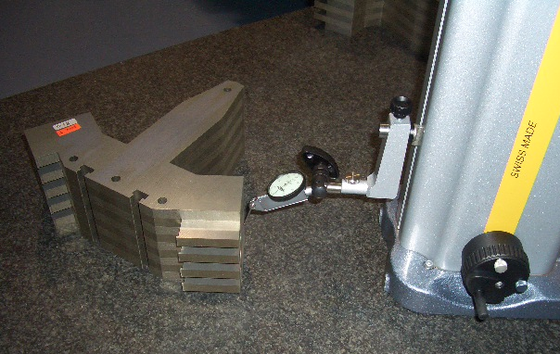
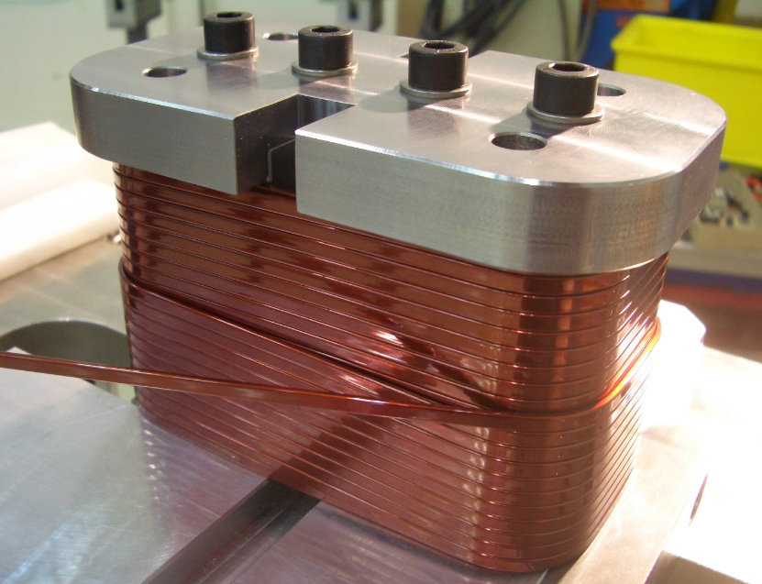
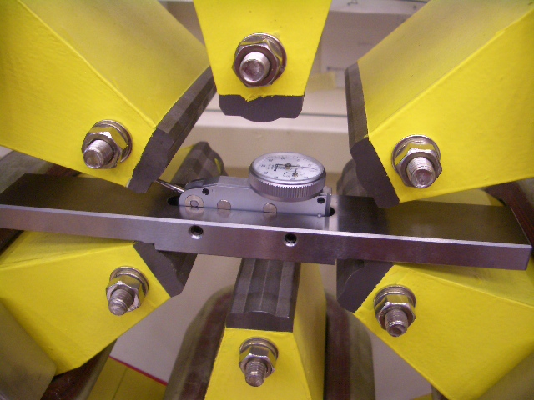
Manufacture and Tests
Manufacture
Tests and measurements

Slide 9
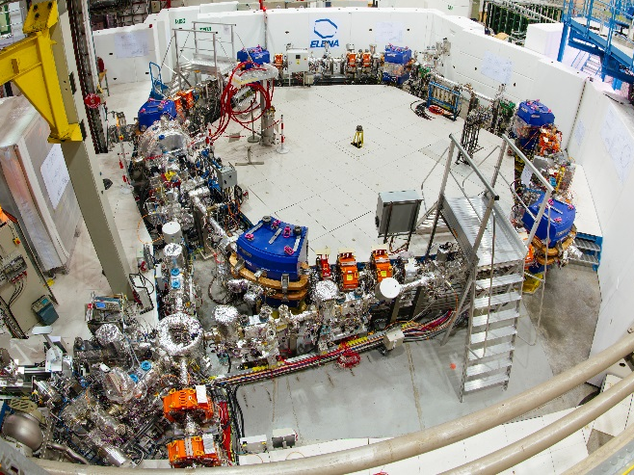
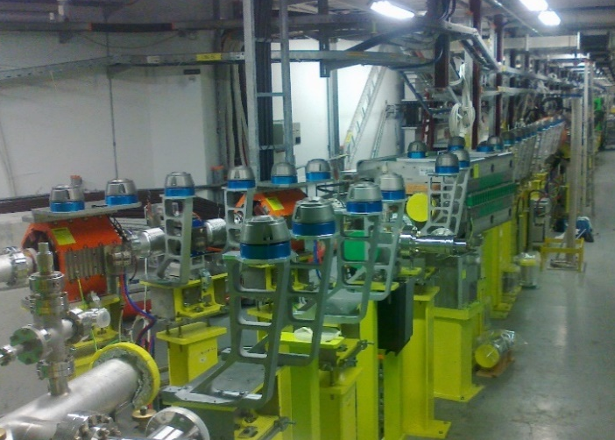
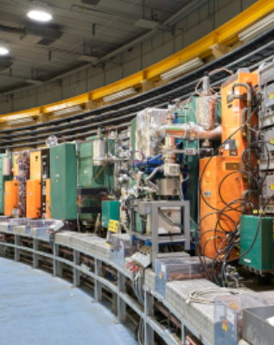
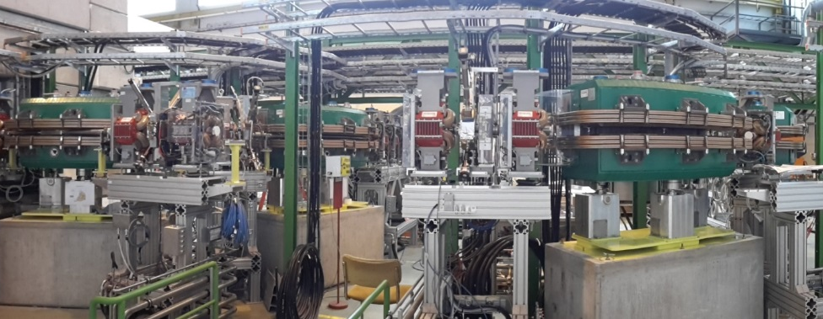
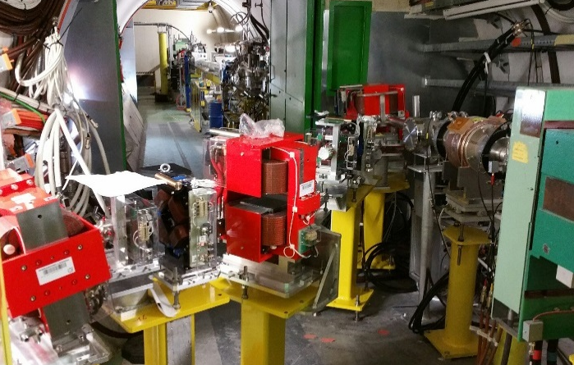
Projects – at CERN
  ELENA
  LINAC 4
  LIU-PSB
  HIE-ISOLDE
  AWAKE

Slide 10
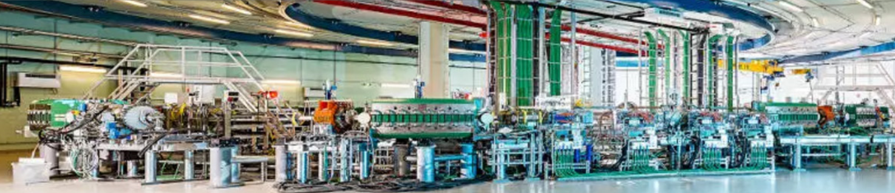
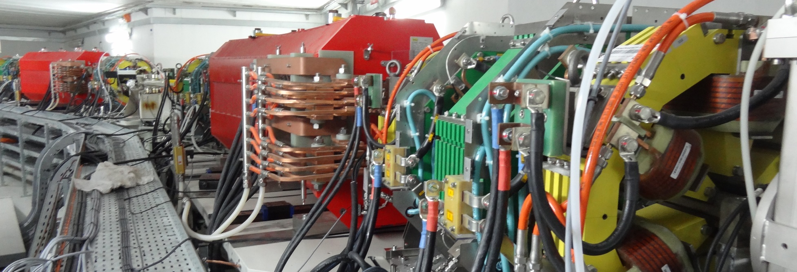
Projects – outside CERN
  MEDAUSTRON, Austria
  SESAME, Jordan

Slide 11
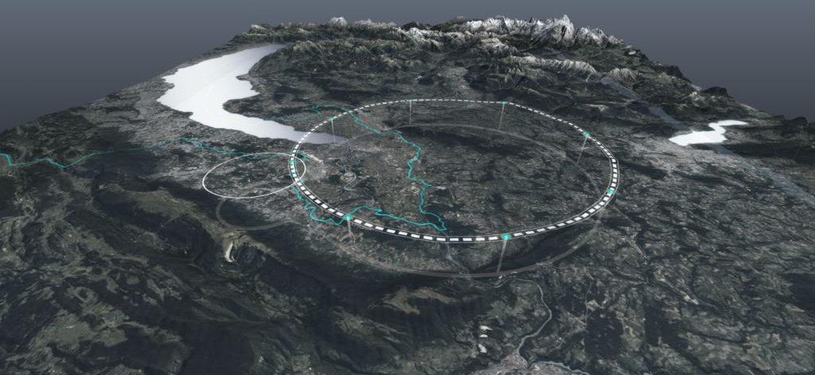

Projects – The Future
FCC – Future Circular Collider
photo: J. Wenninger
http://cern.ch/fcc

Slide 12

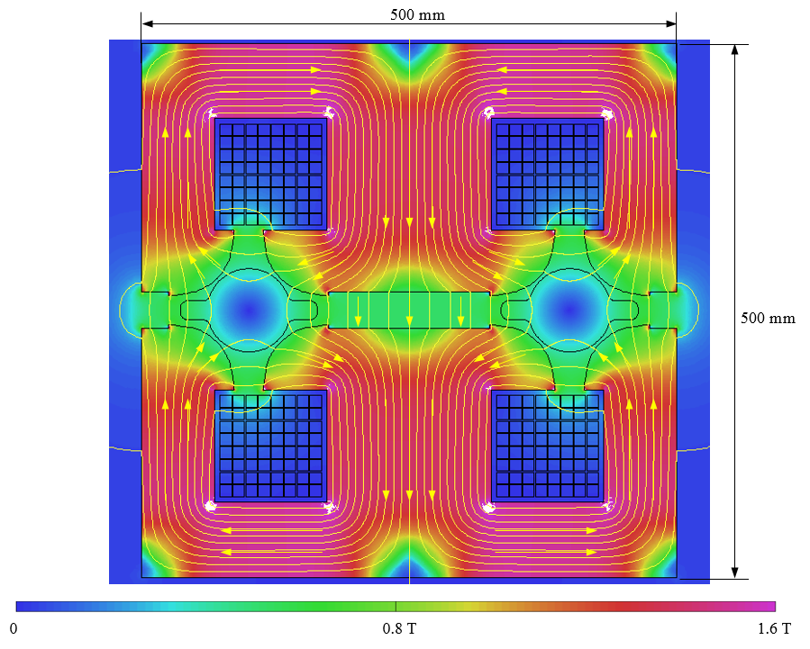
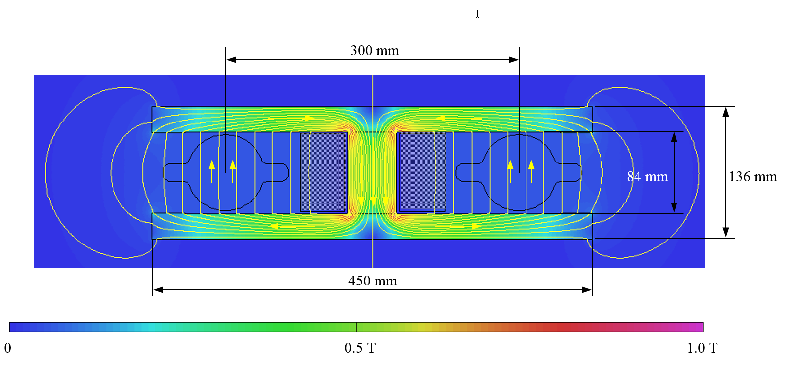
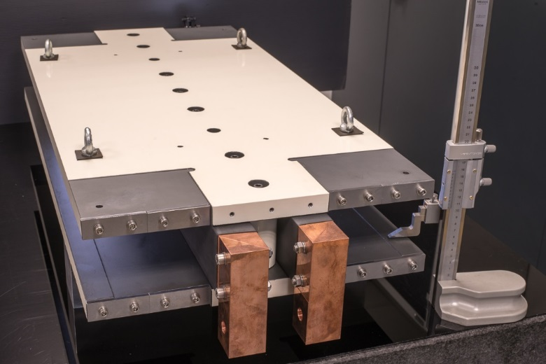
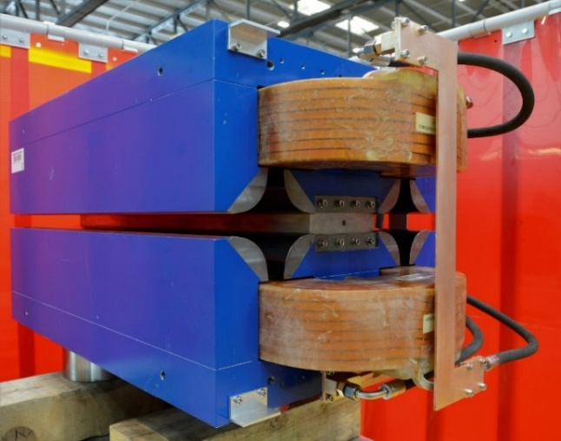
FCC energy efficient magnets
prototype
prototype
Twin-aperture dipole
Twin-aperture quadrupole

Slide 13
Program and Organization of Practical days
Up to 12 participants/days, shared in two groups
Split into two half-day sessions
  Magnet manufacture and testing
  Magnetic measuremements
Hands-on practical work in CERN laboratories
Guided by CERN magnet engineers

Slide 14
Magnet Manufacture and Testing
Introduction to magnet manufacture (1h)
  Materials for magnets
  Magnet components
  Manufacturing technologies
    Yoke manufacturing
    Coil winding and impregnation
  Testing and measurement techniques
Practical work in magnet test facility (2h30’)
  Participants will perform tests and measurements on magnets
  Measurements on systems and apparatus using instruments and formulae learned during the theoretical courses

Slide 15
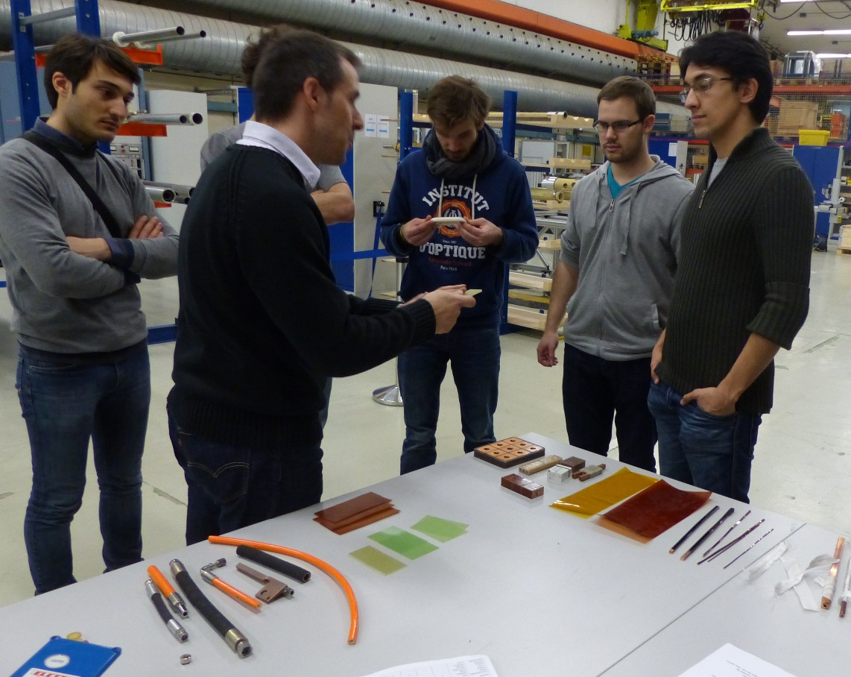
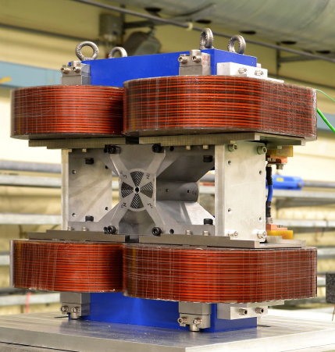
Magnet Manufacture
Coil winding
Yoke manufacturing
Materials, technologies, components, manufacturing processes, and assembly techniques
Coil impregnation
Magnet assembly
Magnet testing

Slide 16
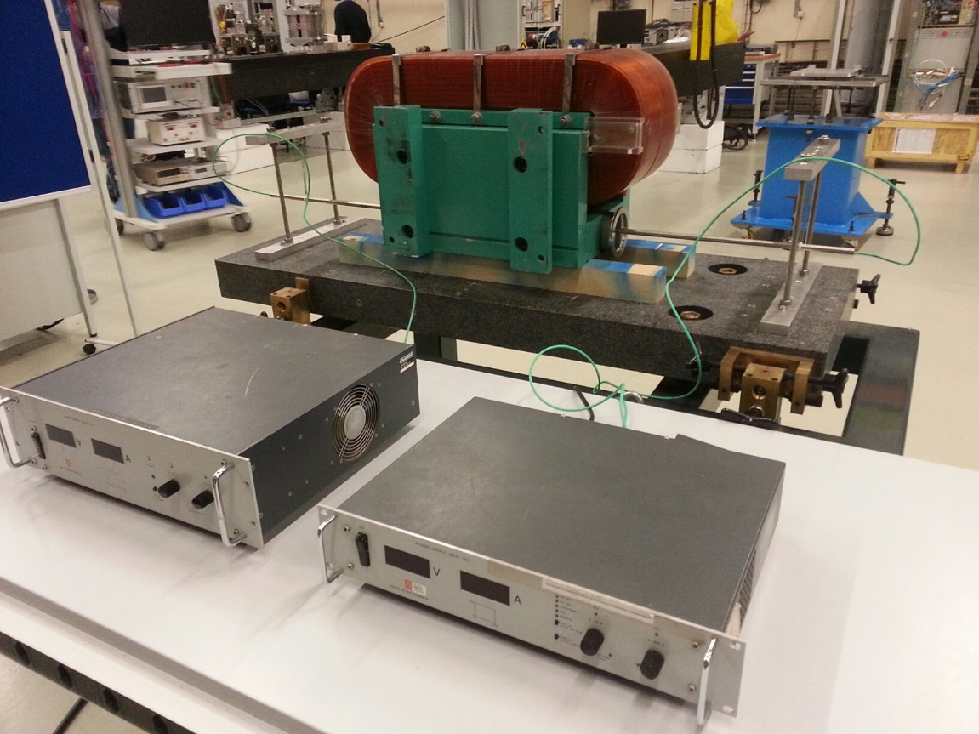
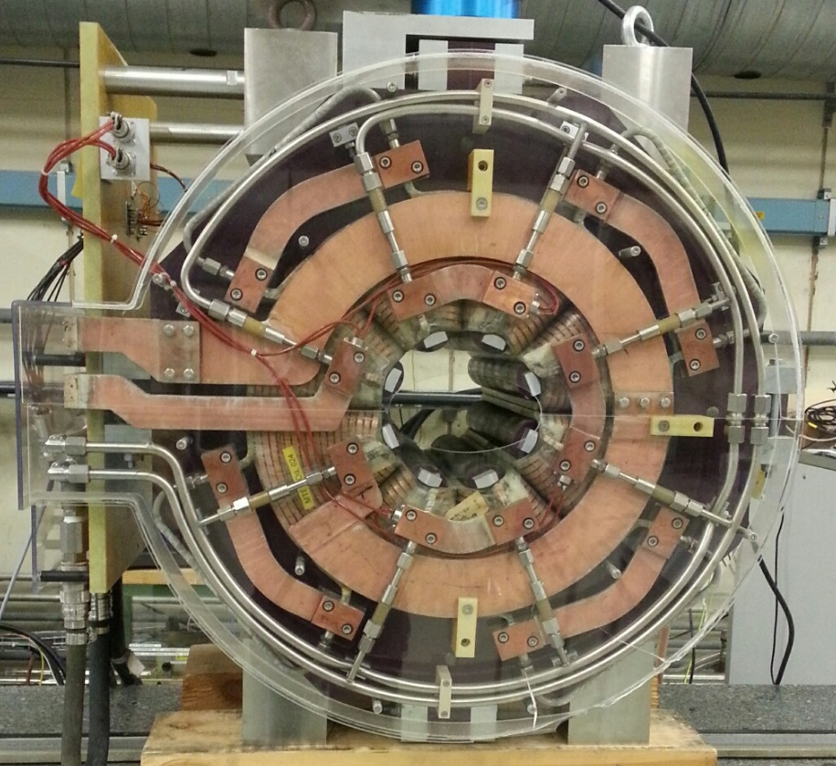
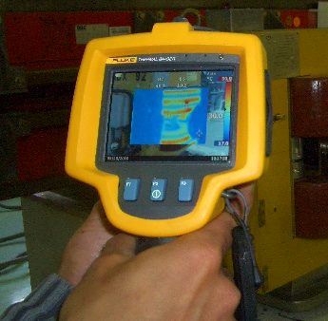
Magnet Testing and Practical Applications
Use of analytical formulae and measurements systems to calculate magnet parameters
Testing magnets to assess their functionnality and reliability

Slide 17
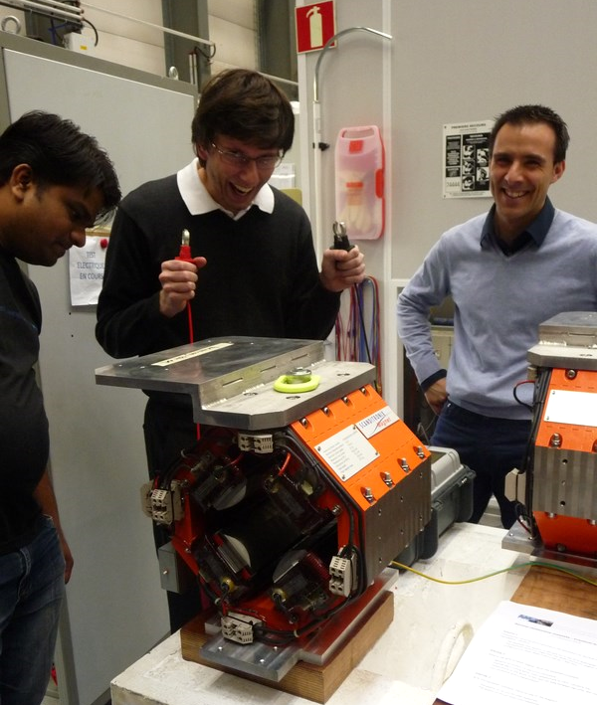
We are looking forward...
...to welcome you at CERN
… and unravel the mysteries of the magnets
…in a relaxed atmosphere!

