Slide 2

Practical Days
Vacuum Systems
V. Baglin
CERN TE-VSC, Geneva
https://indico.cern.ch/event/1470062/timetable/?view=standard#day-2025-02-17
11th and 12th March 2025

Slide 3
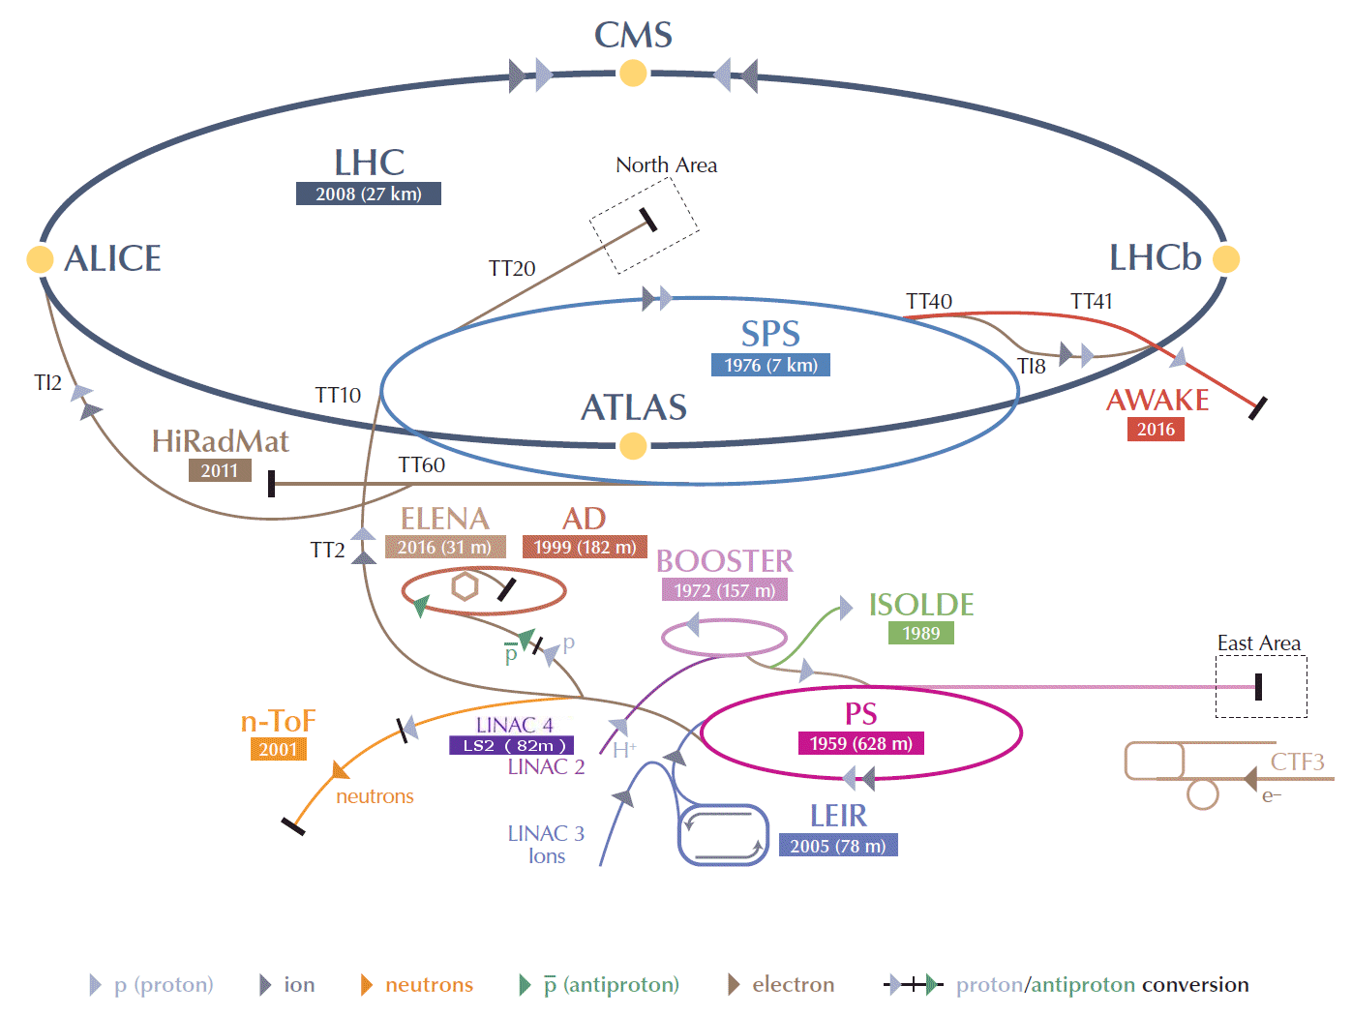
CERN accelerators complex

Slide 4
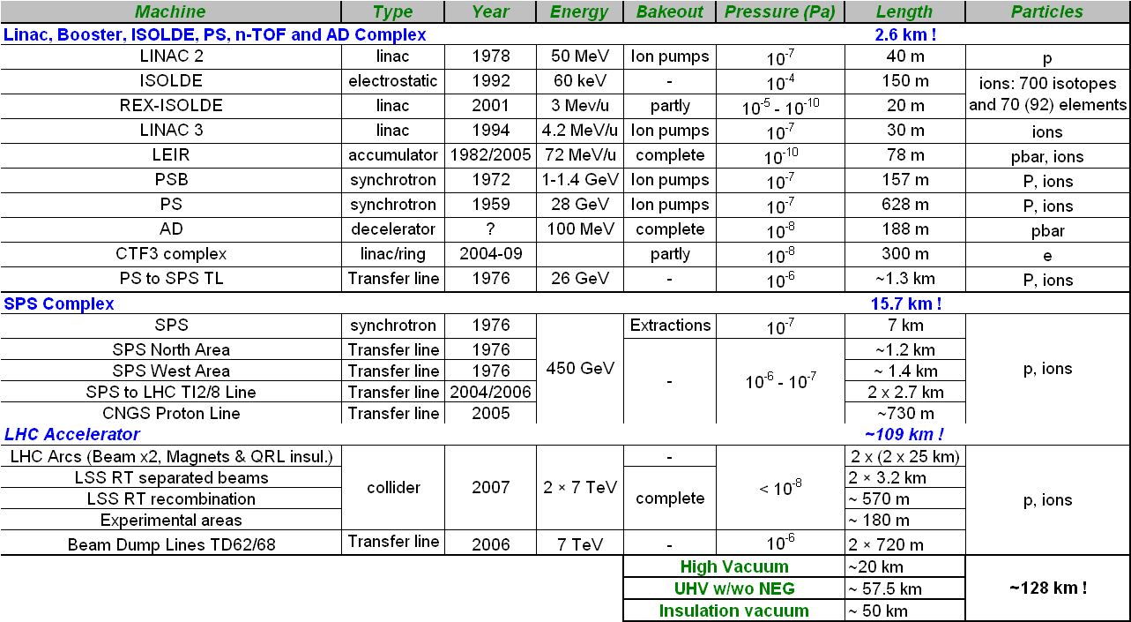
CERN vacuum systems
  2850 ion pumps, 450 turbomolecular pumps, 325 Ti sublimation pumps,…
  6 Km of NEG coated beam pipes, 2750 pressure gauges, 40 leak detectors and 100 RGAs,1930 roughing valves and 510 gate sector valves

Slide 5
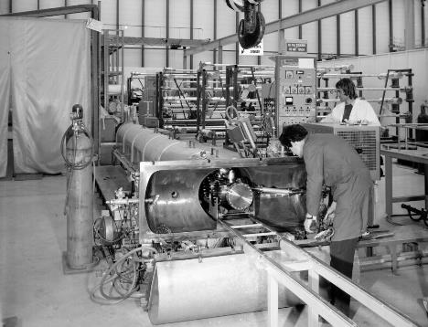
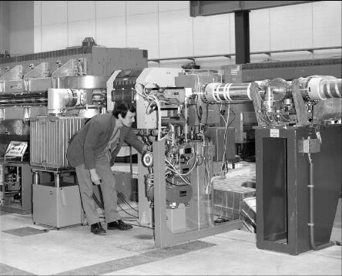
Intersecting Storage Rings
Discovery of :
  Vacuum stability and pressure runaway
  Beam induced multipacting (electron cloud)
Developments of laboratory studies and cleaning methods
1971-1984

Slide 6
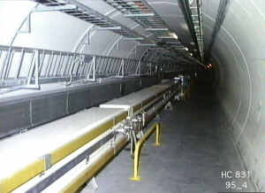
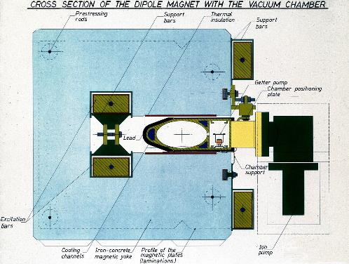
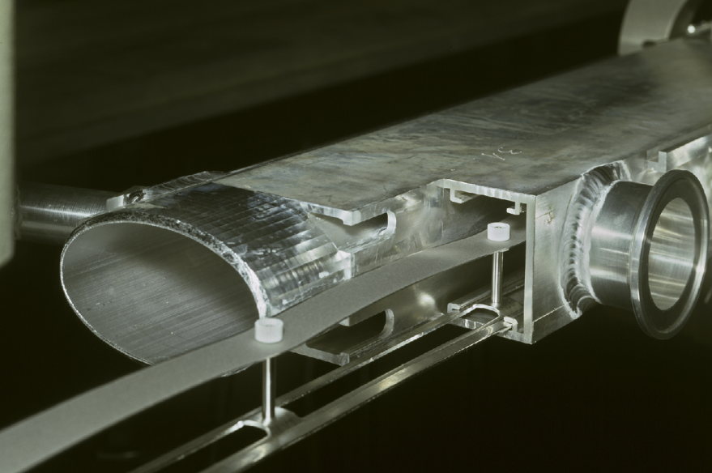
Large Electron Positron Collider
Synchrotron radiation in LEP:
  From 6 to 660 keV critical energy
  Gas desorption studies
Innovative pumping system
  Antechamber with NEG pumping strip
  Water cooled and lead shielded
FCC-ee !!
1989-2000

Slide 7
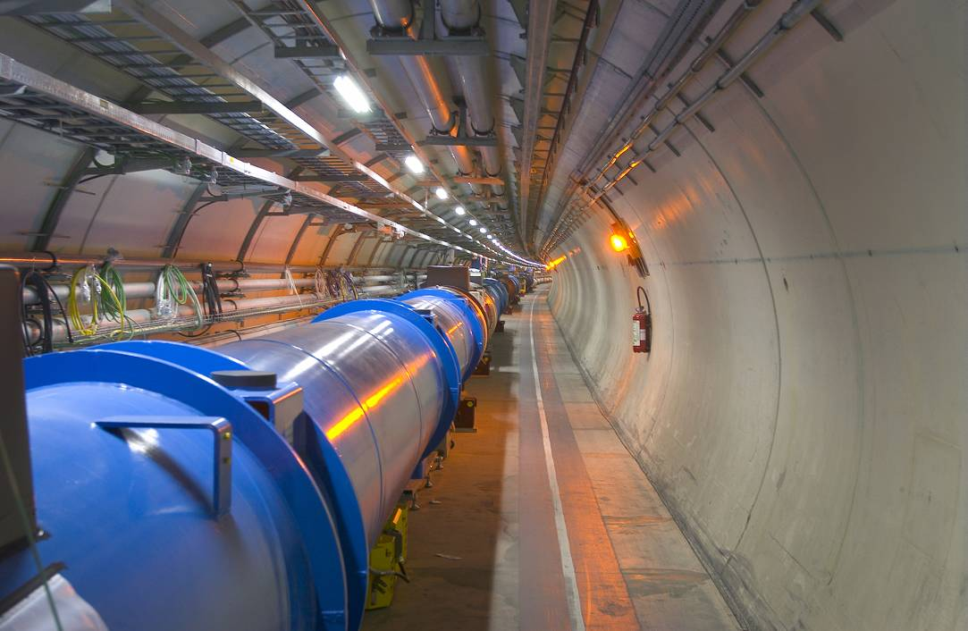
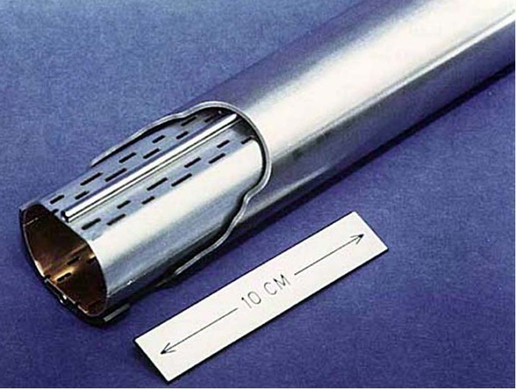
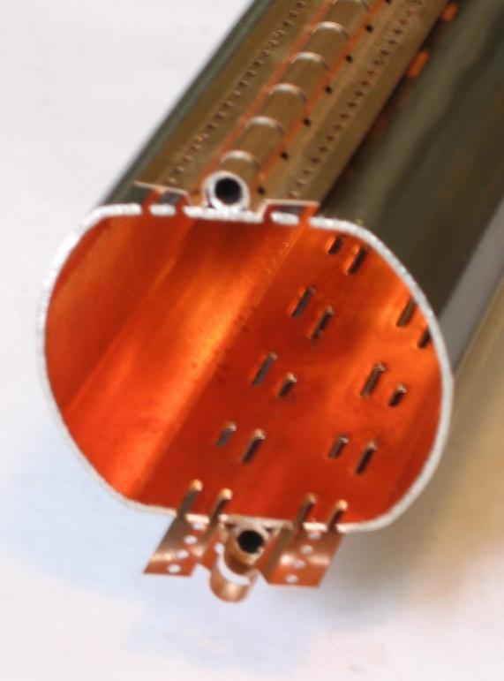
Large Hadron Collider
Cold bore (CB) at 1.9 K which ensures leak tightness
Beam screen (BS) at 5-20 K which intercepts thermal loads and acts as a screen
Started in 2008 – to be upgraded by mid-2026-2029 and operated until 2040…

Slide 8
Vacuum, Surface and Coatings group mandate
Design, construction, operation, maintenance and upgrade of high & ultra-high vacuum systems for Accelerators and Detectors.
Expertise and support on thin-walled vacuum chambers, windows and bellows compensation systems
Expertise in vacuum sealing and leak-tightness technology
Expertise in dynamic vacuum phenomena
Management of the industrial support contract for vacuum work in accelerators
Expertise in vacuum control systems, vacuum interlocks and monitoring tools
Simulation of pressure profiles and synchrotron radiation distribution in accelerators
Coatings, surfaces treatments, surface and chemical analysis for Accelerators and Detectors. Expertise and support in the fields of:
Coatings, electroplating and surface cleaning techniques
Plasma characterisation and simulation
UHV characterization and of material and surfaces
Degassing analysis and treatments

Slide 9
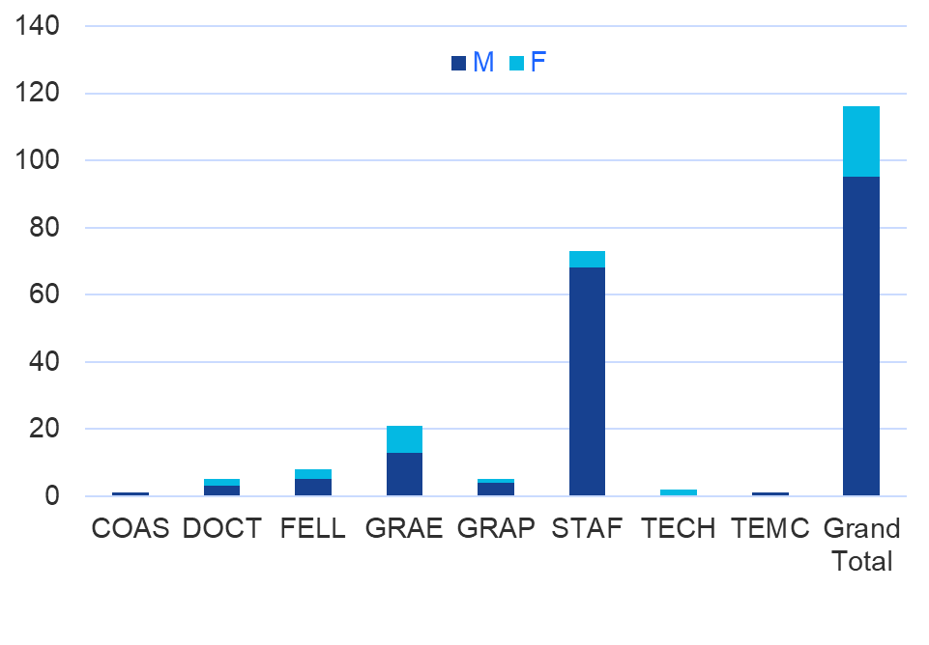
Vacuum, Surface and Coatings group
Design, construction, installation
and operation of the CERN accelerator vacuum systems
73+41 = 114 persons in Dec 2024
Several collaborators from different countries and institutes

Slide 10
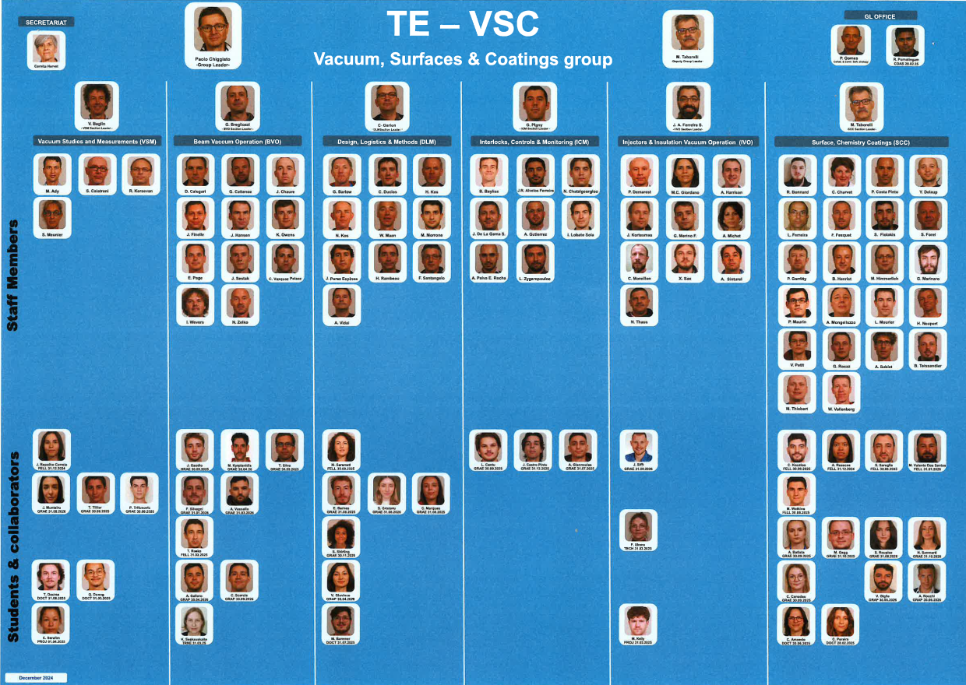
TE-VSC organisation
Group management
+ 6 sections:
Vacuum studies and measurements
Beam vacuum operation
Design, logistics & methods
Interlock, controls & monitoring
Injector & insulation vacuum operation
Surface, chemistry & coatings

Slide 11
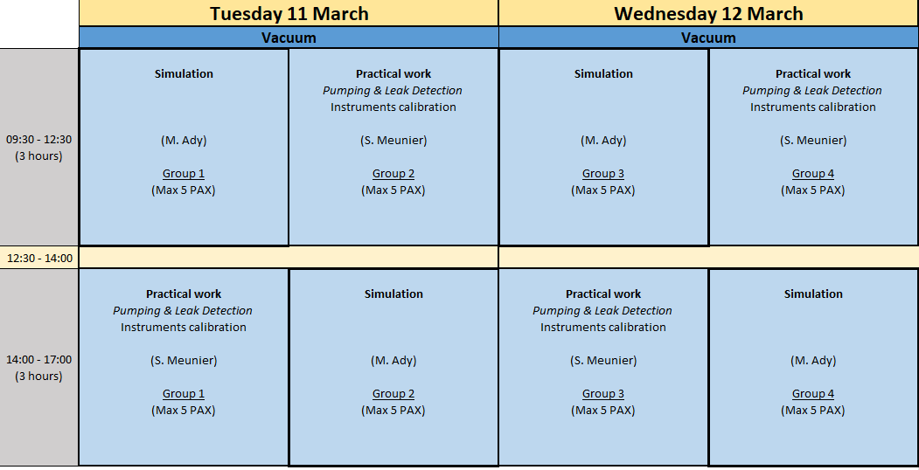
Organisation of practical days at CERN
Simulations & Practical work
4 groups of 5 PAX
Meeting in Bat 112/R-034 & 30-1-039

Slide 12
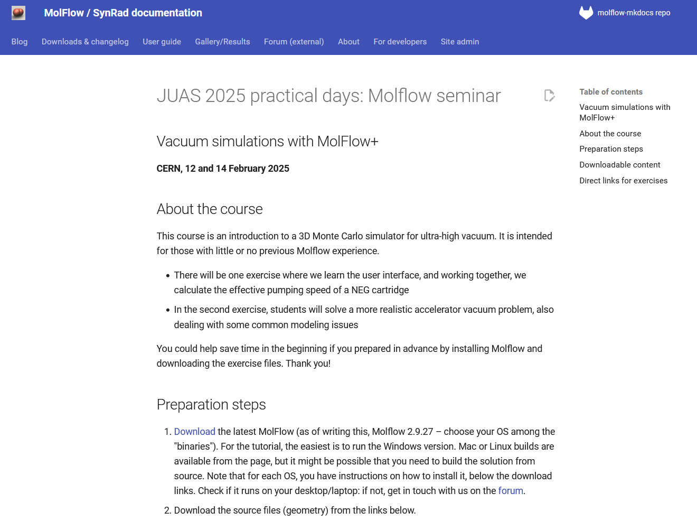
Organisation inputs for Simulations
https://molflow.docs.cern.ch/guide/molflow/tutorials/juas/juas_2025/
Do not forget to bring your laptop & upload Molflow if possible

Slide 13
Simulation

Slide 14
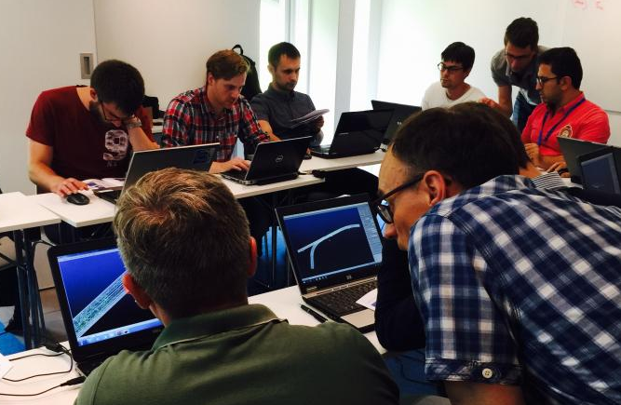
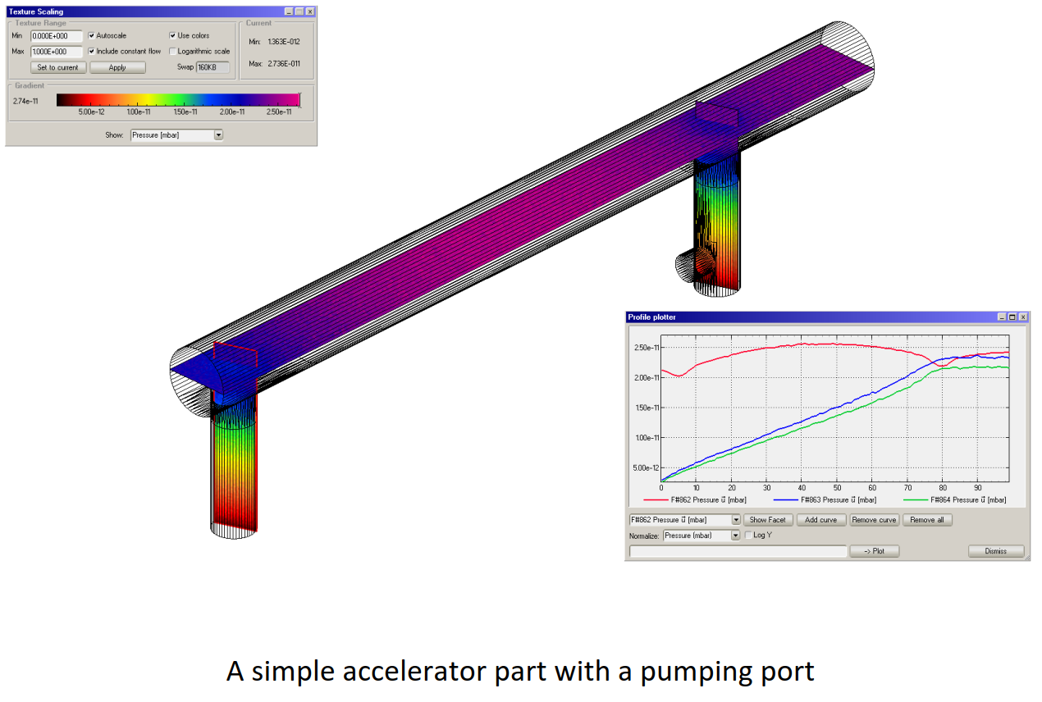
Design of vacuum systems
A test particle Monte-Carlo code for molecular flow
http://molflow.web.cern.ch/
R. Kersevan – M. Ady

Slide 15
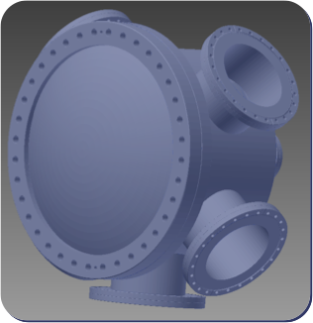
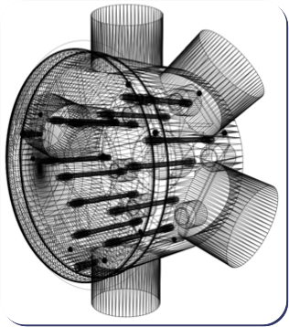
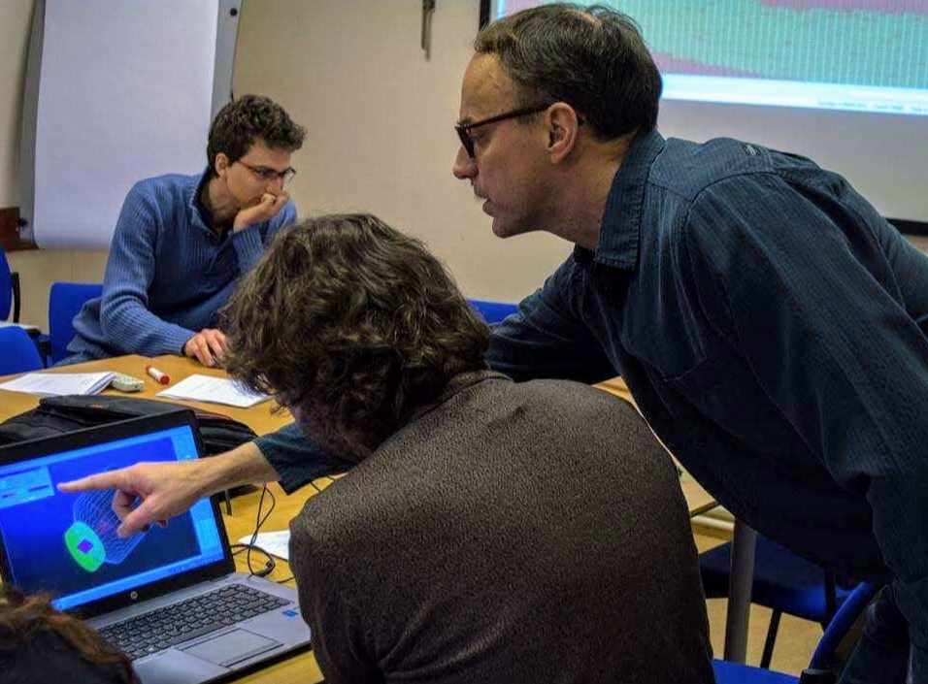
Step 1: creating geometry
CAD
Molflow+
STL format

Slide 16
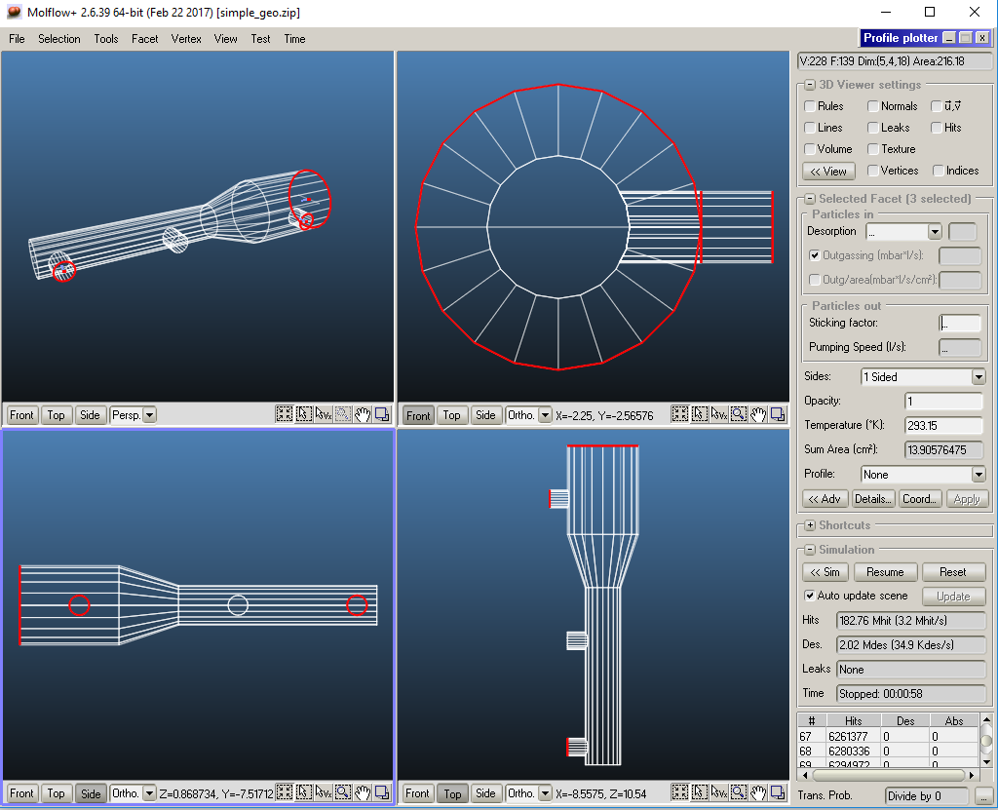
Step 2: adding physics

Slide 17
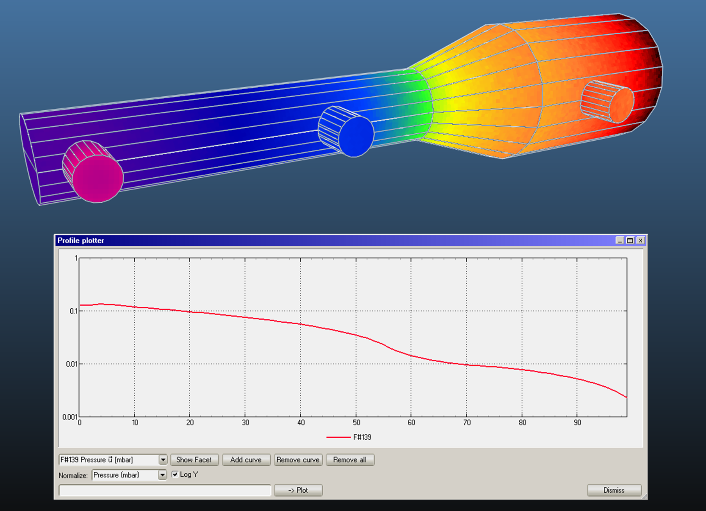
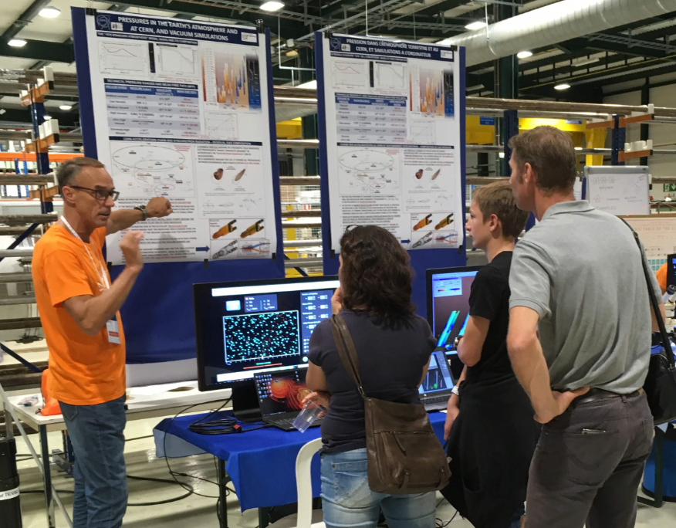
Step 3: simulation and results
100k molecules

Slide 18
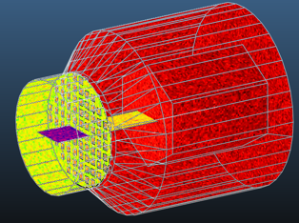
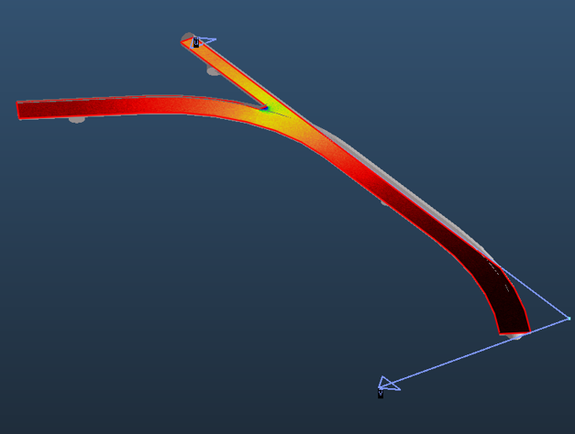
Exercices
Effective pumping speed of a NEG pump
Pressure profile in an accelerator

Slide 19
Practical work

Slide 20
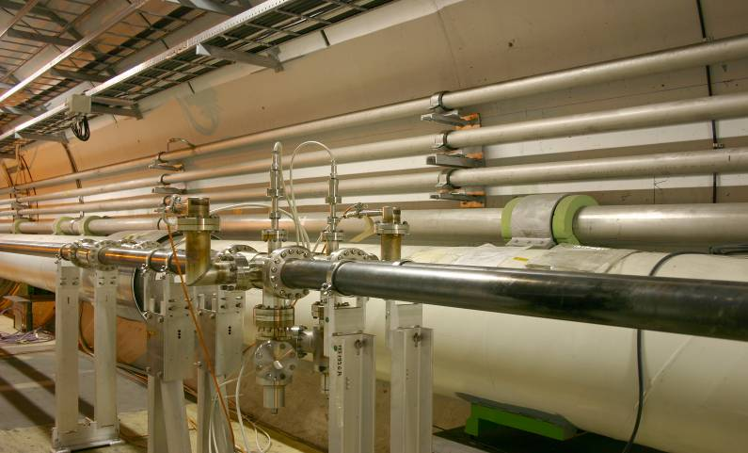
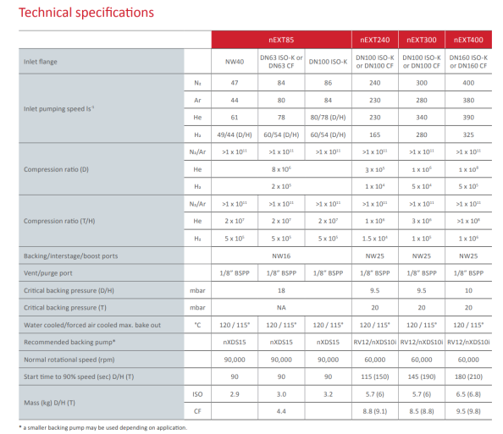
Pump down
Pump down of a vacuum system:
  start pumping
  open roughing valve
  expected pump down curve

Slide 21
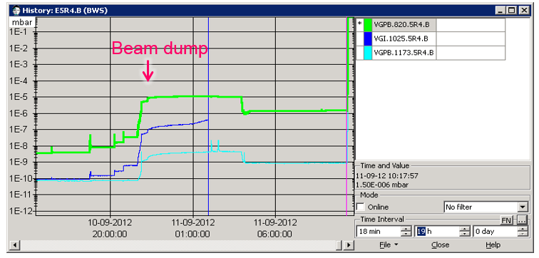
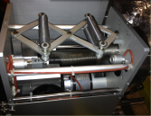
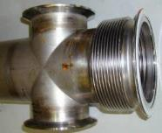
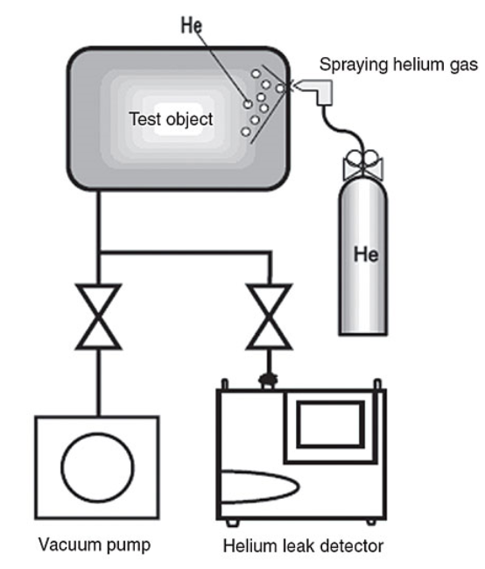
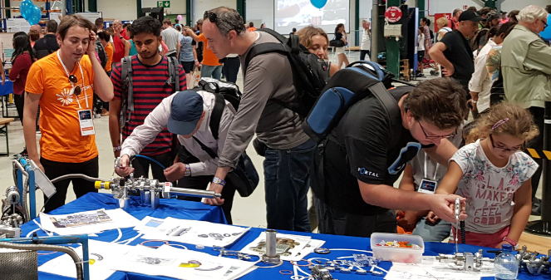
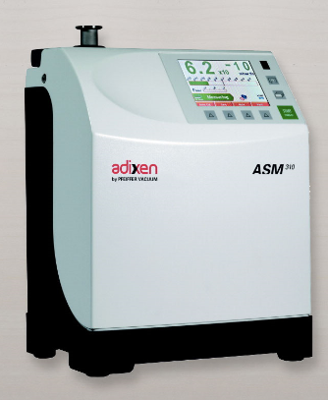
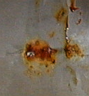
Leak detection
How to locate / identify leaks in a vacuum system ?
He leak detector

Slide 22
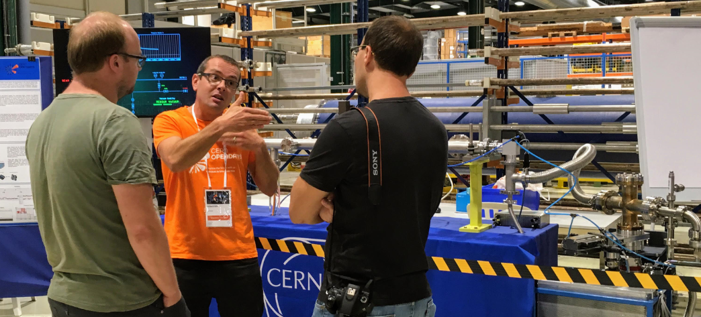
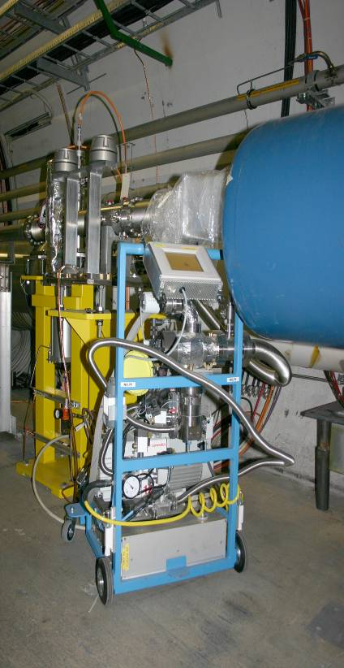
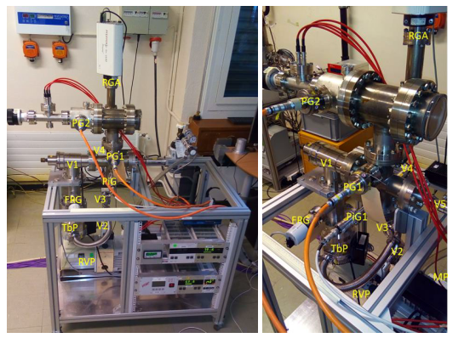
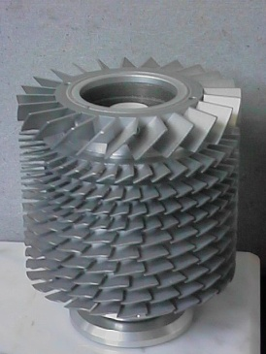
Pumping speed measurement
Pumping speed measurement

Slide 23
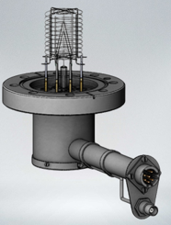
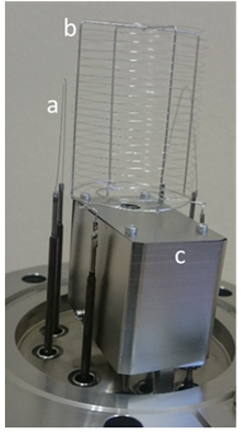
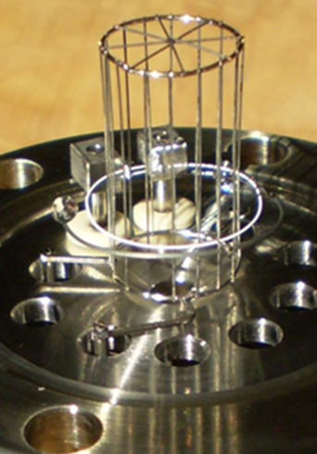
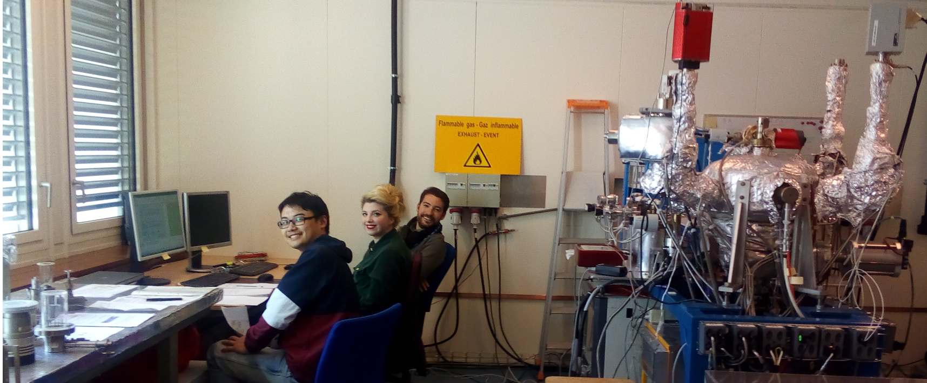
Vacuum gauge
Vacuum gauges description
Vacuum gauge calibration
Gas injections

Slide 24
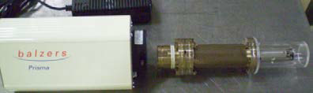
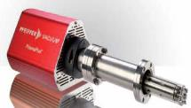
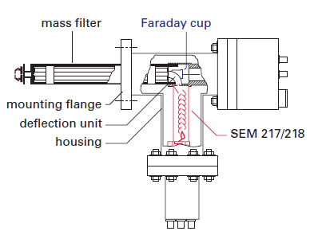



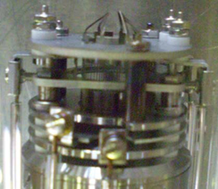
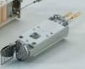
Mass Spectrometry
Description, operation, limits
Calibration

Slide 25
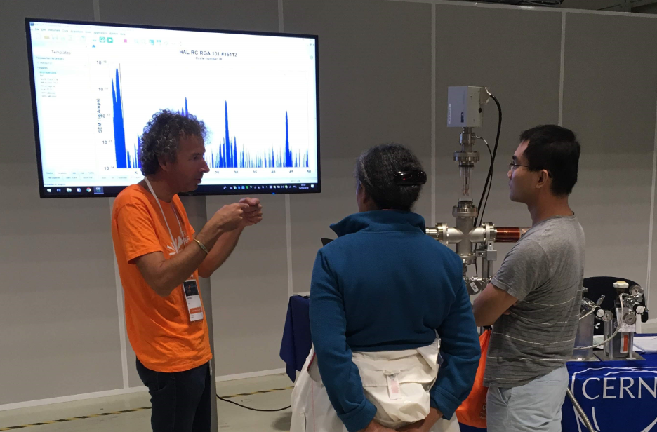
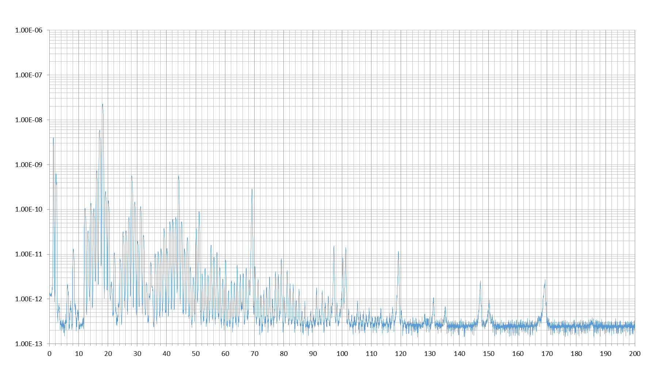
Gas analysis
is my residual gas composition reasonable ?
Estimation of the partial pressure

Slide 26
You are welcome to join our group for the practical days !

Slide 27
Thank you for your attention !!!

