Slide 1
Practical Work on Magnets
Part 2: Magnetic Measurements
11th – 12th March 2025
Joint Universities Accelerator School
JUAS 2025
Lucio Fiscarelli, Jeremie Bauche
TE-MSC
CERN

Slide 2
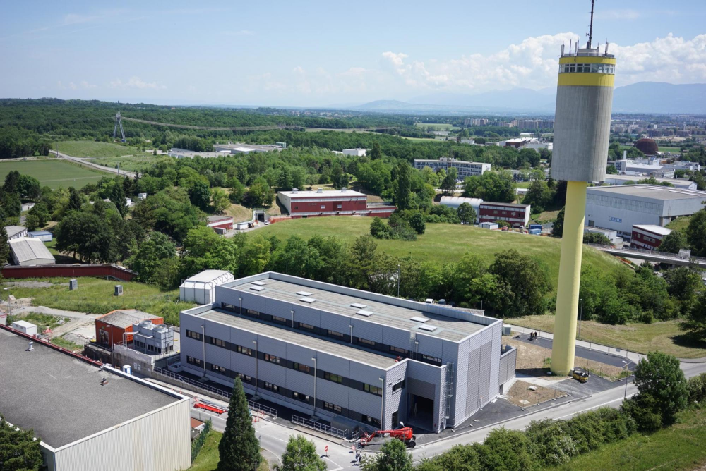
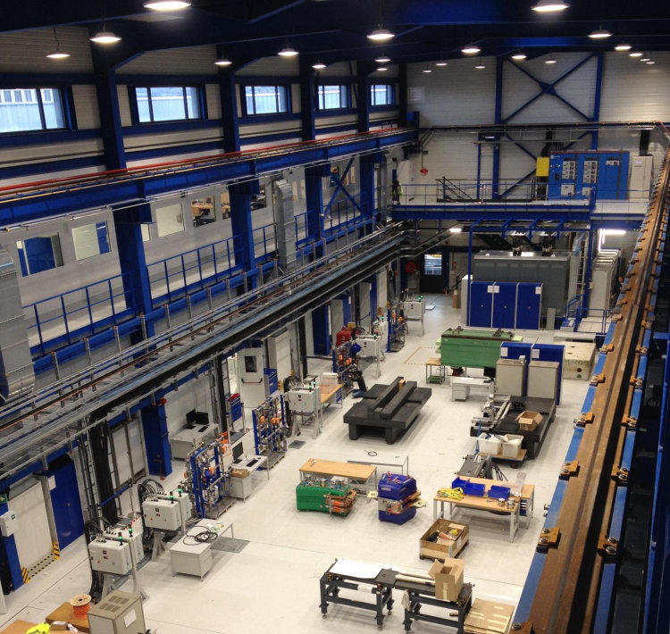
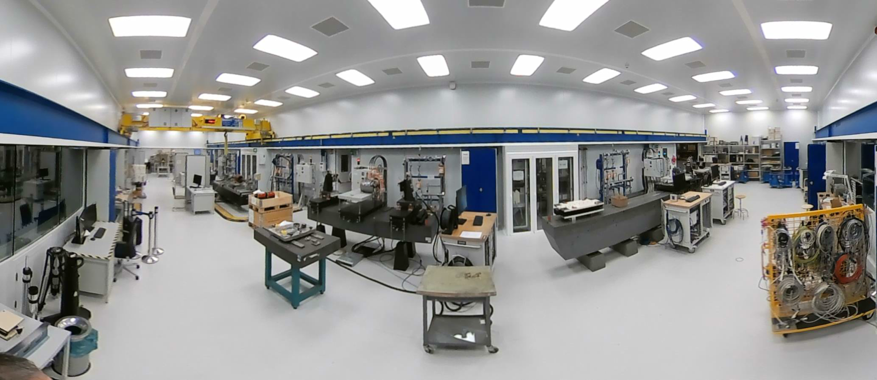
Tour in one of our laboratory
  b.311 lab built in 2017

Slide 3
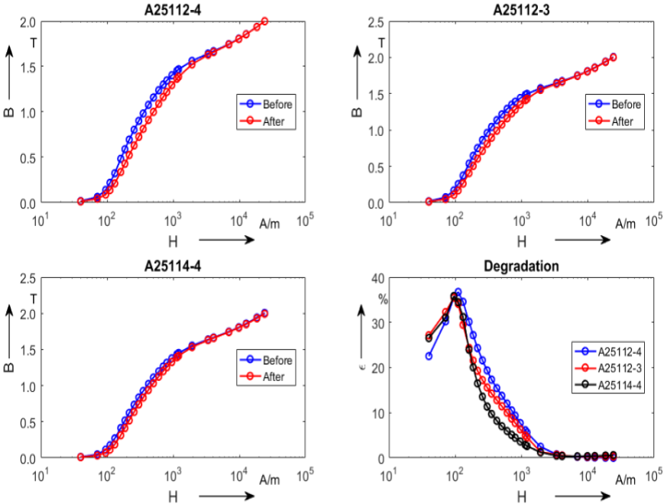
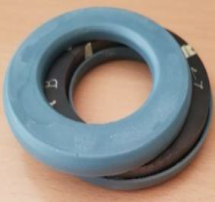
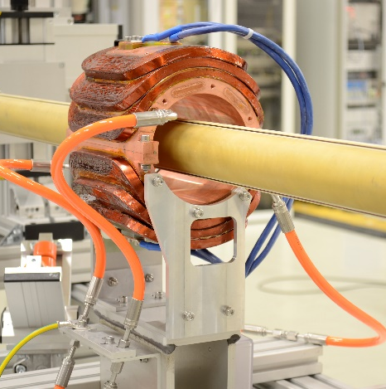
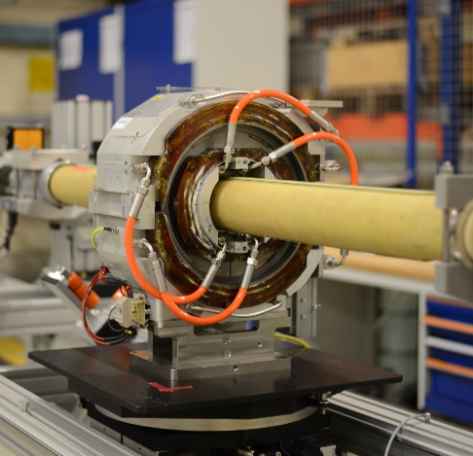
Unterstand the motivation for MM
Magnetic measurements (MM) are performed to:
Characterize soft (iron) and hard (permanent magnets) ferromagnetic materials
Prove that the electro-magnetic design is correct
Monitor production quality and steer manufacturing
Characterization for operations: transfer function, field uniformity, magnetic axis, dynamic effects (eddy currents) and cycling effects (hysteresis)
Provide real-time field measurements for operations
Characterize magnets after repairs or for changes in the operation ranges
  Characterization of the BH-curve on samples of magnetic steel
  Rotating coil measurement on a model and the final magnet
  Field homogeneity reconstructed from rotating coils measurements

Slide 4
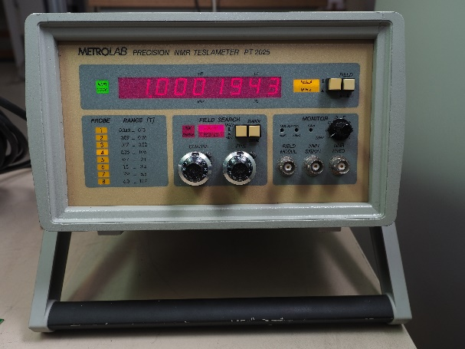
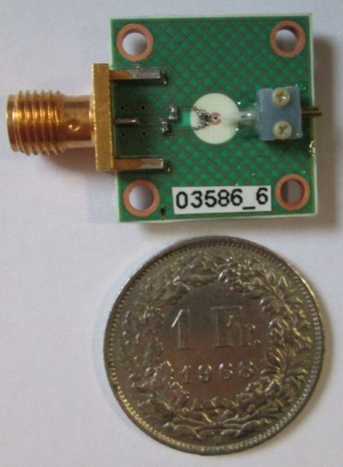
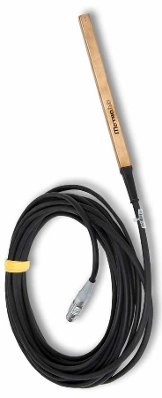
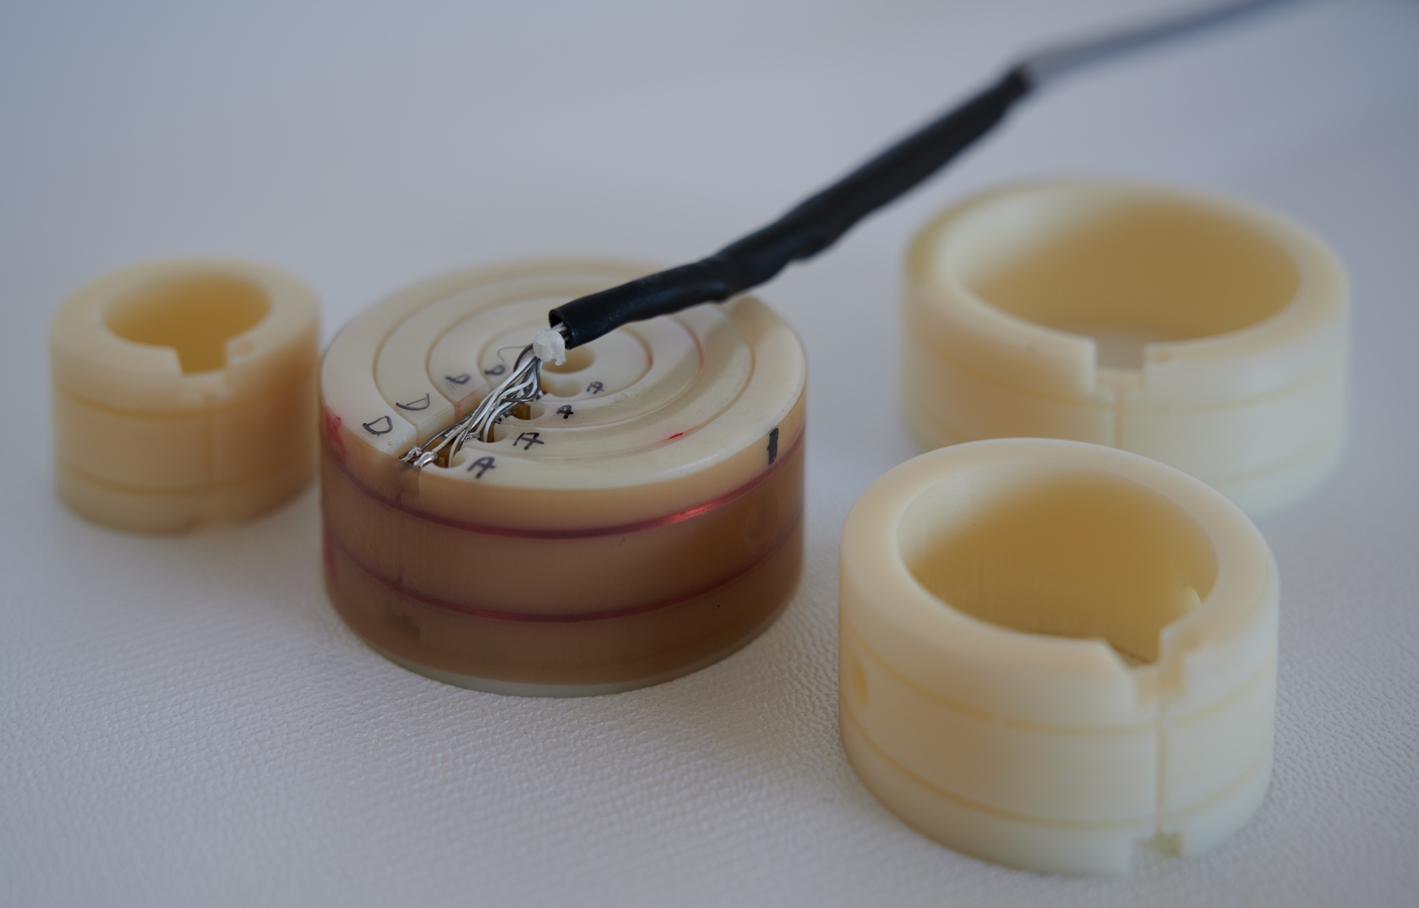
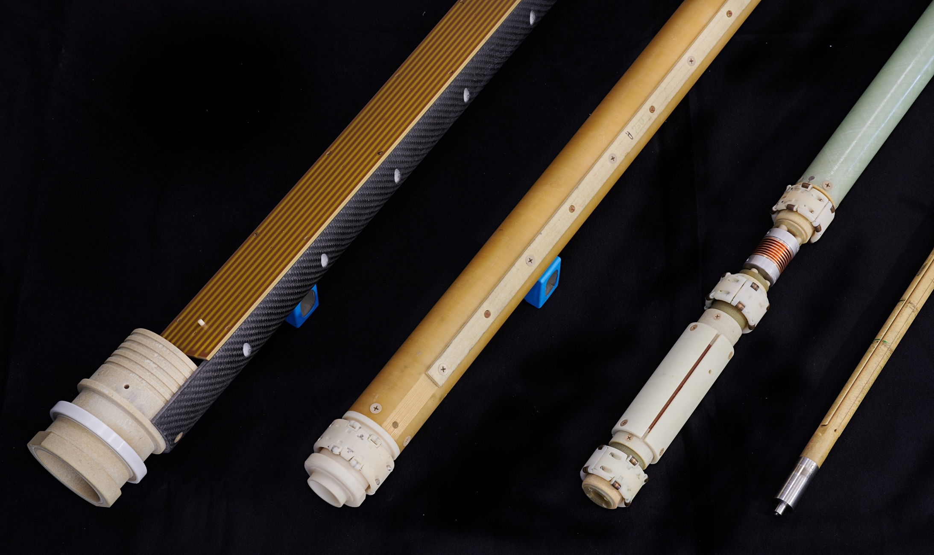
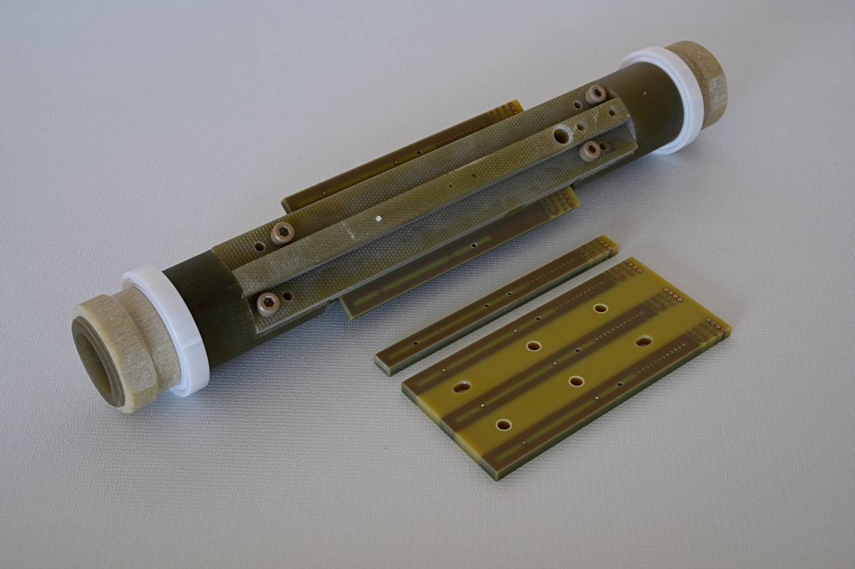
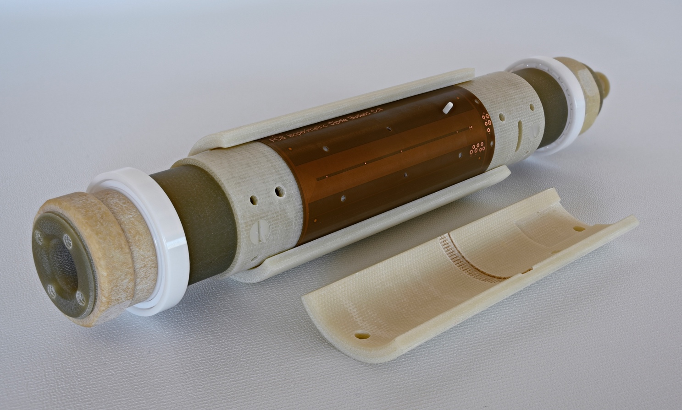
Explore different MM sensors
Various instruments or methods to cover the requirements
  Multiple instruments are complementary
  Overlaps provide estimation of absolute uncertainty and error correction
  Commercial teslameters based on Hall sensors and NMR
  FMR marker
  Concentric induction coils
  Rotating coils with various diameters, lengths, and coil arrangement

Slide 5
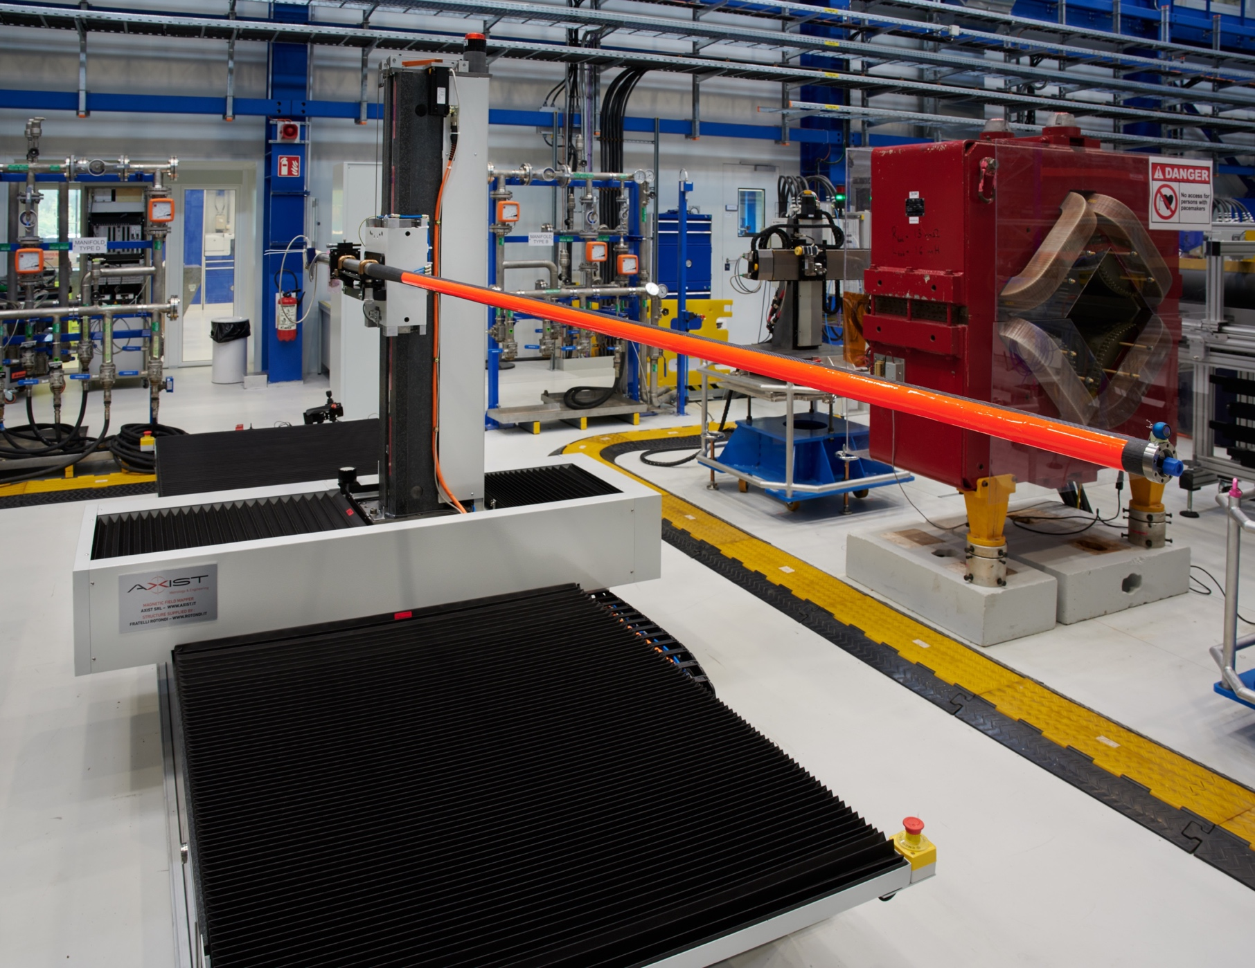
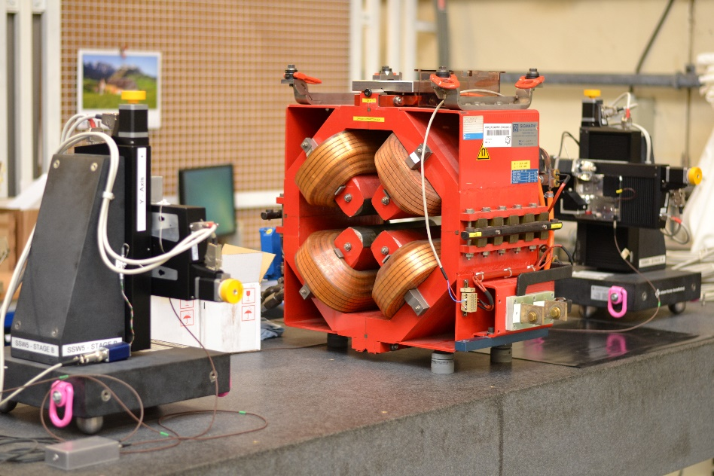
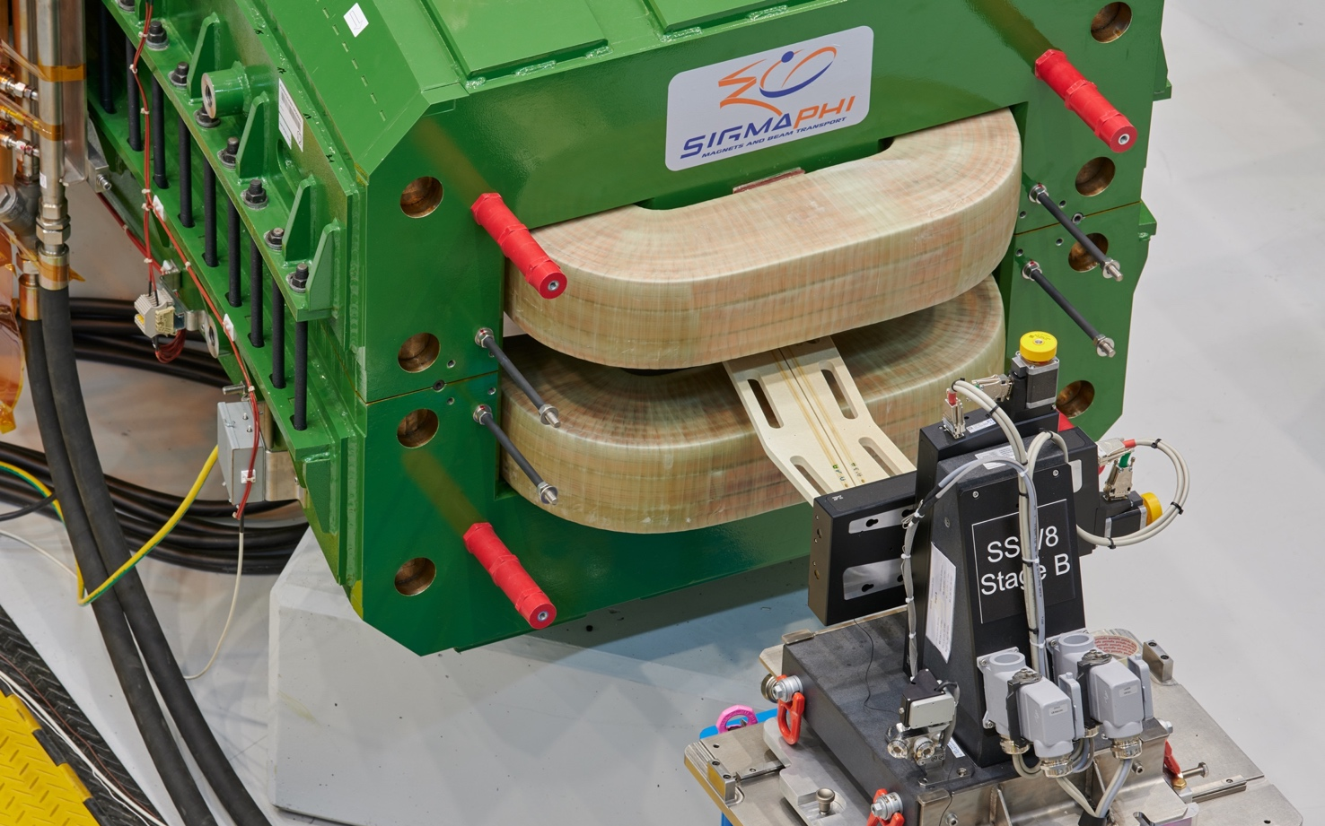
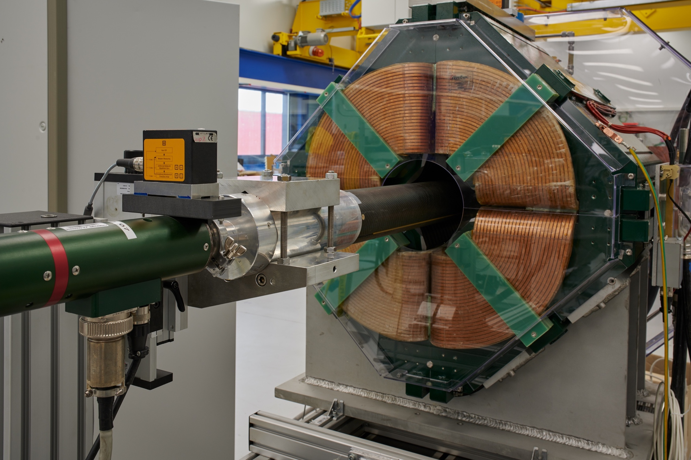
Discover the different MM techniques
  3D mapper
  Single stretched wire bench
  Induction coil magnetometer (“fluxmeter”)
  Rotating coil magnetometer

Slide 6
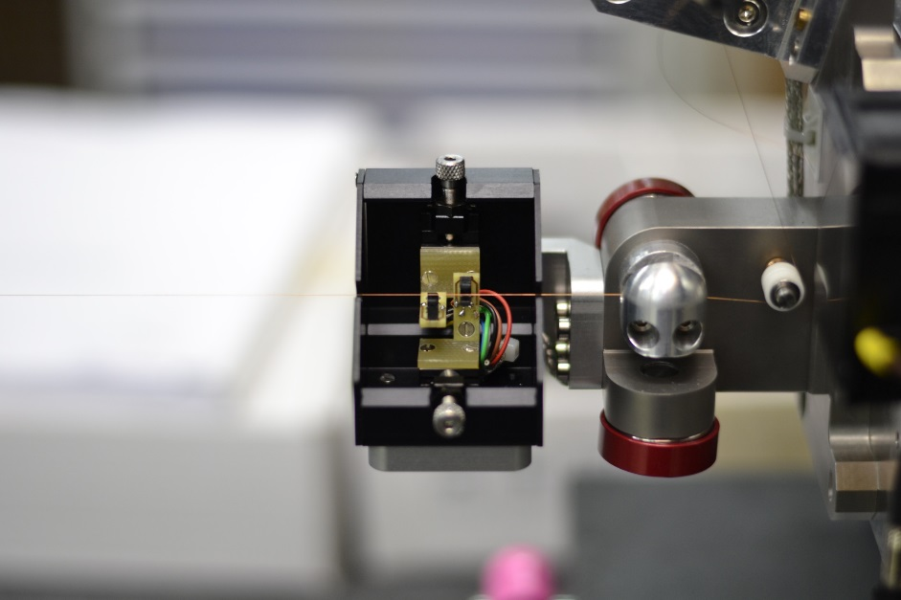
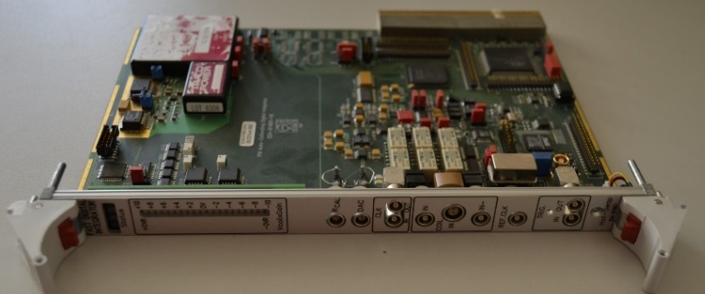
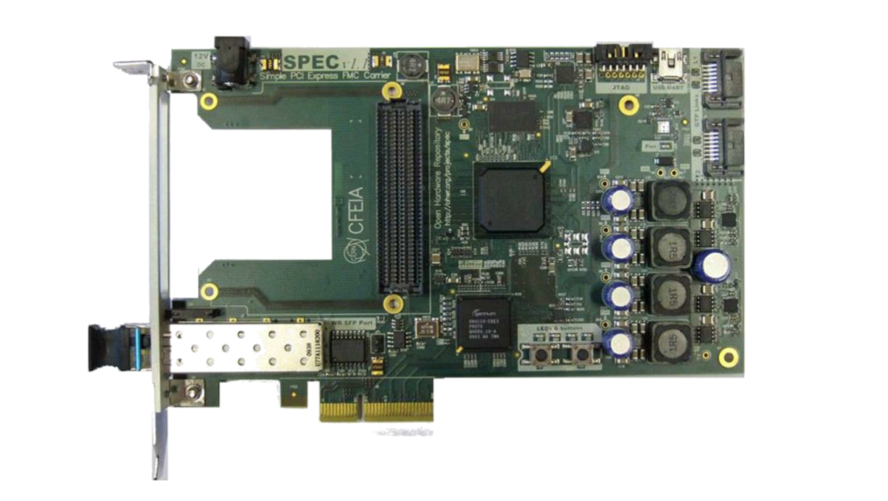
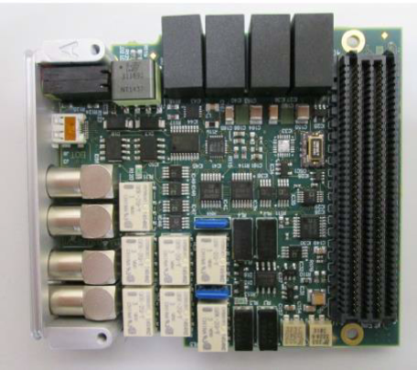
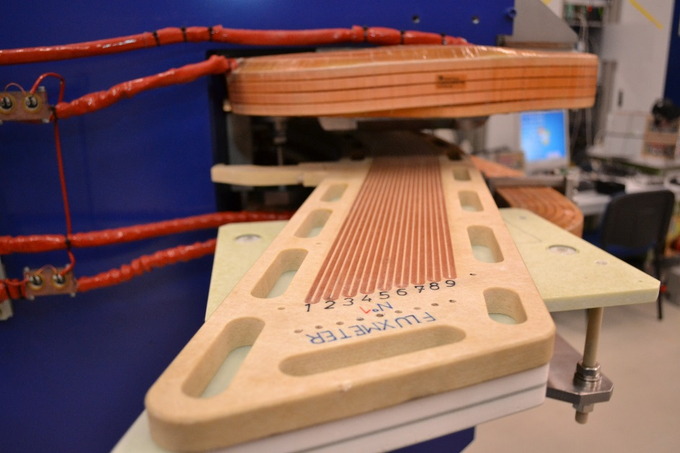
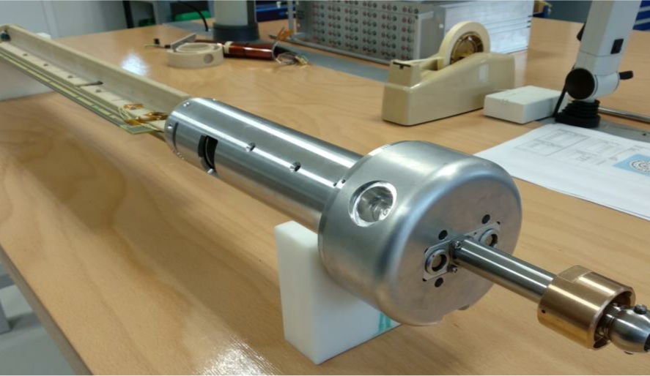
Find out about latest developments
  Photodetectors in the vibrating wire system
  Digital integrator modules
  Multi-coil fluxmeter for the ELENA curved dipoles
  Rotating-coil scanner for HL-LHC magnets

Slide 7
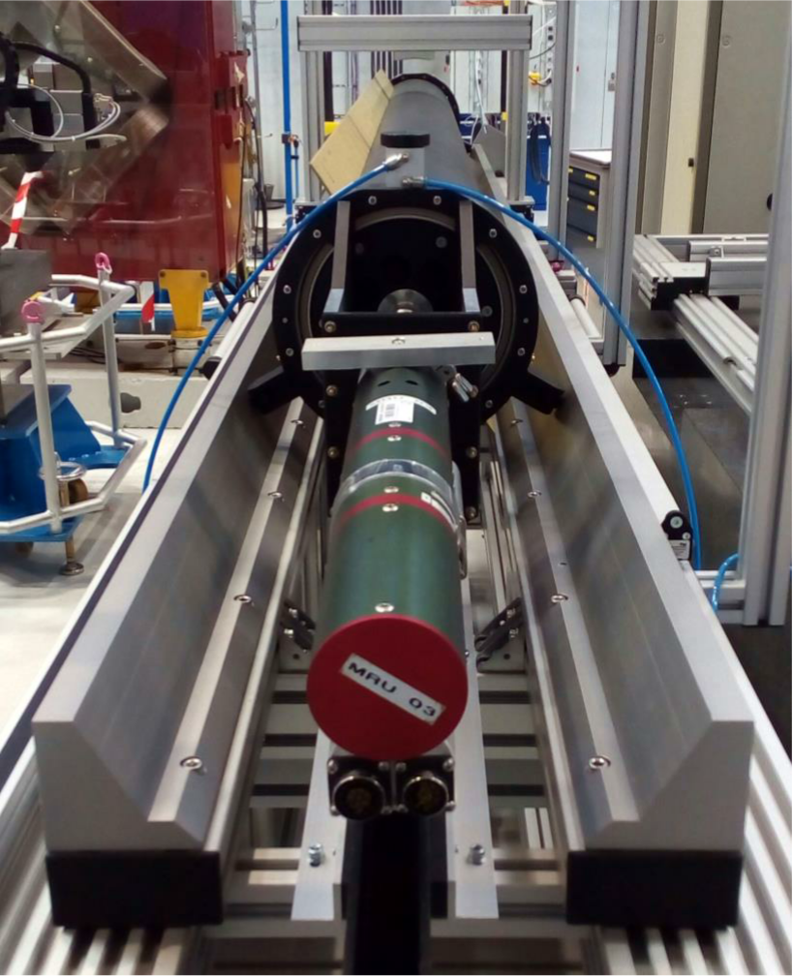
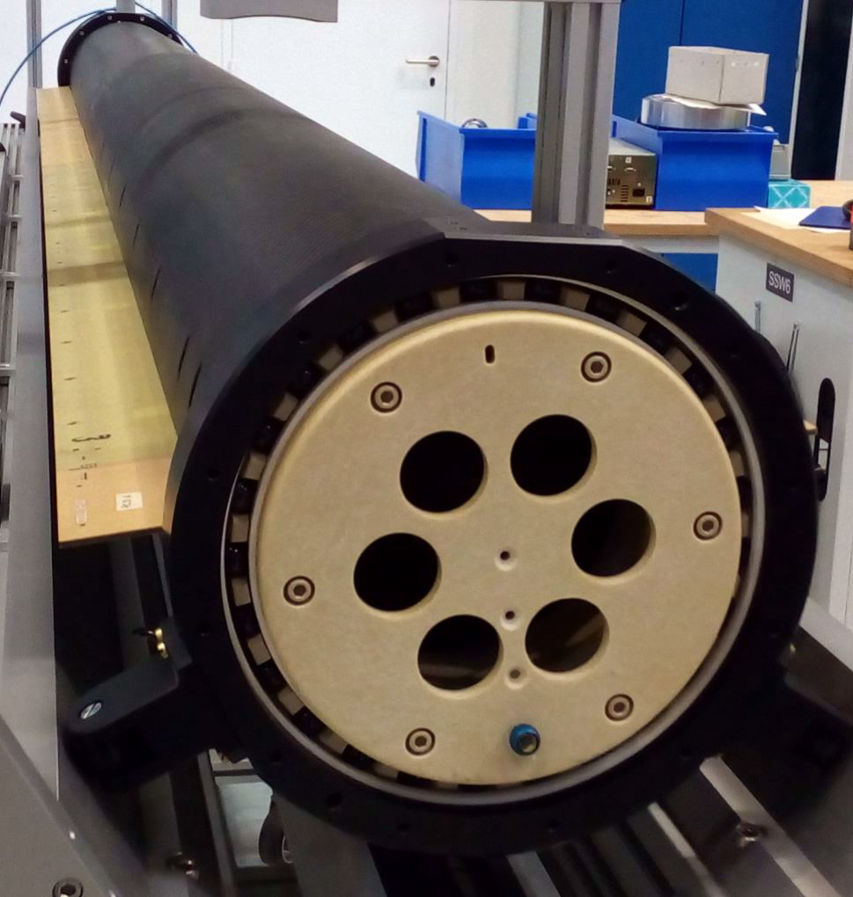
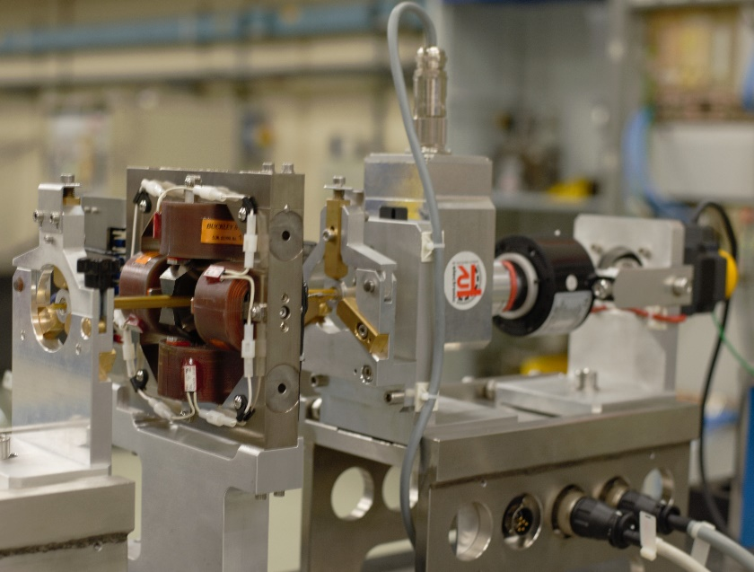
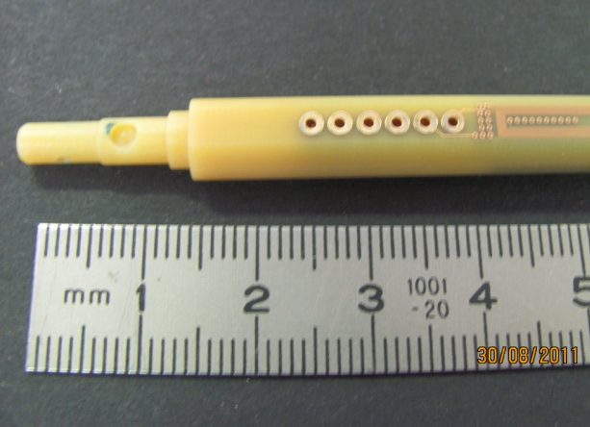
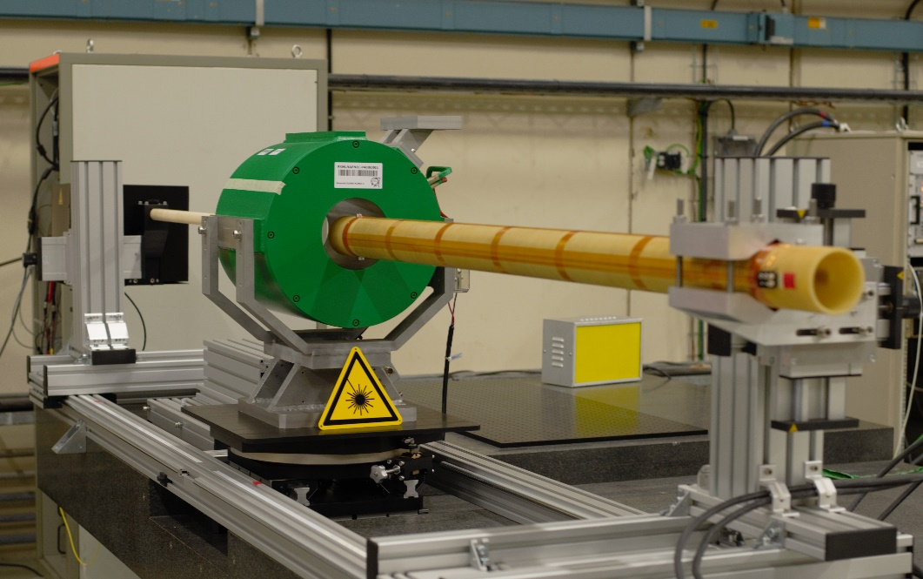
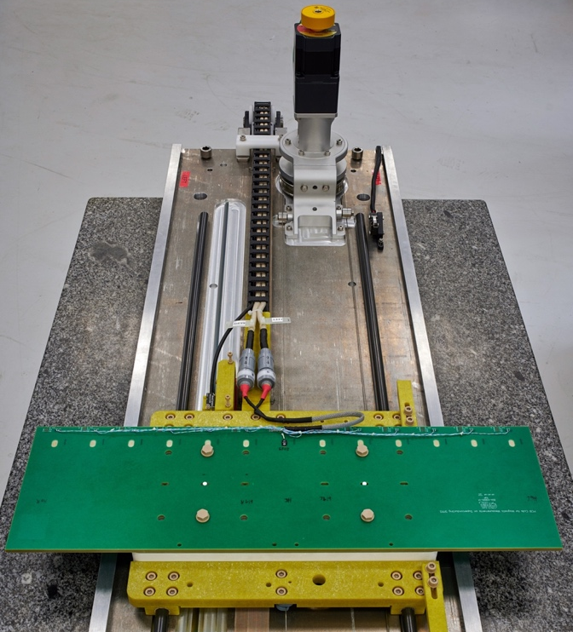
Find out about latest developments
  Large-diameter carbon fibre shaft for FAIR
  Miniature rotating coil using PCB technology for CLIC
  Compass-laser probe for solenoids
  Translating fluxmeter for FAIR dipoles

Slide 8
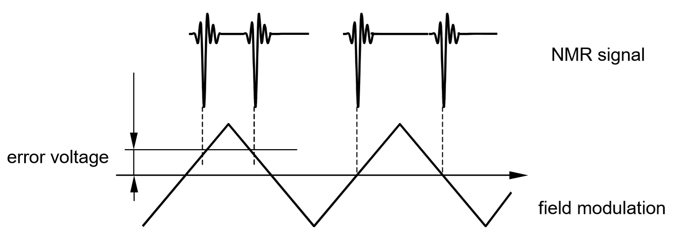
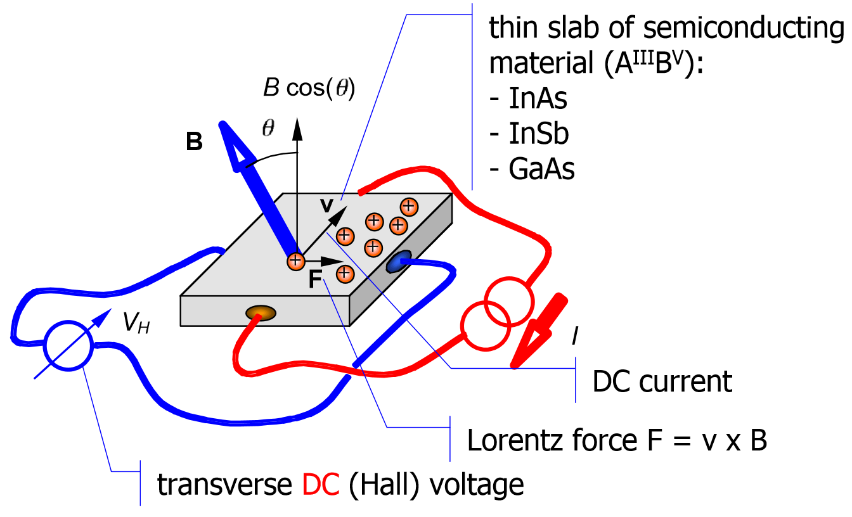
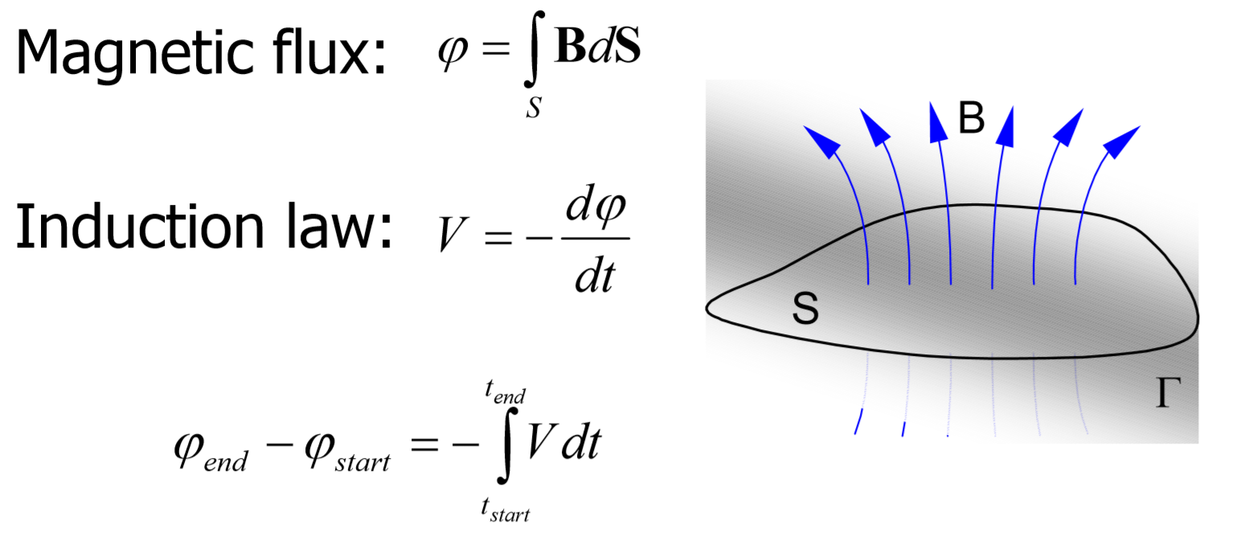
And learn…
… how the sensors work and how to chose the right one
  NMR
  Hall sensors
  Induction coils

Slide 9
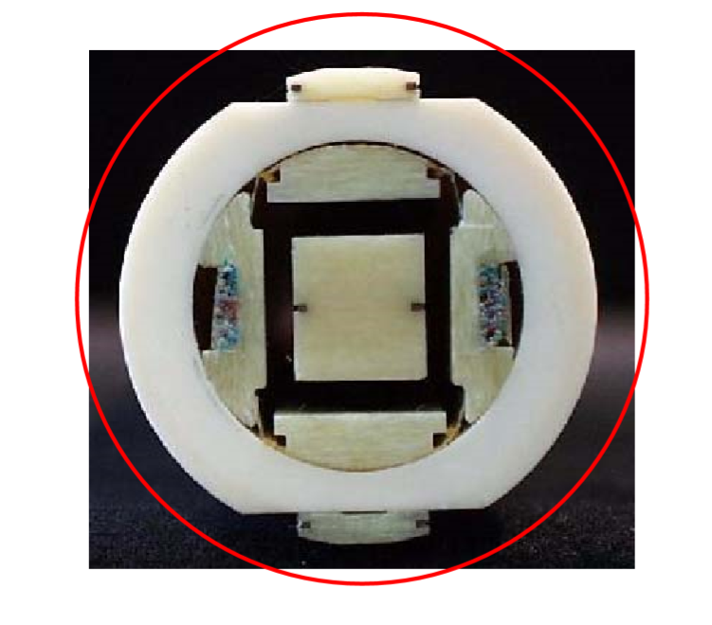
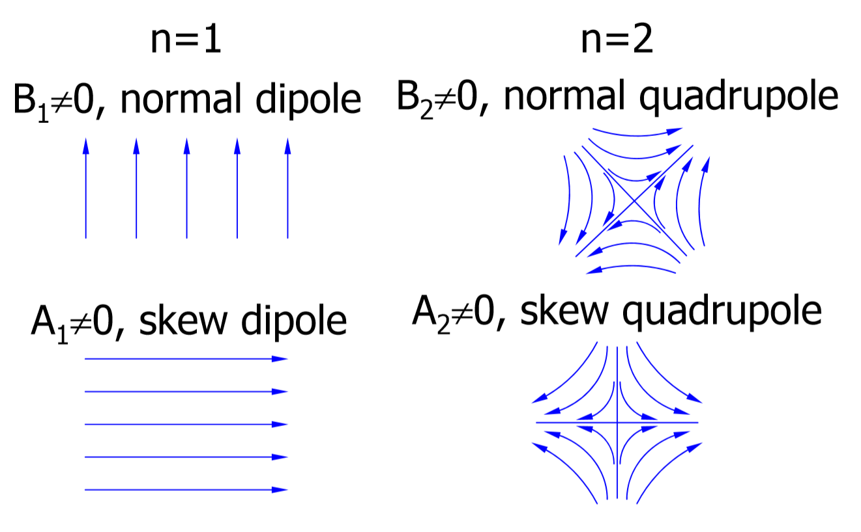
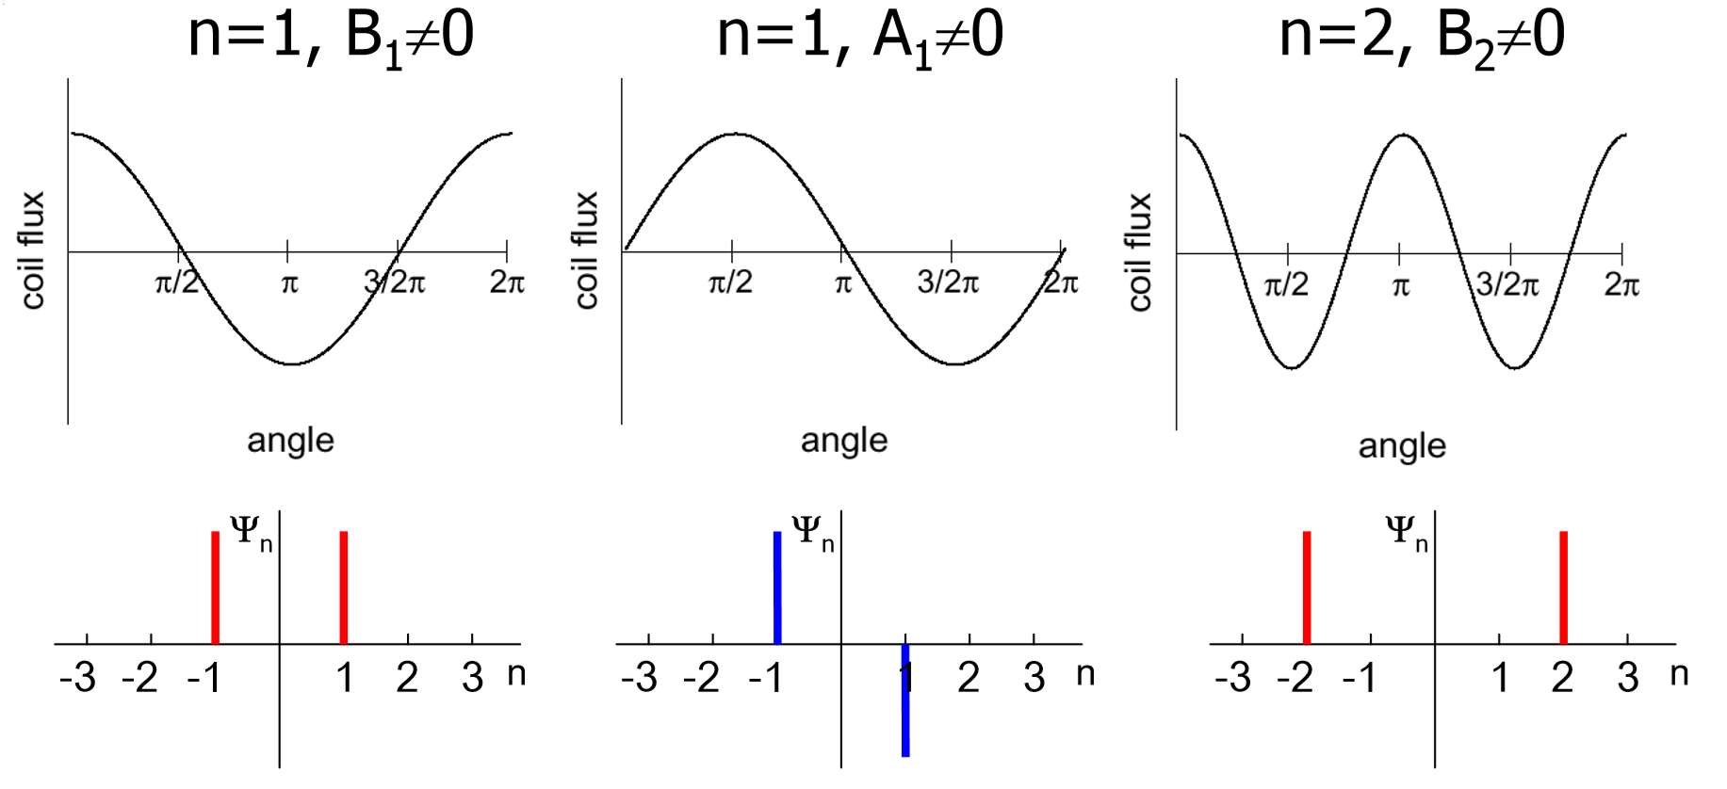
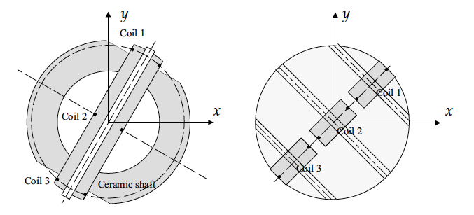
And learn…
… how a rotating-coil system works

Slide 10
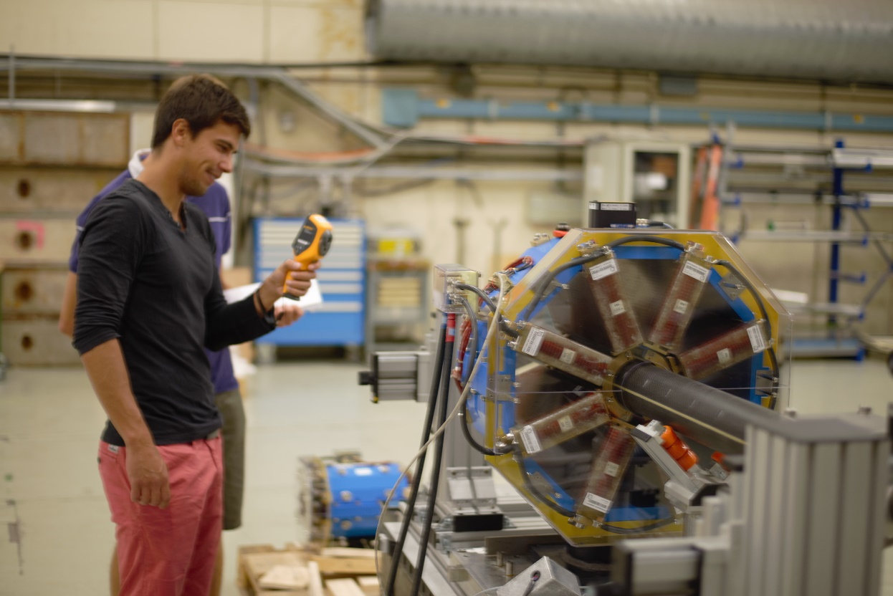
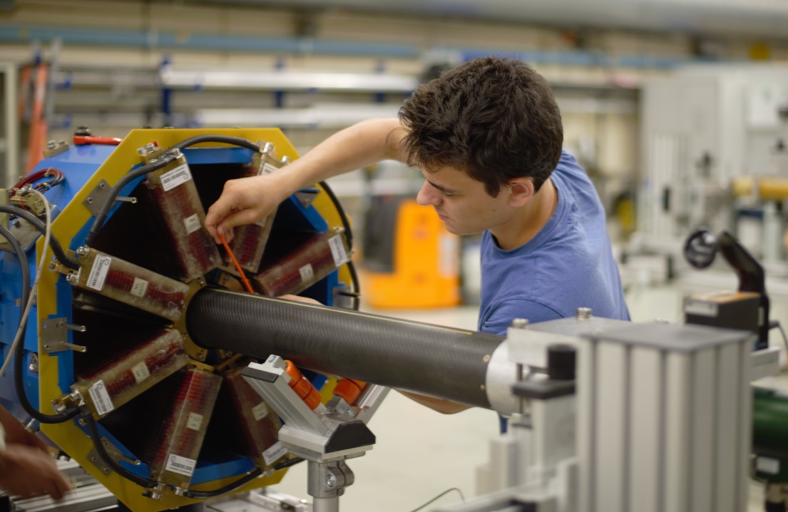
And learn…
… how to measure a real magnet “hands-on”

Slide 11
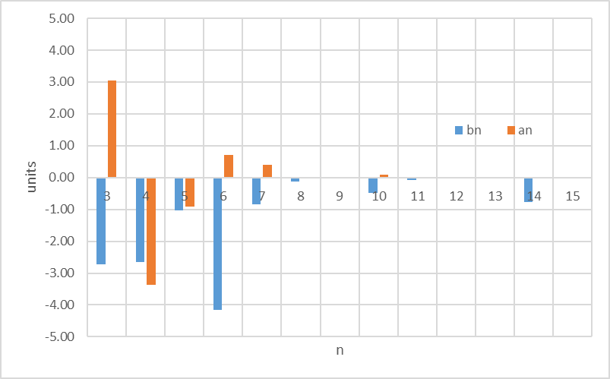
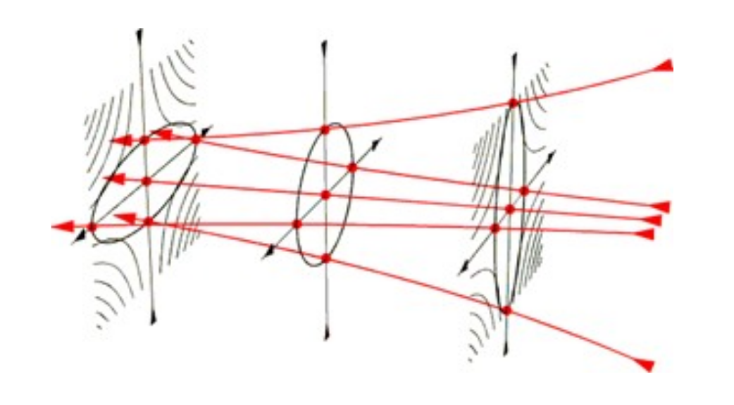
And learn…
… how to analyse and interpret the results

Slide 12
We are looking forward to meet you!
Special thanks to the colleagues for providing the material and pictures

Slide 13
Additional references
  S. Russenschuck, “Field Computation for Accelerator Magnets: Analytical and Numerical Methods for Electromagnetic Design and Optimization”, Wiley, 2011
  A.K. Jain, “Overview of Magnetic Measurement Techniques”, US Particle Accelerator School, 2006
  M. Buzio, “Fabrication and calibration of search coils”, Proceedings of CAS - CERN Accelerator School on Magnets, 2009
  A.K. Jain, “Measurements of Field Quality Using Harmonic Coils”, US Particle Accelerator School, 2001
  CERN Accelerator School on Normal- and Superconducting Magnets, 2023
  Proceedings of CAS - CERN Accelerator School on Magnets, 2009
  Proceedings of CAS - CERN Accelerator School on Magnetic measurement and alignment, 1992
  Proceedings of CAS - CERN Accelerator School on Superconductivity and Cryogenics for Accelerators and Detectors, 2002

