Slide 1
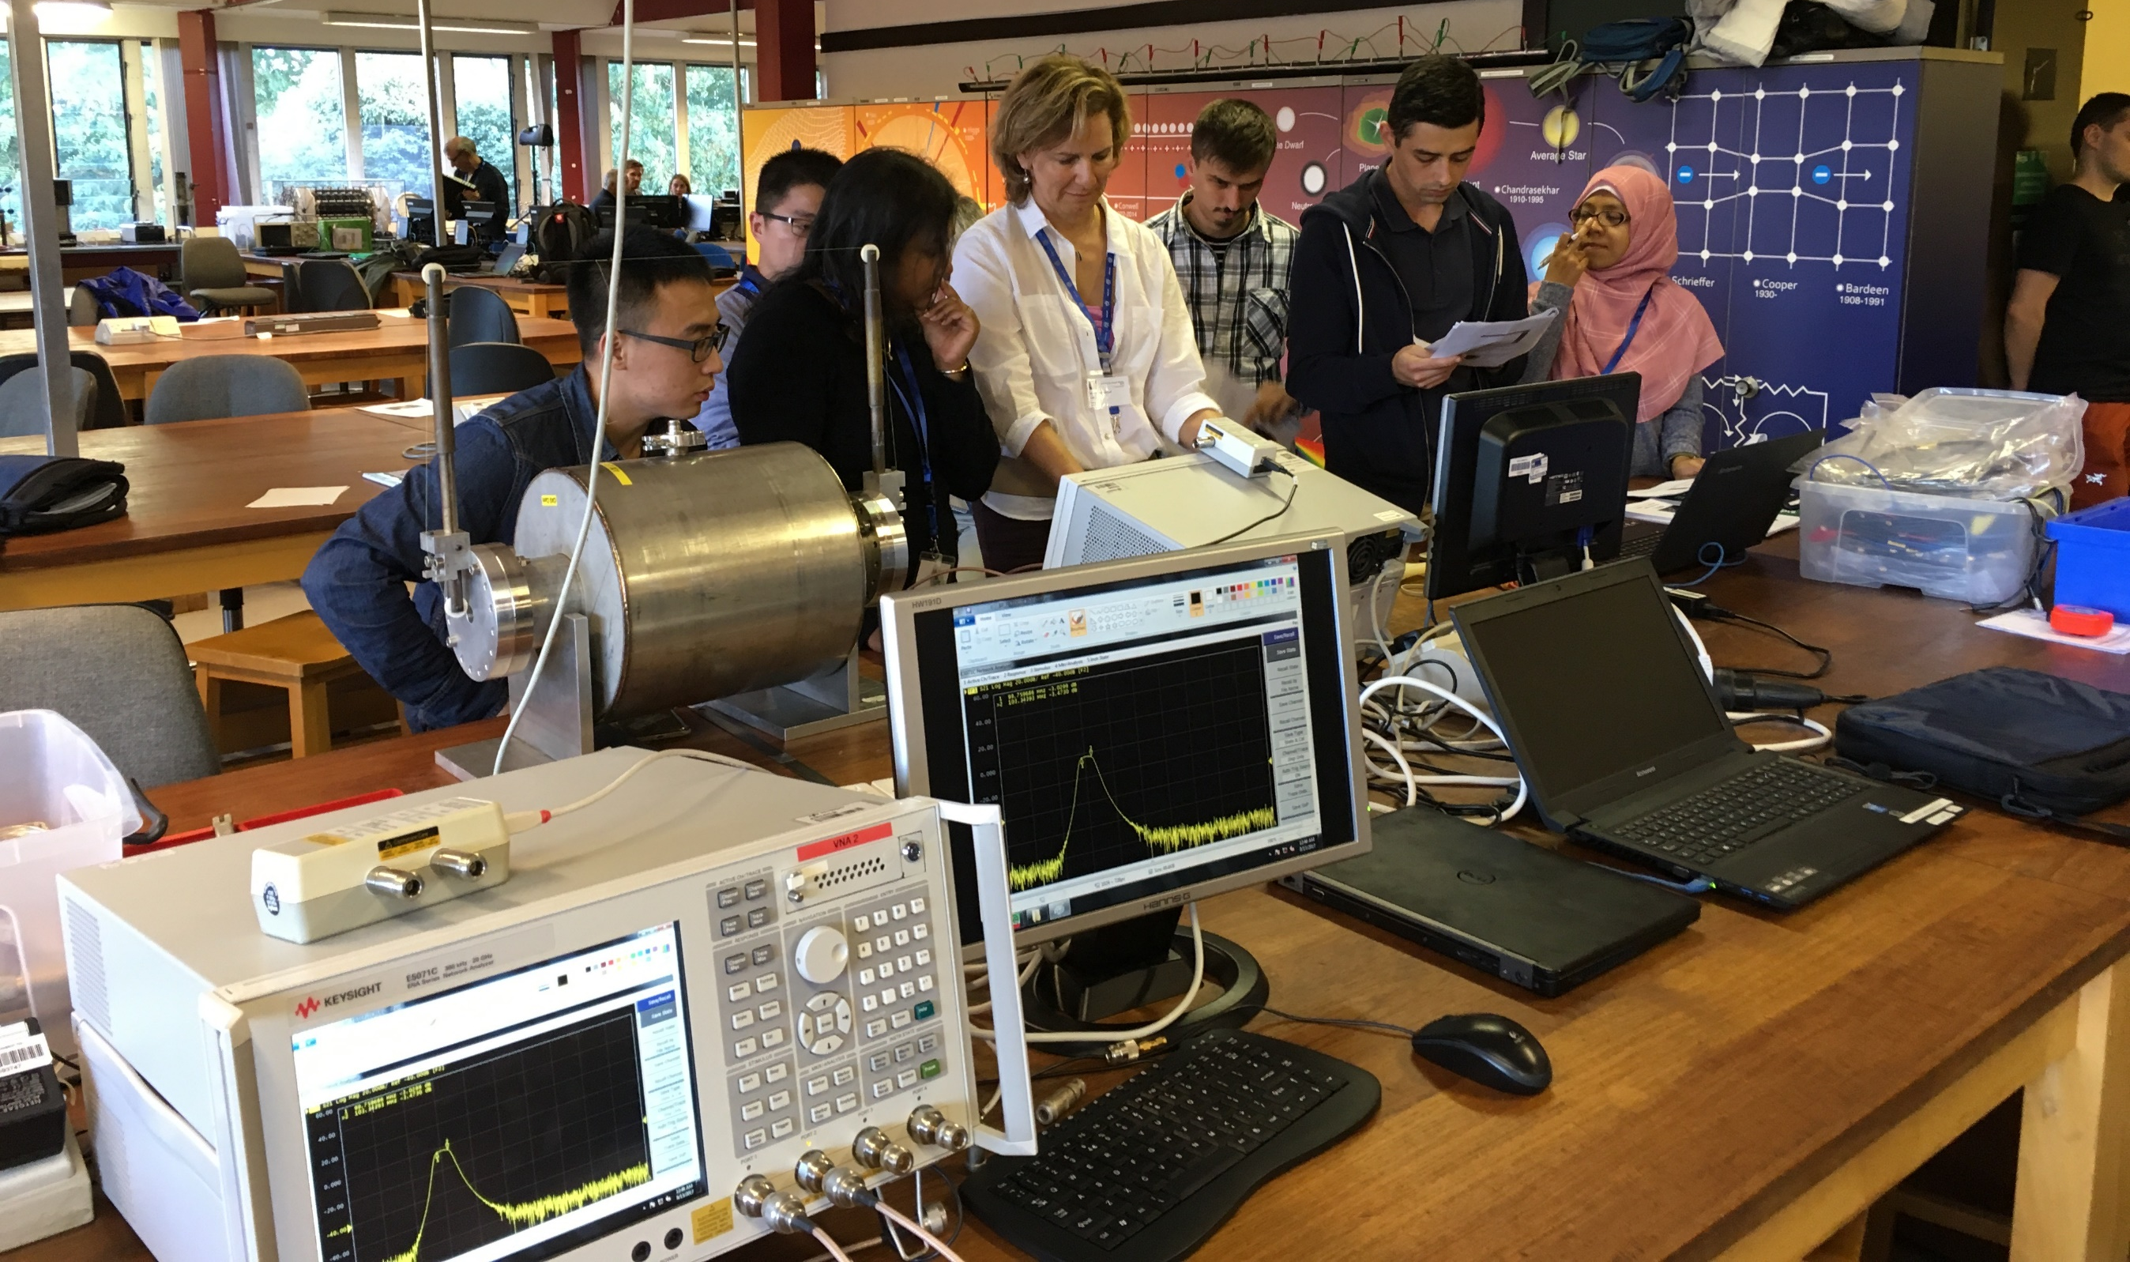
JUAS 2025 Practical Days
– RF Lab Introduction –
Fritz Caspers – CERN
Michele Bozzolan – CERN
Manfred Wendt – CERN

Slide 2
Contents
What is Radio Frequency
RF in accelerators
RF signal measurements
VNA measurements
Scattering parameters (S-parameters)
RF lab gadgets
Practical info

Slide 3
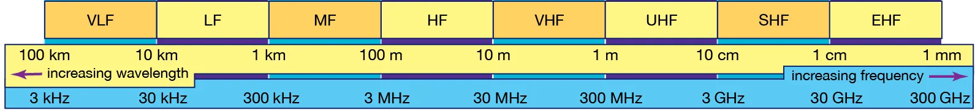

Radio Frequency (RF)
Radio frequency is the range of electromagnetic radiation spectrum used for (radio) communication
RF spectrum
RANGE OF RF FREQUENCIES FINDING APPLICATION IN ACCELERATORS
An RF circuit (or system) needs RF techniques to operate
In principle any system is RF, but if the size of the system is small compared to the signal wavelength we can consider it “low frequency” and use lumped elements approximation.
Rule of thumb is to consider the system RF, and then use RF techniques, when
$$l> \frac{λ}{10}$$

Slide 4
RF in accelerators
RF signal
source
Low-level
RF system
High power
RF system
High power RF
waveguide or coaxial
distribution system
DC acceleration is possible but inefficient → RF acceleration
Real accelerators need RF power (HLRF) and control (LLRF)
Beam measurements (BI) often are RF measurements (e.g. beam position monitors)
LLRF
High power
RF input coupler
beam
signal
RF field probe
signal
RF cavity resonator
q
v
beam
E
metallic beam pipe

Slide 5
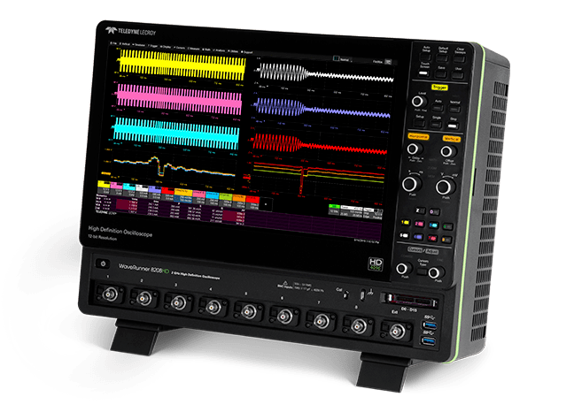
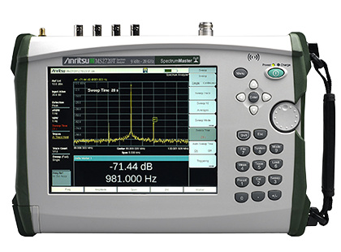
RF signals measurement (1)
There are two main ways to observe signals:
1. Time domain
Oscilloscope: amplitude vs time
  Periodic signals
  Burst signals
  By using Fourier transform frequency domain can be calculated
  Applications:
    Direct observation of signal from a beam pick-up
    Measurement of the waveform shape
2. Frequency domain
Spectrum analyzer: amplitude (only) vs frequency
  Sweeps through a given frequency range in equidistant frequency steps
  Inverse FFT is not doable because phase is missing
  Applications:
    Observation of the frequency spectral contents from the beam
    Measurement of the spectrum emitted from an antenna, beam pickup, cavity coupling loop, etc.

Slide 6
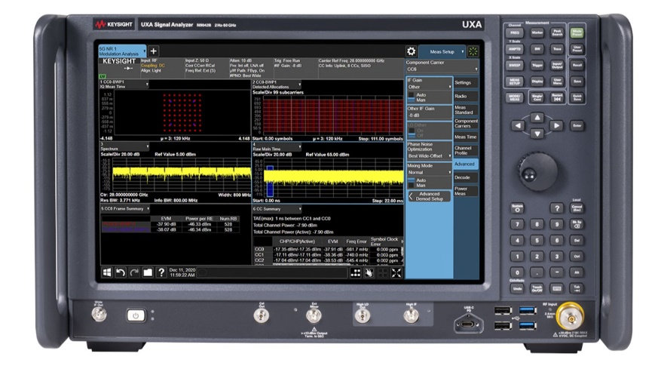
RF signals measurement (2)
Combination of time domain measurements and Fourier transform
Digital oscilloscope with FFT feature or offline signal processing
Dynamic signal analyzer (FFT analyzer)
  Spectrum calculated by applying the Fast Fourier Transform (FFT)
  The spectrum of non-periodic signals and transients can be observed
  Applications:
    Observation of tune sidebands, modulation
    Measurement of the transient behavior of a phase locked loop, etc.

Slide 7
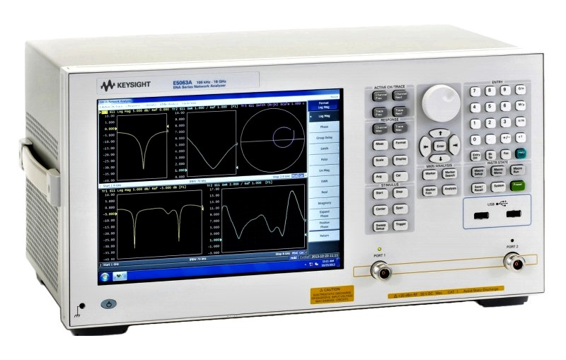
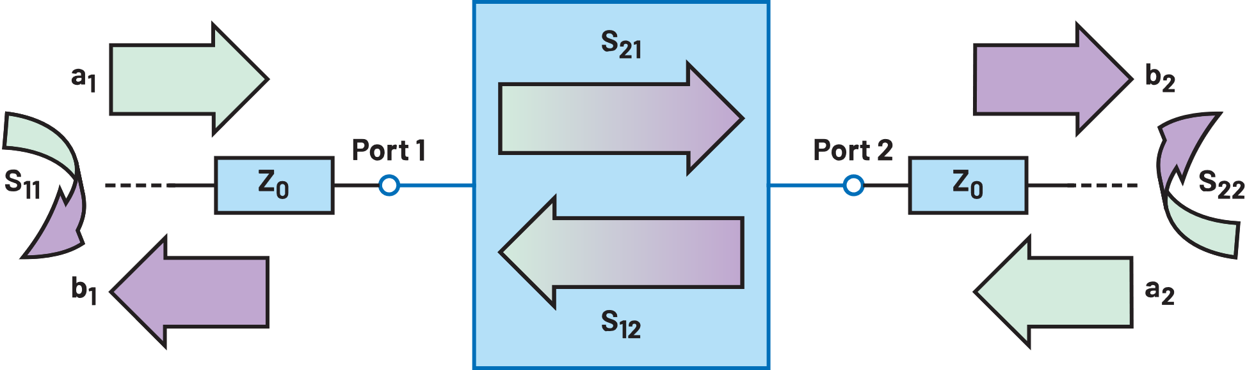
VNA measurements
Vector Network Analyzer (VNA)
  It can have N ports (1 ,2 ,3 ,4, ….)
  It is configured (by the user) to sweep over a frequency range
  Excites the device under test
  For each frequency point it measures a N by N matrix (S parameters)
  Applications:
    Characterization of passive and active RF components,
    Time domain reflectometry by inverse Fourier transformation of the reflection response, etc.
Device under measurement (DUT)
  The VNA is the key RF instrument and with accessories represents an entire RF lab

Slide 8
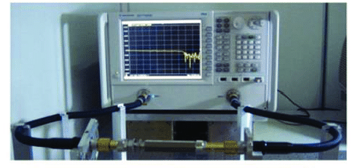
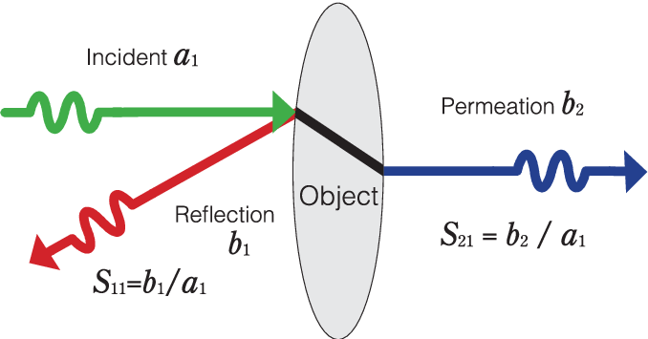
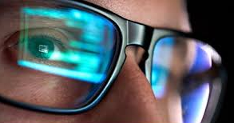

Principle of Scattering (S)-Parameters
reference plane
reference plane
VNA
DUT
S-parameters optical analogy
$\left[\begin{matrix}b_{1} \\ b_{2}\end{matrix}\right]=\left[\begin{matrix}S_{11} & S_{12} \\ S_{21} & S_{22}\end{matrix}\right]$ $\left[\begin{matrix}a_{1} \\ a_{2}\end{matrix}\right]$
with S_{ij} complex numbers !

Slide 9
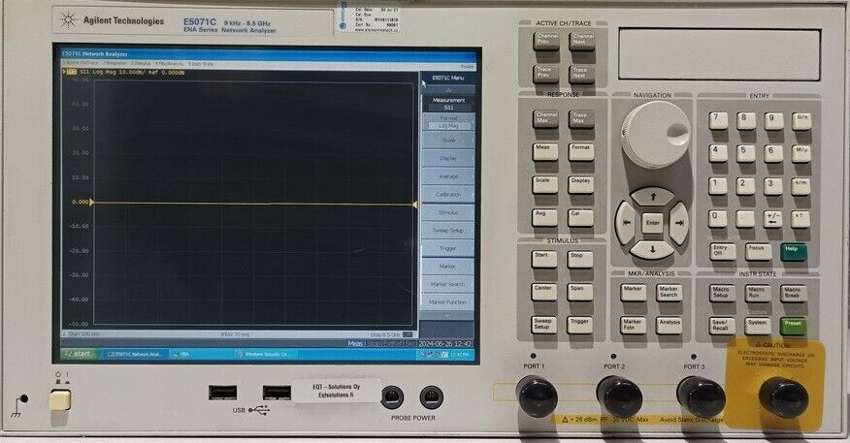
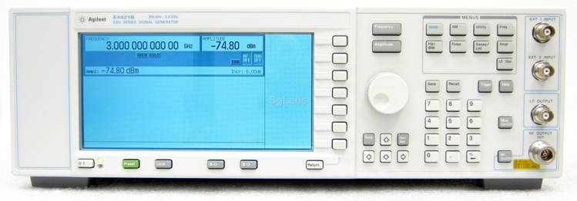
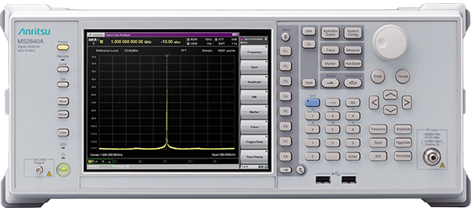
Some gadget of the RF lab

Slide 10
Practical info
Location: CERN (Prevessin site)
When: Tuesday 11th, Wednesday 12th March
Organization:
  Each day has two sessions: Morning and afternoon
  Students will sign up for one of the two RF practical days
    Will further split in small teams, “rotating” through different RF experiments
  Instructors: Fritz Caspers, Michele Bozzolan, Manfred Wendt
Experiments:
  Pillbox cavity (resonant modes, quality factor)
  Other VNA experiments (calibration, slotted line, passive devices, amplifiers)
  Time / frequency domain measurements (amplifiers, modulation, noise)

Slide 11
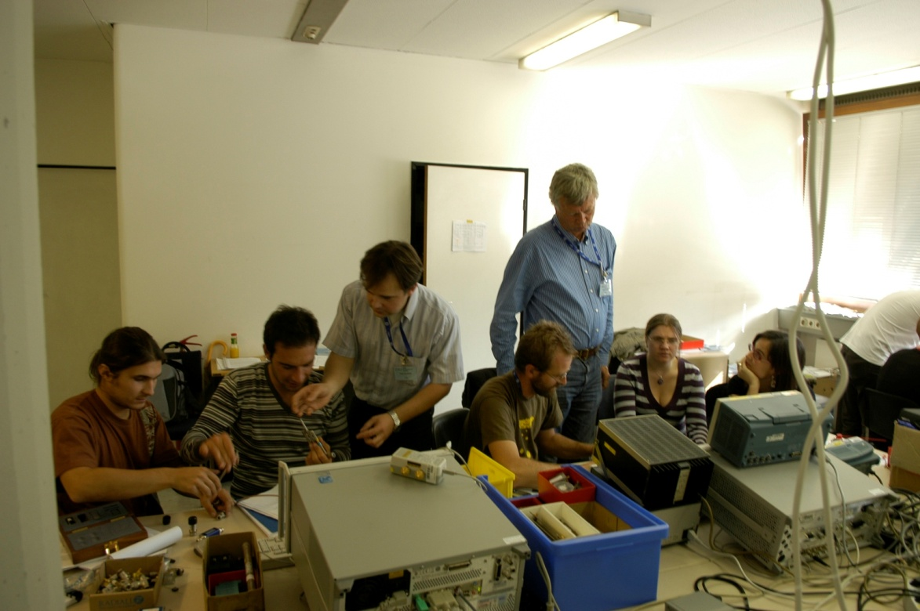
We hope you will have a lot of fun!

