Slide 1
Superconductivity In accelerators
Part I : introduction
JUAS 2025| Claire ANTOINE
Magnets VS RF cavities

Slide 2
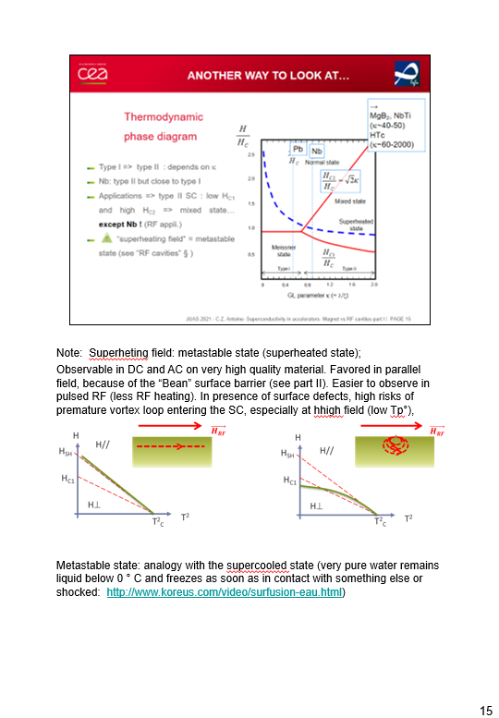


Preamble :
  The aim of this lecture is to provide to physicists non expert in material science a glimpse on how materials are tailored (and must be chosen) for a particular application
  The pptx files are meant to be a “handbook” to recall this kind of details, they contain complementary notes + slides not shown during oral presentation
ArXiv : [2310.09097] Superconductivity in particle accelerators (arxiv.org)
  Outlook:
    Introduction : where SC is found in accelerators and why
    Back to basics : main facts about superconductivity
    Theories (no complete theory exists!)
    Vortex penetration
    Vortex in presence of electric field or current
    Pinning of vortex
    Optimization of SC cables
    Optimization of SRF material
    Some (impressive) examples
I
II
    Note page view
III

Slide 3
Introduction

Slide 4
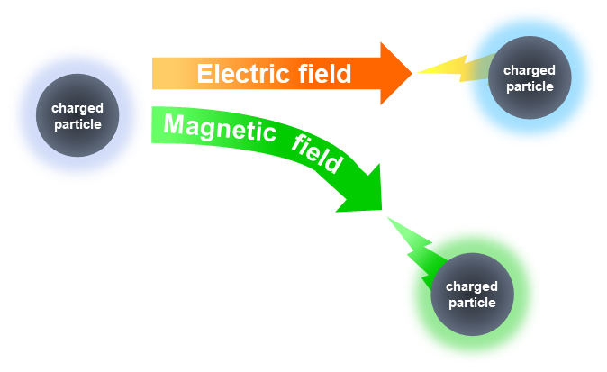
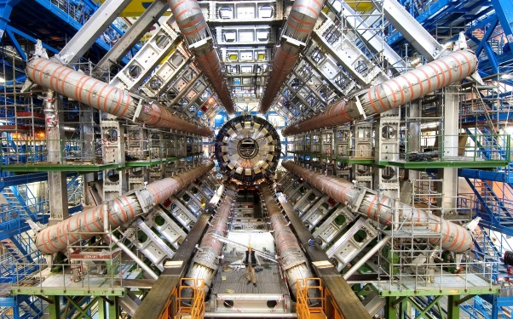
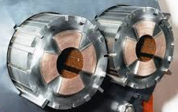
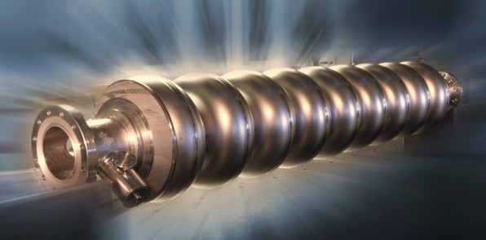
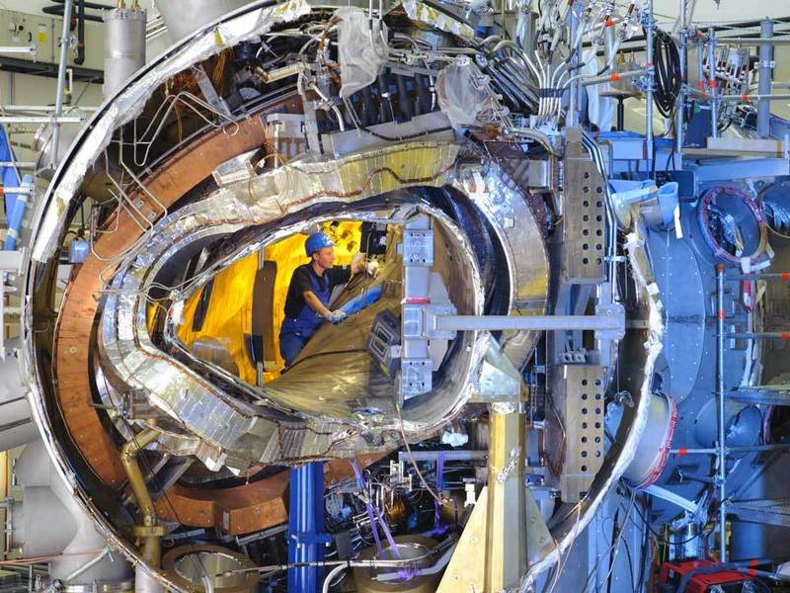
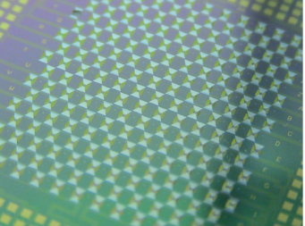
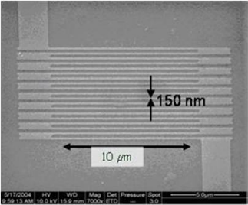
SC in accelerators: where ?
  Magnets (deviation)
    Curvature, focalization magnets
    Detectors
  RF Cavities (acceleration)
  Other close applications
    Magnets for medical imaging (at development origin)
    Fusion magnets
    Electrical engineering (high challenges!!!)
    Josephson Junctions
      SC electronics (RSFQ logic )
      SQUIDS
        Magnetic field detection
        Bolometers
    Nanodetectors (constrictions, wires…)
Notes:
Images from top to bottom: focusing quadrupoles LHC in NbTi, NbTi Atlas detector magnets, 9-cell cavity for Nb electrons (ILC, XFEL), NbTi W7X stellator coils, NbSi bolometer networks (SQUIDS, Application to spatial IR detection), single photon NbN detectors.
Electrical engineering: transport, storage, energy conversion. There exist already SC current limiters, transmission lines, and coming soon: transformers and motors. Should allow enormous reductions in losses (Electricity transmission now generates significant energy losses by Joule effect.) For the electricity transmission network in France, these losses are estimated on average at 2.5% of the Consumption, ie 11.5 TWh per year) Main difficulty: manufacture of HTC SC cables (liquid nitrogen cooled) in long length (because HTC SC are ceramic)

Slide 5
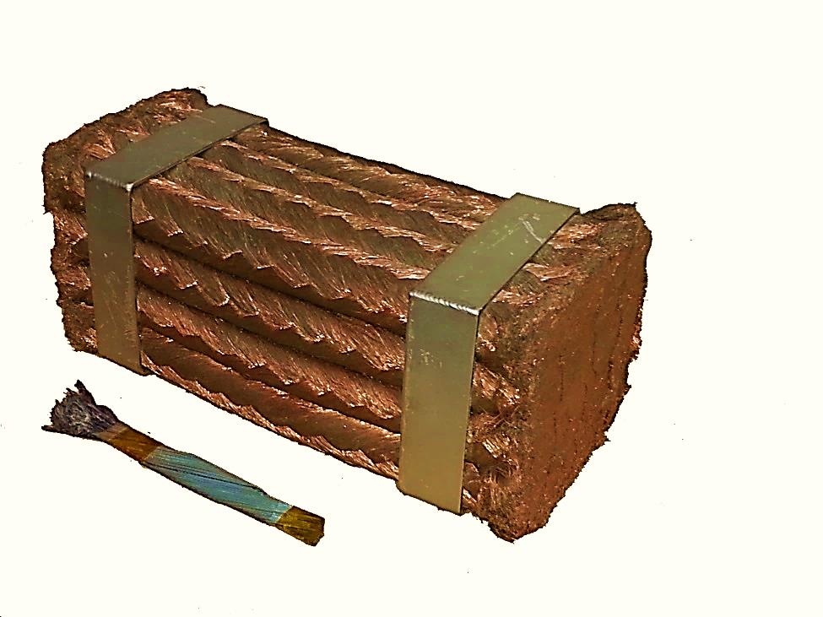
Why ?
  DC
Driving some10 000 A :
Copper Wire
NbTi SC wire (He cooled)
  Electromagnets
  Examples
    LHC @ CERN, NbTi magnets:
      27 km circumference, power ~1 energy plant (only cooling, cryogenic power).
      If magnets = Cu (+Fe) : 100 km circumference, power supply ~4 power plants,
    In detectors: allows increasing « transparency »
      Magnets needed for trajectory curvature. Occupied volume => no detection elements
Notes:
DC SC : gain in weight, and in volume (even accounting the cryostats).
No loss, all the energy consumed is used to cooldown.

Slide 6
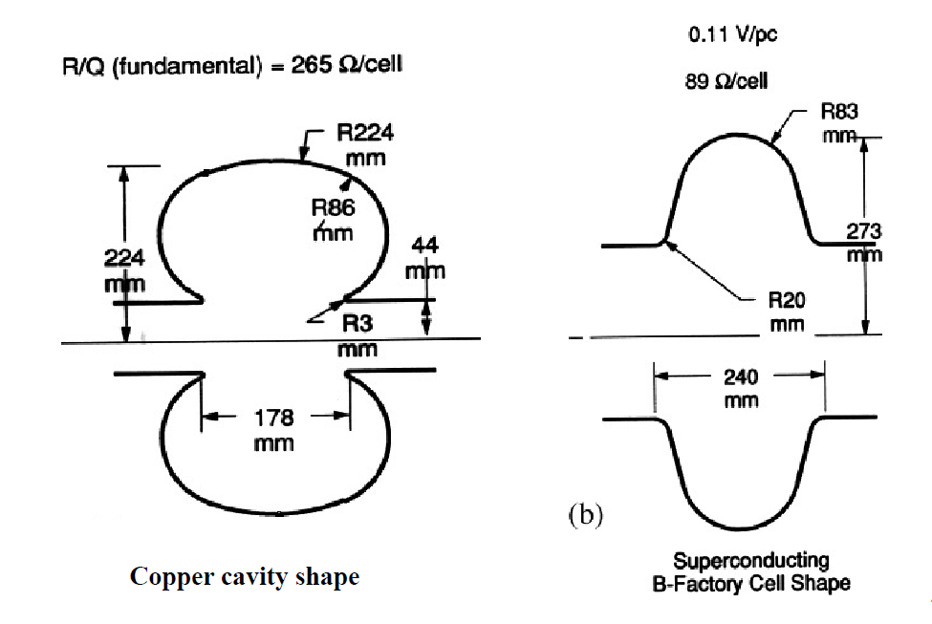
Why?
  RF Cavities
  More complex, depends a lot upon duty cycle
    Duty cycle = 1 (power 100% of the time) <= only superconductivity
  Example
    Proton linacs (neutrons sources):
      (700MHz, CW)
  Other advantages
    Larger aperture => lower impedance => easier alignment and lower wake field / better emittancy
 | Copper | Niobium (SC)
Surface resistance: R_{S} | 7mΩ | 10nΩ
Foreseeable accelerating field: E_{acc} | 1,6 MV/m | 10 MV/m
RF efficiency h_{RF}=P_{beam}/(P_{beam}+P_{cav}) | 15% | 100%
Cryogenic efficiency (h_{cryo}=h_{Carnot} x h_{thermo} avec h_{Carnot}=T_{froid}/(T_{chaud}-T_{froid})) | 100% | 0,2%
>Global efficiency P_{fournie au faisceau}/P_{à la prise} | 7.5% | 49%
Actual length to gain 1 GeV | 833 m | 286 m
Notes:
Data in table : translation from http://formation.in2p3.fr/accelerateurs16/biarrotte_cavites2014.pdf
SC advantages more complicated in RF:
SC much better at high duty cycle, but copper can go to very high fields with very low duty cycle.
Another advantage of SC is:
• Low frequencies can be used:
• design: cavity openings larger => lower impedance => reduced wake field => better emittance,
• in addition, alignment: easy with large openings (machines of several km)
One gains on the surface and wake field resistance (a factor 100 000), but one loses on the cryogenic efficiency (Carnot yield ~ 0,15%, to be multiplied by a technical yield).
Plug power gain: between 2 and 500 times better with SC according to the applications

Slide 7

Some costs elements
Cu
Supra
  Linac costs
    ~ 1/3 tunnel, construction
    ~ 1/3 niobium, cryo
    ~ 1/3 RF, beam control
  ∃ Optimum accelerating field
    Low field => longer machine => cost ↑
    High field => RF costs ↑ for Cu and cryogenic costs ↑ for SC
  Cost↑ with Duty Cycle.
  Other example: CLIC vs ILC (e+/e- collider, Higgs factory)
    ILC : D.C. = 0,5 % @ 1,3 GHz
    CLIC : D.C. = 0,001 % @ 12 GHz
For an arbitrary E, I :
Costs
(investment
+ operation)
100
E_{acc}(MV/m)
50
0,1 %
Duty Cycle
1 %
10 %
100 %
log scale !!!
Notes:
For copper cavities, power dissipation is a huge constraint (most of the power transforms into heat instead of increasing beam energy)
Cavity design is driven by this fact (go to higher frequencies)
For SC cavities, power dissipation is minimal, most of the power goes to the beam
the cavity design decoupled from the dynamic losses
freedom to adapt design to specific application
Lower frequencies available

Slide 8
Back to Basics

Slide 9
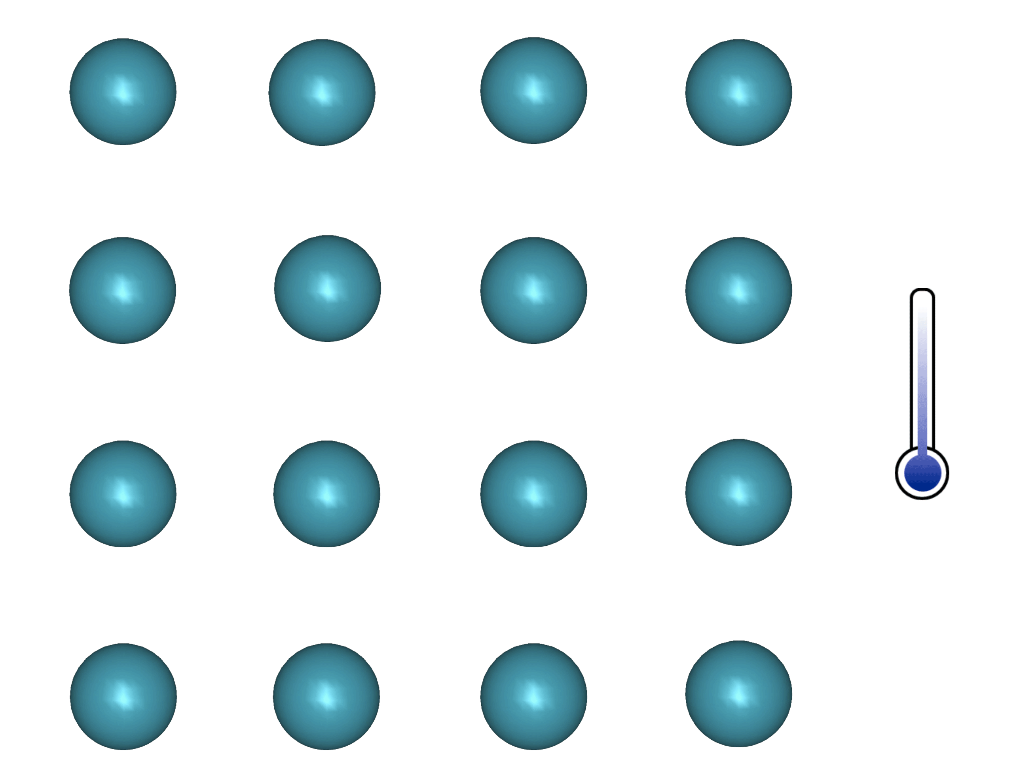
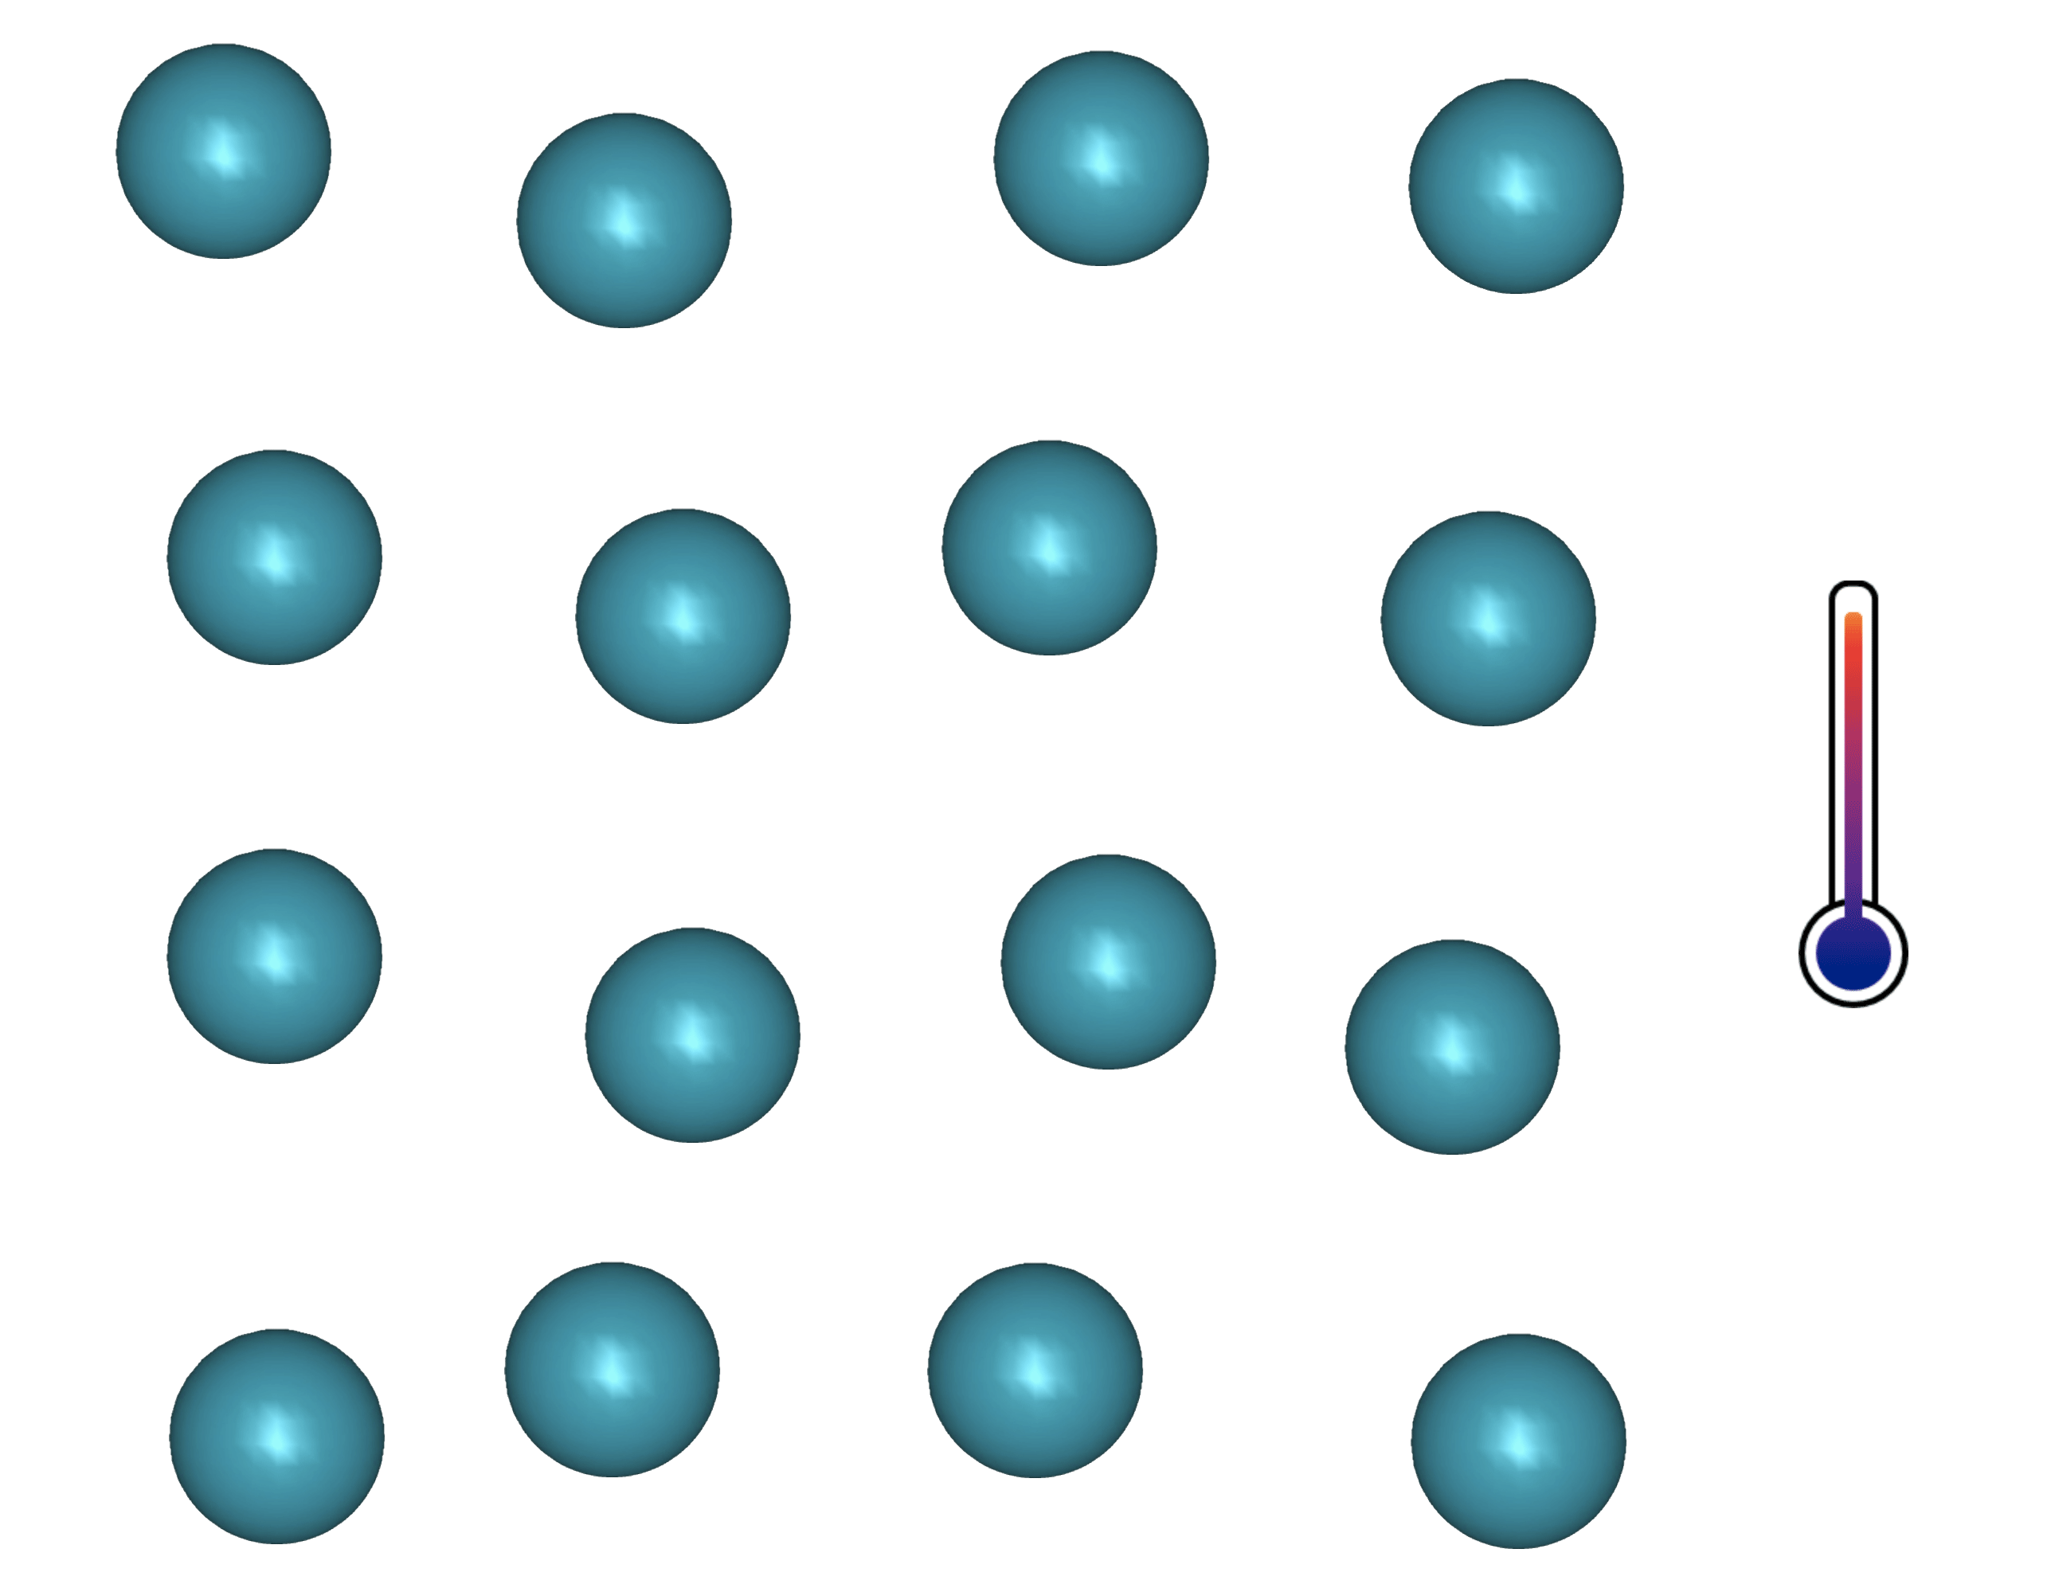
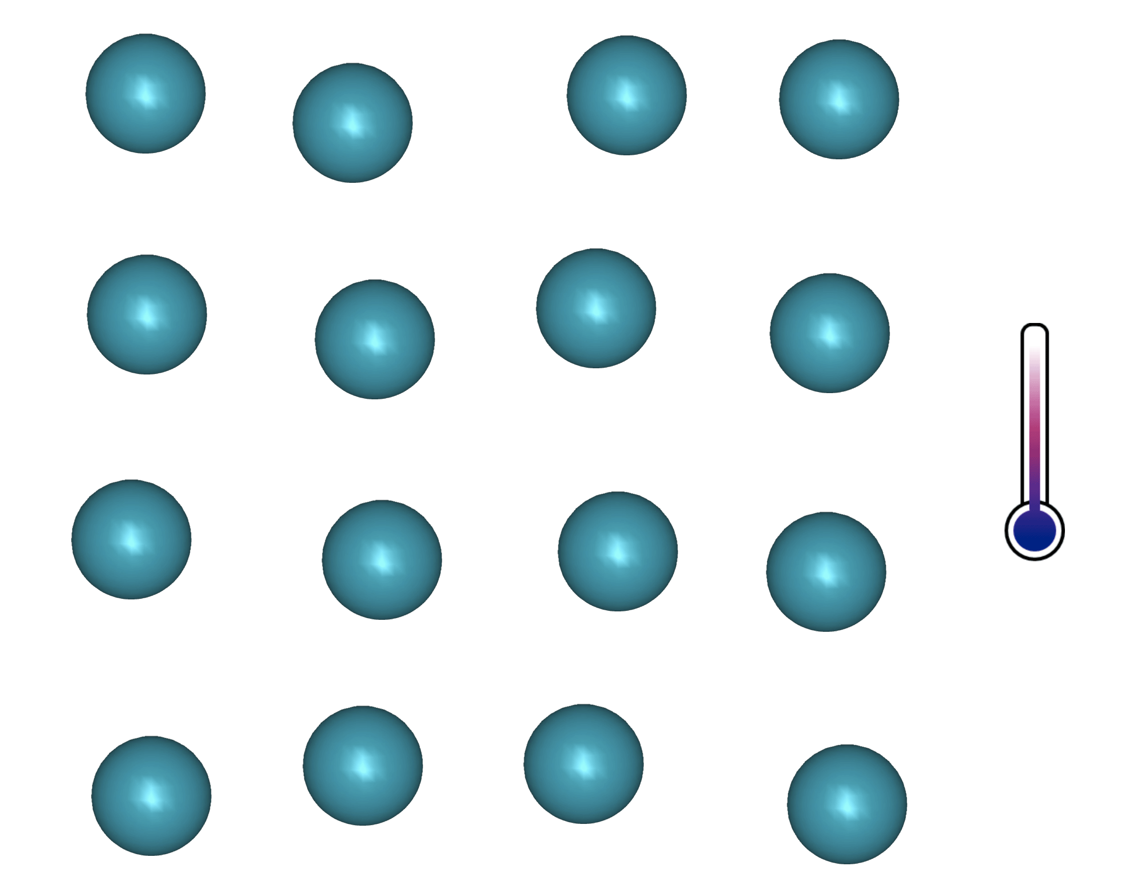
superconductivity
  Simplified principle:
  Coupling of e- via phonons
  Single e- = fermions, Cooper pairs = bosons
  Condensation (Bose-Einstein) + gap opening
  1! Wave function for all paired e- : macroscopic coherent state w. R=0 ( : not always true !!!)
Molecule
E
E
E
Semiconductor
or
insulator
E_{F}
E_{F}
E_{F}
2 Δ(0)
2 Δ(Τ)
Metallic bond
Notes:
Simplified (and of course physically incorrect) mechanism:
When an electron travels between two atoms nucleus (small positive charge), they experience a slight attraction. If another electron arrives in between, it “feels” a slight increase of + charge due to the closed-up atoms and is attracted too, forming a Cooper pair with the first electron. This is observable only at low temperature, because at high temperature thermal agitation counterbalance that kind of movements. Since a electron pair is a Boson, one observes a Bose-Einstein type condensation,
Basics of band theory.
To form a molecule, one has to combine 2 atomic levels into 2 molecular levels: one bounding the other antibonding. Bounding state energy always < initial atomic level energy => molecule is stable. In a material many atomic levels to combine, molecular states cannot occupy the same state of energy (Pauli exclusion principle) and come to lie close together, forming two bands (bounding and antibounding state are now called valence and conduction bands). In insulating and semiconducting material, the valance bound is full and the conduction band is empty. In metallic materials, the 2 bands overlap => conduction band filled only up to the fermi Level. When reaching the superconducting state, this conduction band splits in two, forming a bounding state (the cooper pairs) and an antibounding state called quasiparticles that can be assimilated to normal electrons. At T=OK all the electrons from the initial conduction band = Cooper pairs. When T ↑, some pairs are dissociated by thermal activation. In DC those normal electrons are short-circuited. But in AC or RF, those normal electrons are at the origin of some dissipation.

Slide 10
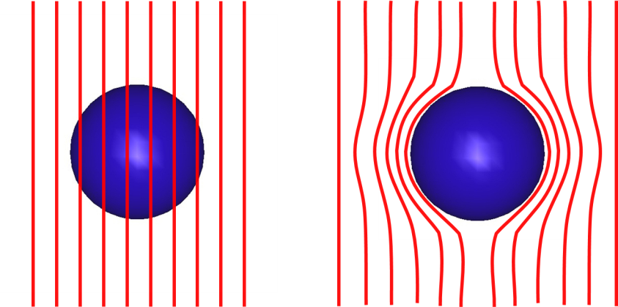
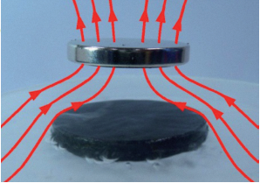
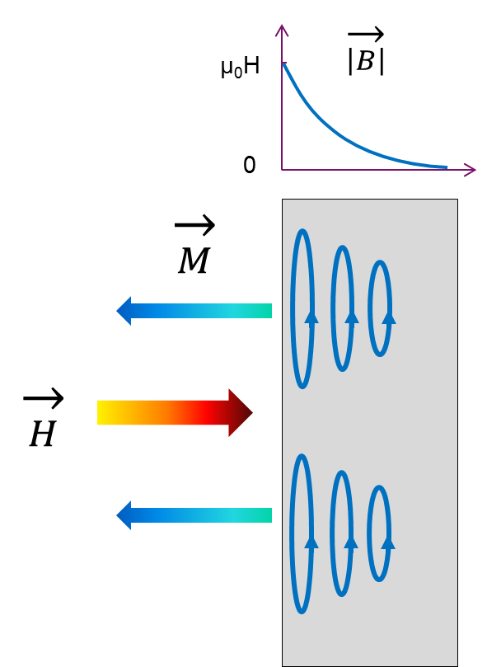


Meissner state, type I & II SC
Magnetic levitation
1,5
$√2κ≤1$
$\sqrt{2}κ=1.5$
$\sqrt{2}κ=2$
$\sqrt{2}κ=3$
$\sqrt{2}κ=5$
Type I
-4πM/H_{C}
1
Type II
Κ :a sc figure of merit (see below)
0,5
λ ∼ 50 nm (Nb)
Supercurrent >> GA/m²
Magnetization of
defect free SC
←
0
0
1
2
3
4
5
$\vec{B }= μ_{0 }(\vec{H }$ + $\vec{M }$) = 0
h = H/Hc
Notes:
In the Meissner state the field penetrates within a depth lambda of a few tens of nm and induces "supercurrents" which in turn generate a magnetic moment opposite to the applied field H
• the resulting field is strictly zero in the supra (except over lambda) These currents reach tens of billions of A/m² -essentially within 50 nm of the surface-
Beyond a certain field, a limit current (J_{D}: depairing current: enough to cause the pairs to break) is reached and the SC is no longer able to screen the field.
The corresponding field: H_{C} is the thermodynamic transition field for type I SC. But there are type II supra which have a different behavior: the field start to penetrate at a field weaker than H_{C}: H_{C1} but the superconductivity persists far beyond (H_{C2}) : it is the mixed state.

Slide 11





type I & II
  Important parameters:
  H_{C} : thermodynamic critical field (intrinsic)
  H_{C1} : 1st critical field (transition: Meissner state => Mixed state, depends on material’s state)
  H_{C2} : 2nd critical field (transition Mixed state => Normal Conducting state, depends on material’s state)
  κ : λ/ξ: Ginzburg-Landau parameter (depends on material’s state, T independent)
  λ : field penetration depth, ξ : Cooper pairs coherence length (see below)
1,5
$$√2κ≤1$$
Type I
$$\sqrt{2κ}=1,5$$
-4πM/H_{C}
$$\sqrt{2κ}=2$$
Type II
$$\sqrt{2κ}=3$$
1
$$\sqrt{2κ}=5$$
0,5
Magnetization of
defect free SC
←
0
0
1
2
3
4
5
H_{C1}
h = H/Hc
H_{C}
H_{C2}
Notes:
Remarks
• H_{C} is still an intrinsic parameter (thermodynamics) of type II SC, but it is no longer directly accessible to the measurement (it is found via the formulas)
• influence of m.f.p.. : λ₀ ~ λ_{L}: intrinsic, in "clean“SC.
If impurities or disorder ("dirty" limit): it plays on the mean free path and changes λ (it is no longer an intrinsic value).
• it also plays on the respective values ​​of H_{C1} and H_{C2}: generally introducing defects (impurities, disorder) makes ↑ H_{C2} and ↓ _{HC1}

Slide 12



Mixed state and vortex
  Mixed state : H > H_{C1}
  Field is not fully screened anymore
  Flux lines enter the material => normal zones surrounded by screening current (≡ vortex)
  Remaining material still in the superconducting state
2λ
2ξ
$$\vec{H }$$
$$\vec{H}>\vec{H_{c1} }$$
B
Ψ
(paramètre d’ordre)
ξ
λ
r
$$\vec{M}\sim −\vec{H_{c1} }$$
    Each votex contains 1! Quantum of flux Φ₀
    Screning currents extend over r ~ λ
NB : do not confuse intermediary state (type I SC, coexistence of normal zone and SC zones, WITHOUT vortex, if H is non uniform) with mixed state (vortex state, for type II SC)
    Φ₀ = h/(2e) = 2,06783376 × 10⁻¹⁵ Weber (T/m²)
Notes:
Suppression of Δ(r) for r < ξ because J(r) reaches J_{D} ; J_{D} = depairing current ~ current density sufficient to break the Cooper pairs (see S27)

Slide 13
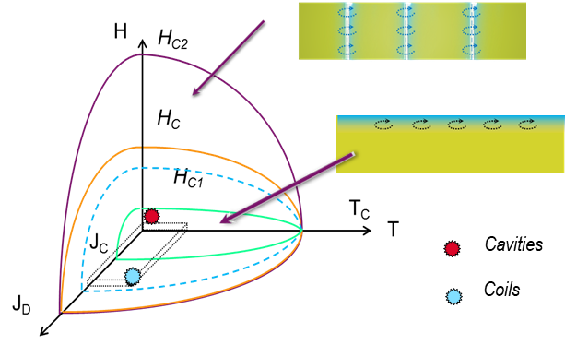
A complex phase diagram
Applications…
  Type II SC : 3 main Phases
    Meissner state (SC, B=0 )
    Mixed state (SC + vortices (B≠0) )
    Normal conducting State
  ∃ thousands of SC
  In practice:
      <10 are actually used
      They are all type II : low H_{C1} and high H_{C2} => mixed state… EXCEPT Nb ! (RF appli.)
    NB : J_{D} depairing current dens. (intrinsic)
    ≠ J_{C} critical current density (technical limit)
    Jc has no meaning in RF (see part II)
Notes:
Among the 10s of 1000s of existing superconductors only a dozen is used for applications and they are all type II, which means they exhibit 2 different superconducting states.
At low temperature, low field and low current density they are in the Meissner state. In presence of external magnetic field supercurrents develop on the surface and fully screen the external magnetic field.
At higher field (or current or temperature) supercurrents do not manage to fully screen the field anymore, and some flux lines enter the material, forming vortices, that is, a flux line inside a normal conducting zone, surrounded by screening currents. The rest of the material is still superconducting. It’s called the mixed state.
Most of the SC applications operate in the mixed state where Cooper pairs can easily short circuit normal conducting areas.
Not in RF!
Indeed, making a normal conducting zone (that is the core of the vortex) oscillate in the RF field would give rise to huge dissipations ! Cavities must compulsorily operate in the Meissner state !
That is why today the best SRF material is niobium, the SC with the highest transition field between Meissner and mixed state HC1.
Note that SC cavities work in a totally different regime compared to SC magnets. Keep in mind that materials that are good for SC magnets are very bad for SRF and vice versa !

Slide 14
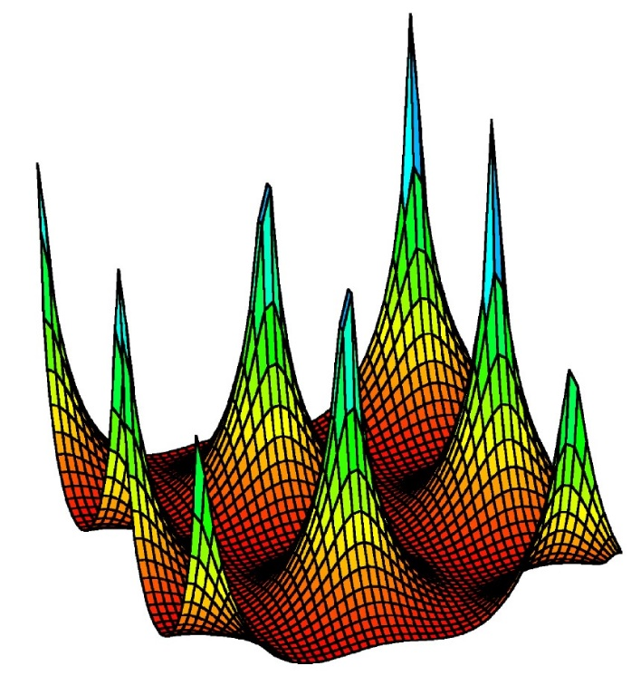
A complex phase diagram
Vortex behavior is conditioning the application limits
  Vortex (Vx) in an ideal material
    Centered hexagonal lattice (triangular)
    Can be pinned on cryst. defects (see part II)
    Several ≠ states
    H>H_{M} => R≠ 0 !
H_{M} ≡ H_{Irr}
H
Vx Liquid
Vx glass
H_{C2}
Vx Lattice
H_{C1}
T²
Notes:
* Not shown in oral presentation
HM "melting" or "moving": this is when the vortices start to move freely in the SC: this marks the beginning of the thermal dissipations (R is no longer = 0)
Sometimes HM is quote Hirr (like irreversible), because it can be measured with DC magnetometry at the limit of the hysteresis
NB “glass” can be considered as a very (very!) viscous liquid…

Slide 15
another way to look at…
Thermodynamic phase diagram
→
MgB₂, NbTi (κ~40-50)
HTc
(κ~60-2000)
Pb
Nb
2.5
      Type I => type II : depends on κ
      Nb: type II but close to type I
      Applications => type II SC : low H_{C1} and high H_{C2} => mixed state… except Nb ! (RF appli.)
      “superheating field” = metastable state (see “RF cavities” § )
Normal state
2.0
1.5
Mixed state
Superheated state
1.0
Meissner state
0.5
Type I
Type II
0
0.4
0.6
1.2
1.6
2.0
GL parameter κ (= λ/ξ)
Notes:
Note: Superheating field: metastable state (superheated state);
Observable in DC and AC on very high quality material. Favored in parallel field, because of the “Bean-Livingston” surface barrier (see part II).
Easier to observe in pulsed RF than CW RF(less RF heating).
In presence of surface defects, high risks of premature vortex loop entering the SC, especially at high field (low Tp°),
Metastable state: analogy with the supercooled state (very pure water remains liquid below 0 ° C and freezes as soon as in contact with something else or shocked: http://www.koreus.com/video/surfusion-eau.html)

Slide 16





Demagnetization coefficient
Geometrical efects
  Elliptical samples : H = H_{C} everywhere
  Arbitrary shape : consider local deformation of flux lines
$$\vec{H }$$
$\vec{B }= μ_{0 }(\vec{H }$ + $\vec{M }$) =>
$\vec{B }= μ_{0 }(\vec{H }$ +(1-D) $\vec{M }$)
    Infinitively thin strip D → 1
    Sphere : D = 1/3
    Infinite cylinder: D = 0
$$\vec{H }$$
If field/shape is not uniform, some areas may transit before others !!!
Notes:
This aspect will be treated in more detail in part II
Main issue with demagnetization factor is interpretation of DC magnetometry results: impossible to measure accurately H_{C1} this way: the results are conditioned by the shape of the sample, the quality of the cutting….Many controversies in the literature.
It makes penetration of the field in a complex object (let’s say a magnet coil ?) difficult to predict, requires a lot of modelling. True also for SC electronics.
Issues also with High Tc material that are in the form of tapes rather that round wires. It needs to be taken into account in magnets design.

Slide 17
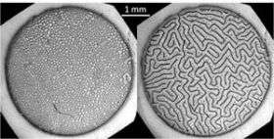
intermediary STATE
(Mixed intermediary for Nb)
  Observed on type I SC (also called Paramagnetic Meissner Effect)
    mixed normal and SC areas without Vx
    due to demagnetization effect (shape factor => observed mostly on thin films),
    Several metastable equivalent configurations,
    Applications : fundamental ϕ: competition between repulsive long distance interaction and small distance attractive interaction.
  Niobium = type II, but…
  Close to H_{C1}:
@ H~H_{C1} behaves ~ type I SC
Meissner Zones
Mixed Zones, with vortex lattice
Type I SC : same T, same H, but
≠ magnetic history
http://phys.org/news/2007-07-superconductivity.html
    Depends on crystallographic quality, see part II
Notes:
* Not shown in oral presentation
Anecdotic, but directly related to demagnetization effect : the field is not at the same level everywhere, some parts transit others not. See web link in next slide to understand how such patterns form.
Concerning Nb: it is a type II SC, but very close to the frontier with type I => unique behavior.

Slide 18
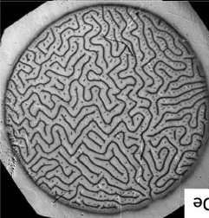
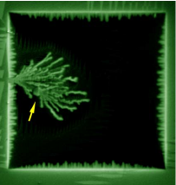
mesophases
    Repulsion only:
    Only 1! uniform phase
    Attraction only :
    2 phases
    Competition between Repulsion et Attraction :
    MESOPHASES
  Applies to numerous physical phenomena:
      Intermediary state in type I SC
      Transient states in type II SC
        Avalanche penetration, dendrites
      Magnetic materials, ferro-fluids
      Solidification/alloying , dendritic growth
      In a general way: propagation fronts, interfacial instabilities (Mullins-Sekerka Instabilities type )
  Complex mathematics
      Numerical treatment only
      Results depend widely on initial conditions
It is not the same thing!
Notes:
* Not shown in oral presentation
General knowledge…
Fingering, Fronts, and Patterns in Superconductors - ppt download (slideplayer.com)
or
https://slideplayer.com/slide/8868045/
In summary:
Intermediate state: Normal region: the displacement of the interface generates eddy currents
In SC Region: B = 0 . At the interface, screening supercurrents
Boundary conditions=> we have the same field on both sides B_{i}.ν_{n} = -D_{B} (∂B / ∂n)_{i} ν_{n} = velocity of the interface
Plane interface => B = μ₀H_{C} whereas curved interface => B = μ₀H_{C} (1_d₀κ - βv_{n})
Analogy with the condition of Gibbs Thomson used e.g. in crystallization :
The surface energy depends on the local normal vector ∇B is the largest near a bump The speed of movement of the interface is highest near a "bump" => the bumps grow even faster. The phenomenon is stabilized by the surface tension but at small wavelengths => dendrites

Slide 19
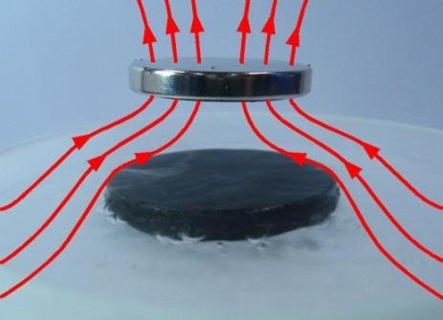
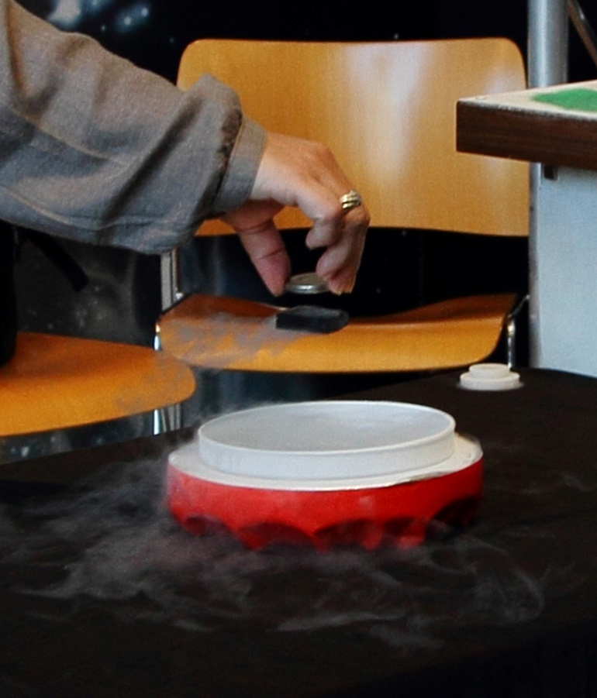
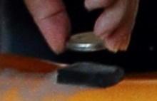
Mixed state: Levitation + stability
  Movement ≡ ΔH
    supercurrents produce - ΔM
    opposes to position change
    brings back the SC in the position “frozen” during cooldown
Only application : …. Impress people ☹
http://hebergement.u-psud.fr/supraconductivite/videossupra.html
Notes:
* Not shown in oral presentation
Superconducting levitation: no application until recently.
First Maglev trains where based on purely magnetic levitation generated with (superconducting) electromagnet.
Only recently maglev have started being developed based on this type of superconducting levitation (where pinning flux line play a role, and the position is fixed by the cooling position not by magnetic repulsion)
Pinning flux : will be explained in part II

Slide 20
Theories - Generalities

Slide 21
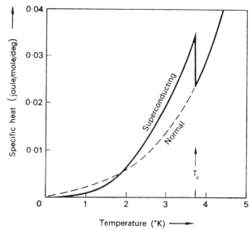
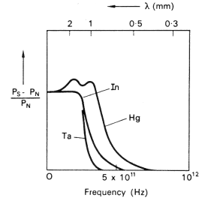
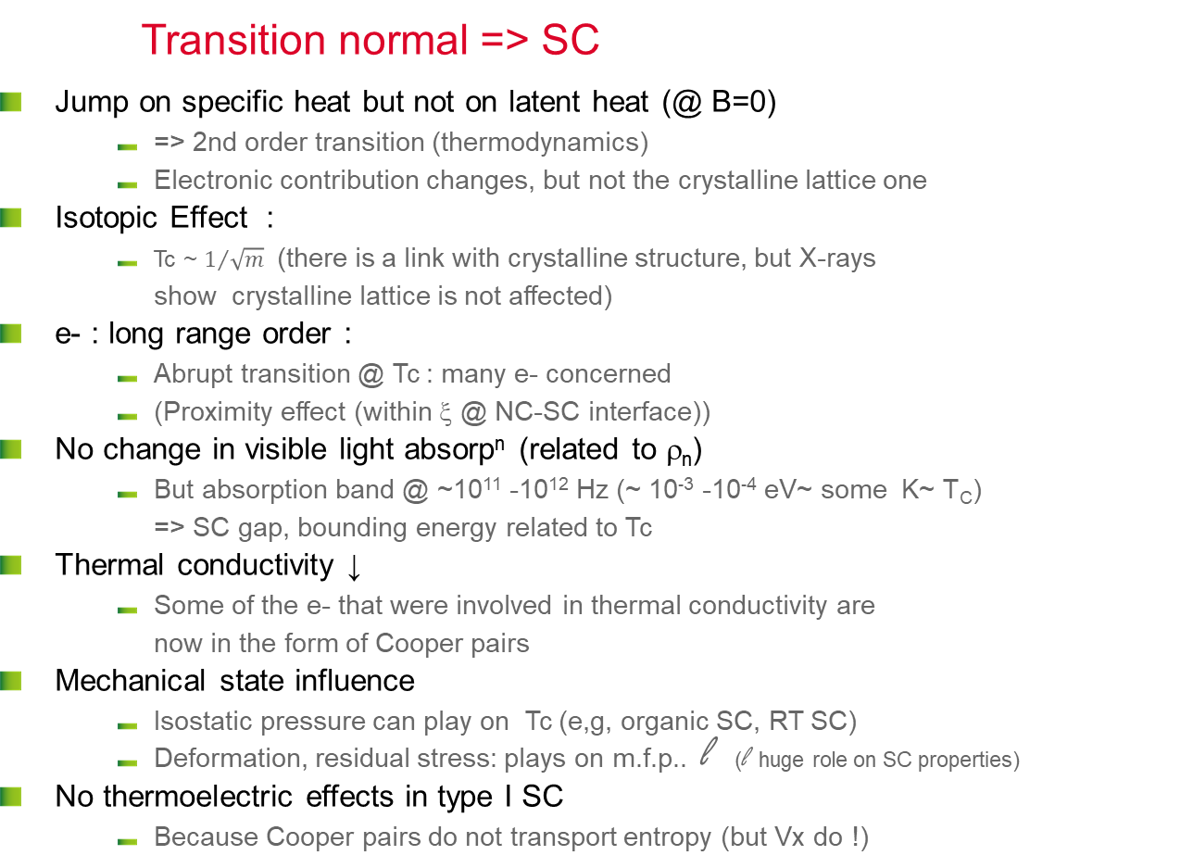
Other affected properties
Transition normal => SC
  Jump on specific heat but not on latent heat (@ B=0)
      => 2nd order transition (thermodynamics)
      Electronic contribution changes, but not the crystalline lattice one
  Isotopic Effect :
      Tc ~ $1/{\sqrt{m}}$ (there is a link with crystalline structure, but X-rays show crystalline lattice is not affected)
  e- : long range order :
      Abrupt transition @ Tc : many e- concerned
      (Proximity effect (within ξ @ NC-SC interface))
  No change in visible light absorp^{n} (related to ρ_{n})
      But absorption band @ ~10¹¹ -10¹² Hz (~ 10⁻³ -10⁻⁴ eV~ some K~ T_{C}) => SC gap, bounding energy related to Tc
  Thermal conductivity ↓
      Some of the e- that were involved in thermal conductivity are now in the form of Cooper pairs
  Mechanical state influence
      Isostatic pressure can play on Tc (e,g, organic SC, RT SC)
      Deformation, residual stress: plays on m.f.p.. l (l huge role on SC properties)
  No thermoelectric effects in type I SC
      Because Cooper pairs do not transport entropy (but Vx do !)
Notes:
The order parameter is discontinuous for the first-order transitions, continuous for those of the second order. Transitions of the second order correspond to cooperative phenomena. Physical quantities show singular behaviors at the point of transition and one can define universal critical exponents,
Proximity effect : normal conducting particles/films, with dimension comparable with ξ in contact with a SC also become (poorly) superconducting.,,,
https://en.wikipedia.org/wiki/Room-temperature_superconductor :
…highly pressurized lanthanum decahydride (LaH₁₀), whose transition temperature is 250 K (−23 °C).^{[1]} Previously the record was held by hydrogen sulfide, which has demonstrated superconductivity under high pressure at temperatures as high as 203 K (−70 °C).^{[2]} By substituting a small part of sulfur in the latter with phosphorus and using even higher pressures, it has been predicted that it might be possible to raise the critical temperature to above 0 °C and achieve room-temperature superconductivity.^{[2]} Part of the research efforts are currently moving towards ternary superhydrides, where it has been predicted that Li₂MgH₁₆ would have a T_{c} of 473 K (200 °C) at 250 GPa^{[3][4]} (way hotter than what is normally considered room temperature).
At atmospheric pressure the record is still held by cuprates, which have demonstrated superconductivity at temperatures as high as 138 K (−135 °C).

Slide 22
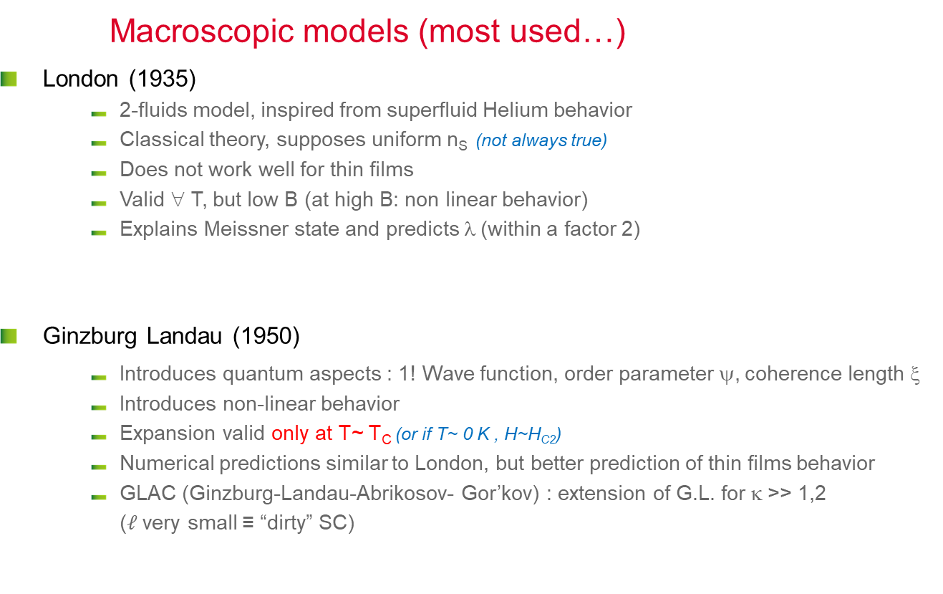
thEories… (1)
Macroscopic models (most used…)
  London (1935)
      2-fluids model, inspired from superfluid Helium behavior
      Classical theory, supposes uniform n_{S} (not always true)
      Does not work well for thin films
      Valid ∀ T, but low B (at high B: non linear behavior)
      Explains Meissner state and predicts λ (within a factor 2)
  Ginzburg Landau (1950)
      Introduces quantum aspects : 1! Wave function, order parameter ψ, coherence length ξ
      Introduces non-linear behavior
      Expansion valid only at T~ T_{C} (or if T~ 0 K , H~H_{C2})
      Numerical predictions similar to London, but better prediction of thin films behavior
      GLAC (Ginzburg-Landau-Abrikosov- Gor’kov) : extension of G.L. for κ >> 1,2 ($ℓ$very small ≡ “dirty” SC)
-4πM/H_{C}
1
0,5
0
0
1
h = H/Hc
Thin film magnetization
(also exists for bulk mater. in a lesser extent)
    Notes:
        Both model apply to low J (J<<J_{D})
        Rather apply to types II (for types I : Pippard)
        GLAC also works at low T
Notes:
Model with 2 fluids proposed by Gorter and Casimir (1934) to explain superfluidity in Helium. Used by F. & H. London (1935) to explain the Meissner effect.
Phenomenological theory; classic.
London: Explains Meissner effect and brings up λ, works well provided that Js is << JD and ns (superelectrons density) is uniform. But many phenomena appear in supra because ns is not uniform (e.g. pinning), so not universal !
GL: Electromagnetism + thermodynamics. Based on second-order phase transitions. Parameter of order called "wave function of condensed electrons". This order parameter measures the symmetry breaking energy U when the superconducting state appears. Condensation energy is ½μ₀Hc²; In the presence of H, ns can vary, free energy can be written as a Taylor development. The solution is found by minimizing ψ (the wave function) and A (the vector potential) over all space, but developing order 1 or 2 valid only near transition (TC ). A second characteristic length appears: ξ.
See slides 25-33 for more details

Slide 23
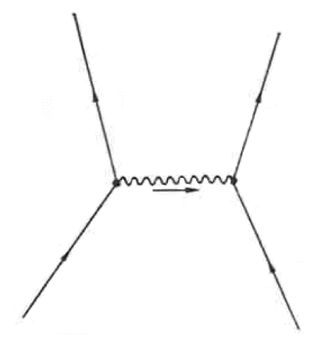
theories… (2)
Most complete…
  BCS (Bardeen-Schrieffer-Cooper) : (1957)
      Local, quantum theory
      In general not used for engineering predictions (too complex),
      Cooper pairs = electrons with opposed moments p and spins (at t)
      1 ! Wave function for all SC e-, correlated system, many exchanges between pairs
      Works for low coupling factor (type II)
      Allows to explain the main aspects of SC (gap, T_{C}, ….)
Other refinements
  Eliashberg
      Valid ∀ T , complex calculation
      High coupling factor (applies to Nb, although type II ?)
  Eilenberg
      Semi-classical theory, still not valid at lower T
      “clean “ type II : takes into account some inhomogeneity
  RF :
      Response to EM wave: Mattis-Bardeen @ weak field
      High current density (J~J_{D}) : “non linear R_{BCS}”
      (clean type II)
p’₁
p’₂
q
p₁
p₂
q = hν_{q} / s
Fréq, phonons
Vit, du son
SC:
      No complete theory ☹
      Many particular, complex developments
      Be careful : limited range of validity
      Many contradictions in literature
      Sometimes far from real world
Notes:
Pbm at the start: Coulombian repulsion, even if it was attractive, is so intense that the gap could not be so small => find another mechanism of weak attraction!
1950: Frolich shows that emission/absoprtion of a phonon = attractive interaction
The total energy of the interacting pairs remains constant although their moments are constantly changing (quantic behavior, delocalization : a cooper pair does not concern 2 determined individual electrons but 2 e- with opposed moments and spins at each instant t)
BCS essentially used to make exact calculation and comfort GL hypothesis (same results at T~T_{C}). What’s new ?
=> Role of phonons, Cooper pairs, BCS gap: replace the e-/ phonon interaction with an effective potential, use the second order perturbation theory.
If strong interaction between pairs, one can no longer make a perturbative treatment, it is necessary to make a variational approach => Eliashberg: directly takes into account the coupling e- / phonon.
London: λ>>ξ (κ>>1), H<<H_{C2}, order parameter constant in space. 1935
Ginzburg-Landau: T~Tc. 1950
BCS: Arbitrary l, Arbitrary T, Arbitrary H, weak coupling electron-phonon. 1957
Eliashberg; Arbitrary l, Arbitrary T, Strong coupling electron-phonon. 1960
Bogolubov-De Gennes: Arbitrary l, Arbitrary T, arbitrary H, weak coupling electron-phonon, order parameter depends on position. 1965
Eilenberger: Arbitrary l, Arbitrary T, Arbitrary H, type II. 1968
Usadel: Eilengerber with approx. dirty limit: λ >> ξ. 1970

Slide 24
Theories – more details

Slide 25
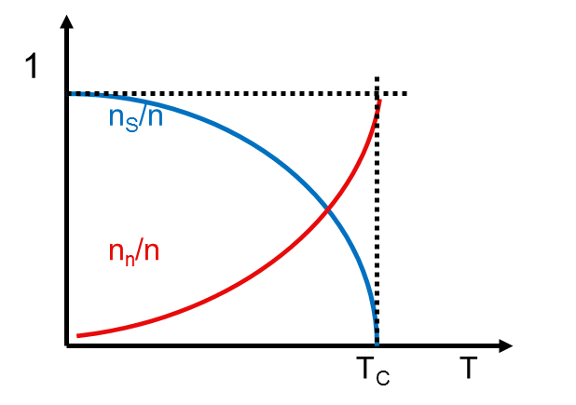

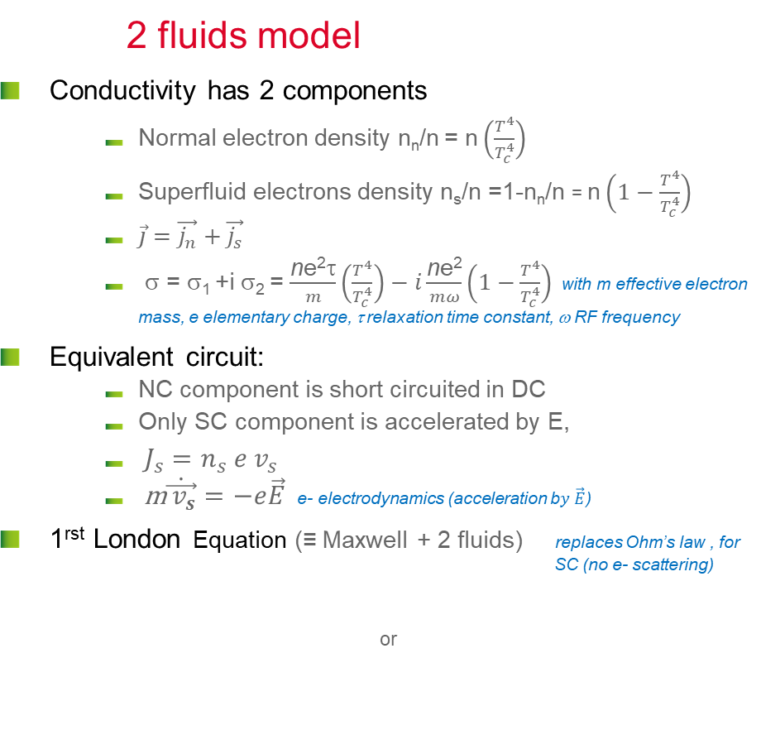

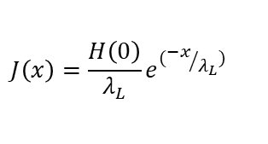

London (I)
2 fluids model
  Conductivity has 2 components
      Normal electron density n_{n}/n = n $\left(\frac{T^{4}}{T_{c}^{4}}\right)$
      Superfluid electrons density n_{s}/n =1-n_{n}/n = n $\left(1−\frac{T^{4}}{T_{c}^{4}}\right)$
      $\vec{j}=\vec{j_{n}}+\vec{j_{s}}$
      σ = σ₁ +i σ₂ = $\frac{\text{n}\text{e}\text{2}\text{t}}{m}\left(\frac{T^{4}}{T_{c}^{4}}\right)−i\frac{\text{n}\text{e}\text{2}}{mω}\left(1−\frac{T^{4}}{T_{c}^{4}}\right)$ with m effective electron mass, e elementary charge, τ relaxation time constant, ω RF frequency
  Equivalent circuit:
      NC component is short circuited in DC
      Only SC component is accelerated by E,
      $J_{s}=n_{s} e v_{s}$
      m$\dot{\vec{{ v}_{s}}}=−e\vec{E}$ e- electrodynamics (acceleration b$y \vec{E}$)
  1^{rst} London Equation (≡ Maxwell + 2 fluids) replaces Ohm’s law , for SC (no e- scattering)
    or
Λ Specific inductance, Λ=$\frac{m}{\text{n}\text{e}\text{2}}$
ρ_{n} Normal conducting resistivity
$$\frac{d\vec{J_{S}}}{dt}=\frac{e^{2}n_{S}}{m}\vec{E}=λ_{L}^{2}\vec{E}$$
$$\vec{J_{S}}=\frac{\vec{A}}{{μ_{0}λ}_{L}^{2}}$$
$$J\left(x\right)=\frac{H\left(0\right)}{λ_{L}}e^{({−x}/{λ_{L}})}$$
Electric field differs from 0 only if current density varies
Notes:
All free electrons (from the conduction band) n of the SC are divided into two groups:
superconducting electrons of density n_{s}/n
normal electrons of density n_{n}/n
As the temperature increases from 0 to the critical temperature Tc, the density ns/n decreases from 1 (all e- in form of Cooper pairs) to 0 (all Cooper pairs broken) when the material becomes normal conducting.
If the current is constant, electric field E cannot appear inside the superconductor because otherwise the super electrons would be continuously accelerated and the current would increase infinitely.
If there is no electric field, the normal electrons are at rest: only the super electrons carry the current in steady state, and they do not scatter on the impurities thanks to coherent state (see below)
First London eq shows that the electric field differs from zero only when the current density varies over time. It describes the ballistic flow of superelectrons in place of Ohm's law (which describes the viscous flow of electrons in a metal) and gives Js as a function of the vector potential A:
This equation suffers from the disadvantage that it is not gauge invariant, but is still true in the Coulomb gauge, where the divergence of A is 0. This equation holds for magnetic fields that vary slowly in space.
Notes
. As will be seen later all Cooper pairs have the same phase, if there is no current. A phase gradient appears only if a current appears
All pairs are correlated, so to break 1 pairs, it would be necessary to provide energy to destroy all pairs
With n= n_{s}+ n_{n}.

Slide 26
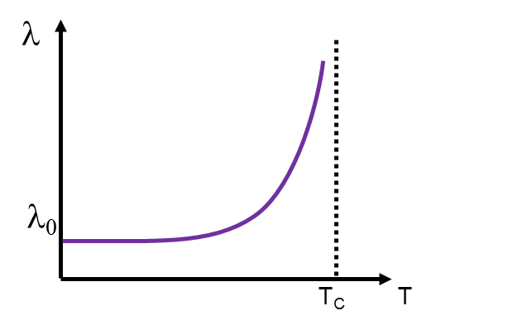




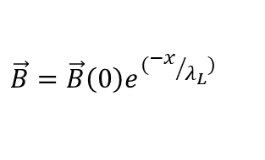







London (II)
  2nd London Equation (rot 1^{rst} eq. + Maxwell)
  London explains Meissner state
      Field penetrates over λ_{L}
      Within this depth => complete screening of H₀
      B = 0 in the core of the SC
      Maximum current density cannot exceed J_{D}
      (depairing current density):
  Perfect diamagnetism when x>>λ_{L}
$$∇×\vec{H}=\vec{J_{S}}$$
$$∇×\frac{d\vec{J_{S}}}{dt}=∇×λ_{L}^{2}\vec{E}$$
$∇^{2}\vec{H}=\frac{\vec{H}}{λ_{L}^{2}}$
$$H\left(x\right)=H\left(0\right)e^{({−x}/{λ_{L}})}$$
$$∇×\vec{E}=−μ_{0}\frac{d\vec{H}}{dt}$$
y
x
$$H$$
$$⊗$$
$$B=0$$
$$JS$$
$$J_{D}\left(T\right)=\frac{H_{C}\left(T\right)}{λ_{L}(T)} \sim J_{0}{\left(1−\frac{T^{2}}{{T_{C}}^{2}}\right)}^{3/2}$$
$$\vec{B}=\vec{B}\left(0\right)e^{({−x}/{λ_{L}})}$$
$$λ_{L}=(\frac{m}{e^{2}n_{s}(T)µ_{0}})$$
Note: $predicted$ λ_{L} < < λ experimental (London does not take into account non –local effects)
Notes:
2nd London equation explains perfect diamagnetism when x>> λ. it makes possible to explain Meissner effect (the supercurrents completely screen H, B = 0 inside), but underestimate λ.
Stationary case: one can neglect the displacement currents in Maxwell's 2nd eq., then one replaces rot E by its Maxwell equivalent in the second eq then one integrates according to time
In fact, the value of the gap (see BCS theory) is influenced by the displacement velocity of the Cooper pairs V_{s} and their momentum p_{f} : Δ (Vs) = Δ- p_{f} | V_{s} |
Thus at high current the gap decreases and more and more pairs are broken by thermal activation. See for example: http://accelconf.web.cern.ch/AccelConf/SRF2013/talks/moioc02_talk.pdf
Non local effects:
The magnetic penetration depth, named now λ₀, differs from the theoretical LONDON penetration depth λ_{L} because of two very different mechanisms:
- one intrinsic, due to the nature of the COOPER pairs*
- the other extrinsic, that adds to the previous one when the superconductor has a high concentration of impurities reducing the mean free path (dirty SC)
* the proportionality relationship between j(r) and A(r) is a local expression while the electrons of a Cooper pair can be several nm apart and “feel” a different potential vector.
(Mangin, P. and R. Kahn (2013). “Superconductivity. An introduction”, EDP sciences).

Slide 27
Ginzburg-Landau Model (I)
Reminder on 1er/2nd order transitions
  SC
      transition = 2nd order if B = 0
      transition =1^{rst} order if B ≠ 0
1rst order Transitions : discontinuous free energy derivatives, heterogeneous systems, transition does not happen everywhere at the same time, e.g. boiling water= liquid + gas mixture. Involves latent heat
2nd order transition: continuous free energy derivative, homogeneous system, all parts transit at the same time, e.g. ferromagnetic transition , nematic transition in liq. Crystals. Second derivative like Cp might diverge.
Phases before and after transition have different symmetries.
High energy phases are always uniform (s symmetry)
Low temperature phase present some order (specific symmetry appears)
Notes:
1 CHEM 212 Chapter 5 Phases and Solutions Dr. A. Al-Saadi. - ppt download (slideplayer.com)

Slide 28
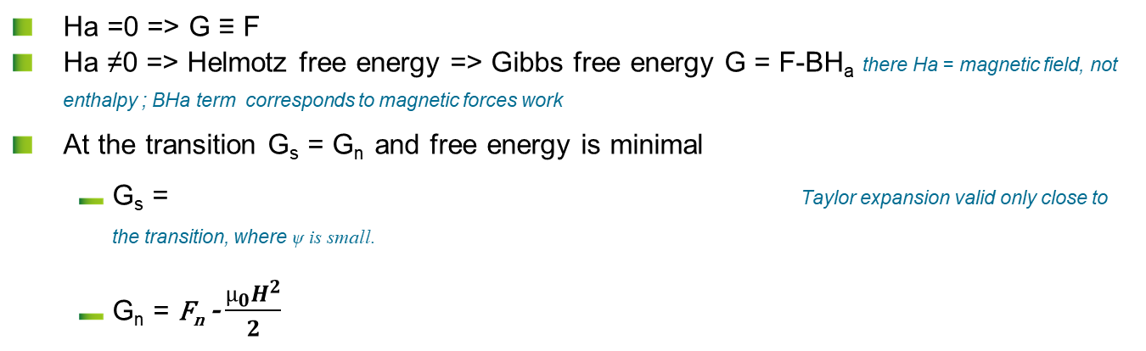
Thermodynamics reminders
Notations may differ with authors…
 | Helmotz free energy | Gibbs free energy
Order | 2nd order (field H_{a}=0) | 1^{rst} order (field H_{a}≠0)
System Variables | T, U (internal energy) | T, H (enthalpy)
Formula | F= U-TS+PV | G= H-TS+PV -µ₀H_{a}M
  Ha =0 => G ≡ F
  Ha ≠0 => Helmotz free energy => Gibbs free energy G = F-BH_{a} there Ha = magnetic field, not enthalpy ; BHa term corresponds to magnetic forces work
  At the transition G_{s} = G_{n} and free energy is minimal
      G_{s} = Taylor expansion valid only close to the transition, where ψ is small.
      G_{n} = F_{n} - $\frac{µ_{0}H^{2}}{2}$
^{n}

Slide 29
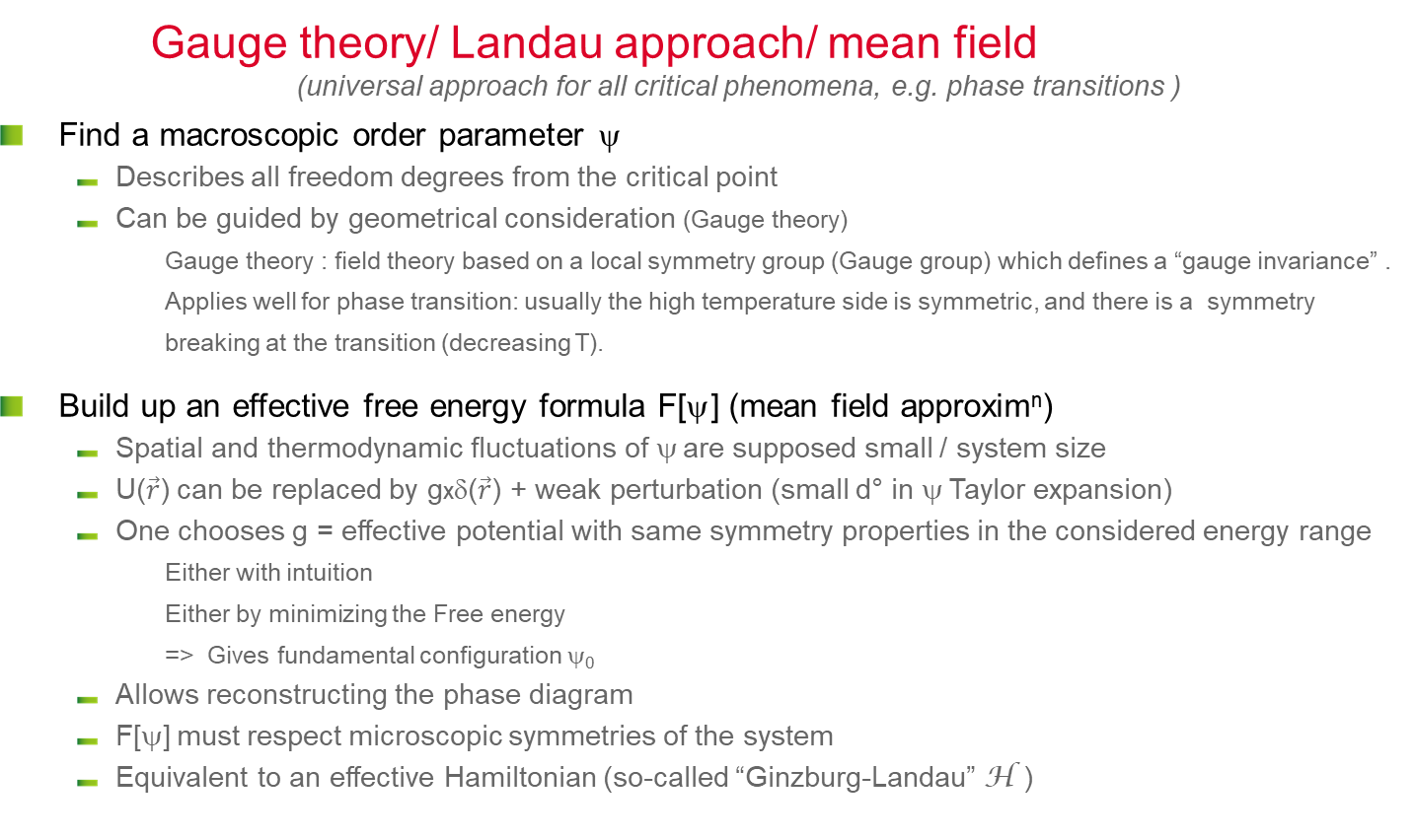



Ginzburg Landau model (II)
Gauge theory/ Landau approach/ mean field (universal approach for all critical phenomena, e.g. phase transitions )
  Find a macroscopic order parameter ψ
      Describes all freedom degrees from the critical point
      Can be guided by geometrical consideration (Gauge theory)
        Gauge theory : field theory based on a local symmetry group (Gauge group) which defines a “gauge invariance” . Applies well for phase transition: usually the high temperature side is symmetric, and there is a symmetry breaking at the transition (decreasing T).
  Build up an effective free energy formula F[ψ] (mean field approxim^{n})
      Spatial and thermodynamic fluctuations of ψ are supposed small / system size
      U($\vec{r}$) can be replaced by gxδ($\vec{r}$) + weak perturbation (small d° in ψ Taylor expansion)
      One chooses g = effective potential with same symmetry properties in the considered energy range
        Either with intuition
        Either by minimizing the Free energy
        => Gives fundamental configuration ψ₀
      Allows reconstructing the phase diagram
      F[ψ] must respect microscopic symmetries of the system
      Equivalent to an effective Hamiltonian (so-called “Ginzburg-Landau” H )
U($\vec{r}$)
Effective potential
      “Gauge Invariant ”
g.δ($\vec{r}$)
$$\vec{r}$$
Notes:
Same approach possible for all other phase transitions: for example
• Ferroelectric transition: the parameter of order $$ = Ms (spontaneous magnetization)
• Water vapor transition: the parameter of order $$= n the density of H₂O
• Higgs Mechanism in elementary Particles
Analogy with model of harmonic oscillator in Quantum. Mechanics: to simulate a bond (chemical, nuclear, etc.), one uses a simplified model, only valid at low energy. If one wants to go further: perturbation method (small perturbative potential compared to the energy of the system), if one wants to go even further ... it becomes complicated ... but it is always based on approximations that need to be justified.
So it’s always the same problem: knowing when the approximations are no longer valid quantitatively, then qualitatively...

Slide 30
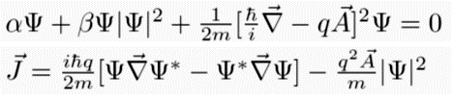

Ginzburg Landau Equations
= 0 if T > T_{C}, ψ ↑↑ if T → 0, and ψ ~ 0 @ T_{C}=>Taylor expansion
  NOTES
      Spatial fluctuations of n_{s} in the term $iℏ\vec{∇}$
      Odd terms ≠ 0 only if 1^{rst} order (field H)
      F₀ must be Gauge invariant : invariant for symmetry operation inside the disordered phase
      At H=0, J=0 and ψ is real => ξ can be derived
      Limit condition at surface : J=0, B-H =0
  Accounts for Meissner state in type I et II SC (supercurrents), flux quantification, macroscopic quantic effects…
  Allows λ and ξ estimation equations valid only close to transition !!!
^{s}
^{n}
Minimization.
Long and complex calculation
Ginzburg Landau Equations
Oops ! coupled non linear differential equations…
=> Numerical treatments only
e.g. H~ H_{C2} and T ~0 or H~0 and T~T_{C}
Notes:
Free energy of a system = energy available to provide work
At a given temperature T, the stable equilibrium state corresponds to a value of y which minimizes the free energy F (ψ, T).
Rem. GL approx^{n} => Proposes a local relation between current and potential vector, but in reality the exact relation is nonlocal, unless 𝐴 ⃗ or the current have slow variations on the scale of ξ0 => e.g. supra type II with l >> ξ0 (clean type II SC). In this case one has the right to use this approximation. For dirty type two : calculation has been developed initially by De Genne and co-authors (see De Gennes, P.-G. and P. A. Pincus (1966). Superconductivity of metals and alloys, WA Benjamin New York.)
General approach for phase transitions:
Close to transition temperature T₀, ψ is small: one can develop/expand
F(ψ,T) = F0(T) + A₀(T) ψ + A(T) ψ² + B(T) ψ³ + C(T) ψ⁴ + ...
where F₀ is the energy of the high temperature phase.
for T > T₀, F must be minimal for ψ = 0 et A(T) > 0.
For T < T₀, F must be minimal for ψ ≠ 0 et A(T) < 0 (concavity ).
The simplest choice is A(T) = a(T − T₀) with a > 0.
For a second order transition one can demonstrate that odd terms are = 0
(A₀(T) = B(T) = 0) and C(T) = c > 0 so F(ψ ,T) = F0(T) + a(T − T₀) ψ ² + c ψ ⁴, a > 0, c > 0
The ψ value that minimize F is a solution of, @ given F and ψ :
= 2a(T − T₀) ψ + 4c ψ ³ = 0
for T > T₀, the only solution is ψ = 0
pour T < T₀, 3 solutions : one maximum at ψ = 0 and 2 minima ψ = ± a(T₀ − T)/2c.
Close to T₀, the order parameter behaves like T₀ − T.

Slide 31
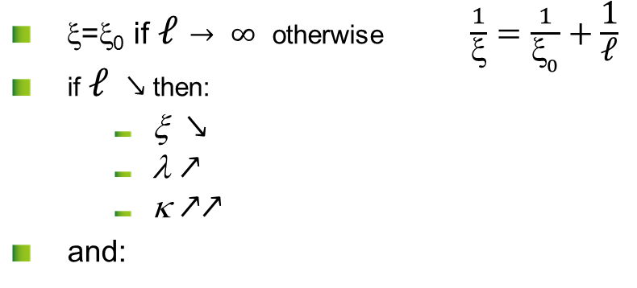

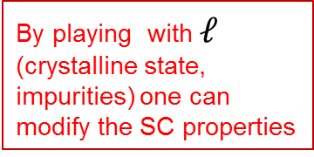
CHARACTERISTIC LENGTHS ξ₀, λ₀, l
Type I
Pippard ξ₀ > λ₀
l₀
Type II
London ξ₀ < λ₀
λ₀
ξ_{o}
ξ_{o}
  ξ=ξ₀ if $ℓ→ ∞$ otherwise $\frac{1}{\text{x}}=\frac{1}{{\text{x}}_{0}}+\frac{\text{1}}{\text{ℓ}}$
  if $ℓ$ $↘$then:
      ξ $↘$
      λ $↗$
      κ $↗↗$
  and:
$ℓ$mean free path
By playing with $ℓ$ (crystalline state, impurities) one can modify the SC properties
Notes:
ξ₀ = clean limit , estimated with G.L , calculated with BCS = coherence lentgh . ξ₀ corresponds ~ diameter where order parameter is 0 inside a vortex
ξ₀ depends on T and diverge @ T~Tc (typical behavior of a critical phenomenon, λ diverges as well).
$ξ_{0}\left(T\right)=\frac{{ℏv}_{F}}{πΔ(T)}$ and $λ_{0}(T)=\sqrt{\frac{{mc}^{2}}{4πe^{2}n_{S}(T)} }=\sqrt{\frac{m}{μ_{0}e^{2}n_{S}(T)} }$ ( « exacts » calculation from BCS)
The size of a Cooper pair is also assimilated to ξ₀ (at T=0) because it is a system coherence length (NB the size of a Cooper pair does not vary with T, only their density).
But do recall the ξ parameter was introduced in the GL model to account for the variation of the order parameter at the vortex core.
NB. Critical parameters ξ, λ, … diverge at the transition
NB. They are strong correlations (exchanges) between superelectrons inside ξ₀
Dirty limit : x~$\sqrt{ξ_{0}𝓁}$ et $λ\sim λ_{0}\sqrt{\frac{ξ_{0}}{𝓁}}$

Slide 32
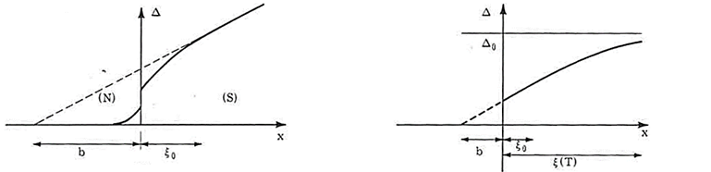


$ℓ$ < ξ : linear GL equations
Dirty SC: G.L. generalization ∀ T
(i. e. : @ GL scale: ~ ξ, λ >> ξ₀, one can assume that ψ, Δ changes are ~ linear)
  Only for very inhomogeneous cases (e.g. H~H_{C2}, or magnetic impurities…)
      H~H_{C2} (when H ↘) : SC phase just appeared, Ψ is very small
        non linear terms in ${\left|ψ\right|}^{4}$ can be neglected, only ${\left|ψ\right|}^{2}$ terms remain
      Screening of magnetic field can be neglected (H>> H_{C1}) so $\vec{Α} \sim \vec{Α_{appl}}$
        GL equations becomes decoupled
        Free energy minimization becomes: $ξ^{2 }\left(T\right){\left(∇+{ik}_{A}\right)}^{2}ψ\left(\vec{r}\right)=−ψ\left(\vec{r}\right)$
        ~ to Schrödinger equation for a particle with mass 2m, charge 2e) : Quantum mechanics sol^{ns} work well.
  For other cases: continuities solutions, variational methods, etc…
      e.g.: “dirty” SC : translation invariance is lost but …
        One add 1 more approximation (average value for all the impurities)
        Potential term due to impurities is treated like a weak perturbation => GLAC
ξ (T) et λ (T) diverge for T ~T_{C} and/or H~H_{C2}
ξ₀ : “Microscopic ”
ξ , λ : “Macroscopic”
Main model used for magnets
Does not apply for SRF
        If you use a model, check if it is valid in your case…
Notes:
Here ξ₀ is ξ₀(T=0), while ξ (T) et λ (T) diverge for T ~Tc and/or H~H_{C2}, and they are very large
At equivalent T (<<T_{C}), one always has « dirty » ξ<< ξ₀ (clean) : ξ ~ $\sqrt{ξ_{0}𝓁}$ et λ ~$λ_{0}$ $\sqrt{ξ_{0}/𝓁}$
Note :
Many “famous” books on superconductivity are in fact focused on magnet application.
For instance “Superconductivity of metals and alloys” by Nobel Prize awarded P. G. De Gennes, starts with a typeI/Type II description, but nearly all the mathematical development included in the text apply to very high κ SC (dirty SC) and are not directly applicable for e.g. Nb/RF .

Slide 33


BCS theory elements (I)
Effective interaction
(nucleus screening by e-, lattice vibrations, etc…)
  Jellium model :
      1) Effective potential due to all charged particles (ions + electrons ~ continuous media) ≡ Screened Coulomb interaction
      2) one consider delays due to phonons (ions move slower than electrons)
  Effective Hamiltonian H = H₀ + V
      H₀ = Hamiltonian for system without interaction (jellium)
      V = Perturbative potential (Interaction with phonons)
  Only electrons close to the Fermi level do “feel” a positive interaction => bound states (Cooper pairs)
  Next simplification :
      only e- with energy E_{v}= ε_{F} ± 2ℏ𝜔_{𝐷} are submitted to a potential ~ –V/2. 𝜔_{𝐷} = Debye frequency
V_{eff} (q, ω)
~ 10⁻⁸ V /e-
ω
ω_{ph} (q)
V_{eff}
ε_{F} - 2$ℏ\text{w}\text{D}$
ε_{F}
ε_{F} + 2$ℏ\text{w}\text{D}$
E
-V/2
Notes:
In the simplified model, one considers that the electrons from a small region of the phase space around the Fermi surface interact with each other by a constant attractive interaction (-V / 2)
It looks like a Bose-Einstein condensation of bosons (often described as), but it is not exactly one, (pairs are non-localized , they all have the same moment).

Slide 34
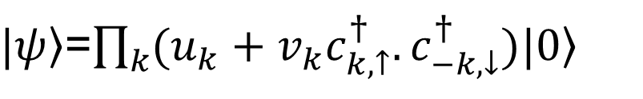
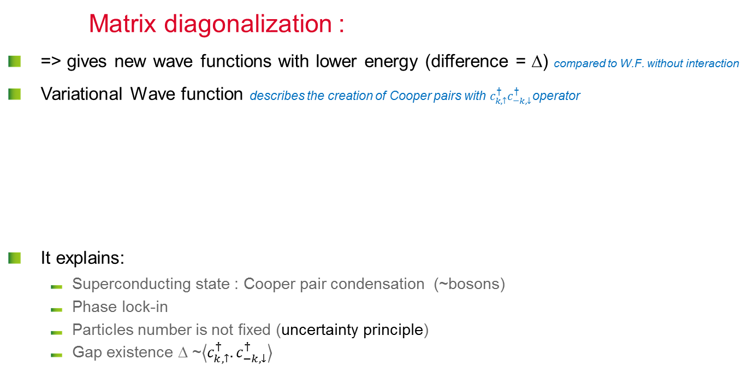
BCS theory elements (II)
Matrix diagonalization :
  => gives new wave functions with lower energy (difference = Δ) compared to W.F. without interaction
  Variational Wave function describes the creation of Cooper pairs with $c_{k,↑}^{†}c_{−k,↓}^{†}$operator
  It explains:
      Superconducting state : Cooper pair condensation (~bosons)
      Phase lock-in
      Particles number is not fixed (uncertainty principle)
      Gap existence Δ ~$\left\langle c_{k,↑}^{†}.c_{−k,↓}^{†}\right\rangle$
$|\left.ψ\right\rangle$=$\prod_{k}{(u_{k}+v_{k}c_{k,↑}^{†}.c_{−k,↓}^{†})|\left.0\right\rangle }$
  Cooper pairs creation operator
  H₀ matrix elements
  V matrix elements
Same symmetry as the GL order parameter 𝜓 …, but not exactly the same value for the gap Δ_{BCS}
Calculations too complex in practice, => simpler formalisms are more often used (London, G.L….)
Notes:
NB BCS approach also applies many other problems with n quantum bodies: e.g. ultra cold atomic gases, core of neutron stars, nucleons pairing , quarks, Anderson-Higgs Cooper pairs symmetry break (= 2 e- of spin and quasi-pulse opposite).
Invariable by reversal of time unless presence of magnetic field.
Phase coherence = same starting idea as GL: but in G.L. = single wave function; does not account for exchange between pairs.
BCS identical individual wave functions for each pair but correlated system: everything is also at the same phase, it also takes into account the interactions between pairs and cooperative effects, (analogy with superfluid He : Cooper pairs flow as a superfluid)
(Rem. the system is correlated because many Cooper pair overlap => macroscopic phase coherence)
Changing the state of a pair => destroying the state of all the system (would require enormous free energy: k_{B}Tc)
Near Tc GL and BCS give the same thing, but GL simpler to handle, BCS allows to justify certain assumptions taken in simpler models
Rem: BCS = weak coupling. Numerical applications not very good for superconductors w. strong coupling as Pb or Hg (one moves away from the relation 2Δ (0) = 3.54 k_{B}Tc), does not work either for HTC supra (YBCO and Pnictides) (numerical result !)

Slide 35
And in AC or RF ?

Slide 36
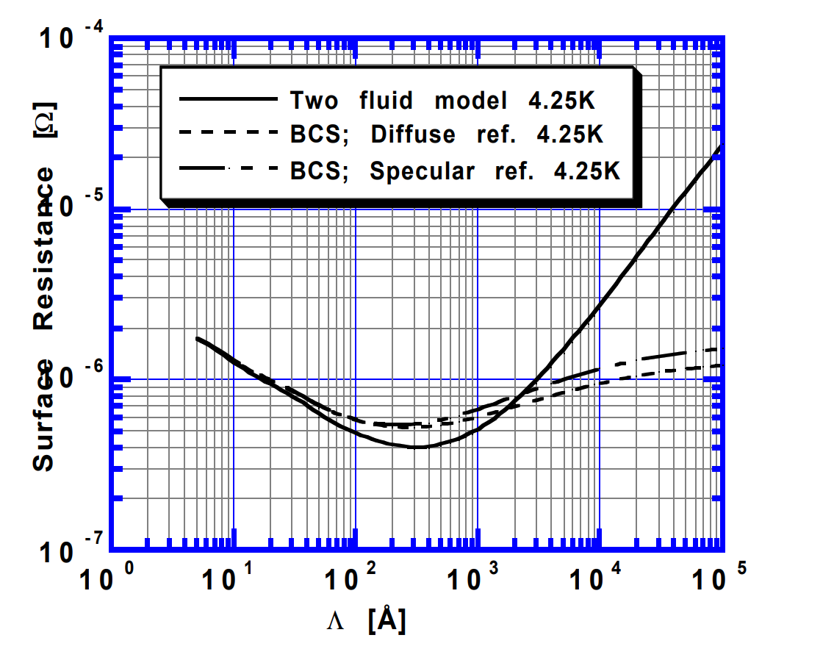
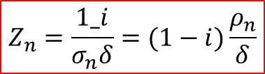
Resistive behavior in AC/RF
Cooper pairs inertia : field is not anymore perfectly screened within λ
  NC case : normal e⁻ are accelerated and dissipate
  Reminder : normal metal in AC
  Extension to SC:
      2 fluids model (London) : σ₁-iσ₂ in place of σ_{n}
      BCS => σ₁/σ_{n} and σ₂/σ_{n} can be numerically estimated (Mattis et Bardeen integrals)
      London approach: σ₁/σ_{n} and σ₂/σ_{n} can be approximated:
  RF surface resistance R_{S}
  In the SC normal e- ~ quasiparticles, e.g Cooper pairs thermally broken at T>0 K
$$Z_{n}=\frac{1_i}{σ_{n}δ}=(1−i)\frac{ρ_{n}}{δ}$$
σ_{n} = 1 / ρ_{n} = DC conductivity @ T
δ = skin depth
~
~
and
~
Only valid at small field !!!
Notes:
Mattis and Bardeen integrals and can only be numerically solved via the BCS theory. R_{BCS} depends on:
λ_{L} is the London field penetration depth, it relates to the depth where supercurrents develop to screen the external field,
ξ is the cooper pair coherence length, Its value at OK is similar to the “size of a cooper pair”. A high ξ makes one less sensitive to defects*. A small ξ, will on the contrary favor pinning (magnet application). For SRF: Nb has a very large ξ about 40 nm.
ℓ is the mean free path, and is a very important parameter. it can totally modify the properties of a superconductor compared to its theoretical one, and it is used to monitor the properties required for specific applications. We’ll see later that for SRF application one has to trade off between two opposite requirement for ℓ.
ρ_{n} is the normal conductivity. This parameters tends to announce that only good normal conductors will have low surface resistance when SC, but the situation is more complex than that.
The last important parameter is the superconducting gap : Δ, which is related to the transition temperature of the superconductor. This parameters says that the highest TC the lower the surface resistance…
“intuitive description”: An electrical field appears inside the superconductor if the current value changes (and vice versa). The increase in current is not instantaneous because of the mass inertia of the superconducting charge carriers, The screen is thus imperfect and the normal electrons will undergo a force and move dissipatedly. In dynamic mode (AC and / or pulsed), the current is carried by both types of charge carriers and the process is dissipative. The electrical properties of an AC superconductor can be seen as a perfect inductance in parallel with a resistance.
Normal electrons at 0 <T <Tc: these are normal electron close to the fermi level in the conduction band, issued from pairs dissociated mainly by thermal activation. Other pair breaking effects: strong current / strong field (which is the case in SRF), presence of magnetic impurities, ....
Rem: to describe these "broken" pairs, one sometimes use the term “quasiparticle”, which is also used in band theory in electronics. It is a concept where the particle is described with an effective mass and effective momentum that take into account its interaction with the lattice. Since it is a quantum mechanics concept, the number of particles is not set, contrary to e- when considered a classical particles. But basically in SC, quasiparticles refer to normal conducting e-.
Note: There is a limit frequency in AC (~ 100 GHz) where the photons produced by the electron accelerations (Bremsstrahlung) can excite the super electrons and make them normal (this is related to the IR absorption band; cf Slide #20).
For a normal conductor real part and imaginary part of the surface impedance are equal
For a superconductor the imaginary part can be 1000 times higher than the real part
Ref Saito: https://accelconf.web.cern.ch/srf99/papers/tup031.pdf

Slide 37
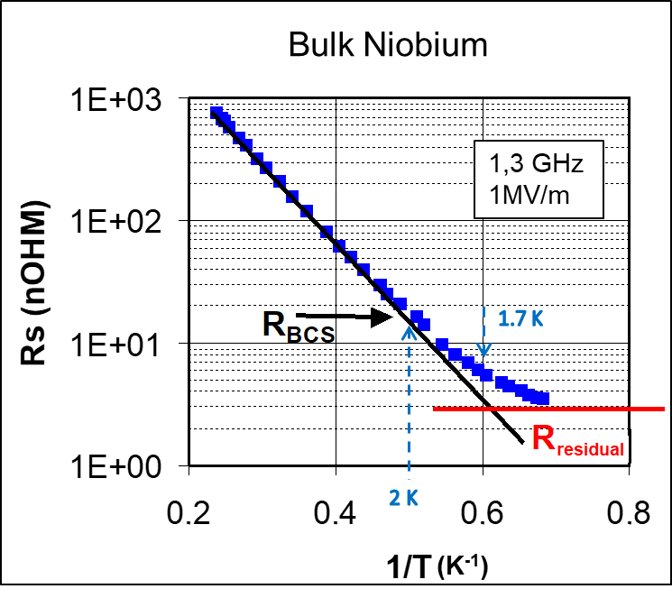
RF Residual resistance or…
… the limits of predictive theories
  Rs (sometimes quoted R₀): Not predicted by BCS!
      Vacancies, dislocations…
      Explained in part II
  Contains the (initially) “unknown”:
  Flux trapped during cooldown:
      Existence of pinning center (e.g. remnant of damage layer, thermal strain, poor recrystallization…)
      Mitigation: Magnetic hygiene (non magnetic steel for nuts and bolt. Active and passive magnetic shielding of the cryostat .Cooldown procedures. => Q₀ x10 !
  Other pair breaking mechanism:
      Existence of magnetic impurity (e.g. vacancies in the oxide layer)
      Proximity effect (∃ a metallic layer at the metal oxide interface: NbO => SC by proximity effect but affects the gap)
      Other suspects (not yet identified)
The metal – (natural) oxide interface not easily modeled : lattice mismatch => stress => dislocations, impurities segregation… What are the exact SC parameters there ? Difficult to include in simple model
Notes:
Flux trapped during cooldown :
importance of the Nb preparation: recrystallization, surface treatments
Active (coils) and passive (ferrite screens) shielding: protection against earth magnetic field. NB conductive ferrite efficiency depends on temperature => optimization needs to be done
Cooling procedure : opposite requirements:
On naked cavities : fast cooldown helps to “drag” the field lines and favor their expulsion at the Tc transition.
Equipped cavities, with e.g. Titanium He vessel : high risk of thermo-current generating flux lines if there is temperature distribution => slow cooldown
Needs some tinkering in each lab
Natural oxide on the surface = protection (diffusion barrier), but also big impact on surface properties.
Surface
oxide, contamination, dust particles
roughness
Oxide
thickness~ 5nm, depends on orientation and previous process
mainly Nb₂O_{5-x}, with ppb impurities content (PO_{x}, SO_{x}…)
one layer NbO @ interface (metallic)
decomposes into suboxides upon baking (UHV)
First 10 nm of Nb
distorted (lattice mismatch)
a lot of interstitial atoms. Mainly H, O (1 At% to 10s of At%), also F, C, P… i.e. surface segregation & chem residue
higher impurity content for EP (O, C) !

Slide 38
First part Conclusion
Superconductivity :
  Quantic phenomenon observable at macroscopic scale
  Coupling of 2 e- (fermions) into a boson (Cooper pair)
    Coupling mechanism only elucidated for conventional SC (metals and alloys)
  No existing complete theory
    Many specific developments (phenomenological)
    Be careful with validity limits
    Many contradiction found in the literature (most of them due to misuse of the proper model)
  Theory often very far from real world (not very conclusive)
  In practice all applications use type II SC
  All of them in mixed state… except SRF acceleration application
  NB. they are some SC RF applications in SC electronics …@ mixed state
Notes:
The performances of a huge machine like an accelerator can be affected by the distribution of impurities on a few atomic layers ☹.
So if you build an accelerator, better to keep some material experts around and ask them what could go wrong before starting : let them help to define the specifications, follow up, post-processing of the SC material.

Slide 39
next:
Part II : mixed state & vortex

