Slide 1
Superconductivity In accelerators
Part II : MIXED state
JUAS 2025| Claire ANTOINE
Magnets VS RF cavities

Slide 2



Why do vortices are so important ?
  Magnets ≠ RF Cavities !!!! !!!!
  Magnet (DC) :
    One aims at very high current densities with 0 resistance
    It means:
      Mixed state
      Non moving, trapped vortices (medium fields: H<H_{irr})
      Defects are voluntarily introduced to ↑ pinning and ↑ λ (↓ ↓ H_{C1} et ↑ ↑ H_{C2})
      J < J_{C} <<< J_{D}
  Cavities
    One aims at very high field with minimal dissipation (but ≠0 ☹)
      H variable, H_{max}~H_{SH} (= f(H_{C}))
      Vortices cannot keep pinned at this frequency => very high dissipations (!),
      One has to prevent Vx entering: keep in Meissner state !
      Reduce # of defects (promoting early Vx penetration), => ↑ ↑ effective H_{C1}
  Good SC for magnet applications are bad for cavities!
  And vice versa !
For the recall:
1 => vortex, many => “vortices”

Slide 3
vortices (I): penetration inside the superconductor

Slide 4
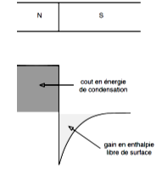
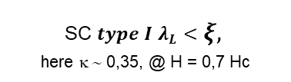



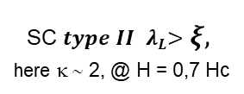



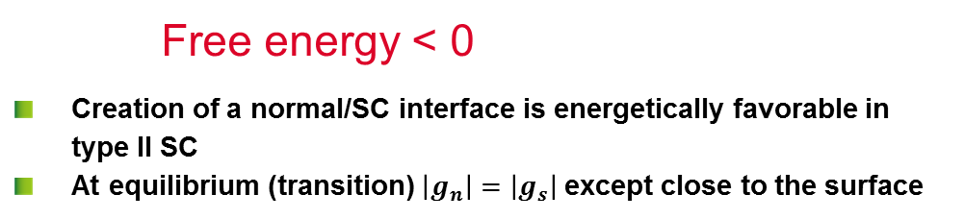


H>H_{C1}: Vortex = energetically favorable
δg_{m} ~ $µ_{0}\frac{H^{2}}{2}(1−e^{−\frac{x}{λ_{L}}})$
B ≠0 over λ
Magnetic energy
Condensation energy
Free energy
ns grows over ξ
δg_{c} ~ ${mµ}_{0}\frac{H_{C}^{2}}{2}\left(\frac{n(x)}{n_{s}}\right)$
SC 𝒕𝒚𝒑𝒆 𝑰 $λ_{L}<ξ,$
here κ ∼ 0,35, @ H = 0,7 Hc
SC 𝒕𝒚𝒑𝒆 𝑰𝑰 ${ λ}_{L}>ξ,$
here κ ∼ 2, @ H = 0,7 Hc
N
$$λ_{L}$$
SC
G
$$λ_{L}$$
SC
G
$\frac{1}{2}µ_{0}H_{c}^{2}$
$\frac{1}{2}µ_{0}H_{c}^{2}$
Cost in condensation energy
0
N
0
Gain in surface free energy
- $\frac{1}{2}µ_{0}H_{c}^{2}$
- $\frac{1}{2}µ_{0}H_{c}^{2}$
$$ξ$$
$$ξ$$
0
2
4
6
8
10
x/λ_{L}
0
2
4
6
8
10
x/λ_{L}
Free energy < 0
  Creation of a normal/SC interface is energetically favorable in type II SC
  At equilibrium (transition) $\left|g_{n}\right|=\left|g_{s}\right|$ except close to the surface

Slide 5
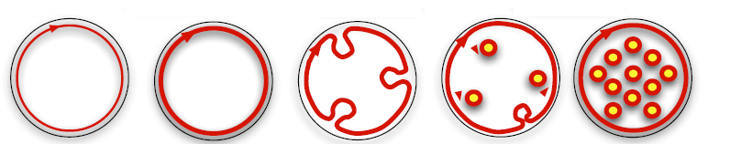
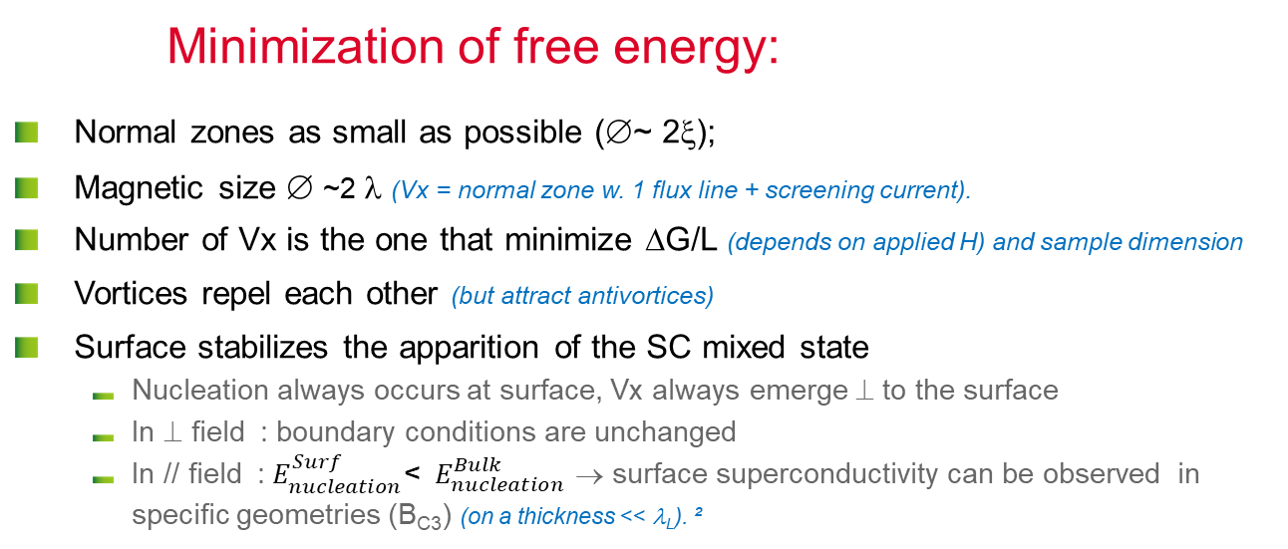


H>H_{C1}: Vortex = energetically favorable
Thin sample, ⊥ field
$$\vec{H }$$
$$H↗$$
Minimization of free energy:
  Normal zones as small as possible (∅~ 2ξ);
  Magnetic size ∅ ~2 λ (Vx = normal zone w. 1 flux line + screening current).
  Number of Vx is the one that minimize ΔG/L (depends on applied H) and sample dimension
  Vortices repel each other (but attract antivortices)
  Surface stabilizes the apparition of the SC mixed state
      Nucleation always occurs at surface, Vx always emerge ⊥ to the surface
      In ⊥ field : boundary conditions are unchanged
      In // field :${ E}_{nucleation}^{Surf}$< ${ E}_{nucleation}^{Bulk}$ → surface superconductivity can be observed in specific geometries (B_{C3}) (on a thickness << λ_{L}). ²
This holds only for ξ< λ
=> Type II SC
Notes:
Lattice of Abrikosov vortices in ramping up magnetic field – YouTube

Slide 6



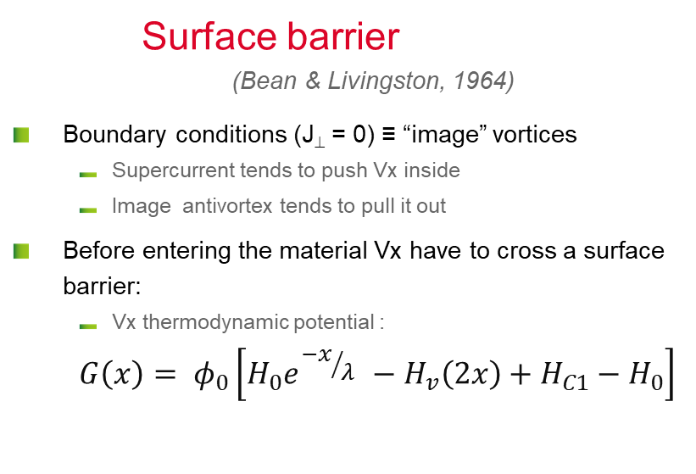
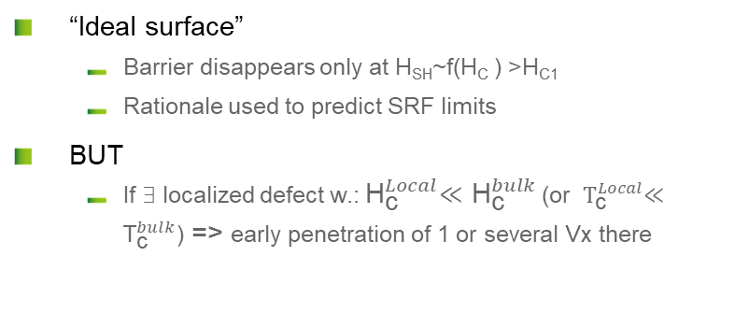

vortex Penetration with B // surface
Surface barrier
(Bean & Livingston, 1964)
  Boundary conditions (J⊥ = 0) ≡ “image” vortices
      Supercurrent tends to push Vx inside
      Image antivortex tends to pull it out
  Before entering the material Vx have to cross a surface barrier:
      Vx thermodynamic potential :
      $$G\left(x\right)= φ_{0}\left[H_{0}e^{{−x}/{λ }}−H_{v}\left(2x\right)+H_{C1}−H_{0}\right]$$
J
H₀
Image Vortex
⬄
J⊥ = 0
$$x$$
λ
G
Image
H₀ < H_{c1}
Meissner
  “Ideal surface”
      Barrier disappears only at H_{SH}~f(H_{C} ) >H_{C1}
      Rationale used to predict SRF limits
  BUT
      If ∃ localized defect w.:${ \text{H}}_{\text{c}}^{Local}≪{\text{H}}_{\text{c}}^{bulk}$ (or ${ \text{T}}_{\text{c}}^{Local}≪{\text{T}}_{\text{c}}^{bulk}$) => early penetration of 1 or several Vx there
H₀ = H_{c1}
$$x$$
H₀ > H_{c1}
H₀ = f(H_{c})
$$H0↗$$
Notes:
Bulk : periodic potential B(x)
Surface => singularity=> distortion in the potential B(x).
Introducing an image vortex allows to describe the shape of B(x) close to the surface
Analogy with « image electron » : to describe the change in the crystalline periodic potential brought by the surface in electrostatics.
=> Bean-Livingston surface barrier in // field. Reason why it is so difficult to nucleate a vortex in // field (SRFlimits of H_{SH}).

Slide 7
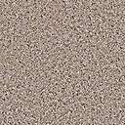





Demagnetization coefficient
Geometrical effects (perfect conductors)
  Elliptical samples : H = H_{C} everywhere
  Arbitrary shape : consider local deformation of flux lines
$$\vec{H }$$
    Infinitively thin strip D → 1
    Sphere : D = 1/3
    Infinite cylinder: D = 0
$\vec{B }= μ_{0 }(\vec{H }$ + $\vec{M }$) =>
$\vec{B }= μ_{0 }(\vec{H }$ +(1-D) $\vec{M }$)
$$\vec{H }$$
Strong influence of geometry, orientation edge effects be careful with measurements!!!
Classical magnetometry gives H_{P} not H_{C1}(convolution of SC properties with geometrical effects)
Notes:
Demagnetization effect :
Origin of difficulty to measure H_{C1} in DC magnetometry (sample in uniform field) => controversies (and different recopies) in literature
Has some consequences when ”wiring” tapes instead of wires (e.g. highTc HYBCO come only in the form of tapes, see slides below). Non uniformity of the field are harder to predict/control.
Origin of the local field enhancement factor due to roughness, dust particles, scratches….β~1/D. Works either for electric or magnetic field, but consequences are not the same: for e.g. β=2 => catastrophic effect if the magnetic field is locally double as the ambient field (in a cavity): the quench will occur there ! But not very harmful if it is electric field: it needs some GV/m to extract electrons from a metallic wall. Dust particles can exhibit βs ~50-500 (see part III) => work inside clean rooms !
For the recall : same mechanism as antennas and Lightning rods

Slide 8
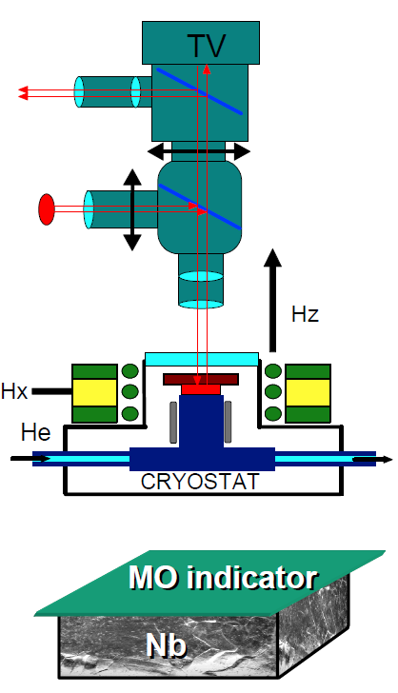

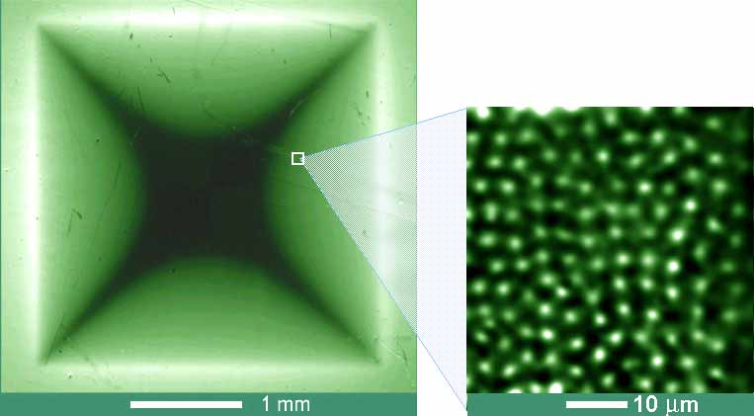

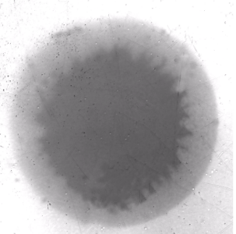
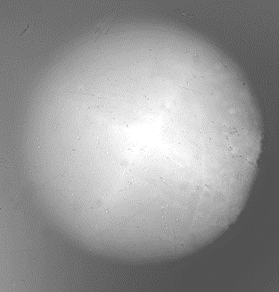

Vortex & (nearly) perfect material
  In ⊥ field : demagnetization effect , local field depends on the shape
$$\vec{H}$$
Nb₂Se
(Abrikosov Vx lattice)
Dark contrast: B=> 0
Light contrast : B↗
http://www.mn.uio.no/fysikk/english/research/groups/amks/superconductivity/mo/
Notes:
Movie in presentation mode.
Magneto-optics (MO) principle:
Sample inside cold cryostat w. transparent window on a microscope stage
Magnetic coil around to generate magnetic field.
On the top of the sample sits an MO indicator (specific crystals where the polarization of the ligth depends on the presence of field : when no field is present, no light reflection => dark contrast. In presence of field, light reflection => white contrast). Allows mapping de flux lines.
Flux penetration dominated by the shape of the sample (demagnetization effect).
Abrikosov vortex lattice (in a “perfect material”): vortex repel each over => they are equidistant. They form a centered hexagonal lattice, sometimes also referred as “trigonal” lattice (improper term if one is referring to a crystallographic symmetry system)

Slide 9
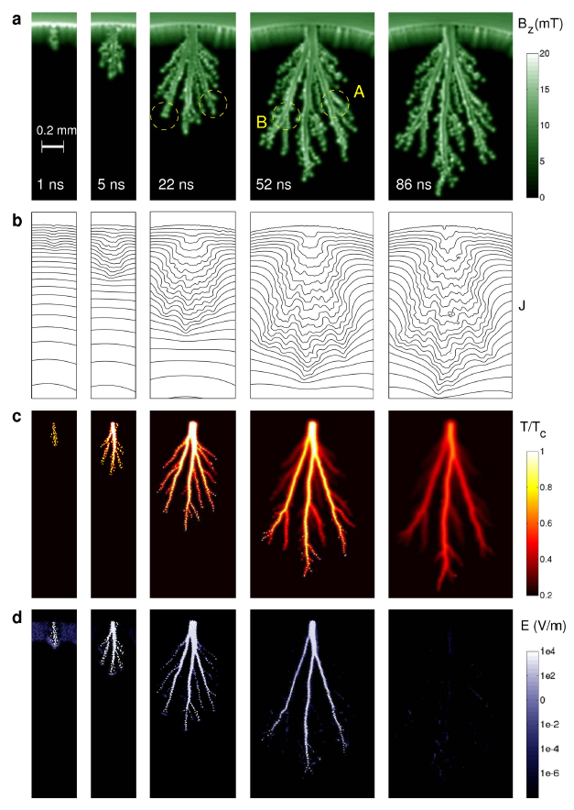
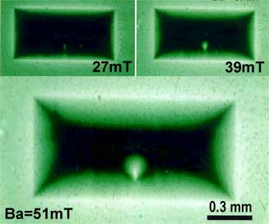

Defects and avalanches
  Localized defect effect…
YBa₂Cu₃O₇ film w. one single defect ↓
  http://www.mn.uio.no/fysikk/english/research/groups/amks/superconductivity/mo/
  Vx penetration (~100 µm) during 1! RF period (ns)
  “flux jumps” ≡ avalanche penetration, observed in transient state (so also expected in RF)
  http://www.nature.com/srep/2012/121126/srep00886/full/srep00886.html?message-global=remove&WT.ec_id=SREP-20121127
$$\vec{B}$$
  MgB_{2 →}
Notes:
“The avalanche stops propagating when heat removal to the substrate eventually balances the heat production. This is seen in the final panel, where the maximum temperature has already decayed to 0.7T_{c}. Shortly after that no thermal traces are left from this dramatic event where superconductivity was lost for a very short period of time”
http://www.mn.uio.no/fysikk/english/research/groups/amks/superconductivity/mo/
Avalanche penetration : worse case scenario of flux jumps
“For instance, we assume that a local flux motion occurs for some reason. This will lead to some energy dissipation and a slight temperature rise. This temperature rise will reduce the pinning force that prevents the flux motion and more flux lines than the initial group will move. This will cause a further energy dissipation and temperature rise. The phenomenon will continue until such positive feedback destroys the superconductivity and the flux motion is completely stopped.”
Matsushita, T. (2007). Flux pinning in superconductors, Springer.
Flux jumps : see also comments in Slide 19

Slide 10
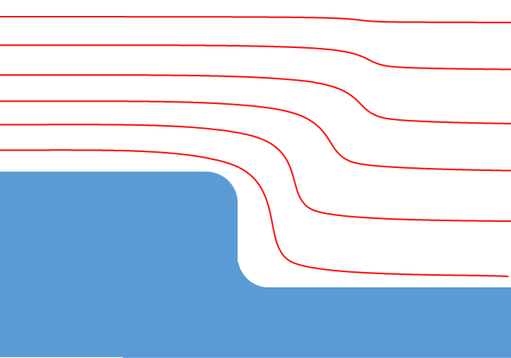
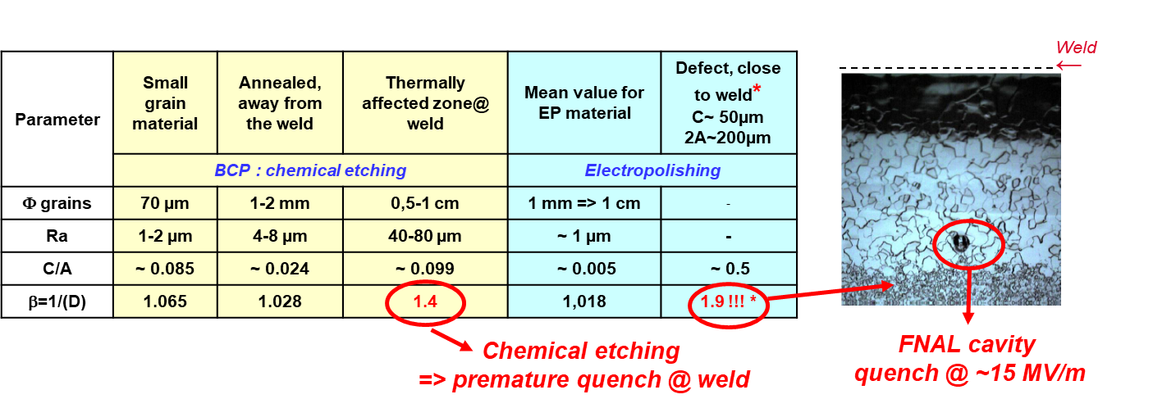
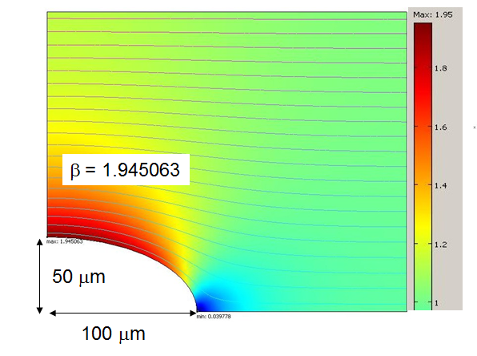
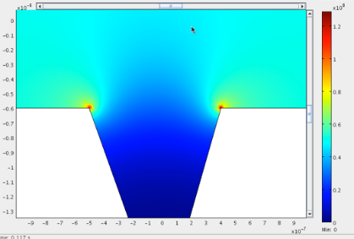
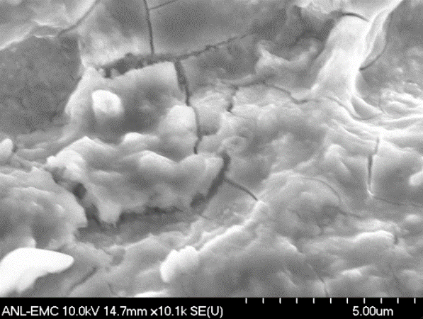
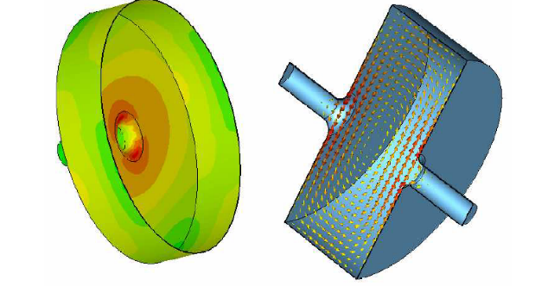
Morphologic defects
  Analytical expression for D= 1/β
m=c/a
c
2a
  Same pit (3D modeling)
  Cracks in a thin film:
[INSEPOV, NOREM, ANL 2011]
  Pit in a cavity)
β ~ 1.6
[SHEMELIN , Cornell, 2008]
β ~ 5
[NOREM, ANL 2011]
Notes:
MO contrast on morphologic defects indicate the existence of a ⊥ component of the field, one gets a local field enhancement β.
Realistic materials often present morphologic defects : general shape, scratches, natural roughness, but also at smaller scale : crystalline facets, inclusion, atomic steps… Even if the field enhancement on a defect is small, the first point reaching the transition field is obviously there.
In SRF, roughness at the µm and the nm scale matters. It is not so much the height of the steps that matters but the angle of curvature on the step edges (trust me on this + see part III)
Conformational equivalent ellipsoids : a topological tool to mimic any morphologic defect
Ref cornell: http://flash.desy.de/sites2009/site_vuvfel/content/e403/e1644/e2271/e2272/infoboxContent2358/TTC-Report2008-07.pdf

Slide 11

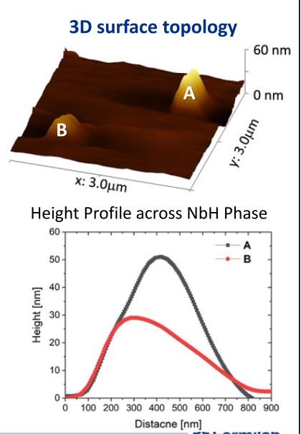
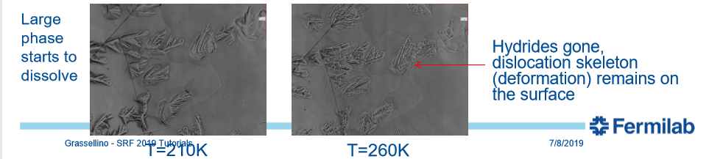
Hydrides in Nb: typical weak spot
Both weakened SC and geometrical effects
  NbHx : low T_{C}, Low H_{C1} or even NC => early Vx entry
  Prominent crystal shape =>early Vx entry
RT
140 K, 60 s
120 s
300 s
  Same pit (3D modeling)
3h @ 140 K
@ 5 K
900 s
2700 s
6000 s
10800 s
µms
3x6 µm
β ~1.8
[A. Romanenko, SRF 2013] ↑
[A. Grassellino, SRF 2019↓]
Cryogenic measurements
[H.Sung,
SRF 2019]
10s of nm
β ~1.15- 1.18
Notes:
Typical weak spot in SRF cavities
Hydrides NbHx: two effects :
Morphologic: field enhancement not negligible
Poor SC : low T_{C}, Low H_{C1}, some compounds event NC (depends on stoichiometry (x))
Premature Vx penetration there, ASA H ↑ !!! Cavities quench at a few MV/m (1.3 GHz, Tesla shape, instead of 45-50 mV/m)
Origin Hydrogen segregation at the metal-oxide interface
Example of large Nb hydrides precipitates:
Ellipsoid to mimic surface protrusion
β Easy to calculate

Slide 12
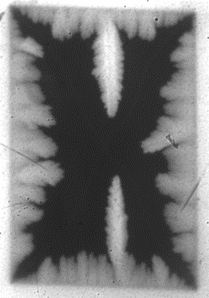
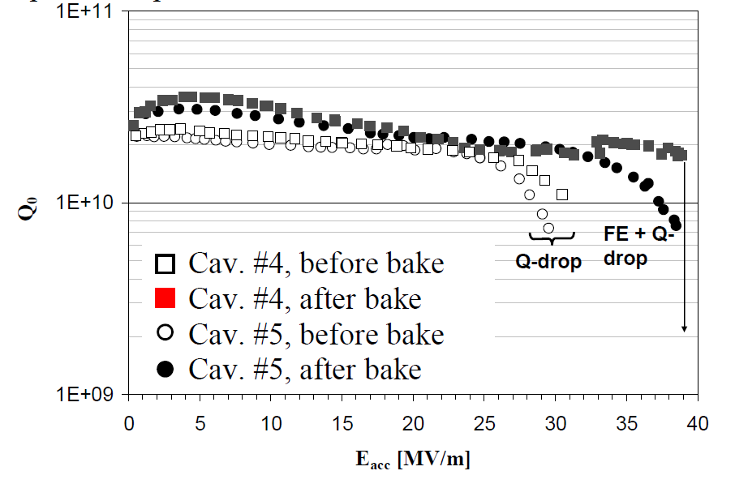
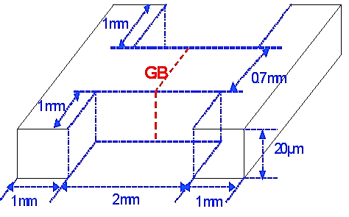
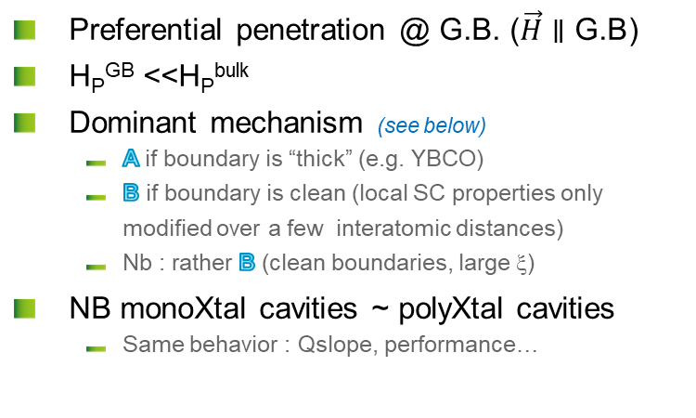
Grain boundaries in Nb
[A. Polyanskii,. H. Sung et al, FNAL/FSU]
  Preferential penetration @ G.B. ($\vec{H}∥\text{G}\text{.}\text{B}$)
  H_{P}^{GB} <<H_{P}^{bulk}
  Dominant mechanism (see below)
      A if boundary is “thick” (e.g. YBCO)
      B if boundary is clean (local SC properties only modified over a few interatomic distances)
      Nb : rather B (clean boundaries, large ξ)
  NB monoXtal cavities ~ polyXtal cavities
      Same behavior : Qslope, performance…
H
    On GB: Josephson Vx
    Interface pinned (GB)
    Current lines are distorted
Monocrystalline cavities
H
    @ 4.5 K
    H_{P}^{GB} ~ 32 mT
    H_{P}^{bulk} ~ 150 mT
GB : not dominant pinning mechanism in Nb !!!
Notes:
Grain boundaries are very often a main pinning center in most of the SC, especially those with high κ (see part III optimization of magnet wires).
GB indeed exhibit degraded SC properties, but it does not seem to affect RF behavior: monocrystalline cavities exhibit exactly the same type of losses as polycrystalline cavities.
Since ξ is much larger than disordered volume around GB => not main pinning center IN NIOBIUM !
Preferential penetration in GB when GB aligns with field (very few chances to occur in cavities)
SRF 2017 (‘who?) => some GB show easy way in, easy way out for the field, while others have pinning behavior. NB some GB can be considered as array of dislocations, depends on relative orientations

Slide 13
Vortex in presence of electric field and/or current
( )

Slide 14
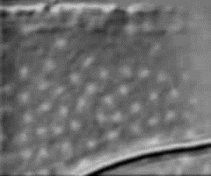
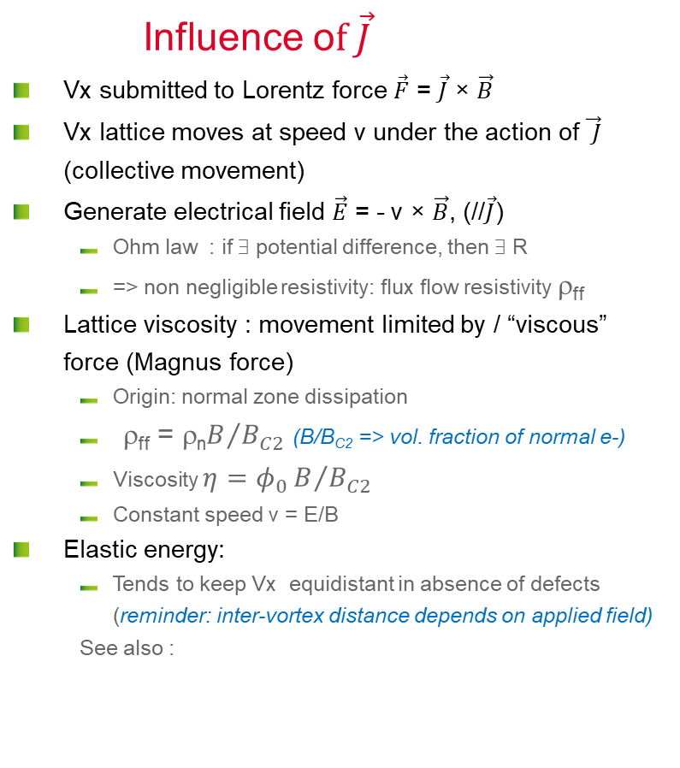

Moving Vortex
http://www.mn.uio.no/fysikk/english/research/groups/amks/superconductivity/sv/
NbSe →
25x35 µm
Influence o$f \vec{J}$
  Vx submitted to Lorentz force $\vec{F}$ = $\vec{J}$ × $\vec{B}$
  Vx lattice moves at speed v under the action of $\vec{ J}$ (collective movement)
  Generate electrical field $\vec{E}$ = - v × $\vec{B}$, (//$\vec{J}$)
      Ohm law : if ∃ potential difference, then ∃ R
      => non negligible resistivity: flux flow resistivity ρ_{ff}
  Lattice viscosity : movement limited by / “viscous” force (Magnus force)
      Origin: normal zone dissipation
      ρ_{ff} = ρ_{n}$B/{B_{C2}}$ (B/B_{C2} => vol. fraction of normal e-)
      Viscosity $η=φ_{0}B/{B_{C2}}$
      Constant speed v = E/B
  Elastic energy:
      Tends to keep Vx equidistant in absence of defects (reminder: inter-vortex distance depends on applied field)
      See also :
V
H
$$\vec{J }$$
Notes:
Movie in the presentation mode
Without an external field, the current (infinite rectilinear) creates a field which revolves around it: hence Vxs are toric. Laplace's force would therefore tend to rotate the torus around its axis so that it does not move.
If the outer field is dominant, the number of vortices does not change, but moves in proportion to the current. Vx enter the material one side and exit the other

Slide 15
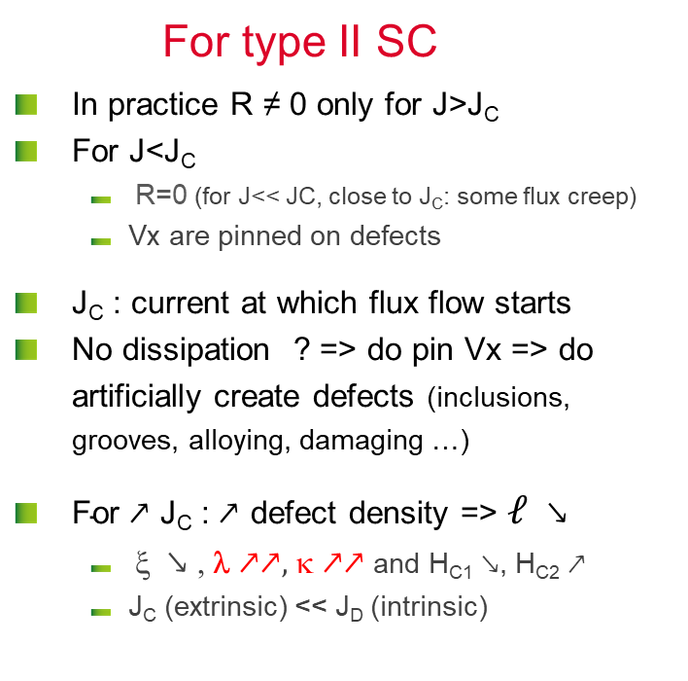
critical current density J_{C}
For type II SC
  In practice R ≠ 0 only for J>J_{C}
  For J<J_{C}
      R=0 (for J<< JC, close to J_{C}: some flux creep)
      Vx are pinned on defects
  J_{C} : current at which flux flow starts
  No dissipation ? => do pin Vx => do artificially create defects (inclusions, grooves, alloying, damaging …)
  $\text{For}↗\text{J}\text{C}\text{ :}↗$ defect density => $ℓ$ $↘$
      ξ $↘$ , λ $↗↗,$ κ $↗↗$ and H_{C1} $↘$, H_{C2} $↗$
      J_{C} (extrinsic) << J_{D} (intrinsic)
normal
E
flux flow
Pinning then flux flow
J_{C}
J
  RF Cavities : pinning is inefficient, J_{C} meaning less: always in the flux flow regime (that is why we want to prevent early Vx penetration and flux trapping during cooldown! )
Notes:
Flux flow resistance : only a fraction of the surface is normal conducting => resistance is proportional to the number of vortices.
Vortices in superconductor containing small spherical inclusions in high magnetic field - YouTubeVortices in superconductor containing small spherical inclusions in high magnetic field – YouTube
https://www.youtube.com/watch?v=ae0oME77Pz0
In fact the transition is not so brutal; some groups of Vx start to unpin and move a few inter-pinning-centers distances before getting trapped again => flux creep. See movie in slide 19 comments

Slide 16
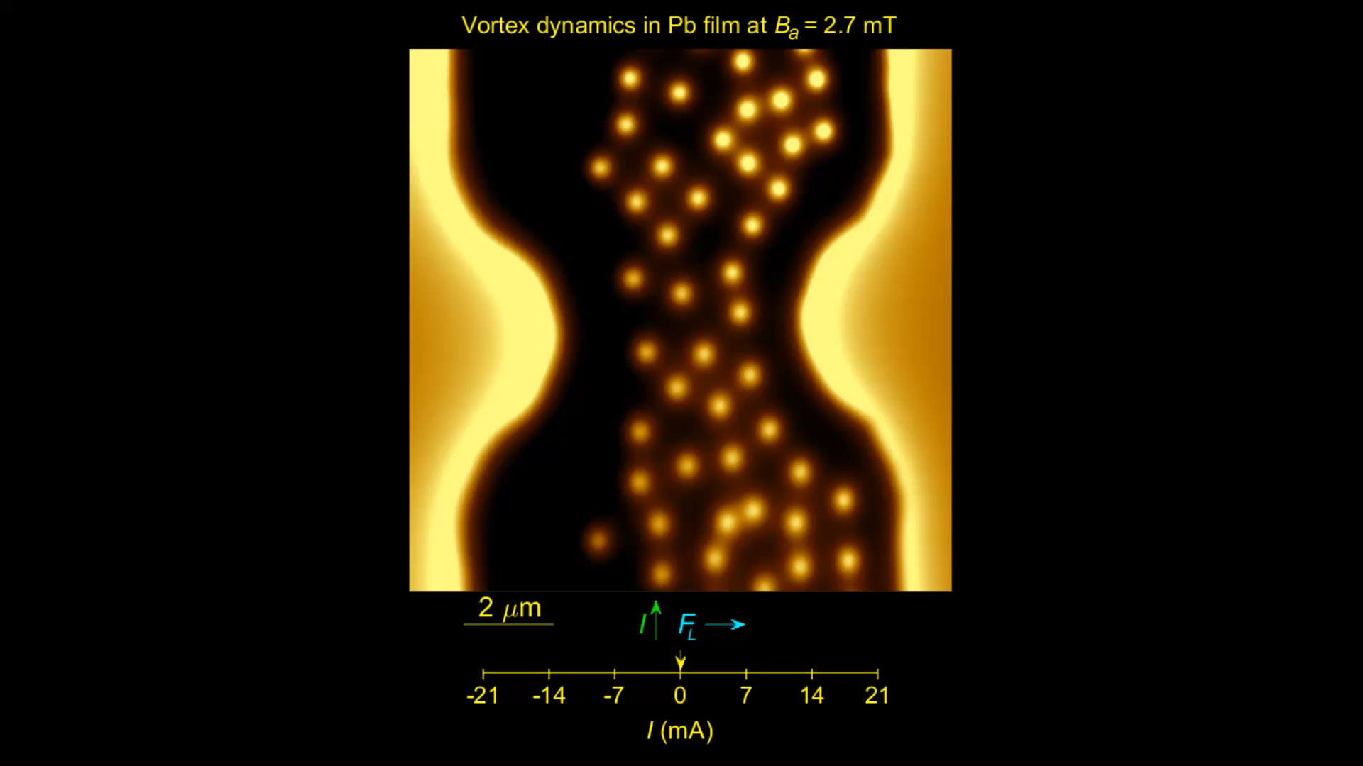
Vortices Avalanches
https://www.eurekalert.org/multimedia/pub/145764.php\
© Dr. Yonathan Anahory
Racah Institute of Physics
The Hebrew University of Jerusalem
Lead films
scanning SQUID-on-tip microscopy technique
allows magnetic imaging at magnetic sensitivity and high resolution (~50 nm)
At high currents (high drives) vortices move at 20 km/s and appear as smeared line.
Notes:
https://www.eurekalert.org/multimedia/pub/145764.php\
“… vortices flowing through a thin superconducting film at rates of tens of GHz, and traveling at velocities much faster than previously thought possible -- up to about 72 000 km/hr. This is not only much faster than the speed of sound, but also exceeds the pair-breaking speed limit of superconducting condensate -- meaning that a vortex can travel 50 times faster than the speed limit of the supercurrent that drives it. This would be like driving an object to travel around the earth in just over 30 minutes. […]
They show a tree-like structure with a single stem that undergoes a series of bifurcations into branches. This channel flow is quite surprising since vortices normally repel each other and try to spread out as much as possible. Here vortices tend to follow each other, which generates the tree-like structure.
A team of theoretical physicists from the USA and Belgium, led by Professors Alexander Gurevich and Milorad Miloševi, partially explained this finding by the fact that when a vortex moves, the appearance of resistance locally heats the material, which makes it easier for following vortices to travel the same route.”

Slide 17
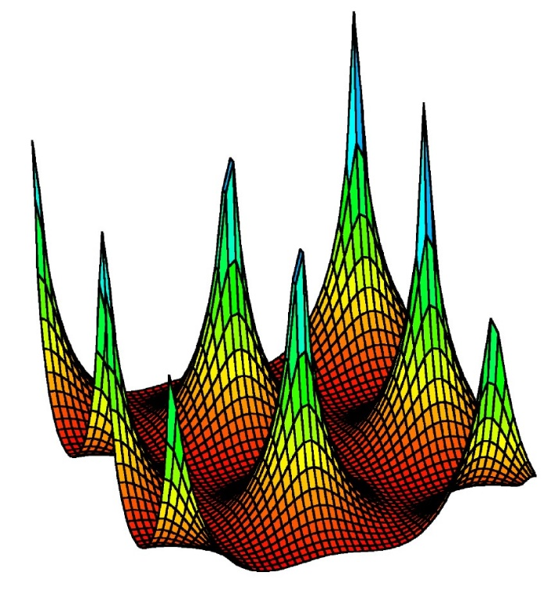
A complex phase diagram
Vortex behavior is conditioning the application limits
  Vortex (Vx)
    Centered hexagonal lattice (triangular)
    Can be pinned on crystalline defects (see below)
    Several ≠ states
    H>H_{M} => R≠ 0
H_{M} defined as the H=f(T) line @ J_{C} (H,T) = 0 in the (H,J,T diagram)
H_{M} ≡ H_{Irr}
H
Vx Liquid
Vx glass
H_{C2}
Vx Lattice
H_{C1}
T²
Notes:
H_{M} , M as "melting" or "moving“. When the vortices start to move freely in the SC, it marks the beginning of the thermal dissipations (R is no longer = 0).
It is usually measured by DC magnetometry:
Superconductor Magnetization Hysteresis". Journal of Siberian Federal University. Mathematics & Physics, 2018. 11(2): p. 219-221.
NB “glass” can be considered as a very (very!) viscous liquid…

Slide 18
vortex (II): pinning on crystalline defects
(Introduction)

Slide 19
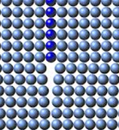
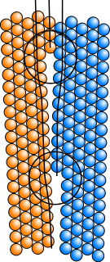
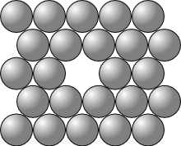
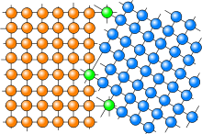
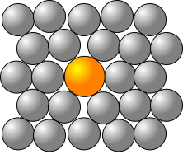
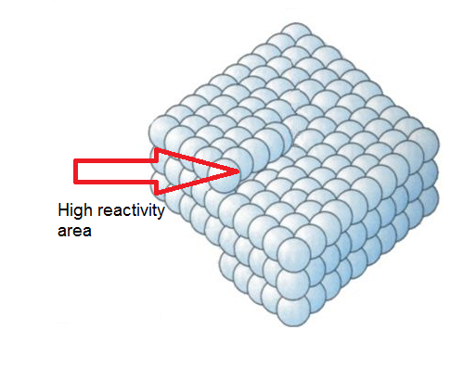
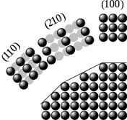
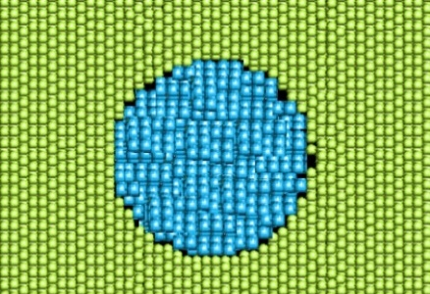
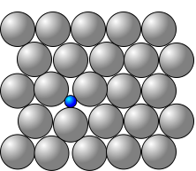
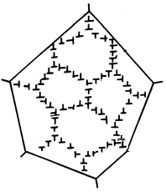
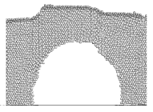
Examples of Crystalline defects
Punctual:
1D:
2D :
Vacancy
Edge dislocation
Surfaces, interfaces (GB)
Substitutional atom
Screw dislocation
3D :
Inclusions
Interstitial atom
Surface faceting
Voids
Dislocation cells
Notes:
Crystalline defects produce an elastic stress on the crystalline lattice. The highest the dimensionality, the highest the stress
En français :
Lacune
Interstitiel
Atome de substitution
Dislocations : coin ou vis
Facettage
Soufflure (vide)
Cellules de dislocations

Slide 20

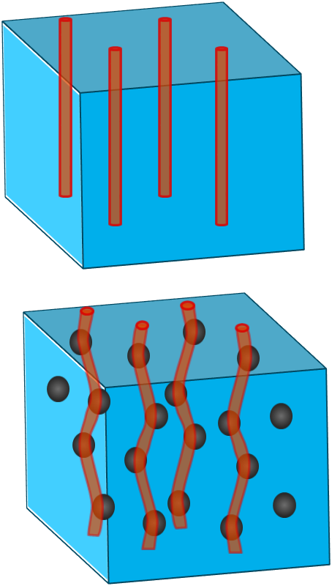
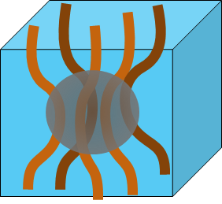
More details on pinning mechanisms
Matsushita : 4 mechanisms from the SC point of view
  A- Condensation energy variation (one saves condensation energy if ⱻ already a normal zone)
  B- Elastic interactions (bending of Vx + lattice elastic moduli in SC state < elastic Mod. In normal state, strong interaction with lattice elastic deformation due to crystalline defects-see below)
  C- Magnetic interaction (if defects >>λ, you can treat it like an interface: image vortex + surface barrier => very strong effect)
  D- Kinetic energy interaction (areas with ≠ξ => ≠ in Vx velocities ?)
IN BRIEF : local effects !!!! (=>2 fluids model not fully OK)
∃ 2 kinds of efficient pinning :
  Strong pinning (surface magnetic pinning) : twinning, voids, non SC aggregates, irradiation defects (columnar), nano-indentations : Dominant mechanism: A then C then D
  Weak pinning centers but many of them: «volume core pinning»
      Dominant mechanism: B ; B less efficient than C but if they are many pinning centers => results into strong pinning
      Mechanism B efficiency 3D → Interface (G.B) → dislocation → punctual defects
Notes:
if V pinning potential and ρ Vx density:
$E_{pinning}\sim \int{V\left(r\right)ρ\left(r\right)d^{3}r}$
Generally λ >a₀ (a₀ ~ ∅ pinning center)
So one can work with mean values over λ (continuum model/ Larkin volume)
Look at a movie on flux jumps : “Recent experiments on a type-II superconductor composed of Molybdenum-Germanium[5] revealed an interesting and unexplained effect: if a magnetic field is applied in a parallel direction with an external current, the superconductor shows a peculiar behavior upon increasing the field” :Visualization of superconducting vortices - YouTube

Slide 21

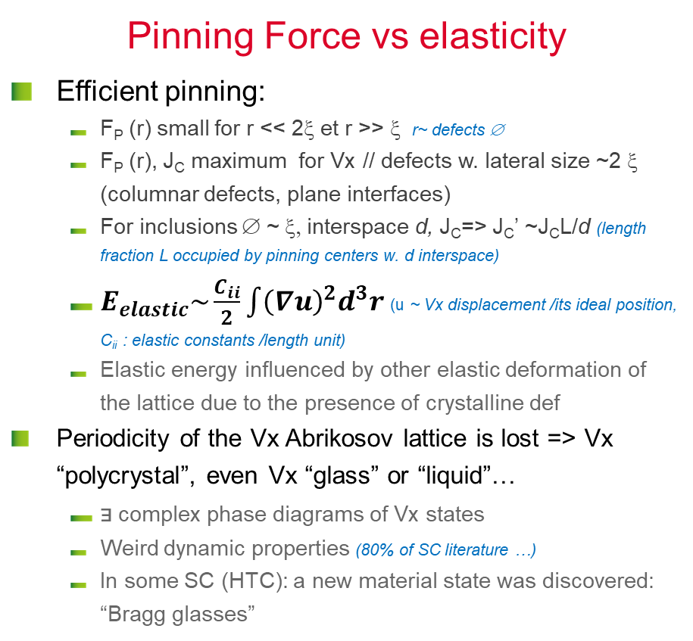
Forces at play
Pinning Force vs elasticity
  Efficient pinning:
      F_{P} (r) small for r << 2ξ et r >> ξ r~ defects ∅
      F_{P} (r), J_{C} maximum for Vx // defects w. lateral size ~2 ξ (columnar defects, plane interfaces)
      For inclusions ∅ ~ ξ, interspace d, J_{C}=> J_{C}’ ~J_{C}L/d (length fraction L occupied by pinning centers w. d interspace)
      $E_{elastic}\sim \frac{C_{ii}}{2}\int{{\left(∇u\right)}^{2}d^{3}r}$ (u ~ Vx displacement /its ideal position, C_{ii} : elastic constants /length unit)
      Elastic energy influenced by other elastic deformation of the lattice due to the presence of crystalline def
  Periodicity of the Vx Abrikosov lattice is lost => Vx “polycrystal”, even Vx “glass” or “liquid”…
      ⱻ complex phase diagrams of Vx states
      Weird dynamic properties (80% of SC literature …)
      In some SC (HTC): a new material state was discovered: “Bragg glasses”
F_{P}
Pinning Force
2ξ
r
Notes:
More efficient pinning : when defect are of the size of ξ (2ξ), and/or are separated by distances ~ ξ.
In general: if volume fraction f with aleatory defects w. ∅ a₀ :
Gain : Δg ~(H_{C}²µ₀/2)fπξ² per length u.. L, i.e. force F~ Δg/L ~(H_{C}²µ₀/2)fπξ²/L
J_{C} = f/Φ₀~(H_{C}²µ₀/2)fπξ (for L~ξ)
J_{C} = f/Φ₀~(H_{C}²µ₀/2)fπξ²/a₀ (for L~a₀) (ad minima, but in practice J_{C} is very difficult to predict)
$E_{elastic}\sim \frac{C_{ii}}{2}\int{{\left(∇u\right)}^{2}d^{3}r}$ (u ~ Vx displacement /its ideal position, C_{ii} : elastic constants /length unit)
Elastic energy influenced by other elastic deformation of the lattice due to the presence of crystalline def
𝐶₁₁ : compression ~ B²/µ₀
𝐶₄₄ : torsion ~ B²/µ₀
𝐶₆₆ : shear ~ BΦ₀/16pµ₀λ_{L}
Usually: 𝐶₄₄ >>𝐶₆₆

Slide 22
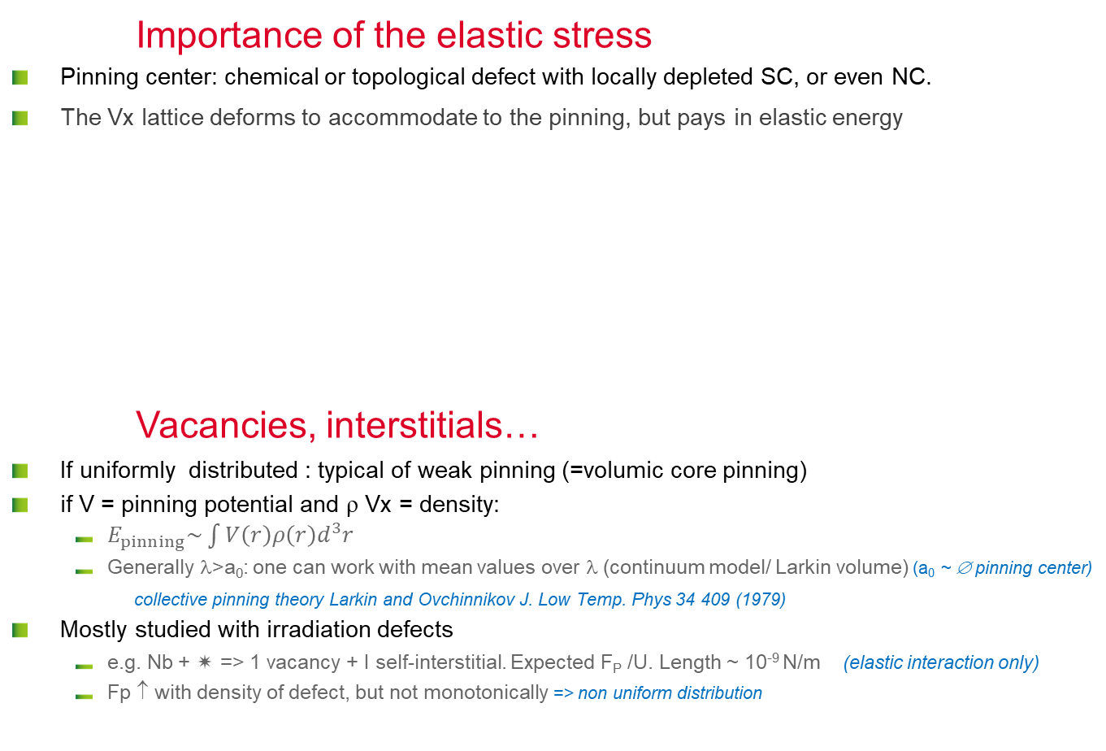
Effect of defects
Importance of the elastic stress
  Pinning center: chemical or topological defect with locally depleted SC, or even NC.
  The Vx lattice deforms to accommodate to the pinning, but pays in elastic energy
Vacancies, interstitials…
  If uniformly distributed : typical of weak pinning (=volumic core pinning)
  if V = pinning potential and ρ Vx = density:
      $E_{pinning}\sim \int{V\left(r\right)ρ\left(r\right)d^{3}r}$
      Generally λ>a₀: one can work with mean values over λ (continuum model/ Larkin volume) (a₀ ~ ∅ pinning center)
      collective pinning theory Larkin and Ovchinnikov J. Low Temp. Phys 34 409 (1979)
  Mostly studied with irradiation defects
      e.g. Nb +  => 1 vacancy + I self-interstitial. Expected F_{P} /U. Length ~ 10⁻⁹ N/m (elastic interaction only)
      Fp ↑ with density of defect, but not monotonically => non uniform distribution
.
⊥
⊥
⊥
°
⊥
⊥
Plays on SC parameters: l, κ...
3D
2D
1D
0D
Strain on the crystalline lattice
Interfaces (oxide layer, inclusions) > GB >⊥ cells > ⊥(=dislocations) > vacancies or interstitials
Notes:
Elastic interaction and segregation:
Atmosphere example : air molecules are free, but atmosphere = denser @ sea level (interaction with gravity)
Same with H @ T >150 K => “Cottrell clouds” of H atoms around dislocations !!!
Elastic strain also affects SC and pinning !!!
Note that defects liable to be efficient pinning center are also liable to help premature Vx nucleation when located at the surface

Slide 23
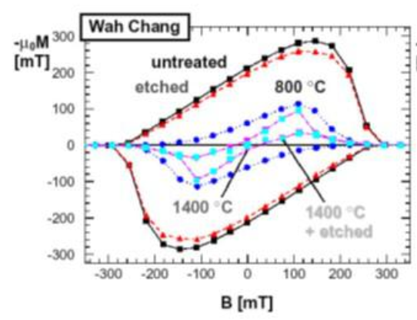
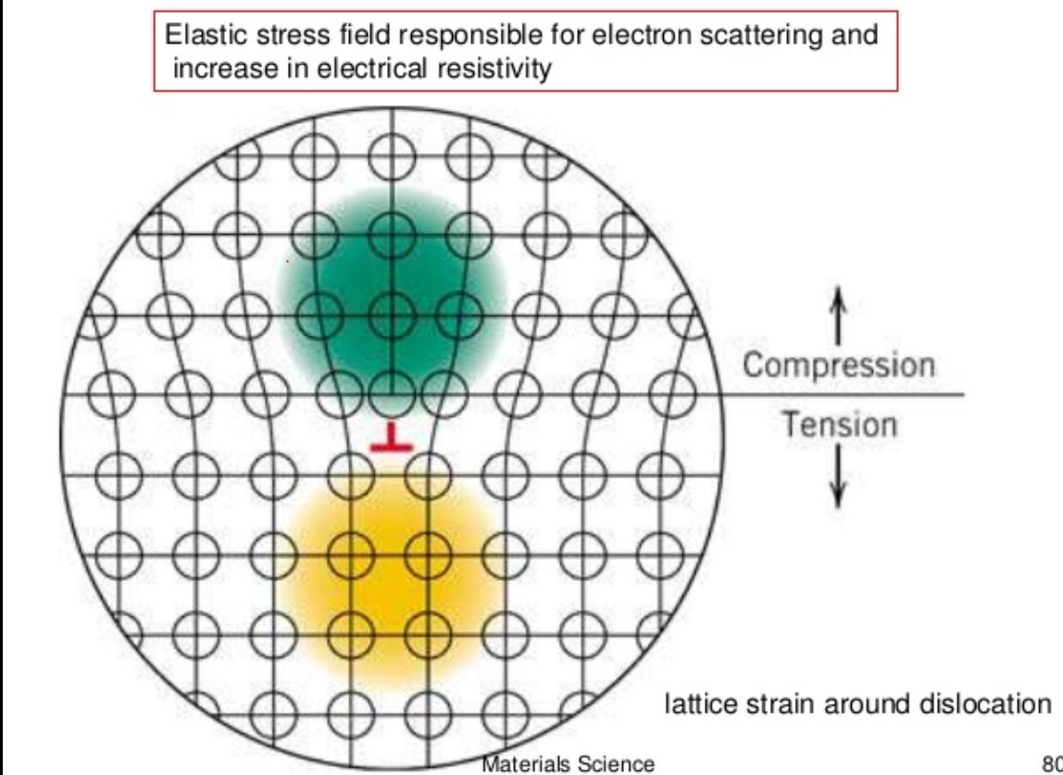
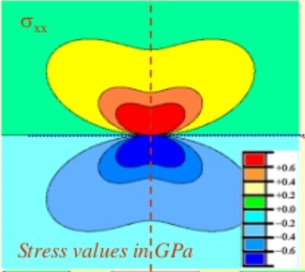

Individual Dislocations
[Bahte et al PAC 98]
  Source of the hysteresis in DC magnetometry
  Local elastic distortion of the lattice
+ 1 GPa
  Dominant mechanism 1! Disloc = B (effect < GB)
  but…
0
- 1 GPa
Stress map around an edge dislocation
http://www.slideshare.net/vamsikrishna393950/stress-fields-around-dislocation/
[Narlikar A, Dew‐Hughes D 1964 #1542]
  They are many dislocation inside Nb, even if well recrystallized
  Non linear behavior => Dislocation repartition is not uniform (not 1D anymore)
Nb | F_{P}/unit lenth or vol
1 ⊥ (H//) | ~10⁻⁶ N/m
5% deformed ~ 10⁸-10⁹ ⊥. cm⁻² | 2-5.10⁻⁵ N/m³
Notes:
See also Ulmaier # 1549. ΔY/Y (relative elasticity difference between SC and NC state depends on:
# defects=Z in volume ξ^3 (Z = nξ^3)
Y/Y  when ℓ and ξ
https://en.wikipedia.org/wiki/Dislocation :
The interface between a metal and an oxide can greatly increase the number of dislocations created. The oxide layer puts the surface of the metal in tension because the oxygen atoms squeeze into the lattice, and the oxygen atoms are under compression. This greatly increases the stress on the surface of the metal and consequently the amount of dislocations formed at the surface. The increased amount of stress on the surface steps results in an increase in dislocations.
In single crystals, the majority of dislocations are formed at the surface. The dislocation density 200 micrometres into the surface of a material has been shown to be six times higher than the density in the bulk
After chemical etching, small pits are formed where the etching solution preferentially attacks the sample surface around the dislocations intercepting this surface, due to the more highly strained state of the material . Thus, the image features indicate points at which dislocations intercept the sample surface. In this way, dislocations in silicon, for example, can be observed indirectly using an interference microscope. Crystal orientation can be determined by the shape of the etch pits associated with the dislocations
forêts de dislocations : = ? shrub, hedge, wild, bramble, branch, shrubbery, thicket, plant, forest ?

Slide 24




dislocation CELLS in Nb
  Dislocations gather in “cells” (as soon as 3-5% strain)
  Stress on dislocation pill-up = stress on 1! Disloc^{n} x 20 !!!
  => 2D defects, analogous to G.B. (ⱻ many more dislocations than GB)
  Expend over a distance larger than G.B. (~ to ξ,=> stronger pinning)
Etching figures revealing dislocation arrays on as received Nb sheet after light etch
Monocrystal, RRR = 5000
[Narlikar, 1964, #1542]
  « Bitter decoration » (Abrikosov lattice visualization)
      In well recrystallized: Abrikosov Lattice everywhere
      In deformed Nb: Abrikosov Lattice only in the core of D. cells, but all Vx close to dislocations cells are attracted and pinned there )
[Herring, 1974, #1544]
Notes:
Typically, for Nb the pinning force per unit length F_{p} is about 2.10⁻⁶ N/m for an isolated dislocation (to be compared to 9.1 10⁻⁴ N/m for a normal conducting precipitate [31]).
They are many more dislocations than grain boundaries in typical Nb used for SRF applications. Moreover, most of the time, dislocations are gathered into dislocation cells where dislocations tangle and pill up into “walls” with high stress concentration and high stress gradients whereas the inner cell are nearly defect less. For heavily deformed material they prefigure future grain or sub-grain boundaries that will appear upon recrystallization. Those dislocation cells are clearly 2D defects similar to GB, rather than 1D. Dislocation structure becomes non uniform in Nb for very small amounts of deformation (3-5 %, equivalent to a density of dislocation ~10⁸-10⁹ cm²) [30]. In heavily deformed metals dislocation density can reach 10¹¹-10¹² cm², but even a very carefully recrystallized material still hold dislocations even at temperatures close to the melting point.
[Antoine, C. Z. (2019). "Influence of crystalline structure on rf dissipation in superconducting niobium." Physical Review Accelerators and Beams 22(3): 034801. ]

Slide 25

Surface/interface PINNING (II)
Surfaces/Interfaces : NC precipitate
  “Image” vortices formalism (J⊥ = 0)
      Supercurrent tends to push Vx inside
      Image antivortex tends to pull it out
  Condensation energy savings => Strong pinning centers
      NC precipitates can trap several vortices
Surfaces/Interfaces :
Grain boundaries
  Disordered area over n atomic distances => local SC parameter affected
  Compare with ξ
      HTC SC : for some orientations n is ~10 (~3 nm) and ξ_{AB} ~ 2 nm => strong pinning
      Nb : n ~2-3 (~<1 nm) and ξ ~ 40 nm => weak pinning
https://areeweb.polito.it/ricerca/superconductivity/melt.htm
YBCO
3.6 nm
Material | F_{P}/unit length
Nb (H// GB) | 7.10⁻⁶ N/m
Nb₃Sn | 6.10⁻⁵-10⁻⁴ N/m
MgB₂ | 4.10⁻⁴ N/m
Notes:
Usually it is considered that grain boundary pinning is a well known fact. Once again, it is because for decades, the superconductors developed for applications were essentially “dirty type II”, i.e. with a very small ξ. In high TC SC the grain boundaries are considered as “weak links” since they transit first and might hinder the propagation of the current. It is not the case for Nb used in SRF.
Once again one observes that a small amount of defects might be desirable as pinning centers while too much is detrimental. Optimizing the material is ttrying to get a given population of defects in the material while minimizing the others. Material scientist know how to do that (more or less, it takes time).

Slide 26






Surface/interface PINNING (I)
Surfaces/Interfaces : strong pinning
  Boundary conditions : ${\vec{J}}_{S}×\vec{n}$=$\vec{0}$ (J⊥ = 0)
  => Vx always exit ⊥ to the surface
  Equilibrium : pinning force = elastic force (line tension) If the Vx is curved , its length ↑ and thus the elastic return force also ↑ . Equilibrium => pinning force also increases as a consequence.
  Macro. scale : Vx must curve to satisfy B.C. (Vx is ⊥ to surface).
  Micro. scale : strong surface state influence
$$\vec{H}$$
  SC sphere
θ cr
n
http://journals.aps.org/prb/abstract/10.1103/PhysRevB.69.224504
$$\vec{H}$$
$${\vec{J}}_{S}$$
$I_{S}$ ~ M(B, T) sinθ
IC can increase with increasing surface roughness (=> thin films applications!!!)
Roughness scale in concern depends on the applied field (µm at low H, nm at high H !)
Notes:
Plays a huge role in thin films and tapes.
SC tapes : artificial pinning centers developed by implementing holes (µm/nm) in the tape

Slide 27

Importance of pinning
Magnets :
  Pinning efficiency drives Jc (and R=0)
  Whenever possible, pinning features are amplified
      Modification of the mean free path: impurities, deformation, alloying
      Artificial pinning : voids, inclusions, topological defects
SRF cavities:
  No pinning at high frequency but…
  If they are pinning centers in the material:
      They can prevent flux lines from being expelled during cooldown (trapped flux lines => oscillating Vx within ~λ)
      => hot spots ! (Vx move in RF field => dissipation)
λ
Notes:
(2) (PDF) Materials design for artificial pinning centres in Superconductor PLD coated conductors (researchgate.net)

Slide 28
next:
Part III : optimization of SC material

Slide 29

Most common superconductors
Material | T_{C} (K) | ρ_{n} (µΩcm) | µ₀H_{C1} (mT)* | µ₀H_{C2} (mT)* | µ₀H_{C} (mT)* | µ₀H_{SH} (mT)* | λ_{L} (nm)* | ξ₀ (nm)* | Type
Pb | 7,1 |  | n.a. | n.a. | 80 |  | 48 |  | I
Nb | 9,22 | 2 | 190 | 400 | 200 | 219 | 40 | 38 | II
NbN | 17,1 | 70 | 20 | 15 000 | 230 | 214 | 200-350 | < 5 | II
NbTi |  |  | 4-13 | >11 000 | 100-200 | 80-160 | 210-420 | 5,4
NbTiN | 17,3 | 35 | 30 |  |  |  | 150-200 | < 5 | II
2H-NbSe₂ | 7,1 | 68 | 13 | 2680- 15000 | 120 | 95 | 100-160 | 8-10 | II- 2gaps
Nb₃Sn | 18,3 | 20 | 50 | 30 000 | 540 | 425 | 80-100 | < 5 | II
Mo₃Re | 15 |  | 30 | 3 500 | 430 | 170 | 140 |  | II
MgB₂ | 39 |  | 30 | 3 500 | 430 | 170 | 140 | 10 | II- 2gaps
YBCO/Cuprates | 93 |  | 10 | 100 000 | 1400 | 1050 | 150 | < 3 | II d-wave
Pnictures Ba_{0.6}K_{0.4}Fe₂As₂ | 38 |  |  |  | 900 | 756 | 200 |  | II s-wave
* @ 0K
Notes:
Higher T_{C} => higher operating temperature (or higher performance at the same T) => reducing cryogenic costs
Magnets : other important parameter is Jc, but it depends on material preparation => not intrinsic
Cavities : 2-Gaps : in RF one is always limited by the smallest.
Symmetry of the gap : related to the Brillouin diagram: Crystal structure is also related to Brillouin zones. So the relative orientation of the grains can influence the way Cooper pairs are scattered (via interface energy) => direct correlation between the theory and the material intrinsic quality (in particular existence of “weak links in HTC)
http://hoffman.physics.harvard.edu/materials/Cuprates.php :
s-wave superconductors have a superconducting gap which is isotropic in all directions, whereas dx²−y² superconductors have a superconducting gap which is anisotropic and is identically zero at four line nodes located at the diagonals of the Brillouin zone => always dissipative in RF

Slide 30
Magnets:
- conductors microscopic developments
- other elements important for design

Slide 31

NbTi : compromize between Jc and Tc
J_{C} Optimization
  Composition:
      H_{C2} optimum for 46-48% Ti (but not Tc)
  Thermal treatments:
      => Metallic Ti precipitates (OK in DC, danger in RF)
  Forming (wiredrawing):
      Final microstructure : defects @ the same scale as Vx lattice
I and wire axis
iconographic sources :
Larbalestier CAS 2013
http://fs.magnet.fsu.edu/~lee/asc/pdf_papers/8.pdf
http://fs.magnet.fsu.edu/~lee/pubs/pjlssctt.pdf
ε : deformation %
@ 5 T, 4 K
Notes:
As seen in part II : best pinning site is an normal, insulating or void region with dimension ~ ξ and // to the flux lines.
Non superconducting inclusions/voids : highest pinning force:
Saving in condensation energy is maximum:
Energy/length = 1/2μ₀H_{C2}πξ² ~10⁻¹¹ J/m
In DC supercurrent short circuit the normal areas, but too many pins result in Tc suppression and current blocking.
http://cas.web.cern.ch/sites/cas.web.cern.ch/files/lectures/erice-2013/apr253larbalestier.pdf
http://cas.web.cern.ch/sites/cas.web.cern.ch/files/lectures/erice-2013/apr255larbalestier.pdf

Slide 32


Digression : NbTi in SRF…
Tuning system : piston/plunger
  To keep the same frequency (as in music)
      This system is based on the mechanical deformation of a metallic membrane
      NbTi was chosen for mechanical reasons (more rigid than Nb)
      Important dissipation occurs a.s.a. E_{acc} ~ 1MV/m (goal > 10MV/m)
      Not predicted by thermal models:
        Field on the gasket ?
        Checked => no !
  Thermal simulation:
      Heat comes from the Nb/NbTi welding area
Ti
Ti precipitates (∅ ~0,4 µm)
NC Metal => RF dissipation !!!!
Nb
Notes:
Titanium also has the same ∅ as Nb, so @ low concentration:
Ti = substitutional impurity
No lattice distortion =>
No strong pinning behavior if no inclusion
Does not affect (much) Tc
Ti reacts preferentially w. O (getter) => affects oxygen diffusion
Ti diffuses preferentially at grain boundaries
Ti is not fully miscible inside Nb (Ti precipitates at low T when [Ti] > 5 W%) => no RF !!!
Precipitates affects strongly SC properties (H_{C1}, J_{C}, H_{C2})
NbTi alloys : harder than pure Nb (true for every alloys comp. to metals)
Useful as flange material
Rigidification if not exposed to RF

Slide 33


Nb₃Sn, MgB₂: too fragile for winding
  Nb₃Sn Fabrication : e.g. “bronze process”
      Nb rod are inserted in a bronze (Cu+Sn) matrix, then co-extrudes => thin Nb wire surrounded w. bronze.
      Forming/winding
      High temperature thermal treatment (problem: solving electrical insulation issues !?)
  MgB₂
http://iopscience.iop.org/article/10.1088/0953-2048/26/5/055008/pdf
http://iopscience.iop.org/article/10.1088/0953-2048/21/3/032001/fulltext/
Contrary to TiN : here grain boundaries ⊥ Jc
Not the same pinning law !
Jc 1/α ∅ grains
Pinning occurs on grain boundaries !
Nowadays : wires are commercially produced, then optimization of cables is done within projects (more details in P. Ferracin’s lecture)
Notes:
http://cas.web.cern.ch/sites/cas.web.cern.ch/files/lectures/erice-2013/apr291flukiger.pptx

Slide 34


HTS: anisotropy, weak links…
  MonoXt^{al} : Jc maximum for (a,b) planes and minimum when // c axis
      ξc<<ξa, ξb
  Realistic material : polycrystalline, ceramic, fragile…
      ξc ≤ disordered area at G.B => grains are decoupled (weak links)
      Jc when B//(a,b) >>Jc when B//c
      => try to introduce preferential orientation (epitaxy)
      => go to composite material: each layer has a role: epitaxy, mechanical strength…)
Current limitation when B↗ : either intragrain pinning either transition of some G.B. in the normal state (competition between 2 mechanisms)
IF B // (ab) : intrinsic pinning : flux line tend to place themselves in the insulating planes (very efficient mechanism !)
http://www.c4s.utcluj.ro/Coated%20Conductors.html
HTC still not much used , but challenges are gigantic (electrical engineering)
Notes:
NB : Bi-2212 is the only HTS SC allowing the fabrication of round wires, but important costs, poor mechanical stability;
Tape shape adds to design difficulty : one has top take into account the demagnetization factor and the fact that the field distribution might not be uniform on the tape itself, as well as collective effects due to the wiring scheme.
Recent Progress in Microwave HTS Technologies in Korea and Japan (springer.com)
Nb @ 2K , 10 GHz Rs~0,3 µΩ
Still 10³ better than HTC

Slide 35






Wire Size influence
Bean model for a thin slab/wire:
    Hyp. : @ H_{appl}> H_{P} : - M~cst ~1/2 H_{P} α J_{C}x a, can be extended to 3D, e.g. wire
    For a same H_{appl} current density is higher if ∅ is small
    Consequencies on the SC cable design:
M(H_{appl})
$\frac{1}{2}$H_{p}
H_{p}(α H_{C1})
H_{C2}
J=const.
Bean model
$− \frac{1}{2}$H_{p}
0
a
2a
Notes
J_{c} ↓ when H_{appl} ↗
Large ∅ favor instabilities (flux jumps, avalanches instead of progressive penetration)
Final performance depends on history in field, current, orientation compare to field…
J_{effectif} ↑↑

Slide 36














Cables Examples
Atlas cable
LHC Cable
ITER Cable
(CICC: cable in conduit conductor)
Nb₃Sn Filament
50 Hz developments

Slide 37
Cavities:
-thermal / superconductivity Compromise
- importance of surface state
-

Slide 38



State of the art SRF Nb
=> High purity (high RRR) well recrystallized bulk Nb, surface polished
  Surface resistance:
  Thermal conductivity:
4,5 K
Nb/Cu
Bulk Nb
(l ∝ RRR)
RRR: Residual Resistivity Ratio
RRR 30: commercial grade
RRR 300: SRF grade
High RRR not required for superconductivity
But for thermal stabilization of defects
[Koechlin, Bonin 1996]

Slide 39




Need for quasi perfect material on the surface !
  Clean room handling, High Pressure Rinsing (HPR)
      No dust particle, no scratch
      Lowers field emission risk
e- emitted by a field emitting sites disturb the beam
Dust particles, scratches: “antenna effect”, local electric field enhancement
Typically X 50 à 100
Notes:
Dust particles pill up along electrical field line => for an antenna that emits electrons, can eventually disappear (melting, vaporization + plasma = breakdown) or become welded forever (statistically:1chance /2) so do not put dust !
It takes ~10 GV/m to extract e- from a metallic wall by tunnel effect. Max E field in SC cavities ~<100 MV/m: local field is brought by β
Some scratches act the same way due to their fractal structure (tip on the tip model) :
NB at RTp°, the mechanism is different => breakdown mostly due to electromigration : https://www.sciencedirect.com/science/article/pii/S0168900212000678

Slide 40


Need for quasi perfect material UNDER the surface !
  Morphology => local field enhancement
  Damage => flux pinning, hot spots
  => Surface treatments, annealing …
To be avoided in SRF !
Polycrystalline Niobium, smooth and well recrystallized material
Damage layer contamination, roughness
  After fabrication: need to remove 150-200µm on cavity’s surface
      Chemical polishing (BCP) ~ 1 µm/min
      Electropolishing (EP) ~ 0.3 µm/min
  Basically
      You oxidize Nb⁰ => Nb⁵⁺ (Nb₂O₅)
      You dissolve it with HF (NbF₅)
  EP : ∃ Viscous layer
      “Spikes” are etched first
      Smoothing effect : grain edges are less sharp, even if some roughness is retained
Even after best surface treatments they are still a lot of defects at the µm and nm level that have a strong influence on SC properties but are difficult to include in models…
Notes:
Cavities surface preparation is a critical step for the fabrication of accelerators based on SRF. After forming the material, one has to remove the damage layer and residual strain, while producing a surface as smooth as possible. This is done with special surface polishing and heat treatments, in particular recrystallization annealing (800C, 2h or 650 C, 8-10 h). For the recall : well recrystallized material => good phonon propagation => plays on SC coupling

Slide 41

Taylored surface composition on Nb
λ
@ 1rst order:
  Modification of the surface composition:
    Adjusting superconducting properties
    Preserving bulk high thermal conductivity
Extra High Q₀: “N-Doping”, “Medium T baking”
Diffusion of N and/or O >>λ
Diminution of , thus Rs, but also Tc and H_{C1}
~ 85 mT
~ 170 mT
λ
Extra High E_{acc}: “N-infusion”, “Low T baking”
Diffusion of N and/or O << λ
Prevents Hydride nucleation?
λ
Tesla shape, 2K
After polishing
Natural oxide layer (5 nm)
Impurities (H (main), O, C…) segregation at Metal-oxide interface (see comments for mechanism)
Notes:
High Q₀ : applications => high duty cycle and CW machines
High E_{acc} : applications => colliders, long machines
Interface segregation :
Mechanism
Position of atoms is governed by
Atomic diffusion (Thermally affected phenomena, Fick’s law)
Elastic interaction with defects (adds a potential term)
AMVF says : Nb thin films also exhibit an antiQslope at low field and they do not have H inside…
Mainly due to elastic stress at the oxide-metal interface
Example for H in Nb
@ RT H is moving freely inside Nb (diffusion)
It is nevertheless submitted to elastic interaction
Compare with Air molecules : free to move (diffusion)
+ gravity => air density increases toward see level

Slide 42

Same thing with cavity real results
[Ito, SRF 2021]
Notes:
Very active field in the SRF community (see e.g. SRF 2021)
Main difference between O and N at first order is their rate of diffusion
With various (T, t) recipes (in presence of N or not) diffusion profiles vary => adjustment of surface superconductivity
O vs N
~ same effect on conductivity, Tc
~ same distortion on the lattice (interstitial Oh sites)
Both interact w. H and/or vacancies and/or dislocations
Differences ?
Oxygen = main impurity in Nb
Oxygen diffuses ~x100 faster than N at a given T (~x 300 for C)
Oxide layer is thinner in presence of N (N blocks diffusion of O and H)
Pauling electronegativity: C=2,55; N=3,04; O=3,44; F=3,98 (NB no data on Fluor diffusion in literature, but certainly present @ surface)
Atomic radius in pm: C= 67; N= 56; O= 48; F= 42 (NB some indication that C not stable in time => forms carbides)
Effective charge  from O to C to N (electromigration data @ high temperature)
Other elements : Ar = non miscible inside Nb ; Ti => rather substitutional atom (but also interacts w.O) ; C => rather forms carbides (but not excluded)
Issues : weak pinning behavior and flux trapping risks !!!
1^{rst} Nb shell
2nd
3rd
4th…

Slide 43

Thin films
  Nb : λ~50 nm => only a few 100s nm of SC necessary
  (the remaining thickness= mechanical support, thermal transfer)
  => Make thin films (1-5 µm) !
  Advantages
    Thermal stability (substrate cavity = copper, Aluminum,… W)
    Cost
    Opens route to innovative materials
    Optimization of R_{BCS} possible (e.g. by playing with m.f.p)
  Disadvantages
    Fabrication and surface preparation of substrate (at least) as difficult as for bulk Nb
    Steep Q₀ decrease often observed by increase of RF field (sputtered niobium films)
    Deposition of innovative materials is very difficult (large parameters space to be explored)
    Most of the known SC have been optimized for wire applications (low HC1, defects, pinning centers… ) => most of the literature recipes are not fitted for SRF application ☹ ☹ ☹
  Recent breakthrough :
    CERN, Jlab were able to produce Nb film with nearly bulk-like behavior (50 Y. of R&D!)*
    Improved substrate preparation + higher energy deposition techniques
    * one switches from metallurgy (6000 y. old) to thin film technologies (< 1 century !)
Notes:
Possible origin of the Q-slope on Nb Sputtered cavities
Depinning of trapped flux
Low H_{C1}
Early vortex penetration due to roughness
Current concentration due to porosities (generating local electrical field)
Line of sight issues => porosities
[G. Rozas]
Internal stress
Advantage: higher Tc (up to a certain impurity concentration)
Disadvantage: adhesion issues (peeling)
High impurities content
Nb = getter material (nearly as good as Ti => high interstitial content)
Carrier gas incorporation (Ar)

Slide 44


Higher Tc material
  Higher Tc materials, e.g. Nb₃Sn: brittle, poor thermal conductivity => go to films (on copper)
  Compounds: less easy to master than pure metals
H_{SH}^{Nb3Sn}
(~ 400 mT @ 0 K)
Nb H_{C1}
(170 à 200 mT)
Hays. "Measuring the RF critical field of Pb, Nb, NbSn". in SRF 97. 1997.
Nb₃Sn
Cornell, 1997
pulsed
=> We have to reduce defect density (yes but which ones?)
Recent results from Cornell CW (Posen, 2015 (17 MV/m))
$$Hi=Hi0\left.\left[1−( \frac{T}{Tc}\right.)^{2}\right]$$
H_{C1}^{Nb3Sn} (~27mT)
(50 mT pour le bulk)
~ 2 K
~ 4 K for Nb
  Vortices enter more easily at lower temperature (counter intuitive !)?
    @ T~T_{C} : H is low => low dissipations => easy to thermally stabilize
    à T<<T_{C} : H is high=> even if small defect => high dissipations => Favors flux jumps
Dissipations :
Notes:
Not all defects are harmful (see doping in Nb). Which one do we need to get rid of ?
Active R&D on this topic
See also
High Frequency Nb3Sn Cavities (cern.ch)
https://accelconf.web.cern.ch/srf2019/papers/mop011.pdf
H_{C1} Measured w. local magnetometry, compared to Hays results

Slide 45


Nb₃Sn Pioneer work: Wuppertal, Cornell
    Limited in E_{acc} , best results today ~20 MV/m
    Very high Q0
    Important developments: FNAL, JLAB, CERN, PKU….
[Lieppe, SRF 2013]
    @ 4,2 K: Q₀ x 20 compare to Nb,
    Applications : high duty cycle, CW (where cryogenic cost are predominant)

Slide 46










Multilayers SIS structures
Enhance Q₀ and E_{ACC} altogether
a)
b)
    Ideal (w/o defect)
    Real world
    (∃ defects on surface)
    Real world
    + dielectric nm layer
    Expected performance enhancement in cavities
    Dielectric barrier
    + SC w. higher T_{C}
    SIS thick Nb/MgO/NbN samples
    Deposited by MS
    Measured by local magnetometry
Notes:
phase transition diagrams in T² => straight lines
theoretical case :transition from Meissner to mixed state at HC1 in perpendicular field, and hopefully, in parallel field case, at the superheating field, because it is very difficult to nucleate a vortex // to the surface.
real life: there are defects on the surface, either morphologic or inclusions with a different composition. Here it is very easy to let a vortex loop enter.
At low temperature, the field is high, and even a small vortex loop will give rise to high dissipation, so inevitably the transition field goes down with field and at operating conditions one is closer from the low HC1 than the hoped high HSH.
One way to fight this is to put a small dielectric layer some 10 s of nm under the surface. The dielectric layer is transparent to RF but it blokes the propagation of vortex.
Now let’s assume that the surface layer is an higher TC material, with lower surface resistance, but probably a lot of defects. Thanks to the dielectric layer, one becomes less sensitive to defects, and one can maintain a high field with only slight dissipation. Moreover if the thickness is les than l, then for energetic reason it is more difficult to nucleate a Vx. It is a way to artificially enhance HC1.
So we gain on both hands : by depositing these multilayers one can hope to gain in accelerating field as well as in quality factor.

Slide 47
Tailored material for SRF
Native oxide
Unstable upon annealing
Protective Layer
e.g, diffusion barrier, and/or low secondary emission layer (↓ multipacting)
Today
RF side
Future ?
“RF” layer, Optimized for superconductivity:
Surface doped Nb
Thick films (Nb₃Sn, MgB₂…)
Multilayers SIS structures.
High purity Niobium Optimized only for thermal conduction
“Structural/thermal conducting” layer
Optimized for thermal transfer (high RRR, high m,f,p.), not necessarily Nb (copper, aluminum)
Native oxide
Not optimized for thermal transfer
Helium side
“External” layer
Optimized for thermal transfer (low Kapitza resistance, e,g, anodization)
At stakes :
Cooling power (any application!)
Can we go to cryocooling ?
For more details on advanced materials, see SRF2021 tutorial:
https://indico.frib.msu.edu/event/38/attachments/159/1143/SRF2021_Tutorial_-_Antoine.pdf
Notes:
http://cas.web.cern.ch/sites/cas.web.cern.ch/files/lectures/erice-2013/apr291flukiger.pptx

Slide 48
Conclusion

Slide 49
Conclusion
All advanced technology are limited by material issues
  Once the technology is mastered :
      Reproducibility issues (lab => large scale production)
      Production costs
      Aging problems
      Not only true for accelerator technology ! (materials for fusion, nuclear power, fuel cells, solar cells , batteries….)
      Particularly true when a technology is pushed to its ultimate limits (e.g. accelerators)
  Advanced technology project: always a compromise between multiples constraints : mechanical, thermal, stability, superconductivity, costs…
      Interdisciplinary work mandatory ! (multiple and complementary expertise's are necessary)
      Do not re-invent the wheel (also meet experts outside the accelerators community !)
      Be prepared to meet diagnostics issues (Where does the breakdown comes from when many conjugate factors occurs together ? => Diagnostic development)
      Allow yourself to break traditions (but not too often because it costs money…)

Slide 50
spares

Slide 51
Dammage and SRF performances
Reproducibility
Main issue on large scale production
Main issue for lab to lab « recipe » transfer
Flux trapping sensitivity
Damage texture
Resistant to recrystallization
Reproducibility
issues
Hot spots:
High dislocation density !
Pinning centers !
Vortex oscillating in RF ?
Trapped or premature entrance ?
Hydride precipitates
Apparition of hot spots
Baking/Doping Interstitials density
Interstitials diffusion = non uniform when dislocations cells
Affects mean free path !
Affects size of hydride pcp^{tates} !
Affects sensitivity to trapped flux !
  Reduce trapped flux due to hydrides
  Higher sensitivity to trapped flux at high concentration
Optimum distribution is yet to be found !
Larger hydrides:
Premature quench (Q-disease)
Strong pinning centers (flux trapping)
H diffusion slowed by O/N interstitials

Slide 52



Consequencies of GB/grain size
  Depinning frequency
  Theory: see e,g, Palmieri TFSRF 2010
  Measurement of complex (/effective) penetration depth: λ_{AC} = λ’ + iλ’’
      Typically used to determine pinning force in SC cables
http://fr.slideshare.net/thinfilmsworkshop/palmieri-rf-losses-trapped-flux
Easy to measure:
’’
$ℓ_{b}$
      $φ_{ac}=\int{b_{ac} dS \sim 2λ_{ac}ℓ_{b}b_{0}}$
      At low frequency : λ’~ δ_{RF} (δ_{RF}= penetration depth in normal state)
      At high frequency λ’ ~ λ’’ ~ λ_{L}<< δ_{RF}
Electrodynamics of the vortex lattice in untwinned YBaCuO by complex impedance measurements Pautrat 2003
Notes:
ω_{P} : depinning frequency
If pinning is increased, ω_{P} goes to higher frequency => this technique can be used to compare preparations/surface treatments and propensity to trap flux
At low temperature or frequency: vortex are pinned on the materials defect (always !).
Since field lines inside Vx go deep in the material the penetration depth λ’ is equivalent to the normal conducting penetration depth.
By nature, materials are full of defects; only some solid state physicists dare imagining “perfect materials”, otherwise, calculations would be too complex ☺!
Same behavior if one put T in place of ω: one needs energy to “depin” a vortex.
pautrat’s paper : https://arxiv.org/pdf/cond-mat/0304488.pdf

Slide 53

sensitivity to trapped magnetic flux/depinning frequency
Pinning is very efficient for bulk but not for thin films Nb in the 100 Mhz-1 Ghz range
Thin films Nb
Depends on quality, can reach some 10 GHz; e.g. here 26 GHz,
Lütke-Entrup et al
http://arxiv.org/pdf/cond-mat/9705017.pdf
Bulk monoX Nb: 10 kHz
Gittleman et al
http://scitation.aip.org/content/aip/journal/jap/39/6/10.1063/1.1656632
See also
D. Janjušević et al
http://journals.aps.org/prb/abstract/10.1103/PhysRevB.74.104501
S. Hall
http://arxiv.org/abs/1507.04105
  High depinning frequency: measured on various SC, various film deposition technique, but can vary with quality of the films.
  e.g.: measurements from Glitterman on Nb₃Sn : ω₀ ~300 GHz!!!
  All thin films show low sensitivity to trapped magnetic flux: because all the flux is efficiently trapped !!!
Notes:
10 kHz is for extremely well recrystallized Nb (RRR ~ 5000)
Mattia Checchin found for SRF Nb https://aip.scitation.org/doi/10.1063/1.5016525 :

Slide 54
Sensitivity to trapped flux is related to pinning
Observations
  100% trapped flux on Nb samples /cavities (cf C. Vallet PhD + recent work)
  Sensitivity to trapped flux of bulk Nb varies
      From lab to lab (≠ measurement geometries, shielding, environment ???)
      From supplier to supplier (cf LCLS @ FNAL proto ≠ series)
      From sheet to sheet (recrystallization varies from batch to batch, and even in the same batch if the Tp° in furnace is not perfectly uniform)
  Highest sensitivity for:
      N doped cavities
      Nb₃Sn
  Lowest sensitivity for:
      Thin film Nb (at least at low field)
Comparative measurements of niobium sheet and sputter coated cavities
Arnold Mayer & Weingarten 1987
(here measured field is not RF field, but external field)
Notes:
Thin film cavities have a small mean free path, with a high depinning frequency. They are probably insensitive to external magnetic field because all the flux lines keep trapped and do not dissipate.

