Slide 1
Cryogenics for superconducting devices
Philippe Lebrun
JUAS Course 2
25 February 2025

Slide 2
Contents
Introduction: cryogens & superconductors
Cryogenic fluids and materials
Refrigeration & liquefaction
Heat transfer & thermal insulation
Thermal screening with cold vapour
References

Slide 3
Characteristic temperatures of cryogens
Cryogen | Triple point [K] | Normal boiling point [K] | Critical point [K]
Methane | 90.7 | 111.6 | 190.5
Oxygen | 54.4 | 90.2 | 154.6
Argon | 83.8 | 87.3 | 150.9
Nitrogen | 63.1 | 77.3 | 126.2
Neon | 24.6 | 27.1 | 44.4
Hydrogen | 13.8 | 20.4 | 33.2
Helium | 2.2 (*) | 4.2 | 5.2
(*): λ Point

Slide 4
Useful range of liquid cryogens
& critical temperature of superconductors
Nb₃Sn
Nb-Ti
Mg B₂
YBCO
Bi-2223

Slide 5
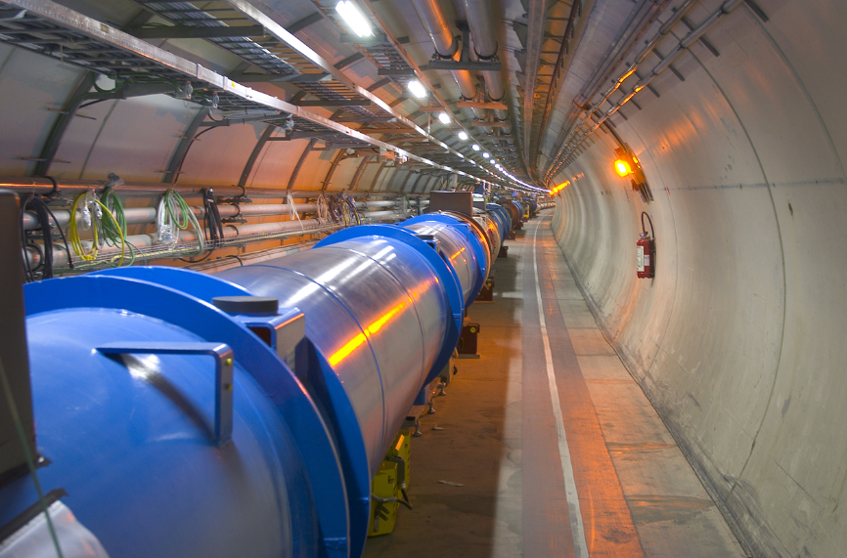
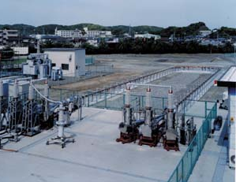
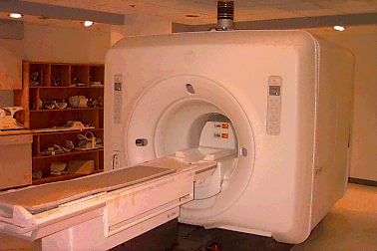
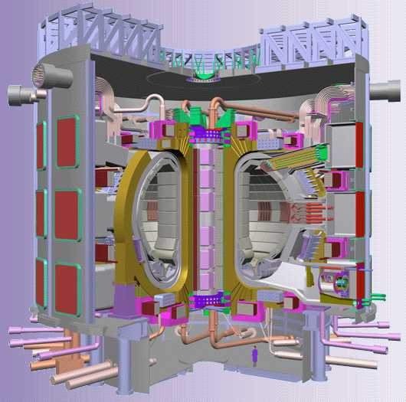
Cooling of superconducting devices
LHe 1.9 K
LIN ~70 K
SCHe 4.5 K
LHe 4.2 K

Slide 6
Contents
Introduction: cryogens & superconductors
Cryogenic fluids and materials
Refrigeration & liquefaction
Heat transfer & thermal insulation
Thermal screening with cold vapour
References

Slide 7
Properties of cryogens compared to water
Property |  | He | N₂ |  | H₂O
Normal boiling point | [K] | 4.2 | 77 |  | 373
Critical temperature | [K] | 5.2 | 126 |  | 647
Critical pressure | [bar] | 2.3 | 34 |  | 221
Liq./Vap. density (*) |  | 7.4 | 175 |  | 1600
Heat of vaporization (*) | [J.g⁻¹] | 20.4 | 199 |  | 2260
Liquid viscosity (*) | [μPl] | 3.3 | 152 |  | 278
(*) at normal boiling point

Slide 8
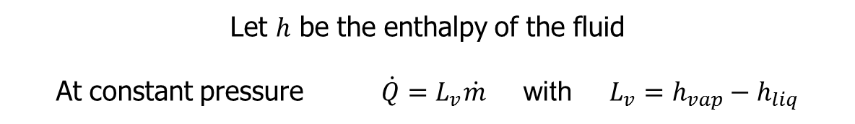
Vaporization of normal boiling cryogens under 1 W applied heat load
Let $h$ be the enthalpy of the fluid
At constant pressure $\dot{Q}=L_{v}\dot{m}$ with $L_{v}=h_{vap}−h_{liq}$
Cryogen | [mg.s⁻¹] | [l.h⁻¹] (liquid) | [l.min⁻¹] (gas NTP)
Helium | 48 | 1.38 | 16.4
Nitrogen | 5 | 0.02 | 0.24

Slide 9
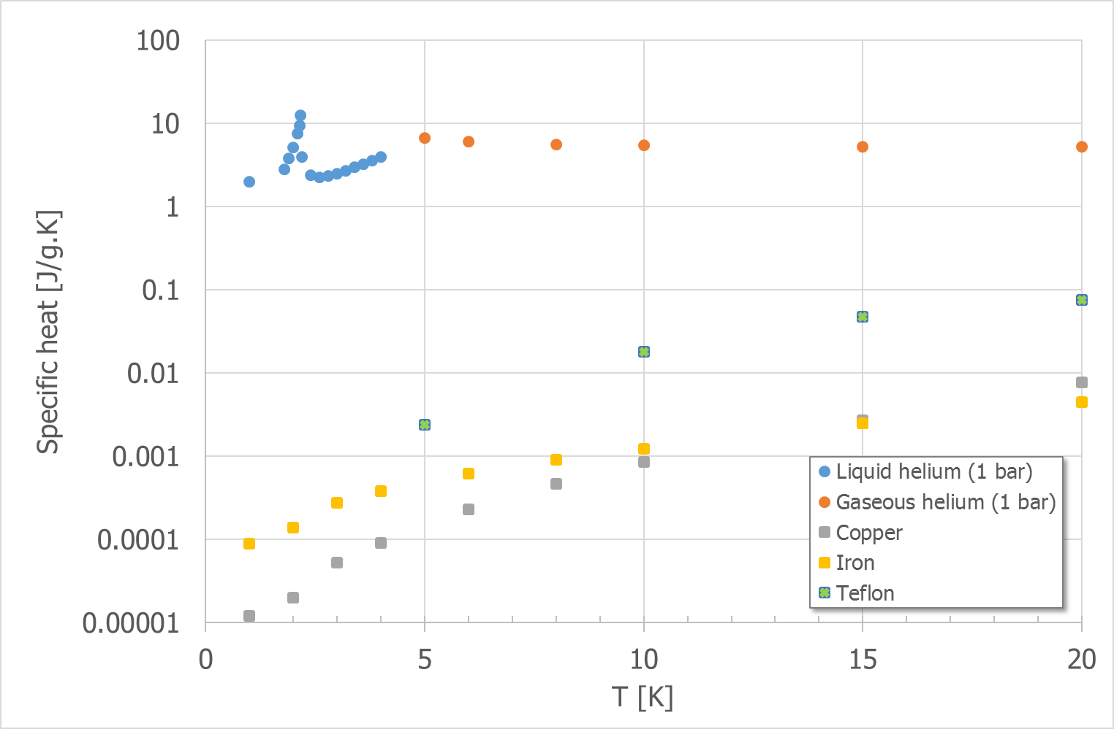
Specific heat of helium and materials
[up to 20 K]

Slide 10
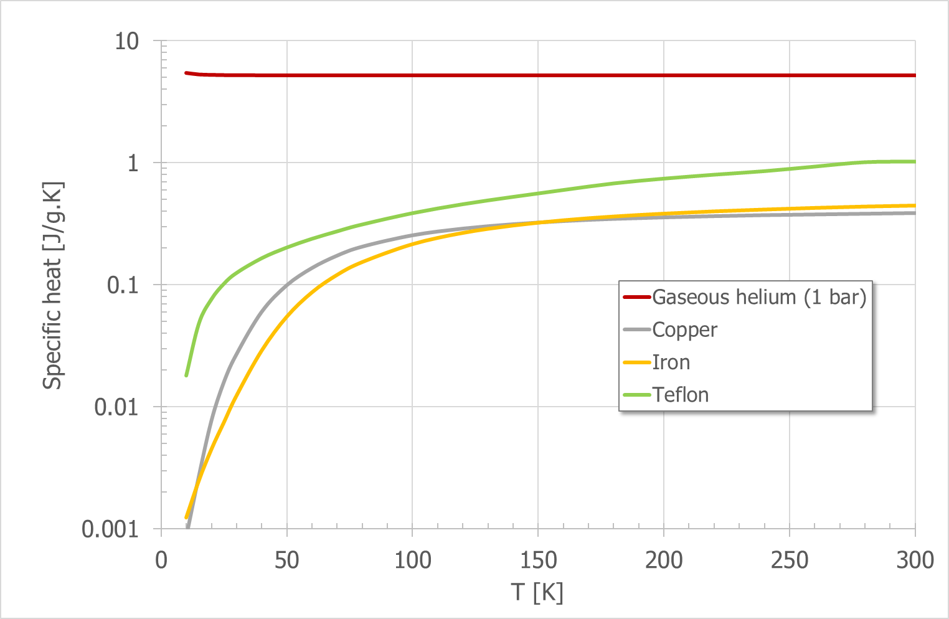
Specific heat of helium and materials
[up to 300 K]

Slide 11
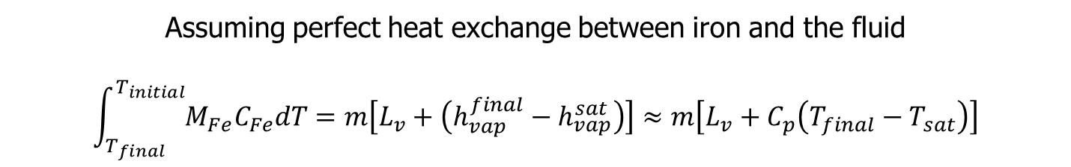
Amount of cryogens required to cool down 1 kg iron
Assuming perfect heat exchange between iron and the fluid
$$\int_{T_{final}}^{T_{initial}}{{M_{Fe}C}_{Fe}dT}=m\left[L_{v}+\left(h_{vap}^{final}−h_{vap}^{sat}\right)\right]≈m\left[L_{v}+C_{p}\left(T_{final}−T_{sat}\right)\right]$$
Using | Latent heat only | Latent heat and enthalpy of gas
LHe from 290 to 4.2 K | 29.5 litre | 0.75 litre
LHe from 77 to 4.2 K | 1.46 litre | 0.12 litre
LN2 from 290 to 77 K | 0.45 litre | 0.29 litre

Slide 12
Contents
Introduction: cryogens & superconductors
Cryogenic fluids and materials
Refrigeration & liquefaction
Heat transfer & thermal insulation
Thermal screening with cold vapour
References

Slide 13
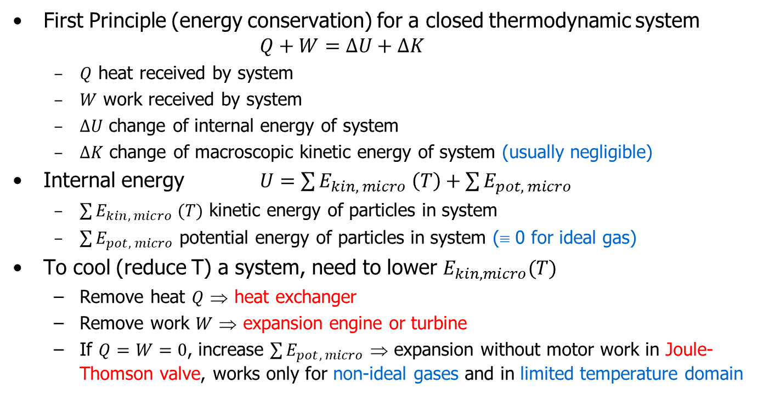
Basic thermodynamics of refrigeration
First Principle
First Principle (energy conservation) for a closed thermodynamic system $Q+W=∆U+∆K$
  $Q$ heat received by system
  $W$ work received by system
  $∆U$ change of internal energy of system
  $∆K$ change of macroscopic kinetic energy of system (usually negligible)
Internal energy $U=\sum{E_{kin, micro} \left(T\right)}+\sum{E_{pot, micro}}$
  $\sum{E_{kin, micro} (T)}$ kinetic energy of particles in system
  $\sum{E_{pot, micro}}$ potential energy of particles in system (≡ 0 for ideal gas)
To cool (reduce T) a system, need to lower $E_{kin, micro}(T)$
  Remove heat $Q$ ⇒ heat exchanger
  Remove work $W$ ⇒ expansion engine or turbine
  If $Q=W=0$, increase $\sum{E_{pot, micro}}$ ⇒ expansion without motor work in Joule-Thomson valve, works only for non-ideal gases and in limited temperature domain

Slide 14
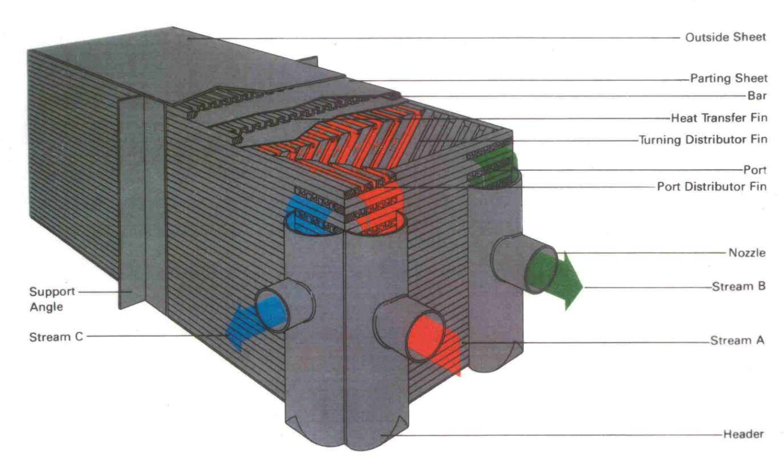
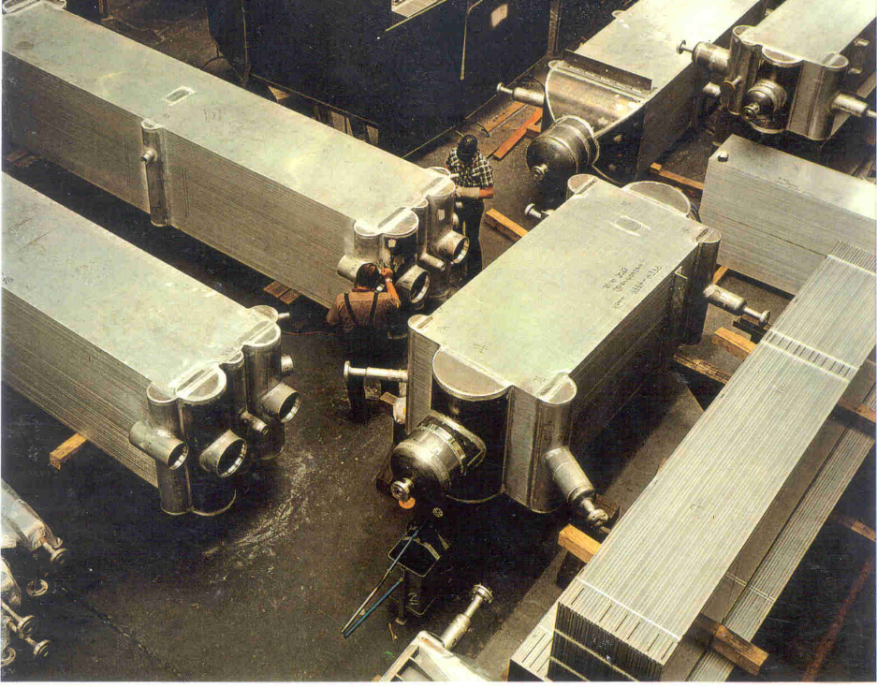
Brazed aluminium plate heat exchanger

Slide 15
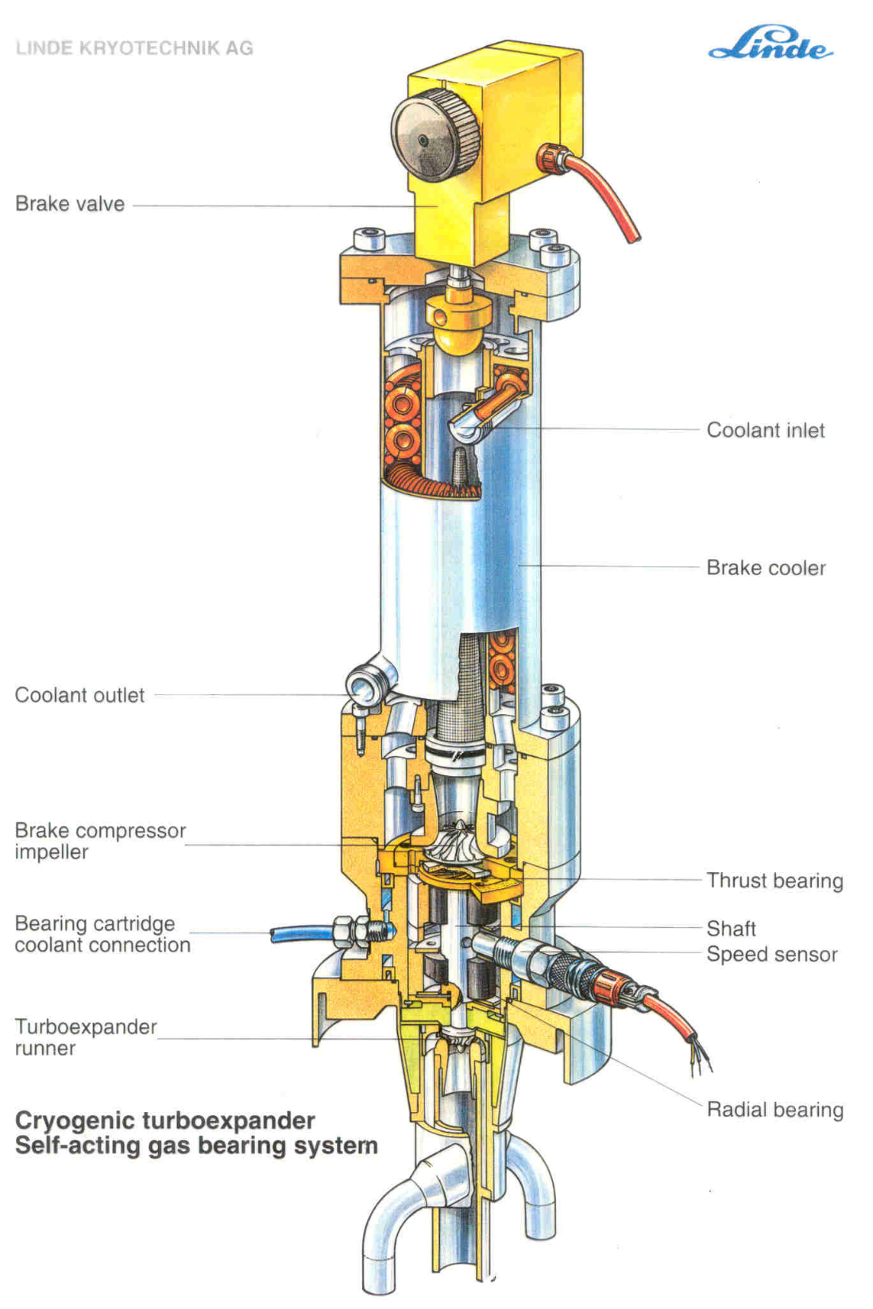
Cryogenic turbo-expander

Slide 16
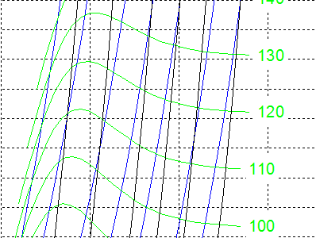
Joule-Thomson inversion temperatures
Isenthalps in T-S diagram can have positive or negative slope, i.e. isenthalpic expansion can produce warming or cooling
⇒ inversion temperature
Cryogen | Maximum inversion temperature [K]
Helium | 43
Hydrogen | 202
Neon | 260
Air | 603
Nitrogen | 623
Oxygen | 761
While air can be cooled down and liquefied by JT expansion from room temperature, helium and hydrogen need precooling down to below inversion temperature by heat exchange or work-extracting expansion (e.g. in turbines)

Slide 17
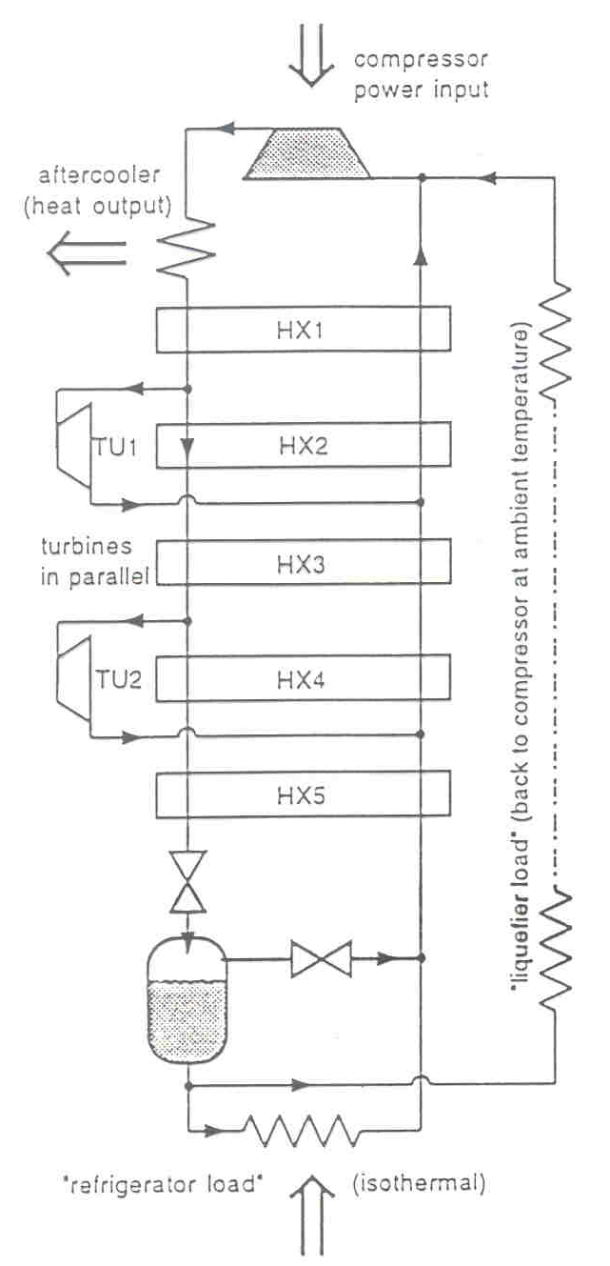
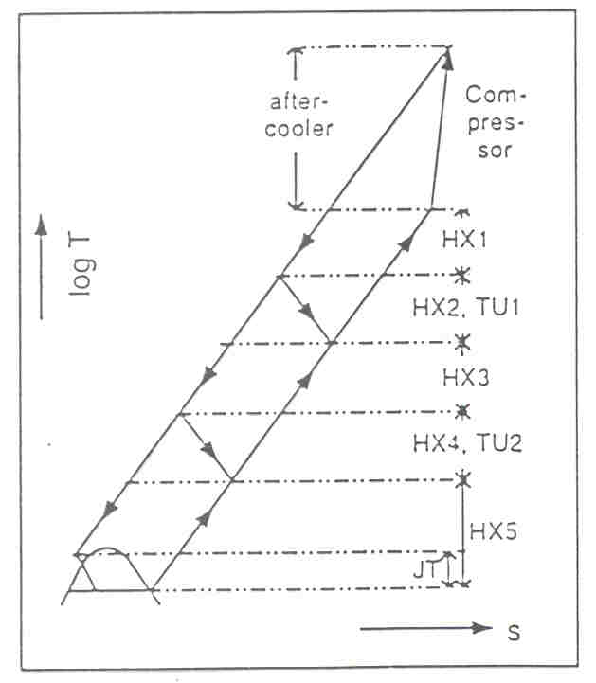
Two-stage Claude cycle

Slide 18
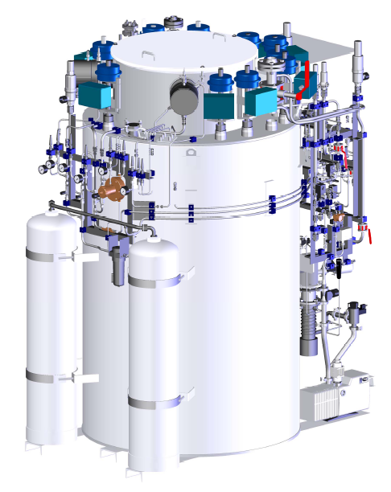
Claude-cycle helium refrigerators/liquefiers
Air Liquide & Linde

Slide 19
Process cycle & T-S diagram of LHC 18 kW @ 4.5 K cryoplant

Slide 20
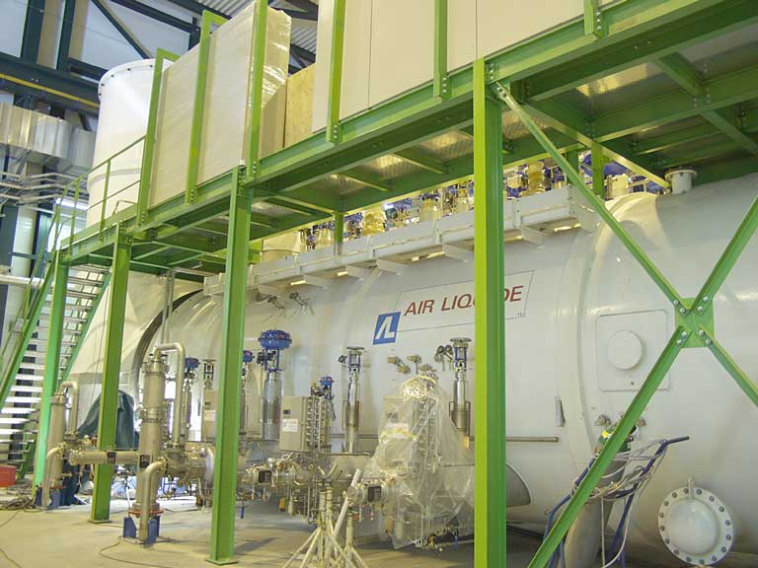
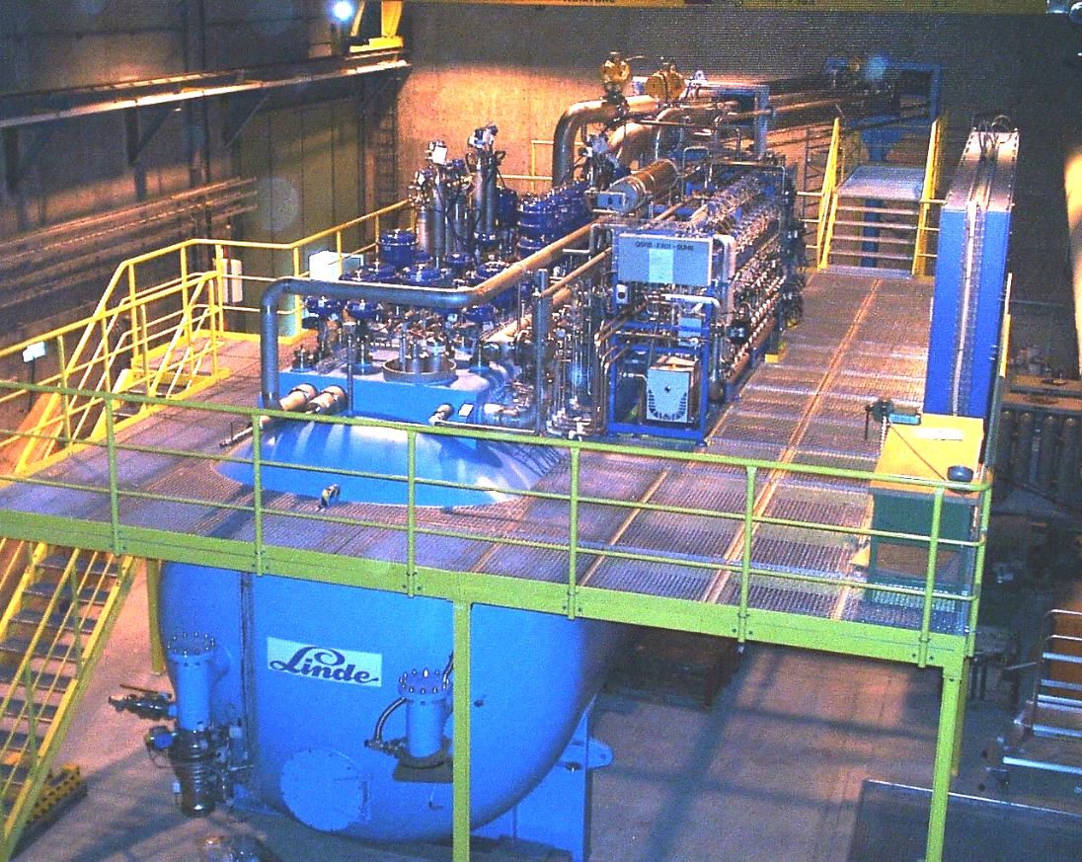
LHC 18 kW @ 4.5 K helium cryoplants
33 kW @ 50 K to 75 K
23 kW @ 4.6 K to 20 K
41 g/s liquefaction
4 MW compressor power
C.O.P. 220-230 W/W @ 4.5 K
Air Liquide
Linde

Slide 21
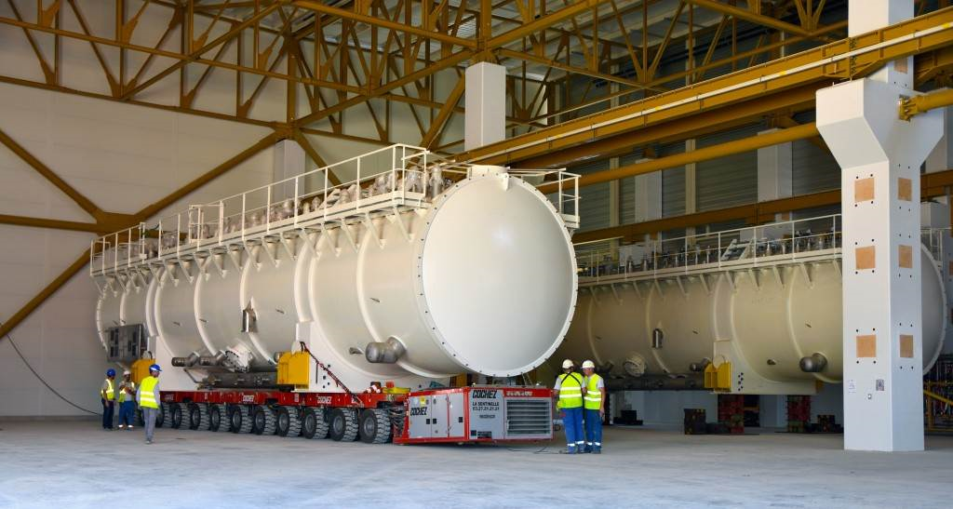
ITER 25 kW @ 4.5 K helium refrigerator

Slide 22
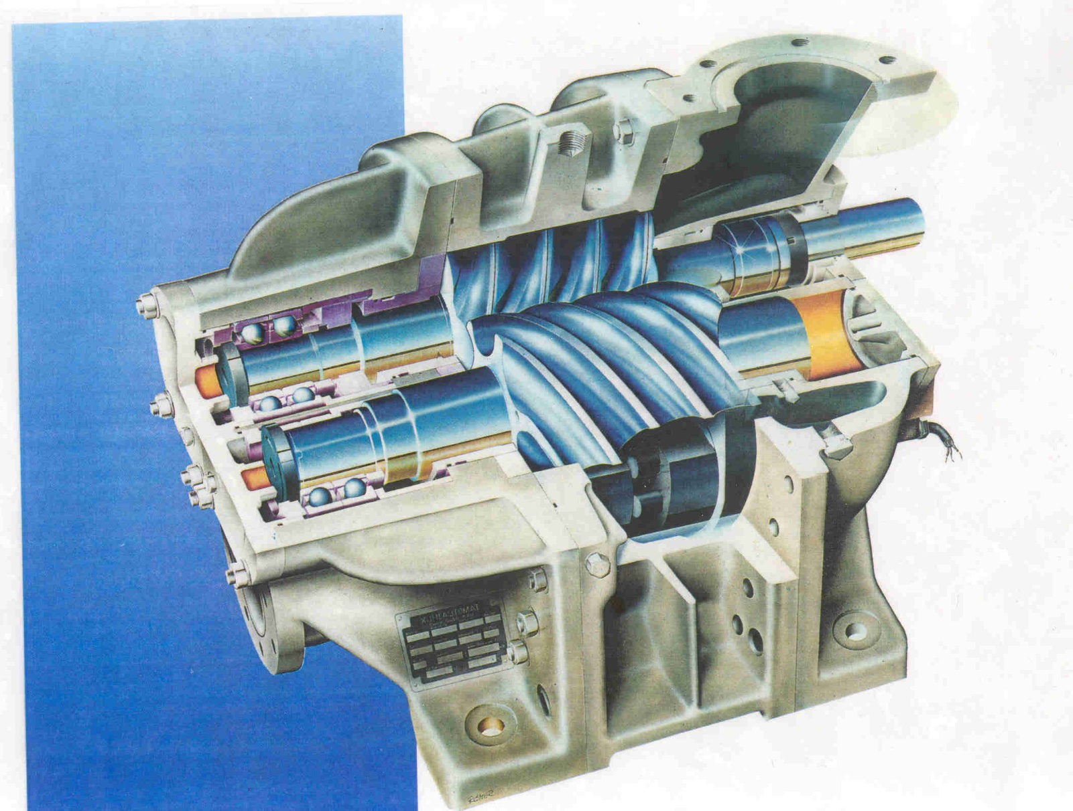
Oil-injected screw compressor

Slide 23
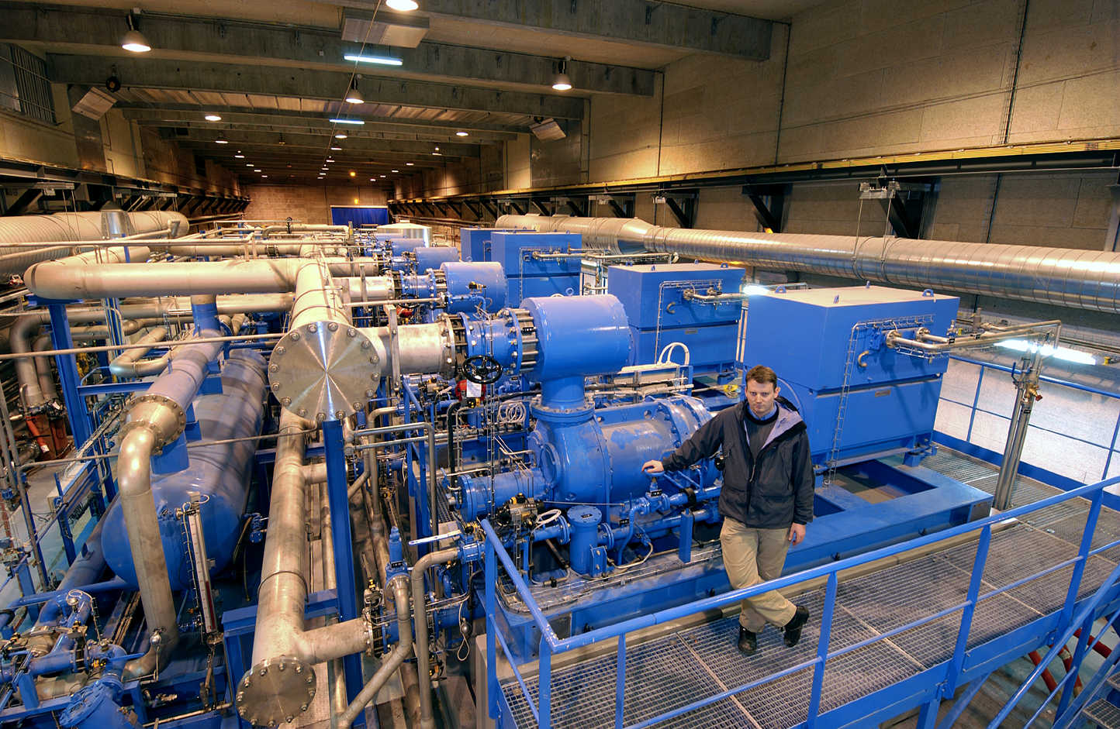
Compressor station of LHC 18 kW@ 4.5 K helium refrigerator

Slide 24
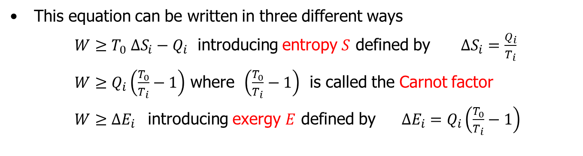
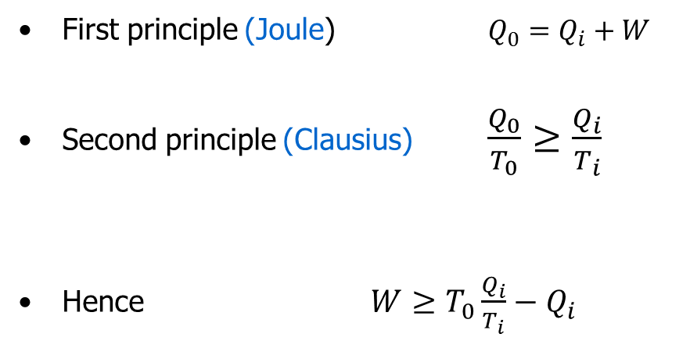
Basic thermodynamics of refrigeration
Second Principle
First principle (Joule) $Q_{0}=Q_{i}+W$
Second principle (Clausius) $\frac{Q_{0}}{T_{0}}≥\frac{Q_{i}}{T_{i}}$
Hence $W≥T_{0}\frac{Q_{i}}{T_{i}}−Q_{i}$
(= for reversible process)
This equation can be written in three different ways
$W≥T_{0} ∆S_{i}−Q_{i}$ introducing entropy $S$ defined by $∆S_{i}=\frac{Q_{i}}{T_{i}}$
$W≥Q_{i}\left(\frac{T_{0}}{T_{i}}−1\right)$ where $\left(\frac{T_{0}}{T_{i}}−1\right)$ is called the Carnot factor
$W≥∆E_{i }$ introducing exergy $E$ defined by $∆E_{i}=Q_{i}\left(\frac{T_{0}}{T_{i}}−1\right)$

Slide 25
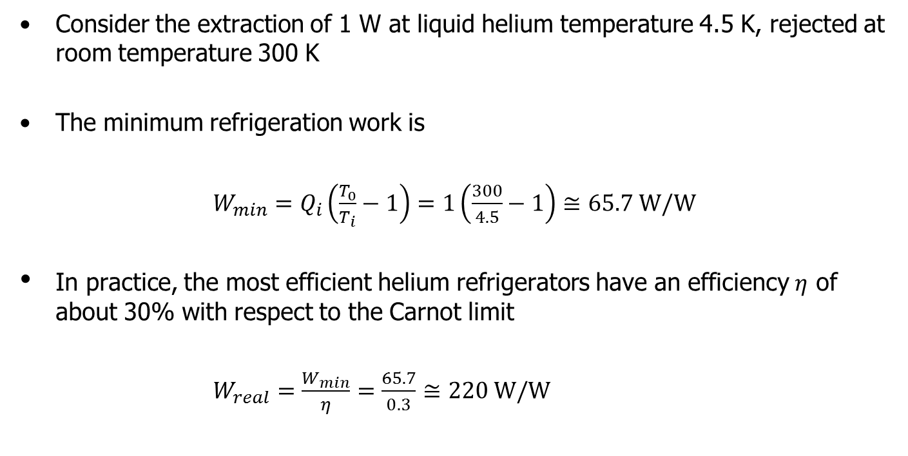
Minimum refrigeration work
Consider the extraction of 1 W at liquid helium temperature 4.5 K, rejected at room temperature 300 K
The minimum refrigeration work is
$W_{min}=Q_{i}\left(\frac{T_{0}}{T_{i}}−1\right)=1\left(\frac{300}{4.5}−1\right)≅65.7 W/W$
In practice, the most efficient helium refrigerators have an efficiency $η$ of about 30% with respect to the Carnot limit
$W_{real}=\frac{W_{min}}{η}=\frac{65.7}{0.3}≅220 W/W$

Slide 26
Contents
Introduction: cryogens & superconductors
Cryogenic fluids amd materials
Refrigeration & liquefaction
Heat transfer & thermal insulation
Thermal screening with cold vapour
References

Slide 27
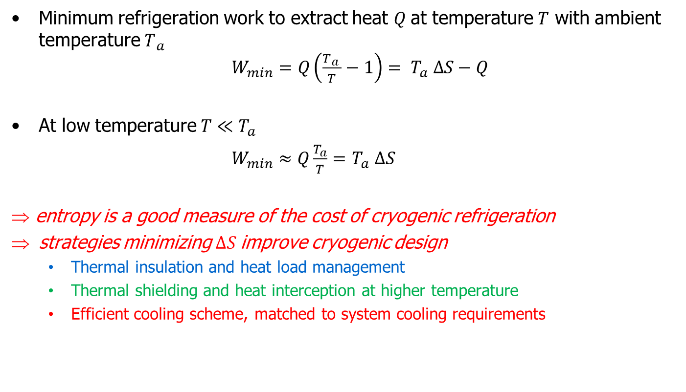
Second-principle thermodynamics at low temperature
Minimum refrigeration work to extract heat $Q$at temperature $T$ with ambient temperature $T_{ a }$ $W_{min}=Q\left(\frac{T_{ a }}{T}−1\right)= T_{a} ∆S−Q$
At low temperature $T≪T_{a}$
$W_{min}≈Q\frac{T_{a}}{T}=$ $T_{a} ∆S$
⇒ entropy is a good measure of the cost of cryogenic refrigeration
strategies minimizing $∆S$improve cryogenic design
  Thermal insulation and heat load management
  Thermal shielding and heat interception at higher temperature
  Efficient cooling scheme, matched to system cooling requirements

Slide 28
Cryogenic design strategies
Ln Q
Increasing S
Q refri
Cooling scheme
Q device
Shielding, heat interception
Q shield
Insulation
T refri
T device
T shield
Ln T

Slide 29
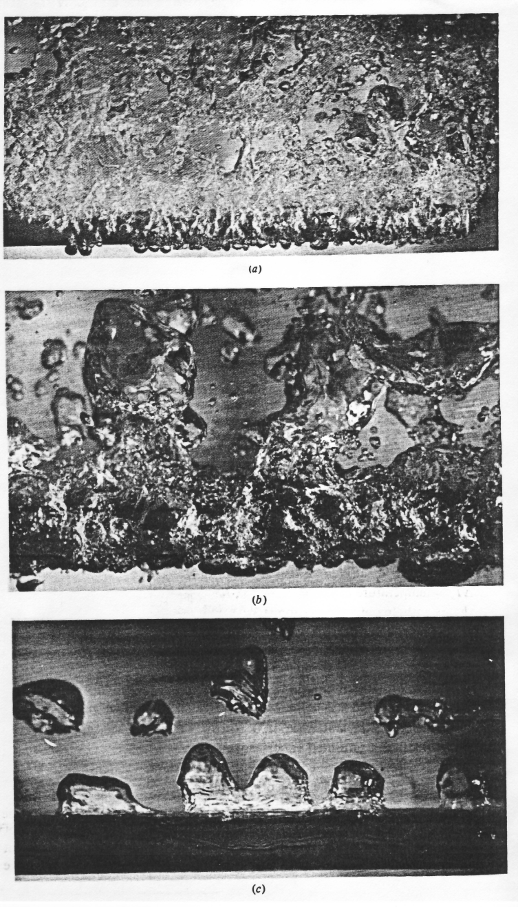
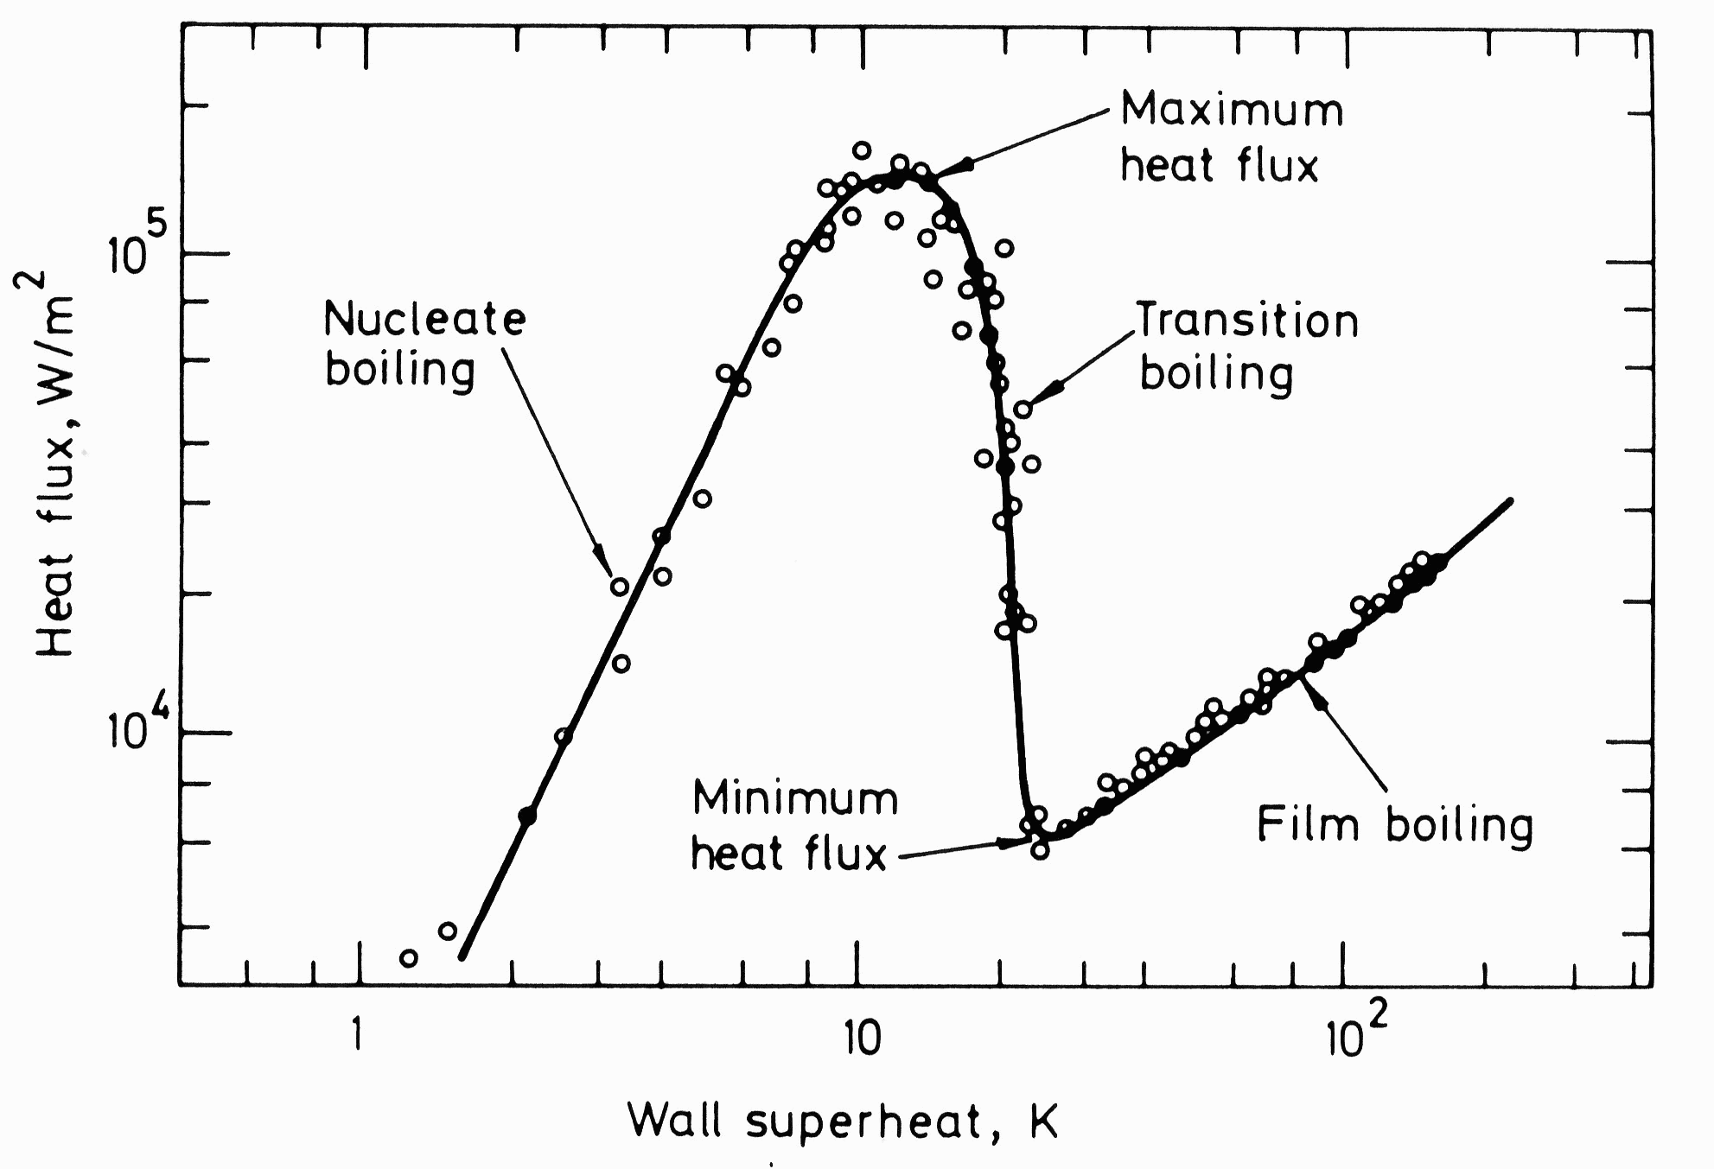
Non-linear heat transfer to liquid cryogens
Pool boiling nitrogen
~ 1.5 10⁵ W/m²

Slide 30
Non-linear heat transfer to liquid cryogens
Pool boiling helium
10⁴ W/m²

Slide 31
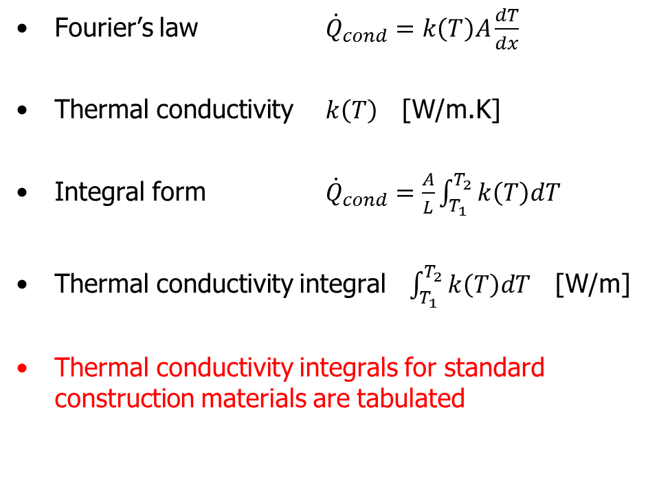
Heat conduction in solids
A
Fourier’s law ${\dot{Q}}_{cond}=k\left(T\right)A\frac{dT}{dx}$
Thermal conductivity $k\left(T\right)$ [W/m.K]
Integral form ${\dot{Q}}_{cond}=\frac{A}{L}\int_{T_{1}}^{T_{2}}{k\left(T\right)dT}$
Thermal conductivity integral $\int_{T_{1}}^{T_{2}}{k\left(T\right)dT}$ [W/m]
Thermal conductivity integrals for standard construction materials are tabulated

Slide 32
Thermal conductivity integrals of selected materials [W/m]
From vanishingly low temperature up to | 20 K | 80 K | 290 K
OFHC copper | 11000 | 60600 | 152000
DHP copper | 395 | 5890 | 46100
1100 aluminium | 2740 | 23300 | 72100
2024 aluminium alloy | 160 | 2420 | 22900
AISI 304 stainless steel | 16.3 | 349 | 3060
G-10 glass-epoxy composite | 2 | 18 | 153

Slide 33
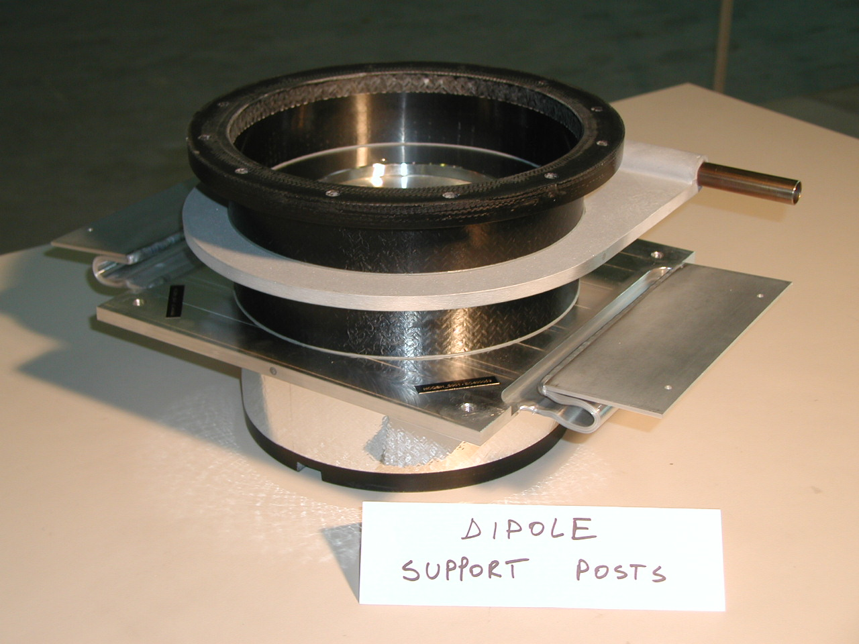
Non-metallic composite support post with heat intercepts
5 K cooling line (SC He)
Aluminium intercept plates glued to G-10 column
Aluminium strips to thermal shield at 50-75 K

Slide 34
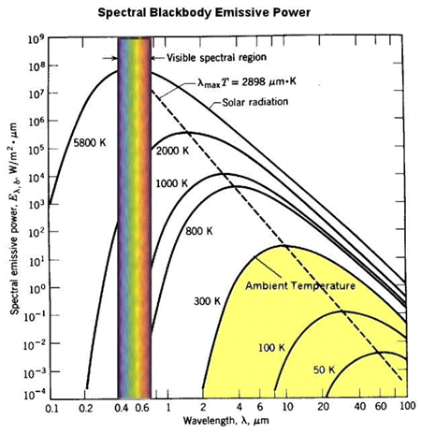
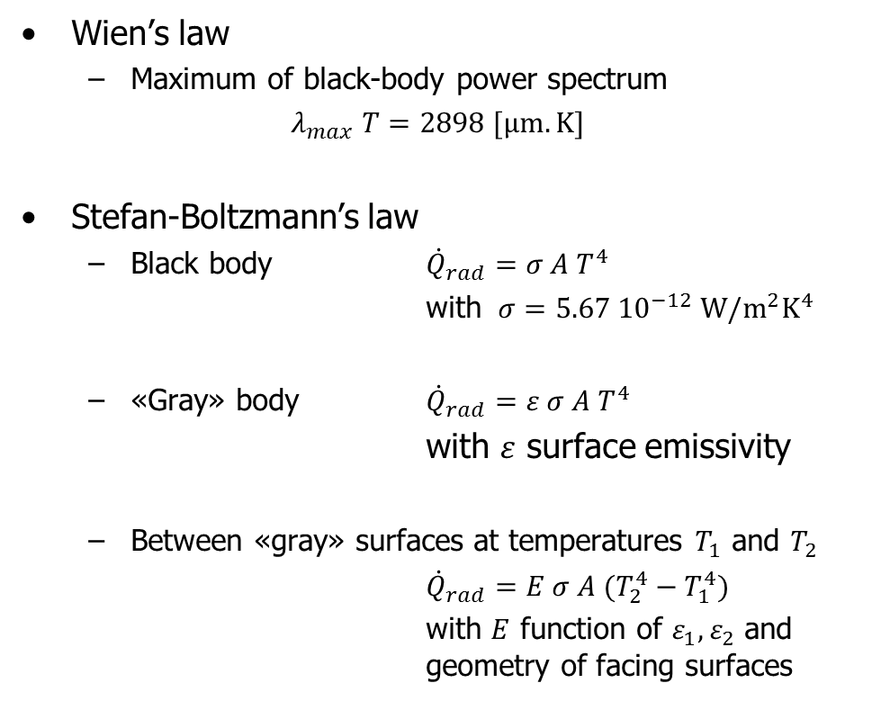
Thermal radiation
Wien’s law
  Maximum of black-body power spectrum
  $λ_{max} T=2898 [μm.K]$
Stefan-Boltzmann’s law
  Black body ${\dot{Q}}_{rad}=σ A T^{4}$
  with $σ=5.67 {10}^{−12} W/m^{2}K^{4}$
  «Gray» body ${\dot{Q}}_{rad}=ε σ A T^{4}$
  with $ε$ surface emissivity
  Between «gray» surfaces at temperatures $T_{1}$ and $T_{2}$
  ${\dot{Q}}_{rad}=E σ A (T_{2}^{4}−T_{1}^{4})$
  with $E$ function of $ε_{1},ε_{2}$ and geometry of facing surfaces

Slide 35
Emissivity of technical materials at low temperatures
 | Radiation from 290 K Surface at 77 K | Radiation from 77 K Surface at 4.2 K
Stainless steel, as found | 0.34 | 0.12
Stainless steel, mech. polished | 0.12 | 0.07
Stainless steel, electropolished | 0.10 | 0.07
Stainless steel + Al foil | 0.05 | 0.01
Aluminium, as found | 0.12 | 0.07
Aluminium, mech. polished | 0.10 | 0.06
Aluminium, electropolished | 0.08 | 0.04
Copper, as found | 0.12 | 0.06
Copper, mech. Polished | 0.06 | 0.02

Slide 36
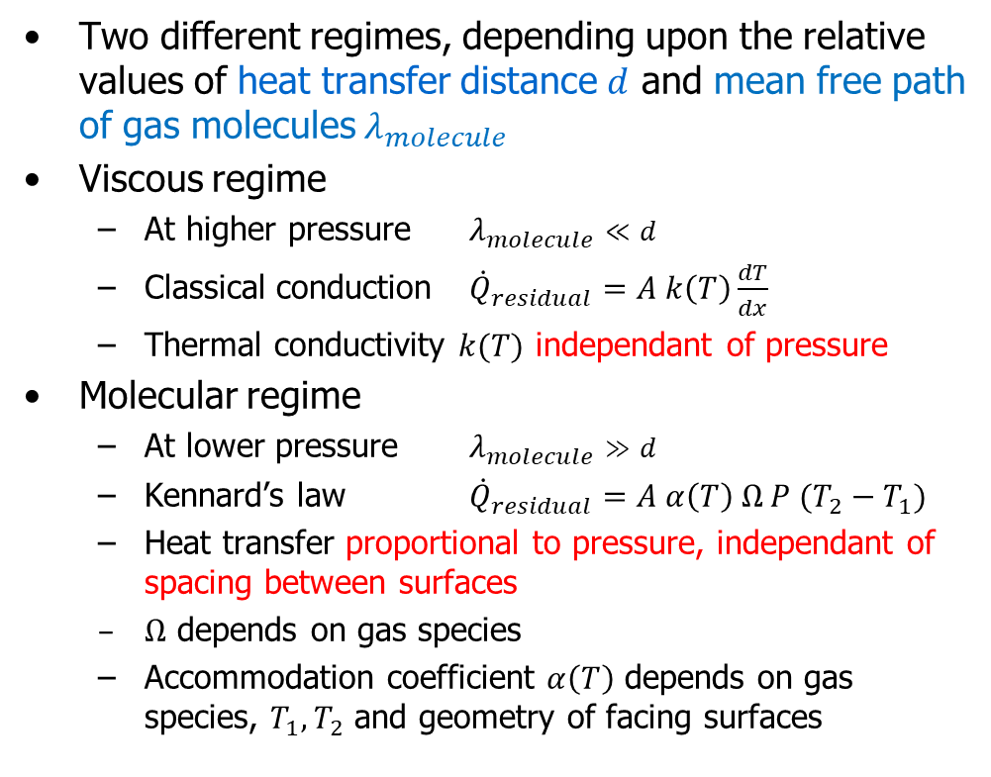
Residual gas conduction
Two different regimes, depending upon the relative values of heat transfer distance $d$ and mean free path of gas molecules $λ_{molecule}$
Viscous regime
  At higher pressure $λ_{molecule}≪d$
  Classical conduction ${\dot{Q}}_{residual}=A k\left(T\right)\frac{dT}{dx}$
  Thermal conductivity $k(T)$ independant of pressure
Molecular regime
  At lower pressure $λ_{molecule}≫d$
  Kennard’s law ${\dot{Q}}_{residual}=A α\left(T\right) Ω P (T_{2}−T_{1})$
  Heat transfer proportional to pressure, independant of spacing between surfaces
  $Ω$ depends on gas species
  Accommodation coefficient $α\left(T\right)$ depends on gas species, $T_{1},T_{2}$ and geometry of facing surfaces

Slide 37
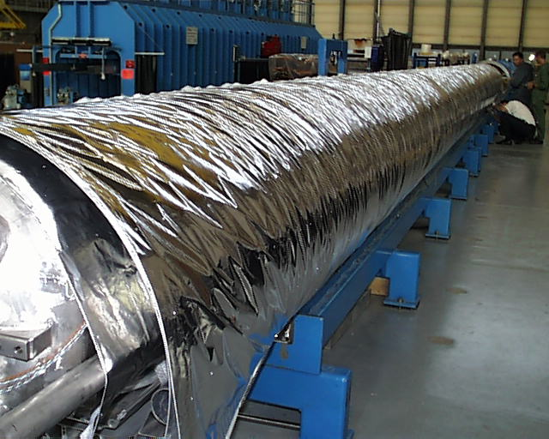
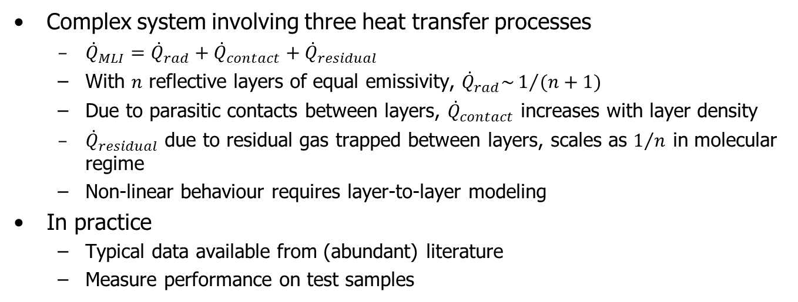
Multi-layer insulation
(MLI)
Complex system involving three heat transfer processes
  ${\dot{Q}}_{MLI}={\dot{Q}}_{rad}+{\dot{Q}}_{contact}+{\dot{Q}}_{residual}$
  With $n$ reflective layers of equal emissivity, ${\dot{Q}}_{rad}\sim 1/{(n+1)}$
  Due to parasitic contacts between layers, ${\dot{Q}}_{contact}$ increases with layer density
  ${\dot{Q}}_{residual}$ due to residual gas trapped between layers, scales as $1/n$ in molecular regime
  Non-linear behaviour requires layer-to-layer modeling
In practice
  Typical data available from (abundant) literature
  Measure performance on test samples

Slide 38
Typical heat fluxes at vanishingly low temperature between flat plates [W/m²]
Black-body radiation from 290 K | 401
Black-body radiation from 80 K | 2.3
Gas conduction (100 mPa He) from 290 K | 19
Gas conduction (1 mPa He) from 290 K | 0.19
Gas conduction (100 mPa He) from 80 K | 6.8
Gas conduction (1 mPa He) from 80 K | 0.07
MLI (30 layers) from 290 K, pressure below 1 mPa | 1-1.5
MLI (10 layers) from 80 K, pressure below 1 mPa | 0.05
MLI (10 layers) from 80 K, pressure 100 mPa | 1-2

Slide 39
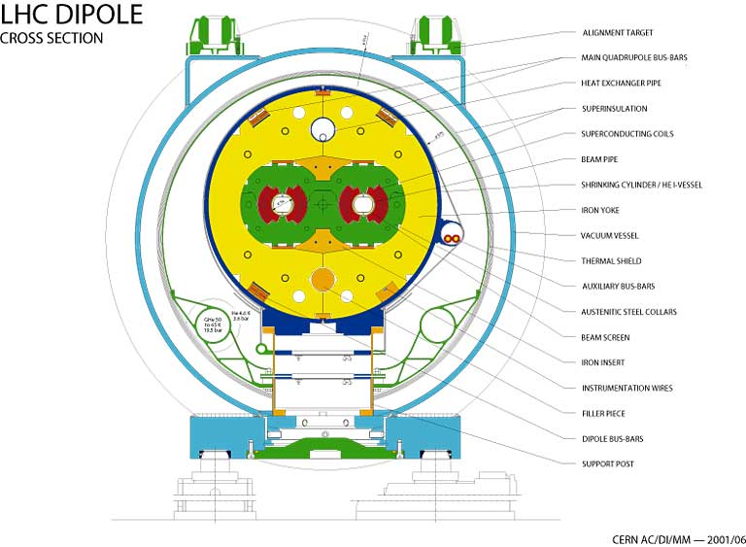
Cross-section of LHC dipole cryostat

Slide 40

LHC cryostat heat inleaks at 1.9 K
Measured
$$\dot{Q}=\dot{m} ∆h(P,T)$$
He property tables
LHC sector (2.8 km)
On full LHC cold sector (2.8 km)
- Measured 560 W, i.e. 0.2 W/m
- Calculated 590 W, i.e 0.21 W/m

Slide 41
Contents
Introduction: cryogens & superconductors
Cryogenic fluids and materials
Refrigeration & liquefaction
Heat transfer & thermal insulation
Thermal screening with cold vapour
References

Slide 42
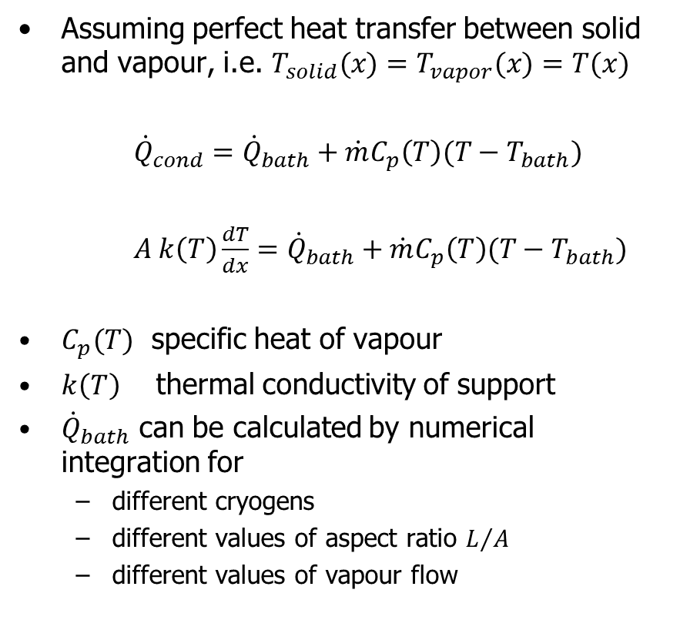
Vapour cooling of cryostat necks and supports with perfect heat transfer
Assuming perfect heat transfer between solid and vapour, i.e. $T_{solid}(x)=T_{vapor}(x)=T(x)$
${\dot{Q}}_{cond}={\dot{Q}}_{bath}+\dot{m}C_{p}\left(T\right)(T−T_{bath})$
$A k\left(T\right)\frac{dT}{dx}={\dot{Q}}_{bath}+\dot{m}C_{p}\left(T\right)(T−T_{bath})$
$C_{p}(T)$ specific heat of vapour
$k\left(T\right)$ thermal conductivity of support
${\dot{Q}}_{bath}$ can be calculated by numerical integration for
  different cryogens
  different values of aspect ratio $L/A$
  different values of vapour flow

Slide 43
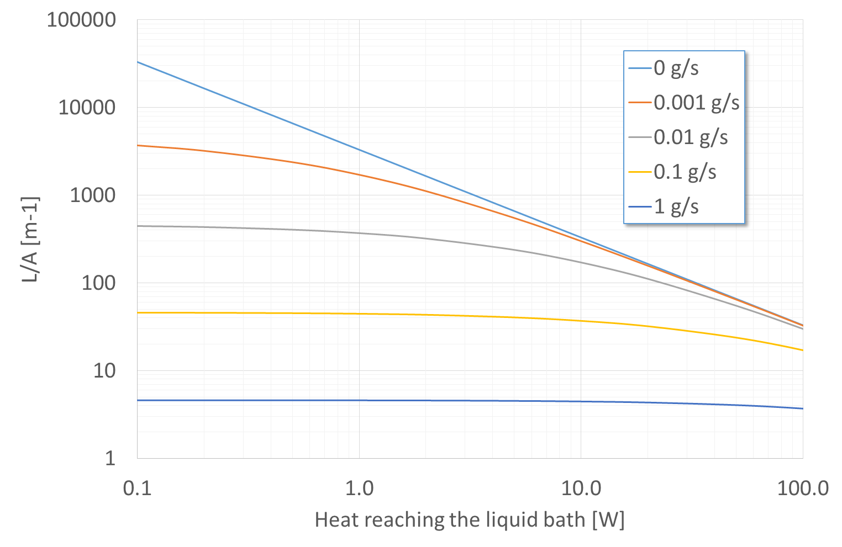
He vapour screening of stainless steel neck between 300 K and 4 K

Slide 44
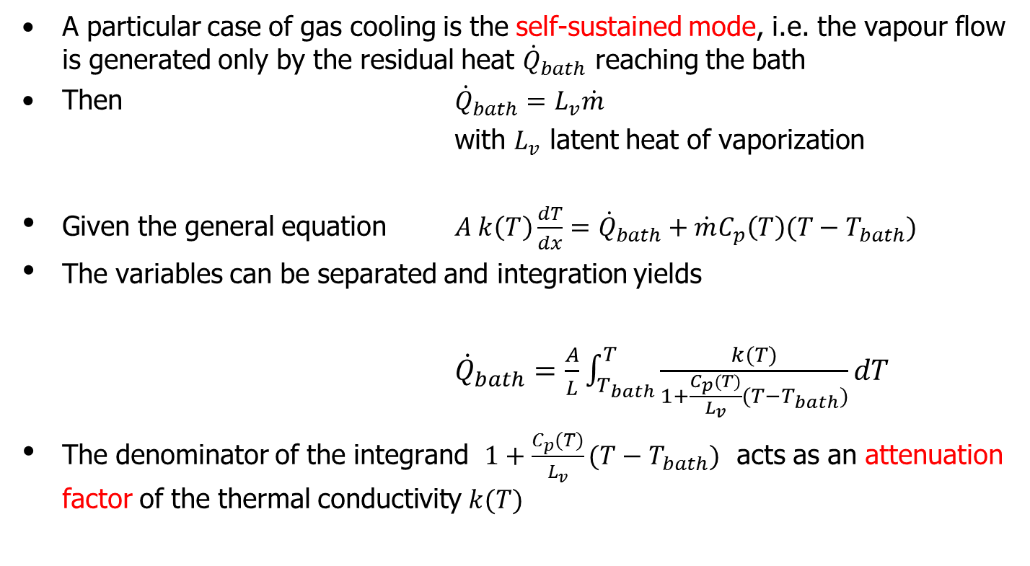
Vapour cooling of cryostat necks and supports in self-sustained mode
A particular case of gas cooling is the self-sustained mode, i.e. the vapour flow is generated only by the residual heat ${\dot{Q}}_{bath}$ reaching the bath
Then ${\dot{Q}}_{bath}=L_{v}\dot{m}$
with $L_{v}$ latent heat of vaporization
Given the general equation $A k\left(T\right)\frac{dT}{dx}={\dot{Q}}_{bath}+\dot{m}C_{p}\left(T\right)(T−T_{bath})$
The variables can be separated and integration yields
${\dot{Q}}_{bath}=\frac{A}{L}\int_{T_{bath}}^{T}{\frac{k(T)}{1+\frac{C_{p}(T)}{L_{v}}(T−T_{bath})}dT}$
The denominator of the integrand $1+\frac{C_{p}(T)}{L_{v}}(T−T_{bath})$ acts as an attenuation factor of the thermal conductivity $k(T)$

Slide 45
Reduction of heat conduction by self-sustained helium vapour cooling
Effective thermal conductivity integral from 4 to 300 K | Purely conductive regime [W.cm⁻¹] | Self-sustained vapour-cooling [W.cm⁻¹]
ETP copper | 1620 | 128
OFHC copper | 1520 | 110
Aluminium 1100 | 728 | 39.9
Nickel 99% pure | 213 | 8.65
Constantan | 51.6 | 1.94
AISI 300 stainless steel | 30.6 | 0.92

Slide 46
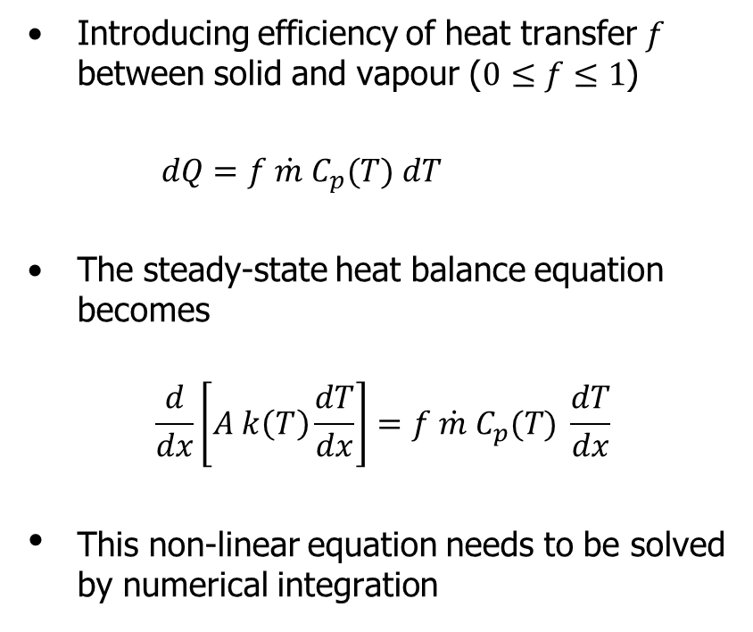
Vapour cooling of cryostat necks and supports with imperfect heat transfer
Introducing efficiency of heat transfer $f$ between solid and vapour ($0≤f≤1$)
$dQ=f \dot{m}{ C}_{p}(T) dT$
The steady-state heat balance equation becomes
$$\frac{d}{dx}\left[A k\left(T\right)\frac{dT}{dx}\right]=f \dot{m}{ C}_{p}(T) \frac{dT}{dx}$$
This non-linear equation needs to be solved by numerical integration

Slide 47
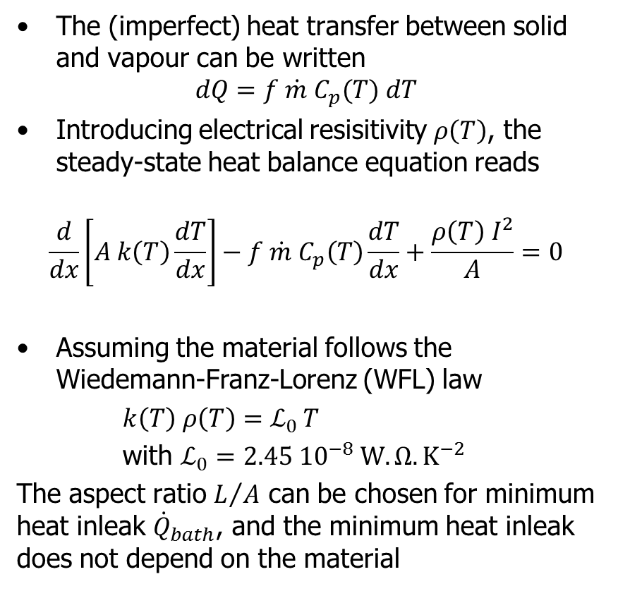
Vapor-cooled current leads
The (imperfect) heat transfer between solid and vapour can be written
$$dQ=f \dot{m}{ C}_{p}(T) dT$$
Introducing electrical resisitivity $ρ\left(T\right)$, the steady-state heat balance equation reads
$$\frac{d}{dx}\left[A k\left(T\right)\frac{dT}{dx}\right]−f \dot{m}{ C}_{p}\left(T\right)\frac{dT}{dx}+\frac{ρ\left(T\right) I^{2}}{A}=0$$
Assuming the material follows the Wiedemann-Franz-Lorenz (WFL) law
$k\left(T\right) ρ\left(T\right)=ℒ_{0 }T$
with $ℒ_{0}=2.45 {10}^{−8} W.Ω.K^{−2}$
The aspect ratio $L/A$ can be chosen for minimum heat inleak ${\dot{Q}}_{bath}$, and the minimum heat inleak does not depend on the material

Slide 48
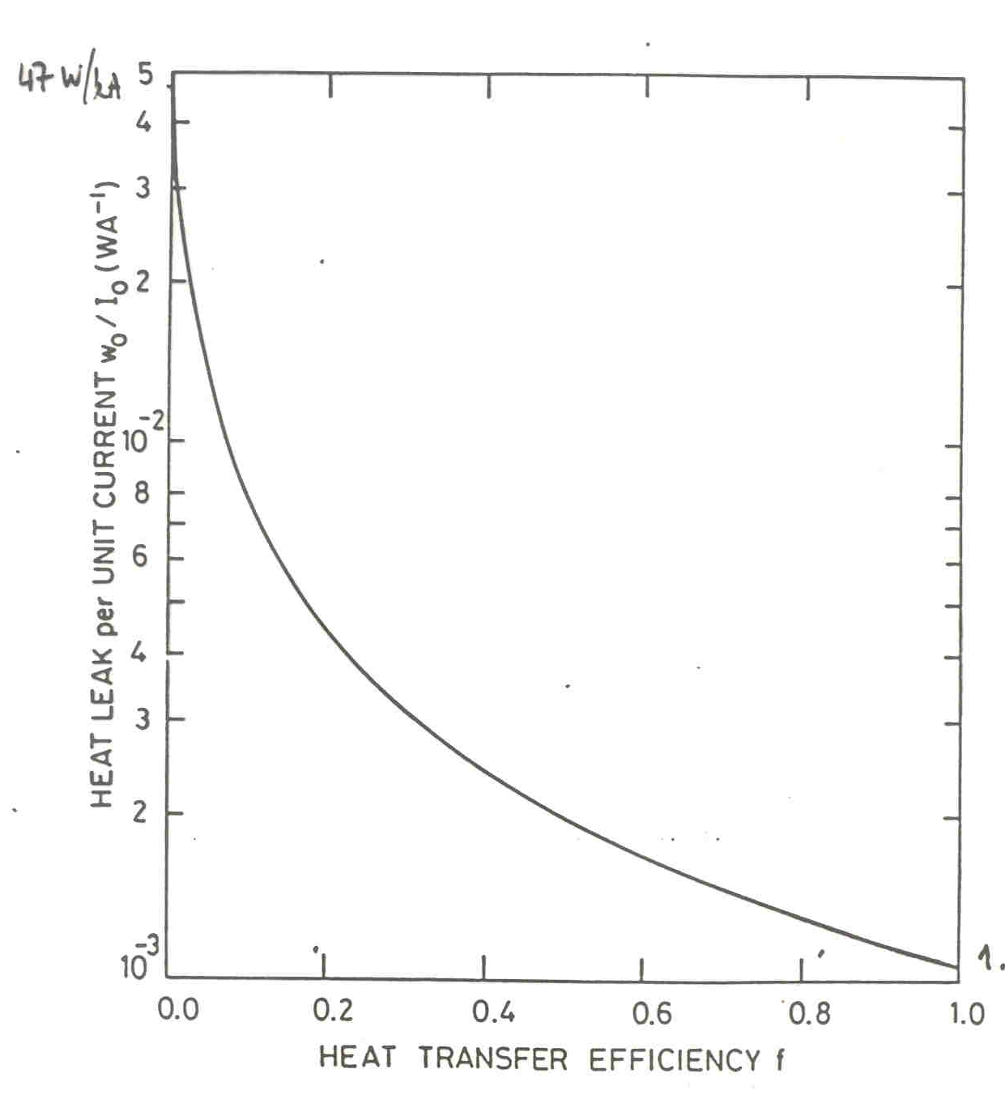
Heat load of optimized current lead
Uncooled
47 W/kA
Material obeying
the WFL law
Minimum residual
heat load
1.04 W/kA

Slide 49
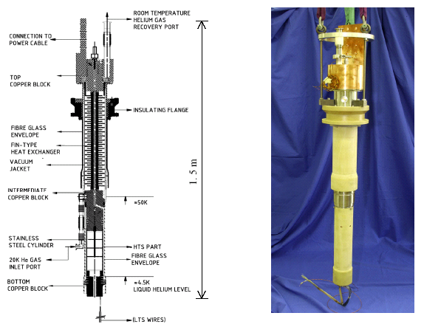
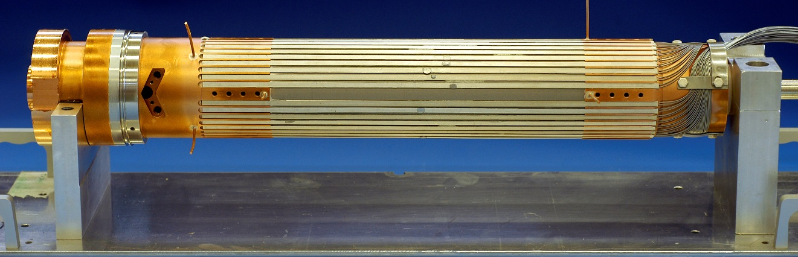
Beating the WFL law: HTS current leads
The WFL law essentially states that good electrical conductors are also good thermal conductors
Efficient current leads need good electrical conductors with low thermal conductivity
Superconductors are bad thermal conductors with zero resisitivity
⇒ Build current lead with superconductor up to temperature as high as possible, i.e. use HTS
Copper
HTS

Slide 50
HTS vs. normal conducting current leads
Type |  | Resistive | HTS (4 to 50 K) Resistive (above)
Heat into LHe | [W/kA] | 1.1 | 0.1
Total exergy consumption | [W/kA] | 430 | 150
Electrical power from grid | [W/kA] | 1430 | 500

Slide 51
Take-home facts
Helium is the only practical cryogen for cooling LTS
Liquid nitrogen is a convenient fluid for precooling and thermal screening
Specific heat of helium is orders of magnitude higher than that of solid materials at low temperature
Cryogenic helium refrigerators and liquefiers have an efficiency not higher than 30% of the Carnot cycle: cryogenic refrigeration is energy costly
Proper cryogenic design should aim at minimizing entropy generation, by reducing parasitic heat in-leaks, temperature differences and pressure drops
Heat transfer processes at low temperature show non-linearities and strong variations w.r. to their values at room temperature
Helium vapour has a high cooling potential for heat interception in cryostat thermal screens, necks, supports and current leads

Slide 52
Some references
Books
K. Mendelssohn, The quest for absolute zero, McGraw Hill (1966)
R.B. Scott, Cryogenic engineering, Van Nostrand, Princeton (1959)
G.G. Haselden, Cryogenic fundamentals, Academic Press, London (1971)
R.A. Barron, Cryogenic systems, Oxford University Press, New York (1985)
B.A. Hands, Cryogenic engineering, Academic Press, London (1986)
S.W. van Sciver, Helium cryogenics, Plenum Press, New York (1986, 2nd edition 2012)
K.D. Timmerhaus & T.M. Flynn, Cryogenic process engineering, Plenum Press, New York (1989)
J.G. Weisend (ed.), The handbook of cryogenic engineering, Taylor & Francis, Philadelphia (1998)
J.G. Weisend (ed.), Cryostat design: case studies, principles and engineering, Springer, Switzerland (2016)

Slide 53
Some references
Reports & Proceedings
Ph. Lebrun, An introduction to cryogenics, CERN-AT-2007-01 (2007) http://cdsweb.cern.ch/record/1012032?ln=en
Proceedings of CAS School on Superconductivity and Cryogenics for Particle Accelerators and Detectors, Erice (2002)
  U. Wagner, Refrigeration
  G. Vandoni, Heat transfer
  Ph. Lebrun, Design of a cryostat for superconducting accelerator magnet
  Ph. Lebrun & L. Tavian, The technology of superfluid helium
  http://cdsweb.cern.ch/record/503603?ln=en
Proceedings of CAS School on Superconductivity for Accelerators, Erice (2013)
  P. Duthil, Basic thermodynamics
  P. Duthil, Material properties at low temperatures
  A. Alekseev, Basics of low-temperature refrigeration
  B. Baudouy, Heat transfer and cooling techniques at low temperature
  V. Parma, Cryostat design
  Ph. Lebrun & L. Tavian, Cooling with superfluid helium
  https://cds.cern.ch/record/1507630?ln=en
Proceedings of ICEC, CEC/ICMC and IIR Cryogenics conferences

Slide 54
Phase diagram of helium

