Slide 1
Superconducting RF cavities for accelerators
Fritz Caspers, Sergio Calatroni
JUAS SC RF lecture 2024
Notes:
This lecture has a long history over the last 25 years. The original version was prepared by W. Weingarten and used until about 2005 and then underwent many extensions , simplifications , modifications but also certain corrections. Thanks to Joachim Tückmantel , Manfred Wendt, Tobias Junginger and many others. The very basics of RF superconductivity were already discussed in this course by Claire Antoine

Slide 2
OUTLINE OF THE LECTURE
Motivation for using RF superconducting technology (LEP example) in comparison with normal conducting cavities and some history incl. other applications of RF superconductivity (slide 2-8)
A short recap on the theory of RF superconductivity (slide 9-16)
Short recap on RF cavity theory; a few “new” terms like the G-factor (slide 17-26)
Examples of SC cavity implementation also for low beta (slide 27-43)
Interactions of the beam with the cavity; Lorentz forces (slide 44-49)
Special diagnostics (slide 50-53)
Fabrication technology (slide 54-64)
Summary (slide 65)
Notes:
A short overview....

Slide 3
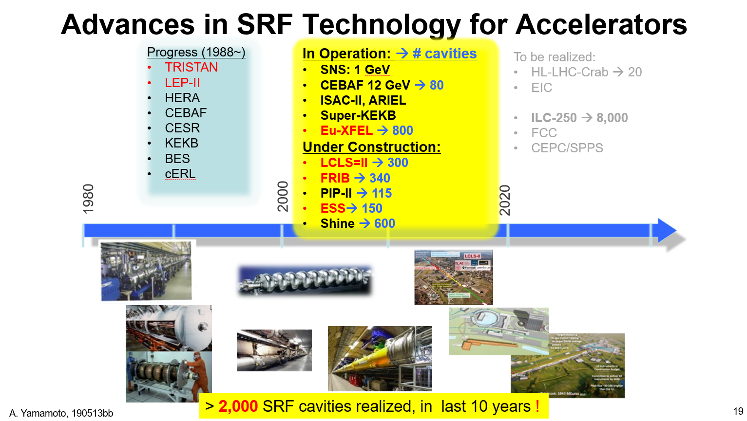
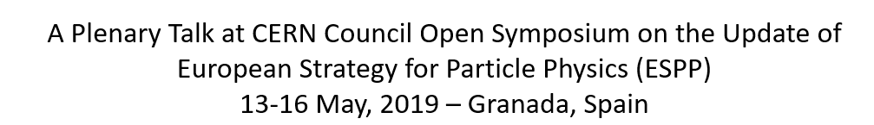
Motivation (I)
Notes:
Lots of hardware burned away from the high (RF) power requirements...and we always want to give most of the precious Rf power to the beam..to compenate the high synchrotron radiation losses..it was a DYNAMIC situation then

Slide 4
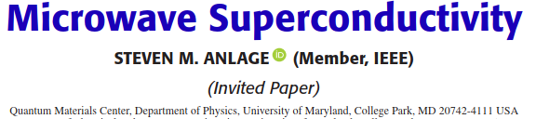
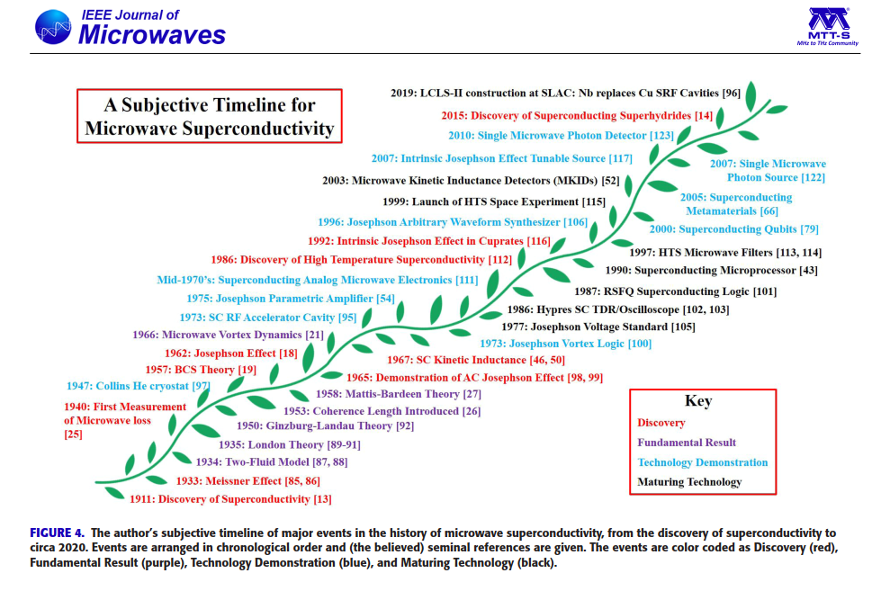
Motivation(II); Historical remarks, a recent (2021) review
(Vol 1; No 1, Jan 2021)
Notes:
And here are the latest news from the press.. a hot and interesting field…despite cryo technology..we could spend a lot of time just on this slide alone, discussing all the inventions and new effects there in in detail but we will focus here only on a few points mentioned…on this graph
The very nice review paper by Anlage is not only covering the range of application in the accelerator domain but gives also an overview
on what is going in the entire range physics and technology important miles stone are many different fundamental results in the 50th and 60th
with one of the first SC accelerator cavities in 1973 .Josephson made a very important discovery (Josephson effect) in a very young age in 1962
and obtained the Nobel prize
Maybe this should be further expanded with 2..3 examples and figures from this paper by Anlage

Slide 5
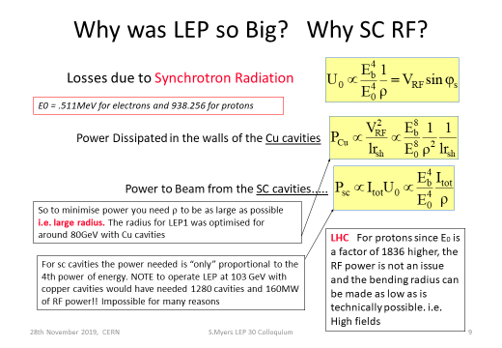
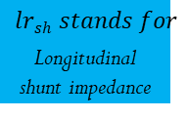

Motivation (III)
$$ρ=machine$$
$radius$ (here)
E_{b}=beam energy; V_{RF}=total voltage from all cavities
$$lrsh stands for$$
_{Longitudinal shunt impedance}
Since P is proportional V² we arrive at the 8th power for NC,
but remain with the 4th power for SC as the cavity losses are small
https://home.cern/news/press-release/cern/lep-story
Notes:
This is the important issue...for a machine with given radius AND synchrotron radiation losses (yes we have it also with hardrons in the LHC now) ..mainly for leptons..the synchrotron radiation scales with 4th power of the energy of the electrons..that was THE big issue for LEP. You see some further explanations added into the slides produced and shown by Steve Myers..

Slide 6
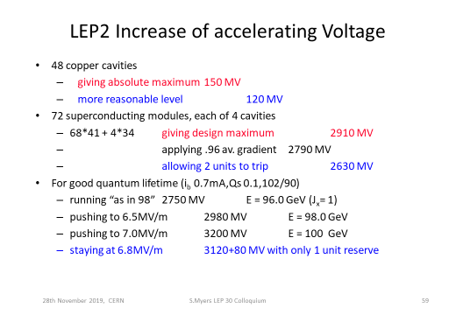
Motivation (IV)
regarding quantum lifetime see e.g.: https://cds.cern.ch/record/402586/files/sl-99-061.pdf
For a good quantum lifetime (related to synchrotron radiation) a sufficient RF bucket hight is required
Notes:
Remember that in LEP we had around 2 kW (average) synchrotron radiation (soft X-rays) loss per meter which had to be (water) cooled away and of course compensated by the RF..thats a lot with 27 km circumference

Slide 7
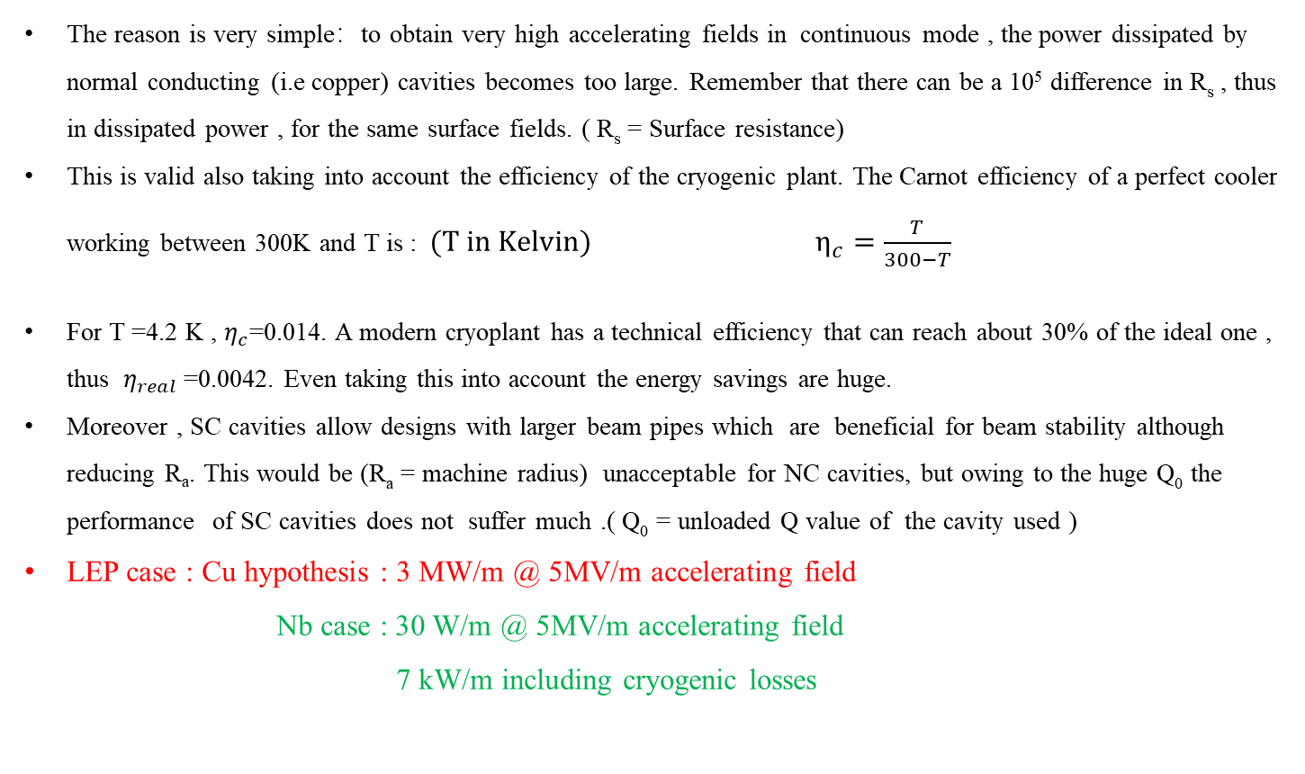
Motivation (V)
The reason is very simple：to obtain very high accelerating fields in continuous mode , the power dissipated by normal conducting (i.e copper) cavities becomes too large. Remember that there can be a 10⁵ difference in R_{s} , thus in dissipated power , for the same surface fields. ( R_{s} = Surface resistance)
This is valid also taking into account the efficiency of the cryogenic plant. The Carnot efficiency of a perfect cooler working between 300K and T is :$(T in Kelvin) η_{c}=\frac{T}{300−T}$
For T =4.2 K , $η_{c}$=0.014. A modern cryoplant has a technical efficiency that can reach about 30% of the ideal one , thus $η_{real}$=0.0042. Even taking this into account the energy savings are huge.
Moreover , SC cavities allow designs with larger beam pipes which are beneficial for beam stability although reducing R_{a}. This would be (R_{a} = machine radius) unacceptable for NC cavities, but owing to the huge Q₀ the performance of SC cavities does not suffer much .( Q₀ = unloaded Q value of the cavity used )
LEP case : Cu hypothesis : 3 MW/m @ 5MV/m accelerating field
Nb case : 30 W/m @ 5MV/m accelerating field
7 kW/m including cryogenic losses
A hypothetical copper cavity with 3 MegaWatt/per meter length would be very hard to cool
Notes:
Copper cavities already get really hot with one MV/meter surface field..good SC cavities can do 30 MV/m ..and in contrast to NC cavities there is very little power loss between subsequent bunches. The normalisation „per meter“refers here to the length of the cavity sections, thus the internal field inside the cavities are locally somewhat higher than the numbers shown here

Slide 8
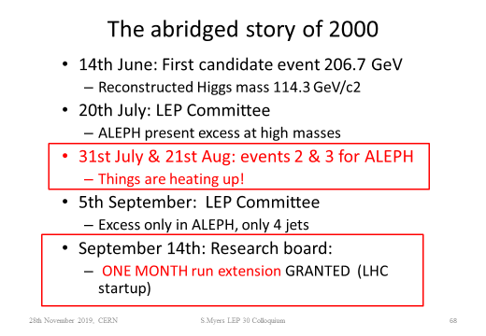
Motivation (VI)
We were not far from getting the HIGGS in LEP
And 3 additional SC cavity modules were already prepared for the winter shutdown
A very good overview(LEP fest 2000)on SC cavity development at CERN until then https://indico.cern.ch/event/408341/contributions/1857059/attachments/817931/1121494/Chiaveri.pdf
Notes:
At this very hot time first indirect candidates were seen in LEP ..but not enough to „sell“ them

Slide 9
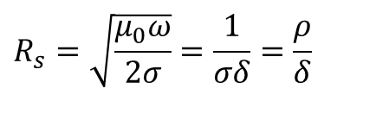


Surface Resistance; recap on theory of RF superconductivity (I)
Since we will deal a lot with the surface resistance R_{s}, ρ= spec. resistivity [Ohm · m]
here is a simple DC model that gives a rough idea of what it means:
Consider a square sheet of metal (length of each side = a) and calculate its resistance to a (DC) transverse current flow: Assume a perfectly conducting metallization where the current enters and leaves the square sheet to assume a homogeneous current flow
The surface resistance R_{s} is the resistance that a square piece of conductor
opposes to the flow of the currents induced by the RF wave, within a layer δ (skin depth)
For DC we talk about R□ (read: “resistance per unit square”) as there is ∞ skin depth or δ =infinity
Quiz: Why is R□ (for DC) and R_{s} (for RF) dimension less ? Use some values for a and calculate..e.g. a=1 mm and also a=1 meter, assume copper with ρ =17 milli Ohm [mm² /m]
This way [mm² /m] to write the unit, visualizes a cooper wire with 1 mm cross section and 1 meter length (=17 milliohm)
$$R=\frac{ρ \text{a}}{\text{d} \text{a}}$$
a
$$=\frac{ρ}{d}$$
a
current
δ
$$R_{s}=\sqrt{\frac{μ_{0}ω}{2σ}}=\frac{1}{σδ}=\frac{ρ}{δ}$$
d
δ=1/√(πfμ₀μ_{r}σ)
for magnetic materials
Notes:
A short reminder on how the resistance per unit square is defined and how it can be visualized..including the transition to the RF surface impedance; we see several consistent notations of the relation between skin depth and surface impedance in this and the following slide..

Slide 10
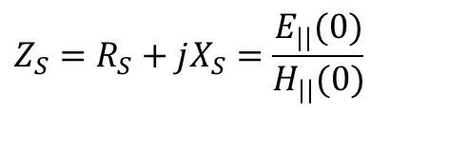
Surface Impedance ; recap on theory (II)
For a plane EM wave incident on a semi-infinite flat metallic surface:
E, H always in complex notation
E, H parallel to the surface
R_{s} and X_{s} are real and imaginary part of the surface impedance respectively
The homogeneous plane wave propagates in z-direction i.e. normal incidence; since orthogonal incidence, no issue on polarization (why ..discussion !)
Reference frame coordinates:
x, y parallel to the surface of the metal
z perpendicular to the surface
z=0: on the surface
See also similar figures in the NC RF lecture at JUAS (NC=normal conducting)
Quiz: in which direction travels the surface current on the conductor surface in this case?
$$Z_{S}=R_{S}+jX_{S}=\frac{E_{||}(0)}{H_{||}(0)}$$
E
(super)
conductor
H ⊗
vacuum
z=0
Notes:
The key issue for RF superconductors is the surface impedance ..but let start with the well know metallic half space and then go to superconductors How is the definition of polarisation for oblique incidence..?What about grazing incidence ? The TEM like field of an ultrarelativistic particle can be seen locally as a homogeneous plane wave propagating in z-direction with the E—field orthogonal to the surface also for beam coupling impedance issues the surface impedance is very relevant.

Slide 11
Surface Impedance in “normal” Metals; recap on theory of RF superconductivity (III)
The surface impedance Z_{s} is defined at the interface between two media.
It can be calculated in a similar way as for continuous media. Skin depth :δ
We take Maxwell’s equation, set the appropriate boundary conditions
for the continuity of the waves (incident, reflected, transmitted), and we get:
Introducing appropriate numbers, e.g. for copper at ambient temp. for f = 1 GHz:
$Z_{S}=\frac{E_{||}(0)}{H_{||}(0)}=\sqrt{\frac{jωμ_{0}}{σ}}=\sqrt{\frac{ωμ_{0}}{2σ}}+j\sqrt{\frac{ωμ_{0}}{2σ}}={ R}_{S}+jX_{S}$ with ${ R}_{S}=\frac{1}{δσ}; recall: δ=\sqrt{\frac{2}{μ0 ωσ}}$
σ_{Cu} = 58.5 ·10⁶ S/m (for copper) R_{s} = 8.2 milli Ω per unit square
S/m stands for Siemens /meter What is the skin depth δ @1 GHz for copper?
Answer: about 2 micron (or micrometer)
Short Quiz: What is the skin depth in copper at ambient temperature for 50 Hz and also for 1 MHz? hint: use scaling! How about stainless nonmagnetic steel with a 50 times lower conductivity than copper? What happens for magnetic steel?
please note that the real part and imaginary part of the surface impedance for metals are equal (i.e. phase =45 deg) only for the ideal case; with surface roughness the real part increases but in particular and much stronger the imaginary part for high frequencies. https://ieeexplore.ieee.org/stamp/stamp.jsp?tp=&arnumber=7167013
Notes:
We know this already from the „normal Rf“ lecture ..but its good to do a recap from time to time.. This example is nice for „scaling“ exercises.

Slide 12
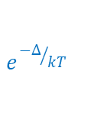
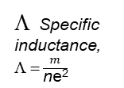
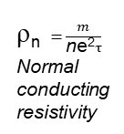
Two fluid model (slide by Claire #1 ) recap on theory (IV)
2 fluids model + cooper pair inertia
  In dynamic mode (AC, pulsed, RF)
      Cooper pairs have some inertia H field is not fully screened
      Normal electrons also “feel” the field
      Current is carried by both types of charge carriers (N and SC)
      The process is dissipative
  R_{BCS}: surface resistance as predicted by BCS
      In RF : skin depth becomes ~ λ_{L}<< δ_{RF}
      High Tc = High Δ is better
      T<<T_{C} is better
      Metallic character in NC state is better
      Small (dirty) is better? (yes @ 1^{rst} order)
  Actual RF surface resistance R_{S} = R_{BCS} + R₀
      Residual resistance : all the “unpredicted”:
        Flux trapping during cooldown
        Pair breaking mechanisms ≠ from thermal
        Non linear effects…
ρ_{n} = $\frac{m}{\text{n}\text{e}\text{2}τ}$
Normal conducting resistivity
Λ Specific inductance, Λ = $\frac{m}{\text{n}\text{e}\text{2}}$
      Normal e-
      Cooper pairs
$$e^{{−∆}/{kT}}$$
Nb/Cu
Bulk Nb
(l ∝ RRR)
Today’s SRF cavities are optimized for thermal conductivity (thermal stabilization), not for SC properties !!!
JUAS 2025: SRF Calatroni Caspers
Notes:
All free electrons (from the conduction band) n of the SC are divided into two groups:
superconducting electrons of density n_{s}/n
normal electrons of density n_{n}/n
As the temperature increases from 0 to the critical temperature Tc, the density ns/n decreases from 1 (all e- in form of Cooper pairs) to 0 (all Cooper pairs broken) when the material becomes normal conducting.
If the current is constant, electric field E cannot appear inside the superconductor because otherwise the super electrons would be continuously accelerated and the current would increase infinitely.
If there is no electric field, the normal electrons are at rest: only the super electrons carry the current in steady state, and they do not scatter on the impurities thanks to coherent state (see below)
First London eq shows that the electric field differs from zero only when the current density varies over time. It describes the ballistic flow of superelectrons in place of Ohm's law (which describes the viscous flow of electrons in a metal) and gives Js as a function of the vector potential A:
Note: R_BCS has a minimum at RRR 20 for niobium (coherence length of pure metal = mean free path)
With n= n_{s}+ n_{n}.

Slide 13
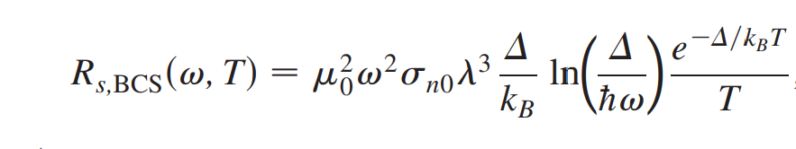
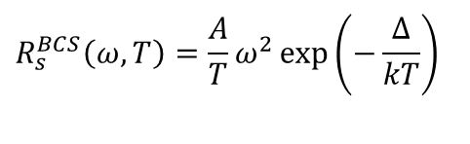

BCS Surface Resistance (1/2) recap on theory (V)
$$R_{s}^{BCS}\left(ω,T\right)=\frac{A}{T}ω^{2}\exp\left(−\frac{Δ}{kT}\right)$$
≈
: superconducting energy gap
(binding energy of Cooper pairs)
k_{B} : Boltzmann constant
ω: frequency
σ_{n0} normal state conductivity
µ₀= Vacuum permeability
λ=London penetration depth
Δ ≈ α · kT_{c} where α for Nb amounts to 1.92 and T_{C} is 9.2 K
$$R_{s}^{BCS}=1.3∙{10}^{−10}Ω∙{\left(f\left[MHz\right]\right)}^{2}∙\frac{1}{T}∙\exp\left(−\frac{17.67 K}{T\left[K\right]}\right)$$
And remember: $P=\frac{1}{2}R_{s}H^{2}$
Numerical example for comparison with the results from the graphic in the previous slide
For f=3 GHz (ω=2πf) and T=2 K) Agreement is quite good for the 32nOhm trace, since this
formula is good for not too pure materials (rather low RRR values i.e. high residual resistance)
R_{s} [Ohm] = 1.3·10⁻¹⁰ (3000)² · ½ · e ^{(-8.83)} = 8.7 · 10⁻⁸ [Ohm]
Notes:
13
RRR<20 means that the electron mean free path must be shorter than the superconducting coherence length of the pure metal (the size of Cooper pairs)
Hand formulas to have a practical numerical example and we like those simple formulae for the exam..

Slide 14
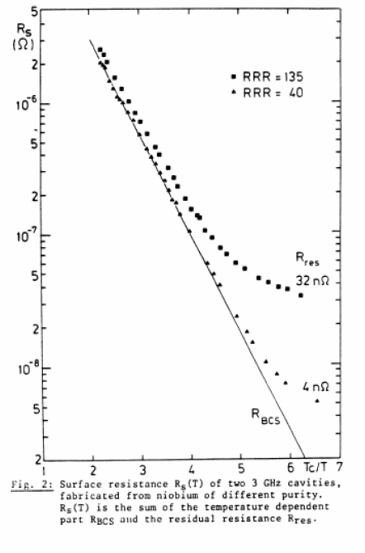


BCS Surface Resistance (2/2) recap on theory (VI)
Material parameter dependence of R_{s} (T, f )
$$R_{s}=R_{s}^{BCS}+R_{res}$$
Niobium @ 3 GHz
Here we assume a critical temperature for Nb as 9.2 K, thus we obtain Tc/T≈ 4.5 (see graphics)
▲
(BCS= Bardeen Cooper Schrieffer) can be calculated theoretically, from material parameters (resistivity, critical temperature); depends on temperature.
■
■
Caveat:
Typo in original
Corrected here
example for 2K
this graphic
The residual resistance usually depends on defects, normal-conducting inclusions, surface contamination, crystalline state and flux trapping
At first order:it does not depend on temperature
■
▲
RRR:
residual resistance ratio
R_{BCS}= Solid line in the diagram
R_{res} cannot be predicted from (im)purity (RRR)
Related Literature: W. Weingarten: Superconducting Cavity-basics; CAS (cern acc. school) Maui Nov 1994; free download via CDS CERN
http://cds.cern.ch/record/308015/files/p167.pdf
Notes:
14
You may try in the graphic a higher temperature (going left on the abscissa) and compare the result with the handy formula result on the previous slide..and you see that lower operational temperature really reduces the surface reistance a lot..but the penalty is the load to the cryo system..
But then in practice there is a limitation due to residual surface resistance R_res

Slide 15
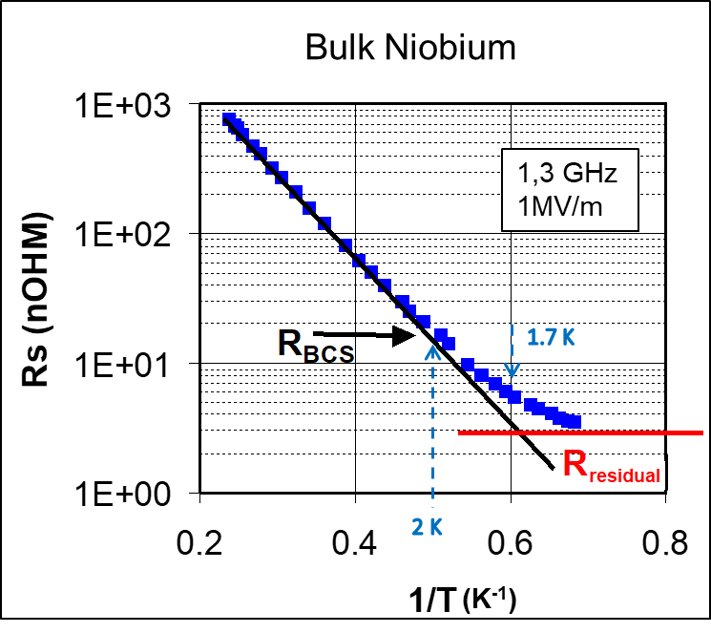


RF Residual resistance or… (Slide by Claire #2) recap on theory (VII)
… the limits of predictive theories
  R_{s} (sometimes quoted R₀): Not predicted by BCS!
      Vacancies, dislocations…
      Explained in part II
  Contains the (initially) “unknown”:
  Flux trapped during cooldown:
      Existence of pinning center (e.g. remnant of damage layer, thermal strain, poor recrystallization…)
      Mitigation: Magnetic hygiene (non magnetic steel for nuts and bolt. Active and passive magnetic shielding of the cryostat .Cooldown procedures. => Q₀ x10 improvment !
  Other pair breaking mechanism:
      Existence of magnetic impurity (e.g. vacancies in the oxide layer)
      Proximity effect (∃ a metallic layer at the metal oxide interface: NbO => SC by proximity effect but affects the gap)
      Other suspects (not yet identified)
The metal – (natural) oxide interface not easily modeled : lattice mismatch => stress => dislocations, impurities segregation… What are the exact SC parameters there ? Difficult to include in simple model
Notes:
Residual resistance due to defects, inclusions, welding, etc. etc.
Flux trapped during cooldown :
importance of the Nb preparation: recrystallization, surface treatments
Active (coils) and passive (ferrite screens) shielding: protection against earth magnetic field. NB conductive ferrite efficiency depends on temperature => optimization needs to be done
Cooling procedure : opposite requirements:
On naked cavities : fast cooldown helps to “drag” the field lines and favor their expulsion at the Tc transition.
Equipped cavities, with e.g. Titanium He vessel : high risk of thermo-current generating flux lines if there is temperature distribution => slow cooldown
Needs some tinkering in each lab
Natural oxide on the surface = protection (diffusion barrier), but also big impact on surface properties.
Surface
oxide, contamination, dust particles
roughness
Oxide
thickness~ 5nm, depends on orientation and previous process
mainly Nb₂O_{5-x}, with ppb impurities content (PO_{x}, SO_{x}…)
one layer NbO @ interface (metallic)
decomposes into suboxides upon baking (UHV)
First 10 nm of Nb
distorted (lattice mismatch)
a lot of interstitial atoms. Mainly H, O (1 At% to 10s of At%), also F, C, P… i.e. surface segregation & chem residue
higher impurity content for EP (O, C) !

Slide 16
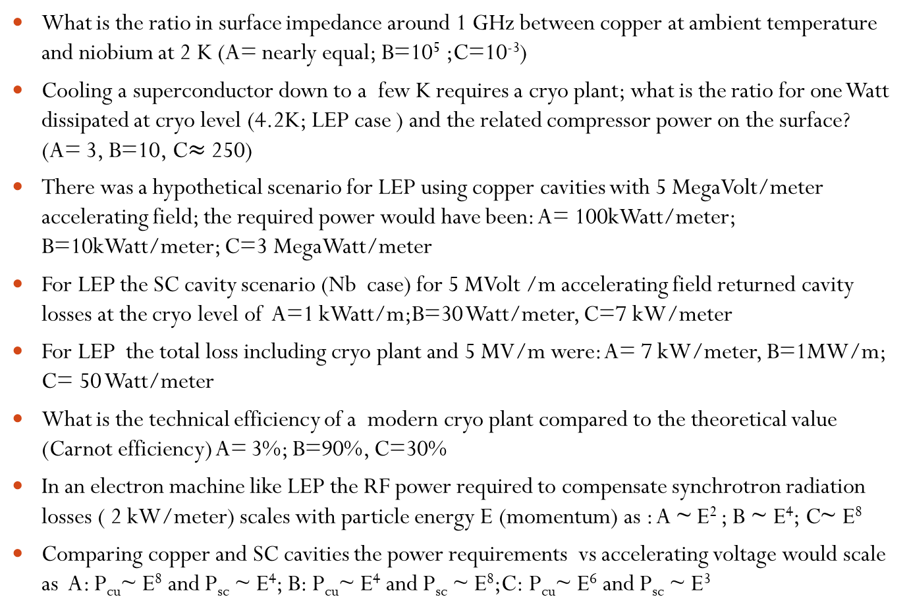
A short quiz (Multiple choice)
What is the ratio in surface impedance around 1 GHz between copper at ambient temperature and niobium at 2 K (A= nearly equal; B=10⁵ ;C=10⁻³)
Cooling a superconductor down to a few K requires a cryo plant; what is the ratio for one Watt dissipated at cryo level (4.2K; LEP case ) and the related compressor power on the surface? (A= 3, B=10, C$≈$ 250)
There was a hypothetical scenario for LEP using copper cavities with 5 MegaVolt/meter accelerating field; the required power would have been: A= 100kWatt/meter; B=10kWatt/meter; C=3 MegaWatt/meter
For LEP the SC cavity scenario (Nb case) for 5 MVolt /m accelerating field returned cavity losses at the cryo level of A=1 kWatt/m;B=30 Watt/meter, C=7 kW/meter
For LEP the total loss including cryo plant and 5 MV/m were: A= 7 kW/meter, B=1MW/m; C= 50 Watt/meter
What is the technical efficiency of a modern cryo plant compared to the theoretical value (Carnot efficiency) A= 3%; B=90%, C=30%
In an electron machine like LEP the RF power required to compensate synchrotron radiation losses ( 2 kW/meter) scales with particle energy E (momentum) as : A ~ E² ; B ~ E⁴; C~ E⁸
Comparing copper and SC cavities the power requirements vs accelerating voltage would scale as A: P_{cu}~ E⁸ and P_{sc} ~ E⁴; B: P_{cu}~ E⁴ and P_{sc} ~ E⁸;C: P_{cu}~ E⁶ and P_{sc} ~ E³
Notes:
16
Nearly all answers can be found in the slides (orginally by Steve Myers) in the beginning

Slide 17
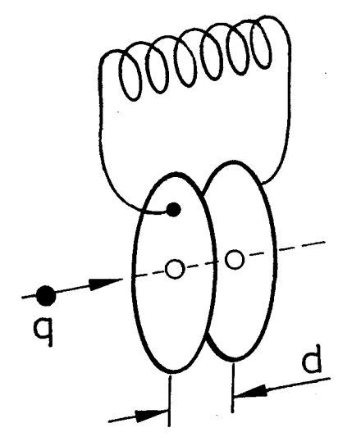
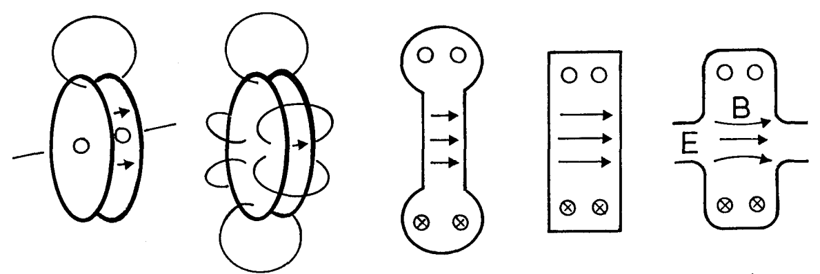
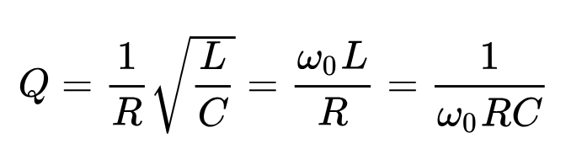
Equivalent circuit; RF cavity theory (I)
The generator may deliver power to R_{p} and to the beam, but also the beam can deliver power to R_{p} and Rg!
Generator
The beam is usually considered as a current source with infinite source impedance.
Ideal transformer
(no parasitic elements hidden in the coupling loop)
Beam
$$R_{p}=\text{resistor} \text{representing} \text{the} \text{losses} \text{of} \text{the} \text{parallel} \text{RLC} \text{equivalent} \text{circuit} (\text{resonator} \text{losses})$$
We have resonance condition, when
^{→ Resonance frequency:}
^{Quality factor}
Notes:
The well know equivalent circuit as a reminder…the beam is the current source ..as usual and the generator is often symbolized as a voltage source (50 Ohm typically where the power has to be up-transformed in voltage as much as possible to give a kick to the beam. In short :any accelerating cavity is a transformer and acts simultaneously as (longitudinal) pickup and kicker.

Slide 18
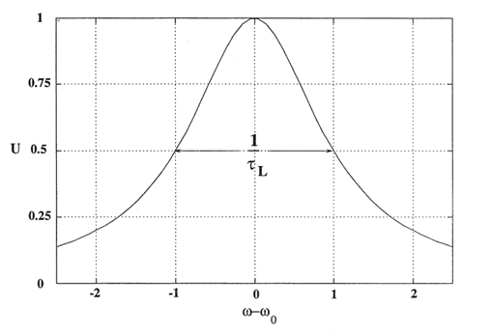
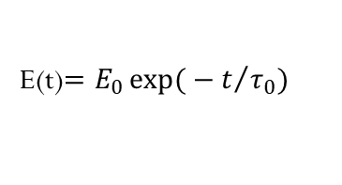

Resonators; RF cavity theory (II)
As we said at the beginning, an accelerating RF cavity is indeed a resonator for an electromagnetic wave. We already mentioned the idea of comparing an RF cavity to an RLC circuit.
Two important quantities characterise a resonator (remember your first physics course..): the resonance frequency f₀ and the quality factor Q₀
E² or V²
$$Q_{0}=\frac{f_{0}}{Δf}=\frac{ω_{0}W}{P_{c}}$$
P_{C} = wall current losses per period
E²=0.5
1/πτ₀
E(t)$=E_{0}\exp{(}−t/{τ_{0})}$
3 dB bandwidth=Δf
0.71 in voltage or
0.5 in power
τ_{O} = time constant for unloaded Q
Since we are only talking about losses in the cavity
Where W is the energy stored in the cavity volume and P_{c} /ω₀ is the energy lost per RF period by the induced surface currents, not from external loading
Notes:
18
The ususal resonance curve but caveat for the 3 dB points , which are 50 % in power and 71% in voltage

Slide 19



The quality- and geometry factors; RF cavity theory (III)
Let’s expand on the latter definition: with W= stored energy in cavity; P_{c} loss per period in the cavity
Thus:
Γ depends only on the shape of the cavity, and is generally calculated numerically with computer codes (MAFIA, URMEL, HFSS...)
For an ideal “pillbox” cavity Γ is e.g. 257 Ω. For an accelerating cavity for relativistic particles (β=1) like those used at CERN; Γ ranges in 270÷295 Ω.
The Q₀ factor of a SC cavity is in the 10⁹÷10¹⁰ range!
$$Q_{0}=\frac{ω_{0}W}{P_{c}}$$
W $=\frac{1}{2}μ_{0}{\int_{V}{\left|H\right|}}^{2}d{V} P_{c}=\frac{1}{2}R_{s}{\int_{S}{\left|H\right|}}^{2}d{s}$
$$Q_{0}=\frac{ω_{0}μ_{0}}{R_{s}}\frac{{\int_{V}{\left|H\right|}}^{2}dV}{{\int_{S}{\left|H\right|}}^{2}d{s}}=\frac{Γ}{R_{s}}$$
Notes:
19
Relation between Q and G.
G is geometry factor and depends only on … geometry, not on material

Slide 20
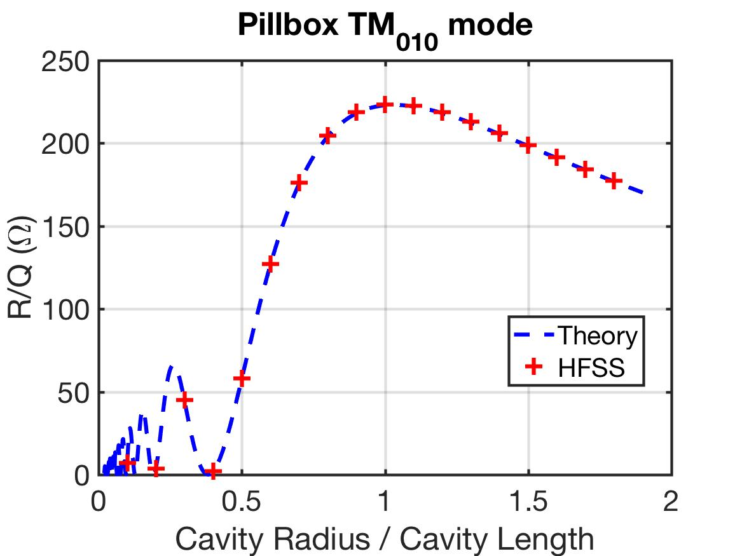
R/Q of a Pill box resonator; RF cavity theory (IV)
Short Quiz: Where is the frequency hidden in this plot?
Use the relation
Radius=1.53 λ₀ /4
Resonance condition for the E₀₁₀ mode
Plot by A. Mostacci JUAS lecture and also private communication
Thus we see for a relativistic beam (this plot is for v/c=1) an optimum for R/L ratio around 1.
Transit time factor !
For slow beams the gap must become shorter such that the beam sees not more than half a RF period
For very long cavities with this mode “nothing “ happens and very short cavities (R/L « 0.5)
are not so efficient; remember: the resonant frequency of this mode (E₀₁₀) only depends on the radius R
Notes:
20
For the R/Q exist MANY definitions (with and without transit time factor, Linac and circuit definition) thus a lot of possible confusion; here ist circuit definition with transit time factor

Slide 21

The geometry factor G for cavities , RF cavity theory (V)
The geometry factor is together with the Q-value an important figure of merit for cavities; this is in particular relevant for superconducting cavities. Lets take the surface resistance R_{s} and we obtain a very simple formula
W=Stored energy in the cavity and P_{c} = current losses in the wall per period
R_{s} is a function of many parameters like surface roughness, material and also treatment of the surface inside the cavity and normally assumed constant over the entire surface.
Typical values for G are around 270 Ohm for pillbox like cavities used for highly relativistic beams and as low as 20 Ohm for cavities used for slow beams.
One may calculate G also with the knowledge of Q in a similar way as the calculation of Q is done via the stored energy in a cavity and the power dissipated per period.
G=453/(1+radius/length) and also G = R_{s} Q
$$Q=2πf_{RES}\frac{W}{Pc}=\frac{ω_{RES}W}{Pc}$$
Notes:
21
The geometry factor is more often used for SC cavities…and its NOT a direct function of beta=v/c of the beam..but an indirect one since the shsape of the cavity and thus the geometry factor changes as a function of beta=v.c

Slide 22
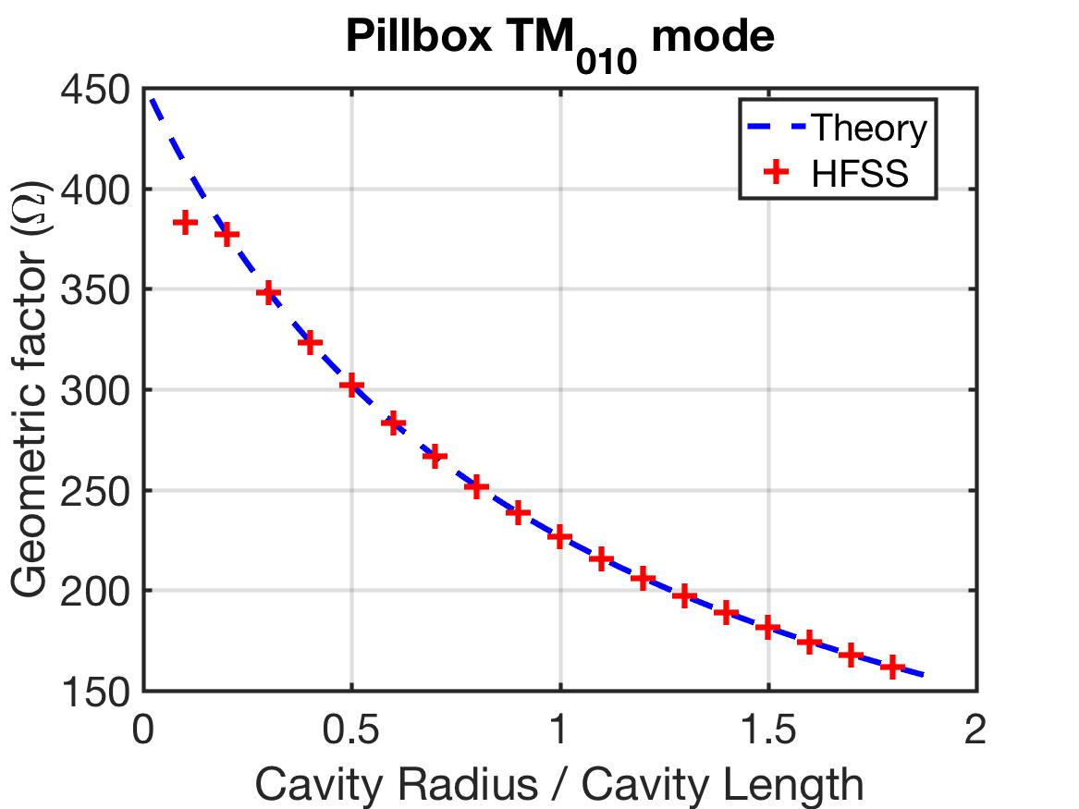
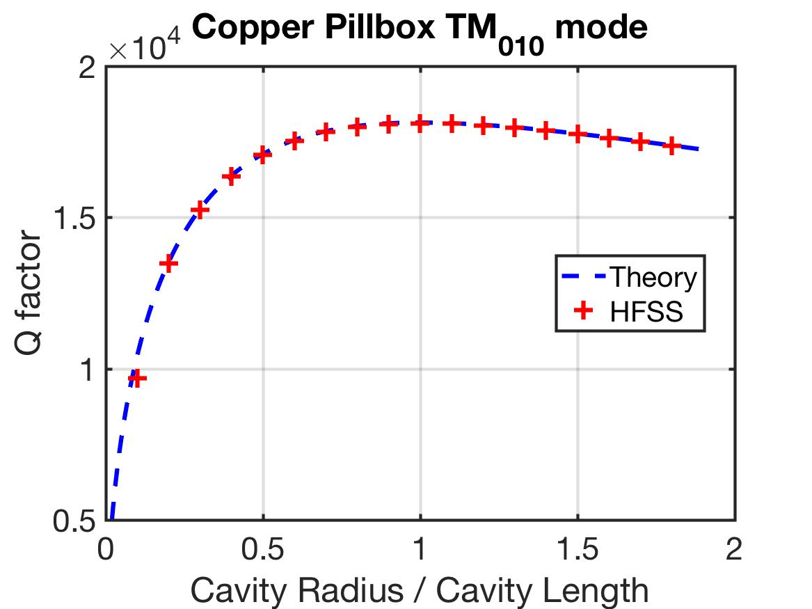
The geometry factor G for cavities ; RF cavity theory (VI)
at resonance: R=0.383λ and if L=λ/2 we get G=453/1.776=255
G-factor vs pillbox geometry
G=453/(1+radius/length)
255
0.766
Plot by A. Mostacci
And now we have a nice plot for The G-factor as well as for the Q factor as a functions of R/L
Just keep in mind that for SC cavities the Unloaded Q is quasi infinite…compared to the loaded one
Notes:
22
Graphics are always appreciated and nicely usable for exams..

Slide 23
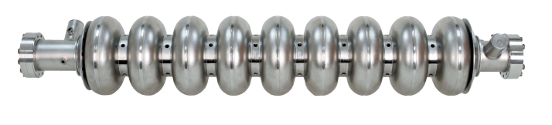
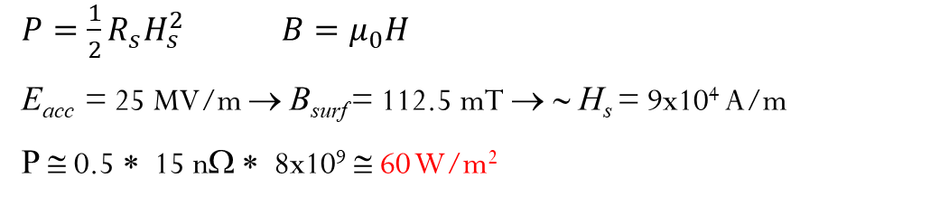
An exercise: power dissipation in SRF cavities
E_{acc} = 25 MV/m @ Q₀ 2x10¹⁰
B_{surf} /E_{acc} ≅ 4.5 mT / (MV/m)
Γ = Q₀∗R_{s} ≅ 295
Total area ≅ 0.88 m²
”TESLA shape” (ILC / LCLS-II / …)
$P={\frac{1}{2}R}_{s}H_{s}^{2}$ $B=μ_{0}H$
E_{acc} = 25 MV/m → B_{surf} = 112.5 mT → ∼ H_{s} = 9x10⁴ A/m
P ≅ 0.5 ∗ 15 nΩ ∗ 8x10⁹ ≅ 60 W/m²
This has consequences for the design of a circular accelerator
Notes:
23
Obviouly the transit time is best when the gap is very short..but then the particle cannot gain much energy since the interaction length is also short ..and we have to find a reasonable compromise between gap length and transit time factor keeping in mind other limitations such as surface electric and magnetic field limitations and also multipactor and heating issues

Slide 24
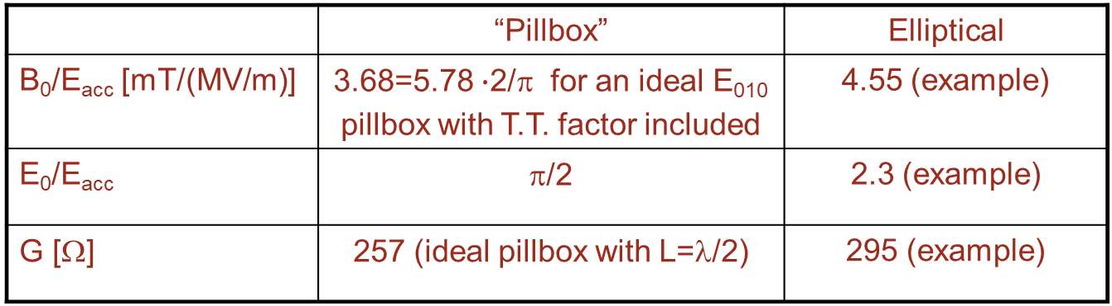
Fields and the G-factor ; RF cavity theory (VIII)
Our cavities are meant to accelerate particles, and the accelerating electric field on axis is of basic importance.
However most of the considerations on the surface impedance are based on the surface magnetic field and on the induced currents.
For a given geometry, there exists a fixed proportionality between B₀, E₀ and E_{acc}.
 | “Pillbox” | Elliptical
B₀/E_{acc} [mT/(MV/m)] | 3.68=5.78 $∙$2/π for an ideal E₀₁₀ pillbox with T.T. factor included | 4.55 (example)
E₀/E_{acc} | π/2 | 2.3 (example)
G [Ω] | 257 (ideal pillbox with L=λ/2) | 295 (example)
Notes:
24
Some practical numbers to get a ballpark and a feeling

Slide 25
Summary for cavity basics and learning targets; RF cavity theory (IX)
The pillbox resonator (TM₀₁₀ mode) allows – as a paradigm - the analytical description of typical accelerator parameters, such as peak surface fields (E and H), power loss and Q-value, shunt impedance, geometry factor, etc.
« Real » accelerator cavities are designed by making use of computer codes such as Microwave Studio, HFSS, Comsol, MAFIA, SUPERFISH, etc.
The response of a cavity to an RF signal (CW or pulsed) from a generator is well described by lumped circuit networks, in particular for the transmission and reflection of an electromagnetic wave on this device
A relation between the surface magnetic field on the equator of an ideal pillbox and the electric field on axis is derived and discussed; This ratio tells us how much accelerating field we get until we hit the B-field limit in SC cavities
We also introduce and use the geometry G here which is less important and less used for NC cavities.
Notes:
Our tool box is ready for use…

Slide 26
Learning targets
After having worked though this chapter and the lectures on basic SC it would be nice if you could
be familiar with the motivation for using RF superconducting cavities in accelerators
be able to dicuss why SC RF cavity technology is barely used outside the accelerator field
see the benefits but also the problems related to RF SC technology
have understood the main difference between DC and RF superconductivity
be able to calculate the RF surface impedance of a given material (NC and SC) vs frequency
have understood the concept of the resistance and impedance per unit square
be able to name some of the materials used for RF SC applications
be familiar with the basics, history and some important milestones of superconducting RF technology in general (see slide by ANLAGE in the beginning this talk)
have some ideas how to measure the surface impedance of RF superconductivity
-
Notes:
And try to practise and to visualize some of the simple formulae we gave in this chapter

Slide 27
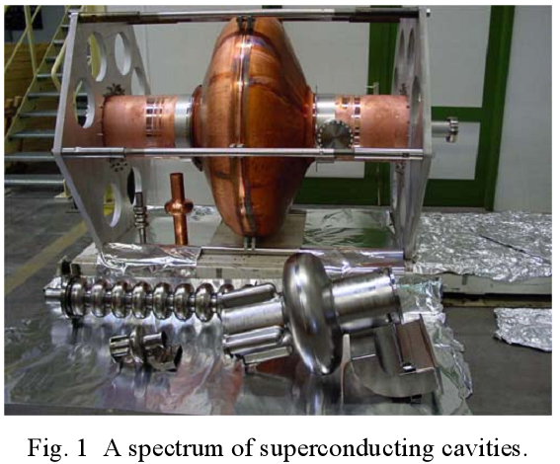
Examples real of RF cavities; SC-cavity implementation (I)
The big object is a single
cell copper cavity niobium
coated inside;
In the foreground some
smaller multiple and single
cell cavities
different frequencies..different sizes .. In this photo from 200 MHz up to 3 GHz
often one talks about “elliptical” cavities; BUT this does not mean that those cavities have an elliptical cross section (although this exists); explanation next slide
(from H. Padamsee, CERN-2004-008)
Notes:
27
A collections of cavities…some from the good old days..

Slide 28
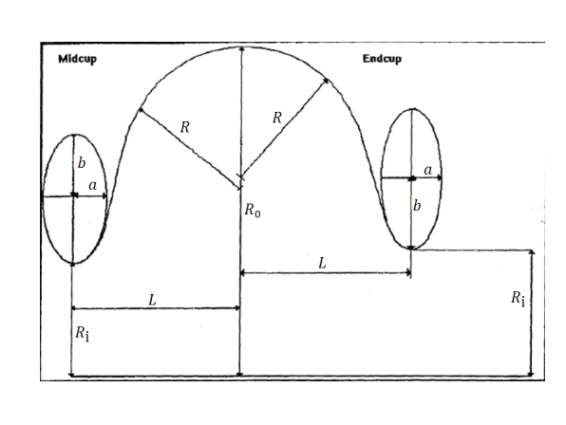
What are elliptical cavities? ; SC-cavity implementation (II)
The asymptotic ellipse
Quiz: Why don’t we find
elliptical cavities for low beta cavities?
The term “elliptical” refers to the the particular shape in the longitudinal cut of such a cavity
which had been found over MANY years of optimization in order to mitigate two point multipactor
inside such type of cavities; the shape (longitudinal cut) is characterized by the asymptotic ellipse
in the transition region from the beampipe to bell shaped cavity form and also near the equator
D. Proch, http://accelconf.web.cern.ch/accelconf/SRF93/papers/srf93g01.pdf
E.Jensen RF Cavity design, Fig 22 ;Proceedings of the CAS-CERN Accelerator School: Advanced
Accelerator Physics, Trondheim,Norway, 19–29 August 2013, edited by W. Herr, CERN-2014-009
Notes:
28
Thus lets retain that this „elliptic“ shape refers to cavities used with high beta=v/c beams for slower beams weed to keep an eyes on the transit time factor and so very careful simulations with local fine tuning of the geometry and choice of suitable materials as well as surface treatment to minimize multipactor effects

Slide 29
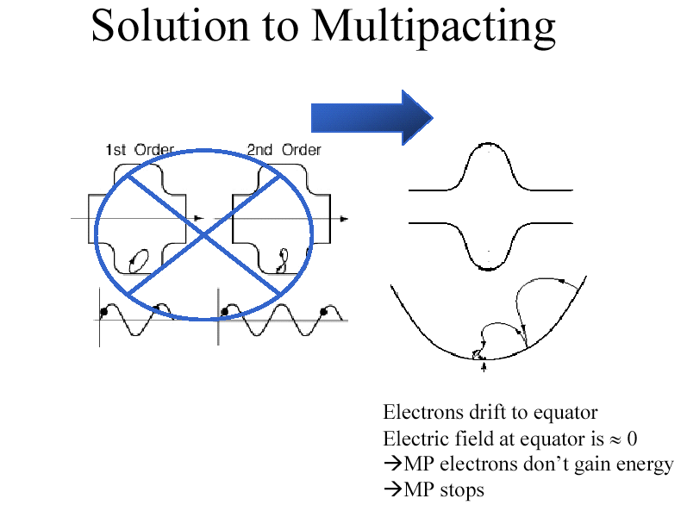
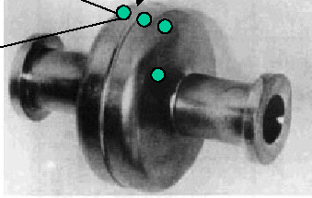
Finding the right cavity shape..learning by doing; SC-cavity implementation (III)
In the old days superconducting cavities had a rather rectangular longitudinal cross-section (left side) which resulted in strong first and second order (2 point) multipactor limiting the useable field strength to a few MV/m. After many years of experimental numerical and theoretical work the Gaussian or bell shape form with the ellipse as asymptote in the transition region (shown in the previous slide) was found.
Thermometers show heating
H. Padamsee; 50 years of RF superconductivity- a perspective CERN Centennial Superconductivity Symposium 2011
https://indico.cern.ch/event/161849/contributions/1410630/attachments/188580/264767/CERNTalkHasan.pdf
Notes:
29
Learning by doing….sometimes a long a and tedious job

Slide 30
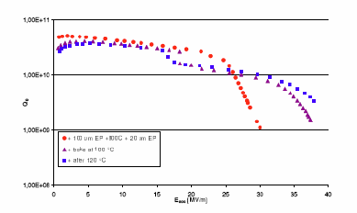
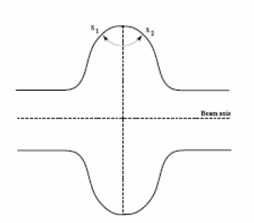
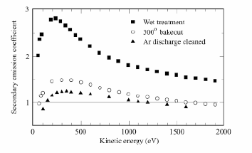
Electron multipacting; SC-cavity implementation (IV)
Localized heating by multiple impact from electron current due to secondary emission in resonance with RF field.
Historically this phenomenon was a severe limitation for the performance of sc cavities.
The invention of the “circular” shape opened up the avenue for higher gradients.
Notes:
30
Usually squared boxed shapes favour resonant multipacting, thus round and elliptical is preferred

Slide 31
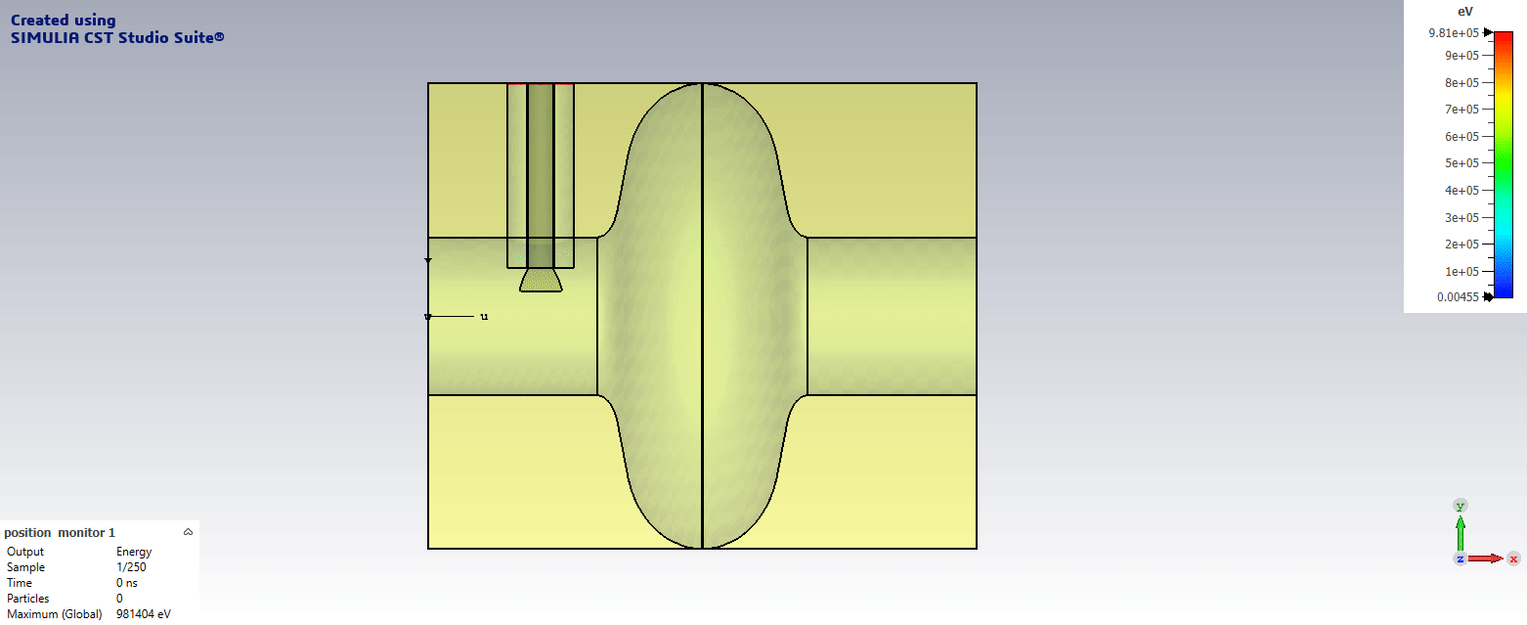
Multipactor movie (By Fatih Yaman); SC-cavity implementation (V)
SEY for Copper was applied according to the Furman-Pivi model.
The cavity is operating in the pi-mode and the frequency is 1.30 GHz. Max. field at the center is 8.42 MV/m,and the input RF power is 163.90 kW.
CST-PS was used for the multipacting simulation, and loaded the rectangular-looking computational domain with 1000 seed electrons (their energy is almost zero, 0.00455eV) homogeneously at the beginning of the simulation. Then when the time evolves the multipactor regions started to generate more electrons while
in the other regions, the seed electrons disappeared.
Notes:
We see the buildup of electrons=growth of electron density versus time in the equator region of this cavity, Starting we have a “seeding”electron density.

Slide 32
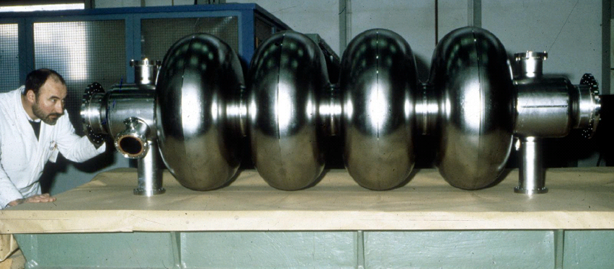
A Typical storage ring cavity (LEP); SC-cavity implementation (VI)
Bulk niobium cavity of LEP (there were 16 bulk niobium and 272 Niobium-on-Copper cavities in LEP), electron-beam welded, 352 MHz.
Long ports for main couplers, short ports for HOM couplers and diagnostics (field probes)
(Sorry LEP again ..not only at the beginning of those slides)
Notes:
Heavy SC cavity stuff at 352 MHz… Niobium is 700 EUR / kg… This is one of the reasons (not only!) why at LEP (and LHC) we used thin films

Slide 33
Integration into LEP cryostat (exploded view) ;SC-cavity implementation (VII)
Comments:
The LEP cryostat could reliably be operated under CW conditions with beam and in pulsed conditions without beam in the present LHC tunnel environment (1.4 % slope= inclination of plane of the ring).
It is worth noting that the lHe tank, the gas openings, and gHe collector were relatively small.
Pulsed operation: The thermal diffusivity κ=λ/(c∙ρ) is such that it takes ~1 ms before the temperature pulse arrives at the niobium helium interface => advantage compared to CW operation.
This cryostat was tested under pulsed conditions with beam in the CERN SPS.
Notes:
It’s the sum of MANY elements which have to work properly together..and the chain likely to rupture at the weakest point

Slide 34
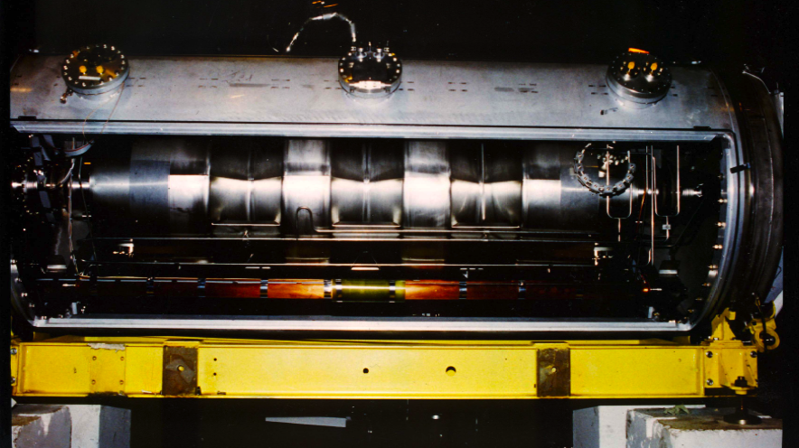
Integration into the LEP cryostat (Photo); SC-cavity implementation (VIII)
Notes:
34
Integration of the actual cavity into the vacuum vessel is a major task low heat loss, cryo cooling, maybe tuners.. All sort of diagnostics .. RF-probes ..the main coupler

Slide 35
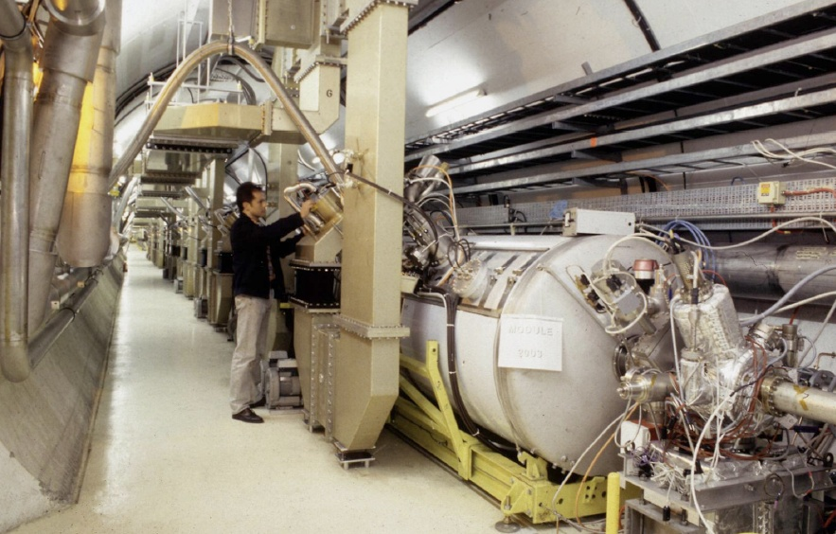
Cryomodules LEP installed in the tunnel, SC-cavity implementation (IX)
Notice the rather flat waveguides for about 350 MHz; there would have simply been no space for the normal aspect ratio (around 1 to 2);
Quiz: Can you estimate the length of the larger size (width) of the waveguide? Does the cutoff frequency of the waveguide depend on its height?
Notes:
Installation of this type of waveguides in the tunnel can be very delicate ..ESS (Lund) knows that really well.. Thus give it enough mechanical margin for waveguide installation

Slide 36
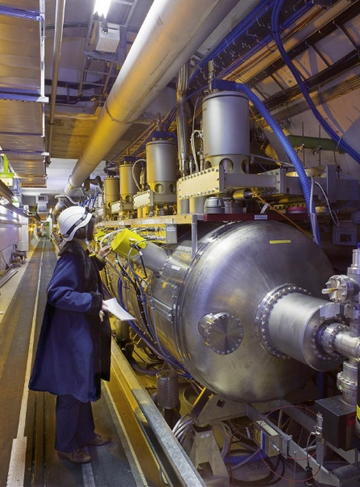
LHC – CERN cavities in the tunnel looking quite similar to the LEP case;
SC-cavity implementation (X)
f_{res} = 400 MHz
  R/Q = 89 Ω
  Q₀ = 2 x 10⁹
  E_{acc} = 5.33 MV/m
  P_{in} = 116 kW (CW) to be transferred to the beam
Niobium-film on Cu
  1-2 µm thickness
4 single-cell cavities per cryomodule
  Each resonator delivers 2 MV
  Blade tuner (detail discussed later)
  «Doorknob» power coupler, 75 Ω coaxial shown on another slide (air cooled in cryo; can you guess the purpose of the blue hose ending above the waveguide top of the cavity
Total of 8 cavities per beam: 16 MV
400 MHz SC cavities in the LHC tunnel
Photo CERN No 0712013-01 available via CDS cern
Notes:
36
Compare the field in each cavity (single cell) of 5.33 MV/meter with the kick delivered to the beam as 2 MegaVolt..what happens with the 116 KW when there is no beam?

Slide 37
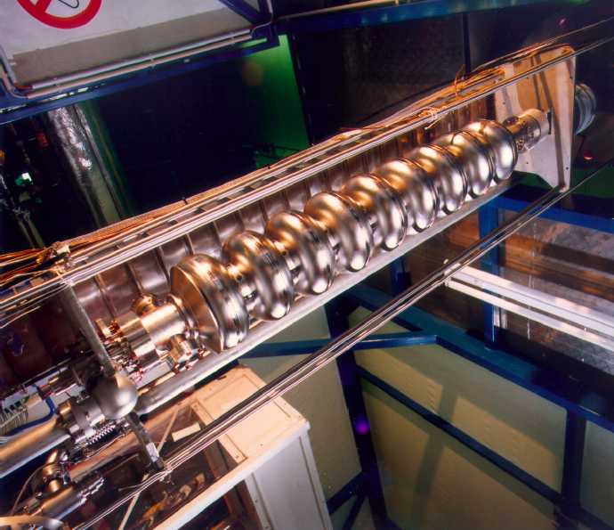
XFEL – DESY; SC-cavity implementation (XI)
f_{res} = 1300 MHz
Standing wave; elliptic
RRR 300 Niobium
TM₀₁₀ π-mode
active length=1.038m
Q₀ >10¹⁰
Iris diam. = 70 mm
Nominal gradient =23.6 MV/m
Cell to cell coupling K=1.87%
B_{peak}/E_{acc}=4.26 mT/MV/m
From: Review of the European XFEL Linac
System Beam dynamics meeting; March 26
2007 Desy (Hans Weise)
Notes:
Now we have an application for electron beams..and this cavity shape was REALLY optimised for a very good ratio of accelerating field vs surface magnetic field

Slide 38
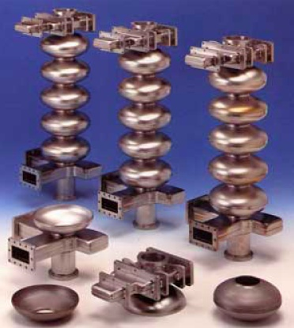
CEBAF – JLAB; SC-cavity implementation (XII)
Here we see the different production
Stages of those SC cavities
Half shells to start with for each cell
Waveguide port couplers
One waveguide for the RF-in
The other for HOMs –out
Note that practically ALL SC multiple
cell cavities are operated in the
standing wave mode (in contrast to
NC multiple cell cavities which are
often in travelling wave mode…some
of them in forward traveling wave
mode ..some using backward waves
This (trav. wave) allows more bandwidth
and is also applied for heavy
Beam-loading
Photo by ACCEL now Research instruments with permission
Notes:
Some practical examples

Slide 39



SPL - CERN/ SNS – ORNL (moderate beta examples);
SC-cavity implementation (XIII)
Quiz: What is characteristic for moderate or low β =v/c value cavities?
A:The bellshape of a cell? B: The shorter gap compared to β =1 cavities? C: the diameter
From Kneisel et al PAC 2001 (Chicago) proceedings
Notes:
Development work is never lost…and will ususally be applied later

Slide 40


Heavy Ion accelerators ATLAS – ANL; SC-cavity implementation (XIV)
Excitation via tankprobe or loop“antenna”; This type of spiral resonator is also known as split ring resonator; 97 and 145 MHz beta=0.06..0.16
This (Left side: SC version)) is kind of similar to a
NC spiral resonator (water cooled) .Note the coupling loop at the left in the NC resonator (only one loop ..mirror)
Here we see a 48.5 MHz spiral resonator (MEBT);
NIMA 949 (2020)162776 by Mentha et al.
Quiz: How would you design the water cooling for the
NC resonator coil ? discussion
Figure from S.Bousson; High power proton
Linacs JUAS 2015
Notes:
This is the superconducting version of a cavity with similar shape (but normal conducting) developed at GSI in the early 80th..This type of structure is good for slow beams and has a very high shunt impedance

Slide 41





Shapes of heavy ion accelerator cavities (low β); SC-cavity implementation (XV)
a λ/2 style
coax resonator
as SC spoke cavity
the beam passes in
the middle 2 gaps
(L to R)
Single spoke resonator λ/4 with 2 gaps
seen by the beam in the “open”end
Single spoke resonator λ/2
beam
beam
Multiple spoke
lamda/2 style
SC resonator
Photos: from JUAS lecture 2015 by Sebastien Bousson or better from Calatroni
A superconducting 4 Rod RFQ
Notes:
Thats one practical application of coaxial line theory for resonators…note that for low beta beams there are often two gaps to pass for the beam while the sign inverts during the passage of the beam through some hole on the resonator like a drift tube)

Slide 42

Shape versus β; SC-cavity implementation (XVI)
Remember: d ≤ β λ/2 here: β =v/c, λ=c/f₀
Trading between transit time factor and geometry factor
We know that for a relativistic beam the gap length should be<λ₀/2, since then the particle sees a half wave
Example: 300 MHz; beta=1, λ=1 meter; a good gap length incl R/Q is ≈40 cm and >50 cm leads to cancellation
Electron accelerators | Proton accelerators | Ion accelerators
β ≅ 1 | β ≅ 0.5 (moderate beta region) | 0.05 ≤ β ≤ 0.2 (low beta region)
350 MHz ≤ f₀ ≤ 3 GHz | 500 MHz ≤ f₀ ≤ 1.5 GHz | 50 MHz ≤ f₀ ≤ 150 MHz
G ≅ 270 Ω (geom. factor) | G ≅ 170 Ω (geom. factor) | G ≅ 20 Ω (geom. factor)
L ≅ 35 cm (f₀ = 350 MHz) | L ≅ 20 cm (f₀ = 350 MHz) | L ≅ 5 cm (f₀ = 150 MHz)
Wide bell shape for beta=1
λ/4 coax
resonator
with two
short gaps
and drift
space in
between
Narrow bell shape
for moderate beta
L
No nose cones for SC cavities !
WHY?
Figures from S.Calatroni
Notes:
42
Keep in mind that the field extends a bit further into the beampipes than the gap length defined this way thats why d is in practise a bit smaller than lamda/2

Slide 43

Intuitive Introduction..the surfer.. Interaction of cavity-beam (I)
JUAS Lecture Archamps 2008
Notes:
43
Surfing on the waves..means to stay in synchronism..more or less..in particular important for multi cell cavities of course this also applies to NC multiple cell cavities when you this on a nice warm summer day near Hawaii or just in the mediterreanean contemplate about the difference between „deeply thinking“ and „deeply sinking“

Slide 44

Reasons for beam induced mechanical oscillations - radiation pressure
Interaction of cavity-beam (II)
Many thanks to: Jean Delayen ;Thomas Jefferson National Accelerator Facility Old Dominion University
more B-field at the
equator of the cavity thus repelling force
more E-field near the axis of the cavity thus contracting force
Notes:
44
Note that this „radiation pressure „ is not always a pressure trying to „inflate„ the cavity; in reality ist rather a position dependent deformation; analogy (the plates of a charged capacitor are attracted, and conductors with parallel currents repell each other

Slide 45


Mechanical oscillation modes; Interaction of cavity-beam (III)
For example: at LEP, radiation pressure on the cavity walls of about 1000N in total possible
Its essentially the batch pattern that reduces periodically the fieldstrength (beamloading) and if this hits
a mechanical resonance we may get a problem .. frequencies are usually a few 10Hz to serval hundred Hz
Notes:
45
The accordeon..with many mechnical modes..

Slide 46

A fast frequency tuner ; Interaction of cavity-beam (IV)
The frequency of the cavity must be tuned to the harmonic spectral line of the bunched beam => need to develop a frequency tuner. Slater’s theorem states that
) dV
4W
The type of plunger is maybe good for slow tuning (say below 1 Hz) but not easy to operate at say 30 Hz , for fast tuning (beam induced vibrations via “radiation pressure” from the time dependent envelope of the field in the cavity via batch structure )we need piezo or magnet-strictive tuners with up to kHz bandwidth
V
We need a rather FAST frequency tuner (plunger is tricky) to compensate those oscillations in the audio range
) dV
W
Notes:
46
Ist like an accordeon (again) just a different machnical mode….and this type of accordeon style frequency tuning had been also proposed around 1980 for the NC SPS single cavities by some hydraulic mechanism in the tunnel but of course never realized this way inseated we had a plunging tuner (very 10 seconds or so) with lots of vacuum problems on its bellows

Slide 47
Learning targets and quiz
After having worked though this chapter it would be nice if you could
- have an idea about SC multiple cell resonators and their mechanical implementation
know that the Q value of superconducting cavities is field strength dependent (Q-slope)
be able to give some examples of typical shapes for SC cavities
be familiar with G-factor and have an idea about its order of magnitude
know that the G-Factor gets worse for low beta cavities and why
be able to explain the difference between R/Q , Q and G-factor
know why elliptical shape cavities have advantages even when they are mechanically more delicate
-
Notes:
Home work…..sorry…

Slide 48
Summary for the previous chapters
A lumped network circuit diagram allows an analytical description of the interaction of the RF cavity with the beam
The cavity is designed to minimize the reflected RF power (which would be wasted anyhow in a load) by eliminating the « reactive beam loading » through tuning the frequency of the cavity and by matching the external Q to the nominal beam current.
Frequency tuners are in addition needed to damp frequency shifts from mechanical resonances excited by external noise sources (microphonics) or the interaction of the electromagnetic pressure with the cavity wall (Lorentz force detuning).
Discussed in the appendix: The beam consists of bunches passing the cavity in batches of milliseconds¹ that may excite higher order modes (HOMs) of the cavity to high voltages, if not sufficiently damped by HOM couplers.
¹ for large storage rings such as LEP.
Notes:
Yes we did hear this now several times..

Slide 49
State of the art SRF research
(fabrication technology (I)
Reaching ultimate performance with bulk Nb cavities
  Maximizing the quality factor Q₀
  Reaching high accelerating gradients E_{acc}
Beyond Niobium: New materials
  High temperature superconductors
  Low temperature superconductors: Nb based materials
Search of new materials beyond Nb (i.e. Nb3Tn,V3Si, NbN for low temperatures and YBCO for high temp); the primary goal is energy saving, not so much the absolute performance in terms of acc. gradient. But reliability is always the fundamental requirement.
Notes:
YBCO not yet practical for most accelerator Rf applications

Slide 50
Some deterministic parameters for cavity performance
Until till now we discussed the role of the RF frequency, the He bath temperature, and sc material with its characteristic critical field and temperature. There are still other (less important) parameters that determine the performance of the cavity as well:
Influencing quantity | Impact quantity | Physical explanation | Cure
External static magnetic field B_{ext} | Residual surface resistance | Creation of vortices | Shielding of ambient magnetic field by Mu-metal / Cryoperm
Residual resistivity ratio RRR | BCS surface resistance | Mean free path dependence of R_{res} | Annealing steps during ingot production/after cavity manufacture
Ratio peak magnetic field to accelerating gradient B_{p}/E_{a} | Max. accelerating gradient | Critical magnetic field as ultimate gradient limitation | Optimization of cavity shape
Nb-H precipitate | Q-value / acc. gradient (Q-disease) | Lowering of T_{c}/B_{c} at precipitates of Nb-H | T-control during chemical polishing Degassing @ 700 °C Fast cool-down
“frozen magnetic flux”
This undesired and normal
conducting compound is often
created during cooldown inside
the cavity when hydrogen present
Notes:
A lot of technological issues are entering the process and ALL of them have to be controlled carfully

Slide 51

Anomalous losses fabrication technology (II)
So-called « anomalous losses » account for all contributions to the RF losses that are not described by the intrinsic parameters of the superconducting material (critical temperature, critical field, BCS (or two fluid ) surface resistance R_{s}, etc.).
These anomalous losses show up as heat and are visible in the R_{s} (T) and Q₀(E_{a}) plots, as well as in the « temperature maps ».
Notes:
A collection of loss mechnism…for SC cavities

Slide 52

Magnetic shielding ; fabrication technology (III)
Why do we need a magnetic shielding?
Notes:
For classical superconductor do make sure that there is no trapped magnetic flux during cooldown !However High TC superconductor can work nicely in a strong static magnetic field e.g. applied for axion search cavities but their Q value is significantly lower than for classical RF superconductors

Slide 53


Electron field emission trajectories; fabrication technology (IV)
Notes:
The nasty consequence of (hidden) electron field emission emitters

Slide 54






Electron field emitters ; fabrication technology (V)
Typical particulate emitters containing impurities
2 µm
2 µm
500 nm
E_{on}(2nA) =140 MV/m
= 31, S = 6.8·10⁻⁶ µm²
E_{on}(2nA) = 132 MV/m
β = 27, S = 7·10⁻⁵ µm²
E_{on}(2nA) > 120 MV/m
= 46, S = 6·10⁻⁷ µm²
Si Nb
Al Mg Nb
Al

Slide 55

Electron field emission and Fowler Nordheim theory; fabrication technology (VI)
Fowler Nordheim theory
Notes:
55
Many people like cold cathodes (often made by many sharp needles) very much, but we hate them inside SC cavities..

Slide 56

Electron field emission and clean room; fabrication technology (VII)
Clean room preparation mandatory
Notes:
56
Very careful , proper and diligent work is required in the clean rooms

Slide 57


Electropolishing: How it works fabrication technology (VIII) [slide by Claire Antoine]
Highly corrosive and toxic mixture
Levelling effect of viscous layer… smaller resistance etched first
The metal is immersed in an electrolyte and subjected to direct current. The metal part to be treated is made anodic and under certain conditions, a controlled dissolution of the metal is achieved

Slide 58

Electropolishing vs Mechanical based polishing
Fabrication technology (IX)
              Typical roughness states

Slide 59



Heat removal fabrication technology (X)
Thermal Improvement of thermal conductivity for Niobium sheets
Cause for “quench”:
RRR…. residual resistance ratio
Notes:
59
The RRR is a key parameter for heat conductivity similar to the RRR case of copper for electrical conductivity in the liner of the LHC which copper coated inside

Slide 60


Heat probes for temp. mapping on cavities 40 years ago; Special Diagnostics (I)
Many features of the cavity can be tested by RF-measurements.
But losses, which occur in the form of localized heat can only be detected by additional diagnostics.
The classical approach is temperature mapping (in the old days)
In the picture:
Herbert Lengeler (cern photo)
Notes:
60
Here we see Herbert Lengeler ..one of the fathers of RF SC technology at CERN, early 80ths

Slide 61

Temperature distribution measurements on SC cavity ; Special Diagnostics (II)
Temperature mapping equipment (~ 1980)
The temperature sensing elements
were Allen Bradley carbon resistors
of nominally 100 Ohm at ambient
The entire setup is later submerged
in liquid helium.
Special care had to be taken for the
selection of the integrated circuit
Elements since normal silicon bipolar
transistors “ freeze” out at cryo.
Notes:
Lots of temperature probes with cryo compatible electronics not trivial in the 70ths and 80ths..;guess why?

Slide 62

Finding hot spots; special diagnostics (III)
Temperature mapping results (today= 2004); a hot spot was detected and later the criminal item(copper particle) got removed..
From H. Padamsee: CERN -2004 - 008
Notes:
Thats the real hard work.. until the last tiny particle it out..

Slide 63

Anomalous losses via T- mapping; special diagnostics (IV)
T-mapping for the diagnosis of anomalous losses
Notes:
63
A sort of unusual projection of the the cavity surface into a 2 D plot

Slide 64

Cleaning procedure; fabrication technology (XI)
From: C. Antoine, (Practical) Limitations & possible solutions ,CAS 2013
Notes:
And the painful and boring cleaning process

Slide 65
Summary
The choice of the technology (normal conducting vs. superconducting) depends on a variety of parameters: mass of accelerated particle, beam energy, beam current, mains power consumption, etc.
If superconducting, the typical interval of RF frequencies is between 300 MHz and 3 GHz.
The technically most suitable superconducting material being niobium, choosing lower frequencies allows operation at 4.2 – 4.5 K, the boiling temperature of lHe, higher frequencies request operation at 1.8 – 2 K. However, the cryogenic installation is much more demanding.
The production of sc cavities requests careful application of quality control measures during the whole cycle of assembly in order to avoid the degradation of performance by « anomalous losses ».
The « anomalous losses » contribute to an extra heat load, which is expensive to cool and which may limit the performance.
Notes:
And this is not really the end..maybe the beginning of the end ..or rather the end of the beginning (Churchill 1944 at the invasion in normandy)

