Slide 2

Vacuum Systems
Slot 5
V. Baglin
CERN TE-VSC, Geneva
https://indico.cern.ch/event/1470062/timetable/?view=standard#day-2025-02-17

Slide 3
Outline
Cryo-pumping
Adsorption isotherms
Synchrotron radiation

Slide 4
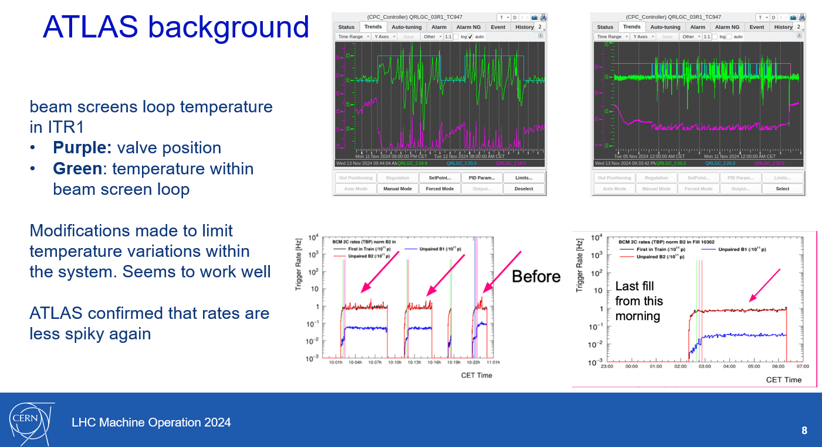
Why cryo-vacuum matters?
Explanation of beam induced background in ATLAS during November 2024 …

Slide 5
1. Cryopumping

Slide 6
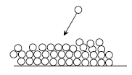
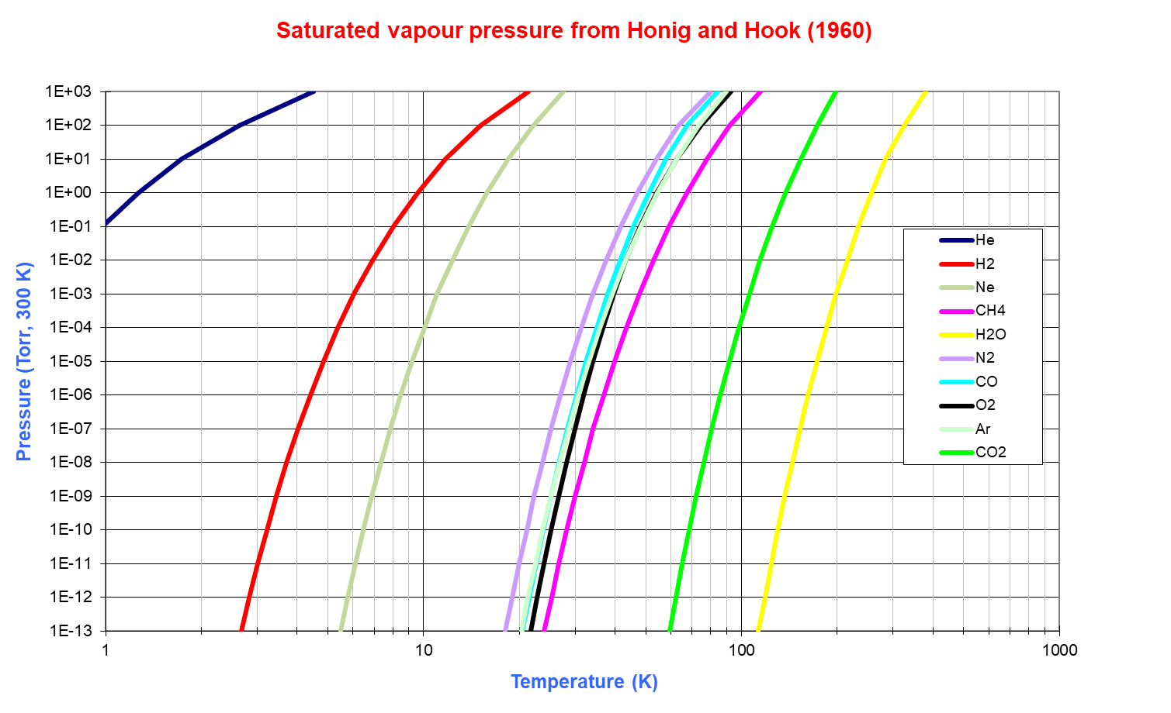
Saturated Vapour Pressure
Pressure over liquid or gas phase (many monolayers condensed)
Follows the Clausius-Clapeyron equation: Log P_{sat} = A – B/T
For a smooth surface:
4.2 K

Slide 7



Desorption probability
The desorption probability, p, of a molecule is a function of the binding energy, E and the temperature, T (first order desorption, Frenkel 1924). The surface coverage, θ, varies like :
The desorption process is characterized by the sojourn time, τ :
For large E and small T, the molecule remains onto the surface : CRYOPUMPING
For some combination of E and T, the molecule is desorbed (bake out)
$$p= \frac{dθ}{dt}=− θ ν_{0}e^{−\frac{E}{kT}}$$
(ν₀ ~ 10¹³ Hz, k = 86.17 10⁻⁶ eV/K)
$$τ= \frac{e^{\frac{E}{kT}}}{ν_{0}}$$

Slide 8
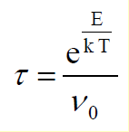
Sojourn time at cryogenic temperature
Cryosorption occurs up to ~ 100 K
1 eV/k =
11,604.5 K
Superfluid He
Liquid He
~LN₂ (77K)
E(eV) | 1.9 K | 4.2 K | 50 K | 70 K
0.01 | 1 10⁶ years | 0.1 s | 1 ps | 0.5 ps
0.02 | ∞ | 3 10³ years | 10 ps | 2 ps
0.15 | ∞ | ∞ | 130 s | 6 ms
0.21 | ∞ | ∞ | 5 years | 130 s
0.3 | ∞ | ∞ | 1 10⁴ years | 12 years

Slide 9
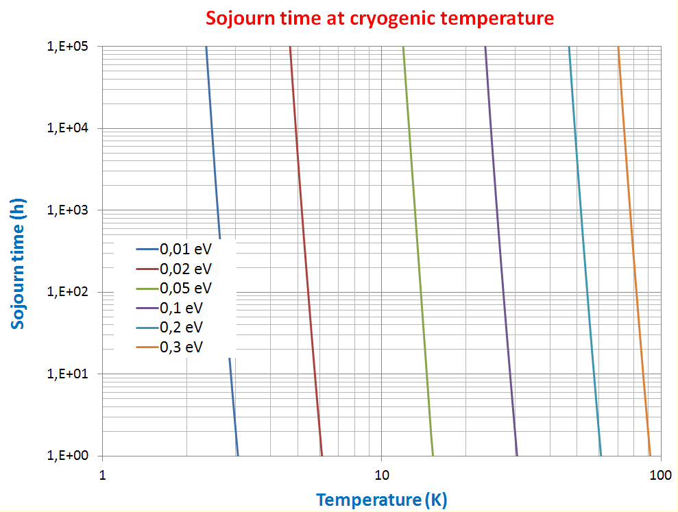
Sojourn time - Physisorbed molecules
Physisorption occurs:
    below 23 K for binding energies < 0.1 eV
    below 50 K for binding energies < 0.2 eV
    below 70 K for binding energies < 0.3 eV
1 year
20
50
70

Slide 10
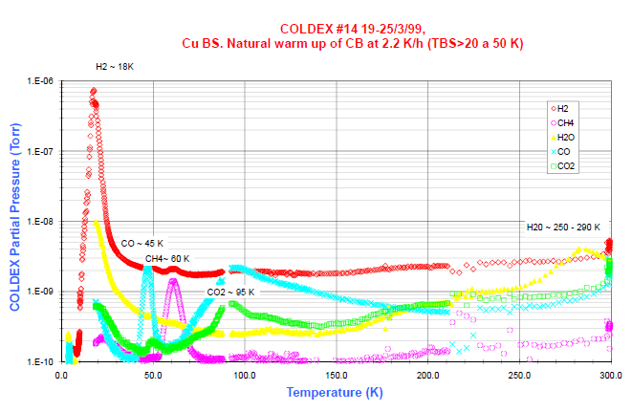
A Natural Warm Up of a St. Steel Cold Bore

Slide 11
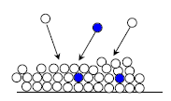
Cryopumping regimes/mechanisms
Physisorption
Sub-monolayer coverage : attractive force (van der Waals) between a gas molecules and a material
Binding energy for physical adsorption
H₂ from 20 to 85 meV for smooth and porous materials respectively
1 h sojourn time at 5.2 K and 26 K for smooth and porous materials resp.
Condensation
For thick gas coverage, only forces between gas molecules
Energy of vaporisation 9 to 175 meV for H₂ and CO₂ resp.
1 h sojourn time at 2.8 K and 53.4 K for H₂ and CO₂ resp.
➔ sub-monolayers quantities of gas can be physisorbed at their boiling temperature
(ex : H₂ boils at 20.3 K and a bake-out above 100 ºC removes water)
Cryotrapping
Use of an easily condensable carrier (e.g. Ar) to trap molecules with
a high vapor pressure gas (e.g. He, H₂)

Slide 12
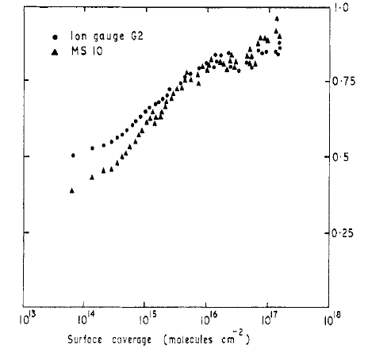
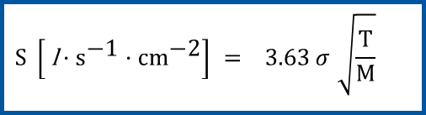
Sticking probability/coefficient
Probability : 0 < σ < 1
ν collision (impingement) rate (molecules.s⁻¹.cm⁻²)
Function of the gas specie, surface condition, surface coverage, temperature of gas and surface
Pumping speed
i.e : σ multiplied by the conductance of a surface
A = area sample (m²); <v>=MB averag. veloc.
H₂ at 300 K incident onto a surface at 3.1 K
J.N. Chubb et al. J. Phys. D, 1968, vol 1, 361
J.N. Chubb et al. Vacuum/vol 15/number 10/491-496
$$\text{S} \left[ \text{l}·{\text{s}}^{\text{−1}}·\text{c}{\text{m}}^{\text{−2}}\right] =\text{ 3.63 }σ \sqrt{\frac{T}{M}}$$
H₂ and CO at 4.2 K :
  S_{H2} = 5.3 ℓ.s⁻¹·cm⁻²
  S_{CO} = 1.4 ℓ.s⁻¹·cm⁻²

Slide 13
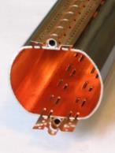
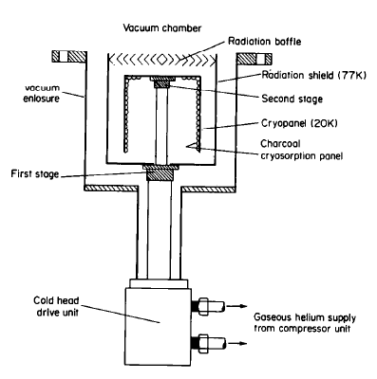
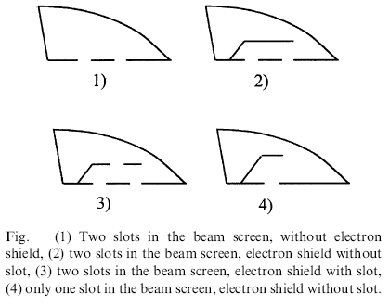
Capture factor, C_{f}
The capture factor takes into account the geometry of the system :
Holes in the electron shield of the LHC beam screen
Baffle in a cryopump
C_{f} ~ 0.3
σ | 1 | 2 | 3 | 4
0.1 | 0.48 | 0.26 | 0.39 | 0.43
1 | 0.68 | 0.36 | 0.51 | 0.57
R. Haefer. J. Phys. E : Sci. Instrum., Vol 14, 1981, 273-288
A.A. Krasnov. Vacuum 73 (2004) 195-199

Slide 14


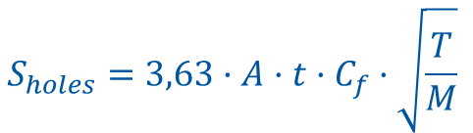
LHC Beam Screen hole’s Pumping Speed
Operating temperature ~ 15 K : molecule’s kinetic energy is accommodated to the vacuum chamber walls, T = 15 K
Transparency, t=4.4%, Capture factor, C_{f}=0.5
Horizontal width 4,6 cm
  Specific surface area A = 1445 cm²/m
Assume P = 2 10⁻⁹ mbar (10¹⁵ H₂/m³) at 15 K, what is the quantity, Q, of gas pumped per m?
1 mbar $·$ℓ at 15 K ⬄ G= 6.4 $·$10²⁰ molecules
At LHC design pressure, ~ monolayers per s per m are pumped on the cold bore
Cold-bore at 1.9 K
$$S_{holes}=3,63·A·t·C_{f}·\sqrt{\frac{T}{M}}$$
 | H₂ | CH₄ | CO | CO₂
ℓ/s/m at 15 K | 316 | 112 | 84 | 67

Slide 15

Thermal transpiration
What is the pressure (gas density) in a cryogenic tube?
  Vacuum gauges are usually located at room temperature to reduce heat load and have more accessibility
For small aperture, the impingment rate, ν, is conserved at the cold / warm transition
Since the average velocity scales like √T
Pressure scaling
Density scaling
In practice:
T₁ (K) = 300 K
T₂ (K) | 4.2 | 77
P₁/P₂ | 8 | 2

Slide 16
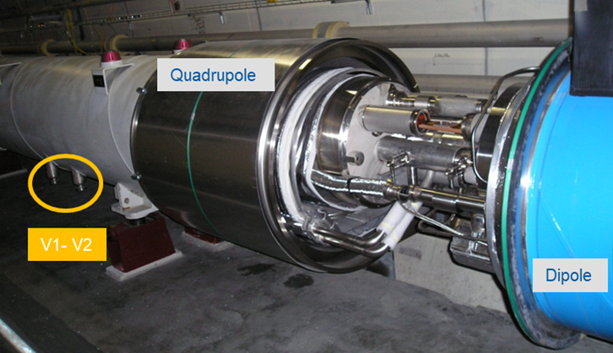
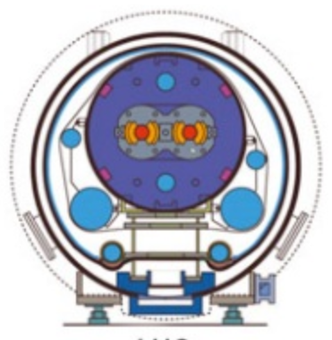

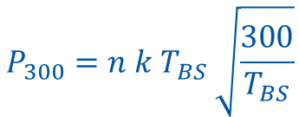
Pressure measurement in a cryogenic machine
What and how is the pressure measured by a gauge located at room temperature for a given gas density in the LHC beam screen at 15 K?
$$P_{300}=n k T_{BS} \sqrt{\frac{300}{T_{BS}}}$$
n (H₂/m³) (year) | 1 10¹⁵ (design) | 2.25 10¹³ (2015) | 2.5 10¹² (2018)
P at 15 K (mbar) | 2 10⁻⁹ | 5 10⁻¹¹ | 5 10⁻¹²
P at RT (mbar) | 1 10⁻⁸ | 2 10⁻¹⁰ | 2 10⁻¹¹
BS

Slide 17
2. Adsorption isotherms

Slide 18
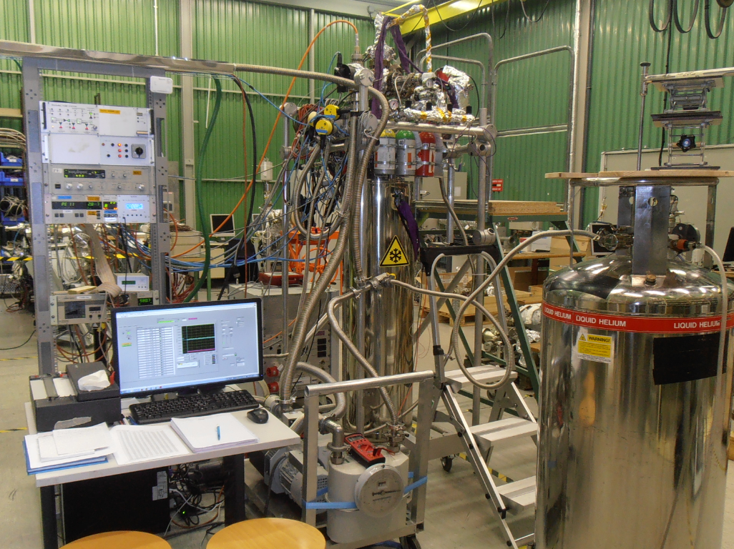
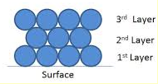

Adsorption isotherm
Measurement, at constant temperature, of the equilibrium pressure for a given gas coverage, θ
Varies with:
molecular species
surface temperature (under 20 K only H₂ and He)
surface nature
gas composition inside the chamber
...
Models :
Henry’s law for low surface coverage
DRK (Dubinin, Radushkevich and Kaganer) for metallic, glass and porous substrate. Valid at low pressure. Good prediction with temperature variation
BET (Brunauer, Emmet and Teller). Multi-monolayer description
$$\frac{P}{θ\left(P_{sat}−P\right)}= \frac{1}{α θ_{m}}+ \frac{\left(α−1\right)}{α θ_{m}} \frac{P}{P_{sat}}$$
α = exp (ΔE/kT) >>1

Slide 19
Saturated Vapor Pressure
Pressure over liquid or gas phase (many monolayers condensed →)
Follows the Clausius-Clapeyron equation: Log P_{sat} = A – B/T
For a smooth surface:
4.2 K

Slide 20
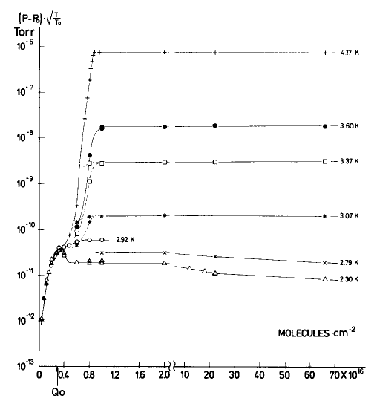
H₂ Adsorption Isotherm on Stainless Steel
The vapor pressure increases when increasing the adsorption of gas up to a few monolayers (~ 10¹⁵ molecules/cm²)
The vapor pressure saturates when several monolayers of gas are adsorbed
The pressure level of the saturation is a function of the temperature
C. Benvenuti, R. Calder, G. Passardi
J.Vac.Sci. 13(6), Nov/Dec 1976, 1172-1182
Q_{o} = one monolayer

Slide 21
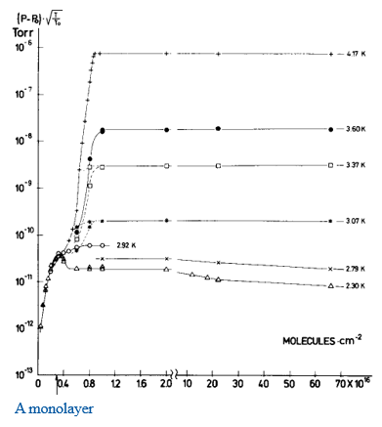
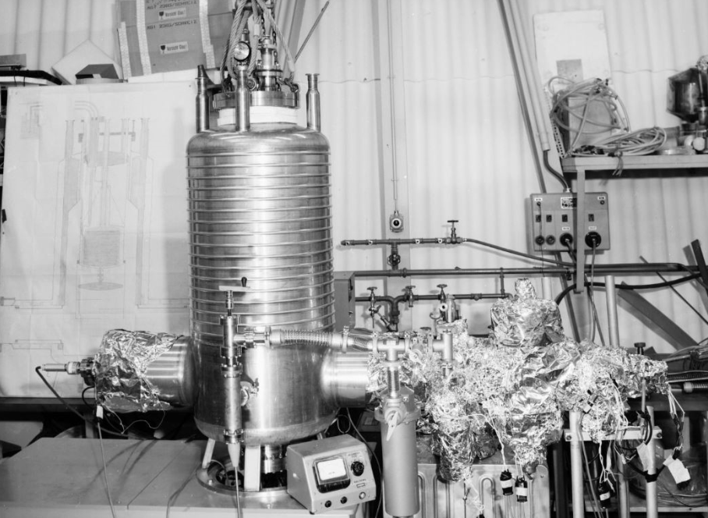
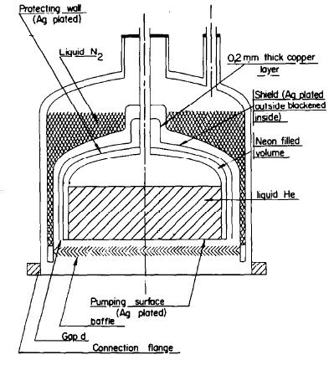
H₂ adsorption isotherm on stainless steel
A condensation cryopumps allows to pump large quantities of H₂ at 2.3 K.
CERN ISR condensation cryopump operated with liquid He at 2.3 K (50 Torr on the He bath)
C. Benvenuti et al. Vacuum, 29, 11-12, (1974) 591

Slide 22
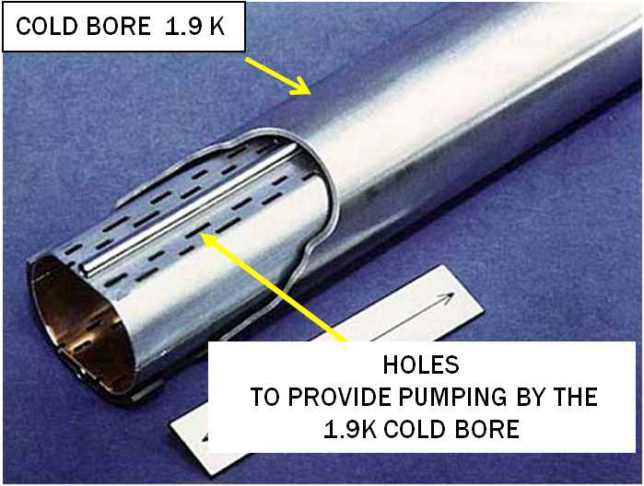
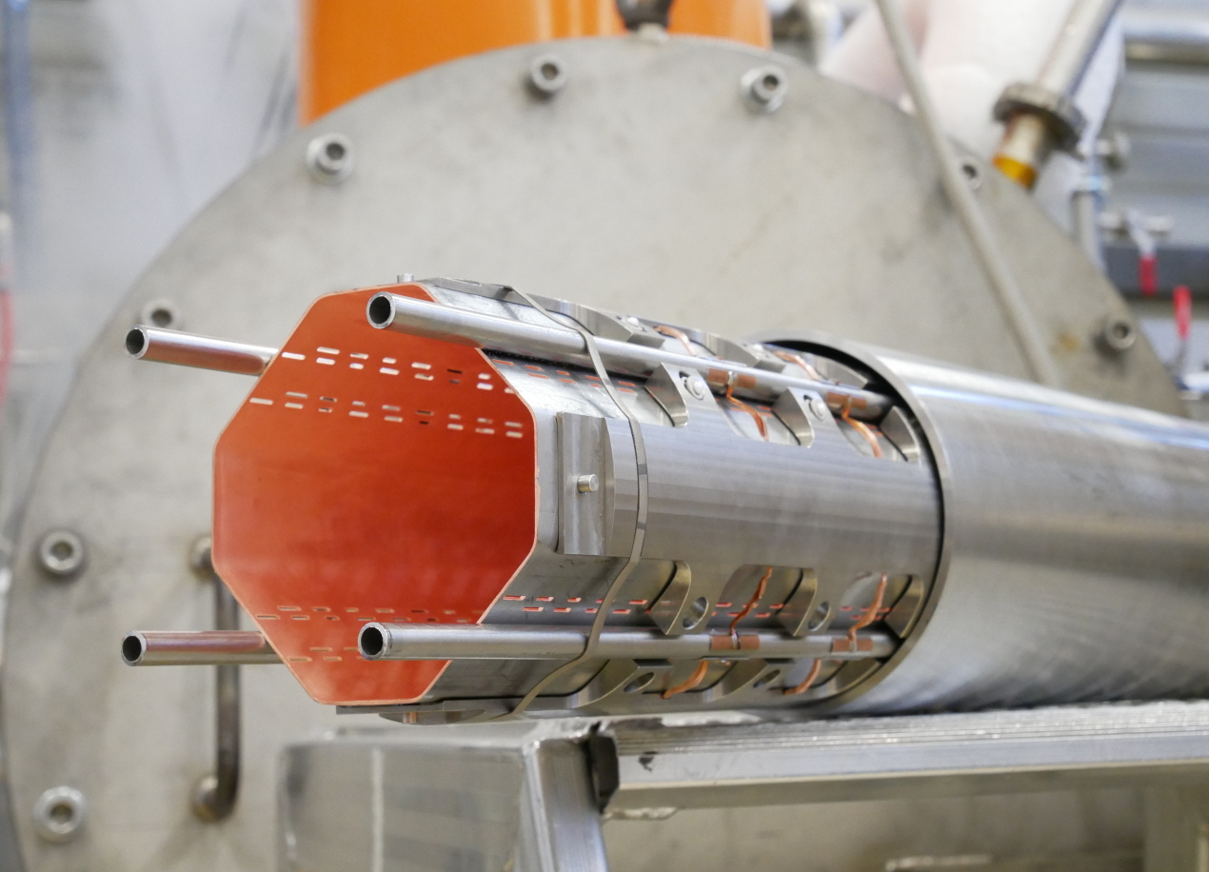
LHC and HL-LHC cold bores
Operating at 1.9 K are modern integrated and distributed condensation cryo-pumps !!!
60-80 K
Beam screen
1.9 K cold bore
The Large Hadron Collider:
A marvel of Technology by L. Evans
Open Access book
Availlable at CERN Document Server
The High Luminosity
Large Hadron Collider
by O. Brüning & L. Rossi
Open Access book
https://doi.org/10.1142/13487

Slide 23
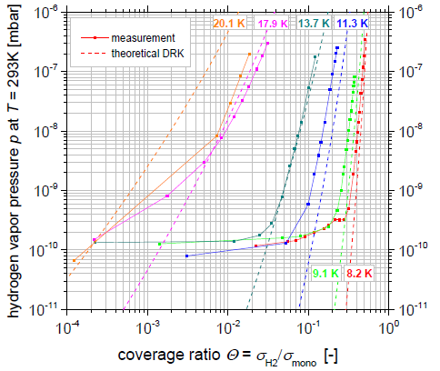
H₂ adsorption isotherms from 8 to 20 K
The surface capacity strongly decreases when increasing the surface temperature
Stainless steel
DRK description
D = 3125 eV⁻²
Θ_{m} = 7 10¹⁴ H₂/cm²
F. Chill et al. PAC’2015, Richmond, USA, 2015.

Slide 24
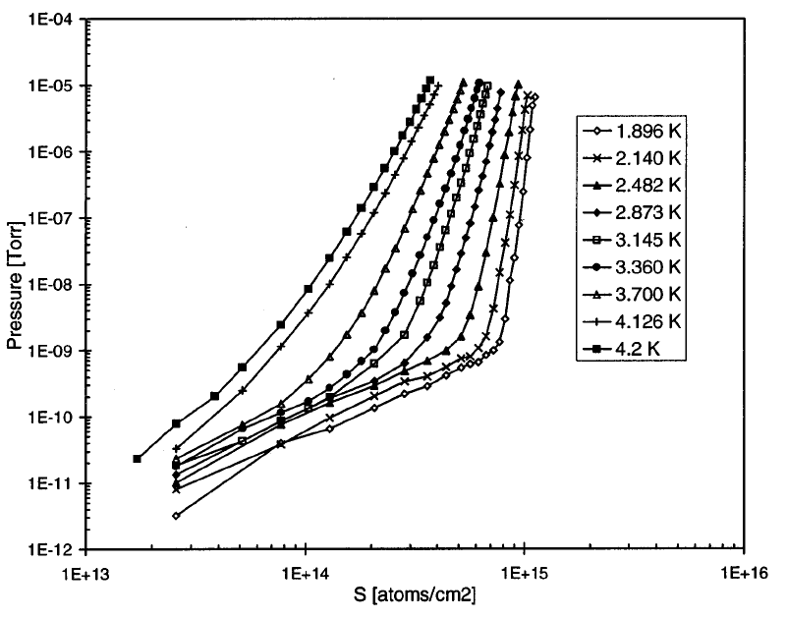
He adsorption isotherm from 1.9 to 4.2 K
Sub-monolayer range
Approaches Henry’s law at low coverage
The isotherms are well described by the DRK model
θ_{m} ~ 1.3 10¹⁵ H₂/cm²
Stainless steel
E. Wallén. J.Vac.Sci.A 15(2), Mar/Apr 1997, 265-274.

Slide 25
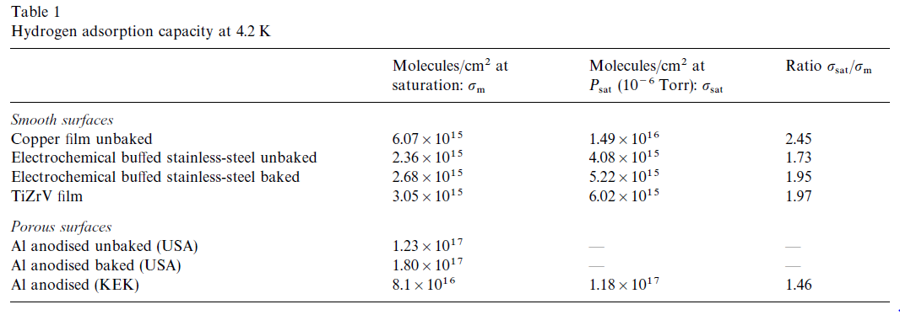
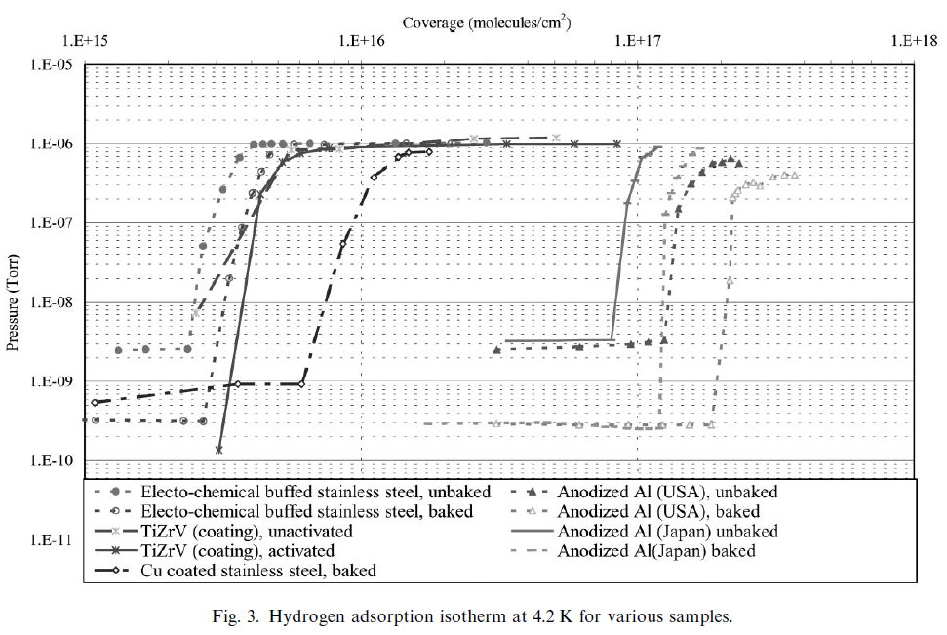
H₂ Isotherms for Industrial Surfaces
Identification of two types of adsorption sites with:
1) high energy (pores, defects)
2) low energy (flat surface).
G. Moulard, B. Jenninger, Y. Saito, Vacuum 60 (2001) 43-60

Slide 26
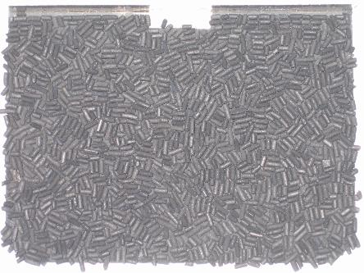
Cryosorbing materials
Large capacity
Large pumping speed
Large temperature working range (up to ~ 30 K)
e.g. activated charcoal used for cryopumps
Capacity ~ 10²² H₂/g i.e. 10²¹ monolayers (P. Redhead, Physical basis of UHV,1968)
Sticking coefficient ~ 30 % at 30 K (T. Satake, Fus. Tech. Vol 6., Sept. 1984)
used for cryopanels held at 20 K
COMMERCIAL CRYOPUMP

Slide 27
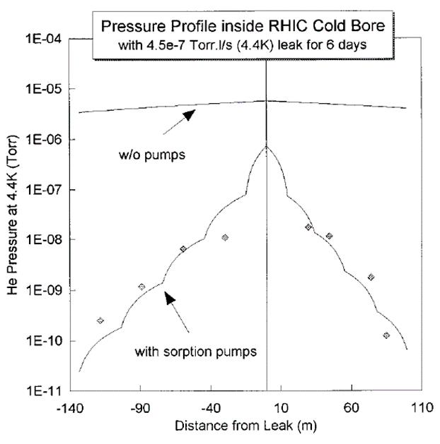
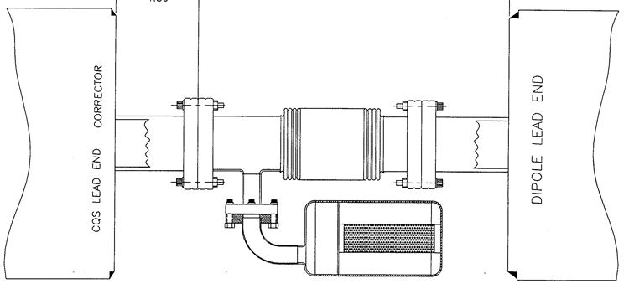
RHIC, Brookhaven, USA
RHIC’s solution: anticipate leaks !!
RHIC use sorption pumps based on 300 g of activated charcoal.
They are located every 30 m to mitigate He leaks and to pump H₂
Test in a 480 m long sector at 4.4 K
RHIC interconnect
H.C. Hseuh, Proc. PAC 1999
H.C. Hseuh, E. Wallén.
J.Vac.Sci.A 16(3), May/Jun 1998, 1145-1150.

Slide 28
Cryo-vacuum: Summary
Gas can be physisorbed for very long period on cryogenic surfaces
The sticking coefficient characterises the pumping speed of a surface
The capture coefficient characterises the pumping speed of a device
At cryogenic temperature, thermal transpiration correction shall be applied
The vapour pressure is the equilibrium pressure as a function of gas coverage
When saturated (many monolayers), the vapour pressure follows the Clausius-Clapeyron law
Adsorption isotherms depend very much on the conditions
Some material can be porous so to adsorb many monolayers of gas without reaching the saturated vapour pressure: cryosorbers

Slide 29
3. Synchrotron radiation

Slide 30
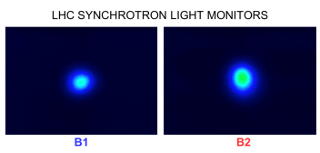
Synchrotron radiation: visible light
In a synchrotron, charged particles can radiate light by synchrotron radiation
This effect can be used for diagnostics purposes
CERN Control Centre LHC beams SR displays
Particles lose energy by synchrotron radiation ➔ should be compensated by RF system
Beam emittance shrinks upon emission of synchrotron radiation (damping wigglers)
Power is dissipated on the machine elements: power density , W/mm², can be extremely HIGH!
Molecules are desorbed from the vacuum chamber wall due to synchrotron radiation

Slide 31
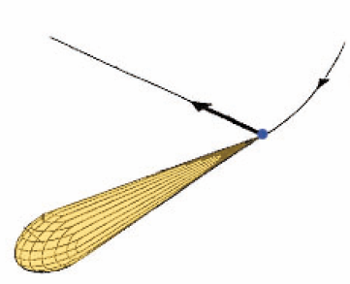
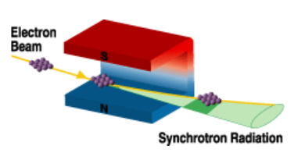
Synchrotron Radiation
A charged particle which is accelerated generate radiation (magnetic bremsstrahlung)
The power of the centripetal radiation is larger than the longitudinal radiation (factor )
For a relativistic particle, the radiation is highly peaked (opening angle ~ 1/ )
The radiation energy range from infrared to gamma rays: from meV to MeV
The SR theory dated from 1950, Schwinger (USA), Sokolov and Ternov (URSS)
B
References :
K. Hübner, CAS 1984, CERN 85-19
R.P. Walker, CAS 1992, CERN 94-01
γ=relativistic factor
1/γ
A. Hofmann, CAS 1996, CERN 98-04
L. Rivkin, CAS 2008

Slide 32
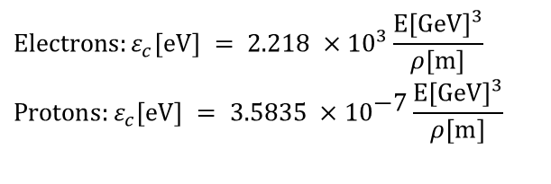
Critical energy
The critical energy split the power spectrum in two equals parts
$$\text{Electrons}:ε_{c}[\text{eV}] = 2\text{.218 }×\text{1}{\text{0}}^{3}\frac{E[\text{GeV}]^{3}}{ρ[m]} \\ \text{Protons}:ε_{c}[\text{eV}] = 3\text{.5835 }×\text{1}{\text{0}}^{\text{−7}}\frac{E[\text{GeV}]^{3}}{ρ[m]}$$
~ 88 % of the emitted photons have an energy lower than the critical energy
Magnetic rigidity:

Slide 33

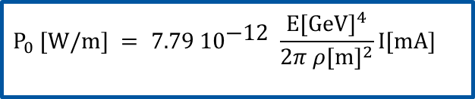
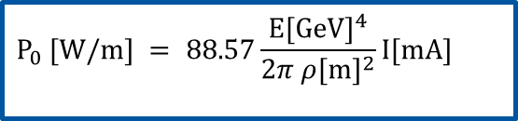
Dissipated power
The average power emitted by the beam per unit of length is
Electrons :
Protons:
$$P_{0} [\text{W}\text{/}\text{m}] =\text{ 88.57}\frac{E[\text{GeV}]^{4}}{2π ρ[m]^{2}}I[\text{mA}]$$
$$P_{0} [\text{W}\text{/}\text{m}] =\text{ 7}.79\text{ 1}{\text{0}}^{\text{−12}} \frac{E[\text{GeV}]^{4}}{2π ρ[m]^{2}}I[\text{mA}]$$
For the total dipole radiation power dissipated around the ring, multiply by 2 π ρ
Protons generate a lot less SR compared to electrons because there is a 1/m₀⁴ dependency in the formula for the radiated power, where m₀ is the mass of the radiating particle. Protons are 1836 times heavier than electrons, so the reduction factor is ~8.8·10⁻¹⁴
$$\frac{88.57}{7.79×{10}^{−12}}={\left(1836\right)}^{4}$$
1836 = ratio of proton to electron mass

Slide 34
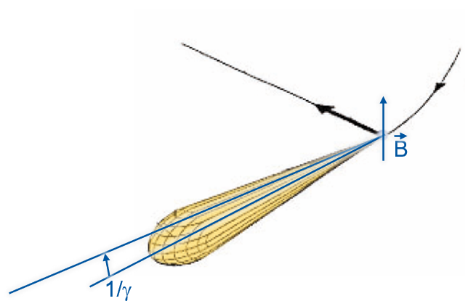
Linear photon flux
The photon flux per unit of length is given by :
Electrons :
Protons:
Example 1:
ESRF-1 (Grenoble):
(high-energy
light source)
ρ = 23.366 m
I = 200 mA
E = 6 GeV
ε_{c} = 20.503 keV
F = 6.604 10¹⁸ ph/s/m
P = 6.692 kW/m
1/γ = 82.5 μrad → 0.82 mm @10 m
Example 2:
LHC (CERN):
(high-energy proton storage ring)
ρ = 2784 m
I = 584 mA
E = 7 000 GeV
ε_{c} = 44 eV
F = 1 10¹⁷ ph/s/m
P = 0.2 W/m
1/γ = 134 μrad → 1.34 mm @10 m

Slide 35
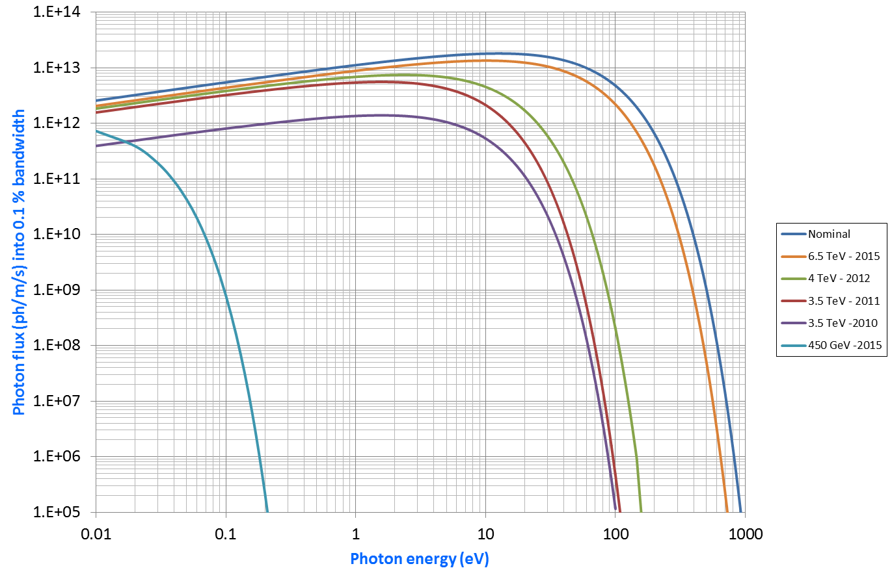
LHC SR Spectrum : from IR to UV
With nominal parameters : 7 TeV and 585 mA
2010, 2011, 2012 and 2015 spectra
Key parameter: photodesorption yield
7 TeV
450 GeV

Slide 36
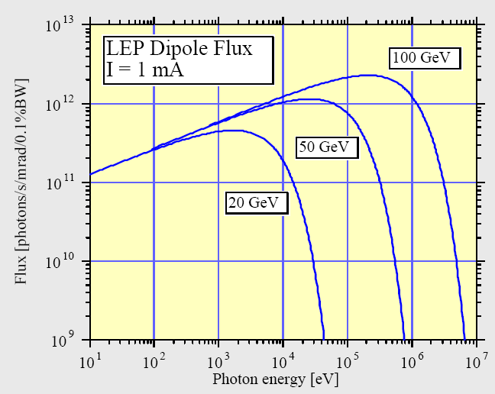
LEP SR spectrum: harder spectrum, X-rays & gamma rays
LEP: electron-positron collider; was installed in the (now) LHC tunnel before LHC; same circumference (26.8 km)
Example 3:
LEP (CERN):
(high-energy
COLLIDER)
ρ = 2963 m
I = 4 mA
E = 100 GeV (up to 104)
ε_{c} = 748.6 keV ←
F = 1.736·10¹⁶ ph/s/m
P = 0.642 kW/m
1/γ = 5.11 μrad → 0.511 mm @100 m

Slide 37
SR impact on different type of machines …
 |  | Soleil | KEK-B |  | LEP |  |  | LHC
 |  |  | LER | HER | Inj. | 1 | 2 | Inj. | Col.
Particle |  | e⁻ | e⁺ | e⁻ | e⁻ | e⁻ | e⁻ | p | p
Beam current | mA | 500 | 2600 | 1100 | 3 | 3 | 7 | 584 | 584
Energy | GeV | 2.75 | 3.5 | 8 | 20 | 50 | 96 | 450 | 7000
Bending radius | m | 5.36 | 16.31 | 104.46 | 2962.96 |  |  | 2784.302
Power | W/m | 14 030 | 20 675 | 5 820 | 0.8 | 30 | 955 | 0 | 0.2
Critical energy | eV | 8 600 | 5 800 | 11 000 | 6 000 | 94 000 | 660 000 | 0 | 44
Photon flux | photons/m/s | 3 10¹⁹ | 7 10¹⁹ | 1 10¹⁹ | 3 10¹⁵ | 7 10¹⁵ | 3 10¹⁶ | 7 10¹⁵ | 1 10¹⁷
Dose at 3000 h | photons/m | 4 10²⁶ | 8 10²⁶ | 1 10²⁶ | 3 10²² | 7 10²² | 3 10²³ | 7 10²² | 1 10²⁴
In LEP, and all synchrotron light sources, the evacuation of the power is an issue
The LHC operates at 7 TeV with ~ 0.6 A. Power evacuation is an issue for the cryogenic system (1 kW/arc), due to the low Carnot efficiency at low temperature
The critical energy varies from a few 10 eV to 660 keV. Strongly bound molecules can be desorbed
The photon flux is large, so large gas load. Adequate dimensioning of the effective pumping speed is required
The annual integrated photon dose is large. Implications on gas reduction and radiation (next lecture)

Slide 38
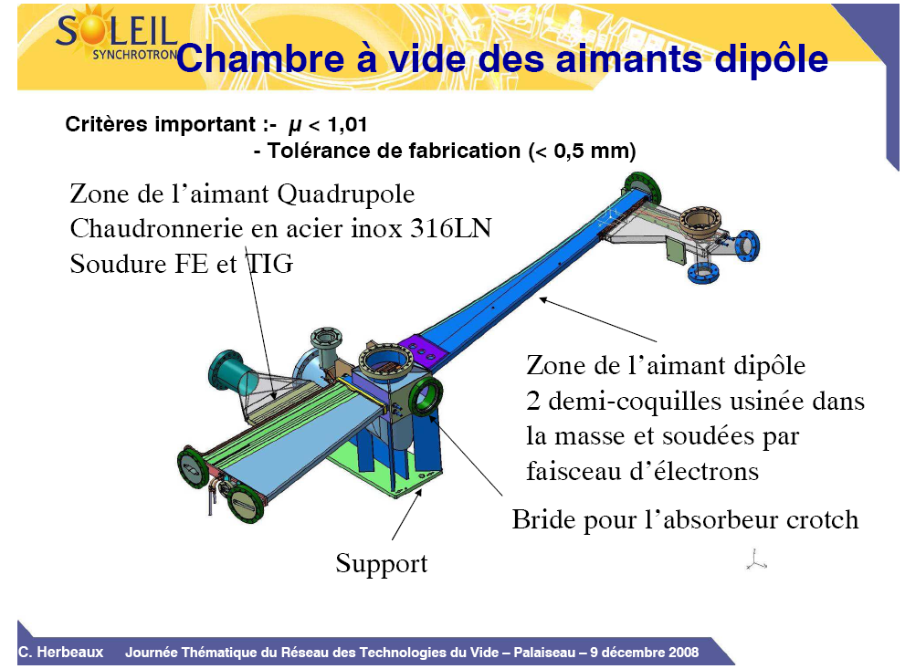
… heavy consequences on design
Stainless steel
NEG coated, in-situ baked to 180ºC
e-
B
e-
SR fan
(C. Herbeaux et al.)
A complex vacuum chamber design with a light extraction path, pumping and instrumentation ports and power absorbers (crotch)

Slide 39
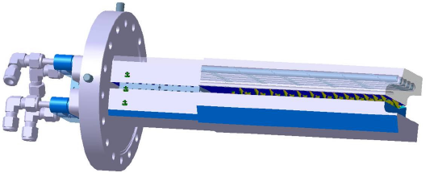
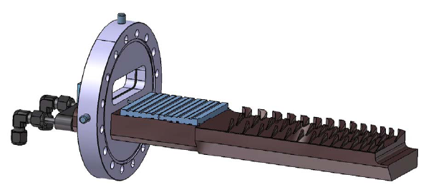
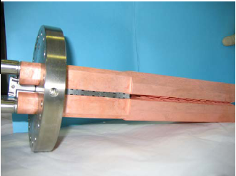
… heavy consequences on design
SR fan
e-
SOLEIL Design
(C. Herbeaux et al.)
Soleil « crotch » power absorber: Water cooled copper (Glidcop) (256 W/mm²)
A sawtooth profile is machined in order to distribute the SR power on a wider area

Slide 40
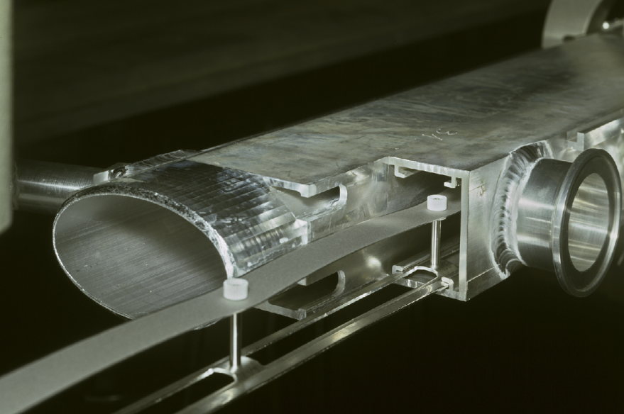
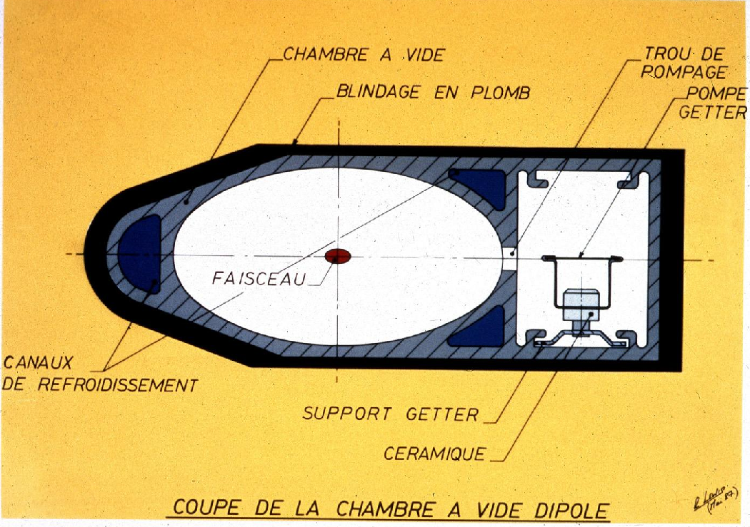
… heavy consequences on design
NEG strip:
30 mm wide (27 active)
Both sides pump
Stick. Coeff:
~ 0.1 (CO, CO₂, N₂)
~ 0.05 (H₂)
SR fan
LEP Design
molecule
(CERN LEP Vacuum group)
Antechamber and distributed NEG pumping, water cooling and lead shielding

Slide 41

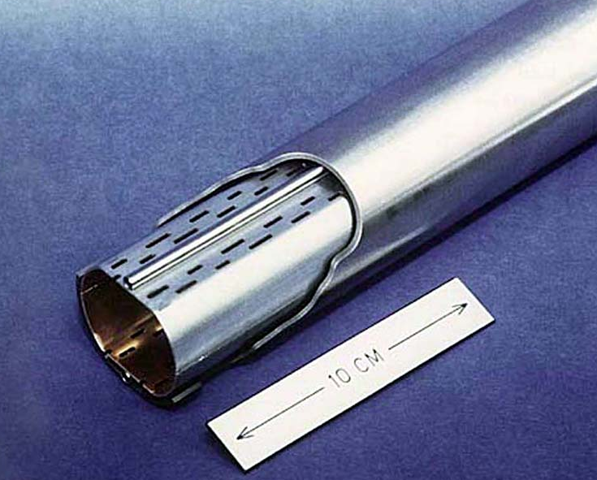
… heavy consequences on design
Courtesy N. Kos CERN TE/VSC
Courtesy N. Kos CERN TE/VSC
LHC Design
(CERN LHC Vacuum group)
Perforated Cu colaminated beam screen to intercept the SR power protecting the 1.9 K cold bore and to allow a distributed pumping

Slide 42
Synch. Rad. Summary
The photon fan generated by relativistic particles moving in a magnetic field is known as synchrotron radiation
The spectrum of synchrotron radiation is described with high precision by well know analytical formulae
Synchrotron radiation depends strongly on the mass of the radiating particle: for equal beam energy electrons generate much more SR than protons
The SR fan is generated in the local plane of the orbit within a narrow cone
The presence of synchrotron radiation must be considered in the design phase, since it can lead to heating problems and large photon-induced desorption yields
The power and flux carried by the SR fan can be large: vacuum components must be designed in such a way to cope with this.
In “extreme” cases (e.g. LEP or FCC-ee), the critical energy of the SR spectrum can be so high to present a formidable challenge in terms of radiation shielding and radioprotection

Slide 43
Some References
C. Benvenuti, Molecular surface pumping: cryopumping, Cern Accelerator School, Vacuum technology, CERN 99-05
V. Baglin, Cold/sticky systems, Cryo-pumping and vacuum systems, Cern Accelerator School, Vacuum in accelerators, CERN 2007-03 & CERN ACC-2023-009
The physical basis of ultra-high vacuum, P.A. Redhead, J.P. Hobson, E.V. Kornelsen. AVS.
Capture pumping technology, K. Welch, North Holland.
Cryopumping, theory and practice, R. Haefer, R. Clarendon press.
Design and modelling of UHV systems of particle accelerators, O. Malyshev, Wiley.
Some Journals Related to Vacuum Technology
Journal of vacuum science and technology A and B
Vacuum

Slide 44
Thank you for your attention !!!

