Slide 2

Vacuum Systems
Slot 6
V. Baglin
CERN TE-VSC, Geneva
https://indico.cern.ch/event/1470062/timetable/?view=standard#day-2025-02-17

Slide 3
Outline
Photon induced molecular desorption
Vacuum instability and ion stimulated desorption
Particle losses and heavy ions stimulated desorption

Slide 4
1. Photon induced
molecular desorption

Slide 5
Photodesorption
The interaction of photons (light) with matters produce the desorption of neutral gases inside the vacuum system
The photon stimulated desorption (PSD) of physisorbed (meV) or chemisorbed (eV) molecules can be direct or non-direct
The identified transmitters are photoelectrons, secondary electrons and phonons
The photon stimulated molecular desorption is a function of the nature of the material, its temperature, its surface state, and of the photon energy and the angle of irradiation.
No model exists, therefore in-situ qualification of the material is required for the design of a future machine.

Slide 6
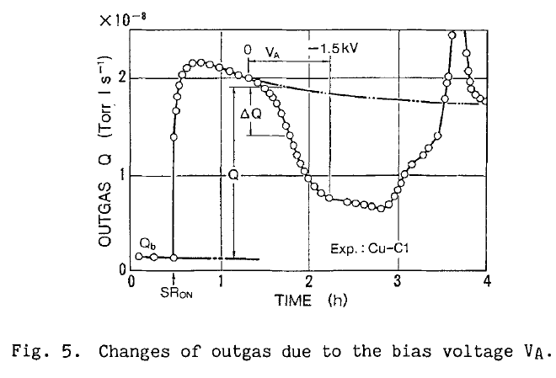
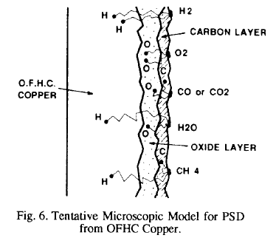
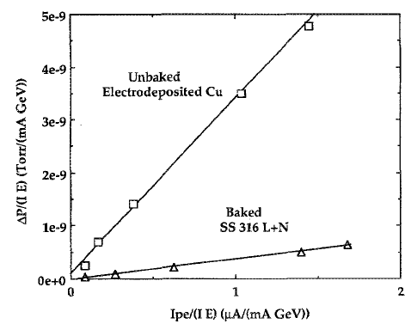
Photodesorption: present understanding
The photodesorption process is linked to the production of photoelectrons and secondary electrons
Photoelectrons contribute to the gas load by ESD
The oxide and carbon layers are believed to be the source of gas
The diffusion of atoms into the solid and their recombination at the surface plays a role
T. Kobari et al Proc .of Vacuum Design of Synch Light Sources Conference, Argonne, 1990
O. Gröbner et. al. EPAC 1992
J. Gómez-Goñi et al. JVSTA 12(4) Jul/Aug 1994, 1714

Slide 7
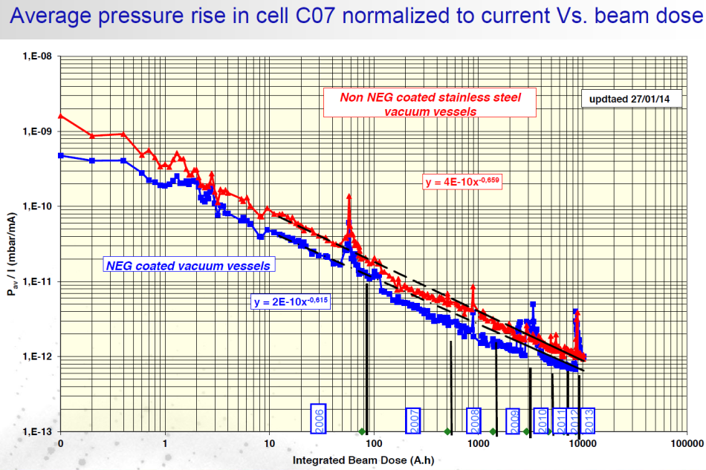

Dynamic pressure due to PSD
The dynamic pressure decreases by several orders of magnitude with photon dose: “photon conditioning”
The photon desorption yield is characterised by η_{photon}
Dynamic pressure:
$$P= \frac{η_{Photons} {\dot{Γ}}_{Photons}}{S}$$
Beam cleaning during the first period of LEP
SOLEIL
With beam P ~ 10⁻¹⁰ Torr
With beam P ~ 2 10⁻⁹ mbar
O. Gröbner. Vacuum 43 (1992) 27-30
C. Herbeaux, Journée thématiques RTVide, décembre 2014

Slide 8



Photo-desorption yield measurement
SR light is extracted from a dipole magnet to irradiate the test chamber at ~ 11 mrad
SR fan is vertically collimated therefore photon flux < 4 eV are attenuated
The gas load is measured by the throughput method via a conductance (72.5 ℓ/s for N₂)
A wire and a collector are biased for current measurement to estimate the photon reflectivity and photoelectron yield
$η=\frac{G}{\dot{Γ}} C \left(ΔP_{2}−ΔP_{1}\right) ≈\frac{G}{\dot{Γ}} CΔP_{2}$
$$Q_{0}=C \left(P_{2}−P_{1}\right)$$
$${Q= η\dot{Γ }+Q}_{0}=C \left(P_{2}^{′}−P_{1}^{′}\right)$$
With G = 2.5 10¹⁹ molecules/mbar.ℓ at RT
J. Gómez-Goni et al. J. Vac. Sci. Technol. A 12(4), Jul/Aug 1994, 1714
V. Baglin et al. EPAC 1998, Stockholm, Sweden.

Slide 9
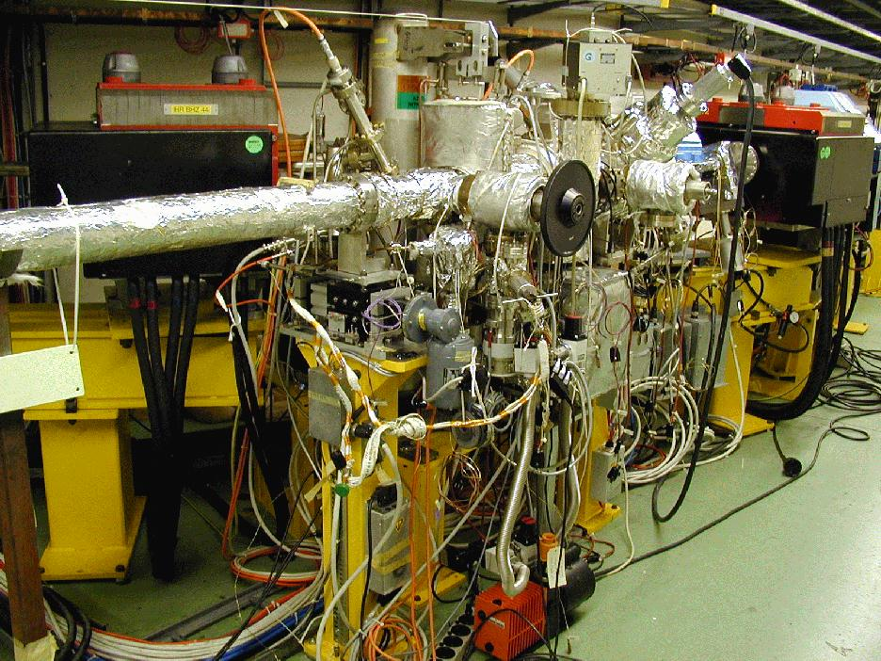
CERN EPA Synchrotron Light Facility 42 - 1999
The LEP Pre-Injector as a multipurpose facility, J-P. Potier, L. Rinolfi, EPAC 1998, Stockholm, Sweden, 1998

Slide 10
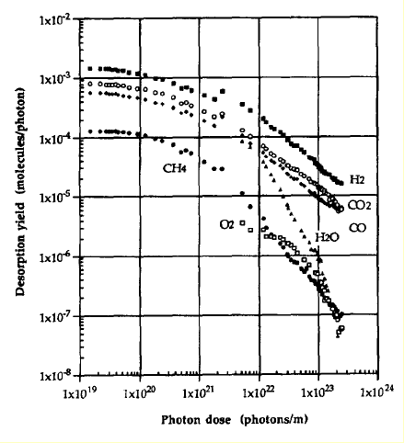
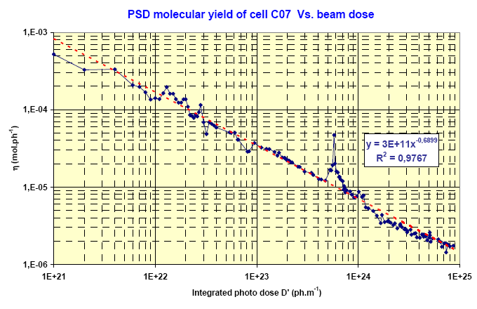
Conditioning under photon irradiation
Typical desorption yield range: from 10⁻³ molecule/photon to 10⁻⁶ when conditioned
Cu baked at 150°C
NEG coated SS activated at 180°C
C. Herbeaux et. al. EPAC 2008, Genoa, Italy
O. Gröbner et al.
J.Vac.Sci. 12(3), May/Jun 1994, 846-853
The hydrogen desorption is characterised by a diffusion process: a = 0,5
M. Andritschky et al., Vacuum 38 (8-10), 933, (1988)
a ~ 0.9-1.3

Slide 11
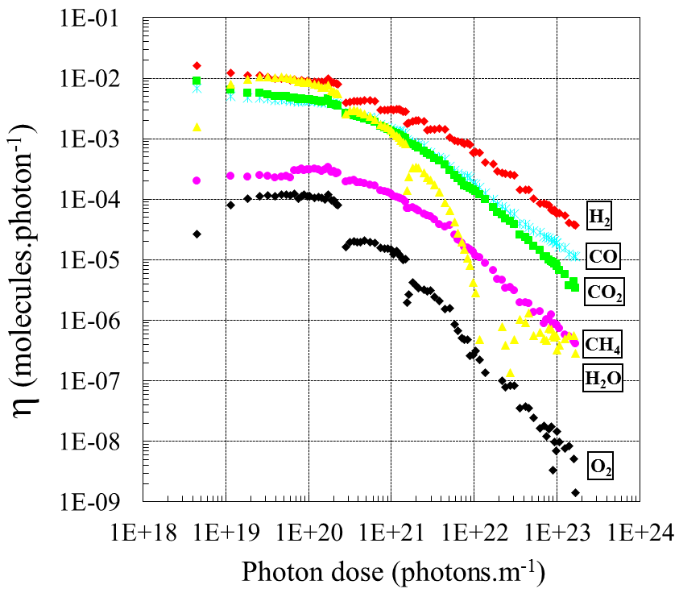
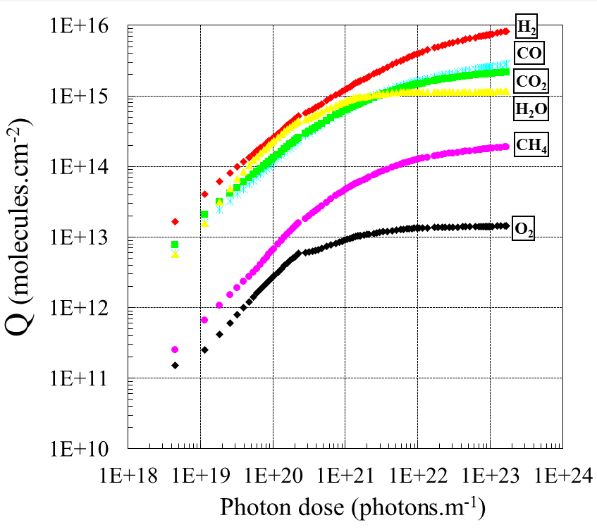
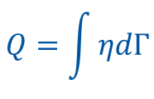
Gas load
The total desorbed quantity amounts to 15 monolayers for an unbaked system
$$Q=\int{ηdΓ}$$
Unbaked stainless-steel
3.75 keV
Unbaked stainless-steel
3.75 keV
Gas | H₂ | CH₄ | H₂O | CO | CO₂ | Total
molecules/cm² x 10¹⁵ | 8.1 | 0.2 | 1.1 | 2.8 | 2.2 | 14.4
C. Herbeaux et al. JVSTA 17(2) Mar/Apr 1999, 635

Slide 12

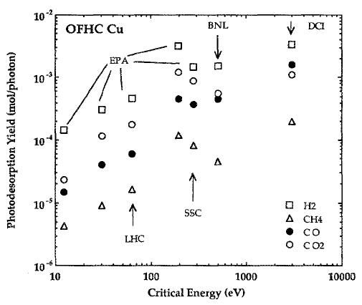
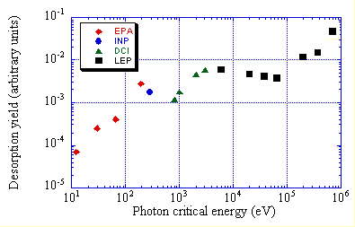
Evolution with critical energy
At low energy, the photoelectric effect dominates: linear trend until ~ 5 keV
Above a few 100 keV, Compton diffusion dominates and produce a cascade of energetic recoil electrons with a diffusion of secondary photons
150°C bake-out
O. Gröbner. CAS 99-15
J. Gómez-Goñi et al. JVSTA 12(4) Jul/Aug 1994, 1714

Slide 13
2. Vacuum instability and ion
stimulated desorption

Slide 14
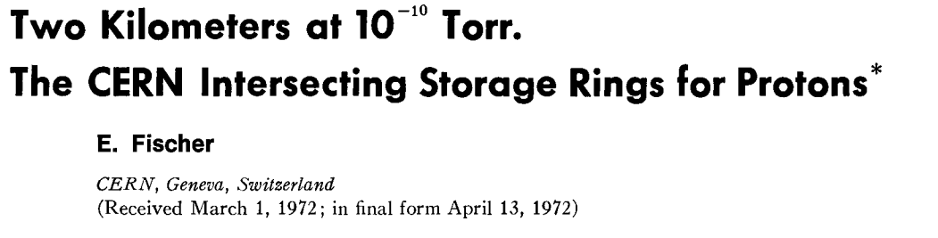
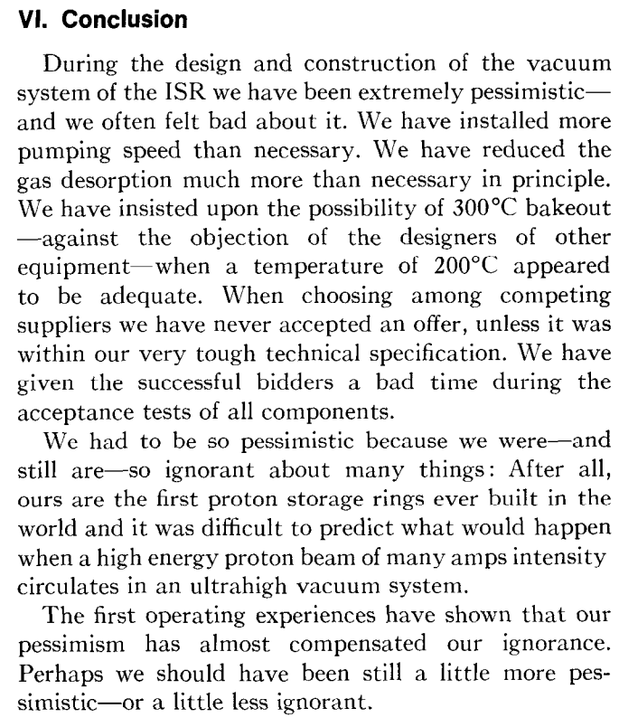
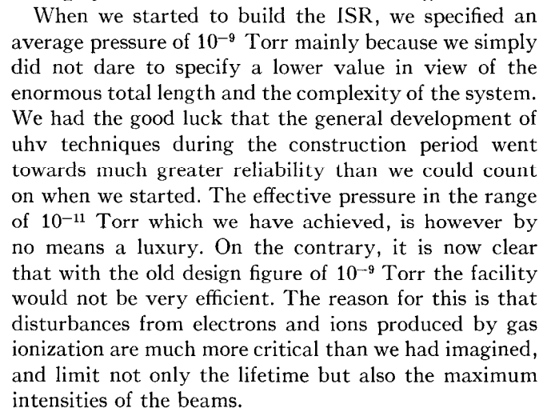



















A lesson from history
1965
7 MCHF
Oct.
1971

Slide 15
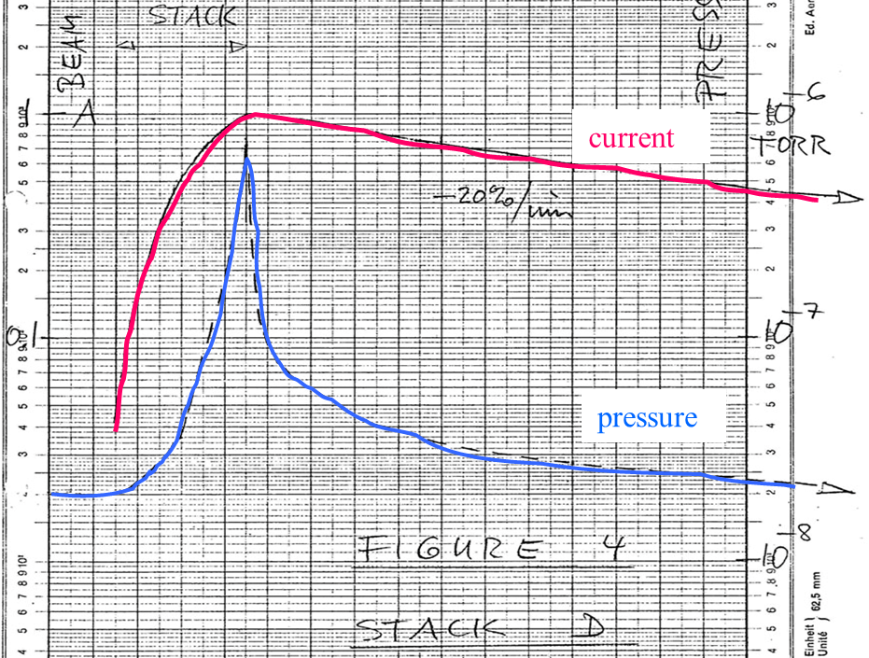
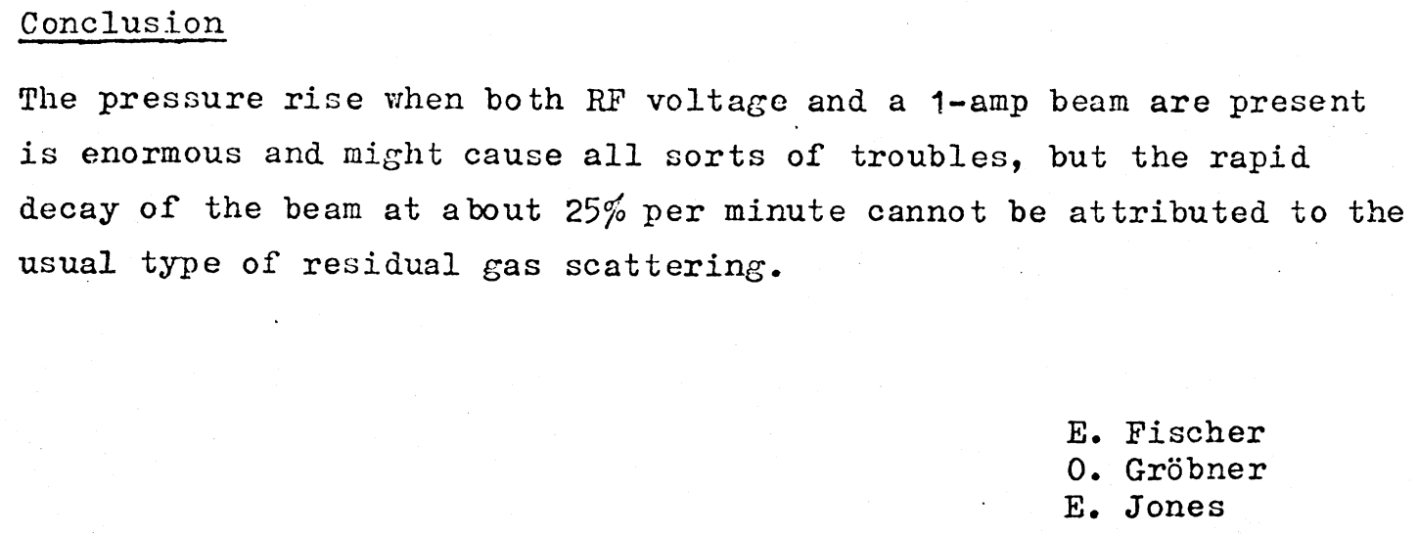





Vacuum Instability : the Effect
In circular machine with large proton current :
    Intersecting Storage Rings (routine 40 A, record 57 A), LHC (0.6 A)
Beam current stacking to 1 A
Pressure increases to 10⁻⁶ Torr (x 50 in a minute)
Beam losses
First documented pressure bump in the ISR
E. Fischer/O. Gröbner/E. Jones RUN8: 18/11/1970

Slide 16
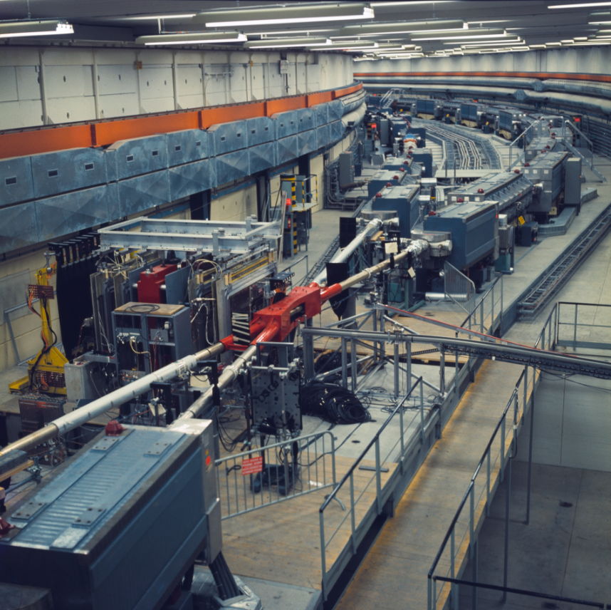
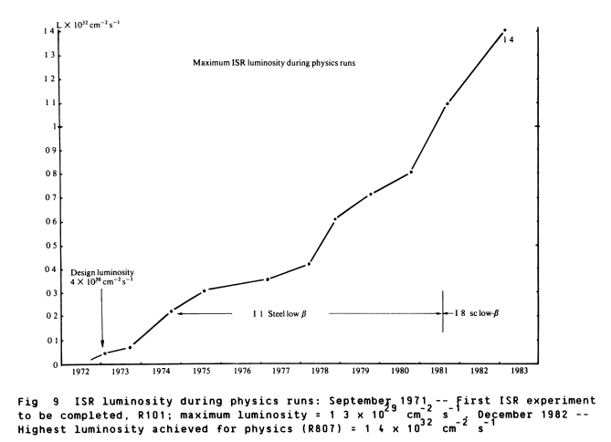
Intersecting Storage Rings
L: 4 10³⁰ to 1.4 10³³ Hz/cm²
62 GeV in center of mass
30-40 A (until 57 A)
50-60 h fills (10 h turn over)
August 1971

Slide 17
The mechanism of vacuum instability
Origin are ions produced by beam gas ionisation
Reduction of the effective pumping speed, Seff
Quasi stationary long tube (C=0)
When the beam current approach the critical current, the pressure increases to infinity

Slide 18
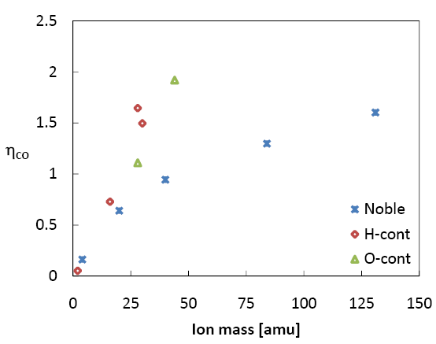
Ion desorption yield
Varies with the material, the ion energy and ion species
Several units of molecules can be desorbed by ions ➔ Sputtering
5 keV, Baked
0.2-0.5 keV
He⁺, Ne⁺, Ar⁺, Kr⁺, Xe⁺
H₂⁺, CH₄⁺,C₂H₄⁺, C₂H₆⁺
CO⁺,N₂⁺,CO₂⁺
LHC beam current (A)
G. Hulla, PhD Thesis, Vienna Tech. U, 2009
O. Gröbner, CERN 99-05
Unbaked
stainless steel
Baked
stainless steel
N₂⁺
N₂⁺
A.G. Mathewson, CERN ISR-VA/76-5
A.G. Mathewson, CERN ISR-VA/76-5

Slide 19
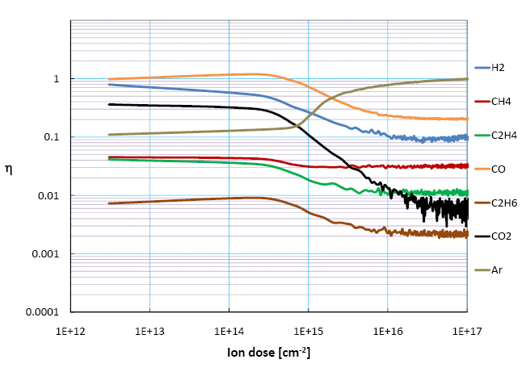
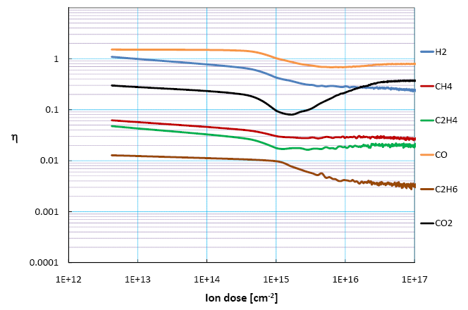
Conditioning and implantation
A conditioning is observed but at high dose, some ions can be implanted !
7 keV, Cu Baked, Ar⁺
7 keV, Cu Baked, CO⁺
G. Hulla, PhD Thesis, Vienna Tech. U, 2009
G. Hulla, PhD Thesis, Vienna Tech. U, 2009
In the LHC : the maximum flux is about 3 10⁸ ions/(cm².s) i.e. a dose of 3 10¹⁵ ions/(cm².year)
In the LHC, there is no “beam” conditioning under ion bombardment

Slide 20
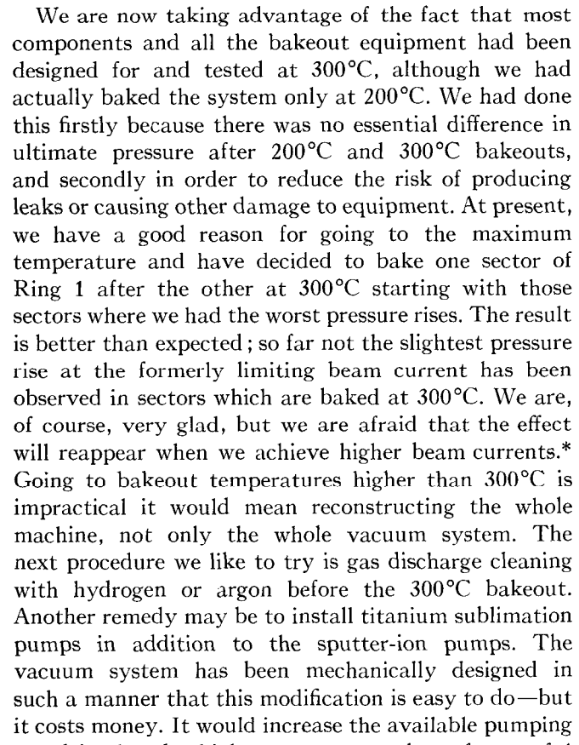
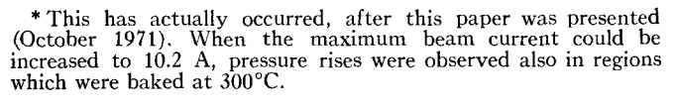










A lesson from history - Epilogue

Slide 21
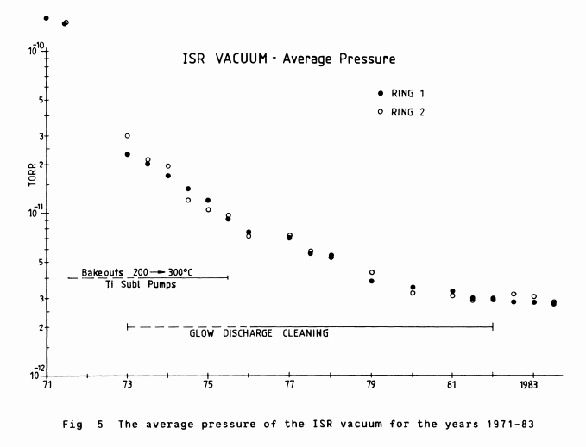
ISR Remedy
Beam cleaning being negligible:
  Increase number of pumps
  Reduce outgassing using 300°C bakeout
  Perform ex-situ Ar/O₂ glow discharge cleaning with in-situ bakeout
➔ ηI_{Crit} increased to ~ 60 A and the machine could reached 57 A and 2×10⁻¹² Torr!
A.G. Mathewson, CERN ISR-VA/76-5
M. Jacob and K. Johnsen, CERN 84-13, 1984

Slide 22
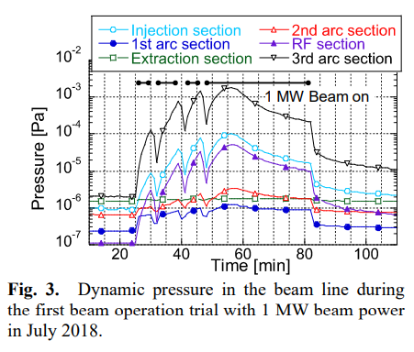
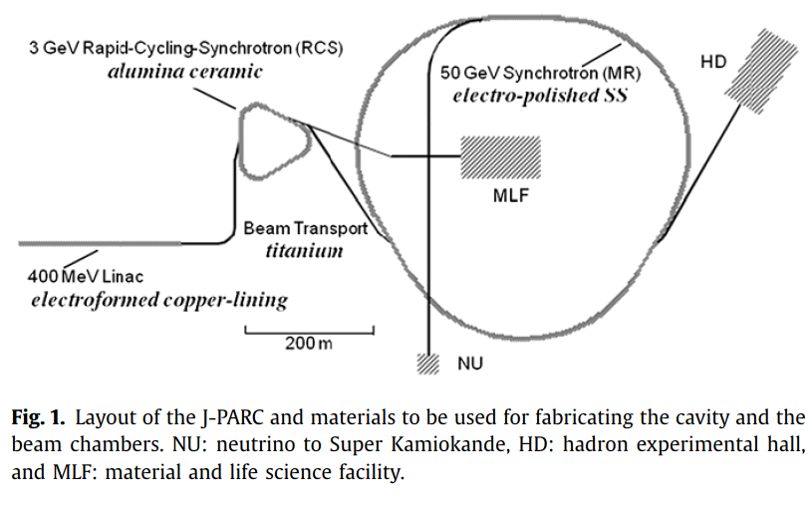
Vacuum Instability in J-Parc?
J-Parc Rapid Cycling Synchrotron (RCS), Main Ring (MR) injector
RF shielded (Cu stripes with capacitors) ceramic chambers in dipoles and quadrupoles and Ti chambers for straights
Probable signature of Ion Stimulated Molecular Desorption
J. Kamiya et al., JPS Conf. Proc. , 011023 (2021)

Slide 23
3. Particle losses
and
heavy ion stimulated desorption

Slide 24
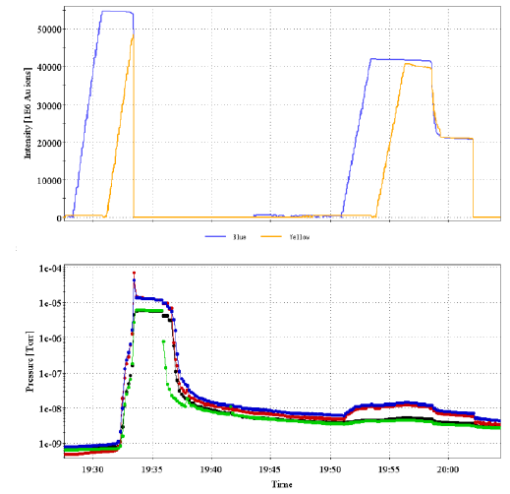
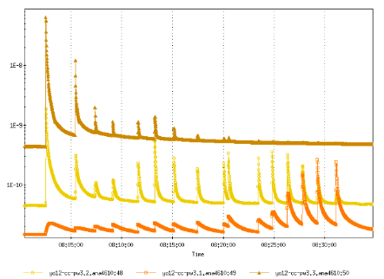
RHIC
Loss of ions from a beam leads to large pressure increases: 10⁻⁸ …10⁻⁵ mbar!
110 bunches, Au⁷⁹⁺,
9.9 GeV/u
3 10⁹, Au⁷⁹⁺, 9.9 GeV/u
1, 2 & 3 mrad
W. Fischer et. al. EPAC 2006, Edinburgh, Scotland
W. Fischer et. al. EPAC 2002, Paris, France

Slide 25

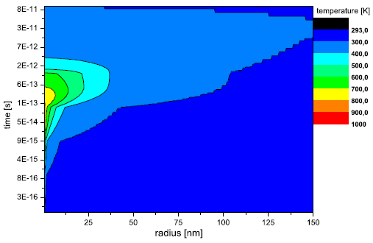
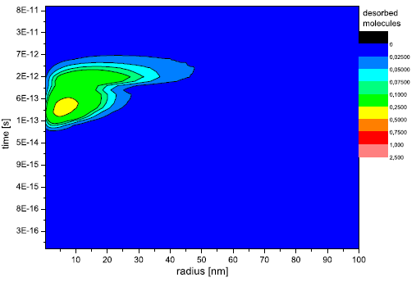
Mecanism
Surface effect (except diffusion H₂) due to a thermal activation
« Inelastic thermal spike model » : a temperature map coupled to the thermal desorption model
M. Bender et al. , NIM B 267 (2007) 885-890
Xe²⁹⁺, 1.4 MeV/u, Perpendicular
300° C
Temperature of atomic Cu subsystem after Xe impact
Desorbed particles per Xe per dt

Slide 26
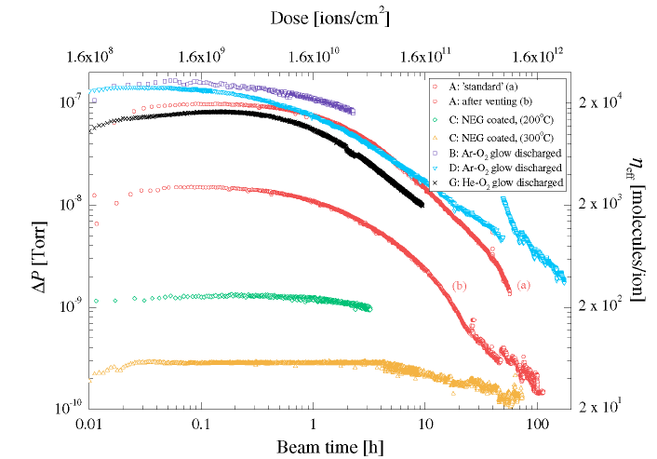
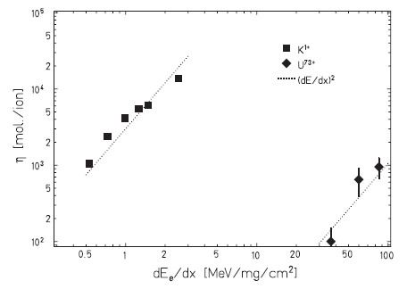
High energy ions
Desorption yields range from 20 – 20 000 molecules per ion
Pb⁵³⁺, 4. 2 MeV/u, 14 mrad
E. Mahner et al. ,
Phys. Rev. ST Accel. Beams 6, 013201 (2003)
The desorption is determined by the energy given to the electrons (electronic stopping force)
L. Prost et al. , PRL 98, 064801 (2007)
The desorption induced by the electrons is the responsible mechanism

Slide 27
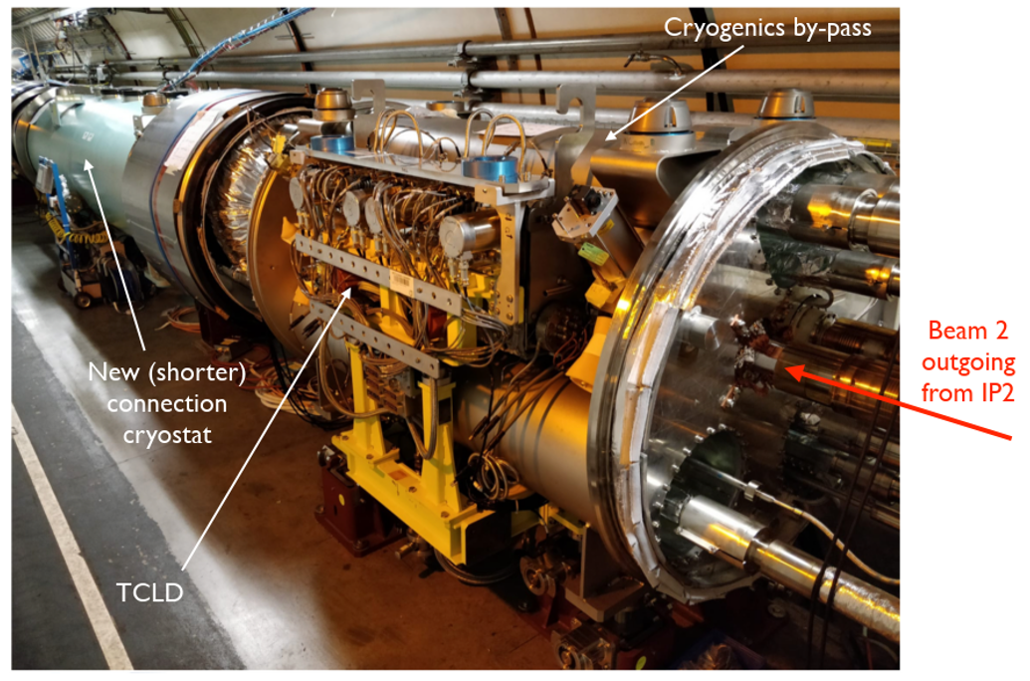
HL-LHC ions collimator
Located in the LHC arcs around IP2 to intercept lead beams with modified charge produced at the interaction point: Pb81⁺ instead of PB82⁺
W jaws
TCLD & LEN Bypass
TCLD
Installed during LS2: 2019-2021
Courtesy S. Redaelli, F. Savary

Slide 28
Slot 7 summary
In accelerators, the circulating beam can contribute to stimulate molecular desorption
Those phenomenon can lead to much larger gas load than the thermal outgassing rate
    ➔ « Dynamic pressure »
Photon stimulated desorption originates from SR
Ion stimulated desorption originates from beam gas ionisation and can lead to vacuum instability
Particle losses may trigger beam dumps / other unwanted phenomena

Slide 29
Thank you for your attention !!!

Slide 31
Some References
Cern Accelerator School, Vacuum technology, CERN 99-05
Cern Accelerator School, Vacuum in accelerators, CERN 2007-03
Cern Accelerator School, Vacuum for particle accelerators, Glumslov, June 2017
The physical basis of ultra-high vacuum, P.A. Redhead, J.P. Hobson, E.V. Kornelsen. AVS.
Scientific foundations of vacuum technique, S. Dushman, J.M Lafferty. J. Wiley & sons.
Les calculs de la technique du vide, J. Delafosse, G. Mongodin, G.A. Boutry. Le vide.
Vacuum Technology, A. Roth. Elsevier Science
Foundations of vacuum science and technology, Ed by J.M. Lafferty. J. Wiley & sons.
Vacuum in Particle Accelerators: Modelling, Design and Operation of Beam Vacuum Systems, O. Malyshev. Wiley VCH.
Some Journals
Journal of Vacuum Science and Technology
Vacuum
Applied Surface Science
Nuclear Instruments and Methods
Physical Review Accelerator and Beams

