Slide 1
2025 Joint Universities Accelerator School
Superconducting Magnets
Section IV
Paolo Ferracin
  (pferracin@lbl.gov)
Lawrence Berkeley National Laboratory (LBNL)

Slide 2
Outine
Section I
  Particle accelerators and magnets
  Superconductivity and practical superconductors
Section II
  Magnetic design
Section III
  Coil fabrication
  Forces, stress, pre-stress
  Support structures
Section IV
  Quench, protection, training

Slide 3
References
Quench, protection, and training
  K.-H. Mess, P. Schmuser, S. Wolff, “Superconducting accelerator magnets”, Singapore: World Scientific, 1996.
  Martin N. Wilson, "Superconducting Magnets", 1983.
  Fred M. Asner, "High Field Superconducting Magnets", 1999.
  P. Ferracin, E. Todesco, S. Prestemon, “Superconducting accelerator magnets”, US Particle Accelerator School, www.uspas.fnal.gov.
  E. Todesco, “Masterclass - Design of superconducting magnets for particle accelerators”, https://indico.cern.ch/category/12408/
  Presentations from Luca Bottura and Martin Wilson
  A. Devred, “Quench origins”, AIP Conference Proceedings 249, edited by M. Month and M. Dienes, 1992, p. 1309-1372.
  E. Todesco, “Quench limits in the next generation of magnets”, CERN–2013–006.
  L. Bottura, “Magnet quench 101”, CERN–2013–006.

Slide 4
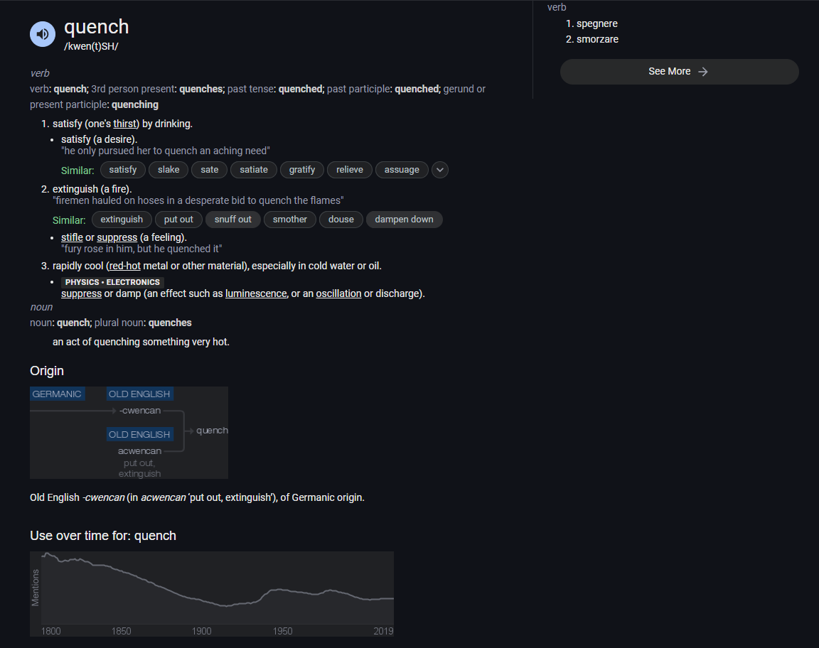
“Quench”

Slide 5
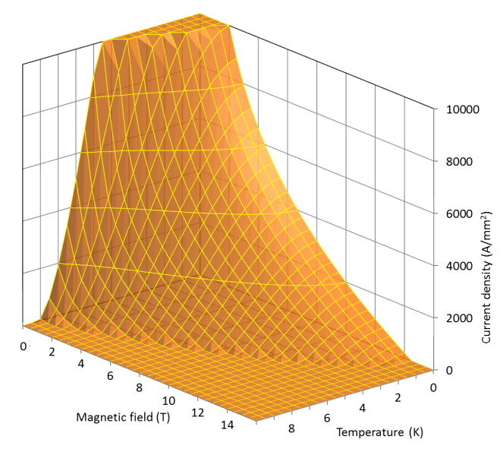
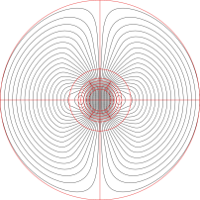
Quench
Magnet ramp-up
Current ramp-up (magnet powering, excitation)
  Increase of bore and coil/conductor field
    Load line
Target
  Achieve operational current/field
    Usually at about 80% of maximum I or short sample current I_{ss}
      i.e. not too close to the critical surface
What if you continue to increase I ?
J
B

Slide 6
Quench
Definitions
First scenario
  Critical surfaces is passed by increasing the current
    The superconductor still carries the critical current at T_{cs}
    The rest flows in the stabilizer → power dissipation
  If power high enough and cooling low enough
    Temperature of the superconductor increases → critical current decreases
      More current in the stabilizer, less in the superconductor → more dissipation
    Irreversible transition → quench → propagation
Conductor-limited quench
J
by L. Bottura
B

Slide 7
Quench
Definitions
Other scenario
  Disturbance → release of energy → increase the temperature of the conductor
    The superconductor still carries the critical current at T_{cs}
    The rest flows in the stabilizer → power dissipation
  If power high enough and cooling low enough
    Temperature of the superconductor increases → critical current decreases
      More current in the stabilizer, less in the superconductor → more dissipation
    Irreversible transition → quench → propagation
Energy-deposited or premature quenches
J
B

Slide 8

Quench
Definitions
In other words
  Conductor-limited quench
    critical surface is crossed because of an increase of I (and B)
  Energy-deposited or premature quenches
    critical surface is crossed because of an increase of T
J
J
B
T

Slide 9
Quench
Disturbances
Which are these disturbances?
We can define a spectrum of disturbances, which classifies the energy disturbances along two dimensions: time and space (M. Wilson).
 |  | Space
 |  | Point | Distributed
Time | Transient | J | J/m³
 | Continuous | W | W/m³
Continuous disturbances are due to a steady power dissipations
  Point: ramp splice with high resistance joint
  Distributed: a.c. losses in the conductor, thermal leak of the cryo-system.
They are usually well understood disturbances.

Slide 10
Quench
Disturbances
 |  | Space
 |  | Point | Distributed
Time | Transient | J | J/m³
 | Continuous | W | W/m³
Transient disturbances are due to a sudden release of energy, either over a small volume (J) or over a large volume (J/m³)
  Flux jumps: dissipative redistribution of magnetic field within the superconductor
    It can be eliminated with small filaments.
  Mechanical disturbances: wire frictional motion, epoxy cracking
    They are less predictable and difficult to avoid, since the are related to mechanical design, material properties, fabrication processes, etc.

Slide 11
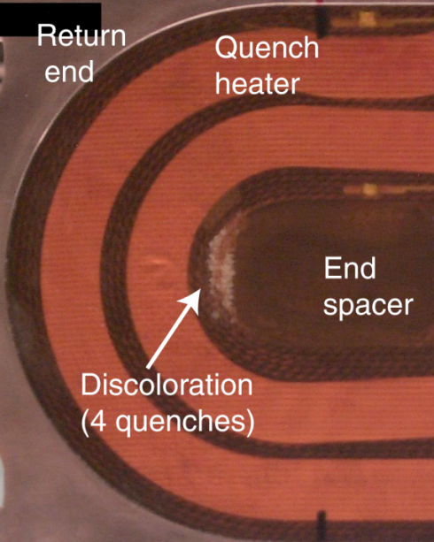
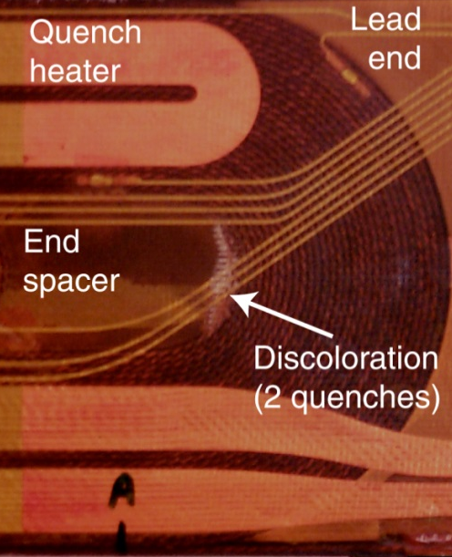
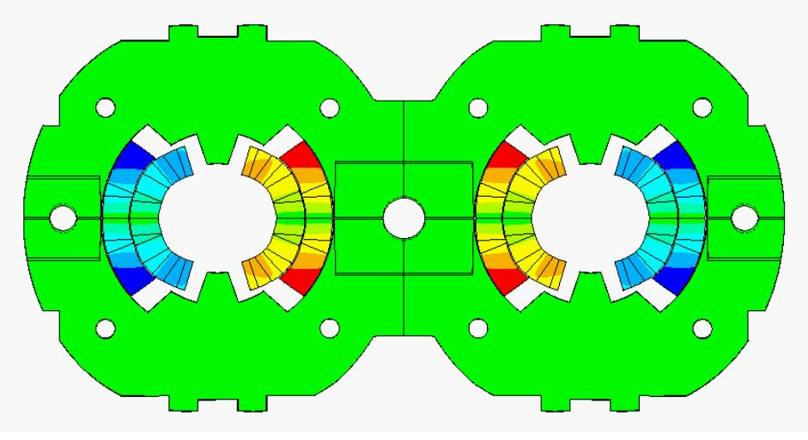
Quench
Disturbances
Epoxy cracking
Frictional motion

Slide 12
Quench stability
In order to reduce the occurrence of a quench, one has to act on multiple fronts.
These fronts can be seen as the different terms of a heat equation along a superconducting wire, that is
Increase of temperature of a superconductor is linked to
  the heat coming from the disturbance,
  the ohmic heat generated once the transition to normal conductivity occurs,
  and the heat removed by conduction along the wire and by the cooling liquid.
Heat capacity
Heat source
Joule heat
Conduction
cooling
generation
Heat transfer

Slide 13
Quench stability
More in general, the equation describes the concept of stability of a superconductor
  capability of a superconductor, and of the cooling system, to withstand a thermal input.
Lets focus on the importance of the stabilizer.
Let’s imagine that
  a certain amount of energy E is released.
  a volume V of the superconductor to a temperature T ≥ T_{c}.
  if E or V are not large enough →
    the temperature of the superconductor will decrease to below the critical temperature, because of cooling and or thermal conductivity.
  If, on the other hand, E or V are large enough →
    the normal zone will increase and a quench propagate.
Heat capacity
Heat source
Joule heat
Conduction
cooling
generation
Heat transfer

Slide 14
Quench stability
More in general, the equation describes the concept of stability of a superconductor
  capability of a superconductor, and of the cooling system, to withstand a thermal input.
Lets focus on the importance of the stabilizer.
We therefore can define
  as minimum quench energy MQE, the minimum energy necessary to initiate a quench;
  as minimum propagation zone MPZ, the minimum volume of superconductor that must be brought beyond the critical temperature in order to initiate a quench.
  The two parameters are connected: MQE is the energy necessary to created MPZ.
Heat capacity
Heat source
Joule heat
Conduction
cooling
generation
Heat transfer

Slide 15
Quench stability
MQE and MPZ
Wire made purely of superconductor at θ₀.
Energy E increases the temp. beyond θ_{c} over a length l.
l
by L. Rossi
A
T
θ_{c}
T_{cs}
θ₀
l dissipates J_{c}²ρAl [W].
Thermal gradient ~ (θ_{c}-θ_{o})/l.
T₀
Conductor length
When power dissipated = power conducted
For a Nb-Ti 6 T magnet l = 0.5 μm and, with 0.3 mm diameter, the required energy is 10⁻⁹ J.
we have to increase k/ρ : composite conductor!

Slide 16
Quench stability
MQE and MPZ
Composite conductor: increase k/ρ by almost a factor 10⁷.
  Nb-Ti vs. Cu
    ρ = 6.5 × 10⁻⁷ vs. 3 × 10⁻¹⁰ [Ω m]
    k = 0.1 W vs. 350 [W m⁻¹ K⁻¹]
Three phases
  All current in the supercond.
  Current shared by the supercond. and stabilizer
  All current in the stabilizer.
MQE: increased from the nJ to the 10-100 μJ level
MPZ: from the µm to the mm level.

Slide 17
Outine
Section I
  Particle accelerators and magnets
  Superconductivity and practical superconductors
Section II
  Magnetic design
Section III
  Coil fabrication
  Forces, stress, pre-stress
  Support structures
Section IV
  Quench, protection, training

Slide 18
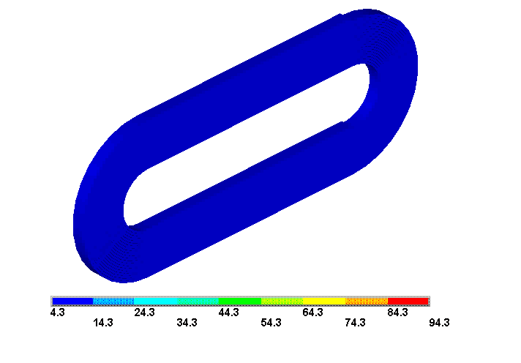
Quench protection
Propagation

Slide 19
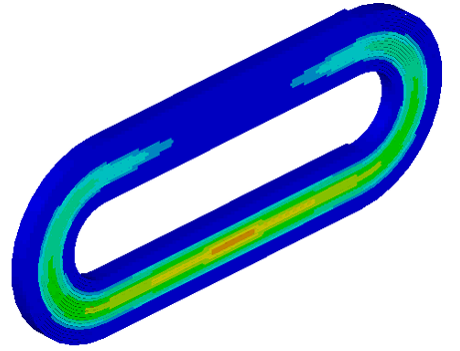
Quench protection
Quench represents a dangerous situation
Joule heating → hot spot temperature
Goal of the quench protection system
  Limit hot spot temperature to avoid conductor/coil degradation
    Limit thermal stress due to different thermal expansion in the coil
    Avoid material damage (resins)
  In most cases room temperature is considered to be safe
Analysis strategy: adiabatic condition→

Slide 20
Quench protection
MIITS
Adiabatic conditions
  Where I is the magnet current, ν the Cu fraction, A the cable cross-sectional area, c_{p}^{ave} the volumetric specific heat of the insulated cable and ρ_{Cu} the copper resistivity
The two terms are expressed in MIITS
If T∞= T_{max} → The right term gives the max # of MIITS to keep the peak temperature below T_{max}
The faster the drop in current, the lower the T∞
  How do we accelerate the drop in current?

Slide 21
Quench protection
Once the quench starts propagating, the magnet can be seen as a L/R circuit
Therefore
We need to maximize R
Quench propagation is not enough
  ~10-20 m/s along the cable
    About 1 s for a 10 m long magnet
  ~10 ms turn-to-turn
  ~50 ms between layers
So we need to make the entire coil resistive by heating it → Quench heaters
L
R_{quench}
I
t

Slide 22
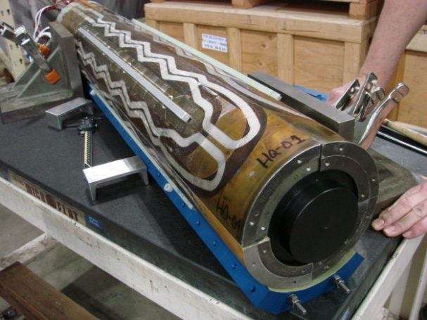
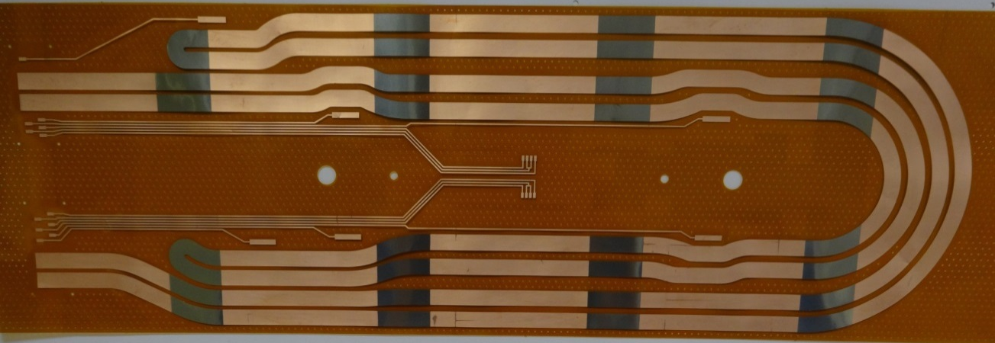
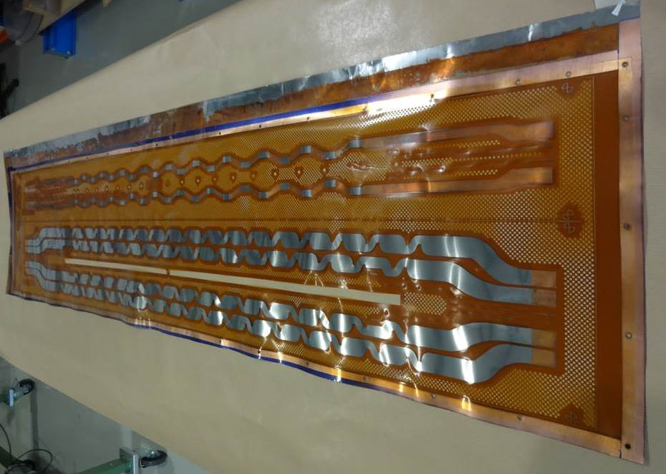
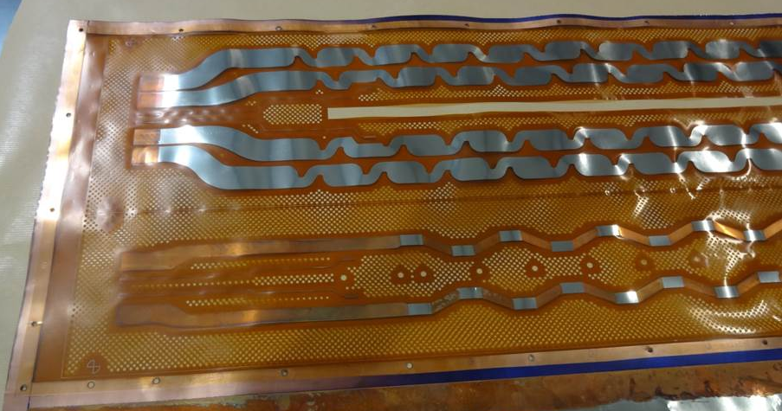
Quench protection
Quench heaters
Stainless steel strips (25 μm) on a polyimide sheet (50 μm) with Cu cladding (~10 μm) or larger width (to reduce V)

Slide 23
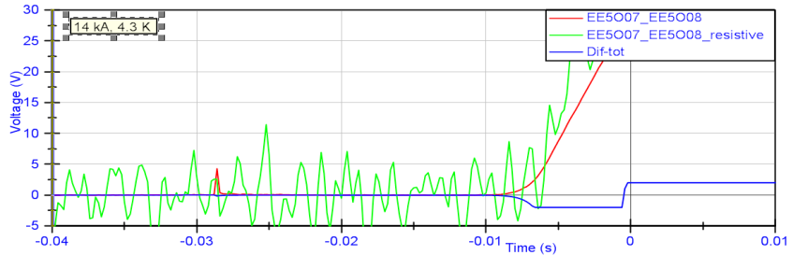
Quench protection
But we need to do it as fast as possible
Detection time: 5 to 20 ms
  t needed to detect a quench
  Voltage threshold ~ 100 mV
  Depends on quench velocity
    high or low field area
Validation time: 5 to 10 ms
  To avoid false events
Switch opening: 2 ms
And then…the quench heaters delay
L
R_{quench}
I
t

Slide 24
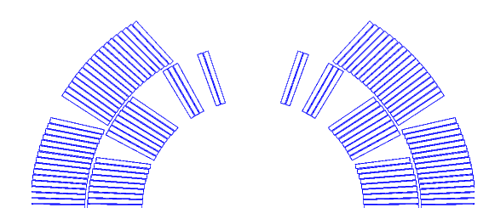
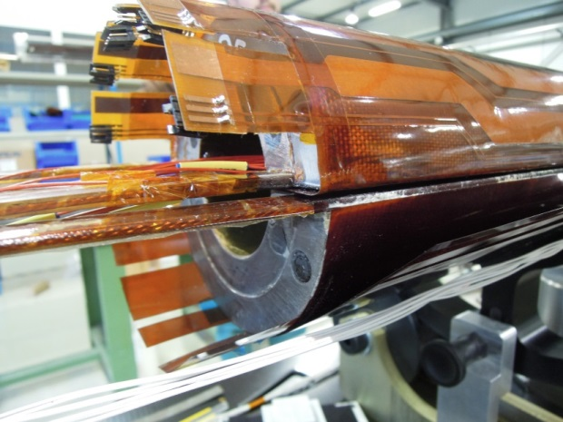
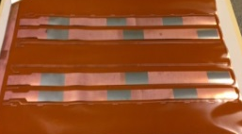
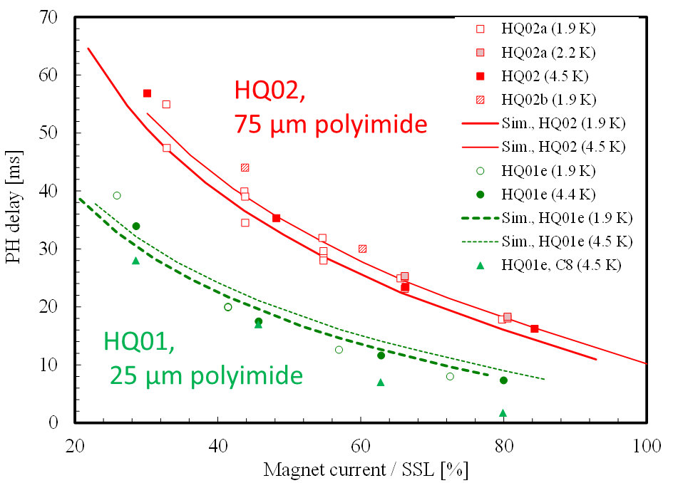
Quench protection
Quench heaters
Heater delay
  From the stainless steel strip to the cable through the polyimide: ~10-20 ms
    A factor 2.5 more to quench to low field part of the coils
      Higher T margin
  Few ms to propagate between heating stations
  Additional 5-10 ms to quench in the low field area
  Then, additional time to quench the inner layer
    Unless quench heater on inner surface
by T. Salmi

Slide 25
Quench protection
Back to the adiabatic condition
If T∞= T_{max} → The right term gives the max # of MIITS available
Then the left term, assuming magnet fully resistive→ MIITS during the drop
The difference gives you the max # of MIITS and time available to quench all
  In general for Nb-Ti: 100-200 ms
  For Nb₃Sn ~30-50 ms very challenging!!!
    Higher energy densities
I
t

Slide 26
Outine
Section I
  Particle accelerators and magnets
  Superconductivity and practical superconductors
Section II
  Magnetic design
Section III
  Coil fabrication
  Forces, stress, pre-stress
  Support structures
Section IV
  Quench, protection, training

Slide 27
Training
Introduction
How do we establish if a magnet
  reached its limit?
  is degraded?
  is limited by conductor motion or flux jumps?
What is “training”?
Which are the causes?

Slide 28
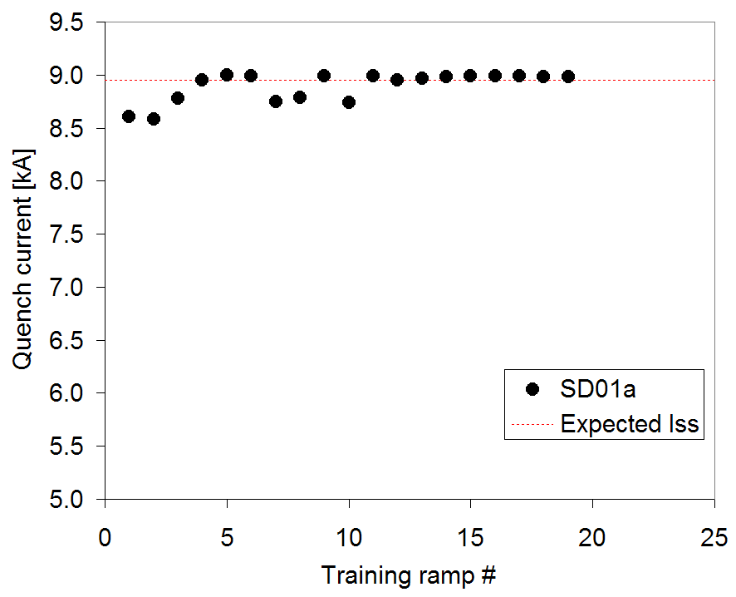
Training
Conductor limited quenches
Conductor limited quenches are usually very stable.
A series of conductor limited quenches appears as a plateau.
  For these reasons they are also called plateau quenches.
After having reached the maximum magnet current during test of the magnet, we have to compare it with the short sample current I_{ss}
  the maximum I according according to strand short sample measurements
J
B

Slide 29
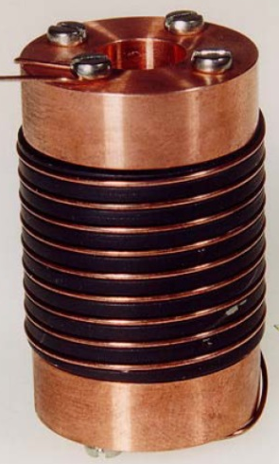
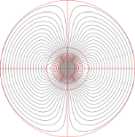
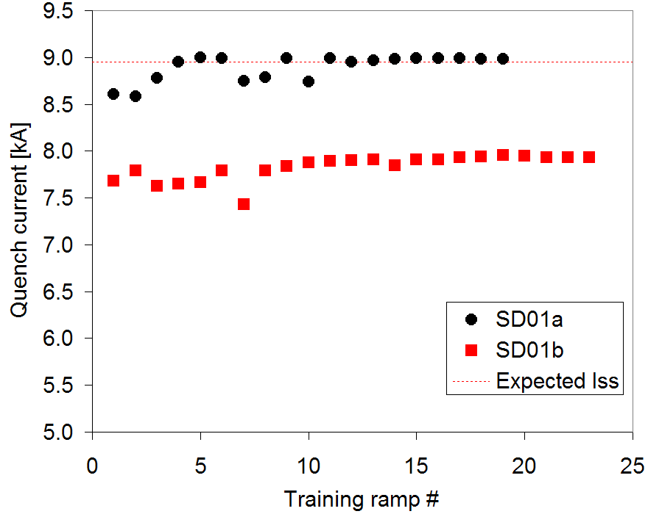
Training
Degraded performance
Wire short sample on a sample holder
  Cooled-down, ramped at different B
    Quench → Critical surface/curve measured
If during magnet test I_{max} = I_{ss}
  victory!
A conductor-limited quench or a plateau at a level lower
  indication of degradation
    Conductor damage
    Error in cable manufacturing
    Stress
  …or disturbances
  …or error in the computations…
J
B

Slide 30
Training
Degraded performance
Voltage signal studies
  Quench have different voltage precursors.
    A motion or a flux jump generates a change in magnetic flux inside the winding.
    A variation of magnetic flux results in a voltage signal detected across the coil.
  Depending on the shape of the voltage signal, it is possible to identify
    Conductor limited quenches: slow, gradual resistive growth
    Flux jump induced quenches: low-frequency flux changes
    Motion induced quenches: acceleration-deceleration-ringing
Conductor limited
Flux-Jump
Motion

Slide 31
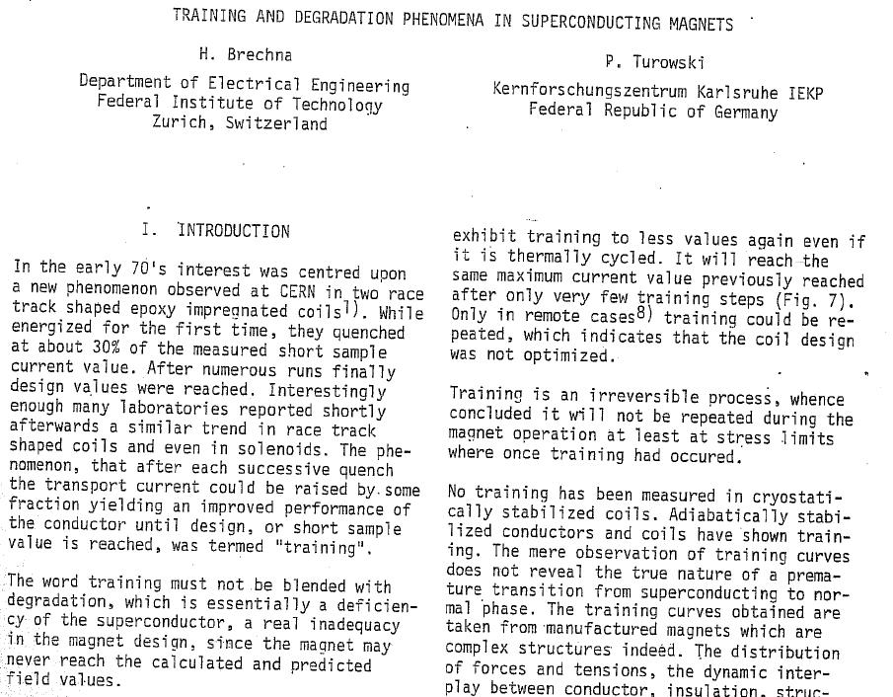
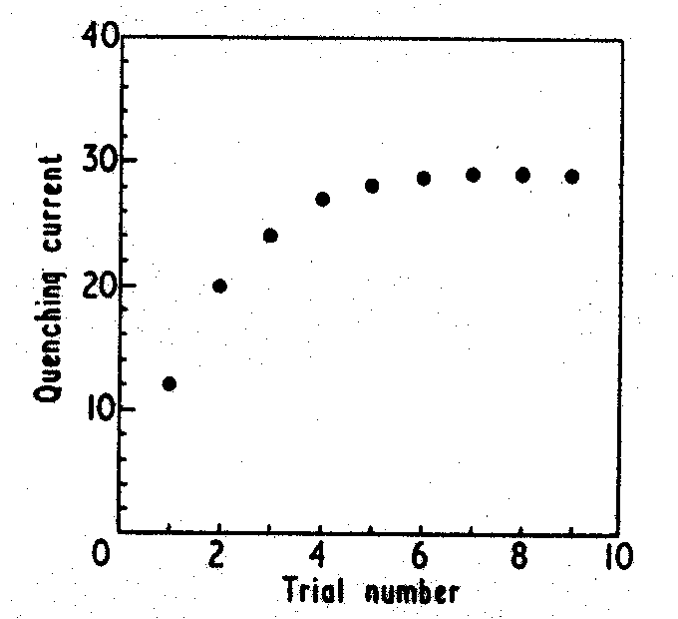
Training
NbZr solenoid
Chester, 1967
P.F. Chester, Rep. Prog. Phys., XXX, II, 561, 1967.
Proceedings of the 6th International Conference on Magnet Technology, 1978. p. 597.

Slide 32
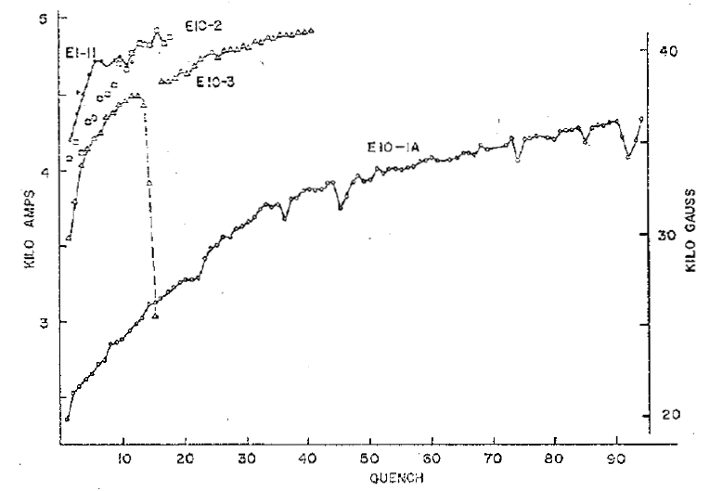
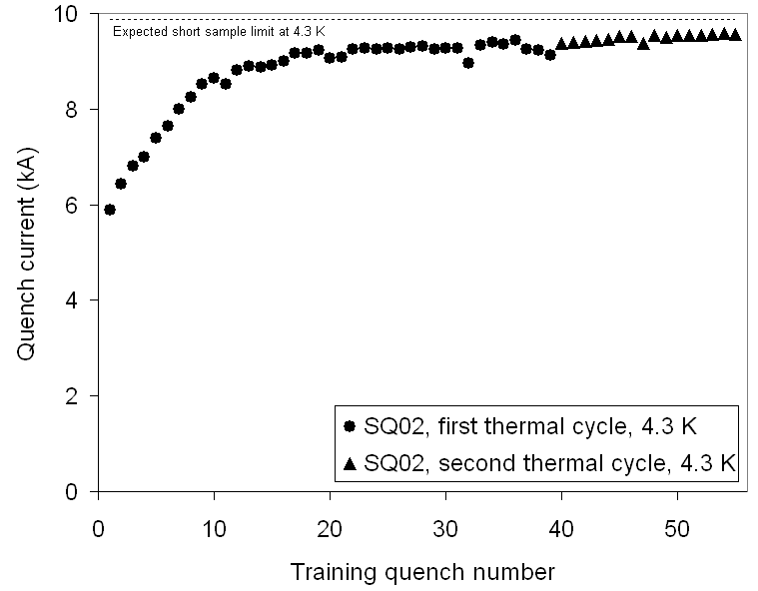
Training
Training is characterized by two phenomena
  The occurrence of premature quenches
    Which are the causes?
  The progressive increase of quench current
    Something not reversible happens, or, in other words, the magnet is somehow “improving” or “getting better” quench after quench.
    Some irreversible change in the coil’s mechanical status is occurring.
In R&D magnets, training may not be an issues.
For accelerator magnets it can be expensive
  both in term of time and cost.

Slide 33
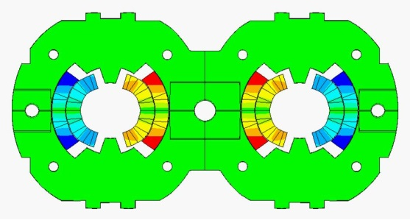


Training
Causes
Mechanical induced quenches are considered the main causes of training
  Frictional motion
    E.m. forces → motion → quench
    Coil locked by friction in a secure state
  Epoxy failure
    E.m. forces → epoxy cracking → quench
    Once epoxy locally fractured, further cracking appears only when the e.m. stress is increased.

Slide 34
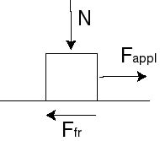
Training
Frictional motion
The Coulomb friction (or static friction) model
  The friction force is given by F_{fr} ≤ μN where μ is the friction factor.
  This means that the friction force depends on F_{app}
    If F_{app} ≤ μN, no sliding occurs, i.e. the friction force prevent motion
    If F_{app} > μN, sliding occurs, and the friction force is constant and = μN.
We can use a contact pressure P instead of force N, and frictional stress or shear stress σ_{fr} instead of F_{fr.}
The frictional energy dissipated per unit area E (J/m²)
  where δ (m) is the relative sliding

Slide 35
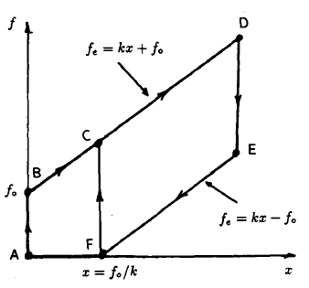
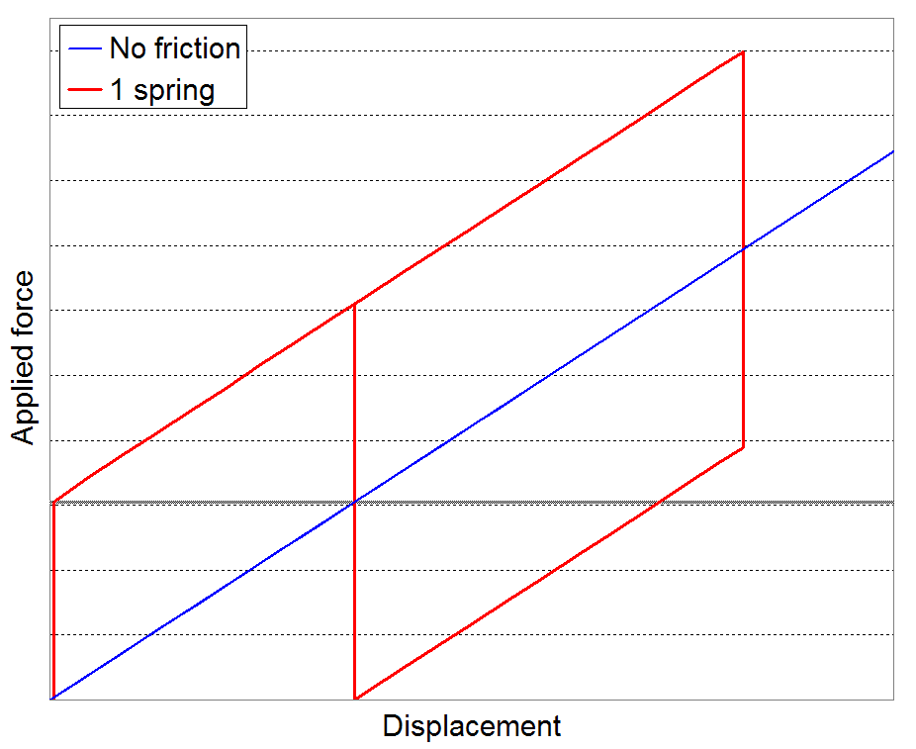
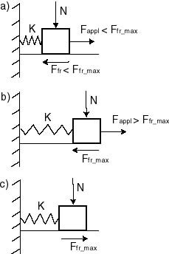
Training
Frictional motion
A simple analytical model has been proposed by O. Tsukamoto and Y. Iwasa.
  A simple force cycle applied to a spring system shows
    Irreversible displacement at the end of the first cycle
    Reduction of total displacement in the second cycle

Slide 36
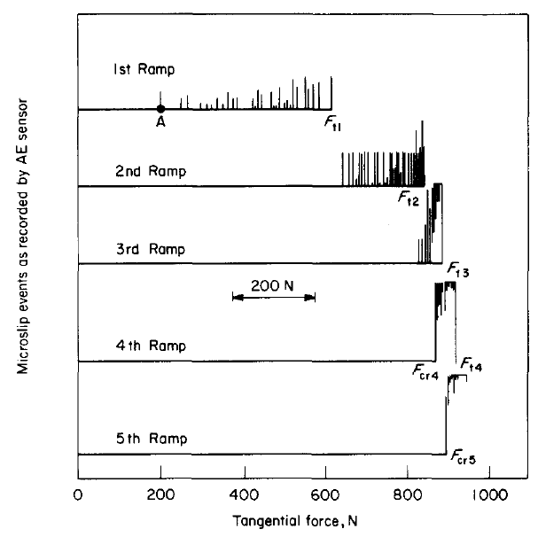
Training
Frictional motion
Acoustic emissions measurements
  AE are emitted during frictional sliding between two surfaces (cracks)
  Kaiser effect
    “During a sequence of cyclic loading, mechanical disturbances such as conductor motion and epoxy fracture appear only when the loading responsible for disturbances exceeds the maximum level achieved in the previous loading sequence.”
by H. Maeda, et al.

Slide 37
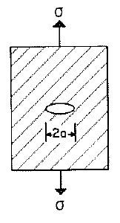
Training
Epoxy failures
Epoxy resin becomes brittle at low temperature
  Micro-cracking or micro-fractures may occur
The phenomenon is enhanced by the fact that the epoxy has an high thermal contraction
  After cool-down the resin is in tension
A brittle material in tension may experience crack
  When a crack propagated, the strain energy is converted in heat.
To prevent it
  fibrous reinforcement (fiberglass) are added
  volume with only resin are minimized
  In general, epoxy used where it is needed (Nb₃Sn magnets).
by M. Wilson

Slide 38
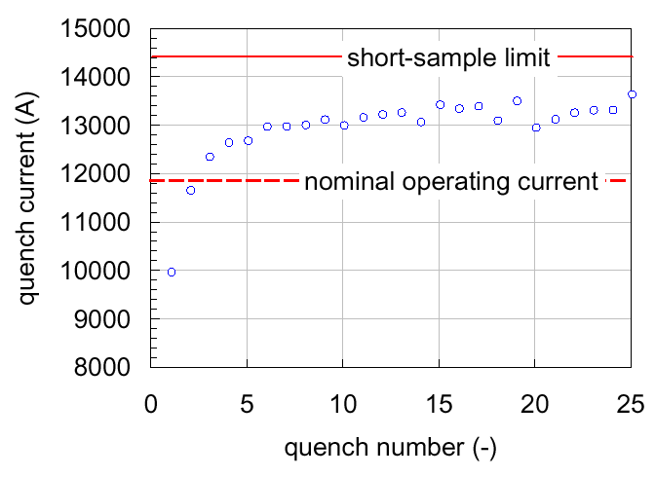
Training
Magnets operate with margin
  Nominal I reached with few quenches.
In general, very emotional process

Slide 39
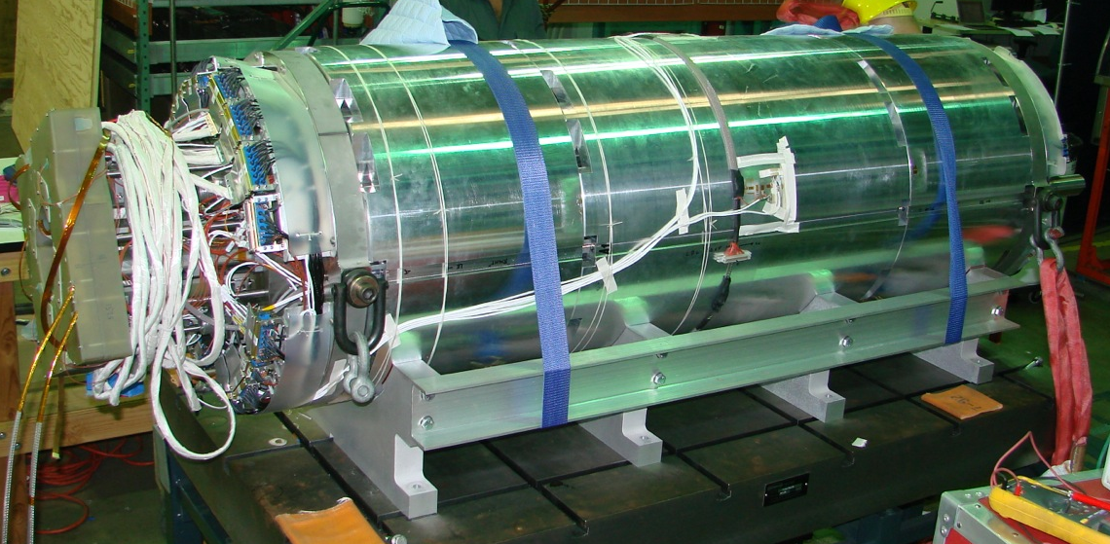
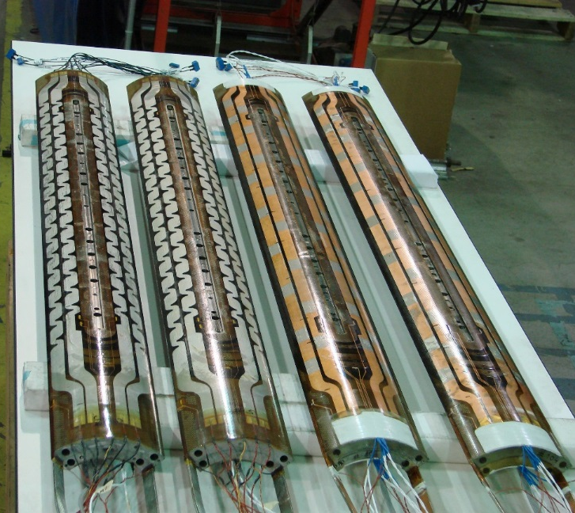
MQXFS01 test
First test of HiLumi Nb₃Sn IR quadrupole
Test at FNAL in 2016

Slide 40
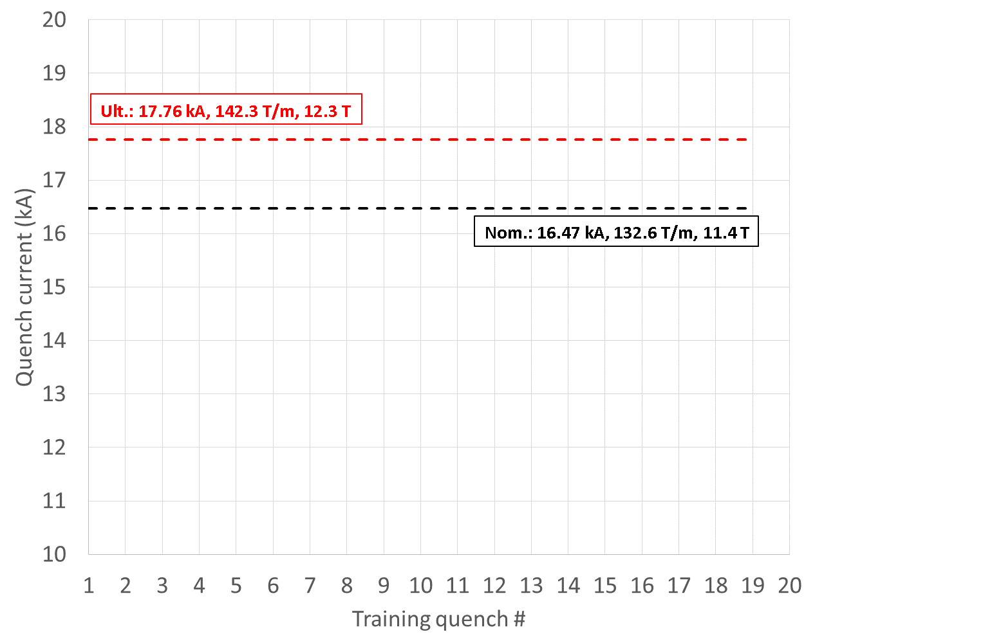
MQXFS01 test
First test of HiLumi Nb₃Sn IR quadrupole

Slide 41
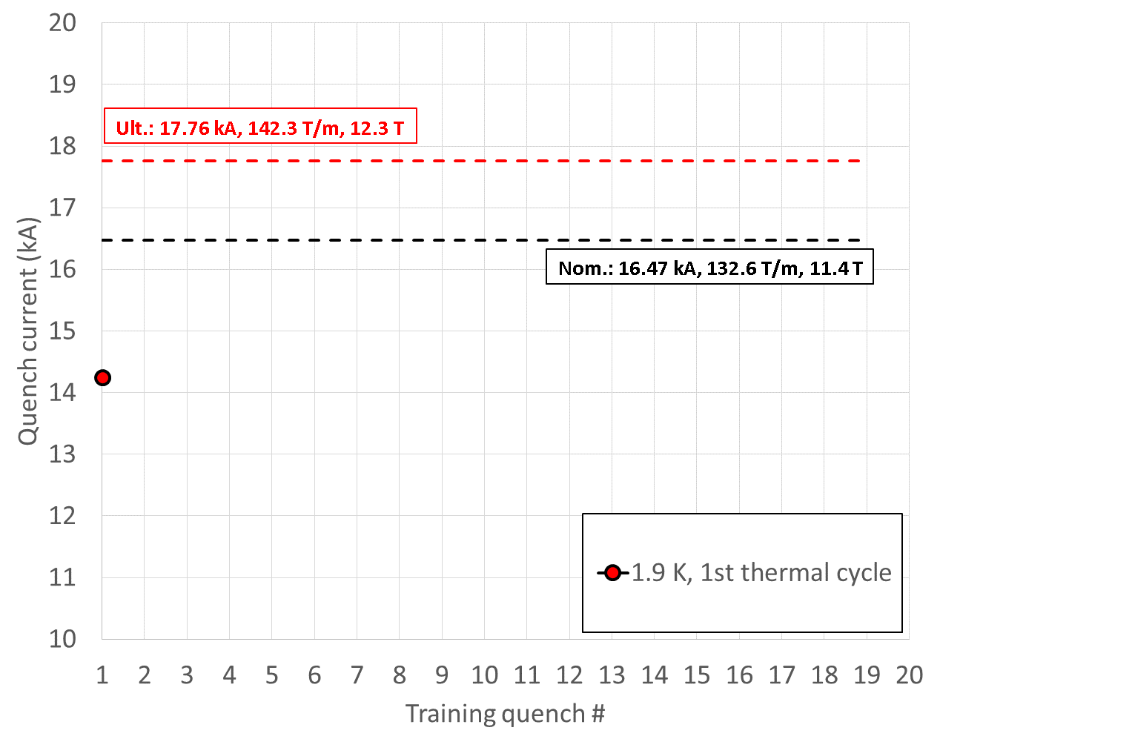
MQXFS01 test
First test of HiLumi Nb₃Sn IR quadrupole

Slide 42
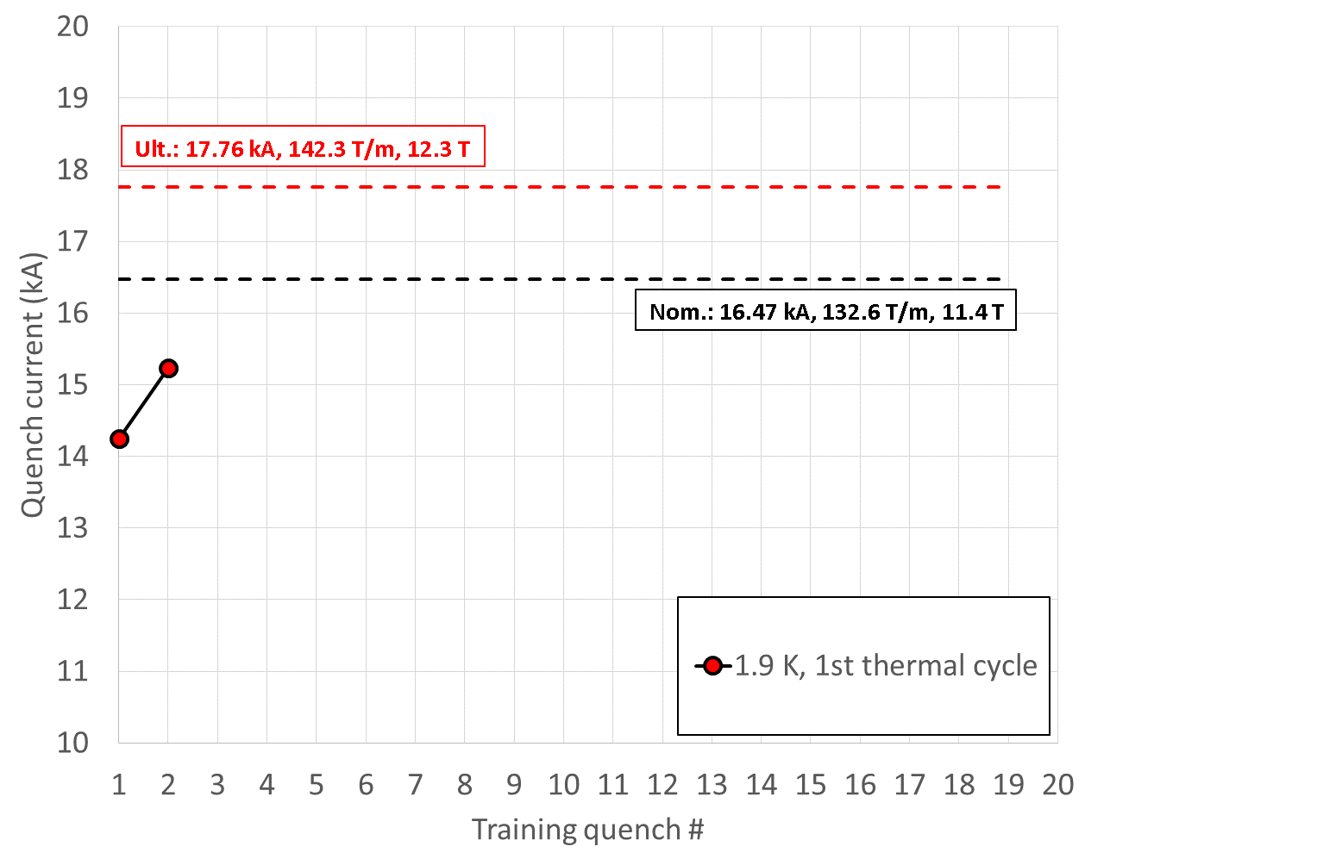
MQXFS01 test
First test of HiLumi Nb₃Sn IR quadrupole

Slide 43
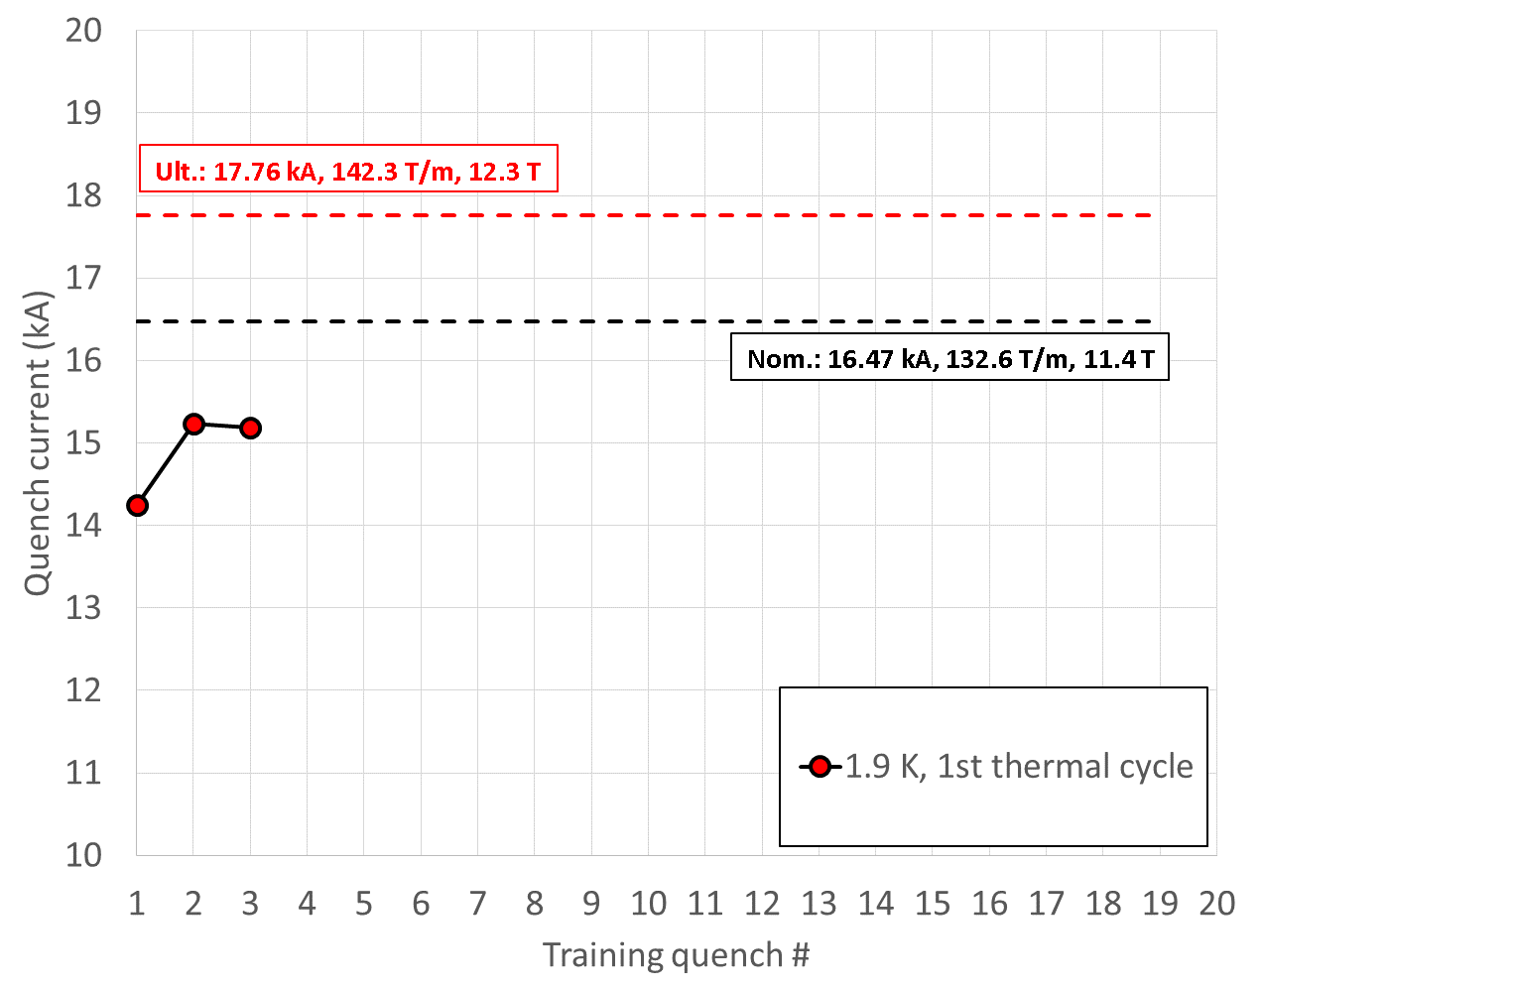
MQXFS01 test
First test of HiLumi Nb₃Sn IR quadrupole

Slide 44
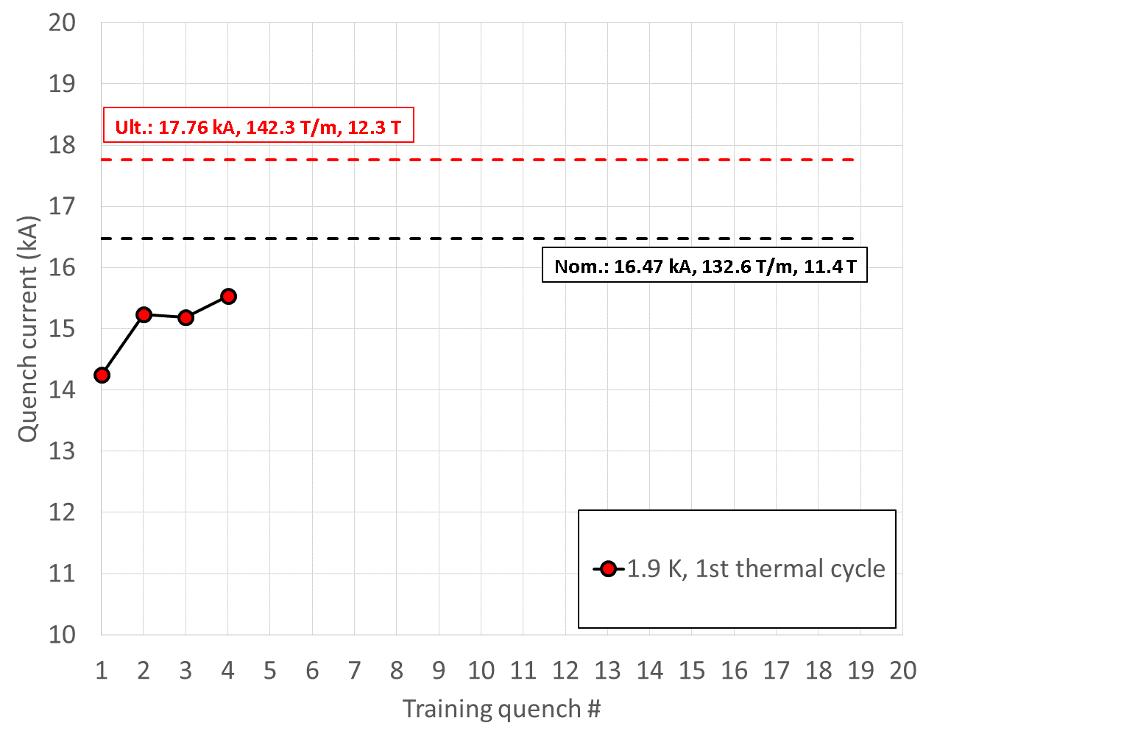
MQXFS01 test
First test of HiLumi Nb₃Sn IR quadrupole

Slide 45
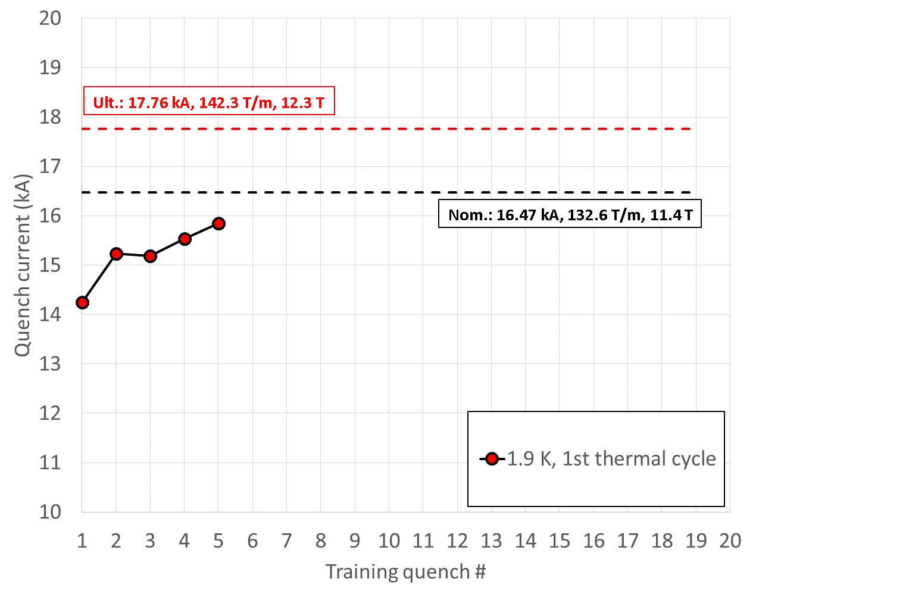
MQXFS01 test
First test of HiLumi Nb₃Sn IR quadrupole

Slide 46
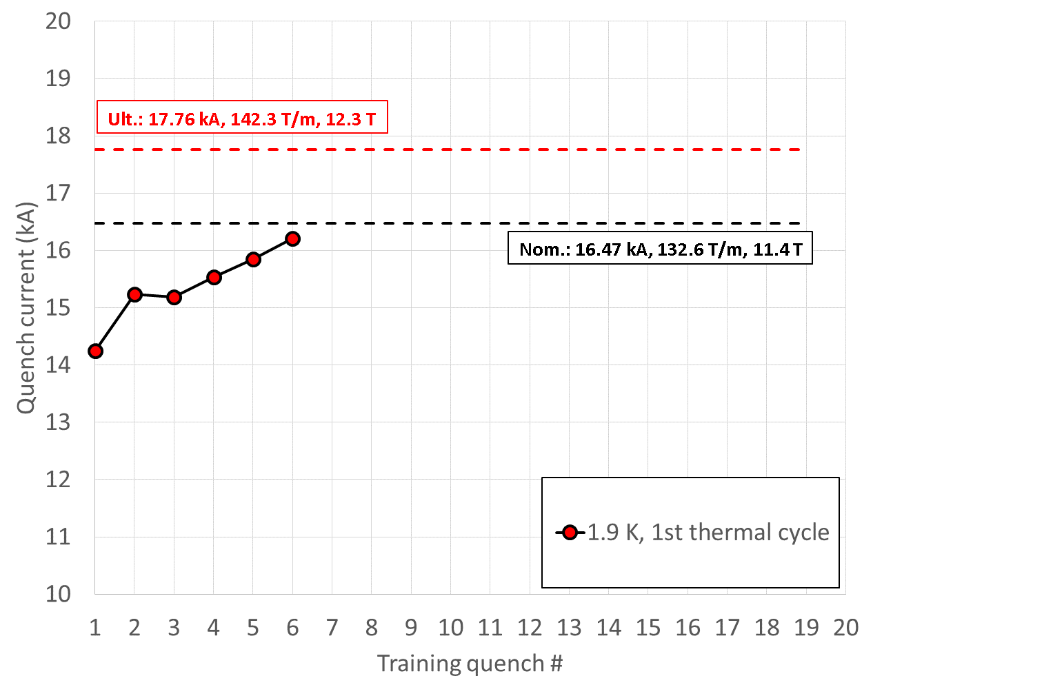
MQXFS01 test
First test of HiLumi Nb₃Sn IR quadrupole

Slide 47
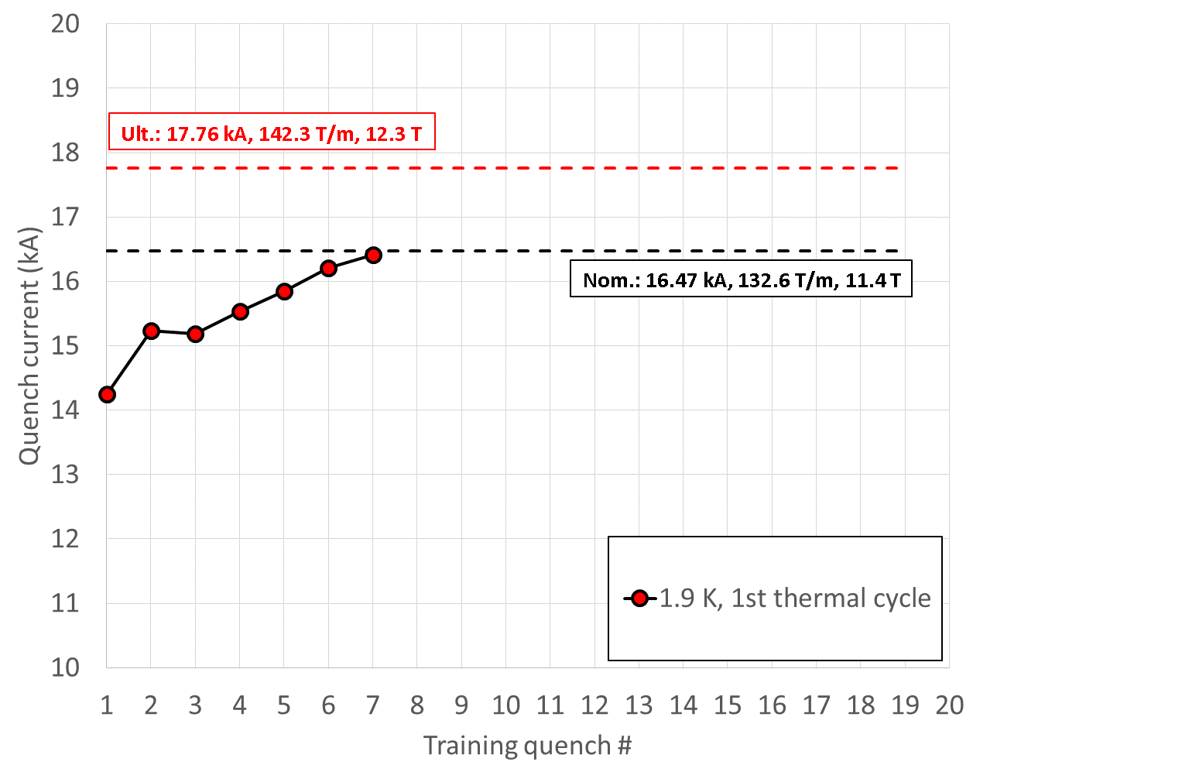
MQXFS01 test
First test of HiLumi Nb₃Sn IR quadrupole

Slide 48
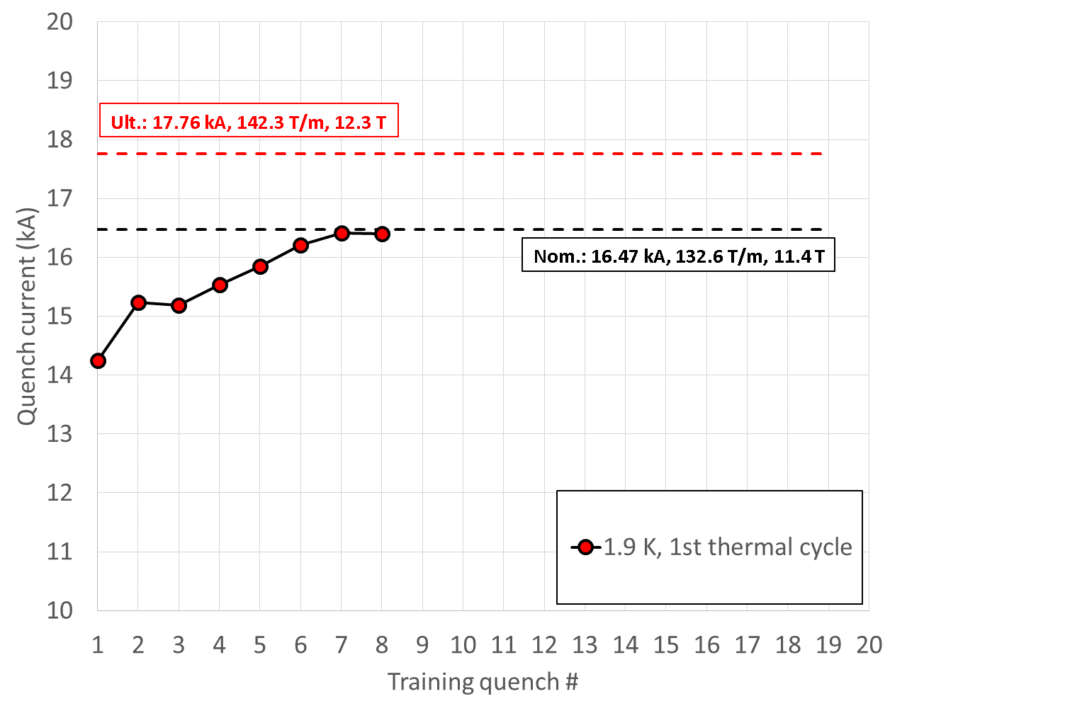
MQXFS01 test
First test of HiLumi Nb₃Sn IR quadrupole

Slide 49
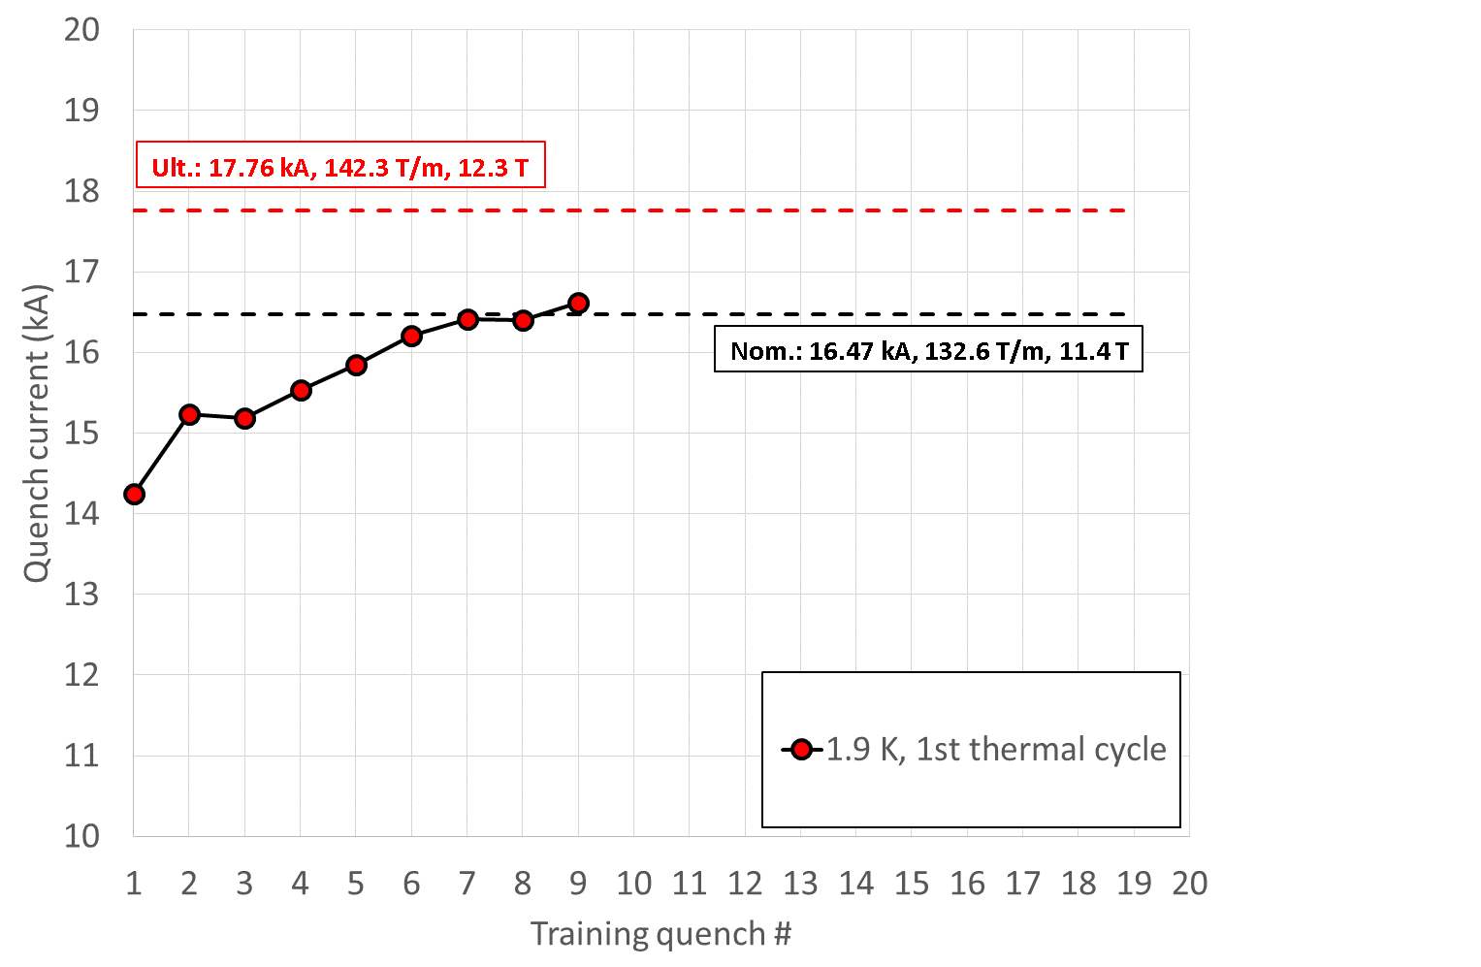
MQXFS01 test
First test of HiLumi Nb₃Sn IR quadrupole

Slide 50

MQXFS01 test
First test of HiLumi Nb₃Sn IR quadrupole

Slide 51
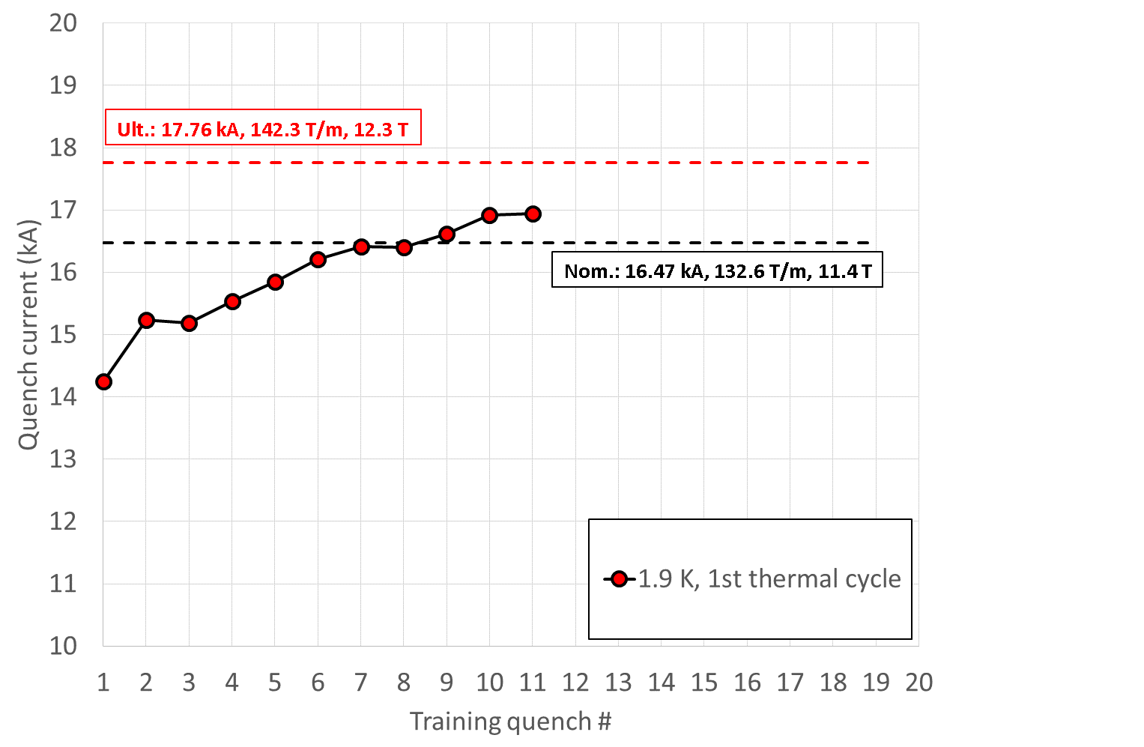
MQXFS01 test
First test of HiLumi Nb₃Sn IR quadrupole

Slide 52
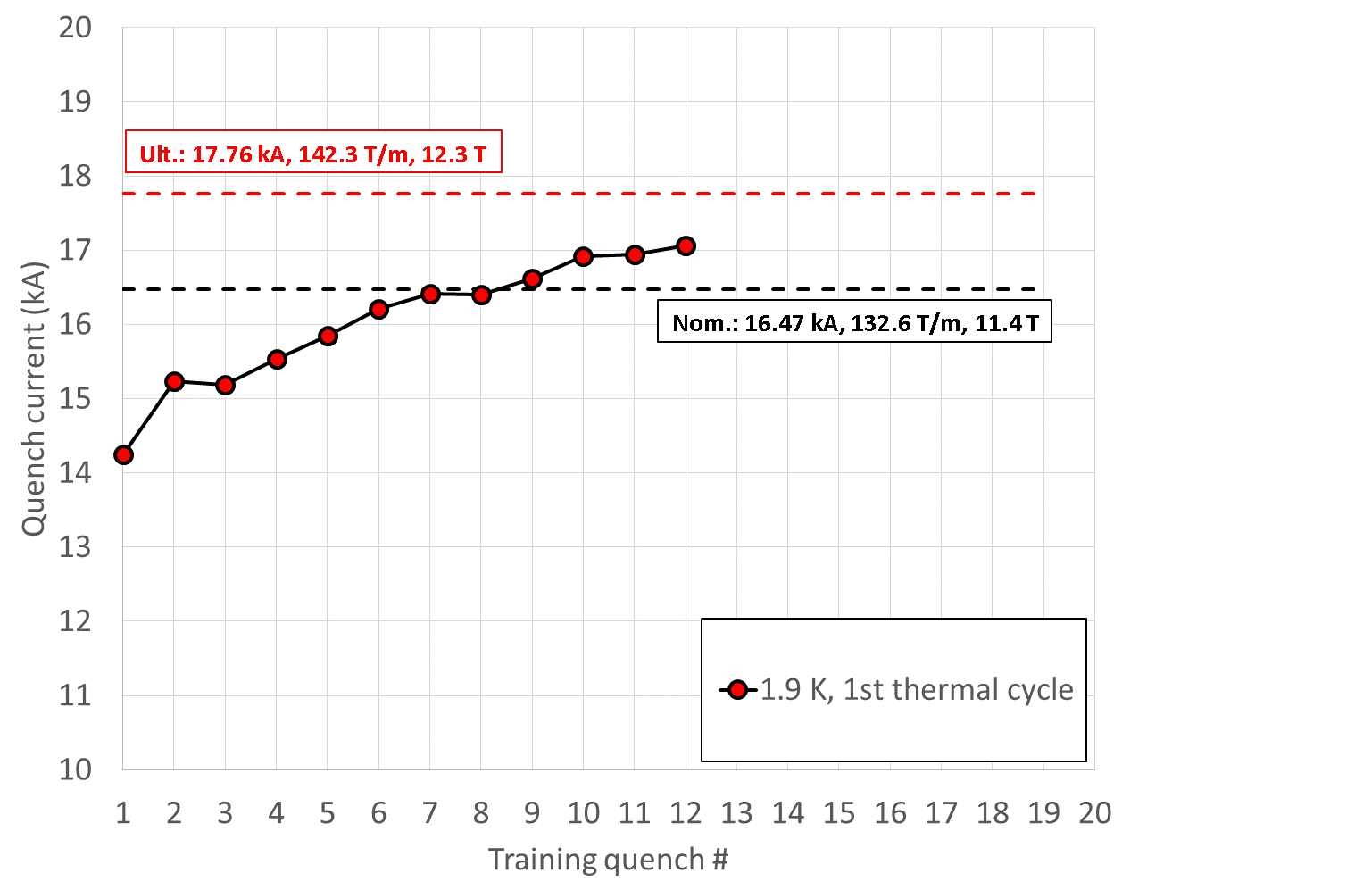
MQXFS01 test
First test of HiLumi Nb₃Sn IR quadrupole

Slide 53
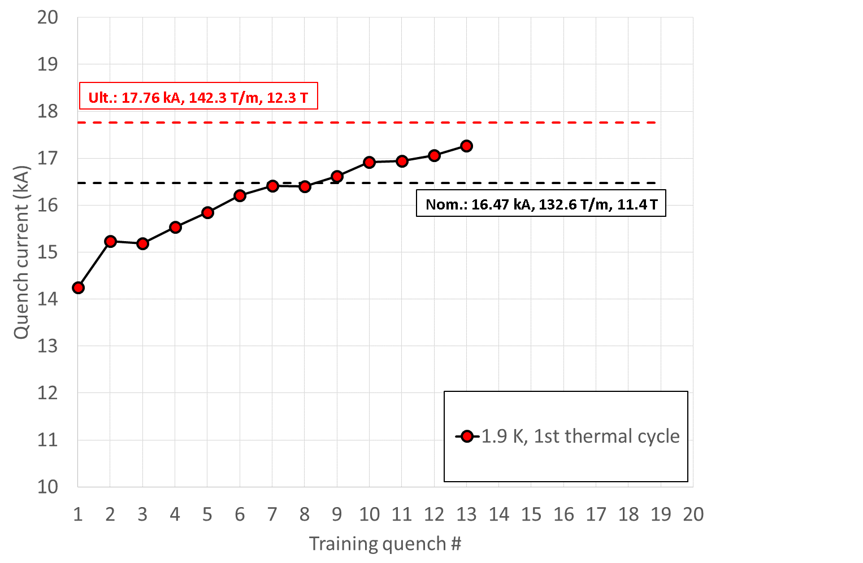
MQXFS01 test
First test of HiLumi Nb₃Sn IR quadrupole

Slide 54
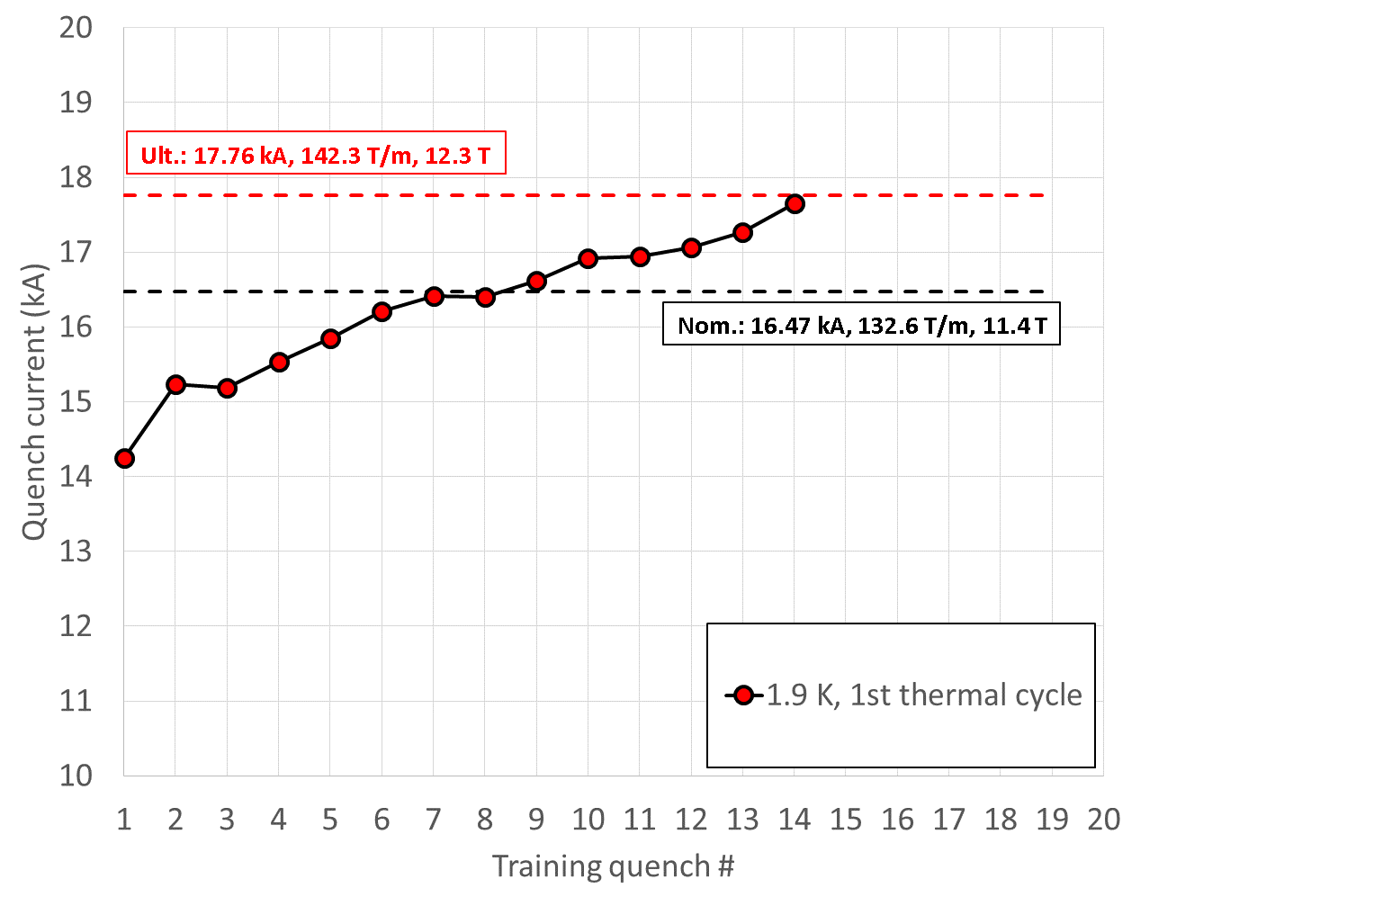
MQXFS01 test
First test of HiLumi Nb₃Sn IR quadrupole

Slide 55
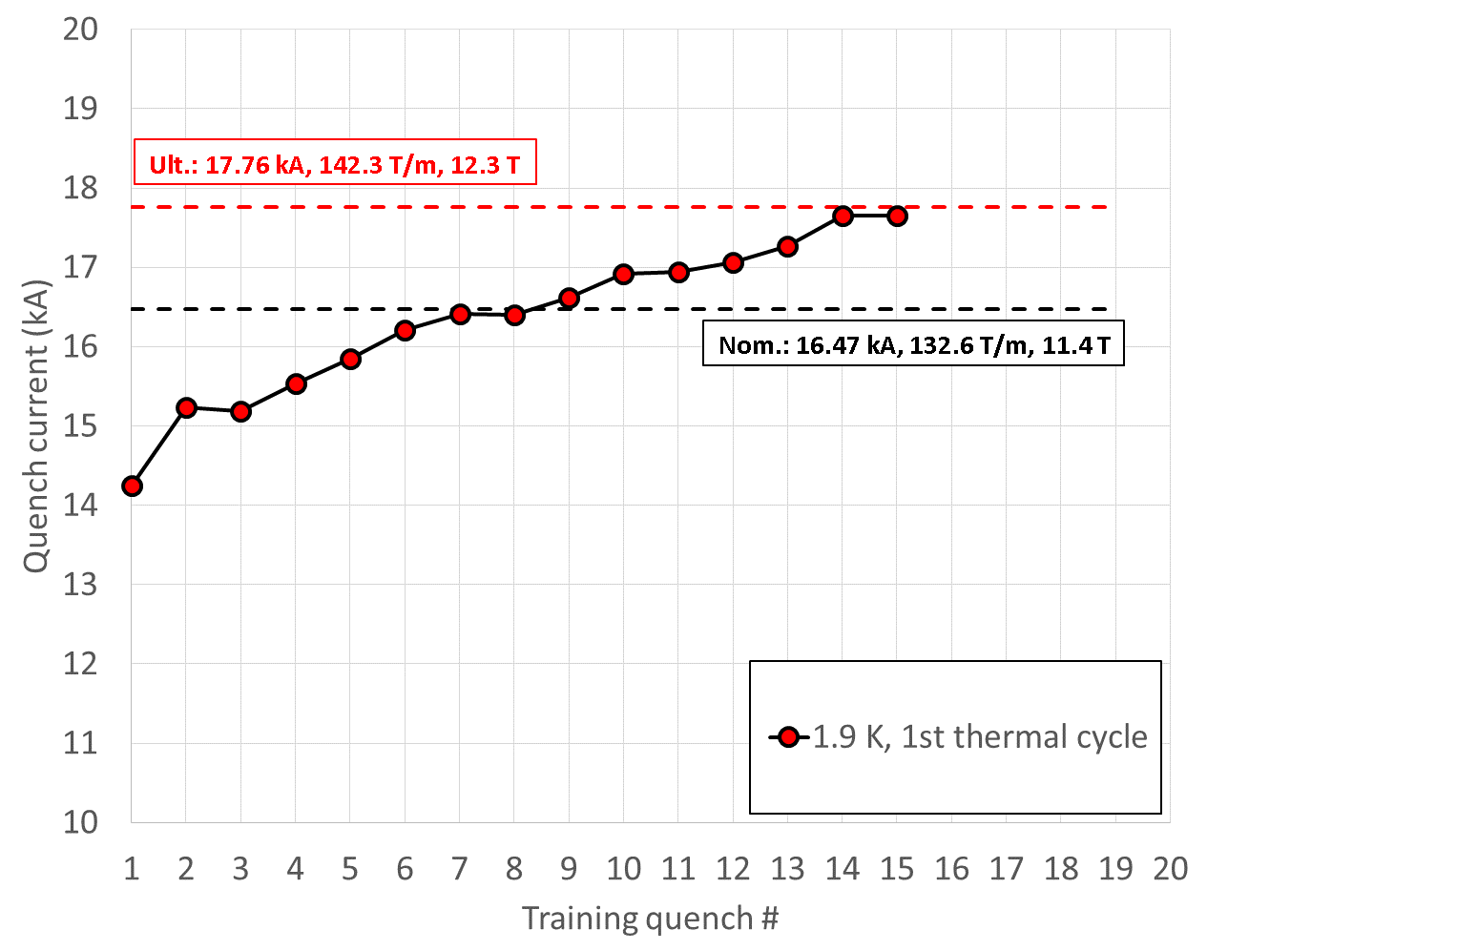
MQXFS01 test
First test of HiLumi Nb₃Sn IR quadrupole

Slide 56

MQXFS01 test
First test of HiLumi Nb₃Sn IR quadrupole

Slide 57

MQXFS01 test
First test of HiLumi Nb₃Sn IR quadrupole

Slide 58

MQXFS01 test
First test of HiLumi Nb₃Sn IR quadrupole

Slide 59

Second MQXFS magnet
Detraining…degradation

Slide 60

Third MQXFS magnet
Third test of HiLumi Nb₃Sn IR quadrupole

Slide 61

Erratic training…..loss of memory

Slide 62






Erratic training…..loss of memory…but significant improvement with wax

Slide 63
Training of LHC sectors to 6.5 TeV

Slide 64

Training of LHC sectors to 6.8-7.0 TeV

Slide 65













Summary
Particle accelerators and superconductors
Magnetic design and coil fabrication

Slide 66






Summary
Forces, stress, pre-stress , support structures
Quench, protection, training

Slide 67
Appendix

Slide 68
Quench
Distributed disturbances
Release of energy uniformly distributed: adiabatic condition.
  The T increase is uniform and no heat is conducted along the coil.
Energy density required to quench
  convenient to use the volumetric specific enthalpy H (J/m³) with γ (kg/m³) is the density
Then, possible to compute the energy density to quench

Slide 69
Temperature and energy margin
At 80% of I_{ss}
  Nb₃Sn has ~5 K of temperature margin at 1.9 K → ~15 mJ/cm³ (strand volume)
    …but impregnated (~adiabatic) coils
  Nb-Ti has ~2 K of temperature margin at 1.9 K → ~3 mJ/cm³ (strand volume)
    …but superfluid LHe surrounding the strands
1.9 K
4.2 K
1.9 K
4.2 K

