Slide 1
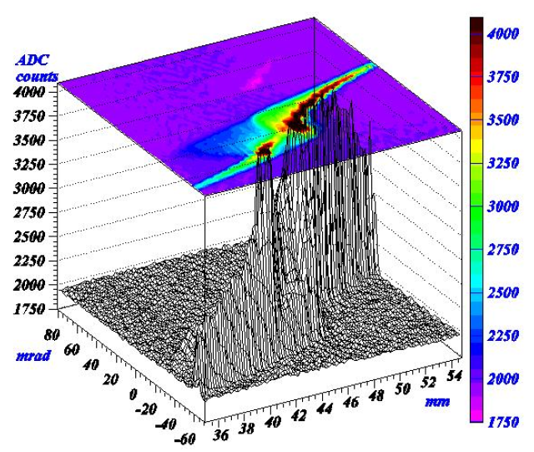


Measurement of transverse Beam Emittance
JUAS 2025, ESI-Archamps at CERN
Peter Forck (GSI and University Frankfurt)

Slide 2
Measurement of transverse Emittance
The emittance characterizes the whole beam quality, assuming linear
behavior as described by second order differential equation.
It is defined within the phase space as:
The measurement is based on determination of:
either profile width σ_{x} and angular width σ_{x}′ at one location
or σ_{x} at different locations and linear transformations.
Different devices are used at transfer lines:
All beams: Quadrupole variation & ’three grid’ method using linear transformations
(not well suited in the presence of non-linear forces)
Lower energies E_{kin} < 100 MeV/u: slit-grid device, pepper-pot
(suited in case of non-linear forces).
Synchrotron: lattice functions results in stability criterion
⇒ beam width delivers emittance:

Slide 3
Outline:
Definition and some properties of transverse emittance
Quadrupole strength variation and position measurement
Slit-Grid device: scanning method
Summary

Slide 4
Particle Trajectory and Characterization of many Particles
Single particle trajectories are forming a beam
They have a distribution of
start positions and angles
Characteristic quantity is
the beam envelope
⇒ Goal:
Behavior of whole ensemble
single particles
trajectory
envelope of all particles
Focus. quad.
drift
Focus. quad.
drift
Plot: Wille

Slide 5
Definition of Offset and Divergence
Horizontal and vertical coordinates at s = 0 :
x : Offset from reference orbit in [mm]
x’: Angle of trajectory in unit [mrad]
x’ = dx / ds
Assumption: par-axial beams:
x is small compared to dipole radius ρ₀
Small angle with p_{x} / p_{s} << 1
x
x
x’
s
l
Longitudinal coordinate:
Longitudinal orbit difference: l = - v₀ ∙ ( t – t₀ ) in unit [mm]
Momentum deviation: δ = ( p – p₀ ) / p₀ sometimes in unit [mrad] = [‰]
Reference particle: No offset x ≡ y ≡ l ≡ 0 & no angle x’ ≡ y’ ≡ δ ≡ 0 for all s
For continuous beam: l has no meaning ⇒ set l ≡ 0 !

Slide 6
Definition of Coordinates and Taylor Expansion B-Field
y
Definition compared to reference orbit
x: horizontal
y: vertical
s: in beam direction
ρ₀: radius of curvature
s
beam
ρ₀
x
$F_{L}= F_{z}$ ⇔ $\frac{1}{ρ_{0}}= \frac{e}{p} ∙B\left( x=0, y=0, s\right)$ on reference orbit
Taylor expansion of magnetic field at location s for field in y direction:
Drift (ρ₀ →∞), dipoles and quadrupoles ⇒ linear beam optics

Slide 7
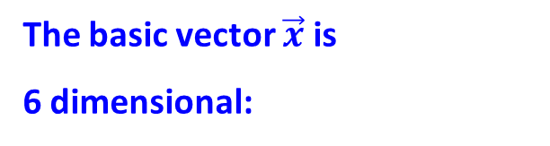

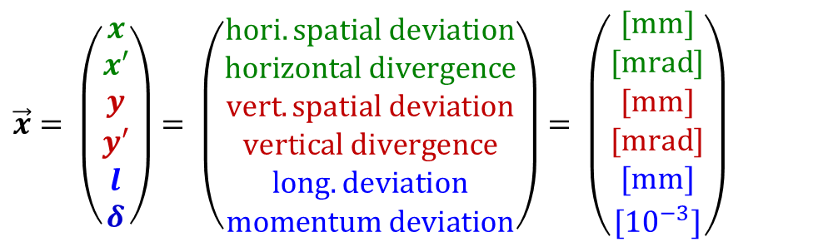
Excurse: Definition of Coordinates and basic Equations
The basic vector $\vec{x}$ is
6 dimensional:
$$\vec{x}= \left(\begin{matrix}x \\ x′ \\ y \\ y′ \\ l \\ δ\end{matrix}\right)= \left(\begin{matrix}hori. spatial deviation \\ horizontal divergence \\ vert.spatial deviation \\ vertical divergence \\ long. deviation \\ momentum deviation\end{matrix}\right)= \left(\begin{matrix}[mm] \\ [mrad] \\ [mm] \\ [mrad] \\ [mm] \\ {[10}^{−3}]\end{matrix}\right)$$
$\vec{x} ∈ ℝ^{6}$
The transformation of a single particle from a location s₀ to s₁ is given by the Transfer Matrix R: $\vec{x}\left(s_{1}\right)=R\left(s_{0}→s_{1}\right)∙\vec{x}\left(s_{0}\right)$
Transfer Matrix $R(s_{0}→s_{1})$is a 6x6 matrix ⇔ $R(s) ∈ ℝ^{6x6}$

Slide 8


Some Properties of the Transfer Matrix
The transformation can be done successive:
for R₁ = R( s₀ → s₁ ) ,…, R_{n} = R( s_{n-1} → s_{n} )
It is R = R_{n} ∙ R_{n-1}∙ … ∙ R₁ as it is a linear transformation
The matrix elements describe the coupling between the components
$R_{11}=\left(x | x\right), R_{12}=\left(x | x′\right),R_{13}=\left(x | y\right),R_{14}=\left(x | y′\right),R_{15}=\left(x | l\right),R_{16}=\left(x | δ\right)$
If all forces are symmetric along
the reference orbit
than the horizontal and
vertical plane are decoupled:
sub-matrix is sufficient
It is det(R) = 1 (Liouville’s Theorem)
i.e. R is invertible
Sub-matrix
here shown for drift L:
$$R = \left(\begin{matrix}(x|x) & (x|x′) & 0 & 0 & 0 & (x|δ) \\ (x′|x) & (x′|x′) & 0 & 0 & 0 & (x′|δ) \\ 0 & 0 & (y|y) & (y|y′) & 0 & 0 \\ 0 & 0 & (y′|y) & (y′|y′) & 0 & 0 \\ (l|x) & (l|x′) & 0 & 0 & (l|l) & (l|δ) \\ 0 & 0 & 0 & 0 & (δ|l) & (δ|δ)\end{matrix}\right)$$

Slide 9
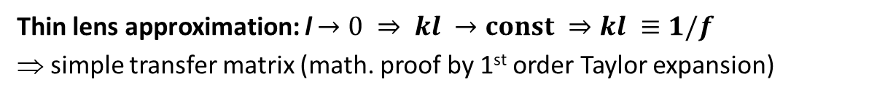
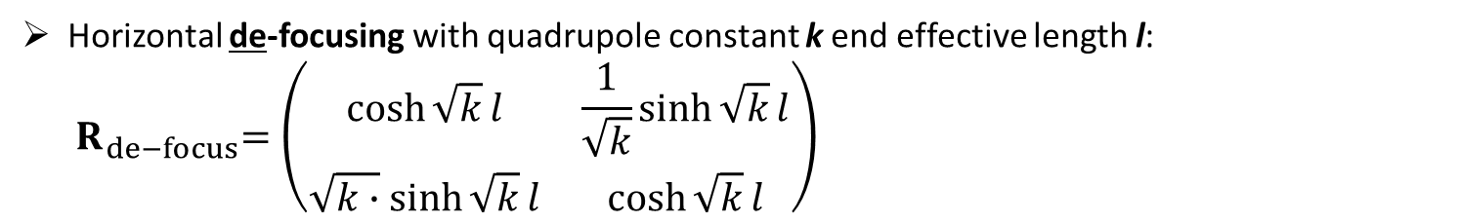
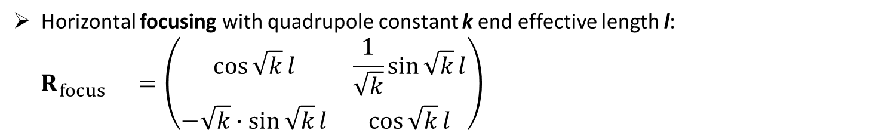
Some Examples for linear Transformations
The 2-dim sub-space (x,x’) can be used in case there is no coupling like dispersion R₁₆ =(x|δ)=0
Important examples are:
Drift with length L: $R_{drift}=\left(\begin{matrix}1 & L \\ 0 & 1\end{matrix}\right)$
Horizontal focusing with quadrupole constant k end effective length l:
$${ R}_{focus} =\left(\begin{matrix}\cos{\sqrt{k}}l & \frac{1}{\sqrt{k}}sin{\sqrt{k}}l \\ −\sqrt{k}∙sin{\sqrt{k}}l & \cos{\sqrt{k}}l\end{matrix}\right)$$
Horizontal de-focusing with quadrupole constant k end effective length l:
$${ R}_{de−focus}=\left(\begin{matrix}\cosh{\sqrt{k}}l & \frac{1}{\sqrt{k}}sinh{\sqrt{k}}l \\ \sqrt{k∙}sinh{\sqrt{k}}l & \cosh{\sqrt{k}}l\end{matrix}\right)$$
Ideal quad.: field gradient g = B_{pole}/a, B_{pole} field at poles, a aperture
→ quadrupole constant k = | g | / (Bρ)₀
Horizontal focusing:
Δx’
f
s
Thin lens approximation: l$→0 ⇒ kl →const ⇒kl ≡1/f$
⇒ simple transfer matrix (math. proof by 1st order Taylor expansion)
Kick: Δx’ = - x/f

Slide 10
Imaging using Quadropules: Here Duplett Focusing
Horizontal
focusing
Horizontal
de-focusing
Single particle trajectories
forming a beam
Characteristic quantity is
the beam envelope
trajectories
Goal: Description of
whole ensemble behavior!
a
L
l
L
b
y
Transfer matrix:
R_{channel}= R_{drift}(b) ∙ R_{de-focus}(kL) ∙ R_{drift}(l) ∙ R_{focus}(kL) ∙ R_{drift}(a)
Plot: Rossbach, Schmüser

Slide 11
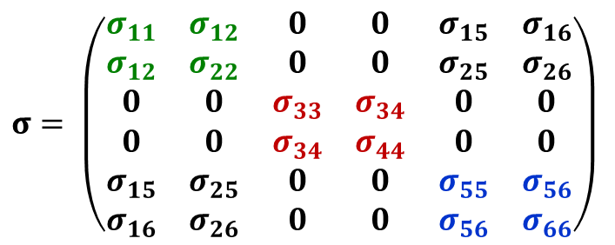
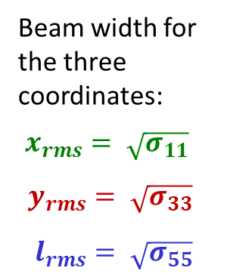
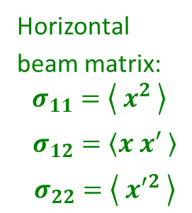
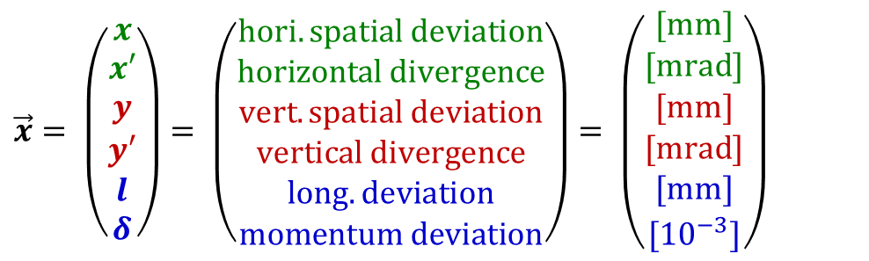
Definition of Beam Matrix
The basic 6 dimensional vextor is:
$$\vec{x}= \left(\begin{matrix}x \\ x′ \\ y \\ y′ \\ l \\ δ\end{matrix}\right)= \left(\begin{matrix}hori. spatial deviation \\ horizontal divergence \\ vert.spatial deviation \\ vertical divergence \\ long. deviation \\ momentum deviation\end{matrix}\right)= \left(\begin{matrix}[mm] \\ [mrad] \\ [mm] \\ [mrad] \\ [mm] \\ {[10}^{−3}]\end{matrix}\right)$$
Transformation of a single particle from s₀ to s₁ is given by the Transfer Matrix R:
$$\vec{x}\left(s_{1}\right)=R\left(s_{0}→s_{1}\right)∙ \vec{x}(s_{0})$$
Transformation of a the envelope from s₀ to s₁ is given by the Beam Matrix σ:
$$σ \left(s_{1}\right)=R\left(s_{0}→s_{1}\right)∙ σ\left(s_{0}\right)∙R^{T}\left(s_{0}→s_{1}\right)$$
Beam width for
the three
coordinates:
$x_{rms}= \sqrt{σ_{11}}$
$$y_{rms}= \sqrt{σ_{33}}$$
$l_{rms}= \sqrt{σ_{55}}$
6-dim Beam Matrix with decoupled hor. & vert. plane:
Horizontal
beam matrix:
$$σ_{11}=\left\langle { x}^{2} \right\rangle$$
$σ_{12}=\left\langle x x′ \right\rangle$
$σ_{22}=\left\langle { x′}^{2} \right\rangle$
$$σ= \left(\begin{matrix}σ_{11} & σ_{12} & 0 & 0 & σ_{15} & σ_{16} \\ σ_{12} & σ_{22} & 0 & 0 & σ_{25} & σ_{26} \\ 0 & 0 & σ_{33} & σ_{34} & 0 & 0 \\ 0 & 0 & σ_{34} & σ_{44} & 0 & 0 \\ σ_{15} & σ_{25} & 0 & 0 & σ_{55} & σ_{56} \\ σ_{16} & σ_{26} & 0 & 0 & σ_{56} & σ_{66}\end{matrix}\right)$$
horizontal
vertical
longitudinal
hor.-long. coupling
10 values
all couplings
→ 21 values

Slide 12



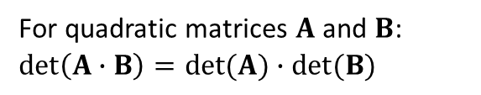

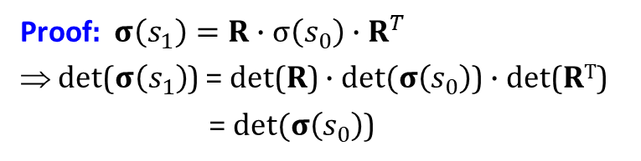
Geometrical Parameters of Phase Space Ellipsoid
$$slope=\frac{σ_{22}}{σ_{12}}=−\frac{γ}{α}$$
x’
$${x′}_{max}=\sqrt{σ_{22}}{=\sqrt{εγ}}_{}$$
$$slope=\frac{σ_{12}}{σ_{11}}=−\frac{α}{β}$$
The phase space distribution is
described by an ellipse
with the characteristics parameters
a
x
b
$$x_{max}=\sqrt{σ_{11}}{=\sqrt{εβ}}_{}$$
Corresponding parameters:
Area: A= π ab =π ε
Beam Matrix | Statistic | Twiss Parameter
σ₁₁ | <x²> | εβ
σ₂₂ | <x’²> | εγ
σ₁₂ | <xx’> | -εα
The determinate is preserved:
Proof: $σ\left(s_{1}\right)=R∙σ\left(s_{0}\right)∙R^{T}$
⇒ det($σ\left(s_{1}\right)$) = det(R) $∙det⁡(σ\left(s_{0}\right)$) $∙$det(R^{T})
= $det⁡(σ\left(s_{0}\right)$)
For quadratic matrices $A$ and $B$:
$$\det\left(A∙B\right)=det⁡(A)∙det⁡(B)$$

Slide 13
Geometrical Parameters of Phase Space Ellipsoid
Gaussian distribution for an ensemble of particles
The phase space distribution is
described by an ellipse
with the characteristics parameters
Corresponding parameters:
Beam Matrix | Statistic | Twiss Parameter
σ₁₁ | <x²> | εβ
σ₂₂ | <x’²> | εγ
σ₁₂ | <xx’> | -εα
The determinate is preserved:

Slide 14
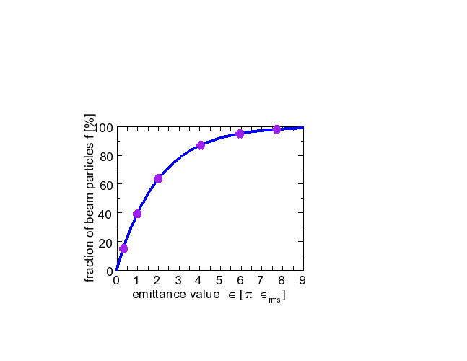
The Emittance for Gaussian and non-Gaussian Beams
The beam distribution can be non-Gaussian, e.g. at:
➢ beams behind ion source
space charged dominated beams at LINAC & synchrotron
cooled beams in storage rings
General description of emittance
using terms of 2-dim distribution:
It describes the value for 1 standard derivation
Variances
Covariance
i.e. correlation
For Gaussian beams only: ε_{rms} ↔ interpreted as area containing a fraction f of ions:
Emittance ε(f) | Fraction f
1 ⋅ ε_{rms} | 15 %
π ⋅ ε_{rms} | 39 %
2π ⋅ ε_{rms} | 63 %
4π ⋅ ε_{rms} | 86 %
8π ⋅ ε_{rms} | 98 %
Care:
No common definition
of emittance concerning
the fraction f

Slide 15

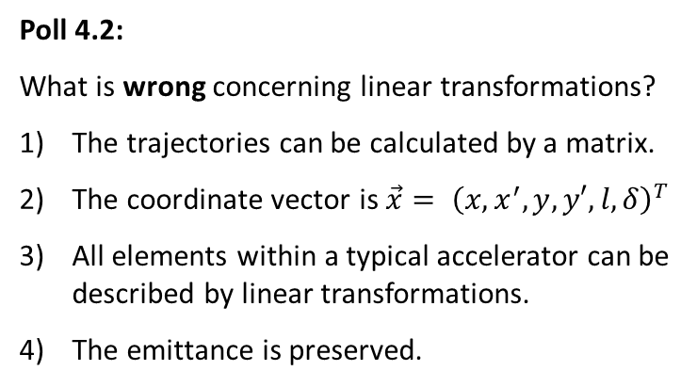
Poll concerning linear Transformations
Poll 4.1:
Which optical elements are non-linear?
Dipole
Quadrupole
Sextupole
Poll 4.2:
What is wrong concerning linear transformations?
The trajectories can be calculated by a matrix.
The coordinate vector is $\vec{x}= {\left(x,x^{′},y,y′,l,δ\right)}^{T}$
All elements within a typical accelerator can be described by linear transformations.
The emittance is preserved.
www.menti.com
code: 1208 6026
Notes:
15

Slide 16
Outline:
Definition and some properties of transverse emittance
Quadrupole strength variation and position measurement
emittance from several profile measurement and beam optical calculation
Slit-Grid device: scanning method
Summary

Slide 17
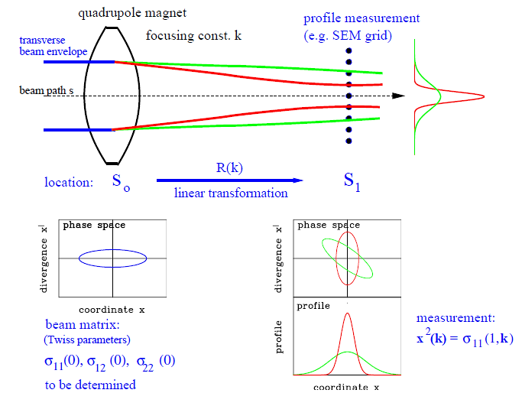
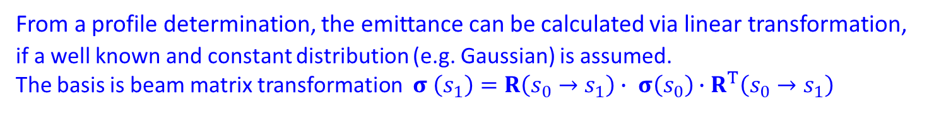
Emittance Measurement by Quadrupole Variation
From a profile determination, the emittance can be calculated via linear transformation,
if a well known and constant distribution (e.g. Gaussian) is assumed.
The basis is beam matrix transformation $σ \left(s_{1}\right)=R\left(s_{0}→s_{1}\right)∙ σ\left(s_{0}\right)∙R^{T}\left(s_{0}→s_{1}\right)$
Measurement of beam width
x²_{max} = σ₁₁(1, k)
matrix R(k) describes the focusing.
With the drift matrix the transfer is
R(k_{i} ) = R_{drift} ⋅ R_{focus}(k_{i} )
Transformation of the beam matrix
σ(1,k_{i}) = R(k_{i} ) ⋅ σ(0) ⋅ R^{T} (k_{i} )
Task: Calculation of matrix σ(0)
at entrance s₀ i.e. all three elements

Slide 18
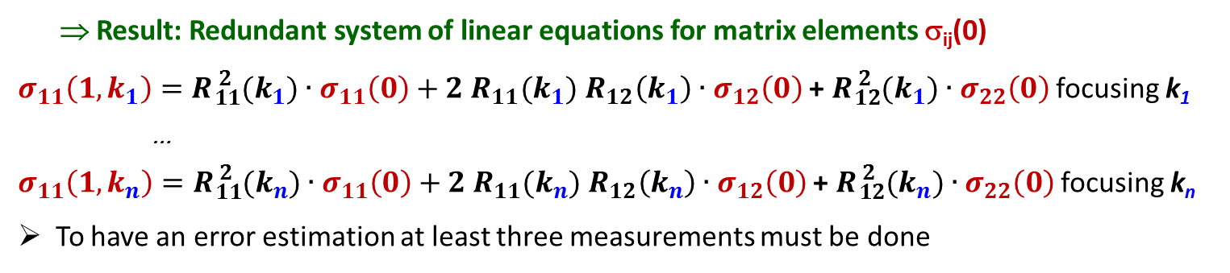
Measurement of transverse Emittance
The beam width x_{max}(s₁) at s₁ is measured ⇔ matrix element σ₁₁(1, k_{i}) = x²_{max} (k_{i})
Different focusing of quadrupoles k₁ , k₂ ... k_{n} are used ⇒ R_{focus}(k_{i})
After the drift the transfer matrix is R(k_{i}) = R_{drift} ⋅ R_{focus}(k_{i})
Task: Calculation of beam matrix σ(0) at entrance s₀ (matrix elements give orientation)
The transformation of the beam matrix is: σ(1,k_{i}) = R(k_{i} ) ⋅ σ(0) ⋅ R^{T} (k_{i} )
⇒ Result: Redundant system of linear equations for matrix elements σ_{ij}(0)
$σ_{11}\left(1,k_{1}\right)=R{}_{11}^{2 }{(k_{1})}∙σ_{11}\left(0\right)+2 R_{11}(k_{1})$ $R_{12}\left(k_{1}\right)∙σ_{12}\left(0\right)$ + $R{}_{12}^{2 }{(k_{1})}∙σ_{22}\left(0\right)$ focusing k₁
…
$σ_{11}\left(1,k_{n}\right)=R{}_{11}^{2 }{(k_{n})}∙σ_{11}\left(0\right)+2 R_{11}(k_{n})$ $R_{12}\left(k_{n}\right)∙σ_{12}\left(0\right)$ + $R{}_{12}^{2 }{(k_{n})}∙σ_{22}\left(0\right)$ focusing k_{n}
To have an error estimation at least three measurements must be done
Assumptions: ➢ Constant emittance, in particular no space-charge broadening
➢ Only elliptical shaped beam distribution is considered
➢ No misalignment, i.e. beam center equals center of the quadrupoles
➢ If not valid: A self-consistent algorithm can be used.

Slide 19
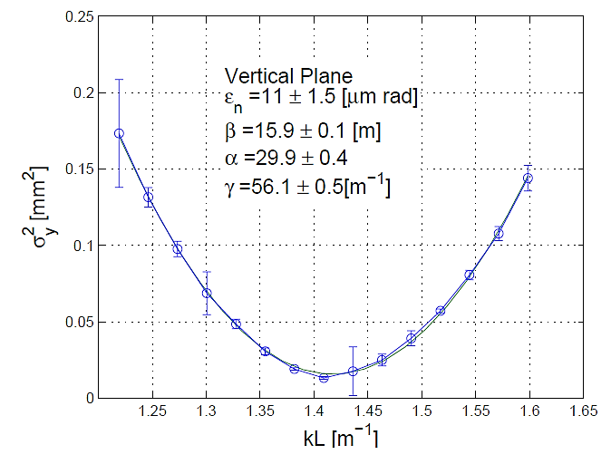

Measurement of transverse Emittance
Using the ‘thin lens approximation’ i.e. the quadrupole has a focal length of f:
Measurement of the matrix-element $11$(1,K) from σ(1,K) = R(K) ∙ σ(0) ∙ R^{T}(K)
Example: Square of the beam width at
ELETTRA 100 MeV e⁻ Linac, YAG:Ce:
For completeness: The relevant formulas
$$=a{∙\left(K−b\right)}^{2}+c$$
The three matrix elements at the quadrupole:
beam width
Focusing strength K [m⁻¹]
G. Penco (ELETTRA) et al., EPAC’08

Slide 20
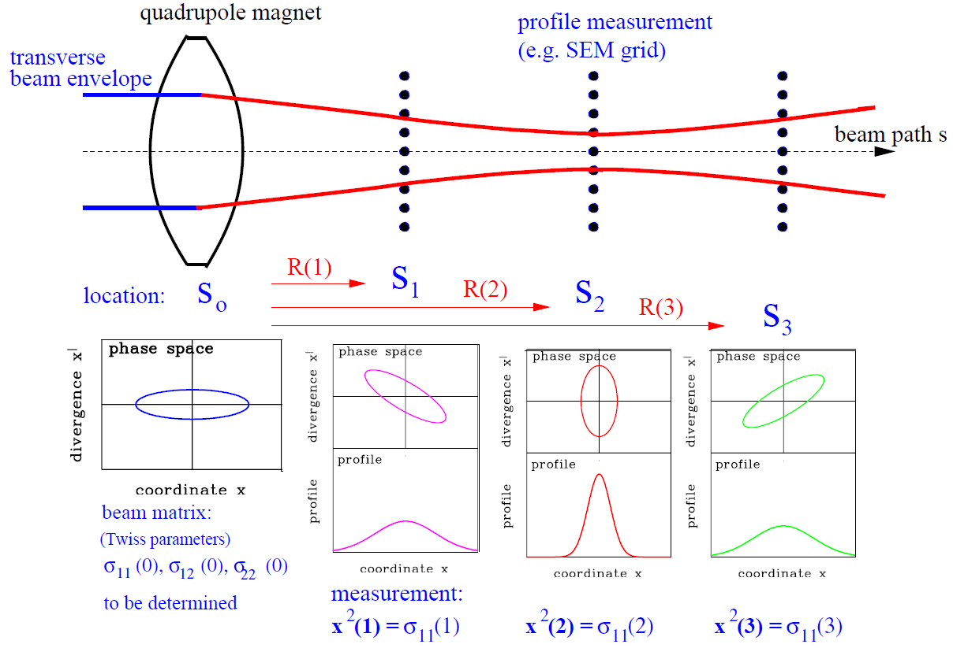
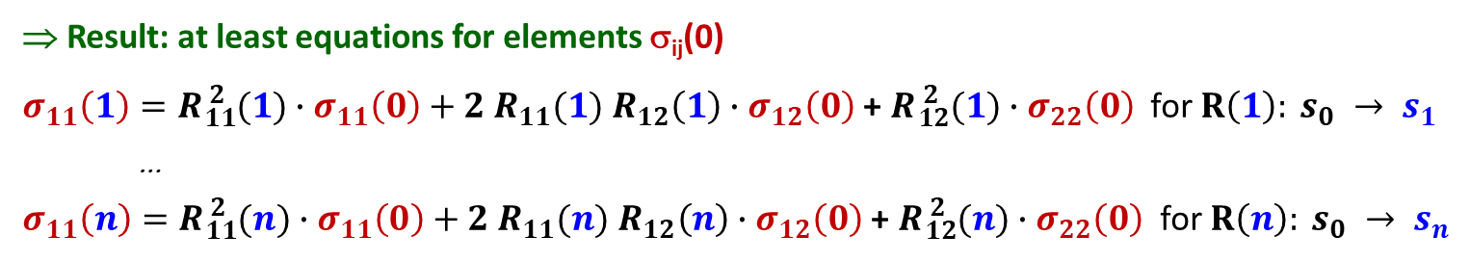
The ‘Three Grid Method’ for Emittance Measurement
Instead of quadrupole variation, the beam width is measured at different locations:
The procedure is:
Beam width x(i) measured
at the locations s_{i}
⇒ beam matrix element
x²(i) = σ₁₁(i).
The transfer matrix R(i) is known.
(without dipole a 3 × 3 matrix.)
The transformations are:
σ(i) = R(i) ⋅ σ(0) ⋅ R^{T}(i)
⇒ redundant equations:
⇒ Result: at least equations for elements σ_{ij}(0)
$σ_{11}\left(1\right)=R{}_{11}^{2 }{(1)}∙σ_{11}\left(0\right)+2 R_{11}(1)$ $R_{12}\left(1\right)∙σ_{12}\left(0\right)$ + $R{}_{12}^{2 }{(1)}∙σ_{22}\left(0\right)$ for $R\left(1\right): s_{0} → s_{1}$
…
$σ_{11}\left(n\right)=R{}_{11}^{2 }{(n)}∙σ_{11}\left(0\right)+2 R_{11}(n)$ $R_{12}\left(n\right)∙σ_{12}\left(0\right)$ + $R{}_{12}^{2 }{(n)}∙σ_{22}\left(0\right)$ for $R\left(n\right): s_{0} → s_{n}$

Slide 21
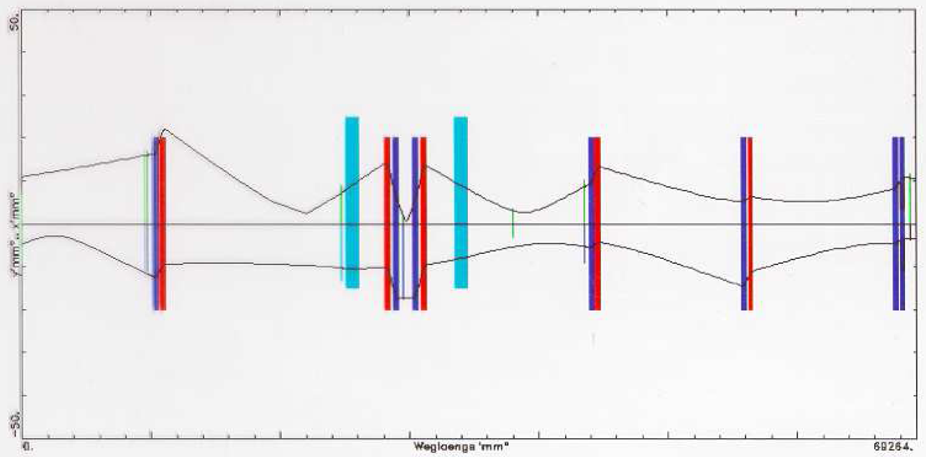
Results of a ‘Three Grid Method’ Measurement
Solution: Solving the linear equations like for quadrupole variation
or fitting the profiles with linear optics code (e.g. MADX).
Example: The hor. and vert. beam envelope and the beam width at a transfer line:
50
Measured horizontal width
Fitted beam hori. envelope
dipole
dipole
Hori. size [mm]
D F
F DD F
D F
D F
D D
0
Vertical size [mm]
Measured vertical width
Fitted beam vert. envelope
50
0
Path Length [m]
70
Assumptions: ➢ constant emittance, in particular no space-charge broadening
➢100 % transmission i.e. no loss due to vacuum pipe scraping
➢ no misalignment, i.e. beam center equals center of the quadrupoles.

Slide 22
Poll concerning Emittance Measurement by linear Transformations
Poll 4.3:
What is correct concerning the emittance measurement by linear transformations?
Only the 2nd statistical moments are determined to characterize the beam distribution.
Any beam distribution can be reliably determined by this methods.
The transfer line can contain any optical element.
In all cases, three measurements are sufficient for an emittance determination.
www.menti.com
code: 1208 6026
Notes:
22

Slide 23
Outline:
Definition and some properties of transverse emittance
Quadrupole strength variation and position measurement
emittance from several profile measurement and beam optical calculation
Slit-Grid device: scanning method
scanning slit → beam position & grid → angular distribution
Summary

Slide 24
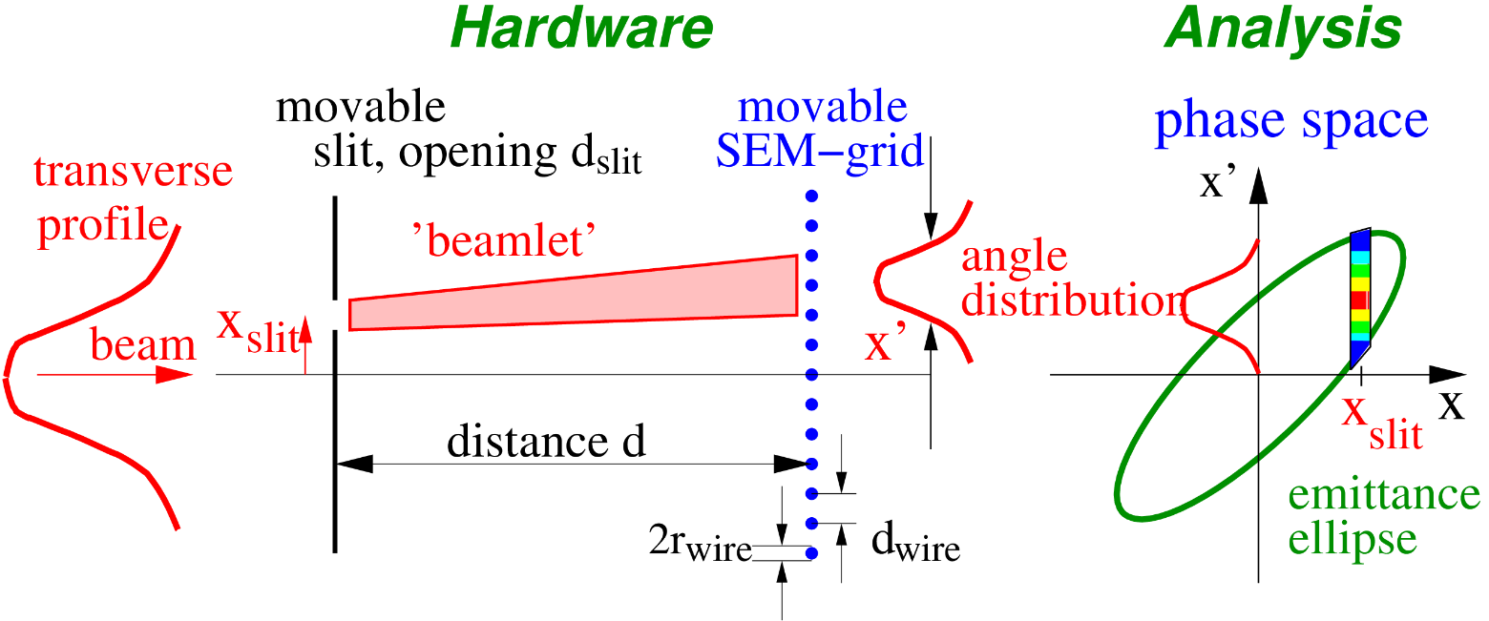
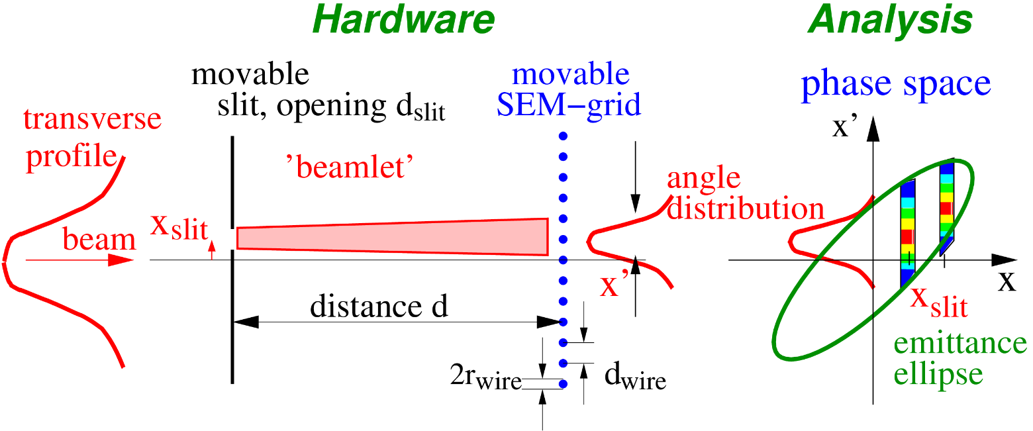
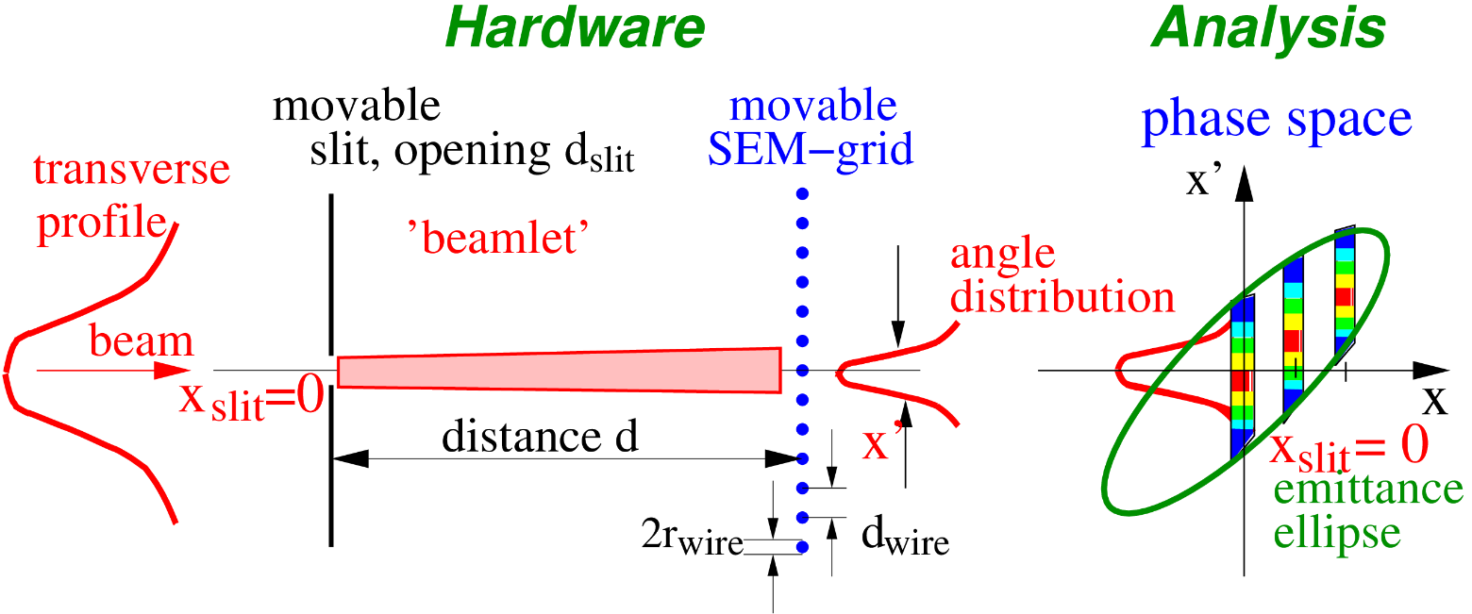
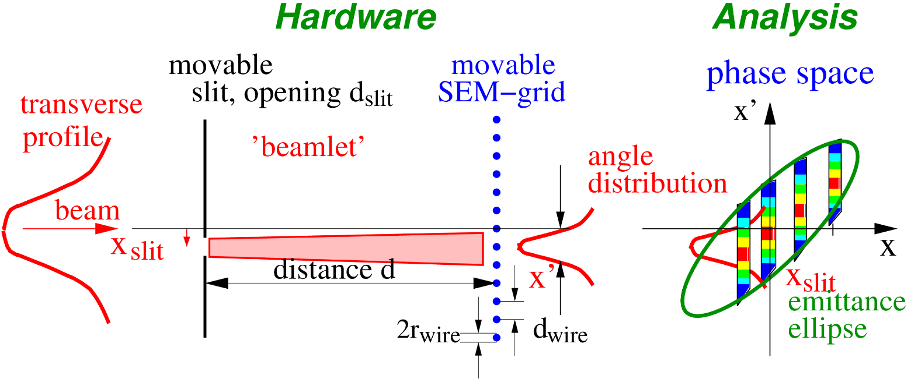
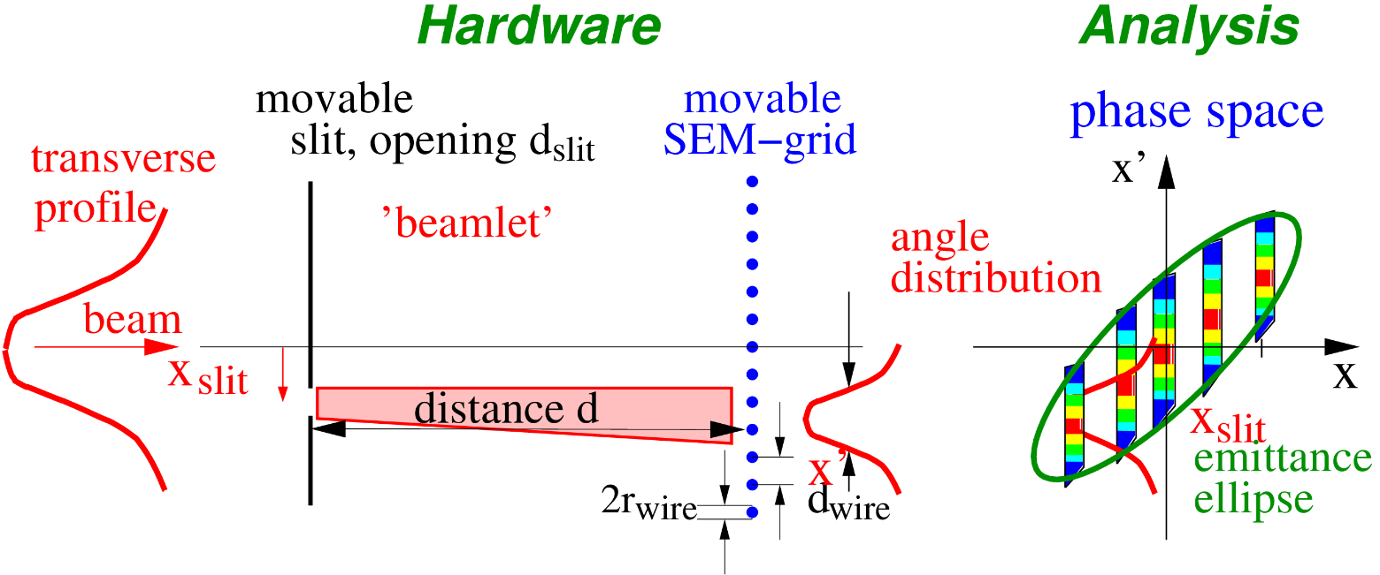
The Slit-Grid Measurement Device
Slit-Grid: Direct determination of position and angle distribution.
Used for protons with E_{kin} < 100 MeV/u ⇒ range R < 1 cm.
Slit: position P(x) with typical width: 0.1 to 0.5 mm
Distance: typ. 0.5 to 5 m (depending on beam energy 0.1 ... 100 MeV)
SEM-Grid: angle distribution P(x′)
Slit
SEM-Grid
RFQ
LINAC
0.5...5 m

Slide 25
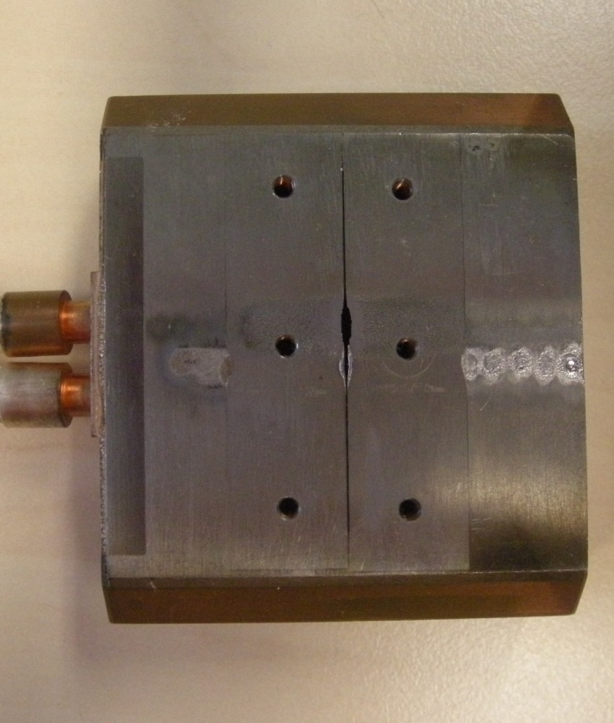
Slit & SEM-Grid
Slit with e.g. 0.1 mm thickness
→ Transmission only from Δx.
Beam surface interaction: e⁻ emission
→ measurement of current.
Example: 15 wire spaced by 1.5 mm:
Example: Slit of width 0.1 mm (defect)
Moved by stepping motor, 0.1 mm resolution
Each wire is equipped with one I/U converter
different ranges settings by R_{i}
→ very large dynamic range up to 10⁶.

Slide 26
Display of Measurement Results
The distribution of the ions is depicted as a function of
Position [mm]
Angle [mrad]
The distribution can be visualized by
Mountain plot
Contour plot
Calc. of 2nd moments <x²> , <x’²> & <xx’>
Emittance value ε_{rms} from
Problems:
Finite binning results in limited resolution
Background → large influence on <x²>, <x’²> and <xx’>
Or fit of distribution i.e. ellipse to data
Effective emittance only
Modern alternative: Tomographic reconstruction
Beam: Ar⁴⁺, 60 KeV, 15 μA
at Spiral2 Phoenix ECR source.
Plot from P. Ausset, DIPAC 2009

Slide 27
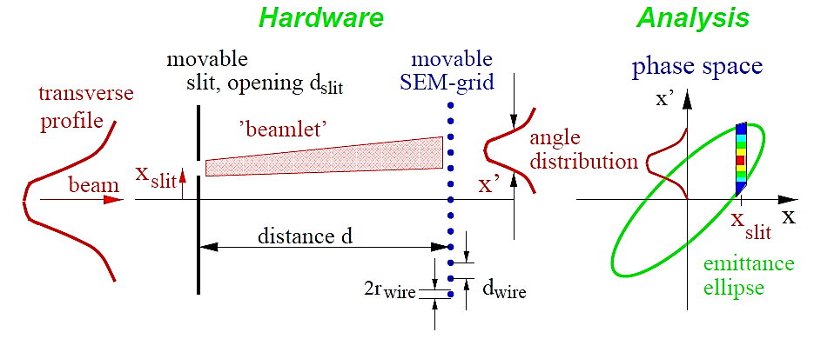
The Resolution of a Slit-Grid Device
The width of the slit d_{slit} gives the resolution in space Δx = d_{slit}.
The angle resolution is Δ x′ = (d_{wire} + 2r_{wire})/d
⇒ discretization element Δx ・ Δx′.
By scanning the SEM-grid the angle resolution can be improved.
Problems for small beam sizes or parallel beams.
For pulsed LINACs: Only one measurement each pulse → long measuring time required.

Slide 28
Poll concerning normalized Emittance
Poll 4.4:
A typical slit-grid emittance installation can be applied for …
all beams and all energies
electron beams for all energies
proton beam energies below 100 MeV only
proton beam energies above 100 MeV only
Poll 4.5:
Assuming an electron and proton beam of 10 MeV (starting from the same source). What do expect concerning the emittance of both beams?
The electron beam has a smaller emittance than the proton beam.
The electron beam has a larger emittance than the proton beam.
Both beams have the same emittance as it relates to the beam energy.
www.menti.com
code: 1208 6026
Notes:
28

Slide 29
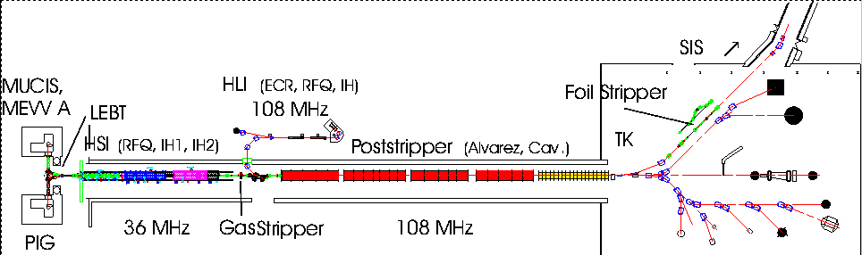
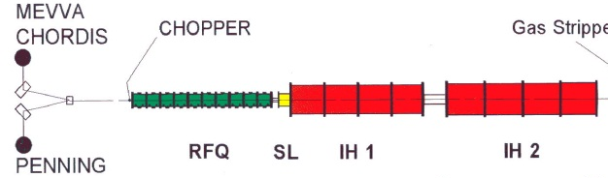
Appendix GSI Ion LINAC: Emittance Measurement Devices
Slit Grid Emittance: Standard device, total 9 device
Pepper-pot Emittance: Special device, total 1 device
Transfer to
Synchrotron
HLI: (ECR,RFQ,IH)
To SIS ↑
All ions, high current, 5 ms@50 Hz, 36&108 MHz
MEVVA
MUCIS
Foil Stripper
Alvarez DTL
RFQ IH1 IH2
U⁴⁺
U²⁸⁺
PIG
Gas Stripper
11.4 MeV/u
β = 0.16
2.2 keV/u
β = 0.0022
Constructed in the 70th, Upgrade 1999,
further upgrades in preparation
120 keV/u
β = 0.016
1.4 MeV/u ⇔ β = 0.054
Remark: For higher energies where ions cannot be stopped,
quadrupole variation is used.
→ Conclusion

Slide 30
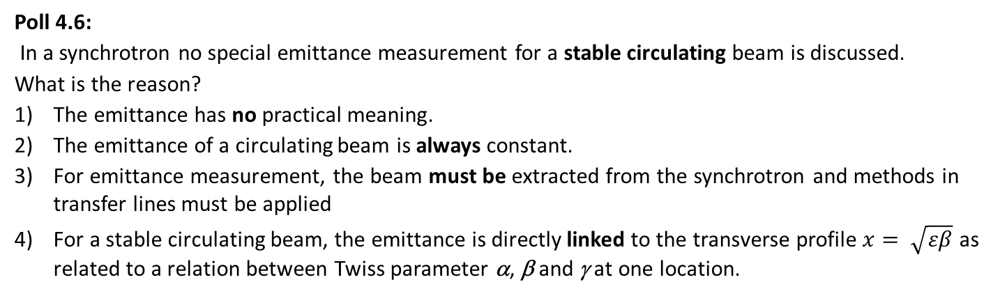
Poll concerning normalized Emittance
Poll 4.6:
In a synchrotron no special emittance measurement for a stable circulating beam is discussed.
What is the reason?
The emittance has no practical meaning.
The emittance of a circulating beam is always constant.
For emittance measurement, the beam must be extracted from the synchrotron and methods in transfer lines must be applied
For a stable circulating beam, the emittance is directly linked to the transverse profile $x= \sqrt{εβ}$ as related to a relation between Twiss parameter α, β and γ at one location.
www.menti.com
code: 1208 6026
Notes:
30

Slide 31
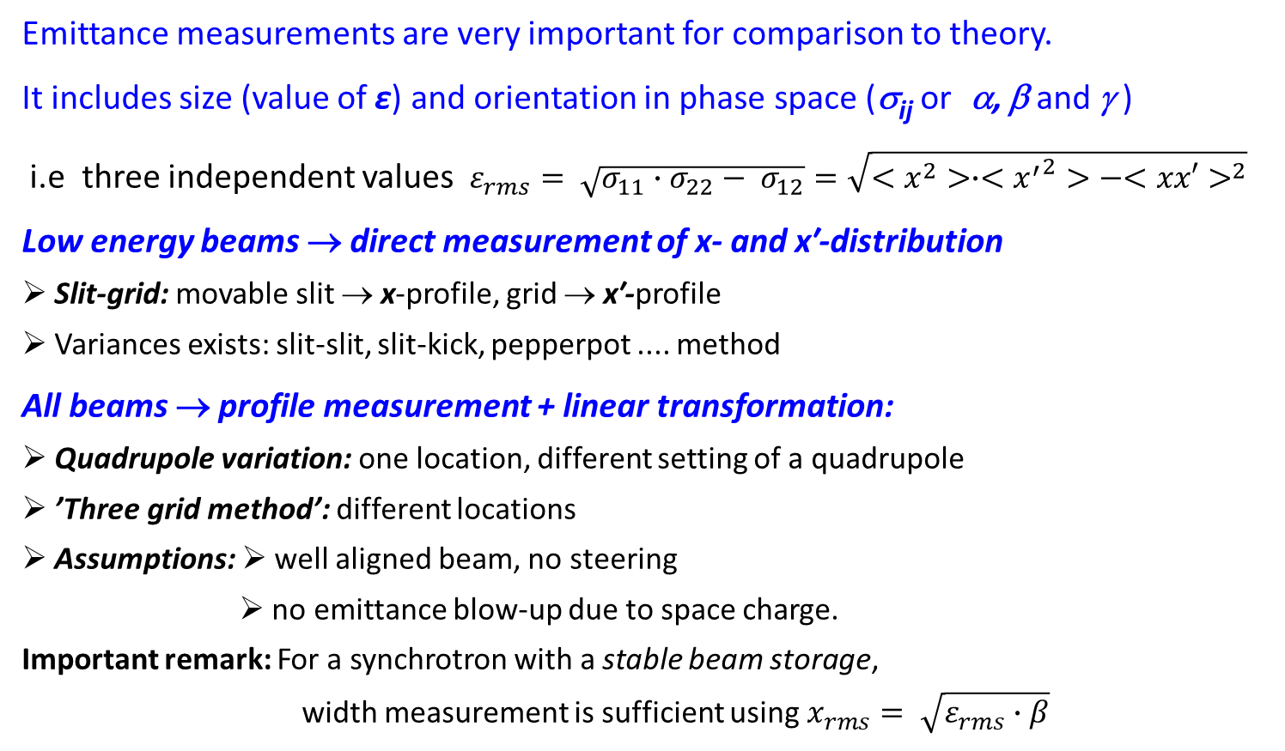
Summary for transverse Emittance Measurement
Emittance measurements are very important for comparison to theory.
It includes size (value of ε) and orientation in phase space (σ_{ij} or α, β and γ )
i.e three independent values $ε_{rms}= \sqrt{σ_{11}∙σ_{22}− σ_{12}}=\sqrt{<x^{2}>∙<{x^{′}}^{2}>−{<xx′>}^{2}}$
Low energy beams → direct measurement of x- and x′-distribution
➢ Slit-grid: movable slit → x-profile, grid → x′-profile
➢ Variances exists: slit-slit, slit-kick, pepperpot .... method
All beams → profile measurement + linear transformation:
➢ Quadrupole variation: one location, different setting of a quadrupole
➢ ’Three grid method’: different locations
➢ Assumptions: ➢ well aligned beam, no steering
➢ no emittance blow-up due to space charge.
Important remark: For a synchrotron with a stable beam storage,
width measurement is sufficient using $x_{rms}= \sqrt{ε_{rms}∙β}$

Slide 32
Backup slides

Slide 33
Quiz related to Beam Emittance and Slit-Grid Method
What is meant by beam quality = emittance, i.e.
what type of quantitative description is used?
What is the geometrical meaning of a phase space distribution for -ε⋅α ≡ σ₁₂ ≡ <xx’> ≠ 0 ?
Expectation: Is the emittance of a 10 MeV electron beam smaller or larger than a proton beam?
Describe shortly the measurement principle of a slit-grid method!
Do you know variances of the slit-grid method?
Why is a slit-grid measurement of 100 MeV electron and proton beam not meaningful?
→ Back to quadrupole variation
Notes:
33

Slide 34
Quiz related to Beam Emittance Measurement
The emittance is defined via statistical parameters <x²>, <xx’>, <x’²>. What does this mean?
What might causes the beam to be different from a Gaussian (i.e. simple) distribution?
What is the principle of an emittance measurement for quadrupole variation?
What is the principle for the 3 grid method?
Can you imaging how a quadrupole variation or 3-grid method must be modified if the beam is ‘non-Gaussian’?
Notes:
34

Slide 35
Outline:
Definition and some properties of transverse emittance
Slit-Grid device: scanning method
scanning slit → beam position & grid → angular distribution
Pepper-pot device: single shot device
hole-plate → beam position & screen → angular distribution
Quadrupole strength variation and position measurement
Summary

Slide 36
Definition of transverse Emittance
The emittance characterizes the whole beam quality:
Ansatz:
Beam matrix at one location:
It describes a 2-dim probability distr.
The value of emittance is:
For the profile and angular measurement:
Geometrical interpretation:
All points x fulfilling x^{t} · σ ⁻¹ · x = 1
are located on a ellipse
σ₂₂x² – 2σ₁₂xx‘ + σ₁₁x‘² = det σ = ε_{x}²

Slide 37
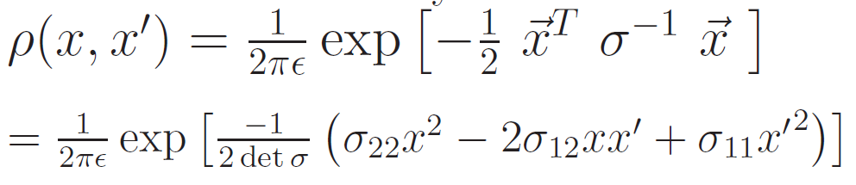
The Emittance for Gaussian Beams
The density function for a 2-dim Gaussian distribution is:
It describes an ellipse with the characteristics
profile and angle Gaussian distribution of width
and the correlation or covariance

Slide 38
The Emittance for Gaussian and non-Gaussian Beams
The beam distribution can be non-Gaussian, e.g. at:
➢ beams behind ion source
space charged dominated beams at LINAC & synchrotron
cooled beams in storage rings
General description of emittance
using terms of 2-dim distribution:
It describes the value for 1 standard derivation
Variances
Covariance
i.e. correlation
For discrete distribution:
and correspondingly for all other moments

Slide 39
The Noise Influence for Emittance Determination
A real measurement of beamlets contains:
Noise i.e. fluctuation of the output
Bias i.e. electrical offset from amplifier
Example: Dependence of ε_{rms} on threshold
From M. Stockli, BIW 2006 and
J. Pfister, Disseration Uni Frankfurt 2010
Biased
Biased
Thresholded
Thresholded
Emittance ε [arb.u.]
Unbiased,
Unbiased
Unbiased,
Unbiased
vs.Unbiased
vs.Unbiased
Negatives
Negatives
zeroed
zeroed
Threshold level of max. [%]
→ Strong influence of noise reduction to
numerical values of <x>, <x’²> and <xx’> and on ε_{rms}
Algorithm & cut-level must be given for evaluation
General: Typical error Δε/ε > 10 %

Slide 40
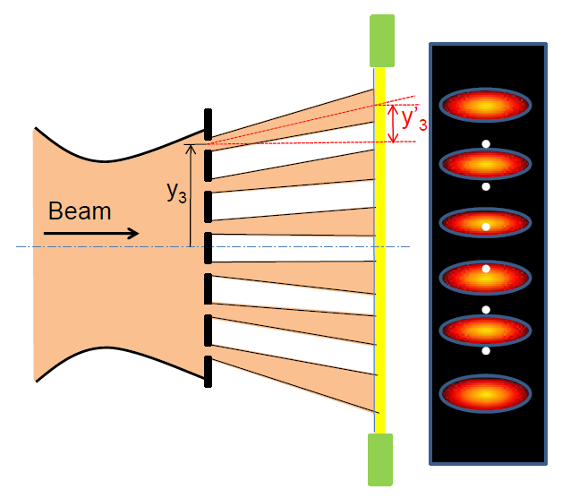
The Pepperpot Emittance Device
For pulsed LINAC: Measurement within one pulse is an advantage
If horizontal and vertical direction coupled → 2-dim evaluation required
(e.g. for ECR ion source)
Good spatial resolution if many holes are illuminated.
Good angle resolution only if spots do not overlap.
Partly from H.R. Kremers et al., ECRIS 2010

Slide 41
The Pepperpot Emittance Device at GSI UNILAC
Example GSI-LINAC 0.12 to 11 MeV/u:
Pepper-pot: 15 × 15 holes with Ø 0.1mm
on a 50 × 50 mm² copper plate
Distance: pepper-pot-screen: 25 cm
Screen: Al₂O₃, Ø 50 mm
Data acquisition: high resolution camera
drive for
pepper-pot
camera
Good spatial resolution if many holes are illuminated.
Good angle resolution only if spots do not overlap.
beam
laser

Slide 42
Result of a Pepperpot Emittance Measurement
Example: Ar ¹⁺ ion beam at 1.4 MeV/u,
screen image from single shot at GSI:
Data analysis:
Projection on
horizontal and vertical plane
→ analog to slit-grid.

Slide 43

The Artist View of a Pepperpot Emittance Device

