Slide 1
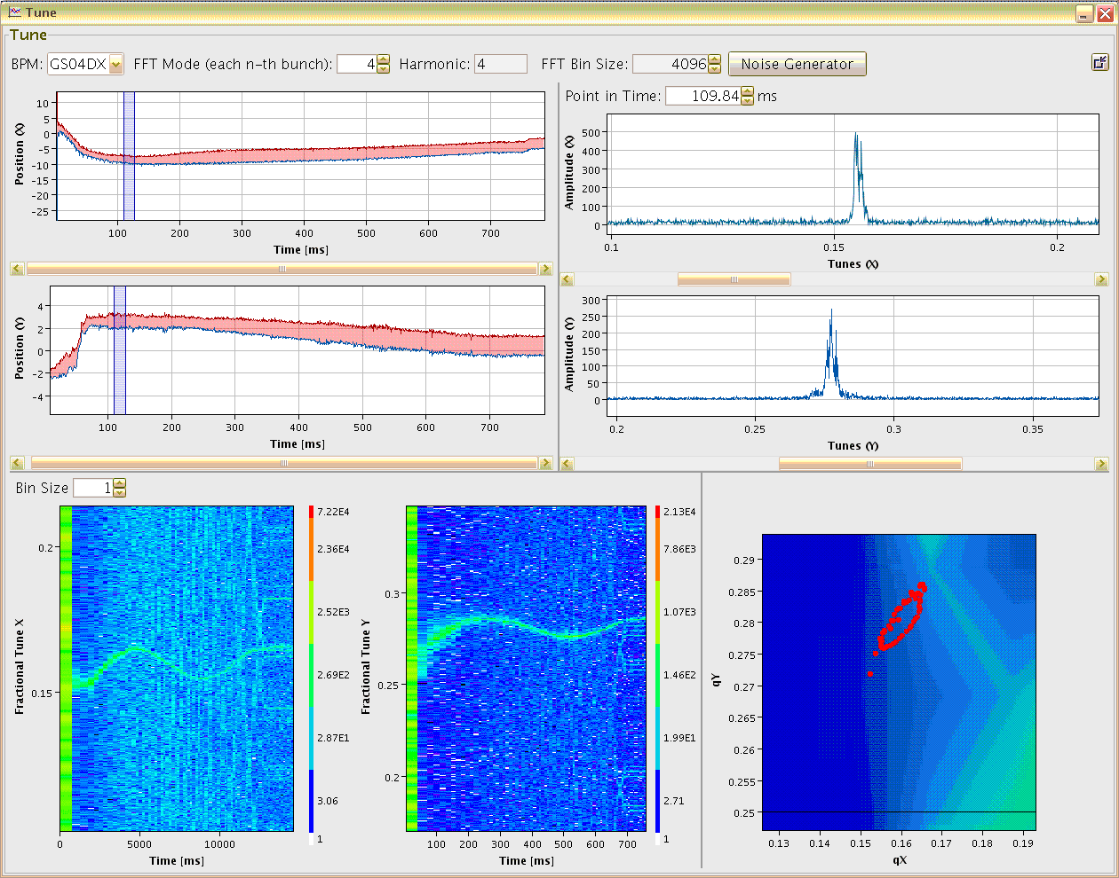


Pick-Ups for bunched Beams
JUAS 2025, ESI-Archamps at CERN
Peter Forck (GSI and University Frankfurt)
vertical tune versus time
0.3
δQ_{y} ≈ 0.02
vert. fractional tune q_{y}
excitation
noise band
δQ ≈ 0.05
0.25
0.2
0
200
400
600
750
time [ms]

Slide 2
Pick-Ups for bunched Beams
Outline:
Time and frequency domain treatment & Fourier Transformation
Signal generation → transfer impedance
Capacitive button BPM for high frequencies
Capacitive linear-cut BPM for low frequencies
Electronics for position evaluation
BPMs for measurement of closed orbit, tune and further lattice functions
Summary

Slide 3
Usage of BPMs
A Beam Position Monitor is an non-destructive device for bunched beams
It has a low cut-off frequency i.e. dc-beam behavior can not be monitored
The abbreviation BPM and pick-up PU are synonyms
1. It delivers information about the transverse center of the beam
Trajectory: Position of an individual bunch within a transfer line or synchrotron
Closed orbit: Central orbit averaged over a period much longer than a betatron oscillation
Single bunch position: Determination of parameters like tune, chromaticity, β-function
Bunch position on a large time scale: bunch-by-bunch → turn-by-turn → averaged position
Time evolution of a single bunch can be compared to ‘macro-particle tracking’ calculations
Feedback: fast bunch-by-bunch damping or precise (and slow) closed orbit correction
2. Information on longitudinal bunch behavior (see next chapter)
Bunch shape and evolution during storage and acceleration
For proton LINACs: the beam velocity can be determined by two BPMs
For electron LINACs: Phase measurement by Bunch Arrival Monitor
Relative low current measurement down to 10 nA.

Slide 4
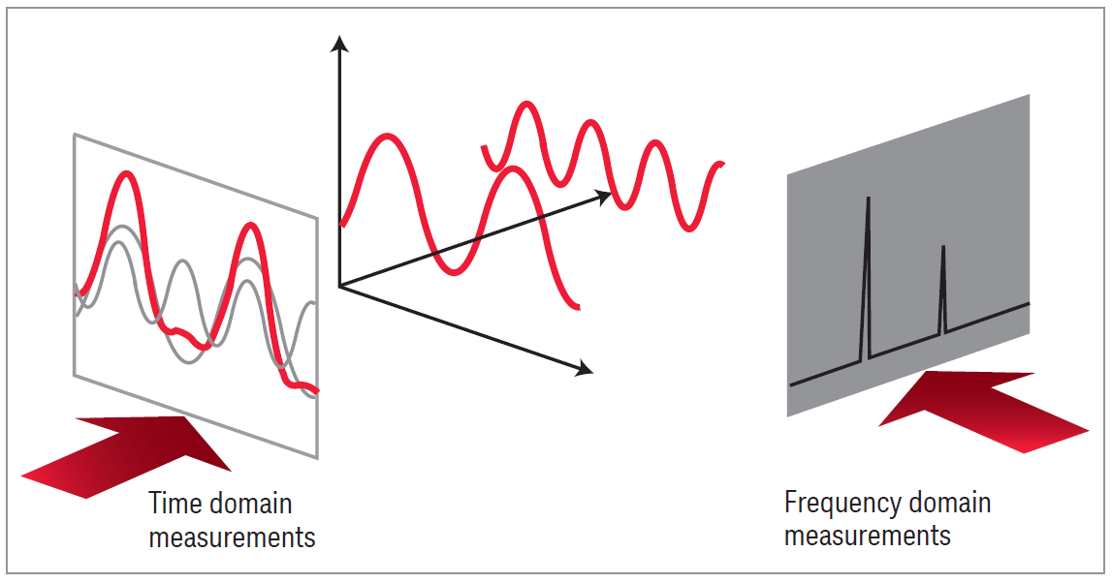
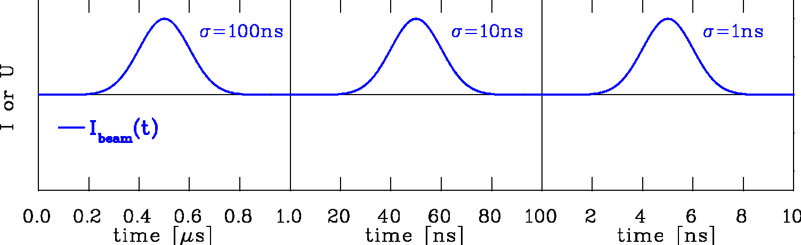
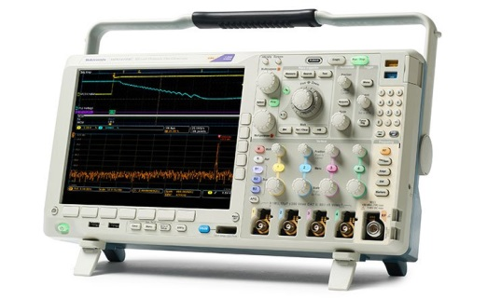
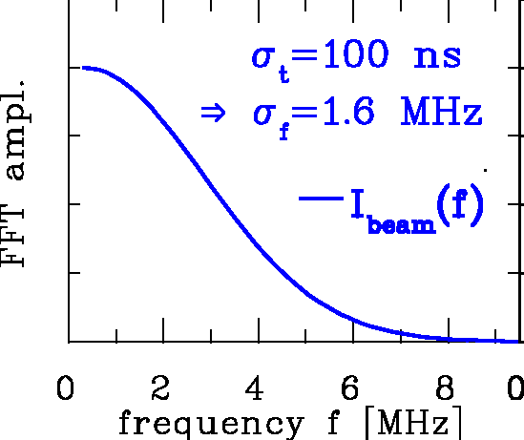
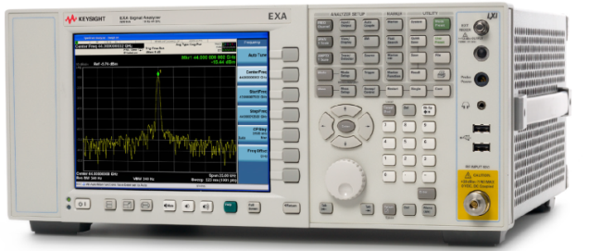
Time Domain ↔ Frequency Domain: Instrumentation
Time domain: Recording of a voltage as a function of time:
Instrument:
Oscilloscope
voltage
I_{beam}
frequency
time
Frequency domain: Displaying of a voltage as a function of frequency:
Instrument:
Spectrum Analyzer
courtesy company Keysight
Fields seems unstructured
Other perspective:
Fields is structured
Photos and idea by Piotr Kowina

Slide 5
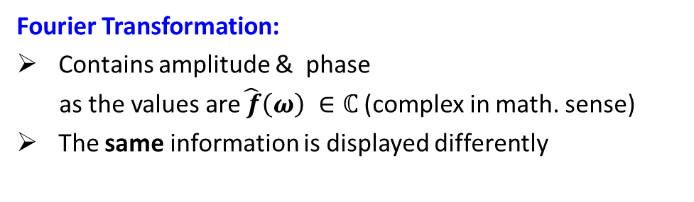

Time Domain ↔ Frequency Domain: Mathematics
Time domain: Recording of a voltage as a function of time:
Mathematics for function $f(t)$:
Fourier Transformation:
$$\hat{f}\left(ω\right)= \int_{−∞}^{∞}{f}\left(t\right)∙e^{−iωt} dt$$
I_{beam}
Frequency domain: Displaying of a voltage as a function of frequency:
Fourier Transformation:
Contains amplitude & phase
as the values are$\hat{ f}\left(ω\right) ∈ℂ$ (complex in math. sense)
The same information is displayed differently
Care: Fourier Transformation of time domain data contains amplitude and phase

Slide 6
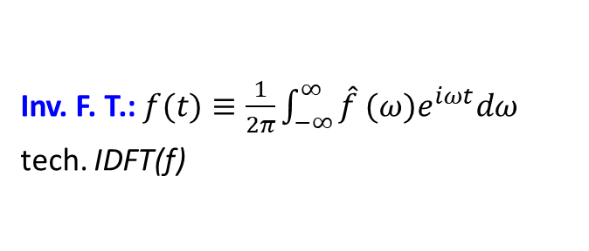
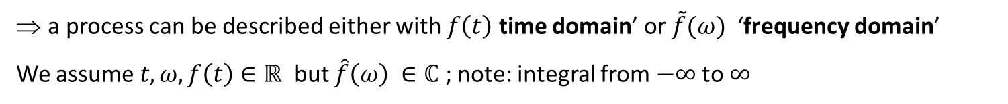
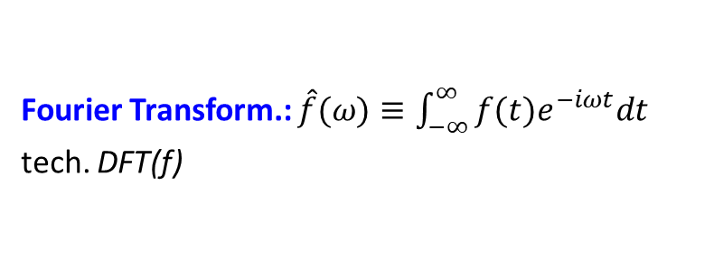
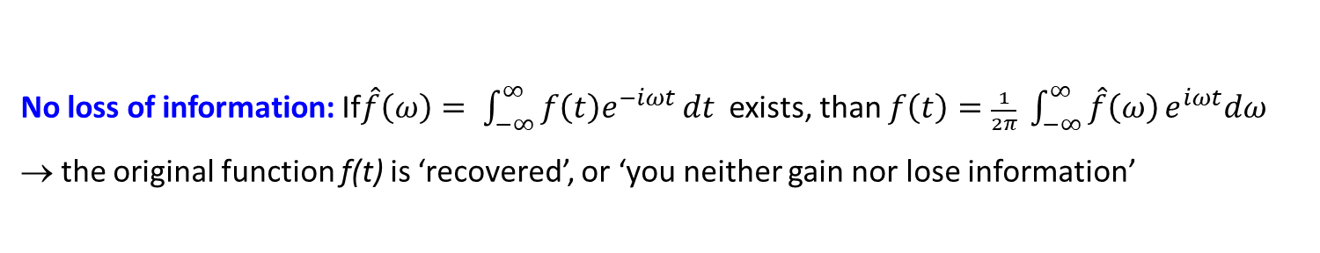
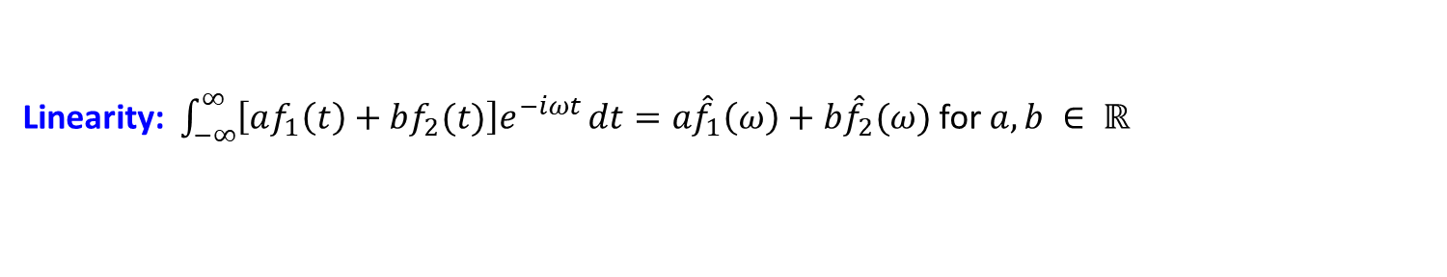
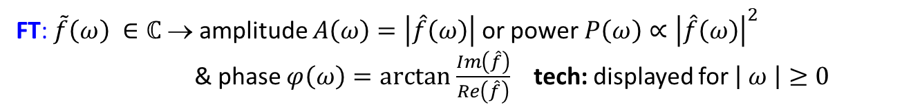
Excurse: Properties of Fourier Transformation
Fourier Transform.: $\hat{f}(ω)≡\int_{−∞}^{∞}{f(t)e^{−iωt}dt}$
tech. DFT(f)
Inv. F. T.: $f(t)≡\frac{1}{2π}\int_{−∞}^{∞}{\hat{f} (ω)e^{iωt}dω}$
tech. IDFT(f)
a process can be described either with $f\left(t\right)$ time domain’ or $\tilde{f}(ω)$ ‘frequency domain’
We assume $t, ω, f\left(t\right)∈ℝ$ but $\hat{f}\left(ω\right) ∈ℂ$ ; note: integral from $−∞$ to $∞$
Im(z)
A
z
FT: $\tilde{f}\left(ω\right) ∈ℂ$ → amplitude $A\left(ω\right)=\left|\hat{f}\left(ω\right)\right|$ or power${P\left(ω\right)∝\left|\hat{f}\left(ω\right)\right|}^{2}$
& phase $φ\left(ω\right)=arctan \frac{Im\left(\hat{f}\right)}{Re\left(\hat{f}\right)}$ tech: displayed for $\left| ω \right|≥0$
ϕ
Re(z)
No loss of information: If$\hat{f}\left(ω\right)= \int_{−∞}^{∞}{f\left(t\right)e^{−iωt}}dt$ exists, than $f\left(t\right)=\frac{1}{2π} \int_{−∞}^{∞}{\hat{f}\left(ω\right)}e^{iωt}dω$
→ the original function f(t) is ‘recovered’, or ‘you neither gain nor lose information’
Linearity: $\int_{−∞}^{∞}{\left[af_{1}\left(t\right)+bf_{2}(t)\right]e^{−iωt}}dt=a{\hat{f}}_{1}\left(ω\right)+b{\hat{f}}_{2}(ω)$for $a, b ∈ ℝ$

Slide 7
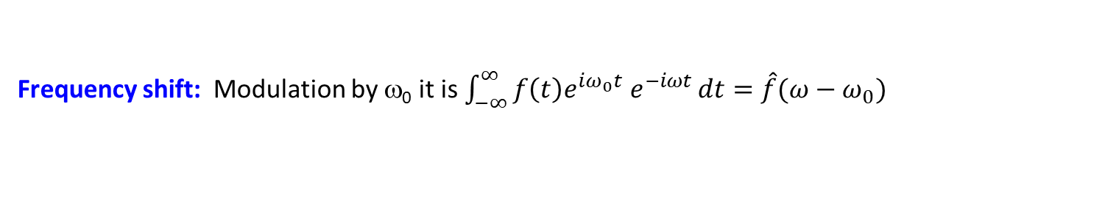
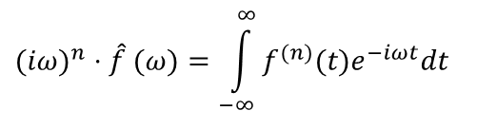
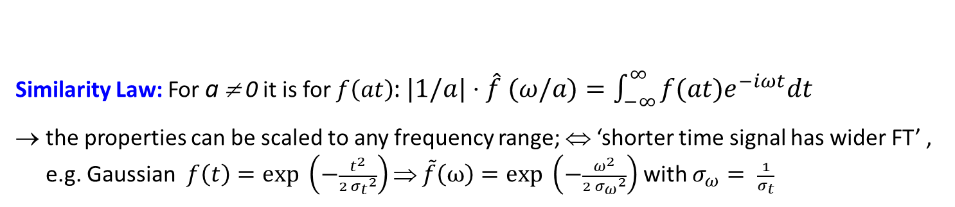
Excurse: Properties of Fourier Transformation
Fourier Transform.: $\hat{f}(ω)≡\int_{−∞}^{∞}{f(t)e^{−iωt}dt}$
tech. DFT(f)
Inv. F. T.: $f(t)≡\frac{1}{2π}\int_{−∞}^{∞}{\hat{f} (ω)e^{iωt}dω}$
tech. IDFT(f)
a process can be described either with $f\left(t\right)$ time domain’ or $\tilde{f}(ω)$ ‘frequency domain’
Similarity Law: For a ≠ 0 it is for $f\left(at\right)$: $|1/a|⋅\hat{f} (ω/a)=\int_{−∞}^{∞}{f(at)e^{−iωt}dt}$
the properties can be scaled to any frequency range; ⇔ ‘shorter time signal has wider FT’ , e.g. Gaussian $f\left(t\right)=exp \left(−\frac{t^{2}}{2 {σ_{t}}^{2}}\right)$⇒ $\tilde{f}\left(ω\right)=exp \left(−\frac{ω^{2}}{2 {σ_{ω}}^{2}}\right)$ with $σ_{ω}= \frac{1}{σ_{t}}$
$$(iω)^{n}⋅\hat{f} (ω)=\int_{−∞}^{∞}{f^{(n)}(t)e^{−iωt}dt}$$
Differentiation Law: For n^{th} derivative f^{(n)}(t) it is:
→ differentiation in time domain corresponds to multiplication with iω in frequency domain
Frequency shift: Modulation by ω₀ it is $\int_{−∞}^{∞}{f\left(t\right)e^{iω_{0}t} e^{−iωt}}dt=\hat{f}(ω−ω_{0})$

Slide 8
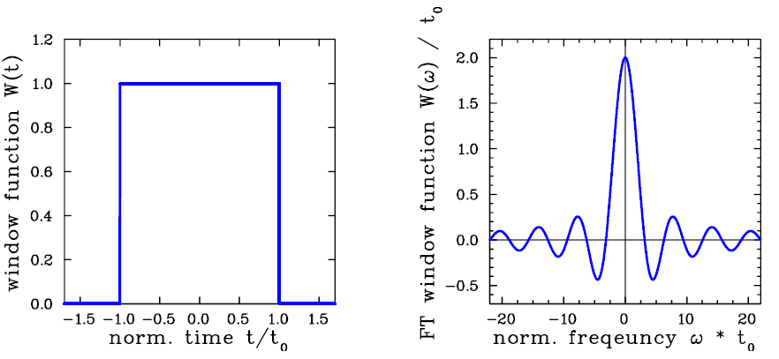
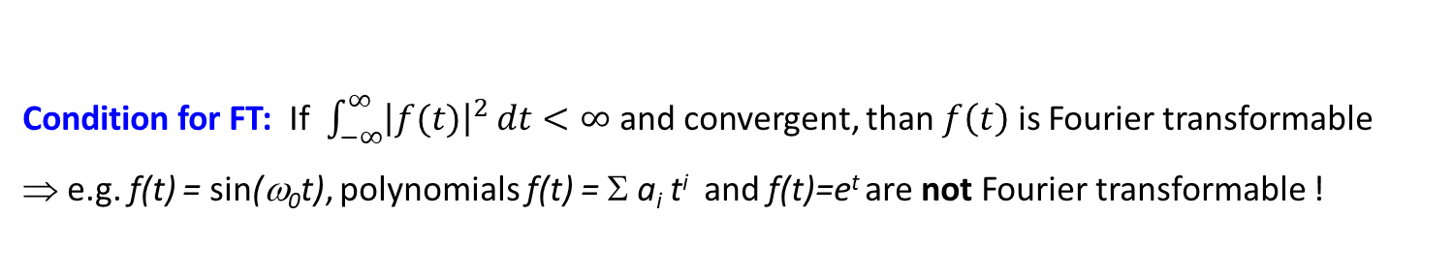

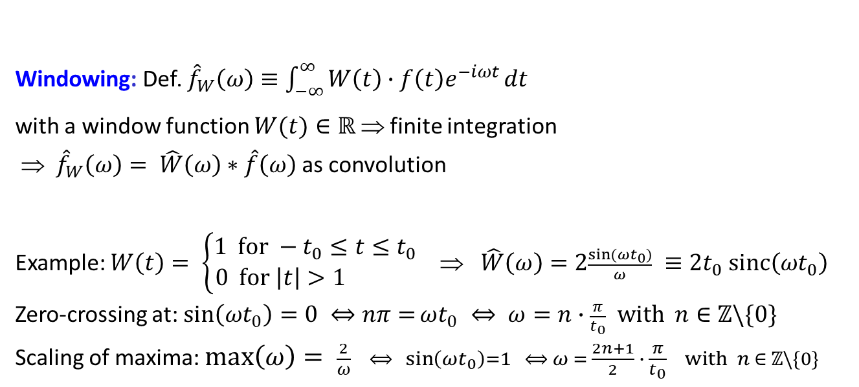
Excurse: Properties of Fourier Transformation
Condition for FT: If $\int_{−∞}^{∞}{{\left|f(t)\right|}^{2}}dt<∞$ and convergent, than $f\left(t\right)$ is Fourier transformable
⇒ e.g. f(t) = sin(ω₀t), polynomials f(t) = Σ a_{i} t^{i} and f(t)=e^{t} are not Fourier transformable !
$$φ(ω)≡0$$
Windowing: Def. ${\hat{f}}_{W}\left(ω\right)≡\int_{−∞}^{∞}{W\left(t\right)∙f\left(t\right)e^{−iωt}}dt$
with a window function $W(t)∈ℝ$ ⇒ finite integration
⇒ ${\hat{f}}_{W}\left(ω\right)= \hat{W}\left(ω\right)∗\hat{f}\left(ω\right)$ as convolution
Example: $W\left(t\right)= \left\{\begin{matrix}1 for −t_{0}≤t≤t_{0} \\ 0 for \left|t\right|>1 \end{matrix}\right.$ ⇒ $\hat{W}\left(ω\right)=2\frac{\sin{(ωt_{0})}}{ω} ≡2t_{0} sinc\left(ωt_{0}\right)$
Zero-crossing at: $\sin\left(ωt_{0}\right)=0 ⇔nπ=ωt_{0} ⇔ ω=n∙\frac{π}{t_{0}} with n∈ℤ\backslash \{0\}$
Scaling of maxima: $max\left(ω\right)= \frac{2}{ω} ⟺ \sin\left(ωt_{0}\right)=1 ⟺ ω = \frac{2n+1}{2} ∙ \frac{π}{t_{0}} with n ∈ ℤ\backslash \{0\}$

Slide 9
Excurse: Fourier Trans. → Convolution & technical Realization
Convolution Law: For the convolution
⇒ FT can be calculated as
convolution in time domain can be expressed as multiplication of FT in frequency domain
Application: Chain of electrical elements calculated in frequency domain more easily
parameters are more easy in frequency domain (bandwidth, f-dependent amplification.....)
amplifier
high pass filter
low pass filter
rectifier
U_{in}(t)
U_{out}(t)
Engineering formulation for finite number of discrete samples:
Digital Fourier Transformation DFT(f): corresponds to math. FT for finite number time
Fast Fourier Transformation: FFT(f) dedicated algorithm for fast calc. with 2^{n} increments
Transfer function H(ω) and h(t) are used to describe electrical elements
Calculation with H(ω) in frequency domain or h(t) time domain
→ ‘Finite Impulse Response’ FIR filter or ‘Infinite Impulse Response’ IIR filter

Slide 10

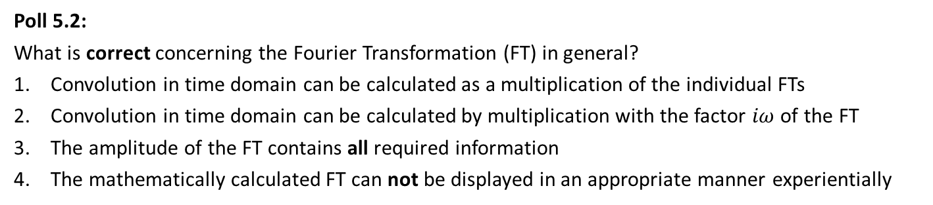
Poll concerning Fourier Transformation
Poll 5.1:
Which statement is wrong?
Fourier Transformation is a integral transformation
Any continuous function can be Fourier transformed
Experimentally, the Fourier Transformation amplitude is observed by a spectrum analyser
Poll 5.2:
What is correct concerning the Fourier Transformation (FT) in general?
Convolution in time domain can be calculated as a multiplication of the individual FTs
Convolution in time domain can be calculated by multiplication with the factor $iω$ of the FT
The amplitude of the FT contains all required information
The mathematically calculated FT can not be displayed in an appropriate manner experientially
www.menti.com
code: 1208 6026
Notes:
10

Slide 11
Pick-Ups for bunched Beams
Outline:
Time and frequency domain treatment & Fourier Transformation
Signal generation → transfer impedance
Capacitive button BPM for high frequencies
Capacitive linear-cut BPM for low frequencies
Electronics for position evaluation
BPMs for measurement of closed orbit, tune and further lattice functions
Summary

Slide 12
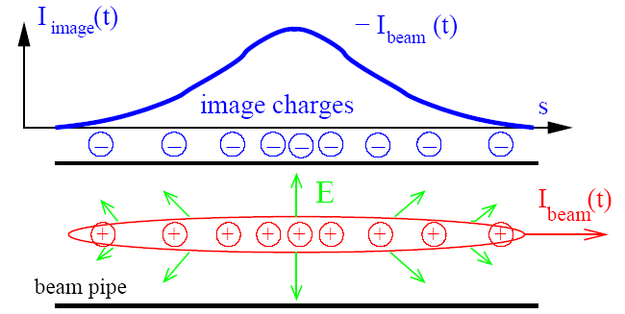
Pick-Ups for bunched Beams
The image current at the beam pipe is monitored on a high frequency basis
i.e. the ac-part given by the bunched beam.
Beam Position Monitor BPM equals Pick-Up PU
Most frequent used instrument!
For relativistic velocities,
the electric field is transversal:

Slide 13
Principle of Signal Generation of capacitive BPMs
The image current at the wall is monitored on a high frequency basis
i.e. ac-part given by the bunched beam.
V
-
+
-
+
-
-
+
-
+
-
+
-
-
+
-
+
-
+
-
+
-
-
+
-
+
-
+
-
+
-
+
-
+
-
-
-
+
+
-
-
+
+
-
-
-
-
+
-
+
-
+
-
-
+
-
+
-
+
-
-
+
-
-
-
-
-
+
-
+
+
-
+
-
-
+
-
+
-
+
-
+
-
+
+
+
+
-
+
-
-
+
-
+
+
+
+
+
+
+
+
+
+
+
+
+
+
+
+
+
+
+
+
+
+
+
+
+
+
+
+
+
+
+
+
+
+
+
+
+
+
+
+
+
+
+
+
+
+
+
+
+
+
+
+
+
+
+
+
+
+
+
+
+
+
+
+
+
+
+
+
+
+
+
+
+
+
+
+
+
+
Animation by Rhodri Jones (CERN)

Slide 14
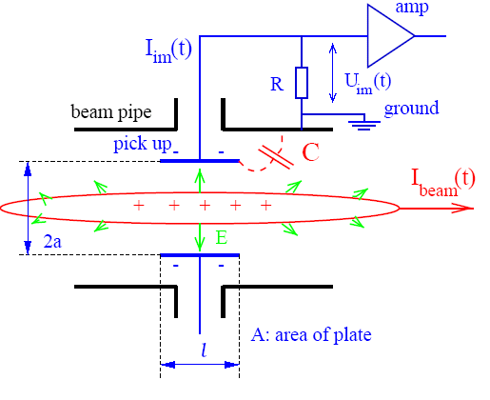
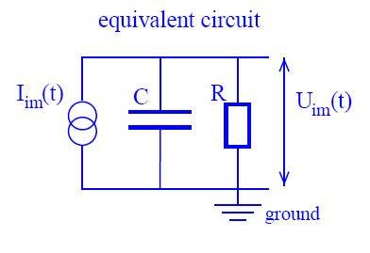
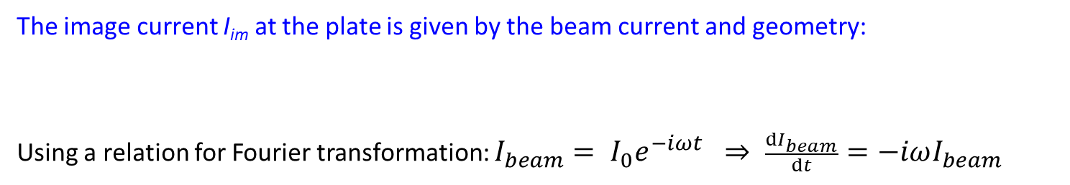
Model for Signal Treatment of capacitive BPMs
The wall current is monitored by a plate or ring inserted in the beam pipe:
The image current I_{im} at the plate is given by the beam current and geometry:
Using a relation for Fourier transformation: $I_{beam}= I_{0}e^{−iωt} ⇒ \frac{dI_{beam}}{dt}=−iωI_{beam}$
$$I_{im}(t) = −\frac{dQ_{im}(t)}{dt}=\frac{−A}{2πal}\text{ · }\frac{dQ_{beam}(t)}{dt}=\frac{−A}{2πa}\text{ · }\frac{1}{βc}⋅\frac{dI_{beam}(t)}{dt} =\frac{A}{2πa}\text{ · }\frac{1}{βc}⋅iωI_{beam}(ω)$$
Better mathematical deviation: See book section 5.3

Slide 15

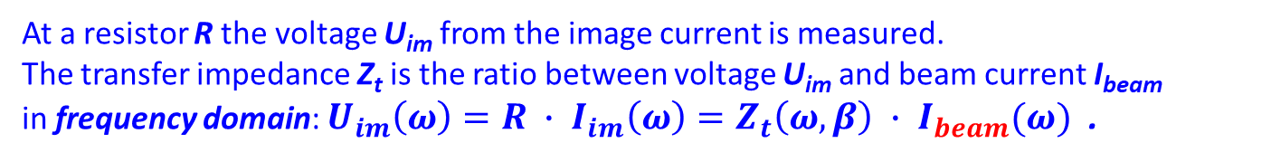
Transfer Impedance for a capacitive BPM
At a resistor R the voltage U_{im} from the image current is measured.
The transfer impedance Z_{t} is the ratio between voltage U_{im} and beam current I_{beam}
in frequency domain: $U_{im}\left(ω\right)=R ∙ I_{im}\left(ω\right)=Z_{t}\left(ω,β\right) ∙ I_{beam}(ω)$ .
Capacitive BPM:
The pick-up capacitance C:
plate ↔ vacuum-pipe and cable.
The amplifier with input resistor R.
The beam is a high-impedance current source:
This is a high-pass characteristic with ω_{cut}= 1/RC:
Amplitude:
Phase:

Slide 16
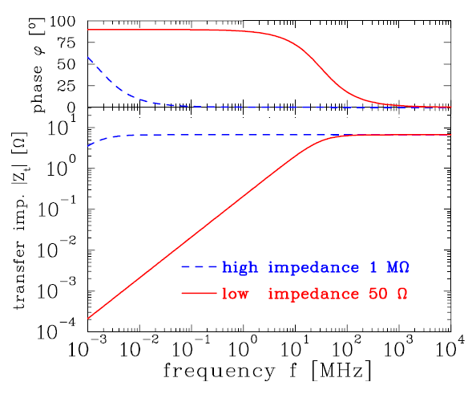


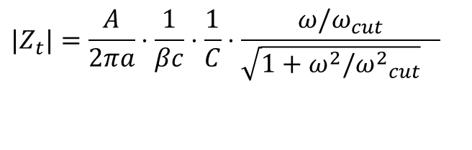
Example of Transfer Impedance for Proton Synchrotron
The high-pass characteristic for typical synchrotron BPM:
$$U_{im}\left(ω\right)=Z_{t}(ω)∙I_{beam}(ω)$$
$$|Z_{t}|=\frac{A}{2πa}⋅\frac{1}{βc}⋅\frac{1}{C}⋅\frac{ω/ω_{cut}}{{\sqrt{1+ω^{2}/{ω^{2}}_{cut}}}_{}}$$
$$φ=\text{arctan}(ω_{cut}/ω)$$
decrease by
fac. 1/ 2 = 3 dB
Parameter for linear-cut BPM:
C = 100pF, l = 10cm, β = 50%
f_{cut}= ω/2π=(2πRC)⁻¹
for R=50 Ω ⇒ f_{cut}= 32 MHz
for R=1 MΩ ⇒ f_{cut}= 1.6 kHz
f_{cut}
Large signal strength → high impedance
Smooth signal transmission → 50 Ω
Remark: For ω → 0 it is Z_{t} → 0 i.e. no signal is transferred from dc-beams e.g.
➢ de-bunched beam inside a synchrotron
➢ for slow extraction in a transfer line

Slide 17
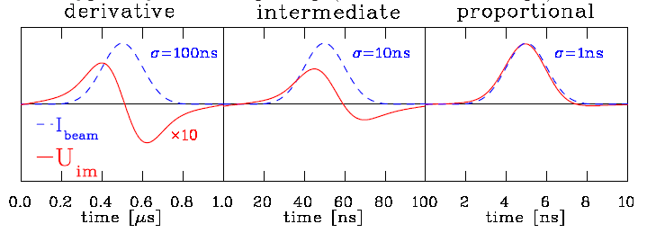
Signal Shape for capacitive BPMs: differentiated ↔ proportional
Depending on the frequency range and termination the signal looks different:
High frequency range ω >> ω_{cut} :
⇒ direct image of the bunch. Signal strength Z_{t} ∝ A/C i.e. nearly independent on length
Low frequency range ω << ω_{cut} :
⇒ derivative of bunch, single strength Z_{t} ∝ A, i.e. (nearly) independent on C
Intermediate frequency range ω ≈ ω_{cut}: Calculation using Fourier transformation
Example: Synchrotron BPM with 50 Ω termination (reality at p-synchrotron : σ>>1 ns):
I_{beam}(t)
U_{im}(t)

Slide 18
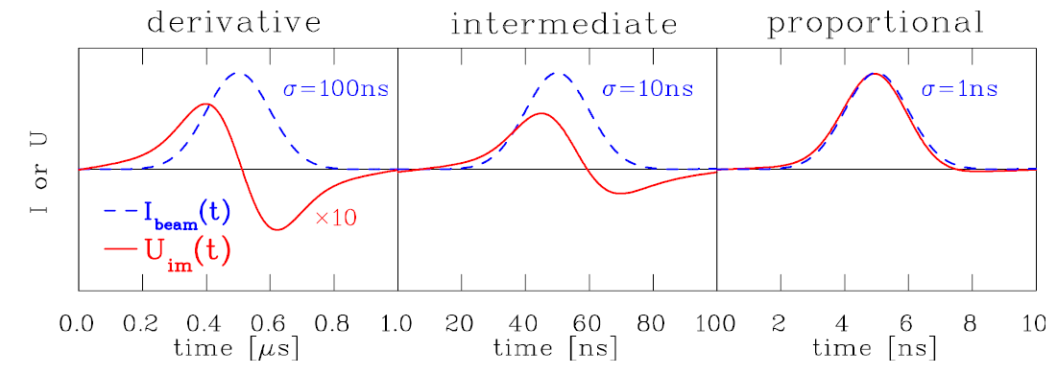
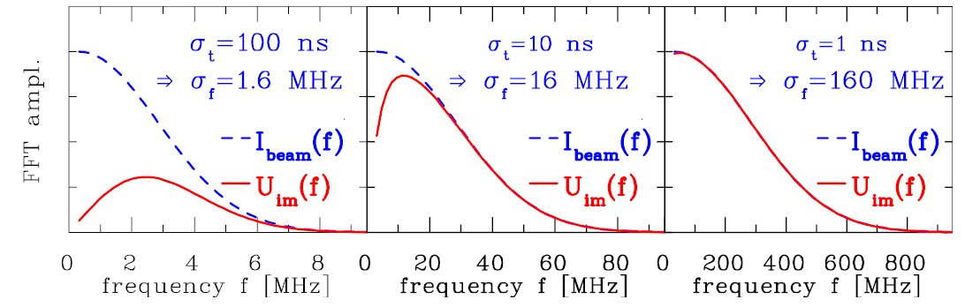
Calculation of Signal Shape (here single bunch)
The transfer impedance is used in frequency domain! The following is performed:
1. Start: Time domain Gaussian function I_{beam}(t) having a width of σ_{t}
inverse Fourier trans.
Fourier trans.
2. FFT of I_{beam}(t) leads to the frequency domain Gaussian I_{beam}(f) with σ_{f} = ( 2πσ_{t} )⁻¹
3. Multiplication with Z_{t}(f) with f_{cut}=32 MHz leads to U_{im}(f) = Z_{t}(f) ∙ I_{beam}(f)
4. Inverse FFT leads to U_{im}(t)

Slide 19
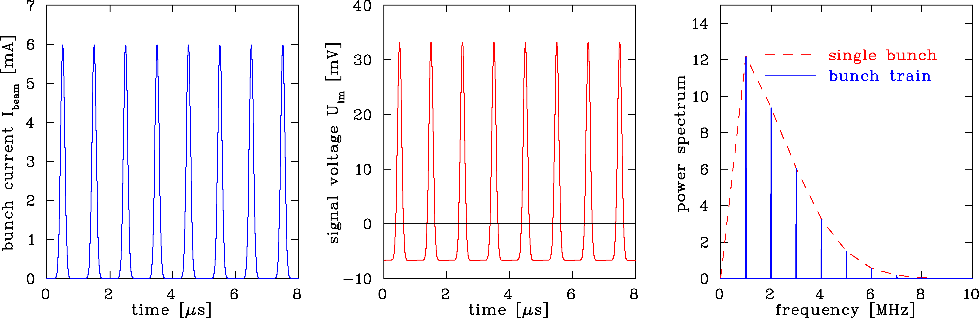
Calculation of Signal Shape: repetitive Bunch in a Synchrotron
Synchrotron filled with 8 bunches accelerated with f_{acc}=1 MHz
BPM terminated with R= 1 MΩ ⇒ f_{acc} >> f_{cut} :
Parameter: R=1 MΩ ⇒ f_{cut}=2 kHz, Z_{t}=5 Ω , all buckets filled
C = 100pF, l = 10cm, β = 50%, σ_{t} = 100 ns ⇒ σ_{l} = 15m
Fourier spectrum is composed of lines separated by acceleration f_{rf}
Envelope given by single bunch Fourier transformation
Baseline shift due to ac-coupling
Remark: 1 MHz< f_{rf} <10 MHz ⇒ Bandwidth ≈100 MHz=10∙f_{rf} for broadband observation

Slide 20
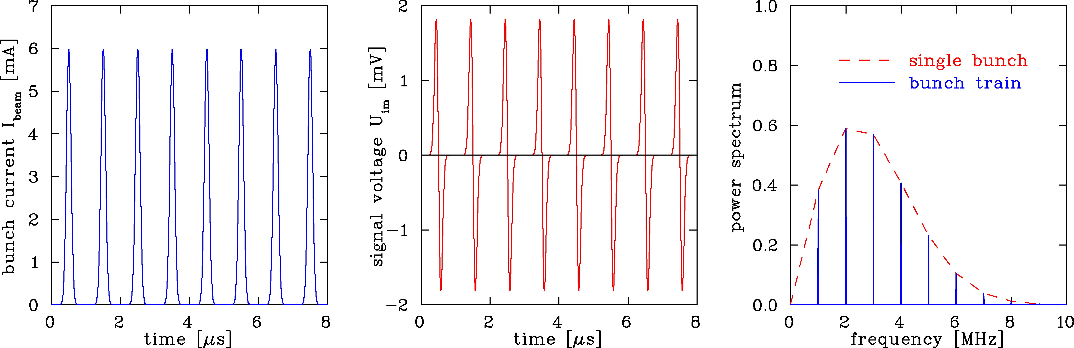
Calculation of Signal Shape: repetitive Bunch in a Synchrotron
Synchrotron filled with 8 bunches accelerated with f_{acc}=1 MHz
BPM terminated with R=50 Ω ⇒ f_{acc}<< f_{cut} :
Parameter: R=50 Ω ⇒ f_{cut}=32 MHz, all buckets filled
C = 100pF, l = 10cm, β = 50%, σ_{t} = 100ns ⇒ σ_{l} = 15m
Fourier spectrum is concentrated at acceleration harmonics
with single bunch spectrum as an envelope.
Bandwidth up to typically 10*f_{acc}

Slide 21
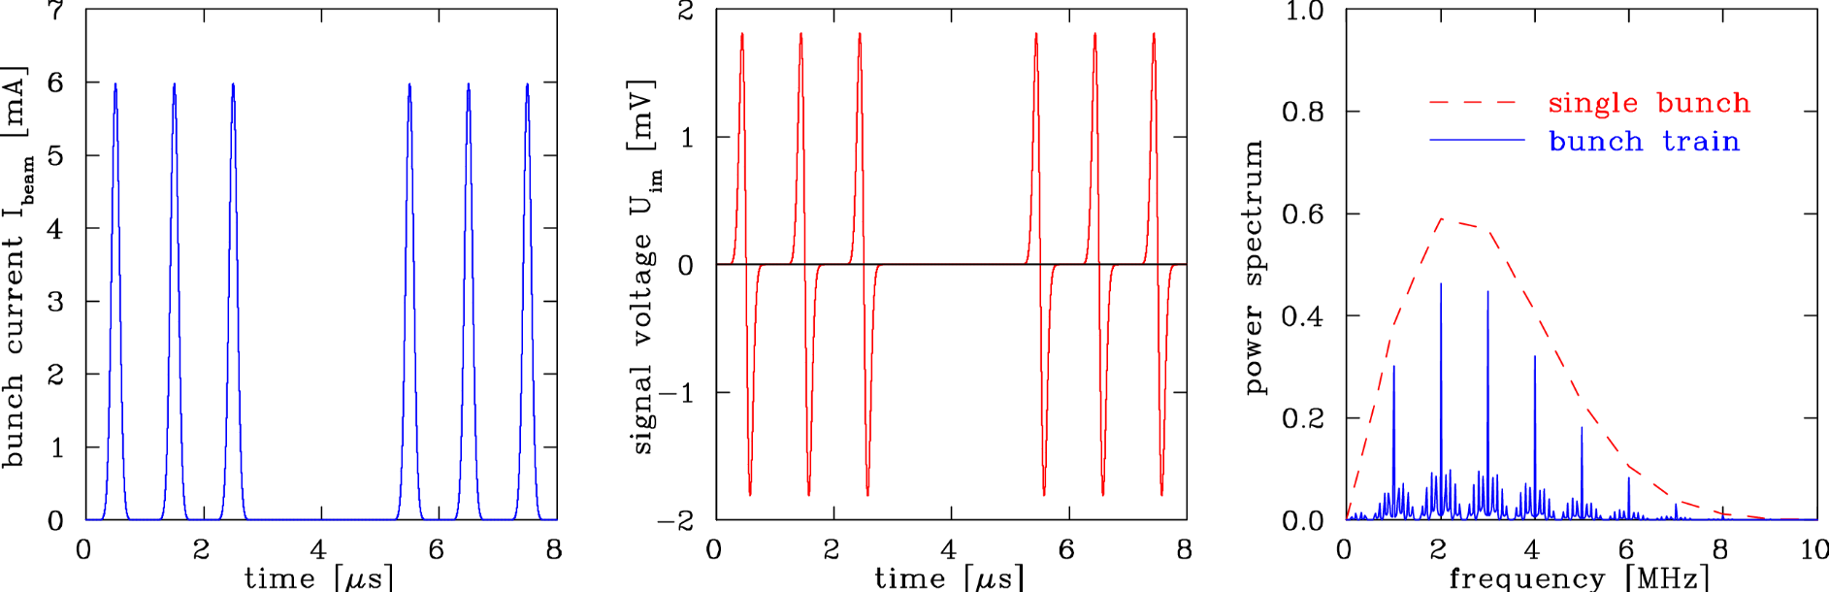
Calculation of Signal Shape: Bunch Train with empty Buckets
Synchrotron during filling: Empty buckets, R=50 Ω:
Parameter: R=50 Ω ⇒ f_{cut}=32 MHz, 2 empty buckets
C = 100pF, l = 10cm, β = 50%, σ_{t} = 100ns ⇒ σ_{l} = 15m
Fourier spectrum is more complex, harmonics are broader due to sidebands

Slide 22
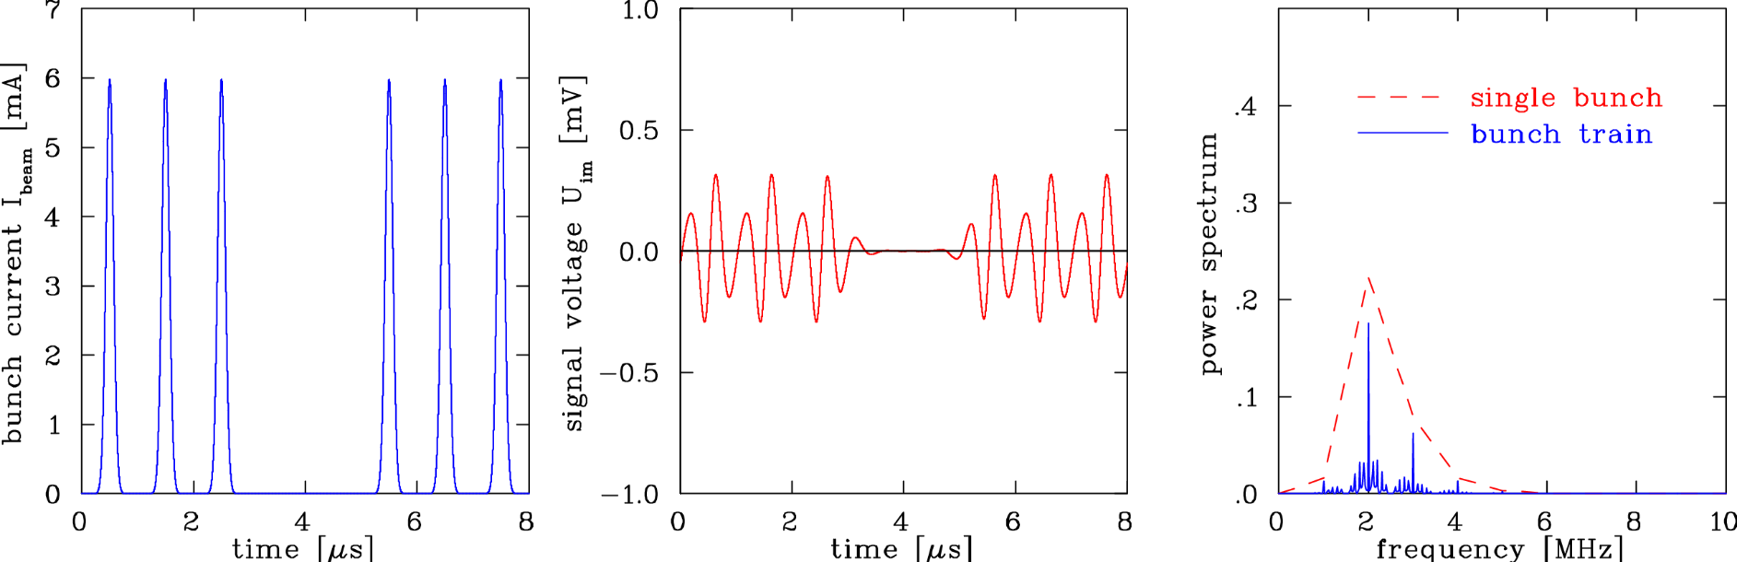
Calculation of Signal Shape: Filtering of Harmonics
Effect of filters, here bandpass:
Parameter: R=50 Ω, 4th order Butterworth filter f_{cut} = 2 MHz
C = 100pF, l = 10cm, β = 50%, σ = 100 ns
n^{th} order Butterworth filter,
math. simple, but not well suited:
Ringing due to sharp cutoff
Other filter types more appropriate
Generally: Z_{tot}(ω) = H_{cable}(ω) ∙ H_{filter}(ω) ∙ H_{amp}(ω) ∙ … ∙Z_{t}(ω)
Remark: For numerical calculations, time domain filters (FIR and IIR) are more appropriate

Slide 23
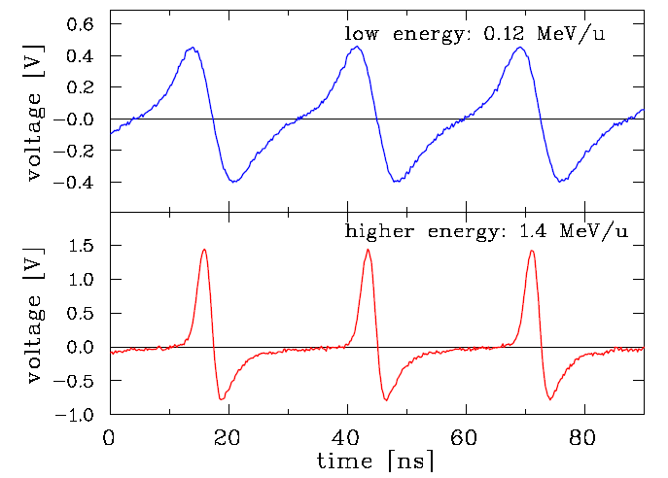
Examples for differentiated & proportional Shape
Proton LINAC, e—LINAC & synchrotron:
100 MHz < f_{rf} < 1 GHz typically
R=50 Ω processing to reach bandwidth
C≈5 pF ⇒ f_{cut} =1/(2πRC)≈ 700 MHz
Example: 36 MHz GSI ion LINAC
Proton synchrotron:
1 MHz < f_{rf} < 30 MHz typically
R=1 MΩ for large signal i.e. large Z_{t}
C≈100 pF ⇒ f_{cut} =1/(2πRC) ≈10 kHz
Example: non-relativistic GSI synchrotron
f_{rf} : 0.8 MHz → 5 MHz
Remark: During acceleration the bunching-factor is increased: ‘adiabatic damping’.

Slide 24
Principle of Signal Generation of a BPMs: off-center Beam
The image current at the wall is
monitored on a high frequency basis
i.e. ac-part given by the bunched beam.
V
-
+
-
+
-
-
+
-
+
-
+
-
-
+
-
+
-
+
-
+
-
-
+
-
+
-
+
-
+
-
+
-
-
+
-
+
+
-
-
-
-
+
-
+
-
-
-
-
+
+
-
+
-
-
+
-
+
-
-
-
-
-
-
-
-
-
+
-
+
+
-
+
+
-
+
-
-
+
-
+
-
+
-
+
-
+
+
+
+
-
+
-
-
+
-
+
+
+
+
+
+
+
+
+
+
+
+
+
+
+
+
+
+
+
+
+
+
+
+
+
+
+
+
+
+
+
+
+
+
+
+
+
+
+
+
+
+
+
+
+
+
+
+
+
+
+
+
+
+
+
+
+
+
+
+
+
+
+
+
+
+
+
+
+
+
+
+
+
+
+
+
+
+
+
+
-
+
+
-
+
+
-
-
-
-
+
-
-
+
-
-
+
+
+
-
-
+
-
+
+
-
-
-
+
-
+
-
-
-
-
-
-
+
-
+
+
+
+
-
+
-
-
+
Animation by Rhodri Jones (CERN)

Slide 25
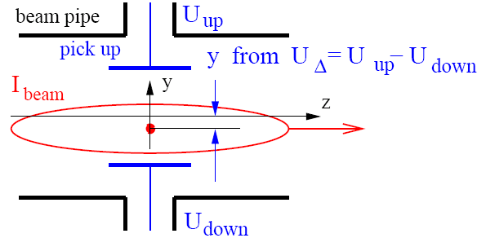
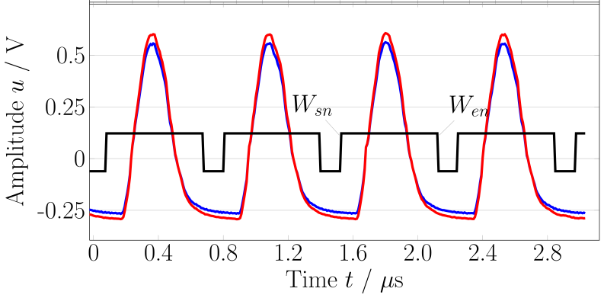

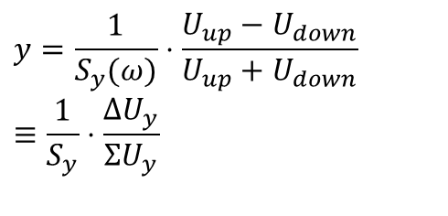
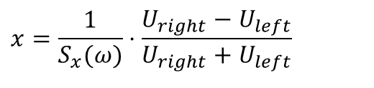
Principle of Position Determination by a BPM
The difference voltage between plates gives the beam’s center-of-mass
most frequent application
$$y=\frac{1}{S_{y}(ω)}⋅\frac{U_{up}−U_{down}}{U_{up}+U_{down}}≡\frac{1}{S_{y}}⋅\frac{ΔU_{y}}{ΣU_{y}}$$
y from ΔU = U_{up} - U_{down}
$$x=\frac{1}{S_{x}(ω)}⋅\frac{U_{right}−U_{left}}{U_{right}+U_{left}}$$
S(ω,x) is called position sensitivity, sometimes the inverse is used k(ω,x)=1/S(ω,x)
S is a geometry dependent, non-linear function,
Units: S=[%/mm], sometimes S=[dB/mm] or k=[mm].
Example: One turn = 4 bunches @ 35 MeV/u
U_{right}
U_{reft}
Typical desired position resolution:
Δx ≈ 0.1 ... 0.3 ⋅ σ_{x} of beam width
It is at least: $∆U ≪ \frac{1}{10} ΣU$

Slide 26
The Artist’s View of a BPM

Slide 27
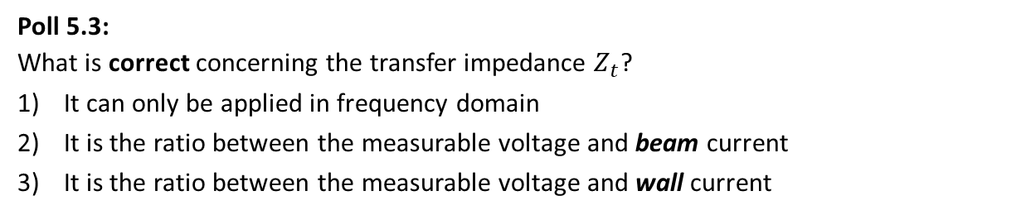
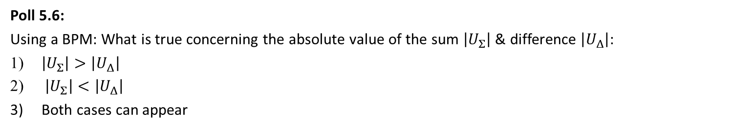
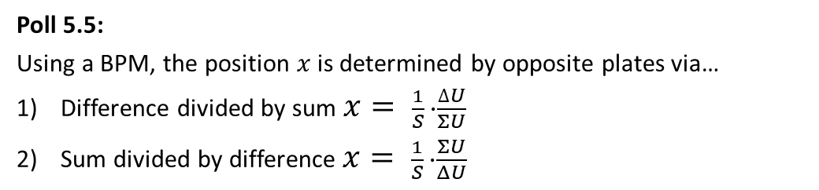
Poll concerning Transfer Impedance
Poll 5.3:
What is correct concerning the transfer impedance $Z_{t}$?
It can only be applied in frequency domain
It is the ratio between the measurable voltage and beam current
It is the ratio between the measurable voltage and wall current
Poll 5.4:
What is correct concerning BPM measurements in general?
Beams of all types of time structure can be monitored
Only positive beam particles (i.e. protons & ions) can be measured
The BPM circuit acts as a high pass filter
www.menti.com
code: 1208 6026
Poll 5.5:
Using a BPM, the position $x$ is determined by opposite plates via…
Difference divided by sum $x= \frac{1}{S} ∙\frac{∆U}{ΣU}$
Sum divided by difference $x= \frac{1}{S} ∙\frac{ΣU}{ΔU}$
Poll 5.6:
Using a BPM: What is true concerning the absolute value of the sum $\left|U_{Σ}\right|$ & difference $\left|U_{Δ}\right|$:
$\left|U_{Σ}\right|>\left|U_{Δ}\right|$
$\left|U_{Σ}\right|<\left|U_{Δ}\right|$
Both cases can appear
Notes:
27

Slide 28
Outline:
Signal generation → transfer impedance
Capacitive button BPM for high frequencies
used at most proton LINACs and electron accelerators
Capacitive linear-cut BPM for low frequencies
Electronics for position evaluation
BPMs for measurement of closed orbit, tune and further lattice functions
Summary

Slide 29
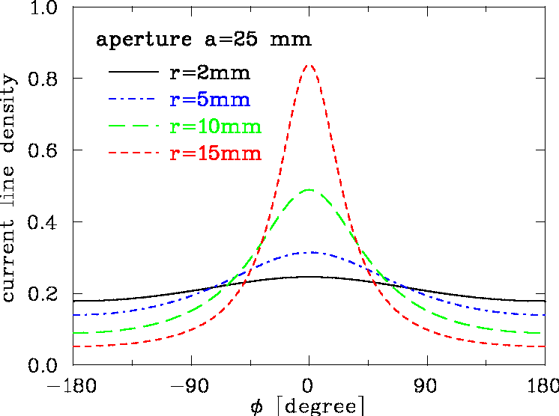
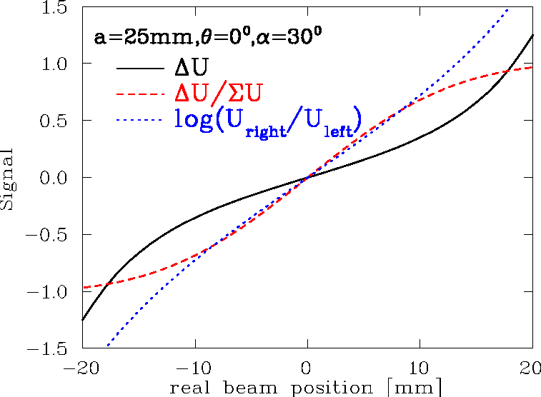
2-dim Model for a Button BPM
‘Proximity effect’: larger signal for closer plate
Ideal 2-dim model: Cylindrical pipe → image current density
via ‘image charge method’ for ‘pencil’ beam:
a
button
φ
α
r
θ =0
Image current: Integration of finite electrode size:
, θ = 0⁰

Slide 30
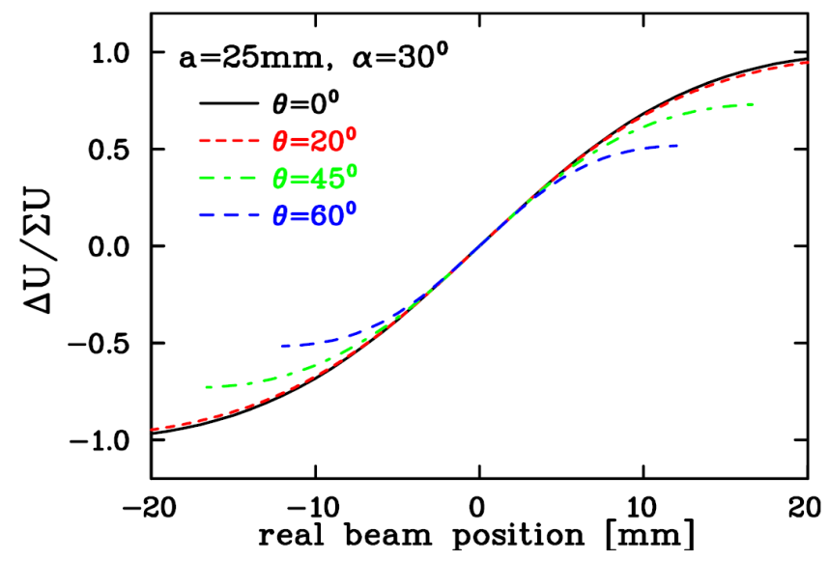
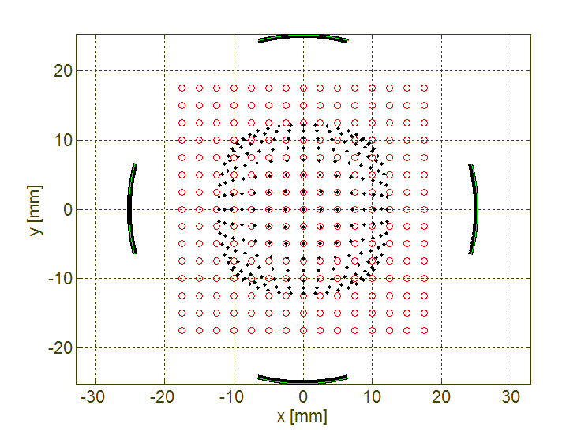
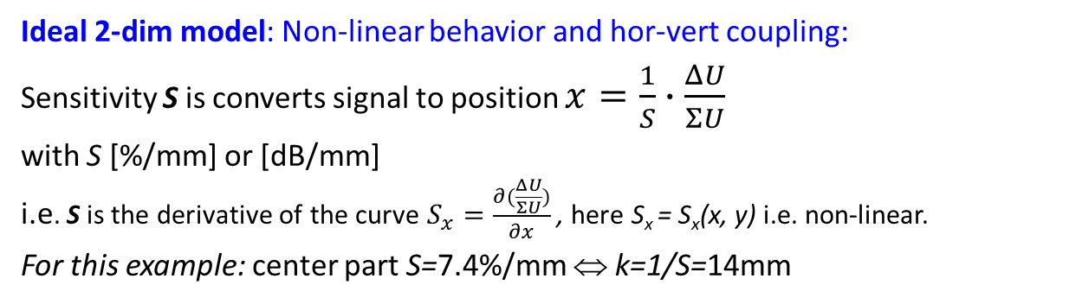
2-dim Model for a Button BPM
Ideal 2-dim model: Non-linear behavior and hor-vert coupling:
Sensitivity S is converts signal to position $x=\frac{1}{S}∙\frac{ΔU}{ΣU}$
with S [%/mm] or [dB/mm]
i.e. S is the derivative of the curve $S_{x}=\frac{∂(\frac{ΔU}{ΣU})}{∂x}$ , here S_{x} = S_{x}(x, y) i.e. non-linear.
For this example: center part S=7.4%/mm ⇔ k=1/S=14mm
a
button
φ
α
θ
r
Horizontal plane:
‘Position Map’:
button
○ real position
• measured posi.

Slide 31
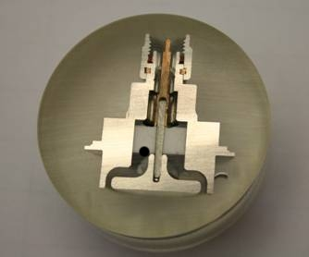
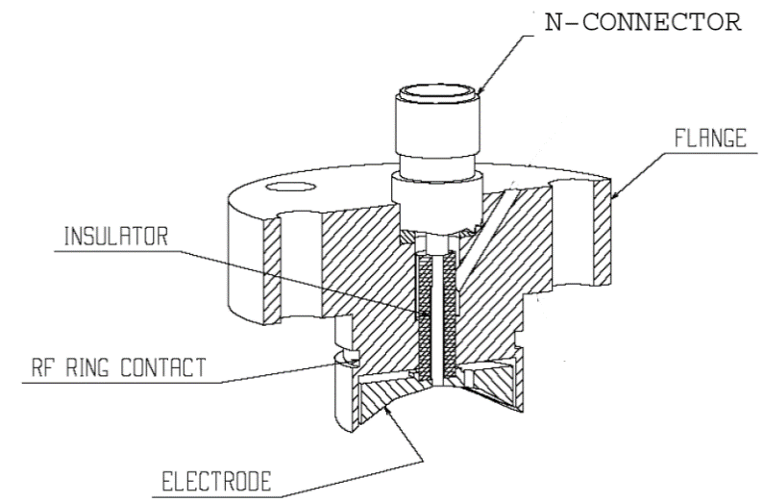



Button BPM Realization
LINACs, e⁻-synchrotrons: 100 MHz < f_{rf} < 3 GHz → bunch length ≈ BPM length
→ 50 Ω signal path to prevent reflections
Button BPM with 50 Ω ⇒
Example: LHC-type inside cryostat:
24 mm, half aperture a=25 mm, C=8 pF
⇒ f_{cut}=400 MHz, Z_{t} = 1.3 Ω above f_{cut}
Ø24 mm
50mm
From C. Boccard (CERN)

Slide 32


Button BPM at Synchrotron Light Sources
The button BPM can be rotated by 45⁰
to avoid exposure by synchrotron light:
Frequently used at boosters for light sources
Example: Booster of ALS, Berkeley

Slide 33

Button BPM at Synchrotron Light Sources
Due to synchrotron radiation, the button insulation might be destroyed
buttons only in vertical plane possible ⇒ increased non-linearity
HERA-e
realization
PEP-realization

Slide 34




Simulations for Button BPM at Synchrotron Light Sources
Example: Simulation for ALBA light source for 72 x 28 mm² chamber
Optimization: horizontal distance and size of buttons
from A.A. Nosych et al., IBIC’14
button 2
button 1
y = 20 mm
y = 10 mm
y = 0 mm
y = 20 mm
y = 10 mm
y = 0 mm
1 mm steps
S_{x}(center) = 7.8 %/mm
for |x|<5mm & y=0mm
S_{y}(center) = 7.2 %/mm
for |y|< 5mm & x=0mm
button 3
button 4
30
20
position x [mm]
real beam position x [mm]
button 2
button 1
18 mm
button 2
button 1
1 mm
steps
y
∅ 7 mm
x
28 mm
button 3
button 4
button 3
30
button 4
72 mm
position x [mm]
Result: non-linearity and xy-coupling occur in dependence of button size and position

Slide 35
Poll concerning Button BPMs and Signal Shape
Poll 5.7:
What is correct? For button BPMs the position sensitivity S(x) is …
independent with respect to the beam-pipe size
linear with respect to x (independent on the button geometry)
non-linear with respect to x (it depends on the button geometry)
The horizontal S(x) is independent on the vertical beam offset y
Poll 5.8:
Assume a small button BPM with a cut-off frequency of f_{cut} = 3 GHz and a beam bunch of 1 ns length. The signal is proportional …
to the bunch current
to the derivative of the bunch current
to the button diameter
www.menti.com
code: 1208 6026
Notes:
35

Slide 36
Outline:
Signal generation → transfer impedance
Capacitive button BPM for high frequencies
used at most proton LINACs and electron accelerators
Capacitive linear-cut or ‘shoe-box’ BPM for low frequencies
used at most proton synchrotrons due to linear position reading
Electronics for position evaluation
BPMs for measurement of closed orbit, tune and further lattice functions
Summary

Slide 37


Linea-cut or ‘Shoe-box’ BPM for Proton Synchrotrons
Frequency range: 1 MHz < f_{rf} < 10 MHz ⇒ bunch-length >> BPM length.
Signal is proportional to actual plate length:
In ideal case: linear reading
Size: 200x70 mm²
Linear-cut BPM:
Advantage: Very linear, low frequency dependence
i.e. position sensitivity S is constant
Disadvantage: Large size, complex mechanics
high capacitance

Slide 38


Technical Realization of a linear-cut BPM
Technical realization at HIT synchrotron of 46 m length for 7 MeV/u→ 440 MeV/u
BPM clearance: 180x70 mm², standard beam pipe diameter: 200 mm.
Quadrupole
Linear Ampl.
Linear Ampl.
70mm
Beam
Horizontal
electrode
Right
channel
180mm

Slide 39


Technical Realization of a linear-cut BPM
Technical realization at HIT synchrotron of 46 m length for 7 MeV/u→ 440 MeV/u
BPM clearance: 180x70 mm², standard beam pipe diameter: 200 mm.
Linear Ampl.
70mm
Horizontal
electrode
Right
channel
180mm

Slide 40
Comparison Linear-cut and Button BPM
 | Linear-cut BPM | Button BPM
Precaution | Bunches longer than BPM | Bunch length comparable to BPM
BPM length (typical) | 10 to 20 cm length per plane | ∅1 to 5 cm per button
Shape | Rectangular or cut cylinder | Orthogonal or planar orientation
Bandwidth (typical) | 0.1 to 100 MHz | 100 MHz to 5 GHz
Coupling | 1 MΩ or ≈1 kΩ (transformer) | 50 Ω
Cutoff frequency (typical) | 0.01… 10 MHz (C=30…100pF) | 0.3… 1 GHz (C=2…10pF)
Linearity | Very good, no x-y coupling | Non-linear, x-y coupling
Sensitivity | Good, care: plate cross talk | Good, care: signal matching
Usage | At proton synchrotrons, f_{rf} < 10 MHz | All electron acc., proton Linacs, f_{rf} > 100 MHz

Slide 41

Poll concerning linear-cut BPMs
Poll 5.9:
Linear-cut BPMs …
are used at proton synchrotrons with an acceleration frequency f_{acc} $≫$ 10 MHz
can distinguish between counter-propagating beams within a collider
provide a linear position sensitivity over a wide range of beam offsets
www.menti.com
code: 1208 6026
Notes:
41

Slide 42
Outline:
Signal generation → transfer impedance
Capacitive button BPM for high frequencies
used at most proton LINACs and electron accelerators
Capacitive linear-cut BPM for low frequencies
used at most proton synchrotrons due to linear position reading
Electronics for position evaluation
analog signal conditioning to achieve small signal processing
BPMs for measurement of closed orbit, tune and further lattice functions
Summary

Slide 43




Excurse: General Noise Sources
Example: Maxwell-Boltzmann distribution of a free electron gas
Any electronics is accompanied with noise due to:
Thermal noise as given by the thermal movement of
electrons described by Maxwell-Boltzmann distribution
Within resistive matter
average movement cancels $U_{mean}=\left\langle U\right\rangle =0$
but standard deviation remains:
$U_{eff}=\sqrt{\left\langle U^{2}\right\rangle }=\sqrt{4k_{B}∙T∙R∙∆f}$
this is white noise i.e. no frequency dependence
k_{B} Boltzmann constant, T temperature, R resistivity, Δf bandwidth
R
at T
$$\sim$$
$$U_{∼}$$
Shot noise as given by the fluctuations of finite amount of electrons
for most electronics not important due to large amount of electrons
Flicker noise or ‘1/f - noise’ as given by trapping of electrons in matter
pink noise due to a frequency , ‘corner-frequency’ f_{c} ≈ 3 kHz i.e. 1/f-noise = thermal noise
Disturbance by Electro-Magnetic Interference EMI:
Not noise, but pick-up of electro-magnetic waves from the environment
leads unwanted signal deformation and depends on the surrounding
Maxwell-Boltzmann distribution: $\frac{1}{N}∙\frac{dN}{dv}= \frac{4}{\sqrt{π}}{\left(\frac{m}{3k_{B}T}\right)}^{3/2}∙ v^{2} ∙exp \left(− \frac{mv^{2}}{2k_{B}T}\right)⁡$

Slide 44




Excurse: Signal to Noise Consideration
The minimum noise is given thermal noise: $U_{eff}=\sqrt{\left\langle U^{2}\right\rangle }=\sqrt{4k_{B}∙T∙R∙∆f}$
R is the input Ohmic resistor → input of a low-noise amplifier (realistic noise figure 2-3 x U_{eff})
Δf is the bandwidth of the signal chain
Simulation:
Broadband ‘white’ noise
For Signal-to-Noise = 2
(Noise: std. deviation, signal: maximum)
⇒ peak just visible
For Signal-to-Noise = 4
⇒ peak well visible
Filtering improves S/N
here: n=50 taps moving average
⇔ bandwidth restriction
noise only
signal only
signal only
S/N=2
S/N=2
U_{eff}
signal only
signal only
filtered
S/N=4
S/N=4
$$y_{j}^{filtered}=\frac{1}{n+1}\sum_{i=j−n/2}^{j+n/2}{y_{i}}$$
sample
sample

Slide 45


General: Noise Consideration
1. Signal voltage given by: $U_{im}(f)=Z_{t}(f)⋅I_{beam}(f)$
2. Position information from voltage difference: $x=1/S⋅ΔU/ΣU$
3. Thermal noise voltage given by: $U_{eff}(R,Δf)=\sqrt{4k_{B}⋅T⋅R⋅Δf}$
Signal-to-noise ΔU_{im}/U_{eff} is influenced by:
Input signal amplitude
→ large or matched Z_{t}
Thermal noise at R=50 Ω for T=300 K
Bandwidth Δf
⇒ Restriction of frequency width
because the power is concentrated
on the harmonics of f_{rf}
Example: GSI-LINAC with f_{rf} = 36 MHz
Remark: Additional contribution by non-perfect electronics typically a factor 2
Moreover, pick-up by electro-magnetic interference can contribute ⇒ good shielding required

Slide 46


Comparison: Filtered Signal ↔ Single Turn
Example: GSI Synchr.: U⁷³⁺, E_{inj}=11.5 MeV/u→ 250 MeV/u within 0.5 s, 10⁹ ions
Position resolution < 30 μm (BPM half aperture a=90 mm)
average over 1000 turns corresponding to ≈1 ms
or ≈1 kHz bandwidth
1000 turn average for closed orbit
Variation < 10 μm (sufficient for application)
Turn-by-turn data have much larger variation
Single turn e.g. for tune
Variation ≈ 150 μm
However: not only noise contributes but additionally beam movement by betatron oscillation
⇒ broadband processing i.e. turn-by-turn readout for tune determination.

Slide 47
Broadband Signal Processing
Hybrid or transformer close to beam pipe for analog ΔU & ΣU generation or U_{left} & U_{right}
Attenuator/amplifier
Filter to get the wanted harmonics and to suppress stray signals
ADC: digitalization → followed by calculation of of ΔU /ΣU
.
Advantage: Bunch-by-bunch possible, versatile post-processing possible
Disadvantage: Resolution down to ≈ 100 µm for linear-cut, i.e. ≈0.1% of aperture,
resolution is worse than narrowband processing

Slide 48
Narrowband Processing for improved Signal-to-Noise
Narrowband processing equals heterodyne receiver (e.g. AM-radio or spectrum analyzer)
Attenuator/amplifier
Mixing with accelerating frequency f_{rf} ⇒ signal with sum and difference frequency
Bandpass filter of the mixed signal (e.g at 10.7 MHz)
Rectifier: synchronous detector
ADC: digitalization → followed calculation of ΔU/ΣU
Advantage: Spatial resolution about 100 time better than broadband processing
Disadvantage: No turn-by-turn diagnosis, due to mixing = ’long averaging time’
For non-relativistic p-synchrotron: → variable f_{rf} leads via mixing to constant intermediate freq.

Slide 49


Excurse: Mixer and Synchronous Detector
Mixer: A passive rf device with
Input RF (radio frequency): Signal of investigation
Input LO (local oscillator): Fixed frequency
Output IF (intermediate frequency)
RF
IF
LO
⇒ Multiplication of both input signals, containing the sum and difference frequency.
Synchronous detector: A phase sensitive rectifier
U₀ sin² ωt
low pass filter
input
U_{rf}(t)=U₀ sin ωt
IF
output U_{dc}∝ U₀
RF
limiting ampl.
LO
+ U_{max} if sin ωt > 0
- U_{max} if sin ωt < 0

Slide 50
Analog versus Digital Signal Processing
Modern instrumentation uses digital techniques with extended functionality.
Traditional analog processing
BPM analog
signal
Analog frequency
translator
Analog demodulator
and filter
ADC
digital
output
Analog
Digital
Digital processing (triggered by telecommunication development)
BPM analog
signal
Analog frequency
translator
ADC
Digital
filter
Digital
Signal Proc.
digital
output
Digital receiver as modern successor of super heterodyne receiver
Basic functionality is preserved but implementation is very different
Digital transition just after the amplifier & filter or mixing unit
Signal conditioning (filter, decimation, averaging) on digital electronics e.g. FPGA
Advantage of DSP: Versatile operation, flexible adoption without hardware modification
Disadvantage of DSP: non, good engineering skill requires for development, expensive

Slide 51
Comparison of BPM Readout Electronics (simplified)
Type | Usage | Precaution | Advantage | Disadvantage
Broadband | p-sychr. | Long bunches | Bunch structure signal Post-processing possible Required for fast feedback Required for transfer lines with few bunches | Resolution limited by noise
Narrowband | all synchr. | Stable beams >100 rf-periods | High resolution | No turn-by-turn Complex electronics
Digital Signal Processing | all | Several bunches ADC 125 MS/s | Very flexible High resolution Trendsetting technology for future demands | Basically non! Limited time resolution by ADC → under-sampling Man-power intensive

Slide 52
Poll concerning BPM Electronics
Poll 5.10:
Which type of electronics delivers a better position resolution?
Broadband signal processing
Narrowband signal processing
Poll 5.11:
Within a transfer line between two synchtrotrons, the positon of a single bunch should be measured. What type of electronics is appropriate?
Broadband signal processing
Narrowband signal processing using the synchrotron bunching
The position of a single bunch can not be measured
Poll 5.12:
Assume turn-by-turn position evaluation within a synchrotron. What type of electronics is appropriate?
Broadband signal processing
Narrowband signal processing
Digital signal processing as the only possible solution
www.menti.com
code: 1208 6026
Notes:
52

Slide 53
Outline:
Signal generation → transfer impedance
Capacitive button BPM for high frequencies
used at most proton LINACs and electron accelerators
Capacitive linear-cut BPM for low frequencies
used at most proton synchrotrons due to linear position reading
Electronics for position evaluation
analog signal conditioning to achieve small signal processing
BPMs for measurement of closed orbit, tune and further lattice functions
frequent application of BPMs
Summary

Slide 54
Trajectory Measurement with BPMs
Trajectory:
The position delivered by an individual bunch within a transfer line or a synchrotron.
Main task: Control of matching (center and angle), first-turn diagnostics
Example: LHC injection 10/09/08 i.e. first day of operation !
10
horizontal
0
x [mm]
-10
-10
10
vertical
0
y [mm]
-10
-10
Monitor number (530 BPMs on 27 km)
From R. Jones (CERN)
Tune values at LHC: Q_{h} = 64.3, Q_{v} = 59.3

Slide 55

Close Orbit Measurement with BPMs
Single bunch position averaged over 1000 bunches → closed orbit with ms time steps.
It differs from ideal orbit by misalignments of the beam or components.
Example: GSI-synchrotron at two BPM locations, 1000 turn average during acceleration:
Closed orbit:
Beam position
averaged over many turns
(i.e. betatron oscillations).
The result is the basic tool
for alignment & stabilization
6
horizontal
5
0
0
horizontal position at 2 BPMs
position [mm]
vertical
position [mm]
-5
-6
along synchrotron
-5
-10
time t = 0 ... 600 ms
-12
4
vertical position at 2 BPMs
signal strength
2
0
position [mm]
time t = 0 ... 600 ms
time t = 0 ... 600 ms
-2

Slide 56
Closed Orbit Feedback: Typical Noise Sources
Beam movement:
Short term (min to 10 ms):
Traffic
Machine (crane) movements
Water & vacuum pumps
50 Hz main power net
Medium term (day to min):
Movement of chambers
due to heating by radiation
Day-night variation
tide, moon cycle
Lang term ( > days):
Ground settlement
Seasons, temperature variation
Power spectral density [mm²/Hz]
0.01
0.1
1
10
100
1000
frequency [Hz]
From M. Böge, PSI, N. Hubert, Soleil

Slide 57

Close Orbit Feedback: BPMs and magnetic Corrector Hardware
Orbit feedback: Synchrotron light source → spatial stability of light beam
Example from SLS-Synchrotron at Villigen, Swiss:
From M. Böge, PSI
Procedure:
1. Position from all BPMs
2. Calculation of corrector setting via
Orbit Response Matrix
3. Digital feedback loop
⇒ regulation time down to 10 ms
⇒ Role od thumb: ≈ 4 BPMs per betatron wavelength
feedback
Acc. optics
Position from all BPMs
Calculation of corrector strength
Setting of correctors
Uncorrected orbit: typ. <x ²>_{rms} ≈ 1 mm
Corrected orbit: <x ²>_{rms} ≈ 1 μm up to 100 Hz bandwidth!

Slide 58


Close Orbit Feedback: Results
Orbit feedback:
Example: 12 beam positions at GSI-SIS during ramping from 8.6 to 500 MeV/u for Ar¹⁸⁺
20
feedback off
20
feedback on
10
10
position [mm]
position [mm]
0
0
-10
position x(t) at 12 BPMs
-10
0
100
200
300
400
0
100
200
300
400
time [ms]
time [ms]
Procedure:
1. Position from all 12 BPMs
2. Calculation of corrector setting on fast (FPGA-based) electronics
3. Submission to corrector magnets
4. New position measurement
⇒ regulation time down to 10 ms
Rule of thumb:
Movement related to tune i.e. ‘natural oscillations by periodic focusing’
To determine the ‘sine-like’ oscillation 4 BPMs per oscillation are required
⇒ 4 BPMs per tune value (but detailed investigation required to determine the # of BPMs)

Slide 59


Tune Measurement: General Considerations
Coherent excitations are required for the detection by a BPM
Beam particle’s in-coherent motion ⇒ center-of-mass stays constant
Excitation of all particles by rf ⇒ coherent motion
⇒ center-of-mass variation turn-by-turn
Graphics by R. Singh, GSI
Notes:
Beam with several particles with randomly distributed phases and amplitude will give only very small fluctuations due to finite number of particles (schottky fluctuations) proportional to sqrt(N)
Beam excitation aligns the particle phases, and allows to measure center-of-mass before the beam decohores due to finite spread in frequency. Thus regular excitation needed. Types of excitation were studied as part of this work, Kick excitation (a wide band, or single time impulse excitation), requires high power, and significantly dilutes the phase space.
Chirp excitation, slow method, difficult to use in day to day operations, BTF excitation, to study the amplitude and phase response of the beam.
A compromise of the both the above methods, band limited (or pseudo random noise) for regular excitation without significant blow-up, usable along the ramp.

Slide 60

Tune Measurement: General Considerations
The tune Q is the number of betatron oscillations per turn.
The betatron frequency is f_{β} = Q⋅ f₀.
Measurement: excitation of coherent betatron oscillations + position from one BPM.
From a measurement one gets only the non-integer part q of Q with Q = n ± q.
Moreover, only 0 < q < 0.5 is the unique result.
Example: Tune measurement for six turns with the three lowest frequency fits:
To distinguish
for q < 0.5 or q > 0.5:
Changing the tune slightly,
the direction of q shift differs.

Slide 61


Tune Measurement: The Kick-Method in Time Domain
The beam is excited to
coherent betatron oscillation
→ the beam position measured
each revolution (’turn-by-turn’)
→ Fourier Trans. gives the non-integer tune q.
Short kick compared to revolution.
The de-coherence time limits the resolution:
N non-zero samples
⇒ General limit of discrete FFT:
N = 200 turn ⇒ Δq > 0.003 as resolution
(tune spreads are typically Δq ≈ 0.001!)

Slide 62
Tune Measurement: De-Coherence Time
The particles are excited to betatron oscillations, but due to the
spread in the betatron frequency, they getting out of phase (’Landau damping’):
Scheme of the individual trajectories of four particles after a kick (top)
and the resulting coherent signal as measured by a pick-up (bottom).
⇒ Kick excitation leads to limited resolution
Remark: The tune spread is much lower for a real machine.

Slide 63
Tune Measurement: Beam Transfer Function in Frequency Domain
Instead of one kick, the beam can be excited by a sweep of a sine wave, called ‘chirp’
→ Beam Transfer Function (BTF) Measurement
as the velocity response to a kick
Principle:
Beam acts like a driven oscillator!
Using a network analyzer:
RF OUT is feed to the beam by a
kicker (reversed powered as a BPM)
The position is measured at
one BPM
Network analyzer: amplitude and
phase of the response
Sweep time up to seconds
due to de-coherence time per band
resolution in tune: up to 10⁻⁴
courtesy: F.Sannibale (LBNL)

Slide 64


Tune Measurement: Result for BTF Measurement
BTF measurement at the GSI synchrotron, recorded at the 25th harmonics.
A wide scan with both sidebands at
h=25th-harmonics:
A detailed scan for the lower sideband
→ beam acts like a driven oscillator:
From the position of the sidebands q = 0.306 is determined.
Advantage: High resolution for tune and tune spread (also for de-bunched beams)
Disadvantage: Long sweep time (up to several seconds).

Slide 65
Tune Measurement: Gentle Excitation with Wideband Noise
Instead of a sine wave, noise with adequate bandwidth can be applied
→ beam picks out its resonance frequency:
Example: Vertical tune within 4096 turn
duration ≃ 15 ms
at GSI synchrotron 11 → 300 MeV/u in 0.7 s
broadband excitation with white noise
of ≈ 10 kHz bandwidth
turn-by-turn position measurement by fast ADC
Fourier transformation of the recorded data
⇒ Continues monitoring with low disturbance
vertical tune versus time
vertical tune at fixed time ≈ 15ms
0.3
δQ_{y} ≈ 0.02
vert. fractional tune q_{y}
excitation
noise band
δQ ≈ 0.05
amplitude [a.u.]
0.25
0.2
0.25
0.3
0.35
0.2
vertical fractional tune q_{y}
Advantage:
Fast scan with good time resolution
Disadvantage: Lower precision
0
200
400
600
750
time [ms]

Slide 66



Excurse: Example of Lattice Functions
The position of dipoles and quadrupoles
give the linear lattice functions
at injection point D = 0 is favored
chromatic correction with sextupoles,
Example: GSI SIS100 ion synchrotron
Length C [m] |  | 1086
Energy E_{kin} [GeV/u] |  | 0.2 → 2
Tune Q_{h/v} | h/v | 18.84 / 18.73
Max. dispersion |D| [m] |  | 1.73
Max. β–function β_{h/v} [m] | h/v | 19.6 / 19.6
Natural chromaticity ξ_{h/v} | h/v | -1.19 / -1.20
Injected emittance ε_{h/v} [mm mrad] | h/v | 35 / 15
Injected mom. spread Δp/p₀ [%] |  | 0.05
Definition of dispersion D(s):
x_{D}(s) = D(s) ⋅ Δp/p₀
Definition of chromaticity ξ per turn:
ΔQ/Q₀ = ξ ⋅ Δp/p₀
x: 80 mm
$x\left(s\right)= \sqrt{ε_{h}β_{h}}$
y: 40 mm
y$\left(s\right)= \sqrt{ε_{v}β_{v}}$
1/6 of SIS100: Length 181 m

Slide 67
β-Function Measurement from Bunch-by-Bunch BPM Data
Excitation of coherent betatron oscillations: From the position deviation
x_{ik} at the BPM i and turn k the β-function β(s_{i}) can be evaluated.
The position reading is:
→ a turn-by-turn position reading at many location (4 per unit of tune) is required.
The ratio of β-functions at different location:
The phase advance is:
Without absolute calibration,
β-function is more precise:

Slide 68


Dispersion Measurement from Closed Orbit Data
Dispersion D(s_{i} ): Change of momentum p by detuned rf-cavity
→ Position reading at one location $x_{i}=D\left(s_{i}\right) ∙\frac{∆p}{p}$:
→ Result from plot of x_{i} as a function of Δp/p ⇒ slope is local dispersion D(s_{i} )
Example: Dispersion measurement D(s) at BPMs at CERN SPS
green histogram: measurement
Theory-experiment correspondence
after correction of
BPM calibration
quadrupole calibration
×: model expectation
6.9 km
From J. Wenninger: CAS on BD, CERN-2009-005 & J. Wenninger CERN-AB-2004-009

Slide 69

Chromaticity Measurement
Chromaticity ξ: Excitation of coherent betatron oscillations and
change of momentum p by detuned rf-cavity:
→ Tune measurement
(kick-method, BTF, noise excitation):
Plot of ΔQ/Q as a function of Δp/p
⇒ slope is chromaticity ξ.
Measurement at LEP

Slide 70
Poll concerning Tune and Lattice Function Measurement
Poll 5.13:
A tune measurement is related to excitation of …
coherent transverse oscillations
incoherent transverse oscillations
coherent longitudinal oscillations
incoherent longitudinal oscillations
Poll 5.14:
The dispersion function along a transfer line is measured using a beam with momentum offset and measuring …
the arrival time at several locations
the beam position at several locations
the beam profile at several locations
nothing, as dispersion is only a theoretical quantity
Poll 5.15:
What is a closed orbit feedback system at a synchrotron?
The alignment of the trajectory of the injected beam during its first turn
The correction of individual bunches during storage
The correction of the beam position averaged over more than 1000 turns
The mechanical movement of the synchrotron magnets
www.menti.com
code: 1208 6026
Notes:
70

Slide 71


Appendix GSI Ion LINAC: Position and mean beam energy Measure
BPM: Capacitive type, for position and time-of-flight
total 25 device
Transfer to
Synchrotron
HLI: (ECR,RFQ,IH)
To SIS ↑
All ions, high current, 5 ms@50 Hz, 36&108 MHz
MEVVA
MUCIS
50 m
Foil Stripper
Alvarez DTL
RFQ IH1 IH2
U⁴⁺
U²⁸⁺
PIG
Gas Stripper
11.4 MeV/u
β = 0.16
2.2 keV/u
β = 0.0022
Constructed in the 70th, Upgrade 1999,
further upgrades in preparation
120 keV/u
β = 0.016
1.4 MeV/u ⇔β = 0.054

Slide 72

Appendix GSI Ion Synchrotron: Position, Tune etc. Measurement
acceleration
BPM: position 1 μs to s
12 devices
Important parameters of SIS-18
BPM: for tune measurement
1 device
Ion (Z) | 1 → 92 (p to U)
Circumference | 216 m
Inj. type | Multi-turn
Injection energy | 11 MeV/u
Max. final energy | ≈ 2 GeV/u
Ramp duration | 0.1 → 1.5 s
Acc. RF | 0.8 → 5 MHz
Harmonic | 4 (= # bunches)
Bunching factor | 0.4 → 0.08
Tune Q_{x} & Q_{y} | 4.3 & 3.3
Exciter: for tune excitation
injec-
tion
Schottky pick-up:
Δp/p, Q, ξ ....
1 device
extrac-
tion

Slide 73

Appendix: Synchrotron Light F. ALBA: Position, tune etc. Measure
BTS:
4 BPM
Beam position:
Center of mass
Many locations!
Frequent operating tool
For position stabilization
i.e. closed orbit feedback
Tune: Q_{x} = 18.18
Q_{y} = 8.37
SEXC
STORAGE RING:
7 or 8 BPM/cell
(120 BPMs in total)
1 SEXC
LTB:
3 BPM
SMES
BOOSTER:
11 BPM/quadrant
(44 BPMs in total)
1 SMES
1 SEXC
SEXC
Abbreviation:
Meas. Stripline → SMES
Exc. Stripline → SEXC
Button BPMs → BPM
From U. Iriso, ALBA

Slide 74
Summary Pick-Ups for bunched Beams
The electric field is monitored for bunched beams using rf-technologies
(’frequency domain’). Beside transformers they are the most often used instruments!
Differentiated or proportional signal: rf-bandwidth ↔ beam parameters
Proton synchrotron: 1 to 100 MHz, mostly 1 MΩ → proportional shape
LINAC, e⁻-synchrotron: 0.1 to 3 GHz, 50 Ω → differentiated shape
Important quantity: transfer impedance Z_{t}(ω, β).
Types of capacitive pick-ups:
Linear-cut (p-synch.), button (p-LINAC, e⁻-LINAC and synch.)
Remark: Stripline BPM as traveling wave devices are frequently used
Position reading: difference signal of four pick-up plates (BPM):
Non-intercepting reading of center-of-mass → online measurement and control
slow reading → closed orbit, fast bunch-by-bunch→ trajectory
➢ Excitation of coherent betatron oscillations and response measurement
excitation by short kick, white noise or sine-wave (BTF)
→ tune q, chromaticity ξ, dispersion D etc.

Slide 75
Backup slides

Slide 76
Quiz related to BPM Signals
What is the cause of the wall current and wall current density?
What is its connection to the beam bunches?
What is the usage of the transfer impedance?
What is the frequency dependence of the transfer impedance and why is it so?
What is baseline shift?
Transfer impedance: Do you know other quantities of similar type?
How you determine the beam position?
Why it is clever to normalize the difference to the sum signal for position calculation?
What are the typical acceleration frequencies at electron and proton
LINACs, synchrotrons and cyclotrons?
→ Back to BPM types
Notes:
76

Slide 77
Quiz related to BPM Types
Assuming a Gaussian bunch of σ_{t} =1 ns long bunch.
What frequency bandwidth is appropriate positon determination?
For what beam condition or accelerator type button BPMs can be arranged
horizontally & vertically? For what parameter it can’t be done?
Why is it an advantage to have a horizontally & vertically orientation of buttons?
Why is a linear positon behavior an advantage?
What can you do if the position map is non-linear? What are precautions?
→ Back to position evaluaton
Notes:
77

Slide 78
Excurse: Network Analyzer NWA
Principle: Network Analyzer provide an active frequency scan
→ frequency response in amplitude and phase for a Device Under Test DUT
NWA
U_{scan}
U_{scan}(t): active frequency scan
U_{refl}
U_{thru}
line impedance Z_{L}
directional coupler
Scattering parameters S_{ij} :
line impedance Z_{L}
Port 1
DUT
Port 2
DUT
√Z_{L}⋅U_{scan}=a₁
S₂₁
b₂=√Z_{L}⋅ U_{thru}
For same Z_{L} at all ports & a₂=0 (no output reflection):
Gain: U_{thru} / U_{scan} = b₂ /a₁ = S₂₁
Input reflection: U_{refl} / U_{scan} = b₁ /a₁ = S₁₁
concerning amplitude and phase (after calibration)
Port 1
S₁₁
S₂₂
Port 2
√Z_{L}⋅U_{refl}=b₁
a₂
S₁₂

Slide 79
Tune Measurement: Result for BTF Measurement
BTF measurement at the GSI synchrotron, recorded at the 25th harmonics.
A wide scan with both sidebands at
h=25th-harmonics:
A detailed scan for the lower sideband
→ beam acts like a driven oscillator:
From the position of the sidebands q = 0.306 is determined. From the width
Δf/f ≈ 5·10⁻⁴ the tune spread can be calculated via
Advantage: High resolution for tune and tune spread (also for de-bunched beams)
Disadvantage: Long sweep time (up to several seconds).

Slide 80

Phase Measurement from Bunch-by-Bunch BPM Data
Excitation of coherent betatron oscillations: From the position deviation
x_{ik} at the BPM i and turn k the betatron phase is measured.
Example: Phase advance μ(s) compared to the expected μ₀(s) by optics calculation e.g. MADX
at each BPM at CERN’s at LEP (e⁺ - e⁻ collider with 27 km, previously in LHC tunnel)
Result:
Model does not describes the reality completely, corrections required
At interaction point IP (detector location) an additional phase shift is originated
Alignment by correction dipoles (steerer), quadrupoles or sextupoles.
From J. Borer et al, EPAC’92

Slide 81

Phase Measurement from Bunch-by-Bunch BPM Data
Excitation of coherent betatron oscillations: From the position deviation
x_{ik} at the BPM i and turn k the beta-function can be determined.
Example: Measured β(s) compared to the expected β₀(s) and normalized
for each BPM at BNL for RHIC (proton-proton or ions circular collider with 3.8 km length)
Result:
Model does not describes
the reality completely
Corrections executed
Increase of the luminosity
Remark:
Measurement accuracy depends on
BPM accuracy
Numerical evaluation method
See e.g.:
R. Tomas et al., Phys. Rev. Acc. Beams 20, 054801 (2017)
A. Wegscheider et al., Phys. Rev. Acc. Beams 20, 111002 (2017)
From X. Shen et al.,
Phys. Rev. Acc. Beams 16, 111001 (2013)

Slide 82
Closed Orbit Feedback: Results
Orbit feedback: Compensating variations of different kind, goal: Δx ≈ 0.1 ∙σ_{x}
Synchrotron light source → spatial stability of light beam
Example from SLS-Synchrotron at Villigen, Swiss:
5
Uncorrected orbit:
Beam offset and
oscillation
here <x ²>_{rms} = 2.3 mm
0
hor. offset x [mm]
-5
path along synchrotron [betatron phase]
0.4
Corrected orbit:
Beam
dynamically corrected
here <x ²>_{rms} = 1 μm !
0.2
hor. offset [mm]
0
-0.2
-0.4
path along synchrotron [betatron-phase]
From M. Böge, PSI

