Slide 1


Longitudinal Parameter Measurement
JUAS 2025, ESI-Archamps at CERN
Peter Forck (GSI and University Frankfurt)
Slow Scan:
bunch length
2σ_{t} = 70 ps
Fast Scan:

Slide 2
Measurement of longitudinal Parameters
Measurement of longitudinal parameter:
Definition of longitudinal phase space
Proton LINAC: Determination of mean energy
Determination of longitudinal emittance
Bunch length measurement for non-relativistic beams
Bunch length measurement for relativistic beams
Bunch length from beam deflection by rf cavity
Summary
Longitudinal ↔ transverse correspondences:
position relative to rf ↔ transverse center-of-mass
bunch structure in time ↔ transverse profile in horizontal and vertical direction
momentum or energy spread ↔ transverse divergence
longitudinal emittance ↔ transverse emittance.

Slide 3
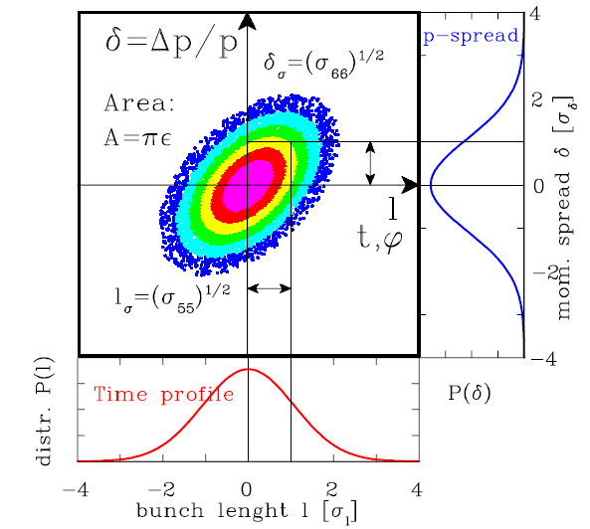
Measurement of longitudinal Parameters
The longitudinal dynamics is described by the longitudinal emittance as given by:
Spread of the bunches l
in time, length or rf-phase.
Momentum spread δ = Δp/p,
or energy spread ΔW/W
A = ε
The normalized value is preserved:

Slide 4
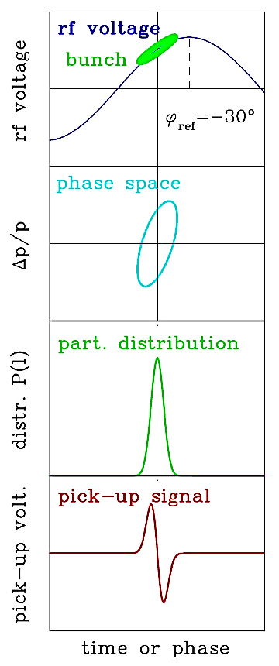
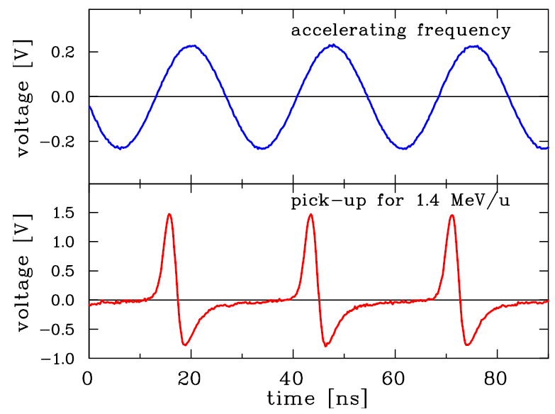
The Bunch Position measured by a Pick-Up
The bunch position is given relative to the accelerating rf.
e.g. φ_{ref}=-30º inside a rf cavity
must be well aligned for optimal acceleration
Transverse correspondence: Beam position
Example: Pick-up signal for f_{rf} =36 MHz rf at GSI-LINAC:
source
ADC
acc. f_{rf}
RFQ
LINAC
BPM
pick-up

Slide 5
Outline:
Definition of longitudinal phase space
Proton LINAC: Determination of mean energy
used for alignment of cavities phase and amplitude
Determination of longitudinal emittance
Bunch length measurement for non-relativistic beams
Bunch length measurement for relativistic beams
Bunch length from beam deflection by rf cavity
Summary

Slide 6
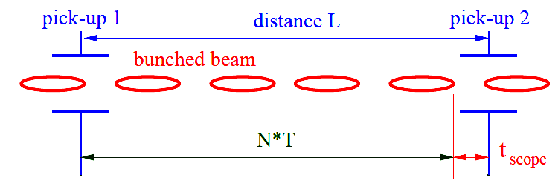
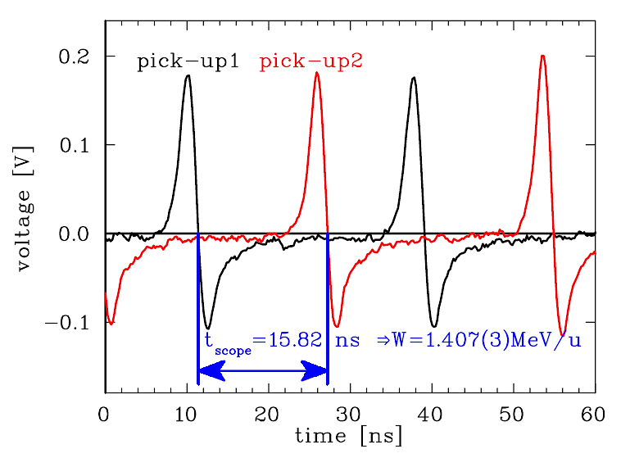
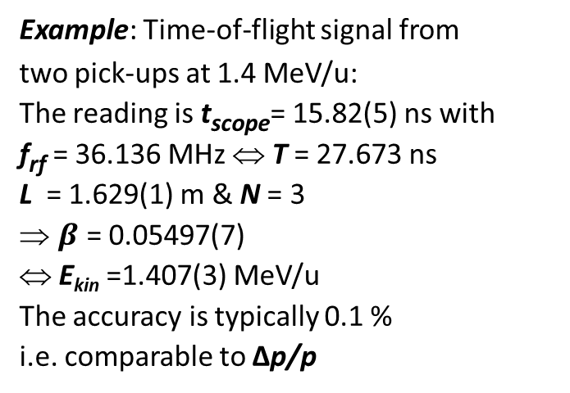
Determination of non-relativistic mean Energy using Pick-Ups
The energy delivered by a LINAC is sensitive to the mechanics, rf-phase and amplitude.
For non-relativistic energies
at proton LINACs time-of-flight (ToF)
with two pick-ups is used:
→ the velocity β is measured.
Example: Time-of-flight signal from
two pick-ups at 1.4 MeV/u:
The reading is t_{scope}= 15.82(5) ns with
f_{rf} = 36.136 MHz ⇔ T = 27.673 ns
L = 1.629(1) m & N = 3
$β$ = 0.05497(7)
⇔ E_{kin} =1.407(3) MeV/u
The accuracy is typically 0.1 %
i.e. comparable to Δp/p
source
ADC
L
RFQ
LINAC
BPM
BPM
pick-up 1
pick-up 2

Slide 7
Precision of TOF Measurement for non-relativistic Energy
The precision of TOF is given by the accuracy in time and distance reading:
Accuracy of scope reading Δt ≈100 ps, uncertainty in distance ΔL ≈ 1 mm.
Example: GSI-LINAC: L = 3.25 m and f_{rf} = 36 MHz:
Location (LINAC module name) | unit | RFQ | IH1 | IH2 | AL4
Output energy W | MeV/u | 0.12 | 0.75 | 1.4 | 11.4
Velocity β | % | 1.6 | 4.0 | 5.5 | 15.5
Total time-of-flight t_{ToF} | ns | 677 | 271 | 197 | 70
Bunch spacing β c/f_{rf} | cm | 13 | 33 | 45 | 129
Resolution ΔE/E | % | 0.07 | 0.10 | 0.12 | 0.22
The accuracy is typically 0.1 % (same order of magnitude as beam’s Δp/p)
The length has to be matched to the velocity
Due to the distance of ≈ 3 m, different solutions for the # of bunches N are possible
→ A third pick-up has to be installed closed by, to get an unique solution.

Slide 8
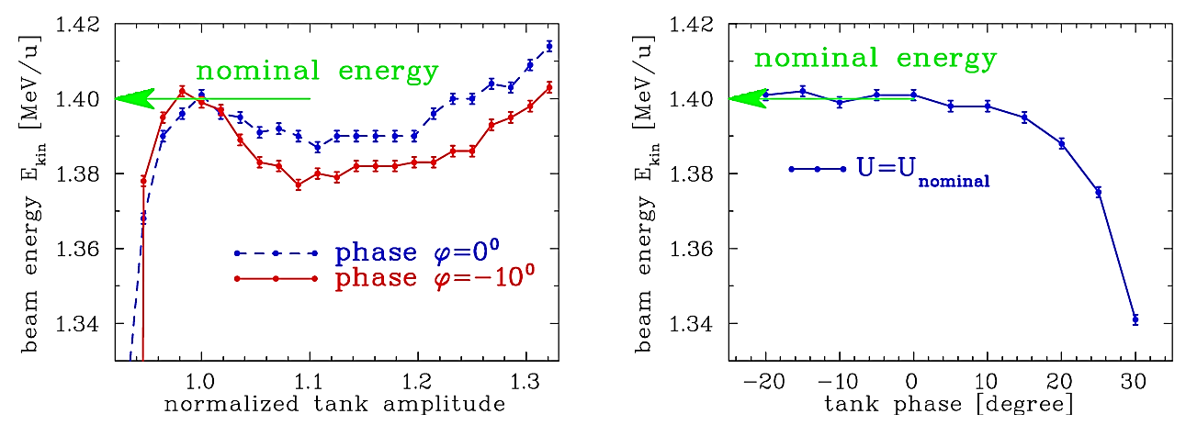
Cavity Alignment using a TOF Measurement
The mean energy is important for the matching between LINAC module.
It depends on phase and amplitude of the rf wave inside the cavities.
Example: Energy at GSI LINAC (nominal energy 1.400 MeV/u):
(distance between pick-ups: L = 1.97 m ⇒ N = 4 bunches)
Proton LINACs: Amplitude and phase should be carefully aligned by precise TOF
Electron LINACs: Due to relativistic velocity, TOF is not applicable.

Slide 9

Poll concerning longitudinal Phase Space and ToF
Poll 6.1:
Compare the longitudinal to the transverse phase space:
The relative momentum spread Δp/p₀ corresponds to the transverse …
beam centre
beam width
beam divergence
beam emittance
Poll 6.2:
The mean energy can be measured via…
two BPMs for relativistic beams only
two BPMs for non-relativistic beams only
two SEM-Grids and the know dispersion
Poll 6.3:
What is correct for a proton facility comprising of several LINAC cavities? ToF measurement are used to align …
the beam position
the quadrupole settings
all cavity amplitudes
only the last cavity amplitude to reach the correct final energy
www.menti.com
code: 1208 6026
Notes:
9

Slide 10
Outline:
Definition of longitudinal phase space
Proton LINAC: Determination of mean energy
used for alignment of cavities phase and amplitude
Determination of longitudinal emittance
LINAC: variation of bunch length
Synchrotron: Topographic reconstruction
Bunch length measurement for non-relativistic beams
Bunch length measurement for relativistic beams
Bunch length from beam deflection by rf cavity
Summary

Slide 11
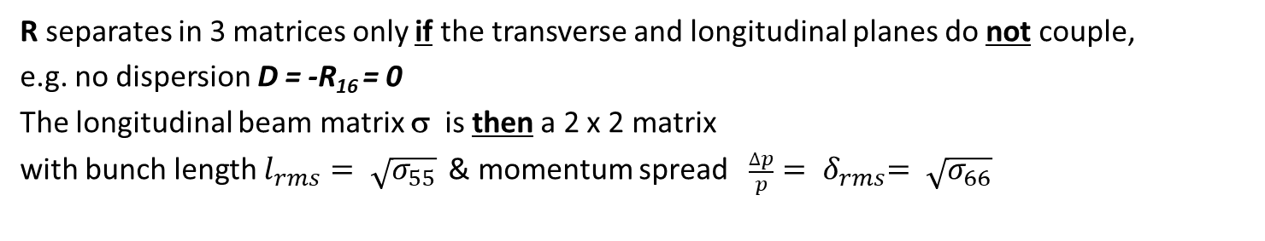
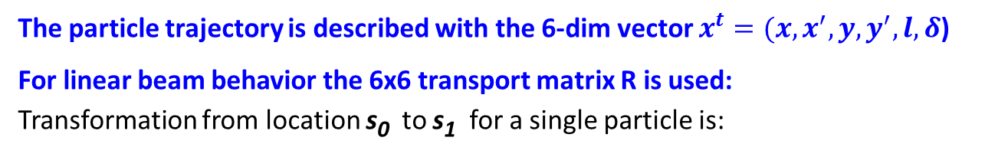
6-dim Phase Space for Accelerators
The particle trajectory is described with the 6-dim vector $x^{t}=(x,x^{′},y, y^{′}, l, δ$)
For linear beam behavior the 6x6 transport matrix R is used:
Transformation from location s₀ to s₁ for a single particle is:
Envelope i.e. emittance
defined by beam matrix:
= 0
σ( s₁ ) = R · σ( s₀ ) · R^{T}
=0
= 0
=0
R separates in 3 matrices only if the transverse and longitudinal planes do not couple,
e.g. no dispersion D = -R₁₆ = 0
The longitudinal beam matrix σ is then a 2 x 2 matrix
with bunch length $l_{rms}= \sqrt{σ_{55}}$ & momentum spread ${ \frac{∆p}{p}= δ}_{rms}= \sqrt{σ_{66}}$

Slide 12
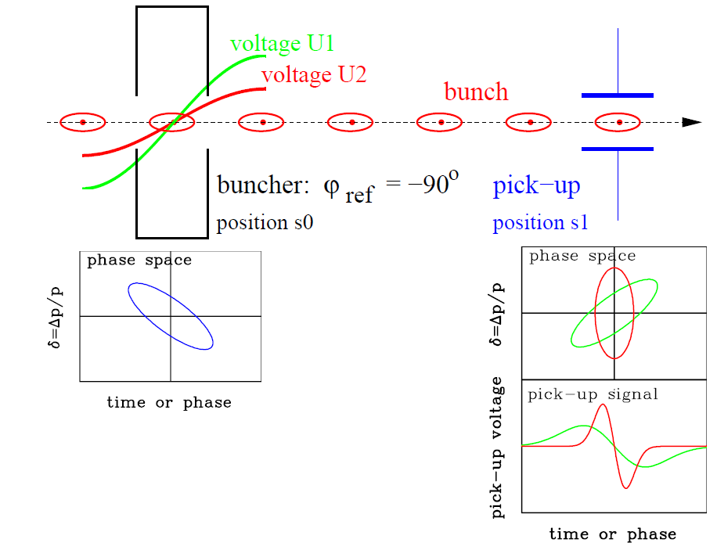
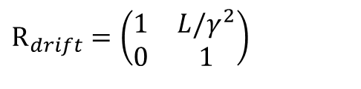

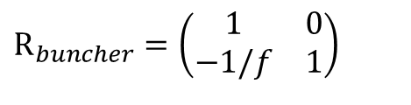
Longitudinal Emittance by linear Transformation using a Buncher
Longitudinal focusing:
Variation of the bunch shape by a rf-buncher
→ components 5 and 6 from 6-dim phase-space
Transversal correspondence:
Quadrupole variation
➢ Transfer matrix of buncher & drift:
$$R_{buncher}=\left(\begin{matrix}1 & 0 \\ −1/f & 1\end{matrix}\right)$$
$${\text{R}}_{drift}=\left(\begin{matrix}1 & L/γ^{2} \\ 0 & 1\end{matrix}\right)$$
with focal length $\frac{1}{f}=\frac{2πf_{rf}}{Apv^{2}}⋅U$:
➢ Variation of buncher amplitude U
⇒ different bunch width at pick-up location

Slide 13
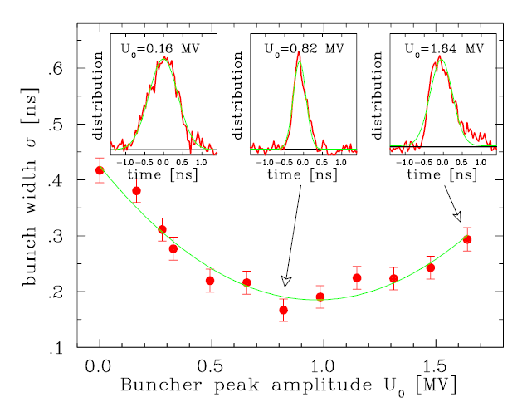
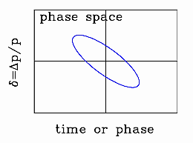
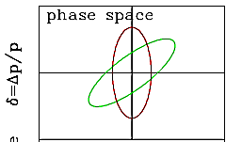

Result of a longitudinal Emittance Measurement
Example GSI LINAC: Voltage variation at buncher for 11.4 MeV/u Ni¹⁴⁺ beam, 31 m drift:
The structure of short bunches can
be determined with special monitor
This example: The resolution is better
than 50 ps or 2º for 108 MHz
Typical bunch length at proton LINACs:
σ_{bunch} ≈ 10 to 300 ps
Determination of longitudinal emittance possible
Application for synchrotron injection:
Shaping of longitudinal phase space by buncher
i.e. long bunches ⇔ low momentum spread
to match to the synchrotron long acceptance
multi-turn
injection
p synchrotron
de-bunched
source
Bunch Shape Monitor
Buncher
RFQ
LINAC
B.
BSM
injection
extraction

Slide 14
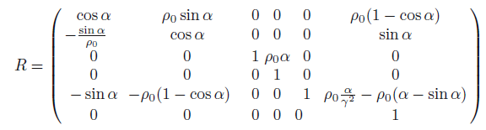

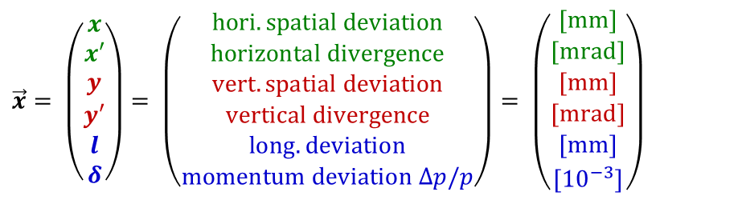
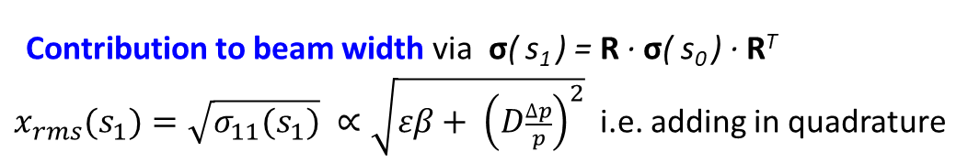
Recap: Transfer Matrix of a Sector Dipole Magnet
Horizontal sector dipole magnet (i.e. edge rectangular to reference orbit)
Basis vector
for trajectory:
$$\vec{x}= \left(\begin{matrix}x \\ x′ \\ y \\ y′ \\ l \\ δ\end{matrix}\right)= \left(\begin{matrix}hori. spatial deviation \\ horizontal divergence \\ vert.spatial deviation \\ vertical divergence \\ long. deviation \\ momentum deviation ∆p/p\end{matrix}\right)= \left(\begin{matrix}[mm] \\ [mrad] \\ [mm] \\ [mrad] \\ [mm] \\ {[10}^{−3}]\end{matrix}\right)$$
x
s
Transformation of trajectory: $\vec{x}\left(s_{1}\right)=R∙\vec{x}(s_{0})$
Dispersion D
ρ₀
Transfer
matrix of a sector
dipole:
α
Contribution to beam width via σ( s₁ ) = R · σ( s₀ ) · R^{T}
$x_{rms}(s_{1})=\sqrt{σ_{11}(s_{1})} ∝\sqrt{εβ+ {\left(D\frac{∆p}{p}\right)}^{2}}$ i.e. adding in quadrature
Result: Fast particle → less bending & slower particle → more bending
Coupling x and δ due to R₁₆ ≠ 0 ⇒ can be used as spectrometer

Slide 15
Measurement of Energy Spread by magnetic Spectrometer
Transfer line: The mom. spread δ = Δp/p can be determined by a magnetic spectrometer:
via dispersion, the momentum is shifted to a spatial distance.
An appropriate optic must b e chosen
to separate the transverse and
longitudinal parameters
source
SEM-Grid
dipole
RFQ
LINAC

Slide 16
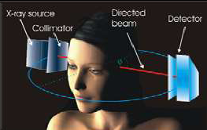
Longitudinal Emittance using tomographic Reconstruction
Tomography is medical image method
Tomography:
2-dim reconstruction of
sufficient 1-dim projections
1st back-
projection
original object
Iterative projection
& back-projection
after sufficient
iterations
Algebraic back projection:
Iterative process by redistributing
the 2-dim image and considering the
differences to the previous iteration step.

Slide 17
Longitudinal Emittance using tomographic Reconstruction
Tomography is medical image method
Tomography:
2-dim reconstruction of
sufficient 1-dim projections
1st back-
projection
original object
Application at accelerators:
Longitudinal emittance
evolution in synchrotrons.
Bunch observation:
Each revolution,
the bunch shape changes a bit
due to synchrotron oscillations.
Fulfilled condition: f_{synch} << f_{rev} .
Iterative projection
& back-projection
after sufficient
iterations
Algebraic back projection:
Iterative process by redistributing
the 2-dim image and considering the
differences to the previous iteration step.

Slide 18
Results of tomographic Reconstruction at a Synchrotron I
Bunches from 500 turns at the CERN PS and the phase space for the first time slice,
measured with a wall current monitor:
Typical bucket filling. Important knowledge for bunch ’gymnastics’.

Slide 19
Results of tomographic Reconstruction at a Synchrotron II
Bunches from 500 turns at the CERN PS and the phase space for the first time slice,
measured with a wall current monitor:
Mismatched bunch shown oscillations and filamentation due to ‘bunch-rotation’.

Slide 20
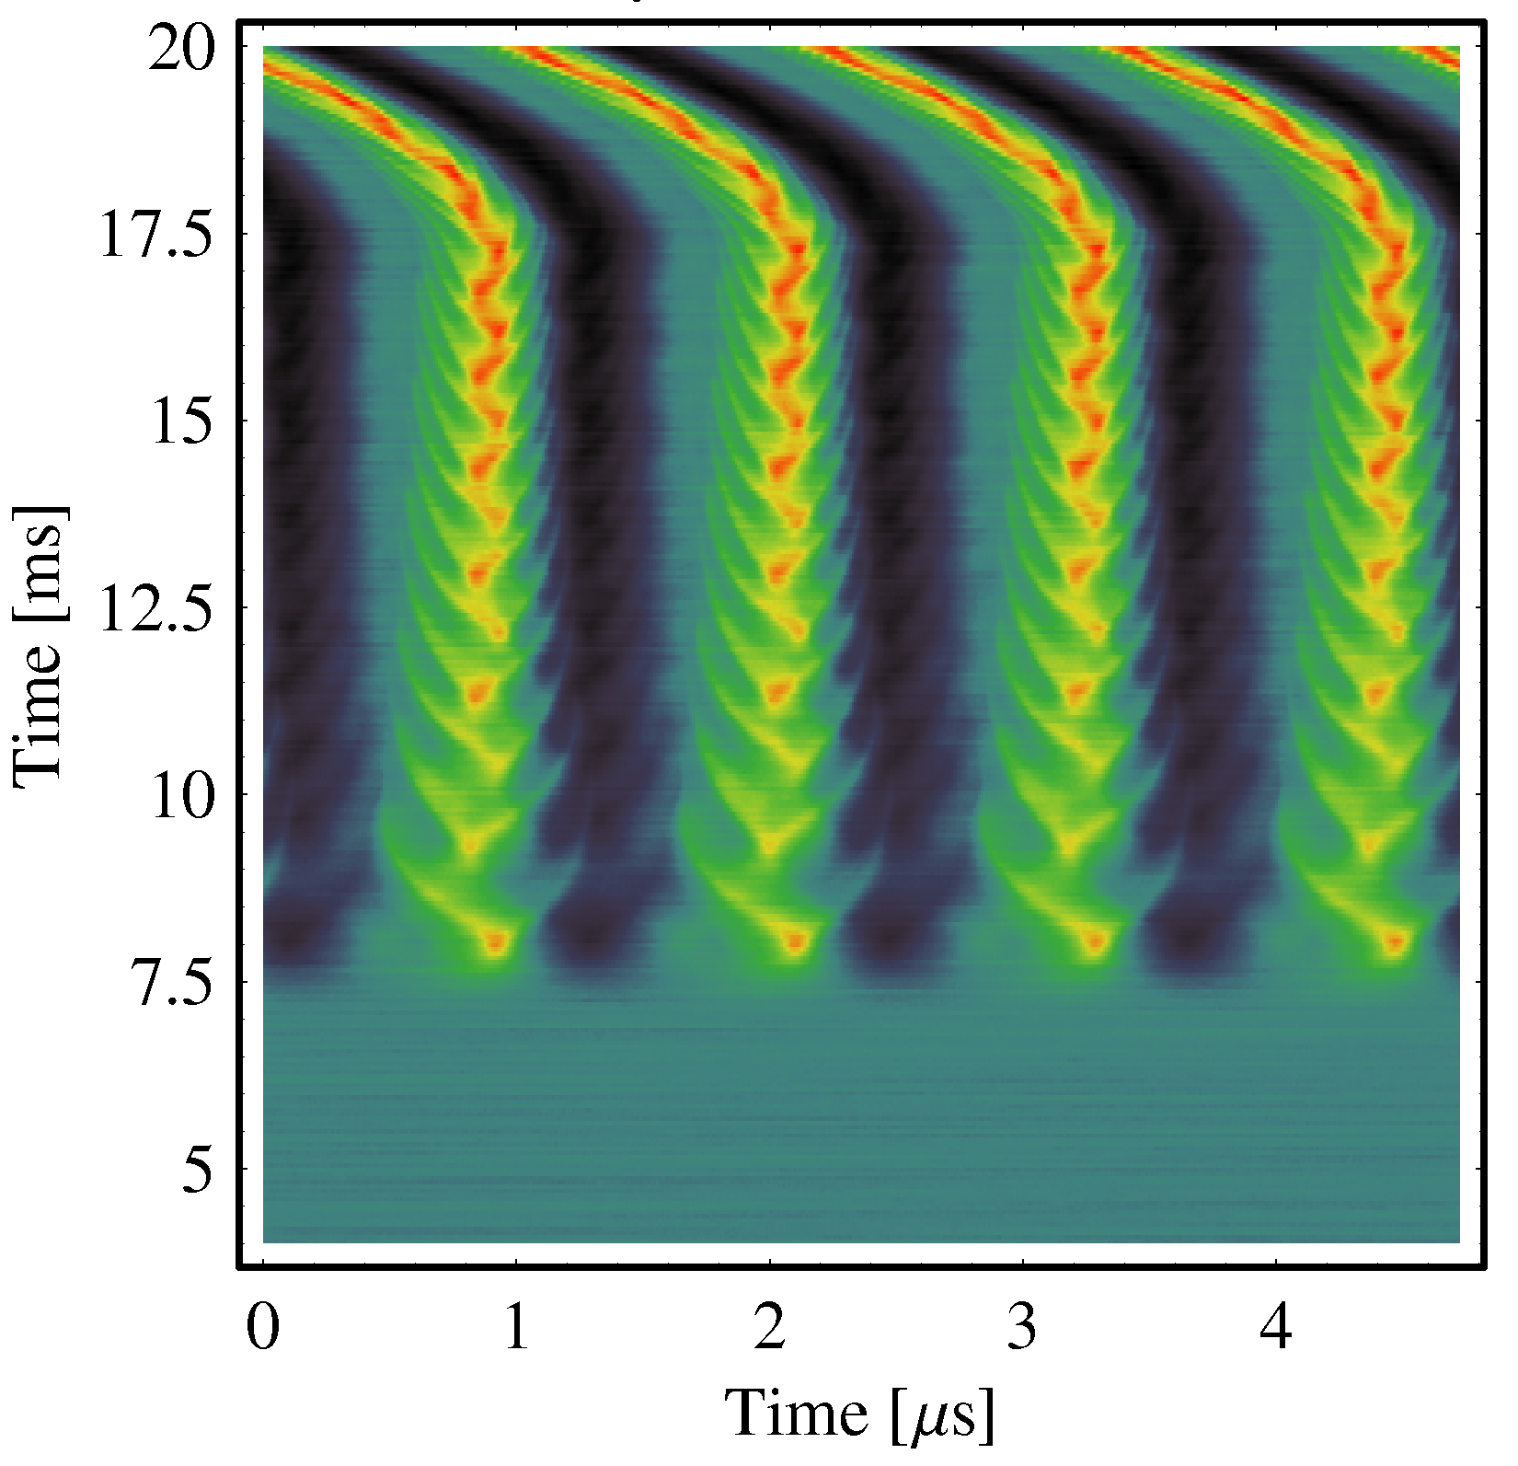
Poll concerning longitudinal Mismatch, long. Emittance
Poll 6.4:
Assume a LINAC facility.
The bunch length variation by a buncher followed by a bunch shape measurement corresponds to an transverse emittance measurement of type
Quadrupole variation
Three grid method
Slit-grid method
www.menti.com
code: 1208 6026
Poll 6.5:
Assume an injection from a proton LINAC to a synchrotron.
What happens if injection energy is not correct?
(i.e. the particles’ revolution frequency differs from the acc. frequency)
The particles perform coherent synchrotron oscillations
The particles perform incoherent synchrotron oscillations
The tune is changed significantly
Nothing, as long as the particles stay within the longitudinal acceptance
f_{acc} shift by 0.2% of nominal value
⇒ Coherent longi. oscillation
→ Streak camera
Notes:
20

Slide 21
Outline:
Definition of longitudinal phase space
Proton LINAC: Determination of mean energy
used for alignment of cavities phase and amplitude
Determination of longitudinal emittance
LINAC: variation of bunch length
Synchrotron: Topographic reconstruction
Bunch length measurement for non-relativistic beams
Determination of particle arrival
Bunch length measurement for relativistic beams
Bunch length from beam deflection by rf cavity
Summary

Slide 22
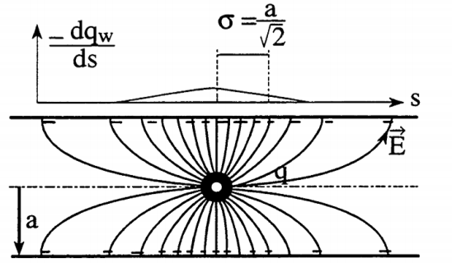
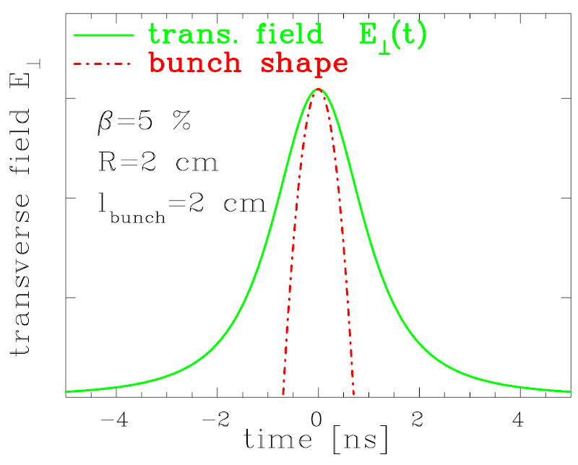
Bunch Structure at low E_{kin}: Not possible with Pick-Ups
Pick-ups are used for:
precise for bunch-center relative to rf
course image of bunch shape
But:
For β << 1 → long. E-field significantly modified:
Example: Comparison pick-up – particle counter:
Ar beam of 1.4 MeV/u (β = 5.5%) , f_{rf} = 108 MHz
σ ≈ R / γ
R
ampl.
1/ f_{rf} = 9.2 ns
⇒ the pick-up signal is insensitive
to bunch ’fine-structure’

Slide 23
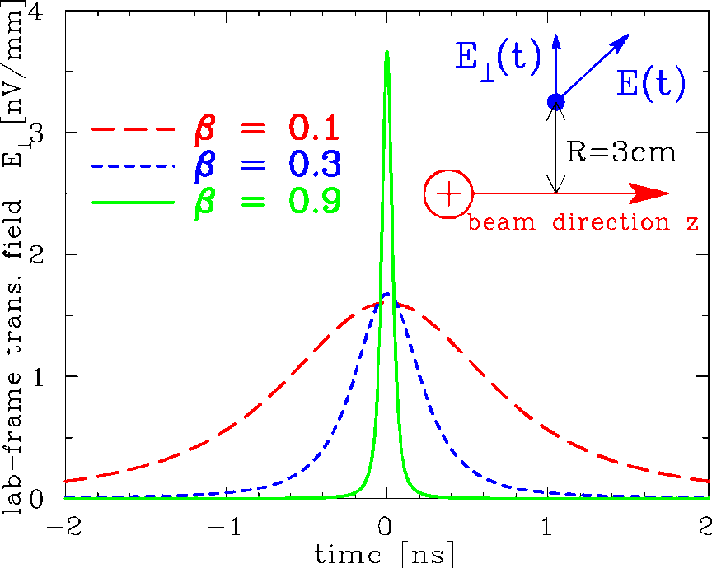
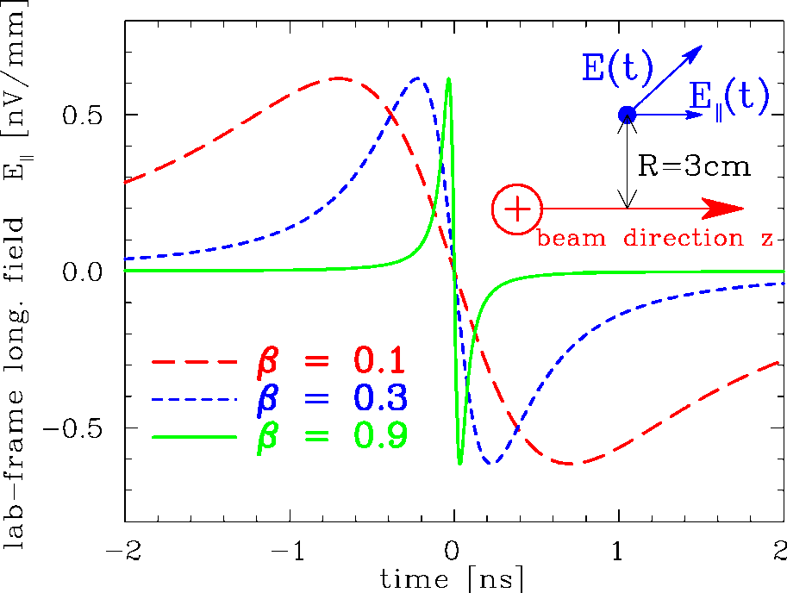
Low Velocity Effect: General Consideration
Lorentz transformation of single point-like charge:
Lorentz boost and transformation of time:
Trans. E⊥lab.-frame of a point charge:
Long. E|| lab.-frame of a point charge:

Slide 24
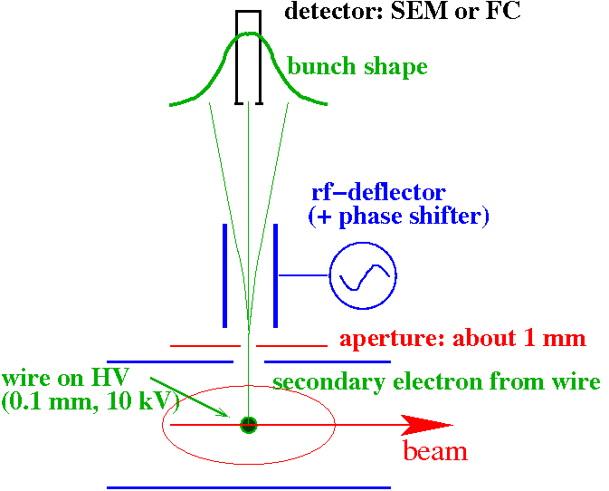
Bunch Structure using secondary Electrons for low E_{kin} Protons
Secondary e⁻ liberated from a wire carrying the time information.
→ Bunch Shape Monitor (BSM)
Working principle:
insertion of a 0.1 mm wire at ≈ 10 kV
emission of secondary e⁻ within less than 10 ps
secondary e⁻ are accelerated
toward an rf-deflector
rf-deflector as ’time-to-space’ converter
detector with a thin slit
slow shift of the phase
resolution ≈ 10 ps ≈ 1º @ 280 MHz
Measurements are comparable
to that obtained with particle detectors.
SEM: secondary electron multiplier

Slide 25
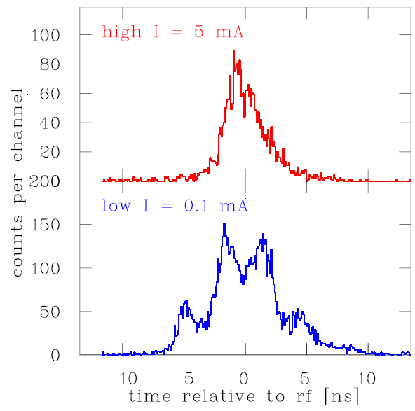
Realization of Bunch Shape Monitor at CERN LINAC2
Example: The bunch shape behind RFQ with120 keV/u:
rf-deflector
movable
HV wire
electron detector
electrons
ion beam
Flange Ø 150 mm

Slide 26
Outline:
Definition of longitudinal phase space
Proton LINAC: Determination of mean energy
used for alignment of cavities phase and amplitude
Determination of longitudinal emittance
LINAC: variation of bunch length
Synchrotron: Topographic reconstruction
Bunch length measurement for non-relativistic beams
Determination of particle arrival
Bunch length measurement for relativistic beams
Synchrotron light monitor and electro-optical modulation of a laser beam
Bunch length from beam deflection by rf cavity
Summary

Slide 27
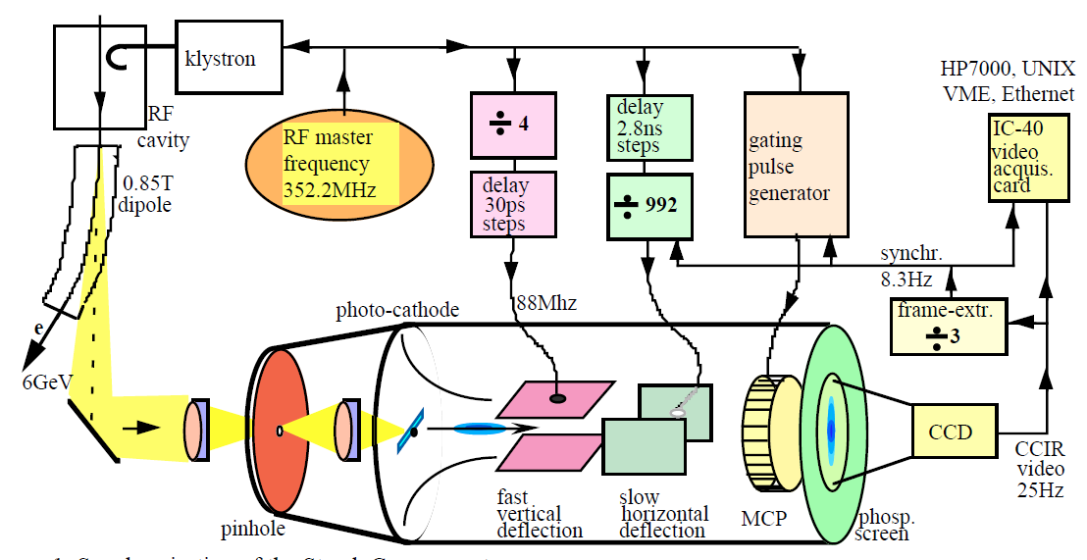
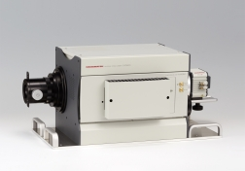
Bunch Length Measurement for relativistic Electrons
Electron bunches are too short (σ_{t} < 100 ps) to be covered by the bandwidth of
pick-ups (f < 3 GHz ⇔ t_{rise} > 100 ps) for structure determination.
→ Time resolved observation of synchr. light with a streak camera: Resolution ≈ 1 ps.
Scheme of a streak camera
Streak camera
e⁻ synchrotron
acc.
freq. f_{rf}
rf cavity
injection
extraction
Streak tube
CMOS
camera
Input optics
≈ 60 cm

Slide 28
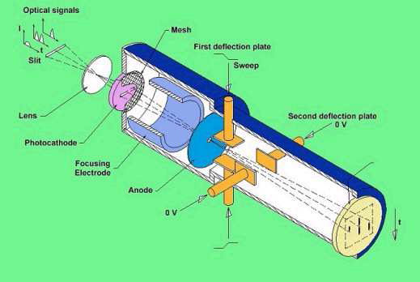
Technical Realization of a Streak Camera
acceleration
focusing
deflection
Hardware of a streak camera
Time resolution down to 0.5 ps
≈ 30 cm
Streak tube
CMOS
camera
Input optics
≈ 60 cm

Slide 29
Results of Bunch Length Measurement by a Streak Camera
The streak camera delivers a fast scan in vertical direction (here 360 ps full scale)
and a slower scan in horizontal direction (24 μs).
Example: Bunch length at the synchrotron light source SOLEIL for U_{rf} = 2 MV
for slow direction 24 μs and scaling for fast scan 360 ps: measure σ_{t} = 35 ps.
Slow Scan:
bunch length
2σ_{t} = 70 ps
Fast Scan:
Streak camera
e⁻ synchrotron
acc.
freq. f_{rf}
rf cavity
injection
extraction
Courtesy of M. Labat et al., DIPAC’07
→ conclusion

Slide 30
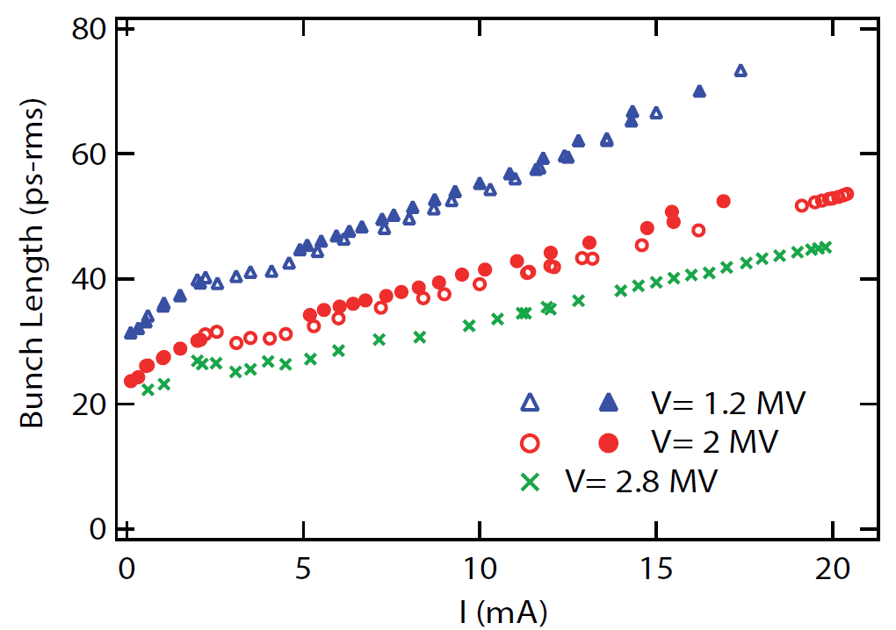
The Importance of Bunch Length by Streak Camera
Short bunches are desired by the synchrotron light users for time resolved spectroscopy.
The bunch focusing is changed by the rf-amplitude.
Example: Bunch length σ_{t} as a function of stored current
(space-charge de-focusing, impedance broadening) for different rf-amplitudes at SOLEIL:
Streak camera
e⁻ synchrotron
acc.
freq. f_{rf}
rf cavity
injection
extraction

Slide 31
The Artist View of a Streak Camera
→ conclusion

Slide 32
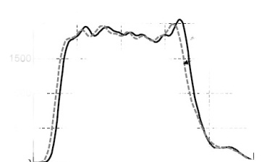
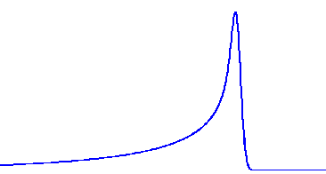
Excurse: LINACs for Free Electron Lasers
4th Generation Light Sources: LINAC based, single pass with large energy loss
E_{electron} ≈ 1 … 18 GeV, coherent light from undulator, E_{γ} < 1000 keV, temporally short pulse
f_{acc} = 1.3 GHz
Flash, Hamburg
I
100ms
Duty cycle ~ XFEL 0.65%
1-5 mA
Goal: Short bunches with high number of particles
short, intense laser pulses for electron generation
Requirement: Position stability ⇒ resolution < 1 µm
t
I
XFEL 600μs
Single bunch duration < 1 ps
Macro-pulse duration
I
2.5kA
1 nC
t
100-500 fs
I
XFEL
222ns bunch spacing
t
t
For comparison: time t_{bunch} = 100 fs ⇔ length l_{bunch} = 30 µm

Slide 33
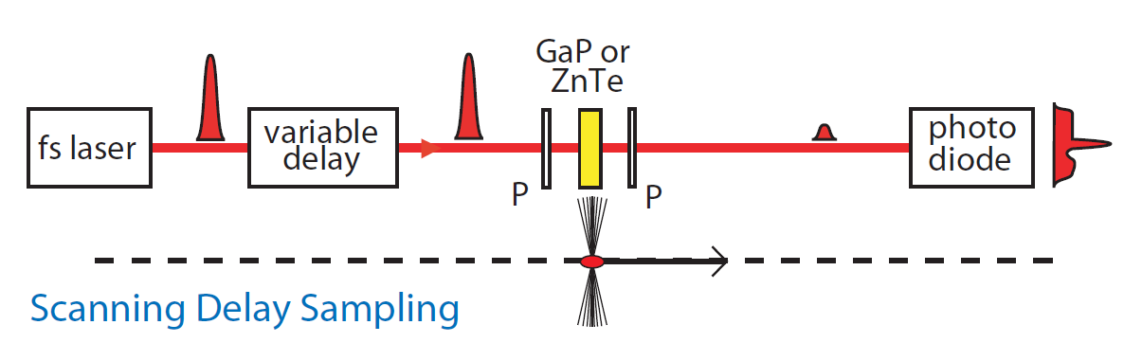
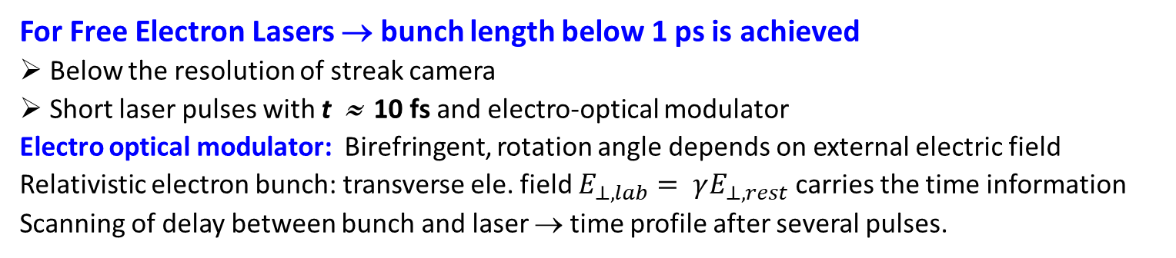
Bunch Length Measurement by electro-optical Method
For Free Electron Lasers → bunch length below 1 ps is achieved
Below the resolution of streak camera
Short laser pulses with t ≈ 10 fs and electro-optical modulator
Electro optical modulator: Birefringent, rotation angle depends on external electric field
Relativistic electron bunch: transverse ele. field $E_{⊥, lab}= γE_{⊥, rest}$ carries the time information
Scanning of delay between bunch and laser → time profile after several pulses.
Bunch compressor
EO monitor
LINAC
LINAC
Undulator
Courtesy S.P.Jamison et al., EPAC 2006

Slide 34
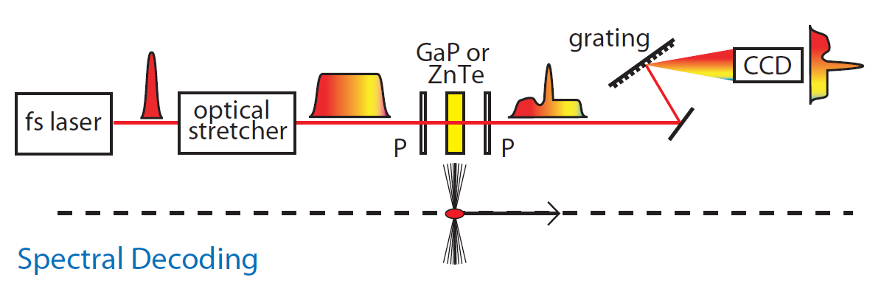
Bunch Length Measurement by electro-optical Method
For Free Electron Lasers → bunch length below 1 ps is achieved
Short laser pulse ⇔ broad frequency spectrum (property of Fourier Transformation)
Optical stretcher: Separation of colors by different path length
⇒ different colors at different time ⇒ single-shot observation
Bunch compressor
EO monitor
LINAC
LINAC
Undulator
Courtesy S.P.Jamison et al., EPAC 2006

Slide 35
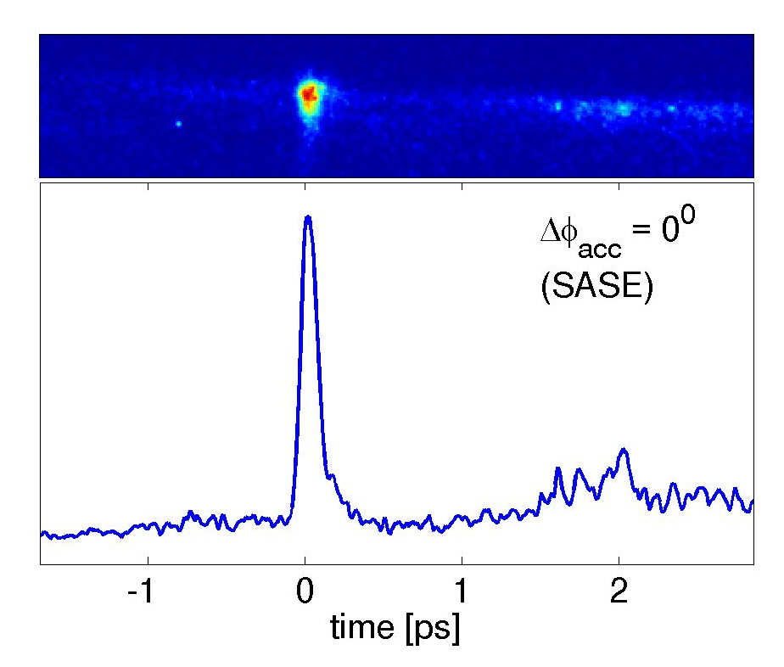
Hardware of a spectral-decoded EOSD Scanning Setup
Laser: Commercial Ti:Sa or Yb-fibre,
10 fs duration, near IR,
Crystal: GaP or ZnTe, 100 µm thickness
Example: Bunch length at FLASH
100 fs bunch duration = 30 µm length!
S. Funkner et al., arXiv1912.01323 (2019)
vacuum flange
crystal
2σ = 110 fs
beam
B. Steffen et al, DIPAC 2009
B. Steffen et al., Phys. Rev. AB 12, 032802 (2009)
→ conclusion

Slide 36
Poll concerning Electron Beam Bunch Length Measurement
Poll 6.6:
Optical synchrotron light is emitted from …
electrons only
electron everywhere along their path
highly relativistic neutral particles if the Lorentz factor is larger than 1000
any charged particles on a curved trajectory
Poll 6.7:
A question related to a typical bunch length at circular synchrotron light sources with f_{rf}=500 MHz: What is the time resolution of a typical streak camera?
1 fs
1 ps
1 ns
www.menti.com
code: 1208 6026
Poll 6.8:
The short bunches with 100 fs length at FEL-facilities are measured with electro-optical methods. Could the same method be applied for 10 MeV proton beams with a bunch length of 100 ps?
Yes, assuming the number of particle per bunch is sufficient
Yes, but the method is very cumbersome and more simple method are available
No, protons at that energy don’t emit synchrotron light in the optical range
No, the transverse electric field does not represent the particle distribution
→ conclusion
Notes:
36

Slide 37
Summary of longitudinal Measurements
Longitudinal ↔ transverse correspondences:
position relative to rf ↔ transverse center-of-mass
bunch structure in time ↔ transverse profile in space
momentum or energy spread ↔ transverse divergence.
Determination uses:
Broadband pick-ups: ➢ position relative to rf, mean energy
➢ emittance at transfer lines or synchrotron via tomography
assumption: bunches longer than pick-up.
Particle detectors: ➢ TOF or secondary e⁻ from wire
→ for non-relativistic proton beams
reason: E-field does not reflect bunch shape.
Streak cameras: ➢ time resolved monitoring of synchrotron radiation
→ for relativistic e⁻-beams, t_{bunch} < 1 ns
reason: too short bunches for rf electronics.
Laser scanning: ➢ Electro-optical modulation of short laser pulse
→ very high time resolution
Beam deflection: ➢ Transverse deflection of primary beam
→ very high time resolution, but most expensive ‘device’.

Slide 38
Backup slides

Slide 39
Bunch Length Measurement for relativistic Electrons
Electron bunches are too short (σ_{t} < 300 ps) to be covered by the bandwidth of
pick-ups (f < 1 GHz ⇔ t_{rise} >300 ps) for structure determination.
→ Time resolved observation of synchr. light with a streak camera: Resolution ≈ 1 ps.
Streak camera
e⁻ synchrotron
acc.
freq. f_{rf}
rf cavity
injection
extraction
From D. Xiang, IPAC’12

Slide 40
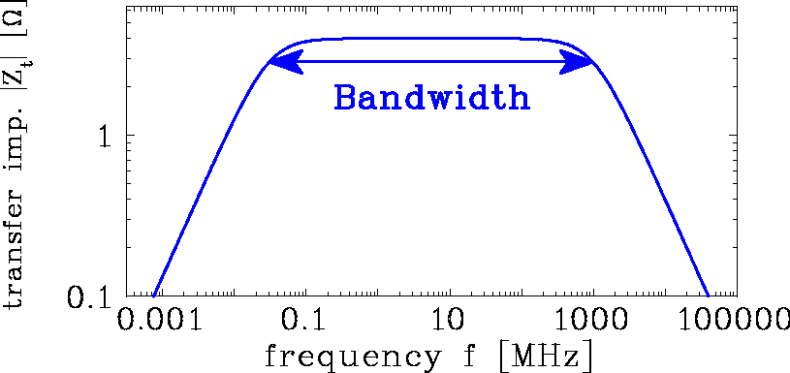
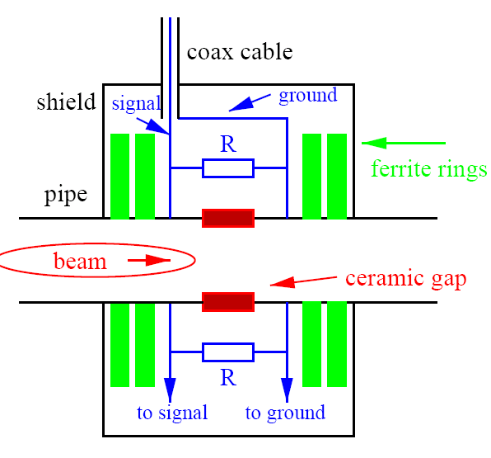
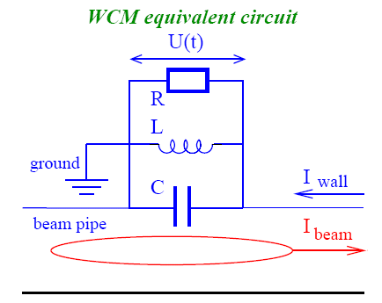
Resistive Wall Current Monitor
Broadband observation of bunches can be performed with a resistive Wall Current Monitor
Principle: ➢ Ceramic gap bridged with n =10…100 resistors of R = 10…100 Ω
➢ Measurement of voltage drop for R_{tot}= R/n = 1…10 Ω
➢ Ferrite rings with high L → forces low frequency components through resistors
Bandwidth: typically f_{low}=R_{tot}/(2πL) ≈ 10 kHz
f_{high}=1/(2πR_{tot}C) ≈ 1 GHz
Application: Broadband bunch observation.
f_{low}
f_{high}
Within bandwidth:

Slide 41
Resistive Wall Current Monitor
Example: Realization at Fermi-Laboratory
ferrite Rings
Gap with Resistors
beam
Gap with Resistors

Slide 42
Bunch observation by Streak Camera
Longitudinal mismatched injection lead to coherent synchrotron oscillations,
coupled bunch motion and bunch shape oscillations
Example: Bunch shape oscillations at Elettra, Trieste:
From M. Ferianis, CAS’07

Slide 43
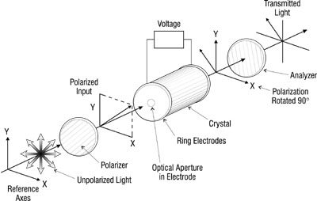
Pockels Effect
Crystal with different index of refractivity on orthogonal planes
Bire-fringent
external electric field changes the phase between orthogonal wave:
‘Pockels effect’ with polarization P = ε₀ χ E
Diagnostics method:
Probing bunch’s electric field by
polarized laser beam
.

Slide 44
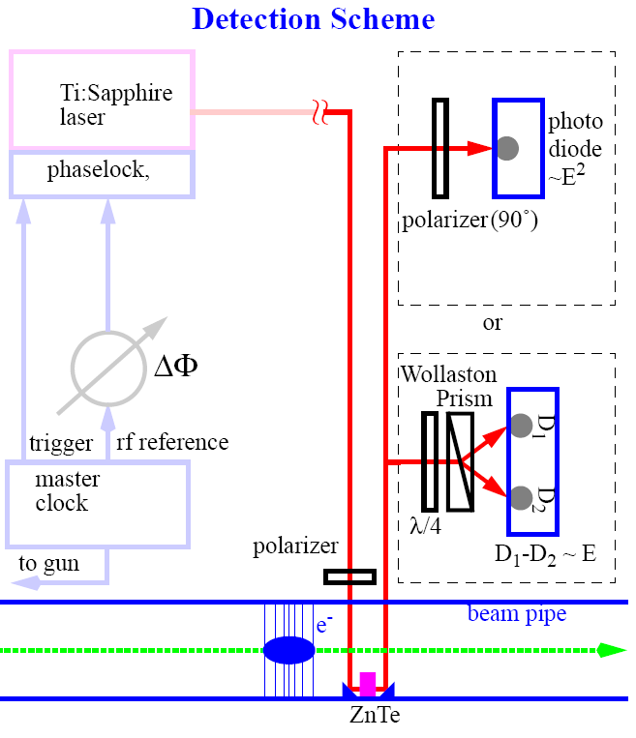
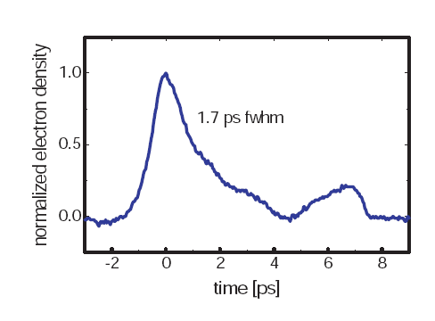
Realization of EOS Scanning
Setup of a scanning EOS method.
Delay line
Using 12fs pulses from
Ti:A_{l2}O₃ laser at 800nm and
ZnTe crystal 0.5mm thick
with a e⁻ - beam 46MeV of 200pC
X. Yan et al, Phys. Rev. Lett. 85, 3404 (2000)

Slide 45
Outline:
Definition of longitudinal phase space
Proton LINAC: Determination of mean energy
used for alignment of cavities phase and amplitude
Determination of longitudinal emittance
LINAC: variation of bunch length
Synchrotron: Topographic reconstruction
Bunch length measurement for non-relativistic beams
Determination of particle arrival
Bunch length measurement for relativistic beams
Synchrotron light monitor and electro-optical modulation of a laser beam
Bunch length from beam deflection by rf cavity
Summary

Slide 46
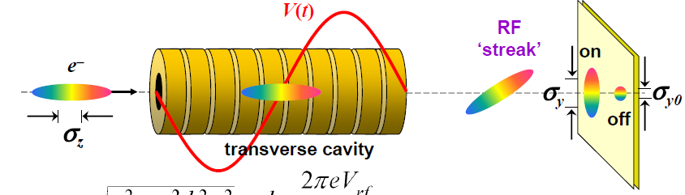
Bunch Length by rf-Deflection: Principle
Transversal deflection of the bunch i.e. time-to-space conversion
Size of the streak given by
k is determined by the rf-power
From D. Xiang, IPAC’12

Slide 47
Bunch Length by rf-Deflection: Hardware
Transversal deflection of the bunch
i.e. time-to-space conversion
Beam energy 320 MeV
Typical beam size 0.2 mm
Length 0.5 m
Frequency 2.998 GHz
Max. rf power 5 MW
Total trans. volt. 4.9 MV
Time resolution 70 fs
Example: Cavity at FERMI, Trieste, Italy
From M. Veronese, BIW’12
→ conclusion

Slide 48
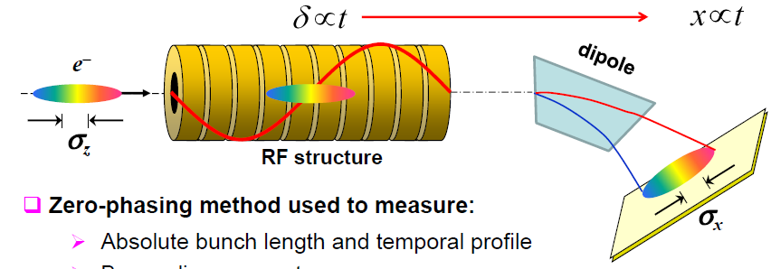
Bunch Length by rf-Deflection: Results
Example: Short bunch generation at Free Electron Laser Facility LCLS, Stanford, USA
Time resolution down to (true) fs range!
Vertical deflection with cavity → time spectum
Horizontal bending
energy (momentum) distribution via dispersion
⇒ Longitudinal phase space determined!
From D. Xiang, PRST-AB, 13, 094001 (2010)

Slide 49
Broadband coaxial Faraday Cups for Bunch Structure
The bunch structure can be observed with cups, having a bandwidth up to several GHz.
Bandwidth and rise time: BW [GHz] = 0.3/t_{rise}[ns]
Impedance of a
coaxial transmission line:
→ impedance matching to prevent
for reflections
Voltage reflection:
Voltage Standing Wave Ratio:
Z = Z₀: no reflection. Z = 0 ⇒ ρ_{V} = −1: short circuit. Z = ∞ ⇒ ρ_{V} = 1: open circuit.

Slide 50
Realization of a Broadband coaxial Faraday Cup

Slide 51
Measurement of Energy Spread by magnetic Spectrometer
Transfer line: The mom. spread δ = Δp/p can be determined by a magnetic spectrometer:
via dispersion, the momentum is shifted to a spatial distance.
An appropriate optic must b e chosen
to separate the transverse and
longitudinal parameters
However, a synchrotron is a very high resolution spectrometer
Goal: Measurement of central momentum p₀
and momentum spread Δp / p₀
un-bunched beam → Schottky noise analysis
bunched beam: broadband FCT or BPM recording
coherent synchrotron oscillations, bunch shape
Schottky
multi-turn
injection
p synchrotron
de-bunched
source
SEM-Grid
dipole
injection
extraction
RFQ
LINAC

Slide 52
Bunch Length Measurement by electro-optical Method
FELs → bunch length below 1 ps is achieved, i.e. below the resolution of streak camera
Short laser pulses with t ≈ 10 fs and electro-optical modulator
Electro optical modulator: birefringent, rotation angle depends on external electric field
Relativistic electron bunches: transverse field E_{⊥ lab} = γ E_{⊥ rest} carries the time information.
Measurement by scanning
Short laser pulses t < 10 fs
and delay line
⇒ scanning method
Measurement spectral decoding
Short laser pulses t < 10 fs
has broad frequency spectrum
and delay line
⇒ single shot determination
Further methods used!
Bunch compressor
EO monitor
From S.P.Jamison et al., EPAC 2006
LINAC
LINAC
Undulator
→ conclusion

