Slide 1


Beam Loss Monitors
JUAS 2025, ESI-Archamps at CERN
Peter Forck (GSI and University Frankfurt)

Slide 2
Beam Loss Monitors
When energetic beam particles penetrates matter, secondary particles are emitted:
this can be e⁻, γ, protons, neutrons, excited nuclei, fragmented nuclei...
⇒ Spontaneous radiation and permanent activation is produced.
⇒ Large variety of Beam Loss Monitors (BLM) depending on the application.
Protection: Sensitive devices e.g. super-conducting magnets to prevent quenching (energy absorption by electronic stopping)
→ interlock signal for fast beam abortion.
Operation: Alignment of the beam to prevent for activation
→ optimal transmission to the target.
Accelerator physics:
→ sensitive detectors for accelerator development
Several loss monitors are used for various secondaries
Different count rate & time resolution
Some applications for usage

Slide 3
Basic Idea of Beam Loss Monitors
Basic idea for Beam Loss Monitors BLM:
A loss beam particle must collide with the vacuum chamber or other insertions
Interaction leads to some shower particle:
e⁻, γ, protons, neutrons, excited nuclei, fragmented nuclei
Detection of these secondaries by an appropriate detector outside of beam pipe
Relative cheap detector installed at many locations
Remark: Due to grazing angle a thin vacuum chamber might be a ‘thick target’
vacuum pipe
beam
lost beam particle
display
BLM detector
Secondary products:
Electromagnetic or hadronic shower products
Charged particles
Neutrons or γ
interlock
front-end
electronics
digitalization
& fast analysis

Slide 4
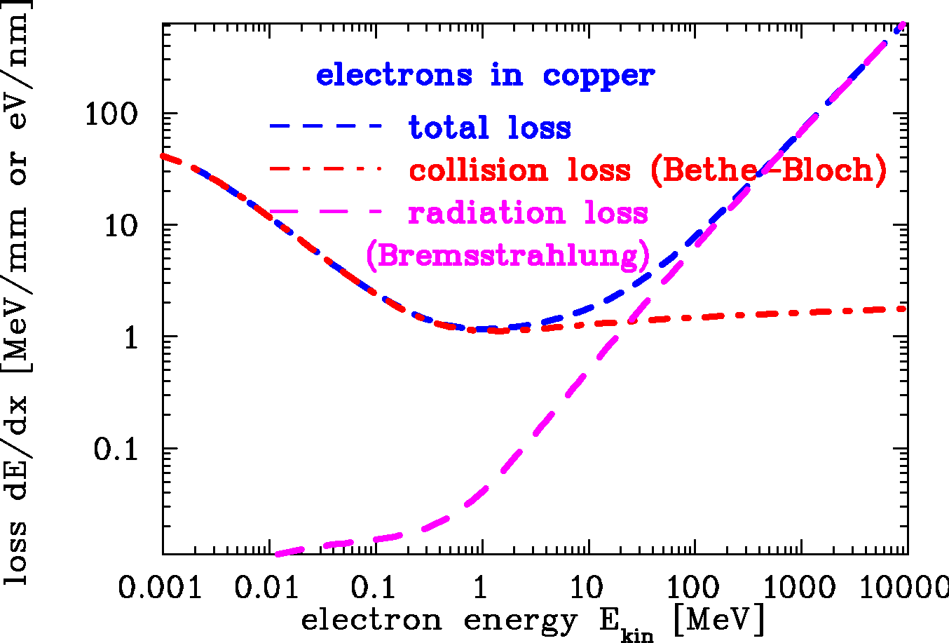
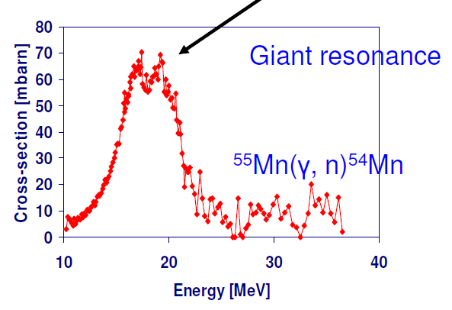
Secondary Particle Production for Electron Beams
Processes for interaction of electrons
For E_{kin} < 10 MeV:
⇒ only electronic stopping (x-rays, slow e⁻).
For E_{kin}> 100 MeV:
Bremsstrahlungs-photon dominated
⇒ γ → e⁺ + e⁻ or μ±...→ electro-magnetic shower
⇒ excitation of nuclear giant resonance E_{res}≈ 10 MeV
→ decay to neutrons via (γ, n), (γ, p) or (γ, np)
→ fast neutrons emitted
→ neutrons: Long ranges in matter
due to lack of ele.-mag. interaction.
LINAC
synch.
Bremsstrahlung
photon:
E_{γ} = E_{i} - E_{f}
Giant resonance
v_{i} , E_{i}
photon γ
fast n
electron
Cross-section [mb]
+
v_{f} , E_{f}
protons
neutrons
nucleus
collective vibration
Photon Energy [MeV]

Slide 5
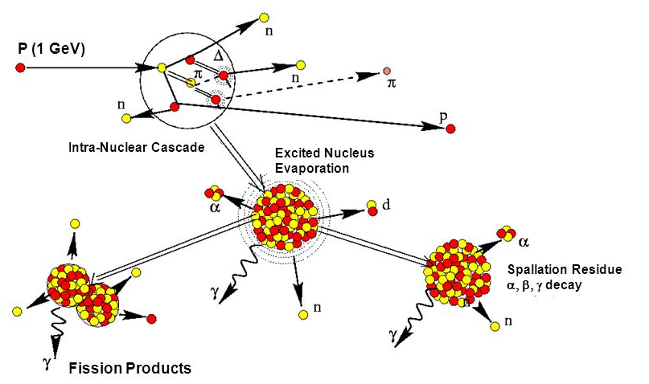
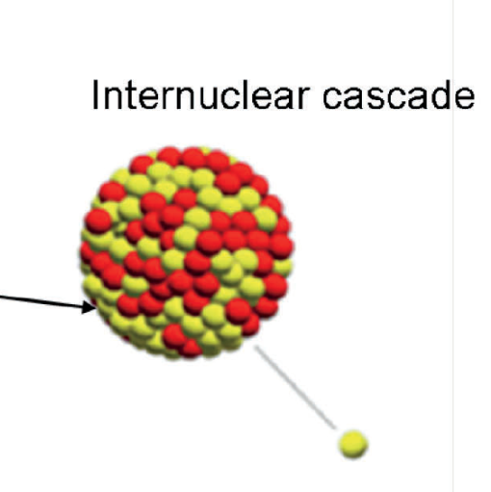
Nuclear Physics Processes for Protons
Nuclear reactions via spallation for protons with E_{kin} ≥ 1 GeV (simplified):
Pre-equilibrium phases: π-exchange within ≈ 10⁻²² s with E_{kin} > 20 MeV ⇒ hadronic shower
τ ≈ 10⁻²² s
forward peaked
E_{kin} > 100 MeV
General properties:
Binding energy:
≈ 5 MeV outer nucleons
≈ 50 MeV inner nucleons
for E_{kin} >> 100 MeV
comparable σ for n & p
τ ≈ 10⁻¹⁸ s
D. Kiselev, CAS 2011

Slide 6
Nuclear Physics Processes for Protons
Nuclear reactions via spallation for protons with E_{kin} ≥ 1 GeV (simplified):
Pre-equilibrium phases: π-exchange within ≈ 10⁻²² s with E_{kin} > 20 MeV ⇒ hadronic shower
Inter-nuclear cascade: Evaporation of n, p, d, α within ≈ 10⁻¹⁸ s with E_{kin} ≈ 1 – 10 MeV
Fission for heavy nuclei
β & γ decay of nuclei with long lifetime τ >> 10⁻⁹ s
τ ≈ 10⁻²² s
forward peaked
E_{kin} > 100 MeV
General properties:
Binding energy:
≈ 5 MeV outer nucleons
≈ 50 MeV inner nucleons
for E_{kin} >> 100 MeV
comparable σ for n & p
τ ≈ 10⁻¹⁸ s
Result on long term t > 1 ms: Radioactive nuclei = activation
D. Kiselev, CAS 2011

Slide 7
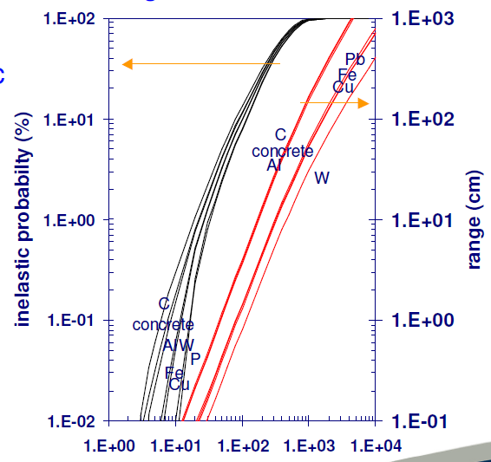
Nuclear Physics Processes for Protons
Nuclear reactions via spallation for protons with E_{kin} ≥ 1 GeV (simplified):
Pre-equilibrium phases: π-exchange within ≈ 10⁻²² s with E_{kin} > 20 MeV ⇒ hadronic shower
Inter-nuclear cascade: Evaporation of n, p, d, α within ≈ 10⁻¹⁸ s with E_{kin} ≈ 1 – 10 MeV
Fission for heavy nuclei
Nuclear reaction probability:
Neutron yield per proton:
100
1.000
10²
forward peaked
E_{kin} > 100 MeV
10
100
10¹
10⁰
nuclear reaction probability [%]
neutrons per proton
1
10
range [cm]
10⁻¹
10⁻²
0.1
1
10⁻³
0.01
0.1
10⁻⁴
1
10
100
1.000
10.000
10
100
1.000
10.000
proton kinetic energy E_{kin} [MeV]
proton kinetic energy E_{kin} [MeV]
E_{kin} ≈ 1 MeV
Thick target: Penetration depth comparable to range
R.H. Thomas, in Handbook on Acc. Phy. & Eng.

Slide 8
Outline:
Physical process from beam-wall interaction
Different types of Beam Loss Monitors
different methods for various beam parameters
Machine protection using BLMs
Summary

Slide 9
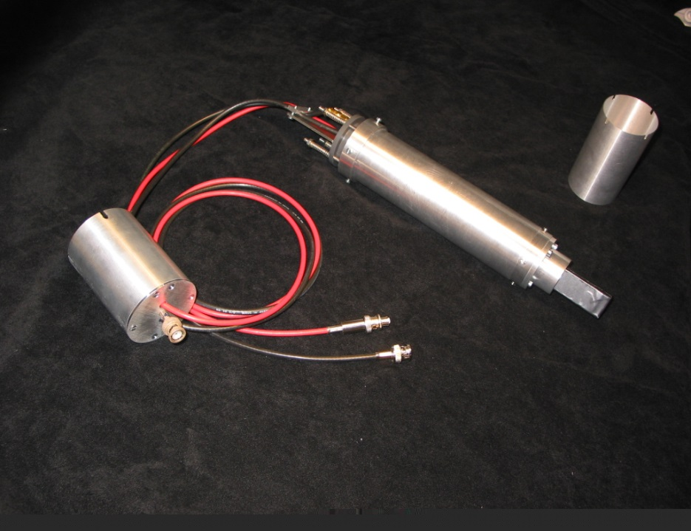
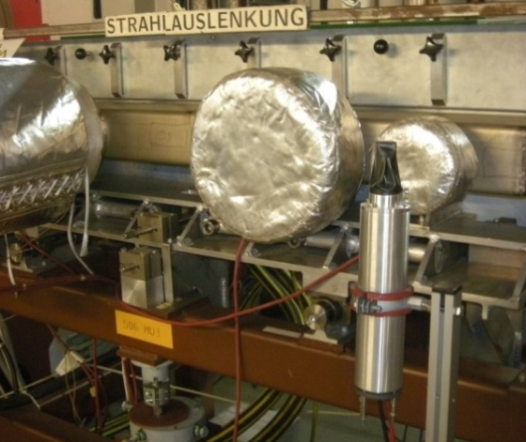
Scintillators as Beam Loss Monitors
Plastics or liquids are used:
detection of charged particles
by electronic stopping
detection of neutrons
by elastic collisions n on p in plastics
and fast p electronic stopping.
Scintillator + photo-multiplier:
counting (large PMT amplification)
or analog voltage ADC (low PMT amp.).
Radiation hardness:
plastics 1 Mrad = 10⁴ Gy
liquid 10 Mrad = 10⁵ Gy
Example: Analog pulses of plastic scintillator:
⇒ broad energy spectrum
due to many particle species and energies.
HV base
Photo-multiplier
inside
Analog pulses U(t)
40 ns
100 mV
Scintillator
2x2x5 cm³
Pulse high distribution N(U)
50 mV

Slide 10
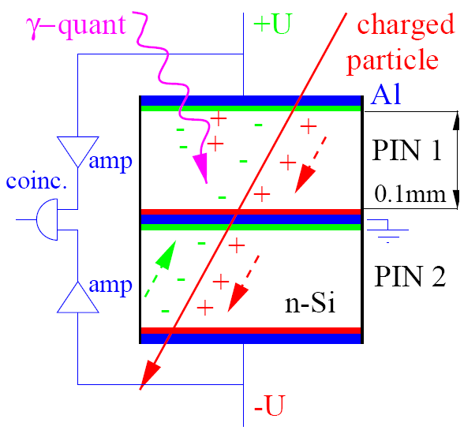
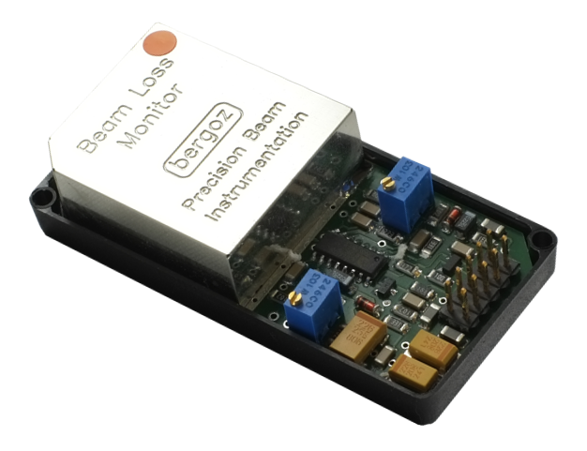
PIN-Diode (Solid State Detector) as BLM
Solid-state detector: Detection of charged particles.
Working principle
About 10⁴ e⁻-hole pairs are created by a Minimum Ionizing Particle (MIP).
A coincidence of the two PIN reduces the background due to low energy photons.
A counting module is used with threshold value comparator for alarming.
→ small and cheap detector.
2 PIN diodes:
7.5 × 20 mm²
0.1 mm thickness.
electronics

Slide 11
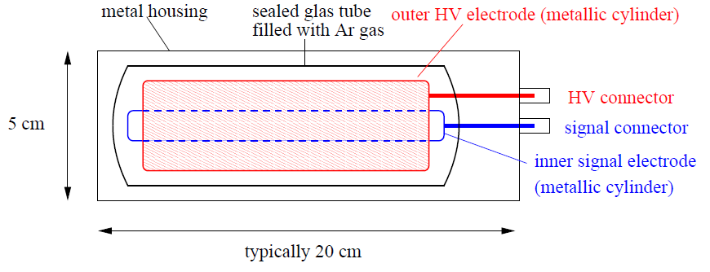
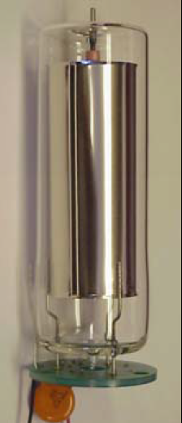
Ionization Chamber as BLM
Energy loss of charged particles in gases → electron-ion pairs → current meas.
W is average energy for one e⁻ -ion pair:
Gas | Ionization Pot. [eV] | W-Value [eV]
Ar | 15.7 | 26.4
N₂ | 15.5 | 34.8
O₂ | 12.5 | 30.8
Air |  | 33.8
shower particle
Sealed tube Filled with Ar or N₂ gas:
Creation of Ar⁺-e⁻ pairs,
average energy W=32 eV/pair
Measurement of this current
Slow time response
due to ≈ 10 μs drift time of Ar⁺.
Per definition: Direct measurement of dose !
15 cm
Notes:
11

Slide 12
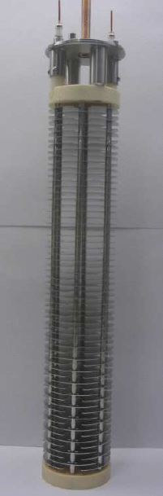
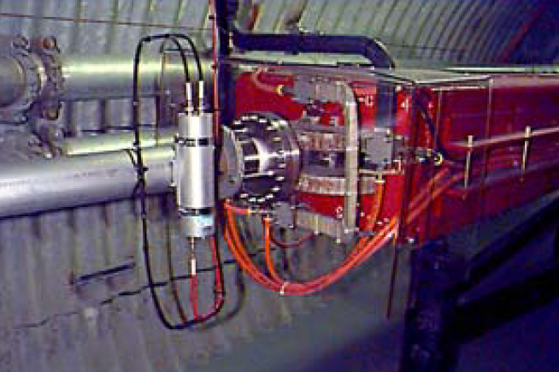
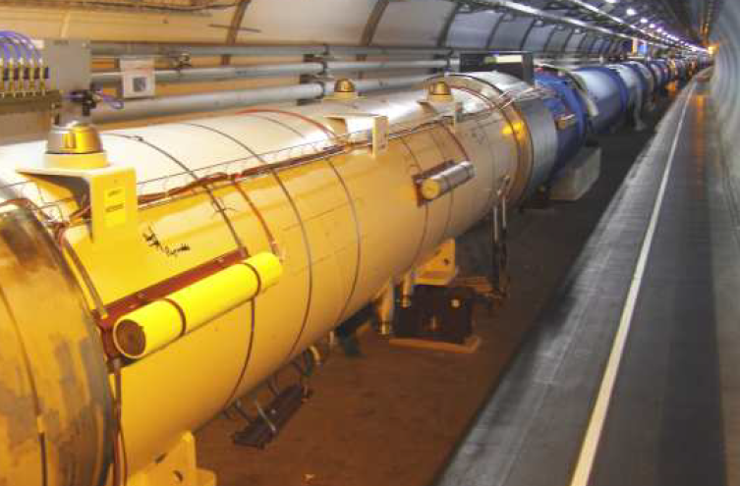
Ionization Chamber as BLM: TEVATRON and CERN Type
Parameter | TEVATRON, RHIC | CERN type
Size | 15cm, ∅ 6 cm | 50 cm, ∅ 9 cm
Gas | Ar at 1.1 bar | N₂ at 1.1 bar
# of electrodes | 3 | 61
Voltage | 1000 V | 1500 V
Reaction time | 3 µs | 0.3 µs
15 cm
38 cm
4000 BLMs at LHC⇔ each ≈ 6m
TEVATRON, RHIC type
CERN type

Slide 13
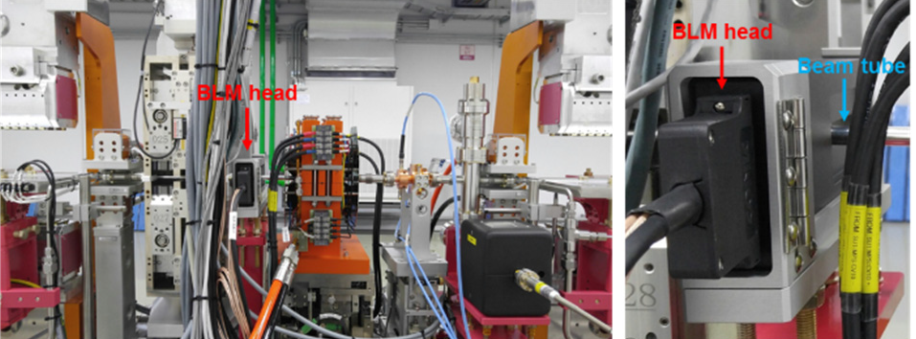
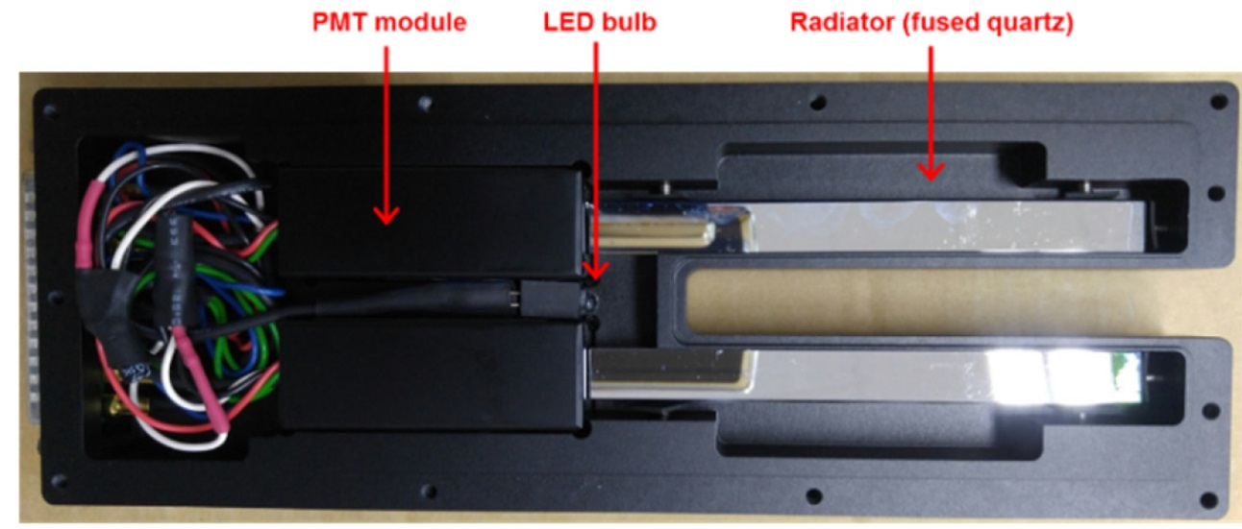

Cherenkov Light Detectors as Beam Loss Monitors
Cherenkov detectors → direct observation of lost electron:
Passage of a charged particle faster than propagation of light
v > c_{medium} = c /n
Technical: Quartz rod n=1.5 & photomultiplier
Example: Korean XFEL behind undulator
Cherenkov light emission:
For v > c_{medium} = c /n
light wave-front like a wake
broadband light emission
light propagation
$$\frac{c}{n}∙t$$
θ
beam
v⋅ t
Advantage:
Detection of fast electrons only
Low sensitive to γ & synch. photons
No saturation effects
Prompt light emission
Usage: Mainly at FELs for
short and intense pulses
beam
11mm
H. Yang, D.C. Shin, FEL Conf. 2017
120mm

Slide 14

Comparison of different Types of BLMs
Different detectors are sensitive to various physical processes
very different count rate, but basically proportional to each other
Typical choice of the detector type:
Ionization Chamber:
Advantage:
- Measurement of absolute dose
Disadvantage:
- Low signal (low γ, eff, no neutron detection),
- Sometimes slow, ion drift time 10 ... 100 µs
⇒ Often used at proton accelerators
38 cm
Scintillator, Cherenkov detector:
Advantage:
- Fast current reading or particle counting
- Can be fabricated in any shape, cheap
Disadvantage:
- Need calibration in many cases
- Scint.: Might suffer from radiation
⇒ Often used at electron accelerators
⇒ Proton accel. at sensitive locations
Photo-multiplier
inside
HV base
Scintillator
2x2x5 cm³

Slide 15

Poll concerning BLM Types
Poll 7.3:
Which type of BLM can distinguish between beam particles and secondaries?
Scintillator
Ionization chamber
Solid state diodes
Cherenkov detectors
Poll 7.1:
Which type of BLM measures the dose directly?
Scintillator
Ionization chamber
Solid state diodes
Cherenkov detectors
Poll 7.2:
Which type of BLM is most sensitive to neutrons?
Scintillator
Ionization chamber
Solid state diodes
Cherenkov detectors
www.menti.com
code: 1208 6026
→ conclusion
Notes:
15

Slide 16
Outline:
Physical process from beam-wall interaction
Different types of Beam Loss Monitors
different methods for various beam parameters
Machine protection using BLMs
interlock generation for beam abort
Summary

Slide 17
Machine Protection Issues for BLM
Losses lead to permanent activation ⇒ maintenance is hampered
and to material heating (vacuum pipe, super-cond. magnet etc.) ⇒ destruction.
Types of losses:
Irregular or fast losses by malfunction of devices (magnets, cavities etc.)
→ BLM as online control of the accelerator functionality and interlock generation.
Regular or slow losses e.g. by lifetime limits or due to collimator
→ BLM used for alignment.
Demands for BLM:
High sensitivity to detect behavior of beam halo e.g. at collimator
Large dynamic range:
→ low signal during normal operation, but large signal in case of malfunction
→ detectable without changing the full-scale-range
e.g. scintillators from 10² 1/s up to 10⁷ 1/s in counting mode.
Monitoring of loss rate in control room and as interlock signal for beam abortion.

Slide 18
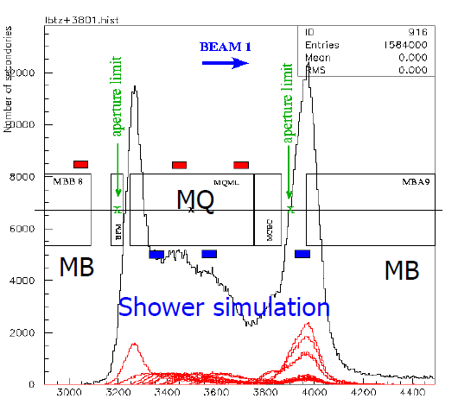
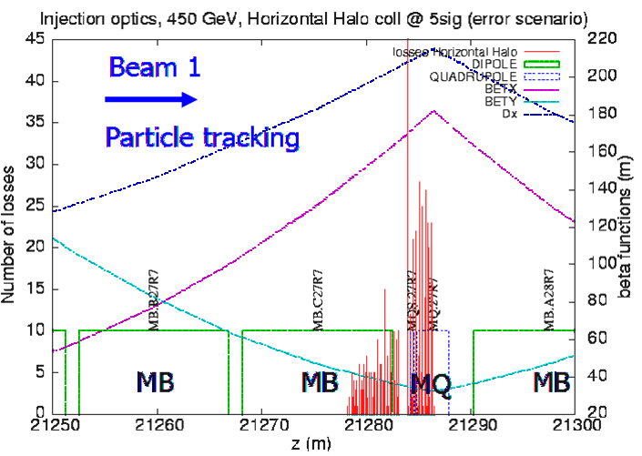
Application: BLMs for Quench-Protection
Super-conducting magnets can be heated above critical temperature T_{c} by the lost beam
⇒ breakdown of super-conductivity = ’quenching’.
⇒ Interlock within 1 ms for beam abortion generated by BLM.
Position of detector at quadruples due to maximal beam size.
High energy particles leads to a shower in forward direction → Monte-Carlo simulation.
Example: Simulation of lost protons at LHC at 450 GeV
→ at focusing quad. D & β_{x} maximum
Example: Simulation of shower particles
Beam Loss Monitors
dispersion
β_{x}-function
lost
protons
β_{y}-function
dipole
dipole
0
4
8
12
0
10
20
30
40
50
Beam path s (m)
Beam path s (m)
quadrupole
B. Dehning, JAS 2014, CERN-2016-002

Slide 19
Application: BLMs for optimal Tune Alignment
Example: Loss rate at a scraper inside the synchrotron as a function of the tune
(i.e. small changes of quadrupole setting):
Beam blow-up by weak resonances can be avoided by proper tune value
→ very sensitive device for optimization.
→ conclusion

Slide 20
Poll concerning Usage of BLMs
Poll 7.4:
Which answer is wrong? Beam loss monitors are used …
to prevent for unnecessary activation
as a system to restrict people access outside of the accelerator shielding
for quench protection for super-conducting components
for beam alignment
www.menti.com
code: 1208 6026
Notes:
20

Slide 21
Summary Beam Loss Monitors
Measurement of the lost fraction of the beam:
detection of secondary products
sensitive particle detectors are used outside the vacuum
cheap installations used at many locations
Used as interlock in all high current machines for protection.
Additionally used for sensitive ‘loss studies’.
Depending on the application different types are used:
Frequently used:
Scintillators: very sensitive, fast response, largest dynamics, not radiation hard
PIN diode: insensitive, fast response, not radiation hard, cheap
IC: medium sensitive, slow response, radiation hard, cheap, absolute measurement of dose
Used for special application:
Electron Multiplier: medium sensitive, fast response, radiation hard
BF₃ tube: only neutrons, slow response, radiation hard, expensive
Optical fibers: insensitive, very slow, radiation hard, very high spatial resolution.

Slide 22
Backup slides

Slide 23
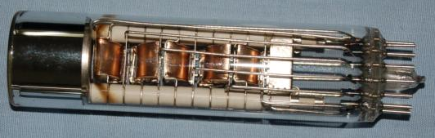
Low Current Measurement: Particle Detectors
Electronic solid state amplifier have finite noise contribution
Theoretical limit:
Signal-to-Noise ratio limits the minimal detectable current
Idea: Amplification of single particles with photo-multiplier, sec. e⁻ multiplier or MCPs
and particle counting typically up to ≈ 10⁶ 1/s
Scheme of a photo-multiplier:
Photon hits photo cathode
Secondary electrons are
acc. to next dynode ΔU ≈ 100 V
Typ. 10 dynodes ⇒ 10⁶ fold amplification
Advantage: no thermal noise
due to electro static acceleration
Typical 1 V signal output
voltage divider with resistors R
HV
dynodes
photon
readout
U≈1 V @50Ω
electron
photo cathode
23
Notes:
23

Slide 24
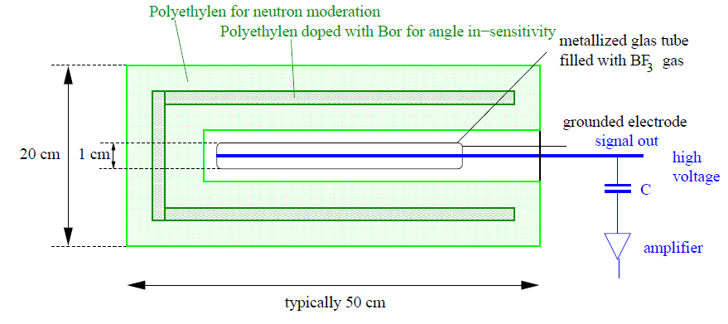
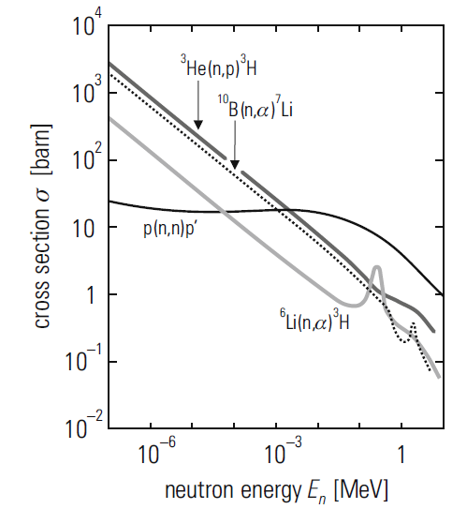
BF₃ Proportional Tubes as BLM
Detection of neutrons only with a ‘REM-counter’:
neutron
∅20cm
moderation by elastic coll. with H
nuclear reaction B(n,α)Li
Physical processes of signal generation:
1. Slow down of fast neutrons by elastic collisions with p
2. Nuclear reaction inside BF₃ gas in tube:
¹⁰B + n → ⁷Li + α with Q = 2.3 MeV.
3. Electronic stopping of ⁷Li and α leads to signal.
Remark: ‘REM-counters’ are frequently used for neutron detection
outside of the concrete shield & in nuclear power plants
C. Grupen, Introduction to Radiation Protection

Slide 25
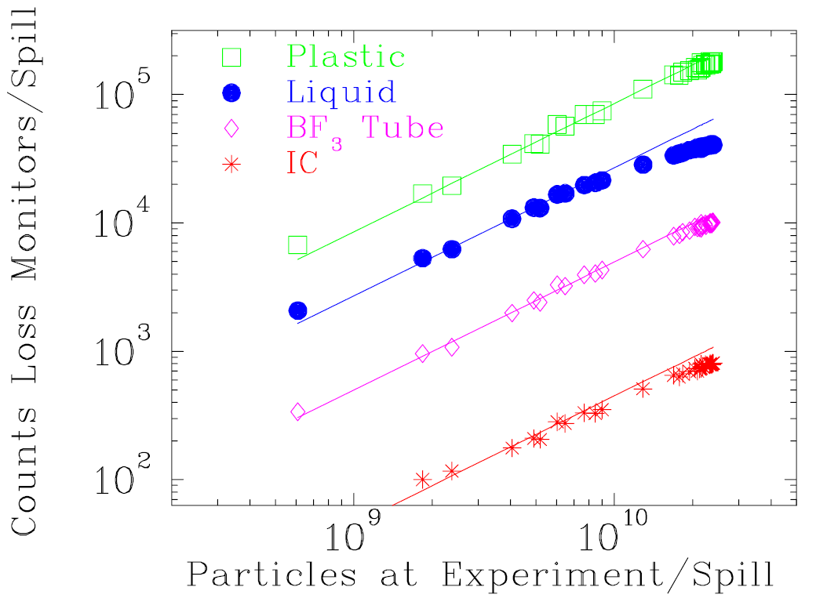
Comparison of different Types of BLMs
Different detectors are sensitive to various physical processes
very different count rate, but basically proportional to each other
Example: Beam loss 800 MeV/u O⁸⁺
for different BLMs at GSI-synchr.:
Typical choice of the detector type:
Ionization Chamber:
Advantage:
- Measurement of absolute dose
Disadvantage:
- Low signal (low γ, eff, no neutron detection),
- Sometimes slow, ion drift time 10 ... 100 µs
⇒ Often used at proton accelerators
Scintillator, Cherenkov detector:
Advantage:
- Fast current reading or particle counting
- Can be fabricated in any shape, cheap
Disadvantage:
- Need calibration in many cases
- Might suffer from radiation
⇒ Often used at electron accelerators
⇒ Linear behavior for all detectors
⇒ Quite different count rate:
r_{IC} < r_{BF3} < r_{liquid} < r_{plastic}

Slide 26
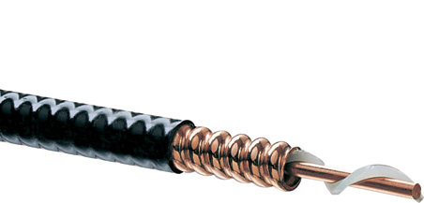
The long, cable-based Ionization Chamber
An air-filled ionization chamber IC can be realized
by a cheap, air-filled co-axial cable:
Air-filled co-ax cable e.g. Andrew HJ4.5-50
∅_{outer}= 20mm
∅_{inner}= 7mm
vacuum pipe
  beam
lost beam particle
Co-ax cable: Long IC-BLM
secondary
TDC
C
signal
-
+
signal
v = c_{cable}
C
TDC
-
+
-
+
air-filled
-
+
R
Δt leads to position
U ≈ 1 kV
Realization: long cable along beam line ⇒ spatial resolution via time-of-flight measurement:
determination of signal arrival at both ends leads to Δt
typical signal resolution of time-of-flight Δt ≈ 10 ns ⇒ position resolution Δx = c_{cable}⋅ Δt = 1.5 m
Advantage of long IC: cheap, good spatial resolution

Slide 27
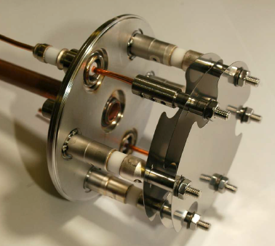
Secondary Electron Monitor as BLM
Ionizing radiation liberates secondary electrons from a surface.
Working principle:
Three plates mounted in a vacuum vessel (passively NEG pumped)
Outer electrodes: biased by U ≈ +1 kV
Inner electrode: connected for current measurement (here current-frequency converter)
→ small and cheap detector, very insensitive.
HV electrodes
Electrode for measured
current
Detector with intrinsic amplification:
Secondary electron multiplier
i.e. a ‘photo-multiplier without
photo-cathode’
electronics

Slide 28
Optical Fibers as BLM
Modification of fiber material is used as a measure of dose.
several km long fibers (cheap due to use in tele-communication)
1 ns infra-red laser pulse
OTDR (optical time domain reflector):
time and amplitude of reflected light ⇒ location of modification.

Slide 29
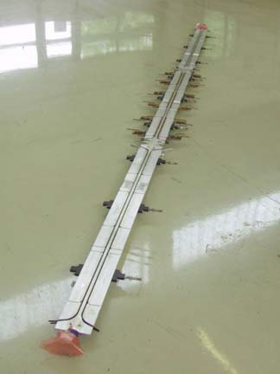
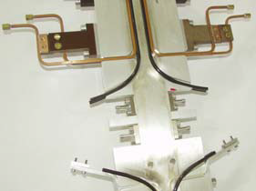
Example for Optical Fibers BLM
Advantage of optical fibers: Good spatial resolution with one detector
Installation parallel to beam pipe
low distance to loss
⇒ high solid angle for small volume
Example: Beam pipe of undulator at FLASH
Alternative detection principle:
Cherenkov light by fast transversing particle

Slide 30
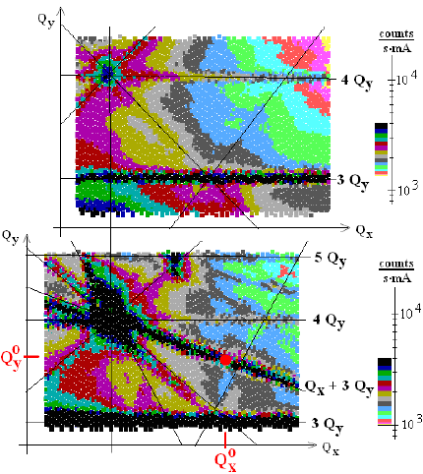
Application: BLMs for optimal Tune Alignment
Example: Tune scan at BESSY II: Tune variation & determination of losses
BLM: Plastic scintillator & PMT
6+3/4
Loss rate with open undulator
low loss (= long lifetime)
at working point at Q⁰_{x} , Q⁰_{y}
high loss
Q⁰_{y}=6.72
6+2/3
low loss
17+3/4
Q⁰_{x}=17.84
Loss rate with closed undulator (16mm, 6T)
high loss (= short lifetime)
excitation of coupling resonance
→ working point must be modified
6+3/4
high loss
low loss
6+2/3
17+3/4
From P. Kuske et al., DIPAC 2001 and PAC 2001

