Slide 1
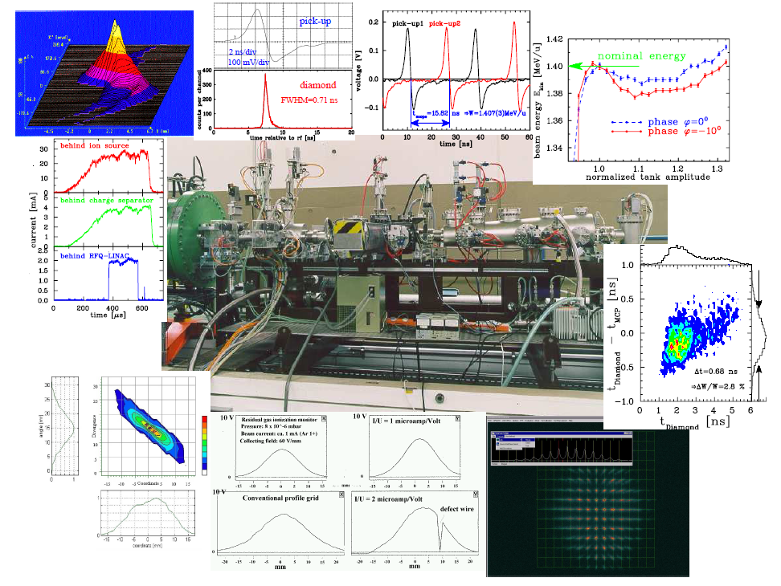


Conclusion on Beam Instrumentation and Diagnostics
JUAS 2025, ESI-Archamps at CERN
Peter Forck (GSI and University Frankfurt)

Slide 2
Conclusion for Beam Diagnostics Course
Diagnostics is the ’sensory organ’ for the beam.
It required for operation and development of accelerators
Four types of demands leads to different installations:
Quick, non-destructive measurements leading to a single number or simple plots.
Instrumentation for daily check, malfunction diagnosis and wanted parameter variation.
Complex instrumentation used for hard malfunction and accelerator development.
Automated measurement and control of beam parameters i.e. feedback
A clear interpretation of the results is a important design criterion.
General comments:
Good knowledge of accelerators, general physics and technologies is needed.
Quite different technologies are used, based on various physics processes.
Each task and each technology calls for an expert.
Accelerator development goes parallel to diagnostics development.
Interesting and challenging subject!

Slide 3
Beam Quantities and their Diagnostics I
LINAC & transport lines: Single pass ↔ Synchrotron: multi pass
Electrons: always relativistic ↔ Protons/Ions: non-relativistic for E_{kin} < 1 GeV/u
Depending on application: Low current ↔ high current
Overview of the most commonly used systems:
Beam quantity |  | LINAC & transfer line | Synchrotron
Current I | General Special | Transformer, dc & ac Faraday Cup Particle Detectors | Transformer, dc & ac Pick-up Signal (relative)
Profile x_{width} | General Special | Screens, SEM-Grids Wire Scanners, OTR Screen MWPC, Fluorescence Light | Ionization Profile Monitor Wire Scanner, Synchrotron Light Monitor
Position x_{cm} | General Special | Pick-up (BPM) Using profile measurement | Pick-up (BPM)
Transverse Emittance ε_{tran} | General Special | Slit-grid Quadrupole Variation Pepper-Pot | Ionization Profile Monitor Wire Scanner Transverse Schottky

Slide 4
Beam Quantities and their Diagnostics II
Beam quantity |  | LINAC & transfer line | Synchrotron
Bunch Length Δφ | General Special | Pick-up Secondary electrons | Pick-up Wall Current Monitor Streak Camera Electro-optical laser mod.
Momentum p and Momentum Spread Δp/p | General Special | Pick-ups (Time-of-Flight) Magnetic Spectrometer | Pick-up (e.g. tomography) Schottky Noise Spectrum
Longitudinal Emittance ε_{long} | General Special | Buncher variation Magnetic Spectrometer | Pick-up & tomography
Tune and Chromaticity Q, ξ | General Special | --- --- | Exciter + Pick-up Transverse Schottky Spectrum
Beam Loss r_{loss} | General | Particle Detectors
Polarization P | General Special | Particle Detectors Laser Scattering (Compton scattering)
Luminocity L | General | Particle Detectors
Destructive and non-destructive devices depending on the beam parameter.
Different techniques for the same quantity ↔ Same technique for the different quantities.

Slide 5
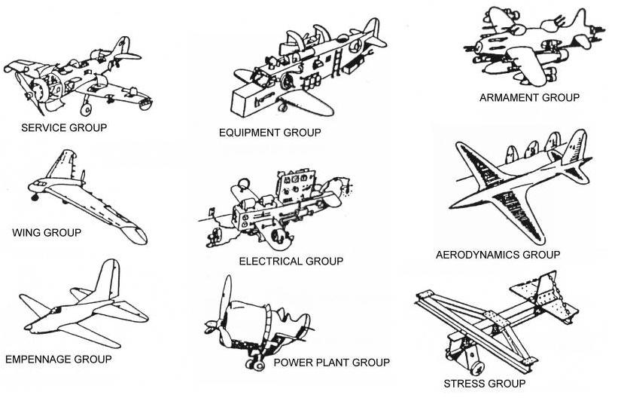
Conclusion for Beam Diagnostics Course
Beam diagnostics
Maintenance
Radio frequency
Magnets
Electrical engineering
Beam dynamics
Operation
Power supplier
Beam optics
Thank you for your attention!
Copy from
Dream Airplanes
by C.W. Miller
For a successful construction and operation of an accelerator,
the understand and appropriate balance of all disciplines is required!

Slide 6
Backup slides

Slide 7
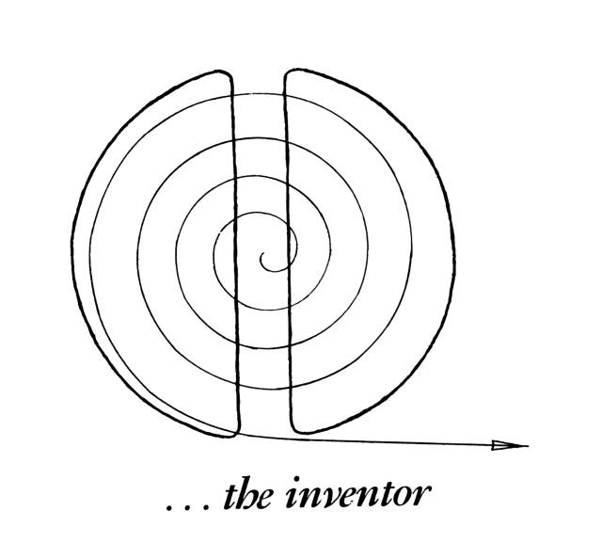
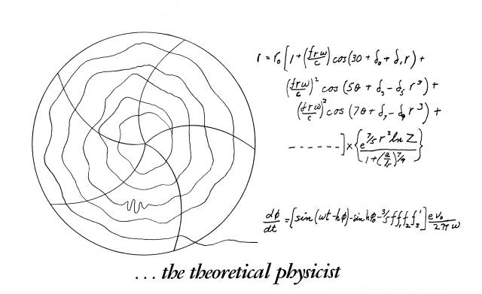
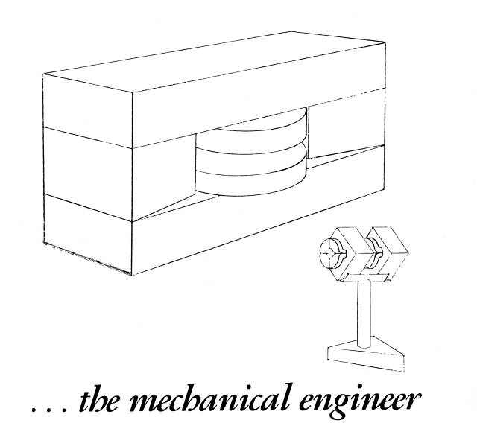
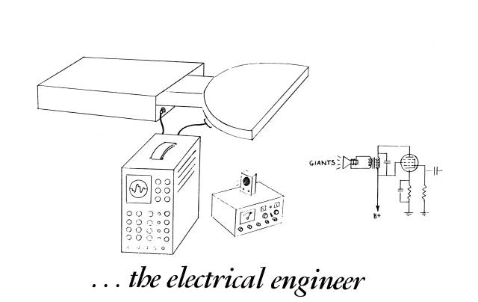
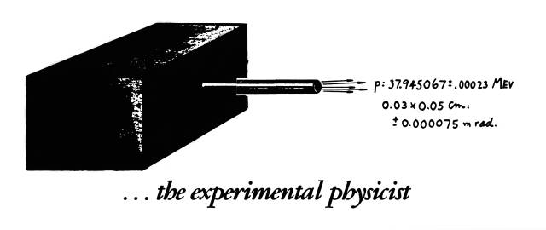
An Cyclotron Accelerator Facility as seen by....
Cartoons by Dave Judd and Ronn MacKenzie

Slide 8
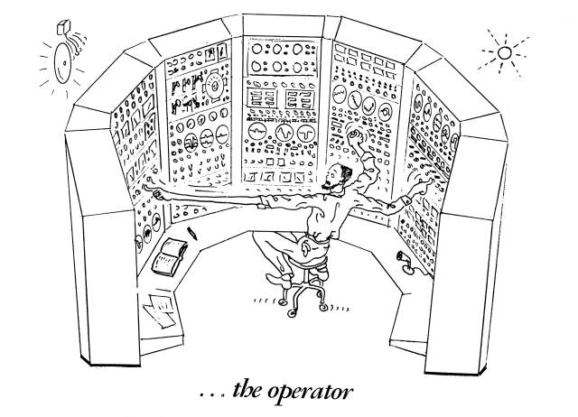
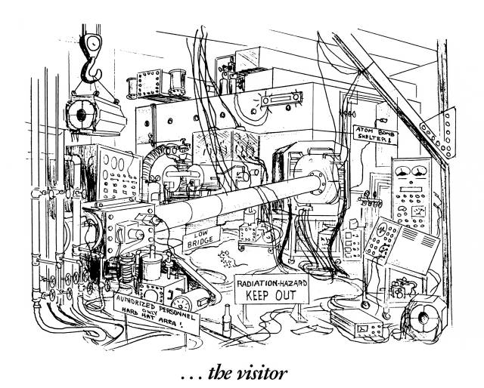
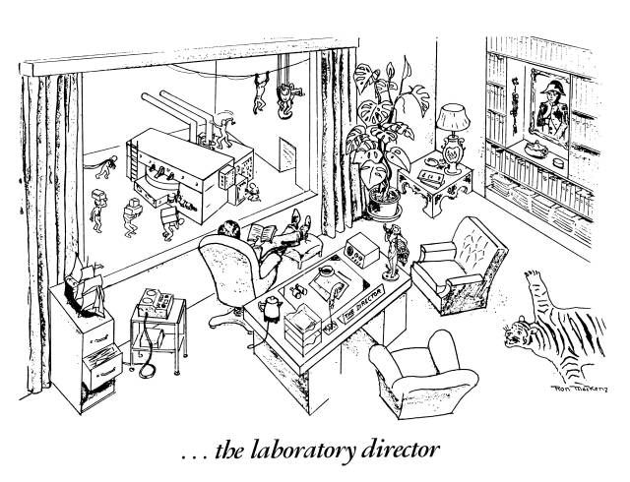

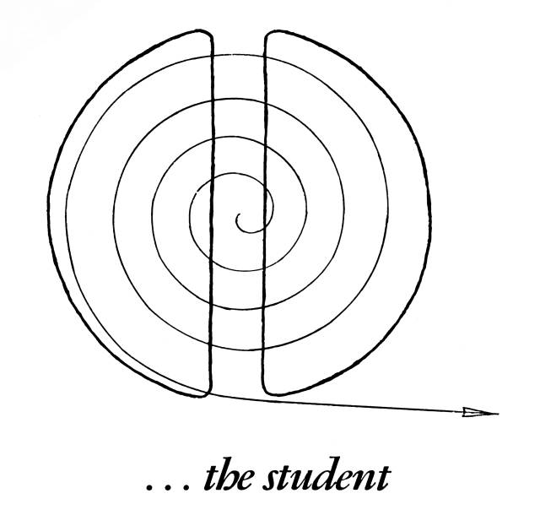
A Cyclotron Accelerator Facility as seen by....
Thank you for your attention!
Cartoons by Dave Judd and Ronn MacKenzie

