Slide 1



Exercises for Beam Diagnostics
JUAS 2025, ESI-Archamps at CERN
Peter Forck (GSI and University Frankfurt)

Slide 2
Exercise #12: Beam diagnostics design for a proton facility
proton source on U = 100 kV
experiment
I_{max}=50mA, I_{min}=0.1µA
E_{kin}= 100 MeV
E_{kin}= 3 MeV
transverse: σ=2mm
bunch length:
σ_{bunch} = 10⁰ of rf
RFQ-LINAC
DTL-LINAC
t_{pulse}=1ms, repetitions 1s
transverse size: σ = 5 mm
bunch length:
σ_{bunch} = 10⁰ of rf
f_{acc}= 300 MHz

Slide 3
Exercise #12: Beam diagnostics design for a proton facility
proton source on U = 100 kV
experiment
I_{max}=50mA, I_{min}=0.1µA
E_{kin}= 100 MeV
E_{kin}= 3 MeV
transverse: σ=2mm
bunch length:
σ_{bunch} = 10⁰ of rf
RFQ-LINAC
DTL-LINAC
t_{pulse}=1ms, repetitions 1s
transverse size: σ=5mm
bunch length:
σ_{bunch} = 10⁰ of rf
f_{acc}=300 MHz
1st synchrotron
l = 200 m
E_{in} = 100 MeV, E_{out}= 1 GeV
0.76 μs < t_{rev} < 1.6 μs
I_{max} = 10¹² protons
2.57MHz< f_{acc}<5.25MHz ⇔ 4 bunches
Tune: Q_{x} = 4.28, Q_{y} = 3.22
Bunch length: σ_{bunch} = 20⁰ of rf
trans. size: σ_{x} =5…3 mm

Slide 4
Exercise #12: Beam diagnostics design for a proton facility
proton source on U = 100 kV
experiment
I_{max}=50mA, I_{min}=0.1µA
E_{kin}= 100 MeV
E_{kin}= 3 MeV
transverse: σ=2mm
bunch length:
σ_{bunch} = 10⁰ of rf
RFQ-LINAC
DTL-LINAC
t_{pulse}=1ms, repetitions 1s
transverse size: σ=5mm
bunch length:
σ_{bunch} = 10⁰ of rf
f_{acc}=300 MHz
experiment:
fast extraction
4 bunches within 0.7 μs
experiment:
slow extraction
1s extraction
1st synchrotron
l = 200 m
E_{in} = 100 MeV, E_{out}= 1 GeV
0.76 μs < t_{rev} < 1.6 μs
I_{max} = 10¹² protons
2.57MHz< f_{acc}<5.25MHz ⇔ 4 bunches
trans. size:
σ_{x}=5 …3 mm
Tune: Q_{x} = 4.28, Q_{y} = 3.22
Bunch length: σ_{bunch} = 20⁰ of rf
trans. size: σ_{x} =5…3 mm
HEBT
length 300 m

Slide 5
Exercise #12: Beam diagnostics design for a proton facility
proton source on U = 100 kV
experiment
I_{max}=50mA, I_{min}=0.1µA
E_{kin}= 100 MeV
E_{kin}= 3 MeV
transverse: σ=2mm
bunch length:
σ_{bunch} = 10⁰ of rf
RFQ-LINAC
DTL-LINAC
t_{pulse}=1ms, repetitions 1s
transverse size: σ=5mm
bunch length:
σ_{bunch} = 10⁰ of rf
f_{acc}=300 MHz
experiment:
fast extraction
4 bunches within 0.7 μs
experiment:
slow extraction
1s extraction
1st synchrotron
l = 200 m
E_{in} = 100 MeV, E_{out}= 1 GeV
0.76 μs < t_{rev} < 1.6 μs
I_{max} = 10¹² protons
2.57MHz< f_{acc}<5.25MHz ⇔ 4 bunches
trans. size:
σ_{x}=5 …3 mm
transfer from 1st synchrotron:
10 x 4 bunches within 0.7 μs
Tune: Q_{x} = 4.28, Q_{y} = 3.22
Bunch length: σ_{bunch} = 20⁰ of rf
trans. size: σ_{x} =5…3 mm
2nd synchrotron
l = 2200 m
E_{in} = 1 GeV, E_{final} = 100 GeV
7.3 µs < t_{rev} < 8.4 μs
I_{max} = 10¹³ protons
5.25 MHz < f_{acc} < 6.00 MHz
(→ complete filling 40 bunches)
HEBT
length 300 m
Tune: Q_{x} = 20.28, Q_{y} = 18.22
Bunch length: σ_{bunch} = 20⁰ of rf
trans. size: σ_{x} =3…1 mm

Slide 6
Exercise #13: Beam diagnostics design for a LINAC FEL
Mode 1: Singh-bunch
Mode 2: 100 bunches, 50 ns spacing
Charge per bunch: Q_{bunch} = 100 pC
photo electron source
within rf-gun
f_{acc}= 1 GHz
laser
beam dump
1st bunch compressor
2nd bunch compressor
1st LINAC
f_{acc}= 1 GHz
2nd LINAC
f_{acc}= 3 GHz
undulator
E_{kin}= 7 MeV
σ_{trans} = 100 µm
σ_{long} = 100 ps
Q_{bunch} = 100 pC
E_{kin}= 0.5 GeV
σ_{trans} = 100 µm
σ_{long} = 100 ps
σ_{trans} = 100 µm
σ_{long} = 1 ps
E_{kin}= 5 GeV
σ_{trans} = 10 µm
σ_{long} = 10 ps
σ_{trans} = 10 µm
σ_{long} = 100 fs
SASE:
X-ray λ =1 nm

Slide 7
Exercise #12: Beam diagnostics design for a proton facility
Now your task:
Step 1: Please form 4 groups for protons and 5 groups including the LINAC FEL
(group1: LINAC, group2: 1st synchrotron, group3: HEBT line, group4: 2nd synchrotron)
Step 2: Review the beam properties and the requirements for the diagnostics
Step 3: Chose appropriate beam instrumentation for beam measurements
(You might form sub-groups to share the work)
Step 4: Summarize your results and prepare a presentation of your results
Step 5: Present your results in the lecture room (including possible open topics…),
duration about 3 min + 3 min questions & answers
Meeting for presentation: about 11:15
If you have any question, remark, comment, doubt, disagreements ….
Please ask me at any time (moreover, I will pass the rooms regularly)
Or ask the other groups on the requirements for their facility part

Slide 8
The following slides discusses exercises inactively.
These exercises discussed here are also given
in the written exercises document
Some slides from the lecture are included
as relevant for the exercise
Some more information are complied in addition

Slide 9
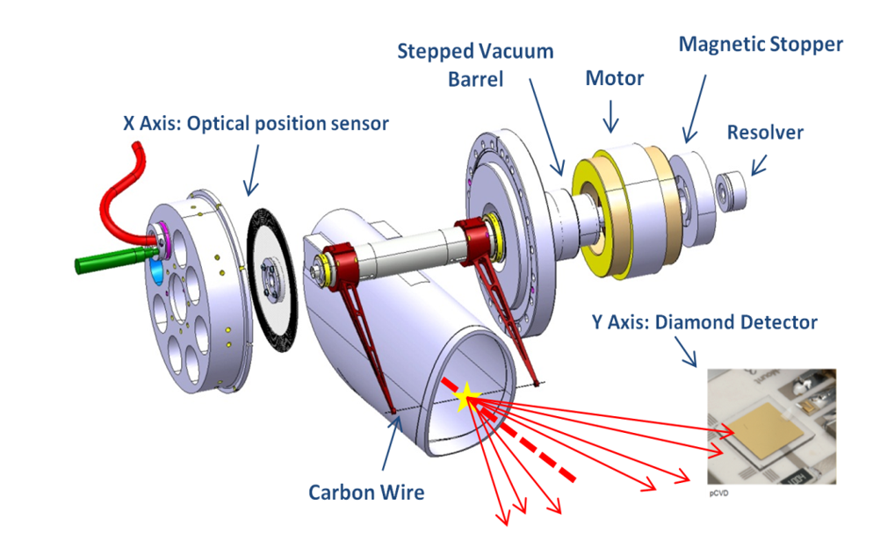
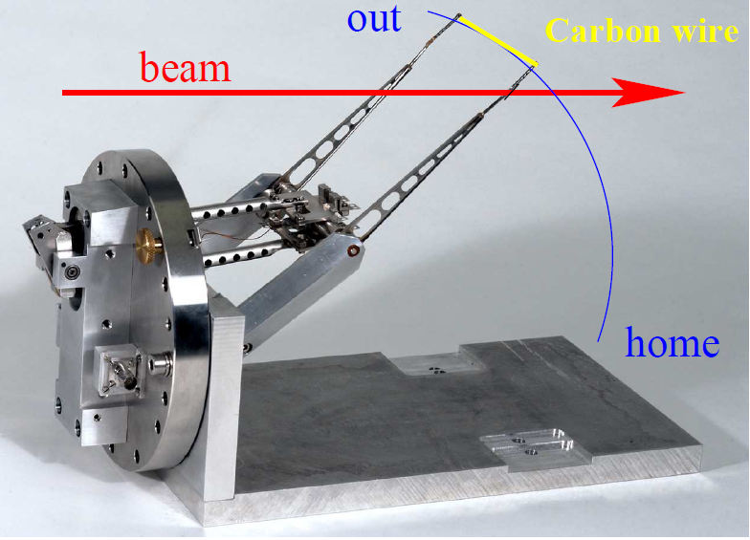
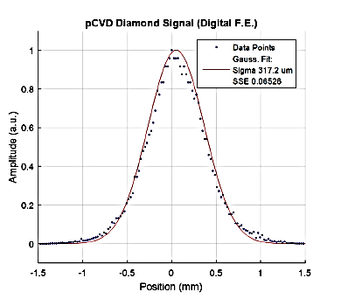
Fast, Flying Wire Scanner
In a synchrotron one wire is scanned though the beam as fast as possible.
Fast pendulum scanner for synchrotrons; sometimes it is called ’flying wire’:
scanner
particle
detector
synchrotron
Scanners used as
reference method!
extraction
From https://twiki.cern.ch/twiki/
bin/viewauth/BWSUpgrade/
injection

Slide 10
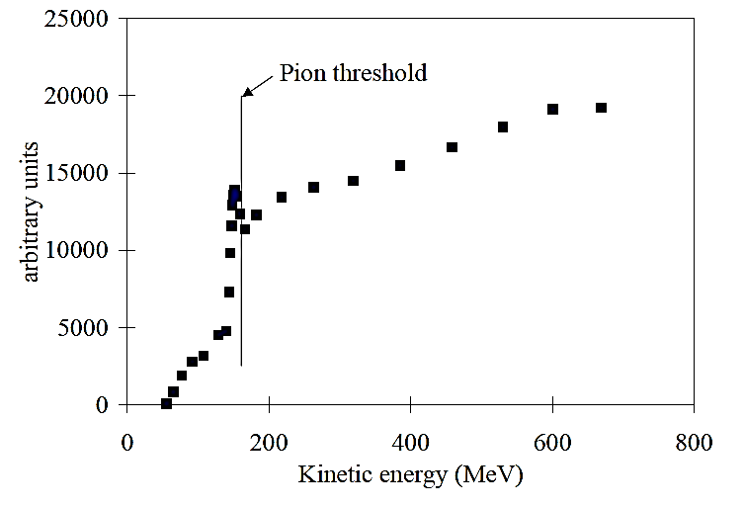
Usage of Flying Wire Scanners
Material: carbon or SiC → low Z-material for low energy loss and high temperature.
Thickness: down to 10 μm → high resolution.
Detection: High energy secondary particles with a detector like a beam loss monitor
Secondary particles:
Proton beam → hadrons shower (π, n, p...)
Electron beam → Bremsstrahlung photons.
Proton impact on
scanner at CERN-PS Booster:
motor
position
encoder
rotating
wire
vacuum tube
Rest mass:
m_{π±} = 140 MeV/c²
m_{π0} = 135 MeV/c²
beam
rotation
shower
A
D
computer
scintillator
photo
multiplier
ADC
Kinematics of flying wire:
Velocity during passage typi. 10 m/s = 36 km/h & typical beam size ∅ 10 mm
⇒ time for traversing the beam t ≈ 1 ms
Challenges: Wire stability for fast movement with high acceleration
U. Raich et al., DIPAC 2005

Slide 11
Exercise #7: Transverse profile by flying wire scanner
Assume a beam of 10¹² protons at 1GeV stored in a synchrotron.
The beam size 10 x 10 mm² with ρ_{beam}=const (for simplification), the revolution time is 1.0 μs.
The wire is made of Carbon with 50 x 50 μm² and scanned with v =10 m/s.
[Carbon is light material of ρ=2.2 g/cm³ density therefore low stopping power.]
The energy loss is dE/ dx= 4.29 MeV/cm.
Assumptions: rectangular beam and wire, no betatron oscillations.
thickness Δx = 50 µm
wire scanned with v = 10 m/s
Basic question:
Does the beam survive and wire the scan?
Movement for distance Δx = 50 µm
within t_{Δx}= Δx / v = 5 µs
d_{beam}
= 10 mm
Δx = 50 µm
beam
beam: circulates in synchrotron with t_{rev} = 1 µs

Slide 12
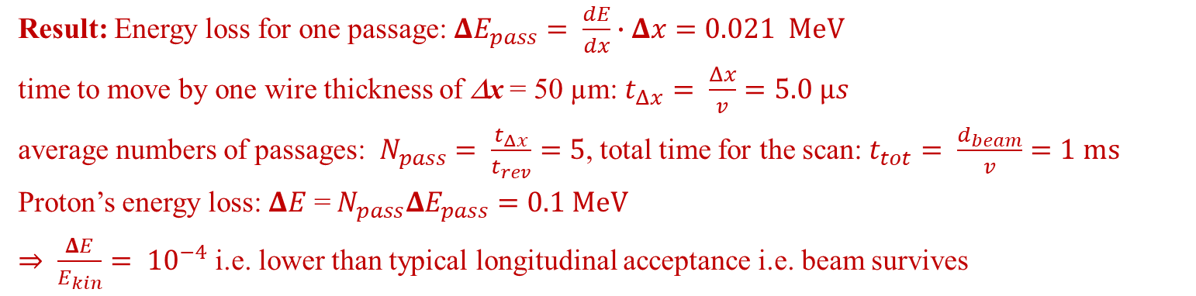
Exercise #7: Transverse profile by flying wire scanner 1/3
Assume a beam of 10¹² protons at 1GeV stored in a synchrotron.
The beam size 10 x 10 mm² with ρ_{beam}=const (for simplification), the revolution time is 1.0 μs.
The wire is made of Carbon with 50 x 50 μm² and scanned with v =10 m/s.
[Carbon is light material of ρ=2.2 g/cm³ density therefore low stopping power.]
The energy loss is dE/ dx= 4.29 MeV/cm.
Calculate the relative energy loss per passage through the wire!
Calculate the average energy loss during the scan! How many passages an ion does in average?
Is this device nearly ‘non-destructive’ ⇔ Are the particles lost?
Result: Energy loss for one passage: $ΔE_{pass}= \frac{dE}{dx}∙Δx=0.021 MeV$
time to move by one wire thickness of Δx = 50 µm: $t_{Δx}= \frac{Δx}{v}=5.0 µs$
average numbers of passages: $N_{pass}= \frac{t_{Δx}}{t_{rev}}=5$, total time for the scan: $t_{tot}= \frac{d_{beam}}{v}=1 ms$
Proton’s energy loss: $ΔE$ =${ N}_{pass}ΔE_{pass}=0.1 MeV$
$⇒ \frac{ΔE}{E_{kin}}= {10}^{−4}$ i.e. lower than typical longitudinal acceptance i.e. beam survives

Slide 13
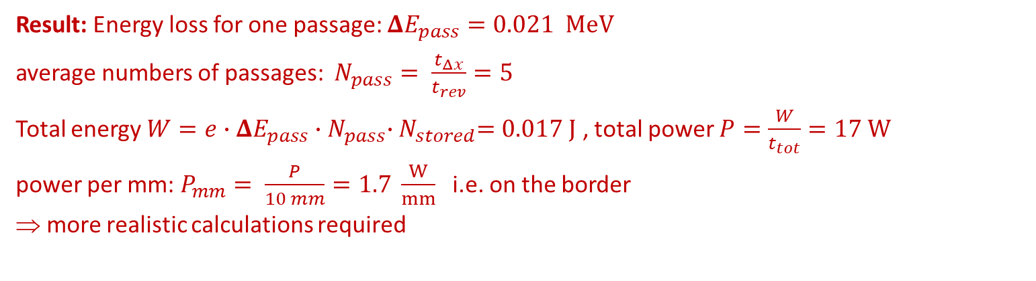
Exercise #7: Transverse profile by flying wire scanner 2/3
Assume a beam of 10¹² protons at 1GeV stored in a synchrotron.
The beam size 10 x 10 mm² with ρ_{beam}=const (for simplification), the revolution time is 1.0 μs.
The wire is made of Carbon with 50 x 50 μm² and scanned with v =10 m/s.
[Carbon is light material of ρ=2.2 g/cm³ density therefore low stopping power.]
The energy loss is dE/ dx= 4.29 MeV/cm.
Role of thumb: The maximum power rate to prevent for destruction is about 1 W/mm.
Is the wire destroyed?
Result: Energy loss for one passage: $ΔE_{pass}=0.021 MeV$
average numbers of passages: $N_{pass}= \frac{t_{Δx}}{t_{rev}}=5$
Total energy $W=e∙ΔE_{pass}{∙N}_{pass}{∙N}_{stored}=0.017 J$ , total power $P=\frac{W}{t_{tot}}=17 W$
power per mm: $P_{mm}= \frac{P}{10 mm}=1.7 \frac{W}{mm}$ i.e. on the border
⇒ more realistic calculations required

Slide 14
Exercise #7: Transverse profile by flying wire scanner: Example
Modification of wire thickness due to sublimation
Example of thinning at LHC
with 1.5⋅10¹³ protons at 3.5 TeV,
slower scan v = 5 cm/s
Example of thinning at SPS
with Pb⁸²⁺ impact
slow scan v = 2 cm/s
Min. thickness 4 µm
B. Sapinski, Proc. BIW 2012

Slide 15
Exercise #7: Transverse profile by flying wire scanner: Example
Mechanical realization of a
flying wire scanner
B. Dehning, Proc. HB 2016

Slide 16
Exercise #7: Transverse profile by flying wire scanner 3/3
Assume a beam of 10⁹ Uranium (mass 238 amu, nucl. chrage Z=92) ions at 1GeV/u stored.
The beam size 10x10 mm with ρ_{beam}=const (for simplification), the revolution time is 1.0 μs.
The wire is made of Carbon with 50x50 μm and scanned with v=10 m/s.
The energy loss is dE/dx= 35640 MeV/cm (instead 4.29 MeV/cm for protons as dE/dx ∝ Z² ).
Why is the energy loss so much larger?
Are the particles lost? Is the wire destroyed? Repeat the same calculation for this case!
Result: Energy loss for one passage:
i.e. for Uranium after one passage
out for longitudinal acceptance
beam is lost during scan!
Result: Energy deposition in the wire
is significantly higher than destruction level
⇒ the wire is destroyed!
What happens for not fully stripped ions (i.e. ions with some bound electrons)?
What is an appropriate method of profile determination for the Uranium case?

Slide 17
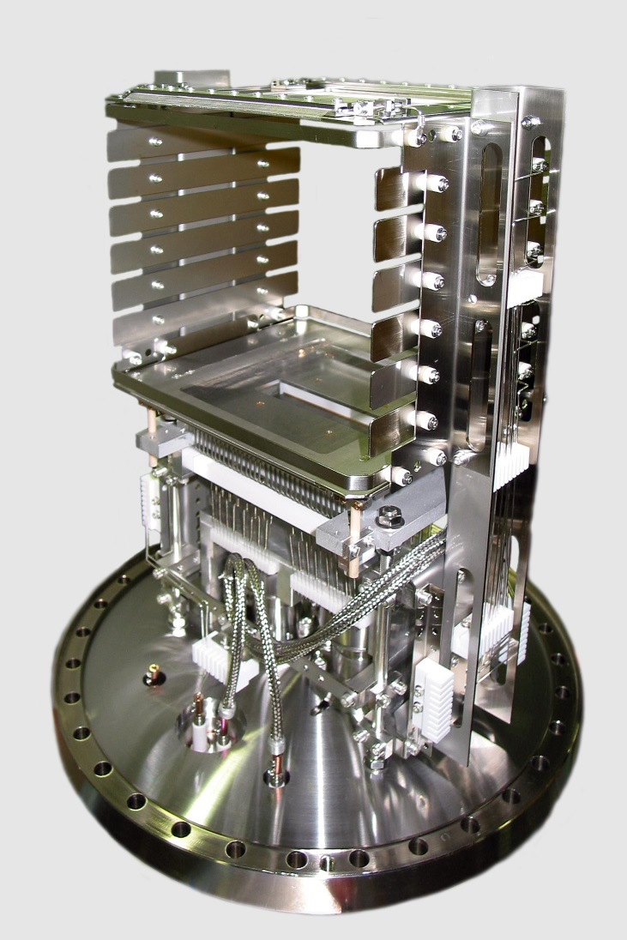

Ionization Profile Monitor at GSI Synchrotron
Non-destructive device for proton synchrotron:
beam ionizes the residual gas by electronic stopping
gas ions or e⁻ accelerated by E -field ≈1 kV/cm
spatial resolved single particle detection
Realization at GSI synchrotron:
One device per plane
175mm
HV electrode
voltage divider
+ 6 kV
R
+ 5 kV
beam
beam
+ 4 kV
175
mm
$$\vec{E}$$
+ 3 kV
MCP:
100 x 48 mm²
ion
e.g. H⁺
+ 2 kV
+ 1 kV
0 kV
63 wires,
2.1mm spacing
MCP
anode
position readout
HV feedthru
Typical vacuum pressure:
Transfer line: N₂ 10⁻⁸... 10⁻⁶ mbar ≅ 3⋅10⁸...3⋅10¹⁰cm⁻³
Synchrotron: H₂ 10⁻¹¹...10⁻⁹ mbar ≅ 3⋅10⁵...3⋅10⁷ cm⁻³
∅300 mm flange

Slide 18
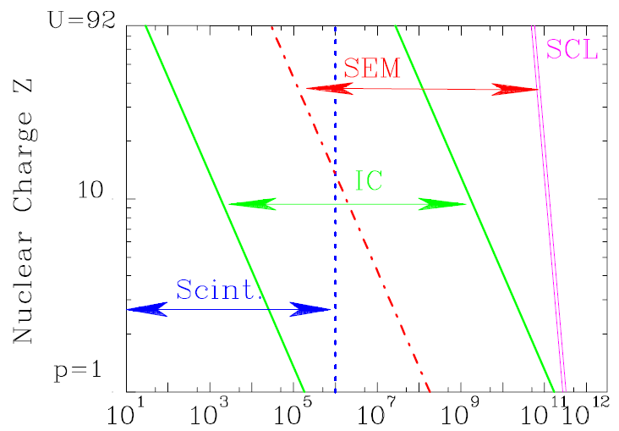
Low Current Measurement for slow Extraction
Slow extraction from synchrotron: lower current compared to LINAC,
but higher energies and larger range R >> 1 cm.
Particle counting:
max: r ≃ 10⁶ 1/s
Energy loss in gas (IC):
min: I_{sec} ≈ 1 pA
max: I_{sec} ≈ 1 μA
Sec. e− emission:
min: I_{sec} ≈ 1 pA
Max. synch. filling:
Space Charge Limit (SCL).
Particle detector technologies for ions of 1 GeV/u, A = 1 cm²:
synchrotron
Scint., IC & SEM
Particles per second
injection
extraction
Notes:
18

Slide 19
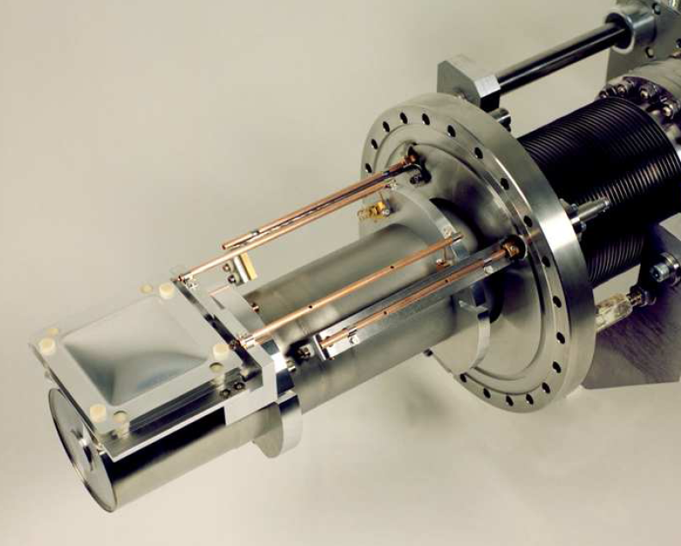
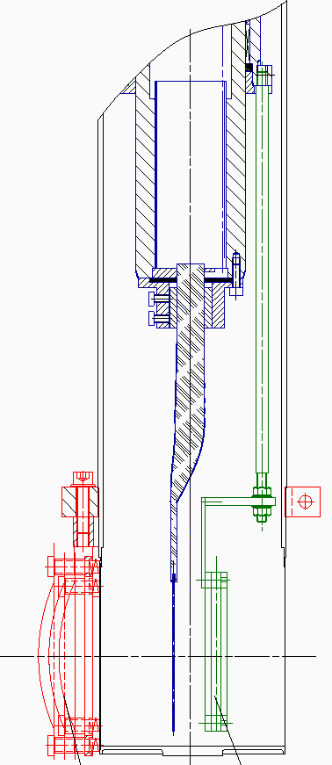
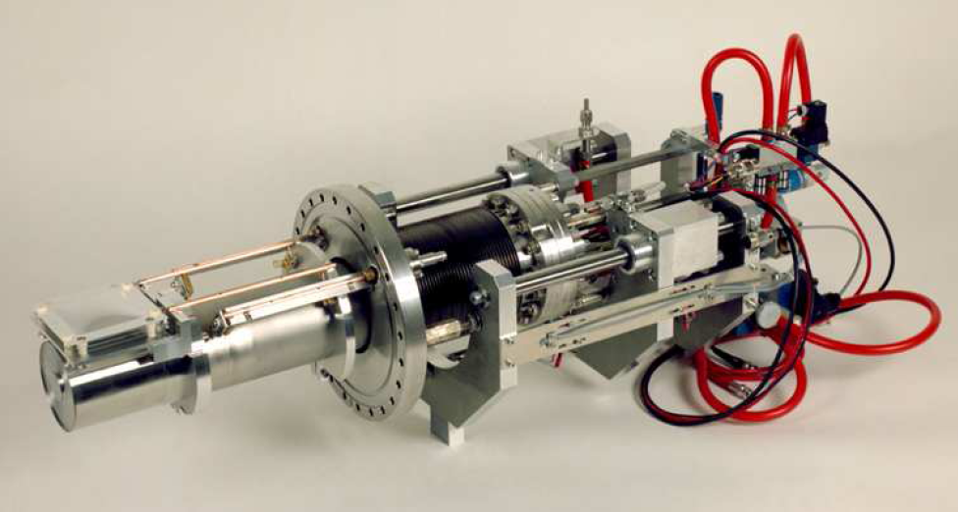
GSI Installation for SEM, IC and Scintillator
SEM in vacuum
IC in Ar-gas at 1 bar
Feed-through with Ø 200 mm flange
beam
SEM
PMT
gas filled
Scintillator
IC
P. Forck et al., DIPAC’97
Notes:
19

Slide 20
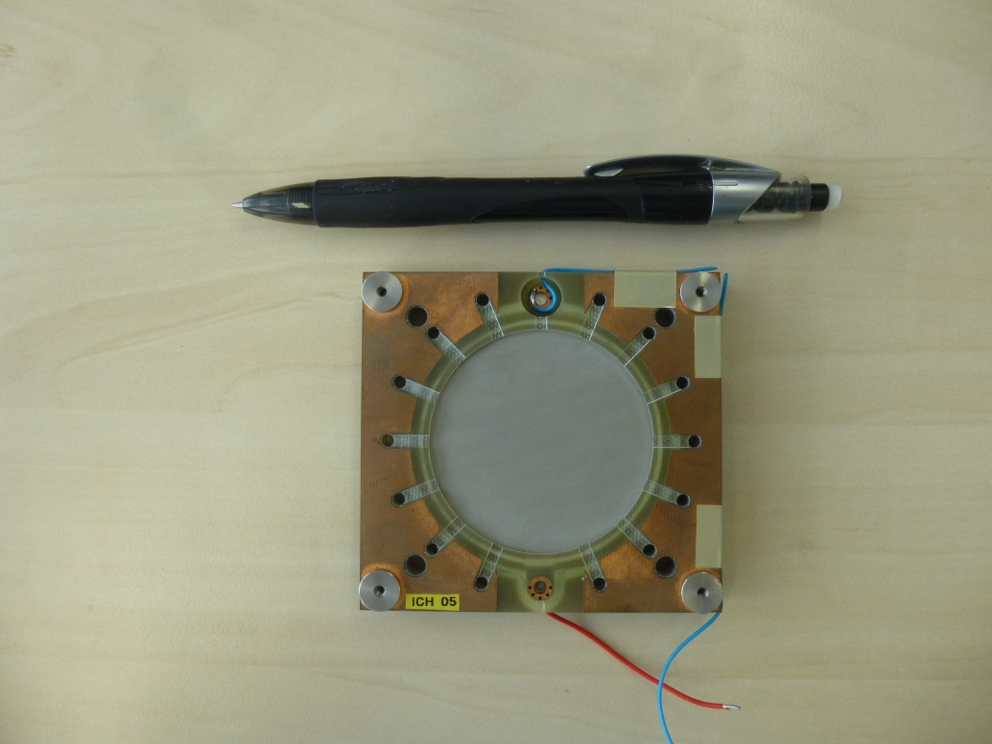
Ionization Chamber (IC): Electron Ion Pairs
Energy loss of charged particles in gases → electron-ion pairs → low current meas.
Example: GSI type:
diameter ∅55 mm
Length Δx
2x 3.2 mm
Voltage:
U_{HV} = 1 kV
Gas: 80% Ar + 20% CO₂
W-value
is the average energy
for one e⁻ -ion pair:
Gas | Ionization Pot. | W-value
He | 24.5 eV | 42.7 eV
N₂ | 15.5 eV | 36.4 eV
O₂ | 12.5 eV | 32.2 eV
Ar | 15.7 eV | 26.3 eV
CO₂ | 13.7 eV | 33.0 eV
GSI realization:
Energy calculation dE/dx with SRIM or LISE
Current measurement via
current-to-frequency converter IFC
Notes:
20

Slide 21
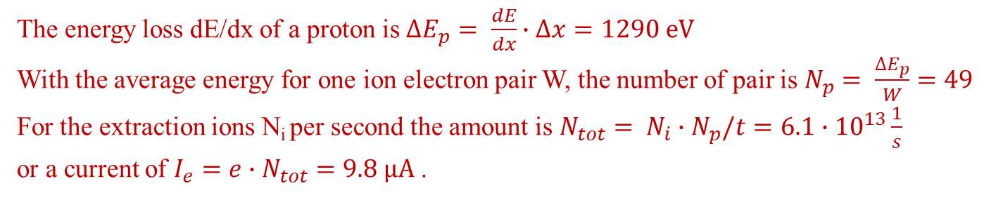
Exercise #4: Slow Extraction Current Measurement 1/2
Assume a beam of N_{i} = 1.25·10¹² protons extracted from a synchrotron within t = 1 s
The current should be measured by an ionization chamber of 0.5cm length filled with Ar
The average energy to create a ion-electron pair is W = 26.3 eV
The energy loss is dE/dx = 2.58 keV/cm
Calculate the ion-electron pairs per proton and the secondary current within the IC!
The energy loss dE/dx of a proton is $∆E_{p}= \frac{dE}{dx}∙∆x=1290 eV$
With the average energy for one ion electron pair W, the number of pair is $N_{p}= \frac{∆E_{p}}{W}=49$
For the extraction ions N_{i} per second the amount is $N_{tot}= N_{i}∙N_{p}/t=6.1∙{10}^{13}\frac{1}{s}$
or a current of $I_{e}=e∙N_{tot}=9.8 μA$ .
The energy loss (described by Bethe-Bloch equation ) scales with dE/dx ∝ Z_{p}²
Assume a beam of N_{i} = 1.8·10¹⁰ Uranium with Z_{p}=92 extracted within 1 s
Calculate the ion-electron pair per proton and the secondary current within the IC!
The energy loss per Uranium is $∆E_{U}={\left(92\right)}^{2}∙∆E_{p}=8464 ∙∆E_{p}=10.9 MeV$
The same calculation as above leads to$I_{e}=1.2 mA$ i.e. saturation of the IC and a SEM is better!

Slide 22
Low Current Measurement for slow Extraction
Slow extraction from synchrotron: lower current compared to LINAC,
but higher energies and larger range R >> 1 cm.
Particle counting:
max: r ≃ 10⁶ 1/s
Energy loss in gas (IC):
min: I_{sec} ≈ 1 pA
max: I_{sec} ≈ 1 μA
Sec. e− emission:
min: I_{sec} ≈ 1 pA
Max. synch. filling:
Space Charge Limit (SCL).
Particle detector technologies for ions of 1 GeV/u, A = 1 cm²:
synchrotron
Scint., IC & SEM
Particles per second
injection
extraction
Notes:
22

Slide 23
Secondary Electron Monitor (SEM): Electrons from Surface
For higher intensities SEMs are used.
Due to the energy loss, secondary e⁻ are emitted from a metal surface.
The amount of secondary e⁻ is proportional to the energy loss
Example: GSI SEM type:
Material | Pure Al (99.5%)
# electrodes | 3
Active surface | 80 x 80 mm ²
Distance between electrodes | 5 mm
Applied volatage | + 100
CO₂ | 13.7 eV
Advantage for Al: good mechanical properties.
Disadvantage: Surface effect!
e.g. decrease of yield Y due to radiation
⇒ calibration versus IC required to reach 5%.
It is a surface effect:
Sensitive to cleaning procedure
Possible surface modification by radiation
Sometimes they are installed permanently in front of an experiment.
Notes:
23

Slide 24
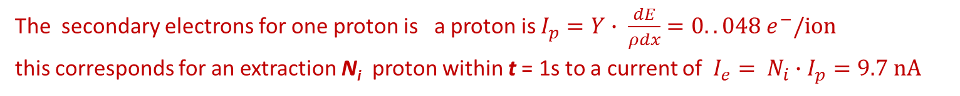
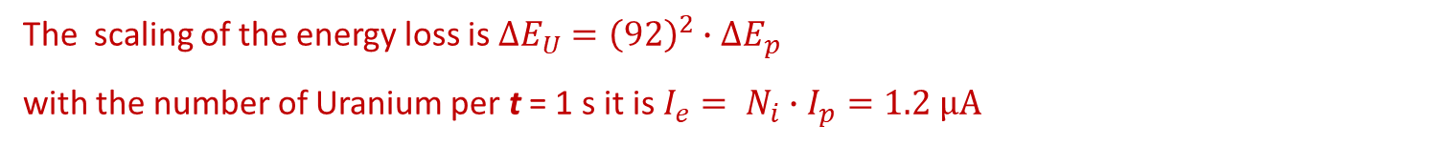
Exercise #3: Slow Extraction Current Measurement 2/2
Assume a beam of N_{i} = 1.25·10¹² protons extracted from a synchrotron within 1 s
The current should be measured by an SEM
For Aluminium plates the secondary electron yield is Y = 27.4 e⁻/(MeV/mg/cm²)
The energy loss (frequently used units!) is dE/ρdx = 1.77 keV/(mg/cm²)
Calculate the electrons per proton and the secondary current emitted by the SEM!
The secondary electrons for one proton is a proton is $I_{p}=Y∙ \frac{dE}{ρdx}=0..048 e^{−}/ion$
this corresponds for an extraction N_{i} proton within t = 1s to a current of $I_{e}= N_{i}∙I_{p}=9.7 nA$
The energy loss (described by Bethe-Bloch equation ) scales with dE/dx ∝ Z_{p}²
Assume a beam of N_{i} = 1.8·10¹⁰ Uranium with Z_{p}=92 extracted within 1 s
Calculate the electron per Uranium and the secondary current by the SEM!
The scaling of the energy loss is $∆E_{U}={\left(92\right)}^{2}∙∆E_{p}$
with the number of Uranium per t = 1 s it is $I_{e}= N_{i}∙I_{p}=1.2 μA$
→ Flying wire

Slide 25
Summary for Beam Profile
Different techniques are suited for different beam parameters:
e⁻-beam: typically Ø 0.01 to 3 mm, protons: typically Ø 3 to 30 mm
Intercepting ↔ non-intercepting methods
Direct observation of electrodynamics processes:
Optical synchrotron radiation monitor: non-destructive, for e⁻-beams, complex, limited res.
X-ray synchrotron radiation monitor: non-destructive, for e⁻-beams, very complex
OTR screen: nearly non-destructive, large relativistic γ needed, e⁻-beams mainly
Detection of secondary photons, electrons or ions:
Scintillation screen: destructive, large signal, simple, all beams
Ionization profile monitor: non-destructive, expensive, limited resolution, for protons
Residual fluorescence monitor: non-destructive, limited signal strength, for protons
Wire based electronic methods:
SEM-grid: partly destructive, large signal and dynamic range, limited resolution
Wire scanner: partly destructive, large signal and dynamics, high resolution, slow scan.

Slide 26
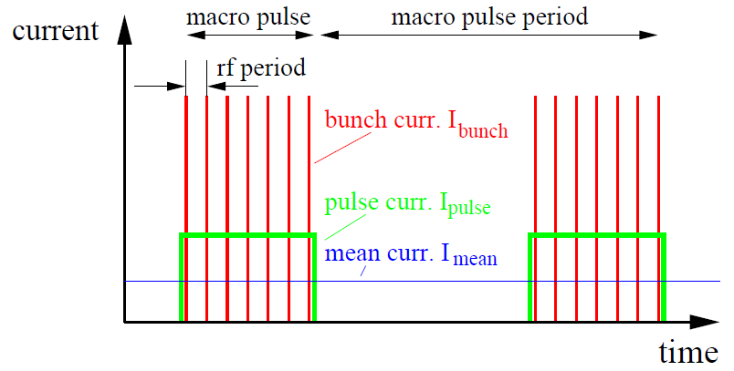
Beam Structure of a pulsed LINAC
Pulsed LINACs and cyclotrons used for injection
to synchrotrons with t_{pulse} ≈100 μs:
One distinguish between:
Mean current I_{mean}
→ long time average in [A]
Pulse current I_{pulse}
→ during the macro pulse in [A]
Bunch current I_{bunch}
→ during the bunch in [C/bunch]
or [particles/bunch]
Remark: Van-de-Graaff (ele-static):
→ no bunch structure
Question:
What is the pulse structure of a beam within a synchrotron?
What does this means for beam current measurement?

Slide 27
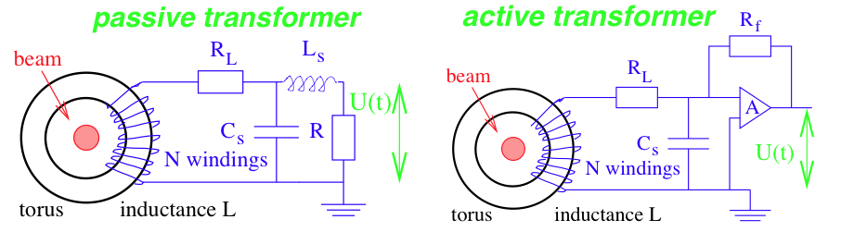
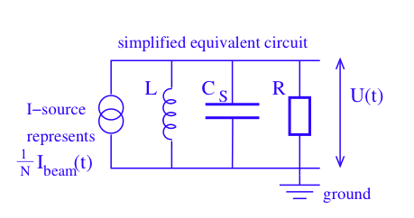
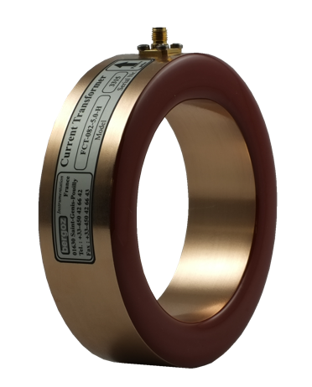
Passive Transformer (or Fast Current Transformer FCT)
Simplified electrical circuit of a passively loaded transformer:
A voltages is measured: U = R · I_{sec} = R /N · I_{beam} ≡ S · I_{beam}
with S sensitivity [V/A],
equivalent to transfer function or transfer impedance Z
beam
Equivalent circuit for analysis of sensitivity and bandwidth
(disregarding the loss resistivity R_{L})

Slide 28
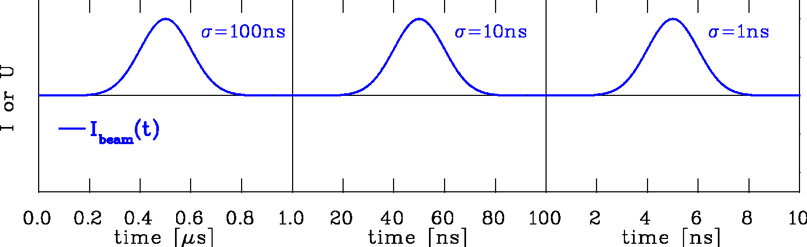
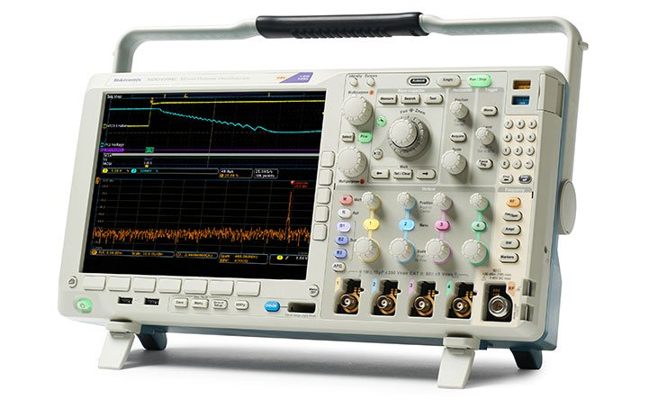
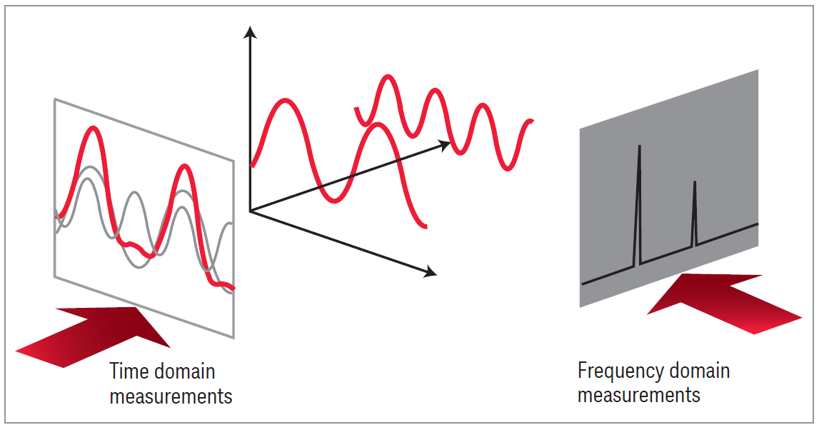
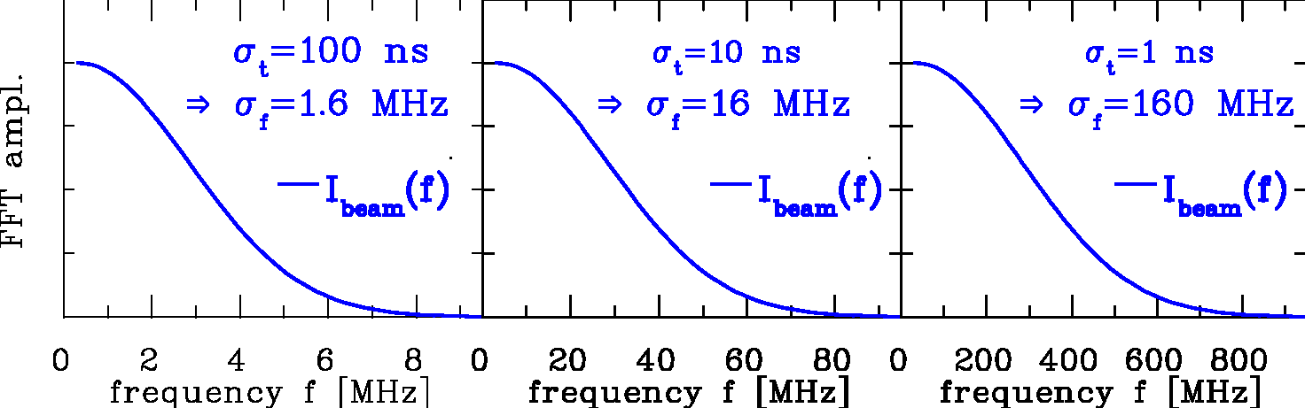
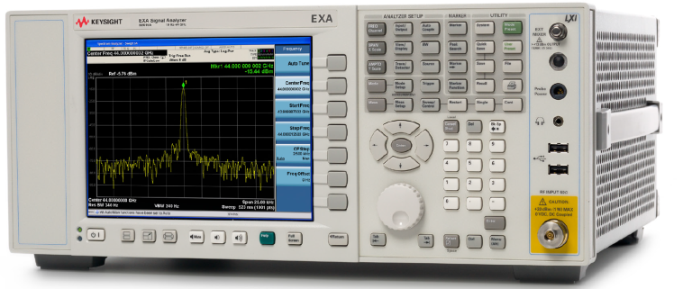
Excurse: Time Domain ↔ Frequency Domain
Time domain: Recording of a voltage as a function of time:
Instrument:
Oscilloscope
Fourier
Transformation:
I_{beam}
Frequency domain: Displaying of a voltage as a function of frequency:
Instrument:
Spectrum Analyzer
voltage
frequency
time
courtesy company Keysight
Care: Fourier Transformation of time domain data contains amplitude and phase

Slide 29
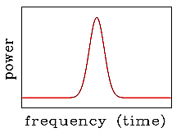
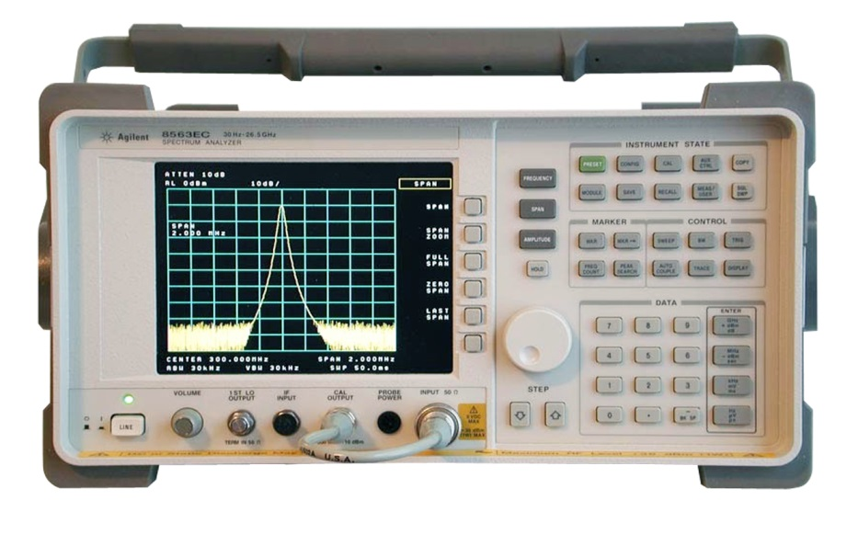
Excurse: Basic Detection Instrument: Analog Spectrum Analyzer
The spectrum analyzer determines the frequency spectrum of a signal:
Steps for an analog device:
Low pass filter, typ. f < 3 GHz
Mixing with
scanning local oscillator
Difference frequency by narrow
band pass filter, width typ. ≈ 1 kHz
Rectification ⇒ units W or dBm
Scan duration typically ≈ 1 s
i.e. averaging signal over many turns
band pass filter ⇒ Δf_{res}
amplitude
detector
video
filter⇒ Δf_{video}
low pass
filter
mixer
IF gain
input amp.
RF
IF
LO
U
display
t
voltage controlled oscillator ⇒ f_{span}
⇒ t_{sweep}
Parameter to be chosen:
Reference level P_{ref} [dBm]
Center frequency f_{LO} = f_{center}
Span f_{span} = f_{stop} - f_{start}
Resolution bandwidth Δf_{res}
i.e. band-pass filter width
Video bandwidth Δf_{video} i.e. data smoothing
Sweep time t_{sweep}

Slide 30
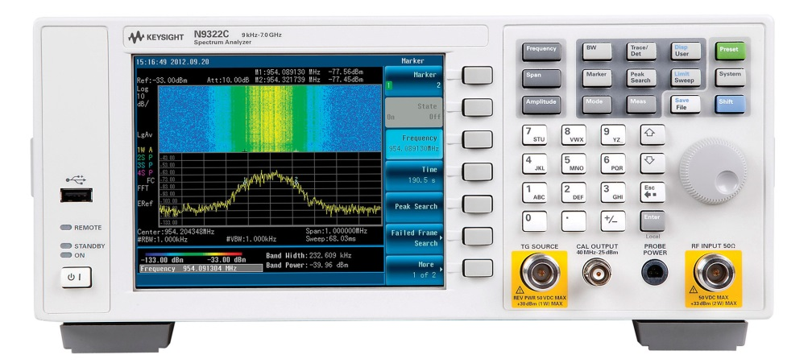
Excurse: Basic Detection Instrument: Digital Spectrum Analyzer
The spectrum analyzer determines the frequency spectrum of a signal:
Steps for an digital, ‘real time’ device:
Low pass filter, typ. f < 3 GHz
Down mixing with
fixed local oscillator
IF filtering
Digitalization: some 10 MSa/s, 16 bit
FFT calculation with
various parameters, windowing, filter ...
band pass filter
0.1 .... 10MHz
low pass
filter
ADC e.g.
≈ 10 MSa/s
FFT
calc.
data
treatm.
mixer
IF gain
input amp.
RF
IF
A
FFT
D
LO
local
oscillator
display
Parameter to be chosen:
FFT parameter, windowing
digital filters
time window
Most often given in traditional parameters
reference level P_{ref} [dBm]
Span f_{span} = f_{stop} - f_{start}
Resolution bandwidth Δf_{res}

Slide 31
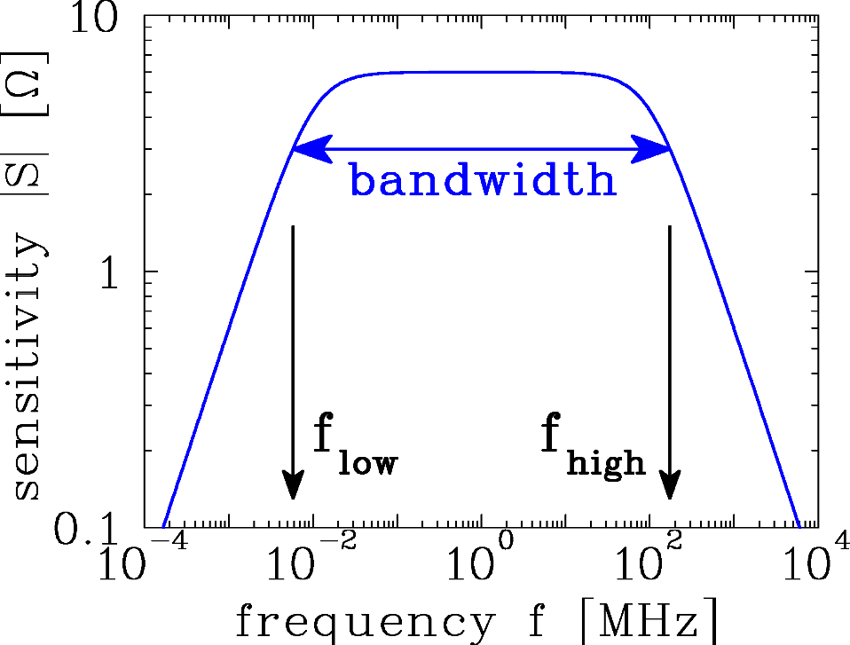
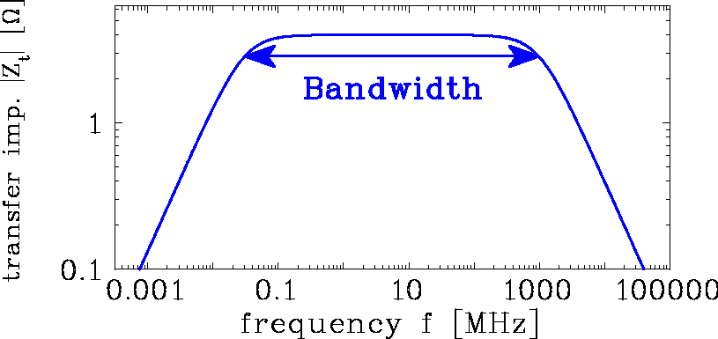
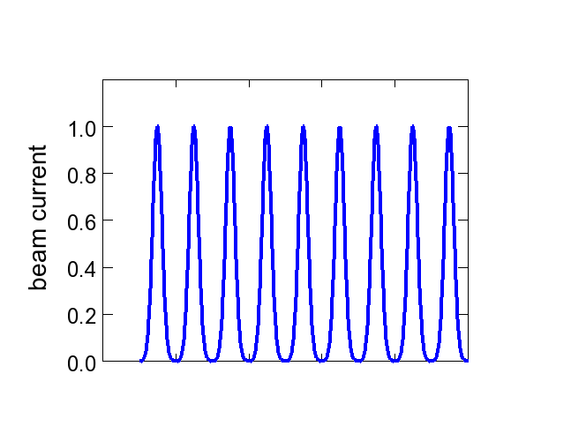
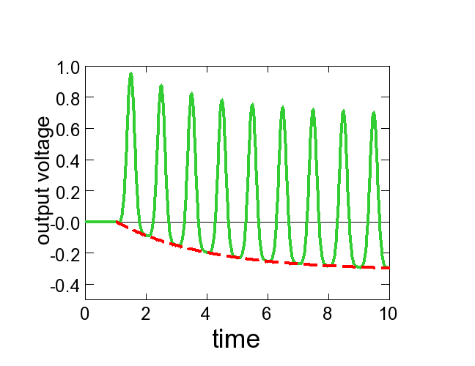

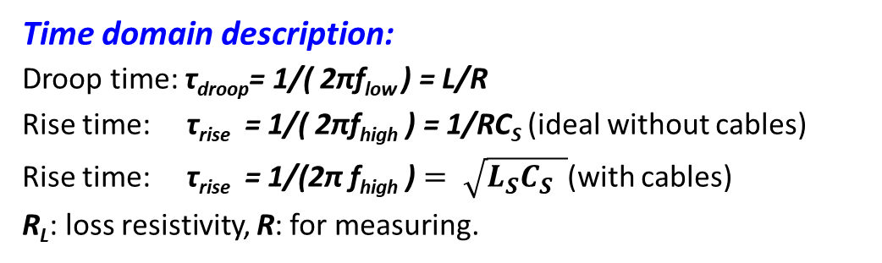

Response of the Passive Transformer: Rise and Droop Time
Time domain description:
Droop time: τ_{droop}= 1/( 2πf_{low} ) = L/R
Rise time: τ_{rise} = 1/( 2πf_{high} ) = 1/RC_{S} (ideal without cables)
Rise time: τ_{rise} = 1/(2π f_{high} ) $= \sqrt{L_{S}C_{S} }$(with cables)
R_{L}: loss resistivity, R: for measuring.
beam current
beam bunch
Bunch train:
beam current
test
pulse
time
time
output volt.
$$τ_{droop}=L/R$$
signal
time
time
$$τ_{rise}=\sqrt{L∙C_{S}}$$
2π f_{low}
=R/L
2πf_{high}
=1/RC_{S}
baseline
Baseline: U_{base} ∝ 1 - exp(-t/τ_{droop})
positive & negative areas are equal

Slide 32
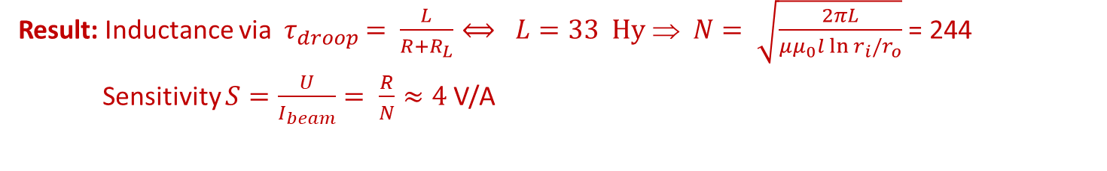
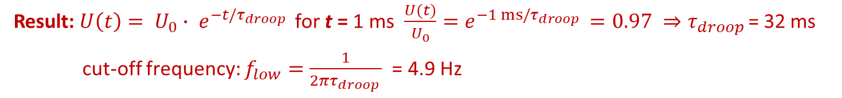
Exercise #3: Transformers for a pulsed LINAC 1/4
Assume a beam with 1 ms macro-pulse length at a LINAC
The current should be measured by a current transformer
The maximum droop should be 3% within 1 ms .
Calculate the required droop time constant and the lower cut-off frequency f_{low} !
Result: $U\left(t\right)= U_{0}∙ e^{−t/τ_{droop }}$ for t = 1 ms $\frac{U(t)}{U_{0}}=e^{−1 ms/τ_{droop }}=0.97 ⇒τ_{droop }$= 32 ms
cut-off frequency: $f_{low}=\frac{1}{2πτ_{droop }}$ = 4.9 Hz
Core size: r_{i} = 30 mm, r_{o} = 60 mm, length l = 40 mm
Permeability of the core: µ_{r} = 10⁵ (µ₀ = 4π·10⁻⁷ Vs/Am)
Passive transformer with R = 1 kΩ termination, R_{L} = 10 Ω loss resistivity
Calculate the number of winding for the given droop and the sensitivity [V/A]!
Hint: 1. Calculate the required inductance L:
2. The inductance of a core with N windings is:
Result: Inductance via ${ τ}_{droop }= \frac{L}{R+R_{L}}⟺ L=33 Hy$ ⇒ $N= \sqrt{\frac{2πL}{μμ_{0}l\ln{r_{i}/r_{o}}}}$ = 244
Sensitivity $S=\frac{U}{I_{beam}}= \frac{R}{N}≈4$V/A
→ Flying wire

Slide 33
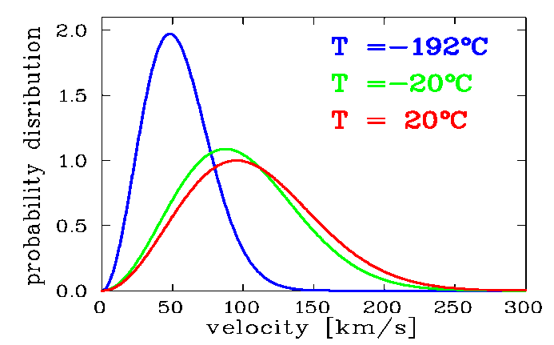
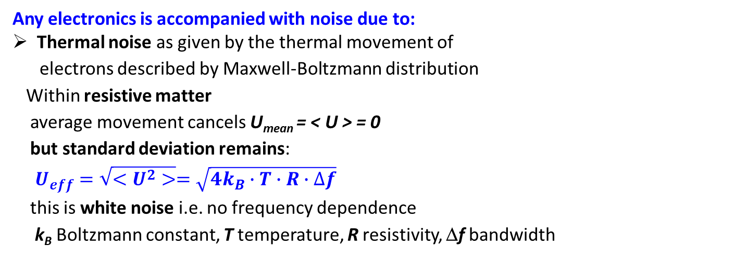


General Noise Sources
Example: Maxwell-Boltzmann distribution of a free electron gas
Any electronics is accompanied with noise due to:
Thermal noise as given by the thermal movement of
electrons described by Maxwell-Boltzmann distribution
Within resistive matter
average movement cancels U_{mean} = < U > = 0
but standard deviation remains:
$U_{eff}=\sqrt{<U^{2}>}=\sqrt{4k_{B}∙T∙R∙∆f}$
this is white noise i.e. no frequency dependence
k_{B} Boltzmann constant, T temperature, R resistivity, Δf bandwidth
R
at T
$$\sim$$
$$U_{∼}$$
Shot noise as given by the fluctuations of finite amount of electrons
for most electronics not important due to large amount of electrons
Flicker noise or ‘1/f - noise’ as given by trapping of electrons in matter
pink noise due to a frequency , ‘corner-frequency’ f_{c} ≈ 3 kHz i.e. 1/f-noise = thermal noise
Disturbance by Electro-Magnetic Interference EMI:
Not noise but pick-up of electro-magnetic waves from the environment
leads unwanted signal deformation and depends on the surrounding
Maxwell-Boltzmann distribution: $\frac{1}{N}∙\frac{dN}{dv}= \frac{4}{\sqrt{π}}{\left(\frac{m}{3k_{B}T}\right)}^{3/2}∙ v^{2} ∙exp \left(− \frac{mv^{2}}{2k_{B}T}\right)⁡$

Slide 34
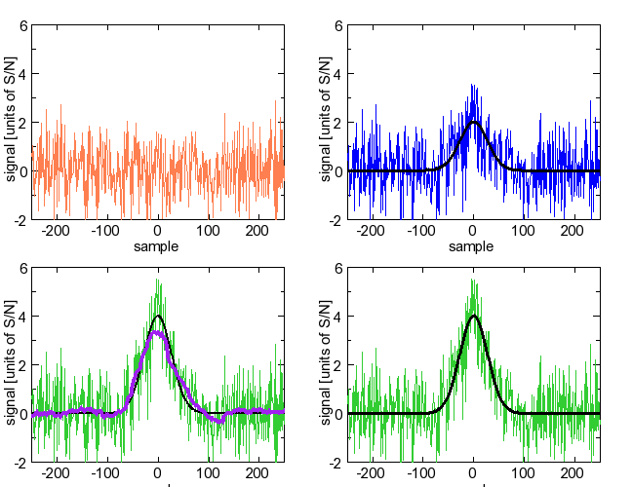
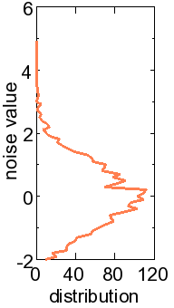
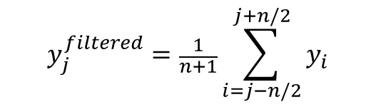
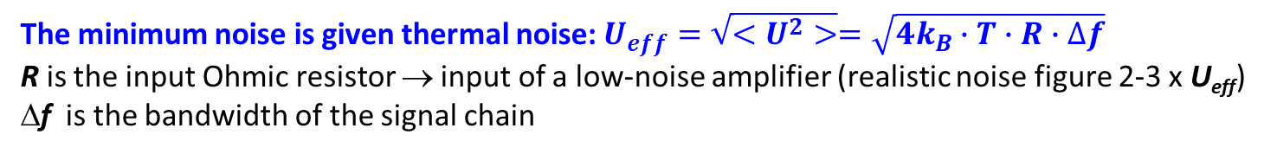
Excurse: Signal to Noise Consideration
The minimum noise is given thermal noise: $U_{eff}=\sqrt{<U^{2}>}=\sqrt{4k_{B}∙T∙R∙∆f}$
R is the input Ohmic resistor → input of a low-noise amplifier (realistic noise figure 2-3 x U_{eff})
Δf is the bandwidth of the signal chain
Simulation:
Broadband ‘white’ noise
For Signal-to-Noise = 2
(Noise: std. deviation, signal: maximum)
⇒ peak just visible
For Signal-to-Noise = 4
⇒ peak well visible
Filtering improves S/N
here: n=50 taps moving average
⇔ bandwidth restriction
signal only
noise only
signal only
S/N=2
S/N=2
U_{eff}
signal only
signal only
filtered
S/N=4
S/N=4
$$y_{j}^{filtered}=\frac{1}{n+1}\sum_{i=j−n/2}^{j+n/2}{y_{i}}$$
sample
sample

Slide 35

Exercise #3: Transformers for a pulsed LINAC 2/4
Assume a beam with 1 ms macro-pulse length at a LINAC
The current should be measured by a current transformer
The maximum droop should be 3% within 1 ms .
Core size: r_{i} = 30mm, r_{o} = 60 mm, length l = 40 mm
Permeability of the core: µ_{r} = 10⁵ (µ₀ = 4π·10⁻⁷ Vs/Am)
Passive transformer with R = 1 kΩ termination, R_{L} = 10 Ω loss resistivity
The upper cut-off frequency is f_{high} = 100 kHz, the lower f_{low} = 100 Hz, R is at T=300 K
Use U_{noise} = (4k_{B}·T·R·Δf)^{1/2} and k_{B} = 1.4·10⁻²³ J/K, bandwidth Δf = f_{high} - f_{low}
Calculate the thermal noise contribution for a resistor at T=300 K!
Calculate the threshold concerning the beam current for a signal-to-noise ratio of S/N = 1!
Result: Thermal noise ${ U}_{noise }= \sqrt{4k_{B}T(R+R_{L})Δf}=1.3 µV$
Beam current for S/N=1 : Sensitivity $I_{beam}=\frac{1}{S}{∙U}_{noise}=0.32 µA$
→Flying wire

Slide 36
‘Active’ Transformer with longer Droop Time
Active Transformer or Alternating Current Transformer ACT:
uses a trans-impedance amplifier (I/U converter) to R ≈ 0 Ω load impedance i.e. a current sink
+ compensation feedback
⇒ longer droop time τ_{droop}
Application: measurement of longer t > 10 μs e.g. at pulsed LINACs
The input resistor is for an op-amp: R_{f}/A << R_{L}
⇒ τ_{droop} = L/(R_{f} /A+R_{L}) ≃ L/R_{L}
Droop time constant can be up to 1 s!
The feedback resistor is also used for range switching.
An additional active feedback loop is used to compensate the droop.

Slide 37
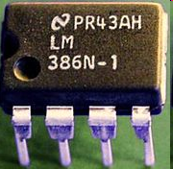
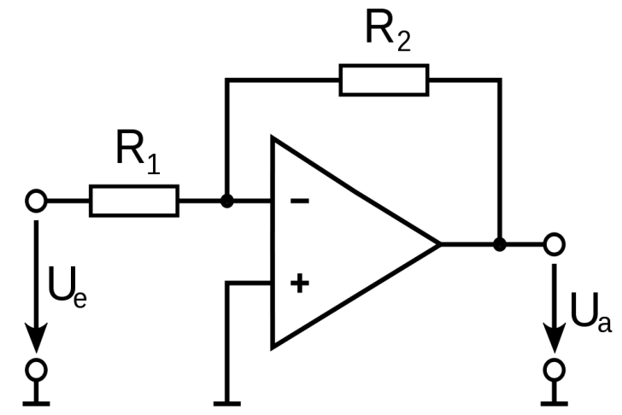
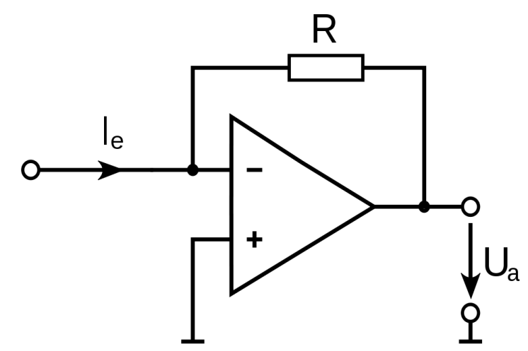
Operational Amplifier Principle
Operational Amplifier: Chips used as a simple equivalent circuit,
but has complex built-in electronics
Without feedback: U_{out} = g_{ol} ∙ ( U₊ - U₋ )
Open loop gain: g_{ol} ≈ 10⁴
With feedback: compensation of both inputs
U₋
U_{out}
U₊
Examples of applications:
Inverting voltage amplifier: U_{out} = g ∙ U_{in} = -R₂ / R₁ ∙ U_{in}
Current-to-voltage converter: U_{out} = - R ∙ I_{in}
i.e. feedback leads current sink at inverting input
I_{in}
U_{in}
U_{out}
U_{out}

Slide 38

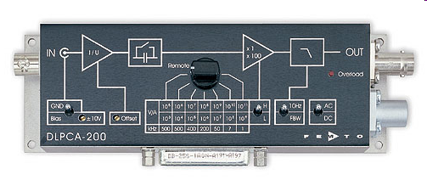
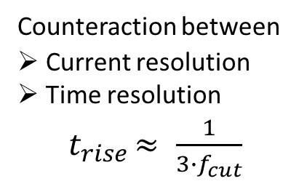
Excurse: Trans-impedance Amplifier = I/U Converter
Current-to-voltage converter: U_{a} = - R ∙ I_{e} ≡ - Z_{t} ∙ I_{e} Z_{t} is called trans-impedance
i.e. feedback leads current sink at inverting input
Z_{t} [V/A] | 10⁵ | 10⁷ | 10⁹ | 10¹¹
Full scale | 100μA | 1μA | 10nA | 100pA
Bandwidth f_{cut} [kHz] | 500 | 400 | 50 | 1.1
Risetime t_{rise} 10 to 90% | 0.7μs | 0.9μs | 7μs | 300μs
Equivalent input noise Noise/full-scale (rel.) Rel.to thermal noise | 10nA 10⁻⁴ ≈ 1 | 450pA 2∙10⁻⁴ ≈ 1 | 3.7pA 3∙10⁻⁴ ≈ 1.6 | 0.8pA 10⁻³ ≈ 10
I_{in}
U_{out}
Counteraction between
Current resolution
Time resolution
${ t}_{rise }≈ \frac{1}{{3∙f}_{cut}}$
→ Flying wire

Slide 39
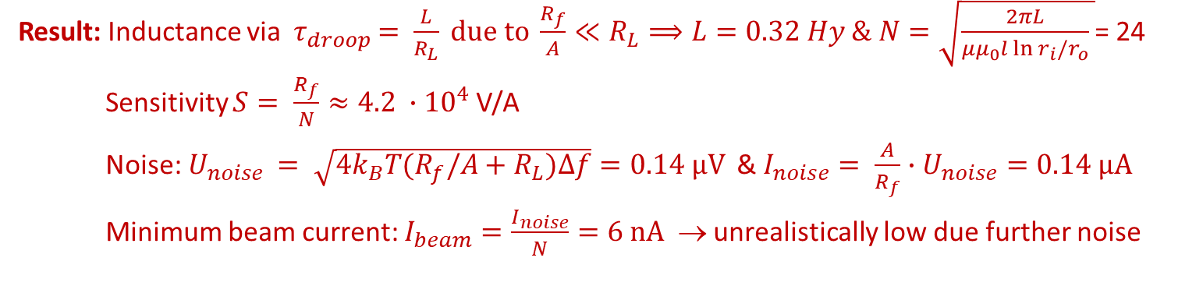
Exercise #3: Transformers for a pulsed LINAC 3/4
As for the previous example: Assume a beam with 1 ms macro-pulse length at a LINAC
The current should be measured by current transformer
Core size: r_{i} = 30mm, r_{o} = 60 mm, length l = 40 mm
Permeability of the core: µ_{r} = 10⁵ (µ₀ = 4π·10⁻⁷ Vs/Am)
The maximum droop should be 3% within 1 ms
The upper cut-off frequency is 100 kHz, the resistor is at T = 300 K
Active transformer with open-loop ampl. A = 10⁶ and R_{f} = 1 MΩ feedback, R_{L} = 10 Ω
Calculate the inductance for the given droop time!
Calculate the number of winding and the sensitivity!
Calculate the threshold concerning the beam current for a signal-to-noise ratio of S/N = 1!
Result: Inductance via ${ τ}_{droop }= \frac{L}{R_{L}} due to \frac{R_{f}}{A}≪R_{L}⟹L=0.32 Hy \& N=\sqrt{\frac{2πL}{μμ_{0}l\ln{r_{i}/r_{o}}} }$= 24
Sensitivity $S= \frac{R_{f}}{N}≈4.2 ∙{10}^{4}$V/A
Noise:$U_{noise }= \sqrt{4k_{B}T(R_{f}/A+R_{L})Δf}=0.14 µV$ & $I_{noise}= \frac{A}{R_{f}}∙U_{noise}=0.14 µA$
Minimum beam current: $I_{beam}=\frac{I_{noise}}{N}=6 nA$ → unrealistically low due further noise
→ Flying wire

Slide 40
Passive Transformer (or Fast Current Transformer FCT)
Simplified electrical circuit of a passively loaded transformer:
A voltages is measured: U = R · I_{sec} = R /N · I_{beam} ≡ S · I_{beam}
with S sensitivity [V/A],
equivalent to transfer function or transfer impedance Z
beam
Equivalent circuit for analysis of sensitivity and bandwidth
(disregarding the loss resistivity R_{L})

Slide 41
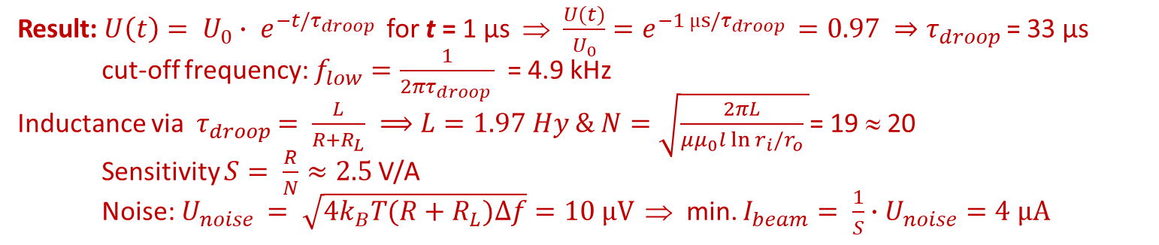
Exercise #3: Transformers for a pulsed LINAC 4/4
Assume a beam with 1 µs pulse length behind a synchrotron to be measured by a transformer
Core size: r_{i} = 30mm, r_{o} = 60 mm, length l = 40mm
The maximum droop should be 3% within 1 µs
Permeability of the core: µ_{r} = 10³ due to µ_{r} ∝ 1/f for f > 100 kHz (µ₀ = 4π·10⁻⁷ Vs/Am)
The upper cut-off frequency is 100 MHz, the resistor is at T=300 K
Fast passive transformer with R = 50 Ω termination
Calculate the droop time and the lower cut-off frequency!
Calculate the inductance for the given droop time!
Calculate the number of winding and the sensitivity!
Calculate the threshold concerning the beam current for a signal-to-noise ratio of S/N = 1!
Result: $U\left(t\right)= U_{0}∙ e^{−t/τ_{droop }}$ for t = 1 µs ⇒ $\frac{U(t)}{U_{0}}=e^{−1 µs/τ_{droop }}=0.97 ⇒τ_{droop }$= 33 µs
cut-off frequency: $f_{low}=\frac{1}{2πτ_{droop }}$ = 4.9 kHz
Inductance via ${ τ}_{droop }= \frac{L}{{R+R}_{L}} ⟹L=1.97 Hy \& N=\sqrt{\frac{2πL}{μμ_{0}l\ln{r_{i}/r_{o}}} }$= 19 ≈ 20
Sensitivity $S= \frac{R}{N}≈2.5$V/A
Noise:$U_{noise }= \sqrt{4k_{B}T(R+R_{L})Δf}=10 µV$ ⇒ min. $I_{beam}= \frac{1}{S}∙U_{noise}=4 µA$
→ Flying wire

Slide 42
Design Criteria for a Current Transformer
Criteria:
1. The output voltage is U ∝ 1/N ⇒ low number of windings for large signal.
2. For a longer droop time, a large inductance L is required due to τ_{droop} = L/R:
L ∝ N² and L ∝ μ_{r} (μ_{r} ≈10⁵ for amorphous alloy)
3. For a large bandwidth the integrating capacitance C_{s} should be low τ_{rise} = √L_{s}C_{s}
Depending on applications the behavior is influenced by external elements:
Passive transformer: R = 50 Ω, τ_{rise} ≈ 1 ns for short pulses
Application: Transfer between synchrotrons : 100 ns < t_{pulse} < 10 μs
Active transformer: Current sink by I/U-converter, τ_{droop} ≈ 1 s for long pulses
Application: macro-pulses at LINACs : 100 μs < t_{pulse} < 10 ms
General:
The beam pipe has to be intersected to prevent the
flow of the image current through the torus
The torus is made of 25 μm isolated flat ribbon
spiraled to get a torus of ≈15 mm thickness,
to have large electrical resistivity
Additional winding for calibration with current source

Slide 43
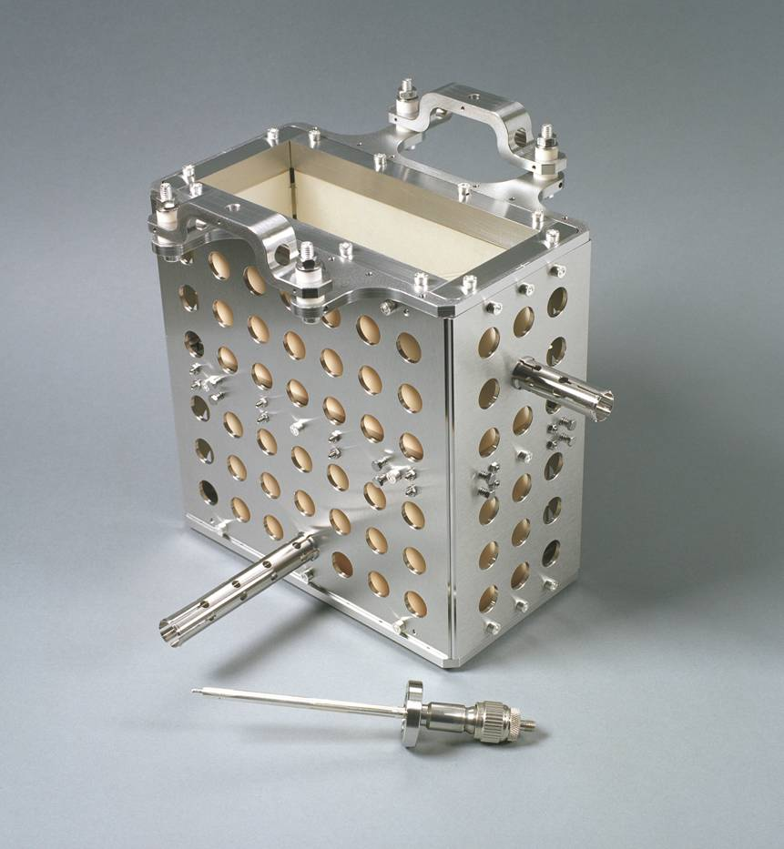
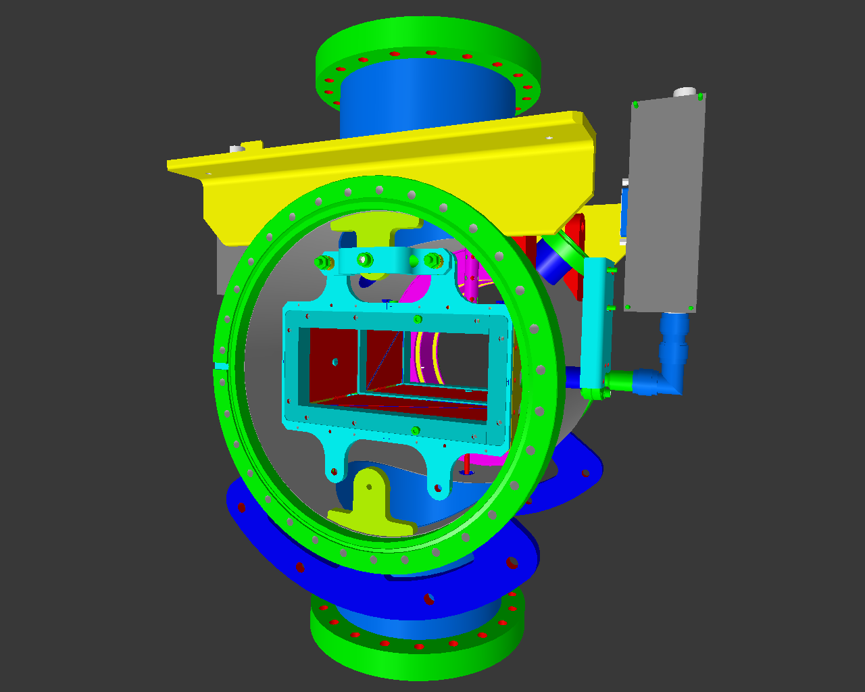

Technical Realization of a Shoe-Box BPM
Technical realization at HIT synchrotron of 46 m length for 7 MeV/u→ 440 MeV/u
BPM clearance: 180x70 mm², standard beam pipe diameter: 200 mm.
Linear Ampl.
70
Right
channel
180

Slide 44
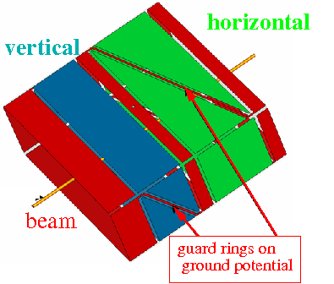

Shoe-box BPM for Proton Synchrotrons
Frequency range: 1 MHz < f_{rf} < 10 MHz ⇒ bunch-length >> BPM length.
Signal is proportional to actual plate length:
In ideal case: linear reading
Size: 200x70 mm²
Shoe-box BPM:
Advantage: Very linear, low frequency dependence
i.e. position sensitivity S is constant
Disadvantage: Large size, complex mechanics
high capacitance

Slide 45
Example of Transfer Impedance for Proton Synchrotron
The high-pass characteristic for typical synchrotron BPM:
U_{im}(ω)=Z_{t}(ω)·I_{beam}(ω)
Parameter for shoe-box BPM:
C=100pF, l=10cm, β=50%
f_{cut}= ω/2π=(2πRC)⁻¹
for R=50 Ω ⇒ f_{cut}= 32 MHz
for R=1 MΩ ⇒ f_{cut}= 1.6 kHz
Large signal strength → high impedance
Smooth signal transmission → 50 Ω

Slide 46


Exercise #8: Signal Estimation for a broad-band BPM 1/2
Assume a shoe-box BPM of length l=20 cm, radius a=10 cm and capacitance C=100 pF
The beam velocity is β= 0.5 and the bunch length is σ_{t}= 100 ns.
Assume a position linear sensitivity of S=1/a i.e. U_{Δ}/U_{Σ} = x/a.
Calculate the transfer impedance for half-cylindrical plate and termination of R = 1 MΩ!
Calculate the sum voltage U_{Σ} for I_{beam} = 1 A !
Calculate the different voltage for x = 1 mm displacement!
Result: Transfer impedance for R= 1 MΩ: $Z_{t}= \frac{l}{βcC}∙ \frac{A}{πa}=\frac{1}{βcC}=6.7 Ω with A= πal$
Sum voltage for I_{beam} = 1 A: U_{Σ} = 2 Z_{t} ⋅ I_{beam} = 13.3 V
Difference voltage for x = 1 mm: U_{Δ} = $\frac{x}{a}$ Z_{t} ⋅ I_{beam} = 67 mV
What are the corresponding values for a termination with R = 50 Ω?
The transfer impedance is not constant, what does it mean? Use Z_{t}(50Ω)=Z_{t}(1MΩ)/20 .
Result: Sum voltage for I_{beam} = 1 A: U_{Σ} = 2 Z_{t} (50⋅$Ω$) ⋅ I_{beam} = 670 mV
Difference voltage for x = 1 mm: U_{Δ} = $\frac{x}{a}$ Z_{t} (50⋅$Ω$) ⋅ I_{beam} = 3.3 mV

Slide 47

Signal Shape for capacitive BPMs: differentiated ↔ proportional
Depending on the frequency range and termination the signal looks different:
High frequency range ω >> ω_{cut}:
⇒ direct image of the bunch. Signal strength Z_{t} ∝ A/C i.e. nearly independent on length
Low frequency range ω << ω_{cut}:
⇒ derivative of bunch, single strength Z_{t} ∝ A, i.e. (nearly) independent on C
Example from synchrotron BPM with 50 Ω termination (reality at p-synchrotron : σ>>1 ns):

Slide 48

Calculation of Signal Shape (here single bunch)
The transfer impedance is used in frequency domain! The following is performed:
1. Start: Time domain Gaussian function I_{beam}(t) having a width of σ_{t}
2. FFT of I_{beam}(t) leads to the frequency domain Gaussian I_{beam}(f) with σ_{f}=(2πσ_{t})⁻¹
3. Multiplication with Z_{t}(f) with f_{cut}=32 MHz leads to U_{im}(f) =Z_{t}(f)∙I_{beam}(f)
4. Inverse FFT leads to U_{im}(t)

Slide 49


Exercise #8: Signal Estimation for a broad-band BPM 2/2
Assume a shoe-box BPM of length l=20 cm, radius a=10 cm and capacitance C=100 pF
The beam velocity is β= 0.5 and the bunch length is σ_{t}= 100 ns.
Assume a position linear sensitivity of S=1/a i.e. U_{Δ}/U_{Σ} = x/a.
Compare the signal strength to the thermal noise (using the theoretical minimum):
The thermal noise voltage at T=300 K is given by
U_{noise} = (4k_{B}·T·R·Δf)^{1/2} and k_{B}=1.4·10⁻²³ J/K within the bandwidth Δf = 100 MHz !
Calculate U_{eff} for R=1 MΩ and R=50 Ω termination !
Result: Thermal noise for R = 1 MΩ: $U_{noise}= \sqrt{4k_{B}TRΔf}=1.3 mV$
Thermal noise for R = 50 Ω: $U_{noise}= \sqrt{4k_{B}TRΔf}=9.2 µV$
A displacement of x = 1 mm should be detected.
What is the minimum beam current I_{beam} to achieve a Signal-to-Noise Ratio S/N=2 !
Result: For R = 1 MΩ & U_{Δ} = 2 U_{noise}(1MΩ): $I_{beam}=\frac{a}{x}∙ \frac{1}{Z_{t}\left(1MΩ\right)}∙U_{noise}=40 mA$
For R = 50 Ω & U_{Δ} = 2 U_{noise}(50Ω): $I_{beam}=\frac{a}{x}∙ \frac{1}{Z_{t}\left(50Ω\right)}∙U_{noise}=5.5 mA$
(not realistic because BPM from a low pass filter f cut (1MΩ)=1.6 kHz: realistic I_{beam} = 5mA)
How can the position resolution be improved significantly? What is the physical reason?

Slide 50


Voltage Spectrum for the BPM and Train of Bunches, R=50 Ω
What is the voltage spectrum for the case of a bunch train with σ_{t}=100 ns and f_{acc}=1 MHz ?
How is the spectrum modified if only part of the buckets are filled?
The spectrum consists of line separated by f_{acc.}
The envelope is given by the voltage signal of a single bunch.
Side bands appear
the power at f_{acc} is
reduced.

Slide 51

Voltage Spectrum for the BPM and Train of Bunches, R=1 MΩ
What is the spectrum and the signal shape for a termination with R=1 MΩ
Sketch and discuss the signal voltage for the case of a bunch train with σ_{t}=100 ns !
The cut-off frequency is
f_{cut}=1/(2πRC)=1.6 kHz
⇒ the proportional shape is recorded
Signal strength for long bunches is U_{signal}=Z_{t}(f>f_{cut}) ·I_{beam}=7 mV
A baseline shift occur i.e. no dc-transmission
Reason for this choice: larger signal independent on bunch length
However: larger thermal noise due to U_{eff}=(4k_{B}·T·Δf·R)^{1/2}

Slide 52
Numerical Value of U_{signal}(t) for Shoe-box BPM
2.2.4 What is the voltage for the case of a single bunch with σ_{t}=1, 10 and 100 ns and
a current of max. value I_{beam}=1mA? (start with σ_{t}=1ns, other case only estimation)
Assume a value of the transfer impedance | Z_{t}(f>f_{cut}) |=7 Ω above f_{cut}=32 MHz.
For short bunches σ_{t}=1 ns → σ_{f}=1/2πσ_{t} = 160 MHz
i.e. main component above f_{cut} ⇒ proportional shape
⇒ U_{signal}=Z_{t} (f>f_{cut}) ·I_{beam}= 7 mV for the σ_{t}=1 ns case
For long bunches with σ_{t}=100 ns → σ_{f}=1/2πσ_{t} = 1.6 MHz
i.e. all frequencies below f_{cut} ⇒ derivative shape
⇒ U_{signal}≈ 0.3 mV for the σ_{t}=100 ns case (i.e. a factor 23 lower!)
For the σ_{t}=10 ns the signal must be calculated:
⇒ U_{signal}≈ 3 mV for the σ_{t}=10 ns case

Slide 53
Exercise #6: Transverse profile by flying wire scanner
Assume a beam of 10¹² protons at 1GeV stored in a synchrotron.
The beam size 10x10 mm with ρ_{beam}=const (for simplification), the revolution time is 1.0 μs.
The wire is made of Carbon with 50x50 μm and scanned with v=10 m/s.
[Carbon is light material of ρ=2.2 g/cm³ density therefore low stopping power.]
The energy loss is dE/ dx= 4.29 MeV/cm.
Calculate the relative energy loss per passage through the wire!
Calculate the average energy loss during the scan! How many passages an ion does in average?
Is this device nearly ‘non-destructive’ ⇔ Are the particles lost?
The maximum power rate to prevent for destruction is 1 W/mm.
Is the wire destroyed?
Repeat the same calculation assuming 10⁹ stored Uranium ions!
The energy loss is now dE/ dx=35640 MeV/cm.
Why is the energy loss so much larger?
Are the particles loss? Is the wire destroyed?
What happens for not fully stripped ions (i.e. ions with some bound electrons)?
What is an appropriate method of profile determination for the Uranium case?

