Slide 1



Solutions for Polls for Beam Diagnostics
JUAS 2025, ESI-Archamps at CERN
Peter Forck (GSI and University Frankfurt)

Slide 2
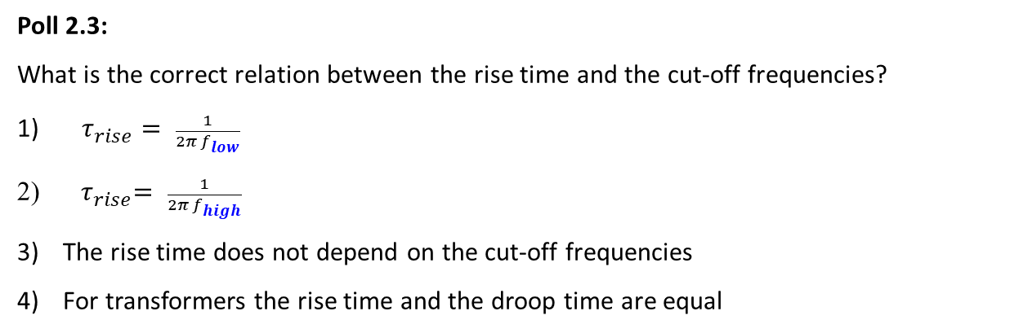
Poll concerning Beam Current Transformers
Poll 2.1:
What is the sensitivity for a current transformer? It is the ratio between the measurable voltage and…
the beam current
the current in the transformer windings
the beam induced current flowing in the vacuum wall
Poll 2.2:
Which statement is correct concerning the comparison of FCT versus ACT?
An FCT has a …
lower bandwidth and a lower sensitivity
higher bandwidth and a lower sensitivity
higher bandwidth and a higher sensitivity
Poll 2.3:
What is the correct relation between the rise time and the cut-off frequencies?
$τ_{rise}= \frac{1}{2π f_{low}}$
${ τ}_{rise}= \frac{1}{2π f_{high}}$
The rise time does not depend on the cut-off frequencies
For transformers the rise time and the droop time are equal
Notes:
2

Slide 3
Poll concerning dc Beam Current Transformers
Poll 2.4:
A DCCT can be used …
at only electro-static accelerators such as Van-de-Graaff, TANDEM or behind an ion source
at only a synchrotron storing a coasting (= un-bunched) beam
at a synchrotron with coasting and bunched beam
Poll 2.5:
The principle of a dc current transformer DCCT is related to …
direct transformation of a dc current
modulation of the particle beam in terms of on ↔ off
modulation of two transformer cores with 180⁰ degree phase shift
modulation of two transformer cores with 0⁰ degree phase shift
Notes:
3

Slide 4

Poll concerning invasive Instrumentation and Faraday Cups
Poll 2.7:
What mean invasive beam instrumentation?
A gas is injected in the beam path
A detector is moved in the beam path
The beam is stopped
A tip is injected at the beam halo
Poll 2.8:
A Faraday Cup is used to measure…
the beam’s electric field
the beam voltage
the beam current
the charge state of an ion beam
Poll 2.10:
Electronic stopping is mediated by…
exchange of electrons between projectile and target
Coulomb interaction
strong interaction
weak interaction
www.menti.com
code: 1352 1839
Poll 2.11:
Comparing the energy loss of protons and heavy ions of same velocity: What is correct?
The energy loss of protons…
are higher than of ions
are lower than of ions
Poll 2.12:
Comparing the energy loss of protons and heavy ions of same velocity: What is correct for energies above 10 MeV/u?
The range of protons are…
longer than of ions
shorter than of ions
Notes:
4

Slide 5
Poll concerning Particle Detectors
Poll 2.13:
What is the basis of an ionization chamber?
It detects only ions
It contains always ions
It is based on ionizations of a gas
Poll 2.14:
What is scintillation? It is light emitted cause by the energy loss of the particles and …
excitation of electronic states
excitation of lattice vibration
related mechanical stress
emission of thermal photon
Poll 2.15:
What is a photomultiplier?
It amplifies directly photons
It only amplifies incoming electrons
It converts photon to electrons
and amplifiers the electrons
4) It contains active electronics (e.g. transistors)
Poll 2.16:
The principle of an SEM is based on:
Emission of electrons from the beam ions
Emission on electrons from an intersecting metal
Back-scattering of beam ions
Emission of ions form an intersecting metal
Notes:
5

Slide 6
Poll concerning Scintillation Screens
Poll 3.1:
What is correct concerning scintillation?
Every material create scintillation photons when a charged particle passes through.
Only proton and ion beams give rise to scintillation photons.
All inorganic material creates the same amount of scintillation photons.
The emitted light is proportional to the energy loss.
Poll 3.2:
Why is optical light from scintillation screens are frequently used?
Every person can check the detector in case of any doubt concerning its functionality.
Generally, only light in this wavelength range is emitted.
High quality optics is available with reasonable financial costs.
All other wavelengths are absorbed by air.
Notes:
6

Slide 7
Poll concerning Optical Transition Radiation
Poll 3.3:
What is correct concerning OTR?
It is only emitted by impact of electron beams.
It is a classical process related to a moving charge.
It depends on the atomic energy levels of the metal atoms.
It involves nuclear processes.
Poll 3.4:
What is correct concerning scintillator & OTR?
Scintillation delivers always more light than OTR.
The spatial resolution of OTR is always better.
Scintillation screen set-up are always much cheaper then set-ups for OTR.
Both methods use comparable optical set-ups.
Notes:
7

Slide 8
Poll concerning Grids and Scanners
Poll 3.5:
The resolution of a SEM-Grid is given by the …
wire thickness
wire spacing
noise contributions for the electronics measuring the current from the emitted secondary electrons
noise from the frequently used beam loss monitors
Poll 3.6:
The resolution of a linear wire scanner is given by the …
wire thickness
wire spacing between the horizontal and vertical direction
noise contributions for the electronics measuring the current from the emitted secondary electrons
noise from the frequently used beam loss monitors
Poll 3.7:
The resolution of a flying wire scanner is given by the …
wire thickness
mechanical deformation of the wire
noise contributions for the electronics measuring the current from the emitted secondary electrons
noise from the frequently used beam loss monitors
Poll 3.8:
The recorded signal from a wire scanner is related to:
In all cases to the emitted secondary electrons
In no case to the emitted secondary electrons
For protons at low energies E_{kin} < 100 MeV to nuclear processes
For protons at high energies E_{kin} > 100 MeV to nuclear processes
Notes:
8

Slide 9
Poll concerning non-invasive Profile Measurement by IPMs
Poll 3.9:
IPMs are based on the residual gas detection of …
electrons only
ion only
alternatively either electrons or ions
simultaneously electrons and ions
Poll 3.10:
Which statement is correct for IPMs?
IPMs are only suited for proton and ion beams.
They require necessarily a vacuum pressure much higher than typical accelerator vacuum.
The electric field is used to detect the residual gas electrons or ion within a ‘4π-geometry’, i.e. all ionic products can be detected
Any collision between beam ions and the residual gas molecule leads to an ionization.
Poll 3.11:
For which beam purpose a magnetic field is applied at IPMs?
In all conditions a magnetic field increases the spatial resolution.
For strong space charge the residual gas electrons is guided by the magnetic field.
For strong space charge the residual gas ions is guided by the magnetic field.
The cyclotron radius is independent on the mass of the moving residual gas particle.
Poll 3.11a:
IPMs are normally not installed a synchrotron light facilities. What might be the reason? Mark the wrong answer!
The spatial resolution is about 50 µm, which is too low for a typical beam size of 10…100 µm.
Electrons do not ionize the residual gas.
The usage of synchrotron radiation monitors is a better method.
Notes:
9

Slide 10
Poll concerning non-invasive Profile Measurement
Poll 3.12:
Which statement is correct for BIF monitors?
BIF monitors are only suited for proton and ion beams.
Any collision between beam ions and the residual gas molecule leads to an fluorescence level and a detectable photon.
BIF monitors needs always a single photon detection via an image intensifier
Different species of residual gas molecules leads to different transition wavelength.
Poll 3.13:
Which statement is correct for IPM and BIF?
Both types have the same signal strength.
They require necessarily a vacuum pressure much higher than within a typical accelerator vacuum tube.
The signal strength scales approximately with the energy loss of the beam particles in gases.
Any ionization of a residual gas atom or molecule leads to the emission of an optical photon.
Notes:
10

Slide 11
Poll concerning Synchrotron Light Monitors
Poll 3.14:
Why are synchrotron light monitors are often used in the optical wavelength range?
Synchrotron light has its maximal emission in the optical wavelength range.
High quality optics is available with reasonable financial costs.
The highest resolution is achieved in the optical wavelength range.
For safety reasons only optical light is allowed in a typical hutch at light sources.
Poll 3.15:
Which method using synchrotron light gives the highest resolution?
Imaging method in the optical range
Imaging methods in the X-ray range
Interference methods in the optical range
→ facility
→ conclusion
Notes:
11

Slide 12
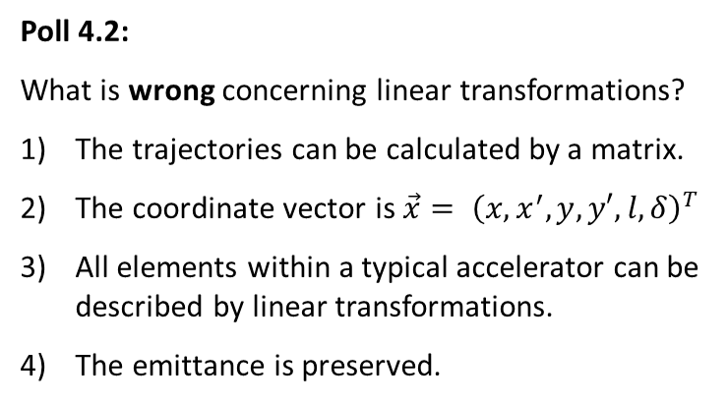
Poll concerning linear Transformations
Poll 4.1:
Which optical elements are non-linear?
Dipole
Quadrupole
Sextupole
Poll 4.2:
What is wrong concerning linear transformations?
The trajectories can be calculated by a matrix.
The coordinate vector is $\vec{x}= {\left(x,x^{′},y,y′,l,δ\right)}^{T}$
All elements within a typical accelerator can be described by linear transformations.
The emittance is preserved.
Notes:
12

Slide 13
Poll concerning Emittance Measurement by linear Transformations
Poll 4.3:
What is correct concerning the emittance measurement by linear transformations?
Only the 2nd statistical moments are determined to characterize the beam distribution.
Any beam distribution can be reliably determined by this methods.
The transfer line can contain any optical element.
In all cases, three measurements are sufficient for an emittance determination.
Notes:
13

Slide 14
Poll concerning normalized Emittance
Poll 4.4:
A typical slit-grid emittance installation can be applied for …
all beams and all energies
electron beams for all energies
proton beam energies below 100 MeV only
proton beam energies above 100 MeV only
Poll 4.5:
Assuming an electron and proton beam of 10 MeV (starting from the same source). What do expect concerning the emittance of both beams?
The electron beam has a smaller emittance than the proton beam.
The electron beam has a larger emittance than the proton beam.
Both beams have the same emittance as it relates to the beam energy.
Notes:
14

Slide 15
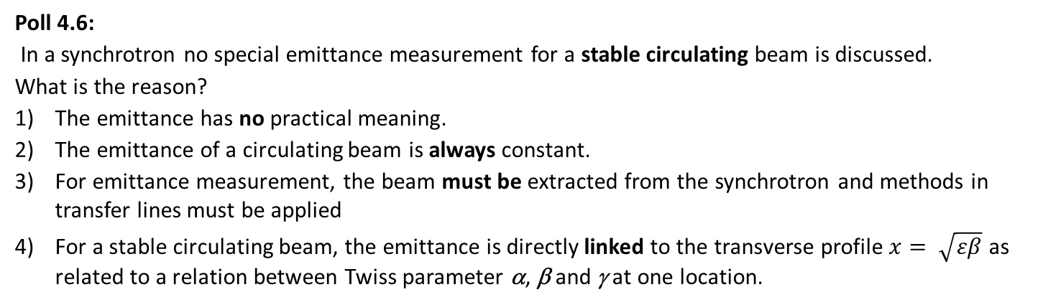
Poll concerning normalized Emittance
Poll 4.6:
In a synchrotron no special emittance measurement for a stable circulating beam is discussed.
What is the reason?
The emittance has no practical meaning.
The emittance of a circulating beam is always constant.
For emittance measurement, the beam must be extracted from the synchrotron and methods in transfer lines must be applied
For a stable circulating beam, the emittance is directly linked to the transverse profile $x= \sqrt{εβ}$ as related to a relation between Twiss parameter α, β and γ at one location.
Notes:
15

Slide 16
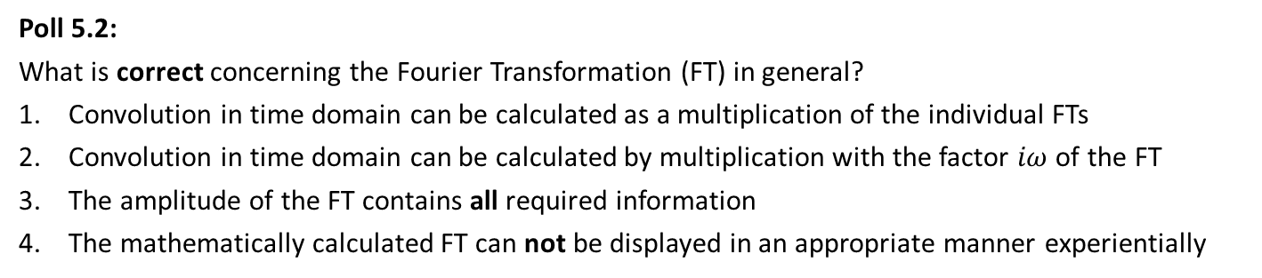
Poll concerning Fourier Transformation
Poll 5.1:
Which statement is wrong?
Fourier Transformation is a integral transformation
Any continuous function can be Fourier transformed
Experimentally, the Fourier Transformation amplitude is observed by a spectrum analyser
Poll 5.2:
What is correct concerning the Fourier Transformation (FT) in general?
Convolution in time domain can be calculated as a multiplication of the individual FTs
Convolution in time domain can be calculated by multiplication with the factor $iω$ of the FT
The amplitude of the FT contains all required information
The mathematically calculated FT can not be displayed in an appropriate manner experientially
Notes:
16

Slide 17
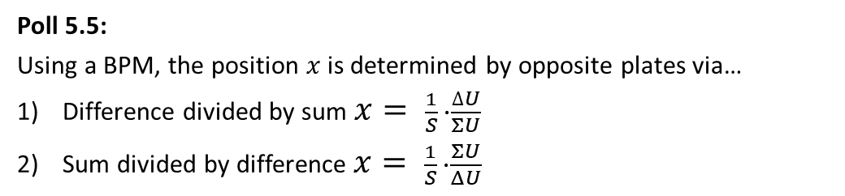
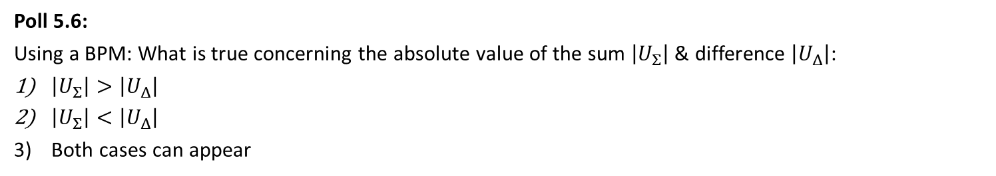
Poll concerning Transfer Impedance
Poll 5.3:
What is correct concerning the transfer impedance?
It can only be applied in frequency domain
It is the ratio between the measurable voltage and beam current
It is the ratio between the measurable voltage and wall current
Poll 5.4:
What is correct concerning BPM measurements in general?
Beams of all types of time structure can be monitored
Only positive beam particles (i.e. protons & ions) can be measured
The BPM circuit acts as a high pass filter
Poll 5.5:
Using a BPM, the position $x$ is determined by opposite plates via…
Difference divided by sum $x= \frac{1}{S} ∙\frac{∆U}{ΣU}$
Sum divided by difference $x= \frac{1}{S} ∙\frac{ΣU}{ΔU}$
Poll 5.6:
Using a BPM: What is true concerning the absolute value of the sum $\left|U_{Σ}\right|$ & difference $\left|U_{Δ}\right|$:
$\left|U_{Σ}\right|>\left|U_{Δ}\right|$
$\left|U_{Σ}\right|<\left|U_{Δ}\right|$
Both cases can appear
Notes:
17

Slide 18
Poll concerning Button BPMs and Signal Shape
Poll 5.7:
What is correct? For button BPMs the position sensitivity S(x) is …
independent with respect to the beam-pipe size
linear with respect to x (independent on the button geometry)
non-linear with respect to x (it depends on the button geometry)
The horizontal S(x) is independent on the vertical beam offset y
Poll 5.8:
Assume a small button BPM with a cut-off frequency of f_{cut} = 3 GHz and a beam bunch of 1 ns length. The signal is proportional …
to the bunch current
to the derivative of the bunch current
to the button diameter
Notes:
18

Slide 19
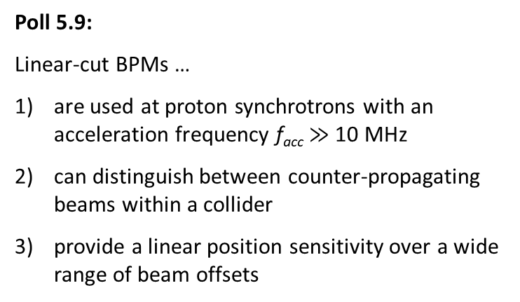
Poll concerning linear-cut BPMs
Poll 5.9:
Linear-cut BPMs …
are used at proton synchrotrons with an acceleration frequency f_{acc} $≫$ 10 MHz
can distinguish between counter-propagating beams within a collider
provide a linear position sensitivity over a wide range of beam offsets
Notes:
19

Slide 20
Poll concerning BPM Electronics
Poll 5.10:
Which type of electronics delivers a better position resolution?
Broadband signal processing
Narrowband signal processing
Poll 5.11:
Within a transfer line between two synchtrotrons, the positon of a single bunch should be measured. What type of electronics is appropriate?
Broadband signal processing
Narrowband signal processing using the synchrotron bunching
The position of a single bunch can not be measured
Poll 5.12:
Assume turn-by-turn position evaluation within a synchrotron. What type of electronics is appropriate?
Broadband signal processing
Narrowband signal processing
Digital signal processing as the only possible solution
Notes:
20

Slide 21
Poll concerning Tune and Lattice Function Measurement
Poll 5.13:
A tune measurement is related to excitation of …
coherent transverse oscillations
incoherent transverse oscillations
coherent longitudinal oscillations
incoherent longitudinal oscillations
Poll 5.14:
The dispersion function along a transfer line is measured using a beam with momentum offset and measuring …
the arrival time at several locations
the beam position at several locations
the beam profile at several locations
nothing, as dispersion is only a theoretical quantity
Poll 5.15:
What is a closed orbit feedback system at a synchrotron?
The alignment of the trajectory of the injected beam during its first turn
The correction of individual bunches during storage
The correction of the beam position averaged over more than 1000 turns
The mechanical movement of the synchrotron magnets
Notes:
21

Slide 22
Poll concerning longitudinal Phase Space and ToF
Poll 6.1:
Compare the longitudinal to the transverse phase space:
The relative momentum spread Δp/p₀ corresponds to the transverse …
beam centre
beam width
beam divergence
beam emittance
Poll 6.2:
The mean energy can be measured via…
two BPMs for relativistic beams only
two BPMs for non-relativistic beams only
two SEM-Grids and the known dispersion
Poll 6.3:
What is correct for a proton facility comprising of several LINAC cavities? ToF measurement are used to align …
the beam position
the quadrupole settings
all cavity amplitudes
the last cavity amplitude to reach the correct final energy
Notes:
22

Slide 23
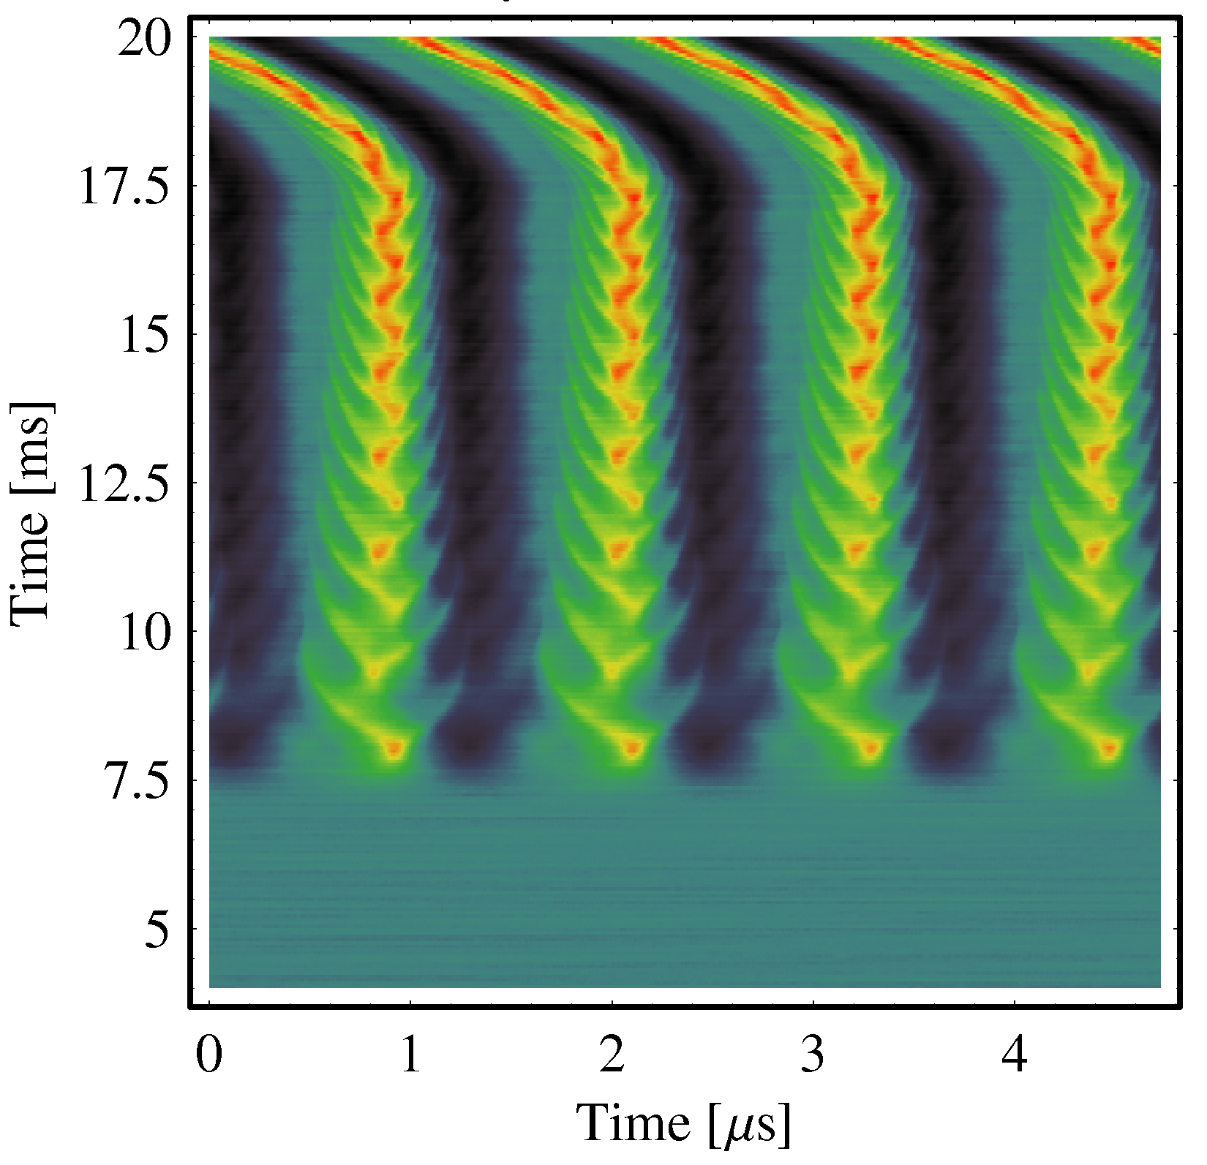
Poll concerning longitudinal Mismatch, long. Emittance
Poll 6.4:
Assume a LINAC facility.
The bunch length variation by a buncher followed by a bunch shape measurement corresponds to an transverse emittance measurement of type
Quadrupole variation
Three grid method
Slit-grid method
Poll 6.5:
Assume an injection from a proton LINAC to a synchrotron.
What happens if injection energy is not correct?
(i.e. the particles’ revolution frequency differs from the acc. frequency)
The particles perform coherent synchrotron oscillations
The particles perform incoherent synchrotron oscillations
The tune is changed significantly
Nothing, as long as the particles stay within the longitudinal acceptance
f_{acc} shift by 0.2% of nominal value
⇒ Coherent longi. oscillation
Notes:
23

Slide 24
Poll concerning Electron Beam Bunch Length Measurement
Poll 6.6:
Optical synchrotron light is emitted from …
electrons only
electron everywhere along their path
highly relativistic neutral particles if the Lorentz factor is larger than 1000
any charged particles on a curved trajectory
Poll 6.7:
A question related to a typical bunch length at circular synchrotron light sources with f_{rf}=500 MHz: What is the time resolution of a typical streak camera?
1 fs
1 ps
1 ns
Poll 6.8:
The short bunches with 100 fs length at FEL-facilities are measured with electro-optical methods. Could the same method be applied for 10 MeV proton beams with a bunch length of 100 ps?
Yes, assuming the number of particle per bunch is sufficient
Yes, but the method is very cumbersome and more simple method are available
No, protons at that energy don’t emit synchrotron light in the optical range
No, the transverse electric field does not represent the particle distribution
Notes:
24

Slide 25
Poll concerning BLM Types
Poll 7.3:
Which type of BLM can distinguish between beam particles and secondaries?
Scintillator
Ionization chamber
Solid state diodes
Cherenkov detectors
Poll 7.1:
Which type of BLM measures the dose directly?
Scintillator
Ionization chamber
Solid state diodes
Cherenkov detectors
Poll 7.2:
Which type of BLM is most sensitive to neutrons?
Scintillator
Ionization chamber
Solid state diodes
Cherenkov detectors
Notes:
25

Slide 26
Poll concerning Usage of BLMs
Poll 7.4:
Which answer is wrong? Beam loss monitors are used …
to prevent for unnecessary activation
as a system to restrict people access outside of the accelerator shielding
for quench protection for super-conducting components
for beam alignment
Notes:
26

