Slide 1

Beam Diagnostic
case study : HEBT
Antoine BEAUDOUIN, Arnaud CIEPLAK, Lisa Beate DINGELDEIN, Florent HERVY, Tomas Albert PASTOR JURO, Vincent PRUY, Jason ROMAIN
07/03/25
Notes:
Every of the 7 Points: What Detector?, Why?, and where?

Slide 2
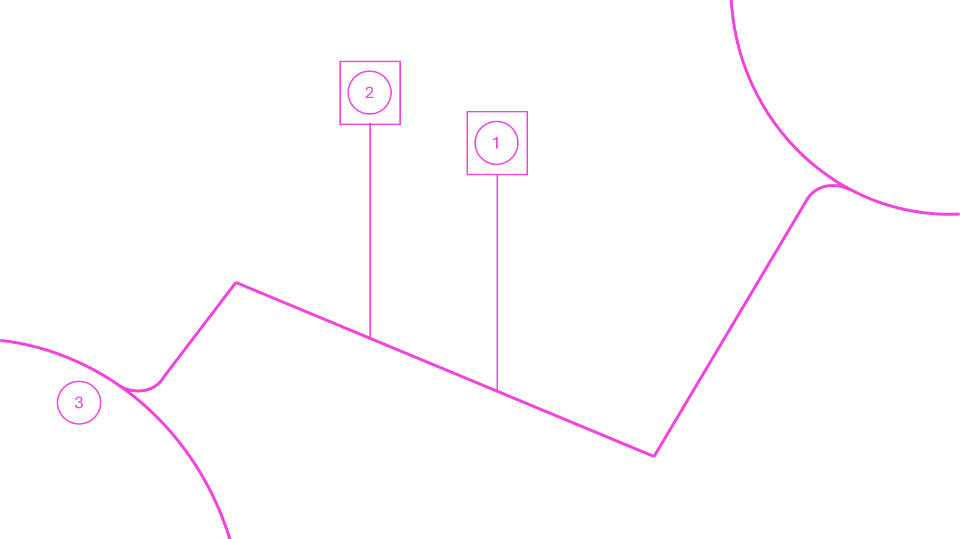
Beam Parameters
Energy | 1 GeV
Transverse beam size | 3-5 mm
Length | 300 m
Current | 100 nA-50 mA
Longitudinal beam size | 10.58 ns

Slide 3
Extraction Parameters
Slow extraction [1] | Low Current: 0.64 MA
Fast single-turn extraction (4 bunches) [2] and [3] | Frequency: 5.3 MHz
Either fast extraction
Or slow extraction
Notes:
Slow extraction: Can be considered as a DC Beam. Defining Factor is the Current
Fast Extraction: Defining Factor is the Frequency. Look at the Bandwidth of the Detector

Slide 4
Beam Current Measurements
2 different Devices
  Slow Extraction:
  1*: Scintillator
  Fast Extraction:
  1´: FCT
1´
1*
1´
1*
1´
Notes:
Slow Extraction: Scintillator
Fast Extraction: Fast Current Transformer

Slide 5
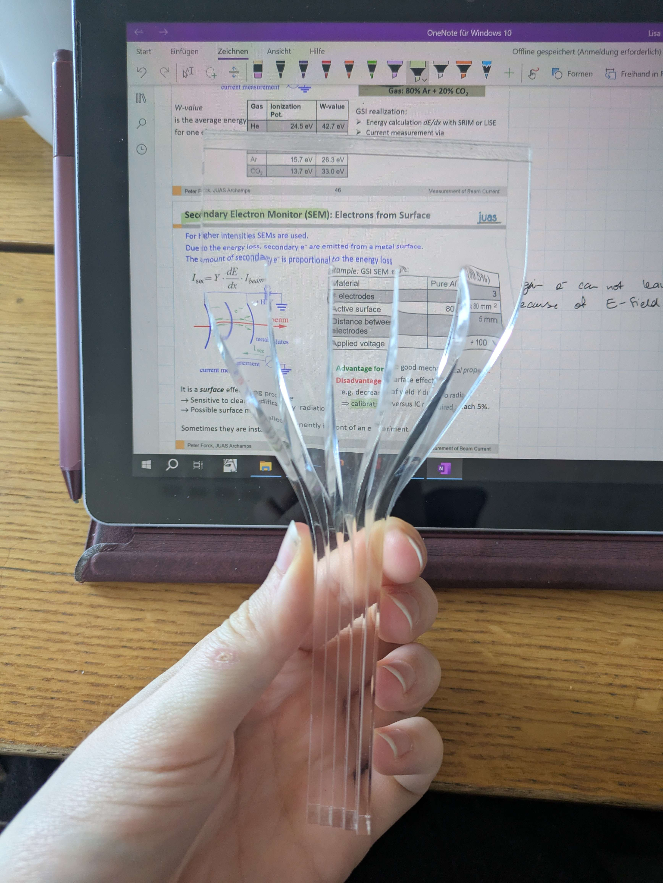
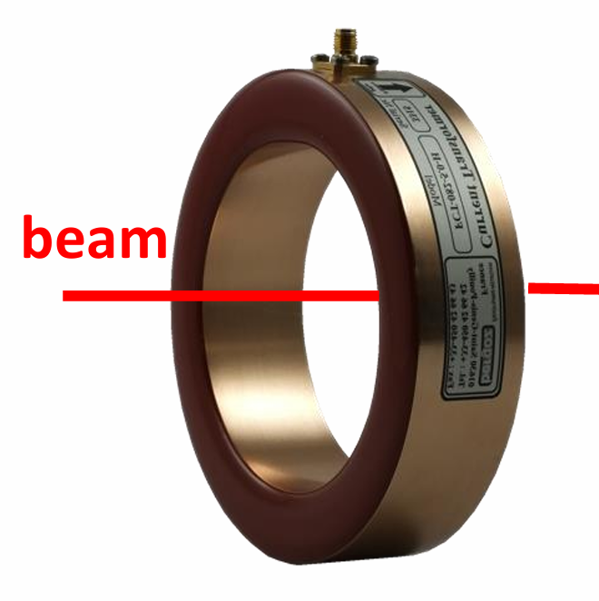
Beam Current Measurements
2 different Devices
  Slow Extraction:
  1*: Scintillator
  Fast Extraction:
  1´: FCT
1´
1*
1´
1*
1´
Notes:
Slow Extraction: Scintillator
Fast Extraction: Fast Current Transformer

Slide 6
2. Transverse Emittance
  3-Grid Method
  only needed once
2

Slide 7
3. Bunch length
  Only for fast extraction
  Button Pick-Up
3
3

Slide 8
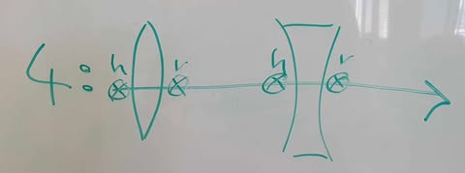
4. BPM
  Only for Fast Extraction
  Shoe-Box
One before and one after each quadrupole

Slide 9
5. Beamloss detector
  Ionization Chamber 5 :
Measurement of absolute dose
No need of calibration (scintillator)
  Scintillator (5) :
scintillator also for current measurement
5
(5)
(5)
5
5
5
5
5

Slide 10
6
6
6. Transverse Profile Measurement
  Scintillation Screen
Convenient for every type of beam
Various intensities possible
6

Slide 11
7. Momentum & Energy
Magnetic Spectrometer
> Add a magnet
7
7
7
7
Notes:
Not Time of Flight
thats too many

Slide 12
8. Longitudinal Emittance
  Buncher
8

Slide 13
Current | FCT | 1’
 | Scintillator | 1*
Transverse Emittance | 3-Grid method | 2
Butch Length | Button Pick-up | 3
Beam Position Monitor | Shoe-box (fast) | 4
1’ 3
5 6
7
1* (5)
6 7
1* 1’
2 (5)
7 8
5
7 3 5
1’ 6
5
Beam loss (in 1*) | Ionization chamber or Scintillator | 5 or (5)
Transverse Profile | Scintillating screen | 6
Momentum and Energy | Magnetic spectrometer | 7
Longitudinal Emittance | Buncher | 8
5
5

