Slide 1
Second synchrotron instrumentation
JUAS Course 2
Group 4
24.02.2025

Slide 2
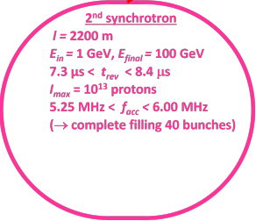
2nd synchrotron
Gamma [ 2.066, 107.6 ]
Beta [ 0.875, 0.999 ]

Slide 3
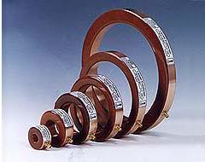
Beam current measurement
Proton energy: 1 GeV - 100 GeV
Beam current: 0.191 A - 0.219 A
→ no Faraday cups
→ non-invasive measurements are needed
Bandwidth: 6 MHz - 5.25 MHz = 0.75 MHz
→ we can use a Fast Current Transformer (FCT)
Rise time: 212 ns

Slide 4
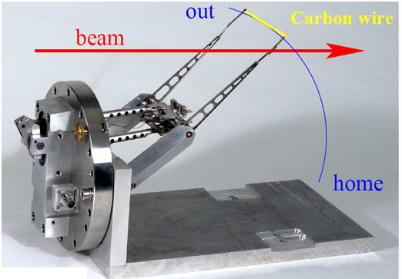
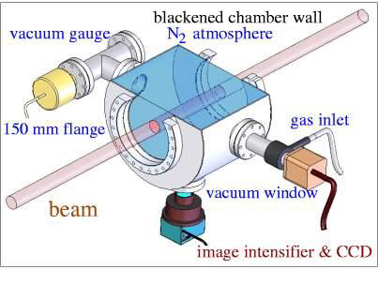
Beam transverse profile
Proton 1GeV-100GeV, 200 mA
=> few SR, heat
Optical Transition Radiation: not enough synchrotron radiation
SEM-Grid: Not fitted for synchrotron (heat)
Linear wire: for low energy protons (because of heat)
Fast wire scanner
  Possible it is for high E synchrotron and almost none destructive
Beam Induced Fluorescence Monitor:
  Easier to install than Ionization Profile Monitor
  Drawback: sensitive to straylight and ionizing radiation
Scintillation screens:
  Invasive system
  Damage with time
  cheap (in case of malfunction)

Slide 5
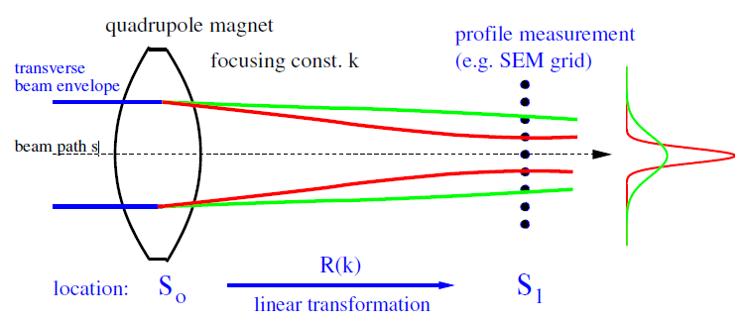
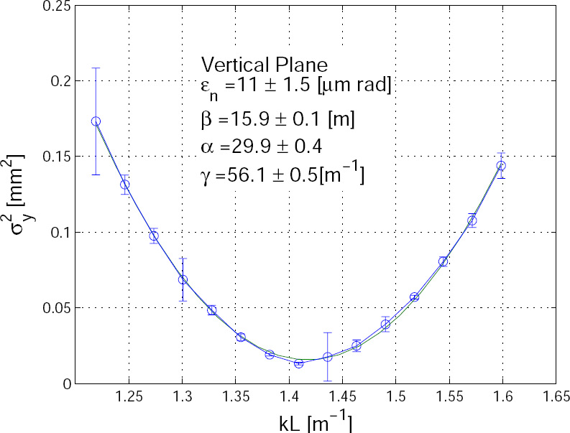

Transverse Emittance Measurement
Quadrupole variation (non-destructive method)
Expected emittance with betatron function 10 m using 3-1 mm transverse size -> 0.9-0.1 mm.rad
Assumptions: well aligned beam, elliptical shape

Slide 6

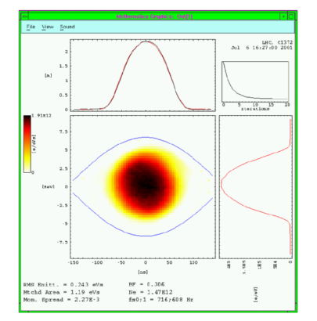
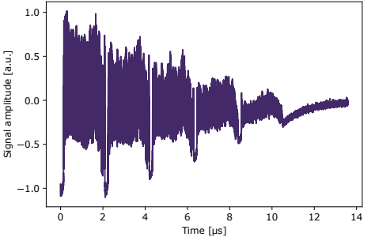
Measuring longitudinal parameters
~ 120 kHz
High current : Wall Current Monitors (~ GHz bandwidth)
Bunch length + profile measurements, ns resolution (bunch length 10 ns)
Synchrotron freq ~ 100 Hz, beam stored ~ 3-4 s
emittance by tomography

Slide 7
The Beam Position Monitor: Capacitive Linear Cut (Shoe Box)
Frequency range compatibility, Linear position sensitivity, Non-destructive
Cut-off frequency : 31.8 MHz
Transfer impedance : Zt (f = 5.25 MHz) = 0.175 Ω →
Zt (f = 6.00 MHz) = 0.200 Ω →
Thermal Noise Voltage : 0.78 μV
BPM operates in high pass regime
Umin = 0.033 V
Umax = 0.044 V
Expected Signal Strength

Slide 8
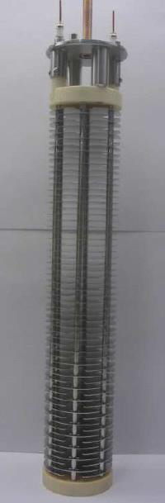
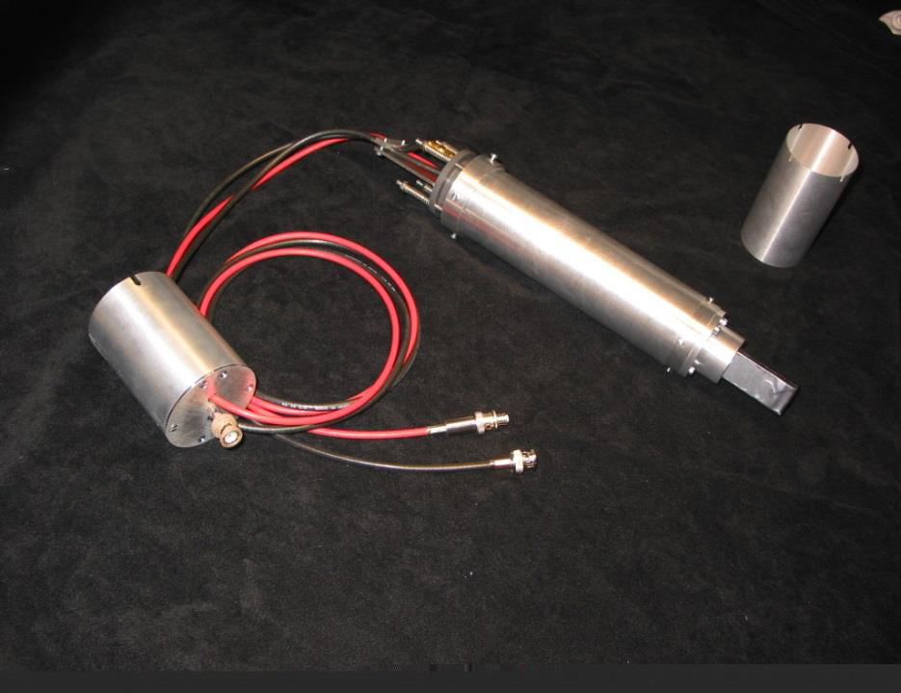
Beam Loss
Scintillators
  fast response (ex: transition)
    interlock signal
  optical signals : chap and andy
Ionization Chambers
  accurate dose measurement
    security
  transverse beam emittance
    fast wire
Scintillators
Ionization Chambers

Slide 9
Thanks for your attention

