Slide 1



Exercise as preparation for the exam
JUAS 2025, ESI-Archamps at CERN
Peter Forck (GSI and University Frankfurt)

Slide 2
Program of today’s interactive Session
Possible subjects of interactive session for exam preparation:
Discussion and some examples from pervious exams
General questions and answers to beam diagnostics
Discussion of polls presented during lecture and some further polls
Further exercises form exercise document as interactive discussion
(‘Exercises_instrumentation.pdf’ posted in INDICO
‘Answers_instrumentation.pdf’ will be posted today)
After topic 1, please decide on the topic 3 or 4 as not all can be realized!
Contributions (questions, comments, remarks) are required from your side.
This session is your event!

Slide 3
Style of the Lecture and Expectation to You
My perspective concerning the style of the lecture:
Presentation of the basics
Some extension to cover recent developments to make it actual
Possible problem: How to distinguish between both? → Exams questions only on basics
Usage of the book:
Description in more detailed manner than on the slides
Might of usage later on when you are working at a accelerator
⇔ might be not so useful for the exam
Exam preparation:
Review the slides
Answer the polls again, you might answer some more presented questions
Try to work on the printed exercises (might be too much for Monday)
⇒ Look to the schematic plots and diagrams and
⇒ Explain the topic yourself or your colleagues

Slide 4
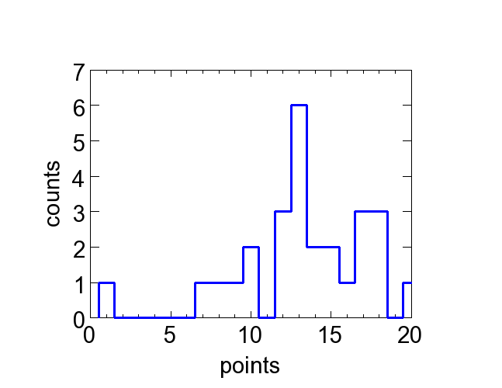
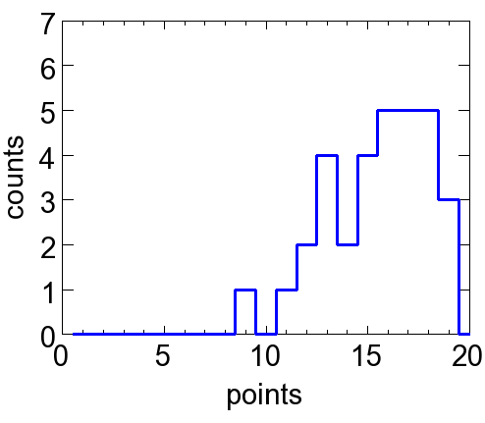
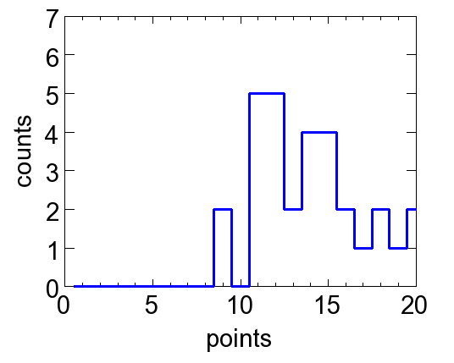
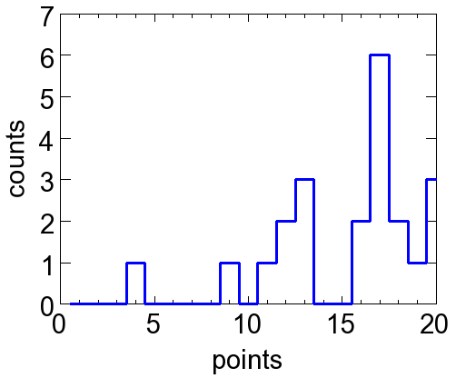
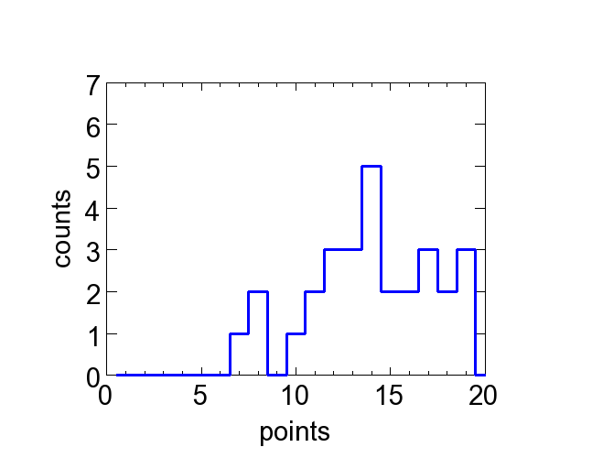
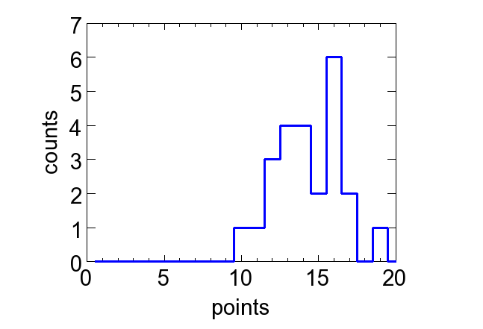
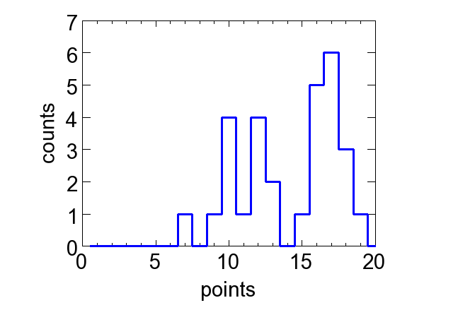
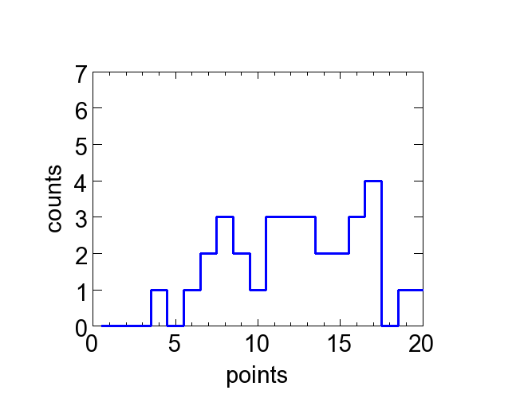
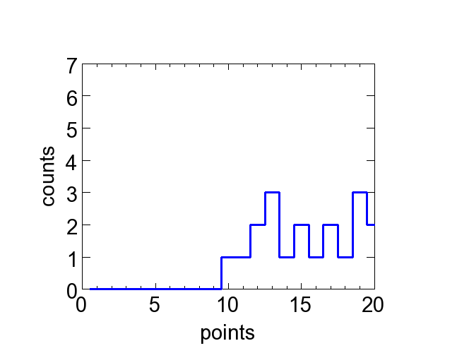
Results of last Years’ Examinations in Beam Instrumentation
Distribution of marks in the last years, 20 points maximal.
2017
µ=13.2
σ=4.2
2024
µ=15.5
σ=2.5
2023
µ=14.0
σ=3.0
2022
µ=15.3
σ=4.0
2021
µ=14.3
σ=2.2
2020
µ=14.2
σ=3.3
2019
µ=14.0
σ=3.5
2016
µ=12.4
σ=4.0
2019 to 2024: Distribution of mean value $\overline{µ}=14.6$and standard deviation $\overline{σ}=3.1$
2018
µ=15.2
σ=3.3

Slide 5
Exercise Example (a bit too simple): Types of BPMs
Assume a proton synchrotron with f_{acc} = 1 MHz acceleration frequency.
Which type of BPM would you install? Give the main reason for your choice.
Answer 1:
Linear-cut BPMs are installed in most low-frequency synchrotrons.
The main reason is the linearity of the position sensitivity.
Additionally: For a high impedance termination, a large signal can achieved due to the low f_{cut}
→ expected answer
rating: 100 %
Answer 2:
Button BPMs are generally a good choice and are e.g. installed at LHC.
The reason is that the beam pipe diameter and shape in only weekly modified to prevent for any wake-field excitation.
→ unexpected answer
rating: almost 100 %
Not correct: For a typical bunch length and beam pipe size, the frequency components are much smaller than the cut-off frequency of the beam pipe (interpreted as a hollow wave-guide).
However: Bunch length was not specified. It could be important for short bunches
(e.g. LHC, f_{acc} = 200 MHz). Moreover, wake-field contributions were not discussed in the lecture.
Answer 3:
Button BPM.
→ wrong answer
rating: 0 %
Answer 4:
Linear-cut BPM.
→ partly answered
rating: ≈ 30 %

Slide 6
Exams Example, Exercise #2: Current Measurements for Proton Beam
Give an appropriate method for current measurement for a proton accelerators:
(a) Behind the ion source, E_{kin} = 100 keV, I_{beam} = 100 mA, pulse duration of t_{pulse} = 1 ms.
Faraday Cup or active transformer, the beam power is sufficient low for a Faraday Cup,
and the beam current sufficient high for a transformer
(b) Behind the ion source with the same parameter as under a) but a I_{beam} = 10 nA.
Faraday Cup, the current is too low for a transformer
(c) Behind a proton LINAC, E_{kin} = 100 MeV, I_{beam} = 100 mA, pulse duration of t_{pulse} =1 ms.
Active transformer due to the high beam power
(d) Permanent monitoring during the 1 s long acceleration within a synchrotron from
E_{kin} = 100 MeV → 1 GeV, circulating beam I_{beam} ≈ 100 mA.
DCCT for a permanent monitoring, or using a FCT and integrating the bunch signal
(e) The circulating current within a synchrotron after acceleration and de-bunching
DCCT no other choice
(f) Fast extraction from a synchrotron in a transport line of 10¹² protons within 1 μs.
Passive transformer, well suited for a bunched beam detection,
Faraday Cup not possible because above pion production threshold.
(g) The same parameters as under f) but with a duration of 10 s by ’slow extraction’.
Ionization chamber

Slide 7
Exam Example: Ionization Profile Monitor IPM (1/2)
The properties of an IPM should be discussed (3 points out of 20):
(a) For what purpose IPMs are used?
IPMs are used for non-invasive profile measurement either at high current LINACs (to prevent for material destruction) or within a synchrotron to measure the undisturbed beam
(b) Describe briefly the principle of an IPM.
Due to the beam’s energy loss, residual gas atoms or molecules are ionized. With the help of an external electric field, the residual gas ions or electrons are accelerated towards an single particle detector with spatial resolution.
(c) Which modification is required for intense beams and why?
The electric field of the beam is comparable to the external electric field. The trajectory of a residual gas ion or electron is influenced such that the spatial distribution does not reflect the particle distribution.
An additional external magnetic field can be applied which guide the electrons on their trajectory towards the detector.

Slide 8
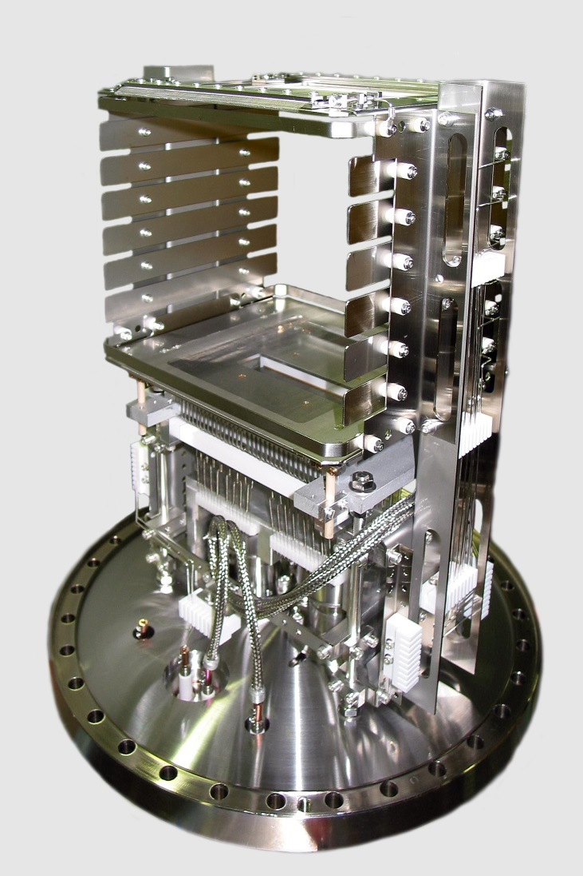

Ionization Profile Monitor at GSI Synchrotron
Non-destructive device for proton synchrotron:
beam ionizes the residual gas by electronic stopping
gas ions or e⁻ accelerated by E -field ≈1 kV/cm
spatial resolved single particle detection
Realization at GSI synchrotron:
One device per plane
175mm
HV electrode
voltage divider
+ 6 kV
R
+ 5 kV
beam
beam
+ 4 kV
175
mm
$$\vec{E}$$
+ 3 kV
MCP:
100 x 48 mm²
ion
e.g. H⁺
+ 2 kV
+ 1 kV
0 kV
63 wires,
2.1mm spacing
MCP
anode
position readout
HV feedthru
Typical vacuum pressure:
Transfer line: N₂ 10⁻⁸... 10⁻⁶ mbar ≅ 3⋅10⁸...3⋅10¹⁰cm⁻³
Synchrotron: H₂ 10⁻¹¹...10⁻⁹ mbar ≅ 3⋅10⁵...3⋅10⁷ cm⁻³
∅300 mm flange

Slide 9
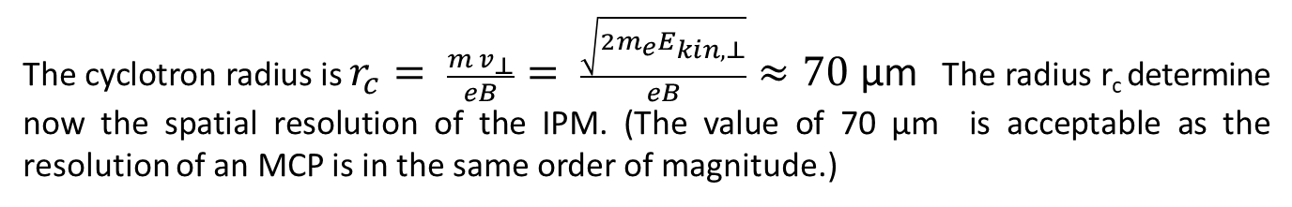
Exam Example: Ionization Profile Monitor IPM (2/2)
(d) Assume and electron is emitted from the residual gas atom with an kinetic energy of E_{kin,⊥} = 5 eV perpendicular to an external magnetic field of B = 0.1 T.
Calculate the cyclotron radius. Why is this quantity of importance?
(You might need: electron mass m_{e}c² = 511 keV, elementary charge e = 1.6 · 10⁻¹⁹ C, velocity of light c = 3 · 10⁸ m/s.)
The cyclotron radius is $r_{c}= \frac{{m v}_{⊥}}{eB}= \frac{\sqrt{2m_{e}E_{kin, ⊥}}}{eB}≈70$ µm The radius r_{c} determine now the spatial resolution of the IPM. (The value of 70 µm is acceptable as the resolution of an MCP is in the same order of magnitude.)
(e) IPMs are seldom used at high energetic electron accelerators. Can you guess why?
Due to the limited resolution as given by the MCP of about 100 μm, IPMs do not deliver sufficient spatial resolution for an electron beam of typically size σ < 100 μm.

Slide 10
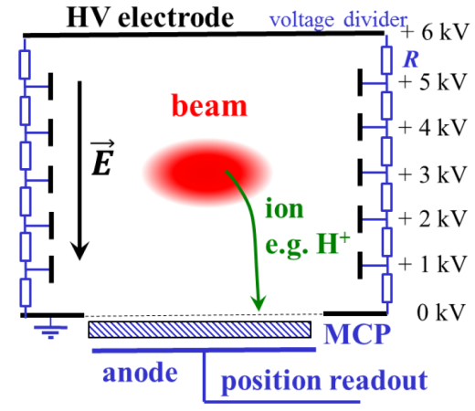
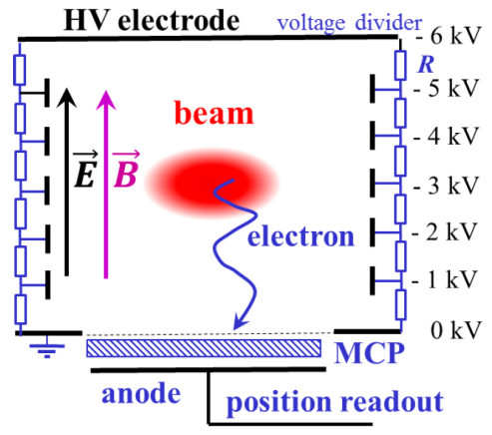
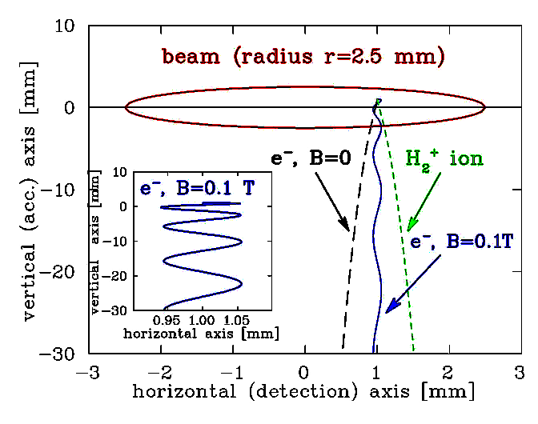
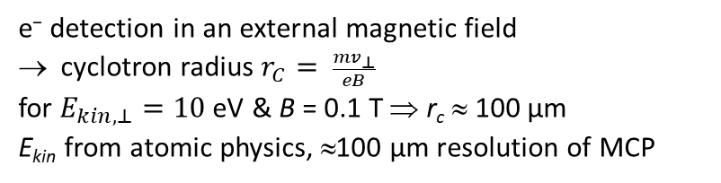
Electron Detection and Guidance by Magnetic Field
Ion detection mode:
Electron detection mode:
⇒ broadening by beam’s electric field
e⁻ detection in an external magnetic field
cyclotron radius $r_{C}= \frac{mv_{⊥}}{eB}$
for $E_{kin,⊥}=10$eV & B = 0.1 T ⇒ r_{c} ≈ 100 µm
E_{kin} from atomic physics, ≈100 µm resolution of MCP
7⋅ 10¹⁰ charges
per 10 m bunch
Time-of-flight: ≈1 - 2 ns ⇒ 2 - 3 cycles.
B-field: Dipole with large aperture
→ IPM is expensive & large device!

Slide 11
Beam Quantities and their Diagnostics I
LINAC & transport lines: single pass ↔ Synchrotron: multi pass
Electrons: always relativistic ↔ Protons/Ions: non-relativistic for E_{kin} < 1 GeV/u
Depending on application: low current ↔ high current
Overview of the most commonly used systems:
Beam quantity |  | Transfer line | Synchrotron
Current I | General Special | Transformer, dc & ac Faraday Cup Particle Detectors | Transformer, dc & ac Pick-up Signal (relative)
Profile x_{width} | General Special | Screens, SEM-Grids Wire Scanners, OTR Screen MWPC, Fluorescence Light | Ionization Profile Monitor Wire Scanner, Synchrotron Light Monitor
Position x_{cm} | General Special | Pick-up (BPM) Using profile measurement | Pick-up (BPM)
Transverse Emittance ε_{trans} | General Special | Slit-grid Quadrupole Variation Pepper-Pot | Ionization Profile Monitor Wire Scanner Transverse Schottky

Slide 12
Beam Quantities and their Diagnostics II
Beam quantity |  | Transfer line | Synchrotron
Bunch Length Δφ | General Special | Pick-up Secondary electrons arrival Electro-optical laser mod. | Pick-up Wall Current Monitor Streak Camera Electro-optical laser mod.
Momentum p and Momentum Spread Δp/p | General Special | Pick-ups (Time-of-Flight) Magnetic Spectrometer | Pick-up (e.g. tomography) Schottky Noise Spectrum
Longitudinal Emittance ε_{long} | General Special | Buncher variation Magnetic Spectrometer | Pick-up & tomography
Tune and Chromaticity Q, ξ | General Special | --- --- | Exciter + Pick-up Transverse Schottky Spectrum
Beam Loss r_{loss} | General | Particle Detectors
Polarization P | General Special | Particle Detectors Laser Scattering (Compton scattering)
Luminosity L | General | Particle Detectors
Destructive and non-destructive devices depending on the beam parameter.
Different techniques for the same quantity ↔ Same technique for the different quantities.
Remark: In most cases no diagnostics device installed inside the rf-cavities (except cyclotron)

Slide 13
Questions related to Particle Detectors for Beam Current
What happens if a particle in a transfer line loses 10 % of is kinetic energy
e.g. by passing through a ionization chamber? What happens if the energy loss is 1 %?
To which physical processes does the word ‘scintillation’ refers?
What is a photo-multiplier?
What is an ionization chamber?
Can ICs be used for other purposes as beam current measurement as well?
What is the physics process of the energy loss of electrons with E_{kin} > 10 MeV in matter?
Example of questions at the end of the chapter on
beam current measurement
→ Question to lecture
Notes:
13

Slide 14
Quiz for Scintillation and OTR Screen Profile Measurement
What is the basic physics of scintillation?
What are the important properties of scintillation from a inorganic material?
What is a the basic physics of optical transition radiation?
Is transition radiation emitted in other (non-optical) wavelength region as well?
What might be a resolution limit of screen measurements?
Do you know about other challenges or limitations for screen measurements?
Example of questions at the end of the chapter on
transverse profile measurement
→ Question to lecture
Notes:
14

Slide 15
Quiz related to Beam Emittance and Slit-Grid Method
What is meant by beam quality = emittance, i.e.
what type of quantitative description is used?
What is the geometrical meaning of a phase space distribution for -ε⋅α ≡ σ₁₂ ≡ <xx’> ≠ 0 ?
Expectation: Is the emittance of a 10 MeV electron beam smaller or larger than a proton beam?
Describe shortly the measurement principle of a slit-grid method!
Do you know variances of the slit-grid method?
Why is a slit-grid measurement of 100 MeV electron and proton beam not meaningful?
Example of questions at the end of the chapter on
Emittance measurement
→ Question to lecture
Notes:
15

Slide 16
Quiz related to BPM Signals
What is the cause of the wall current and wall current density?
What is its connection to the beam bunches?
What is the usage of the transfer impedance?
What is the frequency dependence of the transfer impedance and why is it so?
What is baseline shift?
Transfer impedance: Do you know other quantities of similar type?
How you determine the beam position?
Why it is clever to normalize the difference to the sum signal for position calculation?
What are the typical acceleration frequencies at electron and proton
LINACs, synchrotrons and cyclotrons?
Example of questions at the end of the chapter on
Beam position monitors
→ Question to lecture
Notes:
16

Slide 17
Summary of longitudinal Measurements
Longitudinal ↔ transverse correspondences:
position relative to rf ↔ transverse center-of-mass
bunch structure in time ↔ transverse profile in space
momentum or energy spread ↔ transverse divergence.
Determination uses:
Broadband pick-ups: ➢ position relative to rf, mean energy
➢ emittance at transfer lines or synchrotron via tomography
assumption: bunches longer than pick-up.
Particle detectors: ➢ TOF or secondary e⁻ from wire
→ for non-relativistic proton beams
reason: E-field does not reflect bunch shape.
Streak cameras: ➢ time resolved monitoring of synchrotron radiation
→ for relativistic e⁻-beams, t_{bunch} < 1 ns
reason: too short bunches for rf electronics.
Laser scanning: ➢ Electro-optical modulation of short laser pulse
→ very high time resolution
Beam deflection: ➢ Transverse deflection of primary beam
→ very high time resolution, but most expensive ‘device’.

Slide 18
Exercise (previous exam): Methods of Bunch Length Measurement
For the following accelerators and beam parameters, an appropriate method for bunch shape measurement (bunch shape is a synonym for longitudinal profile) should be chosen; give the main argument for your choice.
In each case, the RMS bunch length is σ = 0.1⋅ t_{acc} of the acceleration period t_{acc} = 1/f_{acc}:
Proton accelerator:
a) After a LINAC providing an energy of 10 MeV accelerated with f_{acc} = 100 MHz.
The beam has a non-relativistic velocity and a bunch of 1 ns length leads to a prolongation of the wall current; an example was discussed in the slides. Therefore, a Bunch Shape Monitor must be used.
A Bunch Shape Monitor is based on the emission of secondary electron from an intersecting wire and it deflection within a resonator operated in phase with the acceleration rf.
b) In a synchrotron with a beam energy of 100 MeV & acceleration frequency of f_{acc} = 1 MHz.
The bunch length is 100 ns. It can be monitored by the time-dependent signal from an FCT (and example was discussed during the lecture in chapter 2 and 6) or a BPM.
c) In a transfer line at an energy of 1 GeV following extraction within one turn from a synchrotron with a bunch length of roughly 10 ns.
As for the synchrotron case an FCT, WCM or BPM is suited. (Synchrotron light monitors are not suited for such proton energy resp. Lorentz factor γ).

Slide 19
Exercise (previous exam): Methods of Bunch Length Measurement
For the following accelerators and beam parameters, an appropriate method for bunch shape measurement (bunch shape is a synonym for longitudinal profile) should be chosen; give the main argument for your choice.
In each case, the RMS bunch length is σ = 0.1⋅ t_{acc} of the acceleration period t_{acc} = 1/f_{acc}:
Electron accelerator:
a) In a synchrotron with a beam energy of 1 GeV &acceleration frequency of f_{acc} = 500 MHz.
The parameter are typical for a synchrotron light source. A streak camera can be used as discussed in the lecture.; its functionality should be described briefly….
b) At the end of a LINAC (as Free Electron Laser) of 10 GeV and a bunch length of σ = 100 fs.
The bunch length after this typical FEL-LINAC is too short for a streak camera.
Electro-optical modulation: Close to a beam, a birefringent crystal is installed. Here the electrical field of the bunch leads a rotation of the polarization change. A polarized laser beam passes this crystal and analyzed with a polarizer. The change of polarization is a measure for the strength and time dependence of the bunch’s electric field.
Alternatively, transverse deflection cavity: A deflecting cavity can be used. Here the electron beam is deflected transversally within a cavity operated by a mode providing a transvers reflection. The phase of the mode is chosen such that the reference particle crosses the cavity at the zero-crossing of the sine wave. Tt acts as a time-to-space converter. After some drift the deflection is monitored on a scintillation screen.

Slide 20
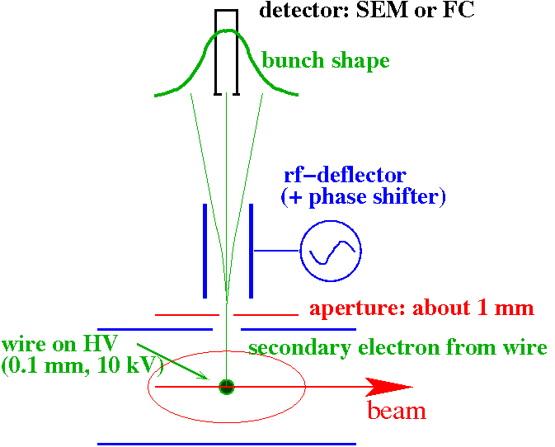
Bunch Structure using secondary Electrons for low E_{kin} Protons
Secondary e⁻ liberated from a wire carrying the time information.
→ Bunch Shape Monitor (BSM)
Working principle:
insertion of a 0.1 mm wire at ≈ 10 kV
emission of secondary e⁻ within less than 10 ps
secondary e⁻ are accelerated
toward an rf-deflector
rf-deflector as ’time-to-space’ converter
detector with a thin slit
slow shift of the phase
resolution ≈ 10 ps ≈ 1º @ 280 MHz
Measurements are comparable
to that obtained with particle detectors.
SEM: secondary electron multiplier

Slide 21
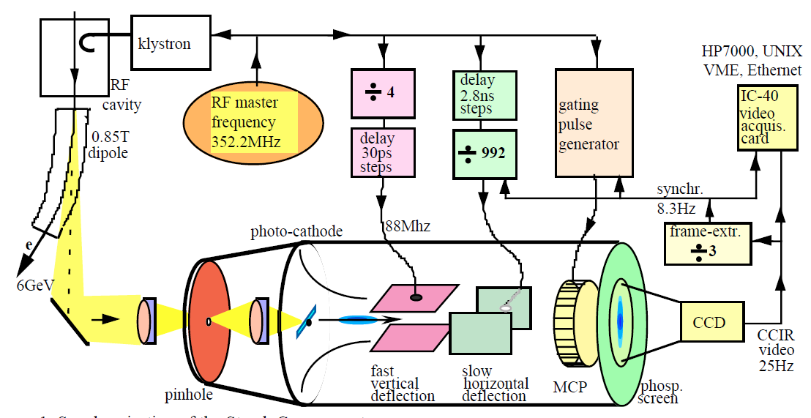
Bunch Length Measurement for relativistic Electrons
Electron bunches are too short (σ_{t} < 100 ps) to be covered by the bandwidth of
pick-ups (f < 3 GHz ⇔ t_{rise} > 100 ps) for structure determination.
→ Time resolved observation of synchr. light with a streak camera: Resolution ≈ 1 ps.
Scheme of a streak camera:
Streak camera
e⁻ synchrotron
acc.
freq. f_{rf}
rf cavity
injection
extraction

Slide 22
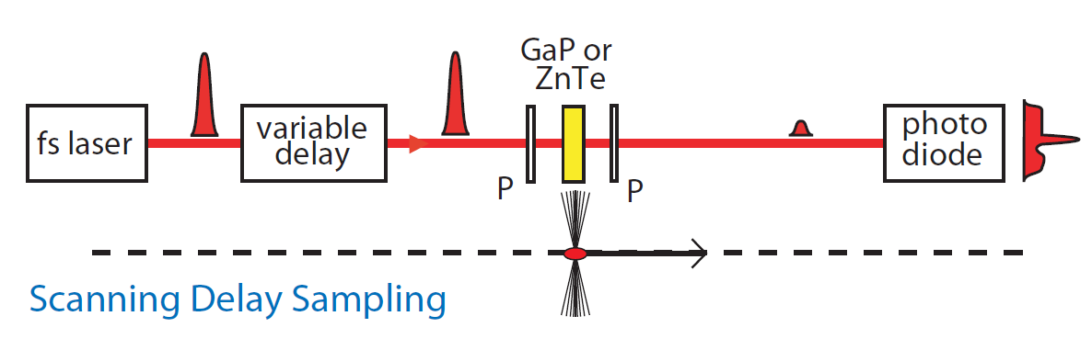
Bunch Length Measurement by electro-optical Method
FELs → bunch length below 1 ps is achieved, i.e. below the resolution of streak camera
Short laser pulses with t ≈ 10 fs and electro-optical modulator
Electro optical modulator: birefringent, rotation angle depends on external electric field
Relativistic electron bunches: transverse field E_{⊥ lab} = γ E_{⊥ rest} carries the time information.
Measurement by scanning
Short laser pulses t < 10 fs
and delay line
⇒ scanning method
Further methods used!
Bunch compressor
EO monitor
LINAC
LINAC
Undulator
crystal
beam
→ conclusion

Slide 23
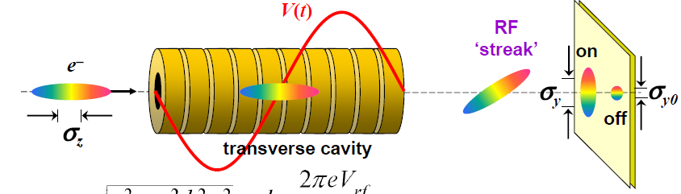
Bunch Length by rf-Deflection: Principle
Transversal deflection of the bunch i.e. time-to-space conversion
Size of the streak given by
k is determined by the rf-power
From D. Xiang, IPAC’12

Slide 24
Program of today’s interactive Session
Possible subjects of interactive session for exam preparation:
Discussion and some examples from pervious exams
General questions and answers to beam diagnostics
Discussion of polls presented during lecture and some further polls
Further exercises form exercise document as interactive discussion
(‘Exercises_instrumentation.pdf’ posted in INDICO at Tuesday 28st of February;
‘Answers_instrumentation.pdf’ posted in INDICO at Friday 3rd of March)
Please decide on the topic as not all can be realized!
Contributions (questions, comments, remarks) are required from your side.
This session is your event!

