Slide 1
RF Engineering
Transmission Lines II &
Pillbox Resonator I
Christine Völlinger (CERN) & Manfred Wendt (BNL)

Slide 2
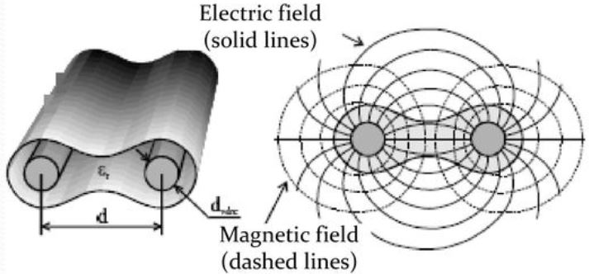
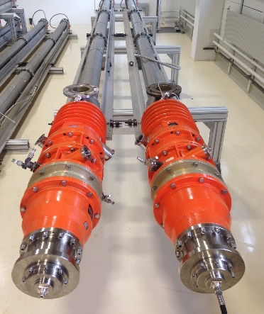
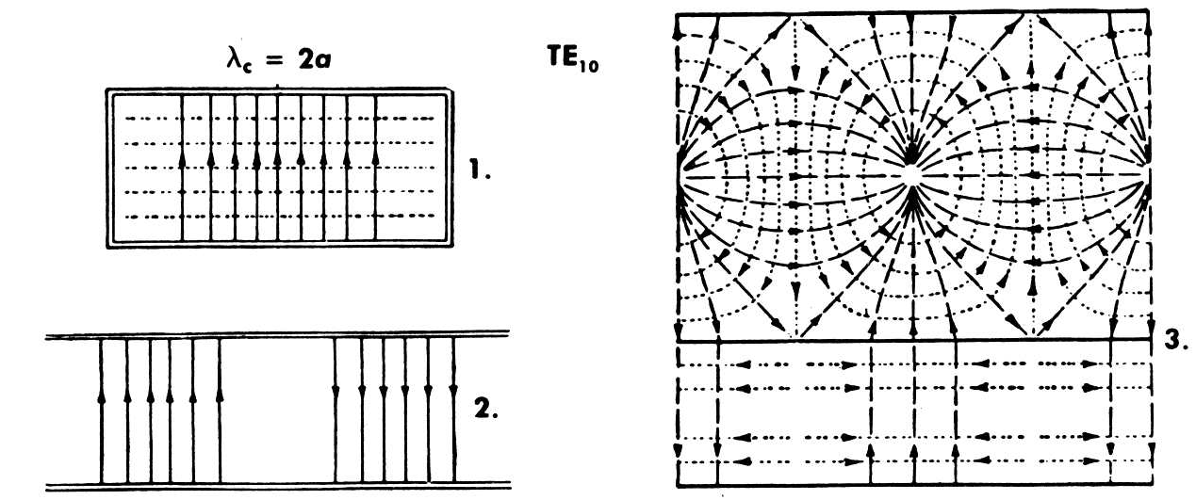
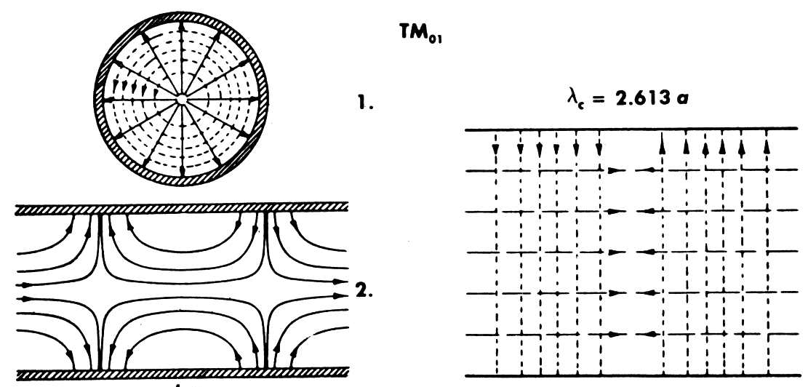
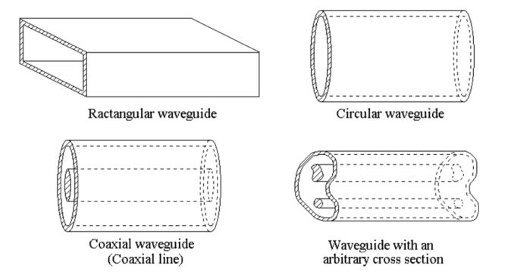
Transmission Lines and Waveguides
Wave patterns in guided wave systems depend on the number of conductors used.
“Open” two-wire system (TEM)
Coaxial line (TEM)
TEM-propagation = 2 conductor system
E-field ---H-field
Source: Ma, Electromagnetic Waves and Applications Part III, univ. lecture
Picture: Coaxial loads for the SPS 200 MHz cavity © CERN
Uniform waveguides rectangular, round, random cross-section (all non-TEM)
E-field
---H-field
Source: Saad, Microwave Engineers Handbook, vol. 1, Artech House
Source: Zhang, Electromagnetic Theory for Microwaves and Optoelectronics, 2nd ed., Springer

Slide 3
Hollow Waveguides
Circular waveguide
Arbitrarly shaped
cross-section waveguide
Rectangular waveguide
Source: Zhang, Electromagnetic Theory for Microwaves and Optoelectronics, 2nd ed., Springer
Waveguides exist in different shapes. They are just hollow metallic tubes with uniform cross-sections.
The metallic waveguide is a completely enclosed system without any radiation losses.
Further, losses due to a dielectric layer, as we have seen for the coaxial line do not exist, equally the inner conductor of the coaxial line is eliminated.
Waveguides present a one-conductor system, so no TEM-mode propagation is possible.
Propagation happens in TE-mode (Transverse-Electric) and TM-mode (Transverse-Magnetic). These modes have a lower frequency limit, the so-called cut-off frequency below which propagation is not possible. The cut-off frequency depends on the dimensions of the waveguide cross-section.

Slide 4
Waveguides & Boundary conditions
Circular waveguide
Arbitrarly shaped
cross-section waveguide
Rectangular waveguide
Source: Zhang, Electromagnetic Theory for Microwaves and Optoelectronics, 2nd ed., Springer
Waves are following the waveguide shape, even if it is bend.
For this, the propagating waves (formerly unbound) now need to fulfil boundary conditions on the walls of the waveguide.
Remember? From EM-field description, we know that:
→ on perfect conducting surfaces, the tangential electric field has to vanish to fulfill the boundary
condition. We speak of an “electric wall”: E_{tangential} = 0.
→ the walls of a waveguide can approximated as a perfect conductor (exception: loss calculation).

Slide 5
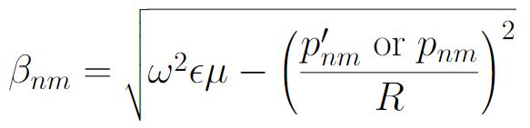



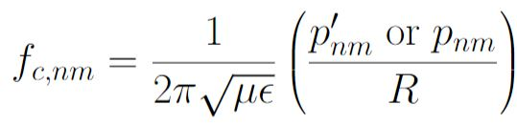
Circular (round) Waveguides (1/6)
Like all transmission lines, also the circular waveguide is characterized by a propagation constant, an attenuation constant and a characteristic impedance.
These quantities are derived by field theory analysis (see lecture of A. Mostacci). Propagation is usually assumed in z-direction.
R
z
For a perfect conducting tube (no resistive attenuation) with radius R, we obtain propagation constants
for the TE-mode and the TM-mode:
→ Roots of the Bessel-function for TM-mode
→ Roots of the derivative of the B.F. for TE-mode
This leads to the so-called cut-off frequencies for the different modes:
Notes:
In 1897, the physicist John William Strutt, better known as Lord Rayleigh gave the mathematical proof that wave propagation in waveguides must be possible. This was a novum as until then, people believed that two conductors would be necessary for the transfer of electromagnetic energy. Rayleigh also gave the theory of the TE- and TM-mode patterns and the cut-off frequency, he was, however, not able to provide experimental proof at the time. The waveguide was then essentially forgotten again until the 1930s.

Slide 6
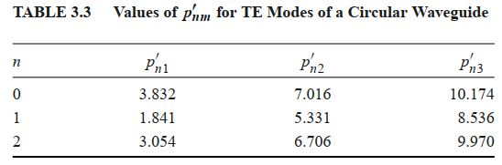
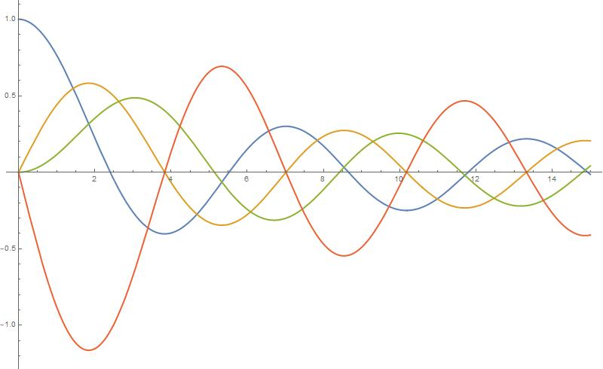

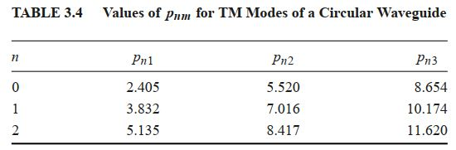

Circular (round) Waveguides (2/6)
Recall the Bessel function and the derivative of the Bessel function with their roots:
Source: Pozar, Microwave Engineering, 4th ed., Wiley
= 1st root of Bessel function of first type
= 2nd root of Bessel function of first type
= 1st root of derivative of Bessel function of first type

Slide 7
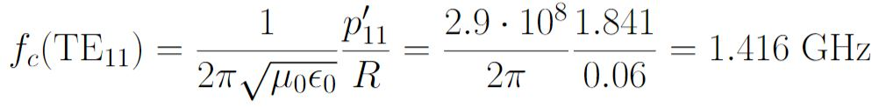
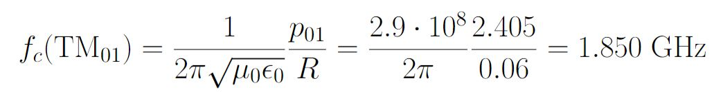
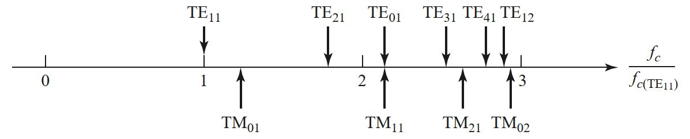
Circular (round) Waveguides (3/6)
Let’s see an example.
→ Calculating cut-off frequencies for a circular waveguide with R = 60 mm.
R= 60 mm
z
TM-mode
TE-mode
Frequencies where these modes start propagating.
Chart of cut-off frequencies relative to f_{c} of TE₁₁-mode:
Source: Pozar, Microwave engineering, 4th ed., Wiley

Slide 8
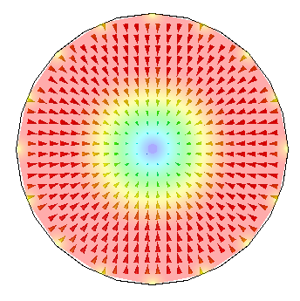
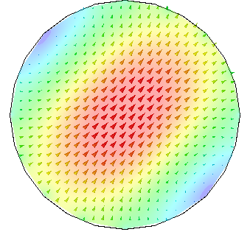
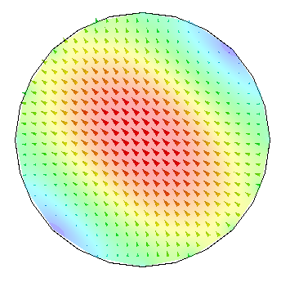
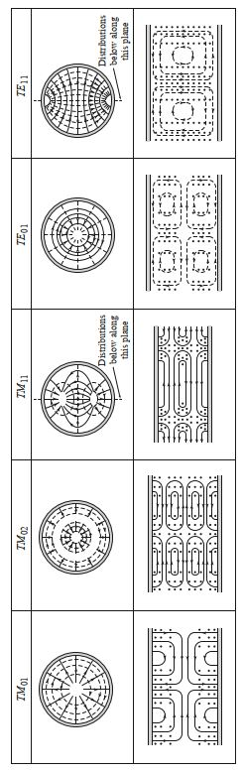
Circular (round) Waveguides (4/6)
Waveguide modes and field patterns
1st mode is TE₁₁. Electric field is transverse.
Mode has 2 polarisations (orientations of the electrical field).
2nd mode is TM₀₁. Magnetic field is transverse.
Simulaton pictures: courtesy E. Jensen, source pictures and chart: Pozar, Microwave engineering, 4th ed., Wiley

Slide 9
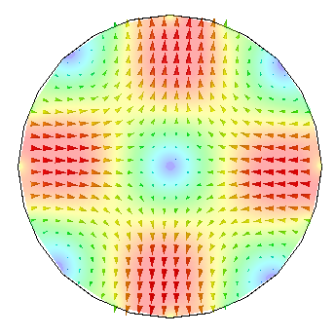
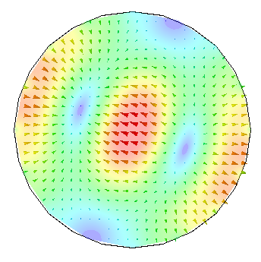
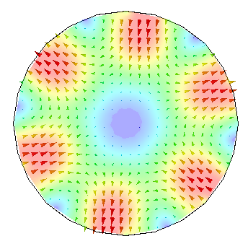
Circular (round) Waveguides (5/6)
Waveguide modes and field patterns
3rd mode is TE₂₁.
Electric field is transverse
4th mode is TM₁₁. Magnetic field is transverse.
6th mode is TE₃₁.
Electric field is transverse.
Further field plots can e.g. be found here: Lee, Lee and Chuang, Plot of Modal Field Distribution in Rectangular and Circular Waveguides. IEEE, Trans. Microwave Theory and Techniques, Vol. MTT-33, no. 3, March 1985
Simulaton pictures: courtesy E. Jensen, source pictures and chart: Pozar, Microwave engineering, 4th ed., Wiley

Slide 10




Circular (round) Waveguides (6/6)
What is actually happening if the wave frequency in a waveguide is below cut-off?
Remember? Propagation constant is defined:
Now for frequencies below cut off, β would become complex:
Then, the propagation constant γ becomes fully real, and the wave is damped even in the loss-less case (α=0), since the propagation is following:
This is called an evanescent wave = a wave that cannot propagate.

Slide 11
Rectangular Waveguides (1/6)
b
a > b
All field quantities are derived by field theory analysis
(see lecture of A. Mostacci).
Wave propagation is usually assumed in z-direction.
The rectangular waveguide is characterized by a propagation constant, attenuation constant and a characteristic impedance.
a
z
Source: Zhang, Electromagnetic Theory for Microwaves and Optoelectronics, 2nd ed., Springer
We distinguish again between TE-modes and TM-modes. TEM-modes do not exist in a waveguide.
We will see that the hollow rectangular waveguide can propagate TE- and TM-modes, and that these modes have cut-off frequencies below which propagation is not possible, similar to the TE- and TM-modes of the circular waveguide.
The derivation of the cut-off frequency is straightforward, please refer to textbooks, if you are interested.
The field components are obtained by the separation method.

Slide 12
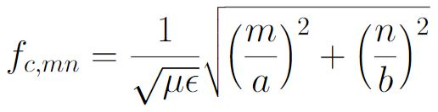
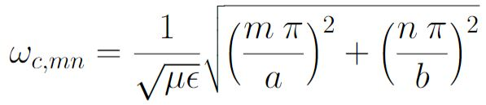
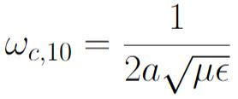
Rectangular Waveguides (2/6)
x
TE-modes
b
a > b
z
y
TE-modes are characterized by a zero electric field in propagation direction. The electric field is in the transverse plane, only.
a
Source: Zhang, Electromagnetic Theory for Microwaves and Optoelectronics, 2nd ed., Springer
Each mode has a cut-off frequency:
TE₁₀-mode is the mode with the lowest cut-off frequency:
The mode with the lowest cut-off frequency is called the dominant mode.
Note that if n=m=0, all field components become zero, there is no TE₀₀ mode.
A waveguide is called overmoded, if more than one mode is propagating in the waveguide at the same time.

Slide 13
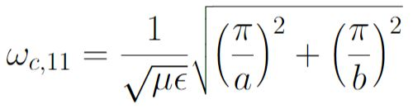
Rectangular Waveguides (3/6)
x
TM-modes
b
a > b
z
y
TM-modes are characterized by a zero magnetic field in propagation direction. The magnetic field is in the transverse plane, only.
a
Source: Zhang, Electromagnetic Theory for Microwaves and Optoelectronics, 2nd ed., Springer
Also in this case, each mode has a cut-off frequency (identical to TE):
TM₁₁ has as cut-off frequency:
There is no TM₀₀-mode, neither do TM₀₁ or TM₁₀ exist. For n=m=0, all field components become zero.
Note that TE₁₀-mode remains the dominant mode, it is the mode with the lowest cut-off frequency.

Slide 14
Rectangular Waveguides (3/6)
x
TM-modes
b
a > b
z
y
TM-modes are characterized by a zero magnetic field in propagation direction. The magnetic field is in the transverse plane, only.
a
Source: Zhang, Electromagnetic Theory for Microwaves and Optoelectronics, 2nd ed., Springer
Also in this case, each mode has a cut-off frequency (identical to TE):
TM₁₁ has as cut-off frequency:
There is no TM₀₀-mode, neither do TM₀₁ or TM₁₀ exist. For n=m=0, all field components become zero.
Note that TE₁₀-mode remains the dominant mode, it is the mode with the lowest cut-off frequency.

Slide 15
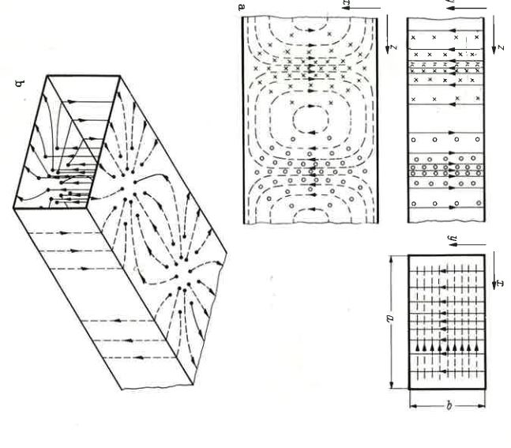
Rectangular Waveguides (4/6)
Field pattern for TE₀₁-mode
What do we actually see?
View from front
(x/y-plane)
Side view narrow
(y/z-plane)
E-field ---H-field
Side view broad
(x/z-plane)
Wall currents and displacement
currents inside the waveguide.
source: Zinke/Brunswig, Hochfrequenztechnik, 5th ed., Springer

Slide 16
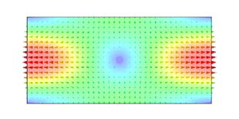
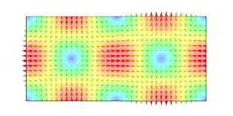
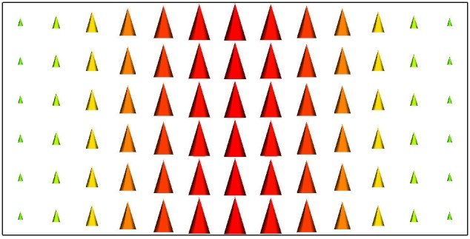
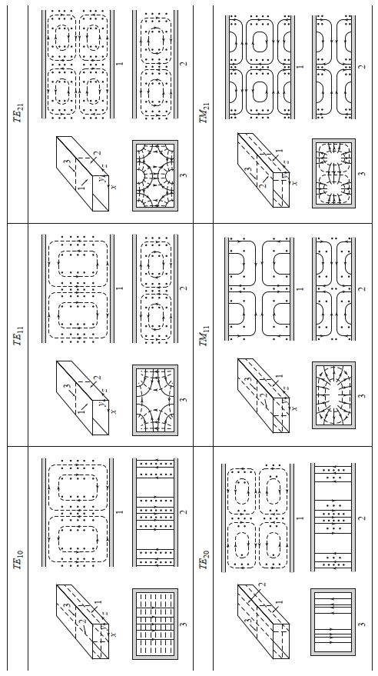
Rectangular Waveguides (5/6)
Fundamental and higher waveguide modes
and field patterns for TE-modes
TE₁₀-mode
TE₁₁-mode
TE₂₁-mode
Simulaton pictures: courtesy E. Jensen, field pattern source: Pozar, Microwave engineering, 4th ed., Wiley

Slide 17
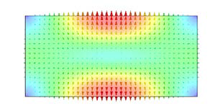
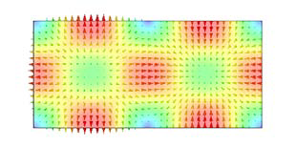
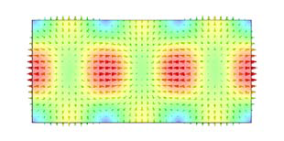
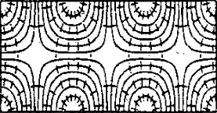
Rectangular Waveguides (6/6)
Fundamental and higher waveguide modes
and field patterns for TM-modes
TM₁₁-mode
TM₂₁-mode
TM₃₁-mode
Simulaton pictures: courtesy E. Jensen, field pattern source: Pozar, Microwave engineering, 4th ed., Wiley, TM31-mode from Lee et al., MTT-33, 1985

Slide 18
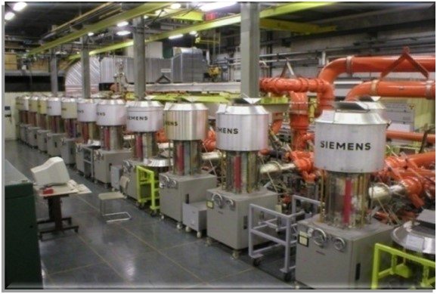
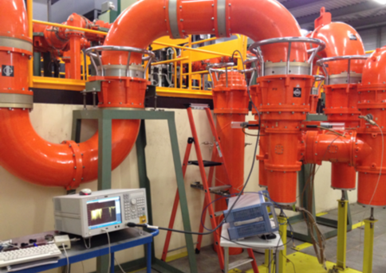
Coaxial line installation
Amplifiers of the 200 MHz travelling wave system in the CERN SPS and their coaxial power lines leading to the underground installation (feeder lines)
Quiz!
Test your knowledge.

Slide 19
Quiz no. 4
Waveguides are used for TEM signal transport
  - true
  - false
In a waveguide, lossy wall-currents exist in…?
  - circular waveguides due to the shape of their outer conductor
  - rectangular waveguides due to the shape of their outer conductor
  - rectangular waveguides only, but not in circular waveguides and not in elliptical waveguides
  - all waveguides

Slide 20
Quiz no. 4
Waveguides are used for TEM signal transport
  - true
  - false (correct answer)
In a waveguide, lossy wall-currents exist in…?
  - circular waveguides due to the shape of their outer conductor
  - rectangular waveguides due to the shape of their outer conductor
  - rectangular waveguides only, but not in circular waveguides and not in elliptical waveguides
  - all waveguides (correct answer)

Slide 21
Cavity resonators
Microwave resonators can be built from waveguides by closing the open ends.
We call this an RF-resonator or a cavity.
Source: Zhang, Electromagnetic Theory for Microwaves and Optoelectronics, 2nd ed., Springer
A cavity stores electric and magnetic energy inside the hollow body.
The frequency of the electromagnetic field resonance depends on the cavity dimensions.
Same as with the rectangular and the circular waveguide, the electromagnetic field has to fulfil the boundary conditions on the resonator walls. The field builds up in resonant modes.
Cavities that are used for the acceleration of particles in our accelerators are mostly of a cylindrical and flat shape. This is why we call them pillbox cavities.
We will later see how resonances can be excited in cavities by feeding RF-signal in, and how such a cavity can be used in accelerators for particle acceleration.

Slide 22
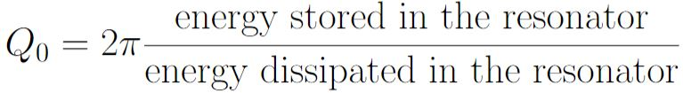
Cavity resonators and Q-value (1/2)
Resonators are classified by their quality factor Q.
The quality factor (or Q-value) can be used as a measure of “how well the cavity is resonating” (more details will come).
define
= unloaded Q
High Q-value is desired in accelerating cavities; Q-value is one of the accelerator efficiency figures-of-merit.
Q-value reduces e.g. due to the power dissipated in the metallic walls or other loss mechanisms.
The connection of the cavity resonator to the outer world will reduce its Q-value as well (we say “it loads the cavity with an additional loss mechanism).
If the cavity is filled with a dielectric, this will produce additional losses → we don’t have this in accelerators.

Slide 23
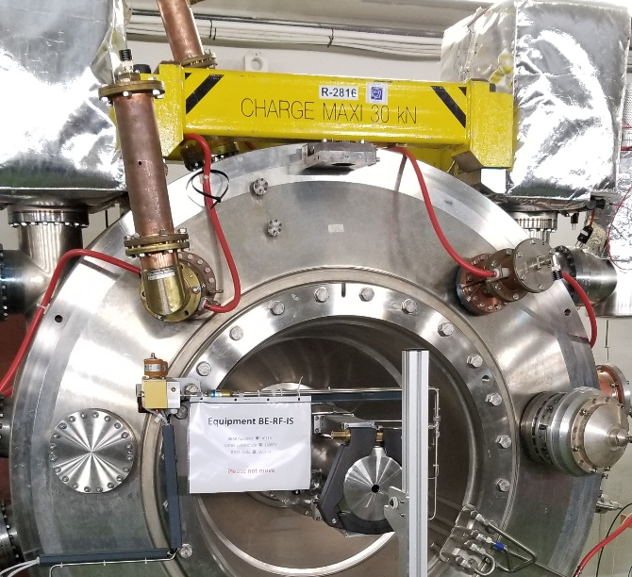
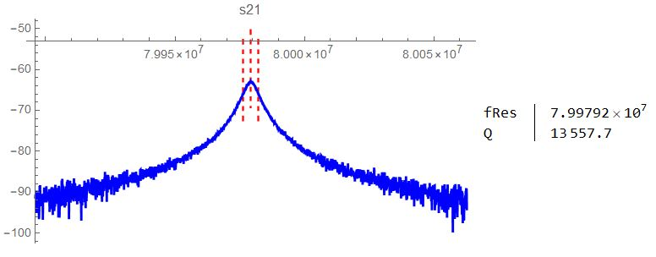
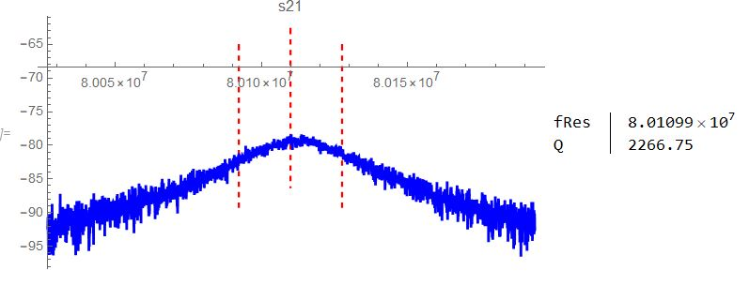
Cavity resonators and Q-value (2/2)
Example: measurements taken on the PS 80MHz pillbox cavity
We tested this cavity for Q-deterioration and shifting of its fundamental mode (~80 MHz).
Q-values obtained from 3-dB-measurement (see dashed red lines, method will be introduced later).
→ Plot on the top has a higher Q-value than the plot below.

Slide 24
Rectangular Cavity Resonators (1/3)
From the field pattern of the TE10-mode in the rectangular waveguide → imagine that the resonant field in a rectangular resonator will build up in a similar way.
Picture source: Caspers, JUAS lecture 2021
y
z
E-field
x
Waveguide TE₁₀-mode
The field is building up in a standing wave pattern, using sine and cosine functions.
From the boundary condition on the resonator wall, the electric field has to be zero, thus we can see multiples of electric field maxima.
The mode indices are counting the maxima of the field along one axis (we see either a TE_{xyz} or a TM_{xyz}- mode.
The mode shown is a TE₁₀₁-mode.
Source: Pozar, Microwave engineering, 4th ed., Wiley

Slide 25
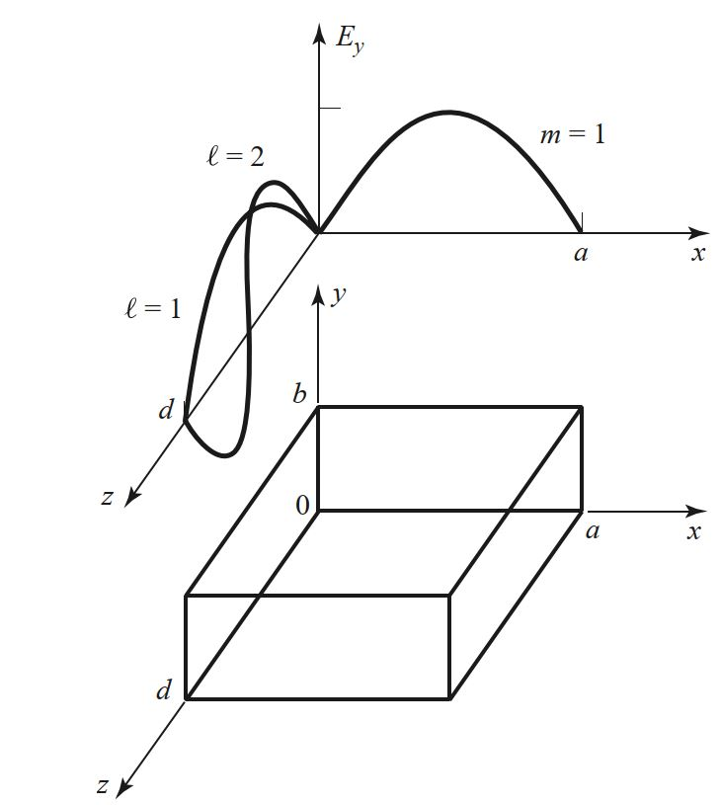
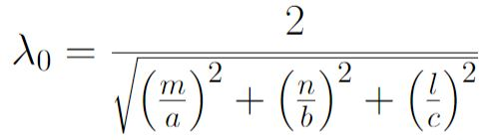
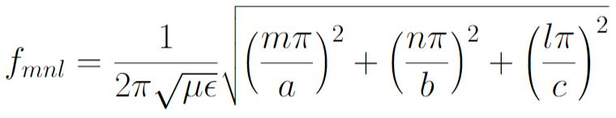
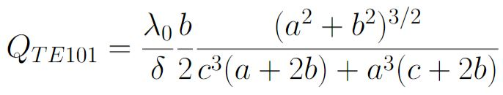
Rectangular Cavity Resonators (2/3)
Formulae for a rectangular resonator
(for derivation see lecture of A. Mostacci or textbooks).
Source: Pozar, Microwave Engineering, 4th ed., Wiley
resonant wavelength:
Resonant frequencies for TE_{mnl}-mode and TM_{nml}-modes:
Q-value for TE₁₀₁:
c
c
TE₁₀₁-mode is the lowest resonant mode, hence also the dominant mode in this resonator.

Slide 26

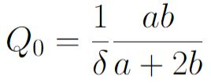
Rectangular Cavity Resonators (3/3)
Picture source: Caspers, JUAS lecture 2021
y
For the case a=c, the formulae simplifies strongly.
z
E-field
x
resonant wavelength:
Q-value for TE₁₀₁:
b
a
c

Slide 27
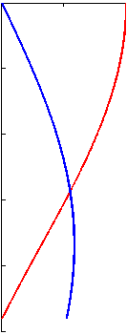
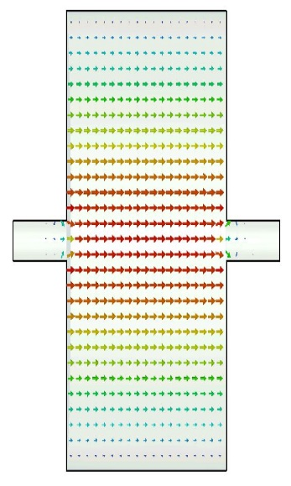
Pillbox Cavity Resonators (1/6)
A cylindrical cavity resonator can be seen as a section of circular waveguide shorted at both ends.
z
Picture source: Caspers,
JUAS lecture 2021
From the TE₁₁-mode (dominant mode for circular waveguide)
→ TE₁₁₁-mode is the dominant TE-mode for a cylindrical cavity.
TM₀₁₀-mode is the dominant TM-mode for a cylindrical cavity.
TM₀₁₀-mode mode is used for acceleration as it has a large electric field along the z-axis.
Electric field is described by Besselfunction J_{0.}
TM₀₁₀-mode and pillbox mode indices?
E_{z}
-B_{θ}
Pillbox cavity is flat compared to a “long” cylindrical cavity.
Also, beam-pipe connection is needed.
Simulation: P. Kramer

Slide 28
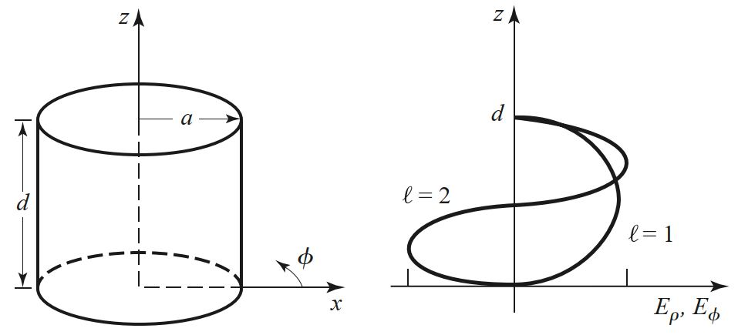
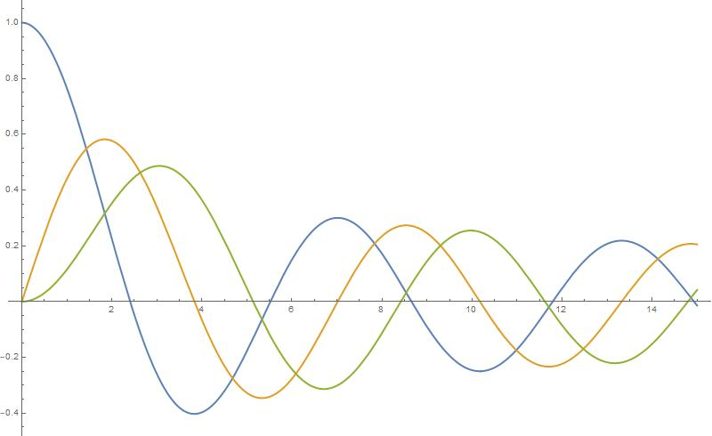
Pillbox Cavity Resonators (2/6)
Picture source: Caspers, JUAS lecture 2021
TM₀₁₀
Mode indices of a pillbox cavity are as follows:
E_{z}
The electric field on the cavity’s axis following the Besselfunction J₀
The first mode-index gives the order of the Bessel function.
The second mode-index indicates the root of the Bessel function which is the number of its zero-crossings.
The third mode-index is the number of half waves (maxima) along the z-axis.
E_{z}
h
a
J₀
Besselfunctions
h
J₁
J₂
h
Source: Pozar, Microwave engineering, 4th ed., Wiley

Slide 29
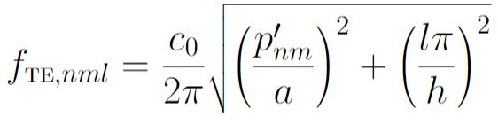
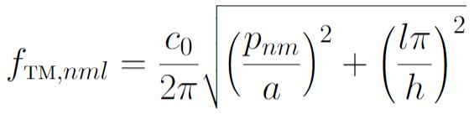
Pillbox Cavity Resonators (3/6)
Formulae for a circular cavity resonator (for derivation see lecture of A. Mostacci or textbooks).
Picture source: Caspers, JUAS lecture 2021
E_{z}
Resonant frequencies for TE_{nml}-mode:
Resonant frequency for TM_{nml}-modes:
E_{z}
h
a
Note that the TM₀₁₀- mode is independent of the cavity height h
(until the TE₁₁₁ mode shows up, roughly at 2a/h=1).

Slide 30
Pillbox Cavity Resonators (4/6)
Recall the Bessel function and the derivative of the Bessel function with their roots:
Source: Pozar, Microwave Engineering, 4th ed., Wiley
= 1st root of Bessel function of first type
= 2nd root of Bessel function of first type
= 1st root of derivative of Bessel function of first type

Slide 31




Pillbox Cavity Resonators (5/6)
For the case of the TM₀₁₀-mode, we have no dependence on cavity height, so we get a much simpler formulae:
E_{z}
TM₀₁₀
E_{z}
h
a
Remember? Skindepth is:

Slide 32

Pillbox Cavity resonators (6/6)
Resonant chart for a general cylindrical cavity showing the excited modes as a function of cavity dimensions.
1st TE-mode is TE111
1st TM-mode is TM010, and shows up for ratios (2a/h)² > 1
(2a/h)²
Source: Pozar, Microwave engineering, 4th ed., Wiley

Slide 33
Thank you for your attention.

Slide 34
Let’s have a break!

Slide 35
Further reading…
POZAR, David M., “Microwave Engineering”, 4th edition, Wiley and sons.
ZHANG, Keqian, “Electromagnetic Theory for Microwaves and Optoelectronics”, 2nd edition, Springer.
BHAT, Shiban, “Stripline-like transmission Lines for Microwave Integrated Circuits”,
New Age International Publishers.
HOFFMANN, “Integrierte Mikrowellenschaltungen”, Springer.
SAAD, “Microwave Engineer’s Handbook”, Vol.1, Artech House Inc.

